Slide 1

CEN207 Data Structures · Week 4
Trees, Heaps and Huffman Coding
CEN207 Data Structures — Week 4
Asst. Prof. Dr. Uğur CORUH · Fall 2026–2027
RTEU Computer Engineering · Fall 2026–2027
Notes:
Today a node gets to point at more than one other node. That single change — one pointer becomes two — is the entire jump from "list" to "tree", and it builds the heap, priority queues, and Huffman coding, all in one sitting.

Slide 2
CEN207 Data Structures · Week 4
Today's plan (3 hours)
Hour | Topic
1 | Trees, vocabulary, shapes Anim 1–2 · traversals: pre/in/post/iterative/level Anim 3–7
2 | Array repr. Anim 8 · binary heap: insert/extract/build/sort Anim 9–12
3 | Priority queue Anim 13 · variants Anim 14–16 · Huffman Anim 17–18
Learning outcomes: LO.1 (explain fundamental data structures) · LO.2 (analyze complexity) · LO.7 (choose the right structure)
RTEU Computer Engineering · Fall 2026–2027
2
Notes:
Eighteen short animations carry the whole lecture; each appears once, exactly where its idea is introduced, and several get a second look at their trickiest edge case.

Slide 3
CEN207 Data Structures · Week 4
This week's concepts — where
Concept | Where
Tree vocabulary, binary tree shapes | Sections 1–2
Traversals (pre/in/post/iterative/level) | Section 3
Array representation of a tree | Section 4
Binary heap, heap sort | Section 5
Priority queue, variants, Huffman | Sections 6–8
RTEU Computer Engineering · Fall 2026–2027
3
Notes:
Every term gets a full definition the first time it appears; this table just says where to find it again.

Slide 4
CEN207 Data Structures · Week 4
How the code examples work
• Every idea has a complete C and Java program
• C: gcc -std=c11 -Wall -Wextra -o /tmp/x file.c && /tmp/x
• Java: javac -d /tmp/j File.java && java -cp /tmp/j File
• Sources: code/week-04/c/ and code/week-04/java/
• Each program's expected output is in the week notes
RTEU Computer Engineering · Fall 2026–2027
4
Notes:
Open a terminal now if you want to run these live; every snippet on today's slides compiles and runs exactly as shown.

Slide 5
CEN207 Data Structures · Week 4
Recap — Weeks 1–2: pointers and lists
• malloc/free: one box, one owner, NULL when empty
• A linked-list node: a value plus one next pointer
• A tree node: a value plus two pointers, left/right
• A list ends at NULL; a tree leaf has both NULL
RTEU Computer Engineering · Fall 2026–2027
5
Notes:
A tree node is a linked-list node with one extra pointer field — that is genuinely the whole new idea.

Slide 6
CEN207 Data Structures · Week 4
Recap — Week 3: stack, queue, recursion
• Recursion is a stack: a call pushes, a return pops
• Today: the same traversal, using our own stack
• The queue (FIFO) returns unchanged, for level order
• Week 3's structures now simply hold tree nodes
RTEU Computer Engineering · Fall 2026–2027
6
Notes:
Nothing about memory is new this week — only new shapes built from the exact same pointer and stack/queue ideas.

Slide 7
CEN207 Data Structures · Week 4
Map of the week — at a glance
Trees & traversals | Heaps & Huffman
Vocabulary, five shapes | Binary heap, heap sort
Five traversal orders | Priority queue, variants
Array representation | Huffman coding
RTEU Computer Engineering · Fall 2026–2027
7
Notes:
Every box on this map gets its own slides below, most with a short animation and a complete C/Java program.

Slide 8
CEN207 Data Structures · Week 4
1. Why Trees? Vocabulary and History
RTEU Computer Engineering · Fall 2026–2027
8
Notes:
Section 1 builds the vocabulary every later section leans on — root, parent, child, leaf, depth, height — on a general tree where a node may have any number of children.

Slide 9
CEN207 Data Structures · Week 4
A question to start
A file manager: one home folder, folders inside folders, files inside those. One root, unlimited branching, and no folder is ever its own ancestor.
RTEU Computer Engineering · Fall 2026–2027
9
Notes:
Ask: is this shape a stack, a queue, or something new? It branches — that is the whole new idea today.

Slide 10
CEN207 Data Structures · Week 4
A short history
• 1857 — Cayley counts trees while counting molecules
• 1968 — Knuth fixes the vocabulary in TAOCP Vol. 1
• Root, leaf, degree, level, height — his terms, still used
• One of the oldest shapes in mathematics, borrowed by CS
RTEU Computer Engineering · Fall 2026–2027
10
Notes:
Cayley was not thinking about computers at all — he was counting hydrocarbon isomers, whose branching structure is literally a tree.

Slide 11
CEN207 Data Structures · Week 4
Intuition — an upside-down tree
• The root is the trunk — drawn at the top
• Everything branches downward from the root
• A leaf has no children — the end of a branch
• Yes, upside down: every CS diagram draws it this way
RTEU Computer Engineering · Fall 2026–2027
11
Notes:
Ask why "root" sits at the top — it is a convention, not a law of nature, but it is completely universal in this field.

Slide 12
CEN207 Data Structures · Week 4
Vocabulary (1/3)
Term | Meaning
Root | The one node with no parent
Parent / child | Edge from A down to B: A is parent, B child
Sibling | Two nodes sharing the same parent
Leaf | A node with no children — degree 0
RTEU Computer Engineering · Fall 2026–2027
12
Notes:
Every one of these is pointed at, one at a time, in the animation right after this table.

Slide 13
CEN207 Data Structures · Week 4
Vocabulary (2/3)
Term | Meaning
Internal node | A node with at least one child
Edge | A parent-child connection; n nodes, n−1 edges
Degree (of a node) | Its number of children
Depth (of a node) | Edges from the root down to it
RTEU Computer Engineering · Fall 2026–2027
13
Notes:
n-1 edges is worth pausing on: every node except the root has exactly one edge, to its own parent.

Slide 14
CEN207 Data Structures · Week 4
Vocabulary (3/3)
Term | Meaning
Height (of a node) | Edges on its longest path down to a leaf
Height (of the tree) | The root's height
Subtree | A node plus everything below it
RTEU Computer Engineering · Fall 2026–2027
14
Notes:
Depth counts down from the root; height counts down from a node to its deepest leaf — the direction of counting is what people confuse.

Slide 15
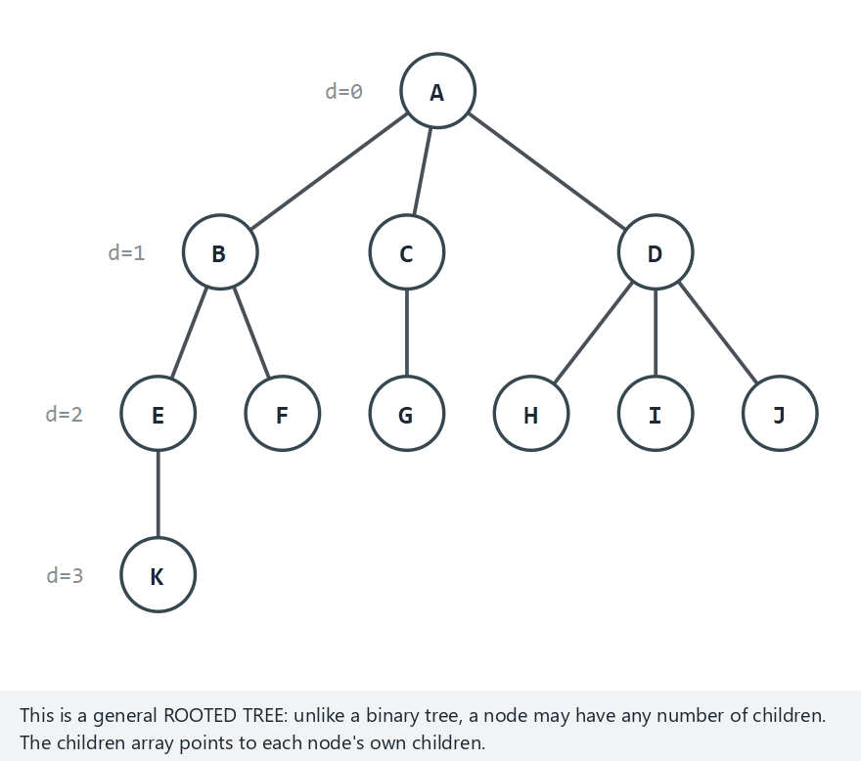
CEN207 Data Structures · Week 4
Tree vocabulary, one term at a time
RTEU Computer Engineering · Fall 2026–2027
15
Notes:
Normal example: an 11-node bushy tree. Watch each term light up on the same real tree, one at a time.

Slide 16
CEN207 Data Structures · Week 4
Edge case — a star: the root has 10 children
RTEU Computer Engineering · Fall 2026–2027
16
Notes:
A star tests "degree" hardest: one node with degree 10, ten leaves each with degree 0, and a tree of height only 1.

Slide 17
CEN207 Data Structures · Week 4
Code — the tree node
typedef struct Node {
char label[4];
struct Node *children[MAX_CHILDREN];
int child_count; /* degree of this node */
int depth;
struct Node *parent;
} Node;
RTEU Computer Engineering · Fall 2026–2027
17
Notes:
Compare this to Week 2's linked-list node: same idea, but children is now an array, since a general tree node may have many children, not just one "next".

Slide 18
CEN207 Data Structures · Week 4
Code — height() (bottom-up, recursive)
int height(Node *n) {
if (n->child_count == 0)
return 0; /* a leaf: height 0 */
int best = -1;
for (int i = 0; i < n->child_count; i++) {
int h = height(n->children[i]);
if (h > best) best = h;
}
return best + 1; /* 1 + tallest child */
}
RTEU Computer Engineering · Fall 2026–2027
18
Notes:
A leaf's height is the base case, 0; every other node is 1 plus its tallest child — pure recursion, no queue needed.

Slide 19
CEN207 Data Structures · Week 4
Code — compute_depths() (top-down, BFS)
void compute_depths(Node *root) {
Node *queue[MAX_NODES];
int front = 0, rear = 0;
root->depth = 0;
queue[rear++] = root;
while (front < rear) {
Node *cur = queue[front++];
for (int i = 0; i < cur->child_count; i++) {
Node *ch = cur->children[i];
ch->depth = cur->depth + 1;
queue[rear++] = ch;
}
}
}
RTEU Computer Engineering · Fall 2026–2027
19
Notes:
Depth needs the parent's answer first, so it walks top-down with a queue — the mirror image of height's bottom-up recursion.

Slide 20
CEN207 Data Structures · Week 4
Complexity
• height: every node visited once — O(n)
• compute_depths: every node visited once — O(n)
• Neither depends on the tree's shape
• A thin chain costs the same as a bushy tree, same n
RTEU Computer Engineering · Fall 2026–2027
20
Notes:
Shape will start to matter a lot once we look at recursion *depth* rather than total work, later this week.

Slide 21
CEN207 Data Structures · Week 4
Common mistakes
• Confusing depth (from the root down) with height (down to a leaf)
• Forgetting a leaf's height is 0, not 1
• Assuming every tree is binary — a general node can have any number of children
RTEU Computer Engineering · Fall 2026–2027
21
Notes:
The binary restriction starts in the very next section, and it is a choice we make for its tricks, not a law of nature.

Slide 22
CEN207 Data Structures · Week 4
Mini-quiz
In the 18-node example, Q1 has children S1 and S2. What is Q1's degree? What is S1's depth, given Q1's depth is 1?
RTEU Computer Engineering · Fall 2026–2027
22
Notes:
Let the class answer both parts before the next slide.

Slide 23
CEN207 Data Structures · Week 4
Answer
Q1's degree is 2 (two children). S1 is a child of Q1, so its depth is Q1's depth + 1 = 2.
RTEU Computer Engineering · Fall 2026–2027
23
Notes:
Depth always adds exactly one per level down from the root — no shortcuts, no exceptions.

Slide 24
CEN207 Data Structures · Week 4
2. Binary Trees: Shapes and Node Counts
RTEU Computer Engineering · Fall 2026–2027
24
Notes:
One restriction — at most two children, called left and right — unlocks the heap, Huffman coding, and next semester's search trees.

Slide 25
CEN207 Data Structures · Week 4
A question to start
Restrict every node to at most two children, left and right. Why would giving up "any number of children" ever be worth it?
RTEU Computer Engineering · Fall 2026–2027
25
Notes:
The payoff is arithmetic tricks on array indices, which section 4 introduces — impossible with unlimited children.

Slide 26
CEN207 Data Structures · Week 4
Code — the binary tree node
typedef struct Node {
int value;
struct Node *left, *right;
} Node;
RTEU Computer Engineering · Fall 2026–2027
26
Notes:
Every program for the rest of this week builds on exactly this struct — one more pointer than a linked-list node.

Slide 27
CEN207 Data Structures · Week 4
Five shapes, precisely defined
Shape | Definition
Full | Every node has 0 or 2 children, never 1
Complete | Every level full except the last, filled left-to-right
Perfect | Full and every leaf at the same depth
Degenerate | Every node has 0 or 1 children — a chain
Balanced | Left/right subtree heights differ by ≤ 1
RTEU Computer Engineering · Fall 2026–2027
27
Notes:
These are five independent yes/no questions — a tree can be complete without being full, and vice versa.

Slide 28
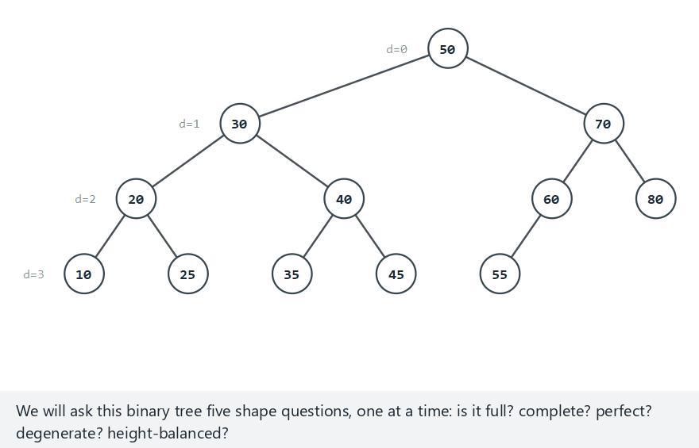
CEN207 Data Structures · Week 4
Binary tree shapes, one question at a time
RTEU Computer Engineering · Fall 2026–2027
28
Notes:
Normal example: 12 nodes, complete but not perfect. The animation asks all five yes/no questions on the same tree.

Slide 29
CEN207 Data Structures · Week 4
Edge case — a degenerate chain, 10 nodes
RTEU Computer Engineering · Fall 2026–2027
29
Notes:
A degenerate tree fails full, complete, and perfect all at once, and its height is n-1 — as bad as a plain linked list.

Slide 30
CEN207 Data Structures · Week 4
How many nodes can fit?
• *Max at height h:* a perfect tree has 2<sup>h+1</sup> − 1 nodes
• Level k holds 2<sup>k</sup> nodes; sum them through level h
• *Min height for n nodes:* ⌊log₂ n⌋, no arrangement beats it
• Each level holds at most twice the nodes of the one above
RTEU Computer Engineering · Fall 2026–2027
30
Notes:
These two formulas come back constantly — the heap in section 5 depends on both.

Slide 31
CEN207 Data Structures · Week 4
Why balance matters
• A balanced tree keeps height close to log₂ n
• Root-to-leaf operations then cost O(log n)
• A degenerate tree's height is n − 1, no better than a list
• Same node count, wildly different cost — shape decides
RTEU Computer Engineering · Fall 2026–2027
31
Notes:
Balance is the whole reason binary search trees, next semester, are worth building carefully rather than by accident.

Slide 32
CEN207 Data Structures · Week 4
Code — is_complete (spotting gaps)
static bool is_complete(Node *root) {
Node *queue[MAX_NODES]; int front = 0, rear = 0;
queue[rear++] = root;
bool seen_gap = false;
while (front < rear) {
Node *n = queue[front++];
if (n == NULL) { seen_gap = true; continue; }
if (seen_gap) return false;
queue[rear++] = n->left;
queue[rear++] = n->right;
}
return true;
}
RTEU Computer Engineering · Fall 2026–2027
32
Notes:
This walks level by level with a queue, deliberately enqueuing NULL placeholders so a real node right after a gap gets caught.

Slide 33
CEN207 Data Structures · Week 4
Code — check_balance (one pass, not two)
static int check_balance(Node *n) {
if (n == NULL) return 0;
int hl = check_balance(n->left);
if (hl == -1) return -1;
int hr = check_balance(n->right);
if (hr == -1) return -1;
if (abs(hl - hr) > 1) return -1;
return 1 + (hl > hr ? hl : hr);
}
RTEU Computer Engineering · Fall 2026–2027
33
Notes:
One sentinel value, -1, carries "already unbalanced" up the recursion so we never re-walk the same subtree twice.

Slide 34
CEN207 Data Structures · Week 4
Complexity
• All five shape checks are O(n) — visit each node once
• is_complete needs O(n) extra space, for its queue
• The other four need only O(h) recursion-stack space
RTEU Computer Engineering · Fall 2026–2027
34
Notes:
h is the height, which is why a degenerate tree's O(n) stack space is the worst case worth worrying about.

Slide 35
CEN207 Data Structures · Week 4
Common mistakes
• Thinking "complete" means every level is full
• Confusing perfect (complete + all leaves equal depth) with complete
• Calling height() twice per node — turns O(n) into O(n²)
RTEU Computer Engineering · Fall 2026–2027
35
Notes:
The one-pass check_balance above exists specifically to avoid that last, very common trap.

Slide 36
CEN207 Data Structures · Week 4
Mini-quiz
A binary tree has height 3 and is perfect. How many nodes does it have? How many of them are leaves?
RTEU Computer Engineering · Fall 2026–2027
36
Notes:
Use both formulas from two slides back.

Slide 37
CEN207 Data Structures · Week 4
Answer
2<sup>4</sup> − 1 = 15 nodes total. The last level (level 3) holds 2<sup>3</sup> = 8 leaves; the other 7 nodes are internal.
RTEU Computer Engineering · Fall 2026–2027
37
Notes:
Every perfect tree's leaf count is exactly half its total nodes, rounded up — a nice sanity check.

Slide 38
CEN207 Data Structures · Week 4
3. Traversals: Visiting Every Node Once
RTEU Computer Engineering · Fall 2026–2027
38
Notes:
A tree has no one natural order — a node has two children, so there is a real choice about which to visit first and when to visit the node itself.

Slide 39
CEN207 Data Structures · Week 4
No single "natural" order
• A node has (up to) two children — a real choice exists
• Three recursive orders: preorder, inorder, postorder
• Two more without recursion: our own stack, and a queue
• Same tree, five orders, generally five different sequences
RTEU Computer Engineering · Fall 2026–2027
39
Notes:
All five programs below share the same 10-node balanced tree [50,30,70,20,40,60,80,10,-,-,45,55], so only the visiting order ever changes.

Slide 40
CEN207 Data Structures · Week 4
Preorder: visit, left, right
Visit the node before either child. The root is always visited first — exactly the order you need to rebuild a tree from scratch.
RTEU Computer Engineering · Fall 2026–2027
40
Notes:
Reading the sequence back in, the very first value read is always the root of whatever subtree comes next.

Slide 41
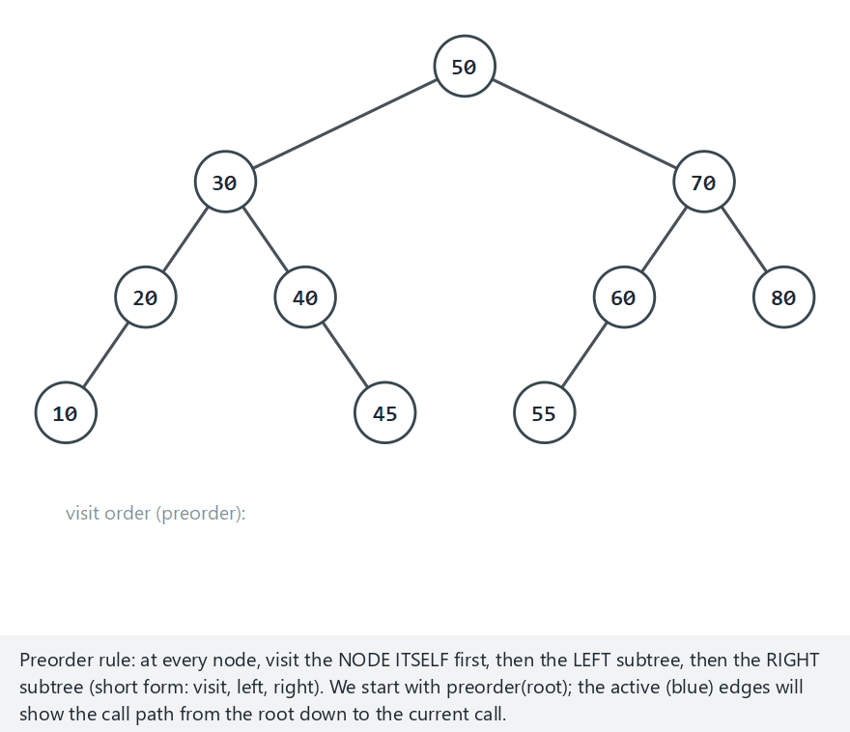
CEN207 Data Structures · Week 4
Preorder, step by step
RTEU Computer Engineering · Fall 2026–2027
41
Notes:
Watch the highlighted call path trace the route from the root down to whichever call is currently active.

Slide 42
CEN207 Data Structures · Week 4
Edge case — a left-skewed chain
RTEU Computer Engineering · Fall 2026–2027
42
Notes:
With only left children, preorder visits in exactly the order the chain was built — visit, then the one child, every time.

Slide 43
CEN207 Data Structures · Week 4
Code — preorder (recursive)
static void preorder(Node *node) {
if (node == NULL) return;
printf("visit %d\n", node->value);
visited[visited_count++] = node->value;
preorder(node->left);
preorder(node->right);
}
RTEU Computer Engineering · Fall 2026–2027
43
Notes:
Visit first, then recurse left, then right — the base case, node == NULL, must come first or this crashes on an empty subtree.

Slide 44
CEN207 Data Structures · Week 4
Inorder: left, visit, right
Visit the node between its children. On a binary search tree, this visits every value in sorted order — previewed here, built later.
RTEU Computer Engineering · Fall 2026–2027
44
Notes:
On these demonstration trees, which are not built by BST rules, inorder still runs left-before-self-before-right; it just does not happen to sort.

Slide 45
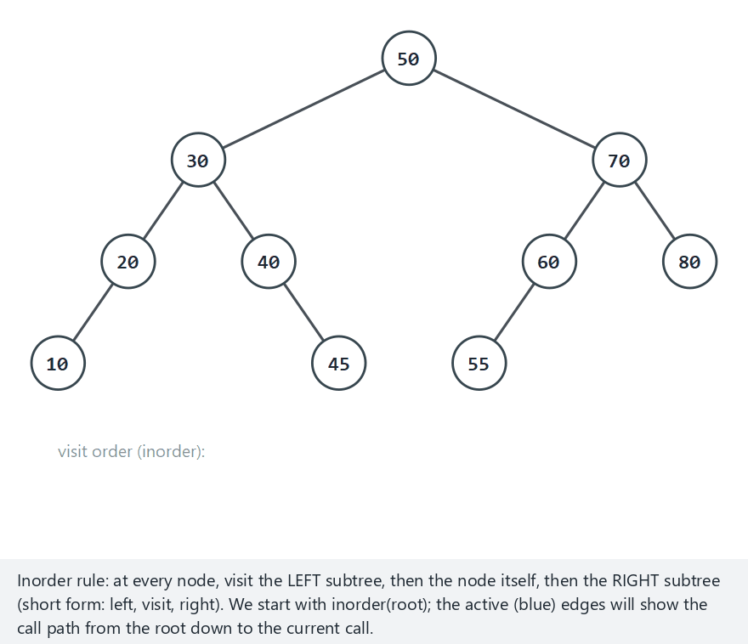
CEN207 Data Structures · Week 4
Inorder, step by step
RTEU Computer Engineering · Fall 2026–2027
45
Notes:
On the normal tree, [50,30,70,...], inorder happens to come out perfectly sorted: 10 20 30 40 45 50 55 60 70 80.

Slide 46
CEN207 Data Structures · Week 4
Edge case — a right-skewed chain
RTEU Computer Engineering · Fall 2026–2027
46
Notes:
With only right children there is no left subtree to visit first, so inorder comes out in the exact chained order — compare this to the left-skewed case, which comes out reversed.

Slide 47
CEN207 Data Structures · Week 4
Code — inorder (recursive)
static void inorder(Node *node) {
if (node == NULL) return;
inorder(node->left);
printf("visit %d\n", node->value);
visited[visited_count++] = node->value;
inorder(node->right);
}
RTEU Computer Engineering · Fall 2026–2027
47
Notes:
Identical shape to preorder — only the position of the "visit" line moves, from first to the middle.

Slide 48
CEN207 Data Structures · Week 4
Postorder: left, right, visit
Visit the node after both children. The root is always visited last — exactly the order you need to delete a tree safely.
RTEU Computer Engineering · Fall 2026–2027
48
Notes:
Free a node's children before the node itself, or you would need the node's own pointers again after they are already gone.

Slide 49
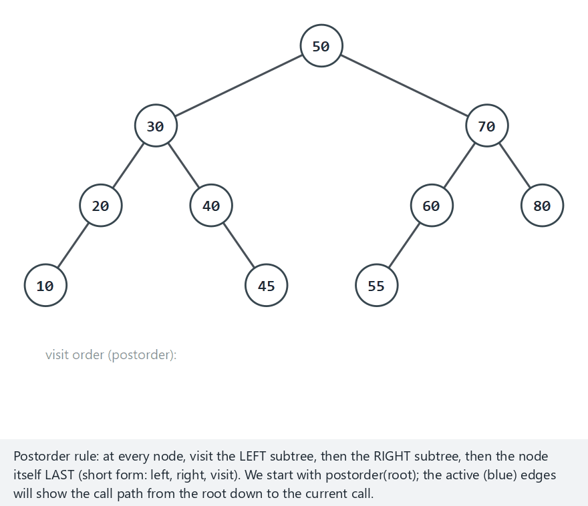
CEN207 Data Structures · Week 4
Postorder, step by step
RTEU Computer Engineering · Fall 2026–2027
49
Notes:
Compare this run's very first and very last printed values with preorder's — root last here, root first there.

Slide 50
CEN207 Data Structures · Week 4
Edge case — a right-skewed chain, reversed
RTEU Computer Engineering · Fall 2026–2027
50
Notes:
With no left subtree, postorder still saves "visit self" for last, so the whole right chain comes out in reverse chained order.

Slide 51
CEN207 Data Structures · Week 4
Code — postorder (recursive)
static void postorder(Node *node) {
if (node == NULL) return;
postorder(node->left);
postorder(node->right);
printf("visit %d\n", node->value);
visited[visited_count++] = node->value;
}
RTEU Computer Engineering · Fall 2026–2027
51
Notes:
Same three lines as always, just moved to the end — visit, left, right becomes left, right, visit.

Slide 52
CEN207 Data Structures · Week 4
Complexity — all three traversals
• O(n) time: every node visited once, O(1) work each
• O(h) recursion-stack space — the tree's height
• O(log n) for a balanced tree, but O(n) for a chain
• That worst case motivates section 3.4's explicit stack
RTEU Computer Engineering · Fall 2026–2027
52
Notes:
Only the order of "visit, left, right" changes between the three; the total work never does.

Slide 53
CEN207 Data Structures · Week 4
Common mistakes
• Forgetting the base case — node == NULL must return
• Not resetting a shared visited-count between scenarios
• Assuming the three orders "mostly agree" — even one extra node makes them diverge
• Picking the wrong traversal: rebuild needs preorder, delete needs postorder
RTEU Computer Engineering · Fall 2026–2027
53
Notes:
All three "visit every node", so a wrong choice still runs — the bug only shows up once the order itself matters.

Slide 54
CEN207 Data Structures · Week 4
Mini-quiz
You must save a tree to a file so that reading the values back in and inserting each one in order rebuilds the exact same tree. Which order?
RTEU Computer Engineering · Fall 2026–2027
54
Notes:
Think about which value must be read first.

Slide 55
CEN207 Data Structures · Week 4
Answer
Preorder. The first value read back must be the root, and preorder is the only order that visits the root before either subtree.
RTEU Computer Engineering · Fall 2026–2027
55
Notes:
This is exactly the "rebuild from scratch" property mentioned at the start of the preorder slides.

Slide 56
CEN207 Data Structures · Week 4
Inorder without recursion
Every recursive traversal secretly uses the compiler's call stack. This time, no recursion at all — our own stack, from Week 3, holding Node * instead of int.
RTEU Computer Engineering · Fall 2026–2027
56
Notes:
Push the whole left spine; when you cannot go left any further, pop, visit, then walk into the right subtree and repeat.

Slide 57
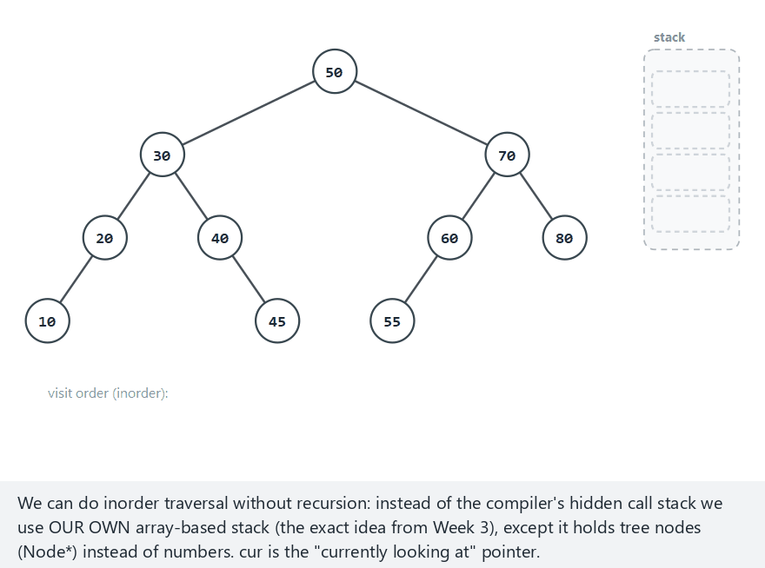
CEN207 Data Structures · Week 4
Iterative inorder, step by step
RTEU Computer Engineering · Fall 2026–2027
57
Notes:
Watch the stack grow as the left spine is pushed, then shrink one pop at a time as each node is visited.

Slide 58
CEN207 Data Structures · Week 4
Edge case — the stack reaches its deepest point
RTEU Computer Engineering · Fall 2026–2027
58
Notes:
All 10 nodes get pushed before a single one is popped — the stack depth equals the whole chain's length.

Slide 59
CEN207 Data Structures · Week 4
Code — push / pop (our own stack)
static void push(Node *n) {
top = top + 1;
stack_data[top] = n;
}
static Node *pop(void) {
Node *n = stack_data[top];
top = top - 1;
return n;
}
RTEU Computer Engineering · Fall 2026–2027
59
Notes:
The exact array-based stack from Week 3 — only the element type changed, from int to Node *.

Slide 60
CEN207 Data Structures · Week 4
Code — the main loop
Node *cur = root;
while (cur != NULL || !is_empty()) {
while (cur != NULL) {
push(cur);
cur = cur->left;
}
cur = pop();
printf("visit %d\n", cur->value);
cur = cur->right;
}
RTEU Computer Engineering · Fall 2026–2027
60
Notes:
Push the whole left spine, pop and visit, then step right and repeat — both halves of the outer while matter.

Slide 61
CEN207 Data Structures · Week 4
Complexity
• O(n) time — every node pushed once, popped once
• O(h) space — matches the recursive version exactly
• No memory saved; only the bookkeeping moved, to our own stack
• Benefit: an explicit stack can grow past a fixed recursion limit
RTEU Computer Engineering · Fall 2026–2027
61
Notes:
A pathologically deep tree can crash a recursive call stack; our own array-based stack just runs out of room more gracefully.

Slide 62
CEN207 Data Structures · Week 4
Common mistakes
• Dropping either half of cur != NULL || !is_empty()
• Forgetting cur = cur->right after visiting a popped node
• Skip it, and every right subtree silently disappears
RTEU Computer Engineering · Fall 2026–2027
62
Notes:
Both halves of that loop condition matter — drop the first and you stop too early, drop the second and you loop forever.

Slide 63
CEN207 Data Structures · Week 4
Mini-quiz
On a perfect tree of height h, what is the maximum number of nodes ever sitting on the stack at once during this traversal?
RTEU Computer Engineering · Fall 2026–2027
63
Notes:
Think about which nodes the stack actually holds at any moment.

Slide 64
CEN207 Data Structures · Week 4
Answer
h + 1.* The stack only ever holds the current left spine, and a perfect tree's longest left spine has h* + 1 nodes.
RTEU Computer Engineering · Fall 2026–2027
64
Notes:
Depths 0 through h, inclusive — that is h+1 nodes, never more.

Slide 65
CEN207 Data Structures · Week 4
Level order (breadth-first) with a queue
Every traversal so far goes deep before wide. Level order visits the root, then every node at depth 1, then depth 2 — needs a queue, not a stack.
RTEU Computer Engineering · Fall 2026–2027
65
Notes:
The first node enqueued, the root, must also be the first processed — that is exactly FIFO, so a stack would give the wrong order.

Slide 66
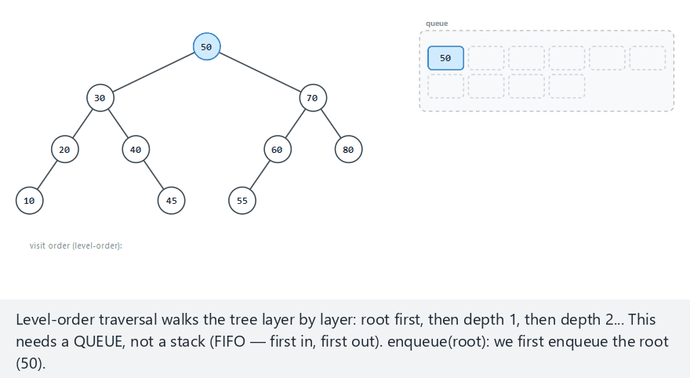
CEN207 Data Structures · Week 4
Level order, step by step
RTEU Computer Engineering · Fall 2026–2027
66
Notes:
Watch each depth finish completely — 50, then 30 and 70, then all four grandchildren — before the next depth starts.

Slide 67
CEN207 Data Structures · Week 4
Edge case — the queue always holds one item
RTEU Computer Engineering · Fall 2026–2027
67
Notes:
Every node here has only one child, so there is never more than one node "at" any depth — the queue never grows past size 1.

Slide 68
CEN207 Data Structures · Week 4
Code — enqueue / dequeue
static void enqueue(Node *n) {
rear = (rear + 1) % QUEUE_CAP;
queue_data[rear] = n;
count++;
}
static Node *dequeue(void) {
Node *n = queue_data[front];
front = (front + 1) % QUEUE_CAP;
count--;
return n;
}
RTEU Computer Engineering · Fall 2026–2027
68
Notes:
The exact circular queue from Week 3 — rear starts at -1 so the very first enqueue correctly lands on index 0.

Slide 69
CEN207 Data Structures · Week 4
Code — the main loop
enqueue(root);
while (!is_empty()) {
Node *cur = dequeue();
printf("visit %d\n", cur->value);
if (cur->left != NULL) enqueue(cur->left);
if (cur->right != NULL) enqueue(cur->right);
}
RTEU Computer Engineering · Fall 2026–2027
69
Notes:
Unlike section 2's completeness check, this loop never enqueues NULL — mixing the two conventions up is a classic source of bugs.

Slide 70
CEN207 Data Structures · Week 4
Complexity
• O(n) time — every node enqueued once, dequeued once
• O(w) space, where w is the tree's maximum width
• w can be as large as O(n) for a bushy, balanced tree
• Contrast with O(h) space for every depth-first traversal
RTEU Computer Engineering · Fall 2026–2027
70
Notes:
Depth-first traversals trade width for depth; level order trades depth for width — neither is free.

Slide 71
CEN207 Data Structures · Week 4
Common mistakes
• Swapping dequeue for pop "because it's basically the same" — that silently becomes depth-first
• Enqueuing NULL children by mistake — crashes on the next dequeue
RTEU Computer Engineering · Fall 2026–2027
71
Notes:
The code still compiles and runs either way; only the actual visiting order reveals the bug.

Slide 72
CEN207 Data Structures · Week 4
Mini-quiz
Can two different binary trees share the exact same level-order sequence of values? True or false?
RTEU Computer Engineering · Fall 2026–2027
72
Notes:
Think about whether a level-order sequence alone tells you which node is whose child.

Slide 73
CEN207 Data Structures · Week 4
Answer
True. A level-order sequence alone does not encode parent-child relationships once a level has any gaps.
RTEU Computer Engineering · Fall 2026–2027
73
Notes:
A preorder-plus-inorder pair together does determine one specific tree; a single level-order sequence does not.

Slide 74
CEN207 Data Structures · Week 4
4. A Complete Tree in an Array
RTEU Computer Engineering · Fall 2026–2027
74
Notes:
For a complete tree specifically, arithmetic on an index replaces every pointer — no malloc, no left/right fields at all.

Slide 75
CEN207 Data Structures · Week 4
A question to start
Pointers cost memory, and finding a parent needs either a stored pointer or a search. For a complete tree, is there a cheaper way?
RTEU Computer Engineering · Fall 2026–2027
75
Notes:
Yes — and it is exactly the representation the binary heap in section 5 is built on.

Slide 76
CEN207 Data Structures · Week 4
The index formulas
• Node at index i: left child at 2*i + 1
• Right child at 2*i + 2
• Parent at (i - 1) / 2 (integer division)
• No left, right, or parent field anywhere — just an array
RTEU Computer Engineering · Fall 2026–2027
76
Notes:
Three formulas are the entire representation; everything else is pure arithmetic on one plain array.

Slide 77
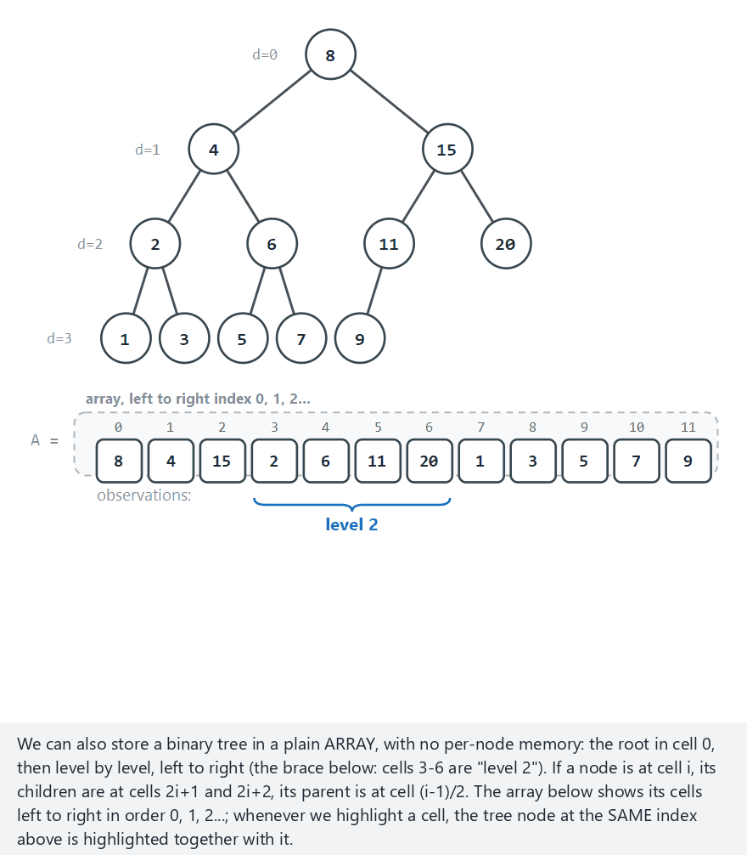
CEN207 Data Structures · Week 4
The array representation, step by step
RTEU Computer Engineering · Fall 2026–2027
77
Notes:
Normal example: 12 nodes, complete, no gaps at all — every formula lands exactly where the picture says it should.

Slide 78
CEN207 Data Structures · Week 4
Edge case — NOT complete: a gap
RTEU Computer Engineering · Fall 2026–2027
78
Notes:
Indices 9 and 10 are empty but index 11 is filled — one real node after a gap is enough to break completeness entirely.

Slide 79
CEN207 Data Structures · Week 4
Code — parent / left / right, is_complete
static int parent(int i) { return (i - 1) / 2; }
static int left(int i) { return 2 * i + 1; }
static int right(int i) { return 2 * i + 2; }
static bool is_complete(int arr[], int n, int last_real) {
for (int i = 0; i <= last_real; i++)
if (arr[i] == EMPTY) return false;
return true;
}
RTEU Computer Engineering · Fall 2026–2027
79
Notes:
Three one-line formulas, then one loop: any empty slot before the last real one means the array is not complete.

Slide 80
CEN207 Data Structures · Week 4
Complexity
• parent, left, right: pure arithmetic — O(1)
• Cost is the same for 10 nodes or 10 million
• is_complete itself: O(n), one scan of the array
RTEU Computer Engineering · Fall 2026–2027
80
Notes:
O(1) child/parent access is the entire point of the array representation — it is exactly what the heap needs next.

Slide 81
CEN207 Data Structures · Week 4
Common mistakes
• Using these formulas on a tree that is not actually complete
• Trusting (i - 1) / 2 without checking your language's integer-division rules
• Forgetting the root (i = 0) has no parent — a special case
RTEU Computer Engineering · Fall 2026–2027
81
Notes:
The formulas still compute *some* index either way; on a non-complete tree, that index may simply be meaningless.

Slide 82
CEN207 Data Structures · Week 4
Mini-quiz
A complete binary tree, stored in an array. The node at index 11 has two children. At which indices? At which index is its parent?
RTEU Computer Engineering · Fall 2026–2027
82
Notes:
Apply all three formulas from a few slides back.

Slide 83
CEN207 Data Structures · Week 4
Answer
Children at 2*11+1 = 23 and 2*11+2 = 24. Parent at (11-1)/2 = 5.
RTEU Computer Engineering · Fall 2026–2027
83
Notes:
Same three formulas, every single time, regardless of how large the tree is.

Slide 84
CEN207 Data Structures · Week 4
5. The Binary Heap
RTEU Computer Engineering · Fall 2026–2027
84
Notes:
A binary heap is a complete tree, from section 4, with one extra rule: every parent beats both its children.

Slide 85
CEN207 Data Structures · Week 4
A question to start
An OS needs the most urgent of a hundred waiting processes, instantly, over and over. Sorting the whole list each time is wasteful. What is the cheapest structure that always keeps the single best item within reach?
RTEU Computer Engineering · Fall 2026–2027
85
Notes:
Sorting on every arrival costs O(n log n) per arrival — far too slow for something this frequent.

Slide 86
CEN207 Data Structures · Week 4
A short history
• 1964 — J. W. J. Williams introduces the heap and heap sort, together
• 1964 — R. W. Floyd publishes an O(n) way to build one
• The heap was invented specifically to make sorting fast
RTEU Computer Engineering · Fall 2026–2027
86
Notes:
Both papers appeared the very same year — the heap and heap sort were never really separate ideas.

Slide 87
CEN207 Data Structures · Week 4
The heap property
• Min-heap: every parent ≤ both children — smallest at the root
• Max-heap: every parent ≥ both children — largest at the root
• Not a sorted structure — siblings have no required order
• Only every parent beats its own two children, nothing more
RTEU Computer Engineering · Fall 2026–2027
87
Notes:
This is the single most common misconception about heaps: a heap is not a sorted array, only a partially ordered one.

Slide 88
CEN207 Data Structures · Week 4
The heap ADT
Operation | What it does | Complexity
peek() | Returns the root without removing it | O(1)
insert(x) | Adds x, restores order by sift-up | O(log n)
extract() | Removes the root, restores by sift-down | O(log n)
build_heap(arr) | Turns any array into a heap, all at once | O(n)
RTEU Computer Engineering · Fall 2026–2027
88
Notes:
Four operations, and the next four subsections build exactly these four, in this order.

Slide 89
CEN207 Data Structures · Week 4
Insertion: sift-up
Place the new value in the next free slot — keeps the tree complete. Then repeatedly swap it with its parent while the heap property is violated. This is sift-up.
RTEU Computer Engineering · Fall 2026–2027
89
Notes:
Stop the moment the property holds, or when the value reaches the root — whichever comes first.

Slide 90
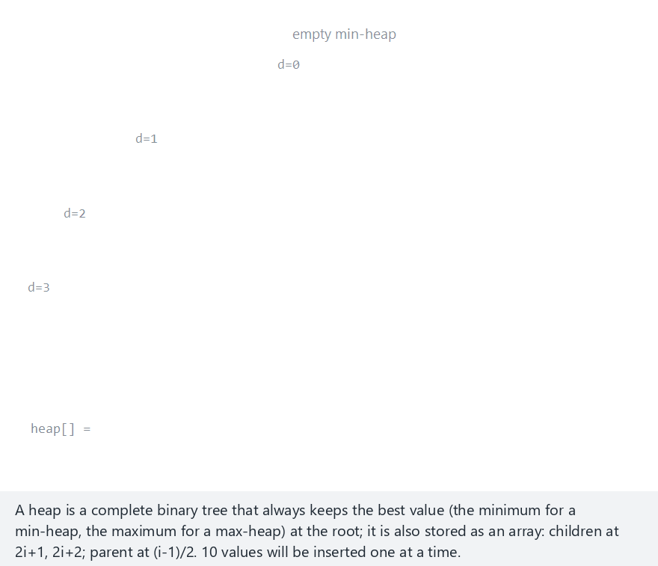
CEN207 Data Structures · Week 4
Insertion by sift-up, step by step
RTEU Computer Engineering · Fall 2026–2027
90
Notes:
Normal example: a min-heap, 10 values inserted one by one: 15, 7, 22, 3, 18, 9, 30, 1, 25, 12.

Slide 91
CEN207 Data Structures · Week 4
Edge case — already in order, no sifting needed
RTEU Computer Engineering · Fall 2026–2027
91
Notes:
12 ascending values into a min-heap: every single insert already satisfies the heap property, so not one swap ever happens.

Slide 92
CEN207 Data Structures · Week 4
Code — insert() / sift-up
void insert(int value) {
heap[size] = value;
int i = size;
size++;
while (i > 0) {
int parent = (i - 1) / 2;
if (!better(heap[i], heap[parent]))
break;
int tmp = heap[parent];
heap[parent] = heap[i];
heap[i] = tmp;
i = parent;
}
}
RTEU Computer Engineering · Fall 2026–2027
92
Notes:
better() hides min-heap vs max-heap behind one function, so the sift-up loop itself never needs to change.

Slide 93
CEN207 Data Structures · Week 4
Complexity
• insert: at most one swap per level — O(log n)
• log n is the height of a complete tree with n nodes
• peek (reading heap[0]): O(1)
RTEU Computer Engineering · Fall 2026–2027
93
Notes:
Height, not size, decides insert's cost — exactly the "why balance matters" idea from section 2, put to work.

Slide 94
CEN207 Data Structures · Week 4
Extraction: sift-down
Save the root, move the last array element into its place — keeps the tree complete. Then repeatedly swap it with its better child. This is sift-down.
RTEU Computer Engineering · Fall 2026–2027
94
Notes:
Shrink size by one first, then sift — the moved element usually does not belong at the root at all.

Slide 95
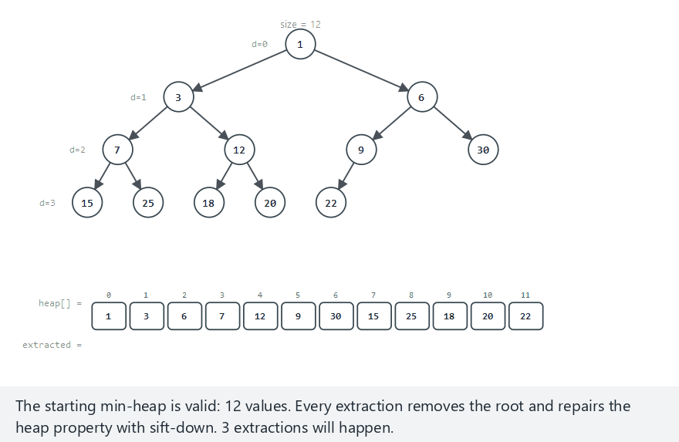
CEN207 Data Structures · Week 4
Extraction by sift-down, step by step
RTEU Computer Engineering · Fall 2026–2027
95
Notes:
Normal example: a min-heap, 12 values, 3 extractions — watch the last element parachute into the root, then sink back down.

Slide 96
CEN207 Data Structures · Week 4
Edge case — drain fully: all 10 values extracted
RTEU Computer Engineering · Fall 2026–2027
96
Notes:
Extracting all 10 values, one at a time, produces them in fully sorted order — that is not a coincidence, it is how heap sort works.

Slide 97
CEN207 Data Structures · Week 4
Code — extract() / sift-down
int extract(void) {
int best = heap[0];
size--;
heap[0] = heap[size]; /* ... */
int i = 0;
while (1) { /* sift-down */
/* ... target = better of left, right child ... */
if (target == i)
break;
/* ... swap heap[i], heap[target]; i = target ... */
}
return best;
}
RTEU Computer Engineering · Fall 2026–2027
97
Notes:
Compare with both children, not just the left one — comparing only one side can leave the property broken on the other.

Slide 98
CEN207 Data Structures · Week 4
Complexity
• extract: at most one swap per level — O(log n)
• The exact mirror image of sift-up's cost
• Same O(log n) bound, going the opposite direction
RTEU Computer Engineering · Fall 2026–2027
98
Notes:
Insert climbs at most log n levels; extract sinks at most log n levels — heights, again, decide everything.

Slide 99
CEN207 Data Structures · Week 4
Common mistakes (insert and extract)
• Calling extract without checking size > 0 first
• Comparing sift-down against only one child, not both
• Using <= instead of < in better — harmless, but changes tie behavior
RTEU Computer Engineering · Fall 2026–2027
99
Notes:
An empty-heap extract reads heap[-1]-adjacent memory silently — a dangerous bug, not a clean crash.

Slide 100
CEN207 Data Structures · Week 4
Building a heap in O(n)
n single inserts cost O(n log n) total. Floyd's algorithm does better: every leaf is already a valid one-node heap; sift-down only the internal nodes, from the last one back to the root.
RTEU Computer Engineering · Fall 2026–2027
100
Notes:
This is a genuinely surprising result — building looks like it should cost the same as n inserts, but it does not.

Slide 101
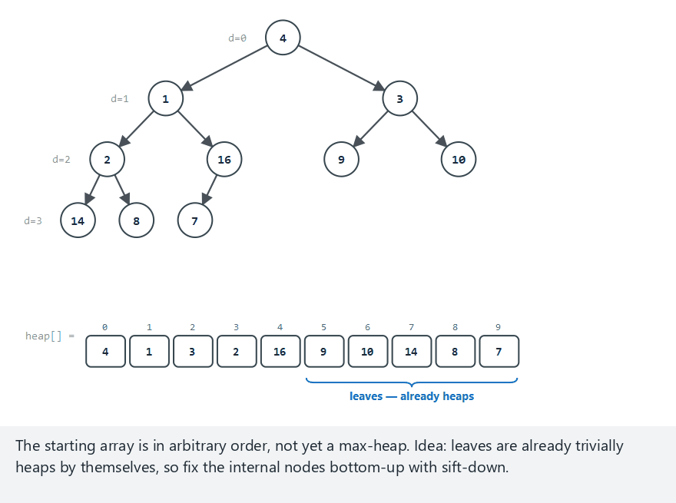
CEN207 Data Structures · Week 4
Build-heap, step by step
RTEU Computer Engineering · Fall 2026–2027
101
Notes:
Normal example: a max-heap, 10 values in arbitrary order — watch how few of the n/2 leaves ever move at all.

Slide 102
CEN207 Data Structures · Week 4
Edge case — already a valid heap
RTEU Computer Engineering · Fall 2026–2027
102
Notes:
Every sift-down call finds target == i immediately and does nothing — build_heap does exactly as much work as the input needs, no more.

Slide 103
CEN207 Data Structures · Week 4
Code — build_heap()
void build_heap(int arr[], int n) {
for (int i = n / 2 - 1; i >= 0; i--)
sift_down(arr, n, i);
}
RTEU Computer Engineering · Fall 2026–2027
103
Notes:
sift_down here is the exact same loop as extract's sift-down; the only new idea is which nodes to call it on, and in which order.

Slide 104
CEN207 Data Structures · Week 4
Why O(n), not O(n log n)?
• Roughly n/2 nodes are leaves — skipped entirely
• Roughly n/4 nodes cost at most 1 swap; n/8 cost at most 2
• "Count at height h times cost h", summed, converges to O(n)
• Many cheap sifts near the bottom dominate the few costly ones near the top
RTEU Computer Engineering · Fall 2026–2027
104
Notes:
This is the one genuinely surprising complexity result of the whole week — worth sitting with for a moment.

Slide 105
CEN207 Data Structures · Week 4
Common mistakes
• Starting the loop at i = 0 instead of i = n/2 - 1 — sifts unfixed subtrees
• Assuming build_heap is "just n calls to insert" — valid, but not the same layout or cost
RTEU Computer Engineering · Fall 2026–2027
105
Notes:
The loop must run backward, from the last internal node to the root, so every node's subtrees are already valid by the time it is sifted.

Slide 106
CEN207 Data Structures · Week 4
Mini-quiz
build_heap and heap_sort's main loop both call sift_down repeatedly. Why is the first O(n) overall, but the second O(n log n)?
RTEU Computer Engineering · Fall 2026–2027
106
Notes:
Think about where in the tree each call to sift-down starts from.

Slide 107
CEN207 Data Structures · Week 4
Answer
build_heap sifts mostly-cheap nodes near the bottom. heap_sort calls sift-down once per extraction, always starting from the root — no cheap majority to average against.
RTEU Computer Engineering · Fall 2026–2027
107
Notes:
Same function, sift_down, called in two very different patterns, with two very different total costs.

Slide 108
CEN207 Data Structures · Week 4
Heap sort — the idea
build_heap, then repeatedly move the root to the sorted tail, shrink, and sift-down. A max-heap sorts ascending; a min-heap sorts descending.
RTEU Computer Engineering · Fall 2026–2027
108
Notes:
Once build_heap and extract both exist, sorting is almost free — this section just wires the two together.

Slide 109
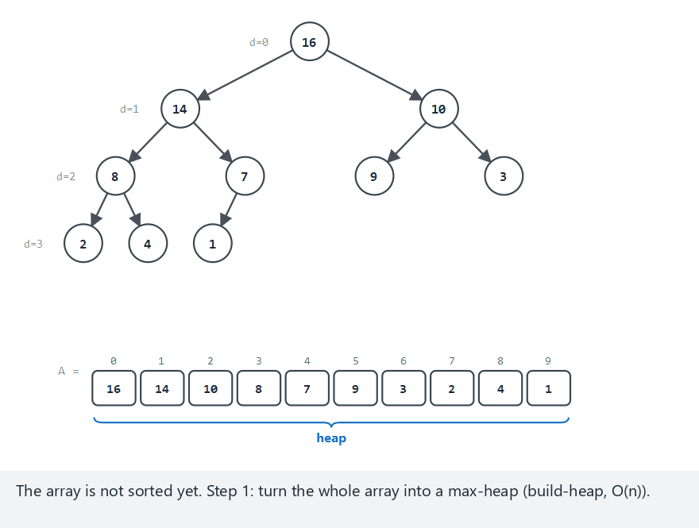
CEN207 Data Structures · Week 4
Heap sort, step by step
RTEU Computer Engineering · Fall 2026–2027
109
Notes:
Normal example: ascending sort with a max-heap, 10 values — watch the sorted region grow from the array's tail backward.

Slide 110
CEN207 Data Structures · Week 4
Edge case — already ascending, same cost anyway
RTEU Computer Engineering · Fall 2026–2027
110
Notes:
Unlike build-heap, heap sort is not adaptive — an already-sorted input still costs the full O(n log n), swap for swap.

Slide 111
CEN207 Data Structures · Week 4
Code — heap_sort()
void heap_sort(int arr[], int n) {
for (int i = n / 2 - 1; i >= 0; i--)
sift_down(arr, n, i);
for (int heap_size = n; heap_size > 1; heap_size--) {
int tmp = arr[0];
arr[0] = arr[heap_size - 1];
arr[heap_size - 1] = tmp;
sift_down(arr, heap_size - 1, 0);
}
}
RTEU Computer Engineering · Fall 2026–2027
111
Notes:
The very same build_heap loop from before, then n-1 rounds of swap-and-sift, each on a shrinking region.

Slide 112
CEN207 Data Structures · Week 4
Complexity
• build_heap: O(n); the loop then runs n − 1 times
• Each round: one O(1) swap plus one O(log n) sift-down
• Total: O(n log n) — sorts in place, no extra array
RTEU Computer Engineering · Fall 2026–2027
112
Notes:
Same asymptotic class as merge sort or quicksort's average case, but with no extra memory needed.

Slide 113
CEN207 Data Structures · Week 4
Common mistakes
• Believing heap sort is stable — it is not
• Sifting over the full array instead of the shrunk region — corrupts the already-sorted tail
RTEU Computer Engineering · Fall 2026–2027
113
Notes:
If a stable sort is required, heap sort is simply the wrong tool, regardless of its good time complexity.

Slide 114
CEN207 Data Structures · Week 4
6. Priority Queue: The ADT a Heap Serves
RTEU Computer Engineering · Fall 2026–2027
114
Notes:
A queue serves whoever arrived first; a priority queue serves whoever matters most, arrival order be damned.

Slide 115
CEN207 Data Structures · Week 4
The ADT
A priority queue manages items, each with a priority. insert/peek/extract map directly onto the heap operations you just built.
RTEU Computer Engineering · Fall 2026–2027
115
Notes:
Almost nothing new here — the heap from section 5 is by far the most common way to implement one.

Slide 116
CEN207 Data Structures · Week 4
The priority queue ADT
Operation | What it does | Complexity
insert(x) | Adds x with its priority | O(log n)
peek() | Returns the top item, keeps it | O(1)
extract() | Removes and returns the top item | O(log n)
update_key(id, p) | Changes an item's priority | O(n) naive
RTEU Computer Engineering · Fall 2026–2027
116
Notes:
update_key is the one genuinely new operation, and it is the whole reason each item needs a permanent id.

Slide 117
CEN207 Data Structures · Week 4
update_key — the new piece
• Priority changes → item may need to move
• Better now: decrease-key — sift up
• Worse now: increase-key — sift down
• Real uses: Dijkstra's algorithm, OS schedulers
RTEU Computer Engineering · Fall 2026–2027
117
Notes:
Each item needs a permanent id, stable no matter where it moves inside the array, or update_key cannot find it again.

Slide 118
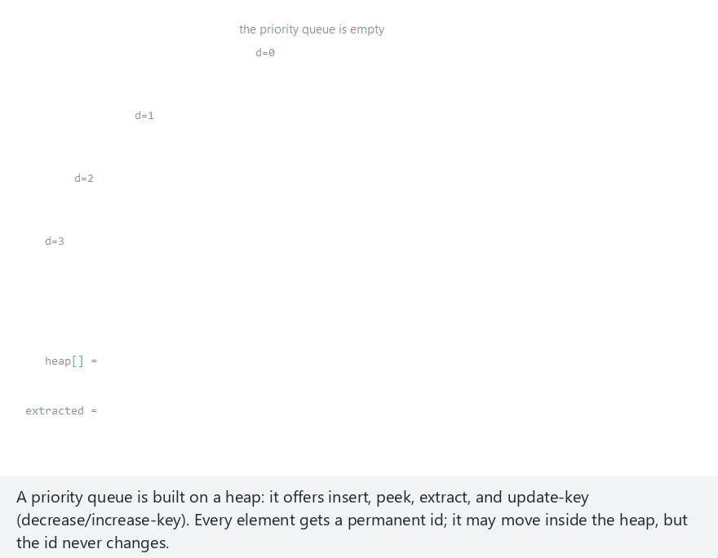
CEN207 Data Structures · Week 4
Priority queue operations, step by step
RTEU Computer Engineering · Fall 2026–2027
118
Notes:
Normal example: min-priority, 10 inserts, a peek, 2 extracts, and one update-key — the same 15,7,22,3,18,... values as section 5's heap-insert.

Slide 119
CEN207 Data Structures · Week 4
Edge case — extract/peek while empty
RTEU Computer Engineering · Fall 2026–2027
119
Notes:
The caller checks size > 0, not the heap operations themselves — this scenario shows that check catching underflow safely.

Slide 120
CEN207 Data Structures · Week 4
Code — Item, insert()
typedef struct {
int id;
int key;
} Item;
void insert(int id, int key) {
heap[size] = (Item){id, key};
sift_up(size);
size++;
}
RTEU Computer Engineering · Fall 2026–2027
120
Notes:
Every item now carries a permanent id alongside its key — the id never moves, even when the item's array slot does.

Slide 121
CEN207 Data Structures · Week 4
Code — update_key()
void update_key(int id, int new_key) {
int i = find_by_id(id);
if (i == -1) { /* … print a message */ return; }
heap[i].key = new_key;
if (i > 0 && better(heap[i], heap[(i - 1) / 2]))
sift_up(i);
else
sift_down(i);
}
RTEU Computer Engineering · Fall 2026–2027
121
Notes:
find_by_id is a linear scan here — a real system adds a hash table from id to index to make this O(log n) too.

Slide 122
CEN207 Data Structures · Week 4
Complexity
• insert, extract: O(log n), inherited from the heap
• peek: O(1)
• update_key: O(n) with a linear scan for the id
• A hash table id→index cuts that to O(log n)
RTEU Computer Engineering · Fall 2026–2027
122
Notes:
That extra bookkeeping is a classic space-for-time trade, worth it once thousands of items are in play.

Slide 123
CEN207 Data Structures · Week 4
Common mistakes
• Confusing an item's id (permanent) with its array index (not)
• Calling peek/extract without checking the queue is non-empty
• Sifting the wrong direction after update_key
RTEU Computer Engineering · Fall 2026–2027
123
Notes:
Decrease-key needs sift-up; increase-key needs sift-down — using the wrong one leaves the heap silently broken.

Slide 124
CEN207 Data Structures · Week 4
Mini-quiz
A min-priority scheduler is keyed by "time to deadline". A running process is just interrupted by something far more urgent. Decrease-key or increase-key? Which sift?
RTEU Computer Engineering · Fall 2026–2027
124
Notes:
Think about what "more urgent" means for the key's numeric value in a min-priority queue.

Slide 125
CEN207 Data Structures · Week 4
Answer
Decrease-key — more urgent means a smaller key. It triggers sift-up, floating toward the root, which holds the minimum.
RTEU Computer Engineering · Fall 2026–2027
125
Notes:
In a min-priority queue, smaller is always better — the same rule as section 5's min-heap.

Slide 126
CEN207 Data Structures · Week 4
7. Heap Variants: Trading One Property for Another
RTEU Computer Engineering · Fall 2026–2027
126
Notes:
Each variant below relaxes or changes one property of the plain binary heap, in exchange for a different advantage.

Slide 127
CEN207 Data Structures · Week 4
The d-ary heap
Same array-backed idea, but every node has up to D children, not 2. Child c of node i is at D*i + 1 + c; parent at (i-1)/D. D = 2 recovers the ordinary binary heap.
RTEU Computer Engineering · Fall 2026–2027
127
Notes:
A larger D makes insert cheaper (fewer levels, one comparison each) but extract more expensive (up to D comparisons per level).

Slide 128
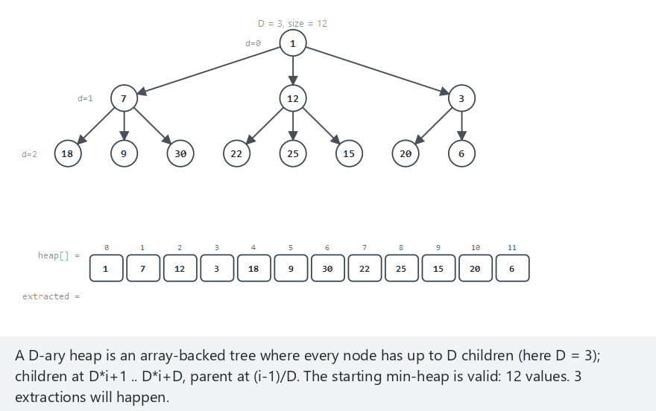
CEN207 Data Structures · Week 4
D-ary heap extraction, step by step
RTEU Computer Engineering · Fall 2026–2027
128
Notes:
Normal example: D=3, a min-heap, 3 extractions from 12 values — watch each sift-down compare against up to 3 children at once.

Slide 129
CEN207 Data Structures · Week 4
Edge case — D=3, drain fully
RTEU Computer Engineering · Fall 2026–2027
129
Notes:
All 10 values extracted, one at a time — again comes out fully sorted, exactly like the plain binary heap's drain case.

Slide 130
CEN207 Data Structures · Week 4
Code — extract() with D children
int extract(void) {
int best = heap[0];
size--;
heap[0] = heap[size];
int i = 0;
while (1) {
int target = i, base = D * i + 1;
/* ... check up to D children, base..base+D-1 ... */
if (target == i) break;
/* ... swap heap[i], heap[target]; i = target ... */
}
return best;
}
RTEU Computer Engineering · Fall 2026–2027
130
Notes:
base = D*i+1 replaces the binary heap's 2*i+1 — every other line of extract stays exactly the same shape.

Slide 131
CEN207 Data Structures · Week 4
Complexity
• extract: O(D · log<sub>D</sub> n) — fewer levels, more per level
• insert: O(log<sub>D</sub> n) — only ever compares one parent
• Larger D: cheaper inserts, potentially costlier extracts
RTEU Computer Engineering · Fall 2026–2027
131
Notes:
Popular for insert-heavy workloads like network event schedulers, where extract is comparatively rare.

Slide 132
CEN207 Data Structures · Week 4
Common mistakes
• Reusing the binary heap's 2*i+1/2*i+2 formulas unchanged
• Choosing a large D purely for a shorter tree, ignoring extract's cost
RTEU Computer Engineering · Fall 2026–2027
132
Notes:
2*i+1 and 2*i+2 are just the D=2 special case of D*i+1+c — plug in the wrong D and the wrong array cell gets touched.

Slide 133
CEN207 Data Structures · Week 4
The binomial heap
Introduced by Jean Vuillemin, 1978. A forest of binomial trees; order k has 2<sup>k</sup> nodes. An n-element heap's orders are exactly the set bits of n in binary.
RTEU Computer Engineering · Fall 2026–2027
133
Notes:
13 = 0b1101 decomposes into orders 0, 2, and 3 — trees of size 1, 4, and 8, summing to 13.

Slide 134
CEN207 Data Structures · Week 4
Union: binary addition with a carry
• Walk orders low to high, like adding two numbers
• One heap has a tree at this order → passes straight through
• Both do → they link, producing a "carry" one order up
• Up to three trees can meet at once: A, B, and an incoming carry
RTEU Computer Engineering · Fall 2026–2027
134
Notes:
This "three trees at once" case is exactly what the hard scenario in the animation is built to exercise.

Slide 135
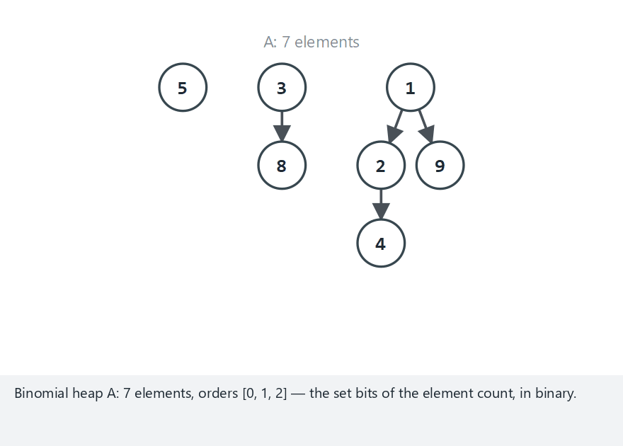
CEN207 Data Structures · Week 4
Binomial heap union, step by step
RTEU Computer Engineering · Fall 2026–2027
135
Notes:
Normal example: min, A has 7 elements (orders 0,1,2), B has 5 (orders 0,2) — watch the carries ripple upward.

Slide 136
CEN207 Data Structures · Week 4
Edge case — one long carry chain
RTEU Computer Engineering · Fall 2026–2027
136
Notes:
A (order 3) union B (order 3): a single carry ripples through every order, just like adding 1000 + 1000 in binary.

Slide 137
CEN207 Data Structures · Week 4
Code — union_heaps()
void union_heaps(Node *a[], Node *b[], Node *result[]) {
Node *carry = NULL;
for (int order = 0; order < MAX_ORDER; order++) {
Node *group[3]; int g = 0;
if (a[order]) group[g++] = a[order];
if (b[order]) group[g++] = b[order];
if (carry) group[g++] = carry;
carry = NULL;
/* ... g==0: none; g==1: pass through ... */
/* ... g>=2: link() two trees, carry up ... */
}
}
RTEU Computer Engineering · Fall 2026–2027
137
Notes:
link() makes the worse root a new leftmost child of the better root — O(1), just a handful of pointer updates.

Slide 138
CEN207 Data Structures · Week 4
Complexity
• link: O(1) — a few pointer reassignments
• union: visits at most O(log n) orders — O(log n)
• insert is defined as union with one order-0 tree — also O(log n)
RTEU Computer Engineering · Fall 2026–2027
138
Notes:
A plain binary heap's insert is also O(log n), but for a completely different reason: sift-up, not linking.

Slide 139
CEN207 Data Structures · Week 4
Common mistakes
• Handling only two trees meeting at an order, forgetting the carry makes three
• Re-deriving insert from scratch instead of just calling union
RTEU Computer Engineering · Fall 2026–2027
139
Notes:
insert is not a separate algorithm to memorize — it is exactly union_heaps with a single-element second heap.

Slide 140
CEN207 Data Structures · Week 4
The leftist heap
Introduced by C. A. Crane, 1972. A pointer tree, generally not complete, built around one operation: merge. insert and extract both fall out of it as special cases.
RTEU Computer Engineering · Fall 2026–2027
140
Notes:
insert is merge with one new node; extract is merge of the root's two children, after the root itself is removed.

Slide 141
CEN207 Data Structures · Week 4
The leftist property
• Every node tracks its null path length (npl)
• NULL has npl −1; a leaf has npl 0
• Leftist: left child's npl never smaller than the right's
• Consequence: the right spine is always O(log n) long
RTEU Computer Engineering · Fall 2026–2027
141
Notes:
The tree may be wildly unbalanced overall — only the right spine is guaranteed short, and merge only ever walks that spine.

Slide 142
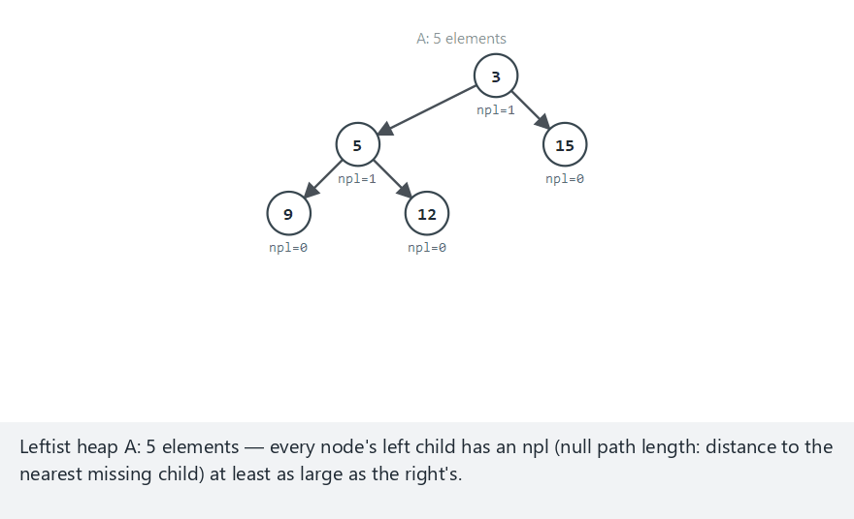
CEN207 Data Structures · Week 4
Leftist heap merge, step by step
RTEU Computer Engineering · Fall 2026–2027
142
Notes:
Normal example: min, A has 5 elements, B has 6 — watch merge splice down both right spines, then fix npls on the way back up.

Slide 143
CEN207 Data Structures · Week 4
Edge case — merging with an empty heap
RTEU Computer Engineering · Fall 2026–2027
143
Notes:
A is empty, merging with an 11-element B — merge's two base cases (t1 == NULL, t2 == NULL) handle this immediately.

Slide 144
CEN207 Data Structures · Week 4
Code — merge() (recursive)
Node *merge(Node *t1, Node *t2) {
if (t1 == NULL) return t2;
if (t2 == NULL) return t1;
if (!better(t1->key, t2->key)) {
Node *tmp = t1; t1 = t2; t2 = tmp;
}
t1->right = merge(t1->right, t2);
if (npl(t1->left) < npl(t1->right)) {
/* ... swap t1->left and t1->right ... */
}
t1->npl = npl(t1->right) + 1;
return t1;
}
RTEU Computer Engineering · Fall 2026–2027
144
Notes:
The better root always wins and absorbs the other tree into its own right side, then the swap restores the leftist property.

Slide 145
CEN207 Data Structures · Week 4
Complexity
• merge: O(log n), bounded by both right spines
• insert, extract: both defined via merge — same O(log n)
• Holds regardless of how unbalanced the rest of the tree is
RTEU Computer Engineering · Fall 2026–2027
145
Notes:
Only the right spine's length matters, and the leftist property guarantees it is always short.

Slide 146
CEN207 Data Structures · Week 4
Common mistakes
• Confusing npl (distance to nearest missing child) with height
• Skipping the child-swap after merge — silently breaks the leftist property
RTEU Computer Engineering · Fall 2026–2027
146
Notes:
Skip that swap, and the whole O(log n) short-right-spine guarantee quietly stops holding.

Slide 147
CEN207 Data Structures · Week 4
Mini-quiz
You need to merge two large heaps together, far more often than inserting single items. Which variant fits best?
RTEU Computer Engineering · Fall 2026–2027
147
Notes:
Think about which structure has no fast way to merge two whole heaps at all.

Slide 148
CEN207 Data Structures · Week 4
Answer
The leftist heap (or the binomial heap). Both are built so merge/union costs only O(log n) — a plain or d-ary heap has no fast way to merge two whole heaps at all.
RTEU Computer Engineering · Fall 2026–2027
148
Notes:
A plain array heap's only way to merge is re-inserting every element of one heap into the other, one at a time.

Slide 149
CEN207 Data Structures · Week 4
8. Huffman Coding
RTEU Computer Engineering · Fall 2026–2027
149
Notes:
The payoff for everything this week has built: a heap of trees, and nothing else, produces an optimal compressed code.

Slide 150
CEN207 Data Structures · Week 4
A question to start
Plain ASCII spends 8 bits on every character, E or Z alike. What if common characters got short codes, and rare ones long — like Morse code already does?
RTEU Computer Engineering · Fall 2026–2027
150
Notes:
The catch: mixed-length codes in one bitstream could be ambiguous to decode, unless built with one very specific property.

Slide 151
CEN207 Data Structures · Week 4
A short history
• 1952 — David Huffman, a term paper at MIT
• Professor Fano's own scheme was good, but not optimal
• Huffman's greedy tree-merging is provably optimal
• Still inside ZIP, JPEG, and MP3 today
RTEU Computer Engineering · Fall 2026–2027
151
Notes:
Huffman's professor offered the class a choice: take the final exam, or find a provably optimal prefix code — Huffman found one.

Slide 152
CEN207 Data Structures · Week 4
Building the tree
Put every symbol in a min-heap, keyed by frequency. Repeatedly: pop the two smallest roots, make a new internal node with those two as children, push it back. Repeat to one.
RTEU Computer Engineering · Fall 2026–2027
152
Notes:
Rare symbols merge early, staying near the bottom; common symbols merge late, staying near the top — exactly what gives them short codes.

Slide 153
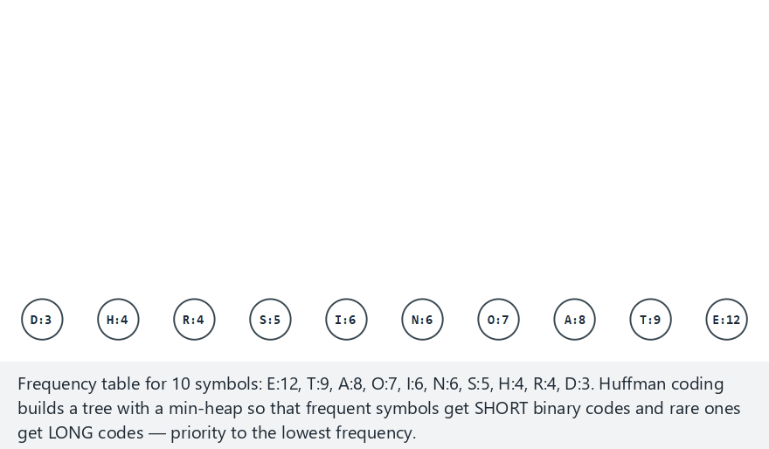
CEN207 Data Structures · Week 4
Building the Huffman tree, step by step
RTEU Computer Engineering · Fall 2026–2027
153
Notes:
Normal example: 10 symbols with English-letter-like frequencies — watch the two smallest roots merge, again and again.

Slide 154
CEN207 Data Structures · Week 4
Edge case — the smallest meaningful example
RTEU Computer Engineering · Fall 2026–2027
154
Notes:
Just 2 symbols: one merge, one root, done — the smallest input for which "build a tree" even means anything.

Slide 155
CEN207 Data Structures · Week 4
Code — the merge loop
int merge_id = 256;
while (heap_size > 1) {
Node *a = heap_pop();
Node *b = heap_pop();
Node *parent = new_internal(a, b, merge_id++);
heap_push(parent);
}
Node *root = heap_pop();
RTEU Computer Engineering · Fall 2026–2027
155
Notes:
heap_pop/heap_push are exactly section 5's min-heap extract/insert, ordering Node pointers instead of plain ints.

Slide 156
CEN207 Data Structures · Week 4
Encoding and decoding
A symbol's code is its root-to-leaf path: left = 0, right = 1. Decoding walks bit by bit from the root; a leaf emits a character and restarts. This works because the code is prefix-free.
RTEU Computer Engineering · Fall 2026–2027
156
Notes:
Every symbol is exactly one leaf, and a leaf has no children — so no code can ever be a prefix of another.

Slide 157
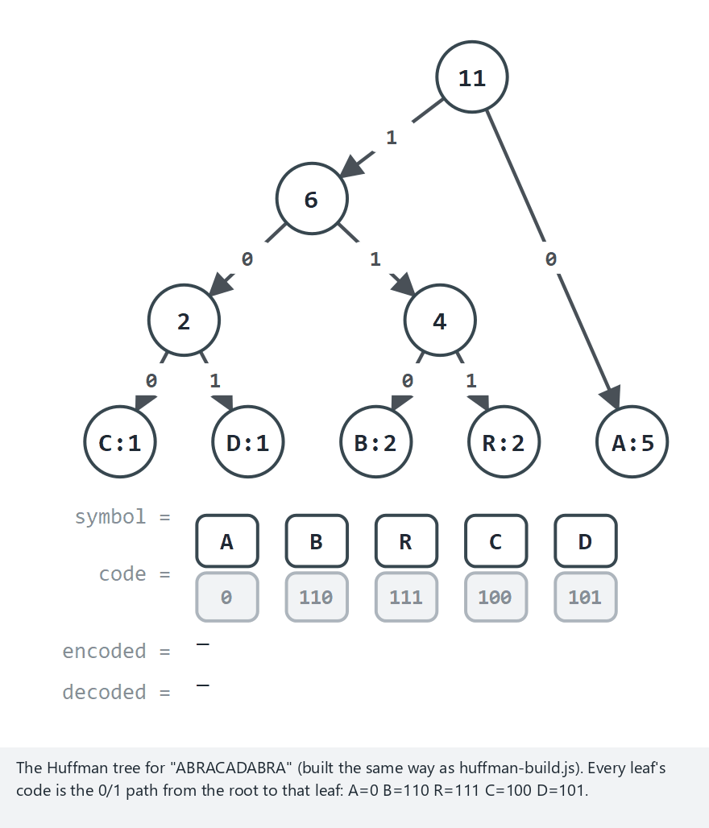
CEN207 Data Structures · Week 4
Encoding and decoding, step by step
RTEU Computer Engineering · Fall 2026–2027
157
Notes:
Normal example: "ABRACADABRA", 11 characters — 88 plain-ASCII bits shrink to 23, because A alone is 5 of the 11 characters.

Slide 158
CEN207 Data Structures · Week 4
Edge case — very skewed: 9 A's, 1 B
RTEU Computer Engineering · Fall 2026–2027
158
Notes:
Only 2 symbols left, so 1 bit per character is the best possible — 10 bits instead of 80, no matter how skewed the frequencies are.

Slide 159
CEN207 Data Structures · Week 4
Code — assign_codes() (walk the tree)
static void assign_codes(Node *node, char *path,
int depth) {
if (node->left == NULL && node->right == NULL) {
path[depth] = '\0';
strcpy(codes[(unsigned char) node->ch], path);
return;
}
path[depth] = '0';
assign_codes(node->left, path, depth + 1);
path[depth] = '1';
assign_codes(node->right, path, depth + 1);
}
RTEU Computer Engineering · Fall 2026–2027
159
Notes:
Only leaves ever record a code; every internal node just extends the path with a 0 (left) or a 1 (right).

Slide 160
CEN207 Data Structures · Week 4
Code — decode() (walk bit by bit)
static char *decode(const char *bits, Node *root,
char *out) {
int n = 0;
Node *node = root;
for (int i = 0; bits[i] != '\0'; i++) {
node = bits[i] == '0' ? node->left : node->right;
if (node->left == NULL && node->right == NULL) {
out[n++] = node->ch;
node = root;
}
}
out[n] = '\0';
return out;
}
RTEU Computer Engineering · Fall 2026–2027
160
Notes:
One tree step per bit; the moment a leaf is reached, emit its character and restart the walk from the root.

Slide 161
CEN207 Data Structures · Week 4
Complexity
• Building: n − 1 merges, O(log n) each — O(n log n)
• Encoding: O(L) — one lookup and append per character
• Decoding: O(B) — one tree step per encoded bit
RTEU Computer Engineering · Fall 2026–2027
161
Notes:
L is the text's length in characters; B is the encoded message's length in bits.

Slide 162
CEN207 Data Structures · Week 4
Common mistakes
• No deterministic tie-breaker — equal frequencies can build two different, equally optimal trees
• Assuming the code table is fixed, like ASCII — it is built per message
• Testing decode alone, never the full decode(encode(text)) == text round trip
RTEU Computer Engineering · Fall 2026–2027
162
Notes:
The decoder always needs either the tree or the frequency table shipped alongside the encoded bits.

Slide 163
CEN207 Data Structures · Week 4
Mini-quiz
In a Huffman tree, can one symbol's code ever be a prefix of another symbol's code?
RTEU Computer Engineering · Fall 2026–2027
163
Notes:
Think about what a leaf's position in the tree does, and does not, allow.

Slide 164
CEN207 Data Structures · Week 4
Answer
No. Every symbol is exactly one leaf, and a leaf has no children — so no code can ever be extended into a different, longer code.
RTEU Computer Engineering · Fall 2026–2027
164
Notes:
This "prefix-free" property is exactly what makes single-pass, unambiguous decoding possible.

Slide 165
CEN207 Data Structures · Week 4
Summary — trees, shapes, traversals, array
Idea | Key fact
Tree | One root, no cycles, n−1 edges for n nodes
Binary tree shapes | Full, complete, perfect, degenerate, balanced
Traversals | Pre/in/post (recursive), iterative, level order
Array representation | 2i+1, 2i+2, (i-1)/2 — all O(1)
RTEU Computer Engineering · Fall 2026–2027
165
Notes:
Five ways to visit the same tree, and one way to store a complete one without a single pointer.

Slide 166
CEN207 Data Structures · Week 4
Summary — heaps, priority queues, Huffman
Idea | Key fact
Binary heap | insert/extract O(log n); build O(n)
Heap sort | O(n log n), in place, not stable
Priority queue | update_key needs a stable id
Variants | d-ary (faster insert), binomial/leftist (fast merge)
Huffman coding | Min-heap of trees; prefix-free codes
RTEU Computer Engineering · Fall 2026–2027
166
Notes:
Every one of these five rows is built from the same two moves: sift-up and sift-down.

Slide 167
CEN207 Data Structures · Week 4
The big picture
One structure, the heap, built from two moves — sift-up, sift-down — produces a sort, a priority queue, three variants, and an optimal compression code.
RTEU Computer Engineering · Fall 2026–2027
167
Notes:
If a student remembers only one sentence from today, this is the one worth remembering.

Slide 168
CEN207 Data Structures · Week 4
Self-check round
Four short questions. Think before the answer appears on the next slide. Full exercises and a ten-question quiz are in the week notes.
RTEU Computer Engineering · Fall 2026–2027
168
Notes:
These mirror the self-check quiz at the end of the written notes, one question per slide, with a shorter set here.

Slide 169
CEN207 Data Structures · Week 4
1. What is the maximum number of nodes in a binary tree of height 4?
RTEU Computer Engineering · Fall 2026–2027
169
Notes:
Ask, wait, then advance.

Slide 170
CEN207 Data Structures · Week 4
2<sup>5</sup> − 1 = 31 nodes — a perfect tree of that height.
RTEU Computer Engineering · Fall 2026–2027
170
Notes:
The same formula from section 2, just with h = 4.

Slide 171
CEN207 Data Structures · Week 4
2. In a complete tree stored in an array, what is the parent index of node 9?
RTEU Computer Engineering · Fall 2026–2027
171
Notes:
Apply the formula from section 4.

Slide 172
CEN207 Data Structures · Week 4
(9 - 1) / 2 = 4, using integer division.
RTEU Computer Engineering · Fall 2026–2027
172
Notes:
Same formula, every time, regardless of the tree's size.

Slide 173
CEN207 Data Structures · Week 4
3. Why is building a heap from n items O(n), not the "obviously plausible" O(n log n)?
RTEU Computer Engineering · Fall 2026–2027
173
Notes:
Recall the height-weighted sum from section 5.5.

Slide 174
CEN207 Data Structures · Week 4
Most nodes are near the bottom, where sift-down is cheap; the sum converges to O(n).
RTEU Computer Engineering · Fall 2026–2027
174
Notes:
The few costly sifts near the top are heavily outnumbered by the many cheap ones near the bottom.

Slide 175
CEN207 Data Structures · Week 4
4. In a priority queue, why does every item need a permanent, stable id?
RTEU Computer Engineering · Fall 2026–2027
175
Notes:
Recall what changes on almost every operation.

Slide 176
CEN207 Data Structures · Week 4
An item's array position changes on nearly every operation; only the id stays fixed.
RTEU Computer Engineering · Fall 2026–2027
176
Notes:
update_key needs some way to find "this specific item" that does not depend on where it currently sits.

Slide 177
CEN207 Data Structures · Week 4
Next week
Week 5 — Graphs and Traversals
Drop "no cycles, one parent" and a tree becomes a graph. Level order generalizes to BFS; the priority queue you built today becomes the engine inside Dijkstra's algorithm.
RTEU Computer Engineering · Fall 2026–2027
177
Notes:
update_key was built for exactly this: "repeatedly extract the closest item, then maybe lower some other item's priority."

Slide 178
CEN207 Data Structures · Week 4
References (1/2)
• Course syllabus, Week 4: docs/syllabus/syllabus.en.md
• Cormen, Leiserson, Rivest, Stein. *Introduction to
Algorithms*, 4th ed. MIT Press
• Sedgewick, Wayne. Algorithms, 4th ed. Addison-Wesley
• Knuth. The Art of Computer Programming, Vol. 1, 3rd ed.
RTEU Computer Engineering · Fall 2026–2027
178
Notes:
These are the same references listed at the end of the week's written notes.

Slide 179
CEN207 Data Structures · Week 4
References (2/2)
• Huffman (1952) · Williams (1964) · Floyd (1964)
• Vuillemin (1978) — the binomial heap
• Cayley (1857) — the first tree-counting paper
• williamfiset/Algorithms · Programiz DSA
RTEU Computer Engineering · Fall 2026–2027
179
Notes:
The historical references — Huffman, Williams, Floyd, Vuillemin, Cayley — are what today's "short history" slides drew on.

