Slide 1
CE205 Data Structures Week-1
Introduction to Data Structure Author: Asst. Prof. Dr. Uğur CORUH

Slide 2
CE205 Data Structures

Slide 3
Week-1

Slide 4
Course Plan and Communication, Course Plan and Communication, Introduction to Linear & Non-Linear Data Structure and Performance Analysis, Implementing Pointer and Objects for Data and Variables Basic of ASN.1 / BER TLV / PER TLV
Download DOC, SLIDE, PPTX

Slide 5
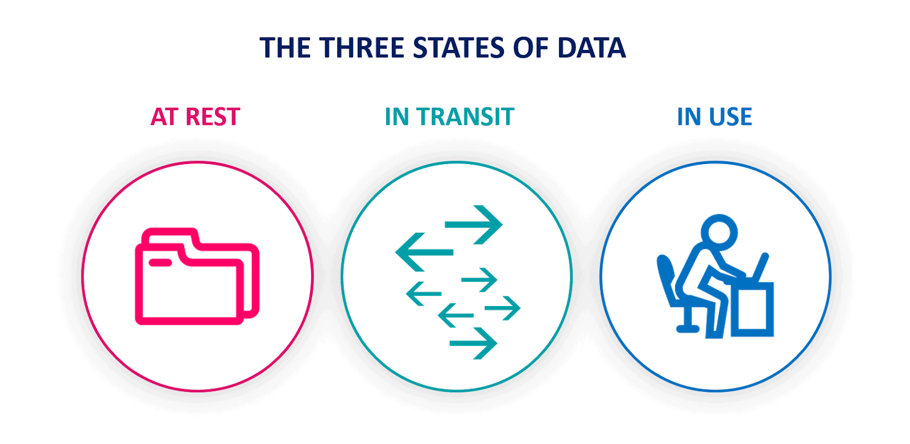
Introduction to Data Structures

Slide 6
Data-in-use
Data in use - Wikipedia
Data-in-transit
Data in transit - Wikipedia
Data-at-rest
Data at rest - Wikipedia

Slide 7
Performance Analysis
Data Structures Tutorials - Performance Analysis with examples
Space Complexity
Data Structures Tutorials - Space Complexity with examples
Time Complexity
Data Structures Tutorials - Time Complexity with examples

Slide 8
Data and Variables
C++ Data Types

Slide 9
Linear & Non-Linear Data Structures
Data Structures Tutorials - Linear and Non-linear types
Data Structure and Types

Slide 10
Implementing Pointer and Objects
Check CS50 Pointer Notes
Week 0 - CS50

Slide 11
ASN.1 / BER TLV / PER TLV
http://lionet.info/asn1c/download.html
GitHub - ucoruh/asn1c-wsl-sample: ASN.1 C WSL and Windows Execution, Debugging and Code Generation Sample

Slide 12
Sample Standard for ASN.1 Usage
https://www.etsi.org/deliver/etsi_ts/125400_125499/125413/04.09.00_60/ts_125413v040900p.pdf

Slide 13
Payment BER TLV Parser Sample
TLV Utilities
https://paymentcardtools.com/

Slide 14
Week-1 End

Slide 15
Week-1 End

