Slide 1

CEN207 Data Structures · Week 14
File Organisation II
CEN207 Data Structures — Week 14
Asst. Prof. Dr. Uğur CORUH · Fall 2026–2027
RTEU Computer Engineering · Fall 2026–2027
Notes:
Week 13 gave us a sorted file and a bucket-hashed file. This week asks: can a small index make search cheaper, can the index itself stay balanced forever, and can a hashed file grow without ever being rebuilt?

Slide 2
CEN207 Data Structures · Week 14
Today's plan (3 hours)
Hour | Topic
1 | Indexes Anim 1–2 · ISAM Anim 3 · B-tree insert Anim 4
2 | B-tree search/delete Anim 5–6 · B+-tree Anim 7
3 | Extendible/linear hashing Anim 8–9 · external sort Anim 10–11
Learning outcomes: LO.1 (explain fundamental data structures) · LO.2 (analyze complexity) · LO.6 (design file-based storage) · LO.7 (choose the right structure)
RTEU Computer Engineering · Fall 2026–2027
2
Notes:
Eleven animations carry the whole lecture; every drawing labels disk pages by number and tracks reads/writes on the right.

Slide 3
CEN207 Data Structures · Week 14
This week's concepts — where
Concept | Where
Primary/secondary index, ISAM | Sections 1–3
B-tree insert/search/delete, B+-tree | Sections 4–7
Extendible hashing, linear hashing | Sections 8–9
External merge sort, replacement selection | Sections 10–11
RTEU Computer Engineering · Fall 2026–2027
3
Notes:
Every term gets a full definition the first time it appears; this table just says where to find it again.

Slide 4
CEN207 Data Structures · Week 14
How the code examples work
• Every idea has a complete C and Java program
• C: gcc -std=c11 -Wall -Wextra -o /tmp/x file.c && /tmp/x
• Java: javac -d /tmp/j File.java && java -cp /tmp/j File
• Sources: code/week-14/c/ and code/week-14/java/
• Two programs create REAL files, only in a self-made lab folder
RTEU Computer Engineering · Fall 2026–2027
4
Notes:
external_merge_sort and replacement_selection create real run files, but always inside a folder they create and delete themselves.

Slide 5
CEN207 Data Structures · Week 14
Recap — Week 13: pages, sorted files, bucket hashing
• A page is the unit of disk I/O — this week's currency too
• A sorted file: binary search over pages, O(log(n/B))
• A bucket-hashed file: ~O(1) search, but overflow chains
• Today: structures that make growth and search both cheap
RTEU Computer Engineering · Fall 2026–2027
5
Notes:
Everything this week either speeds up the sorted file with an index, or fixes the hashed file's fixed bucket count.

Slide 6
CEN207 Data Structures · Week 14
Recap — Week 4: trees and rebalancing
• A BST can degrade to O(n) on adversarial insertion order
• Rebalancing: restructure locally after a change
• A B-tree rebalances whole pages, not single-key nodes
• Splitting and merging pages keeps height O(log n) always
RTEU Computer Engineering · Fall 2026–2027
6
Notes:
Today's B-tree family generalises Week 4's tree idea to pages that hold many keys, not one.

Slide 7
CEN207 Data Structures · Week 14
Map of the week — at a glance
Indexes | Balanced trees | Dynamic hashing | External sorting
Primary, secondary, ISAM | B-tree, B+-tree | Extendible, linear | Merge sort, replacement selection
RTEU Computer Engineering · Fall 2026–2027
7
Notes:
Every box on this map gets its own slides below, each with a step-by-step animation and a complete C/Java program.

Slide 8
CEN207 Data Structures · Week 14
1. Primary (Sparse) Indexes
RTEU Computer Engineering · Fall 2026–2027
8
Notes:
Section 1 opens the indexing family: a tiny, memory-resident structure that turns page-by-page search into one page read.

Slide 9
CEN207 Data Structures · Week 14
A question to start
Binary search over a file's pages already costs O(log(n/B)) reads. Could a structure small enough to live in RAM cut that further?
RTEU Computer Engineering · Fall 2026–2027
9
Notes:
Yes — if the structure is small enough never to touch disk at all, only the ONE data page read remains a real cost.

Slide 10
CEN207 Data Structures · Week 14
Intuition — a book's chapter tabs
• Flipping every page to find a word: too slow
• A tab per chapter, holding each chapter's first word
• Check tabs (free, in your hand), open ONE chapter
• That is exactly what a sparse index does per disk page
RTEU Computer Engineering · Fall 2026–2027
10
Notes:
The tabs never leave your hand (memory); only opening the one right chapter costs a real "page turn" (disk read).

Slide 11
CEN207 Data Structures · Week 14
The idea: one entry per PAGE
• Index: (first_key, page) pairs, one per data page
• Sorted the same way as the file itself
• Small: 1/B the size of the data — fits in RAM, free to scan
• find_page: last entry whose first_key <= key
RTEU Computer Engineering · Fall 2026–2027
11
Notes:
Because it holds one entry per page (not per record), it stays tiny even for a huge file.

Slide 12
CEN207 Data Structures · Week 14
search_key: index scan, then ONE page read
• find_page returns -1 if key is below every first_key
• -1 means: no disk access needed at all
• Otherwise: read that one page, scan it for the key
• Total real disk cost: at most one page read
RTEU Computer Engineering · Fall 2026–2027
12
Notes:
The index alone can already prove a key absent, with zero disk I/O, in the "below range" edge case.

Slide 13
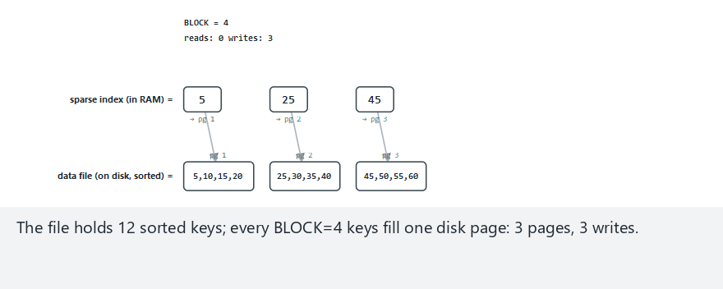
CEN207 Data Structures · Week 14
Primary index, step by step
RTEU Computer Engineering · Fall 2026–2027
13
Notes:
Normal example: 12 keys, block=4 — watch the index scan (free) hand off to a single page read.

Slide 14
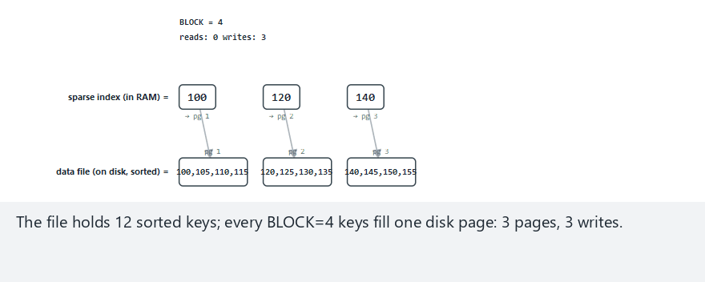
CEN207 Data Structures · Week 14
Edge case — every query below range
RTEU Computer Engineering · Fall 2026–2027
14
Notes:
Every single query is smaller than the smallest key: zero disk reads across the whole scenario.

Slide 15
CEN207 Data Structures · Week 14
Code — find_page
int find_page(IndexEntry index[], int idx_n, int key) {
int page = -1;
for (int i = 0; i < idx_n; i++) {
if (index[i].first_key <= key)
page = index[i].page;
else
break;
}
return page;
}
RTEU Computer Engineering · Fall 2026–2027
15
Notes:
The index is sorted, so once an entry's first_key exceeds the target, the loop can stop.

Slide 16
CEN207 Data Structures · Week 14
Code — search_key
bool search_key(int data[][MAX_BLOCK], const int page_len[],
IndexEntry index[], int idx_n, int key, int *out_page) {
int page = find_page(index, idx_n, key);
if (page == -1) return false;
for (int i = 0; i < page_len[page]; i++)
if (data[page][i] == key) { *out_page = page; return true; }
*out_page = page;
return false;
}
RTEU Computer Engineering · Fall 2026–2027
16
Notes:
page == -1 short-circuits before any disk access; otherwise exactly one page is read and scanned.

Slide 17
CEN207 Data Structures · Week 14
Complexity
• Index scan: O(n/B) comparisons, but zero disk I/O
• One guaranteed disk read: the single data page
• Total real I/O per search: O(1) page reads
• Index space: O(n/B) — proportional to pages, not records
RTEU Computer Engineering · Fall 2026–2027
17
Notes:
A bigger installation would binary-search the index too, but the disk cost stays O(1) either way.

Slide 18
CEN207 Data Structures · Week 14
Common mistakes
• Assuming a sparse index works on an unsorted file
• Confusing "-1: no page qualifies" with "page scanned, no match"
• Letting the index itself grow too big to fit in RAM
RTEU Computer Engineering · Fall 2026–2027
18
Notes:
The third mistake is exactly ISAM's motivation for multiple index levels, coming up next.

Slide 19
CEN207 Data Structures · Week 14
Mini-quiz
Why does a sparse index need only ONE entry per PAGE, not one per record?
RTEU Computer Engineering · Fall 2026–2027
19
Notes:
Think about what a single page read already gives you once you know which page to read.

Slide 20
CEN207 Data Structures · Week 14
Answer
A page read + in-page scan already finds any record on that page. More index entries per page would save zero extra reads.
RTEU Computer Engineering · Fall 2026–2027
20
Notes:
This is exactly why "sparse" works: the index only needs to answer "which page", not "which slot".

Slide 21
CEN207 Data Structures · Week 14
2. Secondary (Dense) Indexes
RTEU Computer Engineering · Fall 2026–2027
21
Notes:
Section 2 generalises indexing to any attribute, including one that repeats across many records.

Slide 22
CEN207 Data Structures · Week 14
A question to start
A primary index works on the file's own sort key. Can an index also help search on a DIFFERENT attribute, one that repeats?
RTEU Computer Engineering · Fall 2026–2027
22
Notes:
Yes — a dense index, sorted by the secondary key itself, makes duplicates cluster together.

Slide 23
CEN207 Data Structures · Week 14
Intuition — a library's subject catalogue
• Books are shelved by call number (primary order)
• A subject catalogue card exists per book, sorted by subject
• Cards for the same subject sit next to each other
• Each card still points to the book's real shelf location
RTEU Computer Engineering · Fall 2026–2027
23
Notes:
The catalogue is dense (one card per book) and sorted by a DIFFERENT key than the shelves.

Slide 24
CEN207 Data Structures · Week 14
The idea: one entry per RECORD, sorted by key
• (key, slot) pairs, ONE per record — not per page
• Sorted by the secondary key itself
• Duplicates end up adjacent because the index is sorted
• A match streak: scan forward until the key changes
RTEU Computer Engineering · Fall 2026–2027
24
Notes:
Dense costs more space (O(n)) than sparse (O(n/B)), the direct price of supporting any attribute.

Slide 25
CEN207 Data Structures · Week 14
search_dense: collect a whole cluster
• Skip non-matching entries before a match starts
• Once inside a match, collect every consecutive one
• A DIFFERENT key after a match: the cluster has ended
• At most one new page read per distinct page touched
RTEU Computer Engineering · Fall 2026–2027
25
Notes:
Two matches sharing a page cost only one read total — the search tracks pages already visited this query.

Slide 26
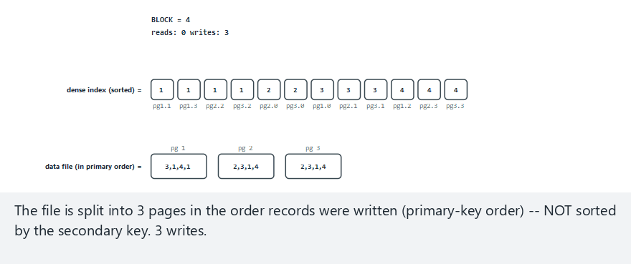
CEN207 Data Structures · Week 14
Secondary index, step by step
RTEU Computer Engineering · Fall 2026–2027
26
Notes:
Normal example: 12 records, block=4 — watch matches cluster together even though the data file is not sorted by this key.

Slide 27
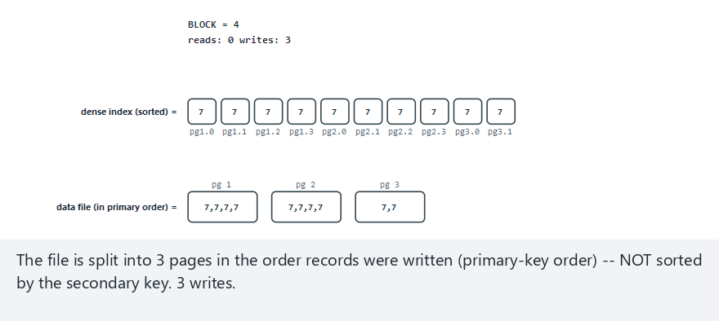
CEN207 Data Structures · Week 14
Edge case — all records share one key
RTEU Computer Engineering · Fall 2026–2027
27
Notes:
The whole index is one giant cluster — the search still finds every match in a single pass.

Slide 28
CEN207 Data Structures · Week 14
Code — search_dense
int search_dense(const IndexEntry index[], int n, int key,
int matches[], int max_matches) {
int count = 0;
for (int i = 0; i < n; i++) {
if (index[i].key == key) {
if (count < max_matches) matches[count] = index[i].slot;
count++;
} else if (count > 0) {
break;
}
}
return count;
}
RTEU Computer Engineering · Fall 2026–2027
28
Notes:
"else if (count > 0) break" is the key line: it only stops once a cluster has actually started and ended.

Slide 29
CEN207 Data Structures · Week 14
Complexity
• Linear scan as written: O(n) worst case
• Production version: binary search to first match, O(log n + m)
• Disk cost: at most one read per distinct matched page
• Space: O(n) — one entry per record, not per page
RTEU Computer Engineering · Fall 2026–2027
29
Notes:
Dense trades sparse's tiny footprint for the ability to search ANY attribute, including duplicates.

Slide 30
CEN207 Data Structures · Week 14
Common mistakes
• Assuming the dense index is sorted by the DATA file's order
• Breaking the scan on the first non-match before a cluster starts
• Forgetting a dense index costs O(n) space, not O(n/B)
RTEU Computer Engineering · Fall 2026–2027
30
Notes:
The data file's physical order and the dense index's sort order are usually completely unrelated.

Slide 31
CEN207 Data Structures · Week 14
Mini-quiz
Why must a dense index hold ONE entry per record, unlike a sparse index's one per page?
RTEU Computer Engineering · Fall 2026–2027
31
Notes:
Think about what a sparse index's "one entry per page" trick relied on.

Slide 32
CEN207 Data Structures · Week 14
Answer
The data file is NOT sorted by the secondary key. Only one index entry per record can guarantee a correct match list.
RTEU Computer Engineering · Fall 2026–2027
32
Notes:
A sparse index's trick only works because the file itself is sorted on that exact key.

Slide 33
CEN207 Data Structures · Week 14
3. ISAM: Multi-Level Index + Overflow
RTEU Computer Engineering · Fall 2026–2027
33
Notes:
Section 3 combines a multi-level index with a growth mechanism: the overflow area.

Slide 34
CEN207 Data Structures · Week 14
A question to start
Sections 1–2 assumed the file never changes. Real files grow. Where does a new record go when its page is already full?
RTEU Computer Engineering · Fall 2026–2027
34
Notes:
ISAM answers with two ideas: index LEVELS to keep the index small, and an OVERFLOW AREA to keep growth cheap.

Slide 35
CEN207 Data Structures · Week 14
A short history — IBM, 1960s
• ISAM (Indexed Sequential Access Method)
• IBM's production answer for early mainframe databases
• Used for decades in commercial data processing
• Combines a sparse index with an overflow area
RTEU Computer Engineering · Fall 2026–2027
35
Notes:
ISAM predates the B-tree (1972) by roughly a decade — it is the file-organisation problem's first industrial answer.

Slide 36
CEN207 Data Structures · Week 14
The idea: index the index, and add an escape valve
• Level-2 index: one entry per page (like Section 1)
• Level-1 index: groups every GROUP level-2 entries
• Two short scans replace one long linear scan
• A full page's new key goes to a linked OVERFLOW chain
RTEU Computer Engineering · Fall 2026–2027
36
Notes:
The home page and its index entry never move; only its overflow chain grows.

Slide 37
CEN207 Data Structures · Week 14
Overflow chains: cheap now, costly later
• Insert into an overflow chain: append, O(1) amortised locally
• Search must walk the WHOLE chain if not on the home page
• Long chains: search performance degrades over time
• Fix: periodic reorganisation rebuilds the file from scratch
RTEU Computer Engineering · Fall 2026–2027
37
Notes:
This trade-off — cheap growth, degrading search — is exactly why real ISAM files need scheduled maintenance.

Slide 38
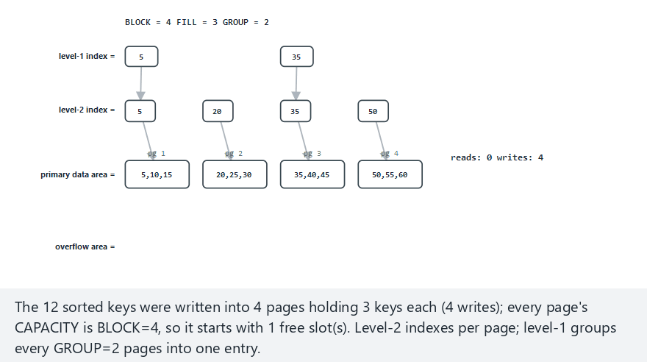
CEN207 Data Structures · Week 14
ISAM, step by step
RTEU Computer Engineering · Fall 2026–2027
38
Notes:
Normal example: 12 keys, block=4, fill=3 — watch two direct inserts, then a third that overflows.

Slide 39
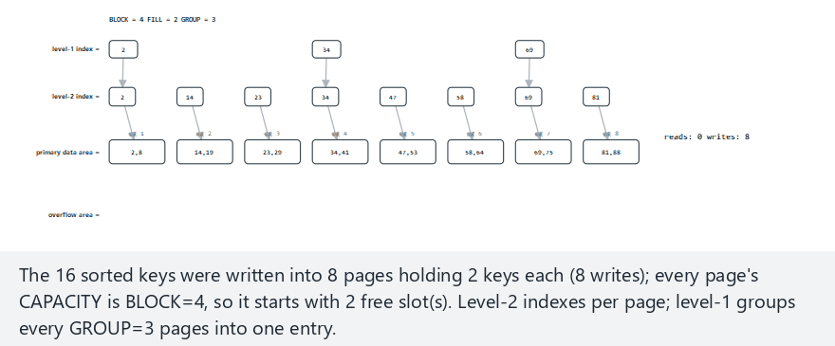
CEN207 Data Structures · Week 14
Edge case — chained overflow, same page
RTEU Computer Engineering · Fall 2026–2027
39
Notes:
Three inserts target the same already-full page; the third has to walk past two overflow nodes to be appended.

Slide 40
CEN207 Data Structures · Week 14
Code — isam_insert
void isam_insert(int key) {
int g = find_group(l1_key, l1_n, key);
int page = find_page(l2_key, g * GROUP, group_hi(g), key);
read_page(page);
if (page_len[page] < BLOCK) {
insert_sorted(page, key);
write_page(page);
} else {
int walked = walk_overflow_chain(page);
append_overflow(page, key);
}
}
RTEU Computer Engineering · Fall 2026–2027
40
Notes:
The two-level descent (find_group, then find_page) is the whole "index the index" idea in four lines.

Slide 41
CEN207 Data Structures · Week 14
Complexity
• Search: O(L) in-memory comparisons + 1 home-page read
• Plus one read per overflow node walked, if not found sooner
• Insert: same search + 1 write (direct) or 2 writes (overflow)
• Search degrades as chains grow — motivates reorganisation
RTEU Computer Engineering · Fall 2026–2027
41
Notes:
L (index levels) stays small even for huge files, exactly the point of grouping level-2 under level-1.

Slide 42
CEN207 Data Structures · Week 14
Common mistakes
• Letting overflow chains grow unbounded, never reorganising
• Attaching a new overflow node to the wrong page's chain
• Stopping at the right GROUP without scanning its pages
RTEU Computer Engineering · Fall 2026–2027
42
Notes:
The new record always attaches to its OWN home page's chain — never the shortest chain, never a neighbour.

Slide 43
CEN207 Data Structures · Week 14
Mini-quiz
Why does ISAM need MULTIPLE index levels, when Section 1's index used just one?
RTEU Computer Engineering · Fall 2026–2027
43
Notes:
Think about what happens to a single-level sparse index over a truly enormous file.

Slide 44
CEN207 Data Structures · Week 14
Answer
Even a "small" one-level index can grow too big for a huge file. Grouping under a level-1 index keeps the top scan tiny.
RTEU Computer Engineering · Fall 2026–2027
44
Notes:
Exactly like a phone book's tabbed sections before the sorted page underneath.

Slide 45
CEN207 Data Structures · Week 14
4. B-Trees: Insertion
RTEU Computer Engineering · Fall 2026–2027
45
Notes:
Section 4 opens the B-tree family: an index that IS a self-balancing tree of disk pages.

Slide 46
CEN207 Data Structures · Week 14
A question to start
ISAM's index levels are fixed at build time. What if the index itself could grow and rebalance, with no reorganisation, ever?
RTEU Computer Engineering · Fall 2026–2027
46
Notes:
That structure is the B-tree — every "node" a whole disk page, splitting and merging to stay balanced.

Slide 47
CEN207 Data Structures · Week 14
A short history — Bayer and McCreight, 1972
• Rudolf Bayer, Edward McCreight, Boeing Research Labs
• "Organization and Maintenance of Large Ordered Indexes"
• "B" is read as Bayer, Boeing, or "balanced" — never settled
• Solved what ISAM's fixed structure could not: provable balance
RTEU Computer Engineering · Fall 2026–2027
47
Notes:
A B-tree's height stays O(log n) no matter how the file grows or shrinks — no separate rebalancing step, ever.

Slide 48
CEN207 Data Structures · Week 14
Intuition — a filing cabinet that grows upward
• Each drawer (page) holds several folders (keys), sorted
• A full drawer splits into two half-full drawers
• The middle folder moves up to the drawer ABOVE
• The cabinet only gets a new TOP drawer when it must
RTEU Computer Engineering · Fall 2026–2027
48
Notes:
Growth always happens at the top (the root), never by adding a new bottom shelf.

Slide 49
CEN207 Data Structures · Week 14
Order m: how many keys per page
• Order m: at most m-1 keys, m children per node
• Root may hold fewer; every other node at least ceil(m/2)-1
• Insert descends to a leaf, exactly like a search would
• If the leaf now holds m keys: split
RTEU Computer Engineering · Fall 2026–2027
49
Notes:
In this week's presets, m=4 (mixed data) and m=3 (worst case, to make splits visible).

Slide 50
CEN207 Data Structures · Week 14
split: push the median up
• mid = n/2; the median key is pushed to the parent
• Left half keeps keys[0..mid-1], right half gets the rest
• If the PARENT now overflows too: split it too
• If the ROOT splits: a new root grows the tree one level
RTEU Computer Engineering · Fall 2026–2027
50
Notes:
This cascading split is the entire mechanism that keeps the tree height O(log_m n).

Slide 51
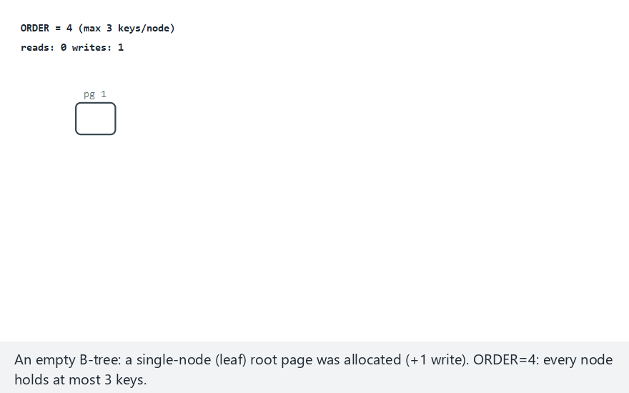
CEN207 Data Structures · Week 14
B-tree insert, step by step
RTEU Computer Engineering · Fall 2026–2027
51
Notes:
Normal example: order=4, 12 mixed keys — watch the first split push a median up, then later a root split.

Slide 52
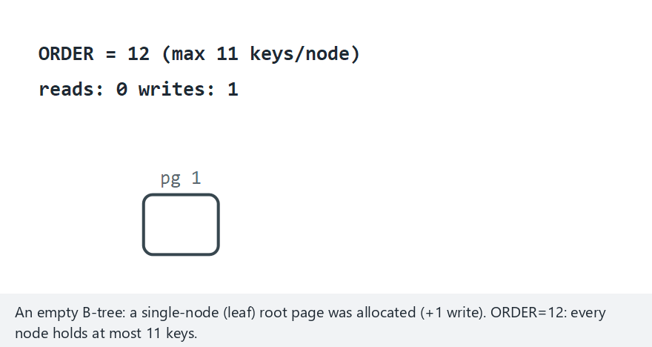
CEN207 Data Structures · Week 14
Edge case — order=12, never splits
RTEU Computer Engineering · Fall 2026–2027
52
Notes:
With order large relative to n, the whole tree stays a single leaf node — a clean contrast to the splitting cases.

Slide 53
CEN207 Data Structures · Week 14
Code — insert_sorted and split
void insert_sorted(Node *node, int key) {
int i = node->n - 1;
while (i >= 0 && node->keys[i] > key) {
node->keys[i + 1] = node->keys[i]; i--;
}
node->keys[i + 1] = key;
node->n++;
}
RTEU Computer Engineering · Fall 2026–2027
53
Notes:
A plain shift-insert into a sorted array — the same idea used by every insertion sort you have already seen.

Slide 54
CEN207 Data Structures · Week 14
Code — b_tree_insert
void b_tree_insert(BTree *t, int key) {
Node *leaf = find_leaf(t->root, key);
insert_sorted(leaf, key);
Node *cur = leaf;
while (cur->n == ORDER) {
int median; Node *right = split(cur, &median);
if (cur->parent == NULL) { t->root = new_root(median, cur, right); return; }
insert_sorted(cur->parent, median);
attach_child(cur->parent, right);
cur = cur->parent;
}
}
RTEU Computer Engineering · Fall 2026–2027
54
Notes:
The while loop is the cascade: it keeps checking upward until a node does not overflow, or the root splits.

Slide 55
CEN207 Data Structures · Week 14
Complexity
• Height: O(log_m n) — order 100, 1 billion records: only 5 levels
• Insert: O(log_m n) reads to find the leaf
• Plus up to O(log_m n) splits, O(m) work each
• Worst case (cascade to root): O(m log_m n)
RTEU Computer Engineering · Fall 2026–2027
55
Notes:
Cascades reaching every level are rare in practice — most inserts cost just one leaf write.

Slide 56
CEN207 Data Structures · Week 14
Common mistakes
• Splitting only the leaf, forgetting the parent may overflow too
• Growing the tree at the wrong end (bottom instead of top)
• Choosing an order so small ordinary data keeps splitting
RTEU Computer Engineering · Fall 2026–2027
56
Notes:
Real B-trees use an order in the hundreds, sized so one node fills exactly one disk page.

Slide 57
CEN207 Data Structures · Week 14
Mini-quiz
Why does a B-tree's height stay O(log_m n) even under an adversarial insertion order?
RTEU Computer Engineering · Fall 2026–2027
57
Notes:
Think about where growth happens, and how often.

Slide 58
CEN207 Data Structures · Week 14
Answer
Every split is local; the tree only grows taller when a split reaches the ROOT. No insertion order makes a long chain.
RTEU Computer Engineering · Fall 2026–2027
58
Notes:
Unlike an unbalanced BST, every leaf is always at the same depth as every other leaf.

Slide 59
CEN207 Data Structures · Week 14
5. B-Tree Search
RTEU Computer Engineering · Fall 2026–2027
59
Notes:
Section 5 asks the simpler question: given a tree that already exists, how cheap is one lookup?

Slide 60
CEN207 Data Structures · Week 14
A question to start
Insertion builds a balanced tree. Given one that already exists, how many pages does finding — or ruling out — one key cost?
RTEU Computer Engineering · Fall 2026–2027
60
Notes:
The answer will turn out to be bounded by the tree's height, plus one, no matter what.

Slide 61
CEN207 Data Structures · Week 14
The idea: descend, comparing at every page
• Start at the root; scan its (small) sorted key list
• Exact match: done
• No match, and it's a LEAF: the key cannot exist — absent
• No match, not a leaf: descend into exactly one child
RTEU Computer Engineering · Fall 2026–2027
61
Notes:
A B-tree keeps every key reachable along a correctly-guided descent; falling off a leaf proves absence.

Slide 62
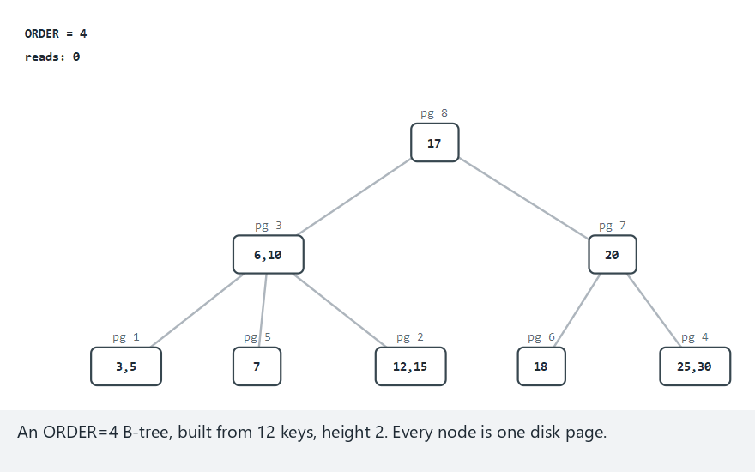
CEN207 Data Structures · Week 14
B-tree search, step by step
RTEU Computer Engineering · Fall 2026–2027
62
Notes:
Normal example: order=4, 12 keys, 3 searches — watch a root-level hit versus a deeper, more expensive search.

Slide 63
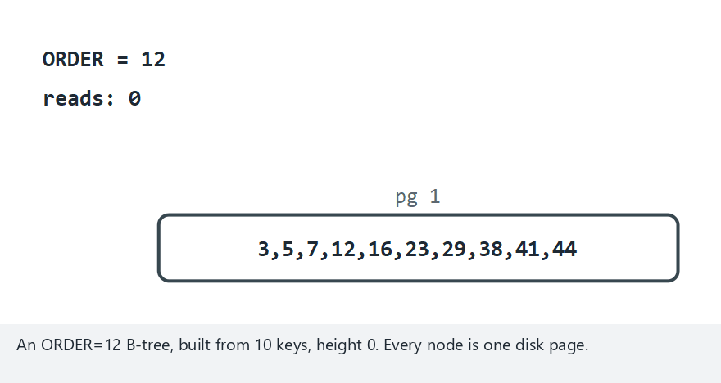
CEN207 Data Structures · Week 14
Edge case — single node, every search is 1 read
RTEU Computer Engineering · Fall 2026–2027
63
Notes:
With order=12 and only 10 keys, the whole file fits on one page — found or not, every search costs exactly one read.

Slide 64
CEN207 Data Structures · Week 14
Code — b_tree_search
bool b_tree_search(Node *node, int key, Node **out_node) {
if (node == NULL) return false;
int i = 0;
while (i < node->n && key > node->keys[i]) i++;
if (i < node->n && key == node->keys[i]) {
*out_node = node; return true;
}
if (node->leaf) return false;
return b_tree_search(node->child[i], key, out_node);
}
RTEU Computer Engineering · Fall 2026–2027
64
Notes:
The leaf check must come AFTER the match check but BEFORE descending — descending on a leaf reads garbage.

Slide 65
CEN207 Data Structures · Week 14
Complexity
• O(log_m n) page reads worst case — one per level
• Within a page: O(log m) binary, or O(m) linear scan
• Same cost whether the key is found OR proven absent
• This is the direct payoff of Section 4's balanced insertion
RTEU Computer Engineering · Fall 2026–2027
65
Notes:
"Not found" is NOT free — the search still walks all the way to a leaf to be sure.

Slide 66
CEN207 Data Structures · Week 14
Common mistakes
• Descending into a leaf's (uninitialised) child array
• Off-by-one in choosing which child index to descend into
• Assuming "not found" costs fewer reads than "found"
RTEU Computer Engineering · Fall 2026–2027
66
Notes:
A wrong child index sends the search down the wrong subtree entirely — silently wrong, not a crash.

Slide 67
CEN207 Data Structures · Week 14
Mini-quiz
Why does B-tree search cost at most (height + 1) reads, whichever key is searched?
RTEU Computer Engineering · Fall 2026–2027
67
Notes:
Think about what is true of every leaf's depth in a B-tree.

Slide 68
CEN207 Data Structures · Week 14
Answer
Every leaf sits at exactly the same depth. A search either finds its key early, or walks to a leaf — never deeper.
RTEU Computer Engineering · Fall 2026–2027
68
Notes:
This is the direct structural guarantee Section 4's split-and-grow-from-the-root mechanism provides.

Slide 69
CEN207 Data Structures · Week 14
6. B-Tree Deletion: Borrow and Merge
RTEU Computer Engineering · Fall 2026–2027
69
Notes:
Section 6 mirrors insertion's split with deletion's two repair moves: borrow, or merge.

Slide 70
CEN207 Data Structures · Week 14
A question to start
Insertion splits an overfull page. Could deletion's mirror image — merging two too-empty pages — sometimes be avoided?
RTEU Computer Engineering · Fall 2026–2027
70
Notes:
Yes — a page just short of the minimum can often borrow a single spare key from a neighbour instead.

Slide 71
CEN207 Data Structures · Week 14
The idea: remove, then fix underflow
• Leaf key: shift-remove, simple
• Internal key: replace with its inorder PREDECESSOR
• The predecessor's own leaf is where the real delete happens
• If that leaf underflows (too few keys): fix it going up
RTEU Computer Engineering · Fall 2026–2027
71
Notes:
Every delete reduces, one way or another, to a leaf removal plus a possible chain of fix-ups above it.

Slide 72
CEN207 Data Structures · Week 14
Fixing underflow: borrow first, merge only if needed
• Left sibling has a spare key? Borrow: rotate through parent
• No? Try the RIGHT sibling the same way
• Neither has a spare? Merge with one sibling
• A merge can underflow the PARENT: the check repeats up
RTEU Computer Engineering · Fall 2026–2027
72
Notes:
Borrow resolves in one step, touching 3 pages; merge removes a page and a key from the parent.

Slide 73
CEN207 Data Structures · Week 14
When a merge reaches the root
• A merge at the top can empty the root of all keys
• The root's one remaining child becomes the new root
• The tree shrinks by exactly one level
• The direct mirror of Section 4's root-split growth
RTEU Computer Engineering · Fall 2026–2027
73
Notes:
This is the only way a B-tree ever loses a level — always at the top, never by pruning a leaf.

Slide 74
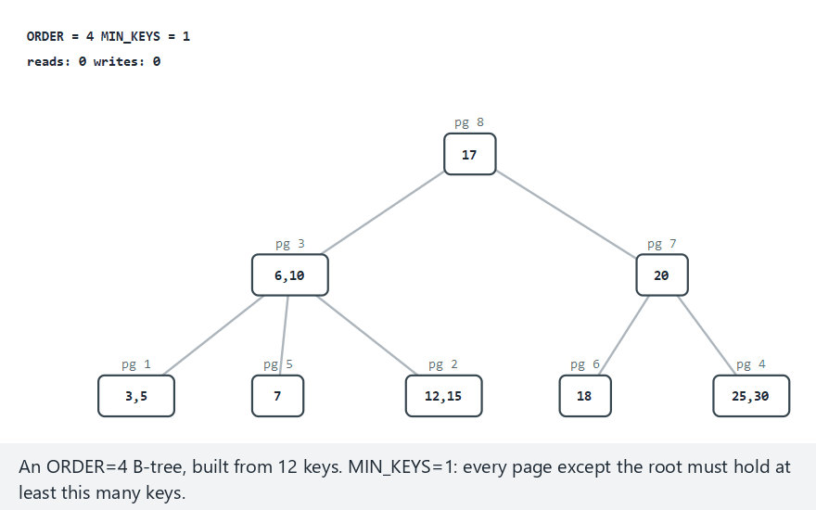
CEN207 Data Structures · Week 14
B-tree delete, step by step
RTEU Computer Engineering · Fall 2026–2027
74
Notes:
Normal example: order=4, 12 keys, 3 deletes — watch a leaf removal that needs no fix-up at all.

Slide 75
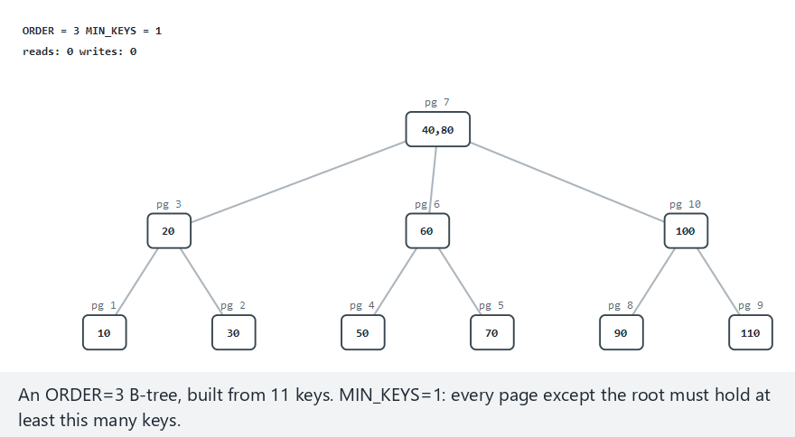
CEN207 Data Structures · Week 14
Edge case — delete until the root shrinks
RTEU Computer Engineering · Fall 2026–2027
75
Notes:
Seven deletions on an order=3 tree, each a merge, until the root itself empties and the tree loses a level.

Slide 76
CEN207 Data Structures · Week 14
Code — fix_underflow (borrow or merge)
void fix_underflow(Node *node) {
while (node->parent != NULL && node->n < MIN_KEYS) {
Node *parent = node->parent;
int idx = child_index(parent, node);
Node *left = idx > 0 ? parent->child[idx - 1] : NULL;
Node *right = idx < parent->n ? parent->child[idx + 1] : NULL;
if (left && left->n > MIN_KEYS) { borrow_from_left(node, parent, left, idx); return; }
if (right && right->n > MIN_KEYS) { borrow_from_right(node, parent, right, idx); return; }
if (left) { merge(left, parent, node, idx - 1); node = parent; }
else { merge(node, parent, right, idx); node = parent; }
}
}
RTEU Computer Engineering · Fall 2026–2027
76
Notes:
Borrow returns immediately (resolved); merge sets node = parent and loops (may cascade).

Slide 77
CEN207 Data Structures · Week 14
Complexity
• Find the key: O(log_m n), same as search
• Fix-up: up to O(log_m n) merges, one level at a time
• Each merge/borrow: O(m) work to shift keys and children
• Borrow: touches 3 pages; merge: removes a page + a key
RTEU Computer Engineering · Fall 2026–2027
77
Notes:
A borrow is strictly cheaper — it resolves in one step, with no risk of cascading further.

Slide 78
CEN207 Data Structures · Week 14
Common mistakes
• Borrowing from a sibling with exactly MIN_KEYS (still underflows)
• Forgetting to move a child pointer along with a borrowed key
• Deleting the wrong copy after an internal-node replacement
RTEU Computer Engineering · Fall 2026–2027
78
Notes:
The real removal always happens at the PREDECESSOR's original leaf, never at the internal node itself.

Slide 79
CEN207 Data Structures · Week 14
Mini-quiz
Why does a B-tree prefer BORROWING over MERGING, whenever a sibling can spare a key?
RTEU Computer Engineering · Fall 2026–2027
79
Notes:
Think about how many pages each option touches, and whether either can cascade.

Slide 80
CEN207 Data Structures · Week 14
Answer
Borrow touches 3 pages and resolves immediately. Merge removes a page from the parent, which can cascade further up.
RTEU Computer Engineering · Fall 2026–2027
80
Notes:
Same "cheaper local fix first" spirit as a dynamic array preferring in-place growth over reallocation.

Slide 81
CEN207 Data Structures · Week 14
7. B+-Trees: Leaf Chains and Range Queries
RTEU Computer Engineering · Fall 2026–2027
81
Notes:
Section 7 asks about range queries — and answers with one structural change: a chain linking every leaf.

Slide 82
CEN207 Data Structures · Week 14
A question to start
"Every order in the last 30 days" is a RANGE query. A plain B-tree keeps re-climbing to the root. Can that be avoided?
RTEU Computer Engineering · Fall 2026–2027
82
Notes:
Yes — if every leaf already knows which leaf comes next, no climbing is ever needed again.

Slide 83
CEN207 Data Structures · Week 14
The idea: keys only in leaves, leaves form a chain
• Internal nodes hold ROUTING copies only — never real data
• Every real key lives in a LEAF
• Every leaf holds a next pointer to the leaf on its right
• A range query: descend ONCE, then follow the chain
RTEU Computer Engineering · Fall 2026–2027
83
Notes:
The chain turns "re-descend for every match" into "walk sideways", a huge win for large result sets.

Slide 84
CEN207 Data Structures · Week 14
Leaf split copies; internal split removes
• Leaf splits: median is COPIED up (stays in the right leaf too)
• Internal splits: median is REMOVED (pure routing, no data lost)
• This ONE difference from Section 4 is the whole B+-tree idea
• Splicing next correctly is the one new bookkeeping step
RTEU Computer Engineering · Fall 2026–2027
84
Notes:
Forgetting to splice next before overwriting it silently drops every leaf after the split point.

Slide 85
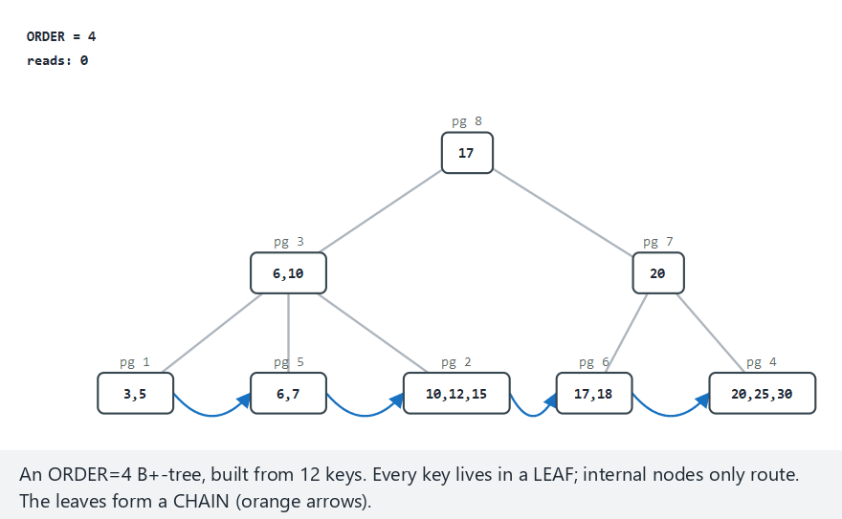
CEN207 Data Structures · Week 14
B+-tree, step by step
RTEU Computer Engineering · Fall 2026–2027
85
Notes:
Normal example: order=4, 12 keys, 3 range queries — watch the orange chain arrows carry the query sideways.

Slide 86
CEN207 Data Structures · Week 14
Edge case — a range covering every key
RTEU Computer Engineering · Fall 2026–2027
86
Notes:
The query walks the ENTIRE chain to the end — never once climbing back to the root.

Slide 87
CEN207 Data Structures · Week 14
Code — range_query
void range_query(Node *root, int lo, int hi, int out[], int *count) {
Node *leaf = find_leaf(root, lo);
*count = 0;
while (leaf != NULL) {
for (int i = 0; i < leaf->n; i++)
if (leaf->keys[i] >= lo && leaf->keys[i] <= hi)
out[(*count)++] = leaf->keys[i];
if (leaf->n > 0 && leaf->keys[leaf->n - 1] > hi) break;
leaf = leaf->next;
}
}
RTEU Computer Engineering · Fall 2026–2027
87
Notes:
ONE descent (find_leaf), then a pure sideways walk — no recursion, no re-visiting internal nodes.

Slide 88
CEN207 Data Structures · Week 14
Complexity
• One lookup: O(log_m n), same as a plain B-tree
• Range of k matches: O(log_m n) + O(k/B) chain reads
• A plain B-tree: could cost O(k) separate root descents
• The chain is the entire source of this speed-up
RTEU Computer Engineering · Fall 2026–2027
88
Notes:
The bigger the result set, the bigger the B+-tree's advantage over a plain B-tree's range query.

Slide 89
CEN207 Data Structures · Week 14
Common mistakes
• Copying the median on an INTERNAL split (only leaves copy)
• Forgetting to splice next before overwriting leaf->next
• Running a range query as repeated single-key searches
RTEU Computer Engineering · Fall 2026–2027
89
Notes:
The third mistake works correctly, but throws away the entire benefit of the leaf chain.

Slide 90
CEN207 Data Structures · Week 14
Mini-quiz
Why can a B+-tree's range query avoid climbing back to the root, unlike a plain B-tree's?
RTEU Computer Engineering · Fall 2026–2027
90
Notes:
Think about what information a B+-tree leaf has that a plain B-tree leaf does not.

Slide 91
CEN207 Data Structures · Week 14
Answer
Every leaf knows its own next leaf, directly, O(1). A plain B-tree has no such shortcut between neighbouring leaves.
RTEU Computer Engineering · Fall 2026–2027
91
Notes:
This one pointer per leaf is the entire structural difference behind the B+-tree's range-query speed.

Slide 92
CEN207 Data Structures · Week 14
8. Extendible Hashing
RTEU Computer Engineering · Fall 2026–2027
92
Notes:
Section 8 returns to hashing, now letting the bucket count itself grow on demand.

Slide 93
CEN207 Data Structures · Week 14
A question to start
Week 13's bucket-hashed file froze its bucket count at creation. Can a hashed file grow one bucket at a time, on demand?
RTEU Computer Engineering · Fall 2026–2027
93
Notes:
Extendible hashing's answer: separate a small, memory-resident directory from the data buckets on disk.

Slide 94
CEN207 Data Structures · Week 14
A short history — Fagin et al., 1979
• Ronald Fagin, Jürg Nievergelt, Nicholas Pippenger, H. R. Strong
• "Extendible Hashing — A Fast Access Method for Dynamic Files"
• Key idea: directory (memory) separate from buckets (disk)
• Growth touches the cheap directory far more than disk pages
RTEU Computer Engineering · Fall 2026–2027
94
Notes:
This directory/data separation is the design pattern later reused by dynamic and distributed hash tables.

Slide 95
CEN207 Data Structures · Week 14
The idea: a directory, doubled only when needed
• Directory: 2^global_depth pointers, indexed by last bits
• Multiple entries can point to the SAME bucket
• Each bucket tracks its own local_depth
• Overflow, local_depth == global_depth: directory DOUBLES first
RTEU Computer Engineering · Fall 2026–2027
95
Notes:
Doubling is pure memory work — zero disk cost — it just creates more, finer-grained pointers to redirect.

Slide 96
CEN207 Data Structures · Week 14
Split, then retry
• Bucket splits: local_depth++, a new bucket is created
• Keys redistribute by the ONE new bit the deeper split examines
• Retry the insert: one split is not always enough
• Adversarial data can need SEVERAL splits in a row
RTEU Computer Engineering · Fall 2026–2027
96
Notes:
The retry is essential — without it, a key that shares the new bit with everything else would be lost.

Slide 97
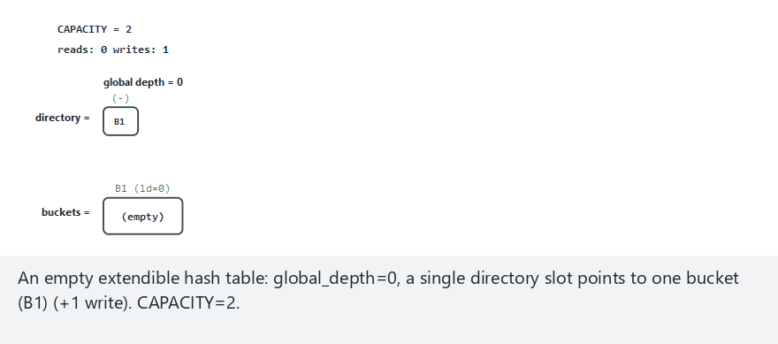
CEN207 Data Structures · Week 14
Extendible hashing, step by step
RTEU Computer Engineering · Fall 2026–2027
97
Notes:
Normal example: capacity=2, 10 keys — watch the directory double the first time a bucket's local_depth catches up.

Slide 98
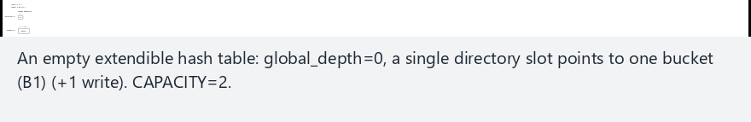
CEN207 Data Structures · Week 14
Edge case — cascading splits
RTEU Computer Engineering · Fall 2026–2027
98
Notes:
Every key is 8 mod 16 — the directory grows all the way to depth 7 before the keys finally separate.

Slide 99
CEN207 Data Structures · Week 14
Code — insert_key
void insert_key(Hash *h, int key) {
int idx = last_bits(key, h->global_depth);
Bucket *b = h->dir[idx];
if (b->n < CAPACITY) { b->keys[b->n++] = key; return; }
if (b->local_depth == h->global_depth) {
h->global_depth++;
double_directory(h);
}
split_bucket(h, b);
insert_key(h, key);
}
RTEU Computer Engineering · Fall 2026–2027
99
Notes:
The recursive retry at the end is what handles the "one split was not enough" cascading case.

Slide 100
CEN207 Data Structures · Week 14
Complexity
• O(1) directory lookup (memory, free)
• 1 page read + 1 write, +2 more per split
• Splits are O(1) amortised — like dynamic array doubling
• Directory space: O(2^global_depth), small unless skewed
RTEU Computer Engineering · Fall 2026–2027
100
Notes:
Every doubling allows twice as many future inserts before the next one is needed.

Slide 101
CEN207 Data Structures · Week 14
Common mistakes
• Splitting the bucket before checking if the directory must double
• Forgetting the retry — one split does not always separate keys
• Assuming every bucket a split creates ends up non-empty
RTEU Computer Engineering · Fall 2026–2027
101
Notes:
An unlucky split can leave a brand-new bucket with zero keys, waiting for a future insert.

Slide 102
CEN207 Data Structures · Week 14
Mini-quiz
Why must the directory double BEFORE a bucket splits, not after?
RTEU Computer Engineering · Fall 2026–2027
102
Notes:
Think about how many directory slots can point to the NEW bucket right after a split.

Slide 103
CEN207 Data Structures · Week 14
Answer
A split needs spare, more-specific slots to redirect. Without doubling first, none exist yet at the current depth.
RTEU Computer Engineering · Fall 2026–2027
103
Notes:
Doubling first creates exactly the additional slots the split then needs.

Slide 104
CEN207 Data Structures · Week 14
9. Linear Hashing
RTEU Computer Engineering · Fall 2026–2027
104
Notes:
Section 9 achieves the same dynamic growth as Section 8, but with no directory at all.

Slide 105
CEN207 Data Structures · Week 14
A question to start
Extendible hashing needs a whole extra directory structure. Can a file grow one bucket at a time with NO directory at all?
RTEU Computer Engineering · Fall 2026–2027
105
Notes:
Linear hashing's answer: commit in advance to a fixed, predictable splitting order.

Slide 106
CEN207 Data Structures · Week 14
A short history — Witold Litwin, 1980
• "Linear Hashing: A New Tool for File and Table Addressing"
• Buckets split in FIXED, round-robin order: 0, then 1, then 2...
• Completely independent of which bucket actually overflowed
• That predictability is what removes the need for a directory
RTEU Computer Engineering · Fall 2026–2027
106
Notes:
Litwin's scheme traded extendible hashing's directory for a single counter, n.

Slide 107
CEN207 Data Structures · Week 14
The idea: a counter n tracks the next split
• level: how many full rounds of doubling completed
• n: how many buckets have split THIS round
• Address: key mod (N0 * 2^level)
• If that address < n (already split): use the next level
RTEU Computer Engineering · Fall 2026–2027
107
Notes:
The address rule's one "bump" condition is the entire trick that keeps addressing correct as buckets split.

Slide 108
CEN207 Data Structures · Week 14
ANY overflow splits bucket n — not the one that overflowed
• Insert always fits: an overflowing bucket just grows
• Any overflow, anywhere, triggers splitting bucket n
• n advances; a full round resets n=0, level++
• A bucket can temporarily hold MORE than CAPACITY
RTEU Computer Engineering · Fall 2026–2027
108
Notes:
This is linear hashing's most distinctive — and most often mis-implemented — rule.

Slide 109
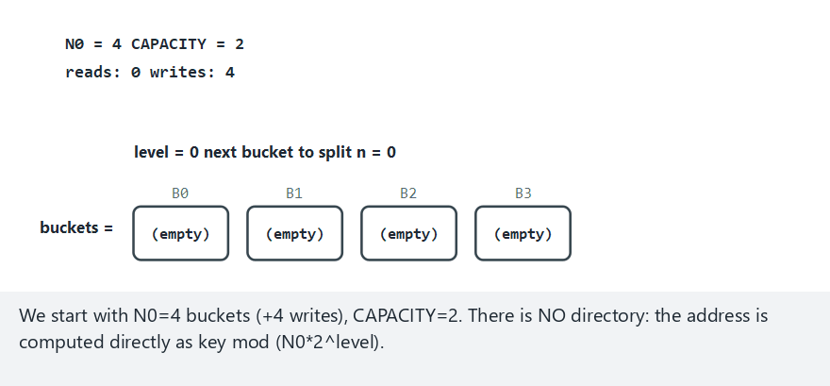
CEN207 Data Structures · Week 14
Linear hashing, step by step
RTEU Computer Engineering · Fall 2026–2027
109
Notes:
Normal example: N0=4, capacity=2, 10 keys — watch an overflow trigger a split of a DIFFERENT bucket.

Slide 110
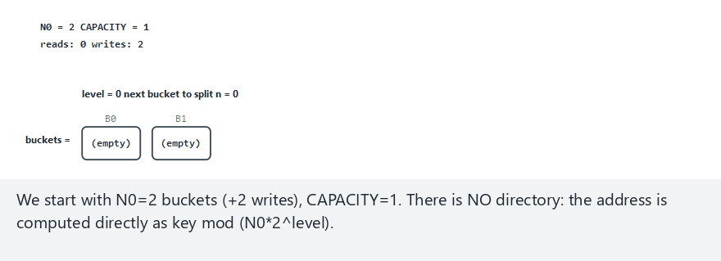
CEN207 Data Structures · Week 14
Edge case — frequent splits, a full round
RTEU Computer Engineering · Fall 2026–2027
110
Notes:
N0=2, capacity=1 — splits happen so often that a full round completes, n resets, and level increases.

Slide 111
CEN207 Data Structures · Week 14
Code — address and split
int address(int key, int level, int n) {
int a = key % (N0 << level);
if (a < n) a = key % (N0 << (level + 1));
return a;
}
void split(Hash *h) {
int new_index = (N0 << h->level) + h->n;
rehash_into(h, h->n, new_index);
h->n++;
if (h->n == (N0 << h->level)) { h->n = 0; h->level++; }
}
RTEU Computer Engineering · Fall 2026–2027
111
Notes:
split() always operates on h->n — never on whichever bucket triggered the call.

Slide 112
CEN207 Data Structures · Week 14
Complexity
• O(1) average insert — same as extendible hashing
• ZERO directory memory: only two integers, level and n
• Trade-off: an individual bucket's size is less tightly bounded
• An overflowing-but-not-yet-due bucket just keeps growing
RTEU Computer Engineering · Fall 2026–2027
112
Notes:
Simplicity (no directory) is paid for with a looser worst-case bound on any one bucket.

Slide 113
CEN207 Data Structures · Week 14
Common mistakes
• Splitting the OVERFLOWING bucket instead of bucket n
• Forgetting the a < n bump when computing an address
• Never resetting n to 0 and advancing level
RTEU Computer Engineering · Fall 2026–2027
113
Notes:
The split target is always "whichever bucket comes next in round-robin order" — completely predictable.

Slide 114
CEN207 Data Structures · Week 14
Mini-quiz
Why can linear hashing avoid a directory entirely, when extendible hashing cannot?
RTEU Computer Engineering · Fall 2026–2027
114
Notes:
Think about how predictable the next split target is.

Slide 115
CEN207 Data Structures · Week 14
Answer
The split target is always predictable from level and n alone. No need to record which entries point to which bucket.
RTEU Computer Engineering · Fall 2026–2027
115
Notes:
The price: a bucket can grow past capacity until its own turn to split finally arrives.

Slide 116
CEN207 Data Structures · Week 14
10. External Merge Sort
RTEU Computer Engineering · Fall 2026–2027
116
Notes:
Section 10 tackles sorting a file too large for RAM — a genuinely different algorithm from Week 10's.

Slide 117
CEN207 Data Structures · Week 14
A question to start
Week 10 sorted arrays that fit in RAM. A billion-record file does not. What changes when "the other half" lives on disk?
RTEU Computer Engineering · Fall 2026–2027
117
Notes:
The divide step adapts easily; the combine (merge) step needs a fundamentally different implementation.

Slide 118
CEN207 Data Structures · Week 14
A short history — the tape sorting era
• 1950s–60s mainframes sorted files far larger than RAM
• Magnetic tape: sequential access only, no random seeks
• "Merge" was often the ONLY efficient operation available
• Knuth's TAOCP Vol. 3 (1973): the classic exhaustive reference
RTEU Computer Engineering · Fall 2026–2027
118
Notes:
The two-phase run-then-merge structure traces directly back to this tape-based era.

Slide 119
CEN207 Data Structures · Week 14
The idea: small sorted runs, then a k-way merge
• Phase 1: chunks of RUN_SIZE, sorted in RAM, written as RUNS
• Phase 2: merge up to FAN_IN runs, ONE buffer per run
• Pick the smallest current buffer value, write it, refill
• Repeat passes until exactly ONE run remains
RTEU Computer Engineering · Fall 2026–2027
119
Notes:
RAM only ever holds FAN_IN buffers plus one output buffer, however enormous the file is.

Slide 120
CEN207 Data Structures · Week 14
A lone leftover run just carries forward
• If a group has only 1 run left, nothing to merge with
• Carry it forward to the next pass untouched — zero I/O
• Wasting a read+write on a solo run is a common mistake
• This optimisation matters most with an odd number of runs
RTEU Computer Engineering · Fall 2026–2027
120
Notes:
This is a small but real optimisation this week's programs implement.

Slide 121
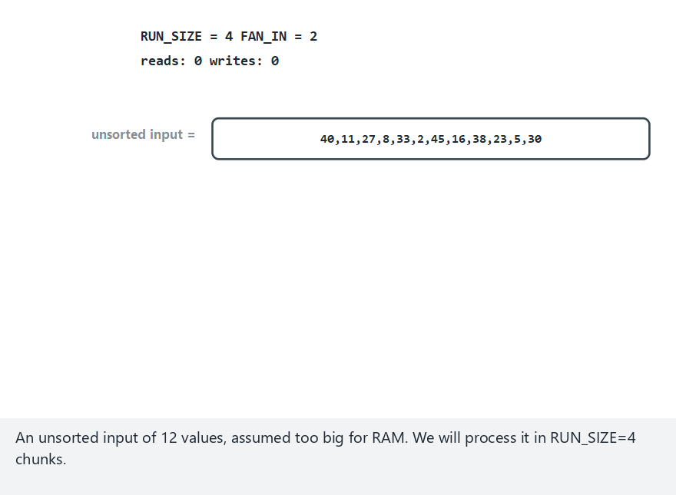
CEN207 Data Structures · Week 14
External merge sort, step by step
RTEU Computer Engineering · Fall 2026–2027
121
Notes:
Normal example: 12 values, RUN_SIZE=4, FAN_IN=2 — watch the first merge's small per-run buffers shrink as values are consumed.

Slide 122
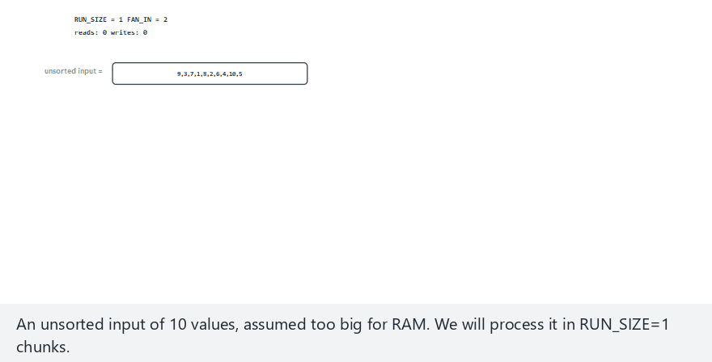
CEN207 Data Structures · Week 14
Edge case — RUN_SIZE=1, many passes
RTEU Computer Engineering · Fall 2026–2027
122
Notes:
Every value starts as its own run — many more merge passes are needed than the normal case.

Slide 123
CEN207 Data Structures · Week 14
Code — merge_group
Run merge_group(Run group[], int g) {
int ptr[FAN_IN] = {0};
Run out = new_run();
while (1) {
int best = -1, best_val = INT_MAX;
for (int i = 0; i < g; i++)
if (ptr[i] < group[i].n && group[i].keys[ptr[i]] < best_val)
{ best_val = group[i].keys[ptr[i]]; best = i; }
if (best == -1) break;
append(&out, best_val);
ptr[best]++;
}
return out;
}
RTEU Computer Engineering · Fall 2026–2027
123
Notes:
Only the CURRENT front value of each run needs to be in RAM — never a whole run at once.

Slide 124
CEN207 Data Structures · Week 14
This program creates REAL files — safely
• Real run files, but only in a self-made LAB FOLDER
• lab_external_merge_sort/, created by the program itself
• Every file, and the folder, removed before the program exits
• Nothing is ever written anywhere else on disk
RTEU Computer Engineering · Fall 2026–2027
124
Notes:
Both external_merge_sort and replacement_selection follow this same safe lab-folder pattern.

Slide 125
CEN207 Data Structures · Week 14
Complexity
• Phase 1: ceil(n/RUN_SIZE) runs, 1 read + 1 write each
• Passes: O(log_FAN_IN(n/RUN_SIZE))
• Each pass touches every record once: O(n/B) I/O per pass
• Total: O((n/B) · log_FAN_IN(n/RUN_SIZE))
RTEU Computer Engineering · Fall 2026–2027
125
Notes:
Dramatically less than trying to load the whole file into memory at once.

Slide 126
CEN207 Data Structures · Week 14
Common mistakes
• Merging a lone leftover run anyway (wasted read + write)
• Buffering an entire run in RAM during a merge
• Choosing FAN_IN larger than RAM can actually hold
RTEU Computer Engineering · Fall 2026–2027
126
Notes:
FAN_IN buffers, one per run merged simultaneously — bounded by real available memory, not convenience.

Slide 127
CEN207 Data Structures · Week 14
Mini-quiz
Why does external merge sort need only O(FAN_IN) RAM buffers, however huge the file?
RTEU Computer Engineering · Fall 2026–2027
127
Notes:
Think about how much of a run a k-way merge actually needs to see at once.

Slide 128
CEN207 Data Structures · Week 14
Answer
A k-way merge only needs each run's CURRENT front value. The runs are already sorted — nothing more is needed.
RTEU Computer Engineering · Fall 2026–2027
128
Notes:
The exact generalisation of Week 10's two-way merge, which likewise only ever looks at two "current" elements.

Slide 129
CEN207 Data Structures · Week 14
11. Replacement Selection: Longer Runs
RTEU Computer Engineering · Fall 2026–2027
129
Notes:
Section 11 asks: can Phase 1's runs be made longer than RAM, using the SAME RAM?

Slide 130
CEN207 Data Structures · Week 14
A question to start
Section 10's Phase 1 always makes runs of exactly RUN_SIZE. Can the same RAM produce runs LONGER than RUN_SIZE?
RTEU Computer Engineering · Fall 2026–2027
130
Notes:
Replacement selection's answer: a record smaller than the last one WRITTEN starts the next run instead.

Slide 131
CEN207 Data Structures · Week 14
The idea: current vs. next, decided by the last WRITE
• Keep a small RAM window (a min-heap in practice)
• Extract the smallest CURRENT-tagged record, write it
• New record >= last written? Tag CURRENT (can extend the run)
• New record < last written? Tag NEXT (waits for the next run)
RTEU Computer Engineering · Fall 2026–2027
131
Notes:
The comparison is against the last value WRITTEN, never against the window's own current minimum.

Slide 132
CEN207 Data Structures · Week 14
Best case, average case, worst case
• All window items NEXT-tagged: current run ends, retag, new run
• Random data: runs average about 2x the window size m
• Already-sorted input: ONE single run, however large the file
• Strictly descending input: worst case, exactly m per run
RTEU Computer Engineering · Fall 2026–2027
132
Notes:
The worst case is no better than Section 10's plain fixed-size chunking — the win is average-case, not guaranteed.

Slide 133
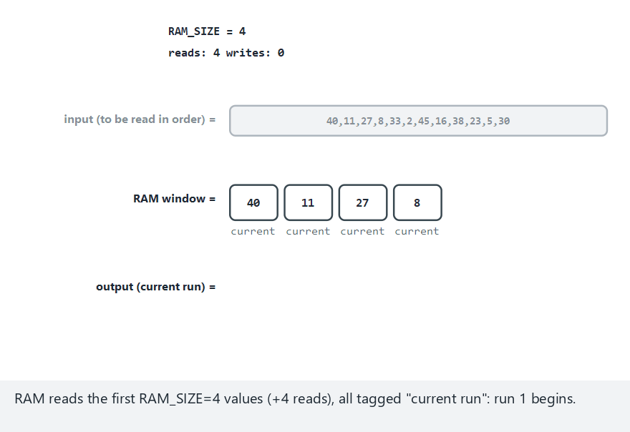
CEN207 Data Structures · Week 14
Replacement selection, step by step
RTEU Computer Engineering · Fall 2026–2027
133
Notes:
Normal example: RAM=4, 12 mixed values — watch window boxes switch between "current" and "next" labels.

Slide 134
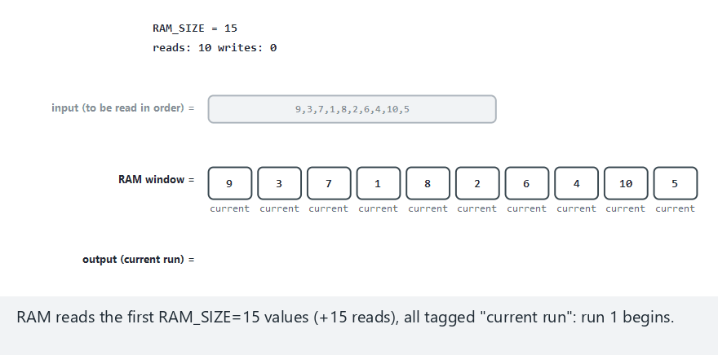
CEN207 Data Structures · Week 14
Edge case — best case, RAM >= n
RTEU Computer Engineering · Fall 2026–2027
134
Notes:
With RAM big enough to hold everything, the result is always ONE fully sorted run, whatever the input order.

Slide 135
CEN207 Data Structures · Week 14
Code — extract_min_current
int extract_min_current(Item window[], int w) {
int best = -1;
for (int i = 0; i < w; i++)
if (window[i].tag == CURRENT &&
(best == -1 || window[i].val < window[best].val))
best = i;
return best;
}
RTEU Computer Engineering · Fall 2026–2027
135
Notes:
Returns -1 when nothing is tagged CURRENT — the signal that this run has ended.

Slide 136
CEN207 Data Structures · Week 14
This program also creates REAL files — safely
• lab_replacement_selection/, created by the program itself
• Every run file removed before the program exits
• Run boundaries match this week's animation exactly
• A production version keeps the window as a real min-heap
RTEU Computer Engineering · Fall 2026–2027
136
Notes:
The code here scans the window linearly, O(m) per record, for clarity — a heap makes it O(log m).

Slide 137
CEN207 Data Structures · Week 14
Complexity
• O(n) total I/O for run creation — same as Section 10 Phase 1
• E[run length] ≈ 2m on random data — half as many later passes
• extract_min_current: O(m) here, O(log m) with a real heap
• Worst case (descending input): no better than plain chunking
RTEU Computer Engineering · Fall 2026–2027
137
Notes:
This average-case win is exactly why real database and OS sort utilities use replacement selection.

Slide 138
CEN207 Data Structures · Week 14
Common mistakes
• Comparing against the window's minimum, not the last WRITE
• Forgetting to reset last_written when a new run starts
• Assuming the "2x" average also holds in the worst case
RTEU Computer Engineering · Fall 2026–2027
138
Notes:
Carrying over the previous run's last value would wrongly tag some of the new run's earliest records.

Slide 139
CEN207 Data Structures · Week 14
Mini-quiz
Why does replacement selection produce runs about TWICE the window size m, on average?
RTEU Computer Engineering · Fall 2026–2027
139
Notes:
Think about what fraction of the window is typically CURRENT-tagged at any moment.

Slide 140
CEN207 Data Structures · Week 14
Answer
Roughly half the window stays CURRENT at any moment, continuously refreshed. The run grows to about 2m before ending.
RTEU Computer Engineering · Fall 2026–2027
140
Notes:
A classical result, analysed in full in Knuth's TAOCP, Volume 3.

Slide 141
CEN207 Data Structures · Week 14
12. Choosing a File Organisation
RTEU Computer Engineering · Fall 2026–2027
141
Notes:
The closing section turns everything this week covered into one decision table.

Slide 142
CEN207 Data Structures · Week 14
Comparison table (1/2)
Structure | Search | Insert
Sorted file (Wk 13) | O(log(n/B)) | O(n/B) shifts
Bucket hash (Wk 13) | ~O(1) + overflow | ~O(1) + overflow
Primary/secondary index | O(1) page + free scan | Expensive
ISAM | O(L) + overflow chain | O(L) + append
RTEU Computer Engineering · Fall 2026–2027
142
Notes:
The index rows assume a mostly-static file; ISAM's overflow area is what makes inserts survivable at all.

Slide 143
CEN207 Data Structures · Week 14
Comparison table (2/2)
Structure | Range query | Reorganise?
B-tree | Repeated descents | Never
B+-tree | Excellent (chain) | Never
Extendible hashing | Poor (no order) | Never
Linear hashing | Poor (no order) | Never
RTEU Computer Engineering · Fall 2026–2027
143
Notes:
"Never reorganise" is the B-tree family's other great property, alongside logarithmic search.

Slide 144
CEN207 Data Structures · Week 14
The one big decision
• Do you need ORDER (range queries, sorted iteration)?
• Or only ever EXACT-MATCH lookups?
• Order matters: a B+-tree's leaf chain is very hard to beat
• Exact-match only, ever-growing file: hashing usually wins
RTEU Computer Engineering · Fall 2026–2027
144
Notes:
This is the exact same question Week 13 first raised — sharpened now by everything this week added.

Slide 145
CEN207 Data Structures · Week 14
Summary (1/2)
• Indexes: primary (sparse), secondary (dense), ISAM
• ISAM adds index LEVELS and an OVERFLOW AREA
• B-trees (Bayer/McCreight 1972): split, search, borrow/merge
• B+-trees: leaf CHAIN makes range queries fast
RTEU Computer Engineering · Fall 2026–2027
145
Notes:
Every B-tree-family operation keeps the tree balanced as it goes — no separate rebalancing pass, ever.

Slide 146
CEN207 Data Structures · Week 14
Summary (2/2)
• Extendible hashing (Fagin et al. 1979): directory, doubled
• Linear hashing (Litwin 1980): no directory, round-robin splits
• External merge sort: small runs, k-way merge, few buffers
• Replacement selection: ~2x longer runs from the same RAM
RTEU Computer Engineering · Fall 2026–2027
146
Notes:
Both hashing schemes grow one bucket at a time, on demand, with no reorganisation pass.

Slide 147
CEN207 Data Structures · Week 14
Self-Check Quiz Recap
RTEU Computer Engineering · Fall 2026–2027
147
Notes:
Ten questions, restated from the week's notes, one per slide pair.

Slide 148
CEN207 Data Structures · Week 14
1. Why does a primary index cost ZERO disk I/O to scan?
RTEU Computer Engineering · Fall 2026–2027
148
Notes:
Recall Section 1.

Slide 149
CEN207 Data Structures · Week 14
It is small enough to stay resident in memory — one entry per PAGE, not per record.
RTEU Computer Engineering · Fall 2026–2027
149
Notes:
Only the one data page it points to is a real disk read.

Slide 150
CEN207 Data Structures · Week 14
2. Why must a dense index be sorted by the SECONDARY key?
RTEU Computer Engineering · Fall 2026–2027
150
Notes:
Recall Section 2.

Slide 151
CEN207 Data Structures · Week 14
The data file's own order tells you nothing about where matching records are — only the index's own sort order does.
RTEU Computer Engineering · Fall 2026–2027
151
Notes:
This is what makes duplicate values cluster together in a dense index.

Slide 152
CEN207 Data Structures · Week 14
3. What does ISAM's overflow area let a file avoid doing immediately?
RTEU Computer Engineering · Fall 2026–2027
152
Notes:
Recall Section 3.

Slide 153
CEN207 Data Structures · Week 14
Re-splitting or reorganising the whole file on every insert — at the cost of degrading search as chains grow.
RTEU Computer Engineering · Fall 2026–2027
153
Notes:
This trade-off is exactly why real ISAM files need periodic reorganisation.

Slide 154
CEN207 Data Structures · Week 14
4. Why does a B-tree split always push exactly ONE key up?
RTEU Computer Engineering · Fall 2026–2027
154
Notes:
Recall Section 4.

Slide 155
CEN207 Data Structures · Week 14
The median is the one key that fits cleanly into NEITHER half after the split — so it is promoted.
RTEU Computer Engineering · Fall 2026–2027
155
Notes:
Half the keys stay, half move to a new sibling, and the median separates them in the parent.

Slide 156
CEN207 Data Structures · Week 14
5. Why does B-tree search cost at most (height + 1) reads?
RTEU Computer Engineering · Fall 2026–2027
156
Notes:
Recall Section 5.

Slide 157
CEN207 Data Structures · Week 14
Every leaf sits at exactly the same depth — insertion only ever grows the tree from the root, never a leaf.
RTEU Computer Engineering · Fall 2026–2027
157
Notes:
A search either finds its key early, or walks to a leaf — never past one.

Slide 158
CEN207 Data Structures · Week 14
6. Why does a B-tree prefer borrowing over merging?
RTEU Computer Engineering · Fall 2026–2027
158
Notes:
Recall Section 6.

Slide 159
CEN207 Data Structures · Week 14
Borrowing touches only 3 pages and resolves immediately; merging can cascade further up the tree.
RTEU Computer Engineering · Fall 2026–2027
159
Notes:
A B-tree only merges when NO sibling has a spare key to lend.

Slide 160
CEN207 Data Structures · Week 14
7. What ONE structural change makes a B+-tree's range queries fast?
RTEU Computer Engineering · Fall 2026–2027
160
Notes:
Recall Section 7.

Slide 161
CEN207 Data Structures · Week 14
Every leaf holds a next pointer to its right neighbour — a chain that needs no climbing back to the root.
RTEU Computer Engineering · Fall 2026–2027
161
Notes:
A plain B-tree has no such shortcut between neighbouring leaves.

Slide 162
CEN207 Data Structures · Week 14
8. Why must extendible hashing's directory sometimes double?
RTEU Computer Engineering · Fall 2026–2027
162
Notes:
Recall Section 8.

Slide 163
CEN207 Data Structures · Week 14
Only when the overflowing bucket's local_depth has caught up to global_depth — other buckets are unaffected.
RTEU Computer Engineering · Fall 2026–2027
163
Notes:
Doubling creates the spare, more-specific slots a split then needs to redirect.

Slide 164
CEN207 Data Structures · Week 14
9. Why can linear hashing split a bucket OTHER than the one that overflowed?
RTEU Computer Engineering · Fall 2026–2027
164
Notes:
Recall Section 9.

Slide 165
CEN207 Data Structures · Week 14
It commits in advance to a fixed round-robin split order, independent of which bucket happens to overflow.
RTEU Computer Engineering · Fall 2026–2027
165
Notes:
This predictability is exactly what removes the need for any directory.

Slide 166
CEN207 Data Structures · Week 14
10. Why does replacement selection typically double the window size m?
RTEU Computer Engineering · Fall 2026–2027
166
Notes:
Recall Section 11.

Slide 167
CEN207 Data Structures · Week 14
The window keeps refilling: roughly half stays CURRENT-tagged at any moment, letting the run grow to ~2m.
RTEU Computer Engineering · Fall 2026–2027
167
Notes:
A classical result analysed in Knuth's TAOCP, Volume 3.

Slide 168
CEN207 Data Structures · Week 14
Next week
Week 15 — Final Project Demonstrations
No new algorithms this week: teams present their project's file-organisation or storage component, before Week 16's final exam period.
RTEU Computer Engineering · Fall 2026–2027
168
Notes:
Every structure from this week remains in daily production use — B+-trees in almost every relational database, external merge sort in every database's sort/index-build utility.

Slide 169
CEN207 Data Structures · Week 14
References (1/2)
• Course syllabus, Week 14: CEN207-2026-2027-Guz-Izlence.en.md
• Bayer, McCreight (1972). "Organization and Maintenance
of Large Ordered Indexes"
• Fagin, Nievergelt, Pippenger, Strong (1979).
"Extendible Hashing"
• Litwin (1980). "Linear Hashing: A New Tool for
File and Table Addressing"
RTEU Computer Engineering · Fall 2026–2027
169
Notes:
These are the same references listed at the end of the week's written notes.

Slide 170
CEN207 Data Structures · Week 14
References (2/2)
• Knuth. TAOCP, Vol. 3: Sorting and Searching, 2nd ed
• Cormen, Leiserson, Rivest, Stein. *Introduction
to Algorithms*. MIT Press
• Sedgewick, Wayne. Algorithms, 4th ed. Addison-Wesley
• williamfiset/Algorithms · Programiz DSA
RTEU Computer Engineering · Fall 2026–2027
170
Notes:
The historical references — Bayer/McCreight, Fagin et al., Litwin — are what today's "short history" slides drew on.

