Slide 1

CEN207 Data Structures · Week 11
Advanced Trees
CEN207 Data Structures — Week 11
Asst. Prof. Dr. Uğur CORUH · Fall 2026–2027
RTEU Computer Engineering · Fall 2026–2027
Notes:
Today we add an ORDERING rule to trees for the first time, then spend the rest of the week keeping that ordered tree from becoming a linked list in disguise.

Slide 2
CEN207 Data Structures · Week 11
Today's plan (3 hours)
Hour | Topic
1 | BST: insert, search, delete, why balance matters
2 | AVL (4 rotations, insert, delete) · red-black · splay
3 | 2-3 tree · segment tree · Fenwick tree · choosing a technique
Learning outcomes: LO.1 (explain fundamental data structures) · LO.2 (analyze complexity) · LO.7 (choose the right structure)
RTEU Computer Engineering · Fall 2026–2027
2
Notes:
Twelve animations carry the whole lecture, one appears the moment its idea is introduced.

Slide 3
CEN207 Data Structures · Week 11
This week's concepts — where
Concept | Where
BST insert/search/delete, degenerate case | Section 1
AVL, red-black, splay, 2-3 tree | Sections 2–5
Segment tree, Fenwick tree | Sections 6–7
Choosing a technique | Section 8
RTEU Computer Engineering · Fall 2026–2027
3
Notes:
Every term gets a full definition the first time it appears; this table just says where to find it again.

Slide 4
CEN207 Data Structures · Week 11
How the code examples work
• Every idea has a complete C and Java program
• C: gcc -std=c11 -Wall -Wextra -o /tmp/x file.c && /tmp/x
• Java: javac -d /tmp/j File.java && java -cp /tmp/j File
• Sources: code/week-11/c/ and code/week-11/java/
• Each program's expected output is in the week notes
RTEU Computer Engineering · Fall 2026–2027
4
Notes:
Open a terminal now if you want to run these live; every snippet on today's slides compiles and runs exactly as shown.

Slide 5
CEN207 Data Structures · Week 11
Bridge from Week 4
• Week 4 gave you tree vocabulary: root, leaf, depth, height, subtree
• Week 4 gave you traversals: inorder, preorder, postorder, level-order
• Week 4's heap was never ordered left-vs-right, only parent-vs-child
• Today's trees add an ordering rule for the first time
RTEU Computer Engineering · Fall 2026–2027
5
Notes:
Nothing new about "what a tree is" is needed today — only a new rule about how keys are arranged inside one.

Slide 6
CEN207 Data Structures · Week 11
Recap — Week 4: height and depth
• Depth of a node = edges from the root to it (root = 0)
• Height of a tree = greatest depth of any node
• Empty tree: height -1 by convention; one node: height 0
• Today: height is the single number that decides every cost
RTEU Computer Engineering · Fall 2026–2027
6
Notes:
Every complexity claim this week is "O(height)" — so today is really about controlling that one number.

Slide 7
CEN207 Data Structures · Week 11
Map of the week — the one rule
• A binary search tree: left subtree smaller, right subtree larger
• That rule alone gives fast search — IF the tree stays shallow
• Four different strategies keep it shallow: AVL, red-black, splay, 2-3
• Two more trees answer range questions instead of single-key ones
RTEU Computer Engineering · Fall 2026–2027
7
Notes:
Ask the class: what could go wrong with just "left smaller, right larger" and nothing else? The answer is coming in section 1.4.

Slide 8
CEN207 Data Structures · Week 11
Map of the week — at a glance
Balanced BSTs | Range-query trees
AVL — strict balance factor | Segment tree — build once, query O(log n)
Red-black — looser, color-based | Fenwick tree — one array, i & -i
Splay — no balance, adapts to use | —
2-3 tree — grows only at the root | —
RTEU Computer Engineering · Fall 2026–2027
8
Notes:
Every box gets its own slides below, most with a short animation and a complete C/Java program.

Slide 9
CEN207 Data Structures · Week 11
Recap — Week 4: traversals
• Inorder: left, visit, right — sorted order on a BST
• Preorder: visit, left, right — copies a tree's shape
• Postorder: left, right, visit — safe for deleting a tree
• Level-order: an explicit queue, breadth-first
RTEU Computer Engineering · Fall 2026–2027
9
Notes:
Every "Expected output" block today prints an INORDER listing — watch it stay sorted at every step.

Slide 10
CEN207 Data Structures · Week 11
Vocabulary check
Term | Meaning
Balance factor | height(left) − height(right)
Rotation | O(1) local pointer rearrangement
Amortized cost | averaged over a long operation sequence
Invertible operation | undoable via subtraction (sum, not min)
RTEU Computer Engineering · Fall 2026–2027
10
Notes:
These four terms recur across almost every section today — point back here if anyone loses track.

Slide 11
CEN207 Data Structures · Week 11
1. The Binary Search Tree
RTEU Computer Engineering · Fall 2026–2027
11
Notes:
Section 1 builds the BST from scratch: insert, search, delete, then the case where it all goes wrong.

Slide 12
CEN207 Data Structures · Week 11
A question to start
Week 1: sorted array, binary search — fast, but inserting costs O(n). Week 2: linked list — insert O(1), but search needs O(n).
Is there a structure that does BOTH better than O(n)?
RTEU Computer Engineering · Fall 2026–2027
12
Notes:
Let the pause land. The answer, the binary search tree, is one single ordering rule.

Slide 13
CEN207 Data Structures · Week 11
A short history
• BST ideas appear independently 1959–1962
• P. F. Windley, A. D. Booth & A. J. T. Colin, T. N. Hibbard
• Hibbard, 1962 — usually credited for working out deletion
• Deletion is exactly what section 1.4 covers today
RTEU Computer Engineering · Fall 2026–2027
13
Notes:
Insertion and search are the "easy" half; deletion is the half that took a dedicated paper to get right.

Slide 14
CEN207 Data Structures · Week 11
Intuition — a phone book, but a tree
• Open to the middle page: is your name before or after it?
• Keep halving — that is binary search on an array
• A BST bakes that same halving into the shape of the structure
• Rule at every node: left smaller, right larger
RTEU Computer Engineering · Fall 2026–2027
14
Notes:
The phone book picture only works because the book is sorted — the BST's rule is what keeps that "sorted" property, everywhere, always.

Slide 15
CEN207 Data Structures · Week 11
The BST ADT
Operation | What it does | Complexity
insert(key) | Adds key; duplicate ignored | O(h)
search(key) | Reports present or not | O(h)
delete(key) | Removes key if present | O(h)
min / max | Smallest / largest key | O(h)
RTEU Computer Engineering · Fall 2026–2027
15
Notes:
h is the tree's CURRENT height — section 1.4 is entirely about what happens when h is not small.

Slide 16
CEN207 Data Structures · Week 11
In memory — insert's idea
• Walk down from the root, comparing key at every node
• Smaller → go left; larger → go right; equal → duplicate, stop
• Reach a NULL child → that is the new node's spot
• Link it in; nothing else in the tree moves
RTEU Computer Engineering · Fall 2026–2027
16
Notes:
Exactly like a search, except the walk ends by CREATING a node instead of failing.

Slide 17
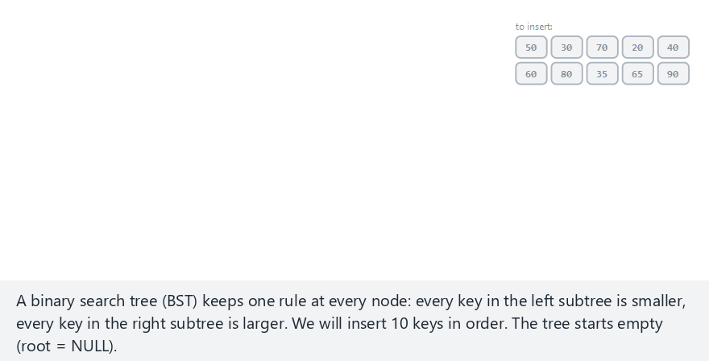
CEN207 Data Structures · Week 11
Binary search tree: insert
RTEU Computer Engineering · Fall 2026–2027
17
Notes:
Normal example: 10 keys in a mixed order. Watch the new leaf attach exactly where the comparisons led.

Slide 18
CEN207 Data Structures · Week 11
Code — bst_insert()
Node *bst_insert(Node *root, int key) {
Node *cur = root, *parent = NULL;
while (cur != NULL) {
parent = cur;
if (key == cur->key) return root;
if (key < cur->key) cur = cur->left;
else cur = cur->right;
}
Node *n = malloc(sizeof(Node));
n->key = key; n->left = NULL; n->right = NULL;
RTEU Computer Engineering · Fall 2026–2027
18
Notes:
The walk down is identical to search; only what happens at the NULL is different.

Slide 19
CEN207 Data Structures · Week 11
Code — bst_insert(), linking in
if (parent == NULL) return n;
if (key < parent->key) parent->left = n;
else parent->right = n;
return root;
}
RTEU Computer Engineering · Fall 2026–2027
19
Notes:
One comparison decides left or right; that is the whole "linking in" step.

Slide 20
CEN207 Data Structures · Week 11
Expected output
insert(50): inorder = 50 height = 0
insert(30): inorder = 30 50 height = 1
insert(70): inorder = 30 50 70 height = 1
insert(20): inorder = 20 30 50 70 height = 2
RTEU Computer Engineering · Fall 2026–2027
20
Notes:
The inorder listing is always sorted, at every single step — that is the ordering rule made visible.

Slide 21
CEN207 Data Structures · Week 11
Why insert is O(h)
• One comparison per level visited, at most
• Never revisits a node once passed
• h small (balanced) → fast; h large (chain) → slow
• Section 1.4 shows exactly how large h can get
RTEU Computer Engineering · Fall 2026–2027
21
Notes:
"One comparison per level" is the whole complexity argument — no hidden loops anywhere.

Slide 22
CEN207 Data Structures · Week 11
Common mistake
• Forgetting to root = bst_insert(root, key);
• Without reassigning, the caller's root never updates
• C/Java pass pointers/references by value here
• The function must return the (possibly new) root
RTEU Computer Engineering · Fall 2026–2027
22
Notes:
This bug is silent — the program runs, just never actually grows the tree.

Slide 23
CEN207 Data Structures · Week 11
Mini question
In the animation's "ascending order" edge case, every new key becomes a RIGHT child. Why never a left one?
RTEU Computer Engineering · Fall 2026–2027
23
Notes:
Answer on the next slide — give the audience 20 seconds first.

Slide 24
CEN207 Data Structures · Week 11
Mini answer
• Every later key is larger than everything already inserted
• So every comparison during the walk says "go right"
• The tree leans entirely to the right — a chain
• This is exactly section 1.4's topic, next
RTEU Computer Engineering · Fall 2026–2027
24
Notes:
This single observation is the seed of the whole "why balance matters" story.

Slide 25
CEN207 Data Structures · Week 11
A question to start — search
insert already walks down comparing keys. search is almost the same walk — how many nodes, worst case?
RTEU Computer Engineering · Fall 2026–2027
25
Notes:
The answer is "at most h+1" — but what IS h, really? Patience — section 1.4.

Slide 26
CEN207 Data Structures · Week 11
The idea — search
• Equal → found; smaller → only the left subtree can have it
• The ordering rule GUARANTEES the right subtree cannot
• Larger → mirror image
• NULL reached before a match → not present
RTEU Computer Engineering · Fall 2026–2027
26
Notes:
"Only the left subtree can have it" is a guarantee, not a guess — that is what the BST rule buys you.

Slide 27
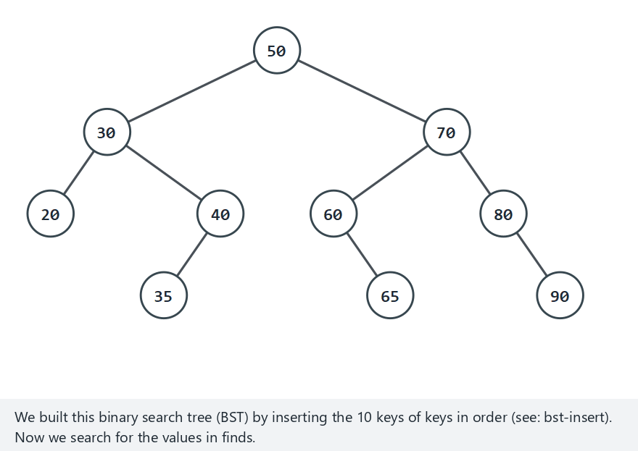
CEN207 Data Structures · Week 11
Binary search tree: search
RTEU Computer Engineering · Fall 2026–2027
27
Notes:
Watch the probe counter — every step down costs exactly one comparison, never more.

Slide 28
CEN207 Data Structures · Week 11
Code — bst_search()
int bst_search(Node *root, int key) {
Node *cur = root;
probes = 0;
while (cur != NULL) {
probes++;
if (key == cur->key) return 1;
if (key < cur->key) cur = cur->left;
else cur = cur->right;
}
return 0;
}
RTEU Computer Engineering · Fall 2026–2027
28
Notes:
Same shape as insert's walk, minus the "create a node" step at the end.

Slide 29
CEN207 Data Structures · Week 11
Expected output
search(65): found, 4 probes
search(20): found, 3 probes
search(55): not found, 3 probes
search(100): not found, 4 probes
RTEU Computer Engineering · Fall 2026–2027
29
Notes:
"Not found" costs a real number of probes too — it is not free, it just stops at a NULL instead of a match.

Slide 30
CEN207 Data Structures · Week 11
Why search is O(h)
• Same one-comparison-per-level argument as insert
• Best case O(1): the root itself
• Worst case: as deep as the tree gets
• Again: everything hinges on h
RTEU Computer Engineering · Fall 2026–2027
30
Notes:
We will keep saying "everything hinges on h" until section 1.4 makes it unavoidable to care.

Slide 31
CEN207 Data Structures · Week 11
Common mistake
• Treating "not found" as an error condition
• It is a normal, expected outcome, not a crash
• The while (cur != NULL) guard handles it cleanly
• Continuing to compare after a match (off-by-one) also wastes work
RTEU Computer Engineering · Fall 2026–2027
31
Notes:
A search that "fails" is doing its job correctly — the key genuinely was not there.

Slide 32
CEN207 Data Structures · Week 11
Mini question
search(10) on a 10-node ascending-insert chain costs 10 probes. search(1) costs only 1. Why such a big gap?
RTEU Computer Engineering · Fall 2026–2027
32
Notes:
Answer on the next slide.

Slide 33
CEN207 Data Structures · Week 11
Mini answer
• That tree is a pure chain: 1 at the root, 10 at the deepest leaf
• Root's own key: one comparison
• Deepest leaf: one comparison per level down to it
• height + 1 comparisons, worst case
RTEU Computer Engineering · Fall 2026–2027
33
Notes:
This is the SAME chain from the insert mini-answer — same cause, same consequence.

Slide 34
CEN207 Data Structures · Week 11
A question to start — delete
Deleting a leaf is easy: detach it. Deleting a node with two children is not. Why not?
RTEU Computer Engineering · Fall 2026–2027
34
Notes:
You cannot just remove it — something has to take its place while keeping order intact.

Slide 35
CEN207 Data Structures · Week 11
The idea — three cases
Case | Fix
Leaf | Detach it
One child | Parent links directly to the child
Two children | Copy in the in-order successor's key, then delete IT
RTEU Computer Engineering · Fall 2026–2027
35
Notes:
Successor = smallest key in the right subtree — walk left from the right child as far as possible.

Slide 36
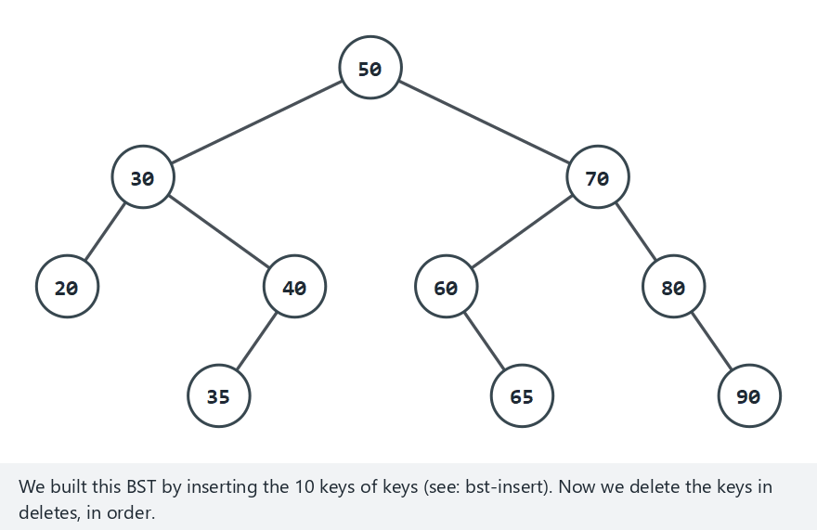
CEN207 Data Structures · Week 11
Binary search tree: delete
RTEU Computer Engineering · Fall 2026–2027
36
Notes:
The normal example deliberately hits all three cases across its four deletes — watch for each one.

Slide 37
CEN207 Data Structures · Week 11
Code — bst_delete(), finding the node
Node *bst_delete(Node *root, int key) {
Node *cur = root, *parent = NULL;
while (cur != NULL && key != cur->key) {
parent = cur;
cur = (key < cur->key) ? cur->left : cur->right;
}
if (cur == NULL) return root;
RTEU Computer Engineering · Fall 2026–2027
37
Notes:
Not found is a genuine no-op — the tree is returned completely unchanged.

Slide 38
CEN207 Data Structures · Week 11
Code — bst_delete(), two children
if (cur->left != NULL && cur->right != NULL) {
Node *succ = cur->right, *succParent = cur;
while (succ->left != NULL) {
succParent = succ; succ = succ->left;
}
cur->key = succ->key;
parent = succParent; cur = succ;
}
RTEU Computer Engineering · Fall 2026–2027
38
Notes:
After this block, cur points at the SUCCESSOR — which now has at most one child, reducing to case 1 or 2.

Slide 39
CEN207 Data Structures · Week 11
Expected output
delete(35): inorder = 20 30 40 50 60 65 70 80 90
delete(70): inorder = 20 30 40 50 60 65 80 90
delete(50): inorder = 20 30 40 60 65 80 90
delete(20): inorder = 30 40 60 65 80 90
RTEU Computer Engineering · Fall 2026–2027
39
Notes:
The inorder list stays sorted after every single delete — that is the invariant being preserved.

Slide 40
CEN207 Data Structures · Week 11
Why delete is O(h)
• Finding the node: O(h)
• Finding a successor: at most another O(h)
• Never revisits nodes already on the search path
• Same worst case as insert and search
RTEU Computer Engineering · Fall 2026–2027
40
Notes:
Two O(h) walks back-to-back is still O(h), not O(h squared) — they never overlap.

Slide 41
CEN207 Data Structures · Week 11
Common mistake
• Copying the successor's key but forgetting to delete ITS node
• The key now exists twice in the tree
• Successor vs. predecessor: either works, but stay consistent
• Forgetting free() in C — a real memory leak
RTEU Computer Engineering · Fall 2026–2027
41
Notes:
AddressSanitizer (our --sanitize pass) catches exactly this leak — we found and fixed similar bugs while building this week.

Slide 42
CEN207 Data Structures · Week 11
Mini question
Why is a BST delete's successor guaranteed to have AT MOST one child?
RTEU Computer Engineering · Fall 2026–2027
42
Notes:
Answer on the next slide.

Slide 43
CEN207 Data Structures · Week 11
Mini answer
• Successor = leftmost node of the right subtree
• Leftmost means: no left child, by definition
• May or may not have a right child
• Never both — so it is always case 1 or case 2
RTEU Computer Engineering · Fall 2026–2027
43
Notes:
This is why the two-children case always safely reduces to one of the simpler two cases.

Slide 44
CEN207 Data Structures · Week 11
A question to start — degenerate
Every section so far states cost as O(h). What IS h, concretely, for n keys in an arbitrary order?
RTEU Computer Engineering · Fall 2026–2027
44
Notes:
We have been avoiding this question on purpose — time to face it.

Slide 45
CEN207 Data Structures · Week 11
The idea — order, not just the key set
• Every technique compares VALUES, never looks at tree SHAPE
• Sorted input: every new key is bigger than everything so far
• Every new key attaches one level deeper than the last
• The tree degenerates into a chain: height n − 1
RTEU Computer Engineering · Fall 2026–2027
45
Notes:
"Binary search tree" alone promises nothing about height — only VALUE ordering, not shape.

Slide 46

CEN207 Data Structures · Week 11
Why balancing matters
RTEU Computer Engineering · Fall 2026–2027
46
Notes:
Normal: 10 ascending keys, height 9. Compare against the ideal height of 3 for 10 nodes.

Slide 47
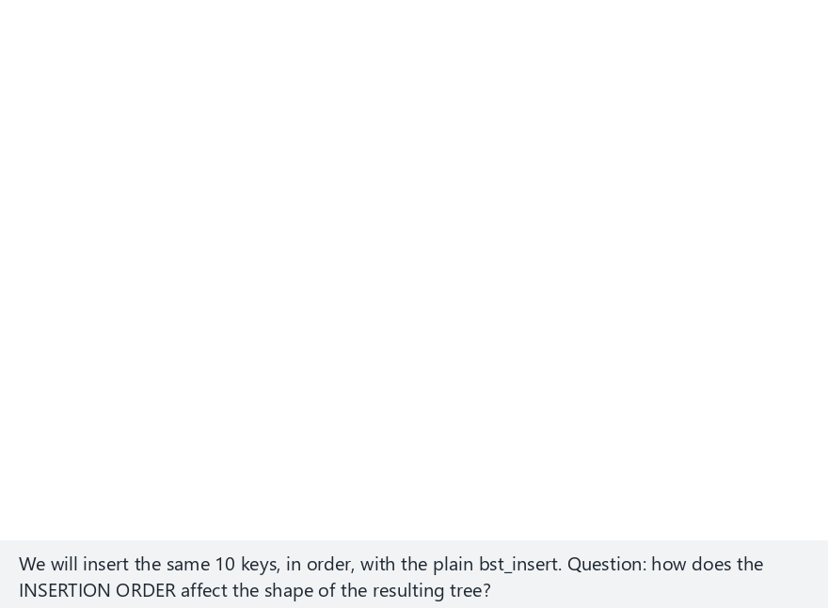
CEN207 Data Structures · Week 11
The same keys, shuffled
RTEU Computer Engineering · Fall 2026–2027
47
Notes:
SAME 10 keys, different order: height 3, not 9. Identical key set, wildly different shape — order is everything.

Slide 48
CEN207 Data Structures · Week 11
Expected output
insert(10): height = 9 (ideal for 10 nodes = 3)
final: n = 10, height = 9, ideal = 3
vs. the shuffled edge case: final: n = 10, height = 3, ideal = 3
RTEU Computer Engineering · Fall 2026–2027
48
Notes:
9 versus 3 — nearly triple the height, same 10 keys, only the arrival order differs.

Slide 49
CEN207 Data Structures · Week 11
Why this matters for complexity
• Worst case height: n − 1 (sorted or reverse-sorted input)
• Every operation from sections 1.1–1.4 becomes O(n)
• Average case (random order): O(log n) — but "random" is not guaranteed
• Sorted input is common in practice: imports, replayed logs
RTEU Computer Engineering · Fall 2026–2027
49
Notes:
"BST" alone guarantees AT MOST O(n) and AT BEST O(log n) — nothing in between is promised.

Slide 50
CEN207 Data Structures · Week 11
Common mistake
• Assuming "it's a BST" means O(log n) automatically
• Benchmarking only with random test data
• Random data HIDES this exact failure mode
• Only a SELF-BALANCING BST guarantees O(log n) worst case
RTEU Computer Engineering · Fall 2026–2027
50
Notes:
This slide is the hinge of the whole lecture — everything from here on exists because of this one gap.

Slide 51
CEN207 Data Structures · Week 11
Mini question
You must build a BST from data you KNOW is already sorted. Cheapest fix, without switching tree types?
RTEU Computer Engineering · Fall 2026–2027
51
Notes:
Answer on the next slide.

Slide 52
CEN207 Data Structures · Week 11
Mini answer
• Shuffle the keys into random order before inserting
• Or: recursively pick the middle element as root, recurse both halves
• Builds a perfectly balanced tree directly, O(n), no rotations
• Sections 2–5 solve the GENERAL problem automatically
RTEU Computer Engineering · Fall 2026–2027
52
Notes:
Next: four different strategies that never need to know the input was sorted in advance.

Slide 53
CEN207 Data Structures · Week 11
2. AVL Trees
RTEU Computer Engineering · Fall 2026–2027
53
Notes:
The first self-balancing BST ever published — a strict rule, enforced everywhere, every time.

Slide 54
CEN207 Data Structures · Week 11
A question to start
We need a BST that stays shallow no matter what order operations arrive in. Does one exist?
RTEU Computer Engineering · Fall 2026–2027
54
Notes:
Real programs insert and delete over time — we cannot always pre-sort or pre-shuffle.

Slide 55
CEN207 Data Structures · Week 11
A short history
• 1962 — Georgy Adelson-Velsky & Evgenii Landis
• "AVL" = their initials
• First self-balancing binary search tree ever published
• Idea: track a balance factor at every node
RTEU Computer Engineering · Fall 2026–2027
55
Notes:
bf = height(left) - height(right). Kept in {-1, 0, +1} everywhere, always.

Slide 56
CEN207 Data Structures · Week 11
The four rotation cases
Case | Shape | Fix
LL | left-heavy, left child left-heavy | one right rotation
RR | right-heavy, right child right-heavy | one left rotation
LR | left-heavy, left child right-heavy | rotate left child left, then right
RL | right-heavy, right child left-heavy | rotate right child right, then left
RTEU Computer Engineering · Fall 2026–2027
56
Notes:
LR and RL are "double rotations" — two single rotations applied back to back.

Slide 57
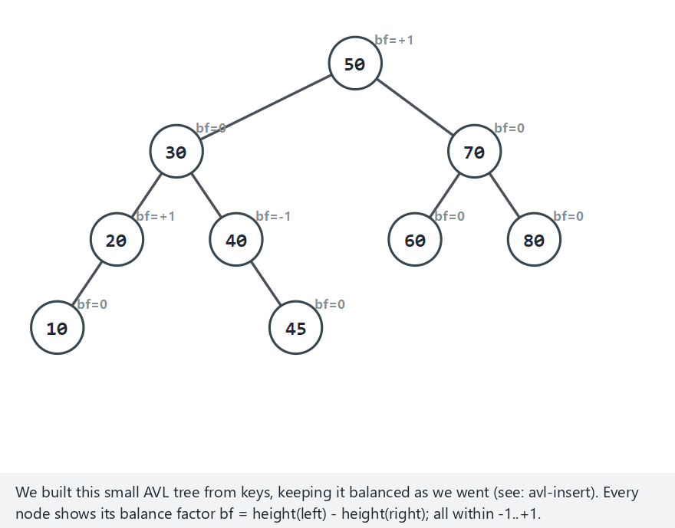
CEN207 Data Structures · Week 11
AVL: the four rebalancing cases
RTEU Computer Engineering · Fall 2026–2027
57
Notes:
Step through LL, RR, LR, RL in the picker — each is a separate preset, built the same way.

Slide 58
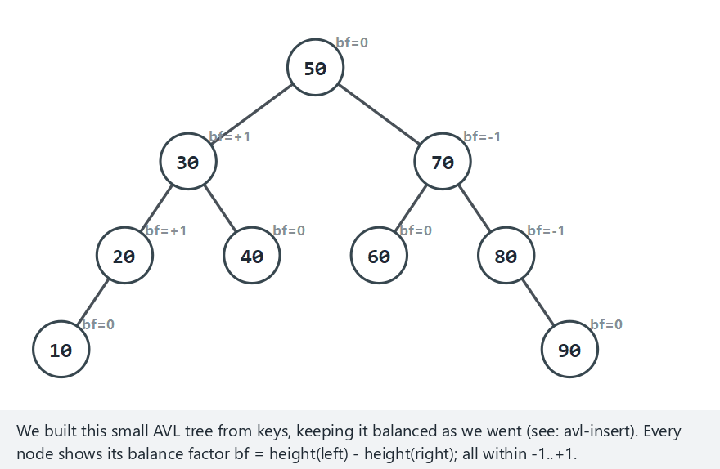
CEN207 Data Structures · Week 11
No rotation needed
RTEU Computer Engineering · Fall 2026–2027
58
Notes:
Contrast case: an insertion that never violates the balance factor at all. Not every insert rotates.

Slide 59
CEN207 Data Structures · Week 11
Mini question
After ONE insertion, how many rotations can an AVL tree need, at most?
RTEU Computer Engineering · Fall 2026–2027
59
Notes:
Answer on the next slide.

Slide 60
CEN207 Data Structures · Week 11
Mini answer
• At most ONE single rotation, or ONE double rotation
• The fix restores the subtree's PRE-insertion height exactly
• So no ancestor further up can have become unbalanced
• Insert never needs to propagate a fix upward
RTEU Computer Engineering · Fall 2026–2027
60
Notes:
This is proven, not just observed — it is why AVL insert stays O(log n) with tiny constant work.

Slide 61
CEN207 Data Structures · Week 11
AVL insert — the idea
• Plain recursive BST insert
• On the way back UP the call stack: update_height, then rebalance
• Check happens at EVERY level as recursion unwinds
• First (and only) unbalanced node found is fixed immediately
RTEU Computer Engineering · Fall 2026–2027
61
Notes:
Two extra lines, added to the same insert you already know from section 1.

Slide 62
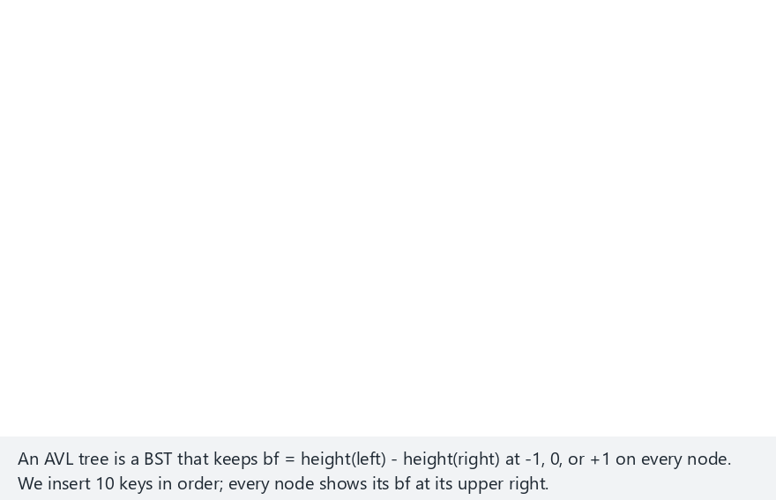
CEN207 Data Structures · Week 11
AVL tree: insert
RTEU Computer Engineering · Fall 2026–2027
62
Notes:
Watch bf on every node — it never leaves {-1, 0, +1}, even mid-insertion the fix is immediate.

Slide 63
CEN207 Data Structures · Week 11
Code — rebalance()
Node *rebalance(Node *n) {
int bf = height(n->left) - height(n->right);
if (bf > 1 && height(n->left->left)
>= height(n->left->right))
return rotate_right(n);
if (bf > 1) {
n->left = rotate_left(n->left);
return rotate_right(n);
}
RTEU Computer Engineering · Fall 2026–2027
63
Notes:
The decision compares the CHILD's balance factor, not the just-inserted key — this form works for delete too.

Slide 64
CEN207 Data Structures · Week 11
Expected output — ascending keys
insert(10): height = 3
Section 1.4's plain BST reached height 9 for the SAME 10 ascending keys.
RTEU Computer Engineering · Fall 2026–2027
64
Notes:
Same worst-case input that broke a plain BST — AVL handles it without breaking a sweat.

Slide 65
CEN207 Data Structures · Week 11
Why AVL is O(log n)
• Height never exceeds 1.44 · log2(n + 2)
• Every operation is O(log n) — WORST case, not just average
• insert: at most one (double) rotation
• delete: up to O(log n) rotations, but each is O(1)
RTEU Computer Engineering · Fall 2026–2027
65
Notes:
This is the guarantee section 1.4 was missing — worst case, not just average case.

Slide 66
CEN207 Data Structures · Week 11
Common mistake
• Forgetting update_height before checking balance factor
• rebalance then reads a STALE height
• Deciding LL vs LR by the just-inserted key (breaks for delete)
• The balance-factor-based decision works for both insert AND delete
RTEU Computer Engineering · Fall 2026–2027
66
Notes:
This exact family of bugs is what makes AVL delete trickier to write correctly than insert.

Slide 67
CEN207 Data Structures · Week 11
AVL delete — rebalancing can cascade
• Reuses section 1.4's exact splice logic (leaf/one/two children)
• Difference: rebalance runs at EVERY ancestor, not just the first
• A delete can shrink a subtree's height
• That shrink can keep propagating all the way to the root
RTEU Computer Engineering · Fall 2026–2027
67
Notes:
Unlike insert, delete's fix does NOT always restore the pre-operation height — so the check must continue upward.

Slide 68
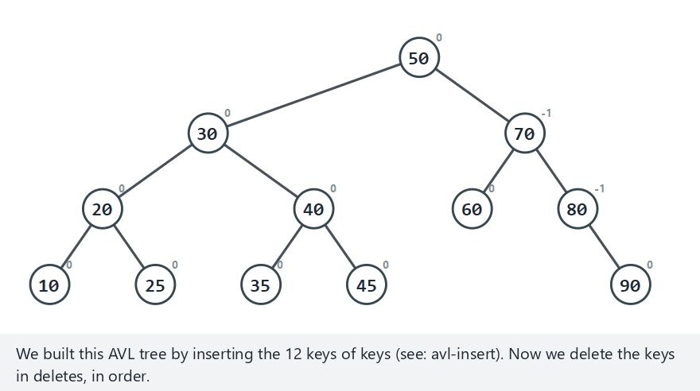
CEN207 Data Structures · Week 11
AVL tree: delete
RTEU Computer Engineering · Fall 2026–2027
68
Notes:
The hard scenario is built so at least one delete cascades — watch for more than one rotation firing.

Slide 69
CEN207 Data Structures · Week 11
Expected output
delete(90): height = 3, inorder = 10 20 25 30 ...
delete(45): height = 3, inorder = 10 20 25 30 ...
Height stays 3 across all six deletes — always rebalanced.
RTEU Computer Engineering · Fall 2026–2027
69
Notes:
The tree never leaves the AVL invariant, even mid-sequence, even while shrinking toward empty.

Slide 70
CEN207 Data Structures · Week 11
Why AVL delete is still O(log n)
• Up to O(log n) rotations — one per ancestor level, worst case
• Each individual rotation is still O(1)
• O(log n) rotations × O(1) each = O(log n) total
• Same asymptotic bound as insert, just a bigger constant
RTEU Computer Engineering · Fall 2026–2027
70
Notes:
"More rotations" does not mean "worse complexity class" — it is still logarithmic, just not as tight a constant as insert.

Slide 71
CEN207 Data Structures · Week 11
Common mistake
• Assuming delete, like insert, needs only one rotation
• The "hard" scenario is deliberately built to disprove this
• Forgetting free() the spliced node in C (a leak)
• Not testing "delete every key down to empty" explicitly
RTEU Computer Engineering · Fall 2026–2027
71
Notes:
We built exactly this "delete to empty" edge case as a unit test — it is worth doing for your own trees too.

Slide 72
CEN207 Data Structures · Week 11
Mini question
An AVL tree of height h has AT LEAST how many nodes?
RTEU Computer Engineering · Fall 2026–2027
72
Notes:
Answer on the next slide.

Slide 73
CEN207 Data Structures · Week 11
Mini answer
• N(h) = 1 + N(h−1) + N(h−2) — the Fibonacci recurrence
• N(h) grows EXPONENTIALLY in h
• So h grows only LOGARITHMICALLY in n
• That is the whole proof, in one line
RTEU Computer Engineering · Fall 2026–2027
73
Notes:
Same recurrence as the rabbits problem — just applied to tree shapes instead of population growth.

Slide 74
CEN207 Data Structures · Week 11
3. Red-Black Trees
RTEU Computer Engineering · Fall 2026–2027
74
Notes:
A looser, color-based balance — fewer rotations in practice, the standard library's usual choice.

Slide 75
CEN207 Data Structures · Week 11
A question to start
AVL's strict balance factor can require rebalancing on almost every insertion. Is there a looser rule?
RTEU Computer Engineering · Fall 2026–2027
75
Notes:
"Looser" here means: tolerate more imbalance before a fix is required.

Slide 76
CEN207 Data Structures · Week 11
A short history
• 1972 — Rudolf Bayer: "symmetric binary B-trees"
• 1978 — Guibas & Sedgewick: the "red-black" name
• Modern insertion algorithm dates from 1978
• Four simple, LOCAL rules instead of exact height comparison
RTEU Computer Engineering · Fall 2026–2027
76
Notes:
Same era as the 2-3 tree (section 5) — Bayer's work connects both.

Slide 77
CEN207 Data Structures · Week 11
The four rules
• Every node is red or black
• The root is always black
• A red node never has a red child ("no two reds in a row")
• Every root-to-NULL path has the same black-height
RTEU Computer Engineering · Fall 2026–2027
77
Notes:
A new key is inserted RED — this can only break rule 3, never rule 4.

Slide 78
CEN207 Data Structures · Week 11
The three fixup cases
Case | Situation | Fix
1 | Uncle is RED | recolor parent+uncle black, grandparent red, continue up
2 | Uncle black, "triangle" | rotate parent, reduces to case 3
3 | Uncle black, "line" | rotate grandparent + recolor, done
RTEU Computer Engineering · Fall 2026–2027
78
Notes:
"Uncle" = the parent's sibling — a very common point of confusion, so say it out loud.

Slide 79
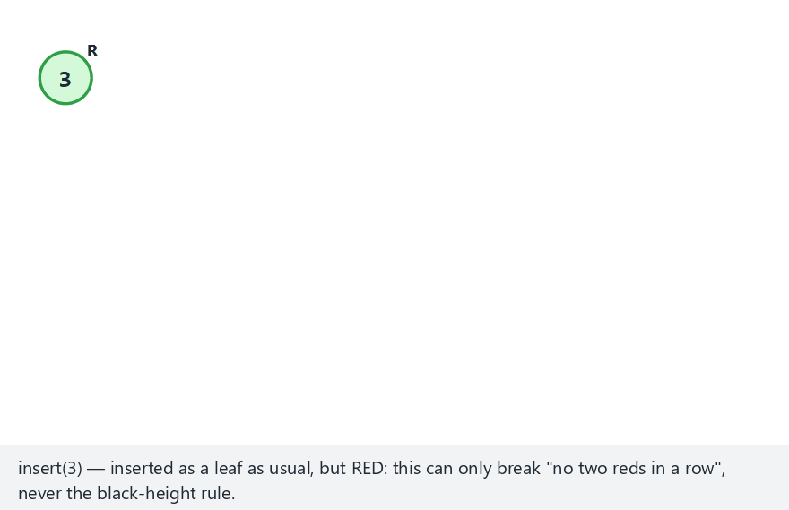
CEN207 Data Structures · Week 11
Red-black tree: insert
RTEU Computer Engineering · Fall 2026–2027
79
Notes:
The normal example is built so all three cases fire across its 10 inserts — watch the colors and the case names.

Slide 80
CEN207 Data Structures · Week 11
Code — fixup(), case 1
while (z->parent && z->parent->color == RED) {
Node *p = z->parent, *g = p->parent;
Node *u = (p == g->left) ? g->right
: g->left;
if (u && u->color == RED) {
p->color = BLACK; u->color = BLACK;
g->color = RED; z = g; continue;
}
RTEU Computer Engineering · Fall 2026–2027
80
Notes:
Case 1 does not rotate at all — pure recoloring, then the violation may reappear two levels up.

Slide 81
CEN207 Data Structures · Week 11
Expected output
insert(3): root = 3, bh = 1, inorder = 3B
insert(69): root = 3, bh = 1, inorder = 3B 69R
insert(31): root = 31, bh = 1, inorder = 3R 31B 69R
RTEU Computer Engineering · Fall 2026–2027
81
Notes:
3B = key 3, Black. 69R = key 69, Red. bh = black-height of the root.

Slide 82
CEN207 Data Structures · Week 11
Why red-black is O(log n)
• Height never exceeds 2 · log2(n + 1)
• Proof: no path can be more than twice the shortest
• (red nodes can never be adjacent)
• Slightly looser than AVL's bound, fewer rotations in practice
RTEU Computer Engineering · Fall 2026–2027
82
Notes:
This is why C++ std::map, Java TreeMap, and the Linux scheduler all use red-black, not AVL.

Slide 83
CEN207 Data Structures · Week 11
Common mistake
• Forgetting rule 2 after the fixup loop ends
• Case 1 can walk the violation all the way to the root
• The unconditional root->color = BLACK; at the end is NOT optional
• Confusing "uncle" with the new node's own sibling
RTEU Computer Engineering · Fall 2026–2027
83
Notes:
Skipping the final recolor is a subtle bug — it only shows up on specific insertion sequences.

Slide 84
CEN207 Data Structures · Week 11
Mini question
Why can inserting a RED leaf never break rule 4 (equal black-height), only rule 3?
RTEU Computer Engineering · Fall 2026–2027
84
Notes:
Answer on the next slide.

Slide 85
CEN207 Data Structures · Week 11
Mini answer
• A red leaf contributes 0 to any path's black-node count
• Every root-to-leaf black-height stays exactly what it was
• Only rule 3 ("no two reds") can break, and only if the parent is red
• That is exactly the situation fixup is designed to repair
RTEU Computer Engineering · Fall 2026–2027
85
Notes:
This is why insertion always starts red — it is the "safer" color to break a rule with.

Slide 86
CEN207 Data Structures · Week 11
4. Splay Trees
RTEU Computer Engineering · Fall 2026–2027
86
Notes:
No strict balance at all — the tree adapts to how you actually use it.

Slide 87
CEN207 Data Structures · Week 11
A question to start
AVL and red-black pay bookkeeping cost on EVERY node, for EVERY operation — even rarely-touched keys. A different way?
RTEU Computer Engineering · Fall 2026–2027
87
Notes:
What if the tree adapted to USAGE PATTERNS instead of enforcing a fixed rule everywhere?

Slide 88
CEN207 Data Structures · Week 11
A short history
• 1985 — Daniel Sleator & Robert Tarjan
• "Self-adjusting binary search trees"
• No balance information stored at all — zero extra memory per node
• Instead: every access reshapes the tree
RTEU Computer Engineering · Fall 2026–2027
88
Notes:
This is a genuinely different philosophy from every other tree today — adapt, don't enforce.

Slide 89
CEN207 Data Structures · Week 11
The idea — move to the root
Move | When | What happens
zig | parent is the root | one single rotation
zig-zig | node & parent both left (or both right) children | rotate parent, then node
zig-zag | node & parent on opposite sides | rotate node twice
RTEU Computer Engineering · Fall 2026–2027
89
Notes:
zig-zig rotates grandparent-parent BEFORE parent-node — that order is what gives the amortized guarantee.

Slide 90

CEN207 Data Structures · Week 11
Splay tree: access
RTEU Computer Engineering · Fall 2026–2027
90
Notes:
The normal example is curated so zig, zig-zig, AND zig-zag all occur — watch for the case name in each caption.

Slide 91
CEN207 Data Structures · Week 11
Code — splay()
void splay(Node *x) {
while (x->parent != NULL) {
Node *p = x->parent, *g = p->parent;
if (g == NULL) { rotate_up(x); }
else if ((x == p->left) == (p == g->left))
{ rotate_up(p); rotate_up(x); }
else { rotate_up(x); rotate_up(x); }
}
}
RTEU Computer Engineering · Fall 2026–2027
91
Notes:
rotate_up(n) rotates n over its OWN parent — the case decides how many times, and in what order.

Slide 92
CEN207 Data Structures · Week 11
Expected output
access(50): root = 50, inorder = 50
access(20): root = 20, inorder = 10 20 30 40 45 50 60 70 80
The just-accessed key is ALWAYS the new root.
RTEU Computer Engineering · Fall 2026–2027
92
Notes:
No matter how deep the key started, one access puts it at the very top.

Slide 93
CEN207 Data Structures · Week 11
Why splay is O(log n) amortized
• No single access is guaranteed O(log n) — can be O(n)
• ANY sequence of m accesses costs O(m log n) total
• O(log n) amortized per access
• Adapts automatically to a "hot" working set
RTEU Computer Engineering · Fall 2026–2027
93
Notes:
"Amortized" = averaged over a long sequence, not guaranteed for any one operation in isolation.

Slide 94
CEN207 Data Structures · Week 11
Common mistake
• Implementing zig-zig as two SEPARATE single rotations ("naive splay")
• Valid tree operation, but loses the amortized guarantee
• Forgetting access on a MISSING key still splays something
• Here: the newly inserted node itself
RTEU Computer Engineering · Fall 2026–2027
94
Notes:
"Naive splay" still produces a correct BST — it just does not have the performance proof behind it.

Slide 95
CEN207 Data Structures · Week 11
Mini question
After many accesses to ONE key, how deep is every OTHER key, roughly?
RTEU Computer Engineering · Fall 2026–2027
95
Notes:
Answer on the next slide.

Slide 96
CEN207 Data Structures · Week 11
Mini answer
• That one key sits at the root every time
• Every OTHER key's depth is barely affected
• Splay only reshuffles nodes ALONG the accessed path
• No "global" balance guarantee — only a local, per-access one
RTEU Computer Engineering · Fall 2026–2027
96
Notes:
This is the precise sense in which a splay tree has "no strict balance".

Slide 97
CEN207 Data Structures · Week 11
5. 2-3 Trees
RTEU Computer Engineering · Fall 2026–2027
97
Notes:
Never even momentarily crooked — because it grows upward, at the root, not at the leaves.

Slide 98
CEN207 Data Structures · Week 11
A question to start
Every tree so far fixes imbalance AFTER it happens. What if imbalance were structurally IMPOSSIBLE?
RTEU Computer Engineering · Fall 2026–2027
98
Notes:
A completely different philosophy from rotations — prevent, don't repair.

Slide 99
CEN207 Data Structures · Week 11
A short history
• 1972 — Rudolf Bayer & Edward McCreight
• A stepping stone to the B-tree (Week 14, disk-backed files)
• Node holds 1 key (2-node) or 2 keys (3-node)
• Every leaf sits at EXACTLY the same depth, always
RTEU Computer Engineering · Fall 2026–2027
99
Notes:
Same Bayer as red-black's ancestor paper — two related ideas from the same period.

Slide 100
CEN207 Data Structures · Week 11
The idea — overflow and split
• New key inserted into the correct leaf, sorted
• Leaf already had 2 keys → now has 3, temporarily: overflow
• Split into two 2-nodes; MIDDLE key promoted to the parent
• Parent can overflow the same way — cascades upward
RTEU Computer Engineering · Fall 2026–2027
100
Notes:
If the cascade reaches the root and splits there, height grows by one — EVERYWHERE at once.

Slide 101
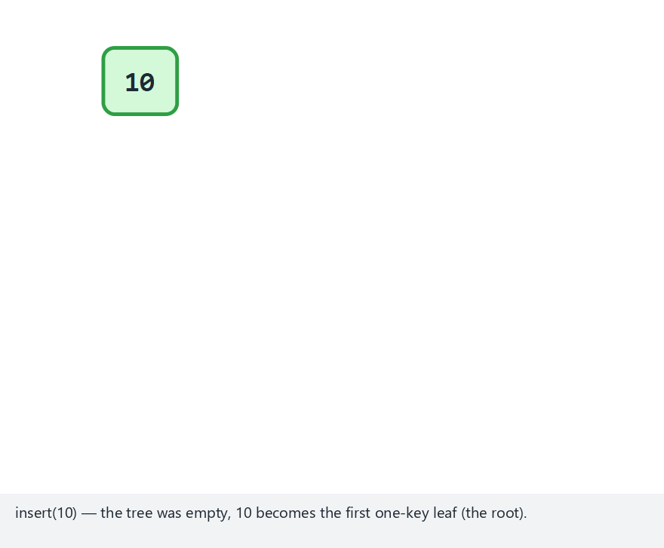
CEN207 Data Structures · Week 11
2-3 tree: insert
RTEU Computer Engineering · Fall 2026–2027
101
Notes:
Watch the level-order listing's bracket groups — every leaf-level group stays at the same row.

Slide 102
CEN207 Data Structures · Week 11
Code — the overflow loop
while (node->nkeys == 3) {
split_node(node, &left, &right, &promoted);
if (depth == 0) {
/* root split: height + 1 */
return new_root(promoted, left, right);
}
Node *parent = path[--depth];
replace_with_split(parent, node,
promoted, left, right);
node = parent;
}
RTEU Computer Engineering · Fall 2026–2027
102
Notes:
No rotation anywhere in this whole function — only splitting and promoting.

Slide 103
CEN207 Data Structures · Week 11
Expected output
insert(20): height = 0, level-order = [10,20]
insert(30): height = 1, level-order = [20] [10] [30]
RTEU Computer Engineering · Fall 2026–2027
103
Notes:
The moment a node WOULD hold 3 keys, it splits immediately — you never actually see a 3-key node printed.

Slide 104
CEN207 Data Structures · Week 11
Why 2-3 tree insert is O(log n)
• Every leaf at the same depth h → h = O(log n)
• Walk down: O(h); splits cascade up: at most O(h), each O(1)
• Zero rotations, ever — unlike every other tree today
• Direct ancestor of Week 14's B-tree
RTEU Computer Engineering · Fall 2026–2027
104
Notes:
"Zero rotations" is the single biggest structural difference from AVL, red-black, and splay.

Slide 105
CEN207 Data Structures · Week 11
Common mistake
• Sizing child[] for only 3 slots (the steady-state max)
• Mid-overflow, a node briefly needs 4 children — real buffer overflow
• Splitting a node without freeing the old shell afterward
• Promoting the wrong key (must be the MIDDLE one)
RTEU Computer Engineering · Fall 2026–2027
105
Notes:
We found exactly this array-sizing bug while building this week's program — a genuine memory-corruption crash.

Slide 106
CEN207 Data Structures · Week 11
Mini question
Why does a 2-3 tree's height grow ONLY at the root, never partway down?
RTEU Computer Engineering · Fall 2026–2027
106
Notes:
Answer on the next slide.

Slide 107
CEN207 Data Structures · Week 11
Mini answer
• A split only responds to ITS OWN node's overflow
• The promoted key goes to ITS OWN parent, never a sibling
• The cascade only ever travels straight up one path
• The only place it can run out of "parent" is the root
RTEU Computer Engineering · Fall 2026–2027
107
Notes:
This is exactly why height growth is always global, never local — there is nowhere else for it to happen.

Slide 108
CEN207 Data Structures · Week 11
6. Segment Trees
RTEU Computer Engineering · Fall 2026–2027
108
Notes:
A genuinely different question: not "is x here", but "what about a whole RANGE".

Slide 109
CEN207 Data Structures · Week 11
A question to start
"What is the SUM of every value between index l and r?" A loop answers in O(n). Many such queries — can we do better?
RTEU Computer Engineering · Fall 2026–2027
109
Notes:
This is a very common real question: totals over a window, a date range, a price range.

Slide 110
CEN207 Data Structures · Week 11
The idea — precompute every range once
• Built once over a fixed-size array
• Node i responsible for range [lo, hi]; children 2i, 2i+1
• Leaf holds one value; internal node holds sum of its two children
• Query walks down: outside → 0, inside → precomputed sum, partial → recurse both
RTEU Computer Engineering · Fall 2026–2027
110
Notes:
"Partial overlap" only ever happens at O(log n) nodes total — that is the whole complexity argument.

Slide 111
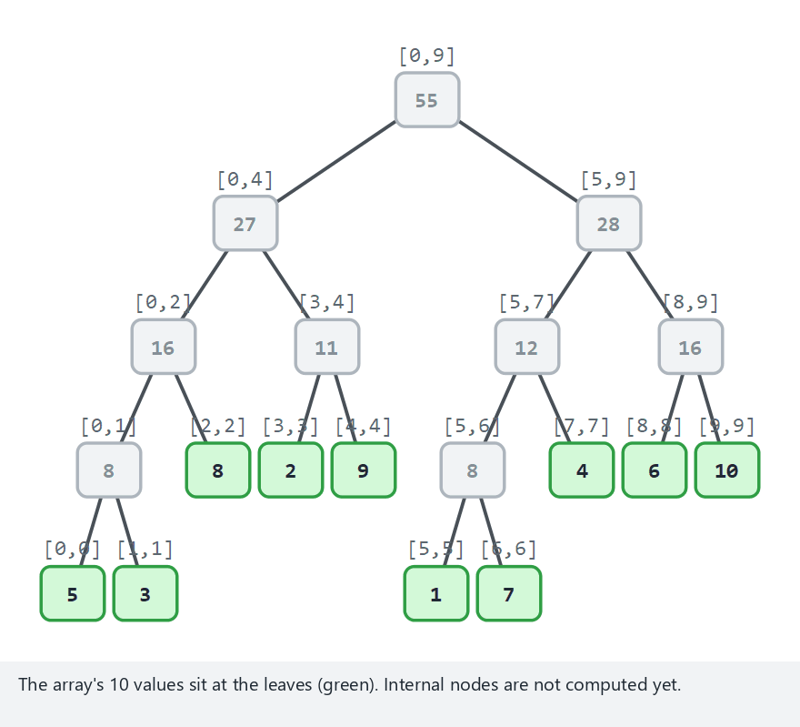
CEN207 Data Structures · Week 11
Segment tree: build and query
RTEU Computer Engineering · Fall 2026–2027
111
Notes:
Watch which nodes turn green (fully inside, used directly) versus which get pruned (dim, no overlap).

Slide 112
CEN207 Data Structures · Week 11
Code — query()
long query(int i, int lo, int hi, int l, int r) {
if (r < lo || hi < l) return 0;
if (l <= lo && hi <= r) return tree[i];
int mid = (lo + hi) / 2;
return query(2*i, lo, mid, l, r)
+ query(2*i+1, mid + 1, hi, l, r);
}
RTEU Computer Engineering · Fall 2026–2027
112
Notes:
Three cases, three lines of logic — outside, fully inside, partial.

Slide 113
CEN207 Data Structures · Week 11
Expected output
query(0,9) = 55
query(2,5) = 20
query(7,7) = 4
RTEU Computer Engineering · Fall 2026–2027
113
Notes:
A single-point query is just a range of length one — the same function handles it with no special case.

Slide 114
CEN207 Data Structures · Week 11
Why segment tree query is O(log n)
• build(): O(n) total — visits every node once
• Each level: at most TWO "partially overlapping" nodes
• Every other node at that level: answered or pruned immediately
• Total work proportional to height: O(log n)
RTEU Computer Engineering · Fall 2026–2027
114
Notes:
"At most two per level" — one at each boundary of [l, r] — is the key fact, worth repeating.

Slide 115
CEN207 Data Structures · Week 11
A structural difference from sections 1–5
• Segment tree SHAPE depends only on n, never on data values
• Every BST-family tree's shape depends on VALUE comparisons
• A segment tree can never degenerate the way section 1.4's BST did
• No insertion-order problem exists here at all
RTEU Computer Engineering · Fall 2026–2027
115
Notes:
This is worth pausing on — it is a genuinely different kind of tree from everything else today.

Slide 116
CEN207 Data Structures · Week 11
Common mistake
• Sizing the array as 2n instead of 4n
• Confusing "fully inside" with "fully outside" (swapped conditions)
• Rebuilding the WHOLE tree (O(n)) for one single-point update
• A dedicated O(log n) point-update function is the natural fix
RTEU Computer Engineering · Fall 2026–2027
116
Notes:
The 4n sizing comes from n not necessarily being a power of two — the tree is not perfectly "complete".

Slide 117
CEN207 Data Structures · Week 11
Mini question
Why is query's cost O(log n), not O(log n) TIMES the number of nodes at each level?
RTEU Computer Engineering · Fall 2026–2027
117
Notes:
Answer on the next slide.

Slide 118
CEN207 Data Structures · Week 11
Mini answer
• At most TWO nodes per level are "partially overlapping"
• Every other node: fully inside (done) or fully outside (pruned)
• Total work proportional to height, not width
• O(log n), not O(log n) · O(n)
RTEU Computer Engineering · Fall 2026–2027
118
Notes:
This is the same "at most two per level" fact from the complexity slide — now as a self-check.

Slide 119
CEN207 Data Structures · Week 11
7. Fenwick Trees
RTEU Computer Engineering · Fall 2026–2027
119
Notes:
The same range-sum idea, with no explicit tree at all — one array, one bitwise trick.

Slide 120
CEN207 Data Structures · Week 11
A question to start
A segment tree needs up to 4n explicit nodes. Could a PLAIN ARRAY answer prefix sums just as fast?
RTEU Computer Engineering · Fall 2026–2027
120
Notes:
"Fenwick tree" and "binary indexed tree (BIT)" are the same structure, two common names.

Slide 121
CEN207 Data Structures · Week 11
A short history
• 1994 — Peter Fenwick
• "A new data structure for cumulative frequency tables"
• No tree pointers, no recursion required
• One array, one arithmetic trick: i & -i
RTEU Computer Engineering · Fall 2026–2027
121
Notes:
Much newer than every other structure today — a genuinely modern, minimal-overhead idea.

Slide 122
CEN207 Data Structures · Week 11
The idea — i & -i isolates the lowest set bit
• bit[i] holds the sum of a range of size i & -i ending at i
• update(i, delta): walk UP, i += i & -i
• query(i): prefix sum 1..i, walk DOWN, i -= i & -i
• Both walks: O(log n) steps, no tree structure needed
RTEU Computer Engineering · Fall 2026–2027
122
Notes:
"i & -i" relies on two's-complement negation — the same trick works identically in C and Java.

Slide 123
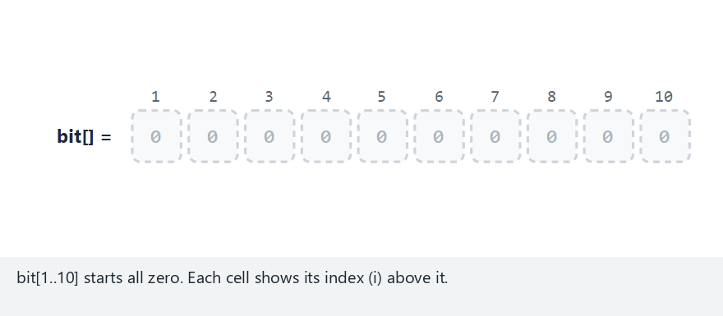
CEN207 Data Structures · Week 11
Fenwick tree: update and query
RTEU Computer Engineering · Fall 2026–2027
123
Notes:
Watch the brace under the highlighted cell — it shows exactly which range that cell is responsible for.

Slide 124
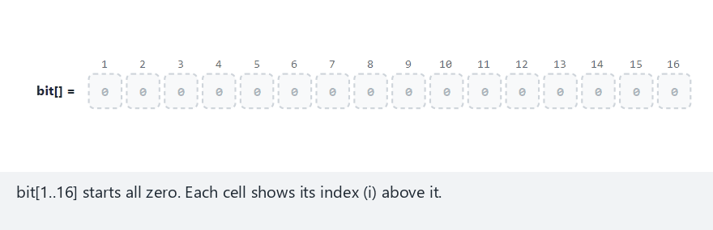
CEN207 Data Structures · Week 11
The i & -i chain length, in isolation
RTEU Computer Engineering · Fall 2026–2027
124
Notes:
update(1) touches 5 cells on n=16; query(16) touches only 1 — the exact opposite extremes.

Slide 125
CEN207 Data Structures · Week 11
Code — update() and query()
void update(int i, int delta) {
while (i <= n) { bit[i] += delta; i += i & (-i); }
}
int query(int i) {
int sum = 0;
while (i > 0) { sum += bit[i]; i -= i & (-i); }
return sum;
}
RTEU Computer Engineering · Fall 2026–2027
125
Notes:
Four lines total for both operations — this is the entire structure.

Slide 126
CEN207 Data Structures · Week 11
Expected output
update(3, 5)
update(7, 2)
query(10) = 7
RTEU Computer Engineering · Fall 2026–2027
126
Notes:
Two updates, one query — the running sum reflects both deltas correctly, O(log n) each.

Slide 127
CEN207 Data Structures · Week 11
Why Fenwick is O(log n), O(n) space
• i & -i at least doubles (update) or halves (query) distance to the boundary
• At most floor(log2(n)) + 1 iterations, either direction
• Space: one plain int array — dramatically less than a segment tree
• Preferred in practice when the array's size will not change
RTEU Computer Engineering · Fall 2026–2027
127
Notes:
Less code, less memory, same asymptotic guarantee — the appeal is purely practical, not theoretical.

Slide 128
CEN207 Data Structures · Week 11
Common mistake
• Using 0-indexing — i & -i needs index 0 to be all-zero bits
• Fenwick trees are ALWAYS 1-indexed
• Writing a home-made "negation" instead of the language's -
• Reaching for Fenwick on range-MIN/MAX queries (does not work)
RTEU Computer Engineering · Fall 2026–2027
128
Notes:
Range min/max is not INVERTIBLE the way sum is — that rules it out structurally, not just by convention.

Slide 129
CEN207 Data Structures · Week 11
Mini question
For n=16, why does update(1) take exactly 5 steps (i = 1, 2, 4, 8, 16)?
RTEU Computer Engineering · Fall 2026–2027
129
Notes:
Answer on the next slide.

Slide 130
CEN207 Data Structures · Week 11
Mini answer
• i += i & -i: 1→2→4→8→16, then the loop stops (i would exceed n)
• Five cells touched, each responsible for a range including index 1
• query(15) instead takes 4 steps: one per 1-bit in 15's binary (1111)
• Update and query walk opposite directions, different bit patterns
RTEU Computer Engineering · Fall 2026–2027
130
Notes:
"One step per 1-bit" for query is a clean, memorable rule worth writing on the board.

Slide 131
CEN207 Data Structures · Week 11
8. Choosing a Technique
RTEU Computer Engineering · Fall 2026–2027
131
Notes:
Seven structures, one question each solves best — let's put them side by side.

Slide 132
CEN207 Data Structures · Week 11
Comparison — balanced BSTs
Structure | Worst-case height | Rebalance cost
Plain BST | O(n) | none
AVL | O(log n), tightest | <=1 rotation/insert
Red-black | O(log n), looser | fewer rotations avg.
Splay | O(log n) amortized | full splay/access
RTEU Computer Engineering · Fall 2026–2027
132
Notes:
"Tightest" vs "looser" is about the CONSTANT factor, not the big-O class — both are logarithmic.

Slide 133
CEN207 Data Structures · Week 11
Comparison — structural & range trees
Structure | Rebalance cost | Best for
2-3 tree | node splits, no rotations | bridge to Week 14's B-tree
Segment tree | none after build | many range sum/min/max queries
Fenwick tree | none | range sum + frequent point updates
RTEU Computer Engineering · Fall 2026–2027
133
Notes:
2-3, segment, and Fenwick trees solve genuinely different problems from the balanced-BST family.

Slide 134
CEN207 Data Structures · Week 11
Choosing — by workload
• Lookup-heavy → AVL (tightest bound)
• Mixed insert/delete/search → red-black (fewer rotations)
• Skewed "hot key" access → splay (adapts, low memory)
• Range questions → segment tree or Fenwick tree
RTEU Computer Engineering · Fall 2026–2027
134
Notes:
"Most balanced" is not the only axis that matters — the workload decides the right structure.

Slide 135
CEN207 Data Structures · Week 11
Mini question
A colleague says "always use red-black, it's the most balanced and library-tested". What would you ask first?
RTEU Computer Engineering · Fall 2026–2027
135
Notes:
Answer on the next slide.

Slide 136
CEN207 Data Structures · Week 11
Mini answer
• Is the workload lookup-heavy, or a mixed insert/delete/search?
• Is access skewed toward a small hot-key set?
• Are the questions about RANGES, not single keys?
• Will this feed into a disk-backed structure later (Week 14)?
RTEU Computer Engineering · Fall 2026–2027
136
Notes:
Every one of today's structures is the RIGHT answer for some specific workload — none is universally best.

Slide 137
CEN207 Data Structures · Week 11
Summary
• BST: insert/search/delete all O(h) — but h depends on ORDER
• Sorted input degenerates a BST to a chain: O(n), no better than a list
• AVL, red-black, splay, 2-3 tree: four different fixes, four trade-offs
• Segment tree, Fenwick tree: O(log n) answers to RANGE questions
RTEU Computer Engineering · Fall 2026–2027
137
Notes:
One sentence per structure — if you remember only this slide, you have the whole week.

Slide 138
CEN207 Data Structures · Week 11
Exercises preview
• Prove a BST of height h has at most 2^(h+1) − 1 nodes
• Trace red-black's fixup cases by hand on the "hard" scenario
• Sketch what changes to turn a segment tree into range-MIN
• Full list of 10 exercises: this week's notes
RTEU Computer Engineering · Fall 2026–2027
138
Notes:
All ten exercises build directly on this week's actual programs — trace them with the real code open.

Slide 139
CEN207 Data Structures · Week 11
Self-check quiz preview
• Why does AVL insert need at most one rotation, but delete can cascade?
• Why can a Fenwick tree not support range-minimum queries?
• Why is a segment tree's shape independent of the data?
• Full 10-question quiz with answers: this week's notes
RTEU Computer Engineering · Fall 2026–2027
139
Notes:
Try answering from memory before checking the notes — that is the whole point of a self-check.

Slide 140
CEN207 Data Structures · Week 11
Looking ahead
• Week 12 — strings: matching algorithms, and the trie
• A trie stores strings by shared PREFIX, not numeric comparison
• Week 13 — direct and sequential file organization
• Week 14 — the B-tree: this week's 2-3 tree, generalized for disk
RTEU Computer Engineering · Fall 2026–2027
140
Notes:
The 2-3 tree you met today is literally the m=3 special case of Week 14's B-tree.

Slide 141
CEN207 Data Structures · Week 11
Questions?
CEN207 Data Structures — Week 11
Asst. Prof. Dr. Uğur CORUH · Fall 2026–2027
RTEU Computer Engineering · Fall 2026–2027
141
Notes:
Open the floor — and point back to whichever animation preset best answers whatever comes up.

