Slide 1

CEN207 Data Structures · Week 6
Search and Hashing
CEN207 Data Structures — Week 6
Asst. Prof. Dr. Uğur CORUH · Fall 2026–2027
RTEU Computer Engineering · Fall 2026–2027
Notes:
Last week we explored a whole graph to answer a question. This week flips that idea: can we compute exactly where to look, without exploring anything at all?

Slide 2
CEN207 Data Structures · Week 6
Today's plan (3 hours)
Hour | Topic
1 | Search costs, jump Anim 1–2 · interpolation Anim 3–4
2 | Exponential Anim 5–6 · Fibonacci Anim 7–8 · hashing idea
3 | Division Anim 9–10 · chaining Anim 11–12 · probing Anim 13–18 · rehashing Anim 19–20
Learning outcomes: LO.1 (explain fundamental data structures) · LO.2 (analyze complexity) · LO.7 (choose the right structure)
RTEU Computer Engineering · Fall 2026–2027
2
Notes:
Twenty-one short animations carry the whole lecture; each idea gets one normal run and one edge/hard run, right where it is introduced.

Slide 3
CEN207 Data Structures · Week 6
This week's concepts — where
Concept | Where
Jump, interpolation, exponential, Fibonacci search | Sections 2–5
Hashing, division method, prime table size | Section 7
Collisions, chaining, load factor | Section 8
Open addressing, rehashing | Sections 9–10
RTEU Computer Engineering · Fall 2026–2027
3
Notes:
Every term gets a full definition the first time it appears; this table just says where to find it again.

Slide 4
CEN207 Data Structures · Week 6
How the code examples work
• Every idea has a complete C and Java program
• C: gcc -std=c11 -Wall -Wextra -o /tmp/x file.c && /tmp/x
• Java: javac -d /tmp/j File.java && java -cp /tmp/j File
• Sources: code/week-06/c/ and code/week-06/java/
• Each program's expected output is in the week notes
RTEU Computer Engineering · Fall 2026–2027
4
Notes:
Open a terminal now if you want to run these live; every snippet on today's slides compiles and runs exactly as shown.

Slide 5
CEN207 Data Structures · Week 6
Recap — linear and binary search (Week 1)
• Linear search: check every cell, one by one — O(n)
• Binary search: sorted array, halve the range — O(log n)
• Binary search needs the array sorted first
• Today: strategies between and beyond these two
RTEU Computer Engineering · Fall 2026–2027
5
Notes:
Everything this week either beats binary search on a special case, or drops "compare" entirely for "compute".

Slide 6
CEN207 Data Structures · Week 6
Recap — arrays and linked lists (Week 2)
• Array: contiguous memory, O(1) access by index
• Linked list: nodes and pointers, O(1) insert at head
• Search structures below build directly on both
• A hash table's bucket is often a small linked list
RTEU Computer Engineering · Fall 2026–2027
6
Notes:
Nothing here is brand new machinery — Week 2's two basic structures reappear as building blocks all through today.

Slide 7
CEN207 Data Structures · Week 6
Map of the week — at a glance
Faster search (sorted) | Hashing
Jump, interpolation search | Direct addressing, division method
Exponential, Fibonacci search | Chaining, open addressing, rehashing
RTEU Computer Engineering · Fall 2026–2027
7
Notes:
Every box on this map gets its own slides below, most with a short animation and a complete C/Java program.

Slide 8
CEN207 Data Structures · Week 6
1. The Search Problem and Costs
RTEU Computer Engineering · Fall 2026–2027
8
Notes:
Section 1 sets up the one question every algorithm today answers differently: how many comparisons before you find — or rule out — a key?

Slide 9
CEN207 Data Structures · Week 6
A question to start
Binary search already takes only O(log n). Is there any reason to look for something even faster, or something completely different?
RTEU Computer Engineering · Fall 2026–2027
9
Notes:
Yes to both — faster comparison-based search exists for special data, and hashing drops comparisons almost entirely.

Slide 10
CEN207 Data Structures · Week 6
What "search" means here
• Given a collection and a target key, find its location
• Or correctly report: the key is not present
• We count comparisons (or probes) as the cost
• Fewer comparisons for the same correctness = a better search
RTEU Computer Engineering · Fall 2026–2027
10
Notes:
"Correctness first, speed second" — every algorithm today must still get the right answer on every input.

Slide 11
CEN207 Data Structures · Week 6
Cost, restated as a question
• Linear search: no assumption on the data, O(n) worst case
• Binary search: needs sorted data, O(log n) worst case
• Can sorted data be searched even faster than O(log n)?
• Can we search without comparisons at all?
RTEU Computer Engineering · Fall 2026–2027
11
Notes:
Sections 2–6 answer the first question; Sections 7 onward answer the second, with hashing.

Slide 12
CEN207 Data Structures · Week 6
When binary search isn't enough
• Binary search always checks the middle, no matter what
• But real data often has structure binary search ignores
• Evenly spread values? A formula can guess better than "middle"
• Data outside memory (disk, tape)? Every access has to count
RTEU Computer Engineering · Fall 2026–2027
12
Notes:
Every algorithm in Sections 2–5 exploits one extra fact about the data that plain binary search throws away.

Slide 13
CEN207 Data Structures · Week 6
Today's toolbox — five strategies
Strategy | Exploits
Jump search | Cheap block jumps beat many comparisons
Interpolation search | Values are roughly evenly spread
Exponential search | Target is likely near the front
Fibonacci search | No division/multiplication needed
RTEU Computer Engineering · Fall 2026–2027
13
Notes:
Hashing, the biggest idea of the week, gets its own toolbox slide later, right before Section 7 begins.

Slide 14
CEN207 Data Structures · Week 6
Mini-quiz
Binary search always looks at the array's middle element first. Under what condition might a smarter first guess do better?
RTEU Computer Engineering · Fall 2026–2027
14
Notes:
Think about what extra information the array's actual values might carry, beyond just being sorted.

Slide 15
CEN207 Data Structures · Week 6
Answer
When values are roughly evenly spread. The middle is only "index-optimal" — a value-aware guess (Section 3) can land closer to the target.
RTEU Computer Engineering · Fall 2026–2027
15
Notes:
This is exactly the idea Section 3's interpolation search turns into a full algorithm.

Slide 16
CEN207 Data Structures · Week 6
2. Jump Search
RTEU Computer Engineering · Fall 2026–2027
16
Notes:
Section 2 opens the "faster than binary" family: instead of halving, jump forward in fixed blocks, then scan one block linearly.

Slide 17
CEN207 Data Structures · Week 6
A question to start
Binary search jumps to the middle every time. What if jumping in fixed-size blocks instead turned out to be simpler, and still fast?
RTEU Computer Engineering · Fall 2026–2027
17
Notes:
Jump search trades binary search's recursion for one straight line of block jumps, then a short linear scan.

Slide 18
CEN207 Data Structures · Week 6
A short history
• Block-style search appears in Knuth's *Sorting and
Searching* (1973), as an alternative to binary search
• The key design choice: how big should each block be?
• The answer, block = floor(sqrt(n)), balances two costs
RTEU Computer Engineering · Fall 2026–2027
18
Notes:
This is one of the cleanest examples in the course of calculus (minimizing a sum) driving an algorithm's design.

Slide 19
CEN207 Data Structures · Week 6
Intuition — skipping pages in a book
• Flipping one page at a time to find a word: too slow
• Binary search: always split remaining pages in half
• Jump search: flip whole sections first, then one page
• Stop the big jumps once you have passed the word
RTEU Computer Engineering · Fall 2026–2027
19
Notes:
A block is like a chapter — check its last page, and only open it fully once you know the word is inside.

Slide 20
CEN207 Data Structures · Week 6
The jump search idea
• Requires a sorted array, exactly like binary search
• block = floor(sqrt(n)): the jump distance
• Jump forward one block until a boundary is >= target
• Then scan that one block linearly, left to right
RTEU Computer Engineering · Fall 2026–2027
20
Notes:
Two phases, each simple on its own: coarse jumps to find the right block, then a short linear scan inside it.

Slide 21
CEN207 Data Structures · Week 6
Why sqrt(n)?
• n/block jumps, then up to block linear steps
• Total cost: n/block + block comparisons, worst case
• This sum is smallest when block = sqrt(n)
• Result: O(sqrt(n)) — between O(log n) and O(n)
RTEU Computer Engineering · Fall 2026–2027
21
Notes:
Balancing "few big jumps" against "short final scan" is exactly a minimize-the-sum calculus problem, solved once for all n.

Slide 22
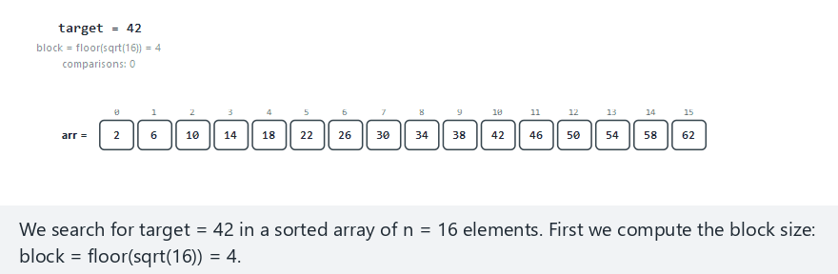
CEN207 Data Structures · Week 6
Jump search, step by step
RTEU Computer Engineering · Fall 2026–2027
22
Notes:
Normal example: 16 sorted values, target found in the second block — watch the block boundary checks, then the short linear scan.

Slide 23
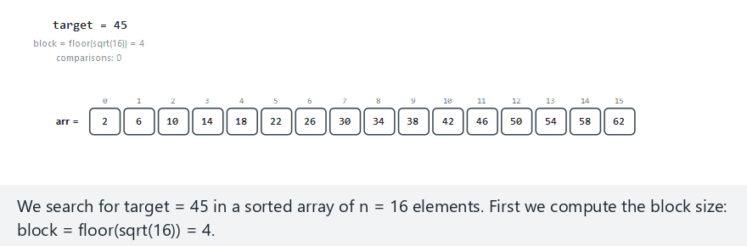
CEN207 Data Structures · Week 6
Edge case — target in range but absent
RTEU Computer Engineering · Fall 2026–2027
23
Notes:
The target falls between two real values — the linear scan inside the right block stops early, the moment it passes the target.

Slide 24
CEN207 Data Structures · Week 6
Code — finding the right block
int block = (int) sqrt((double) n);
if (block < 1) block = 1;
int prev = 0, step = block, comp = 0;
while (step < n) {
comp++;
if (arr[step - 1] >= target) break;
prev = step;
step += block;
}
RTEU Computer Engineering · Fall 2026–2027
24
Notes:
`block` is computed once, from `n` alone — it never depends on `target`, only the array's size.

Slide 25
CEN207 Data Structures · Week 6
Code — linear scan inside the block
if (step > n) step = n;
for (int i = prev; i < step; i++) {
comp++;
if (arr[i] == target) return i;
if (arr[i] > target) break;
}
return -1;
RTEU Computer Engineering · Fall 2026–2027
25
Notes:
The same "sorted array" fact that lets binary search stop early also lets this final scan stop early, on `arr[i] > target`.

Slide 26
CEN207 Data Structures · Week 6
Complexity
• Block-finding phase: at most n/block jumps
• Linear-scan phase: at most block comparisons
• With block = sqrt(n): total O(sqrt(n))
• Worse than binary search's O(log n), but simpler code
RTEU Computer Engineering · Fall 2026–2027
26
Notes:
Jump search is a genuine middle ground: faster than linear search, simpler (no recursion) than binary search.

Slide 27
CEN207 Data Structures · Week 6
Common mistakes
• Forgetting the array must be sorted first
• Using a fixed block size instead of sqrt(n)
• Scanning past the block boundary instead of stopping there
RTEU Computer Engineering · Fall 2026–2027
27
Notes:
A wrong block size still finds the right answer — it just loses the O(sqrt(n)) guarantee.

Slide 28
CEN207 Data Structures · Week 6
Mini-quiz
An array has n = 100 elements. What block size does jump search use, and how many comparisons does it need in the worst case?
RTEU Computer Engineering · Fall 2026–2027
28
Notes:
Recall the formula from a few slides back, then apply the O(sqrt(n)) bound.

Slide 29
CEN207 Data Structures · Week 6
Answer
`block = 10` (sqrt(100)). Worst case: about 10 jumps plus 10 linear steps — ~20 comparisons, far below linear search's 100.
RTEU Computer Engineering · Fall 2026–2027
29
Notes:
This is the O(sqrt(n)) bound made concrete: 20 is close to 2*sqrt(100), the theoretical worst case.

Slide 30
CEN207 Data Structures · Week 6
3. Interpolation Search
RTEU Computer Engineering · Fall 2026–2027
30
Notes:
Section 3 replaces "always check the middle" with "compute where the target should be" — a formula instead of a fixed split point.

Slide 31
CEN207 Data Structures · Week 6
A question to start
A phone book is sorted and roughly evenly spread. Would you really start a search for "Smith" at the exact middle page?
RTEU Computer Engineering · Fall 2026–2027
31
Notes:
Nobody does — you flip straight toward the back, because you already know roughly where "S" should be.

Slide 32
CEN207 Data Structures · Week 6
A short history
• The idea appears in 1957, in early work on
searching ordered files (W. W. Peterson)
• Later formalized and analyzed as interpolation search
• Best case on uniform data: close to O(log log n)
RTEU Computer Engineering · Fall 2026–2027
32
Notes:
O(log log n) is a genuinely small number — for a billion elements, it is only around 5.

Slide 33
CEN207 Data Structures · Week 6
Intuition — a phone book
• Looking for "Smith": jump close to the back, not the middle
• Looking for "Baker": jump close to the front
• The jump uses the value, not just position, to guess
• Binary search only ever uses position — it ignores values
RTEU Computer Engineering · Fall 2026–2027
33
Notes:
This single difference, using the value instead of ignoring it, is the entire idea of interpolation search.

Slide 34
CEN207 Data Structures · Week 6
The interpolation search idea
• Requires a sorted array, exactly like binary search
• Estimate target's position proportionally between ends
• pos = lo + (target-arr[lo])*(hi-lo) / (arr[hi]-arr[lo])
• Narrow lo/hi toward pos, exactly like binary search
RTEU Computer Engineering · Fall 2026–2027
34
Notes:
Everything after the formula is identical to binary search — only how the split point is chosen has changed.

Slide 35
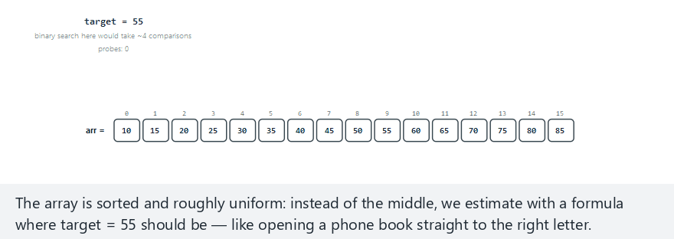
CEN207 Data Structures · Week 6
Interpolation search, step by step
RTEU Computer Engineering · Fall 2026–2027
35
Notes:
Normal example: 16 uniformly spread values — watch the formula's estimate land very close to the target in a single probe.

Slide 36
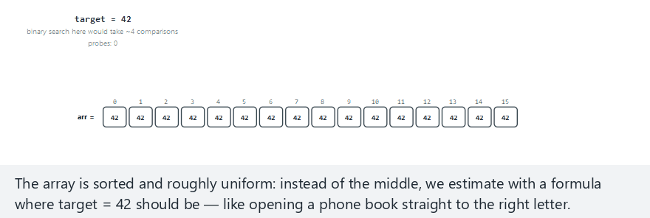
CEN207 Data Structures · Week 6
Edge case — a guard against division by zero
RTEU Computer Engineering · Fall 2026–2027
36
Notes:
Every value in this range is identical — arr[hi] equals arr[lo], so the formula's denominator would be zero without an explicit guard.

Slide 37
CEN207 Data Structures · Week 6
Code — the position formula
while (lo <= hi && target >= arr[lo]
&& target <= arr[hi]) {
if (arr[hi] == arr[lo]) {
/* … guard: avoid division by zero … */
return lo;
}
int pos = lo + (int) ((double)
(target - arr[lo]) * (hi - lo)
/ (arr[hi] - arr[lo]));
RTEU Computer Engineering · Fall 2026–2027
37
Notes:
The guard is not optional — without it, an all-equal range crashes the program with a division-by-zero error.

Slide 38
CEN207 Data Structures · Week 6
Code — narrowing the range
if (arr[pos] == target) return pos;
if (arr[pos] < target) lo = pos + 1;
else hi = pos - 1;
RTEU Computer Engineering · Fall 2026–2027
38
Notes:
Identical in shape to binary search's narrowing step — only `pos` came from a formula instead of `(lo + hi) / 2`.

Slide 39
CEN207 Data Structures · Week 6
Complexity
• Uniform data: close to O(log log n) on average
• Skewed data (one huge outlier): degrades toward O(n)
• Worst case is never better than binary search's O(log n)
• The formula's power depends entirely on the data's shape
RTEU Computer Engineering · Fall 2026–2027
39
Notes:
Interpolation search is a genuine trade: excellent on the right data, no better than linear search on the wrong data.

Slide 40
CEN207 Data Structures · Week 6
Common mistakes
• Forgetting the arr[hi] == arr[lo] division guard
• Using interpolation search on skewed (non-uniform) data
• Assuming O(log log n) is a worst-case guarantee — it isn't
RTEU Computer Engineering · Fall 2026–2027
40
Notes:
A skewed array can make interpolation search's probes climb toward O(n), demonstrating exactly the second mistake.

Slide 41
CEN207 Data Structures · Week 6
Mini-quiz
An array's values are extremely skewed — mostly small, one huge outlier at the end. Is interpolation search still a good choice?
RTEU Computer Engineering · Fall 2026–2027
41
Notes:
Recall the complexity slide's second bullet point, a few slides back.

Slide 42
CEN207 Data Structures · Week 6
Answer
No, not necessarily. Skewed data can push interpolation search's cost toward O(n) — plain binary search's O(log n) becomes the safer choice.
RTEU Computer Engineering · Fall 2026–2027
42
Notes:
"Roughly uniform" is not a minor detail in interpolation search's description — it is the condition the whole speed-up depends on.

Slide 43
CEN207 Data Structures · Week 6
4. Exponential Search
RTEU Computer Engineering · Fall 2026–2027
43
Notes:
Section 4 answers a very different question from Sections 2–3: what if you do not even know how big the array is?

Slide 44
CEN207 Data Structures · Week 6
A question to start
You are searching a huge, sorted stream of data, and you do not know its length. Where could binary search even start?
RTEU Computer Engineering · Fall 2026–2027
44
Notes:
Binary search's very first step needs `hi = n - 1` — if `n` is unknown, that step cannot even be taken.

Slide 45
CEN207 Data Structures · Week 6
A short history
• 1976 — Jon Bentley and Andrew Yao publish
"An almost optimal algorithm for unbounded searching"
• Also called unbounded or galloping search
• Used today inside several merge and set-intersection algorithms
RTEU Computer Engineering · Fall 2026–2027
45
Notes:
"Galloping" is a vivid name for the doubling phase — small steps that get bigger and bigger, like a horse picking up speed.

Slide 46
CEN207 Data Structures · Week 6
Intuition — searching an unbounded list
• No known end? Grow a guess at the end instead
• Check index 1, then 2, then 4, then 8, then 16, …
• Stop doubling once you have clearly gone too far
• Now a normal, bounded binary search finishes the job
RTEU Computer Engineering · Fall 2026–2027
46
Notes:
The doubling phase's only job is to manufacture a valid `hi` for binary search to use — nothing more.

Slide 47
CEN207 Data Structures · Week 6
The exponential search idea
• Check arr[0] first — the target might be right there
• Grow bound: 1, 2, 4, 8, … until arr[bound] >= target
• Run ordinary binary search inside [bound/2, bound]
• Needs a sorted array, same as every strategy so far
RTEU Computer Engineering · Fall 2026–2027
47
Notes:
The array does need a known upper bound in practice — "unbounded" here means "we do not need to know n in advance", not "infinite".

Slide 48
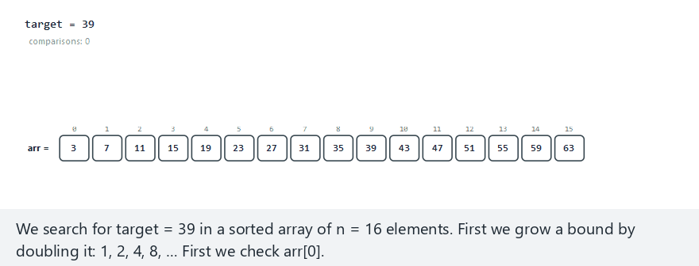
CEN207 Data Structures · Week 6
Exponential search, step by step
RTEU Computer Engineering · Fall 2026–2027
48
Notes:
Normal example: 16 sorted values, target found around the middle — watch the bound double, then binary search take over inside it.

Slide 49
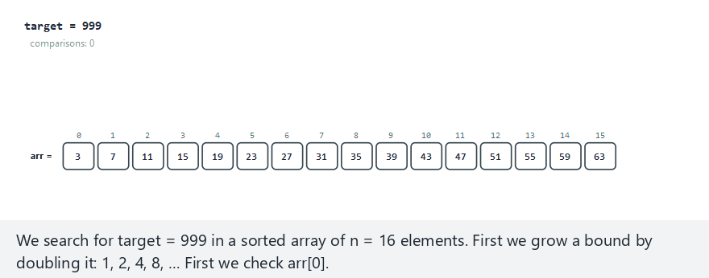
CEN207 Data Structures · Week 6
Edge case — target beyond the last value
RTEU Computer Engineering · Fall 2026–2027
49
Notes:
The bound doubles all the way past the array's real end, clamped to n-1, before binary search reports not found.

Slide 50
CEN207 Data Structures · Week 6
Code — growing the bound
int comp = 1;
if (arr[0] == target) return 0;
int bound = 1;
while (bound < n) {
comp++;
if (arr[bound] >= target) break;
bound *= 2;
}
RTEU Computer Engineering · Fall 2026–2027
50
Notes:
This whole block only decides where binary search should start — it never itself finds the target, except by luck at index 0.

Slide 51
CEN207 Data Structures · Week 6
Code — binary search inside the bound
int lo = bound / 2;
int hi = (bound < n) ? bound : n - 1;
while (lo <= hi) {
int mid = lo + (hi - lo) / 2;
comp++;
if (arr[mid] == target) return mid;
if (arr[mid] < target) lo = mid + 1;
else hi = mid - 1;
}
RTEU Computer Engineering · Fall 2026–2027
51
Notes:
Exactly binary search from Week 1, unchanged — only the starting `lo` and `hi` come from the doubling phase above.

Slide 52
CEN207 Data Structures · Week 6
Complexity
• Bound-finding phase: O(log index), where index
is where the target actually is
• Binary search phase: O(log(bound)), so O(log index) too
• Total: O(log index) — much better than O(log n)
when the target is near the front
RTEU Computer Engineering · Fall 2026–2027
52
Notes:
This is the whole payoff: exponential search adapts to WHERE the answer is, not just to how big the array is.

Slide 53
CEN207 Data Structures · Week 6
Common mistakes
• Forgetting to clamp bound to n - 1 near the end
• Restarting binary search from [0, bound] instead of
[bound/2, bound] — wastes the doubling phase's work
• Assuming this needs a known n — it explicitly does not
RTEU Computer Engineering · Fall 2026–2027
53
Notes:
Clamping matters because `arr[bound]` would otherwise read past the array's real end.

Slide 54
CEN207 Data Structures · Week 6
Mini-quiz
An array has one million elements, but the target sits at index 3. Roughly how many comparisons does exponential search need?
RTEU Computer Engineering · Fall 2026–2027
54
Notes:
Recall the complexity slide: the cost depends on the target's INDEX, not the array's size.

Slide 55
CEN207 Data Structures · Week 6
Answer
Only a handful — about log2(3) + 1 ≈ 3 comparisons total, regardless of the array holding a million elements.
RTEU Computer Engineering · Fall 2026–2027
55
Notes:
Binary search alone would still need about 20 comparisons here — exponential search's advantage is largest exactly when the target is near the front.

Slide 56
CEN207 Data Structures · Week 6
5. Fibonacci Search
RTEU Computer Engineering · Fall 2026–2027
56
Notes:
Section 5 closes the "faster search on sorted data" family with a strategy that never divides or multiplies at all.

Slide 57
CEN207 Data Structures · Week 6
A question to start
Every strategy so far divides: n/block, (hi-lo)/2, bound/2. What if the hardware running your program could not divide cheaply?
RTEU Computer Engineering · Fall 2026–2027
57
Notes:
This was a real, practical constraint on early computers — some had no hardware division instruction at all.

Slide 58
CEN207 Data Structures · Week 6
A short history
• 1953 — Jack Kiefer's Fibonacci search technique,
first developed for optimization, not arrays
• Adapted to array search soon after
• Uses only addition and subtraction — no /, no *
RTEU Computer Engineering · Fall 2026–2027
58
Notes:
Kiefer's original problem was finding the peak of a function using as few measurements as possible — the same math reused here.

Slide 59
CEN207 Data Structures · Week 6
Intuition — Fibonacci numbers as a ruler
• Fibonacci numbers: 1, 1, 2, 3, 5, 8, 13, 21, …
• Each one is the sum of the two before it
• Pick the smallest Fibonacci number >= n as a "ruler"
• Split the range using that ruler, not by dividing
RTEU Computer Engineering · Fall 2026–2027
59
Notes:
The ruler shrinks by exactly one Fibonacci step at a time, which is what replaces halving in binary search.

Slide 60
CEN207 Data Structures · Week 6
The Fibonacci search idea
• Requires a sorted array, exactly like binary search
• Track a triple (fib, fib1, fib2), one Fibonacci step apart
• Probe at offset + fib2; compare, then shrink the triple
• < target: shrink by one step; > target: shrink by two
RTEU Computer Engineering · Fall 2026–2027
60
Notes:
"Shrink by two steps" on an overshoot is what keeps the whole algorithm free of any multiplication or division.

Slide 61
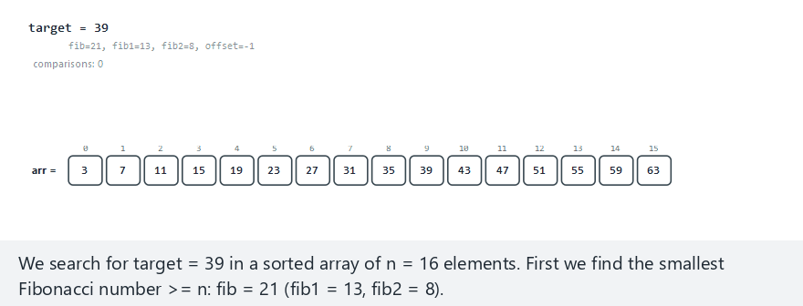
CEN207 Data Structures · Week 6
Fibonacci search, step by step
RTEU Computer Engineering · Fall 2026–2027
61
Notes:
Normal example: 16 sorted values, target found around the middle — watch the (fib, fib1, fib2) triple shrink after each probe.

Slide 62
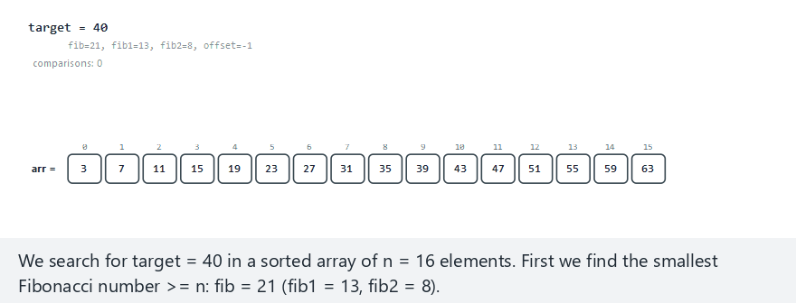
CEN207 Data Structures · Week 6
Edge case — target in range but absent
RTEU Computer Engineering · Fall 2026–2027
62
Notes:
The main loop ends with fib1 == 1 — one element is left over and checked separately, then reported not found.

Slide 63
CEN207 Data Structures · Week 6
Code — the Fibonacci triple and probe
int fib2=0, fib1=1, fib=fib1+fib2;
while (fib < n) {
fib2=fib1; fib1=fib; fib=fib1+fib2;
}
int offset = -1;
while (fib > 1) {
int i = (offset+fib2 < n-1)
? offset+fib2 : n-1;
RTEU Computer Engineering · Fall 2026–2027
63
Notes:
The while-loop above only runs once, before any comparisons — it just finds the starting Fibonacci triple for `n`.

Slide 64
CEN207 Data Structures · Week 6
Code — shrinking the triple
if (arr[i] < target) {
fib=fib1; fib1=fib2; fib2=fib-fib1;
offset = i;
} else if (arr[i] > target) {
fib=fib2; fib1=fib1-fib2; fib2=fib-fib1;
} else {
return i;
}
RTEU Computer Engineering · Fall 2026–2027
64
Notes:
Every line here is `+` or `-` only — this is the concrete proof that no division or multiplication was ever needed.

Slide 65
CEN207 Data Structures · Week 6
Complexity
• Same order as binary search: O(log n)
• Slightly more comparisons in practice, on average
• Its real advantage: no division or multiplication
• Historically valuable on hardware without fast division
RTEU Computer Engineering · Fall 2026–2027
65
Notes:
On modern hardware division is cheap, so Fibonacci search is now mostly of historical and educational interest.

Slide 66
CEN207 Data Structures · Week 6
Common mistakes
• Forgetting the leftover single-element check at the end
• Computing the Fibonacci triple inside the main loop
• Assuming it beats binary search's O(log n) — it does not
RTEU Computer Engineering · Fall 2026–2027
66
Notes:
The "one element left over" case is exactly what this section's not-present edge case was built to show.

Slide 67
CEN207 Data Structures · Week 6
Mini-quiz
Why might Fibonacci search have mattered more in the 1950s and 1960s than it does on today's hardware?
RTEU Computer Engineering · Fall 2026–2027
67
Notes:
Recall the "short history" slide's motivation, a few slides back.

Slide 68
CEN207 Data Structures · Week 6
Answer
Division was expensive, or unavailable, on early hardware. Fibonacci search's pure addition/subtraction avoided that cost entirely.
RTEU Computer Engineering · Fall 2026–2027
68
Notes:
Modern CPUs have fast hardware division, so this specific advantage has mostly disappeared — the algorithm survives as an elegant idea.

Slide 69
CEN207 Data Structures · Week 6
6. Comparing the Five Search Strategies
RTEU Computer Engineering · Fall 2026–2027
69
Notes:
Section 6 is a short pause before hashing — a single table to compare everything Sections 2–5 just built.

Slide 70
CEN207 Data Structures · Week 6
Comparison — what each one needs
Strategy | Needs | Best case
Jump search | Sorted array | O(sqrt(n))
Interpolation search | Sorted, uniform | O(log log n)
Exponential search | Sorted array | O(log index)
RTEU Computer Engineering · Fall 2026–2027
70
Notes:
"Needs" here is the extra assumption beyond "sorted" that each strategy relies on to beat plain binary search.

Slide 71
CEN207 Data Structures · Week 6
Comparison — Fibonacci and the recap
Strategy | Needs | Best case
Fibonacci search | Sorted array | O(log n)
Binary search (Week 1) | Sorted array | O(log n)
Linear search (Week 1) | Nothing | O(n)
RTEU Computer Engineering · Fall 2026–2027
71
Notes:
Every row on both tables shares one requirement: the data must be sorted first — hashing, starting next, drops that requirement entirely.

Slide 72
CEN207 Data Structures · Week 6
When to use which
• Data roughly uniform? Interpolation search
• Target usually near the front? Exponential search
• Simple code, no division available? Jump or Fibonacci
• No special structure? Plain binary search is enough
RTEU Computer Engineering · Fall 2026–2027
72
Notes:
None of these strategies is ever the "wrong" choice — each is a specialist that wins only under its own assumption.

Slide 73
CEN207 Data Structures · Week 6
Mini-quiz
A sorted log file grows constantly, so its length n is never known in advance. Which of today's strategies fits best, and why?
RTEU Computer Engineering · Fall 2026–2027
73
Notes:
Recall which strategy specifically does not require knowing `n` ahead of time.

Slide 74
CEN207 Data Structures · Week 6
Answer
Exponential search. It only grows a bound until it overshoots — it never needs n known in advance, unlike binary search.
RTEU Computer Engineering · Fall 2026–2027
74
Notes:
This is precisely the "unbounded searching" framing from Bentley and Yao's original 1976 paper.

Slide 75
CEN207 Data Structures · Week 6
7. Hashing: From Direct Addressing to Hash Functions
RTEU Computer Engineering · Fall 2026–2027
75
Notes:
Section 7 opens the second half of the week: instead of comparing values, compute exactly where a key belongs.

Slide 76
CEN207 Data Structures · Week 6
A question to start
Every search so far compares values, again and again. Could we instead compute a key's location directly, in one step?
RTEU Computer Engineering · Fall 2026–2027
76
Notes:
Yes — that single idea, "compute, don't compare", is the entire foundation of hashing.

Slide 77
CEN207 Data Structures · Week 6
A short history
• 1953 — Hans Peter Luhn, at IBM, proposes using
a computed function to place records directly
• This internal memo is widely credited as hashing's origin
• The idea: turn a key into a table index, by formula
RTEU Computer Engineering · Fall 2026–2027
77
Notes:
Luhn also invented the separate, unrelated credit-card checksum that bears his name — a different, more famous invention by the same person.

Slide 78
CEN207 Data Structures · Week 6
Intuition — direct addressing
• Keys are small integers, 0..m-1? Just use the key
itself as the array index — O(1), no computing needed
• table[key] = value — direct addressing, no hash at all
• Problem: real keys rarely fit 0..m-1 neatly
• Student IDs, phone numbers: far too many possible values
RTEU Computer Engineering · Fall 2026–2027
78
Notes:
Direct addressing is the ideal case hashing is trying to approximate, once the key space is far bigger than the table.

Slide 79
CEN207 Data Structures · Week 6
The hashing idea
• A hash function h(key) maps any key to 0..m-1
• m = the table size; h must be fast, ideally O(1)
• Two different keys landing on the same index: a collision
• Sections 8–10 build the machinery to handle collisions
RTEU Computer Engineering · Fall 2026–2027
79
Notes:
A perfect hash function with zero collisions exists in theory, but in practice collisions are expected and must be handled.

Slide 80
CEN207 Data Structures · Week 6
The division method
• Simplest common hash function: h(k) = k mod m
• Maps any integer key into [0, m-1] — always, in O(1)
• The choice of m changes how well keys spread out
• A careless m can make many keys collide on purpose
RTEU Computer Engineering · Fall 2026–2027
80
Notes:
"mod" is the whole function — its simplicity is exactly why it is the natural first hash function to teach.

Slide 81
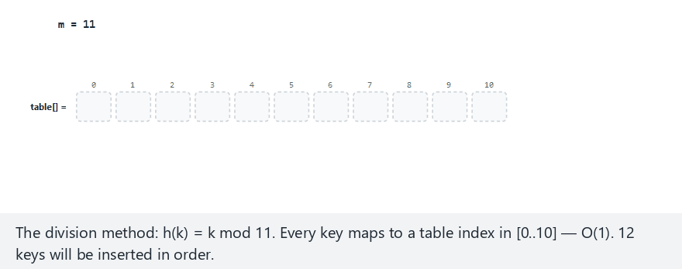
CEN207 Data Structures · Week 6
Division method, step by step
RTEU Computer Engineering · Fall 2026–2027
81
Notes:
Normal example: m = 11 (prime), 12 assorted keys — watch most keys spread out, with only the occasional collision.

Slide 82
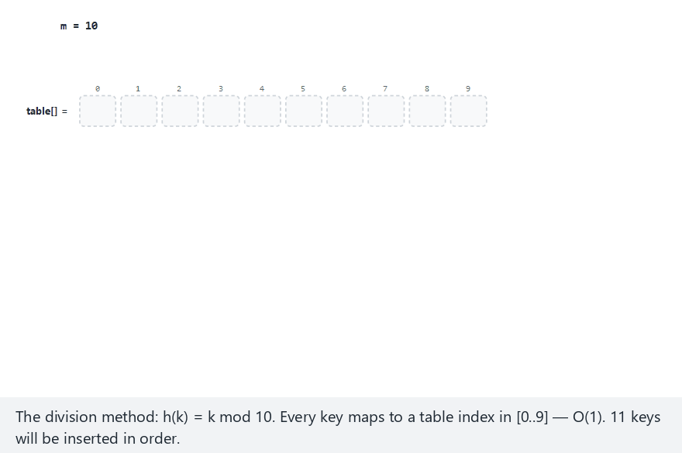
CEN207 Data Structures · Week 6
Edge case — m a power of 10: disaster
RTEU Computer Engineering · Fall 2026–2027
82
Notes:
m = 10, and every key is a multiple of 10 — k mod 10 is 0 for every single key: total collision, the worst possible spread.

Slide 83
CEN207 Data Structures · Week 6
Why prime m?
• Keys sharing a common factor with m collide badly
• m a power of 10, keys multiples of 10: total collapse
• A prime m shares no factor with most key patterns
• Rule of thumb: pick m prime, avoid powers of 2 or 10
RTEU Computer Engineering · Fall 2026–2027
83
Notes:
This is not a superstition — it follows directly from how the modulo operation interacts with a key's own factors.

Slide 84
CEN207 Data Structures · Week 6
Code — the division hash function
/* + m) % m guards negative keys in C */
int hash_division(int key, int m) {
return ((key % m) + m) % m;
}
RTEU Computer Engineering · Fall 2026–2027
84
Notes:
In C, `key % m` can be negative when `key` is negative — the extra `+ m` fixes that before the final `% m`.

Slide 85
CEN207 Data Structures · Week 6
Complexity
• h(k) = k mod m: one division — O(1), always
• This O(1) cost is what makes hashing attractive at all
• The real cost of a hash table lives in collisions
• Sections 8–10 are entirely about managing that cost
RTEU Computer Engineering · Fall 2026–2027
85
Notes:
A hash function's own cost is essentially free; every remaining slide this week is about what happens after two keys collide.

Slide 86
CEN207 Data Structures · Week 6
Common mistakes
• Picking m as a power of 2 or 10 out of convenience
• Forgetting the negative-key guard in languages like C or Java
• Assuming O(1) always holds, even with many collisions
RTEU Computer Engineering · Fall 2026–2027
86
Notes:
The negative-key guard slide's `+ m` trick is a small detail that a surprising number of real bugs trace back to.

Slide 87
CEN207 Data Structures · Week 6
Mini-quiz
m = 8 and every key in a dataset happens to be even. What fraction of the table's cells can ever be used?
RTEU Computer Engineering · Fall 2026–2027
87
Notes:
Think about which remainders `key mod 8` can produce when `key` is always even.

Slide 88
CEN207 Data Structures · Week 6
Answer
At most half. An even key mod 8 can only land on an even index (0, 2, 4, 6) — the odd-indexed cells are never reachable at all.
RTEU Computer Engineering · Fall 2026–2027
88
Notes:
This is the same "shared factor" problem as the power-of-10 edge case, just with the factor 2 instead of 10.

Slide 89
CEN207 Data Structures · Week 6
8. Collisions and Separate Chaining
RTEU Computer Engineering · Fall 2026–2027
89
Notes:
Section 8 accepts that collisions are normal, then builds the first of two standard ways to survive them.

Slide 90
CEN207 Data Structures · Week 6
A question to start
Two different keys hash to the same index. The table has only one cell there. Where does the second key go?
RTEU Computer Engineering · Fall 2026–2027
90
Notes:
There is no single right answer — the rest of today's lecture is two different, equally valid answers to this exact question.

Slide 91
CEN207 Data Structures · Week 6
Intuition — a shared mailbox slot
• Two students share the same mailbox number by chance
• Solution: hang a small list off that one mailbox slot
• Any number of keys can share one slot, one after another
• This is separate chaining: a linked list per bucket
RTEU Computer Engineering · Fall 2026–2027
91
Notes:
Collisions never overwrite anything here — they simply grow a list, which is exactly Week 2's linked list reused.

Slide 92
CEN207 Data Structures · Week 6
The chaining idea
• Table cell i holds the head of a linked list
• Insert: new node becomes the list's head — O(1)
• Search: walk the list, comparing each key — O(chain length)
• Empty chain (NULL): the key is certainly not present
RTEU Computer Engineering · Fall 2026–2027
92
Notes:
Insertion never has to search the chain first — the new node always goes straight to the front.

Slide 93
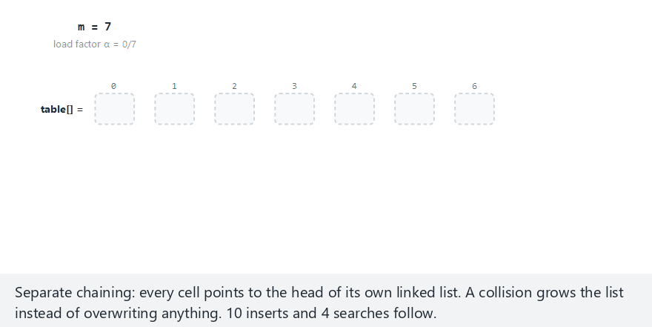
CEN207 Data Structures · Week 6
Separate chaining, step by step
RTEU Computer Engineering · Fall 2026–2027
93
Notes:
Normal example: m = 7, 10 inserts, 4 searches — watch a bucket's chain grow, then get walked during a search.

Slide 94
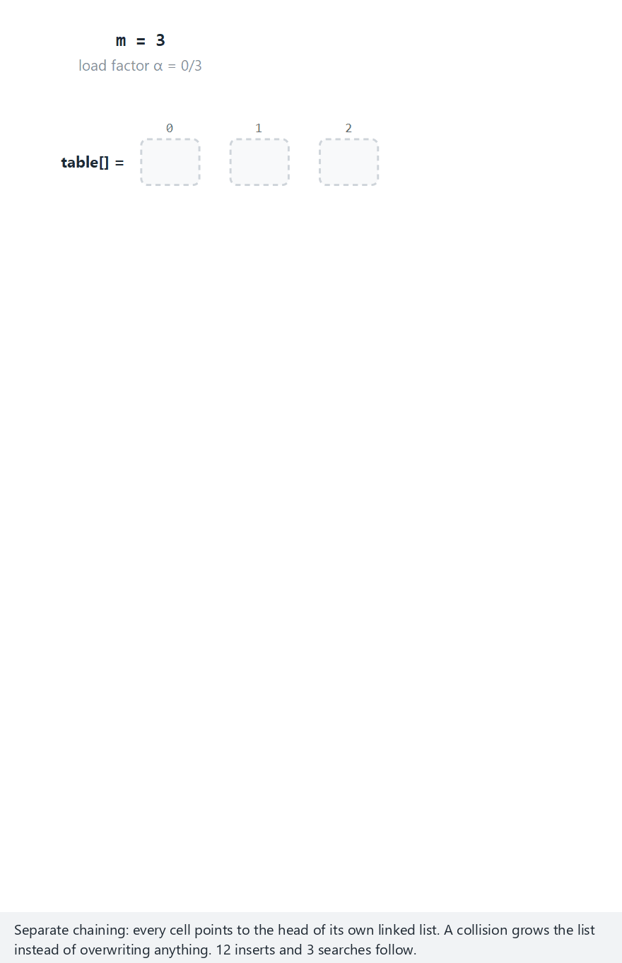
CEN207 Data Structures · Week 6
Edge case — a heavily loaded table
RTEU Computer Engineering · Fall 2026–2027
94
Notes:
m = 3, 12 keys: load factor α = 4 — chains grow long, and searching now costs several probes on average, not O(1).

Slide 95
CEN207 Data Structures · Week 6
Code — insert (head of the chain)
void insert(int key) {
int idx = key % M;
Node *n = malloc(sizeof(Node));
n->key = key;
n->next = table[idx]; /* new head */
table[idx] = n;
}
RTEU Computer Engineering · Fall 2026–2027
95
Notes:
This is Week 2's "insert at head" linked-list operation, completely unchanged — only the bucket comes from a hash.

Slide 96
CEN207 Data Structures · Week 6
Code — search (walk the chain)
bool search(int key) {
int idx = key % M;
for (Node *c = table[idx]; c;
c = c->next) {
if (c->key == key) return true;
}
return false;
}
RTEU Computer Engineering · Fall 2026–2027
96
Notes:
A `NULL` chain is handled for free here — the for-loop simply never runs, and the function returns false immediately.

Slide 97
CEN207 Data Structures · Week 6
Load factor
• α = n / m — keys stored, divided by table size
• α = 0.5: chains average length 0.5 — nearly O(1)
• α = 4: chains average length 4 — real cost, not O(1)
• A hash table's speed depends directly on α
RTEU Computer Engineering · Fall 2026–2027
97
Notes:
Load factor is the single number that predicts, on average, how many nodes a search must walk past.

Slide 98
CEN207 Data Structures · Week 6
Complexity
• Insert: always O(1) — straight to the chain's head
• Search (average): O(1 + α) — one hash, plus the chain
• Search (worst case): O(n) — every key in one chain
• Keeping α small is what keeps chaining fast in practice
RTEU Computer Engineering · Fall 2026–2027
98
Notes:
The worst case is deliberately alarming — Section 10's rehashing exists specifically to prevent α from ever getting that large.

Slide 99
CEN207 Data Structures · Week 6
Common mistakes
• Letting α grow unbounded without ever resizing the table
• Forgetting an empty chain (NULL) means "definitely absent"
• Confusing "collision" with "error" — collisions are expected
RTEU Computer Engineering · Fall 2026–2027
99
Notes:
A hash table with zero collisions ever is not a realistic design goal — managing them well is the actual goal.

Slide 100
CEN207 Data Structures · Week 6
Mini-quiz
A table has m = 5 buckets and n = 20 keys, spread evenly by chaining. What is the load factor, and the average chain length?
RTEU Computer Engineering · Fall 2026–2027
100
Notes:
Apply the load factor formula from a few slides back directly.

Slide 101
CEN207 Data Structures · Week 6
Answer
α = 20 / 5 = 4. On average, each chain holds about 4 keys — search costs roughly 4 comparisons, not O(1).
RTEU Computer Engineering · Fall 2026–2027
101
Notes:
This exact scenario is what Section 10's rehashing later fixes, by growing the table before α gets this large.

Slide 102
CEN207 Data Structures · Week 6
9. Open Addressing
RTEU Computer Engineering · Fall 2026–2027
102
Notes:
Section 9 answers the collision question a second way: instead of a list outside the table, keep every key inside it.

Slide 103
CEN207 Data Structures · Week 6
A question to start
Separate chaining needs extra memory for list nodes. Could every key instead live directly inside the table's own cells?
RTEU Computer Engineering · Fall 2026–2027
103
Notes:
Yes — this whole section is three different rules for where to look next, when a key's home cell is occupied.

Slide 104
CEN207 Data Structures · Week 6
The open addressing idea
• No lists: every key lives in the table array itself
• Collision at h(key)? Probe a sequence of other cells
• Stop at the first empty cell — the key settles there
• Deleting needs a tombstone marker, not a true empty cell
• Three probing rules follow: linear, quadratic, double hashing
RTEU Computer Engineering · Fall 2026–2027
104
Notes:
All three rules answer exactly one question differently: "the home cell is taken — where do I look next?" The tombstone detail is explained fully in Section 9a.

Slide 105
CEN207 Data Structures · Week 6
9a. Linear Probing
RTEU Computer Engineering · Fall 2026–2027
105
Notes:
The simplest probing rule: if a cell is taken, just try the very next one, wrapping around at the end.

Slide 106
CEN207 Data Structures · Week 6
The linear probing idea
• Collision at h(key)? Try h(key)+1, +2, +3, …
• Wrap around with mod m when the index passes the end
• Stop at the first cell that is empty or deleted
• Simple to code, but keys tend to pile up in runs
RTEU Computer Engineering · Fall 2026–2027
106
Notes:
Those growing runs are exactly what the next slide's "primary clustering" describes.

Slide 107
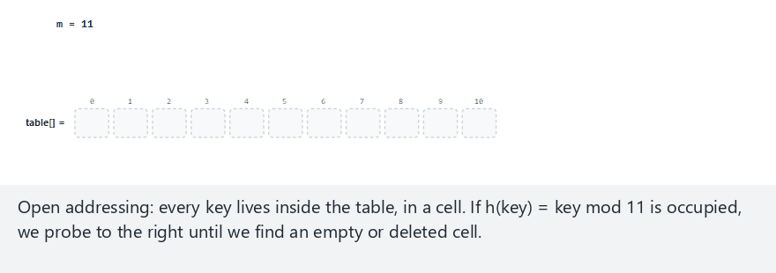
CEN207 Data Structures · Week 6
Linear probing, step by step
RTEU Computer Engineering · Fall 2026–2027
107
Notes:
Normal example: m = 11, 10 inserts, a search, and a delete — watch a probe sequence form, then get walked again during the search.

Slide 108
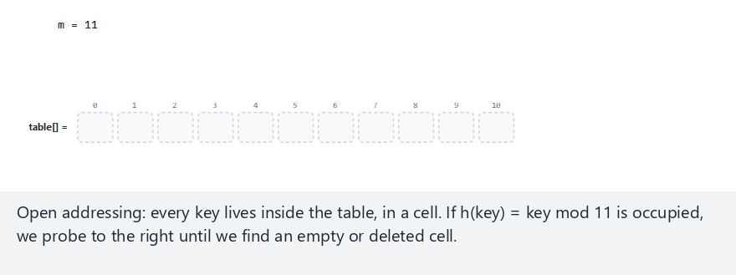
CEN207 Data Structures · Week 6
Edge case — search after a delete
RTEU Computer Engineering · Fall 2026–2027
108
Notes:
Without a tombstone, this exact search would wrongly stop at the emptied cell and report "not found" — even though the key is still further along the probe chain.

Slide 109
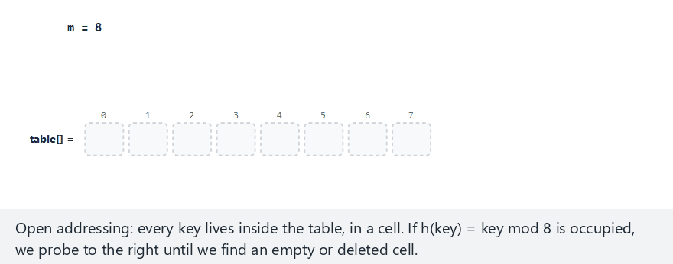
CEN207 Data Structures · Week 6
Edge case — the table fills up
RTEU Computer Engineering · Fall 2026–2027
109
Notes:
m = 8, 8 keys collide into the same cell in sequence — the table fills exactly, and the next insert is correctly rejected.

Slide 110
CEN207 Data Structures · Week 6
Code — insert with linear probing
bool insert(int key) {
int idx = key % M;
for (int i = 0; i < M; i++) {
if (state[idx] != OCCUPIED) {
table[idx] = key;
state[idx] = OCCUPIED;
return true;
}
idx = (idx + 1) % M;
}
return false; /* table full */
}
RTEU Computer Engineering · Fall 2026–2027
110
Notes:
`state[idx] != OCCUPIED` accepts both EMPTY and DELETED cells — reusing a tombstone's slot for a new key.

Slide 111
CEN207 Data Structures · Week 6
Code — delete leaves a tombstone
bool delete_key(int key) {
int idx = key % M;
for (int i = 0; i < M; i++) {
if (state[idx] == EMPTY)
return false;
if (table[idx] == key) {
state[idx] = DELETED;
return true;
}
idx = (idx + 1) % M;
}
return false;
}
RTEU Computer Engineering · Fall 2026–2027
111
Notes:
`DELETED`, never `EMPTY` — this one-word difference is what keeps every later search's probe chain intact.

Slide 112
CEN207 Data Structures · Week 6
Primary clustering
• Colliding keys always retrace the same linear path
• Occupied runs grow, and growing runs attract more collisions
• This snowball effect is called primary clustering
• Sections 9b and 9c fix this with a less predictable step
RTEU Computer Engineering · Fall 2026–2027
112
Notes:
"Predictable" is the actual problem — every key that collides at the start of a run walks the exact same growing run to escape it.

Slide 113
CEN207 Data Structures · Week 6
Complexity
• Insert / search, low load factor: close to O(1)
• As α approaches 1: clustering makes cost climb sharply
• Worst case: O(m) — scanning the whole table
• Keeping α well below 1 matters even more than chaining
RTEU Computer Engineering · Fall 2026–2027
113
Notes:
Open addressing has no "extra" memory to fall back on — once the table is full, no key at all fits, unlike chaining.

Slide 114
CEN207 Data Structures · Week 6
Common mistakes
• Clearing a deleted cell to EMPTY instead of DELETED
• Letting α reach 1.0 — insertion then never terminates cleanly
• Forgetting search must also walk past DELETED cells
RTEU Computer Engineering · Fall 2026–2027
114
Notes:
Every one of these mistakes still compiles and often "looks" correct on small test cases — that is exactly what makes them dangerous.

Slide 115
CEN207 Data Structures · Week 6
Mini-quiz
A key is deleted, leaving a tombstone. A later search() walks past that cell without stopping. Why is that the correct behavior?
RTEU Computer Engineering · Fall 2026–2027
115
Notes:
Recall the tombstone edge-case animation's speaker note, a few slides back.

Slide 116
CEN207 Data Structures · Week 6
Answer
Because a key placed after the deleted one may have probed right past it. Stopping at a tombstone would wrongly report it as absent.
RTEU Computer Engineering · Fall 2026–2027
116
Notes:
A tombstone means "something was here, keep looking" — only a true EMPTY cell means "nothing was ever placed beyond this point".

Slide 117
CEN207 Data Structures · Week 6
9b. Quadratic Probing
RTEU Computer Engineering · Fall 2026–2027
117
Notes:
Quadratic probing keeps every key inside the table too, but replaces linear probing's fixed step with a fast-growing one.

Slide 118
CEN207 Data Structures · Week 6
The quadratic probing idea
• Collision at home? Try home + 1², home + 2², …
• Step size grows fast: 1, 4, 9, 16, … instead of 1, 1, 1, …
• Spreads colliding keys apart — reduces primary clustering
• New trap: the i² sequence can cycle without success
RTEU Computer Engineering · Fall 2026–2027
118
Notes:
The growing step is the whole fix for clustering — but that same growth is what can cause the new cycling problem.

Slide 119
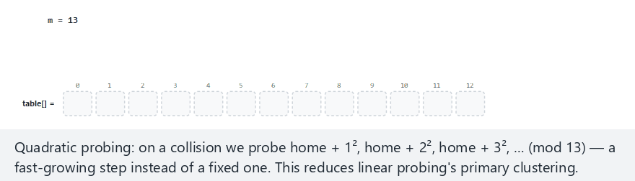
CEN207 Data Structures · Week 6
Quadratic probing, step by step
RTEU Computer Engineering · Fall 2026–2027
119
Notes:
Normal example: m = 13 (prime), 10 keys — watch the i² jumps land on scattered cells instead of one growing run.

Slide 120
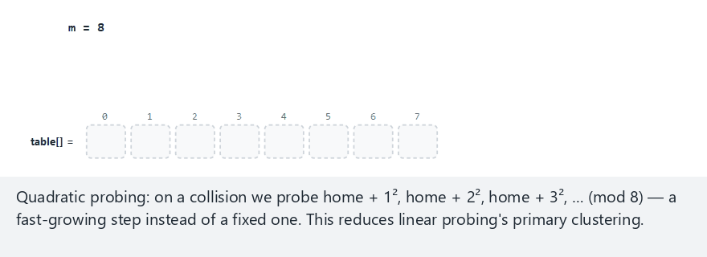
CEN207 Data Structures · Week 6
Edge case — m a power of 2: a cycle
RTEU Computer Engineering · Fall 2026–2027
120
Notes:
m = 8, not prime — the i² sequence revisits the same few cells forever, even though free cells still exist elsewhere in the table.

Slide 121
CEN207 Data Structures · Week 6
Code — insert with quadratic probing
bool insert(int key) {
int home = key % M;
for (int i = 0; i < M; i++) {
int idx = (home + i*i) % M;
if (state[idx] != OCCUPIED) {
table[idx] = key;
state[idx] = OCCUPIED;
return true;
}
}
return false;
}
RTEU Computer Engineering · Fall 2026–2027
121
Notes:
`i*i` is the only real change from linear probing's code — the step now depends on `i`, not on a fixed +1.

Slide 122
CEN207 Data Structures · Week 6
Complexity, and why m matters
• Insert / search, low load factor: close to O(1)
• Less clustering than linear probing at the same α
• Requires m prime and α <= 0.5 — else the i²
sequence can cycle without reaching a free cell
RTEU Computer Engineering · Fall 2026–2027
122
Notes:
Unlike linear probing, a bad m here can break correctness outright, not just slow things down — this condition is genuinely stronger.

Slide 123
CEN207 Data Structures · Week 6
Common mistakes
• Choosing m as a power of 2, "because it's a round number"
• Letting α exceed 0.5 — cycling becomes likely
• Treating a cycled insert the same as a genuinely full table
RTEU Computer Engineering · Fall 2026–2027
123
Notes:
The animation's edge case flags a cycle explicitly, exactly so it is never confused with a table that is truly full.

Slide 124
CEN207 Data Structures · Week 6
Mini-quiz
m = 8. Why is quadratic probing riskier here than with m = 11?
RTEU Computer Engineering · Fall 2026–2027
124
Notes:
Recall the "complexity, and why m matters" slide's last bullet.

Slide 125
CEN207 Data Structures · Week 6
Answer
8 is a power of 2, not prime. The i² sequence can cycle through only a few cells, even when the table still has free space.
RTEU Computer Engineering · Fall 2026–2027
125
Notes:
This is exactly the scenario the quadratic-cycle edge-case animation demonstrated a few slides back.

Slide 126
CEN207 Data Structures · Week 6
9c. Double Hashing
RTEU Computer Engineering · Fall 2026–2027
126
Notes:
Double hashing keeps the same "probe inside the table" idea, but makes the step itself depend on the key.

Slide 127
CEN207 Data Structures · Week 6
The double hashing idea
• Two hash functions: h1(key) for the home, h2(key) for
the step
• probe(i) = (h1(key) + i * h2(key)) mod m
• Different keys usually get different steps
• Colliding keys no longer retrace the same path
RTEU Computer Engineering · Fall 2026–2027
127
Notes:
This directly fixes linear probing's problem: two keys sharing a home cell now usually take completely different routes from there.

Slide 128
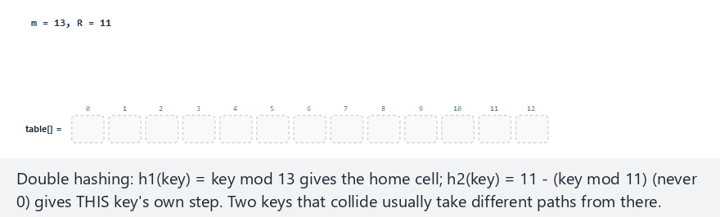
CEN207 Data Structures · Week 6
Double hashing, step by step
RTEU Computer Engineering · Fall 2026–2027
128
Notes:
Normal example: m = 13, R = 11, 10 keys — watch two keys share a home cell, then follow visibly different probe paths.

Slide 129
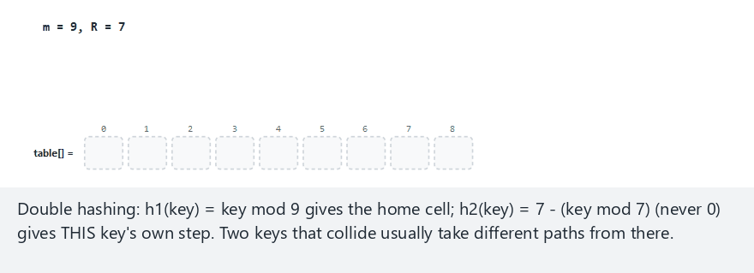
CEN207 Data Structures · Week 6
Edge case — a shared-factor cycle
RTEU Computer Engineering · Fall 2026–2027
129
Notes:
m = 9, not prime — a key's step shares a common factor with m, so its probe sequence cycles without reaching every cell.

Slide 130
CEN207 Data Structures · Week 6
Code — the two hash functions
int h1(int key, int m) {
return key % m;
}
int h2(int key, int r) {
return r - (key % r); /* r < m, prime */
}
RTEU Computer Engineering · Fall 2026–2027
130
Notes:
`h2` is built so its result is always in `[1, r]` — never 0, since a step of 0 would reprobe the same cell forever.

Slide 131
CEN207 Data Structures · Week 6
Code — probing with two hashes
int idx = h1(key, M);
int step = h2(key, R);
for (int i = 0; i < M; i++) {
if (state[idx] != OCCUPIED) {
table[idx] = key;
return idx;
}
idx = (idx + step) % M;
}
RTEU Computer Engineering · Fall 2026–2027
131
Notes:
`step` is computed once per key, outside the loop — every collision for this key then reuses that same personal step.

Slide 132
CEN207 Data Structures · Week 6
Complexity, and why m matters
• Insert / search: close to O(1) for α well below 1
• Least clustering of the three probing rules
• Needs m prime so every step reaches every cell
• Usually the best open-addressing choice in practice
RTEU Computer Engineering · Fall 2026–2027
132
Notes:
A composite m can let some keys' steps cycle, exactly like Section 9b — double hashing is not immune to the same underlying issue.

Slide 133
CEN207 Data Structures · Week 6
Common mistakes
• Letting h2(key) possibly return 0 — an infinite step
• Choosing m and R so they share a common factor
• Forgetting R itself must be prime, and R < m
RTEU Computer Engineering · Fall 2026–2027
133
Notes:
A step of exactly 0 is the single most dangerous bug here — it reprobes the very same occupied cell forever.

Slide 134
CEN207 Data Structures · Week 6
Mini-quiz
Linear, quadratic, and double hashing all require m prime for good behavior. Which one is most forgiving if m is not prime?
RTEU Computer Engineering · Fall 2026–2027
134
Notes:
Recall each subsection's "why m matters" bullets, and compare how strict each condition was.

Slide 135
CEN207 Data Structures · Week 6
Answer
Linear probing. It still reaches every cell whenever m is composite — only its clustering gets worse, not its correctness.
RTEU Computer Engineering · Fall 2026–2027
135
Notes:
Quadratic and double hashing can outright fail to find a free cell on a bad m; linear probing degrades gracefully instead, just more slowly.

Slide 136
CEN207 Data Structures · Week 6
10. Rehashing
RTEU Computer Engineering · Fall 2026–2027
136
Notes:
Section 10 answers the question every collision-resolution technique this week has been dodging: what happens when the table gets too full?

Slide 137
CEN207 Data Structures · Week 6
A question to start
Every technique in Section 9 gets slower as α climbs toward 1. What should happen before that actually occurs?
RTEU Computer Engineering · Fall 2026–2027
137
Notes:
The table should grow — but growing a hash table is not as simple as growing an array, because every key's index depends on m.

Slide 138
CEN207 Data Structures · Week 6
The rehashing idea
• Pick a threshold for α (commonly around 0.7–0.8)
• Crossing it triggers a rehash: build a bigger table
• New size: the next prime at least 2 * m
• Every key must be reinserted — its index may change
RTEU Computer Engineering · Fall 2026–2027
138
Notes:
A key's index depends on m through the mod operation — change m, and almost every key's correct index changes too.

Slide 139
CEN207 Data Structures · Week 6
Why every key must move
• h(k) = k mod m — change m, and h(k) usually changes
• Copying old cells to new ones directly would be wrong
• Instead: reinsert each key into the new, empty table
• This uses the exact same insert() already written
RTEU Computer Engineering · Fall 2026–2027
139
Notes:
Rehashing needs no new insertion logic at all — it just calls the ordinary insert() once per surviving key.

Slide 140
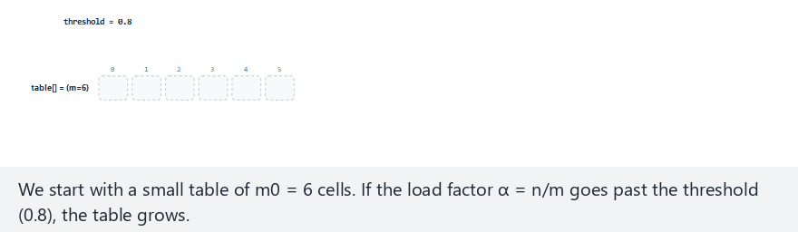
CEN207 Data Structures · Week 6
Rehashing, step by step
RTEU Computer Engineering · Fall 2026–2027
140
Notes:
Normal example: m0 = 6, 10 keys — watch α cross the threshold, a new prime-sized table appear, and every key's index get recomputed.

Slide 141
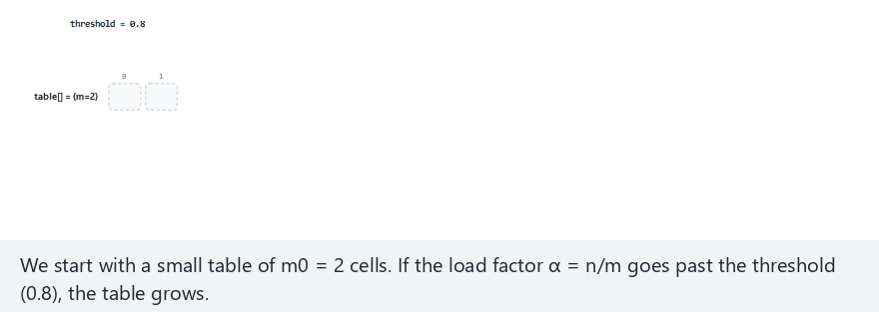
CEN207 Data Structures · Week 6
Edge case — growing twice in a row
RTEU Computer Engineering · Fall 2026–2027
141
Notes:
m0 = 2 is tiny — the threshold is crossed almost immediately, and a second rehash follows soon after the first.

Slide 142
CEN207 Data Structures · Week 6
Code — finding the next prime size
int is_prime(int x) {
if (x < 2) return 0;
for (int i=2; i*i<=x; i++)
if (x % i == 0) return 0;
return 1;
}
int next_prime(int x) {
while (!is_prime(x)) x++;
return x;
}
RTEU Computer Engineering · Fall 2026–2027
142
Notes:
This is the exact same reasoning as Section 7's division method — the new table size still needs to be prime.

Slide 143
CEN207 Data Structures · Week 6
Code — growing and reinserting
void rehash(void) {
int newM = next_prime(2 * m);
/* … allocate newState, newTable … */
for (int i = 0; i < m; i++)
if (state[i] == OCCUPIED)
insert_into(newState, newTable,
newM, table[i]);
m = newM; /* … swap in new arrays … */
}
RTEU Computer Engineering · Fall 2026–2027
143
Notes:
The loop walks every OLD cell once, so this whole operation costs O(m) — expensive, but it happens rarely.

Slide 144
CEN207 Data Structures · Week 6
Amortized complexity
• A single rehash costs O(n) — every key reinserted
• Rehashes happen rarely: table size at least doubles
• Spread across many inserts, average cost stays O(1)
• This is the same amortized idea as Week 2's dynamic array
RTEU Computer Engineering · Fall 2026–2027
144
Notes:
"Amortized" means the occasional expensive operation, averaged over many cheap ones, still comes out to a small constant.

Slide 145
CEN207 Data Structures · Week 6
Common mistakes
• Never rehashing at all — α grows without bound
• Growing to a size that is not prime
• Rehashing on every single insert instead of past a threshold
RTEU Computer Engineering · Fall 2026–2027
145
Notes:
Rehashing on every insert would make EVERY insert cost O(n) — the whole point of a threshold is to make it rare.

Slide 146
CEN207 Data Structures · Week 6
Mini-quiz
A table with m = 6 holds n = 5 keys, and the threshold is 0.8. One more key is inserted. Does a rehash trigger, and to what size?
RTEU Computer Engineering · Fall 2026–2027
146
Notes:
Compute the new α after the insert, then compare it to the threshold, then apply next_prime(2*m).

Slide 147
CEN207 Data Structures · Week 6
Answer
Yes. α = 6/6 = 1.0 > 0.8 — a rehash triggers. New size: next_prime(12) = 13.
RTEU Computer Engineering · Fall 2026–2027
147
Notes:
This is exactly the normal-preset animation's scenario above, with the same m0 = 6 starting size.

Slide 148
CEN207 Data Structures · Week 6
11. Choosing a Collision-Resolution Technique
RTEU Computer Engineering · Fall 2026–2027
148
Notes:
Section 11 is the practical payoff of the whole second half of the week: which technique should you actually reach for?

Slide 149
CEN207 Data Structures · Week 6
Chaining vs. open addressing
 | Chaining | Open addressing
Extra memory | Yes, per node | No, in-place
High α | Degrades gracefully | Degrades sharply
Deletion | Simple | Needs tombstones
RTEU Computer Engineering · Fall 2026–2027
149
Notes:
Every row is a genuine trade-off — neither column is simply "better" in every situation.

Slide 150
CEN207 Data Structures · Week 6
Choosing within open addressing
• Simple code, α kept low? Linear probing is enough
• Want less clustering, willing to require prime m?
Quadratic probing
• Want the best spread available? Double hashing
RTEU Computer Engineering · Fall 2026–2027
150
Notes:
This ordering is also roughly the historical order these three techniques were developed in, each fixing the previous one's weak spot.

Slide 151
CEN207 Data Structures · Week 6
A practical rule of thumb
• Deletions are frequent or memory is not tight? Chaining
• Memory matters and α is kept well below 1? Open addressing
• Either way: rehash before α gets too large
• No universally "best" choice — only best for your case
RTEU Computer Engineering · Fall 2026–2027
151
Notes:
Real hash table libraries (Java's HashMap, for instance) make exactly this kind of engineering trade-off explicitly, in their documentation.

Slide 152
CEN207 Data Structures · Week 6
Mini-quiz
A hash table will hold millions of keys, with almost no deletions, and memory is tight. Which family fits best, and why?
RTEU Computer Engineering · Fall 2026–2027
152
Notes:
Recall the practical rule of thumb slide's first two bullets.

Slide 153
CEN207 Data Structures · Week 6
Answer
Open addressing, likely double hashing. No deletions to worry about, and no extra per-node memory for millions of chain links.
RTEU Computer Engineering · Fall 2026–2027
153
Notes:
If deletions later become common, tombstones would need careful handling — chaining might then become the better trade-off instead.

Slide 154
CEN207 Data Structures · Week 6
Summary — faster search on sorted data
Idea | Key fact
Jump search | O(sqrt(n)), block = sqrt(n)
Interpolation search | O(log log n) on uniform data
Exponential / Fibonacci | Unbounded n / no division
RTEU Computer Engineering · Fall 2026–2027
154
Notes:
Every row here still compares values — hashing, summarized next, is the one idea this week that mostly does not.

Slide 155
CEN207 Data Structures · Week 6
Summary — hashing and collisions
Idea | Key fact
Hash function | h(k) = k mod m, O(1), m prime
Chaining | Linked list per bucket, O(1+α)
Open addressing | In-place, needs tombstones, rehashing
RTEU Computer Engineering · Fall 2026–2027
155
Notes:
Both collision families still share one number that predicts their speed: the load factor α = n/m.

Slide 156
CEN207 Data Structures · Week 6
The big picture
Sorted data supports faster-than-binary search by exploiting extra structure. Hashing drops comparison entirely: compute a location, handle collisions, and grow the table before it fills.
RTEU Computer Engineering · Fall 2026–2027
156
Notes:
If a student remembers only one sentence from today, this is the one worth remembering.

Slide 157
CEN207 Data Structures · Week 6
Self-check round
Four short questions. Think before the answer appears on the next slide. Full exercises and a ten-question quiz are in the week notes.
RTEU Computer Engineering · Fall 2026–2027
157
Notes:
These mirror the self-check quiz at the end of the written notes, one question per slide, with a shorter set here.

Slide 158
CEN207 Data Structures · Week 6
1. An array has 400 elements. What block size does jump search use, and roughly how many comparisons in the worst case?
RTEU Computer Engineering · Fall 2026–2027
158
Notes:
Ask, wait, then advance.

Slide 159
CEN207 Data Structures · Week 6
block = sqrt(400) = 20. Worst case: about 20 + 20 = 40 comparisons — far below linear search's 400.
RTEU Computer Engineering · Fall 2026–2027
159
Notes:
This is the exact O(sqrt(n)) bound from Section 2, applied to a bigger n.

Slide 160
CEN207 Data Structures · Week 6
2. Why does interpolation search's formula need a guard against arr[hi] == arr[lo]?
RTEU Computer Engineering · Fall 2026–2027
160
Notes:
Recall Section 3's division-by-zero edge case.

Slide 161
CEN207 Data Structures · Week 6
Without it, the formula's denominator would be zero — a division-by-zero error, since an all-equal range makes arr[hi] - arr[lo] = 0.
RTEU Computer Engineering · Fall 2026–2027
161
Notes:
This is exactly what the all-equal edge-case animation in Section 3 was built to demonstrate.

Slide 162
CEN207 Data Structures · Week 6
3. Why should a hash table's size m usually be chosen prime?
RTEU Computer Engineering · Fall 2026–2027
162
Notes:
Recall Section 7's power-of-10 example.

Slide 163
CEN207 Data Structures · Week 6
A prime m shares no common factor with most key patterns, avoiding the severe clustering a composite m (like a power of 10) can cause.
RTEU Computer Engineering · Fall 2026–2027
163
Notes:
This same fact matters even more strongly for quadratic and double hashing, from Section 9.

Slide 164
CEN207 Data Structures · Week 6
4. Why must a deleted cell in open addressing become a tombstone, not a plain empty cell?
RTEU Computer Engineering · Fall 2026–2027
164
Notes:
Recall Section 9a's tombstone edge case.

Slide 165
CEN207 Data Structures · Week 6
A later search stops at the first truly empty cell. Clearing to empty would wrongly cut off the probe chain for keys placed after it.
RTEU Computer Engineering · Fall 2026–2027
165
Notes:
This is the single most common real-world bug in open-addressing implementations, and exactly what the tombstone animation demonstrated.

Slide 166
CEN207 Data Structures · Week 6
Next week
Week 7 — Project Demonstrations
No new algorithms this week: teams present their project's search or hashing component, followed by Week 8's quiz before graph algorithms resume in Week 9.
RTEU Computer Engineering · Fall 2026–2027
166
Notes:
Weeks 7–8 are the exam-week project demo and quiz block; Week 9 then moves on to weighted graph algorithms, building on Week 5.

Slide 167
CEN207 Data Structures · Week 6
References (1/2)
• Course syllabus, Week 6: docs/syllabus/syllabus.en.md
• Cormen, Leiserson, Rivest, Stein. *Introduction to
Algorithms*, 4th ed. MIT Press
• Knuth. *The Art of Computer Programming, Vol. 3:
Sorting and Searching*, 2nd ed
• Bentley, J., Yao, A. (1976). "An almost optimal
algorithm for unbounded searching"
• Luhn, H. P. (1953). Internal IBM memorandum on hashing
RTEU Computer Engineering · Fall 2026–2027
167
Notes:
These are the same references listed at the end of the week's written notes.

Slide 168
CEN207 Data Structures · Week 6
References (2/2)
• Kiefer, J. (1953). "Sequential minimax search
for a maximum"
• Peterson, W. W. (1957). "Addressing for
random-access storage"
• Sedgewick, Wayne. Algorithms, 4th ed. Addison-Wesley
• williamfiset/Algorithms · Programiz DSA
RTEU Computer Engineering · Fall 2026–2027
168
Notes:
The historical references — Luhn, Kiefer, Bentley and Yao — are what today's "short history" slides drew on.

