Slide 1
CE208-Database Management Systems
Database and Fundamental Concepts Author: Asst. Prof. Dr. Yıldıran YILMAZ

Slide 2
CE208-Database Management Systems
Week-2 (Database and Fundamental Concepts)
Spring Semester, 2021-2022
Instructor: Yıldıran Yılmaz Email: yildiran.yilmaz@erdogan.edu.tr Office Hours: Thursday
Download PDF-MS, PDF-MD, DOCX-MD, PPTX-MD, PPTX-MS

Slide 3
Why we use the database?
The purpose of the database;
helping people and organizations keep track of things.

Slide 4
Why we use the database?
Lists are used to keep track of things without using a database.
Shopping list,
to-do list,
List of paid invoices

Slide 5
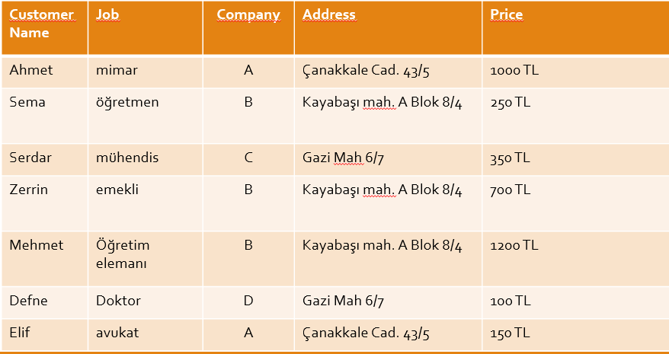
Why we use the database?
center h:450px

Slide 6
Why we use the database?
Problems with lists;
For example, the address of company B has changed.
Address information in 3 lines should also change
If it is missing, information inconsistency occurs.
It can cause both a waste of time and an error.

Slide 7
Why we use the database?
Problems with lists;
For example, company A no longer works with your company,
If you delete the record related to company A from the list, you will lose information such as customer information and company address where the product was sold.

Slide 8
Why we use the database?
Problems with shared data;
For example, different departments of your company need to display company information;
Communication department: company, address
Marketing department: company, price
Customer service: customer name, job, company

Slide 9
Why we use the database?
Problems with shared data;
Sharing all of this information with all departments is inconvenient for different reasons.
Security
customer privacy
etc.

Slide 10
Why we use the database?
The biggest drawback for lists is that it combines different types of information into a table.

Slide 11
Why we use the database?
For DMS, the process of placing different types of information in different tables is called normalisation.
For the previous list;
customers
Worked companies
sales information

Slide 12
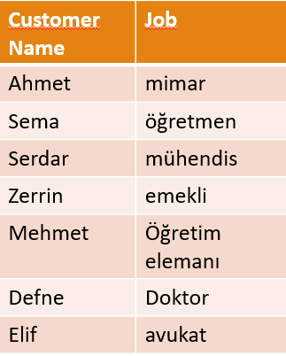
Why we use the database?
Customers
center h:450px

Slide 13
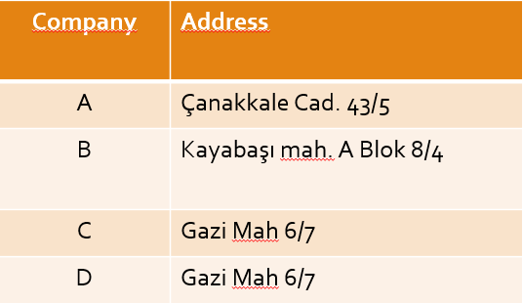
Why we use the database?
Worked Companies
center h:450px

Slide 14
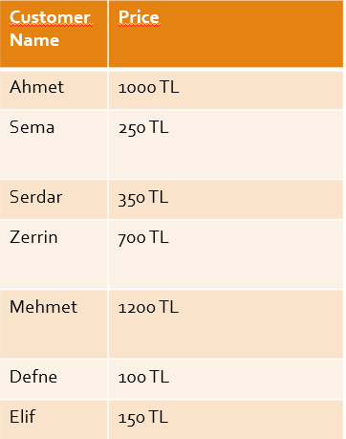
Why we use the database?
Sales Information
center h:450px

Slide 15
Why we use the database?
When different types of information are placed in different tables, most of the problems related to the following works are eliminated;
changing information
deleted information
with shared information.

Slide 16
Why we use the database?
When different types of data are in different tables;
Relationships need to be established in order to answer questions such as which customer bought the product from which company ?

Slide 17
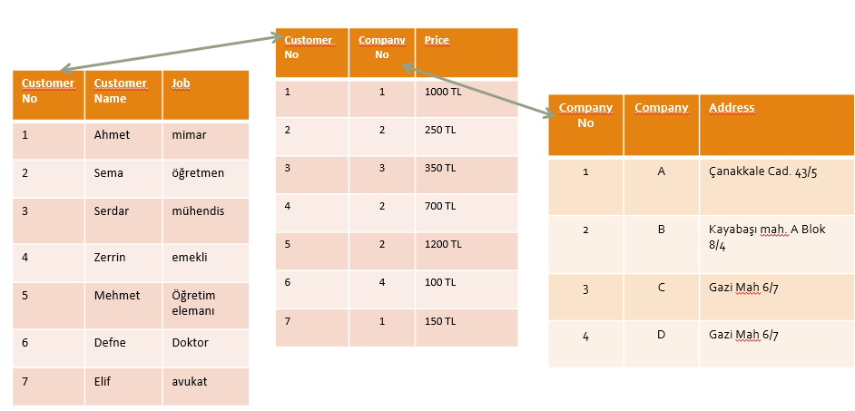
Why we use the database?
Relations
center h:450px

Slide 18
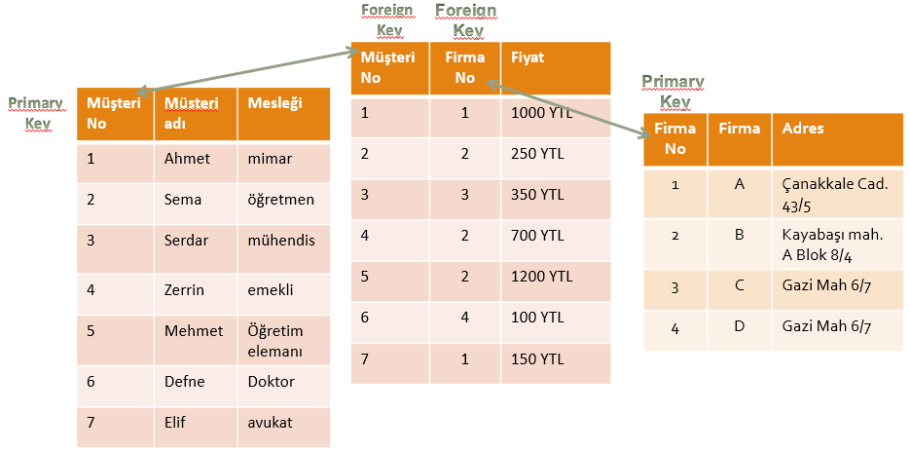
Why we use the database?
Relations
center h:450px

Slide 19
Why we use the database?
Joining tables
So what is done to get the initial holistic list?
SQL language is used.

Slide 20
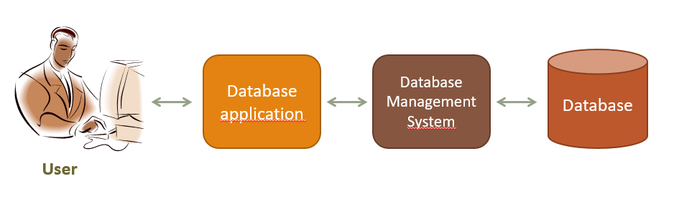
What is database management system?
Components of the database system;
center h:450px

Slide 21
What is database management system?
The user does the following:
It uses the database to perform its work,
Adds new data
Modify existing data,
deletes data,
Reads data through queries or reports

Slide 22
What is database management system?
Database Application:
It is one or more computer programs that provide communication between the database management system and the user.
Creates queries and reports,
Receives data from the user or sends the data to the user,

Slide 23
What is database management system?
Database Management System:
It receives requests from the application and performs them by reading or writing data on database files,
It reads SQL statements and converts these statements into instructions for the computer’s operating system to read or write data on database files.

Slide 24
What is database management system?
Functions of Database Application
Functions of Database Management System

Slide 25
What is database management system?
Database Application:
Creates and processes forms,
Creates queries and forwards queries,
Creates and operates reports,
Performs application logic,
Controls the application.

Slide 26
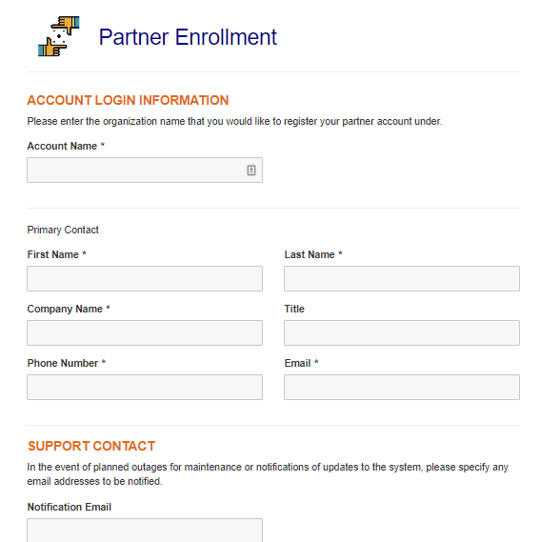
What is database management system?
Database Application:
Creates and processes forms, for example, in a web-based application;
Creates HTML and other web formats to be displayed on the user’s computer,
When the user fills out the forms and sends the data back, it sends the DBMS requests for the necessary adjustments.
If an error occurs in the process, it displays the necessary message to the user and/or performs the necessary actions.
bg right:30% h:400

Slide 27
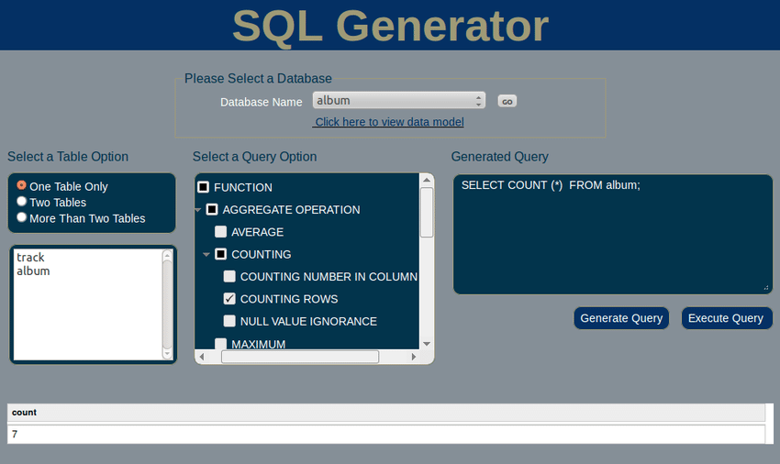
What is database management system?
Database Application:
Creates queries and forwards queries,
Generates the query to be transmitted to DBMS,
These requests are usually expressed in SQL,
When the query is executed, the results are formatted and transmitted to the user,
bg right:50% h:380px

Slide 28
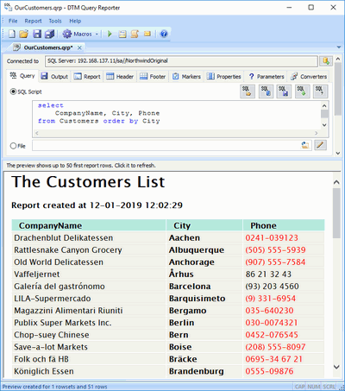
What is database management system?
Database Application:
Creates and operates reports,
Data is requested from DBMS through queries and query results are presented in the form of reports,
bg right:50% h:650

Slide 29
What is database management system?
Database Application:
Performs application logic,
For example, the user made a request for 10 units, but 8 units were found in stock,
What happens depends on the logic of the program,
It is the task of the application program to implement the appropriate logic.

Slide 30
What is database management system?
Database Application:
Controls the application

Slide 31
What is database management system?
The Database Management System does the following:
Creating the database, creating the tables,
Reading data from the database and updating the data,
Realizing the limitations on data values,
It prevents one user’s process from interfering with the other user’s process.
Allowing users to take action within the limits of their authority,
Backing up data in the database.

Slide 32
Database
Database is data stores that consist of following related records.
Metadata (metadata)
index
stored procedure
trigger
data integrity (referential integrity)

Slide 33
Database
Data about the structure of the database is called metadata.
Table names
column names
Properties of tables and columns etc.

Slide 34
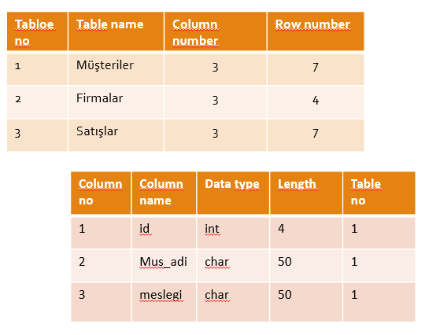
Database
Metadata example:
center h:450px

Slide 35
Database
Some databases contain application metadata.
This metadata defines application components such as forms and reports.
DBMS has several tools to show the structure of the database.

Slide 36
Database
At the same time, there are indexes used in databases to improve the performance of the database.
Indexes are tools that show which records are in which tables.

Slide 37
Database
Stored procedures are compiled SQL statements.
Because they are database objects, they are directly included in the database manager program.
For example, stored procedures can be created for the purpose of taking a backup of data in a table or remove a backup of data that has passed more than a year.

Slide 38
Database
Stored procedures are codes for doing a specific duty defined in a database.
These codes are optimized because they are compiled at the same time as they are written, and they are the fastest ready-to-run codes.

Slide 39
Database
A trigger is a special type of stored procedure that automatically runs when an event occurs in the database server.
The events that trigger the triggers on the table are insert, update, delete events.

Slide 40
Database
For example, it is a typical use of triggers to decrease or increase the amount of stock as a result of stock movements.

Slide 41
Database
Since both triggers and stored procedures are codes on the database, they run on the database server.
It is one of the powerful components of the Client & Server architecture.
There are databases in client & server architecture as follows.
Oracle, Sybase, MS SQL, Interbase, FireBird etc.

Slide 42
Database
Because they work on the server where the data is located, the data does not go back and forth between the client and the server.
Therefore minimal data is sent from the server to the client side.

Slide 43
Database
In a relational database
Let’s assume that the department information of the person in the PERSONNEL table is kept in the SECTION_NO variable and
the name of the department is in the SECTION table.

Slide 44
Database
If the section numbered as 1 is used by any personnel, the record with SECTION_NO value of 1 from the SECTION table must not be deleted.
Protecting data integrity by making such controls is called referential integrity.

Slide 45
Database
The use of triggers is highly preferred in order to ensure data integrity.

Slide 46
Database
There can be 3 types of database systems:
used by a single person,
used by small businesses,
Used by large international companies

Slide 47
Database
used by a single person,
Painter
Whose house was painted, when and how much?
What was painted in the painting, what colors and styles were used?
Who referenced others? Who are the referrals?

Slide 48
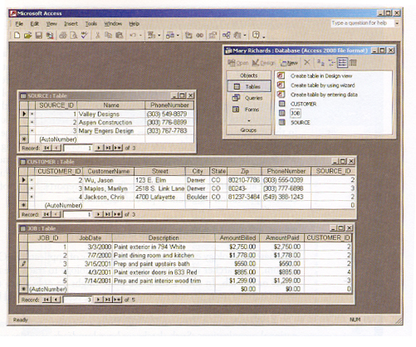
Database Systems
used by a single person,
center h:450px

Slide 49
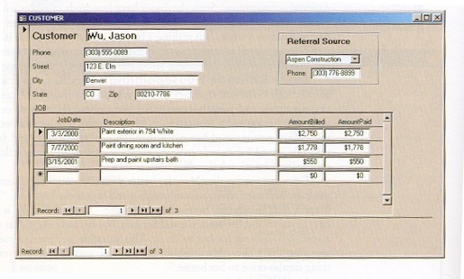
Database Systems
used by a single person,
center h:450px

Slide 50
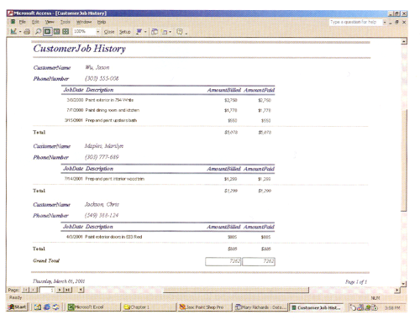
Database Systems
used by a single person,
center h:450px

Slide 51
Database Systems
used by small businesses,
What are the rented musical instruments? How much is it rented?
Which musical instruments are rented the most?
Who made the lease? (multi-user database)
The same instrument cannot be selected by two different dealers at the same time!

Slide 52
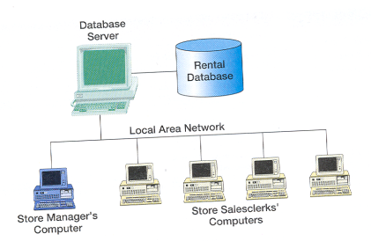
Database Systems
used by small businesses,
center h:450px

Slide 53
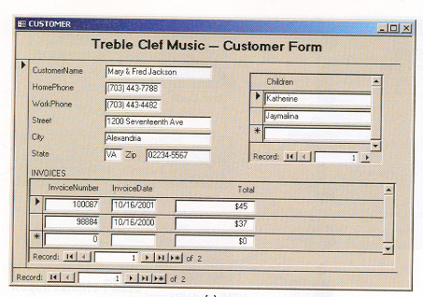
Database Systems
used by small businesses,
center h:450px

Slide 54
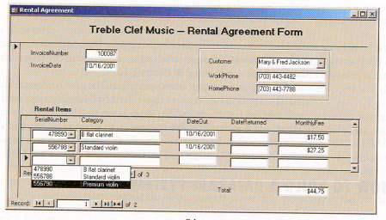
Database Systems
used by small businesses,
center h:450px

Slide 55
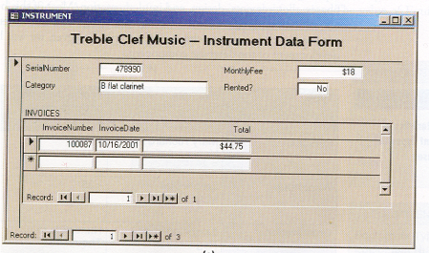
Database Systems
used by small businesses,
center h:450px

Slide 56
Database Systems
Used by large international companies,
Driver licensing and auto registration office
It has 52 different centers
Accidents of people, traffic violations are kept,
Is the license renewable, are there any limitations?
Database is used by 100s of people
Licensing and registration staff
Those who follow law enforcement
Finance department staff
Reachable 24 hours a day, 7 days a week

Slide 57
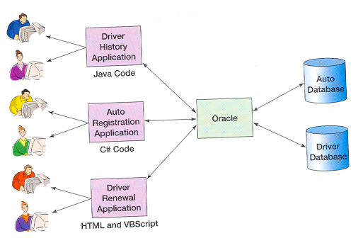
Database Systems
Used by large international companies,
center h:450px

Slide 58
References
Kroenke, D. M. (2006). Database Processing: Fundamentals, Design, and Implementation .Pearson Education International. Singapore,Canada,Japan.
http://www.delphiturkiye.com/trigger.htm

Slide 59
$End−Of−Week−2−Module$

