Slide 1

CEN429 Secure Programming · Week 10
Certificates and Cryptographic Methods
CEN429 Secure Programming — Week 10
Asst. Prof. Dr. Uğur CORUH · 20.11.2026
RTEU Computer Engineering · 2026-2027 Fall
Notes:
Speaker note: This week we build the building blocks of cryptography and PKI end to end: modes, MAC, RSA and elliptic curves, signatures, certificate chains, revocation, and key storage.

Slide 2
CEN429 Secure Programming · Week 10
Today's Plan (3 Hours)
Hour | Section | Topic
1 | 1–3 | Algorithm/key selection · block cipher modes/padding · MAC/HMAC
2 | 4–6 | RSA/ECC (OAEP/PSS) · digital signature · Diffie–Hellman
3 | 7–13 | PKI · X.509 · building a chain with OpenSSL · CRL/OCSP · HSM/PKCS#11 · post-quantum · project
Learning outcomes (LO.2 / LO.4): choose the right algorithm, mode, padding, and key length · spot the pitfalls of signatures and key exchange · correctly validate a certificate chain
In cryptography, mistakes are usually not in the algorithm but in the usage: the wrong mode, the wrong padding, an unverified signature, an unchecked chain.
RTEU Computer Engineering · 2026-2027 Fall
2
Notes:
Speaker note: This week is about using crypto correctly, and PKI. Students saw an introduction in Week 3; here we recap from scratch and go deeper. Emphasis: not the right algorithm, but the right USE.

Slide 3
CEN429 Secure Programming · Week 10
What We Bring from Earlier Weeks
• Symmetric and asymmetric encryption — symmetric encryption runs fast with a single shared key; asymmetric
encryption uses a public/private key pair, making key distribution easy but slow (Week 3)
• AEAD — authenticated encryption gives confidentiality and integrity together, in a single call (Week 3)
• Digest, MAC, and digital signature — a digest is a one-way fingerprint; a MAC proves a message hasn't changed
with a shared key, a signature does the same with a public/private key pair (Week 3)
• Forward secrecy — deleting a session's derived key after use, so that even if today's key leaks, past
sessions cannot be decrypted (Week 3)
• TLS certificate validation — the client checking a server certificate's chain, validity, intended usage, and
name (Week 3)
This week we go deeper: asymmetric mathematics and the right mode/padding (Sections 2, 4) · HMAC's internal structure and signature pitfalls (Sections 3, 5) · DH and authentication (Section 6) · PKI, X.509, and revocation (Sections 7–10).
RTEU Computer Engineering · 2026-2027 Fall
3

Slide 4
CEN429 Secure Programming · Week 10
This Week's Concepts
Each term is defined once, where it first appears in the body; here we only mark where.
Concept | Where
Block cipher modes, padding | Section 2
MAC, HMAC | Section 3
RSA, elliptic curve (ECC) | Section 4
Digital signature | Section 5
Diffie–Hellman (DH) | Section 6
PKI, CA | Section 7
Certificate, X.509 | Section 8
Building a chain with OpenSSL | Section 9
CRL, OCSP | Section 10
HSM, PKCS#11, SoftHSM | Section 11
Post-quantum (PQC) | Section 12
RTEU Computer Engineering · 2026-2027 Fall
4

Slide 5
CEN429 Secure Programming · Week 10
1. Algorithm and Key Selection
RTEU Computer Engineering · 2026-2027 Fall
5

Slide 6
CEN429 Secure Programming · Week 10
A Brief History — Keys, Certificates, PKI
• 1976–77 — Diffie–Hellman and RSA: talking securely with someone you don't know
• 1988 — the X.509 certificate format; identity carries a CA signature
• 1995 — commercial CAs and PKI; then CRL and OCSP (revocation)
• 2014 Heartbleed · 2015 Let's Encrypt · 2018 TLS 1.3 · 2022–24 PQC (Kyber/Dilithium)
Today's rules (the right mode/padding, chain validation, revocation) came out of these painful lessons.
RTEU Computer Engineering · 2026-2027 Fall
6

Slide 7
CEN429 Secure Programming · Week 10
Current, Standard, Properly Used
Three rules:
• Current: an unbroken algorithm (AES, SHA-256, Ed25519).
• Standard: don't write your own crypto; use a proven library.
• Properly used: the right mode, padding, key management.
RTEU Computer Engineering · 2026-2027 Fall
7

Slide 8
CEN429 Secure Programming · Week 10
What to Avoid
• MD5, SHA-1 (for digests), DES/3DES, RC4.
• ECB mode.
• Your own "encryption" algorithm.
• A fixed/predictable IV or key.
RTEU Computer Engineering · 2026-2027 Fall
8

Slide 9
CEN429 Secure Programming · Week 10
Key Length
Purpose | Recommendation (approx.)
Symmetric | AES-128 (sufficient), AES-256
RSA | ≥ 2048, prefer 3072
ECC | 256-bit (≈ RSA-3072)
Digest | SHA-256+
RTEU Computer Engineering · 2026-2027 Fall
9

Slide 10
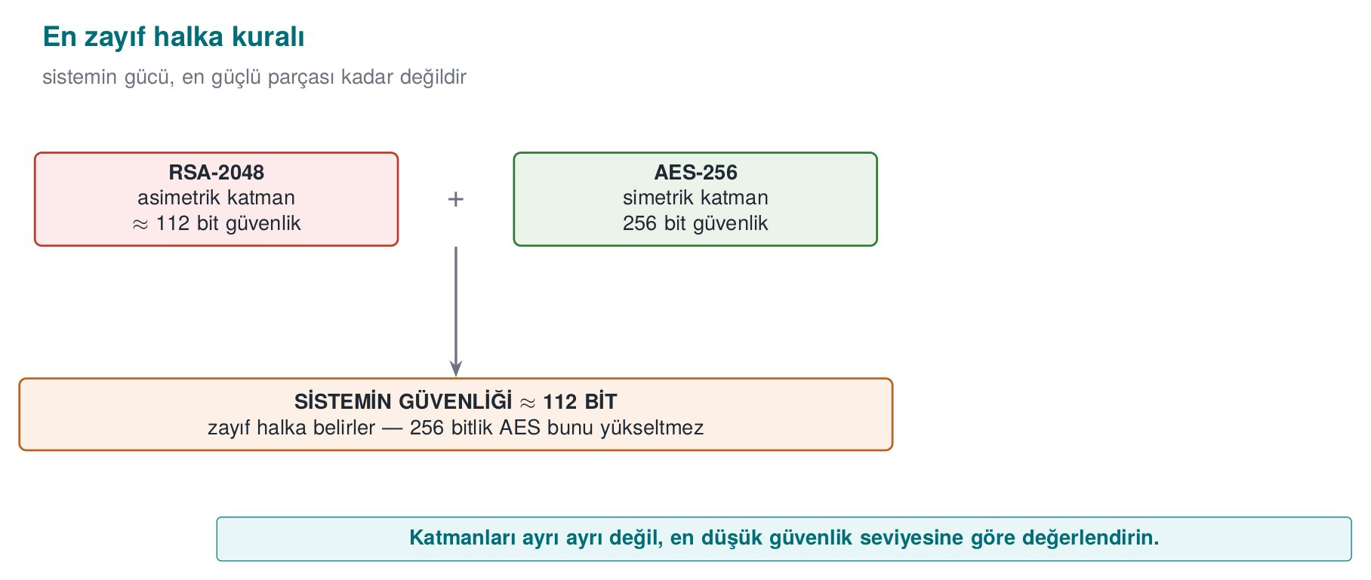
CEN429 Secure Programming · Week 10
The Weakest-Link Rule
• Choose components with balanced strength.
• Targeting 128 bits? Use RSA-3072 or ECC.
RTEU Computer Engineering · 2026-2027 Fall
10

Slide 11
CEN429 Secure Programming · Week 10
Which Mode?
Need | Choice
Confidentiality + integrity | AES-GCM / ChaCha20-Poly1305
Speed only (no hardware AES) | ChaCha20-Poly1305
Never | ECB
Legacy CBC system | + encrypt-then-MAC, a single error
RTEU Computer Engineering · 2026-2027 Fall
11

Slide 12
CEN429 Secure Programming · Week 10
Which Asymmetric Algorithm?
Need | Choice
Signature (modern) | Ed25519
Key agreement | X25519
RSA encryption | RSA-OAEP (≥3072)
RSA signature | RSA-PSS
RTEU Computer Engineering · 2026-2027 Fall
12

Slide 13
CEN429 Secure Programming · Week 10
Decision Rule
• Choose current, standard, properly used.
• AEAD first; ECC first.
• Write the decision and its rationale into S8.
RTEU Computer Engineering · 2026-2027 Fall
13

Slide 14
CEN429 Secure Programming · Week 10
2. Block Cipher Modes and Padding
RTEU Computer Engineering · 2026-2027 Fall
14

Slide 15
CEN429 Secure Programming · Week 10
ECB · Never
• ECB: encrypts each block independently.
• Same block → same ciphertext block → pattern leaks.
• The famous "ECB penguin" example.
Don't use ECB.
RTEU Computer Engineering · 2026-2027 Fall
15

Slide 16
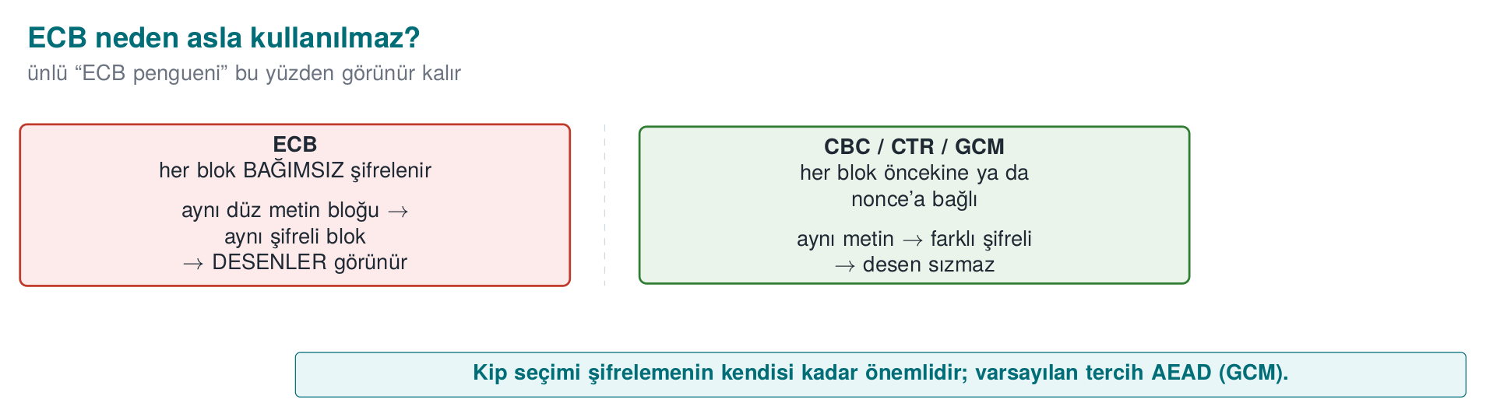
CEN429 Secure Programming · Week 10
Why ECB Is Bad — Diagram
RTEU Computer Engineering · 2026-2027 Fall
16

Slide 17
CEN429 Secure Programming · Week 10
CBC · Use with Care
• CBC: each block is chained with the previous one; an IV is required.
• The IV must be random and never repeated.
• Does not provide integrity on its own → a separate MAC is required.
RTEU Computer Engineering · 2026-2027 Fall
17

Slide 18
CEN429 Secure Programming · Week 10
CBC + Padding = Risk
• CBC requires padding.
• Handling padding incorrectly → padding oracle (coming up next).
• This is why the modern choice is AEAD.
RTEU Computer Engineering · 2026-2027 Fall
18

Slide 19
CEN429 Secure Programming · Week 10
PKCS#7 Padding · Example
Let's encrypt the 13-byte text "MERHABA DUNYA" with AES-128-CBC (K and IV are fixed here only for the demo):
printf 'MERHABA DUNYA' | openssl enc -aes-128-cbc -K "$K" -iv "$IV" -out cikti.bin
xxd -p cikti.bin
The output is 16 bytes (32 hex characters) — the input was 13 bytes, so 3 bytes of padding were added.
RTEU Computer Engineering · 2026-2027 Fall
19

Slide 20
CEN429 Secure Programming · Week 10
PKCS#7 Padding · Output
Let's look at the padding content with -nopad (for teaching purposes only):
4d45 5248 4142 4120 4455 4e59 4103 0303 MERHABA DUNYA...
The last three bytes are `03 03 03`: the number of missing bytes (16 − 13 = 3) worth of bytes, each with that value, were added — exactly the PKCS#7 rule. A normal openssl enc -d reads and strips these bytes automatically.
RTEU Computer Engineering · 2026-2027 Fall
20

Slide 21
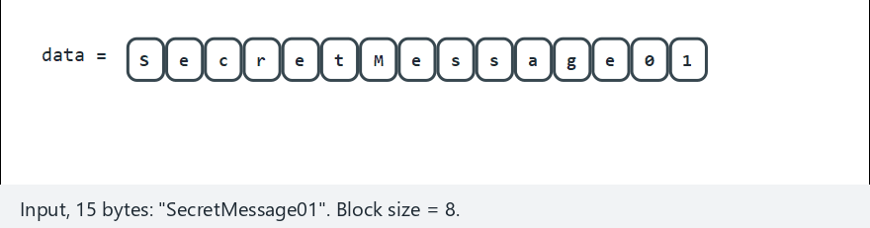
CEN429 Secure Programming · Week 10
PKCS#7 · Padding and the Check — Animation
RTEU Computer Engineering · 2026-2027 Fall
21
Notes:
Speaker note: padding added + three checks (length, last-byte range, every padding byte). Which
corruption stops at which check.

Slide 22
CEN429 Secure Programming · Week 10
GCM · the Modern Choice (AEAD)
• AES-GCM: confidentiality and integrity together.
• No padding; a nonce (a number used once) is required.
• The nonce must never repeat (under the same key).
RTEU Computer Engineering · 2026-2027 Fall
22

Slide 23
CEN429 Secure Programming · Week 10
Nonce/IV Rule
• The IV/nonce must be unique.
• Nonce reuse in GCM is catastrophic (the key/data can leak).
• Use a counter or a random value (of sufficient length).
RTEU Computer Engineering · 2026-2027 Fall
23

Slide 24
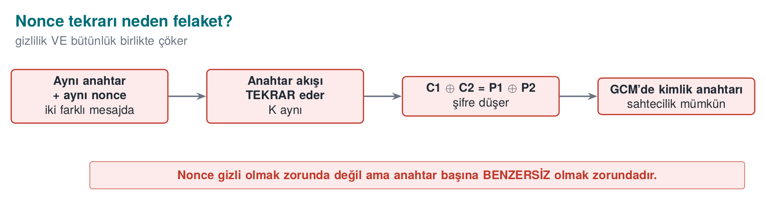
CEN429 Secure Programming · Week 10
Nonce Reuse — Diagram
RTEU Computer Engineering · 2026-2027 Fall
24

Slide 25
CEN429 Secure Programming · Week 10
ChaCha20-Poly1305
• An AEAD alternative to AES-GCM.
• Fast when there is no hardware AES support.
• The same nonce rule applies.
RTEU Computer Engineering · 2026-2027 Fall
25

Slide 26
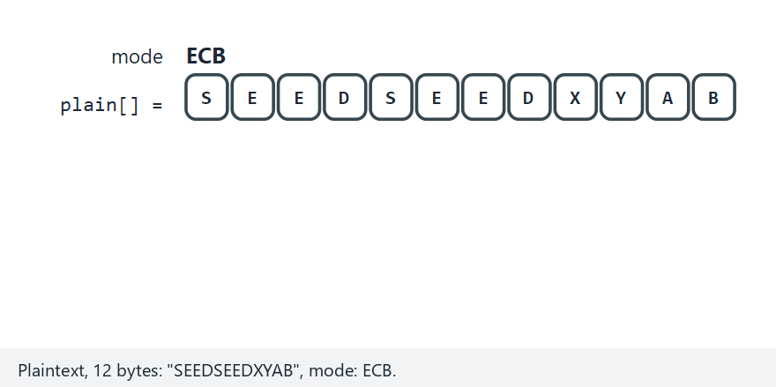
CEN429 Secure Programming · Week 10
Comparing the Modes — Animation
RTEU Computer Engineering · 2026-2027 Fall
26
Notes:
Speaker note: Same message, four modes. ECB: pattern leaks (same byte = same output). CBC: flipping one bit
garbles that block and flips the SAME bit one block later. CTR: flipping one bit changes EXACTLY one bit. The
GCM-like mode: tampering is REJECTED on tag mismatch.

Slide 27
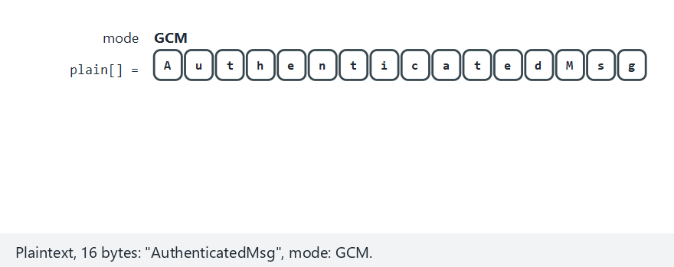
CEN429 Secure Programming · Week 10
Modes · Edge Case
RTEU Computer Engineering · 2026-2027 Fall
27
Notes:
Speaker note: GCM's fail-closed behavior — no plaintext at all when the tag doesn't match.

Slide 28
CEN429 Secure Programming · Week 10
Padding Oracle · the Problem, Step by Step
1. While decrypting CBC, the server gives a different response/timing for invalid padding versus invalid MAC.
2. The attacker modifies the ciphertext and watches the responses.
3. From the response difference, they decrypt the plaintext byte by byte.
RTEU Computer Engineering · 2026-2027 Fall
28

Slide 29
CEN429 Secure Programming · Week 10
Why Does It Happen?
• The error message/timing leaks internal state.
• The attacker uses this like an oracle.
RTEU Computer Engineering · 2026-2027 Fall
29

Slide 30
CEN429 Secure Programming · Week 10
The Fix
• Use AEAD (GCM): no padding, a single verification.
• If CBC is unavoidable: encrypt-then-MAC + one and the same error.
• A timing difference is a leak too → make it constant-time.
RTEU Computer Engineering · 2026-2027 Fall
30

Slide 31
CEN429 Secure Programming · Week 10
Lesson
Encryption alone is not enough; integrity and a consistent error are required.
The padding oracle is the classic example of a "usage mistake."
RTEU Computer Engineering · 2026-2027 Fall
31

Slide 32
CEN429 Secure Programming · Week 10
Section 1–2 — Quick Check
1. Explain the weakest-link rule with an example.
2. Why is ECB never used?
3. Why is nonce reuse catastrophic in GCM?
4. How does AEAD close off the padding oracle?
RTEU Computer Engineering · 2026-2027 Fall
32
Notes:
Speaker note: Next, MAC/HMAC and asymmetric crypto.

Slide 33
CEN429 Secure Programming · Week 10
Section 1–2 — Answers
1. A system is only as secure as its weakest component. E.g., using AES-256 but storing the key in a plain file → the key is the weakest link.
2. ECB turns the same plaintext block into the same ciphertext block → the pattern leaks, no semantic security.
3. The same key+nonce repeats the keystream (confidentiality collapses), and the GHASH authentication key can be recovered → catastrophe.
4. AEAD verifies the tag first and refuses to decrypt text with an invalid tag → no oracle is left for a padding error.
RTEU Computer Engineering · 2026-2027 Fall
33

Slide 34
CEN429 Secure Programming · Week 10
3. MAC, HMAC, and Integrity
RTEU Computer Engineering · 2026-2027 Fall
34

Slide 35
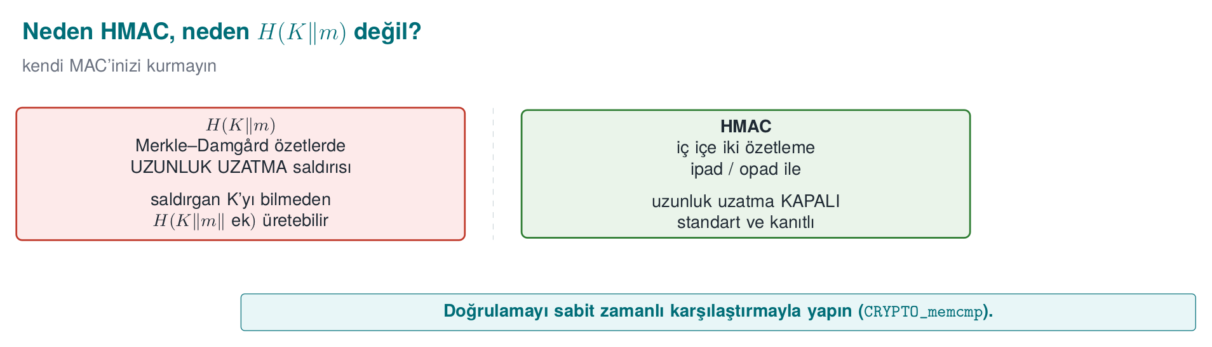
CEN429 Secure Programming · Week 10
Why HMAC — Diagram
RTEU Computer Engineering · 2026-2027 Fall
35

Slide 36
CEN429 Secure Programming · Week 10
Why MAC?
• Encryption gives confidentiality, not integrity.
• An attacker can modify the ciphertext.
• MAC: the message has not changed and came from the right party.
RTEU Computer Engineering · 2026-2027 Fall
36

Slide 37
CEN429 Secure Programming · Week 10
HMAC
• A MAC built on a digest function (HMAC-SHA256).
• A symmetric key; both parties know the same key.
• Verified with a constant-time comparison.
RTEU Computer Engineering · 2026-2027 Fall
37

Slide 38
CEN429 Secure Programming · Week 10
HMAC-SHA-256 · Real Output
Let's compute the HMAC of a payment instruction (a 32-byte key, fixed here only for the demo):
printf 'tutar=100;alici=TR00' | \
openssl dgst -sha256 -mac HMAC -macopt hexkey:$ANAHTAR
SHA2-256(stdin)= a08fb115...c5f9a1
RTEU Computer Engineering · 2026-2027 Fall
38

Slide 39
CEN429 Secure Programming · Week 10
HMAC-SHA-256 · Avalanche Effect
Using the same key, let's change only the amount (100 → 900):
SHA2-256(stdin)= 8a786eac...91a46be
A single-character change (1→9) makes the tag come out completely different — this is called the avalanche effect. Without knowing the key, an attacker cannot produce a valid new tag; the receiver catches the mismatch.
RTEU Computer Engineering · 2026-2027 Fall
39

Slide 40
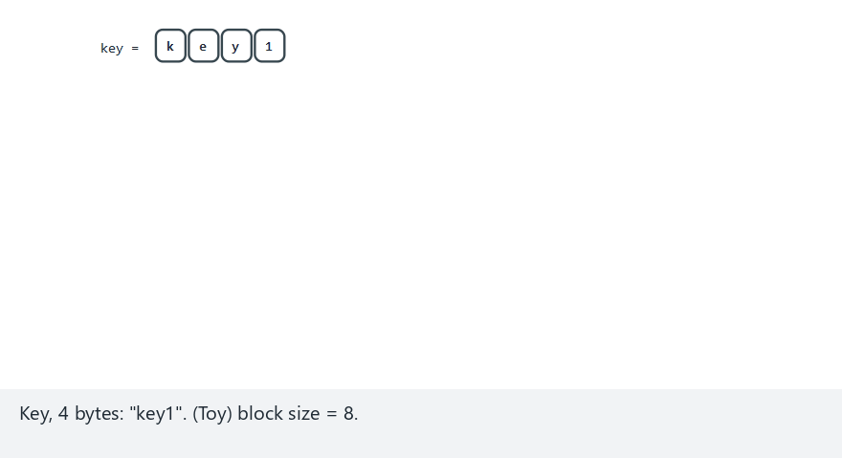
CEN429 Secure Programming · Week 10
HMAC · Inner/Outer Digest — Animation
RTEU Computer Engineering · 2026-2027 Fall
40
Notes:
Speaker note: K' xor ipad -> inner digest (with the message); K' xor opad -> outer digest (with the
inner digest) = the tag. Compare a short/long/exactly-one-block key.

Slide 41
CEN429 Secure Programming · Week 10
Constant-Time Comparison
/* YANLIS: ilk farkta durur, sure farki sizdirir */
if (memcmp(hesaplanan, gelen, 32) == 0) { /* kabul */ }
/* DOGRU: her zaman 32 baytin tamamini gezer */
if (CRYPTO_memcmp(hesaplanan, gelen, 32) == 0) { /* kabul */ }
Rule: always compare secret values such as a MAC/signature/password digest with a constant-time comparison; memcmp/== leaves an open door to a timing attack.
RTEU Computer Engineering · 2026-2027 Fall
41

Slide 42
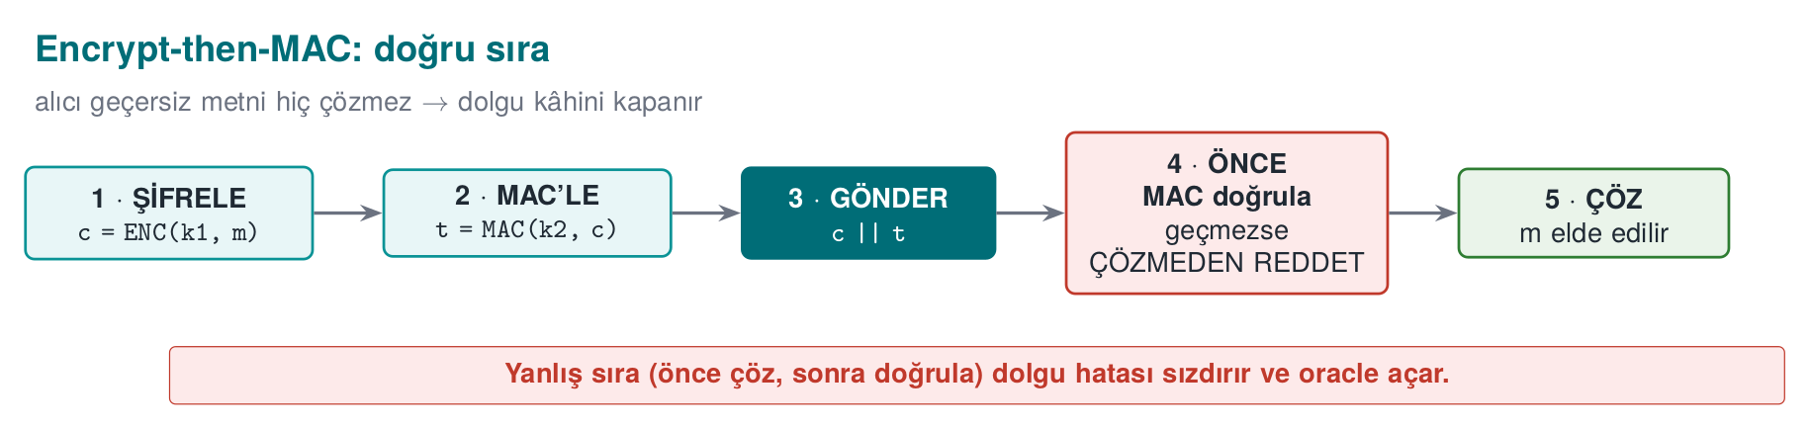
CEN429 Secure Programming · Week 10
Encrypt-then-MAC — Diagram
RTEU Computer Engineering · 2026-2027 Fall
42

Slide 43
CEN429 Secure Programming · Week 10
The Correct Order · Encrypt-then-MAC
1. şifrele: c = ENC(k1, m)
2. MAC'le: t = MAC(k2, c)
3. gönder: c || t
• Encrypt first, then MAC the ciphertext.
• If the MAC does not pass, don't even attempt to decrypt.
RTEU Computer Engineering · 2026-2027 Fall
43

Slide 44
CEN429 Secure Programming · Week 10
Wrong Orders
• MAC-then-encrypt: open to the padding oracle.
• Encrypt-and-MAC: the MAC can leak the plaintext.
• The correct way: encrypt-then-MAC (or AEAD, which already does this).
RTEU Computer Engineering · 2026-2027 Fall
44

Slide 45
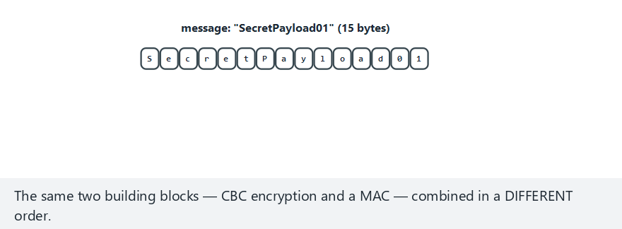
CEN429 Secure Programming · Week 10
Why the Order Matters — Animation
RTEU Computer Engineering · 2026-2027 Fall
45
Notes:
Speaker note: same tamper, two orders. EtM always rejects with the SAME failure (MAC). MtE can report TWO
DIFFERENT failures (padding / MAC) depending on what the tamper corrupted — that's the padding-oracle shape.

Slide 46
CEN429 Secure Programming · Week 10
Replay
• The attacker resends a valid message again.
• The MAC is valid (the message hasn't changed), but the operation is repeated.
• Fix: nonce, timestamp, counter.
RTEU Computer Engineering · 2026-2027 Fall
46

Slide 47
CEN429 Secure Programming · Week 10
AEAD Does It All
• AES-GCM: encryption + integrity together.
• "Associated data" (AAD) also authenticates headers/context.
• Modern choice: AEAD instead of a separate MAC.
RTEU Computer Engineering · 2026-2027 Fall
47

Slide 48
CEN429 Secure Programming · Week 10
This Section's Rule · MAC/HMAC
• Provide integrity with HMAC, not plain H(K‖m) (risk of length extension).
• When combining encryption + MAC, the order is encrypt-then-MAC.
• Tag/signature comparison must be constant-time; don't use a function with an early exit.
RTEU Computer Engineering · 2026-2027 Fall
48

Slide 49
CEN429 Secure Programming · Week 10
4. Asymmetric Cryptography: RSA and ECC
RTEU Computer Engineering · 2026-2027 Fall
49

Slide 50
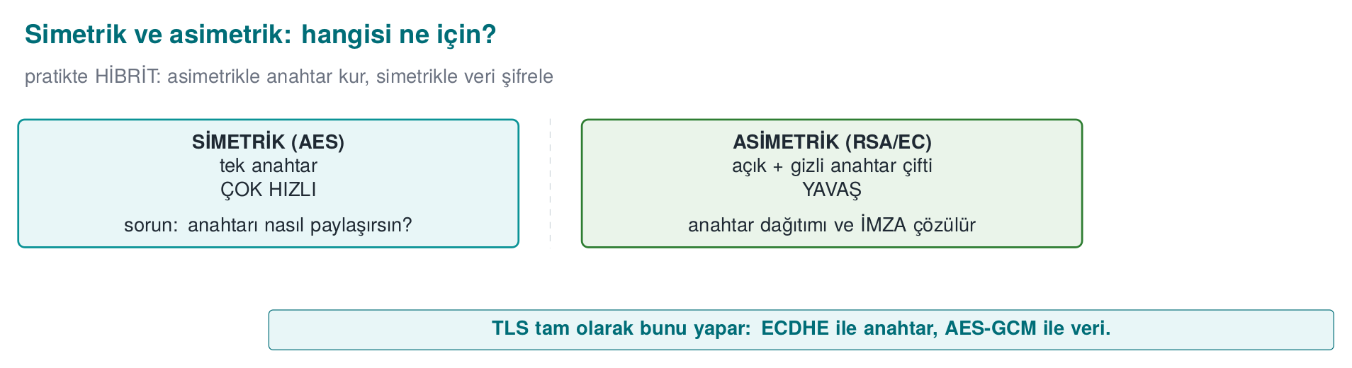
CEN429 Secure Programming · Week 10
Symmetric ↔ Asymmetric — Diagram
RTEU Computer Engineering · 2026-2027 Fall
50

Slide 51
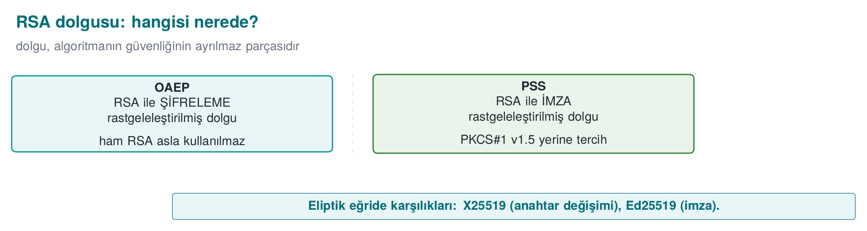
CEN429 Secure Programming · Week 10
OAEP / PSS — Diagram
RTEU Computer Engineering · 2026-2027 Fall
51

Slide 52
CEN429 Secure Programming · Week 10
RSA · Two Jobs
• Encryption: encrypt with the public key, decrypt with the private key.
• Signing: sign with the private key, verify with the public key.
• Large keys (2048+).
RTEU Computer Engineering · 2026-2027 Fall
52

Slide 53
CEN429 Secure Programming · Week 10
RSA · Padding Is Required
• Raw RSA is insecure.
• For encryption: OAEP padding.
• For signing: PSS padding.
• Old PKCS#1 v1.5: avoid where possible.
RTEU Computer Engineering · 2026-2027 Fall
53

Slide 54
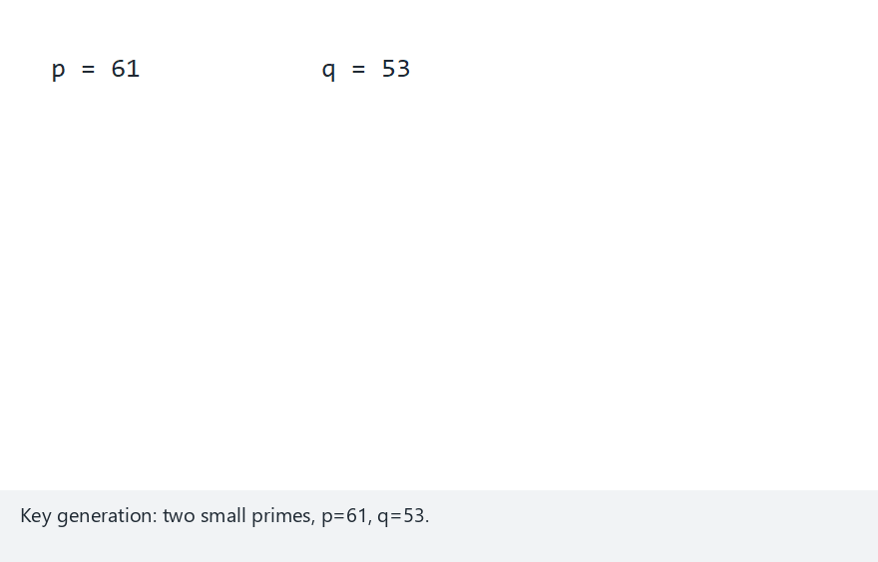
CEN429 Secure Programming · Week 10
Toy RSA · End to End — Animation
RTEU Computer Engineering · 2026-2027 Fall
54
Notes:
Speaker note: the classic p=61, q=53, e=17 example. n, phi, d; encrypt/decrypt/sign/verify are the same
exponentiation, only the exponent changes. Why a tampered signature and the wrong public key fail.

Slide 55
CEN429 Secure Programming · Week 10
OAEP vs PSS
• OAEP: RSA encryption padding.
• PSS: RSA signature padding.
• Common mix-up: OAEP is not for signing, PSS is not for encryption.
RTEU Computer Engineering · 2026-2027 Fall
55

Slide 56
CEN429 Secure Programming · Week 10
OAEP's Randomness · Command
Let's encrypt the same message twice with OAEP:
openssl pkeyutl -encrypt -pubin -inkey rsa_acik.pem -in kisa.txt -out c1.bin \
-pkeyopt rsa_padding_mode:oaep -pkeyopt rsa_oaep_md:sha256
openssl pkeyutl -encrypt -pubin -inkey rsa_acik.pem -in kisa.txt -out c2.bin \
-pkeyopt rsa_padding_mode:oaep -pkeyopt rsa_oaep_md:sha256
cmp c1.bin c2.bin && echo AYNI || echo FARKLI
RTEU Computer Engineering · 2026-2027 Fall
56

Slide 57
CEN429 Secure Programming · Week 10
OAEP's Randomness · Result
c1.bin c2.bin differ: char 1, line 1
FARKLI
Same key, same plaintext, but different ciphertext — OAEP mixes in a fresh random value on every encryption. Raw RSA (without padding) is deterministic (c = m^e mod n); that is why it is never used directly for encryption.
RTEU Computer Engineering · 2026-2027 Fall
57

Slide 58
CEN429 Secure Programming · Week 10
ECC · Why?
• The same security with a smaller key (256-bit ≈ RSA-3072).
• Faster, less space.
• Ideal for mobile/embedded.
RTEU Computer Engineering · 2026-2027 Fall
58

Slide 59
CEN429 Secure Programming · Week 10
Ed25519 and X25519
• Ed25519: the modern signature algorithm.
• X25519: modern key agreement (DH).
• Common mix-up: Ed25519 signs, X25519 exchanges keys.
RTEU Computer Engineering · 2026-2027 Fall
59

Slide 60
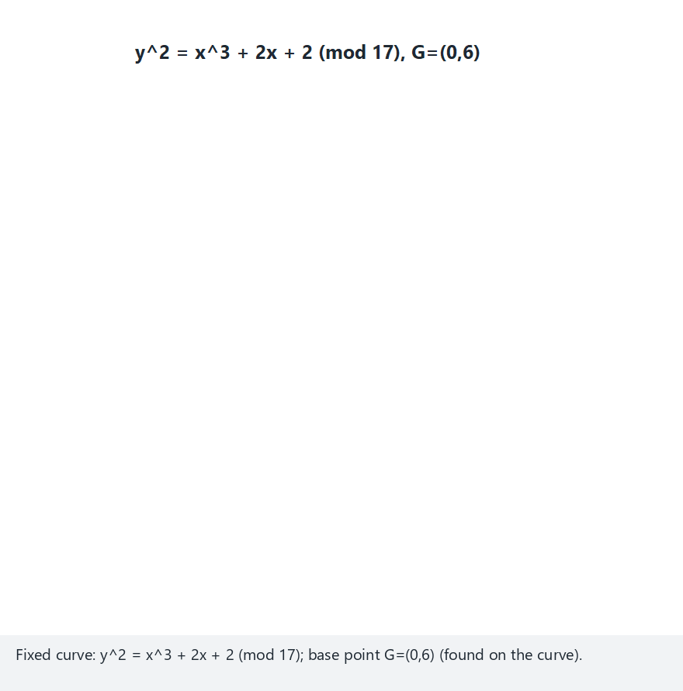
CEN429 Secure Programming · Week 10
ECDH · Point Addition — Animation
RTEU Computer Engineering · 2026-2027 Fall
60
Notes:
Speaker note: inside X25519/Ed25519 it's POINT ADDITION ON A CURVE instead of exponentiation. Same DH
idea, different math. Mallory intercepting still gives two different keys.

Slide 61
CEN429 Secure Programming · Week 10
RSA-3072 vs Ed25519 · Measurement
Both at roughly 128 bits of security (see the table in Section 1):
wc -c rsa_acik.pem ed_acik.pem
wc -c belge.rsa.sig belge.ed.sig
RTEU Computer Engineering · 2026-2027 Fall
61

Slide 62
CEN429 Secure Programming · Week 10
RSA-3072 vs Ed25519 · Result
File | RSA-3072 | Ed25519
Public key (PEM) | 636 bytes | 116 bytes
Signature | 384 bytes | 64 bytes
The public key is ~5.5 times smaller, the signature 6 times smaller. In IoT/mobile handshakes, in embedded flash, or on a blockchain, this difference adds up.
RTEU Computer Engineering · 2026-2027 Fall
62

Slide 63
CEN429 Secure Programming · Week 10
Symmetric + Asymmetric Together
1. X25519 ile ortak sır türet
2. Ondan bir AES anahtarı çıkar (KDF)
3. AES-GCM ile veriyi şifrele
• Asymmetric: carry the key. Symmetric: encrypt the data.
• TLS does exactly this.
RTEU Computer Engineering · 2026-2027 Fall
63

Slide 64
CEN429 Secure Programming · Week 10
Section 3–4 — Quick Check
1. Why is encrypt-then-MAC the correct order?
2. How is replay prevented?
3. Which is OAEP and which is PSS for?
4. What's the difference between Ed25519 and X25519?
RTEU Computer Engineering · 2026-2027 Fall
64
Notes:
Speaker note: Next, digital signature pitfalls and DH.

Slide 65
CEN429 Secure Programming · Week 10
Section 3–4 — Answers
1. The receiver verifies the MAC first; if it fails, it does not decrypt → a modified ciphertext is never processed (closes off the padding oracle).
2. Freshness: a nonce/counter, a timestamp + window, a one-time challenge.
3. OAEP = RSA encryption padding; PSS = RSA signature padding.
4. Ed25519 = signing (EdDSA); X25519 = key exchange (ECDH). Same curve family, different job.
RTEU Computer Engineering · 2026-2027 Fall
65

Slide 66
CEN429 Secure Programming · Week 10
5. Digital Signatures and Pitfalls
RTEU Computer Engineering · 2026-2027 Fall
66

Slide 67
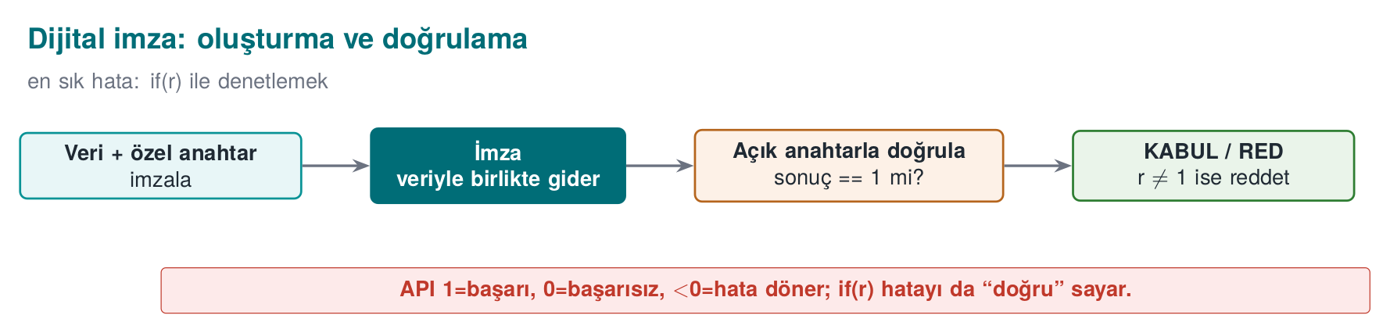
CEN429 Secure Programming · Week 10
Digital Signature — Diagram
RTEU Computer Engineering · 2026-2027 Fall
67

Slide 68
CEN429 Secure Programming · Week 10
Signature · What Does It Provide?
• Integrity: the message has not changed.
• Identity/non-repudiation: the private key holder signed it.
• Verification: with the public key, anyone can do it.
RTEU Computer Engineering · 2026-2027 Fall
68

Slide 69
CEN429 Secure Programming · Week 10
Signature · Where Is It Used?
• Signing software/updates.
• Certificates (CA signature).
• Signing documents/transactions.
• Server identity in TLS (CertificateVerify).
RTEU Computer Engineering · 2026-2027 Fall
69

Slide 70
CEN429 Secure Programming · Week 10
Pitfall 1 · Not Checking the Return Value
int r = EVP_DigestVerify(ctx, imza, n, veri, m);
if (r) guncellemeyi_kur(); /* HATALI */
A negative error value is also treated as "true." The correct check is r == 1.
RTEU Computer Engineering · 2026-2027 Fall
70

Slide 71
CEN429 Secure Programming · Week 10
Pitfall 2 · Not Including the Version in the Signature
• If the signature covers only the content, an attacker can install an old but validly signed version (downgrade).
• The signed content must also cover the version number; an old version must be rejected.
RTEU Computer Engineering · 2026-2027 Fall
71

Slide 72
CEN429 Secure Programming · Week 10
Pitfall 3 · Verifying with the Wrong Key
• Is the verification key trusted? Where did it come from?
• If you verify with the attacker's key, their signature is "valid."
• The key must be pinned, or come from a trusted chain.
RTEU Computer Engineering · 2026-2027 Fall
72

Slide 73
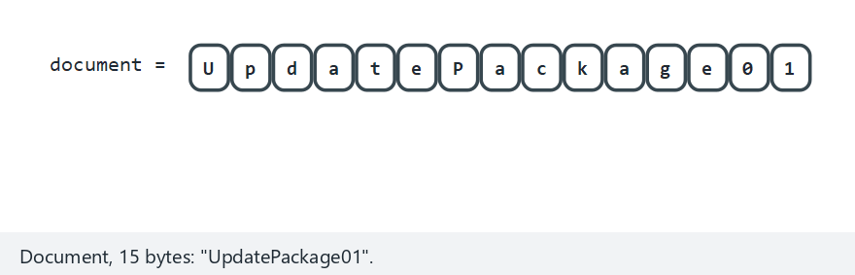
CEN429 Secure Programming · Week 10
Signature Verification · Three Scenarios — Animation
RTEU Computer Engineering · 2026-2027 Fall
73
Notes:
Speaker note: correct signature accepted; document tampered after signing -> rejected; a message signed
with the attacker's own key, checked against the REAL public key -> rejected.

Slide 74
CEN429 Secure Programming · Week 10
Signature · the Digest Rule
• A signature is really the signing of a digest.
• A weak digest (MD5/SHA-1) → a weak signature.
• Use SHA-256+.
RTEU Computer Engineering · 2026-2027 Fall
74

Slide 75
CEN429 Secure Programming · Week 10
6. Diffie–Hellman and MITM
RTEU Computer Engineering · 2026-2027 Fall
75

Slide 76
CEN429 Secure Programming · Week 10
DH · What Does It Do?
• Two parties derive a shared secret without sharing a private key.
• Key agreement over the network.
• The modern form: X25519.
RTEU Computer Engineering · 2026-2027 Fall
76

Slide 77
CEN429 Secure Programming · Week 10
DH · Step by Step (Concept)
Ali: a gizli, A = g^a açık gönderir
Veli: b gizli, B = g^b açık gönderir
Ortak sır: A^b = B^a = g^(ab)
An eavesdropper sees g^a and g^b but cannot compute g^(ab).
RTEU Computer Engineering · 2026-2027 Fall
77

Slide 78
CEN429 Secure Programming · Week 10
X25519 · Both Sides Reach the Same Secret
openssl genpkey -algorithm X25519 -out alice.key
openssl genpkey -algorithm X25519 -out bob.key
openssl pkey -in alice.key -pubout -out alice.pub
openssl pkey -in bob.key -pubout -out bob.pub
openssl pkeyutl -derive -inkey alice.key -peerkey bob.pub -out alice_sir.bin
openssl pkeyutl -derive -inkey bob.key -peerkey alice.pub -out bob_sir.bin
RTEU Computer Engineering · 2026-2027 Fall
78

Slide 79
CEN429 Secure Programming · Week 10
X25519 · Result
8c53744a000c1a6f...bbc1376
8c53744a000c1a6f...bbc1376
AYNI
Alice and Bob, without ever knowing each other's private key, reached the same 32-byte secret by exchanging only public keys over the network. This raw secret is not used directly as an AES key; it is first passed through a KDF (HKDF) to derive session keys.
RTEU Computer Engineering · 2026-2027 Fall
79

Slide 80
CEN429 Secure Programming · Week 10
Unauthenticated DH · MITM Risk
• If Alice and Bob don't verify each other's identity...
• An attacker sits in the middle: doing DH separately with Alice and separately with Bob.
• Listening to/modifying both.
RTEU Computer Engineering · 2026-2027 Fall
80

Slide 81
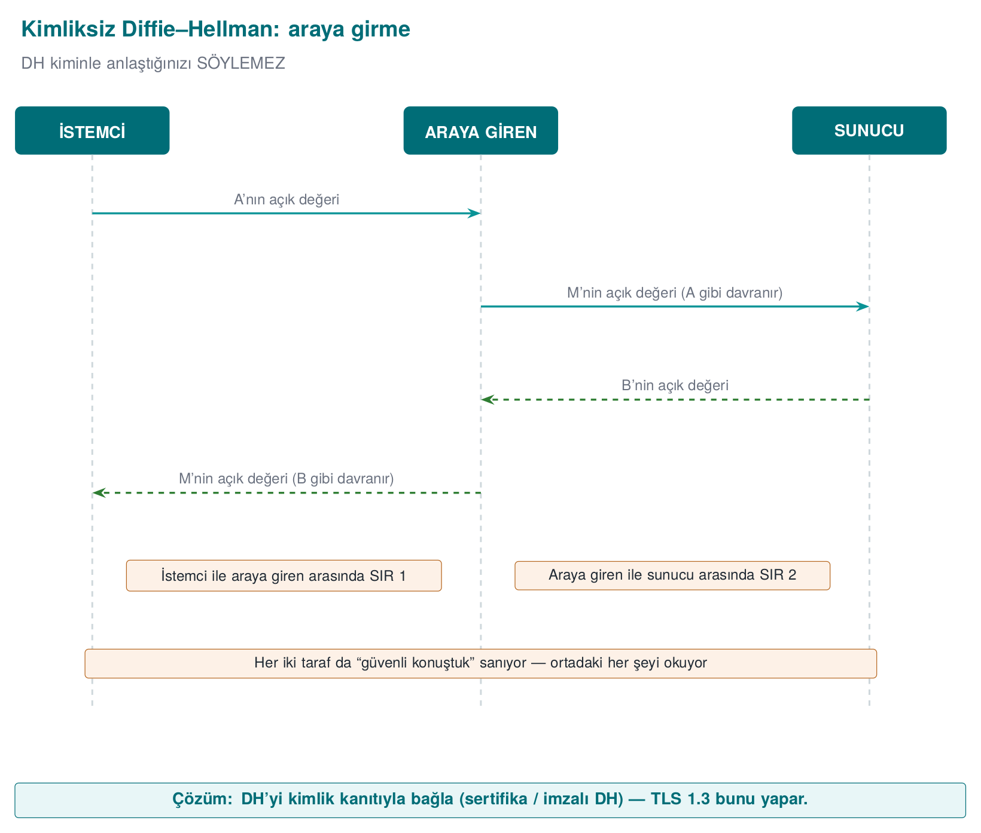
CEN429 Secure Programming · Week 10
Unauthenticated DH · MITM — Diagram
RTEU Computer Engineering · 2026-2027 Fall
81

Slide 82
CEN429 Secure Programming · Week 10
MITM · Diagram
Alice ↔ [Attacker] ↔ Bob
two separate DH exchanges; the attacker sits in the middle
Both sides think "I've established a secure channel."
RTEU Computer Engineering · 2026-2027 Fall
82

Slide 83
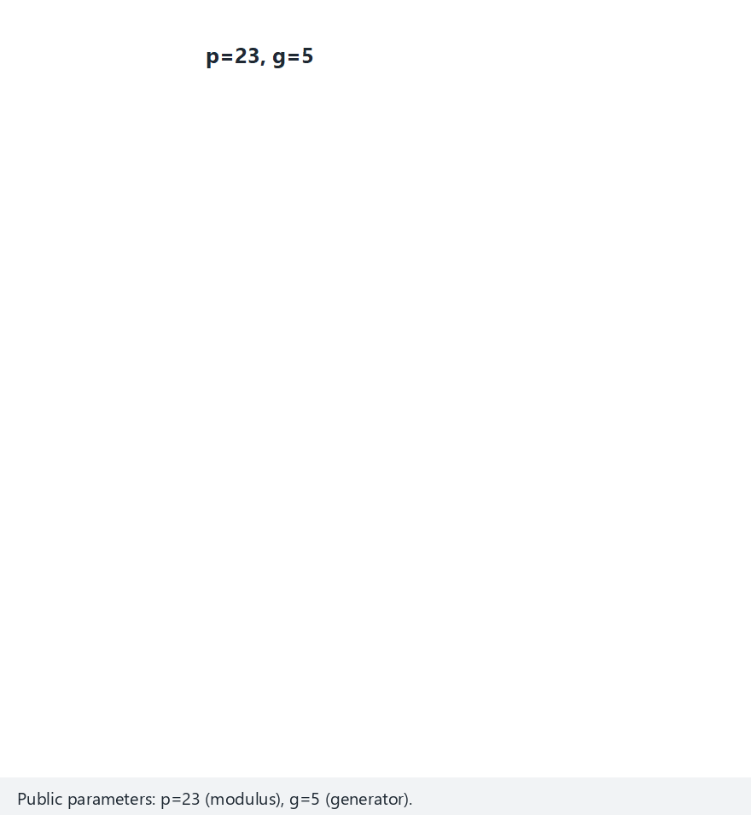
CEN429 Secure Programming · Week 10
DH and MITM — Animation
RTEU Computer Engineering · 2026-2027 Fall
83
Notes:
Speaker note: the classic p=23, g=5 example. First the honest exchange (Alice/Bob reach the same key).
Then Mallory intercepts: Alice gets one key, Bob gets a DIFFERENT key — both are really talking to Mallory.

Slide 84
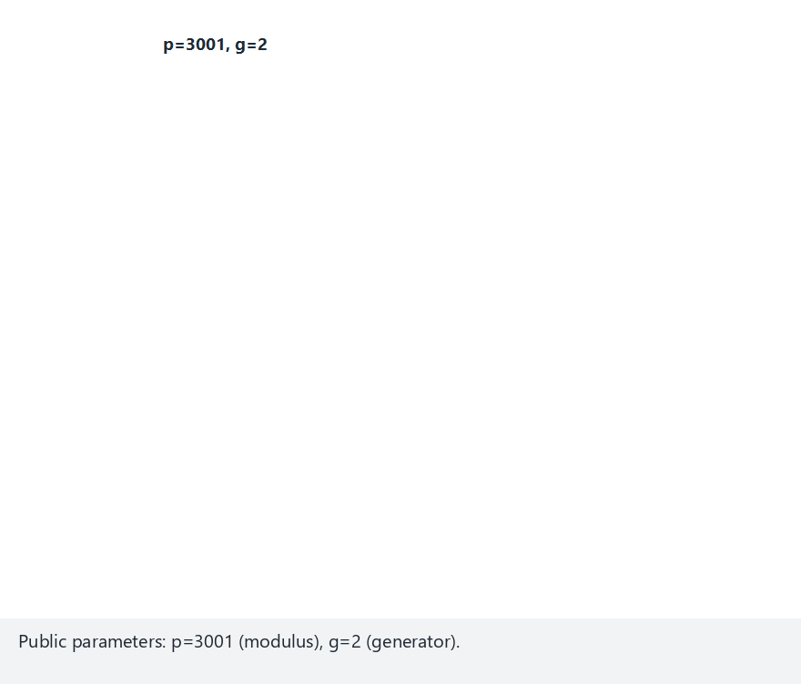
CEN429 Secure Programming · Week 10
DH/MITM · Edge Case
RTEU Computer Engineering · 2026-2027 Fall
84

Slide 85
CEN429 Secure Programming · Week 10
The Fix · Authenticated DH
• The DH values are signed with a key whose identity is known.
• CertificateVerify in TLS 1.3.
• The other side verifies this identity (certificate chain).
RTEU Computer Engineering · 2026-2027 Fall
85

Slide 86
CEN429 Secure Programming · Week 10
Forward Secrecy
• A new DH key for every session.
• Even if the long-term key leaks, old sessions cannot be decrypted.
• Modern TLS provides this.
RTEU Computer Engineering · 2026-2027 Fall
86

Slide 87
CEN429 Secure Programming · Week 10
Section 5–6 — Quick Check
1. Why is if (r) wrong in signature verification?
2. Why must the version be part of the signature?
3. How does MITM happen against unauthenticated DH? The fix?
4. What does forward secrecy provide?
RTEU Computer Engineering · 2026-2027 Fall
87
Notes:
Speaker note: Next, PKI, X.509, chain, revocation.

Slide 88
CEN429 Secure Programming · Week 10
Section 5–6 — Answers
1. Verification returns 1=success, 0=failure, <0=error; if (r) also treats the error (−1) as "true." Check for `r == 1`.
2. Otherwise an attacker can present an old/insecure version as "valid" with the same signature (downgrade). The version must be part of the signed data.
3. The attacker establishes a separate key with each side. Fix: bind DH to authentication (signed DH / a certificate).
4. Each session uses an ephemeral key; even if the long-term key leaks, past sessions cannot be decrypted.
RTEU Computer Engineering · 2026-2027 Fall
88

Slide 89
CEN429 Secure Programming · Week 10
7. Public Key Infrastructure (PKI)
RTEU Computer Engineering · 2026-2027 Fall
89

Slide 90
CEN429 Secure Programming · Week 10
The Problem · Who Do We Trust?
• You've seen a public key. Does it really belong to that person/site?
• A malicious actor can present their own key as "the bank."
• PKI solves this trust problem.
RTEU Computer Engineering · 2026-2027 Fall
90

Slide 91
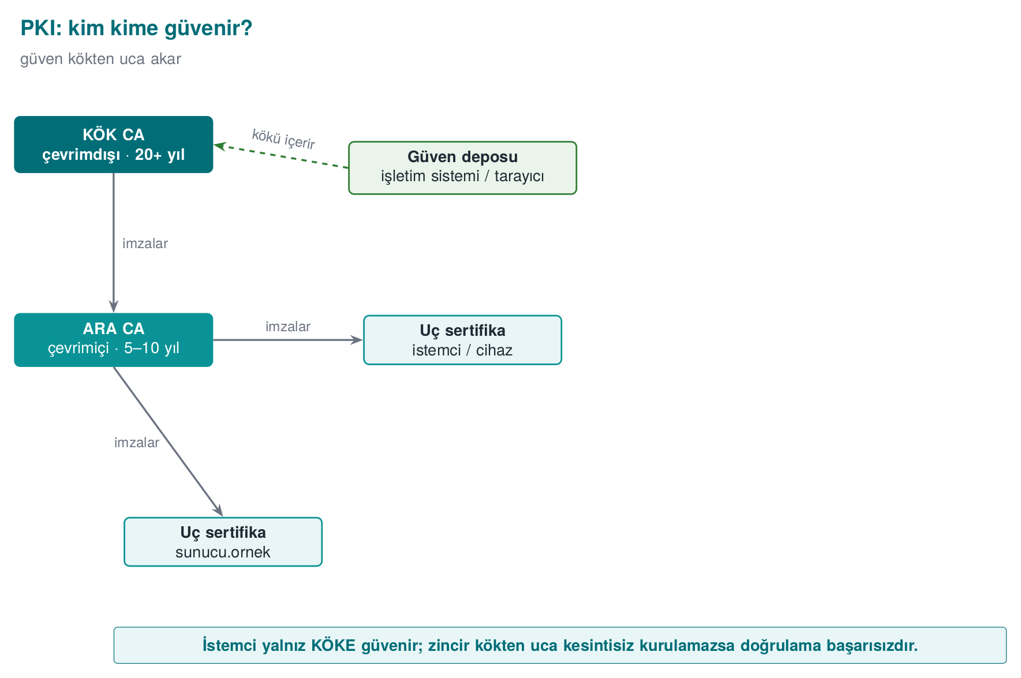
CEN429 Secure Programming · Week 10
Chain of Trust
Each level signs the one below it.
RTEU Computer Engineering · 2026-2027 Fall
91

Slide 92
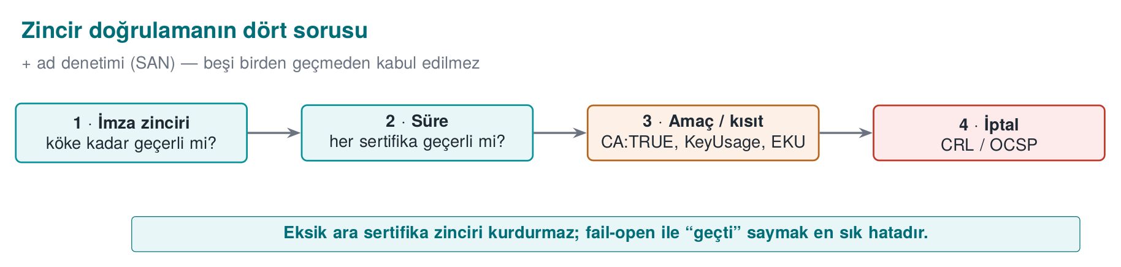
CEN429 Secure Programming · Week 10
Chain Validation — Diagram
RTEU Computer Engineering · 2026-2027 Fall
92

Slide 93
CEN429 Secure Programming · Week 10
Root and Intermediate CA
• Root CA: offline, self-signed, heavily protected.
• Intermediate CA: issues day-to-day certificates.
• If the root leaks, it's a catastrophe; this is why an intermediate CA is used.
RTEU Computer Engineering · 2026-2027 Fall
93

Slide 94
CEN429 Secure Programming · Week 10
Trust Store
• The OS/browser carries the trusted root CAs.
• If a chain reaches one of these roots, it is trusted.
• If it can't, it is untrusted.
RTEU Computer Engineering · 2026-2027 Fall
94

Slide 95
CEN429 Secure Programming · Week 10
Four Questions
When validating a certificate chain:
1. Is the signature valid? (at every level)
2. Does the chain reach a trusted root?
3. Has the validity period not expired?
4. Does the name match (SAN)?
All four must be yes.
RTEU Computer Engineering · 2026-2027 Fall
95

Slide 96
CEN429 Secure Programming · Week 10
Question 1 · Chain (Issuer/Subject)
openssl x509 -in sunucu.crt -noout -issuer -subject
openssl x509 -in ara.crt -noout -issuer -subject
openssl x509 -in kok.crt -noout -issuer -subject
issuer=CN=...Ara CA subject=CN=localhost
issuer=CN=...Kok CA subject=CN=...Ara CA
issuer=CN=...Kok CA subject=CN=...Kok CA
The chain reads: sunucu's issuer = ara's subject; the root signs itself.
RTEU Computer Engineering · 2026-2027 Fall
96

Slide 97
CEN429 Secure Programming · Week 10
Question 2 · Validity
openssl x509 -in sunucu.crt -noout -dates
openssl x509 -in sunucu.crt -noout -checkend 0
notBefore=Sep 23 2026 GMT
notAfter=Dec 22 2026 GMT
Certificate will not expire
-checkend 0: "has it expired as of right now?" TLS clients ask this automatically on every connection.
RTEU Computer Engineering · 2026-2027 Fall
97

Slide 98
CEN429 Secure Programming · Week 10
Question 3 · Usage (CA:TRUE/FALSE)
openssl x509 -in sunucu.crt -noout -ext basicConstraints,keyUsage
openssl x509 -in ara.crt -noout -ext basicConstraints,keyUsage
sunucu.crt: CA:FALSE (baska sertifika imzalayamaz)
ara.crt: CA:TRUE, pathlen:0 (yalniz uc sertifika imzalayabilir)
RTEU Computer Engineering · 2026-2027 Fall
98

Slide 99
CEN429 Secure Programming · Week 10
Question 4 · Name (SAN)
X509v3 Subject Alternative Name:
DNS:localhost, IP Address:127.0.0.1
The client compares the address it connected to against this list — not the CN in Subject.
A client library asks these four questions on your behalf; turning off verify or swallowing errors means none of the four questions are ever asked.
RTEU Computer Engineering · 2026-2027 Fall
99

Slide 100
CEN429 Secure Programming · Week 10
With OpenSSL · Example
openssl verify -CAfile kok.crt \
-untrusted ara.crt sunucu.crt
• -CAfile: the trusted root.
• -untrusted: the intermediate certificate(s).
RTEU Computer Engineering · 2026-2027 Fall
100

Slide 101
CEN429 Secure Programming · Week 10
SPKI Pinning
• The application embeds the digest of the expected server key.
• Even a fake but "valid" certificate is not accepted.
• A backup pin is required (so you're not locked out when the key changes).
RTEU Computer Engineering · 2026-2027 Fall
101

Slide 102
CEN429 Secure Programming · Week 10
This Section's Rule · Chain Validation
• Don't skip any of the chain validation's four questions (signature, validity, usage, name).
• verify does not check the name — SAN checking must be done separately.
• Even a cryptographically correct chain can't connect if the server doesn't send the intermediate certificate.
RTEU Computer Engineering · 2026-2027 Fall
102

Slide 103
CEN429 Secure Programming · Week 10
8. The X.509 Certificate
RTEU Computer Engineering · 2026-2027 Fall
103

Slide 104
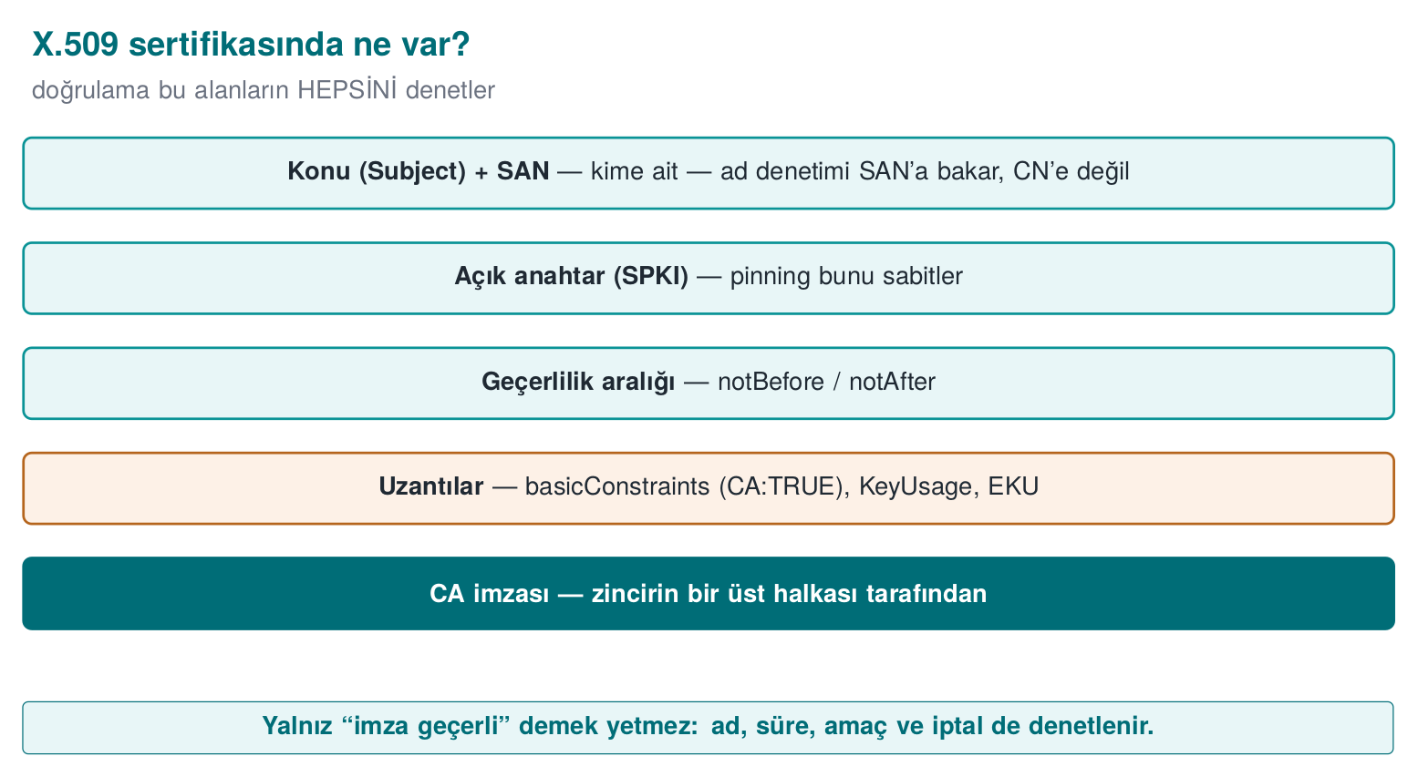
CEN429 Secure Programming · Week 10
X.509 Fields — Diagram
RTEU Computer Engineering · 2026-2027 Fall
104

Slide 105
CEN429 Secure Programming · Week 10
What's Inside?
• Subject: who it belongs to (domain name).
• Public key.
• Validity: start/end.
• Issuer: which CA signed it.
• Signature.
RTEU Computer Engineering · 2026-2027 Fall
105

Slide 106
CEN429 Secure Programming · Week 10
SAN · Name Checking
• SAN (Subject Alternative Name): the domain names the certificate is valid for.
• Name checking is done against the SAN, not the CN.
• A certificate for example.com must not be valid for baska.com.
RTEU Computer Engineering · 2026-2027 Fall
106

Slide 107
CEN429 Secure Programming · Week 10
Real Certificate · Top-Level Fields
Version: 3 (0x2)
Serial Number: 35:e2:f6:8d:...:76:e7
Signature Algorithm: ecdsa-with-SHA256
Issuer: CN=CEN429 Lab Ara CA
Validity: Sep 23 2026 – Dec 22 2026
Subject: CN=localhost
Subject Public Key Info: 256 bit, NIST CURVE: P-256
Real openssl x509 -text output; each field carries the answer to one of the "four questions" (next section).
RTEU Computer Engineering · 2026-2027 Fall
107

Slide 108
CEN429 Secure Programming · Week 10
Real Certificate · Extensions
X509v3 Basic Constraints: CA:FALSE
X509v3 Key Usage: critical, Digital Signature
X509v3 Extended Key Usage: TLS Web Server Authentication
X509v3 Subject Alternative Name:
DNS:localhost, IP Address:127.0.0.1
X509v3 Authority Key Identifier: F5:BA:39:86:...
The Authority Key Identifier is the fingerprint of the CA that signed the certificate; when building the chain, it prevents confusion with a "fake intermediate CA with the same name but a different key."
RTEU Computer Engineering · 2026-2027 Fall
108

Slide 109
CEN429 Secure Programming · Week 10
9. Building a Certificate Chain with OpenSSL
RTEU Computer Engineering · 2026-2027 Fall
109

Slide 110
CEN429 Secure Programming · Week 10
Goal
Let's build a small chain:
Root CA → Intermediate CA → Server certificate.
Then let's validate it with verify and see the typical mistake.
RTEU Computer Engineering · 2026-2027 Fall
110

Slide 111
CEN429 Secure Programming · Week 10
Step 1 · Root CA (Self-Signed)
openssl req -x509 -newkey ed25519 \
-keyout kok.key -out kok.crt \
-subj "/CN=Ders Kok CA" -days 3650 -nodes
The root signs itself; it is kept offline.
RTEU Computer Engineering · 2026-2027 Fall
111

Slide 112
CEN429 Secure Programming · Week 10
Step 2 · Intermediate CA (Signed by the Root)
openssl req -newkey ed25519 -keyout ara.key \
-out ara.csr -subj "/CN=Ders Ara CA" -nodes
openssl x509 -req -in ara.csr -CA kok.crt -CAkey kok.key \
-CAcreateserial -out ara.crt -days 1825
RTEU Computer Engineering · 2026-2027 Fall
112

Slide 113
CEN429 Secure Programming · Week 10
Step 3 · Server Certificate (Signed by the Intermediate)
openssl req -newkey ed25519 -keyout sunucu.key \
-out sunucu.csr -subj "/CN=ornek.test" -nodes
openssl x509 -req -in sunucu.csr -CA ara.crt -CAkey ara.key \
-CAcreateserial -out sunucu.crt -days 365
RTEU Computer Engineering · 2026-2027 Fall
113

Slide 114
CEN429 Secure Programming · Week 10
Step 4 · Validate (Missing Intermediate)
openssl verify -CAfile kok.crt sunucu.crt
# HATA: unable to get local issuer certificate
The chain can't reach the root: the intermediate certificate is missing.
RTEU Computer Engineering · 2026-2027 Fall
114

Slide 115
CEN429 Secure Programming · Week 10
Step 5 · Validate (With the Intermediate)
openssl verify -CAfile kok.crt \
-untrusted ara.crt sunucu.crt
# OK
Given the intermediate certificate, the chain is complete.
RTEU Computer Engineering · 2026-2027 Fall
115

Slide 116
CEN429 Secure Programming · Week 10
Lesson
• The server must also send the intermediate certificate.
• If it's missing, the client says "issuer not found."
• The most common TLS configuration mistake in the field.
RTEU Computer Engineering · 2026-2027 Fall
116

Slide 117
CEN429 Secure Programming · Week 10
The Chain's Four Questions · in Practice
• Signature: each level signed by the one above ✓
• Root: -CAfile kok.crt trust store ✓
• Validity: within -days ✓
• Name: SAN checking in the application (verify does not check the name!)
RTEU Computer Engineering · 2026-2027 Fall
117

Slide 118
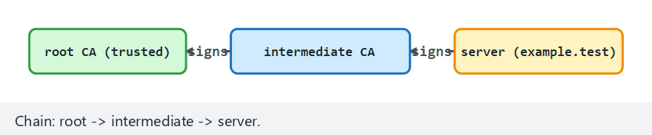
CEN429 Secure Programming · Week 10
Chain Validation · Six Scenarios — Animation
RTEU Computer Engineering · 2026-2027 Fall
118
Notes:
Speaker note: missing intermediate, expired, wrong root, CA:FALSE issuer, wrong hostname, complete chain
— all answer the same four questions.

Slide 119
CEN429 Secure Programming · Week 10
Chain · Edge Case (Expired)
RTEU Computer Engineering · 2026-2027 Fall
119

Slide 120
CEN429 Secure Programming · Week 10
Turning Off Certificate Validation
/* ASLA: */
SSL_CTX_set_verify(ctx, SSL_VERIFY_NONE, NULL);
This opens the door to MITM. A line left in "for testing" is a catastrophe in the field.
RTEU Computer Engineering · 2026-2027 Fall
120

Slide 121
CEN429 Secure Programming · Week 10
Skipping Name Checking
• If the chain is valid but the name is not verified, the attacker's valid certificate is accepted.
• The hostname (SAN) must always be checked.
RTEU Computer Engineering · 2026-2027 Fall
121

Slide 122
CEN429 Secure Programming · Week 10
Critical Reading Rule
Ask this when reading TLS setup code:
• Is validation turned on?
• Is the name checked?
• Is it fail-closed on error?
RTEU Computer Engineering · 2026-2027 Fall
122

Slide 123
CEN429 Secure Programming · Week 10
10. Certificate Revocation
RTEU Computer Engineering · 2026-2027 Fall
123

Slide 124
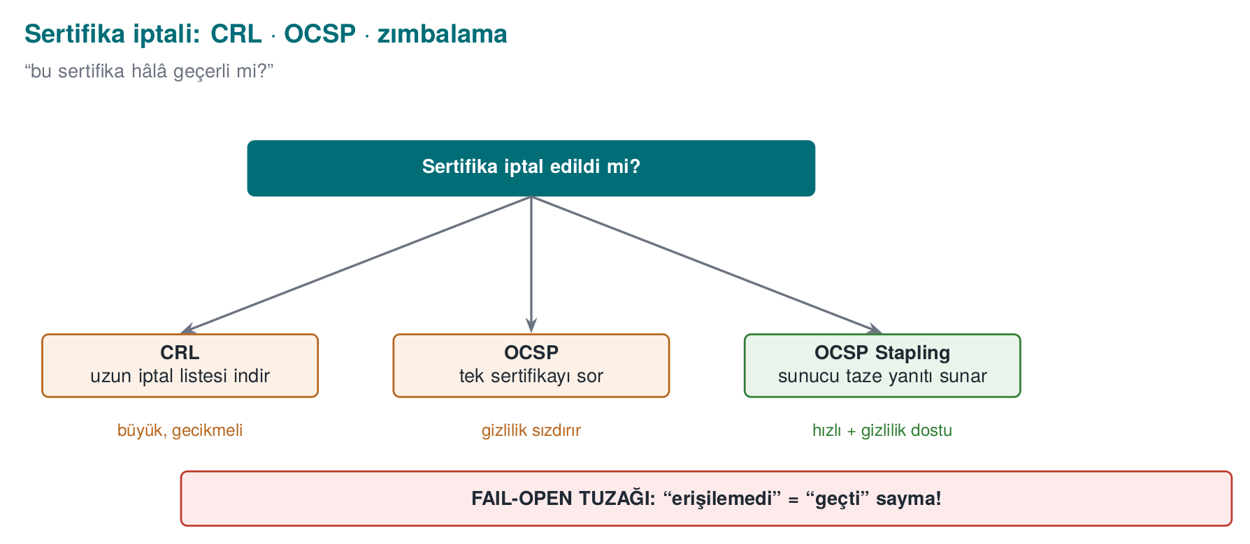
CEN429 Secure Programming · Week 10
Certificate Revocation — Diagram
RTEU Computer Engineering · 2026-2027 Fall
124

Slide 125
CEN429 Secure Programming · Week 10
Why Revoke?
• If a certificate's private key leaks, it must be revoked before it expires.
• A revoked certificate must not be accepted.
RTEU Computer Engineering · 2026-2027 Fall
125

Slide 126
CEN429 Secure Programming · Week 10
CRL
• CRL: a periodic list of revoked certificates.
• Can be large, and can be out of date.
RTEU Computer Engineering · 2026-2027 Fall
126

Slide 127
CEN429 Secure Programming · Week 10
OCSP
• OCSP: asking about a certificate's status on the spot.
• More current; but has privacy/speed issues.
RTEU Computer Engineering · 2026-2027 Fall
127

Slide 128
CEN429 Secure Programming · Week 10
OCSP Stapling
• The server fetches the OCSP response itself and presents it along with the certificate.
• Gains privacy + speed.
RTEU Computer Engineering · 2026-2027 Fall
128

Slide 129
CEN429 Secure Programming · Week 10
CRL Workflow · Revoke and Generate
openssl ca -config ara.cnf -revoke sunucu.crt
openssl ca -config ara.cnf -gencrl -out ara.crl
Revoking Certificate 35E2F68D...76E7.
Database updated
The certificate file does not change; only a revocation record is added to the CA's ledger (index.txt). -gencrl turns this record into a list signed with the CA's own key.
RTEU Computer Engineering · 2026-2027 Fall
129

Slide 130
CEN429 Secure Programming · Week 10
Validating with a CRL · Result
openssl verify -crl_check -CAfile kok.crt \
-untrusted ara.crt -CRLfile ara.crl sunucu.crt
error 23 at 0 depth lookup: certificate revoked
error sunucu.crt: verification failed
Even though the certificate has not yet expired, it is rejected because it is listed in the CRL — revocation checking works independently of validity checking.
RTEU Computer Engineering · 2026-2027 Fall
130

Slide 131
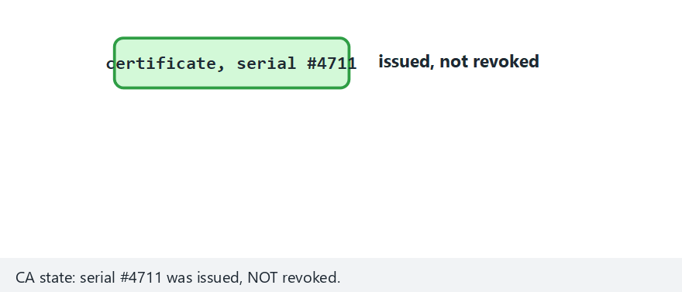
CEN429 Secure Programming · Week 10
CRL vs OCSP — Animation
RTEU Computer Engineering · 2026-2027 Fall
131
Notes:
Speaker note: OCSP is always LIVE. A CRL is cacheable but can go STALE — once nextUpdate passes it must
say "stale," not "good." In the edge case a stale CRL does NOT show the revocation.

Slide 132
CEN429 Secure Programming · Week 10
⚠️ The Fail-Open Trap
• Accepting a certificate when OCSP is unreachable = fail-open.
• An attacker can block OCSP and slip a revoked certificate through.
• Mitigation: Must-Staple, short-lived certificates.
RTEU Computer Engineering · 2026-2027 Fall
132

Slide 133
CEN429 Secure Programming · Week 10
Section 7–10 — Quick Check
1. What are the four questions of chain validation?
2. What is name checking done against (CN or SAN)?
3. Why does a missing intermediate certificate break verify?
4. What is fail-open, and how is it mitigated?
RTEU Computer Engineering · 2026-2027 Fall
133
Notes:
Speaker note: Next, HSM, PKCS#11, PQC, project.

Slide 134
CEN429 Secure Programming · Week 10
Section 7–10 — Answers
1. (1) is the chain valid to the root, (2) is it within its validity period, (3) does it have the right purpose/constraint (CA:TRUE, KeyUsage/EKU), (4) has it been revoked (CRL/OCSP).
2. SAN (Subject Alternative Name); CN is no longer used.
3. The chain cannot be built to the root; the trust path is never completed → failure. The server must also send the intermediate certificate.
4. Fail-open: counting an error/unreachability as "passed." Mitigation: fail-closed, OCSP stapling / must-staple, reject on error.
RTEU Computer Engineering · 2026-2027 Fall
134

Slide 135
CEN429 Secure Programming · Week 10
11. Storing Keys in Hardware
RTEU Computer Engineering · 2026-2027 Fall
135

Slide 136
CEN429 Secure Programming · Week 10
What Is an HSM?
• HSM: dedicated hardware that stores/operates keys.
• The key never leaves the HSM; you say "sign this," and the result comes back.
• Tamper-resistant.
RTEU Computer Engineering · 2026-2027 Fall
136

Slide 137
CEN429 Secure Programming · Week 10
PKCS#11
• The standard interface for talking to key modules.
• The application never sees the value of the key.
• HSMs and software simulations expose this same interface.
RTEU Computer Engineering · 2026-2027 Fall
137

Slide 138
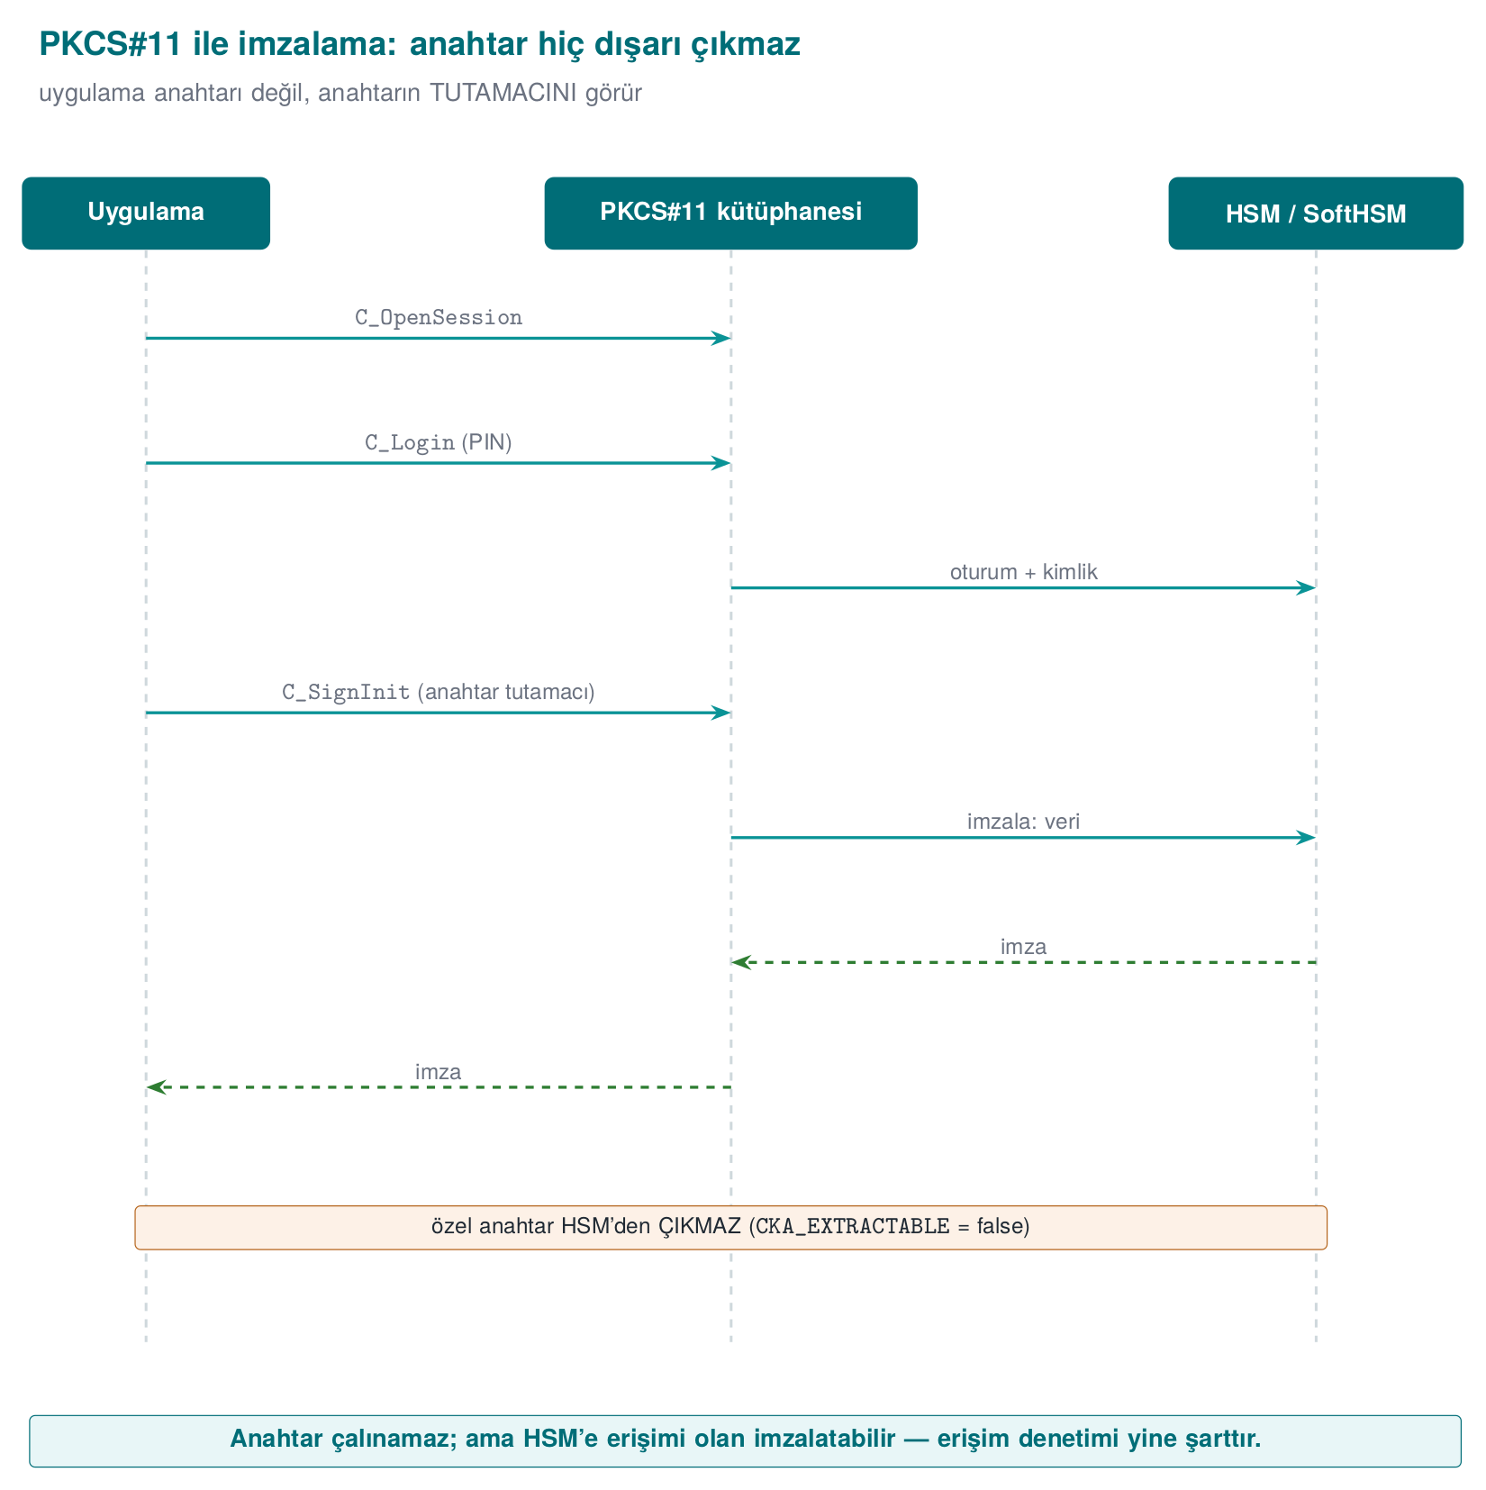
CEN429 Secure Programming · Week 10
Signing with PKCS#11 — Diagram
RTEU Computer Engineering · 2026-2027 Fall
138

Slide 139
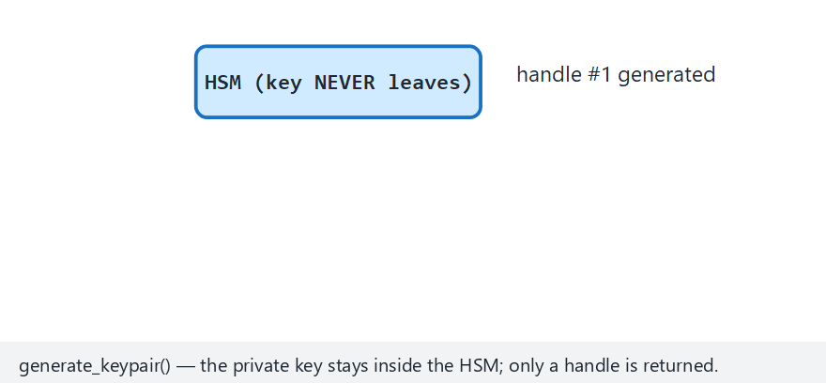
CEN429 Secure Programming · Week 10
The Key Never Leaves — Animation
RTEU Computer Engineering · 2026-2027 Fall
139
Notes:
Speaker note: generate_keypair() returns only a HANDLE. sign(handle, data) computes the signature INSIDE
the HSM. An unknown/destroyed handle is rejected; a signature made under one handle does not verify under
another.

Slide 140
CEN429 Secure Programming · Week 10
SoftHSM
• A software simulation of an HSM; the same PKCS#11 interface.
• For development/testing; no real hardware protection.
• A real HSM in production.
RTEU Computer Engineering · 2026-2027 Fall
140

Slide 141
CEN429 Secure Programming · Week 10
Why Hardware?
• In software, the key is exposed to a whitebox attacker (Week 11).
• In hardware, the key is isolated → far stronger.
• If possible, never put the key in software at all.
RTEU Computer Engineering · 2026-2027 Fall
141

Slide 142
CEN429 Secure Programming · Week 10
Key Lifecycle
Stage | What's Done
Generation | Strong randomness (CSPRNG)
Storage | HSM/TEE or protected
Use | Least privilege, constant-time
Crypto-period | A lifespan limit
Renewal | Regular
Destruction | Secure erasure from memory
RTEU Computer Engineering · 2026-2027 Fall
142

Slide 143
CEN429 Secure Programming · Week 10
This Section's Rule · Key Storage
• When generating a valuable key, CKA_EXTRACTABLE=false must be set explicitly; don't rely on the default.
• On an HSM the key never leaves; the application only says "sign" through a handle.
• SoftHSM is for testing; production requires a real HSM/hardware protection.
RTEU Computer Engineering · 2026-2027 Fall
143

Slide 144
CEN429 Secure Programming · Week 10
12. Post-Quantum Cryptography
RTEU Computer Engineering · 2026-2027 Fall
144

Slide 145
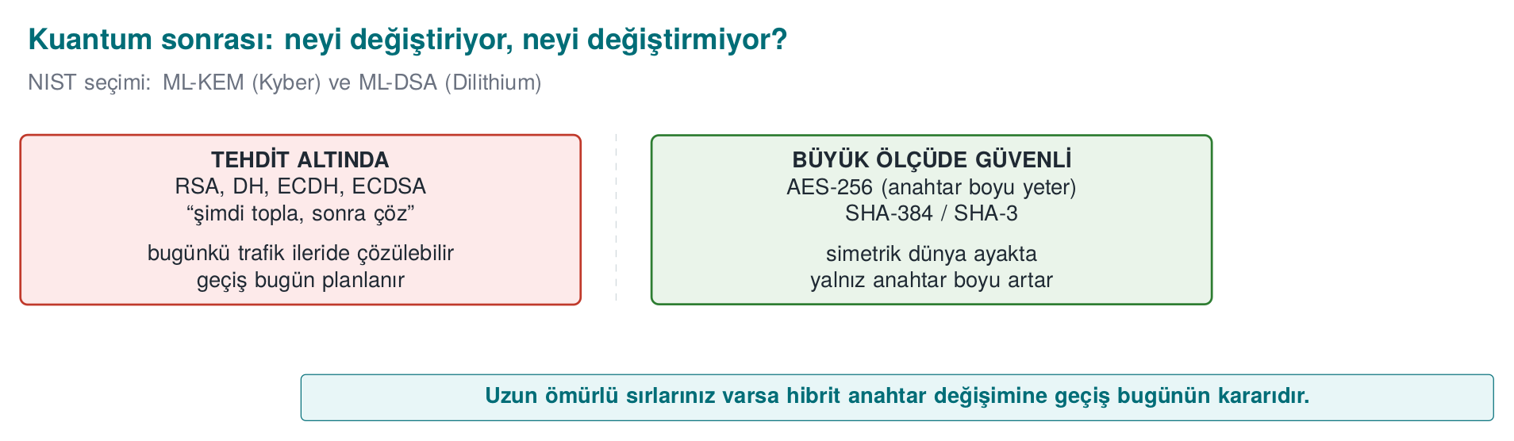
CEN429 Secure Programming · Week 10
Post-Quantum — Diagram
RTEU Computer Engineering · 2026-2027 Fall
145

Slide 146
CEN429 Secure Programming · Week 10
The Threat
• A sufficiently powerful quantum computer could break today's RSA/ECC.
• The "harvest now, decrypt later" attack: store encrypted data today, decrypt it in the future.
RTEU Computer Engineering · 2026-2027 Fall
146

Slide 147
CEN429 Secure Programming · Week 10
PQC · Approach
• Quantum-resistant algorithms (e.g., ML-KEM key encapsulation).
• Standardization is ongoing.
• Crypto agility: a design that lets you swap the algorithm easily.
RTEU Computer Engineering · 2026-2027 Fall
147

Slide 148
CEN429 Secure Programming · Week 10
PQC Sizes · Command
OpenSSL 3.5 can generate the standardized PQC algorithms today:
openssl genpkey -algorithm ML-KEM-768 -out mlkem.pem
openssl genpkey -algorithm ML-DSA-65 -out mldsa.pem
openssl pkeyutl -sign -inkey mldsa.pem -rawin -in belge.txt -out belge.mldsa.sig
wc -c mlkem_pub.pem mldsa_pub.pem belge.mldsa.sig
RTEU Computer Engineering · 2026-2027 Fall
148

Slide 149
CEN429 Secure Programming · Week 10
PQC Sizes · Result
Algorithm | Public Key | Signature
Ed25519 (classical) | 116 bytes | 64 bytes
RSA-3072 (classical) | 636 bytes | 384 bytes
ML-KEM-768 (PQC) | 1,714 bytes | —
ML-DSA-65 (PQC) | 2,770 bytes | 3,309 bytes
ML-DSA-65: the public key is ~24 times larger than Ed25519's, the signature ~52 times larger. TLS's hybrid (classical + PQC) approach exists to manage this transition cost.
RTEU Computer Engineering · 2026-2027 Fall
149

Slide 150
CEN429 Secure Programming · Week 10
What Should You Do Today?
• Be crypto-agile (don't hardcode the algorithm).
• Watch PQC for long-lived secrets.
• No panic; but prepare.
RTEU Computer Engineering · 2026-2027 Fall
150

Slide 151
CEN429 Secure Programming · Week 10
13. Project: This Week (S8, S11)
RTEU Computer Engineering · 2026-2027 Fall
151

Slide 152
CEN429 Secure Programming · Week 10
Project · S8/S11
• Algorithm inventory: purpose, algorithm, mode, key length, library.
• key lifecycle table.
•
•
RTEU Computer Engineering · 2026-2027 Fall
152

Slide 153
CEN429 Secure Programming · Week 10
End to End: a Crypto Design Case Study
A mobile app:
• Encrypts sensitive data locally.
• Talks to a server securely.
• Verifies updates.
Let's design the crypto.
RTEU Computer Engineering · 2026-2027 Fall
153

Slide 154
CEN429 Secure Programming · Week 10
Local Data Encryption
• AES-256-GCM (AEAD): confidentiality + integrity.
• A counter or random nonce, never repeated.
• The key in TEE/HSM; otherwise whitebox (Week 11).
RTEU Computer Engineering · 2026-2027 Fall
154

Slide 155
CEN429 Secure Programming · Week 10
Server Communication
• TLS 1.3: X25519 key agreement + AEAD.
• Certificate chain validation + (if applicable) SPKI pinning + a backup pin.
• Not fail-open.
RTEU Computer Engineering · 2026-2027 Fall
155

Slide 156
CEN429 Secure Programming · Week 10
Update Verification
• An Ed25519 signature; verify == 1.
• The signed content covers the version; downgrade rejected.
• The verification key is pinned/embedded (protected by integrity).
RTEU Computer Engineering · 2026-2027 Fall
156

Slide 157
CEN429 Secure Programming · Week 10
Key Inventory (S8)
Key | Purpose | Alg/Length | Storage
Data key | Local encryption | AES-256 | TEE/whitebox
Session key | TLS | X25519-derived | Memory, short-lived
Signature verification | Update | Ed25519 public | Embedded
RTEU Computer Engineering · 2026-2027 Fall
157

Slide 158
CEN429 Secure Programming · Week 10
Classic Crypto Mistakes — Summary
Mistake | Section | The Right Way
Writing your own crypto | 1 | A proven library, a standard algorithm
ECB mode | 2 | AEAD (GCM / ChaCha20-Poly1305)
IV/nonce reuse | 2 | A unique, non-repeating nonce
Encryption without integrity | 3 | AEAD or encrypt-then-MAC
Raw RSA / wrong padding | 4 | OAEP (encryption), PSS (signing)
Weak digest | 5 | SHA-256+
Not checking the signature return value | 5 | == 1, and the version is covered
Not checking the chain/name | 7 | The four questions + SAN checking
Fail-open revocation | 10 | Must-Staple, short lifetimes
Embedding the key in plaintext | 11 | HSM/TEE; otherwise whitebox + a layer (Week 11)
All ten mistakes were covered earlier in this deck; here they are gathered in one glance.
RTEU Computer Engineering · 2026-2027 Fall
158

Slide 159
CEN429 Secure Programming · Week 10
Solved Self-Check
RTEU Computer Engineering · 2026-2027 Fall
159

Slide 160
CEN429 Secure Programming · Week 10
Question 1
What is the security level of an RSA-2048 + AES-256 system?
Answer: ~112 bits (RSA-2048 is the weakest link). For 128 bits, use RSA-3072 or ECC.
RTEU Computer Engineering · 2026-2027 Fall
160

Slide 161
CEN429 Secure Programming · Week 10
Question 2
"Invalid padding" and "invalid MAC" as separate messages: what's the risk?
Answer: A padding oracle; the attacker can decrypt the message by watching the responses. Use one and the same error; prefer AEAD.
RTEU Computer Engineering · 2026-2027 Fall
161

Slide 162
CEN429 Secure Programming · Week 10
Question 3
Why is `if (EVP_DigestVerify(...))` wrong?
Answer: A negative error value also counts as true; the check should be == 1. Also, the signed content must cover the version.
RTEU Computer Engineering · 2026-2027 Fall
162

Slide 163
CEN429 Secure Programming · Week 10
Question 4
Why does `verify` fail without the intermediate certificate?
Answer: The chain can't reach the root; the intermediate certificate is missing. In the field, this usually means the server isn't sending the intermediate certificate.
RTEU Computer Engineering · 2026-2027 Fall
163

Slide 164
CEN429 Secure Programming · Week 10
Question 5
What happens when `openssl verify` is given both a correct and an irrelevant intermediate certificate?
Answer: OpenSSL builds the chain along any valid path it can (e.g., directly to the root); the irrelevant certificate just remains an unused candidate, and validation can still succeed. This is an operational, not a cryptographic, situation.
RTEU Computer Engineering · 2026-2027 Fall
164

Slide 165
CEN429 Secure Programming · Week 10
Question 6
Why is reusing the same random value in two ECDSA signatures a disaster?
Answer: The private key can be computed from the two signatures. Ed25519 or deterministic ECDSA (RFC 6979) removes this risk.
RTEU Computer Engineering · 2026-2027 Fall
165

Slide 166
CEN429 Secure Programming · Week 10
Question 7
Why is the root CA kept offline, and why does an intermediate CA exist?
Answer: Compromise of the root key collapses the entire chain, and removing the root from trust stores takes years. The intermediate CA does the day-to-day work; if it is compromised, only that one is revoked.
RTEU Computer Engineering · 2026-2027 Fall
166

Slide 167
CEN429 Secure Programming · Week 10
Question 8
Why shouldn't the key be placed in software? Alternative?
Answer: A whitebox attacker can extract a key embedded in software. Alternative: HSM/TEE (PKCS#11); otherwise whitebox + a layer (Week 11).
RTEU Computer Engineering · 2026-2027 Fall
167

Slide 168
CEN429 Secure Programming · Week 10
Glossary
Term | Meaning
AEAD | Encryption + integrity together
Encrypt-then-MAC | The correct order
OAEP/PSS | RSA encryption/signature padding
Ed25519/X25519 | Signature / key agreement
SAN | Certificate name checking
CRL/OCSP | Revocation list / on-the-spot query
RTEU Computer Engineering · 2026-2027 Fall
168

Slide 169
CEN429 Secure Programming · Week 10
Glossary (Continued)
Term | Meaning
Nonce | A number used once
KDF | Key derivation function
Forward secrecy | Old sessions can't later be decrypted
Trust store | Trusted root CAs
Crypto-period | A key's lifespan
Crypto agility | Easily swapping the algorithm
RTEU Computer Engineering · 2026-2027 Fall
169

Slide 170
CEN429 Secure Programming · Week 10
Next Week
Week 11 — Whitebox Cryptography
This week we saw the "entrust it to hardware" path for protecting a key (HSM, PKCS#11, CKA_EXTRACTABLE=false, Section 11). Week 11 asks the same question with no hardware available: how do you protect a key inside an application that is pure software, with no access to any HSM? Table-based whitebox AES and the attacks built against it (BGE, DCA, DFA) are the software-side counterpart of this week's "the key must never be exposed" principle.
RTEU Computer Engineering · 2026-2027 Fall
170

