Slide 1

CEN429 Secure Programming · Week 2
Computer Viruses and Security Models
CEN429 Secure Programming — Week 2
Asst. Prof. Dr. Uğur CORUH · 25.09.2026
RTEU Computer Engineering · 2026-2027 Fall
Notes:
Speaker note: Last week we established the language of security (asset, threat, STRIDE, attack tree). This week we fill in three columns: threat (malware), defence (security models), common language (CWE/CVE/CVSS). There are six demos; keep the lab open in WSL or Visual Studio.

Slide 2
CEN429 Secure Programming · Week 2
Today's Plan (3 Hours)
Hour | Topic
1 | Malware: history, anatomy, types · concealment
2 | Demo 1–2 · countermeasures · attack tree (Demo 4) · access and models (Demo 3, 6)
3 | CWE · OWASP · CVE · CVSS (Demo 5) · lifecycle · project
Learning outcome: LO.1 (identifies and classifies common software security vulnerabilities)
RTEU Computer Engineering · 2026-2027 Fall
2
Notes:
Speaker note: Compile the demos once beforehand (build.ps1 or build.sh inside code/). Keep the first three demos open so there's no waiting in class.

Slide 3
CEN429 Secure Programming · Week 2
What We Bring from Earlier Weeks
• Asset, threat, vulnerability, risk and the attacker model — the language for telling an asset's value, the
threat against it, the vulnerability that makes it possible, and the risk (probability × impact) apart (Week 1)
• STRIDE and the attack tree — asking about the threats at an interface with STRIDE's six letters, then
breaking them from a root goal into branches with AND/OR logic (Week 1)
This week: we make this language concrete through malware (the threat side) and access models (the defence side); we add cost to the attack tree and compute the cheapest attack path (Demo 04).
RTEU Computer Engineering · 2026-2027 Fall
3

Slide 4
CEN429 Secure Programming · Week 2
This Week's Concepts
Each term is defined once, where it first appears in the body; here we only mark where.
Concept | Where
Malware | Section 1
A virus's three parts | Section 1
Malware types | Section 1
Concealment: polymorphic/metamorphic | Section 2
Detection methods | Section 2
Entropy | Section 2
Audit log | Section 3
Access control | Section 4
DAC / MAC / RBAC | Section 4
Bell–LaPadula, Biba, Clark–Wilson | Section 4
CWE | Section 5
CVE and CVSS | Section 5
OWASP Top 10 and MASVS | Section 5
Vulnerability lifecycle | Section 5
RTEU Computer Engineering · 2026-2027 Fall
4

Slide 5
CEN429 Secure Programming · Week 2
How Do the Demos Work?
• One source, two platforms: Windows (Visual Studio 2022 Community, MSVC) and WSL/Linux (GCC)
• Demos that need hashing/encryption use the OS's BCrypt library on Windows and OpenSSL on Linux
(code/common/cen429_crypto.h) — you don't need to install OpenSSL on Windows either
• Build: Windows .build.ps1 · WSL/Linux ./build.sh
• Run: in each demo's folder, Windows .demo.ps1 · WSL/Linux sh demo.sh
• Demo 6 (TOCTOU) only runs on WSL/Linux
⚠️ Ethics: No demo contains real malware, self-replicating code, file deletion/encryption, or a network attack. All of them are safe simulations that run in their own folder without administrator rights; only try what you learn on your own computer.
RTEU Computer Engineering · 2026-2027 Fall
5

Slide 6
CEN429 Secure Programming · Week 2
1. Malware: Types and History
RTEU Computer Engineering · 2026-2027 Fall
6

Slide 7
CEN429 Secure Programming · Week 2
"Virus" Is Not Everything
Malware: any program that causes harm without its owner's consent.
• Virus is only one type of malware.
• The distinction is made by how it spreads:
  – Virus: attaches to another file, spreads when the carrier runs
  – Worm: spreads on its own, over the network
  – Trojan horse: looks innocent, does not copy itself
  – Ransomware / rootkit / bot / wiper: payload or behaviour types
RTEU Computer Engineering · 2026-2027 Fall
7
Notes:
Speaker note: Ask the students: "What do you call something that infects your phone?" Most say "virus." After this week they'll use the right term.

Slide 8
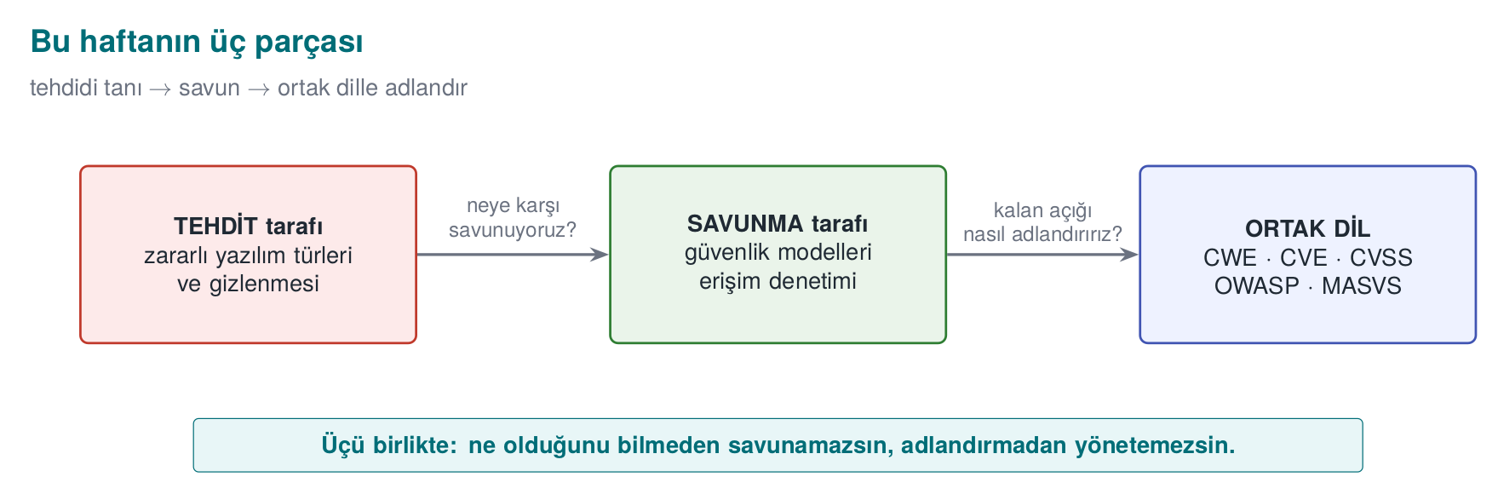
CEN429 Secure Programming · Week 2
The Week's Three Parts — Diagram
• Threat: malware types and concealment
• Defence: access control and formal models
• Common language: CWE · CVE · CVSS · OWASP · MASVS
RTEU Computer Engineering · 2026-2027 Fall
8

Slide 9
CEN429 Secure Programming · Week 2
A Short History — Malware and Security Models
• 1949 — von Neumann: self-reproducing automata (the virus's mathematical root)
• 1971 Creeper · 1986 Brain (first PC virus) · 1988 Morris Worm halts the internet
• 1973–77 — Bell–LaPadula (confidentiality), Biba (integrity); 1987 Clark–Wilson
• 1999 → 2006 — CVE · CWE · CVSS: a common classification language
Two separate strands: recognising malware + modelling access. Today we see both at once.
RTEU Computer Engineering · 2026-2027 Fall
9

Slide 10
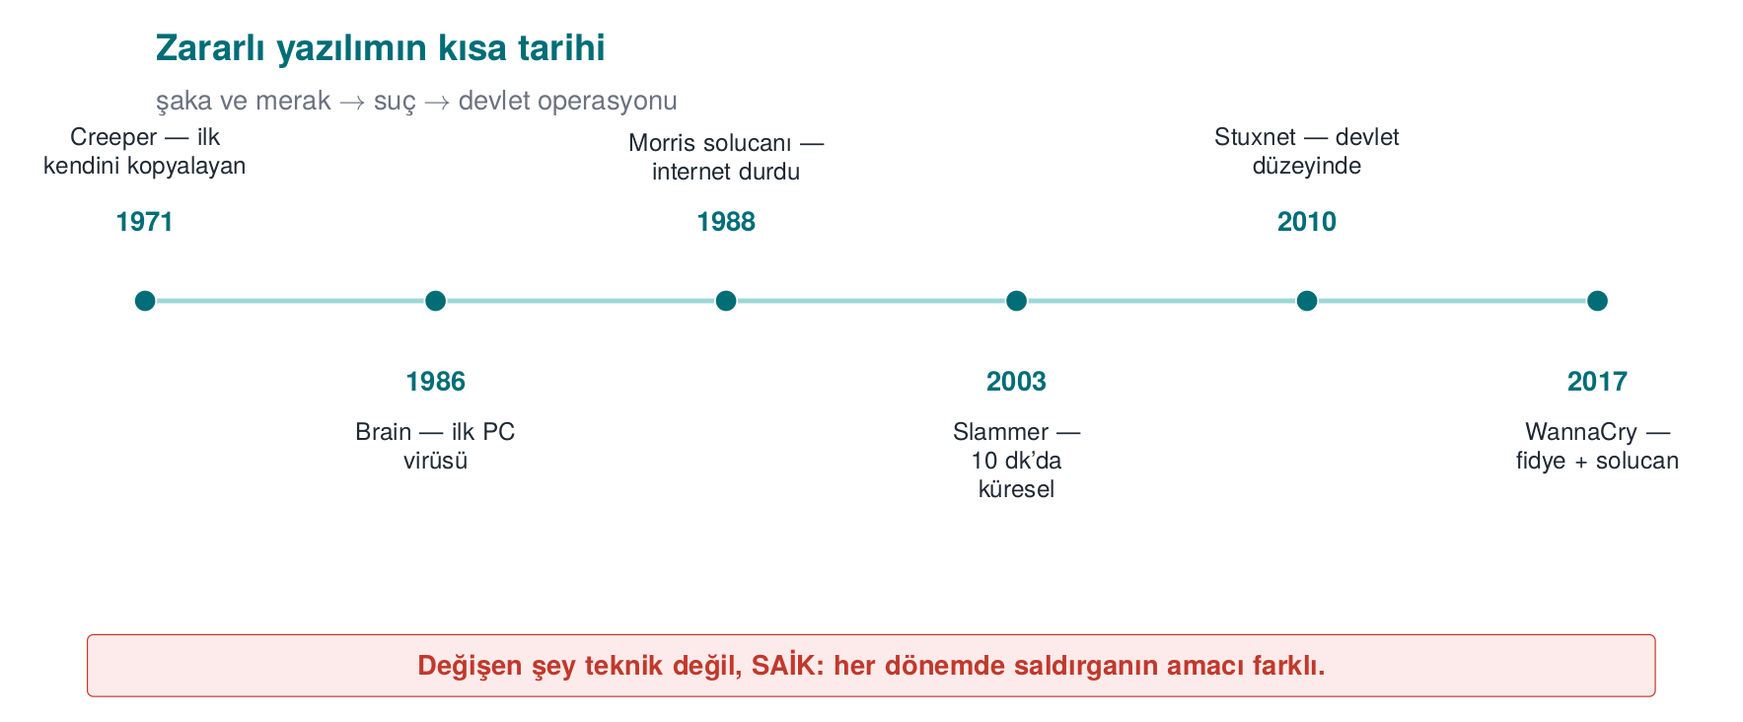
CEN429 Secure Programming · Week 2
A Short History of Malware — Diagram
RTEU Computer Engineering · 2026-2027 Fall
10

Slide 11
CEN429 Secure Programming · Week 2
Short History: Milestones
Year | Event | Type
1984 | Cohen's definition | Theory: "complete detection is impossible"
1986 | Brain | First widespread PC virus (boot sector)
1988 | Morris | First major worm to spread across the internet
1989 | Brewer–Nash | Chinese Wall: the conflict-of-interest model
1999 | Schneier | Attack Trees
2000 | ILOVEYOU | Millions via an email attachment
2001 | Code Red | Worm spreading in memory via a network flaw
2003 | SQL Slammer | Half in 10 minutes — the fastest-spreading worm
2010 | Stuxnet | Worm targeting industrial controllers
2017 | WannaCry | Self-spreading ransomware
2017 | NotPetya | A wiper (destructive) disguised as ransomware
2019/2023 | CVSS v3.1 / v4.0 | Severity scoring standard, two generations
RTEU Computer Engineering · 2026-2027 Fall
11
Notes:
Speaker note: Give the dates accurately. WannaCry spread to machines that had not updated AFTER the patch was released; we'll return to this "patch gap" at the end of the lecture.

Slide 12
CEN429 Secure Programming · Week 2
Cohen 1984: The Limit of Detection
A virus is a program that can copy itself (possibly by modifying itself) into other programs.
• Cohen proved: there is no general algorithm that correctly answers "is this program a virus?" in every case (it reduces from the halting problem).
• Practical consequence: no antivirus can detect at 100%.
  – ✅ False positive: flags a clean file
  – ❌ False negative: misses a piece of malware
We will see this with our own eyes in Demo 01.
RTEU Computer Engineering · 2026-2027 Fall
12

Slide 13
CEN429 Secure Programming · Week 2
A Virus's Three Parts
Part | Job | Disease analogy
Infection mechanism | Copies itself | Entering a cell and multiplying
Trigger | The "when?" condition | Incubation period
Payload | The actual damage | Symptoms
• Code that waits for the trigger condition and then goes off is called a logic bomb.
• No part is mandatory: there are viruses that only spread, with no payload (still a vulnerability all the same).
RTEU Computer Engineering · 2026-2027 Fall
13

Slide 14
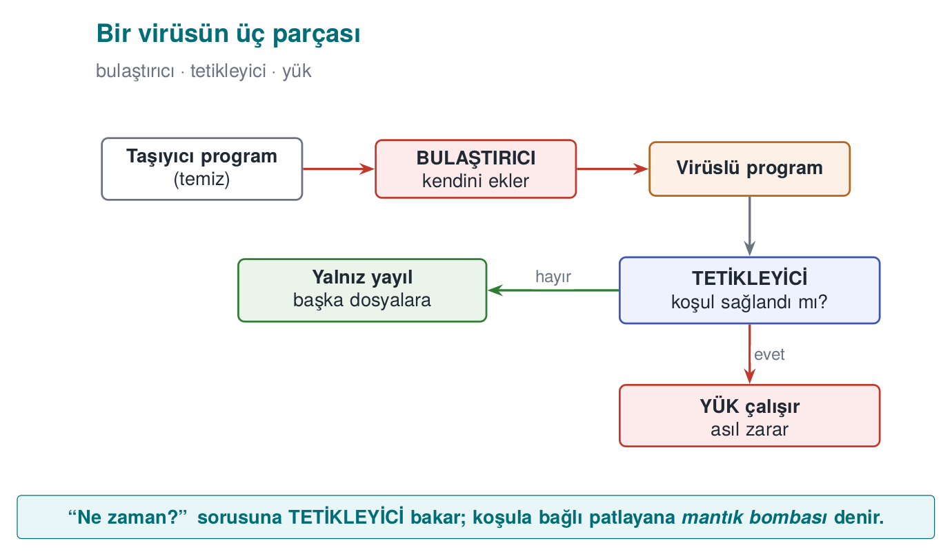
CEN429 Secure Programming · Week 2
A Virus's Three Parts — Diagram
RTEU Computer Engineering · 2026-2027 Fall
14

Slide 15
CEN429 Secure Programming · Week 2
Virus Subtypes
• Program (file) virus: infects an executable file; when the file runs, the virus runs too.
• Macro virus: written in an office document's macro language; runs when the document opens (Melissa, 1999).
• Boot sector virus: infects the disk's first sector, runs before the operating system (Brain, 1986).
  – Modern UEFI Secure Boot has made this class much harder.
RTEU Computer Engineering · 2026-2027 Fall
15
Notes:
Speaker note: The "enable macros" prompt is still an attack vector. Tell students never to enable macros in a document they don't recognise.

Slide 16
CEN429 Secure Programming · Week 2
Worm, Trojan Horse, Ransomware
Type | Spread | Example
Worm | On its own, over the network; no user needed | Morris, Code Red, WannaCry
Trojan horse | Looks innocent; the user runs it; doesn't copy itself | "Free game", fake update
Ransomware | Encrypts files, demands money | CryptoLocker, WannaCry
A worm's danger is speed: hundreds of thousands of machines within minutes.
RTEU Computer Engineering · 2026-2027 Fall
16

Slide 17
CEN429 Secure Programming · Week 2
Other Types
• Rootkit: hides itself and other malware from the operating system (removes itself from file/process/network listings). The hardest class to detect.
• Bot / botnet: a network of machines taking remote commands (DDoS, spam, cryptomining).
• Spyware / adware: collects data or shows adverts.
• Wiper: looks like ransomware but permanently destroys data (NotPetya). The goal is not money but destruction.
• Backdoor: leaves behind hidden access.
RTEU Computer Engineering · 2026-2027 Fall
17

Slide 18
CEN429 Secure Programming · Week 2
How Fast Does a Worm Spread?
The SI model — susceptible (S) and infected (I) machines:
i(t+dt) = i(t) + beta * i(t) * (1 - i(t)/N) * dt
• beta * i: as infected machines multiply, scanning speeds up → exponential growth
• (1 - i/N): as susceptible machines shrink, the hit rate drops → saturation
• Result: a quiet opening → a sudden explosion → saturation (an S-curve)
⚠️ The defender's only window is the opening phase
RTEU Computer Engineering · 2026-2027 Fall
18
Notes:
Speaker note: First explain the formula in words: every infected machine scans a random address, and infects it if it hits a susceptible one. Then give the Code Red and Slammer numbers.

Slide 19
CEN429 Secure Programming · Week 2
The SI Model: Step by Step
• S (susceptible): not yet infected, vulnerable machine.
• I (infected): already infected, itself scanning too.
• N: total number of vulnerable machines (S + I).
• Every infected machine scans a random address per unit time; if the address happens to hit a susceptible machine, it infects that one too.
RTEU Computer Engineering · 2026-2027 Fall
19
Notes:
Speaker note: First write the letters on the board: S, I, N. Then ask "what does every infected machine do?"; the answer is on this slide.

Slide 20
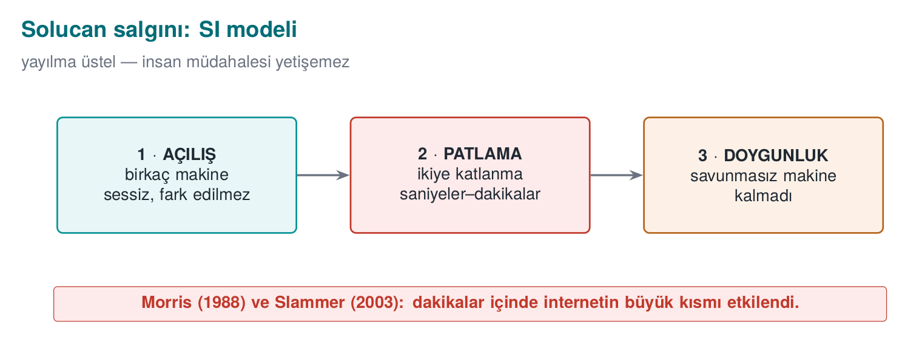
CEN429 Secure Programming · Week 2
Epidemic Model — Diagram
RTEU Computer Engineering · 2026-2027 Fall
20

Slide 21
CEN429 Secure Programming · Week 2
Demo 09 — Epidemic Simulation
code/week-02/09-outbreak-simulation · calculation only, no network
Senaryo: Slammer benzeri (rastgele tarama, hizli UDP)
54 s 78 0.1% |..............................|
1.5 dk 1430 1.9% |#.............................|
2.4 dk 45601 60.8% |##################............|
3.3 dk 74429 99.2% |##############################|
%90 doygunluk: Code Red ~13.3 sa · Slammer ~2.7 dk · Hitlist ~50 s
• Code Red (2001): ~359,000 servers · doubling time ~37 min
• Slammer (2003): a single 404-byte UDP packet · doubled every ~8.5 s
• ✅ Lesson: human-speed response can't keep up → patch in advance, close ports, automate defence
RTEU Computer Engineering · 2026-2027 Fall
21
Notes:
Speaker note: Halve the beta value and rerun; show how the saturation time stretches out. The real point: a single overflow flaw made the initial infection possible.

Slide 22
CEN429 Secure Programming · Week 2
Real Numbers: Code Red vs. Slammer
Event | Entry path | Speed
Code Red (2001) | IIS .ida overflow (CVE-2001-0500) | ~359,000 servers; doubling time ~37 min
SQL Slammer (2003) | SQL Server resolution service, single 404-byte UDP packet (CVE-2002-0649) | doubled every ~8.5 s; 90% within ~10 min
Two things made Slammer fast: a single packet was enough (no connection setup), and it scanned targets as fast as possible.
RTEU Computer Engineering · 2026-2027 Fall
22

Slide 23
CEN429 Secure Programming · Week 2
Why Did Slammer Slow Down?
• After the first minute, its spread rate dropped.
• Why? Not defence — the network's bandwidth filled up.
• The worm clogged its own propagation channel with its own traffic.
• Lesson: sometimes the attacker's own success creates its own limit.
RTEU Computer Engineering · 2026-2027 Fall
23

Slide 24
CEN429 Secure Programming · Week 2
Doubling Time
• The time it takes for the number of infected machines to double is the most intuitive measure of an epidemic's speed.
• Code Red: doubling time ~37 minutes.
• Slammer: doubling time ~8.5 seconds.
• A ~260-fold difference — even though both are "worms," the defence window is completely different.
RTEU Computer Engineering · 2026-2027 Fall
24

Slide 25
CEN429 Secure Programming · Week 2
Reading the Demo 09 Output: The Opening Phase
• In the first 54 seconds only 78 machines are infected (0.1%).
• Almost nothing is visible on the graph.
• 1.5 minutes later the explosion begins.
• Saying "it's small for now" is the most expensive mistake with exponential growth.
RTEU Computer Engineering · 2026-2027 Fall
25

Slide 26
CEN429 Secure Programming · Week 2
Reading the Demo 09 Output: Speed and Hitlist
• Speed (beta): raising the scanning speed brings saturation down from hours to minutes.
• That's why defence must be automatic: a firewall rule, network segmentation, patching in advance.
• Hitlist: if the attacker starts with a ready-made target list, the opening phase is skipped.
• The defender's already-narrow window closes completely.
RTEU Computer Engineering · 2026-2027 Fall
26

Slide 27
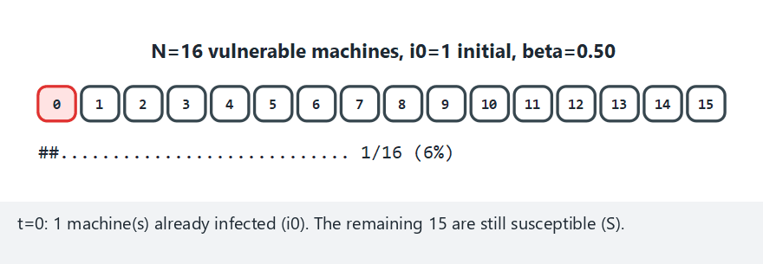
CEN429 Secure Programming · Week 2
The SI Epidemic Model: Step by Step (animation)
RTEU Computer Engineering · 2026-2027 Fall
27
Notes:
Speaker note: Compute the SI difference equation at each step; show that growth is fastest around 50% and then slows as fewer targets remain.

Slide 28
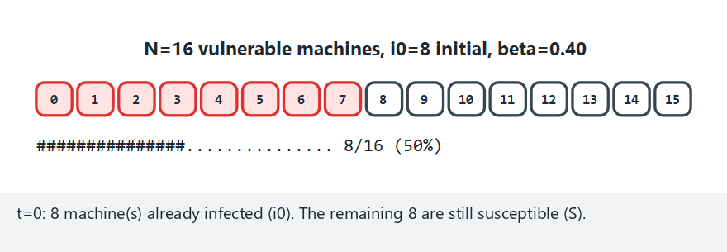
CEN429 Secure Programming · Week 2
Epidemic — Edge Case: Already Half-Infected
RTEU Computer Engineering · 2026-2027 Fall
28
Notes:
Speaker note: When the attacker skips the opening phase with a hitlist, saturation is reached much faster; the defender's window is nearly gone.

Slide 29
CEN429 Secure Programming · Week 2
A Lesson for the Programmer (Epidemics)
• The programmer does not determine the propagation speed.
• But the programmer makes the mistake that makes the initial infection possible.
• Code Red, Slammer, Blaster — all of them spread through a bounds-unchecked overflow.
• Every listening network port is an attack surface; never open a service you don't use.
RTEU Computer Engineering · 2026-2027 Fall
29

Slide 30
CEN429 Secure Programming · Week 2
Try It Yourself: What If Beta Is Halved?
Halve the beta value inside outbreak.c and rerun it.
Question: How does the saturation time change? In the hitlist scenario, if you raise i0 to 100, how much of a difference remains?
Answer: Halving beta slows growth, so the saturation time lengthens. In the hitlist scenario the opening phase is already skipped, so raising i0 has a smaller effect — the hitlist's real power is skipping the opening, not the starting count.
RTEU Computer Engineering · 2026-2027 Fall
30

Slide 31
CEN429 Secure Programming · Week 2
2. Propagation and Concealment
RTEU Computer Engineering · 2026-2027 Fall
31

Slide 32
CEN429 Secure Programming · Week 2
The Concealment Ladder
Method | What changes? | Defence
Encryption | Body encrypted, decryptor fixed | Sign the decryptor
Oligomorphism | A handful of decryptor forms | Sign them all
Polymorphism | Decryptor regenerated in every copy | Decrypt via emulation
Metamorphism | No encryption, the entire code is rewritten | Watch behaviour
Key idea: the encrypted body looks different in every copy, but always the same once decrypted.
RTEU Computer Engineering · 2026-2027 Fall
32

Slide 33
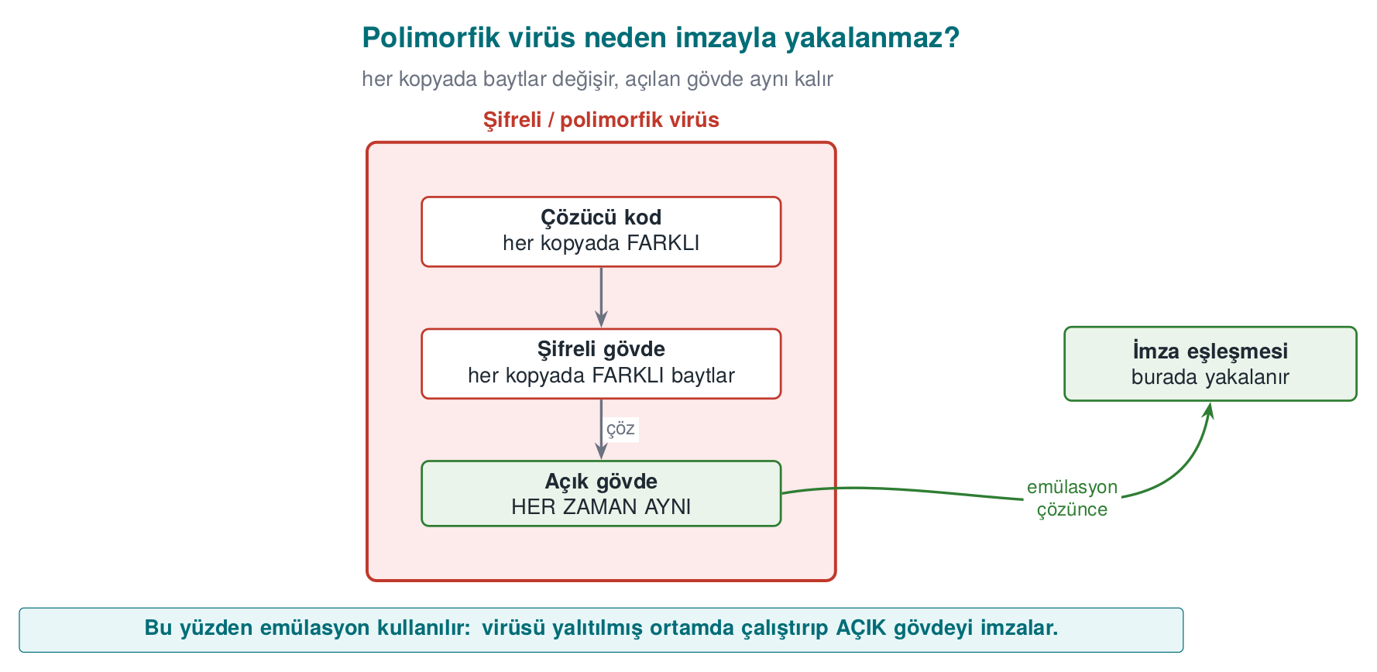
CEN429 Secure Programming · Week 2
Structure of an Encrypted/Polymorphic Virus
Emulation runs the decryptor exactly to see this last box.
RTEU Computer Engineering · 2026-2027 Fall
33

Slide 34
CEN429 Secure Programming · Week 2
Demo 01 — Toy Antivirus
code/week-02/01-signature-scanner · Book: Recipe 12.1
• A harmless, non-executable "CAPSULE" format: header + decryptor + body.
• Four methods, four limits:
Method | Catches | Evaded by
Hash | The exact same file | A single byte changing
Pattern | A small change | The decryptor changing (polymorphism)
Heuristic | Signature-free samples | False positives/negatives
Emulation | All of them | Anti-emulation
RTEU Computer Engineering · 2026-2027 Fall
34

Slide 35
CEN429 Secure Programming · Week 2
Demo 01 — Hash Is Fragile, Pattern Is Resilient
STEP 2 (hash):
sample_a.bin CAUGHT Sample.BlueCat.A
sample_a_1byte.bin CLEAN <- one byte changed, digest is different
STEP 3 (pattern):
poly_1.bin CAUGHT Sample.Decoder.xs32
poly_2.bin CAUGHT Sample.Decoder.xs32
poly_3.bin CLEAN <- the decoder changed too (polymorphism)
Hash breaks on a single byte due to the avalanche effect; pattern catches the decryptor, but polymorphism evades it too.
RTEU Computer Engineering · 2026-2027 Fall
35
Notes:
Speaker note: poly_1 and poly_2 use the same algorithm (xs32) with a different seed; poly_3 uses a different algorithm (lcg8) plus junk instructions. The pattern signature was looking for ALGO=xs32, which isn't in poly_3.

Slide 36
CEN429 Secure Programming · Week 2
Demo 01 — Heuristic: Two Kinds of Error
STEP 5 (heuristic):
sample_a.bin CLEAN score= 0 <- FALSE NEGATIVE (missed it)
poly_1.bin SUSPICIOUS score= 80
archive.bin SUSPICIOUS score= 50 <- FALSE POSITIVE (harmless)
• Caught the polymorphic sample without a signature ✅
• But flagged a harmless high-entropy file as suspicious ❌
• And missed the plain-body sample ❌
This is exactly Cohen's uncertainty.
RTEU Computer Engineering · 2026-2027 Fall
36

Slide 37
CEN429 Secure Programming · Week 2
Demo 01 — Emulation Solves All of Them
STEP 6 (emulation):
poly_1.bin CAUGHT ... | 5 commands, 0 NOP, xs32
poly_2.bin CAUGHT ... | 5 commands, 0 NOP, xs32
poly_3.bin CAUGHT ... | 8 commands, 4 NOP, lcg8
• Runs the decryptor in a safe virtual machine and scans the unpacked body.
• All three polymorphic copies reduced to the same signature.
• Powerful but expensive; can be evaded if the malware detects "I'm in a virtual machine."
Conclusion: one method isn't enough → layered defence.
RTEU Computer Engineering · 2026-2027 Fall
37

Slide 38
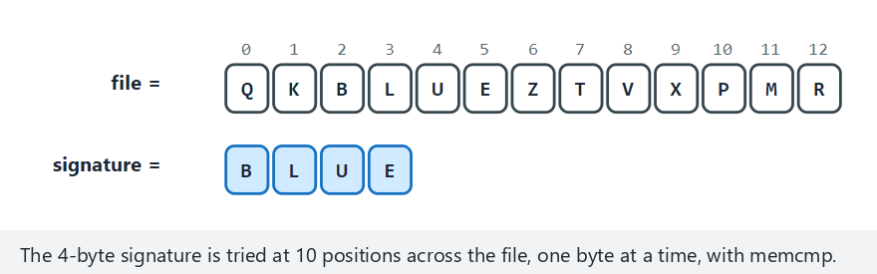
CEN429 Secure Programming · Week 2
Signature Scanning: Hash + Pattern + Emulation (animation)
RTEU Computer Engineering · 2026-2027 Fall
38
Notes:
Speaker note: Show how the hash is evaded by one byte, how the pattern catches the decoder, and why emulation catches everything.

Slide 39
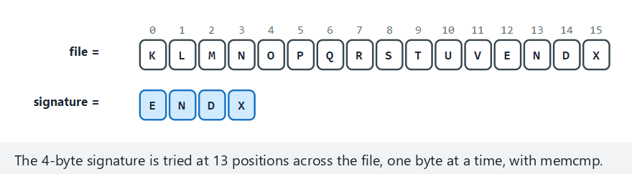
CEN429 Secure Programming · Week 2
Signature Scan — Edge Case: Signature at the Last Position
RTEU Computer Engineering · 2026-2027 Fall
39
Notes:
Speaker note: Pattern matching must work correctly at the very last possible position too; off-by-one bugs show up right here.

Slide 40
CEN429 Secure Programming · Week 2
Entropy: A Measure of Randomness
$$ H = -sum_{b=0}^{255} p(b),log_2 p(b) quad (0 dots 8 text{ bits/byte}) $$
• H ~ 0: always the same byte · H ~ 4–5: text/code
• H ~ 6: compiled program · H ~ 8: encrypted/packed/random
Antivirus: "is this code packed/encrypted?" · EDR: "a process rapidly encrypting files?" (ransomware)
RTEU Computer Engineering · 2026-2027 Fall
40

Slide 41
CEN429 Secure Programming · Week 2
Demo 02 — Entropy Meter
code/week-02/02-entropy
tekduze.txt 0.00 |........................| tekduze
belge.txt 4.17 |#############...........| dusuk
kod.bin 6.23 |###################.....| orta
sifreli.bin 7.95 |########################| YUKSEK
rastgele.bin 7.95 |########################| YUKSEK
⚠️ Entropy alone doesn't say "malicious": .zip/.png are high too. It's a clue only when it's high in an unexpected place.
RTEU Computer Engineering · 2026-2027 Fall
41

Slide 42
CEN429 Secure Programming · Week 2
Demo 02 — Hot Zone and Ransomware Signature
Mixed file (window 512):
1024-1535 4.04 low
1536-2047 7.54 HIGH <- hidden encrypted section
2048-2559 7.57 HIGH
Ransomware trace: document.txt 4.06 --> encrypted.bin 7.94
• A packed program's pattern: a small unpacker + a high-entropy body.
• If a process makes this jump across many files in a short time, behaviour-based protection raises an alarm.
RTEU Computer Engineering · 2026-2027 Fall
42

Slide 43
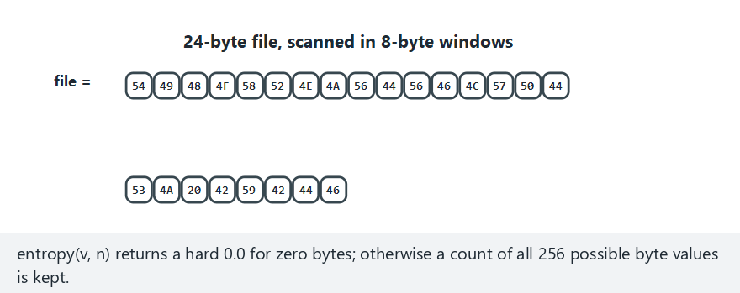
CEN429 Secure Programming · Week 2
Entropy: Windowed Scanning (animation)
RTEU Computer Engineering · 2026-2027 Fall
43
Notes:
Speaker note: Show how the histogram accumulates per window, and how H = -Σ p(b) log2 p(b) is computed step by step.

Slide 44
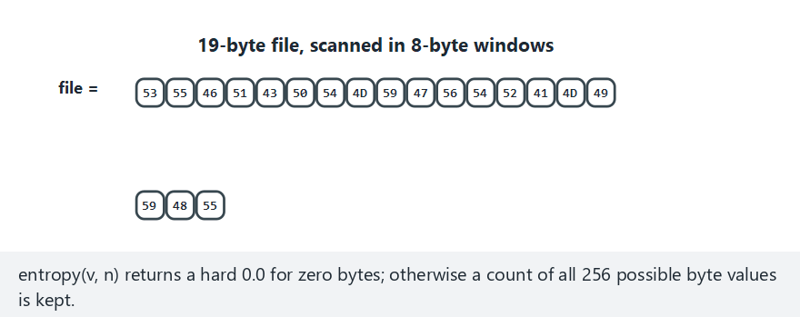
CEN429 Secure Programming · Week 2
Entropy — Edge Case: Window Doesn't Divide Evenly
RTEU Computer Engineering · 2026-2027 Fall
44
Notes:
Speaker note: Show that the calculation still works correctly when the last window's size differs from the others.

Slide 45
CEN429 Secure Programming · Week 2
Countermeasures
Method | Strong | Weak
Signature-based | Fast, low false-positive rate | Misses unknown/polymorphic samples
Heuristic | New, signature-free samples | False positives/negatives
Behaviour-based | Resistant to concealment | Damage may already have started
Sandbox | Sees real behaviour | Slow; anti-VM
Emulation | Unpacks the decryptor | Anti-emulation
Reputation / cloud | Good against fast-spreading threats | Privacy, connectivity
Modern EDR combines all of them, weighting behaviour most heavily.
RTEU Computer Engineering · 2026-2027 Fall
45

Slide 46
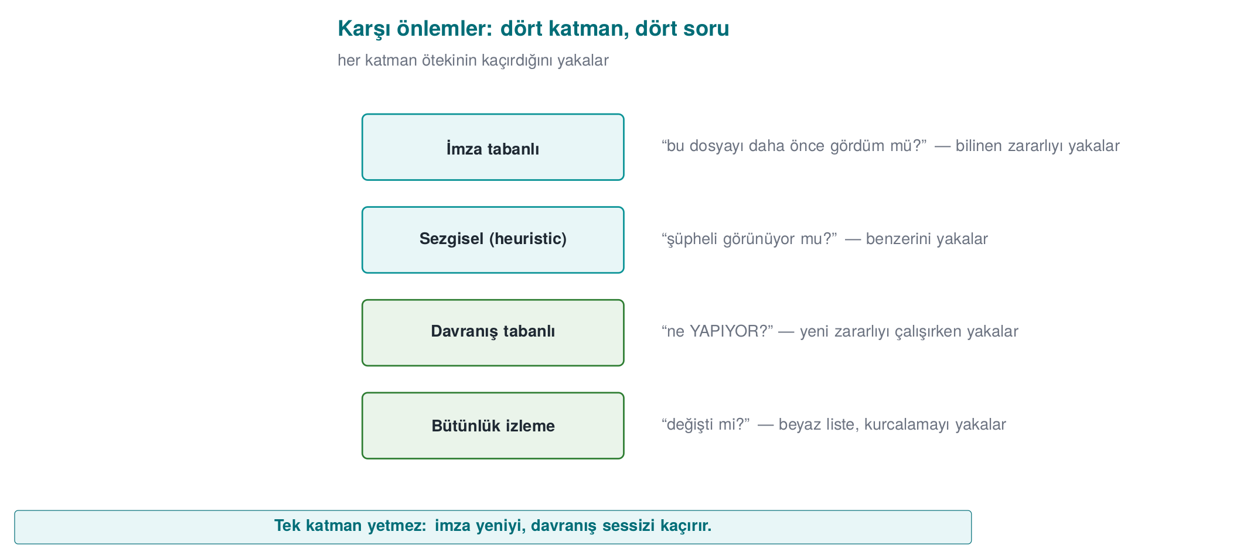
CEN429 Secure Programming · Week 2
Countermeasure Layers — Diagram
RTEU Computer Engineering · 2026-2027 Fall
46

Slide 47
CEN429 Secure Programming · Week 2
A Behavioural Trace in EDR
• A process reads hundreds of files in a short time and writes them back in high-entropy form.
• Without even looking at the content, this behaviour alone is near-certain evidence of ransomware.
• Behaviour-based protection looks at what a file "does," not what it "is."
• This clue is the runtime version of the same idea as the entropy jump in Demo 02.
RTEU Computer Engineering · 2026-2027 Fall
47

Slide 48
CEN429 Secure Programming · Week 2
The Same Toolbox: Attacker and Defender
• The technique malware uses to hide and the technique legitimate software uses to protect itself are very often the same.
• The difference is intent and context: one protects your asset, the other evades signatures.
• The encrypted body + decryptor pattern exists both in a polymorphic virus and in a protected mobile app.
• This symmetry will come back throughout the term (Weeks 9, 11).
RTEU Computer Engineering · 2026-2027 Fall
48

Slide 49
CEN429 Secure Programming · Week 2
Example: Why Does a Mobile Payment App Keep Constants Encrypted?
• Sensitive strings/constants are kept encrypted, decrypted only at use, to slow down reverse engineering.
• When an assessor sees a high-entropy region in a binary, they ask:
  – Where is the decryptor?
  – How does it find the key?
  – How long does the key stay exposed in memory?
• The same entropy measurement is the common tool of both the antivirus and the assessor.
RTEU Computer Engineering · 2026-2027 Fall
49

Slide 50
CEN429 Secure Programming · Week 2
Reputation / Cloud-Based Detection
• The file's prevalence, source, and digital signature are queried in the cloud.
• "Seen on millions of users and clean" is trusted; "never seen, unsigned" is suspicious.
• Strength: updates instantly against fast-spreading threats.
• Weakness: needs connectivity and raises privacy concerns (file information goes to the cloud).
RTEU Computer Engineering · 2026-2027 Fall
50

Slide 51
CEN429 Secure Programming · Week 2
Demo 07 — Rule-Based Detection
code/week-02/07-rule-engine · a YARA-like mini engine, our own harmless patterns
rule Word_Context {
string $a = "download"
string $b = "run"
string $magic = "CAPSULE/1"
condition ($a and $b) and $magic
}
Step | Result | Lesson
Harmless manual | Word_Pair matched | ❌ A context-free rule → false positive
Modified variant | only the wildcard (??) pattern caught it | ✅ Target the skeleton that doesn't change
Corrupt rule file | REJECTED | ✅ A detection tool is a parser too
RTEU Computer Engineering · 2026-2027 Fall
51
Notes:
Speaker note: A narrow rule misses; a broad rule raises false alarms. A rule only catches the known; that's why it's used together with heuristic and behaviour-based methods.

Slide 52
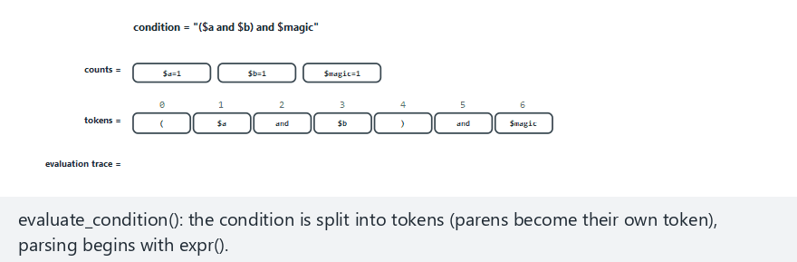
CEN429 Secure Programming · Week 2
Rule Engine: The Condition Evaluator (animation)
RTEU Computer Engineering · 2026-2027 Fall
52
Notes:
Speaker note: expr() -> and_expr() -> not_expr() -> primary(), one grammar level per precedence. Point out that and/or always evaluate BOTH sides -- no short-circuit.

Slide 53
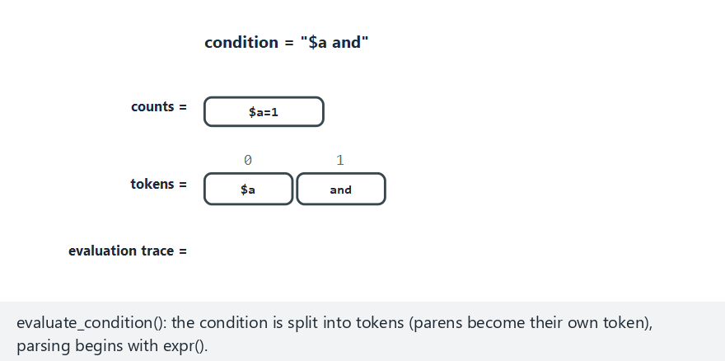
CEN429 Secure Programming · Week 2
Condition Evaluator — Edge Case: A Broken Condition
RTEU Computer Engineering · 2026-2027 Fall
53
Notes:
Speaker note: "$a and" has no right-hand side -- the parser detects this and returns -1 (CONDITION ERROR), it never crashes or silently matches.

Slide 54
CEN429 Secure Programming · Week 2
Blacklist vs. Whitelist
• Blacklist: "recognise the bad" — list known malware, allow everything else.
• Whitelist: "recognise the good" — list known-good, and be suspicious of everything else.
• Integrity monitoring is the file-level form of a whitelist.
• While the system is known-good, every file's digest is written to a manifest, then compared regularly.
RTEU Computer Engineering · 2026-2027 Fall
54
Notes:
Speaker note: Tripwire, AppLocker/WDAC, and code-signing checks all rest on this idea.

Slide 55
CEN429 Secure Programming · Week 2
Question — Which Type, Which Layer?
An email attachment named "invoice.pdf.exe" runs when opened, and mails itself to everyone in the address book.
Question: What type of malware is this? Which layer would catch it first?
Answer: A worm/trojan mix — the user opens it (starts like a trojan horse), then it spreads on its own (like a worm). The first layer to catch it: signature/pattern (if it's a known sample) or heuristic (if it's new).
RTEU Computer Engineering · 2026-2027 Fall
55

Slide 56
CEN429 Secure Programming · Week 2
Question — Supply Chain Attack
A backdoor is added, during the build, to a software's official update (SUNBURST-like).
Question: Would signature-based detection and whitelisting catch this?
Answer: No, both fail. The file is validly signed and already on the whitelist (the update comes from the official source). This is exactly what makes a supply chain attack terrifying: the source you trust has itself been compromised.
RTEU Computer Engineering · 2026-2027 Fall
56

Slide 57
CEN429 Secure Programming · Week 2
Demo 08 — Integrity Monitoring (Whitelist)
code/week-02/08-integrity-monitoring · SHA-256 manifest + HMAC seal
CHANGED library.bin 5ab02b71... -> 12c5803f... (48->62 B)
DELETED data.txt (in the manifest, not in the folder)
NEW hidden.bin (not in the baseline)
-- attacker rewrites the manifest --
RESULT: integrity preserved <- monitor FOOLED
SEAL INVALID -> DO NOT TRUST the manifest
✅ Catches a digest change · ⚠️ the expected values must be protected too (HMAC/signature, key kept separately)
Recipe 12.2: CRC32 → SHA-256/HMAC · runtime integrity checking in Week 6
RTEU Computer Engineering · 2026-2027 Fall
57
Notes:
Speaker note: The assessor first modifies the file, then the expected value. If the second test isn't passed, the check only protects against accidents.

Slide 58
CEN429 Secure Programming · Week 2
Assessor: How to Break an Integrity Check?
A two-step test:
1. First modify a monitored file → is it detected?
2. Then try to modify the expected values too (the manifest, the embedded digest).
If the second test can't be passed, the check only protects against accidents, not against an attacker.
RTEU Computer Engineering · 2026-2027 Fall
58

Slide 59
CEN429 Secure Programming · Week 2
Constant-Time Comparison
• When comparing two digests, does it stop at the first differing byte, or does it always take the same time?
• A time difference can leak the number of correct bytes (a timing side channel).
• Integrity and HMAC comparisons must be done in constant time.
• This is why Demo 08's HMAC seal uses a special comparison.
RTEU Computer Engineering · 2026-2027 Fall
59

Slide 60
CEN429 Secure Programming · Week 2
Why Isn't CRC32 Enough?
• CRC32 was designed for error detection, not against an attacker.
• Finding different content that gives the same CRC32 value is easy (collisions are cheap).
• An attacker can modify a file and restore the CRC to its old value.
• That's why integrity checking needs a cryptographic digest (SHA-256) or a signature.
RTEU Computer Engineering · 2026-2027 Fall
60

Slide 61
CEN429 Secure Programming · Week 2
Incidents: How Did They Get In?
Incident | Entry path | Error class
Morris (1988) | fingerd gets() overflow · sendmail DEBUG · rsh trust | CWE-120/242 · 489 · 287
Code Red (2001) | IIS .ida overflow (CVE-2001-0500) | CWE-120
Slammer (2003) | SQL resolution service, single UDP packet (CVE-2002-0649) | CWE-121
Blaster (2003) | RPC/DCOM overflow (CVE-2003-0352) | CWE-120
Conficker (2008) | Server service path handling (CVE-2008-4250) · weak password | CWE-119 · 521
WannaCry (2017) | SMBv1 (CVE-2017-0144) · patch had shipped 2 months earlier | memory safety
NotPetya (2017) | distributed via an update server | CWE-494
SUNBURST (2020) | backdoor in the build environment | supply chain
RTEU Computer Engineering · 2026-2027 Fall
61
Notes:
Speaker note: Read the table by how they got in, not by what the malware did. 1988-2008 is mostly a single overflow; after 2017 it's update and build processes.

Slide 62
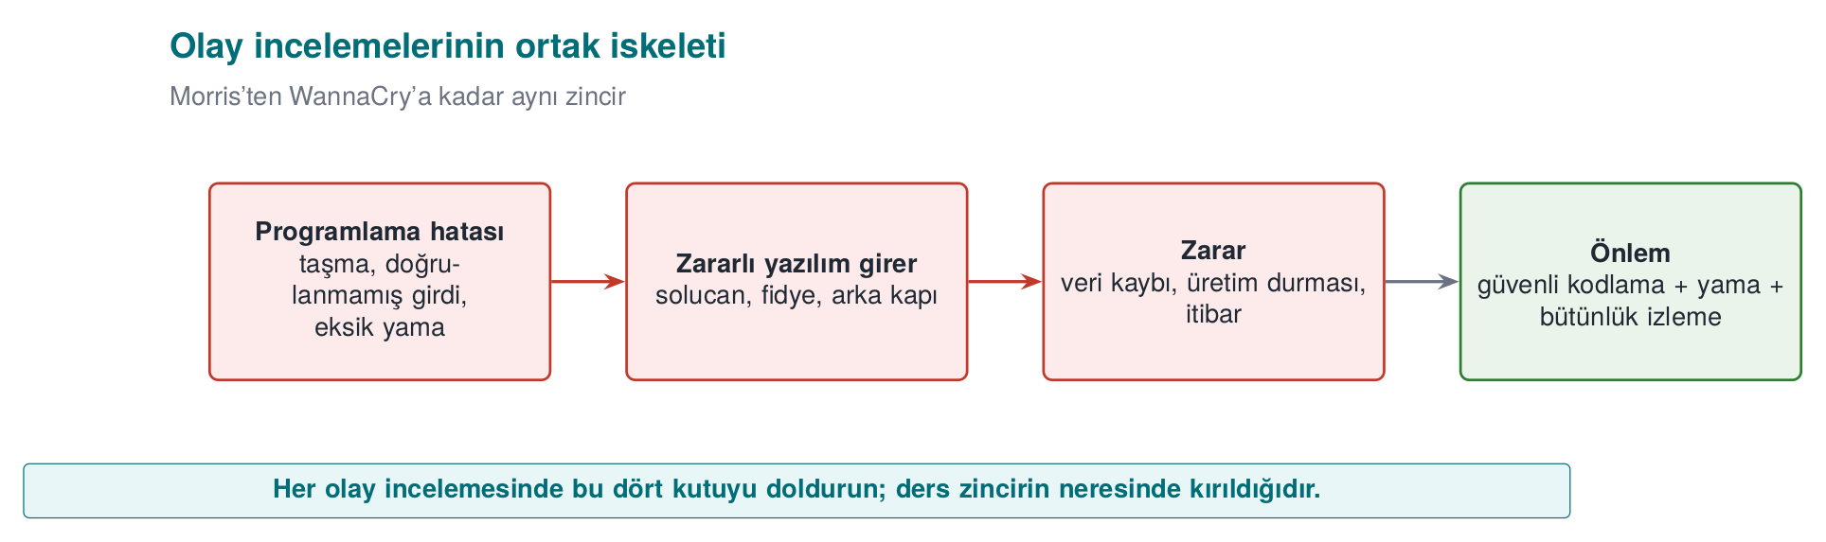
CEN429 Secure Programming · Week 2
The Skeleton of an Incident Review — Diagram
RTEU Computer Engineering · 2026-2027 Fall
62

Slide 63
CEN429 Secure Programming · Week 2
Lessons for the Programmer from These Incidents
1. Bounds checking: most 1988–2008 epidemics were a single buffer overflow (Weeks 1 and 4)
2. Leaving debug code in a release (Morris / sendmail DEBUG)
3. Opening an unnecessary service: every port is an attack surface (Slammer, Blaster)
4. Signed updates + client-side verification (NotPetya) — Weeks 3 and 10
5. Build environment and supply chain security (SUNBURST) — Week 5 SBOM
6. The update mechanism is a security feature: patch delay = an open door
RTEU Computer Engineering · 2026-2027 Fall
63
Notes:
Speaker note: Discussion question: which old epidemics' door did Office's default blocking of macros in documents from the internet (since 2022) close?

Slide 64
CEN429 Secure Programming · Week 2
Stuxnet (2010): A Nation-State-Level Attack
• Target: industrial controllers (PLCs) — a uranium enrichment plant.
• Entry: code loading via merely displaying a shortcut (.lnk) file + four zero-day flaws.
• Stolen driver signatures were used — it looked trustworthy because it was signed.
• Lesson for the programmer: never execute code while displaying content; protect signing keys in hardware (an HSM).
RTEU Computer Engineering · 2026-2027 Fall
64

Slide 65
CEN429 Secure Programming · Week 2
Trend: 1988–2008 vs. After 2017
• 1988–2008: most epidemics spread through a single buffer overflow (Morris → Conficker).
• After 2017: the entry point shifted to update and build processes (NotPetya, SUNBURST).
• Instead of breaking the code, the attacker now hijacks the path the code takes to reach you.
• Two ends of the defence: bounds checking (Weeks 1, 4) + signed updates/supply chain (Weeks 3, 5, 10).
RTEU Computer Engineering · 2026-2027 Fall
65

Slide 66
CEN429 Secure Programming · Week 2
WannaCry: Three Lessons in One Incident
Topic | What happened in WannaCry? | This week's connection
Propagation | Spread like a worm via an SMB flaw (EternalBlue), with no user action | Worm definition, epidemic model
Payload | Encrypted files and demanded ransom | Entropy jump (Demo 02)
Patch gap | The patch had shipped weeks before the attack | Update = a security feature
A single incident ties together this week's three main topics.
RTEU Computer Engineering · 2026-2027 Fall
66

Slide 67
CEN429 Secure Programming · Week 2
A Patch Delay Is a Vulnerability
• The patch for WannaCry's flaw had been released two months before the attack.
• Slammer's had existed months in advance too.
• Conclusion: the update mechanism is part of the security feature.
• A product that's hard/slow to update keeps even fixed bugs open for months.
RTEU Computer Engineering · 2026-2027 Fall
67

Slide 68
CEN429 Secure Programming · Week 2
Discussion: Why Are Macros Disabled by Default?
Question: Since 2022, Office has blocked macros by default in documents that come from the internet. Which weakness of old epidemics like Melissa and ILOVEYOU does this close?
Answer: It closes the propagation path that relied on the user falling for the "enable macros" trap. A safe default is stronger than user training: training may not work on every user, but a safe default protects everyone at once.
RTEU Computer Engineering · 2026-2027 Fall
68

Slide 69
CEN429 Secure Programming · Week 2
Supply Chain: From SUNBURST to NotPetya
• NotPetya (2017): an accounting software's update server was hijacked, spreading to tens of thousands of machines.
• SUNBURST (2020): a monitoring software's build environment was breached, and a backdoor was added to a signed library.
• Common point: the attacker targets the source you trust, not you.
• Defence: sign updates + verify on the client, protect the build environment (Week 5 SBOM).
RTEU Computer Engineering · 2026-2027 Fall
69

Slide 70
CEN429 Secure Programming · Week 2
One-Line Lessons from These Incidents
Incident | What should the programmer have done?
Morris | Bounds-checked reading, not leaving debug code in a release
Code Red / Slammer / Blaster | Validating network input length, closing unnecessary services
WannaCry | Bounds checking in the parser, disabling the old protocol, not delaying the patch
NotPetya | Signing updates and verifying them on the client
SUNBURST | Protecting the build environment, reproducible builds
RTEU Computer Engineering · 2026-2027 Fall
70

Slide 71
CEN429 Secure Programming · Week 2
Misconception: "Every Piece of Malware Is a Virus"
Misconception: Anything that infects gets called a "virus."
Reality: Virus is only one type — it attaches to a carrier and runs when the carrier runs. A worm needs no carrier; a trojan horse doesn't copy itself.
Getting the type wrong leads to the wrong defence: a worm needs a network patch, while a trojan horse needs user training.
RTEU Computer Engineering · 2026-2027 Fall
71

Slide 72
CEN429 Secure Programming · Week 2
Misconception: "My Signature Database Is Up to Date, I'm Safe"
Misconception: An up-to-date signature database is sufficient protection.
Reality: A signature only catches the known. A single-byte change evades a hash signature; a polymorphic copy whose decryptor has changed evades a pattern signature (Demo 01).
A signature is the start of defence, not the end.
RTEU Computer Engineering · 2026-2027 Fall
72

Slide 73
CEN429 Secure Programming · Week 2
Misconception: "High Entropy = Malicious"
Misconception: Every high-entropy file is suspicious.
Reality: Encrypted, compressed, and random data are always close to 8; so are .zip, .png, and an encrypted backup.
Entropy is only a meaningful clue in an unexpected place (Demo 02).
RTEU Computer Engineering · 2026-2027 Fall
73

Slide 74
CEN429 Secure Programming · Week 2
Misconception: The Limits of Sandbox and Emulation
"The sandbox came back clean, so it's clean." Malware can sense the virtual environment and go dormant; the result means "it did nothing under these conditions," not "it's harmless."
"Emulation solves metamorphic malware too." Emulation catches the moment an encrypted body is decrypted; metamorphic code has no fixed body to decrypt. Behaviour-based detection is needed here.
RTEU Computer Engineering · 2026-2027 Fall
74

Slide 75
CEN429 Secure Programming · Week 2
Misconception: "We'll Buy a Product That Detects 100%"
Misconception: If we choose the right product, no malware slips through.
Reality: As Cohen (1984) proved, there is no general algorithm that answers "is this program a virus?" correctly in every case.
Every detection method strikes a balance between false positives and false negatives.
RTEU Computer Engineering · 2026-2027 Fall
75

Slide 76
CEN429 Secure Programming · Week 2
Misconception: "I Did Integrity Monitoring with a Plain SHA-256 List"
Misconception: A file list plus digests is sufficient integrity checking.
Reality: Just as the attacker modifies the file, they can update the list too.
Expected values must be keyed (HMAC) or signed, and must sit where the attacker cannot reach (Demo 08).
RTEU Computer Engineering · 2026-2027 Fall
76

Slide 77
CEN429 Secure Programming · Week 2
Misconception: "The Patch Shipped, We're Done"
Misconception: The risk ends the moment a patch is released.
Reality: The patch for the flaw WannaCry used had shipped about two months before the attack.
The risk lasts until the patch is applied; a released patch also gives the attacker a roadmap.
RTEU Computer Engineering · 2026-2027 Fall
77

Slide 78
CEN429 Secure Programming · Week 2
Checklist — Malware and Detection
• propagation and purpose.
•
•
• strong/weak side of hash, pattern, heuristic, behaviour/EDR, sandbox, and emulation.
•
• one lesson each from Morris, Code Red, Slammer, Stuxnet, WannaCry, NotPetya, and SUNBURST.
RTEU Computer Engineering · 2026-2027 Fall
78

Slide 79
CEN429 Secure Programming · Week 2
3. Attack Trees and the Audit Log
RTEU Computer Engineering · 2026-2027 Fall
79

Slide 80
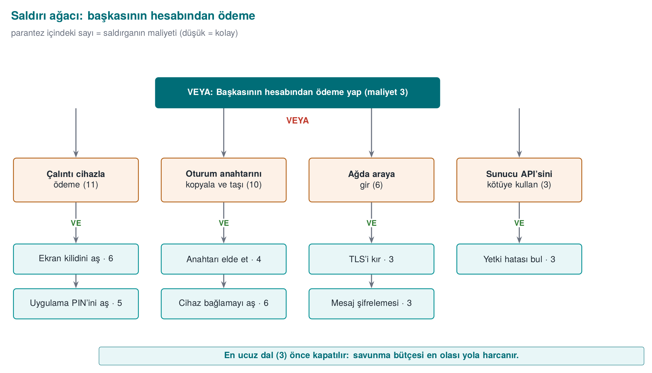
CEN429 Secure Programming · Week 2
Attack Tree = Quantitative Threat
• Root: the attacker's goal · Branches: ways to reach it.
• OR: the cheapest child is enough · AND: the sum of the children is needed.
• Writing a cost on the leaves finds the cheapest attack.
RTEU Computer Engineering · 2026-2027 Fall
80

Slide 81
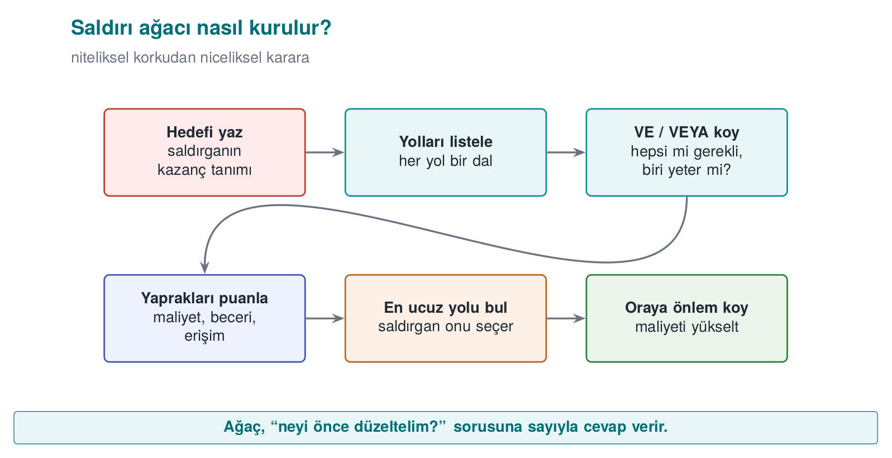
CEN429 Secure Programming · Week 2
Steps for Building an Attack Tree — Diagram
RTEU Computer Engineering · 2026-2027 Fall
81

Slide 82
CEN429 Secure Programming · Week 2
Demo 04 — Defence Raises the Cost
code/week-02/04-attack-tree
BEFORE: CHEAPEST ATTACK = 2 (read from memory)
AFTER: CHEAPEST ATTACK = 8 (RASP added)
• RASP (anti-debug, anti-hook) was added to the "read from memory" branch.
• The cheapest attack rose from 2 → 8 units; the weakest point changed.
• This is how you justify a security investment with a number.
RTEU Computer Engineering · 2026-2027 Fall
82
Notes:
Speaker note: AND nodes force the attacker to break multiple layers together; the quantitative form of defence in depth.

Slide 83
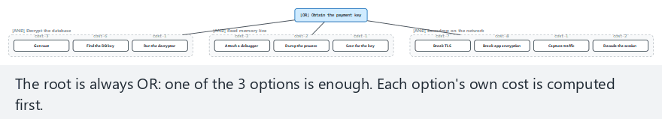
CEN429 Secure Programming · Week 2
Attack Tree: The Cheapest Path (animation)
RTEU Computer Engineering · 2026-2027 Fall
83
Notes:
Speaker note: Show how every AND/OR node's cost is computed bottom-up; find the cheapest branch.

Slide 84
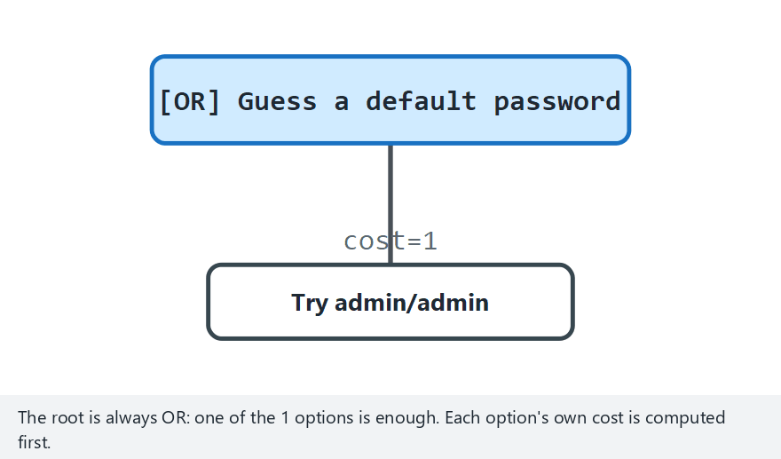
CEN429 Secure Programming · Week 2
Attack Tree — Edge Case: Root Is a Single Leaf
RTEU Computer Engineering · 2026-2027 Fall
84
Notes:
Speaker note: Show that the calculation still works correctly on the simplest possible tree, with no branching at all.

Slide 85
CEN429 Secure Programming · Week 2
Misconception: "AND and OR Don't Matter"
Misconception: In an attack tree, the node type doesn't matter.
Reality: At an OR node the cheapest child is enough; at an AND node the sum of the children is needed.
Confusing them misidentifies the cheapest path, and defence spending goes to the wrong branch.
RTEU Computer Engineering · 2026-2027 Fall
85

Slide 86
CEN429 Secure Programming · Week 2
Misconception: "Let's Strengthen the Most Expensive Branch"
Misconception: Strengthening the seemingly most dangerous/complex attack path is best.
Reality: The attacker always picks the cheapest path. If the defence doesn't raise the cost of the cheapest path to the root, the cheapest attack's cost doesn't change at all (Demo 04).
RTEU Computer Engineering · 2026-2027 Fall
86

Slide 87
CEN429 Secure Programming · Week 2
Misconception: "Adding a Countermeasure Is Enough"
Misconception: Adding a defence node to the tree closes the risk.
Reality: Every countermeasure can itself be bypassed. Without writing the ways to defeat it (a counter-countermeasure) under the countermeasure node, the calculation comes out optimistic.
RTEU Computer Engineering · 2026-2027 Fall
87

Slide 88
CEN429 Secure Programming · Week 2
Attack Tree vs. Audit Log: Two Questions
• Attack tree: "Where does the attacker come from?" — a beforehand, planning question.
• Audit log: "Did they get in, what did they do?" — an afterward, evidence question.
• The only way to understand what happened after an incident, and find who's responsible, is a reliable record.
• The book covers this in Recipe 13.11; the advice still holds today, only the tools have been updated.
RTEU Computer Engineering · 2026-2027 Fall
88

Slide 89
CEN429 Secure Programming · Week 2
Audit Log: What to Write, What Not to Write?
✅ Log it | ❌ Never log it
Login attempts (who, when, from where) | Password, PIN, token, private key
Permission and setting changes | Full card number, personal data
Sensitive operations (approval, export, deletion) | Decrypted secret data
Security check results | Debug output in a release build
Recipe 13.11 · design the log assuming the attacker will read it too
RTEU Computer Engineering · 2026-2027 Fall
89

Slide 90
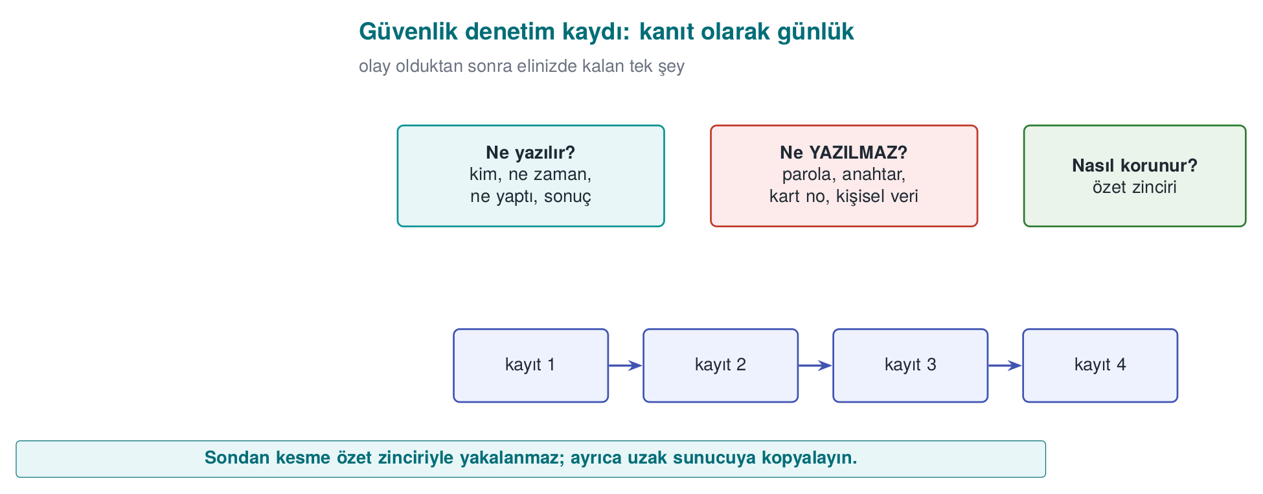
CEN429 Secure Programming · Week 2
Audit Log — Diagram
RTEU Computer Engineering · 2026-2027 Fall
90

Slide 91
CEN429 Secure Programming · Week 2
Demo 10 — Log Injection (CWE-117)
code/week-02/10-log-injection
UNSAFE:
AUDIT login user=bob
AUDIT login user=admin result=SUCCESS ... <- FORGED line
AUDIT login user=carol^[[2K^Mhidden ... <- erases screen
SAFE:
AUDIT login user=bob\x0A2026-... (single line)
forged 'admin SUCCESS' line(s): 0
✅ Escape it (xNN) · ✅ cap the length · ✅ syslog(LOG_INFO, "%s", input) — the input is never a format string
RTEU Computer Engineering · 2026-2027 Fall
91
Notes:
Speaker note: A single line break embedded in a username wrote a fake administrator login into the log that never happened. Mention the format-string trap as a bridge to Week 4.

Slide 92
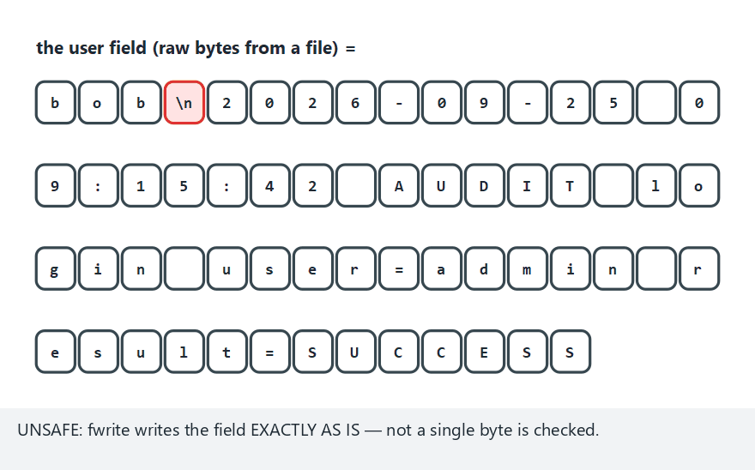
CEN429 Secure Programming · Week 2
Log Injection: Unsafe vs. Safe (animation)
RTEU Computer Engineering · 2026-2027 Fall
92
Notes:
Speaker note: Show how the escaping loop handles every byte, and why the line ending stays on a single line.

Slide 93
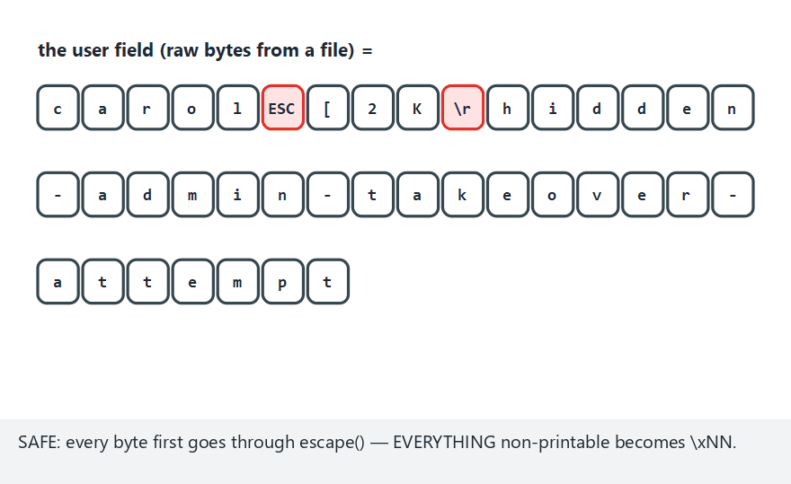
CEN429 Secure Programming · Week 2
Log Injection — Edge Case: ANSI Escape Sequence
RTEU Computer Engineering · 2026-2027 Fall
93
Notes:
Speaker note: Show that the screen-clearing ESC sequence becomes just as harmless once escaped the same way.

Slide 94
CEN429 Secure Programming · Week 2
Vulnerable Code: Log Injection and Format String
fprintf(log, "giris: %s\n", kullanici_adi); /* CWE-117 */
syslog(LOG_INFO, kullanici_girdisi); /* CWE-134 */
User-supplied data must never be used in a log as an unescaped line break or directly as a format string: syslog(LOG_INFO, "%s", girdi).
RTEU Computer Engineering · 2026-2027 Fall
94

Slide 95
CEN429 Secure Programming · Week 2
Digest Chain: Simple but Breakable
• Idea: every record contains the digest of the previous record.
• Modifying a record breaks only that record's own digest (the verifier always checks the stored chain, never a recomputed one).
• Problem: the digest is unkeyed — a capable attacker can recompute every digest downstream, hiding the tampering completely.
• Solution: make the digest keyed → an HMAC chain (next slide).
RTEU Computer Engineering · 2026-2027 Fall
95

Slide 96
CEN429 Secure Programming · Week 2
Why Is Logging Removed from Release Builds?
• A log is designed assuming an attacker can read it too.
• Every secret written to a log has effectively been given to everyone who can access the log file.
• Debug code silenced by a disabled flag stays in the binary.
• It leaks information through its strings and can be turned back on — so it must be fully stripped from the release build.
RTEU Computer Engineering · 2026-2027 Fall
96

Slide 97
CEN429 Secure Programming · Week 2
Demo 11 — Tamper-Resistant Logging
code/week-02/11-tamper-evident-log · HMAC chain + key evolution
Attack | Evolving key | Static key
Modifying a record | ✅ MAC:BROKEN | ✅ caught
Deleting a record / reordering | ✅ ORDER:BROKEN | ✅ caught
Rewriting history with a compromised key | ✅ TAMPERED | ❌ appears INTACT
The key evolves one-way at every record, and the old key is deleted → records before the compromise stay protected
RTEU Computer Engineering · 2026-2027 Fall
97
Notes:
Speaker note: Schneier–Kelsey 1999. The verifier keeps the starting key offline. The strongest evidence is a remote copy the attacker cannot reach.

Slide 98
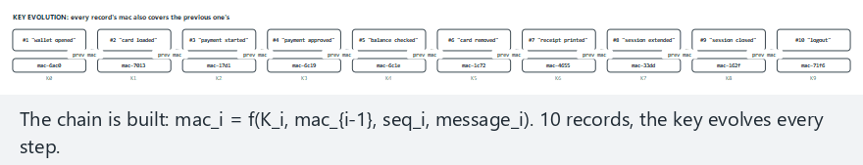
CEN429 Secure Programming · Week 2
Tamper-Evident Logging: The HMAC Chain (animation)
RTEU Computer Engineering · 2026-2027 Fall
98
Notes:
Speaker note: Show how each record's digest includes the previous record's digest, and how changing one record's message breaks only that record's own check — later records still verify against their own untouched stored digest.

Slide 99
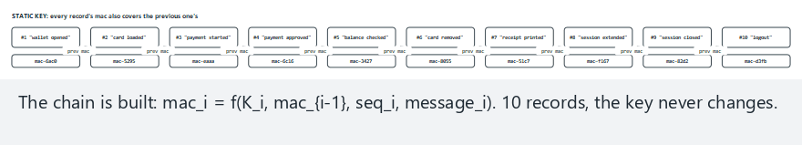
CEN429 Secure Programming · Week 2
HMAC Chain — Edge Case: Static Key (No Evolution)
RTEU Computer Engineering · 2026-2027 Fall
99
Notes:
Speaker note: Show why the same attack slips through undetected with a static key — connect this to why forward security matters.

Slide 100
CEN429 Secure Programming · Week 2
Forward Security: Why Does the Key Evolve?
• After every record, the key changes through a one-way function; the old key is deleted.
• When an attacker compromises the machine, they find only the current key.
• They cannot go back from that point to the keys that sealed earlier records.
• Result: records before the compromise stay protected (Schneier–Kelsey, 1999).
RTEU Computer Engineering · 2026-2027 Fall
100

Slide 101
CEN429 Secure Programming · Week 2
Question — Is Truncation from the End Caught?
Delete the last three lines from the chain Demo 11 produces.
Question: Will the verifier notice? Why?
Answer: Only if the chain's final value or record count is kept separately (on a remote server). If the chain itself is kept only in the file, truncation from the end does not break internal consistency — because there is no record after the deleted ones left to show an inconsistency.
RTEU Computer Engineering · 2026-2027 Fall
101

Slide 102
CEN429 Secure Programming · Week 2
Rule (Summary): Audit Log
• Write user data by escaping and bounding it.
• Never write secrets (password, key).
• Seal the log with a keyed chain; evolve the key at every record.
• Don't keep the verification key on the same machine as the log.
• Where possible, send records immediately to a separate server.
RTEU Computer Engineering · 2026-2027 Fall
102

Slide 103
CEN429 Secure Programming · Week 2
How Is This Applied in the Field? — Mobile Logging
• In mobile apps, the on-device log is kept to a minimum and contains no sensitive fields.
• Security events (integrity failure, debugger detection) are reported to the server.
• This is the "reporting" leg of the RASP measures we'll see in Week 6.
• The on-device log is in the attacker's hands; the real evidence is the remote copy.
RTEU Computer Engineering · 2026-2027 Fall
103

Slide 104
CEN429 Secure Programming · Week 2
Misconception: "Let's Log Everything"
Misconception: More information means better evidence.
Reality: Password, PIN, key, and the full card number must never go into a log (CWE-532).
A record carries just enough information to reconstruct the event: who, what, when, where, result.
RTEU Computer Engineering · 2026-2027 Fall
104

Slide 105
CEN429 Secure Programming · Week 2
Misconception: "I Wrote the Username As-Is"
Misconception: A field coming from the user can be written straight to the log.
Reality: An input containing a line break produces a fake log line (CWE-117, Demo 10).
Control characters must be escaped, or structured (field-by-field) logging must be used.
RTEU Computer Engineering · 2026-2027 Fall
105

Slide 106
CEN429 Secure Programming · Week 2
Misconception: "I Appended a Digest to the Record, So Tampering Will Show"
Misconception: Appending a digest to the end of the file is sufficient protection.
Reality: An attacker can recompute an unkeyed digest.
An HMAC chain catches insertion/modification; to catch truncation from the end, the final chain value must be kept separately (on a remote server) (Demo 11).
RTEU Computer Engineering · 2026-2027 Fall
106

Slide 107
CEN429 Secure Programming · Week 2
Checklist — Attack Tree and Audit Log
• AND/OR rules and find the cheapest path.
• how a defence changes the cheapest path (Demo 04).
• should and shouldn't appear in an audit log line.
•
• what they can't catch.
RTEU Computer Engineering · 2026-2027 Fall
107

Slide 108
CEN429 Secure Programming · Week 2
4. Access Control and Models
RTEU Computer Engineering · 2026-2027 Fall
108

Slide 109
CEN429 Secure Programming · Week 2
Subject, Object, Right — and the Matrix
• Subject (user/process) · Object (file/record) · Right (read/write/execute).
 | payment_key | log
application | — | write
library | read, write | write
attacker | — | —
The matrix is stored in two forms: ACL (column: the object holds who can access it) · Capability (row: the subject's tickets).
RTEU Computer Engineering · 2026-2027 Fall
109

Slide 110
CEN429 Secure Programming · Week 2
DAC · MAC · RBAC
Model | Who decides? | Example
DAC | The owner of the object | Unix chmod, Windows DACL
MAC | System/policy (owner cannot change it) | Bell–LaPadula, SELinux
RBAC | Permissions attach to roles, users are assigned to roles | The "Accountant" role
Real systems use all three together; the effective decision is usually the intersection.
DAC is flexible but leak-prone; MAC is strict (military/labelled); RBAC is enterprise, role-based and easy to administer.
RTEU Computer Engineering · 2026-2027 Fall
110

Slide 111
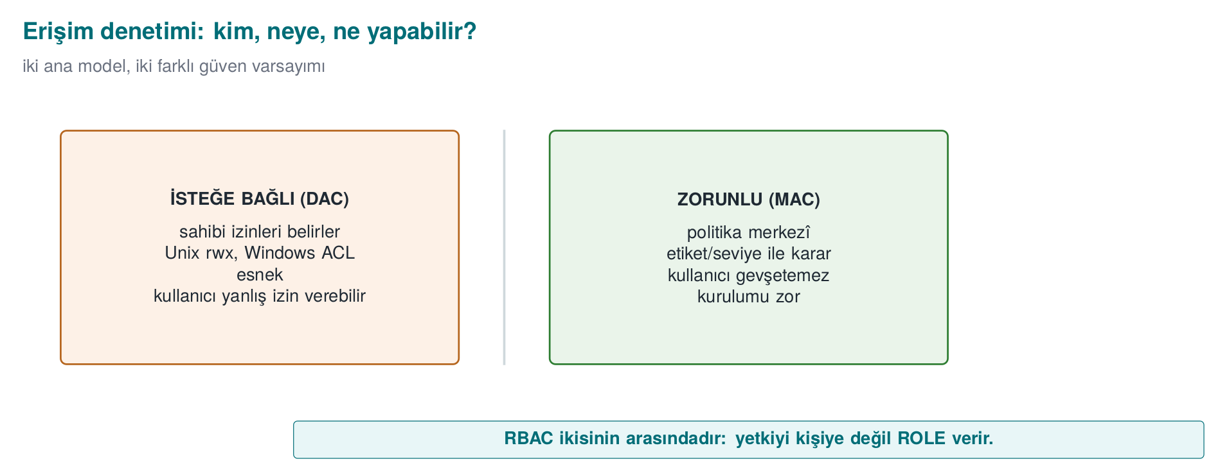
CEN429 Secure Programming · Week 2
DAC and MAC — Diagram
RTEU Computer Engineering · 2026-2027 Fall
111

Slide 112
CEN429 Secure Programming · Week 2
Demo 03 — DAC Alone (Matrix)
code/week-02/03-access-model
library(D ) R payment_key (D ) DAC:YES => ALLOW
app (D ) R payment_key (D ) DAC:no => DENY (not in the matrix)
attacker(D ) R payment_key (D ) DAC:no => DENY
Not even the application has direct access to the payment key → least privilege.
RTEU Computer Engineering · 2026-2027 Fall
112

Slide 113
CEN429 Secure Programming · Week 2
Bell–LaPadula: Confidentiality
Levels: Public < Confidential < Top Secret
• No read up: cannot read something more confidential than itself.
• *No write down (the -property):** cannot write to something less confidential than itself.
"Read down, write up" — confidential information cannot leak downward.
Example: a user labelled "Confidential" cannot read a "Top Secret" document; a "Top Secret" process cannot write to a "Public" file (this is how the leak is prevented).
RTEU Computer Engineering · 2026-2027 Fall
113
Notes:
Speaker note: Military origin (1973). "No write down" seems odd at first; the goal is to prevent top-secret information from being written somewhere a clerk could see it.

Slide 114
CEN429 Secure Programming · Week 2
Biba: Integrity (the Reverse of BLP)
Levels: External < Application < Kernel (trustworthiness)
• No read down: cannot read data less trustworthy than itself.
• No write up: cannot write to data more trustworthy than itself.
"Read up, write down" — dirty information cannot rise upward and corrupt the clean.
RTEU Computer Engineering · 2026-2027 Fall
114

Slide 115
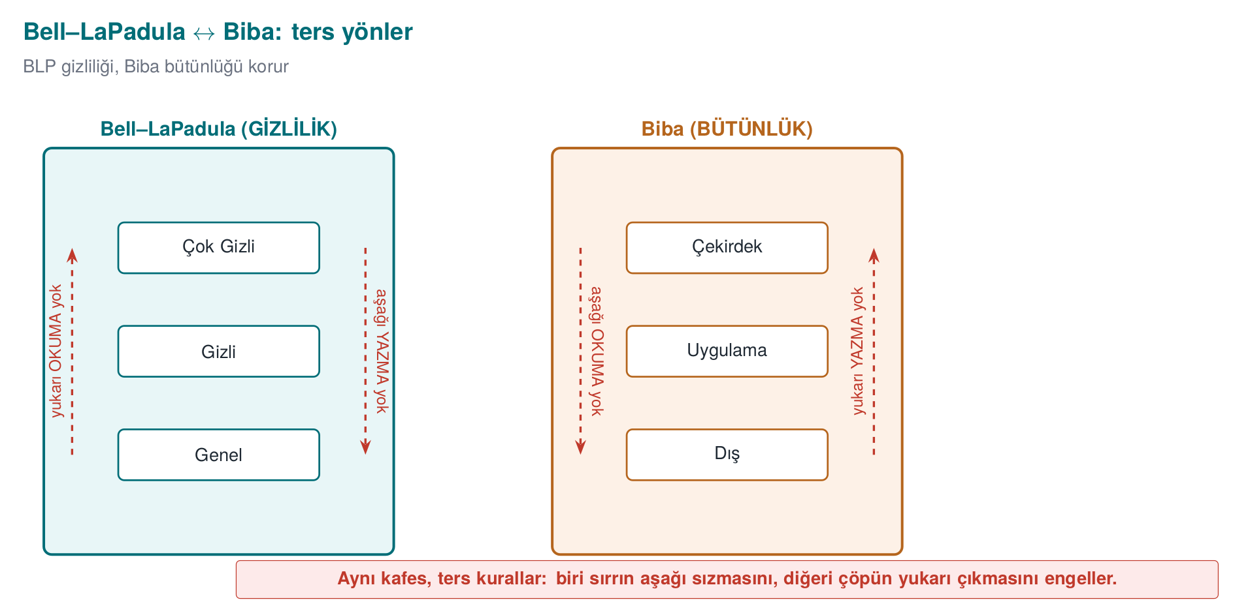
CEN429 Secure Programming · Week 2
BLP and Biba: Opposite Directions
Opposite directions: BLP protects confidentiality (no read up + no write down), Biba protects integrity (no read down + no write up).
If data must be both confidential and trustworthy at once → it is only processed at its own level.
RTEU Computer Engineering · 2026-2027 Fall
115

Slide 116
CEN429 Secure Programming · Week 2
Clark–Wilson: Commercial Integrity
Instead of military levels, well-formed transactions + separation of duty (1987, banking):
• CDI: data whose integrity is preserved (a balance).
• TP: only approved transactions touch a CDI (no direct writes).
• IVP: regularly checks consistency ("debits = credits").
• Separation of duty: initiator ≠ approver.
"Touch data not directly, but through verified transactions."
RTEU Computer Engineering · 2026-2027 Fall
116

Slide 117
CEN429 Secure Programming · Week 2
Demo 03 — BLP and Biba Output
BLP: clerk READ operation BLP:DENY => DENY (read up)
general WRITE notice BLP:DENY => DENY (write down)
Biba: listener WRITE record BIBA:DENY => DENY (write up)
processor READ incoming BIBA:DENY => DENY (read down)
DAC says YES (allowed) in both cases; it is the system (MAC) rule that brings the denial.
RTEU Computer Engineering · 2026-2027 Fall
117

Slide 118
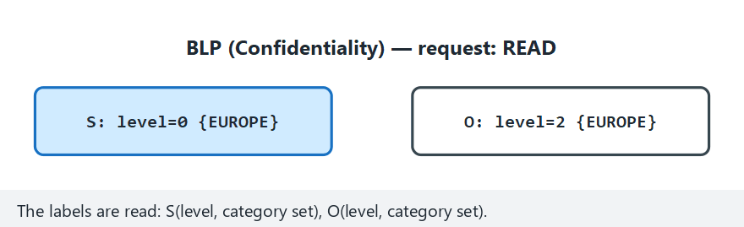
CEN429 Secure Programming · Week 2
Access Matrix: DAC + BLP + Biba + Chinese Wall (animation)
RTEU Computer Engineering · 2026-2027 Fall
118
Notes:
Speaker note: Show that dominates() uses the exact same label comparison for BLP and Biba, just in opposite directions.

Slide 119
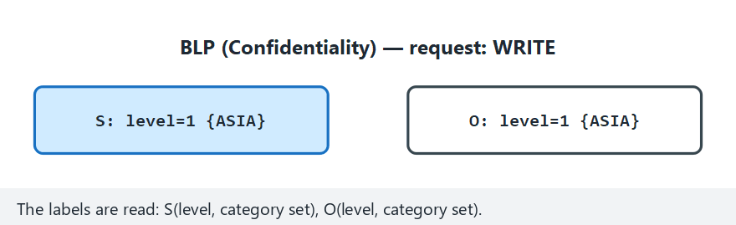
CEN429 Secure Programming · Week 2
Access Matrix — Edge Case: Equal Labels
RTEU Computer Engineering · 2026-2027 Fall
119
Notes:
Speaker note: When both sides are at exactly the same level, show why both BLP and Biba always allow the request.

Slide 120
CEN429 Secure Programming · Week 2
The Unix Access Model
-rwxr-x--- → owner / group / others, each with read-write-execute.
• Three identities: effective / real / saved UID.
• setuid: the program runs with the authority of its owner (usually root) — powerful but dangerous.
• sticky bit: cannot delete someone else's file in /tmp.
Book: Recipe 2.1
RTEU Computer Engineering · 2026-2027 Fall
120

Slide 121
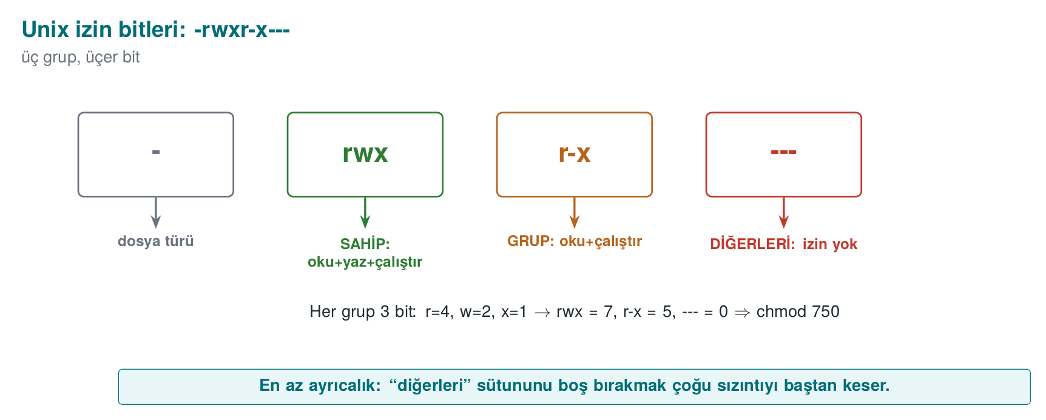
CEN429 Secure Programming · Week 2
Unix Permission Bits — Diagram
RTEU Computer Engineering · 2026-2027 Fall
121

Slide 122
CEN429 Secure Programming · Week 2
The Windows Access Model
Concept | Unix | Windows
Identity | UID/GID | SID
Permission | Mode bits | ACEs inside a DACL
Auditing | syslog (external) | SACL (built-in)
"Open to everyone" | chmod 777 | NULL DACL
• DACL: who can do what (ACE = SID + right + allow/deny).
• Modern Windows: MIC and AppContainer (Biba-like). Book: Recipe 2.2
RTEU Computer Engineering · 2026-2027 Fall
122

Slide 123
CEN429 Secure Programming · Week 2
Demo 06 — TOCTOU Race (CWE-367)
code/week-02/06-toctou (WSL/Linux only) · Book: Recipe 2.3
UNSAFE (lstat first, then fopen):
>>> ATTACK SUCCEEDED: write redirected to secret_target.txt!
SAFE (O_NOFOLLOW, one step):
rejected: the target is a symbolic link
The gap between checking and using is a race. Solution: a single atomic step (O_NOFOLLOW, O_EXCL), work through the fd.
RTEU Computer Engineering · 2026-2027 Fall
123

Slide 124
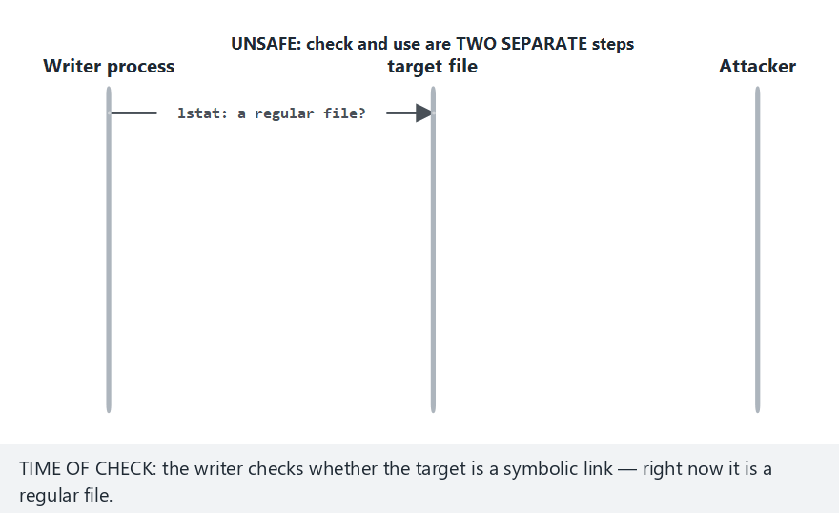
CEN429 Secure Programming · Week 2
The TOCTOU Race: The Window Between Check and Use (animation)
RTEU Computer Engineering · 2026-2027 Fall
124
Notes:
Speaker note: Show exactly when the attacker swaps in the symbolic link, right between lstat() and fopen(), on the timeline.

Slide 125
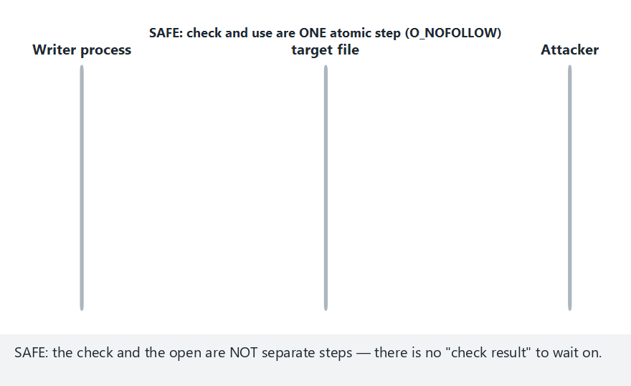
CEN429 Secure Programming · Week 2
TOCTOU — Edge Case: SAFE, No Attacker
RTEU Computer Engineering · 2026-2027 Fall
125
Notes:
Speaker note: Show that the SAFE version behaves normally with no extra cost when there is no attacker.

Slide 126
CEN429 Secure Programming · Week 2
Demo 12 — The ACE Evaluation Algorithm
code/week-02/12-ace-evaluation · Recipe 2.2
1a canonical: DENY Everyone FULL | ALLOW Marketing WRITE => DENY
1b broken: ALLOW Marketing WRITE | ... DENY Everyone => ALLOW
2a NULL DACL (unrelated account) => ALLOW (TAKE_OWNER, WRITE_DAC dahil!)
2b EMPTY DACL (same account) => DENY
3b inheritance broken => DENY (list ended)
• Order matters: explicit DENY → explicit ALLOW → inherited DENY → inherited ALLOW
• ❌ NULL DACL = every right to everyone · ✅ grant the needed rights explicitly
• The owner can change permissions no matter what the DACL says
RTEU Computer Engineering · 2026-2027 Fall
126
Notes:
Speaker note: In 1a and 1b the ACEs are the same, only the order differs. In the last step, show the demo's own file's real ACL with icacls.

Slide 127
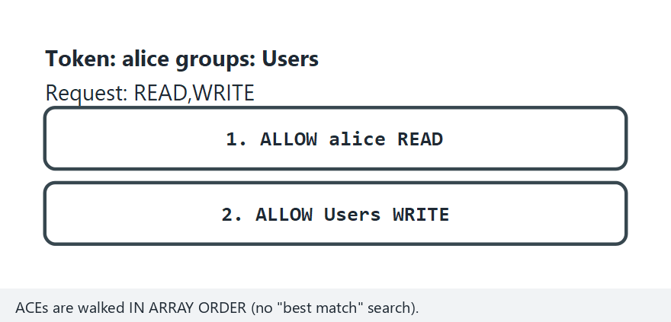
CEN429 Secure Programming · Week 2
Windows ACE Evaluation Order (animation)
RTEU Computer Engineering · 2026-2027 Fall
127
Notes:
Speaker note: Show how each ACE is compared against the SIDs in the token, and why the first matching DENY stops the list right there.

Slide 128
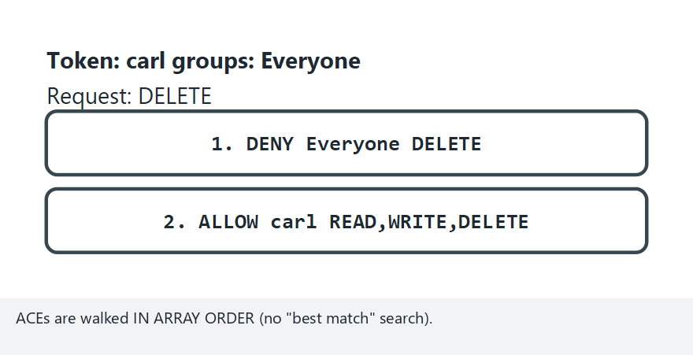
CEN429 Secure Programming · Week 2
ACE Order — Edge Case: Canonical Order, DENY First
RTEU Computer Engineering · 2026-2027 Fall
128
Notes:
Speaker note: Show why having DENY at the front of the list, in canonical order, is the safest arrangement.

Slide 129
CEN429 Secure Programming · Week 2
Demo 13 — Unix Permissions, umask, setuid
code/week-02/13-unix-permissions-umask · Recipe 2.1, 2.7, 1.3
alice read paradox.txt ---rwxrwx owner -> DENY
zoe read paradox.txt ---rwxrwx other -> ALLOW
0666 & ~umask: 000 -> rw-rw-rw- 022 -> rw-r--r-- 077 -> rw-------
seteuid(1001) r/e/s = 1001/1001/0 <- saved UID still 0!
• The first matching class decides (owner → group → others)
• fopen() requests 0666 → for a sensitive file: open(..., 0600)
• Dropping privilege for good: setresuid() + verify
RTEU Computer Engineering · 2026-2027 Fall
129
Notes:
Speaker note: This is a simulation; no real setuid file is created, no sudo is needed. The system's actual setuid programs are only listed.

Slide 130
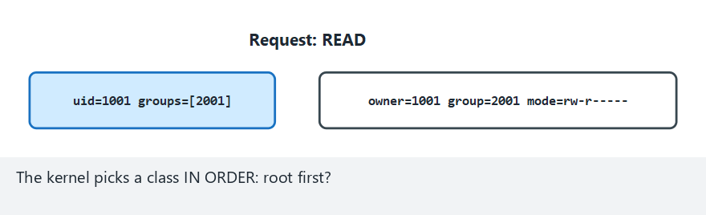
CEN429 Secure Programming · Week 2
Unix Permission Check and umask (animation)
RTEU Computer Engineering · 2026-2027 Fall
130
Notes:
Speaker note: Step through how the root/owner/group/other class is picked, and the requested & ~umask bit operation.

Slide 131
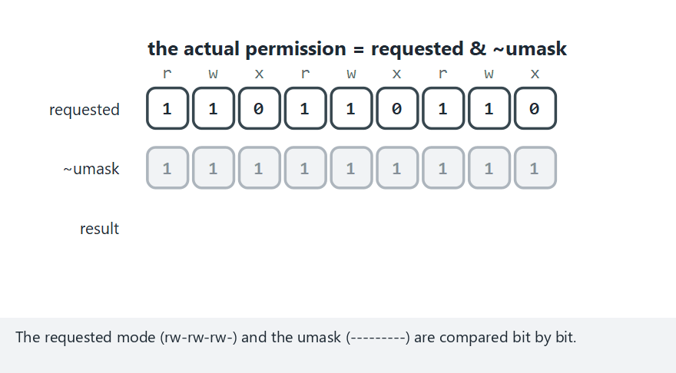
CEN429 Secure Programming · Week 2
Unix Permissions — Edge Case: umask 000 Danger
RTEU Computer Engineering · 2026-2027 Fall
131
Notes:
Speaker note: Show why a file opened with umask 000 ends up writable by everyone.

Slide 132
CEN429 Secure Programming · Week 2
Demo 14 — RBAC, Separation of Duty, Clark–Wilson
code/week-02/14-rbac-clark-wilson · a bank simulation
ASSIGN carl TELLER SSD(TELLER,APPROVER) -> DENY
SESSION dana TELLER,AUDITOR DSD(TELLER,AUDITOR) -> DENY
SESSION dana AUDITOR -> OK
dana IVP: expected 20250, found 20250
• SSD: cannot be assigned to two conflicting roles · DSD: cannot have both active in the same session
• Only a certified TP touches a CDI; a large transfer → second-person approval
• ⚠️ If a faulty TP gets certified, the rules don't see it — the IVP catches it
RTEU Computer Engineering · 2026-2027 Fall
132

Slide 133
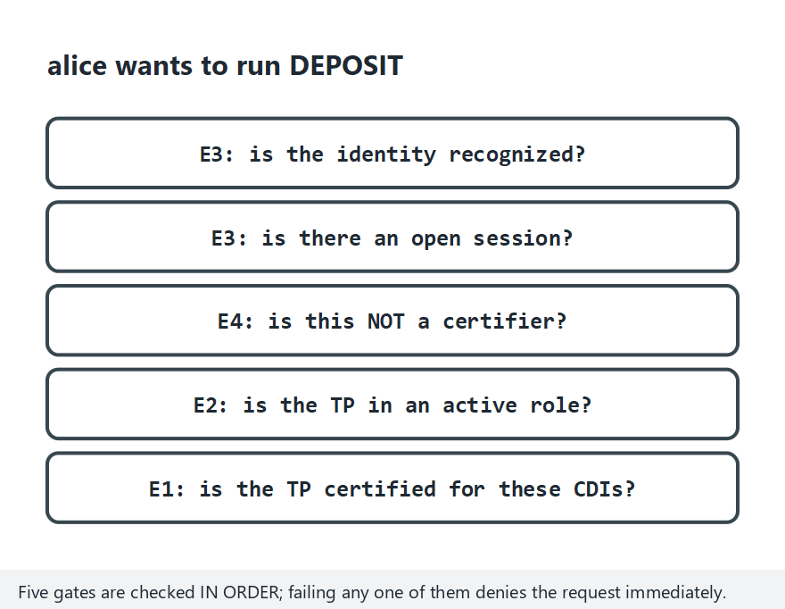
CEN429 Secure Programming · Week 2
RBAC + Clark–Wilson: Transaction Check Gates (animation)
RTEU Computer Engineering · 2026-2027 Fall
133
Notes:
Speaker note: Walk through the E1-E4 gates in order: is the role held, is the TP certified, is there an open session, does only a TP touch the CDI.

Slide 134
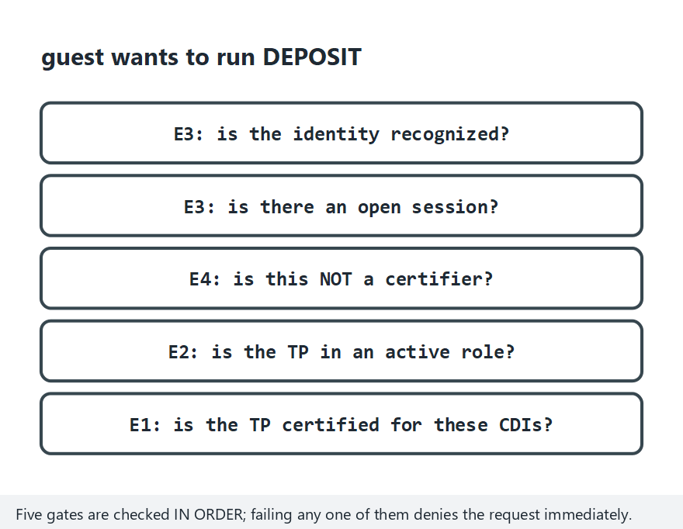
CEN429 Secure Programming · Week 2
RBAC — Edge Case: User Not Recognized
RTEU Computer Engineering · 2026-2027 Fall
134
Notes:
Speaker note: Show that the E3 identity gate comes before the role/TP gates and stops the request right at the start.
Speaker note: Field equivalent: the four-eyes principle, split knowledge and dual control, daily reconciliation.

Slide 135
CEN429 Secure Programming · Week 2
Misconception: "We Verified Identity, So We Verified Authorization Too"
Misconception: A user who can log in can do anything.
Reality: Authentication is the question "who are you?"; authorization is the question "can you do this?" — separate steps.
CWE-862 (missing authorization), fourth on the 2025 CWE Top 25, is exactly this mistake.
RTEU Computer Engineering · 2026-2027 Fall
135

Slide 136
CEN429 Secure Programming · Week 2
Misconception: "If There's an Error, Let's Allow It"
Misconception: If the policy can't be read or is unclear, access should be granted so the user isn't inconvenienced.
Reality: The safe default principle says the exact opposite: if the policy can't be read, the answer must be deny (CWE-636, the "fail-open" error).
"Fail-closed" (deny on error) is the default for secure systems.
RTEU Computer Engineering · 2026-2027 Fall
136

Slide 137
CEN429 Secure Programming · Week 2
Misconception: "NULL DACL and an Empty DACL Are the Same"
Misconception: Both look like "no permissions."
Reality: A NULL DACL (no DACL at all) grants full access to everyone — including taking ownership. An empty DACL (a list with no ACEs) grants no rights to anyone.
The first is a serious vulnerability (CWE-732); confusing the two is dangerous (Demo 12).
RTEU Computer Engineering · 2026-2027 Fall
137

Slide 138
CEN429 Secure Programming · Week 2
Misconception: "ACE Order Doesn't Matter"
Misconception: The same ACEs in a different order give the same result.
Reality: Windows evaluates ACEs in order and stops at the first determining entry.
In canonical order, explicit deny entries come before allow entries; a manually mis-ordered DACL can cancel out an intended denial (Demo 12).
RTEU Computer Engineering · 2026-2027 Fall
138

Slide 139
CEN429 Secure Programming · Week 2
Misconception: "chmod 777 Fixed the Problem"
Misconception: Papering over an "access denied" error with chmod 777 is a practical fix.
Reality: Opening permissions to everyone doesn't solve the problem, it magnifies it.
Secrets should be created with 0600, and umask should be set deliberately at the start of the program (Demo 13).
RTEU Computer Engineering · 2026-2027 Fall
139

Slide 140
CEN429 Secure Programming · Week 2
Misconception: "We Set Up RBAC, So Separation of Duty Comes for Free"
Misconception: Setting up role-based access control automatically provides separation of duty.
Reality: If the same person is given both the "initiate refund" and "approve refund" roles, RBAC does not provide separation of duty.
A static (SSD) or dynamic (DSD) separation-of-duty constraint must be defined separately (Demo 14).
RTEU Computer Engineering · 2026-2027 Fall
140

Slide 141
CEN429 Secure Programming · Week 2
The Mobile Permission Model and Least Privilege
• Every app runs in its own sandbox — it cannot access other apps' data by default.
• Sensitive resources (camera, location, contacts) require runtime permission; there's no access without user approval.
• This is a hybrid model resembling DAC (user consent) combined with MAC (the system's mandatory sandbox boundary).
• It is the concrete form, in today's mobile operating systems, of the principle of least privilege (Week 1).
RTEU Computer Engineering · 2026-2027 Fall
141

Slide 142
CEN429 Secure Programming · Week 2
Checklist — Access Control
• who decides?"
•
• difference between authentication and authorization with an example.
• ls -l output, the setuid/sticky bits, and a umask calculation.
• critical.
• separately with SSD/DSD in RBAC.
RTEU Computer Engineering · 2026-2027 Fall
142

Slide 143
CEN429 Secure Programming · Week 2
5. Vulnerability Classification
RTEU Computer Engineering · 2026-2027 Fall
143

Slide 144
CEN429 Secure Programming · Week 2
CWE: A Catalogue of Weakness Types
• CWE = the type of a weakness (SQL injection → CWE-89).
• CWE Top 25: that year's 25 most common/dangerous weaknesses.
CWE | Weakness
CWE-787 | Out-of-bounds write
CWE-79 | XSS
CWE-89 | SQL injection
CWE-367 | TOCTOU (Demo 06)
CWE-798 | Hardcoded credentials/key
Hierarchical: pillar → class → base → variant. Pick the most concrete CWE.
RTEU Computer Engineering · 2026-2027 Fall
144

Slide 145
CEN429 Secure Programming · Week 2
Misconception: "CWE and CVE Are the Same Thing"
Misconception: Both mean the same thing and can be used interchangeably.
Reality: CWE is the type of a weakness (SQL injection → CWE-89). CVE is the identity of a specific flaw in a specific product (Heartbleed → CVE-2014-0160).
A CVE belongs to one or more CWE types.
RTEU Computer Engineering · 2026-2027 Fall
145

Slide 146
CEN429 Secure Programming · Week 2
Misconception: "Picking the Most General CWE Is Safe"
Misconception: When unsure, writing the top-level (general) CWE is safer.
Reality: A top-level entry like CWE-20 (improper input validation) doesn't explain the fix.
Rule: pick the most concrete CWE possible (preferably at the base level).
RTEU Computer Engineering · 2026-2027 Fall
146

Slide 147
CEN429 Secure Programming · Week 2
OWASP Top 10 and MASVS
Document | Scope | Type
CWE / Top 25 | All software | Catalogue / priority
OWASP Top 10 | Web | Awareness / priority
OWASP ASVS | Web | Verification standard
OWASP MASVS + MASTG | Mobile | Verification + testing
MASVS-RESILIENCE = resistance to reverse engineering → this course's code obfuscation (Weeks 9, 14), RASP (Week 6), and white-box (Week 11) topics.
RTEU Computer Engineering · 2026-2027 Fall
147

Slide 148
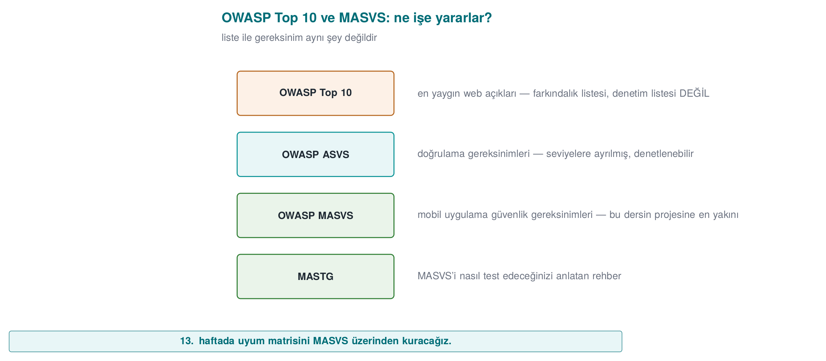
CEN429 Secure Programming · Week 2
OWASP and MASVS — Diagram
RTEU Computer Engineering · 2026-2027 Fall
148

Slide 149
CEN429 Secure Programming · Week 2
Misconception: "OWASP Top 10 Is a Checklist"
Misconception: If I satisfy the 10 items on the Top 10, I'm secure.
Reality: The Top 10 is an awareness document, not a verification standard.
Verifiable requirements live in ASVS for the web, and in MASVS and MASTG for mobile.
RTEU Computer Engineering · 2026-2027 Fall
149

Slide 150
CEN429 Secure Programming · Week 2
CVE and CVSS
• CVE: the identity of a specific flaw in a specific product (CVE-2014-0160 = Heartbleed). A name, not a severity.
• CVSS: a flaw's severity, 0.0–10.0. Three groups: Base (fixed), Temporal, Environmental.
A CVE belongs to one or more CWE types.
RTEU Computer Engineering · 2026-2027 Fall
150

Slide 151
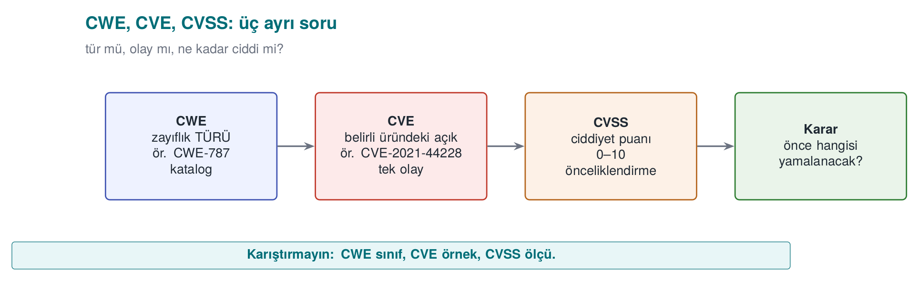
CEN429 Secure Programming · Week 2
CWE, CVE, CVSS — Diagram
RTEU Computer Engineering · 2026-2027 Fall
151

Slide 152
CEN429 Secure Programming · Week 2
CVSS v3.1 Base Score Metrics
Metric | Question | Values
AV | From where? | Network / Adjacent / Local / Physical
AC | How hard? | Low / High
PR | Privileges needed? | None / Low / High
UI | Victim needed? | None / Required
S | Does scope change? | Unchanged / Changed
C/I/A | Impact? | High / Low / None
v4.0: separate VC/VI/VA + SC/SI/SA instead of scope; base score = CVSS-B.
RTEU Computer Engineering · 2026-2027 Fall
152

Slide 153
CEN429 Secure Programming · Week 2
Demo 05 — CVSS Calculator
code/week-02/05-cvss (Python)
AV:N/AC:L/PR:N/UI:N/S:U/C:H/I:H/A:H = 9.8 Critical
... S:U -> S:C = 10.0 Critical
AV:L (local) /PR:L/... C:H/I:H/A:H = 7.8 High
• Remote + unauthenticated is highest; a scope change pushes it to 10.0.
• ⚠️ The base score doesn't know the context: a 4.0 flaw that hits your asset exactly can matter more to you than a 9.8.
RTEU Computer Engineering · 2026-2027 Fall
153

Slide 154
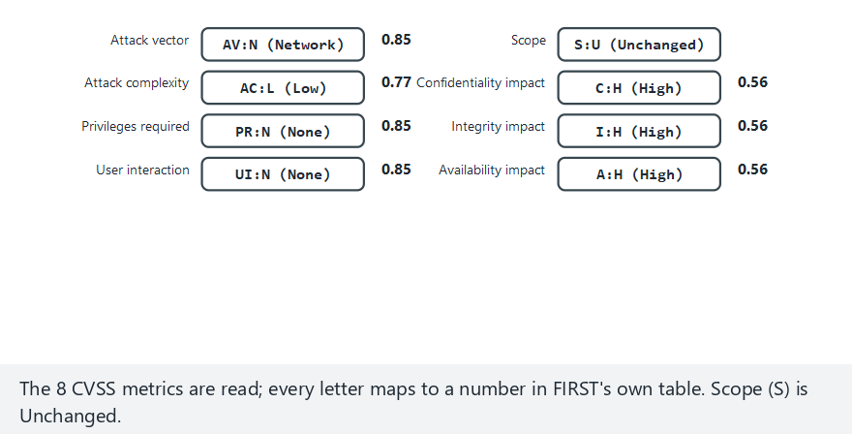
CEN429 Secure Programming · Week 2
CVSS v3.1 Base Score Calculation (animation)
RTEU Computer Engineering · 2026-2027 Fall
154
Notes:
Speaker note: Show how the Impact and Exploitability sub-scores are computed from the eight metrics, and how the formula changes with scope.

Slide 155
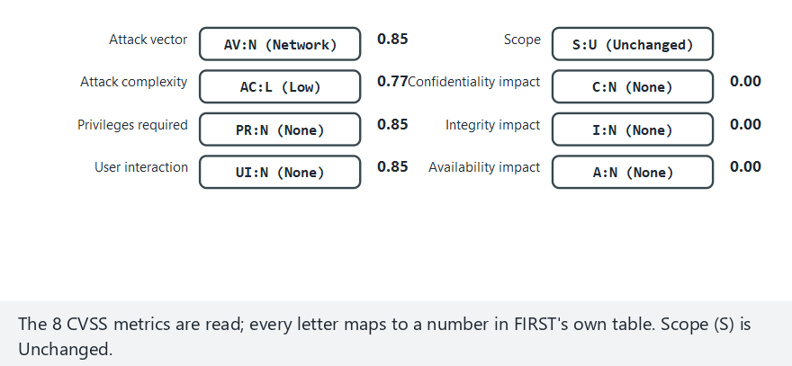
CEN429 Secure Programming · Week 2
CVSS — Edge Case: No Impact at All
RTEU Computer Engineering · 2026-2027 Fall
155
Notes:
Speaker note: Show that when C/I/A are all None, the Impact sub-score is 0 and the base score is a hard 0.0.

Slide 156
CEN429 Secure Programming · Week 2
CVSS Score → Severity Band
Score | Band
0.0 | None
0.1–3.9 | Low
4.0–6.9 | Medium
7.0–8.9 | High
9.0–10.0 | Critical
Even with the same impact (C:H/I:H/A:H), a remote + unauthenticated flaw scores a higher band than a local + authenticated one.
RTEU Computer Engineering · 2026-2027 Fall
156

Slide 157
CEN429 Secure Programming · Week 2
CVSS v4.0 in Brief
• Released in 2023; fixes some of v3.1's weaknesses.
• The base score is now called CVSS-B.
• The Scope (S) metric was removed; replaced by separate Vulnerable System Impact (VC/VI/VA) and Subsequent System Impact (SC/SI/SA).
• With exploit maturity (E) and threat/environmental metrics, CVSS-BTE can be computed.
• This course's calculator was written for v3.1; in the field it's still the most common.
RTEU Computer Engineering · 2026-2027 Fall
157

Slide 158
CEN429 Secure Programming · Week 2
Misconception: "I'll Feed a v3.1 Vector into v4.0"
Misconception: A CVSS v3.1 vector works directly in a v4.0 calculator.
Reality: v4.0 has no Scope (S); it has AT, VC/VI/VA, SC/SI/SA metrics, and UI takes three values (N/P/A).
Vectors are not converted between versions, they're rebuilt.
RTEU Computer Engineering · 2026-2027 Fall
158

Slide 159
CEN429 Secure Programming · Week 2
CVSS's Common Mistake
Misconception: "CVSS is 9.8, let's patch it right away; 4.0 can wait."
• The base score doesn't know the context: it measures only the flaw's own properties.
• A 4.0 flaw that's exactly the door to your most valuable asset can matter more to you than a 9.8.
• This is what the Environmental metrics and your asset table (S5) are for.
• The score is a starting point for prioritisation, not the final word.
RTEU Computer Engineering · 2026-2027 Fall
159

Slide 160
CEN429 Secure Programming · Week 2
Assessor: From Finding to Score
Concrete questions for rating a finding reproducibly:
• Can the attacker use this over the network, or only with the device in hand (AV)?
• Does it need prior privilege or user interaction first (PR, UI)?
• Does the impact stay in the affected component, or spill outside it (S)?
In this course's context (the program runs on the attacker's device), most findings come out local (AV:L); the risk doesn't drop even if the score does.
RTEU Computer Engineering · 2026-2027 Fall
160

Slide 161
CEN429 Secure Programming · Week 2
Beyond CVSS: EPSS
• EPSS (Exploit Prediction Scoring System): the probability a flaw is exploited within 30 days (0–1).
• CVSS measures severity, EPSS measures probability — they answer different questions.
• "EPSS is high, so CVSS must be high too" is wrong; the two are measured independently.
• Reading them together clarifies the priority order.
RTEU Computer Engineering · 2026-2027 Fall
161

Slide 162
CEN429 Secure Programming · Week 2
Beyond CVSS: KEV
• KEV (Known Exploited Vulnerabilities): a catalogue of flaws proven to be exploited.
• Every entry: a CVE id, evidence of exploitation, remediation guidance.
• "Not in KEV means it's not being exploited" is wrong — absence from the list is not proof of safety.
• A flaw in KEV must be handled as a priority, even with a low CVSS score.
RTEU Computer Engineering · 2026-2027 Fall
162

Slide 163
CEN429 Secure Programming · Week 2
SSVC: Decision Points
Five questions that turn a finding into a decision:
• Is there an exploit? · Can it be automated?
• What is the technical impact? · How widely is the mission affected?
• How is public well-being affected?
The result is one of four decisions: *Track / Track / Attend / Act**
RTEU Computer Engineering · 2026-2027 Fall
163

Slide 164
CEN429 Secure Programming · Week 2
Example: Five Findings, Two Rankings
No | Finding | System | EPSS | KEV
B1 | No length check in the parser, remote code execution | Internet-facing | 0.62 | Yes
B5 | Local privilege escalation in the driver | Employee computers | 0.41 | Yes
B4 | Cookie missing the Secure flag | Internet-facing | 0.08 | No
Ranking by CVSS alone and ranking with EPSS+KEV added can come out differently; B5 sits in the middle by CVSS but rises to the top because it's in KEV.
RTEU Computer Engineering · 2026-2027 Fall
164

Slide 165
CEN429 Secure Programming · Week 2
Misconception: "Device Flaws Score Low, So They're Unimportant"
Misconception: A flaw scoring AV:L (local access) can be ignored if the score is low.
Reality: In this course's attacker model, the device is already in the attacker's hands (white-box).
The risk doesn't decrease even if the score does; the score should be written alongside attack potential (time, expertise, equipment).
RTEU Computer Engineering · 2026-2027 Fall
165

Slide 166
CEN429 Secure Programming · Week 2
Practice: Build the Vector Yourself
Question: An attacker takes over a system completely over the network, without authentication, without user interaction (confidentiality, integrity, and availability are all fully broken). What is the CVSS v3.1 vector and score?
Answer: AV:N/AC:L/PR:N/UI:N/S:U/C:H/I:H/A:H → 9.8 (Critical). If the scope had also changed (S:C), the score would rise to 10.0.
RTEU Computer Engineering · 2026-2027 Fall
166

Slide 167
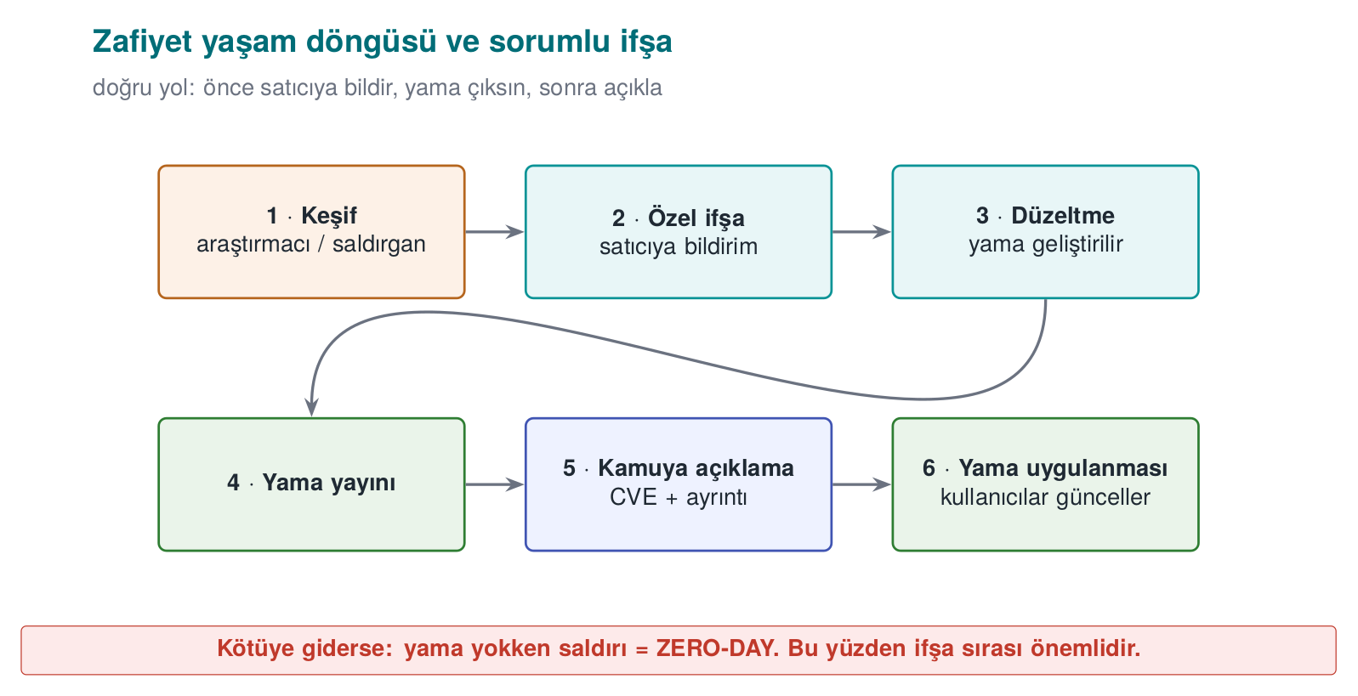
CEN429 Secure Programming · Week 2
The Vulnerability Lifecycle
• Zero-day: a flaw the vendor doesn't know about / has no patch for.
• Responsible disclosure: report to the vendor first, wait ~90 days, then disclose.
• Patch gap: once the patch ships, the flaw becomes public; whoever hasn't updated stays vulnerable (WannaCry).
RTEU Computer Engineering · 2026-2027 Fall
167

Slide 168
CEN429 Secure Programming · Week 2
The Lifecycle: Four Stages
1. Discovery: the flaw is found (a researcher, an attacker, or the vendor).
2. Report: the researcher reports it to the vendor (or the attacker quietly uses it).
3. Patch: the vendor writes and releases a fix.
4. Release: the patch reaches the user; the risk ends if it's applied.
The time between every arrow is the window given to the attacker.
RTEU Computer Engineering · 2026-2027 Fall
168

Slide 169
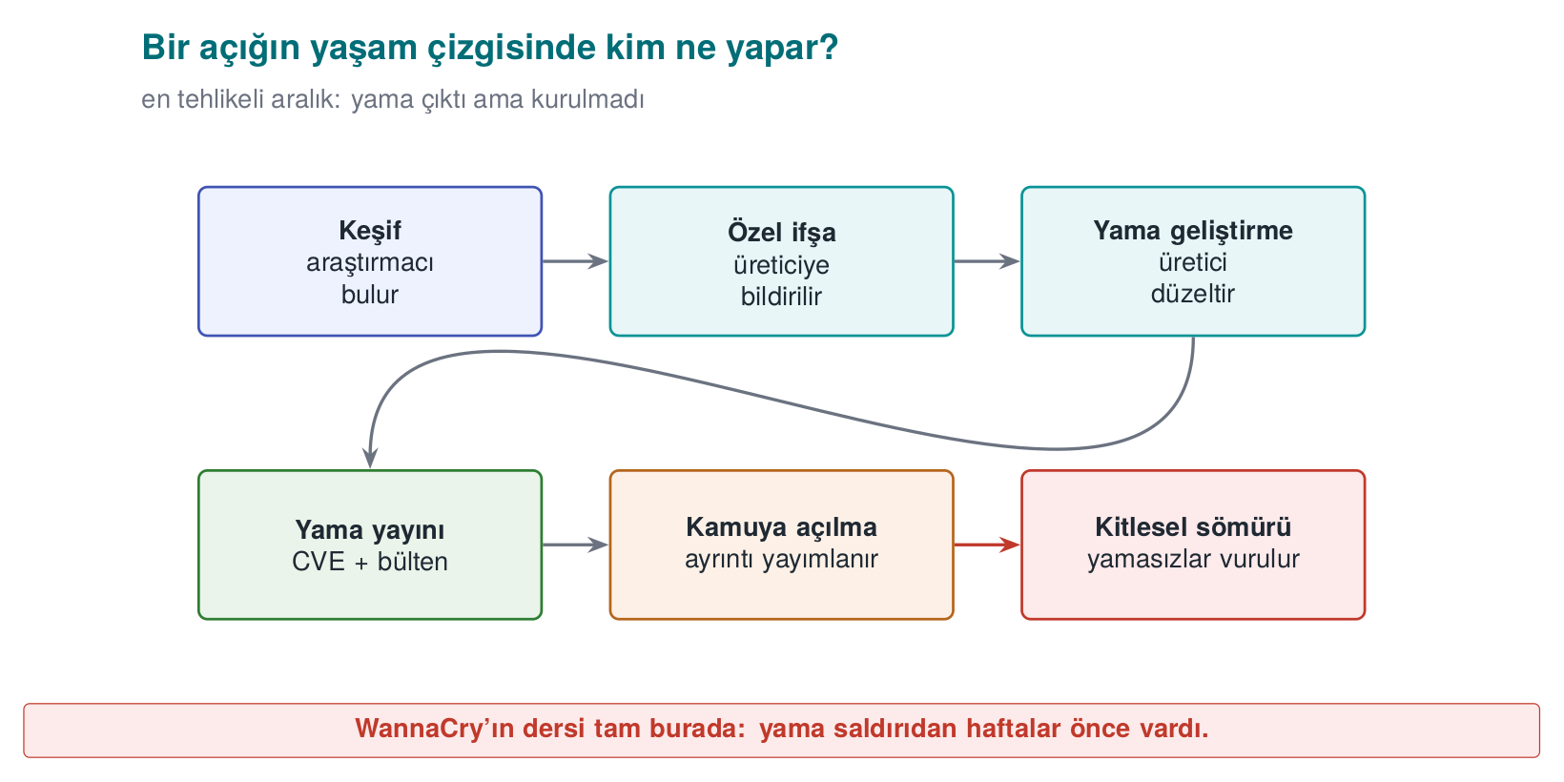
CEN429 Secure Programming · Week 2
A Flaw's Lifeline — Diagram
RTEU Computer Engineering · 2026-2027 Fall
169

Slide 170
CEN429 Secure Programming · Week 2
Responsible Disclosure vs. Full Disclosure
 | Responsible disclosure (coordinated) | Full disclosure
Who knows first? | The vendor | Everyone at once
Waiting period | ~90 days (for the patch) | None
Goal | Protect users while pushing the vendor to act | Force the vendor's hand
Risk | Low (disclosed once a patch exists) | High (the flaw is known while unpatched)
Full disclosure is the controversial one in the industry.
RTEU Computer Engineering · 2026-2027 Fall
170

Slide 171
CEN429 Secure Programming · Week 2
Bug Bounty Programmes
• Programmes where companies reward researchers who report flaws responsibly.
• Goal: steer researchers toward responsible disclosure instead of full disclosure.
• A gain for the researcher; early warning for the company.
• Now standard practice at most large tech companies.
RTEU Computer Engineering · 2026-2027 Fall
171

Slide 172
CEN429 Secure Programming · Week 2
In the Field: What Happens When a Flaw Is Reported?
For a product team, the lifecycle is a process:
• A reporting channel: security.txt, a security email address.
• A responsible person/team.
• A patch SLA: how quickly will it be fixed?
• A release/patch announcement mechanism.
An assessment questions not just the code, but this process too.
RTEU Computer Engineering · 2026-2027 Fall
172

Slide 173
CEN429 Secure Programming · Week 2
Why Is Full Disclosure Controversial?
Question: Why is full disclosure considered risky?
Answer: The flaw is announced to everyone while there's no patch. It forces the vendor to act, but it also hands attackers a ready-made roadmap — while users are still unprotected.
RTEU Computer Engineering · 2026-2027 Fall
173

Slide 174
CEN429 Secure Programming · Week 2
Checklist — Vulnerability Classification
•
• distinguish CWE, CVE, and CVSS in one sentence each.
• by hand.
• different questions.
•
RTEU Computer Engineering · 2026-2027 Fall
174

Slide 175
CEN429 Secure Programming · Week 2
Term Project: This Week (S4)
• one CWE to every row of your S4 attack/threat table.
• attack tree (Demo 04 format) for your most critical asset; cheapest path + most effective countermeasure.
• CVEs of the components you use and score them with CVSS.
• access model (DAC / MAC / RBAC).
| ID | Tehdit | Varlik | Yol | CWE | Onlem | Bolum |
RTEU Computer Engineering · 2026-2027 Fall
175

Slide 176
CEN429 Secure Programming · Week 2
Class Activities
1. Classify the malware, pick the layer: type and first catching layer across six scenarios
2. Attack tree duel: the other group hunts for a cheaper path not on the tree
3. From matrix to model: write the same policy as an ACL, capability list, and BLP/Biba labels
4. From finding to patch order: rank five findings with CWE + CVSS + EPSS + KEV + SSVC
5. Tamper with the audit log: try modifying/deleting/truncating the Demo 11 chain
6. Code-reading tournament: write the CWE, the attack, and the fix for four code pieces
7. Incident autopsy: fill in CVE-CWE-CVSS-dates for Heartbleed/WannaCry/Log4Shell
RTEU Computer Engineering · 2026-2027 Fall
176
Notes:
Speaker note: Use groups of 3-4; see the activity boxes in the lecture notes for timing.

Slide 177
CEN429 Secure Programming · Week 2
Self-Check (Selected)
1. Difference between virus, worm, trojan horse?
2. Polymorphism ≠ metamorphism: what's the difference?
3. Does high entropy prove malice?
4. BLP's two rules, and what do they protect?
5. How does Biba differ from BLP?
6. Difference between DAC and MAC?
7. Difference between CWE and CVE?
8. What does the CVSS Base score not measure?
RTEU Computer Engineering · 2026-2027 Fall
177
Notes:
Speaker note: ask first, then open the two answer slides.

Slide 178
CEN429 Secure Programming · Week 2
Self-Check — Answers (1–4)
1. A virus infects another program; a worm copies itself over the network on its own; a trojan horse looks useful while carrying hidden harm.
2. Polymorphic encrypts itself differently in every copy; metamorphic rewrites its own code.
3. No. High entropy is a clue (encrypted/packed); alone it doesn't prove malice (legitimate compression is high-entropy too).
4. BLP: no read up + no write down → protects confidentiality.
RTEU Computer Engineering · 2026-2027 Fall
178

Slide 179
CEN429 Secure Programming · Week 2
Self-Check — Answers (5–8)
1. Biba is the reverse of BLP: no read down + no write up → protects integrity.
2. DAC: the owner decides permissions (flexible, leak-prone); MAC: the system's mandatory labelled rules (strict).
3. CWE is a weakness type (e.g. CWE-416); CVE is a concrete flaw in a specific product.
4. The CVSS Base score measures exploitability/impact, but alone doesn't measure how likely exploitation is in the field (threat/environment).
RTEU Computer Engineering · 2026-2027 Fall
179

Slide 180
CEN429 Secure Programming · Week 2
Self-Check (Continued)
1. The strength/weakness of signature and heuristic detection?
2. How is log injection (CWE-117) prevented?
3. What is responsible disclosure?
RTEU Computer Engineering · 2026-2027 Fall
180
Notes:
ask first, then open the answer slide

Slide 181
CEN429 Secure Programming · Week 2
Self-Check — Answers (9–11)
1. Signature is fast but misses new samples; heuristic finds new ones but produces false alarms.
2. Sanitise/escape line-break and control characters in user data written to the log; use structured logging.
3. Reporting a flaw to the vendor first, allowing time for a patch, and disclosing it publicly afterward.
RTEU Computer Engineering · 2026-2027 Fall
181

Slide 182
CEN429 Secure Programming · Week 2
Glossary
Term | Meaning
Polymorphic | Encrypted differently in every copy
Signature/heuristic | Known trace / suspicious behaviour
Entropy | A measure of randomness
DAC/MAC/RBAC | Access control models
BLP/Biba | Confidentiality / integrity model
CWE/CVE/CVSS | Type / concrete flaw / score
RTEU Computer Engineering · 2026-2027 Fall
182

Slide 183
CEN429 Secure Programming · Week 2
Glossary (continued)
Term | Meaning
EPSS | The probability a flaw is exploited within 30 days
KEV | A catalogue of proven exploited flaws
SSVC | A Track–Act decision from exploit/impact/prevalence
Responsible / full disclosure | Report to the vendor first / disclose publicly right away
Authentication / authorization | "Who are you?" / "Can you do this?"
Safe default | If the policy is unclear, the answer is deny (fail-closed)
RTEU Computer Engineering · 2026-2027 Fall
183

Slide 184
CEN429 Secure Programming · Week 2
Next Week
Week 3 — Data Security: In Transit, at Rest, in Use
This week we used the entropy measure to detect malware; next week we reuse it again to assess the disorder in the input of a cryptographic random number generator (CSPRNG). Week 3 covers encryption fundamentals, TLS 1.3 and certificate pinning, local encryption with AES-GCM, and secure deletion (Source: Viega & Messier, Recipes 9.1–9.3, 10.7–10.9, 4.9–4.11, 13.2).
The vulnerability language we prioritised this week with CWE and CVSS will reappear in Week 12 as an input to penetration-test planning.
RTEU Computer Engineering · 2026-2027 Fall
184

