Slide 1

CEN429 Secure Programming · Week 4
Code Hardening: C/C++
CEN429 Secure Programming — Week 4
Asst. Prof. Dr. Uğur CORUH · 09.10.2026
RTEU Computer Engineering · 2026-2027 Fall
Notes:
Speaker note: This week we harden the code itself: first bug-free code, then protections that limit the damage if a bug slips through, and finally obfuscation that makes it harder to read.
Speaker note: This week we harden the code itself: first bug-free code, then protections that limit the damage if a bug slips through, and finally obfuscation that makes it harder to read.

Slide 2
CEN429 Secure Programming · Week 4
Today's Plan (3 Hours)
Hour | Section | Topic
1 | 1 | Layers of hardening · SEI CERT · input validation principles · CERT pairs
2 | 2–4 | Format string Demo 1 · UAF Demo 2 · integer/UB Demo 3 · error handling/signals · static analysis · sanitizers · fuzzing Demo 4
3 | 5–7 | Compiler/OS protections Demo 5 · secure build pipeline (CI) · code obfuscation Demo 6–7 · end to end · project
Learning outcome: LO.3 (binary application protections)
RTEU Computer Engineering · 2026-2027 Fall
2
Notes:
Speaker note: This week we harden the code itself. We assume students know C but not security terms; we will define every term. Demos are under code/week-04.

Slide 3
CEN429 Secure Programming · Week 4
A Brief History — the Race Between Memory Bugs and Defences
• 1988 — Morris Worm announces the buffer overflow to the world
• 1996 — Smashing the Stack for Fun and Profit teaches exploitation to everyone
• 1998 → 2004 — canary (StackGuard) · ASLR (PaX) · DEP/NX · FORTIFY
• 2012–13 — AddressSanitizer and fuzzing (AFL) catch bugs automatically
This course follows this race: write the bug → let the tool catch it → let the compiler/OS protect.
RTEU Computer Engineering · 2026-2027 Fall
3

Slide 4
CEN429 Secure Programming · Week 4
What We Bring from Earlier Weeks
• Process memory: stack and heap — the stack automatically manages the local variables of function calls, the heap is managed manually with malloc/free (Week 1)
• Buffer overflow — writing more data to an array than its allocated size; the overflowing bytes land on neighbouring memory (Week 1)
• Stack frame and return address — the region a function call gets on the stack, holding its local variables and the return address (Week 1)
• The white-box attacker model — the owner of the device is also a possible attacker; they can read memory, attach a debugger (Week 1)
• CWE — a numbered catalogue of software weaknesses (Week 2)
This week: on top of these foundations we build SEI CERT rules, sanitizers, and compiler/OS protections — applying the Weeks 1–3 principles/threat-model/crypto foundation to the C/C++ code itself.
RTEU Computer Engineering · 2026-2027 Fall
4

Slide 5
CEN429 Secure Programming · Week 4
This Week's Concepts
Each term is defined once, where it first appears in the body; here we only mark where.
Concept | Where
Layers of hardening · SEI CERT | Section 1
Input validation principles | Section 1
Format string vulnerability | Section 2
Use-after-free (UAF) | Section 3
Undefined behaviour (UB) | Section 3
Error handling, signals | Section 3
Static analysis · sanitizers · fuzzing | Section 4
Compiler/OS protections · CI | Section 5
Code obfuscation | Section 6
RTEU Computer Engineering · 2026-2027 Fall
5

Slide 6
CEN429 Secure Programming · Week 4
Pointer
• Pointer: a variable that holds a memory address.
• p is an address; *p is the value at that address.
• Wrong address → crash or wrong data.
RTEU Computer Engineering · 2026-2027 Fall
6

Slide 7
CEN429 Secure Programming · Week 4
Compiler Flag
• Flag: an option passed to the compiler.
• Example: -O2 (optimisation), -Wall (warnings), -fsanitize=address.
• The right flags catch many bugs at compile time.
RTEU Computer Engineering · 2026-2027 Fall
7

Slide 8
CEN429 Secure Programming · Week 4
Warning vs Error
• Error: compilation stops.
• Warning: compilation continues but a problem is reported.
• Rule: turn warnings into errors (-Werror) — an ignored warning is a future vulnerability.
RTEU Computer Engineering · 2026-2027 Fall
8

Slide 9
CEN429 Secure Programming · Week 4
How Do the Demos Work?
• Demos live under code/week-04; they run on Windows (Visual Studio 2022) and WSL/Linux.
• Build: Windows .build.ps1 · WSL/Linux ./build.sh
• Run: in each demo folder, Windows .demo.ps1 · WSL/Linux sh demo.sh
• Fuzzing (Demo 4) needs clang on Linux/WSL (sudo apt install -y clang); on Windows it needs Visual Studio's "C++ AddressSanitizer" component.
⚠️ Ethics: the demos run only against our own small programs; none of them touch another program or system.
RTEU Computer Engineering · 2026-2027 Fall
9

Slide 10
CEN429 Secure Programming · Week 4
1. Layers and SEI CERT
RTEU Computer Engineering · 2026-2027 Fall
10

Slide 11
CEN429 Secure Programming · Week 4
Three Layers, the Right Order
Code hardening is three layers. The order matters:
1. First, bug-free code (secure coding)
2. Then, limit the damage (compiler/OS protections)
3. Finally, make it harder to read (obfuscation)
⚠️ Obfuscation does not fix the bug.
RTEU Computer Engineering · 2026-2027 Fall
11

Slide 12
CEN429 Secure Programming · Week 4
Why This Order?
• Adding protection to buggy code is like painting over a rotten foundation.
• First remove the bug; then catch what slips through; finally slow down reverse engineering.
• We will see all three this week, in this order.
RTEU Computer Engineering · 2026-2027 Fall
12

Slide 13
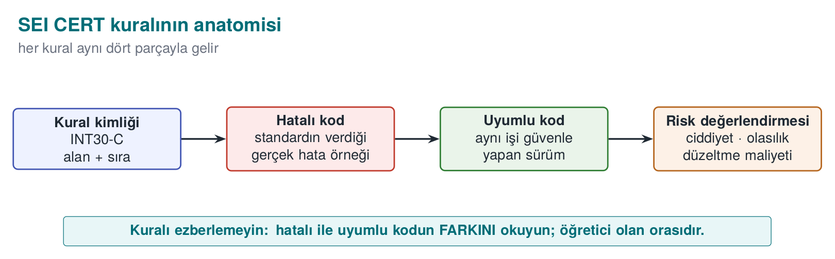
CEN429 Secure Programming · Week 4
Anatomy of a CERT Rule — Diagram
SEI CERT C/C++: the rulebook of secure coding, distilled from real-world vulnerabilities.
RTEU Computer Engineering · 2026-2027 Fall
13

Slide 14
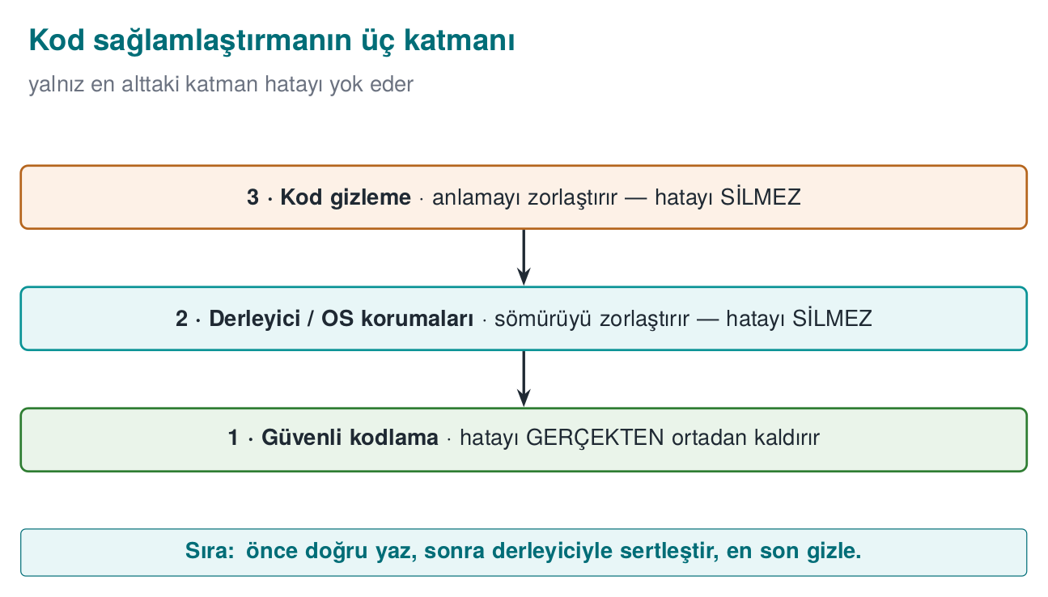
CEN429 Secure Programming · Week 4
Three Layers — Diagram
RTEU Computer Engineering · 2026-2027 Fall
14

Slide 15
CEN429 Secure Programming · Week 4
Layer 2 · Secure Coding
• Question: is there a bug in my code?
• Tools: CERT rules, sanitizers, fuzzing.
• Goal: not writing the bug in the first place.
RTEU Computer Engineering · 2026-2027 Fall
15

Slide 16
CEN429 Secure Programming · Week 4
Layer 3 · Compiler/OS
• Question: if a bug slips through, is it hard to exploit?
• Tools: canary, FORTIFY, ASLR, NX, RELRO, CFI.
• Goal: making exploitation of the remaining bug expensive.
RTEU Computer Engineering · 2026-2027 Fall
16

Slide 17
CEN429 Secure Programming · Week 4
Layer 4 · Obfuscation
• Question: does someone reading the code understand it?
• Tools: symbol/string hiding, removing logging, flattening.
• Goal: slowing down reverse engineering.
RTEU Computer Engineering · 2026-2027 Fall
17

Slide 18
CEN429 Secure Programming · Week 4
From the Field: Scheme Requirements
In a certified product:
• "Common vulnerabilities must be addressed: sensitive data, injection, overflow, language-specific weaknesses"
• "Defensive programming consistent across the entire codebase"
• "Protection against static and dynamic reverse engineering"
➡️ Eighteen hardening measures on the native side alone.
RTEU Computer Engineering · 2026-2027 Fall
18

Slide 19
CEN429 Secure Programming · Week 4
SEI CERT: What Does a Rule Look Like?
Parts of every CERT rule:
• Identifier: STR31-C, MEM50-CPP
• Title: one sentence
• Noncompliant example and compliant solution
• Risk level (L1/L2/L3) and a CWE link
RTEU Computer Engineering · 2026-2027 Fall
19

Slide 20
CEN429 Secure Programming · Week 4
Rule or Recommendation?
• Rule: violating it is a vulnerability, and it can be checked automatically.
• Recommendation: good practice.
• Start a review with L1 (highest risk) rules.
RTEU Computer Engineering · 2026-2027 Fall
20

Slide 21
CEN429 Secure Programming · Week 4
How Is the Risk Level Determined?
Risk = severity × likelihood × cost to fix.
• L1: high risk, these first.
• L2 / L3: progressively lower.
RTEU Computer Engineering · 2026-2027 Fall
21

Slide 22
CEN429 Secure Programming · Week 4
CERT Categories (1)
Abbreviation | Category | Example
INT | Integers | INT32-C: do not allow signed overflow
ARR/STR | Array/string | STR31-C: allocate sufficient space
MEM | Memory | MEM30-C: do not access freed memory
FIO | File I/O | FIO30-C: exclude input from the format string
RTEU Computer Engineering · 2026-2027 Fall
22

Slide 23
CEN429 Secure Programming · Week 4
CERT Categories (2)
Abbreviation | Category | Example
ENV | Environment | ENV33-C: do not call system()
SIG | Signals | SIG30-C: only safe fn. in the handler
ERR | Error handling | ERR33-C: detect a library error
CON/MSC | Concurrency/misc | CON43-C, MSC32-C
C++: MEM50-CPP, CTR50-CPP, STR50-CPP, EXP53-CPP, ERR50-CPP.
RTEU Computer Engineering · 2026-2027 Fall
23

Slide 24
CEN429 Secure Programming · Week 4
Automated CERT Auditing
• Warnings: -Wall -Wextra -Wformat=2 -Wconversion
• clang-tidy cert-*
• cppcheck --addon=cert
• MSVC /analyze
The evaluator runs this scan first, then reads by hand.
RTEU Computer Engineering · 2026-2027 Fall
24

Slide 25
CEN429 Secure Programming · Week 4
Input Validation
RTEU Computer Engineering · 2026-2027 Fall
25

Slide 26
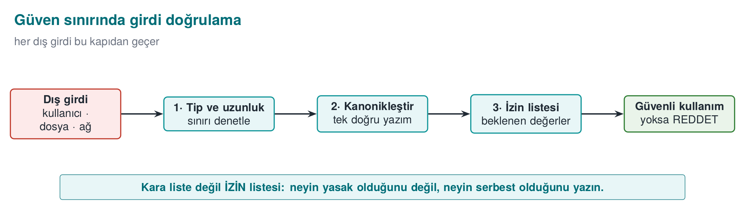
CEN429 Secure Programming · Week 4
Input Validation — Diagram
RTEU Computer Engineering · 2026-2027 Fall
26

Slide 27
CEN429 Secure Programming · Week 4
Where Does Input Come From?
From more places than you'd think. And all of it is untrusted:
• Command line, environment variables
• File, network
• IPC (another process on the same machine)
• Database, library interface (JNI)
RTEU Computer Engineering · 2026-2027 Fall
27

Slide 28
CEN429 Secure Programming · Week 4
Commonly Forgotten Inputs
• Even argv[0] can be the attacker's; PATH, LANG.
• Length fields inside a file format.
• Network: says "16 bytes," sends 1 byte.
• "Our own data" may have changed since.
RTEU Computer Engineering · 2026-2027 Fall
28

Slide 29
CEN429 Secure Programming · Week 4
Five Principles of Input Validation
1. Allow-list (enumerate what's permitted), not a deny-list.
2. Canonicalize first, then validate.
3. Length → type → range → format, in that order.
4. At the trust boundary, as early as possible.
5. Reject, don't "clean up" and use it anyway.
RTEU Computer Engineering · 2026-2027 Fall
29

Slide 30
CEN429 Secure Programming · Week 4
Principle 1 · Allow-List
• Deny-list: "these are forbidden" — something always gets forgotten.
• Allow-list: "only these are permitted" — a safe default.
Example: a username may only contain [a-z0-9_].
RTEU Computer Engineering · 2026-2027 Fall
30

Slide 31
CEN429 Secure Programming · Week 4
Principle 2 · Canonicalize
• The same thing, spelled differently: /tmp/../etc, %2e%2e/.
• Reduce it to one form (canonicalize) first, then check it.
• Otherwise the check can be bypassed.
RTEU Computer Engineering · 2026-2027 Fall
31

Slide 32
CEN429 Secure Programming · Week 4
Principle 3 · strtol, Not atoi
errno = 0;
long value = strtol(s, &end, 10);
if (end == s) return -1; /* no digits at all */
if (*end != '\0') return -1; /* "12abc" */
if (errno == ERANGE) return -1; /* overflowed */
if (value < min_val || value > max_val) return -1; /* business rule */
RTEU Computer Engineering · 2026-2027 Fall
32

Slide 33
CEN429 Secure Programming · Week 4
Why Is atoi Dangerous?
• atoi("abc") = 0 (the error is silent)
• atoi("99999999999") = undefined (overflow)
• atoi("12abc") = 12 (the extra characters are ignored)
strtol reports every error to you; atoi does not.
RTEU Computer Engineering · 2026-2027 Fall
33

Slide 34
CEN429 Secure Programming · Week 4
Principle 3 · a Length-Prefixed Record
if (remaining < 3) return -1; /* not even a header */
uint16_t length = buffer[1] << 8 | buffer[2];
if (length > remaining - 3) return -1; /* SOURCE: declared > received */
if (length > sizeof rec->data) return -1; /* DEST: doesn't fit */
memcpy(rec->data, buffer + 3, length);
RTEU Computer Engineering · 2026-2027 Fall
34

Slide 35
CEN429 Secure Programming · Week 4
Two Separate Checks, the Right Order
• Source check: is the declared length greater than the data that arrived?
• Destination check: does it fit in the destination buffer?
• Order: remaining < 3 first, so remaining - 3 does not wrap.
• In the field: every array coming from JNI is re-validated on the native side.
RTEU Computer Engineering · 2026-2027 Fall
35

Slide 36
CEN429 Secure Programming · Week 4
CERT Pair · STR31-C
strcpy(copy, name); /* WRONG */
int n = snprintf(copy, sizeof copy, "%s", name); /* COMPLIANT */
if (n < 0 || (size_t)n >= sizeof copy) { /* truncated */ }
strcpy does not know bounds; snprintf knows the size and reports truncation.
RTEU Computer Engineering · 2026-2027 Fall
36

Slide 37
CEN429 Secure Programming · Week 4
CERT Pair · INT30-C
size_t remaining = total - read_count; /* WRONG: read_count>total → huge number */
if (read_count > total) return ERROR; /* COMPLIANT: check order first */
size_t remaining = total - read_count;
Unsigned subtraction wraps; check the logic first.
RTEU Computer Engineering · 2026-2027 Fall
37

Slide 38
CEN429 Secure Programming · Week 4
CERT Pair · MEM30-C
for (n = head; n; n = n->next) free(n); /* WRONG */
while (n) { Node *s = n->next; free(n); n = s; } /* COMPLIANT */
Reading n->next after free(n) = accessing freed memory.
RTEU Computer Engineering · 2026-2027 Fall
38

Slide 39
CEN429 Secure Programming · Week 4
CERT Pair · ERR33-C
FILE *f = fopen(path,"rb"); fread(t,1,n,f); /* WRONG */
if (!f) return ERROR;
if (fread(t,1,n,f) < n && ferror(f)) return ERROR; /* COMPLIANT */
Check every return value; fopen can return NULL.
RTEU Computer Engineering · 2026-2027 Fall
39

Slide 40
CEN429 Secure Programming · Week 4
Rule: Tie the Finding to an Identifier
Match every finding to a CERT identifier:
"This line is a MEM30-C violation (CWE-416)."
This makes the finding objective and searchable.
RTEU Computer Engineering · 2026-2027 Fall
40

Slide 41
CEN429 Secure Programming · Week 4
Section 1 — Quick Check
1. The three layers, and the right order?
2. Difference between a rule and a recommendation?
3. Why is atoi more dangerous than strtol?
RTEU Computer Engineering · 2026-2027 Fall
41
Notes:
Speaker note: Next, the format string vulnerability.

Slide 42
CEN429 Secure Programming · Week 4
Section 1 — Answers
1. Order: secure code (source) → compiler/tool protections → OS/runtime protections. First write it correctly, then harden it, then defend it at runtime.
2. A rule always applies, and violating it is a defect; a recommendation is good practice depending on context.
3. atoi does not report errors (undefined/0 on overflow/invalid input); strtol lets you check both the error and the bound via endptr+ERANGE.
RTEU Computer Engineering · 2026-2027 Fall
42

Slide 43
CEN429 Secure Programming · Week 4
2. Format String Vulnerability
RTEU Computer Engineering · 2026-2027 Fall
43

Slide 44
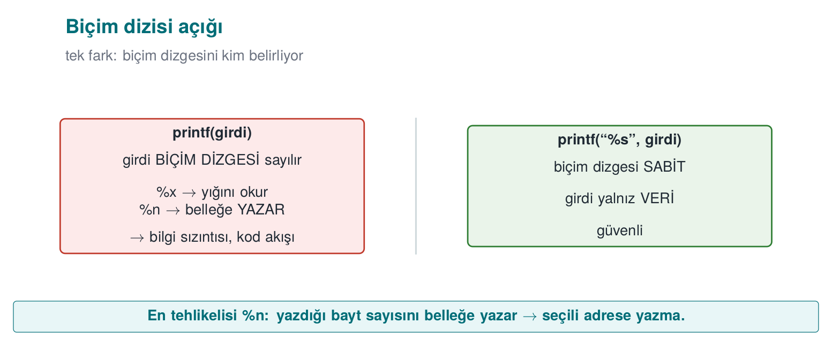
CEN429 Secure Programming · Week 4
Format String Vulnerability — Diagram
RTEU Computer Engineering · 2026-2027 Fall
44

Slide 45
CEN429 Secure Programming · Week 4
The Problem · printf(input)
printf(user_input); /* WRONG */
printf("%s", user_input); /* CORRECT */
In the first case, user input is interpreted as a format string.
RTEU Computer Engineering · 2026-2027 Fall
45

Slide 46
CEN429 Secure Programming · Week 4
Why Is It Dangerous?
printf treats the % markers in the format string as a command.
If the user supplies %x, %s, %n, they make the program do work.
RTEU Computer Engineering · 2026-2027 Fall
46

Slide 47
CEN429 Secure Programming · Week 4
Brief History · Format String Bugs
• 1999–2000 — real vulnerabilities in widely used FTP servers like wu-ftpd brought this bug class to wide attention.
• Attackers used user data that leaked into logging calls as a format string to leak information, even achieve remote code execution.
• Lesson: a "harmless-looking" marker like %n is actually a write primitive.
• Response: -Wformat-security at compile time, _FORTIFY_SOURCE at run time.
RTEU Computer Engineering · 2026-2027 Fall
47

Slide 48
CEN429 Secure Programming · Week 4
Marker · %x, %p
• Reads values off the stack and prints them.
• → information leak (addresses, secret values).
• Weakens ASLR (if an address leaks).
RTEU Computer Engineering · 2026-2027 Fall
48

Slide 49
CEN429 Secure Programming · Week 4
Marker · %s
• Treats a value on the stack as a pointer and reads the string at that address.
• Random address → crash or memory read.
RTEU Computer Engineering · 2026-2027 Fall
49

Slide 50
CEN429 Secure Programming · Week 4
Marker · %n
• Writes the number of characters printed so far to an address.
• → writes to memory → corruption, hijacking control.
• The most dangerous one.
RTEU Computer Engineering · 2026-2027 Fall
50

Slide 51
CEN429 Secure Programming · Week 4
The Same Bug Elsewhere
Not just printf:
syslog, fprintf, snprintf, err/warn — they all take a format string.
Rule: the format string is always constant (FIO30-C).
RTEU Computer Engineering · 2026-2027 Fall
51

Slide 52
CEN429 Secure Programming · Week 4
Demo 1 — Format String
code/week-04/01-format-string · CWE-134
Step | What Is Seen?
0 | GCC -Wformat-security warns; MSVC /analyze catches it
2 %x.%x… | The stack is dumped, the secret (synthetic) value appears
3 AAAA%n | Unprotected Linux crashes; Windows CRT rejects %n
4 | _FORTIFY_SOURCE: %n in writable segment
5 | Markers appear only as text
RTEU Computer Engineering · 2026-2027 Fall
52

Slide 53
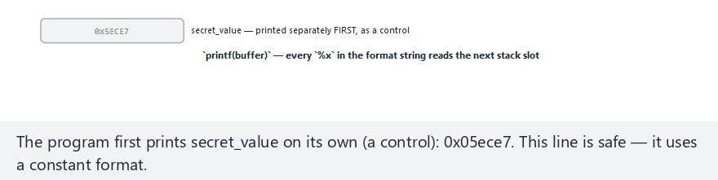
CEN429 Secure Programming · Week 4
Animation — %x scans the stack
RTEU Computer Engineering · 2026-2027 Fall
53
Notes:
Speaker note: show live how %x scans argument slots in order, where it reaches the secret value, and open the "what %n would do" preset too.

Slide 54
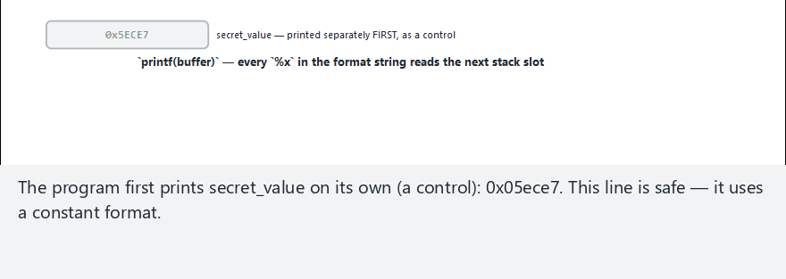
CEN429 Secure Programming · Week 4
Animation — Edge Case: What %n Would Do Next
RTEU Computer Engineering · 2026-2027 Fall
54
Notes:
Speaker note: open the "percent-n" preset from the selector; emphasize that %n does not just read, it writes — this is why a "harmless-looking" marker is actually a write primitive.

Slide 55
CEN429 Secure Programming · Week 4
The Fix · Layer by Layer
1. The format string is always constant (FIO30-C).
2. Warning: -Wformat -Wformat-security -Werror=format-security.
3. Have the compiler check your own function too:
void gunluk_yaz(int duzey, const char *bicim, ...)
__attribute__((format(printf, 2, 3)));
1. Runtime: _FORTIFY_SOURCE=2; MS CRT has %n disabled.
RTEU Computer Engineering · 2026-2027 Fall
55

Slide 56
CEN429 Secure Programming · Week 4
3. Memory: Use-After-Free
RTEU Computer Engineering · 2026-2027 Fall
56

Slide 57
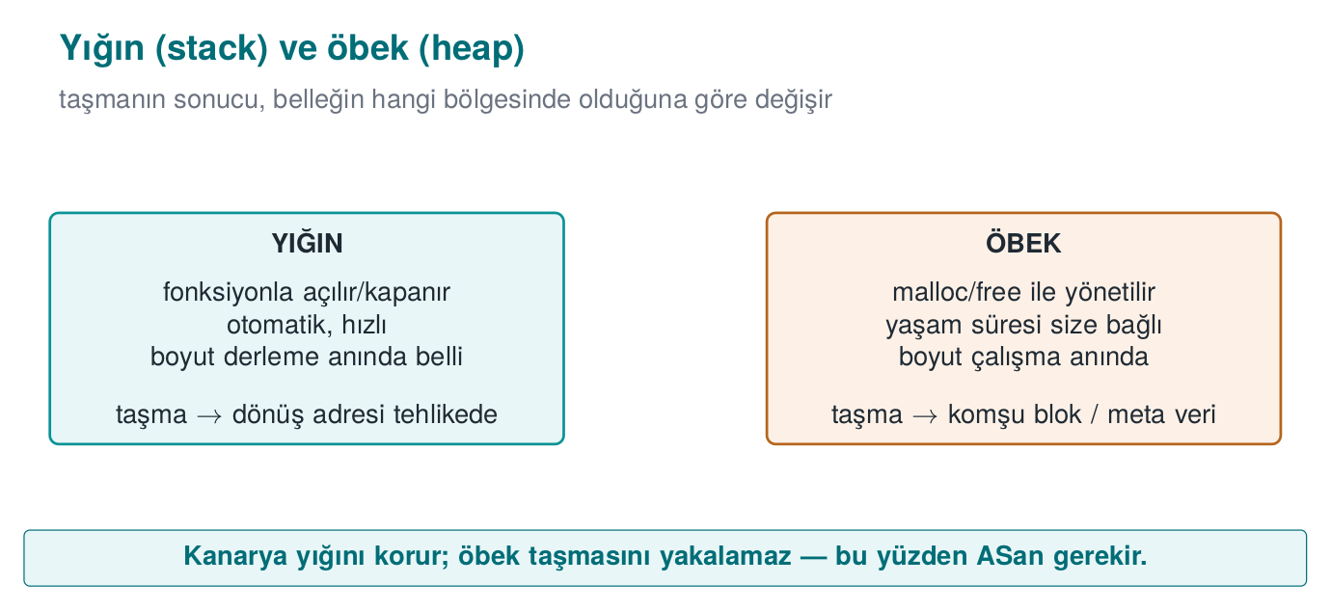
CEN429 Secure Programming · Week 4
Stack and Heap — Diagram
RTEU Computer Engineering · 2026-2027 Fall
57

Slide 58
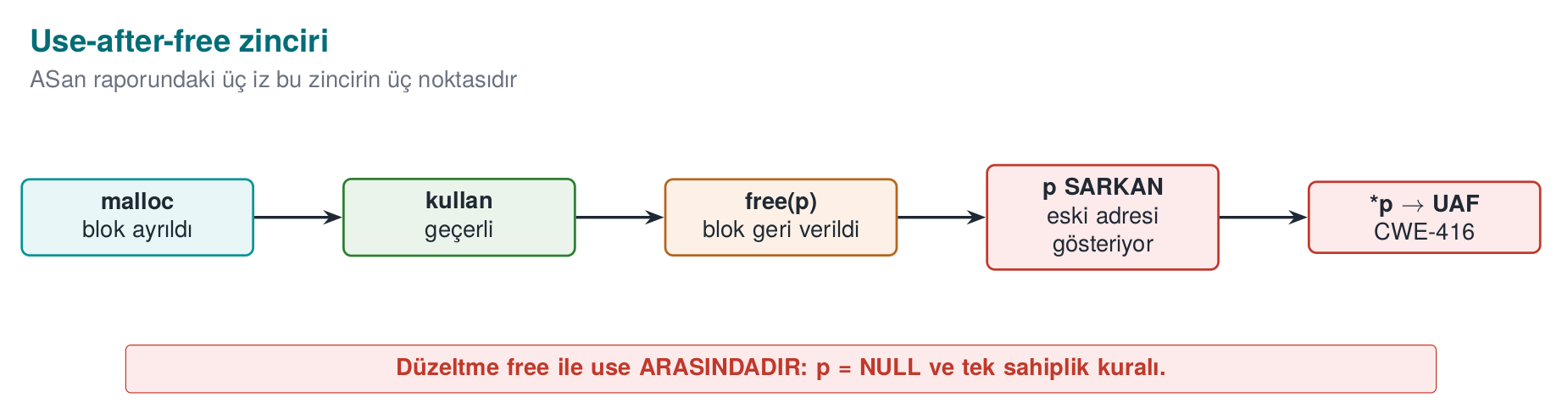
CEN429 Secure Programming · Week 4
Use-After-Free — Diagram
RTEU Computer Engineering · 2026-2027 Fall
58

Slide 59
CEN429 Secure Programming · Week 4
What Is UAF? · Step 1
• An object is on the heap.
• Two pointers point to the same object.
RTEU Computer Engineering · 2026-2027 Fall
59

Slide 60
CEN429 Secure Programming · Week 4
UAF · Step 2
• One of them frees it.
• The other still holds that address → a dangling pointer.
RTEU Computer Engineering · 2026-2027 Fall
60

Slide 61
CEN429 Secure Programming · Week 4
UAF · Step 3
• The allocator gives the same block to another object.
• The dangling pointer now reads/writes foreign data.
• If the object has a function pointer (C++ virtual table), the risk grows.
RTEU Computer Engineering · 2026-2027 Fall
61

Slide 62
CEN429 Secure Programming · Week 4
Why Is UAF So Common?
Most of the "memory corruption fixed" notes in browser/OS updates fall into this class.
Complex ownership → a dangling pointer.
RTEU Computer Engineering · 2026-2027 Fall
62

Slide 63
CEN429 Secure Programming · Week 4
Demo 2 — UAF and Double Free
code/week-04/02-use-after-free · CWE-416/415 · MEM30-C
Step | What Is Seen?
1 | The freed block gets reused → role user → admin
2 ASan | heap-use-after-free + locations
3 | Double free → undefined behaviour
4 ASan | attempting double-free
5 | free + NULL, single owner → safe
RTEU Computer Engineering · 2026-2027 Fall
63

Slide 64
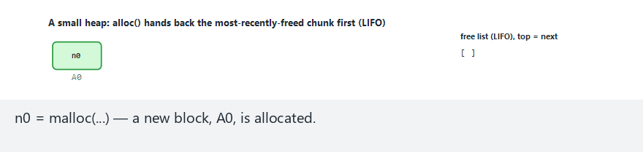
CEN429 Secure Programming · Week 4
Animation — a small heap
RTEU Computer Engineering · 2026-2027 Fall
64
Notes:
Speaker note: show live how a freed block goes onto the free list and how the next malloc hands it back; switch to the "double-free" preset too.

Slide 65
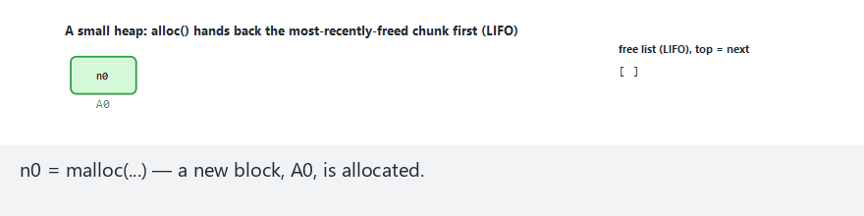
CEN429 Secure Programming · Week 4
Animation — Edge Case: Double Free
RTEU Computer Engineering · 2026-2027 Fall
65
Notes:
Speaker note: open the "double-free" preset from the selector; show live how freeing the same pointer a second time corrupts the allocator's free list, and how this usually opens the door to a further heap overflow.

Slide 66
CEN429 Secure Programming · Week 4
ASan Report · Three Stack Traces
ERROR: heap-use-after-free
#0 mode_uaf uaf.c:49 <- 1. USE
freed here:
#1 mode_uaf uaf.c:38 <- 2. FREE
allocated here:
#1 mode_uaf uaf.c:32 <- 3. ALLOCATION
The fix is usually at location 2: the ownership decision was wrong there.
RTEU Computer Engineering · 2026-2027 Fall
66

Slide 67
CEN429 Secure Programming · Week 4
Fix · the C Side
• Set the pointer to NULL after free.
• Establish a single owner, a single release point.
• Write down the ownership rule: "who releases this memory?"
RTEU Computer Engineering · 2026-2027 Fall
67

Slide 68
CEN429 Secure Programming · Week 4
Fix · C++ Smart Pointers
Need | C++
Single owner | std::unique_ptr
Shared | std::shared_ptr
Non-owning observation | std::weak_ptr → lock()
Array | std::vector, std::array
if (auto o = cache.lock()) use(*o); // otherwise stale memory is never accessed
⚠️ get() is a raw pointer; when a vector grows, its iterators are invalidated.
RTEU Computer Engineering · 2026-2027 Fall
68

Slide 69
CEN429 Secure Programming · Week 4
Integers and UB
RTEU Computer Engineering · 2026-2027 Fall
69

Slide 70
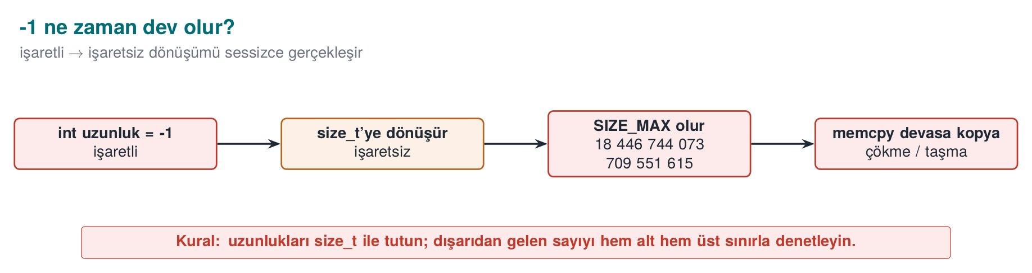
CEN429 Secure Programming · Week 4
Integer Overflow — Diagram
RTEU Computer Engineering · 2026-2027 Fall
70

Slide 71
CEN429 Secure Programming · Week 4
Four Integer Bugs
Bug | Example | Result
Unsigned wraparound | 0u - 1 = 4,294,967,295 | Logic error
Signed overflow | INT_MAX + 1 | Undefined
Conversion loss | long long→int | Truncation
Shift | 1 << 31 | Undefined
RTEU Computer Engineering · 2026-2027 Fall
71

Slide 72
CEN429 Secure Programming · Week 4
Why Does It Matter? · Multiplication Overflow
uint32_t size = count * 4; /* count = 0x40000001 → size = 4 */
array = malloc(size); /* small block */
/* loop writes `count` times → heap overflow */
Writing too much into a small allocated block = an overflow.
RTEU Computer Engineering · 2026-2027 Fall
72

Slide 73
CEN429 Secure Programming · Week 4
UB · the Compiler Can Delete the Check
Undefined behaviour (UB): an operation whose result the C/C++ standard does not define (e.g., signed integer overflow).
if (x + 100 < x) /* assumes "if it overflows, it gets smaller" */
return -1; /* signed overflow is UB → the compiler MAY DELETE this branch */
• It "works" at -O0, at -O2 the check disappears.
• UB cannot be relied on.
RTEU Computer Engineering · 2026-2027 Fall
73

Slide 74
CEN429 Secure Programming · Week 4
Correct: Check First
if ((b > 0 && a > INT_MAX - b) ||
(b < 0 && a < INT_MIN - b)) return false; /* before the overflow */
if (__builtin_mul_overflow(a, b, &result)) return false; /* GCC/Clang */
/* C23: <stdckdint.h> ckd_add/ckd_mul · MSVC: <intsafe.h> */
Catch the overflow before it happens.
RTEU Computer Engineering · 2026-2027 Fall
74

Slide 75
CEN429 Secure Programming · Week 4
Demo 3 — UB and UBSan
code/week-04/03-undefined-behavior · CWE-190/758
• Signed overflow, invalid shift, misaligned access
• On x86, most produce a wrong result silently
• -fsanitize=undefined → signed integer overflow: 2147483647 + 1 ...
• Windows: no UBSan → /RTC, /analyze, CERT
⚠️ -fwrapv hides the logic error; do not use it for diagnosis.
RTEU Computer Engineering · 2026-2027 Fall
75

Slide 76
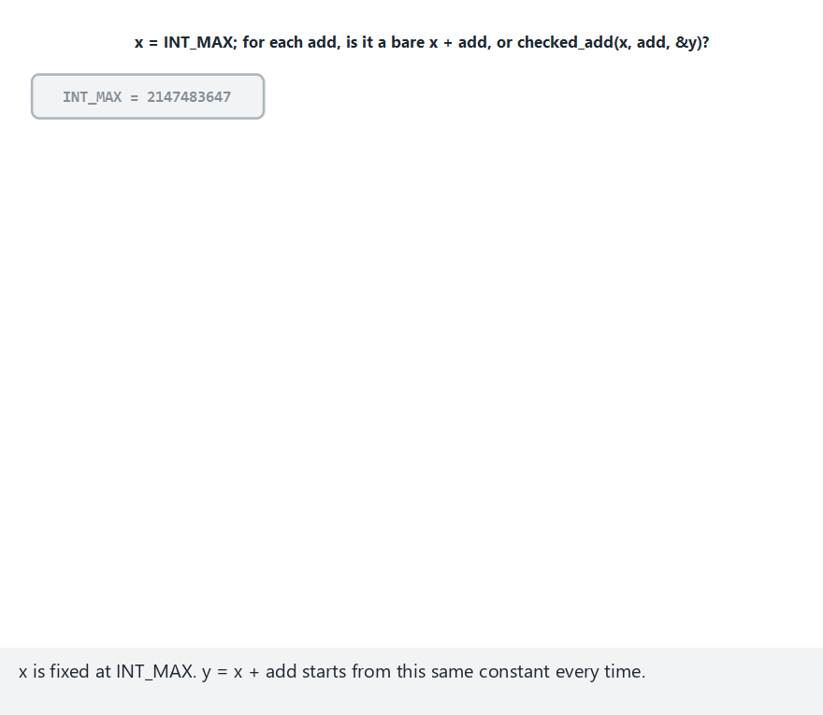
CEN429 Secure Programming · Week 4
Animation — INT_MAX + add
RTEU Computer Engineering · 2026-2027 Fall
76
Notes:
Speaker note: show live how the unchecked add silently wraps, and how checked_add catches the same overflow before adding.

Slide 77
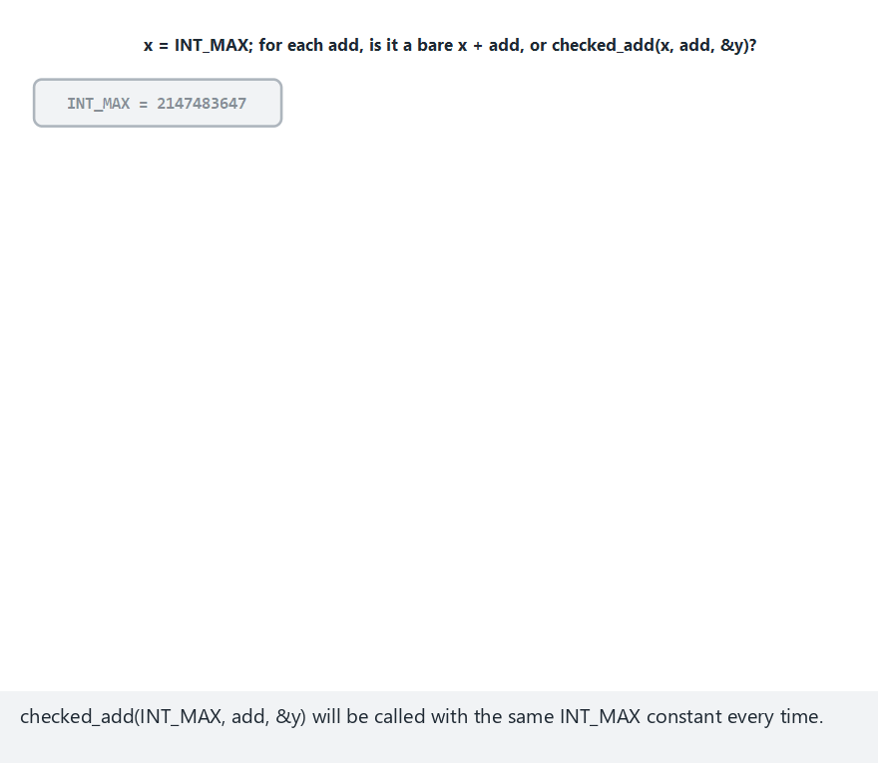
CEN429 Secure Programming · Week 4
Animation — Edge Case: the Secure Version Rejects the Same Input
RTEU Computer Engineering · 2026-2027 Fall
77
Notes:
Speaker note: open the "edge-secure" preset from the selector; compare side by side how the SAME sequence of adds that leads to UB in the buggy version is stopped by checked_add BEFORE adding in the compiled secure version.

Slide 78
CEN429 Secure Programming · Week 4
Error Handling and Signals
RTEU Computer Engineering · 2026-2027 Fall
78

Slide 79
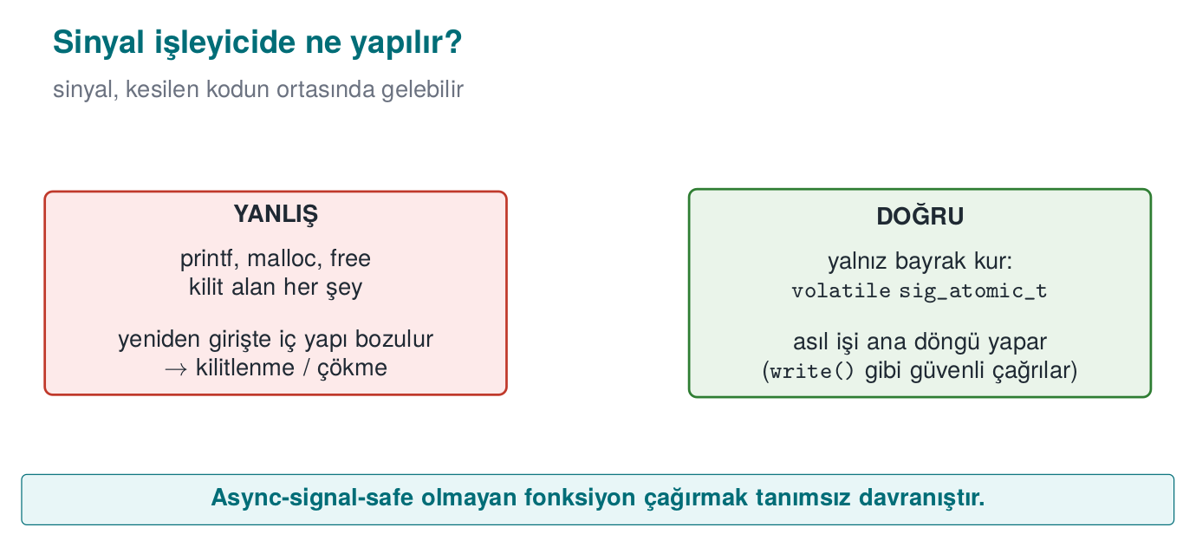
CEN429 Secure Programming · Week 4
Signal Handler — Diagram
RTEU Computer Engineering · 2026-2027 Fall
79

Slide 80
CEN429 Secure Programming · Week 4
Unchecked Return Value
Call | If Not Checked
malloc | Writing to NULL
setresuid | Stays privileged
RAND_bytes | The "random" key is zero
EVP_DecryptFinal_ex | Tampered data is assumed verified
RTEU Computer Engineering · 2026-2027 Fall
80

Slide 81
CEN429 Secure Programming · Week 4
Rules for Error Handling
1. Check every return value (ERR33-C); [[nodiscard]].
2. On error, return to a safe state (goto cleanup) — fail-closed.
3. The message must not give a hint: "no such user" ≠ "wrong password."
RTEU Computer Engineering · 2026-2027 Fall
81

Slide 82
CEN429 Secure Programming · Week 4
From the Field: Opaque Return Values
• Native functions do not return a detailed error code.
• Only success/failure, and even that is opaque (Week 9).
• A detailed code = a map for the attacker of "which check you tripped."
• A separate, secure channel for diagnosis → recorded as a trade-off.
RTEU Computer Engineering · 2026-2027 Fall
82

Slide 83
CEN429 Secure Programming · Week 4
Signal Handler · Rule
static volatile sig_atomic_t stop = 0;
static void handler(int s){ (void)s; stop = 1; } /* ONLY a flag */
• No printf, malloc, free in the handler (SIG30-C).
• Do not call functions that are not async-signal-safe.
• sigaction() instead of signal().
RTEU Computer Engineering · 2026-2027 Fall
83

Slide 84
CEN429 Secure Programming · Week 4
Real Incident: regreSSHion
• 2024 CVE-2024-6387: the timeout signal handler called an unsafe logging function.
• Result: remote code execution risk.
• Lesson: only set a flag inside a handler.
RTEU Computer Engineering · 2026-2027 Fall
84

Slide 85
CEN429 Secure Programming · Week 4
Section 2–3 — Quick Check
1. Why is %n the most dangerous?
2. The three traces in a UAF report? Which one gets the fix?
3. Why can if (x+100 < x) be deleted?
4. Why is there no printf in a signal handler?
RTEU Computer Engineering · 2026-2027 Fall
85
Notes:
Speaker note: After the break, static analysis, sanitizers, fuzzing.

Slide 86
CEN429 Secure Programming · Week 4
Section 2–3 — Answers
1. %n WRITES the number of bytes printed so far to memory → an attacker can write to an address of their choosing and hijack control flow.
2. allocated-by · freed-by · use-here. The fix is usually between freed↔use: set the pointer to NULL after free, or fix the lifetime.
3. Signed overflow is undefined behaviour; the compiler assumes "overflow never happens" → the condition is always false → it deletes it. Do the check with __builtin_add_overflow.
4. printf is not async-signal-safe; if the handler re-enters it, locks/state get corrupted → deadlock/crash. Only safe calls like write are allowed.
RTEU Computer Engineering · 2026-2027 Fall
86

Slide 87
CEN429 Secure Programming · Week 4
4. Static Analysis, Sanitizers, Fuzzing
RTEU Computer Engineering · 2026-2027 Fall
87

Slide 88
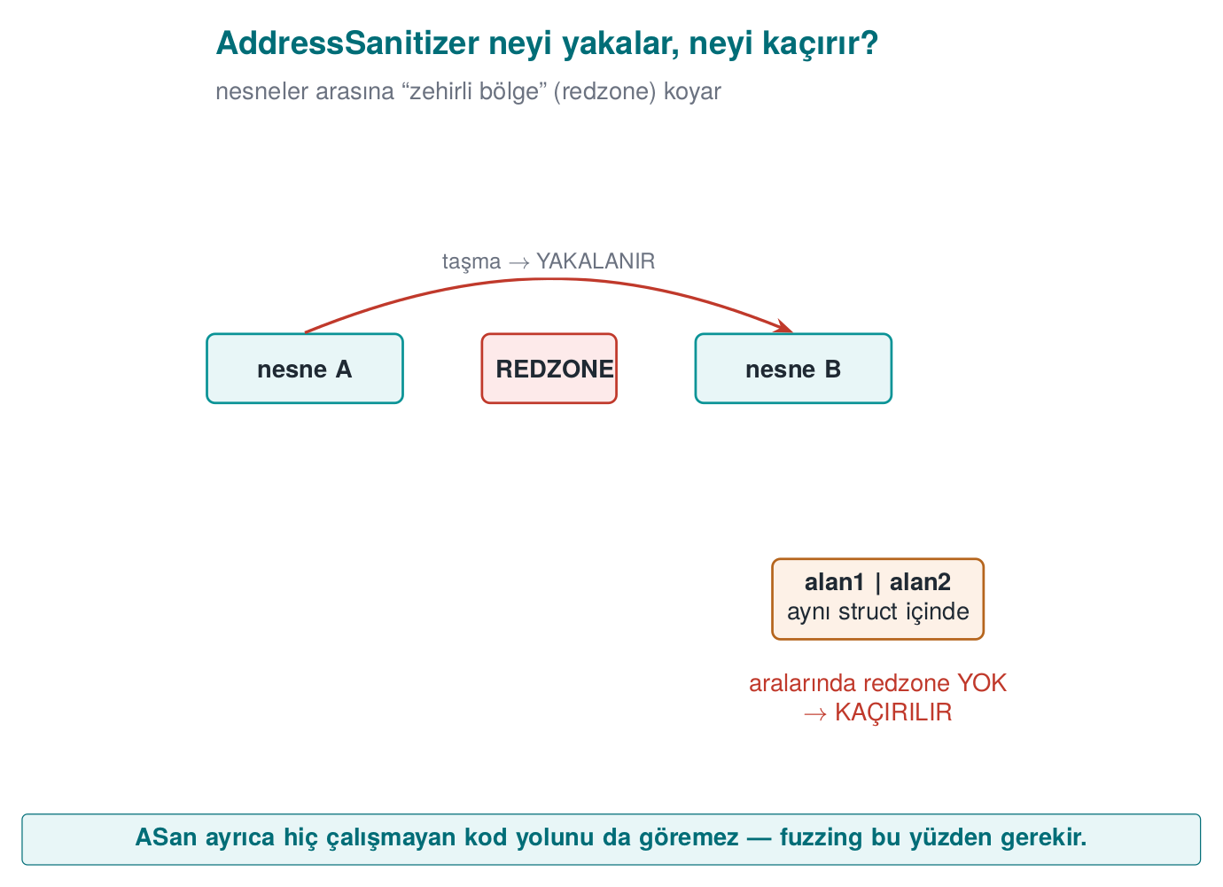
CEN429 Secure Programming · Week 4
ASan Redzone — Diagram
RTEU Computer Engineering · 2026-2027 Fall
88

Slide 89
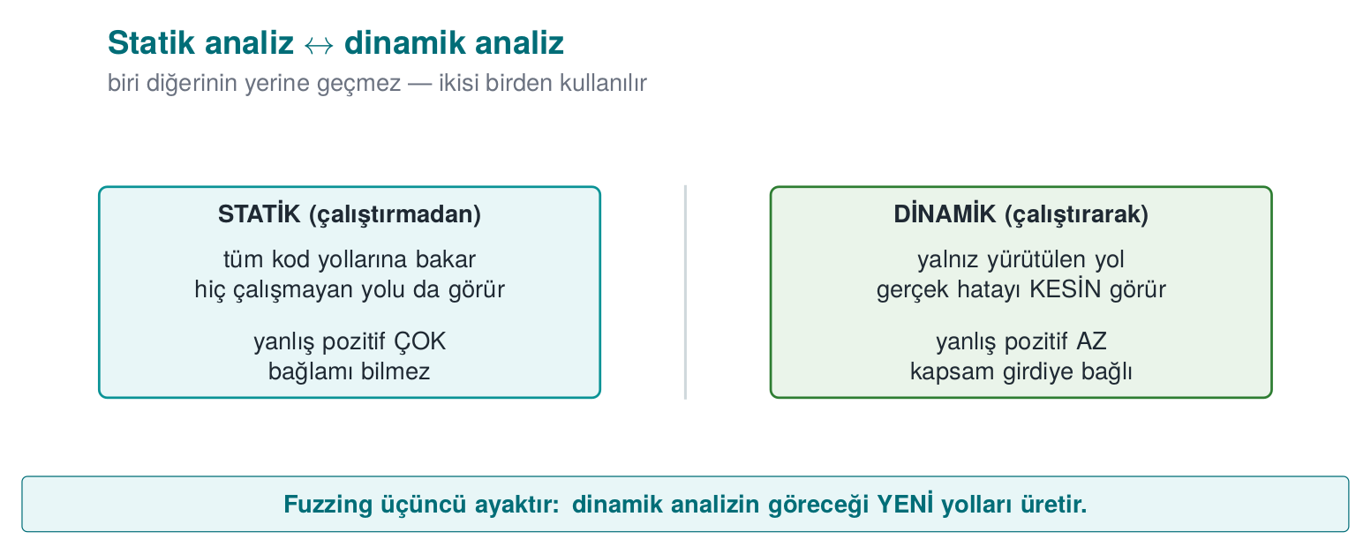
CEN429 Secure Programming · Week 4
Static ↔ Dynamic — Diagram
RTEU Computer Engineering · 2026-2027 Fall
89

Slide 90
CEN429 Secure Programming · Week 4
What Is Static Analysis?
Examining code without running it, looking for bugs.
Advantage: it also sees paths that never execute. Disadvantage: it produces false alarms.
RTEU Computer Engineering · 2026-2027 Fall
90

Slide 91
CEN429 Secure Programming · Week 4
Static Analysis · Layer by Layer
Level | Tool | What It Finds
Warnings | -Wall -Wextra -Wconversion | Conversion, format
Analyser | -fanalyzer, clang --analyze, /analyze | NULL, leaks
Rule | clang-tidy cert-*, cppcheck | CERT violation
Semantic | CodeQL, Semgrep | Data flow
Commercial | Coverity, Klocwork | Deep analysis
RTEU Computer Engineering · 2026-2027 Fall
91

Slide 92
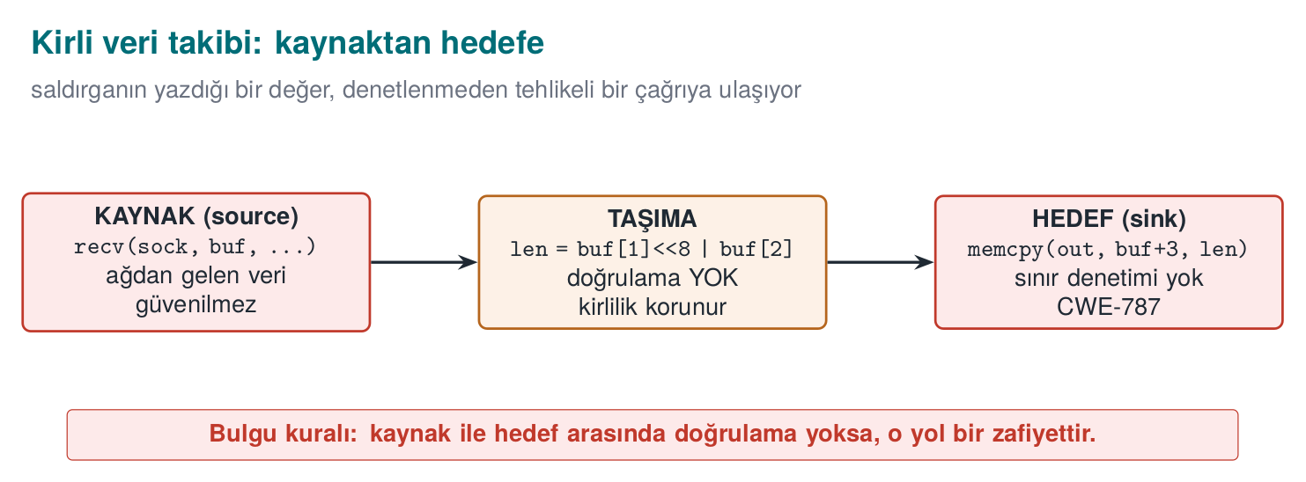
CEN429 Secure Programming · Week 4
Tainted Data: Source → Sink
The tool sees unvalidated data flowing to a dangerous place.
RTEU Computer Engineering · 2026-2027 Fall
92

Slide 93
CEN429 Secure Programming · Week 4
Living with False Alarms
1. Start with high-confidence rules.
2. Every suppression has a reason: // NOLINT(cert-err33-c): neden.
3. Zero warnings on new code (enforced by CI).
The evaluator asks for the developer's own scan report.
RTEU Computer Engineering · 2026-2027 Fall
93

Slide 94
CEN429 Secure Programming · Week 4
What Is a Sanitizer?
A tool that catches memory/UB bugs while the program runs.
Almost no false alarms; but it only finds bugs on the path that actually executes.
→ combine with tests + fuzzing.
RTEU Computer Engineering · 2026-2027 Fall
94

Slide 95
CEN429 Secure Programming · Week 4
Brief History · AddressSanitizer
• 2012 — Google released AddressSanitizer (ASan): compile-time instrumentation + shadow memory catches overflow/UAF immediately.
• Before this, this class of bug usually crashed silently or went unnoticed entirely.
• ASan + fuzzing together catch input that doesn't crash the program but does corrupt memory (this week's Sections 4/11).
RTEU Computer Engineering · 2026-2027 Fall
95

Slide 96
CEN429 Secure Programming · Week 4
The Sanitizer Family
Sanitizer | Finds | Flag
ASan | Overflow, UAF, double free | -fsanitize=address
LSan | Leaks | with ASan
UBSan | Overflow, shift, NULL | -fsanitize=undefined
MSan | Uninitialized reads | -fsanitize=memory
TSan | Data race | -fsanitize=thread
RTEU Computer Engineering · 2026-2027 Fall
96

Slide 97
CEN429 Secure Programming · Week 4
How Does ASan Work? · Shadow Memory
• One shadow byte per 8 bytes: how much of it is valid?
• A poisoned region (redzone) before/after arrays.
• Freed blocks wait in quarantine.
• A shadow check before every access.
RTEU Computer Engineering · 2026-2027 Fall
97

Slide 98
CEN429 Secure Programming · Week 4
ASan's Blind Spot
struct { char name[8]; long role; } k;
strcpy(k.name, long_input); /* name → role overflows */
A field-to-field overflow inside the same structure → no poisoned region in between → ASan cannot see it (Week 1 Demo 3).
RTEU Computer Engineering · 2026-2027 Fall
98

Slide 99
CEN429 Secure Programming · Week 4
Sanitizers Do Not Ship in the Release Build
gcc -g -O1 -fno-omit-frame-pointer \
-fsanitize=address,undefined p.c -o p_test
• Slows things down (~2×), uses memory.
• Only in test/CI; disabled in the release build.
RTEU Computer Engineering · 2026-2027 Fall
99

Slide 100
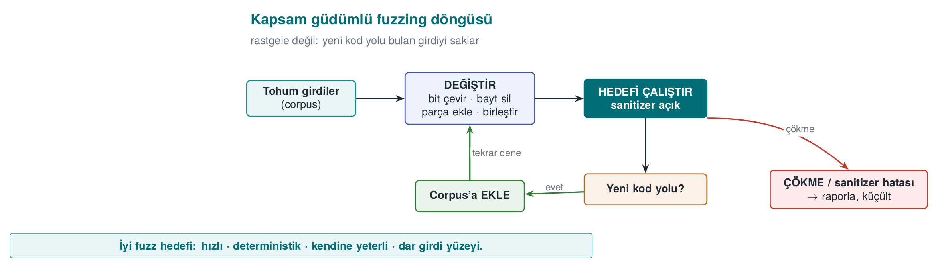
CEN429 Secure Programming · Week 4
What Is Fuzzing? · Coverage-Guided
Fuzzing: feeding a program a large number of automatically generated, mostly malformed inputs to look for crashes.
An input that opens a new code path is saved and worked on further.
RTEU Computer Engineering · 2026-2027 Fall
100

Slide 101
CEN429 Secure Programming · Week 4
What Does Fuzzing Find?
• It finds magic bytes and the right length field on its own.
• Inputs a human would never think of.
• Tools: libFuzzer, AFL++, honggfuzz, OSS-Fuzz (tens of thousands of bugs).
RTEU Computer Engineering · 2026-2027 Fall
101

Slide 102
CEN429 Secure Programming · Week 4
Brief History · Fuzzing
• 1990 — Barton Miller's "Fuzz" study crashed 25-33% of Unix utilities with random input; the academic origin of fuzzing.
• 2013 — AFL (american fuzzy lop) made coverage feedback practical and mainstream.
• Then came libFuzzer (built into the compiler, fast) and OSS-Fuzz (a service that continuously fuzzes major open-source projects).
RTEU Computer Engineering · 2026-2027 Fall
102

Slide 103
CEN429 Secure Programming · Week 4
Writing a Fuzz Target
int LLVMFuzzerTestOneInput(const uint8_t *data, size_t size) {
parse_document((const unsigned char *)data, size);
return 0;
}
clang -g -O1 -fsanitize=fuzzer,address fuzz.c parser.c -o f
./f corpus/ -max_total_time=10
RTEU Computer Engineering · 2026-2027 Fall
103

Slide 104
CEN429 Secure Programming · Week 4
A Good Fuzz Target
Four properties:
• Fast (no network/disk)
• Deterministic (same input → same result)
• Stateless (not affected by the previous call)
• Single job (tests one function)
RTEU Computer Engineering · 2026-2027 Fall
104

Slide 105
CEN429 Secure Programming · Week 4
Demo 4 — Finding Bugs with Fuzzing
code/week-04/04-fuzzing · CWE-125/787
Step | What Happens?
1 | seeds/normal.bin is fine
2 | libFuzzer ≤ 10 s → a crashing input
3 | Replay with ASan → full report
4 | Fixed version → no crash
5 | crash.bin is safely rejected
"This function was fuzzed for this long" = strong evidence (S16).
RTEU Computer Engineering · 2026-2027 Fall
105

Slide 106
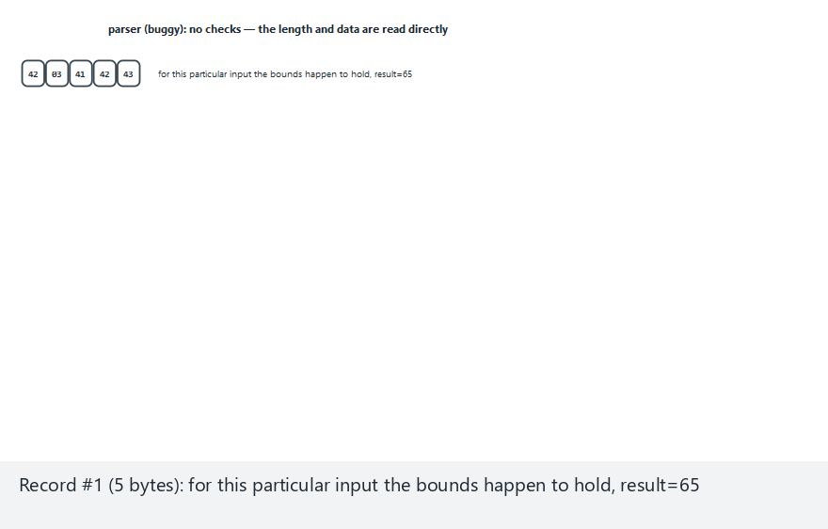
CEN429 Secure Programming · Week 4
Animation — an allow-list parser
RTEU Computer Engineering · 2026-2027 Fall
106
Notes:
Speaker note: show live which bound each record violates (or doesn't); contrast with the buggy version reading out of bounds on the same inputs.

Slide 107
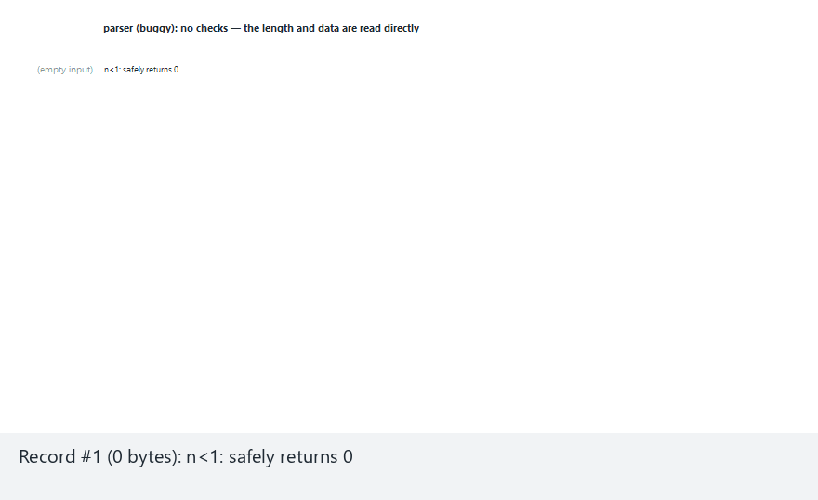
CEN429 Secure Programming · Week 4
Animation — Edge Case: Every Record Is Malformed
RTEU Computer Engineering · 2026-2027 Fall
107
Notes:
Speaker note: open the "edge-all-bad" preset from the selector; show that NOT ONE record passes, and walk through which principle (length/type/range/format) each one violates and is rejected for.

Slide 108
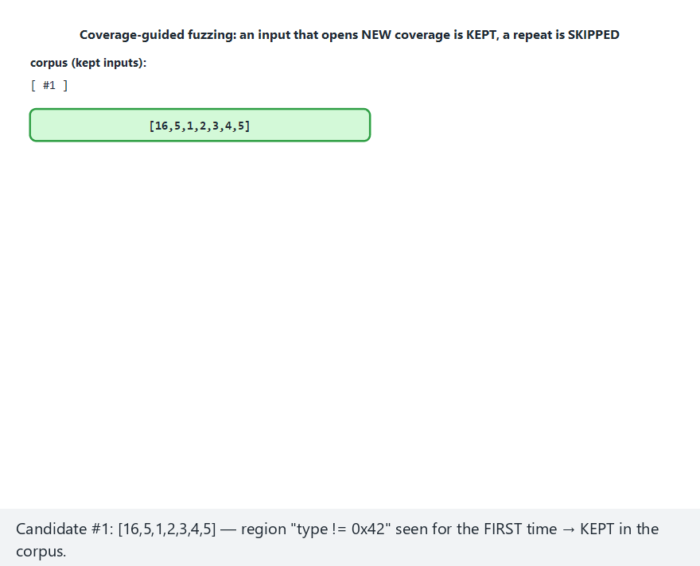
CEN429 Secure Programming · Week 4
Animation — coverage-guided fuzzing
RTEU Computer Engineering · 2026-2027 Fall
108
Notes:
Speaker note: show live whether each candidate opens new coverage, and how the session stops the moment a crash is found.

Slide 109
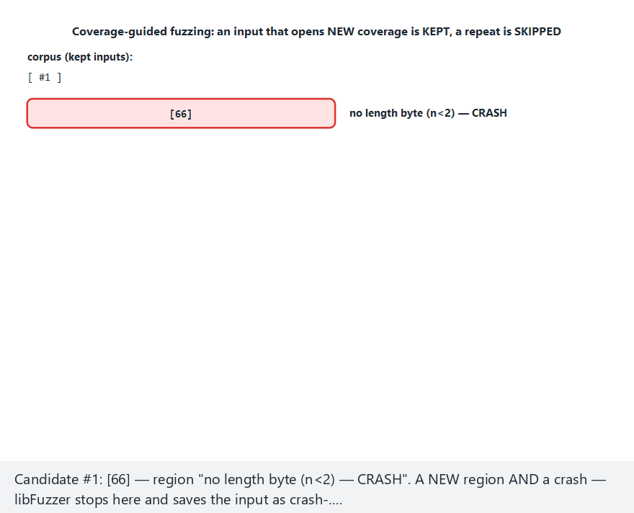
CEN429 Secure Programming · Week 4
Animation — Edge Case: the Very First Candidate Crashes
RTEU Computer Engineering · 2026-2027 Fall
109
Notes:
Speaker note: open the "edge-immediate-crash" preset from the selector; make the point that the most valuable input can sometimes appear at the very first step of a session — this is a result of the mutation strategy, not "luck."

Slide 110
CEN429 Secure Programming · Week 4
Section 4 — Quick Check
1. The difference between static and dynamic analysis?
2. Which overflow can ASan not see?
3. The four properties of a good fuzz target?
RTEU Computer Engineering · 2026-2027 Fall
110
Notes:
Speaker note: Next, compiler and OS protections.

Slide 111
CEN429 Secure Programming · Week 4
Section 4 — Answers
1. Static: examines all paths without running the code (can have false positives). Dynamic: while running, observes real bugs only on the path that actually executes.
2. ASan sees the places where it placed a redzone; it cannot see a field-to-field overflow inside an object, or paths that never execute.
3. Fast, deterministic, self-sufficient (not dependent on external state), a target that handles a narrow input surface and fails cleanly on a crash.
RTEU Computer Engineering · 2026-2027 Fall
111

Slide 112
CEN429 Secure Programming · Week 4
5. Compiler and OS Protections
RTEU Computer Engineering · 2026-2027 Fall
112
Notes:
Speaker note: These are the "limit the damage if a bug slips through" layer. None of them removes the bug; they make exploitation harder.

Slide 113
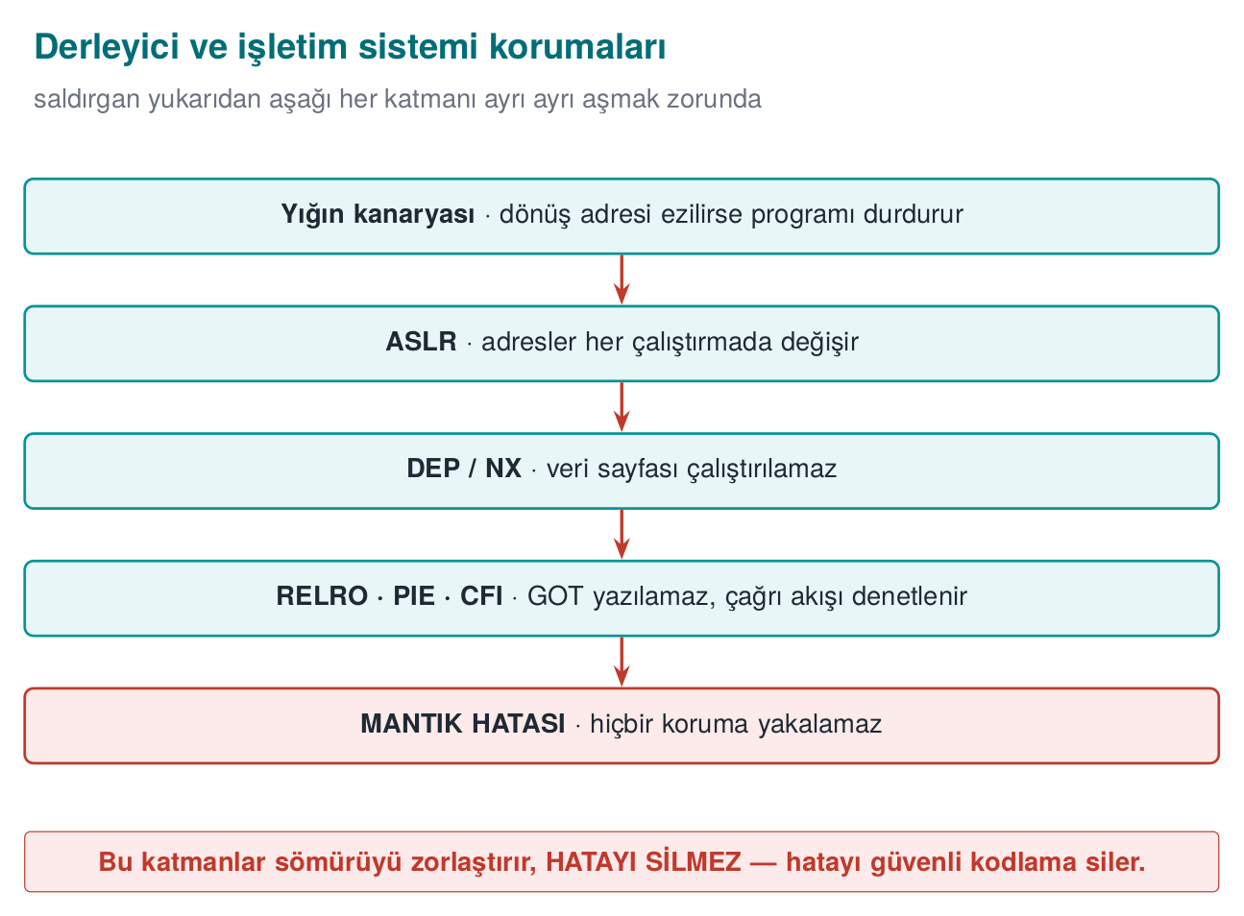
CEN429 Secure Programming · Week 4
Compiler/OS Protections — Diagram
RTEU Computer Engineering · 2026-2027 Fall
113

Slide 114
CEN429 Secure Programming · Week 4
Layer 3 · the Idea
Say a bug slipped through.
• There are automatic protections that make exploitation expensive.
• Most are turned on with a compile flag.
• Not free, but cheap.
RTEU Computer Engineering · 2026-2027 Fall
114

Slide 115
CEN429 Secure Programming · Week 4
Stack Canary
• A sentinel value is placed just before the return address.
• If an overflow corrupts this value, it is noticed before the return and the program halts.
• -fstack-protector-strong / MSVC /GS.
RTEU Computer Engineering · 2026-2027 Fall
115

Slide 116
CEN429 Secure Programming · Week 4
Brief History · Compiler/OS Protections
• 1998 — StackGuard: the first to add the stack-canary idea to a compiler automatically.
• 2001 — the PaX project brought ASLR (address space layout randomization) to the Linux kernel.
• 2003–2004 — W^X / NX / DEP: a memory page can no longer be both writable and executable at once.
• Together, these three form the foundation of today's compiler/OS protections.
RTEU Computer Engineering · 2026-2027 Fall
116

Slide 117
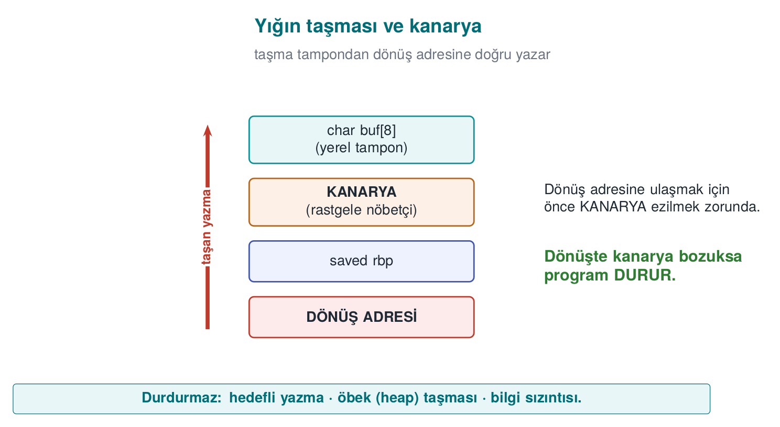
CEN429 Secure Programming · Week 4
Stack Overflow and Canary — Diagram
RTEU Computer Engineering · 2026-2027 Fall
117

Slide 118
CEN429 Secure Programming · Week 4
_FORTIFY_SOURCE
• Catches library calls that write more than a buffer's known size.
• -D_FORTIFY_SOURCE=2 (+ at least -O1).
• Does not protect your own loops.
RTEU Computer Engineering · 2026-2027 Fall
118

Slide 119
CEN429 Secure Programming · Week 4
PIE + ASLR
• ASLR: randomizes addresses.
• PIE: makes the program itself load at a random address too.
• -fPIE -pie / /DYNAMICBASE /HIGHENTROPYVA.
RTEU Computer Engineering · 2026-2027 Fall
119

Slide 120
CEN429 Secure Programming · Week 4
DEP/NX and RELRO
• DEP/NX: makes the data region non-executable (default).
• RELRO: makes tables like the GOT read-only → -Wl,-z,relro,-z,now.
RTEU Computer Engineering · 2026-2027 Fall
120

Slide 121
CEN429 Secure Programming · Week 4
CFI / CFG and the Shadow Stack
• CFI/CFG: checks that indirect calls only go to valid targets.
• -fcf-protection, -fsanitize=cfi / /guard:cf.
• Shadow stack: a second copy of the return addresses (CET).
RTEU Computer Engineering · 2026-2027 Fall
121

Slide 122
CEN429 Secure Programming · Week 4
Protections · One Table
Protection | GCC/Clang | MSVC
Canary | -fstack-protector-strong | /GS
FORTIFY | -D_FORTIFY_SOURCE=2 | Secure CRT
PIE/ASLR | -fPIE -pie | /DYNAMICBASE
NX | default | /NXCOMPAT
RELRO | -Wl,-z,relro,-z,now | —
CFI | -fcf-protection | /guard:cf
RTEU Computer Engineering · 2026-2027 Fall
122

Slide 123
CEN429 Secure Programming · Week 4
⚠️ Every Protection Has Limits
Protection | Stops | Does Not Stop
Canary | Overflow reaching the return address | Heap overflow, a leaked canary
FORTIFY | Library-call overflow | Your own loops
ASLR | Assuming a fixed address | Address leak
NX | Code in the data region | Code reuse (ROP)
RTEU Computer Engineering · 2026-2027 Fall
123

Slide 124
CEN429 Secure Programming · Week 4
The Main Rule
Every protection makes a technique harder; it does not remove a class of bug.
None of them is enough for a logic error → secure coding comes first.
RTEU Computer Engineering · 2026-2027 Fall
124

Slide 125
CEN429 Secure Programming · Week 4
Demo 5 — Turning Protections On and Off
code/week-04/05-compiler-protections · CWE-121
• The same overflow: overflow_weak (off) vs overflow_hardened (on).
• Hardened: *** stack smashing detected *** / Windows 0xC0000409.
• Weak: silent corruption or a crash.
readelf -h p | grep Type # DYN = PIE
readelf -d p | grep BIND_NOW # full RELRO
readelf -s p | grep __stack_chk # canary
RTEU Computer Engineering · 2026-2027 Fall
125

Slide 126
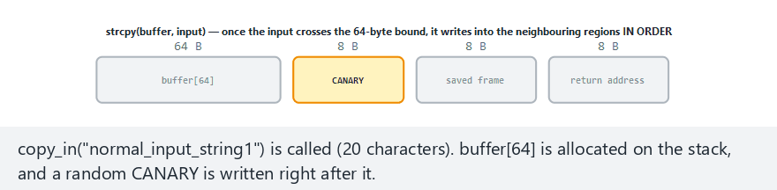
CEN429 Secure Programming · Week 4
Animation — the stack canary
RTEU Computer Engineering · 2026-2027 Fall
126
Notes:
Speaker note: show live how strcpy fills buffer[64] and reaches the canary, then the frame and return address; highlight the hardened build catching it.

Slide 127
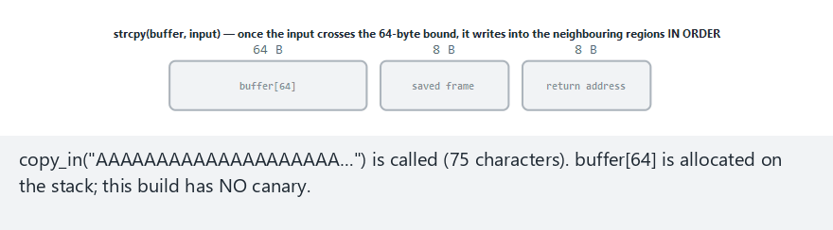
CEN429 Secure Programming · Week 4
Animation — Edge Case: Same Overflow, WEAK Build Has No Canary
RTEU Computer Engineering · 2026-2027 Fall
127
Notes:
Speaker note: open the "weak-overflow" preset from the selector; show that the exact SAME 75-character input we just saw caught by the canary in the hardened build sails straight through to the return address when the canary is absent — without the flag on, nothing but CERT/sanitizer/fuzzing stops this.

Slide 128
CEN429 Secure Programming · Week 4
Recommended Release Flags
GCC/Clang:
-O2 -D_FORTIFY_SOURCE=2 -fstack-protector-strong -fPIE -pie -Wl,-z,relro,-z,now -fcf-protection -Wall -Wextra -Wformat=2 -Werror=format-security
MSVC:
/O2 /GS /sdl /guard:cf /DYNAMICBASE /HIGHENTROPYVA /NXCOMPAT /CETCOMPAT /W4
RTEU Computer Engineering · 2026-2027 Fall
128

Slide 129
CEN429 Secure Programming · Week 4
Protection Table = Evidence
• The evaluator extracts a protection table for every binary and .so.
• A disabled protection is a finding; its justification must be in the trade-off record.
• Scheme: the application can also verify itself that the protections are enabled.
RTEU Computer Engineering · 2026-2027 Fall
129

Slide 130
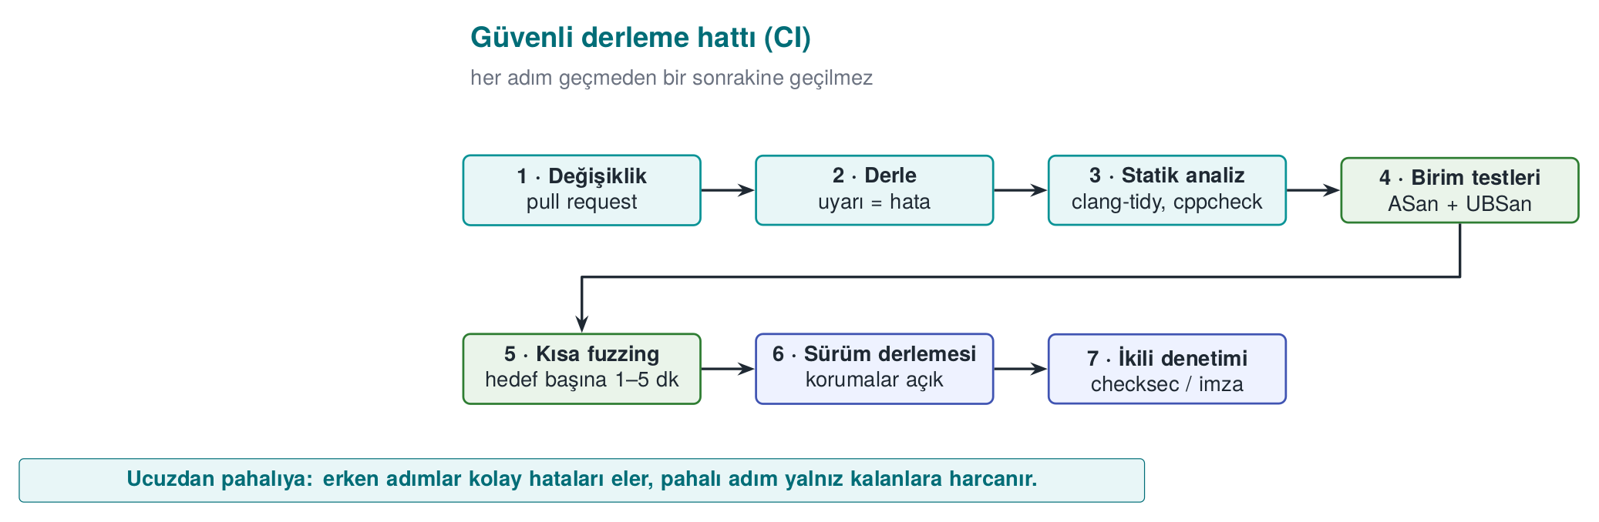
CEN429 Secure Programming · Week 4
Secure Build Pipeline (CI)
CI (Continuous Integration): a system that runs an automatic build + tests on every code change.
Every failing step stops the merge.
RTEU Computer Engineering · 2026-2027 Fall
130

Slide 131
CEN429 Secure Programming · Week 4
CI · Failure Criteria
Stage | Failure
Build | A single warning
Sanitizer-enabled test | Any report
Fuzzing | A new crash (old corpus = regression)
Binary audit | Log strings, symbols, a disabled protection
RTEU Computer Engineering · 2026-2027 Fall
131

Slide 132
CEN429 Secure Programming · Week 4
The Course's CMake Modes
Mode | Flags
korumasiz | -O0
optimize | -O2
asan | -O1 -fsanitize=address
denetimli | -O2 -D_FORTIFY_SOURCE=2
guvenli | -O2 + fixed source
Most of the protection flags: Demo 5's overflow_hardened.
RTEU Computer Engineering · 2026-2027 Fall
132

Slide 133
CEN429 Secure Programming · Week 4
The Build Environment Is a Target Too
• Access logging; pinning dependencies (Week 5's SBOM).
• Signed releases; reproducible builds.
• If the build machine is compromised, the entire product is affected.
RTEU Computer Engineering · 2026-2027 Fall
133

Slide 134
CEN429 Secure Programming · Week 4
Section 5 — Quick Check
1. What does the canary stop, and what does it not stop?
2. Why is ASLR weakened by an information leak?
3. Why is "no protection is enough for a logic error"?
RTEU Computer Engineering · 2026-2027 Fall
134
Notes:
Speaker note: Next, an introduction to code obfuscation.

Slide 135
CEN429 Secure Programming · Week 4
Section 5 — Answers
1. Stops: a sequential stack overflow that overwrites the return address (the canary gets corrupted). Does not stop: a targeted write, a heap overflow, an information leak.
2. A single leaked address reveals the module's base address (the offset is fixed) → the entire randomisation collapses.
3. Protections catch memory violations; incorrect authorization/business logic is a valid memory access → no protection is triggered. Correct design + review is required.
RTEU Computer Engineering · 2026-2027 Fall
135

Slide 136
CEN429 Secure Programming · Week 4
6. Introduction to Code Obfuscation
RTEU Computer Engineering · 2026-2027 Fall
136
Notes:
Speaker note: The introductory layer of obfuscation. Depth comes in Weeks 9 and 14.

Slide 137
CEN429 Secure Programming · Week 4
Layer 4 · Why?
• White-box attacker: reads strings, finds functions by name, bypasses checks.
• Obfuscation: same behaviour, harder to understand.
RTEU Computer Engineering · 2026-2027 Fall
137

Slide 138
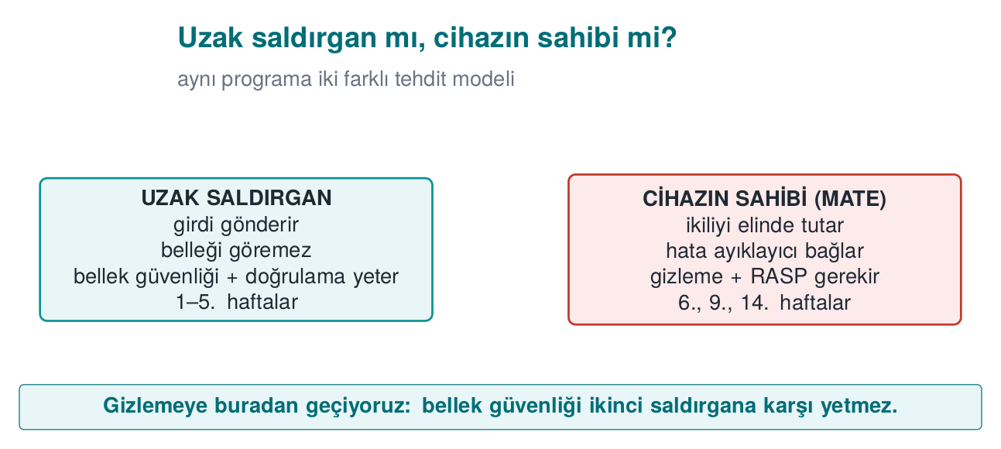
CEN429 Secure Programming · Week 4
Two Attacker Models — Diagram
RTEU Computer Engineering · 2026-2027 Fall
138

Slide 139
CEN429 Secure Programming · Week 4
The Purpose of Obfuscation
Not making it impossible, but making it expensive (Cookbook 12.1):
• cost > the value being protected
• make automation harder (diversification, Week 14)
• buy time for the other layers
A few simple techniques + data hiding, rather than one advanced technique.
RTEU Computer Engineering · 2026-2027 Fall
139

Slide 140
CEN429 Secure Programming · Week 4
Brief History · a Taxonomy of Obfuscation
• 1997 — Collberg, Thomborson, and Low published the work that organized obfuscation techniques into a systematic taxonomy: layout, data, control, and preventive transformations.
• What we saw this week — string/symbol hiding = a data transformation; control-flow flattening and the opaque predicate = a control transformation.
• The taxonomy is still the shared vocabulary of academic and industrial obfuscation literature.
RTEU Computer Engineering · 2026-2027 Fall
140

Slide 141
CEN429 Secure Programming · Week 4
Obfuscation Map
Family | What It Hides | Week
Layout | Names, structure | 4
Data | Constants, strings, variables | 4, 9
Control flow | Algorithm structure | 4, 9
Preventive | Analysis tool | 9
Virtualisation | Machine code | 9, 14
RTEU Computer Engineering · 2026-2027 Fall
141

Slide 142
CEN429 Secure Programming · Week 4
From the Field: 18 Measures on the Native Side
Symbol visibility off · name mangling · constant arithmetic hiding · string encryption (decrypt on use, wipe immediately) · opaque booleans · your own library functions · fake operation/dead branch · flattening + randomised exit · no logging in the release build.
➡️ The strength comes from combining them, and from RASP.
RTEU Computer Engineering · 2026-2027 Fall
142

Slide 143
CEN429 Secure Programming · Week 4
Three Cheap Measures
Measure | How?
Hide symbols | static, -fvisibility=hidden, strip -s
Remove logging | Empty the macro at compile time
Hide strings | Encrypt at compile time, decrypt on use, wipe immediately
RTEU Computer Engineering · 2026-2027 Fall
143

Slide 144
CEN429 Secure Programming · Week 4
Logging Macro
#ifdef LOG_ENABLED
# define LOG(...) fprintf(stderr, __VA_ARGS__)
#else
# define LOG(...) ((void)0) /* neither the string nor the call end up in the binary */
#endif
LOG_ENABLED is not defined in the release build → the logging is never compiled in.
RTEU Computer Engineering · 2026-2027 Fall
144

Slide 145
CEN429 Secure Programming · Week 4
⚠️ a Runtime Flag Is Not Enough
if (debug_flag) printf("..."); /* BAD */
• The string remains in the binary.
• The attacker can flip the flag and turn logging back on.
• The right way: remove it at compile time.
RTEU Computer Engineering · 2026-2027 Fall
145

Slide 146
CEN429 Secure Programming · Week 4
⚠️ String Hiding ≠ Key Storage
• The decrypted string sits in memory, in the clear, while it's in use.
• The decryption key is inside the program.
• What it stops: static scans like strings.
• Against someone inspecting it while running → RASP (6). A real key → whitebox (11).
RTEU Computer Engineering · 2026-2027 Fall
146

Slide 147
CEN429 Secure Programming · Week 4
Demo 6 — Symbol and String Leakage
code/week-04/06-symbol-strings · CWE-200/215
Step | What Happens?
1 | secret_exposed and secret_hidden give the same result
2 strings | The license string and [LOG] are visible in the open one; not in the closed one
3 nm | license_verify is visible in the open one; no symbol in the closed one
4 | Windows: names are in the PDB; the closed build produces no PDB
RTEU Computer Engineering · 2026-2027 Fall
147

Slide 148
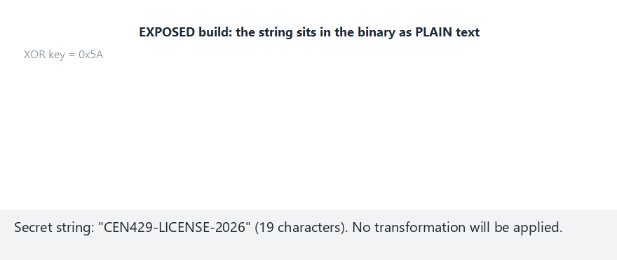
CEN429 Secure Programming · Week 4
Animation — string + symbol hiding
RTEU Computer Engineering · 2026-2027 Fall
148
Notes:
Speaker note: show live how every byte is XOR'd with the key, and how the symbols visible with nm differ between the exposed and hidden builds.

Slide 149
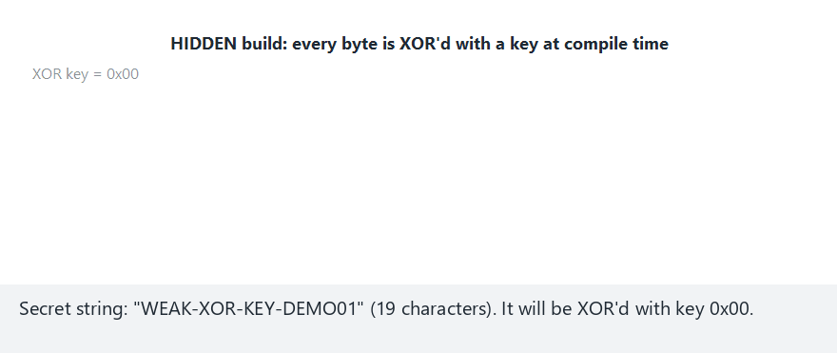
CEN429 Secure Programming · Week 4
Animation — Edge Case: a Bad Key Choice (0x00)
RTEU Computer Engineering · 2026-2027 Fall
149
Notes:
Speaker note: open the "edge-zero-key" preset from the selector; show live that when the XOR key is 0x00, every byte XORs with itself and stays unchanged — the "hiding" step does nothing at all. Key choice is part of the design too.

Slide 150
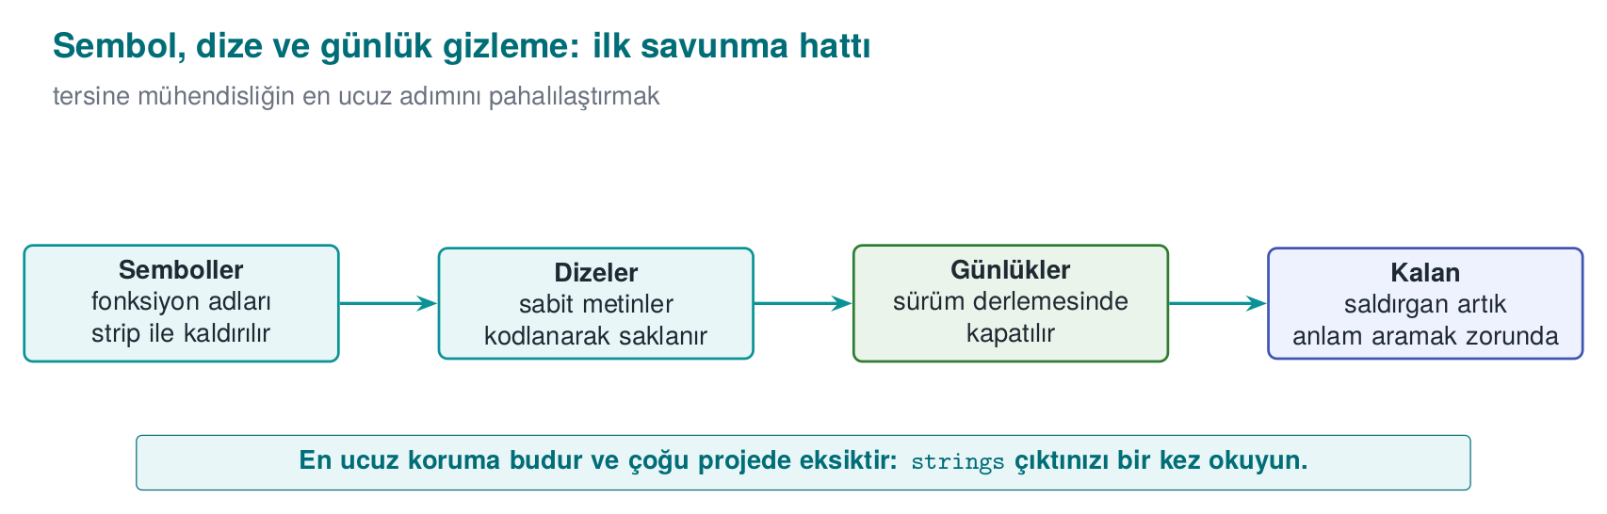
CEN429 Secure Programming · Week 4
Symbol and String Hiding — Diagram
RTEU Computer Engineering · 2026-2027 Fall
150

Slide 151
CEN429 Secure Programming · Week 4
Control-Flow Flattening
int state = 1;
for (;;) switch (state) {
case 1: state = 2; break;
case 2: state = (condition ? 3 : 4); break;
case 3: state = 5; break;
case 4: return FAILURE;
case 5: return SUCCESS;
}
The blocks' natural adjacency is lost; the order lives only in the state variable.
RTEU Computer Engineering · 2026-2027 Fall
151

Slide 152
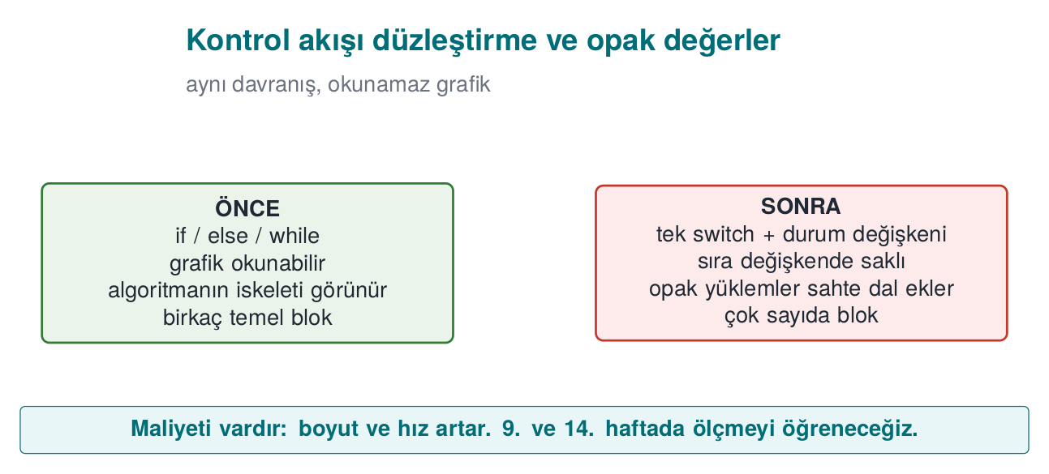
CEN429 Secure Programming · Week 4
Flattening: Before/After — Diagram
RTEU Computer Engineering · 2026-2027 Fall
152

Slide 153
CEN429 Secure Programming · Week 4
What Strengthens Flattening
• Hide the state values (arithmetic transformation)
• Fake/dead blocks (which one is real?)
• Randomised exit (where the error was caught becomes unreadable)
• Opaque values (a single byte cannot flip it)
The template alone is solved quickly on its own → Week 9 depth.
RTEU Computer Engineering · 2026-2027 Fall
153

Slide 154
CEN429 Secure Programming · Week 4
Demo 7 — Flattening
code/week-04/07-flow-flattening
Step | What Happens?
1 | pin.c and pin_flattened.c give the same result (the PIN is synthetic)
2 | objdump: the flattened version has far more branches
3 | Timing: the cost of flattening
➡️ Automated with Tigress's Flatten in Week 14; measuring effectiveness in Week 9.
RTEU Computer Engineering · 2026-2027 Fall
154

Slide 155
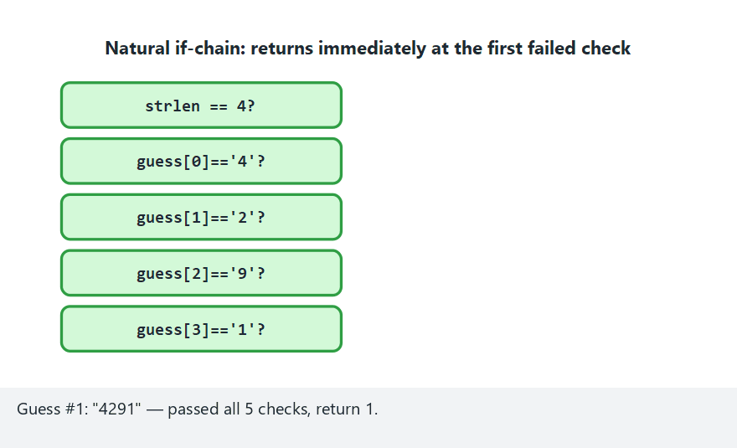
CEN429 Secure Programming · Week 4
Animation — the dispatcher state machine
RTEU Computer Engineering · 2026-2027 Fall
155
Notes:
Speaker note: show live how the plain version takes a direct if-chain while the flattened version walks the dispatcher from state=0 again for every guess.

Slide 156
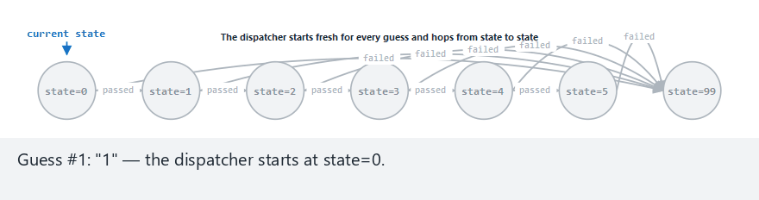
CEN429 Secure Programming · Week 4
Animation — Edge Case: Every Guess Has the Wrong Length
RTEU Computer Engineering · 2026-2027 Fall
156
Notes:
Speaker note: open the "flat-all-wrong-length" preset from the selector; even in the flattened version, the dispatcher MUST still pass through the length-check state first — reading stays harder, but the meaning of the flow hasn't changed.

Slide 157
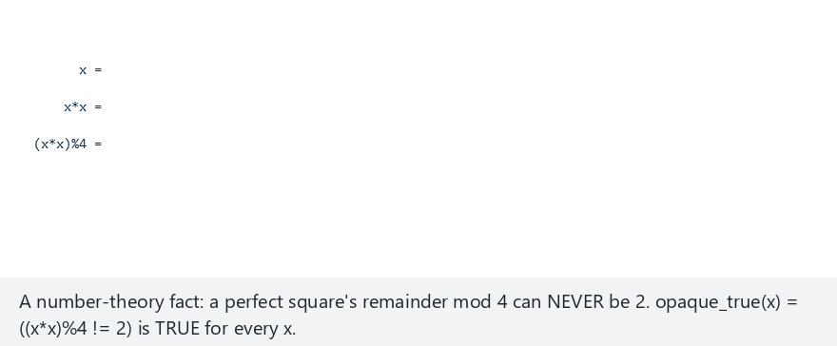
CEN429 Secure Programming · Week 4
Animation — the opaque predicate
RTEU Computer Engineering · 2026-2027 Fall
157
Notes:
Speaker note: prove experimentally that (x*x)%4 is never 2 for any integer; highlight that the decoy branch (decoy_branch) never runs.

Slide 158
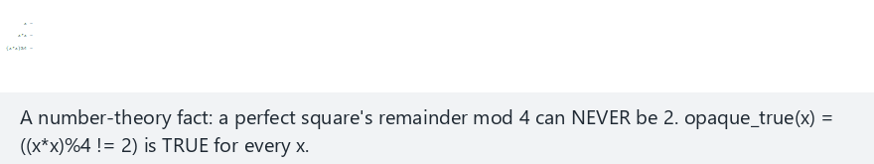
CEN429 Secure Programming · Week 4
Animation — Edge Case: Values Near the INT Bounds
RTEU Computer Engineering · 2026-2027 Fall
158
Notes:
Speaker note: open the "edge-extremes" preset from the selector; show that the (x*x)%4 identity still never equals 2 even at values like INT_MAX/INT_MIN (despite the potential for signed overflow) — tie this back to this week's integer overflow section.

Slide 159
CEN429 Secure Programming · Week 4
Concept: Three Techniques Leading into Week 9
• Function name hiding: exported names are meaningless; readability handled via a macro.
• Allocation-size hiding: blur the "32 bytes = a key" tell.
• Dynamic decryption: sensitive code sits encrypted in the binary; conflicts with DEP/NX, used selectively.
RTEU Computer Engineering · 2026-2027 Fall
159

Slide 160
CEN429 Secure Programming · Week 4
Section 6 — Quick Check
1. Does obfuscation fix the bug?
2. Why isn't silencing logging with a runtime flag enough?
3. Three techniques that strengthen flattening?
RTEU Computer Engineering · 2026-2027 Fall
160
Notes:
Speaker note: Next, the project and the solved self-check.

Slide 161
CEN429 Secure Programming · Week 4
Section 6 — Answers
1. No. Obfuscation only makes reverse engineering harder; the bug stays where it is. Fix first, then obfuscate.
2. The string/code remains in the binary; the attacker can flip the flag or read the strings. Remove logging in the release build at compile time (macro/dead-code elimination).
3. Opaque predicates + fake blocks/dead branches + state-variable encoding & randomised exit (also name/string hiding).
RTEU Computer Engineering · 2026-2027 Fall
161

Slide 162
CEN429 Secure Programming · Week 4
End to End: Closing One Overflow in Three Layers
RTEU Computer Engineering · 2026-2027 Fall
162
Notes:
Speaker note: We trace a single overflow from buggy code to attack, then to the fix; we see all three of this week's layers (coding, compiler/OS, not obfuscation but correction) in the same example. Can be worked through on the board.

Slide 163
CEN429 Secure Programming · Week 4
Buggy Code
void greet(const char *name) {
char buffer[16];
strcpy(buffer, name); /* no bound */
printf("Hello %s\n", buffer);
}
What happens if name is longer than 16 bytes?
RTEU Computer Engineering · 2026-2027 Fall
163

Slide 164
CEN429 Secure Programming · Week 4
What Happens? · Step by Step
• buffer is 16 bytes on the stack.
• strcpy copies name all the way to its end, paying no attention to bounds.
• A name longer than 16 → neighbouring memory (including the return address) is corrupted.
RTEU Computer Engineering · 2026-2027 Fall
164

Slide 165
CEN429 Secure Programming · Week 4
Attack · Outcome
• Short overflow: a neighbouring variable gets corrupted (a logic bug).
• Long overflow: the return address gets corrupted → crash or control hijacking.
• Without protection: a serious vulnerability (CWE-121).
RTEU Computer Engineering · 2026-2027 Fall
165

Slide 166
CEN429 Secure Programming · Week 4
Fix 1 · Bounded Copying
int n = snprintf(buffer, sizeof buffer, "%s", name);
if (n < 0 || (size_t)n >= sizeof buffer) {
/* truncated: reject or flag it */
}
snprintf knows the size and reports truncation.
RTEU Computer Engineering · 2026-2027 Fall
166

Slide 167
CEN429 Secure Programming · Week 4
Fix 2 · Layers
• Coding: snprintf (STR31-C).
• Compiler: -fstack-protector-strong (canary).
• FORTIFY: -D_FORTIFY_SOURCE=2 checks the library call.
• Testing: ASan catches the overflow with a long input.
RTEU Computer Engineering · 2026-2027 Fall
167

Slide 168
CEN429 Secure Programming · Week 4
Lesson: One Line, Many Layers
• One bug: strcpy.
• Defence: the right function + compiler protection + sanitizer testing.
• But the real fix is in the first line: bounded copying.
RTEU Computer Engineering · 2026-2027 Fall
168

Slide 169
CEN429 Secure Programming · Week 4
Classic Mistakes — Summary
Mistake | Section | Rule
Ignoring warnings | 1 | Turn warnings into errors with -Werror; keep the CERT scan clean
"Cleaning up" input and using it anyway | 1 | Reject dangerous input; allow-list + rejection is safest
Not checking the return value | 2–3 | Check every return (ERR33-C); fopen/malloc can return NULL
Hiding UB with -fwrapv | 2–3 | Making the overflow "defined" hides the logic bug; diagnose with UBSan
Shipping the sanitizer in the release build | 4 | Test/CI only; disabled in the release build
Covering up a bug with obfuscation | 6 | Obfuscation doesn't fix it, only hides it; fix first, then obfuscate
All six mistakes were covered earlier in this deck; here they are gathered in one glance.
RTEU Computer Engineering · 2026-2027 Fall
169

Slide 170
CEN429 Secure Programming · Week 4
7. Project and Closing
RTEU Computer Engineering · 2026-2027 Fall
170

Slide 171
CEN429 Secure Programming · Week 4
Project · S9 "Code Hardening" — 1
• checksec/dumpbin).
• clang-tidy/cppcheck; fix ≥ 5 findings (with rule ids).
RTEU Computer Engineering · 2026-2027 Fall
171

Slide 172
CEN429 Secure Programming · Week 4
Project · S9 — 2
•
•
• strings output.
• -Werror.
Measure card: Description → Implementation → Verification → Residual risk.
RTEU Computer Engineering · 2026-2027 Fall
172

Slide 173
CEN429 Secure Programming · Week 4
Solved Self-Check
RTEU Computer Engineering · 2026-2027 Fall
173

Slide 174
CEN429 Secure Programming · Week 4
Question 1
Which of the three layers actually removes the bug?
Answer: Only secure coding (layer 2). Compiler/OS protections make exploitation harder; obfuscation slows down reading — neither one removes the bug.
RTEU Computer Engineering · 2026-2027 Fall
174

Slide 175
CEN429 Secure Programming · Week 4
Question 2
What is the mildest outcome of `printf(girdi)`?
Answer: An information leak (reading the stack via %x/%p). The worst is writing to memory via %n.
RTEU Computer Engineering · 2026-2027 Fall
175

Slide 176
CEN429 Secure Programming · Week 4
Question 3
The three stack traces in a UAF report? Which one gets the fix?
Answer: Use, free, allocation. The fix is usually at the free point (an ownership decision).
RTEU Computer Engineering · 2026-2027 Fall
176

Slide 177
CEN429 Secure Programming · Week 4
Question 4
Why can `if (x + 100 < x)` be deleted?
Answer: Signed integer overflow is undefined behaviour; the compiler assumes "overflow never happens" and can optimise the check away, deleting it.
RTEU Computer Engineering · 2026-2027 Fall
177

Slide 178
CEN429 Secure Programming · Week 4
Question 5
Why is there no `printf` in a signal handler?
Answer: printf/malloc are not async-signal-safe; if the handler calls them while interrupted mid-state, corruption follows. Only a flag is set (SIG30-C).
RTEU Computer Engineering · 2026-2027 Fall
178

Slide 179
CEN429 Secure Programming · Week 4
Question 6
Which overflow can ASan not see?
Answer: A field-to-field overflow inside the same structure (there is no poisoned region between them).
RTEU Computer Engineering · 2026-2027 Fall
179

Slide 180
CEN429 Secure Programming · Week 4
Question 7
The four properties of a good fuzz target?
Answer: Fast, deterministic, stateless, single job.
RTEU Computer Engineering · 2026-2027 Fall
180

Slide 181
CEN429 Secure Programming · Week 4
Question 8
What does the canary stop, and what does it not stop?
Answer: Stops: a stack overflow that reaches the return address. Does not stop: heap overflow, corruption of earlier variables, a leaked canary.
RTEU Computer Engineering · 2026-2027 Fall
181

Slide 182
CEN429 Secure Programming · Week 4
Question 9
Why is ASLR weakened by an information leak?
Answer: If one address leaks, the attacker can calculate the other addresses relative to it; the advantage of randomisation is lost.
RTEU Computer Engineering · 2026-2027 Fall
182

Slide 183
CEN429 Secure Programming · Week 4
Question 10
Why isn't silencing logging with a runtime flag enough?
Answer: The string remains in the binary and the attacker can flip the flag to turn logging back on. It must be removed at compile time.
RTEU Computer Engineering · 2026-2027 Fall
183

Slide 184
CEN429 Secure Programming · Week 4
Question 11
Three techniques that strengthen flattening?
Answer: Hiding state values, fake/dead blocks, a randomised exit point (and opaque values).
RTEU Computer Engineering · 2026-2027 Fall
184

Slide 185
CEN429 Secure Programming · Week 4
Question 12
Why is string hiding not the same as key storage?
Answer: The decrypted string is in memory, in the clear, while it's in use, and the decryption key sits inside the program; it only stops static scanning.
RTEU Computer Engineering · 2026-2027 Fall
185

Slide 186
CEN429 Secure Programming · Week 4
Summary: This Week in One Sentence
First bug-free code (CERT + sanitizer + fuzzing), then limit the damage (compiler/OS protections), and finally make it harder to read (obfuscation) — and no protection substitutes for secure coding. Secure code is not written once; it is checked with tools on every build.
RTEU Computer Engineering · 2026-2027 Fall
186

Slide 187
CEN429 Secure Programming · Week 4
Glossary
Term | Meaning
UB | Undefined behaviour
UAF | Use-after-free
CERT/CWE | Rulebook / weakness catalogue
Sanitizer | Runtime bug detector
Fuzzing | Finding crashes with random input
Canary/ASLR/NX | Compiler/OS protections
RTEU Computer Engineering · 2026-2027 Fall
187

Slide 188
CEN429 Secure Programming · Week 4
Next Week
Week 5 — Java and Interpreted Languages
This week we dealt with manually managed memory in C/C++ and compiler/OS protections; Week 5 shows how the JVM eliminates most of these bugs (overflow, UAF, UB), but opens a new bug class such as injection (SQL, command, path).
The SEI CERT Java rules will be compared with today's SEI CERT C/C++ rules; we will also cover obfuscation with ProGuard/R8, dependency security, and SBOM.
Preparation: JDK 17+, Maven · code/week-05.
RTEU Computer Engineering · 2026-2027 Fall
188
First correct code, then protection, finally obfuscation. The order matters.

