Slide 1

CEN429 Secure Programming · Week 9
Advanced Obfuscation and Diversification
CEN429 Secure Programming — Week 9
Asst. Prof. Dr. Uğur CORUH · 13.11.2026
RTEU Computer Engineering · 2026-2027 Fall
Notes:
Speaker note: This week we cover advanced code obfuscation rules. Framework: obfuscation does not make something unbreakable, it makes it expensive. We present every technique as a security rule — what it protects, its cost, its limit, how it is measured. Key protection is not obfuscation (week 11).

Slide 2
CEN429 Secure Programming · Week 9
Today's Plan (3 Hours)
Hour | Section | Topic
1 | 1–2 | Why is obfuscation a rule? · MATE · taxonomy · rule template
2 | 3 | Control-flow rules (K-01…K-06)
3 | 4–6 | Data rules · virtualisation/dynamic · diversification · measurement
Learning outcome (LO.3): write obfuscation as a security rule · state each technique's cost and limit · measure a protection and justify it
RTEU Computer Engineering · 2026-2027 Fall
2
Notes:
Speaker note: Today we take the obfuscation introduction from week 4 to an advanced level and add measurement. Main framework: obfuscation does not give unbreakability, it raises cost. We present every technique as a "rule."

Slide 3
CEN429 Secure Programming · Week 9
What We Bring from Earlier Weeks
• The white-box / MATE attacker model — the threat model where whoever holds the device is also the attacker (Week 1)
• Debugger — a tool that runs a program step by step and shows variables (gdb, lldb); we saw its run-time detection in the RASP context (Week 6)
• Entropy — a measure of how disordered a data's bytes look; we saw it in detecting encrypted/packed content and in random number generation (Weeks 2, 3)
• Compiler flags, `strings` and the symbol table — compiler options and the tools that list a binary's readable text/name list; the entry-level steps of obfuscation (Week 4)
• Decompilation — turning a binary/bytecode back into something close to readable code; we saw it on JVM bytecode (Week 5)
• XOR — 1 if the two bits differ, 0 if they match; a^b^b=a undoes itself; we decoded it by hand in Java string obfuscation (Week 5)
• Logging — the informational messages a program writes while running; if sensitive information ends up in a log, the attacker reads it (Week 2)
This week: we use these tools and concepts at an advanced level and in a measurable way.
RTEU Computer Engineering · 2026-2027 Fall
3

Slide 4
CEN429 Secure Programming · Week 9
This Week's Concepts
Each term is defined once, where it first appears in the body; here we only mark where.
Concept | Where
Obfuscation as a security rule, MATE | Section 1
Obfuscation taxonomy (five families) | Section 2
The "protection rule" template (protects what/cost/limit/measurement) | Section 2
Control-flow rules (K-01–K-06) | Section 3
Data obfuscation rules (K-07–K-09) | Section 4
Whole-program rules (K-10–K-12) | Section 4
Diversification | Section 5
Obfuscation's four metrics (potency/resilience/stealth/cost) | Section 5
Deobfuscation (the other side's tools) | Section 5
Its place in layered defence, project S9 | Section 6
RTEU Computer Engineering · 2026-2027 Fall
4

Slide 5
CEN429 Secure Programming · Week 9
What Is Source Code?
• The human-readable program text that you write (e.g., a C file).
• Example: int topla(int a, int b) { return a + b; }
Source code is compiled and turned into the form the machine runs.
RTEU Computer Engineering · 2026-2027 Fall
5

Slide 6
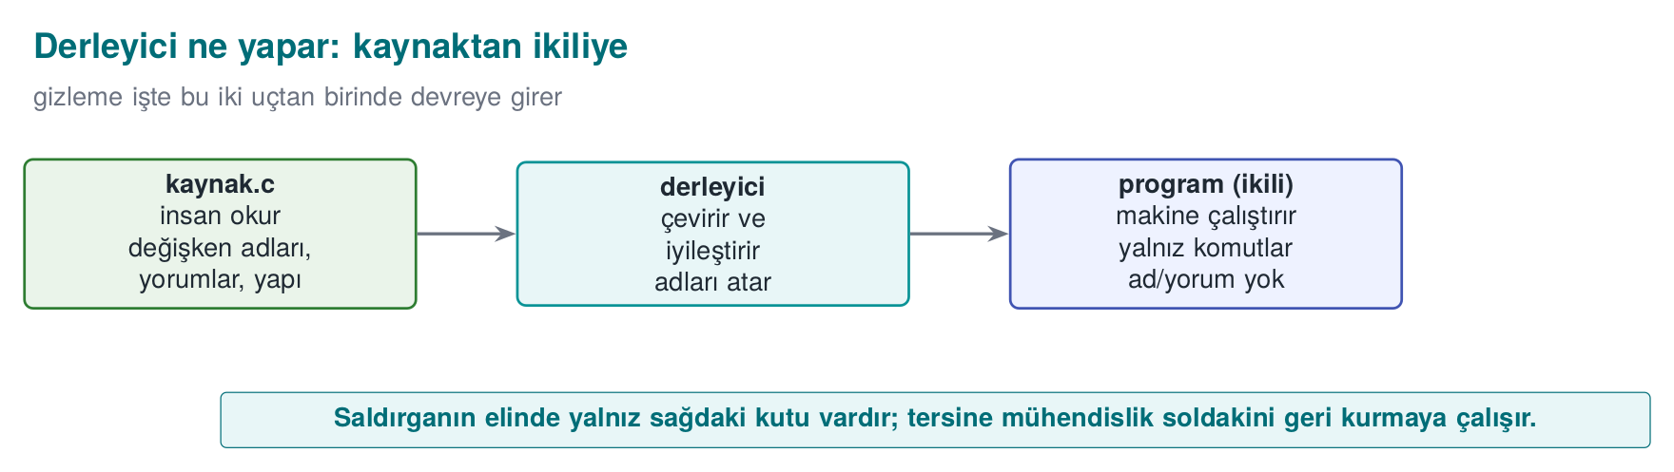
CEN429 Secure Programming · Week 9
Compiler and Binary
• Compiler: the program that translates source code into machine code (gcc, clang).
• Binary: the result of compilation; the file the computer runs directly (.exe, .so).
RTEU Computer Engineering · 2026-2027 Fall
6

Slide 7
CEN429 Secure Programming · Week 9
Machine Code and Assembly
• Machine code: the numeric instructions the processor understands.
• Assembly: a somewhat more human-readable form of machine code (mov, cmp, jmp).
This is what you see when you open a binary.
RTEU Computer Engineering · 2026-2027 Fall
7

Slide 8
CEN429 Secure Programming · Week 9
What Is Reverse Engineering?
Reverse engineering: looking at a binary and trying to work out what the program does.
This is the attacker's basic job.
RTEU Computer Engineering · 2026-2027 Fall
8

Slide 9
CEN429 Secure Programming · Week 9
Decompiler
• Decompiler: a tool that turns a binary back into a form close to readable code.
• Examples: Ghidra, IDA.
Goal: someone with no access to the source can infer the logic just by looking at the binary.
RTEU Computer Engineering · 2026-2027 Fall
9

Slide 10
CEN429 Secure Programming · Week 9
Bit, Byte, Hexadecimal
• Bit: 0 or 1.
• Byte: 8 bits.
• Hexadecimal (hex): written with a 0x prefix; 0x2A = 42.
We will see values like 0x5A in the code; these are just numbers.
RTEU Computer Engineering · 2026-2027 Fall
10

Slide 11
CEN429 Secure Programming · Week 9
What Is XOR?
• XOR (^): 1 if the two bits differ, 0 if they are the same.
• Property: a ^ b ^ b == a → it undoes itself.
c = a ^ 0x5A; /* encode */
a = c ^ 0x5A; /* decode */
It is heavily used in obfuscation because it is reversible.
RTEU Computer Engineering · 2026-2027 Fall
11

Slide 12
CEN429 Secure Programming · Week 9
What Is Entropy (Randomness)?
• Entropy: how "random" a piece of data looks.
• Cryptographic keys look high-entropy (irregular bytes).
If an attacker sees a high-entropy block in a binary, they say "there might be a key here."
RTEU Computer Engineering · 2026-2027 Fall
12

Slide 13
CEN429 Secure Programming · Week 9
Function, Branch, Condition
• Function: a block of code that does one job (grant_access).
• Branch: a fork in the road, like an if.
• Condition: the expression that decides which way the branch goes.
RTEU Computer Engineering · 2026-2027 Fall
13

Slide 14
CEN429 Secure Programming · Week 9
Basic Block
• Basic block: a sequence of instructions that runs straight through, with no branch.
• When an if is reached the block ends, and two new blocks begin.
Program = basic blocks wired together.
RTEU Computer Engineering · 2026-2027 Fall
14

Slide 15
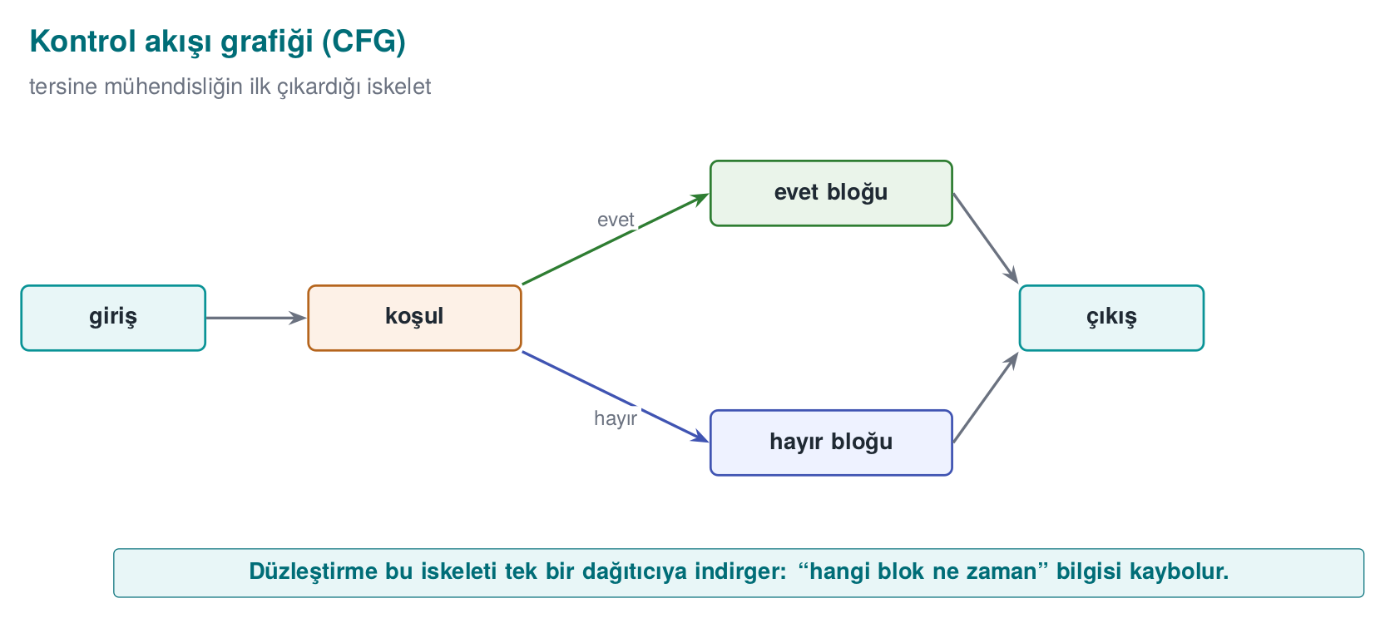
CEN429 Secure Programming · Week 9
Control Flow Graph (CFG)
• CFG (Control Flow Graph): a diagram that makes basic blocks its nodes and the transitions between them its edges.
• It is the program's "road map."
RTEU Computer Engineering · 2026-2027 Fall
15

Slide 16
CEN429 Secure Programming · Week 9
This Week's Question in One Sentence
I have delivered the program to the user; the attacker now owns it. How do I make it harder for them to read and modify my code?
Answer: code obfuscation rules. Let's begin.
RTEU Computer Engineering · 2026-2027 Fall
16

Slide 17
CEN429 Secure Programming · Week 9
1. Why Is Obfuscation a Rule?
RTEU Computer Engineering · 2026-2027 Fall
17

Slide 18
CEN429 Secure Programming · Week 9
First, a Question
You have delivered a mobile app to the user.
• Whose machine is the code running on now?
• Are your server-side security checks still valid here?
• How many times can the attacker try?
RTEU Computer Engineering · 2026-2027 Fall
18
Notes:
Speaker note: Have the students answer first. Answer: on the attacker's machine, server-side checks no longer apply, unlimited attempts.

Slide 19
CEN429 Secure Programming · Week 9
MATE: the Attacker at the End
Man-At-The-End = an attacker who possesses the program itself.
• The binary is in their hands
• They can read and modify memory
• They have a decompiler and a debugger in hand
• They can try as many times as they like
This is also called the white-box model (week 1).
RTEU Computer Engineering · 2026-2027 Fall
19

Slide 20
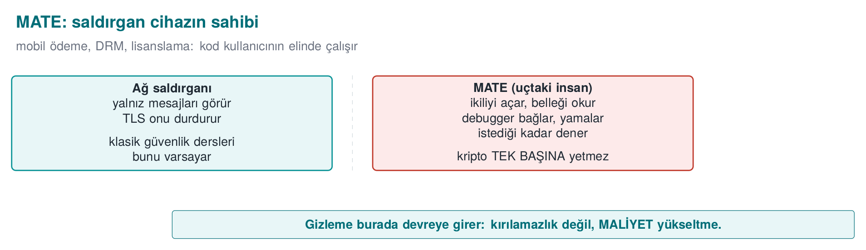
CEN429 Secure Programming · Week 9
The MATE Attacker Model — Diagram
RTEU Computer Engineering · 2026-2027 Fall
20

Slide 21
CEN429 Secure Programming · Week 9
Black Box ≠ White Box
 | Black box | White box (MATE)
Sees | Input/output | Everything
Environment | Remote server | The attacker's device
Attempts | Limited | Unlimited
Defence | Crypto, verification | + obfuscation, RASP, whitebox
Cryptography assumes a black box; that assumption collapses on delivery.
RTEU Computer Engineering · 2026-2027 Fall
21

Slide 22
CEN429 Secure Programming · Week 9
A Brief History — Where Does Code Obfuscation Come From?
• 1976 — Diffie & Hellman: the idea of "incomprehensible but working" (protection through effort)
• 1997 — Collberg et al. taxonomy + potency–resilience–stealth–cost (this course's five families)
• 2000 — Wang et al.: control-flow flattening — precise analysis is NP-hard in general (K-04)
• 2001 — Barak et al.: perfect obfuscation is impossible → not "unbreakability" but cost
• 2002 — Chow et al. whitebox AES (week 11) · 2015 Obfuscator-LLVM (Junod et al., K-11) · Tigress (week 14)
Obfuscation is a practical delaying discipline built on top of an impossibility theorem.
RTEU Computer Engineering · 2026-2027 Fall
22

Slide 23
CEN429 Secure Programming · Week 9
The Honest Truth
An attacker with enough time, skill, and motivation breaks every obfuscation.
Cookbook (Recipe 12.1): anti-tampering is not "unbreakable."
So what is the goal, then?
RTEU Computer Engineering · 2026-2027 Fall
23

Slide 24
CEN429 Secure Programming · Week 9
The Goal: Make Breaking It Uneconomical
Obfuscation is a tool for raising cost, not for keeping a secret.
• Make breaking it expensive
• Make automating it harder
• Buy time for the other layers
Let's turn these into three rules.
RTEU Computer Engineering · 2026-2027 Fall
24

Slide 25
CEN429 Secure Programming · Week 9
Rule 1 — Push the Cost Above the Value
The attack must be more expensive than the protected asset.
• Protecting a 10 TL secret with 1000 TL of effort: a waste
• Protecting a 1000 TL secret with 10 TL of effort: insufficient
First determine the asset's value, then choose the protection.
RTEU Computer Engineering · 2026-2027 Fall
25

Slide 26
CEN429 Secure Programming · Week 9
Rule 2 — Break Automation
An attack that works on one copy should not work on every copy.
• This is called diversification (section 5 of this week)
• With tooling in week 14 (Tigress --Seed)
One crack should not open every door.
RTEU Computer Engineering · 2026-2027 Fall
26

Slide 27
CEN429 Secure Programming · Week 9
Rule 3 — Buy Time for the Other Layers
Obfuscation is not a defence on its own; it is a layer.
• RASP (week 6) protects it while it is running
• Integrity checking, server-side checks
• Holding out until the key/version is renewed is enough
RTEU Computer Engineering · 2026-2027 Fall
27

Slide 28
CEN429 Secure Programming · Week 9
The Source's Language: Every Countermeasure Is a "Rule"
The technical guide writes every countermeasure under three headings:
• Description — what it protects
• Implementation — how it is done
• Example usage — where
Usually with a compliance ID too (e.g., "sensitive data is never logged in plain text").
We will write it the same way: what it protects · how · cost · limit.
RTEU Computer Engineering · 2026-2027 Fall
28

Slide 29
CEN429 Secure Programming · Week 9
2. Taxonomy and Rule Template
RTEU Computer Engineering · 2026-2027 Fall
29

Slide 30
CEN429 Secure Programming · Week 9
What Does Obfuscation Hide?
Collberg's classification: we split obfuscation by what it hides.
There are five families. Let's go through them in order.
RTEU Computer Engineering · 2026-2027 Fall
30

Slide 31
CEN429 Secure Programming · Week 9
Family 1 — Layout
What does it hide? Names, format, metadata.
• Making symbols invisible
• Making function/file names meaningless
• Stripping logging from the release build
We met this in week 4; this week we go deeper.
RTEU Computer Engineering · 2026-2027 Fall
31

Slide 32
CEN429 Secure Programming · Week 9
Family 2 — Data
What does it hide? Constants, strings, variables.
• String encoding
• Constant transforms
• Variable splitting/merging
• Opaque boolean
→ Section 4 of this week.
RTEU Computer Engineering · 2026-2027 Fall
32

Slide 33
CEN429 Secure Programming · Week 9
Family 3 — Control Flow
What does it hide? The algorithm's structure.
• Control-flow flattening
• Opaque predicates
• Bogus and dead branches
• Random exit
→ Section 3 of this week (coming up shortly).
RTEU Computer Engineering · 2026-2027 Fall
33

Slide 34
CEN429 Secure Programming · Week 9
Family 4 — Anti-Analysis
What does it hide? The analysis tools' own work.
• Structures that mislead a decompiler
• Decoding code at runtime
→ Concept this week, RASP in week 6.
RTEU Computer Engineering · 2026-2027 Fall
34

Slide 35
CEN429 Secure Programming · Week 9
Family 5 — Virtualisation
What does it hide? The machine code itself.
• Turning a function into a custom VM's bytecode
→ Concept this week (K-10), with tooling in week 14 (Tigress Virtualize).
RTEU Computer Engineering · 2026-2027 Fall
35

Slide 36
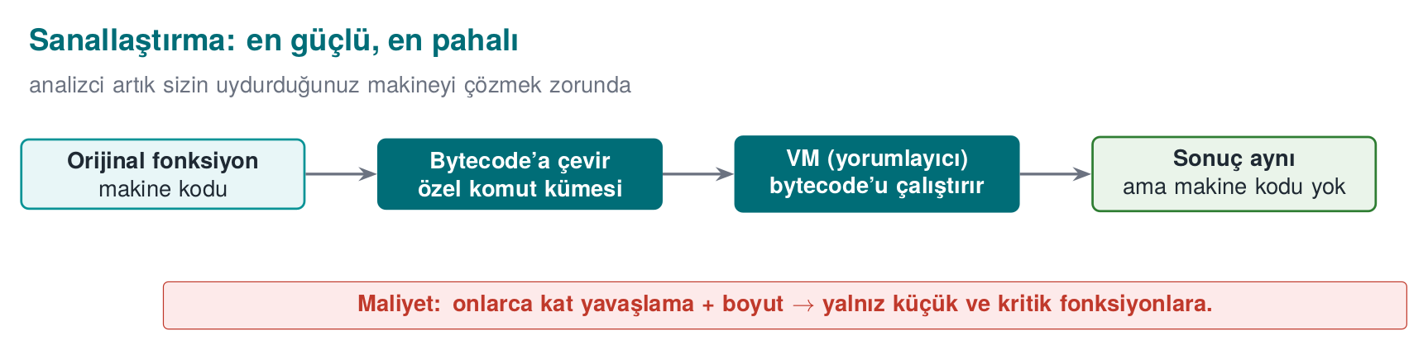
CEN429 Secure Programming · Week 9
Virtualisation — Diagram
RTEU Computer Engineering · 2026-2027 Fall
36

Slide 37
CEN429 Secure Programming · Week 9
The Five Families: Summary
Family | Hides
Layout | Name, format
Data | Constant, string, variable
Control flow | Structure
Anti-analysis | Tool's work
Virtualisation | Machine code
Rule: the families are used together, not alone.
RTEU Computer Engineering · 2026-2027 Fall
37

Slide 38
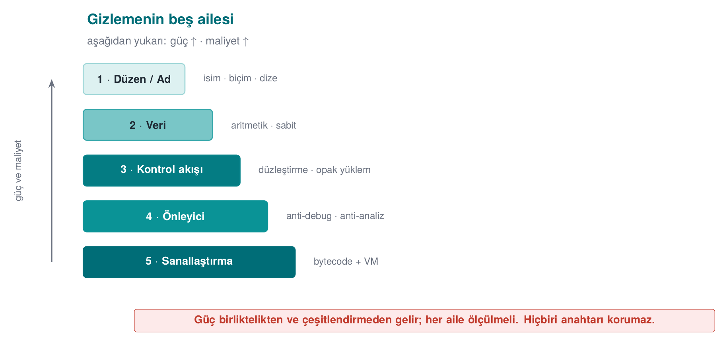
CEN429 Secure Programming · Week 9
Five Families — Potency ↑ Cost ↑
RTEU Computer Engineering · 2026-2027 Fall
38

Slide 39
CEN429 Secure Programming · Week 9
In the Field: All Together
The native countermeasures listed in a certified product cover this entire map:
symbol hiding · name obfuscation · arithmetic transform · string encoding · opaque boolean · bogus operation · dead branch · flattening · random exit · stripping logging
None of them is strong alone; strength comes from togetherness.
RTEU Computer Engineering · 2026-2027 Fall
39

Slide 40
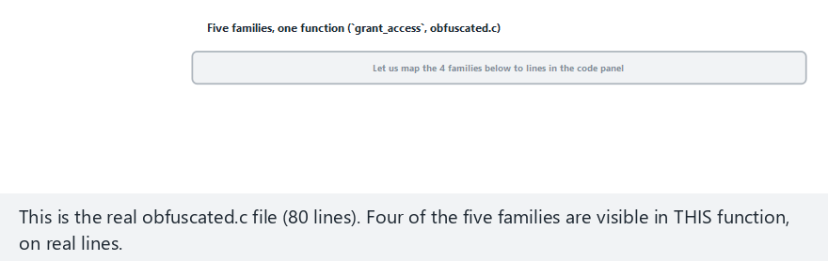
CEN429 Secure Programming · Week 9
Animation · Five Families, One Function
RTEU Computer Engineering · 2026-2027 Fall
40
Notes:
Speaker note: show the four families on real grant_access/obfuscated.c lines, then run the dispatcher live against 10 tokens to confirm behavior is preserved.

Slide 41
CEN429 Secure Programming · Week 9
Animation · Five Families — Edge Case (all valid)
RTEU Computer Engineering · 2026-2027 Fall
41
Notes:
Speaker note: all 10 tokens are valid — the dispatcher runs the full traversal every time, always GRANTED.

Slide 42
CEN429 Secure Programming · Week 9
What Obfuscation GIVES
• A delay against static analysis (strings, symbols, decompilation)
• Resistance against automated attack (via diversification)
• Time for the other layers
• A measurable increase in cost
RTEU Computer Engineering · 2026-2027 Fall
42

Slide 43
CEN429 Secure Programming · Week 9
What Obfuscation DOES NOT Give
• The secrecy of a secret → that is cryptography's job
• Protection against reading memory → RASP, whitebox
• Permanent security → there is no such thing as "unbreakable"
• Free protection → every obfuscation comes with a cost
RTEU Computer Engineering · 2026-2027 Fall
43

Slide 44
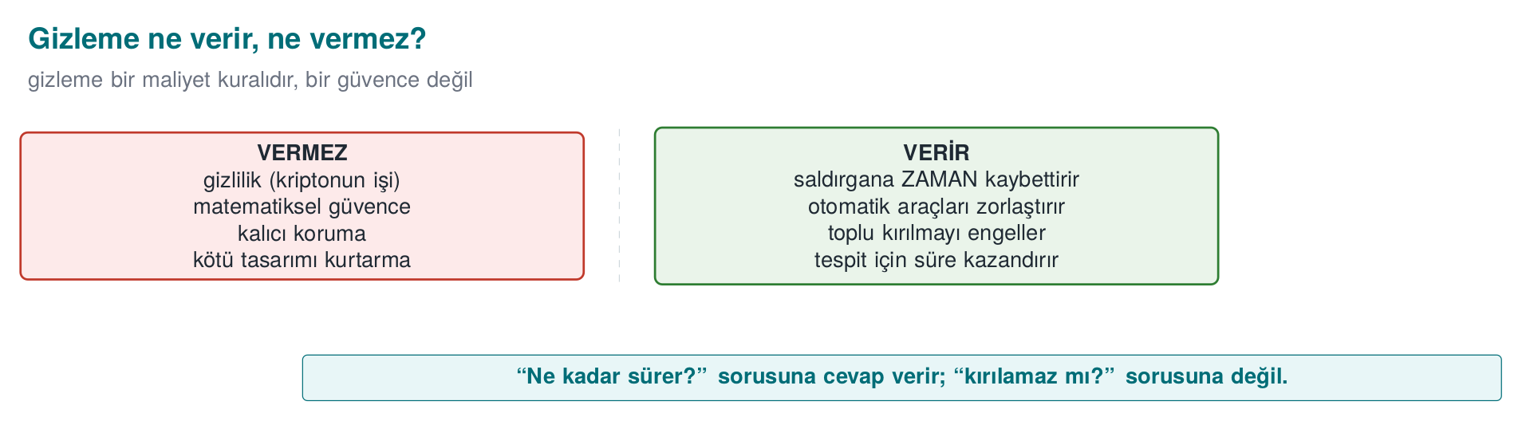
CEN429 Secure Programming · Week 9
What Obfuscation Gives and Does Not Give — Diagram
RTEU Computer Engineering · 2026-2027 Fall
44

Slide 45
CEN429 Secure Programming · Week 9
⚠️ The Most Common Mistake
Mistaking obfuscation for storing a key.
• An embedded/hidden key is still there
• The program has to use it while it runs → it is exposed in memory
• The decoding logic is inside too
Secrecy is cryptography's job, not obfuscation's. (week 3)
RTEU Computer Engineering · 2026-2027 Fall
45

Slide 46
CEN429 Secure Programming · Week 9
The "Protection Rule" Template
RULE K-xx: <technique>
What does it protect? : which asset / code section
Against which threat? : static / dynamic / automated / tampering
How? : one sentence (concept)
Cost : size, speed, maintenance, debugging
Limit : what it does not protect
Measurement : how effectiveness is verified
RTEU Computer Engineering · 2026-2027 Fall
46

Slide 47
CEN429 Secure Programming · Week 9
Why Is the "Measurement" Line Required?
Obfuscation is not "present/absent."
• The evaluator (week 13) asks how much each layer delays the attack
• Protection without measurement = a claim, not evidence
In the project you will write S9 using this template.
RTEU Computer Engineering · 2026-2027 Fall
47

Slide 48
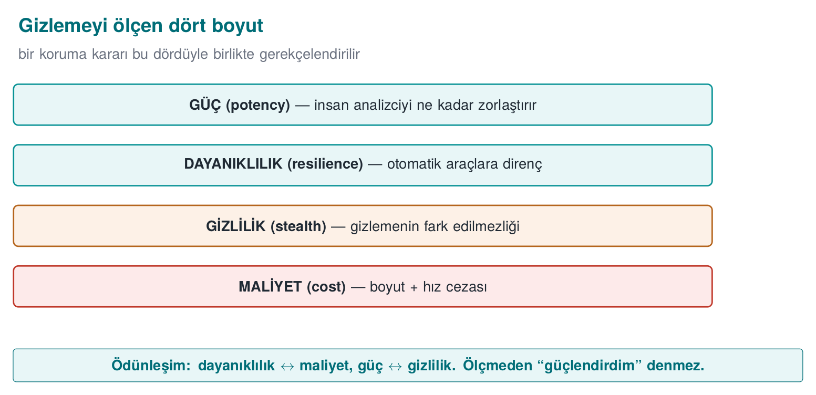
CEN429 Secure Programming · Week 9
Four Metrics — Diagram
RTEU Computer Engineering · 2026-2027 Fall
48

Slide 49
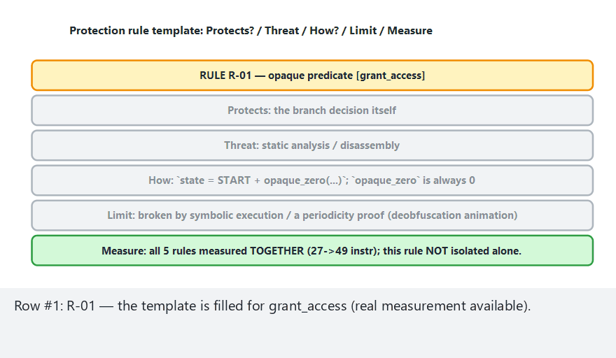
CEN429 Secure Programming · Week 9
Animation · Protection Rule Template
RTEU Computer Engineering · 2026-2027 Fall
49
Notes:
Speaker note: 5 real rules x 2 assets (measured grant_access, conceptual lisans_dogrula) — stress which one was measured and which is illustrative.

Slide 50
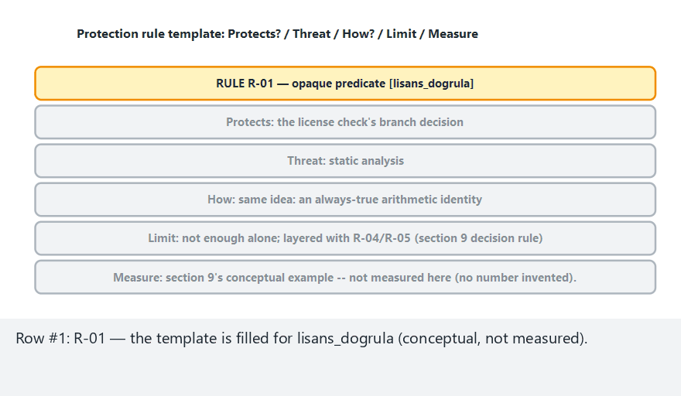
CEN429 Secure Programming · Week 9
Animation · Protection Rule Template — Edge Case (conceptual asset only)
RTEU Computer Engineering · 2026-2027 Fall
50
Notes:
Speaker note: all 10 rows are lisans_dogrula — no measurement at all; use this to make the "measured" vs "illustrated" distinction crystal clear.

Slide 51
CEN429 Secure Programming · Week 9
Section 2 — Quick Check
1. How does the MATE attacker differ from a black box?
2. What were obfuscation's three rules?
3. Does obfuscation protect a key? Why?
RTEU Computer Engineering · 2026-2027 Fall
51
Notes:
Speaker note: have them answer first, then open this slide.

Slide 52
CEN429 Secure Programming · Week 9
Section 2 — Answers
1. MATE possesses the program (the code/memory is theirs, unlimited attempts); a black box only sees input/output.
2. Push the cost above the value · break automation (diversify) · buy time for the other layers.
3. No. The key is exposed in memory while running and the decoding logic is inside; secrecy is cryptography's job.
RTEU Computer Engineering · 2026-2027 Fall
52

Slide 53
CEN429 Secure Programming · Week 9
3. Control-Flow Rules
RTEU Computer Engineering · 2026-2027 Fall
53

Slide 54
CEN429 Secure Programming · Week 9
The Purpose of This Section
We treat the CFG (already defined in the background section) as this section's skeleton; the attacker's first job is to extract that skeleton.
In week 4 we introduced flattening.
In this section we add the rules that strengthen it:
K-01 opaque predicate · K-02 arithmetic encoding · K-03 bogus/dead · K-04 flattening (in depth) · K-05 random exit · K-06 call hiding
All examples are synthetic, built around a single check: grant_access.
RTEU Computer Engineering · 2026-2027 Fall
54

Slide 55
CEN429 Secure Programming · Week 9
K-01 · Opaque Predicates and Loops
RTEU Computer Engineering · 2026-2027 Fall
55

Slide 56
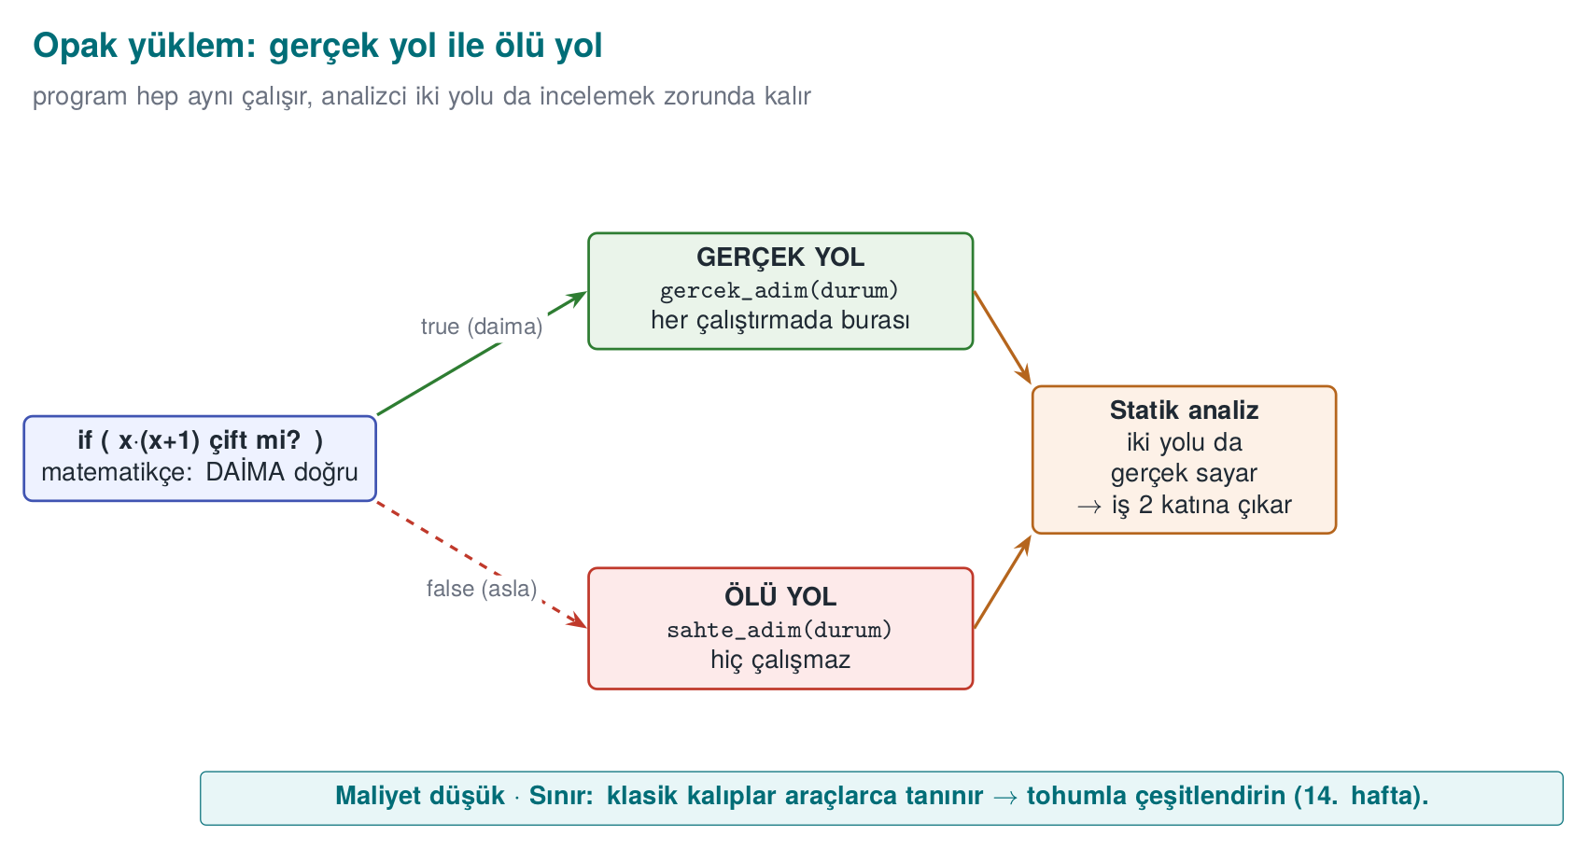
CEN429 Secure Programming · Week 9
Opaque Predicate — Diagram
RTEU Computer Engineering · 2026-2027 Fall
56

Slide 57
CEN429 Secure Programming · Week 9
K-01 · What Does It Protect?
• Which condition a branch is taken under
• How many times a loop runs
Idea: branch on an expression whose value the programmer knows but the tool cannot easily resolve.
RTEU Computer Engineering · 2026-2027 Fall
57

Slide 58
CEN429 Secure Programming · Week 9
K-01 · Opaque Predicate Example
/* x*(x+1) is always even → result is always true */
static int opaque_true(unsigned x) {
return ((x * (x + 1)) & 1u) == 0;
}
The programmer knows: it is always true. Static analysis cannot easily prove this.
RTEU Computer Engineering · 2026-2027 Fall
58

Slide 59
CEN429 Secure Programming · Week 9
K-01 · How Is It Used?
if (opaque_true(counter)) {
state = real_step(state); /* always entered */
} else {
state = fake_step(state); /* dead path: never runs */
}
The analyst thinks both paths are "real"; they spend their time on the fake path.
RTEU Computer Engineering · 2026-2027 Fall
59

Slide 60
CEN429 Secure Programming · Week 9
K-01 · Opaque Loop
The guide makes loops a separate rule:
• for/while are never shown directly
• Hidden inside flattening
• The body is split into small blocks
• Iteration is driven by a state variable
The information "this loop runs N times" cannot be read off the CFG.
RTEU Computer Engineering · 2026-2027 Fall
60

Slide 61
CEN429 Secure Programming · Week 9
K-01 · Cost and Limit
• Cost: low–medium (extra arithmetic/branch)
• Limit: well-known opaque predicate patterns are recognised automatically
• Countermeasure: diversify (section 5)
• Measurement: basic block count before/after
RTEU Computer Engineering · 2026-2027 Fall
61

Slide 62
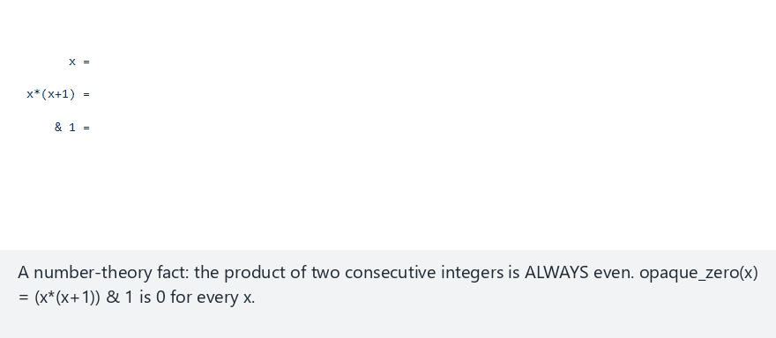
CEN429 Secure Programming · Week 9
Animation · Opaque Predicate Insertion
RTEU Computer Engineering · 2026-2027 Fall
62
Notes:
Speaker note: sweep grant_access's real opaque_zero(x)=(x*(x+1))&1 over many x; all come out 0. Then show the real use line (40).

Slide 63
CEN429 Secure Programming · Week 9
Animation · Opaque Predicate — Edge Case (large values)
RTEU Computer Engineering · 2026-2027 Fall
63
Notes:
Speaker note: even at large x values just under the JS safe-integer bound, the identity still comes out 0.

Slide 64
CEN429 Secure Programming · Week 9
K-02 · Arithmetic Encoding
RTEU Computer Engineering · 2026-2027 Fall
64

Slide 65
CEN429 Secure Programming · Week 9
K-02 · What Does It Protect?
Constants and simple computations.
It hides directly readable hints like "this number is 0x1F, this operation is an XOR."
RTEU Computer Engineering · 2026-2027 Fall
65

Slide 66
CEN429 Secure Programming · Week 9
K-02 · Equivalent Expressions (MBA)
Replace an operation with an equivalent one that produces the same result but looks complex:
a + b ≡ (a ^ b) + 2*(a & b)
x * 2 ≡ x << 1
Same result, complex appearance. (MBA = mixed boolean-arithmetic)
RTEU Computer Engineering · 2026-2027 Fall
66

Slide 67
CEN429 Secure Programming · Week 9
K-02 · Hide the Constant
/* 0x2A is not written directly; produced from two parts */
static uint8_t threshold(void) {
uint8_t a = 0x37, b = 0x1D;
return (uint8_t)(a ^ b); /* = 0x2A */
}
Searching the binary for 0x2A returns nothing.
RTEU Computer Engineering · 2026-2027 Fall
67

Slide 68
CEN429 Secure Programming · Week 9
K-02 · Cost and Limit
• Cost: low
• Limit: MBA simplifiers (arybo/msynth) can undo many expressions
• Rule: weak on its own → combine it with control flow
• Measurement: a byte/strings search for the constant should return nothing
RTEU Computer Engineering · 2026-2027 Fall
68

Slide 69
CEN429 Secure Programming · Week 9
K-03 · Bogus Operations and Dead Branches
RTEU Computer Engineering · 2026-2027 Fall
69

Slide 70
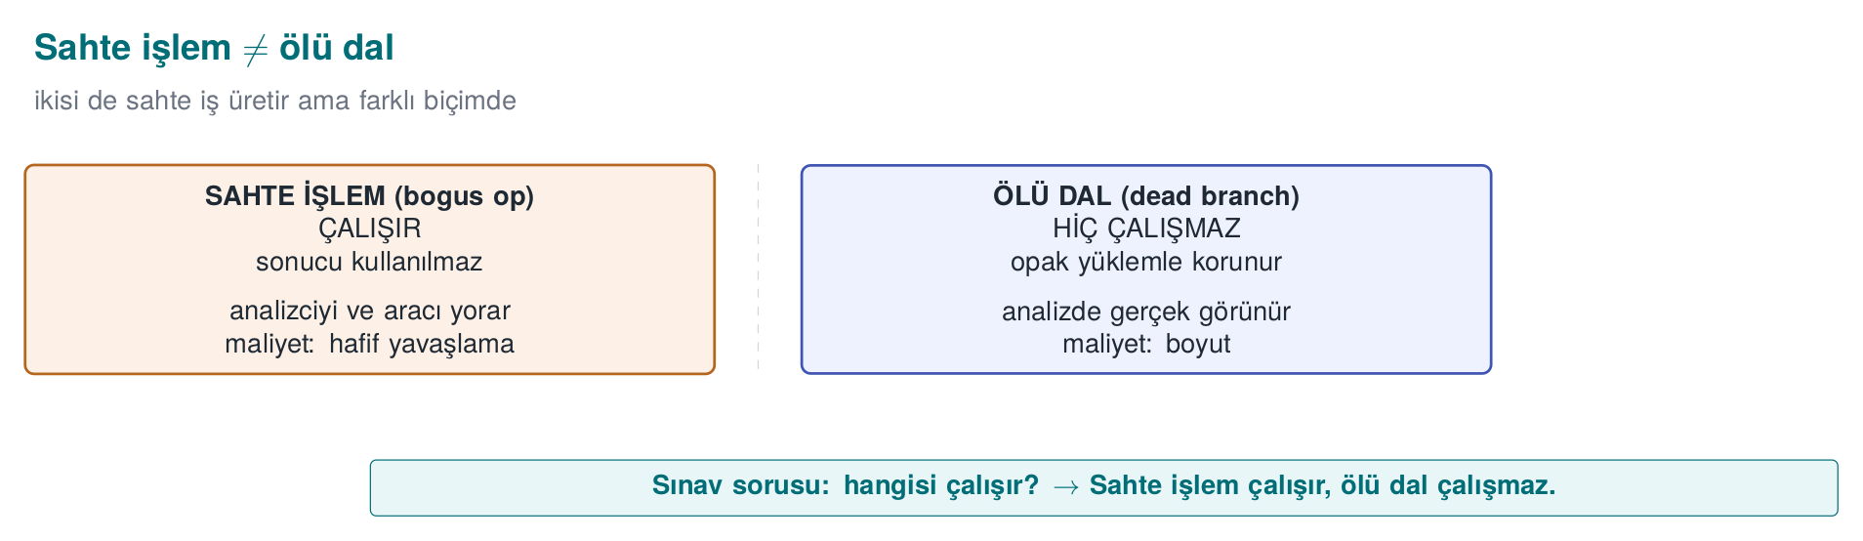
CEN429 Secure Programming · Week 9
Bogus Operation ≠ Dead Branch — Diagram
RTEU Computer Engineering · 2026-2027 Fall
70

Slide 71
CEN429 Secure Programming · Week 9
K-03 · The Two Are Different!
The guide makes these separate rules. The difference is critical:
• Bogus operation: runs, does not change the result
• Dead branch: never runs (protected by an opaque predicate)
RTEU Computer Engineering · 2026-2027 Fall
71

Slide 72
CEN429 Secure Programming · Week 9
K-03 · Comparison
 | Bogus operation | Dead branch
Does it run? | Yes | No
Result | Unchanged | (does not run)
Purpose | Hide the real thing in a crowd | Show a fake path
RTEU Computer Engineering · 2026-2027 Fall
72

Slide 73
CEN429 Secure Programming · Week 9
K-03 · Bogus Operation Example
crc = crc32_update(crc, data, n);
crc ^= (constant ^ constant); /* = crc; result unchanged */
constant ^ constant == 0 → the CRC does not change, but the code gets more crowded.
RTEU Computer Engineering · 2026-2027 Fall
73

Slide 74
CEN429 Secure Programming · Week 9
K-03 · Dead Branch Example
if (opaque_false()) { /* always false */
fake_check(); /* never runs */
}
The analyst treats this block as "real" and examines it; they waste time.
RTEU Computer Engineering · 2026-2027 Fall
74

Slide 75
CEN429 Secure Programming · Week 9
K-03 · Cost and Limit
• Cost: low (bogus operation) → medium (dead branches grow the CFG)
• Limit: dead code elimination drops the branch once the opaque predicate protecting it is solved
• Dependency: depends on the opaque predicate's quality
• Measurement: time needed to tell dead branches apart from real ones
RTEU Computer Engineering · 2026-2027 Fall
75

Slide 76
CEN429 Secure Programming · Week 9
K-04 · Control-Flow Flattening
RTEU Computer Engineering · 2026-2027 Fall
76

Slide 77
CEN429 Secure Programming · Week 9
K-04 · What Does It Protect?
The algorithm's structure:
• The natural adjacency of blocks
• The information "which block leads to which"
RTEU Computer Engineering · 2026-2027 Fall
77

Slide 78
CEN429 Secure Programming · Week 9
K-04 · Idea: Vertical → Horizontal
• Normal: blocks follow one another (vertical flow)
• Flattened: all blocks sit in a single switch dispatcher (horizontal)
• The order can only be read from a state variable
RTEU Computer Engineering · 2026-2027 Fall
78

Slide 79
CEN429 Secure Programming · Week 9
K-04 · Template
int state = START;
for (;;) switch (state) {
case START: state = STEP1; break;
case STEP1: state = condition ? STEP2 : FAIL; break;
case STEP2: state = DONE; break;
case FAIL: return DENIED;
case DONE: return GRANTED;
default: return DENIED; /* random exit (K-05) */
}
RTEU Computer Engineering · 2026-2027 Fall
79

Slide 80
CEN429 Secure Programming · Week 9
K-04 · Weak on Its Own
We said back in week 4: an experienced analyst can solve this template fairly quickly.
Strength comes from reinforcements. In order:
RTEU Computer Engineering · 2026-2027 Fall
80

Slide 81
CEN429 Secure Programming · Week 9
K-04 · Reinforcement 1 — State Values (K-02)
• Scattered, arithmetically produced values instead of case 1, 2, 3
• The sequence is invisible
• Which step follows which cannot be read
RTEU Computer Engineering · 2026-2027 Fall
81

Slide 82
CEN429 Secure Programming · Week 9
K-04 · Reinforcement 2 — Bogus/Dead (K-03)
• Bogus cases are added
• Telling which case is real becomes harder
RTEU Computer Engineering · 2026-2027 Fall
82

Slide 83
CEN429 Secure Programming · Week 9
K-04 · Reinforcement 3 — Random Exit (K-05)
• Errors exit through the default branch with an unpredictable state
• Where the failure happened cannot be read
RTEU Computer Engineering · 2026-2027 Fall
83

Slide 84
CEN429 Secure Programming · Week 9
K-04 · Reinforcement 4 — Opaque Transitions (K-01)
• case transitions depend on opaque conditions, not fixed values
• Static tracing becomes even harder
RTEU Computer Engineering · 2026-2027 Fall
84

Slide 85
CEN429 Secure Programming · Week 9
K-04 · Cost and Limit
• Cost: medium–high (block/branch count grows a lot, performance drops)
• Limit: flattening alone → can be undone with symbolic execution (section 5)
• Strength: comes from the reinforcements
• Measurement: CFG node/edge count, tracing time
RTEU Computer Engineering · 2026-2027 Fall
85

Slide 86
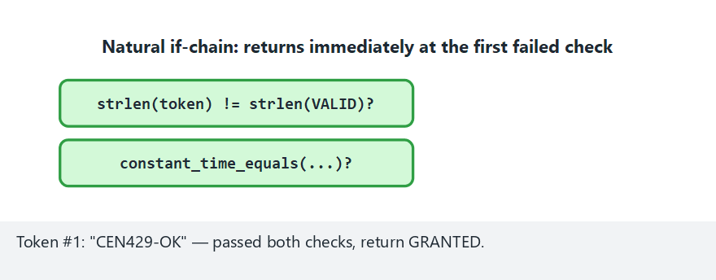
CEN429 Secure Programming · Week 9
Animation · Control-Flow Flattening
RTEU Computer Engineering · 2026-2027 Fall
86
Notes:
Speaker note: run clean.c's natural if-chain against obfuscated.c's switch dispatcher side by side, same tokens.

Slide 87
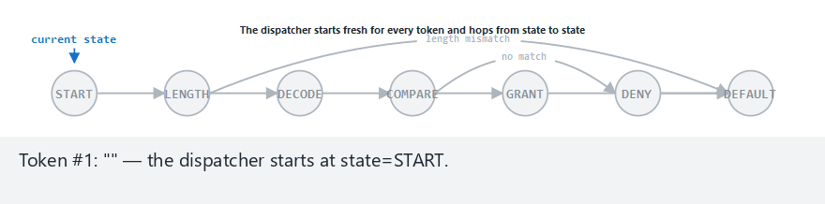
CEN429 Secure Programming · Week 9
Animation · Flattening — Edge Case (shortest path)
RTEU Computer Engineering · 2026-2027 Fall
87
Notes:
Speaker note: all wrong length — the dispatcher never reaches DECODE/COMPARE, falling to default by the shortest path.

Slide 88
CEN429 Secure Programming · Week 9
K-05 · Random Exit
RTEU Computer Engineering · 2026-2027 Fall
88

Slide 89
CEN429 Secure Programming · Week 9
K-05 · What Does It Protect?
Where a check fails.
The attacker typically:
• Finds the "failure branch"
• Turns it into the "success branch"
RTEU Computer Engineering · 2026-2027 Fall
89

Slide 90
CEN429 Secure Programming · Week 9
K-05 · How?
if (!signature_valid(p)) {
state = unpredictable_value(); /* not defined in the switch → default */
break;
}
There is no direct return DENIED; the state goes to an unpredictable value.
RTEU Computer Engineering · 2026-2027 Fall
90

Slide 91
CEN429 Secure Programming · Week 9
K-05 · Success Should Exit the Same Way Too
• A successful exit uses the same method too
• So success and failure look alike in the flow
• The analyst cannot say "this is the accept branch"
RTEU Computer Engineering · 2026-2027 Fall
91

Slide 92
CEN429 Secure Programming · Week 9
K-05 · Cost and Limit
• Cost: low
• Limit: not meaningful on its own, only together with flattening
• Goal: a single-byte patch should not be enough to bypass the check
• Measurement: time needed for a "find and flip the failure branch" attack
RTEU Computer Engineering · 2026-2027 Fall
92

Slide 93
CEN429 Secure Programming · Week 9
K-06 · Call and Dependency Hiding
RTEU Computer Engineering · 2026-2027 Fall
93

Slide 94
CEN429 Secure Programming · Week 9
K-06 · What Does It Protect?
Hints like: "this function calls memcmp, so it must be doing a comparison."
Standard library calls tell the attacker what you are doing.
RTEU Computer Engineering · 2026-2027 Fall
94

Slide 95
CEN429 Secure Programming · Week 9
K-06 · How?
• Your own constant-time esit_mi instead of memcmp on the critical path
• No recognisable name appears to the linker
• Bogus parameters: add parameters that are never used → the signature becomes misleading
RTEU Computer Engineering · 2026-2027 Fall
95

Slide 96
CEN429 Secure Programming · Week 9
K-06 · ⚠️ Do Not Break Constant-Timeness
When you write your own comparison, make sure it stays constant-time (week 3).
• An early-exit comparison → opens a side channel
• Do not create a new hole while adding a protection
RTEU Computer Engineering · 2026-2027 Fall
96

Slide 97
CEN429 Secure Programming · Week 9
K-06 · Cost and Limit
• Cost: low–medium (your own versions need maintenance)
• Limit: behavioural analysis can still reveal what it does → this is a delay
• Measurement: count of recognisable library calls in the binary
RTEU Computer Engineering · 2026-2027 Fall
97

Slide 98
CEN429 Secure Programming · Week 9
Section 3 — Summary
• K-01 opaque predicate/loop · K-02 arithmetic encoding
• K-03 bogus operation ≠ dead branch
• K-04 flattening (with reinforcements)
• K-05 random exit · K-06 call hiding
None is sufficient on its own; together and measured.
RTEU Computer Engineering · 2026-2027 Fall
98

Slide 99
CEN429 Secure Programming · Week 9
Section 3 — Quick Check
1. What is the difference between a bogus operation and a dead branch?
2. What are the 4 rules that strengthen flattening?
3. Which attack does random exit make harder?
RTEU Computer Engineering · 2026-2027 Fall
99
Notes:
Speaker note: have them answer first, then open.

Slide 100
CEN429 Secure Programming · Week 9
Section 3 — Answers
1. A bogus operation runs but does not change the result; a dead branch, protected by an opaque predicate, never runs at all.
2. Hide the state values (K-02) · bogus/dead blocks (K-03) · random exit (K-05) · opaque predicate transitions (K-01).
3. The "find the failure branch and flip it to success" attack; a single-byte patch is no longer enough.
RTEU Computer Engineering · 2026-2027 Fall
100

Slide 101
CEN429 Secure Programming · Week 9
4. Data and Whole-Program Rules
RTEU Computer Engineering · 2026-2027 Fall
101

Slide 102
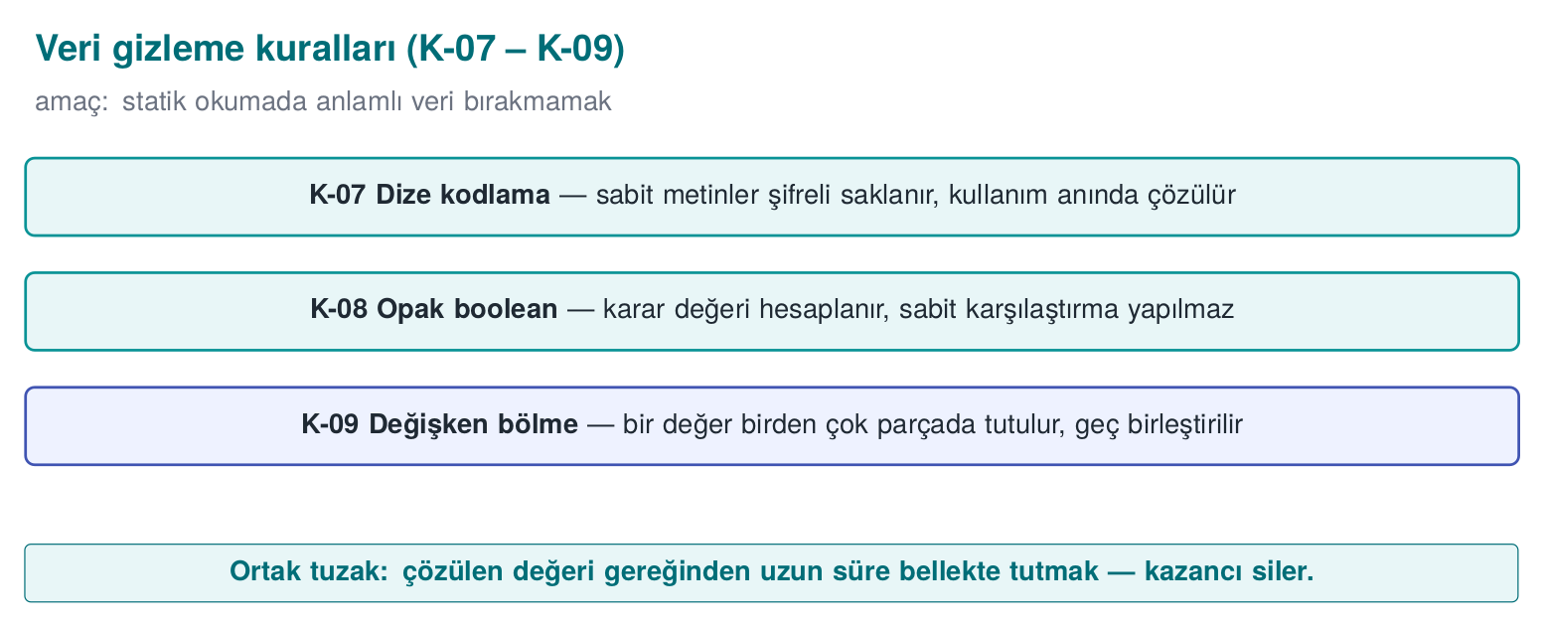
CEN429 Secure Programming · Week 9
Data Obfuscation Rules K-07–K-09 — Diagram
RTEU Computer Engineering · 2026-2027 Fall
102

Slide 103
CEN429 Secure Programming · Week 9
Control Flow ≠ Data
• Control flow (section 3): hides the algorithm's structure
• Data obfuscation (this section): hides the values the program processes
Strings, constants, tables, variables.
RTEU Computer Engineering · 2026-2027 Fall
103

Slide 104
CEN429 Secure Programming · Week 9
K-07 · String Encoding
RTEU Computer Engineering · 2026-2027 Fall
104

Slide 105
CEN429 Secure Programming · Week 9
K-07 · What Does It Protect?
The readable text inside a binary.
The cheapest attack step: strings.
"Lisans gecersiz" or a URL → tells the attacker exactly where to look.
RTEU Computer Engineering · 2026-2027 Fall
105

Slide 106
CEN429 Secure Programming · Week 9
K-07 · Idea
• Sensitive strings are encoded before compilation (e.g., XOR)
• They stay encoded in the binary
• Decoded at the moment of use
• Wiped the instant the job is done
RTEU Computer Engineering · 2026-2027 Fall
106

Slide 107
CEN429 Secure Programming · Week 9
K-07 · Example (Synthetic)
static const uint8_t HIDDEN[] = {0x3B,0x2A,0x2E,0x2E,0x2D};
void use(void) {
char tmp[sizeof HIDDEN];
for (size_t i=0;i<sizeof HIDDEN;i++)
tmp[i] = HIDDEN[i] ^ 0x5A; /* decode */
process(tmp, sizeof HIDDEN);
secure_wipe(tmp, sizeof tmp); /* wipe immediately */
}
RTEU Computer Engineering · 2026-2027 Fall
107

Slide 108
CEN429 Secure Programming · Week 9
K-07 · ⚠️ Critical Limit
• The decoded string is exposed in memory while running
• The decoding key is also in the binary
• This is a static-scan countermeasure
In the field: the decoding key is split and distributed, and the decoding function gets extra checks.
RTEU Computer Engineering · 2026-2027 Fall
108

Slide 109
CEN429 Secure Programming · Week 9
K-07 · String Obfuscation ≠ Key Storage
Again: string obfuscation stops strings, it does not protect a key.
• For the key → whitebox (week 11) or hardware
• Measurement: the sensitive string must not be found in strings output
RTEU Computer Engineering · 2026-2027 Fall
109

Slide 110
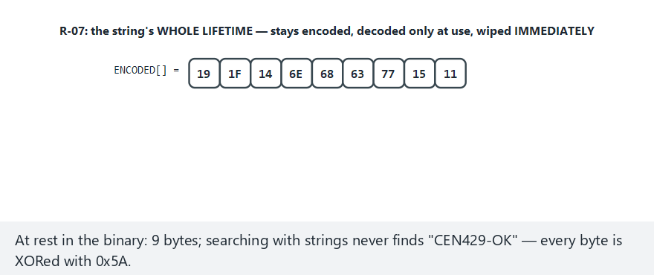
CEN429 Secure Programming · Week 9
Animation · String Encryption
RTEU Computer Engineering · 2026-2027 Fall
110
Notes:
Speaker note: ENCODED[]'s real lifetime -- encoded at rest, decoded, wiped IMMEDIATELY; then show the cycle repeating every call.

Slide 111
CEN429 Secure Programming · Week 9
Animation · String Encryption — Edge Case (never valid)
RTEU Computer Engineering · 2026-2027 Fall
111
Notes:
Speaker note: none of the 10 tokens are valid — the decode+wipe cycle still runs identically every single time; confirm it live.

Slide 112
CEN429 Secure Programming · Week 9
K-08 · Opaque Boolean
RTEU Computer Engineering · 2026-2027 Fall
112

Slide 113
CEN429 Secure Programming · Week 9
K-08 · Problem: Plain 0/1 Is Dangerous
Returning a check's result as a plain 0/1:
• The attacker flips a single byte
• "Failure" becomes "success"
RTEU Computer Engineering · 2026-2027 Fall
113

Slide 114
CEN429 Secure Programming · Week 9
K-08 · Idea
Tie the true/false value to:
• Multiple values
• In a way a single-byte patch cannot flip
Functions return an opaque return code instead of a plain boolean.
RTEU Computer Engineering · 2026-2027 Fall
114

Slide 115
CEN429 Secure Programming · Week 9
K-08 · Example (Concept)
typedef struct { uint32_t a, b; } Decision;
static Decision allow(void) {
return (Decision){ 0xA3C1u, 0x5C3Eu }; /* a ^ b == 0xFFFF */
}
static int decision_grants(Decision k) {
return (k.a ^ k.b) == 0xFFFFu;
}
The calling side verifies both fields.
RTEU Computer Engineering · 2026-2027 Fall
115

Slide 116
CEN429 Secure Programming · Week 9
K-08 · Cost and Limit
• Cost: low
• Limit: solvable with enough scrutiny
• Goal: block a single-byte patch and crude branch-flipping
• Measurement: independent points > 1 needed to flip the result
RTEU Computer Engineering · 2026-2027 Fall
116

Slide 117
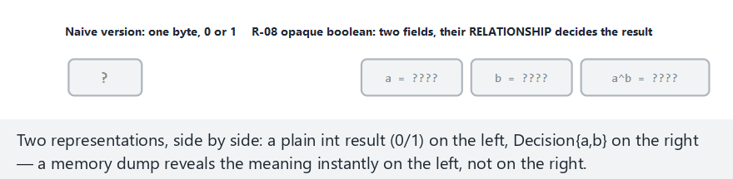
CEN429 Secure Programming · Week 9
Animation · Data Encoding (Opaque Boolean)
RTEU Computer Engineering · 2026-2027 Fall
117
Notes:
Speaker note: plain int result (0/1) side by side with Decision{a,b} -- which one gives its meaning away instantly in a memory dump?

Slide 118
CEN429 Secure Programming · Week 9
Animation · Data Encoding — Edge Case (all granted)
RTEU Computer Engineering · 2026-2027 Fall
118
Notes:
Speaker note: all 10 tokens valid -- a^b is 0xFFFF every single time, never anything else.

Slide 119
CEN429 Secure Programming · Week 9
K-09 · Variable Splitting and Restructuring
RTEU Computer Engineering · 2026-2027 Fall
119

Slide 120
CEN429 Secure Programming · Week 9
K-09 · What Does It Protect?
The recognisable footprint of a sensitive variable in memory.
Patterns like "a 32-byte block = an AES key" point the attacker straight at it.
RTEU Computer Engineering · 2026-2027 Fall
120

Slide 121
CEN429 Secure Programming · Week 9
K-09 · How?
• Split a variable (produce a 32-bit value from two 16-bit shares)
• Merge several variables into a single word
• Rearrange arrays
• Change buffer size/order/layout
• Fill with random values after use
RTEU Computer Engineering · 2026-2027 Fall
121

Slide 122
CEN429 Secure Programming · Week 9
K-09 · Cost and Limit
• Cost: low–medium
• Limit: only slows down static/pattern analysis
• Measurement: time needed to recognise the sensitive buffer from the pattern
RTEU Computer Engineering · 2026-2027 Fall
122

Slide 123
CEN429 Secure Programming · Week 9
Whole-Program Rules: K-10, K-11, K-12
RTEU Computer Engineering · 2026-2027 Fall
123

Slide 124
CEN429 Secure Programming · Week 9
K-10 · Virtualisation (Concept)
What does it protect? A function's machine code.
How? The function → a custom VM's bytecode; the bytecode and a small interpreter are embedded in the binary.
The attacker does not see familiar code — they see a custom instruction set they must first solve.
RTEU Computer Engineering · 2026-2027 Fall
124

Slide 125
CEN429 Secure Programming · Week 9
K-10 · Cost and Limit
• Cost: high (interpreted code is slow; maintenance is expensive)
• Use: only the most critical, small, rarely-changing functions
• Limit: once the VM is solved once, everything it protects opens up; if not diversified, every copy is identical
• Week 14: Tigress Virtualize
RTEU Computer Engineering · 2026-2027 Fall
125

Slide 126
CEN429 Secure Programming · Week 9
K-11 · Compiler-Based (O-LLVM)
What does it protect? The rules above, applied through a compiler pass, not by hand.
• LLVM-based obfuscators: flattening, bogus control flow, instruction-substitution passes
• The source stays readable; protection is a compile option
• A different seed per build → easy diversification
RTEU Computer Engineering · 2026-2027 Fall
126

Slide 127
CEN429 Secure Programming · Week 9
K-11 · Cost and Limit
• Cost: medium (depends on the passes selected)
• Limit: known pass patterns are recognisable; stay current with the tool's version
• Measurement: the difference between binaries produced with different seeds
RTEU Computer Engineering · 2026-2027 Fall
127

Slide 128
CEN429 Secure Programming · Week 9
K-12 · Dynamic Encryption (Concept)
What does it protect? The most sensitive code sections, by keeping them encrypted in the binary.
How? The section stays encrypted → decoded only right when it is about to run → then re-encrypted/wiped.
RTEU Computer Engineering · 2026-2027 Fall
128

Slide 129
CEN429 Secure Programming · Week 9
K-12 · ⚠️ Risk
• Directly conflicts with OS memory protections (DEP/NX, W^X)
• Done wrong, it both crashes and opens a new hole
• The code sits exposed in memory for a moment while running → a memory dump can catch it
RTEU Computer Engineering · 2026-2027 Fall
129

Slide 130
CEN429 Secure Programming · Week 9
K-12 · Rule
If adding one protection turns off another, measure the net gain and record the trade-off.
In practice it is used very selectively, on small sections.
RTEU Computer Engineering · 2026-2027 Fall
130

Slide 131
CEN429 Secure Programming · Week 9
The Java/Managed Side (from Week 5)
• This week's rules are for native (C/C++)
• The managed-language equivalent: ProGuard/R8 name obfuscation + dead code elimination + shrinking
• APIs reached via -keep and reflection
RTEU Computer Engineering · 2026-2027 Fall
131

Slide 132
CEN429 Secure Programming · Week 9
The Two Sides Work Together
• The Java side is obfuscated with R8
• The native side, with this week's rules
• Cross-check: native verifies Java's integrity, Java verifies native's (week 6, RASP)
RTEU Computer Engineering · 2026-2027 Fall
132

Slide 133
CEN429 Secure Programming · Week 9
Section 4 — Summary
• K-07 string encoding · K-08 opaque boolean · K-09 variable splitting
• K-10 virtualisation (expensive) · K-11 compiler-based (O-LLVM) · K-12 dynamic (risky)
Data obfuscation complements control-flow obfuscation.
RTEU Computer Engineering · 2026-2027 Fall
133

Slide 134
CEN429 Secure Programming · Week 9
Section 4 — Quick Check
1. Does string obfuscation protect the key?
2. Why does an opaque boolean make a single-byte patch harder?
3. What are virtualisation's two biggest costs?
RTEU Computer Engineering · 2026-2027 Fall
134
Notes:
Speaker note: have them answer first, then open; then move to section 5.

Slide 135
CEN429 Secure Programming · Week 9
Section 4 — Answers
1. No. The decoded string is exposed in memory; the decoding key is inside; it only stops static (strings) scanning.
2. The result depends on multiple values; flipping it requires changing >1 independent points.
3. High performance cost (tens of times slower) and high maintenance cost; that is why it is used only on small/critical functions.
RTEU Computer Engineering · 2026-2027 Fall
135

Slide 136
CEN429 Secure Programming · Week 9
5. Diversification and Measurement
RTEU Computer Engineering · 2026-2027 Fall
136

Slide 137
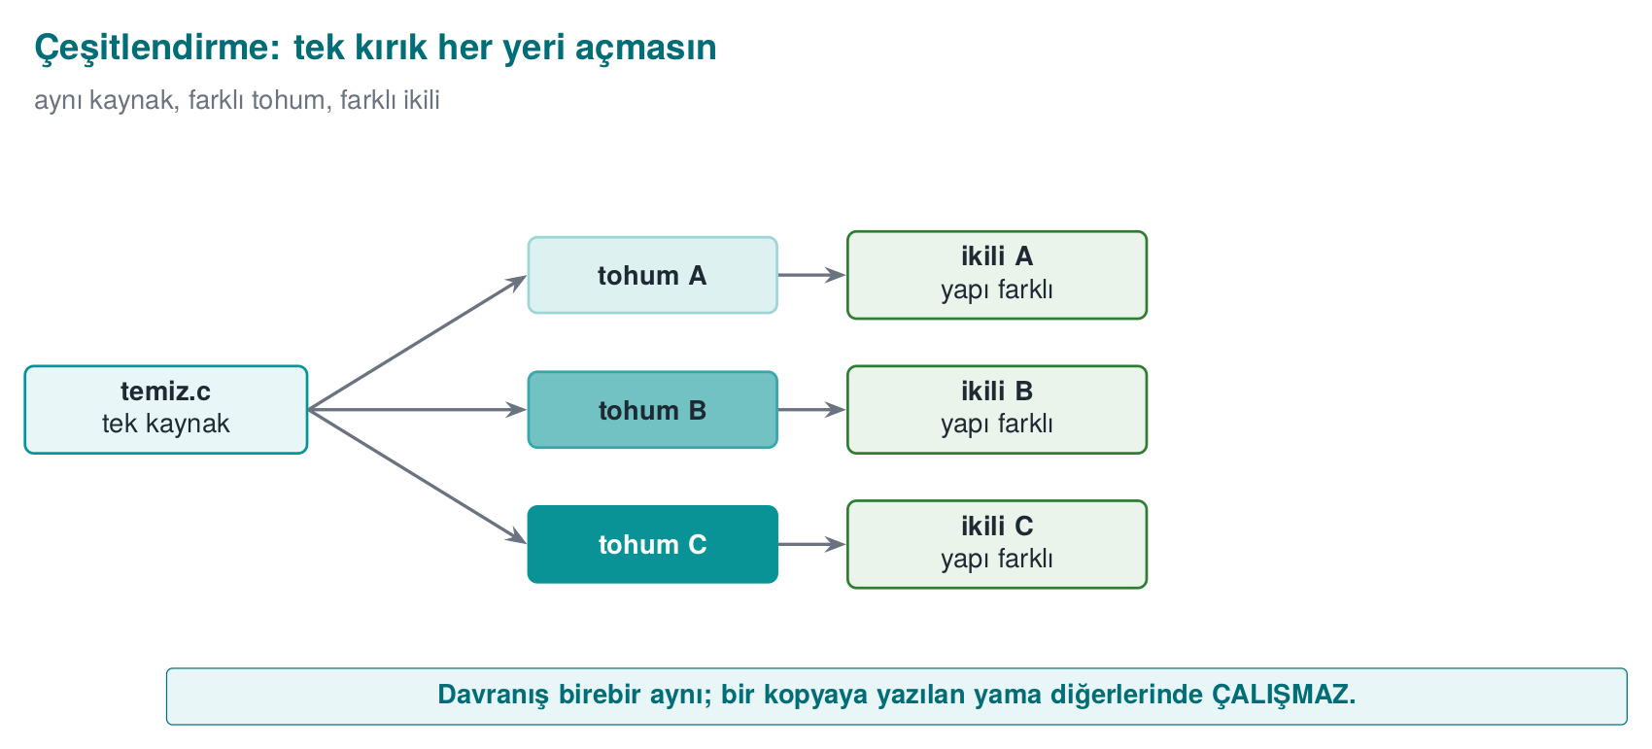
CEN429 Secure Programming · Week 9
Diversification — Diagram
RTEU Computer Engineering · 2026-2027 Fall
137

Slide 138
CEN429 Secure Programming · Week 9
Diversification: Recall Rule 2
An attack that works on one copy should not work on every copy.
If the attacker can crack one copy and distribute the patch/script to everyone, one crack opens every door.
RTEU Computer Engineering · 2026-2027 Fall
138

Slide 139
CEN429 Secure Programming · Week 9
Origin: an Idea Borrowed from Biology
• 1993 — Fred Cohen, "Operating System Protection Through Program Evolution": software that changes the
system over time → the root of diversification in time
• 1997 — Forrest, Somayaji, Ackley, "Building Diverse Computer Systems" (HotOS): randomizing without changing
behaviour (e.g., stack-frame size) can disrupt even a buffer overflow → the root of diversification in space
In nature, diversity keeps a disease from killing an entire species, only the individuals without resistance; in software the same idea keeps one crack from opening every copy.
RTEU Computer Engineering · 2026-2027 Fall
139
Notes:
Speaker note: both papers are 30+ years old; Tigress's --Seed compresses this idea into a single flag (week 14).

Slide 140
CEN429 Secure Programming · Week 9
What Is Diversification?
Producing binaries from the same source that are behaviourally equivalent, structurally different.
Opaque predicates, bogus blocks, state values change from copy to copy.
RTEU Computer Engineering · 2026-2027 Fall
140

Slide 141
CEN429 Secure Programming · Week 9
Two Kinds of Diversification
• In space: every build/distribution gets a different seed
  – An attack written for one copy does not work on another
• In time: every release gets a new arrangement
  – An attack written for the old release breaks in the new one
Works together with key/version renewal (week 10).
RTEU Computer Engineering · 2026-2027 Fall
141

Slide 142
CEN429 Secure Programming · Week 9
What Does Diversification Prevent?
• It does not raise obfuscation's potency (a single copy can still be cracked)
• But it prevents scaling
Week 14: with tooling, via Tigress --Seed, RandomFuns.
RTEU Computer Engineering · 2026-2027 Fall
142

Slide 143
CEN429 Secure Programming · Week 9
Diversification Effectiveness: a Simple Metric
• Compile the same source with two different seeds
• Measure the byte difference of the protected functions
• The higher the difference, the lower the odds that an attack on one works on the other
Write this metric into S9.
RTEU Computer Engineering · 2026-2027 Fall
143

Slide 144
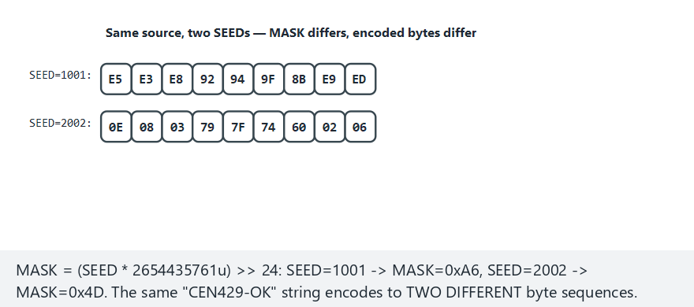
CEN429 Secure Programming · Week 9
Animation · Diversification
RTEU Computer Engineering · 2026-2027 Fall
144
Notes:
Speaker note: SEED=1001 vs SEED=2002 -- MASK/ENCODED differ, but GRANTED/DENIED agrees across 10 tokens; show it live.

Slide 145
CEN429 Secure Programming · Week 9
Animation · Diversification — Edge Case (length never matches)
RTEU Computer Engineering · 2026-2027 Fall
145
Notes:
Speaker note: both seeds reject instantly by the shortest path -- agreement holds on every path, not just the full one.

Slide 146
CEN429 Secure Programming · Week 9
Measuring Obfuscation
RTEU Computer Engineering · 2026-2027 Fall
146

Slide 147
CEN429 Secure Programming · Week 9
Why Measure?
To defend a protection decision.
Collberg's framework: four dimensions.
These four are the foundation of week 13's attack potential scoring.
RTEU Computer Engineering · 2026-2027 Fall
147

Slide 148
CEN429 Secure Programming · Week 9
Metric 1 — Potency
Question: how incomprehensible is it to a human?
How: complexity metrics — CFG node/edge count, cyclomatic complexity, nesting depth (before/after).
RTEU Computer Engineering · 2026-2027 Fall
148

Slide 149
CEN429 Secure Programming · Week 9
Metric 2 — Resilience
Question: how much does it withstand an automated tool?
How: how long/successfully a deobfuscation tool (symbolic execution, a simplifier) takes to undo the protection.
RTEU Computer Engineering · 2026-2027 Fall
149

Slide 150
CEN429 Secure Programming · Week 9
Metric 3 — Stealth
Question: does the obfuscation give itself away?
How: is obfuscated code statistically distinguishable from normal code?
If it is distinguishable, the attacker knows where to look.
RTEU Computer Engineering · 2026-2027 Fall
150

Slide 151
CEN429 Secure Programming · Week 9
Metric 4 — Cost
Question: how much does it cost us?
How: size increase, runtime, memory, maintenance, debugging difficulty.
RTEU Computer Engineering · 2026-2027 Fall
151

Slide 152
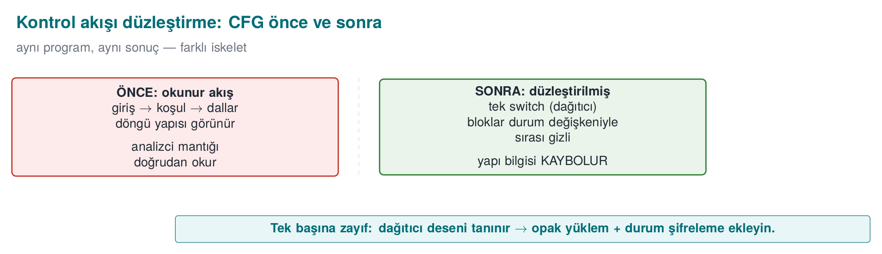
CEN429 Secure Programming · Week 9
Before Flattening (Concept)
Few nodes, readable flow.
RTEU Computer Engineering · 2026-2027 Fall
152

Slide 153
CEN429 Secure Programming · Week 9
After Flattening (Concept)
Many nodes, a single hub; "which block comes next" cannot be read.
RTEU Computer Engineering · 2026-2027 Fall
153

Slide 154
CEN429 Secure Programming · Week 9
Potency Measurement Example
Metric | Before | After
Basic blocks | 5 | 34
Edges | 6 | 60
Cyclomatic complexity | 3 | 28
You take these numbers from the decompiler and write them into S9.
RTEU Computer Engineering · 2026-2027 Fall
154

Slide 155
CEN429 Secure Programming · Week 9
Cost Measurement Example
size ./program_temiz ./program_gizli # boyut
# süre: aynı girdiyle N kez çalıştır, ortalama
Metric | Before | After
Size | 100 KB | 128 KB
Runtime | 1.0× | 1.7×
RTEU Computer Engineering · 2026-2027 Fall
155

Slide 156
CEN429 Secure Programming · Week 9
Interpreting the Measurement
• Potency ↑ (34 blocks) and cost ↑ (28% size, 1.7× time)
• This trade-off is expected
• Decision: is the gain acceptable given the asset's value?
Do not say "strong"; show these numbers.
RTEU Computer Engineering · 2026-2027 Fall
156

Slide 157
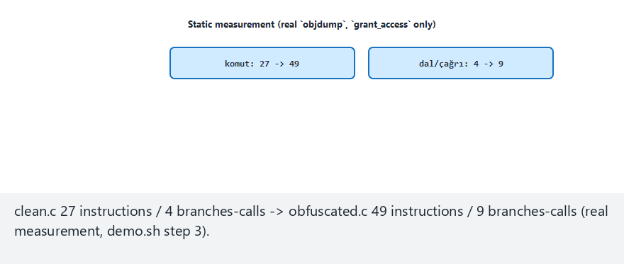
CEN429 Secure Programming · Week 9
Animation · Measuring Obfuscation
RTEU Computer Engineering · 2026-2027 Fall
157
Notes:
Speaker note: show the real 27->49 instruction / 4->9 branch-call numbers, then the dynamic cost (steps per token) live across 10 tokens.

Slide 158
CEN429 Secure Programming · Week 9
Animation · Metrics — Edge Case (most expensive path)
RTEU Computer Engineering · 2026-2027 Fall
158
Notes:
Speaker note: all valid tokens -- the dispatcher takes the longest (6-step) path every time, dynamic cost maxed out.

Slide 159
CEN429 Secure Programming · Week 9
The Four Metrics Trade Off
Raising | Result
Potency ↑ / resilience ↑ | Cost ↑
Complexity ↑ | Stealth ↓ (draws more attention)
Good decision: balance the four against the value of the asset.
RTEU Computer Engineering · 2026-2027 Fall
159

Slide 160
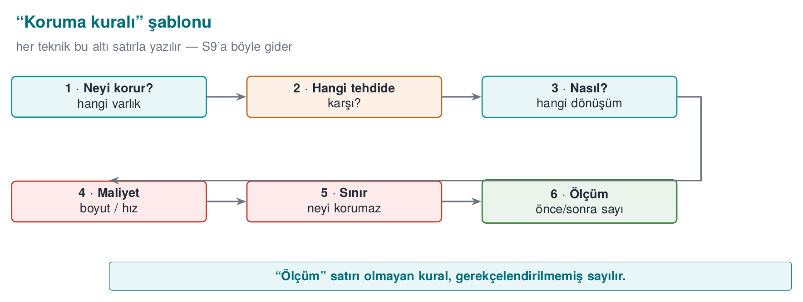
CEN429 Secure Programming · Week 9
Decision Rule (Write into S9)
RTEU Computer Engineering · 2026-2027 Fall
160

Slide 161
CEN429 Secure Programming · Week 9
Deobfuscation and Resilience
RTEU Computer Engineering · 2026-2027 Fall
161

Slide 162
CEN429 Secure Programming · Week 9
Why Should We Know the Other Side's Tools?
To measure resilience correctly.
We learn these to test our own defence — not to attack.
RTEU Computer Engineering · 2026-2027 Fall
162

Slide 163
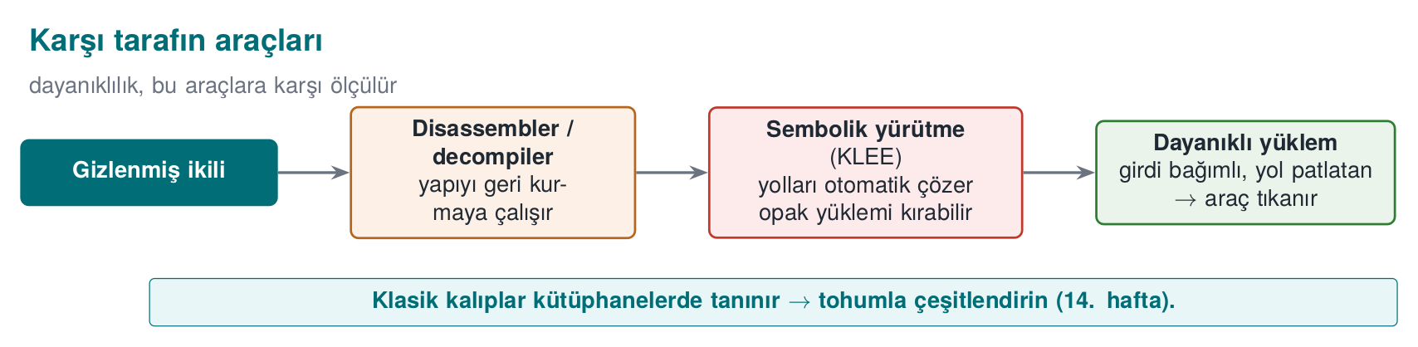
CEN429 Secure Programming · Week 9
The Other Side's Tools — Diagram
RTEU Computer Engineering · 2026-2027 Fall
163

Slide 164
CEN429 Secure Programming · Week 9
Tool 1 — Symbolic Execution (KLEE)
• Program paths are solved as mathematical constraints
• Opaque predicates and flattening can be undone this way
Resilience rule: tie opaque predicates to structures that are expensive to solve (factorization, hashing), grow the state space — but measure the cost.
RTEU Computer Engineering · 2026-2027 Fall
164

Slide 165
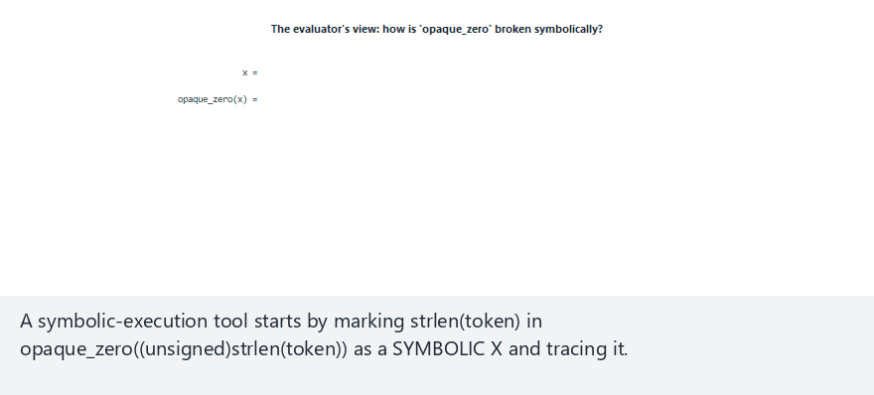
CEN429 Secure Programming · Week 9
Animation · Deobfuscation
RTEU Computer Engineering · 2026-2027 Fall
165
Notes:
Speaker note: constant-fold the real opaque_zero via a periodicity proof (x mod 2); then stress R-04/R-05/R-07 are STILL standing -- resilience != cost.

Slide 166
CEN429 Secure Programming · Week 9
Animation · Deobfuscation — Edge Case (alternating parity)
RTEU Computer Engineering · 2026-2027 Fall
166
Notes:
Speaker note: x=0..9 in order -- shows the period (2) directly, making "just the 2 residue classes are enough" concrete.

Slide 167
CEN429 Secure Programming · Week 9
Tool 2 — MBA Simplifier
• Undoes arithmetic encoding (K-02)
• Countermeasure: also tie encoded constants to opaque predicates — layers that depend on each other are harder to solve separately
Rule: do not count arithmetic encoding as a secrecy layer on its own; combine it with control flow.
RTEU Computer Engineering · 2026-2027 Fall
167

Slide 168
CEN429 Secure Programming · Week 9
Tool 3 — Pattern Recognition
• Recognises known library/pass patterns
Rule: diversify; do not rely on a single opaque predicate pattern or a single VM design.
(in space: several patterns/seeds · in time: change the patterns every release)
RTEU Computer Engineering · 2026-2027 Fall
168

Slide 169
CEN429 Secure Programming · Week 9
Main Takeaway
Banescu et al. (Tigress + KLEE): how much each transform withstands symbolic execution is measured.
Resilience is not a claim, it is a measured quantity.
Do not say "strong"; produce a number: "this transform pipeline did not let this problem, of this size, be solved in this much time, against this tool."
RTEU Computer Engineering · 2026-2027 Fall
169

Slide 170
CEN429 Secure Programming · Week 9
6. Layered Defence, Project, Closing
RTEU Computer Engineering · 2026-2027 Fall
170

Slide 171
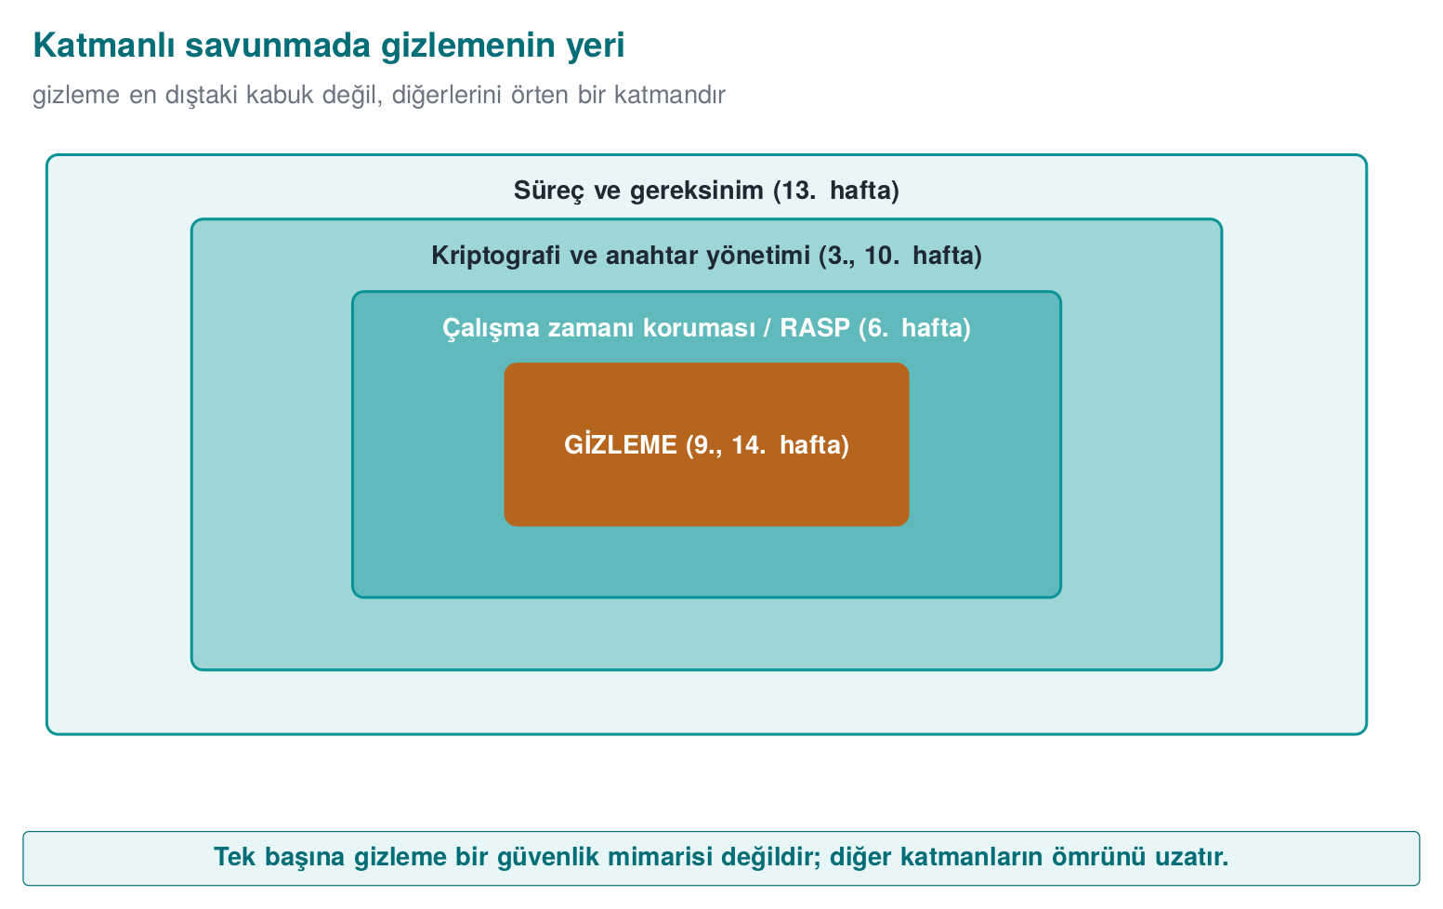
CEN429 Secure Programming · Week 9
Obfuscation in Layered Defence — Diagram
RTEU Computer Engineering · 2026-2027 Fall
171

Slide 172
CEN429 Secure Programming · Week 9
Obfuscation's Place in Layered Defence
Layer | Week | Relationship
Memory safety/secure compilation | 4 | Does not replace it; works together
RASP | 6 | Obfuscation also hides RASP; RASP protects obfuscation while it runs
Whitebox | 11 | The real protection for the key; obfuscation is the shell
Key renewal | 10 | Time "until it is renewed"
Certification | 12–13 | The delay is scored
RTEU Computer Engineering · 2026-2027 Fall
172

Slide 173
CEN429 Secure Programming · Week 9
An Observation from the Field
In a certified product, the native countermeasures cover all of this week's rules.
But the document notes, next to every one of them: "not strong on its own."
What convinces an evaluator: togetherness + diversification + measured delay.
RTEU Computer Engineering · 2026-2027 Fall
173

Slide 174
CEN429 Secure Programming · Week 9
End to End: Layer by Layer Protection
RTEU Computer Engineering · 2026-2027 Fall
174

Slide 175
CEN429 Secure Programming · Week 9
The Goal of This Example
We take a single synthetic check (grant_access) and protect it layer by layer.
At every step: what was added · what we gained · what we paid.
RTEU Computer Engineering · 2026-2027 Fall
175
Notes:
Speaker note: This section combines all the rules in a single example; it can be done live on the board.

Slide 176
CEN429 Secure Programming · Week 9
Step 0 · Unprotected Start
int grant_access(const char *token) {
if (token_valid(token))
return GRANTED; /* single branch, single return */
return DENIED;
}
Weakness: a single branch, strings, bypassed with a single-byte patch.
RTEU Computer Engineering · 2026-2027 Fall
176

Slide 177
CEN429 Secure Programming · Week 9
Step 0 · What Does the Attacker Do?
• strings → GRANTED/DENIED and the related strings
• Decompile → a single if, two returns
• Flip the failure branch to success (a single byte)
Time: minutes. Skill: low.
RTEU Computer Engineering · 2026-2027 Fall
177

Slide 178
CEN429 Secure Programming · Week 9
Step 1 · K-07 Encode the String/Constant
/* GRANTED/DENIED and strings no longer appear in plain text */
static int grant_code(void){ return 0x9E ^ 0x9F; } /* =1 */
• Gain: strings does not find the sensitive text
• Cost: very low
RTEU Computer Engineering · 2026-2027 Fall
178

Slide 179
CEN429 Secure Programming · Week 9
Step 1 · Measurement
Metric | Step 0 | Step 1
Sensitive strings in strings | 3 | 0
Binary size | baseline | +0.5%
The first layer is the cheapest and gives the highest return.
RTEU Computer Engineering · 2026-2027 Fall
179

Slide 180
CEN429 Secure Programming · Week 9
Step 2 · K-02 Arithmetic Encoding
/* comparison turns into a complex but equivalent expression */
int threshold = ((a ^ b) + 2*(a & b)); /* = a + b */
• Gain: the constant/computation is not directly readable
• Cost: low
RTEU Computer Engineering · 2026-2027 Fall
180

Slide 181
CEN429 Secure Programming · Week 9
Step 3 · K-04 Flatten
int state = START;
for(;;) switch(state){
case START: state = check()?STEP:FAIL; break;
case STEP: state = DONE; break;
case FAIL: return DENIED;
case DONE: return GRANTED;
}
No single if anymore; the order lives in the state variable.
RTEU Computer Engineering · 2026-2027 Fall
181

Slide 182
CEN429 Secure Programming · Week 9
Step 3 · What Changed?
• The CFG is now "horizontal" — the blocks sit in one switch
• Which branch means "success" cannot be read directly
• Cost: medium (more blocks/branches, a bit slower)
RTEU Computer Engineering · 2026-2027 Fall
182

Slide 183
CEN429 Secure Programming · Week 9
Step 4 · K-05 Random Exit
if (!check()) { state = unpredictable_value(); break; } /* →default */
• Where the error was caught cannot be read from the flow
• A single-byte patch is no longer enough
RTEU Computer Engineering · 2026-2027 Fall
183

Slide 184
CEN429 Secure Programming · Week 9
Step 5 · K-03 Bogus + Dead
crc ^= (s ^ s); /* bogus operation: result unchanged */
if (opaque_false()) fake(); /* dead branch: never runs */
• The real logic sits in a crowd
• Cost: medium
RTEU Computer Engineering · 2026-2027 Fall
184

Slide 185
CEN429 Secure Programming · Week 9
Step 6 · K-08 Opaque Boolean
Decision k = allow(); /* a^b==0xFFFF */
if (decision_grants(k)) apply();
• The result is not a plain 0/1 → a single byte cannot flip it
• Flipping it requires multiple points
RTEU Computer Engineering · 2026-2027 Fall
185

Slide 186
CEN429 Secure Programming · Week 9
The Cumulative Effect of the Layers
Step | Rule | Attack time (relative) | Cost
0 | — | 1× | —
1 | K-07 | 2× | very low
2 | K-02 | 3× | low
3 | K-04 | 8× | medium
4–6 | K-05/03/08 | 20×+ | medium
(Relative, for illustration; real values are measured.)
RTEU Computer Engineering · 2026-2027 Fall
186

Slide 187
CEN429 Secure Programming · Week 9
Step 7 · K-10 Virtualisation?
• Only for the most critical function
• Cost: high (tens of times slower)
• Unnecessary for most checks
Rule: do not go this far if the value is low.
RTEU Computer Engineering · 2026-2027 Fall
187

Slide 188
CEN429 Secure Programming · Week 9
End to End: Takeaway
• Every layer made the attack a little more expensive
• Every layer added a cost
• Where you stop depends on the asset's value and on what you measured
This table is exactly the protection table you will put into S9.
RTEU Computer Engineering · 2026-2027 Fall
188

Slide 189
CEN429 Secure Programming · Week 9
Project · S9 (Advanced Hardening) — 1
1. Protection table
For 2–3 critical sections (license, key derivation, integrity), fill in the rule template:
what it protects · threat · how · cost · limit · measurement
RTEU Computer Engineering · 2026-2027 Fall
189

Slide 190
CEN429 Secure Programming · Week 9
Project · S9 — 2
2. Measurement
For at least one technique, before/after:
• Count of sensitive strings in strings output
• CFG node count
• Binary size, the duration of an operation
RTEU Computer Engineering · 2026-2027 Fall
190

Slide 191
CEN429 Secure Programming · Week 9
Project · S9 — 3, 4
3. Diversification decision: yes/no + justification
4. Limit and remaining risk: what does each protection not protect?
"This string obfuscation does not protect the key; for the key see S8 whitebox/hardware."
Later: S15 (week 14, putting obfuscation into the build pipeline) · S16 (week 12, testing that behaviour is unchanged).
RTEU Computer Engineering · 2026-2027 Fall
191

Slide 192
CEN429 Secure Programming · Week 9
Through an Evaluator's Eyes
What S9 is graded on is not "I used a lot of techniques."
It is graded on: the justification and measurement of every technique.
An unmeasured protection = a claim. Not evidence.
RTEU Computer Engineering · 2026-2027 Fall
192

Slide 193
CEN429 Secure Programming · Week 9
Self-Check (1–6)
1. What is MATE? Why does it leave cryptography insufficient on its own?
2. "Makes it expensive" — give an asset-value example?
3. Bogus operation ≠ dead branch?
4. Why is flattening weak on its own? Name 3 reinforcements?
5. Which attack does random exit make harder?
6. Does string obfuscation protect the key?
RTEU Computer Engineering · 2026-2027 Fall
193

Slide 194
CEN429 Secure Programming · Week 9
Self-Check — Answers (1–6)
1. MATE = Man-At-The-End: the attacker fully possesses the device (memory, debugger, key). Crypto assumes a secure endpoint; under MATE the key is exposed while running → crypto alone is not enough.
2. Obfuscation does not mean unbreakable; it demands more time/skill/tools for the attack. If breaking 100 TL worth of content requires 10,000 TL of effort, the attacker gives up.
3. A bogus operation runs but its result is not used (it tires the analyst out); a dead branch, protected by an opaque predicate, never runs.
4. In flattening, the dispatcher pattern is recognisable and the state variable can be tracked. Reinforcements: opaque predicate · encrypting the state variable · bogus states/blocks + random exit.
5. It makes pattern-matching and automated-script attacks (expecting the same pattern for the same input) and symbolic execution harder.
6. No. String/table obfuscation makes static strings scanning harder, but the key is exposed in memory while running → whitebox/HSM is required.
RTEU Computer Engineering · 2026-2027 Fall
194

Slide 195
CEN429 Secure Programming · Week 9
Self-Check (7–12)
1. What are virtualisation's two costs?
2. Which OS protection does self-modifying code conflict with?
3. The four metrics; which ones trade off?
4. Does diversification prevent potency or scaling?
5. Which rules does KLEE break? How is resilience increased?
6. Fill in the rule template for a section.
RTEU Computer Engineering · 2026-2027 Fall
195

Slide 196
CEN429 Secure Programming · Week 9
Self-Check — Answers (7–12)
1. A large performance penalty (the interpreter is slow) + a size increase (VM + bytecode); maintenance/debugging difficulty.
2. W^X / DEP-NX (writable-and-executable memory is forbidden); writing to a code page needs mprotect/VirtualProtect, which is blocked or suspicious.
3. Potency · resilience · stealth · cost. Potency/resilience ↑ → cost ↑ and stealth ↓ (looks abnormal). Main trade-off: resilience ↔ cost.
4. It prevents scaling — it does not raise a single copy's strength; a crack does not spread to every copy (it breaks reuse of the attack).
5. KLEE is symbolic execution; it can solve opaque predicates/flattening. Rule: make predicates resistant to symbolic execution (input-dependent, hard to solve); path-exploding structures raise resilience.
6. Example: Rule [flattening] → Goal [hide the flow] → How [Tigress Flatten + opaque predicate] → Measurement [size +X%, speed −Y%, instructions N→M]. The measurement line is required.
RTEU Computer Engineering · 2026-2027 Fall
196

Slide 197
CEN429 Secure Programming · Week 9
Glossary (1)
Term | Meaning
MATE / white box | An attacker who possesses the program
Opaque predicate | A condition whose value the programmer knows, that the tool struggles to resolve
Flattening | Moving the flow into a single switch
Bogus operation | Code that runs but does not change the result
Dead branch | A branch (protected by an opaque predicate) that never runs
RTEU Computer Engineering · 2026-2027 Fall
197

Slide 198
CEN429 Secure Programming · Week 9
Glossary (2)
Term | Meaning
Opaque boolean | A true/false value that cannot be flipped with a single byte
Virtualisation | Turning a function into custom VM bytecode
Diversification | Structurally different copies from the same source
Potency/resilience/stealth/cost | The obfuscation metrics
RTEU Computer Engineering · 2026-2027 Fall
198

Slide 199
CEN429 Secure Programming · Week 9
Sources
• Cookbook (Viega & Messier) Chapter 12 — anti-tampering
• Secure programming technical guide — native countermeasures
• Collberg & Nagra, Surreptitious Software — taxonomy, measurement
• Schrittwieser et al. (ACM CSUR 2016) — overview, deobfuscation
• Banescu et al. — Tigress + KLEE resilience measurement
• Obfuscator-LLVM — compiler-based
RTEU Computer Engineering · 2026-2027 Fall
199

Slide 200
CEN429 Secure Programming · Week 9
Next Week
Week 10 — Certificates and Cryptographic Methods
We said "obfuscation does not protect the key" this week; week 10 covers choosing keys correctly, their lifecycle, and protecting them with PKI. Rule (this week) → whitebox (week 11) → automation (week 14): these three weeks form one whole.
RTEU Computer Engineering · 2026-2027 Fall
200

