Slide 1

CEN429 Secure Programming · Week 1
Introduction to Secure Programming and the Application Protection Plan
CEN429 Secure Programming — Week 1
Asst. Prof. Dr. Uğur CORUH · 18.09.2026
RTEU Computer Engineering · 2026-2027 Fall
Notes:
Speaker note: Introduce yourself and the course. This course is about "learning defence by seeing the attack." There will be working demos every week.

Slide 2
CEN429 Secure Programming · Week 1
Today's plan (3 hours)
Hour | Topic
1 | Course introduction · What is security? · The attacker · Principles · Overview of application protection
2 | Protection plan · STRIDE and risk score · Attack tree · Worked example "Vault" · Class exercise
3 | Demo 1–2 · Secure start-up · Overflows · Demo 3–4 · Memory management · Partitioning · Secure process · Project
Learning outcomes: LO.1 (identifies and classifies vulnerabilities) · LO.5 (produces a software plan using secure design principles)
RTEU Computer Engineering · 2026-2027 Fall
2
Notes:
Speaker note: Build the demos once beforehand (Windows: `.\build.ps1` inside code, WSL: `./build.sh`), so there's no waiting in class. Show students that both environments give the same result; in Visual Studio, Open Folder on the `code` folder is enough.

Slide 3
CEN429 Secure Programming · Week 1
How We're Starting This Course
• This is the course's first week; we don't build on a previous week.
• Assumed prior knowledge: functions, arrays, and pointers in C; cd and ls in a terminal (PowerShell or Linux).
• The "This Week's Concepts" table below does not define this week's terms one by one — it shows which section teaches each one.
• The pattern we'll follow all term: buggy code → attack → fix.
RTEU Computer Engineering · 2026-2027 Fall
3

Slide 4
CEN429 Secure Programming · Week 1
This Week's Concepts
Each term is defined once, where it first appears in the body; here we only mark where.
Concept | Where
Security | Section 1
Asset | Section 1
Threat and vulnerability | Section 1
The CIA triad | Section 1
Attacker model | Section 1
White-box / MATE | Section 1
Secure design principles | Section 1
Defence in depth | Section 2
Trade-off | Section 2
Threat modelling | Section 3
STRIDE | Section 3
Attack tree | Section 3
Data flow diagram (DFD) | Section 3
RTEU Computer Engineering · 2026-2027 Fall
4

Slide 5
CEN429 Secure Programming · Week 1
How the Demos Work
• One source, two/three environments: Windows (Visual Studio 2022 Community or PowerShell), WSL, and Linux
• Build: Windows .build.ps1 · WSL/Linux ./build.sh — build once before class
• Run: Windows .demo.ps1 · WSL/Linux sh demo.sh
• Visual Studio: File > Open > Folder → code → configuration Windows (MSVC) → Build > Build All
• 4 demos this week, under code/week-01
⚠️ Ethics: Every demo runs only inside its own folder and asks for no administrator rights. Only try these techniques on your own computer.
RTEU Computer Engineering · 2026-2027 Fall
5

Slide 6
CEN429 Secure Programming · Week 1
A short history — the idea of secure programming
• 1975 — Saltzer & Schroeder: the 8 principles of secure design (least privilege, defence in depth…)
• 1970s–80s — the CIA triad becomes a common language
• 1998–99 — STRIDE at Microsoft; Schneier introduces attack trees
• 2001–03 — Building Secure Software and the Secure Programming Cookbook (the course's main source)
Today's tools (CIA · attacker model · STRIDE · attack tree) are products of this lineage.
RTEU Computer Engineering · 2026-2027 Fall
6

Slide 7
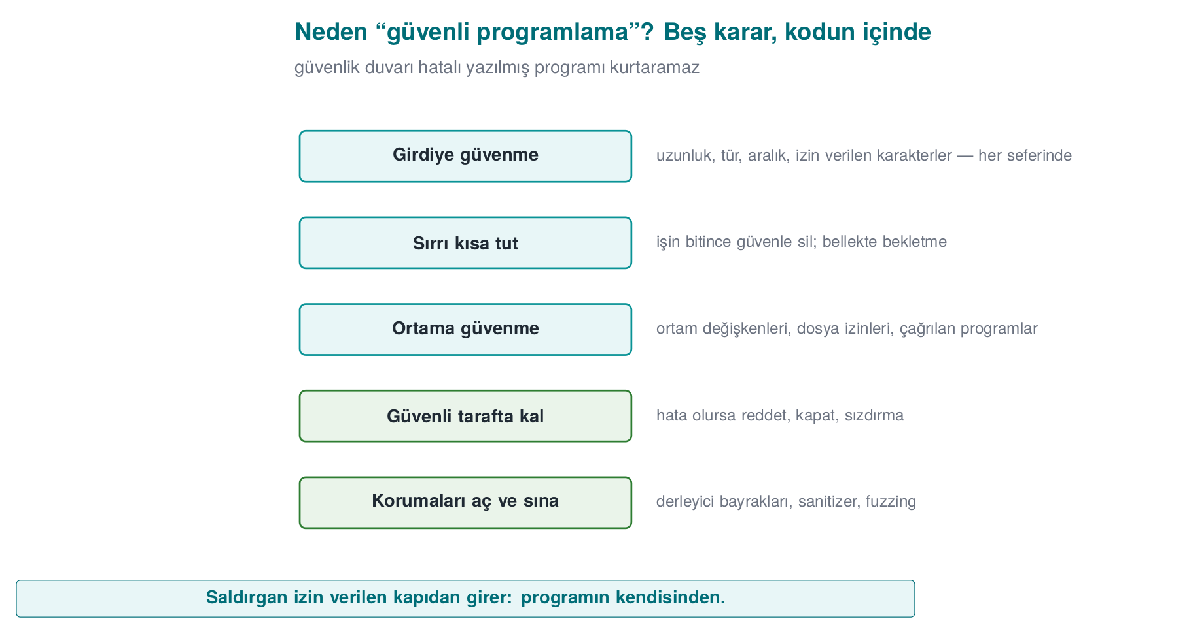
CEN429 Secure Programming · Week 1
The five decisions of secure programming — diagram
RTEU Computer Engineering · 2026-2027 Fall
7

Slide 8
CEN429 Secure Programming · Week 1
How the course runs
• One term project: a C/C++ application + a security guide written "as if it were going through certification"
  – Midterm check: week 7 demo · Final check: week 15 demo
• Two quizzes: week 8 (1–6) · week 16 (9–14)
• Grade: Midterm = 0.6·Project1 + 0.4·Quiz1 · Final = 0.7·Project2 + 0.3·Quiz2
• Every week: buggy code → attack → fix
⚠️ Ethics: Only try these techniques on your own computer and on the demos provided.
RTEU Computer Engineering · 2026-2027 Fall
8

Slide 9
CEN429 Secure Programming · Week 1
1. What is security?
RTEU Computer Engineering · 2026-2027 Fall
9

Slide 10
CEN429 Secure Programming · Week 1
The Vault analogy
Concept | Vault | Software
Asset | Money | Password, payment key
Threat | Thief | Someone who wants to steal the password
Vulnerability | Faulty lock | An unchecked strcpy
Attack | Picking the lock | Becoming administrator with a long username
Countermeasure | A new lock | Length checking
Risk | Probability × impact | "If it's found, every account is gone"
RTEU Computer Engineering · 2026-2027 Fall
10
Notes:
Speaker note: Ask students for their own examples: "For your Instagram account, what are the asset, the threat, the vulnerability?"

Slide 11
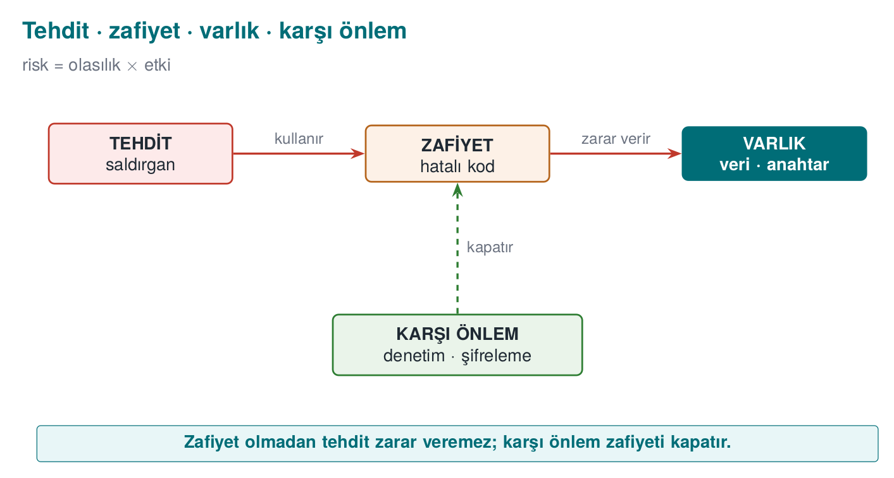
CEN429 Secure Programming · Week 1
Threat · vulnerability · asset — diagram
RTEU Computer Engineering · 2026-2027 Fall
11

Slide 12
CEN429 Secure Programming · Week 1
Security's three goals: CIA
 | Question | If broken
Confidentiality | Can only authorized parties see it? | Passwords leak
Integrity | Can it be changed without authorization? | A balance, a grade changes
Availability | Does it work when needed? | The system crashes
+ Authentication · Authorization · Non-repudiation
Question: A banking app writes the balance unencrypted → ? · The recipient IBAN changes in transit → ? · It crashes on a holiday night → ?
RTEU Computer Engineering · 2026-2027 Fall
12

Slide 13
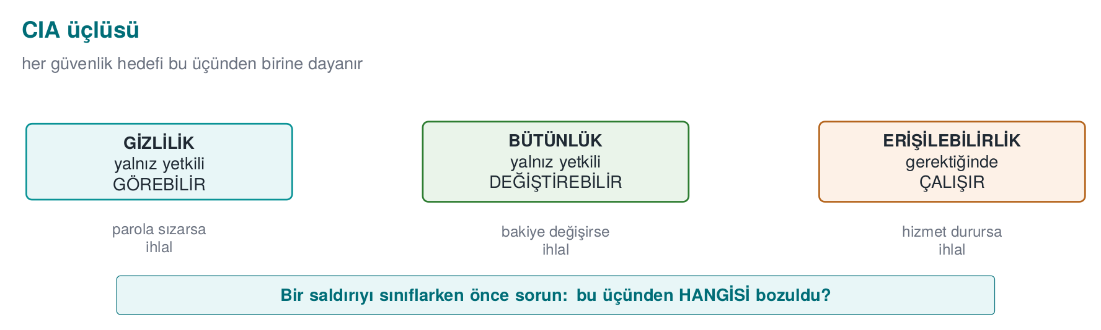
CEN429 Secure Programming · Week 1
The CIA triad — diagram
Answer to the question: balance unencrypted → C; IBAN changes in transit → I; crashes on a holiday night → A.
RTEU Computer Engineering · 2026-2027 Fall
13

Slide 14
CEN429 Secure Programming · Week 1
The CIA triad — typical countermeasures and related concepts
Goal | Typical countermeasure
Confidentiality | Encryption, access control
Integrity | Hash, MAC, digital signature
Availability | Redundancy, resource limiting
+ Authentication: are you really who you say you are? · Authorization: do you have permission to do this? · Non-repudiation: who did this, and can they deny it afterward?
RTEU Computer Engineering · 2026-2027 Fall
14

Slide 15
CEN429 Secure Programming · Week 1
Bug ≠ vulnerability, but…
A very large share of security vulnerabilities are ordinary software bugs.
Heartbleed (2014, CVE-2014-0160)
• Client: "Send me 64 KB back" — but sends only a few bytes
• The server never checks the length → sends back neighboring memory (passwords, keys)
• A single missing length check → a significant part of the internet was affected
RTEU Computer Engineering · 2026-2027 Fall
15
Notes:
Speaker note: In Demo 4 we'll see a bug from the same family (a length check) with our own hands.

Slide 16
CEN429 Secure Programming · Week 1
Who is the attacker, what can they reach?
Attacker | Access | Defence
Remote | Only network messages | Input validation, TLS
Local user | Files, environment variables | Permissions, secure start-up
Insider | Source code, server | Privilege separation, audit logging
Device owner (white-box) | Memory, debugger, binary | RASP, obfuscation, white-box
What's different about this course: what do we do if the program runs on the attacker's device?
RTEU Computer Engineering · 2026-2027 Fall
16
Notes:
Speaker note: Examples: mobile payment, DRM, game cheats, license checks. "Just hide the key" isn't enough; the attacker can read memory.

Slide 17
CEN429 Secure Programming · Week 1
White-box / MATE
• MATE (Man-At-The-End): an attacker who owns the program.
• Reads the code, sees the memory, modifies it.
• The real situation for mobile/desktop applications (this course's main theme).
RTEU Computer Engineering · 2026-2027 Fall
17

Slide 18
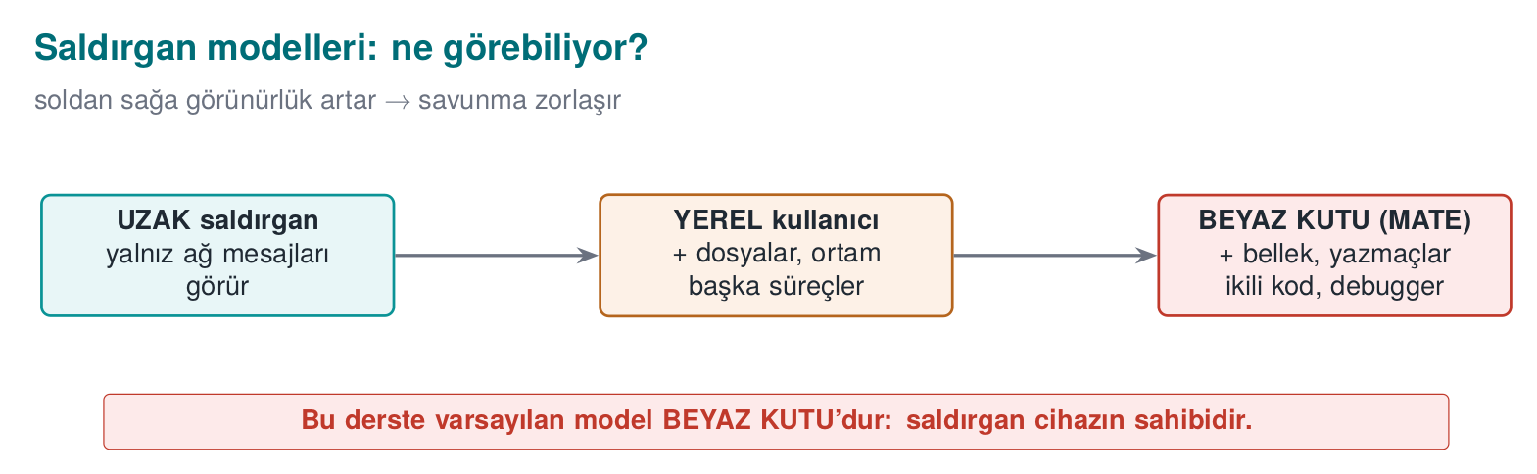
CEN429 Secure Programming · Week 1
Attacker models — diagram
RTEU Computer Engineering · 2026-2027 Fall
18

Slide 19
CEN429 Secure Programming · Week 1
Attackers — real-world examples
Attacker | Example
Remote | Someone attacking a web server
Local user | Another student on a shared server
Insider | An employee abusing their role
Device owner (white-box) | Someone trying to crack a mobile payment app on their own phone
Apply each row to your own project: which one is your attacker?
RTEU Computer Engineering · 2026-2027 Fall
19

Slide 20
CEN429 Secure Programming · Week 1
Secure design principles (Saltzer & Schroeder, 1975)
Principle | One sentence
Least privilege | Run with only the privilege needed
Secure default | The default is "no permission"
Complete mediation | Check every access, every time
Open design | Security rests on the secrecy of the key, not the algorithm
Economy of mechanism | Simple = fewer bugs
Separation of privilege | Two conditions for a critical operation
Least common mechanism | Reduce shared resources
Acceptability | Unusable security gets bypassed
+ Defence in depth: don't rely on one countermeasure, build layers.
RTEU Computer Engineering · 2026-2027 Fall
20

Slide 21
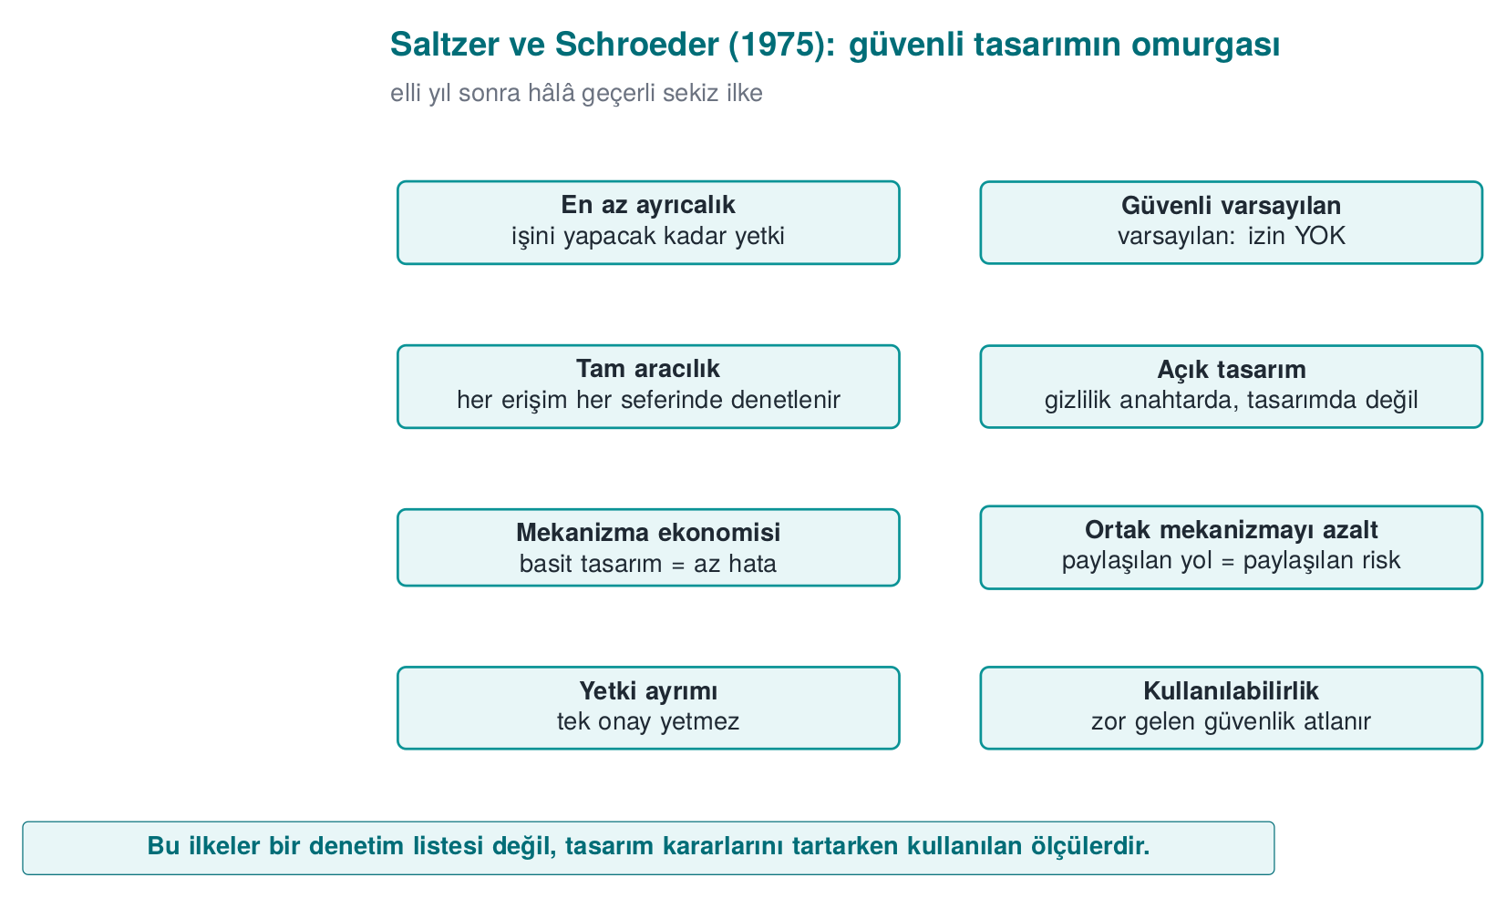
CEN429 Secure Programming · Week 1
Saltzer and Schroeder's principles — diagram
RTEU Computer Engineering · 2026-2027 Fall
21

Slide 22
CEN429 Secure Programming · Week 1
Secure design principles — examples (1/2)
Principle | Example
Least privilege | The reporting program runs as an ordinary user, not administrator
Secure default | A new user's admin field starts at 0
Complete mediation | Permission is not checked once and then cached
Open design | You do not write your own encryption algorithm
No principle is abstract; each one shows up as a concrete decision in code.
RTEU Computer Engineering · 2026-2027 Fall
22

Slide 23
CEN429 Secure Programming · Week 1
Secure design principles — examples (2/2)
Principle | Example
Economy of mechanism | A clear 20-line check beats a "clever" 500-line one
Separation of privilege | Both a password and an SMS code for a money transfer
Least common mechanism | Every session gets its own temporary file
Psychological acceptability | Asking for a password every 5 minutes leads to it being written on paper
Unusable security is bypassed security.
RTEU Computer Engineering · 2026-2027 Fall
23

Slide 24
CEN429 Secure Programming · Week 1
2. Overview of application protection
RTEU Computer Engineering · 2026-2027 Fall
24

Slide 25
CEN429 Secure Programming · Week 1
Defence in depth
• Defence in depth: not a single countermeasure, but many.
• If one is bypassed, another stops it.
• A "security shell" is the combination of these layers.
RTEU Computer Engineering · 2026-2027 Fall
25

Slide 26
CEN429 Secure Programming · Week 1
Why a single countermeasure is not enough
Countermeasure | What it doesn't solve
Bug-free code | The attacker opens the binary and reads the logic
Obfuscated code | Stops it with a debugger and reads the memory
Memory protected against monitoring | The key sits in code as plain text → a single string scan is enough
Hidden key | Changes a single check and bypasses the protection
➡️ Each layer closes the previous one's gap; the attacker must defeat all of them at once
RTEU Computer Engineering · 2026-2027 Fall
26
Notes:
Speaker note: Building analogy: good lock, open window, key under the doormat, safe with no combination. Ask students "who would do this?" for each row.

Slide 27
CEN429 Secure Programming · Week 1
Seven layers: inside out
# | Layer | Question | Week
1 | Secure design | What, against whom? | 1–2
2 | Secure coding | Is my code bug-free? | 1, 4, 5
3 | Compiler/OS protections | If a bug slips through, is exploitation hard? | 4
4 | Obfuscation | Can someone reading the code understand it? | 4, 5, 9, 14
5 | RASP | Does it notice it's under attack? | 6
6 | Cryptography | Even if captured, is the data meaningless? | 3, 10, 11
7 | Assurance | How do we prove it works? | 12–13
RTEU Computer Engineering · 2026-2027 Fall
27
Notes:
Speaker note: The inner layers are "write it correctly," the outer layers are "what happens when the code is in the attacker's hands." This table is the term's roadmap.

Slide 28
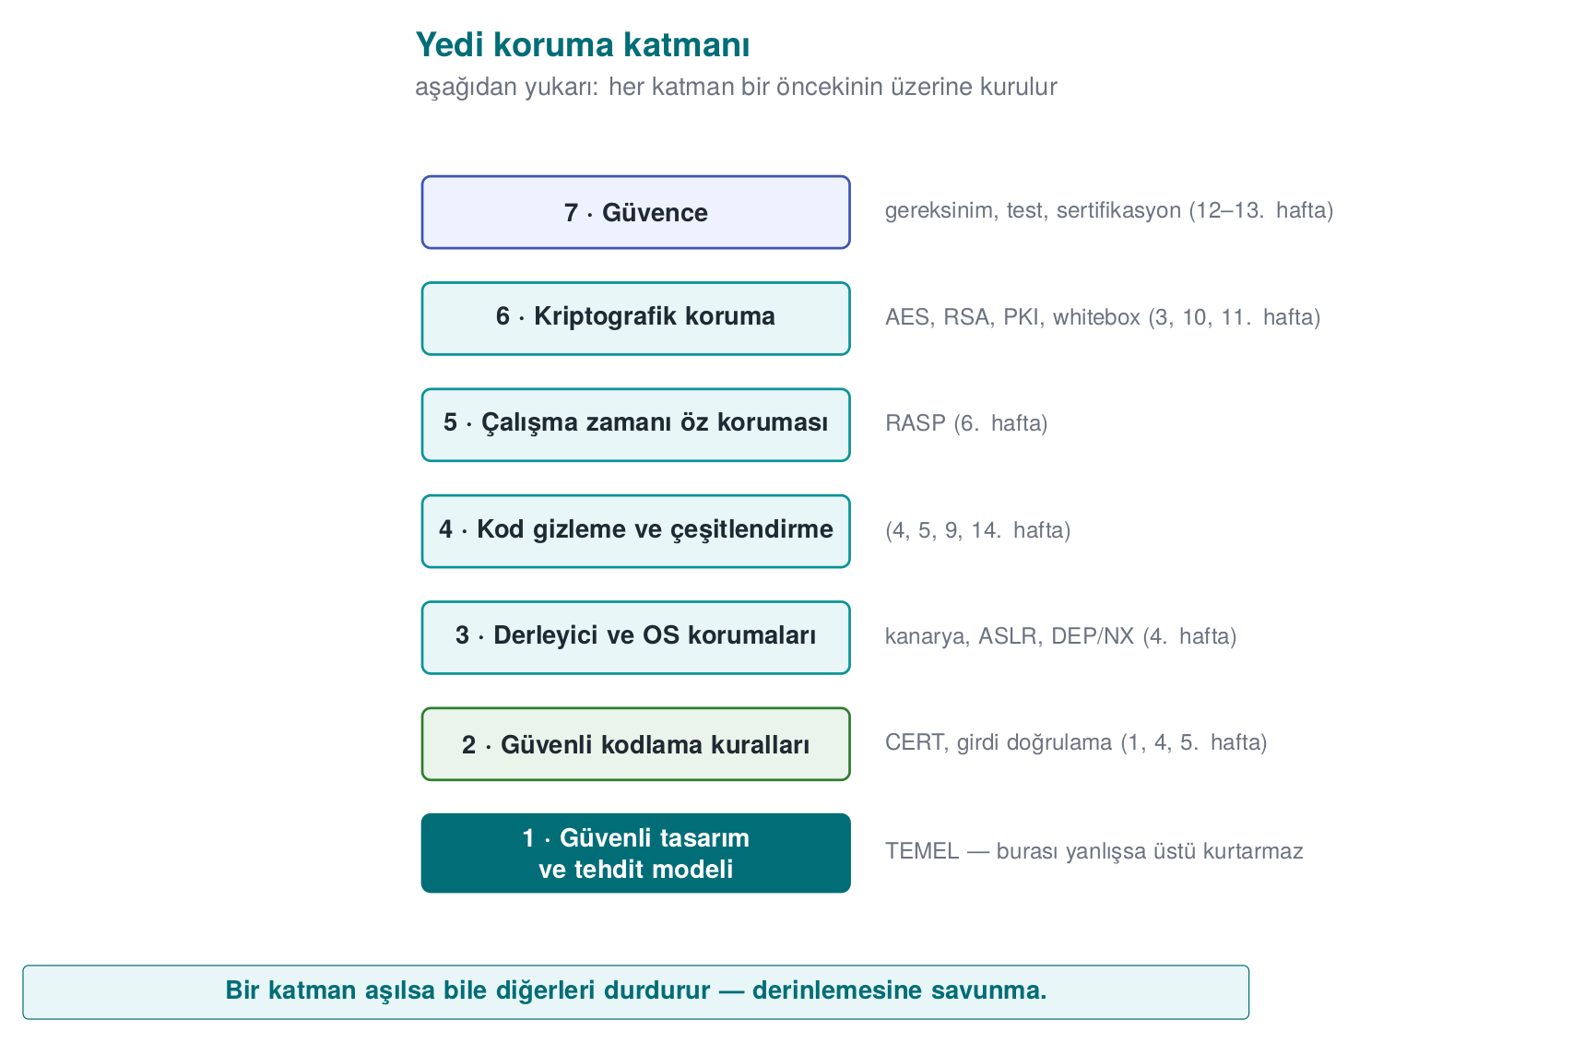
CEN429 Secure Programming · Week 1
Seven layers — diagram (inside out)
Even if a bug slips past the outer layers, the next layer tries to stop it (defence in depth).
RTEU Computer Engineering · 2026-2027 Fall
28

Slide 29
CEN429 Secure Programming · Week 1
Seven layers — typical techniques and the attacker they stop
# | Layer | Typical techniques | Attacker it stops
1 | Design | Threat model, asset/interface tables, least privilege | Anyone looking for a design flaw
2 | Coding | Input validation, bounds checking, SEI CERT rules | An attacker sending input remotely
3 | Compiler/OS | Canary, ASLR, DEP/NX, CFI, _FORTIFY_SOURCE | An attacker exploiting a memory bug
4 | Obfuscation | Control-flow flattening, opaque predicates, virtualisation | A reverse-engineering analyst
5 | RASP | Debugger/hook/root detection, integrity checking | An attacker inspecting the running program
6 | Cryptography | Authenticated encryption, key hierarchy, white-box | An attacker who captures the data
7 | Assurance | Code review, fuzzing, penetration testing, certification | Auditors and evaluators
RTEU Computer Engineering · 2026-2027 Fall
29

Slide 30
CEN429 Secure Programming · Week 1
The security shell: where the layers meet
A sensitive key is carried inside several layers at once:
1. Stays encrypted on disk
2. Decrypted only at the moment it's needed, only as much as needed
3. The code section where it is decrypted is obfuscated and integrity-checked
4. The process has debugger detection running
➡️ In week 3 we'll build a four-shell design step by step
RTEU Computer Engineering · 2026-2027 Fall
30

Slide 31
CEN429 Secure Programming · Week 1
Which layer, when? By attacker model
Application | Where is the attacker? | Priority
Server-side web service | On the network; no access to code or server | 1, 2, 3, 6, 7
Desktop business app | On the user's computer; the user is not the attacker | 1, 2, 3, 6
Mobile payment | The device may be in the attacker's hands | All; especially 4, 5, 6
Game, licensed software | The user is the attacker | 4, 5
Embedded device | Physical access | 2, 3, 6 + hardware
White-box attacker: owns the program itself — copies it, opens it, modifies it, re-runs it
RTEU Computer Engineering · 2026-2027 Fall
31

Slide 32
CEN429 Secure Programming · Week 1
⚠️ Obfuscation is not a substitute for correct code
• Obfuscation slows the attacker down, it does not fix the bug
• An obfuscated overflow is still an overflow
• Outer layers only make sense once the inner layers are solid
The server never trusts the client. Even an obfuscated client can send inconsistent data to the server.
RTEU Computer Engineering · 2026-2027 Fall
32
Notes:
Speaker note: A game cheat example: the client is obfuscated, but the server accepts "100 meters in one second" movement.

Slide 33
CEN429 Secure Programming · Week 1
The white-box attacker's six paths (1/2)
A six-row attack table for a sensitive library running on the client side:
# | Attacker's path | Example | Layer that answers
1 | Bypassing platform controls | A rooted device, an emulator, a modified OS | 5 (RASP)
2 | Reverse-engineering the code | Reading logic/keys with a decompiler | 4 (obfuscation), 6
3 | Modifying the code | Flipping an if check and repackaging | 5 (integrity), 4
RTEU Computer Engineering · 2026-2027 Fall
33

Slide 34
CEN429 Secure Programming · Week 1
The white-box attacker's six paths (2/2)
# | Attacker's path | Example | Layer that answers
4 | Abusing interfaces | Calling the library from your own program | 1 (design), 5, 6
5 | Extracting assets at runtime | Memory dump, debugger, hook | 2 (erasure), 5, 6 (white-box)
6 | Redirecting control flow at runtime | Skipping a branch, changing a return value | 5 (flow counter), 4
This table is the starting point for the threats section of a protection plan.
RTEU Computer Engineering · 2026-2027 Fall
34

Slide 35
CEN429 Secure Programming · Week 1
Trade-off
• Every protection carries a cost: speed, complexity, expense.
• Security is not "infinite protection," it is balanced protection.
• We write the remaining risk down explicitly.
RTEU Computer Engineering · 2026-2027 Fall
35

Slide 36
CEN429 Secure Programming · Week 1
The cost of protection
Cost | Example
Performance | Control-flow flattening can slow a function several times over
Size | Virtualisation, white-box tables make the binary bigger
Maintenance | Crash reports from obfuscated code are unreadable
False positive | An overly sensitive root check punishes a legitimate user
➡️ Every countermeasure is written with its justification: this asset, against this attacker, at this cost
RTEU Computer Engineering · 2026-2027 Fall
36

Slide 37
CEN429 Secure Programming · Week 1
An evaluator reads the table backward
1. String scan → is a key, URL, error message visible?
2. Opening the binary → is the logic readable?
3. Attaching a debugger → does the program notice?
4. Modifying the code → does the integrity check catch it?
5. Memory dump → is a secret found?
Every step that isn't stopped becomes a finding in the report
RTEU Computer Engineering · 2026-2027 Fall
37
Notes:
Speaker note: The project's security guide will answer, for every layer, "which countermeasure did I take, how did I test it?"

Slide 38
CEN429 Secure Programming · Week 1
Try it yourself (3 min)
1. What is the attacker model for an offline password manager? Which layers matter?
2. "It runs on the server, no need to obfuscate" — when is this true, when is it false?
3. In a game that uses only obfuscation, which attack path stays open?
RTEU Computer Engineering · 2026-2027 Fall
38
Notes:
Speaker note: ask first, then open this slide.

Slide 39
CEN429 Secure Programming · Week 1
Try it yourself — answers
1. Offline password manager: the attacker owns the device/file (white-box). Layers that matter: cryptography (a KDF from the password + AEAD), secure coding, some obfuscation/RASP.
2. "Runs on the server": true if no sensitive logic/key is sent to the client; false if code/a key runs on the client (white-box).
3. Obfuscation only: if there's no server-side validation, a patched-client cheat stays open — obfuscation doesn't fix the logic.
RTEU Computer Engineering · 2026-2027 Fall
39

Slide 40
CEN429 Secure Programming · Week 1
3. The application protection plan and threat modelling
RTEU Computer Engineering · 2026-2027 Fall
40

Slide 41
CEN429 Secure Programming · Week 1
Threat modelling
• Threat modelling: systematically answering "what will we protect, against whom, and how?"
• It lists assets, threats, and countermeasures.
• Today we'll do it with STRIDE and attack trees.
RTEU Computer Engineering · 2026-2027 Fall
41

Slide 42
CEN429 Secure Programming · Week 1
Application protection plan: 7 steps
1. Scope — What are we protecting? Which binary, which version, which hash?
2. Architecture and interfaces — Who talks to whom, over which channel?
3. Assets — Where does it live, when is it erased, C or I?
4. Threats — Who is the attacker, by which path do they reach the asset?
5. Countermeasures — Which layer, which countermeasure?
6. Verification — How is it proven that it works?
7. Residual risk — What was accepted, and why
→ In certification this plan becomes a security guide hundreds of pages long. You will write a 20–30 page version of it for the project.
RTEU Computer Engineering · 2026-2027 Fall
42

Slide 43
CEN429 Secure Programming · Week 1
Step 1 detail: Scope
Question: What are we evaluating?
• Saying "version 2.1" alone is not enough
• Which binary, which source code, which hash value?
• In certification this is called the target of evaluation
RTEU Computer Engineering · 2026-2027 Fall
43

Slide 44
CEN429 Secure Programming · Week 1
Step 2 detail: Architecture and interfaces
Question: What are the components, how do they talk?
• What are the components?
• Which channel do they talk to each other over?
• How is identity verified on each channel?
RTEU Computer Engineering · 2026-2027 Fall
44

Slide 45
CEN429 Secure Programming · Week 1
Step 3 detail: Assets
Question: Where and when is the protected data?
• Every piece of data to be protected is listed one by one
• Where does it live, when is it created, when is it erased?
• Does it need confidentiality (C) or integrity (I)?
RTEU Computer Engineering · 2026-2027 Fall
45

Slide 46
CEN429 Secure Programming · Week 1
Step 4 detail: Threats
Question: Who is the attacker, how do they reach it?
• Who is the attacker? (see attacker models)
• By which path can they reach each asset?
• STRIDE and the attack tree come in here
RTEU Computer Engineering · 2026-2027 Fall
46

Slide 47
CEN429 Secure Programming · Week 1
Step 5 detail: Countermeasures
Question: Which countermeasure, in which layer?
• One countermeasure is chosen for each threat
• Which of the seven layers does the countermeasure belong to?
• An unjustified countermeasure is in the wrong place or unnecessary
RTEU Computer Engineering · 2026-2027 Fall
47

Slide 48
CEN429 Secure Programming · Week 1
Step 6 detail: Verification
Question: How is it proven that it works?
• A test is written for each countermeasure
• A unit test, or a bypass attempt?
• A countermeasure with no test does not exist in an evaluator's eyes
RTEU Computer Engineering · 2026-2027 Fall
48

Slide 49
CEN429 Secure Programming · Week 1
Step 7 detail: Residual risk
Question: What did we knowingly accept?
• Risks that can't be closed, or are knowingly accepted
• The reason for each (e.g. performance, usability)
• The plan never ends: as the product changes, step 1 is revisited and it is updated
RTEU Computer Engineering · 2026-2027 Fall
49

Slide 50
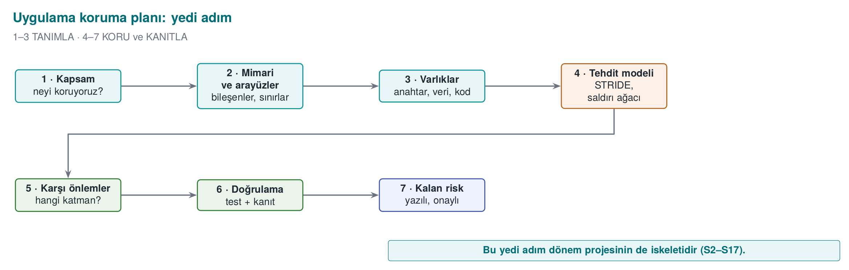
CEN429 Secure Programming · Week 1
The protection plan — diagram
RTEU Computer Engineering · 2026-2027 Fall
50

Slide 51
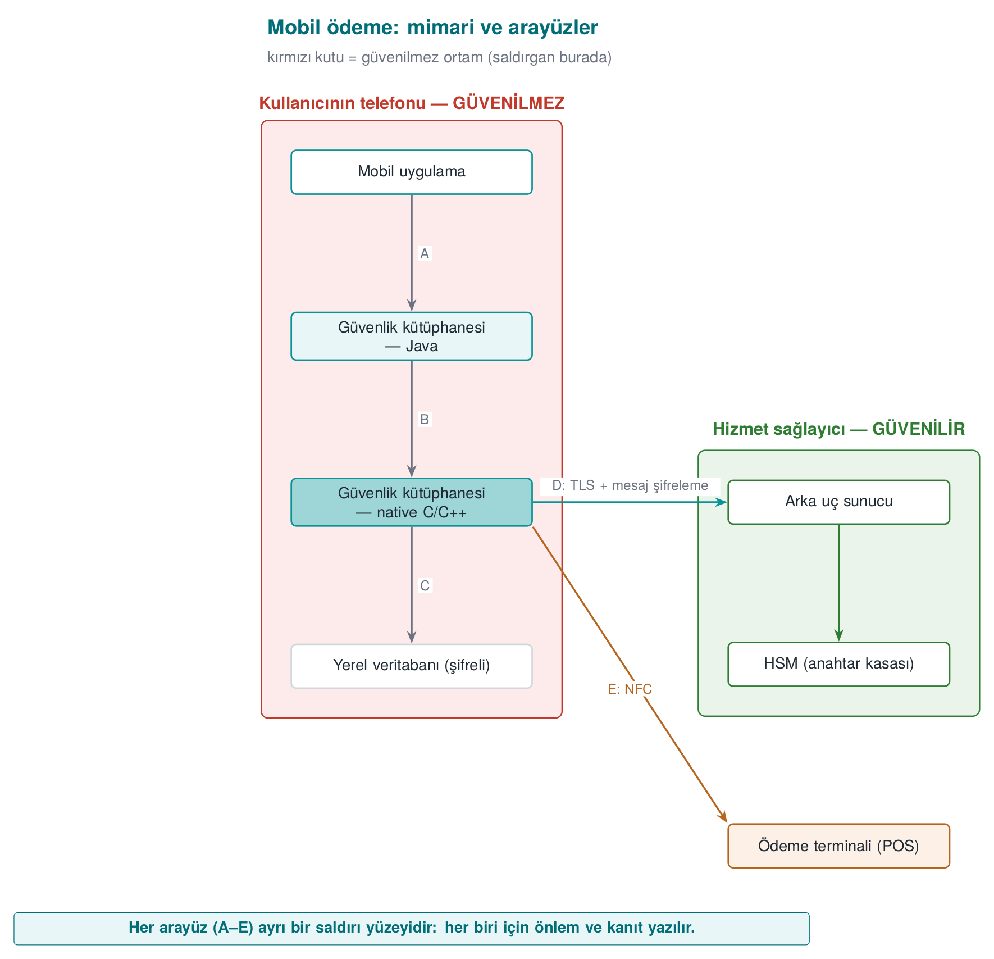
CEN429 Secure Programming · Week 1
Example architecture: a mobile payment app
• The phone may be in the attacker's hands: root, debugger, memory dump
• The most sensitive work runs in the native C/C++ layer
RTEU Computer Engineering · 2026-2027 Fall
51
Notes:
Speaker note: This architecture is only for showing the method. We'll use the interface and asset table method all term; the methods that protect the table's assets are opened up one at a time in the coming weeks (3: security shells, 4 and 9: native hardening, 6: RASP, 10: key hierarchy, 11: white-box).

Slide 52
CEN429 Secure Programming · Week 1
Interface and asset tables
Interface | Ends | Authentication | Confidentiality / integrity
C | native – database | — | Encryption + MAC, key bound to the device
D | SDK – server | Certificate pinning | TLS + message-level encryption on top
Asset | Where | Lifetime | Protection
One-time payment key | DB (encrypted), memory | One payment | C, I
Session key | Memory only | Session | C, I
Transaction counter | DB | Persistent | I
An asset not on the list is an asset that's not protected.
RTEU Computer Engineering · 2026-2027 Fall
52

Slide 53
CEN429 Secure Programming · Week 1
Interface table — full list (mobile payment)
Interface | Ends | Authentication | Confidentiality / integrity
A | App – Library (Java) | The caller's signature is verified | Same process; no sensitive data crosses
B | Library (Java) – native | Mutual integrity check | Crosses encrypted and masked
C | native – local database | — | Encryption + MAC, key bound to the device
D | Library – back-end server | Certificate pinning + server verification | TLS + message-level encryption on top
E | Library – payment terminal | Payment protocol | One-time payment key
RTEU Computer Engineering · 2026-2027 Fall
53

Slide 54
CEN429 Secure Programming · Week 1
Asset table — full list (mobile payment)
Asset | Where | Creation → deletion | Protection
One-time payment key | DB (encrypted), memory | Downloaded from server → used → erased | C, I
Device fingerprint | Memory, two separate pieces | Computed at start-up | I
Session key | Memory only | Derived → erased at session end | C, I
Transaction counter | Database | Increments on every payment | I
Server public key | Embedded in the app | At build time | I
RTEU Computer Engineering · 2026-2027 Fall
54

Slide 55
CEN429 Secure Programming · Week 1
STRIDE
 | Threat | Breaks | Example
S | Spoofing | Authentication | A fake app calling the SDK
T | Tampering | Integrity | A native check altered in the binary
R | Repudiation | Non-repudiation | "I didn't make this payment"
I | Information disclosure | Confidentiality | Key read from a memory dump
D | Denial of service | Availability | Thousands of fake registration requests
E | Elevation of privilege | Authorization | Ordinary user → administrator
Draw the data flow diagram → ask the six letters for every arrow that crosses a trust boundary.
RTEU Computer Engineering · 2026-2027 Fall
55

Slide 56
CEN429 Secure Programming · Week 1
Example system
A mobile banking application:
• user login
• balance display
• money transfer
Let's apply every STRIDE letter to this system.
RTEU Computer Engineering · 2026-2027 Fall
56

Slide 57
CEN429 Secure Programming · Week 1
S · Spoofing
• Threat: acting as someone else (a fake user/server).
• Example: a fake server, a stolen session.
• Countermeasure: strong authentication, TLS + certificate checking.
RTEU Computer Engineering · 2026-2027 Fall
57

Slide 58
CEN429 Secure Programming · Week 1
T · Tampering
• Threat: modifying data/code without authorization.
• Example: changing the transfer amount.
• Countermeasure: integrity (MAC/signature), integrity checking (RASP).
RTEU Computer Engineering · 2026-2027 Fall
58

Slide 59
CEN429 Secure Programming · Week 1
R · Repudiation
• Threat: denying what you did.
• Example: "I didn't make that transfer."
• Countermeasure: secure log, signature, audit trail.
RTEU Computer Engineering · 2026-2027 Fall
59

Slide 60
CEN429 Secure Programming · Week 1
I · Information disclosure
• Threat: confidential data leaking.
• Example: a balance/password leak.
• Countermeasure: encryption, least privilege, leak-free error messages.
RTEU Computer Engineering · 2026-2027 Fall
60

Slide 61
CEN429 Secure Programming · Week 1
D · Denial of service
• Threat: making the service unavailable.
• Example: excessive requests, resource exhaustion.
• Countermeasure: rate limiting, resource quotas, input limits.
RTEU Computer Engineering · 2026-2027 Fall
61

Slide 62
CEN429 Secure Programming · Week 1
E · Elevation of privilege
• Threat: gaining unauthorized privilege.
• Example: an ordinary user becomes administrator.
• Countermeasure: least privilege, privilege checking, secure default.
RTEU Computer Engineering · 2026-2027 Fall
62

Slide 63
CEN429 Secure Programming · Week 1
STRIDE Summary for the Banking Example
Letter | Countermeasure in this system
S | TLS + authentication
T | MAC/signature + RASP
R | Secure log
I | Encryption + least privilege
D | Rate limiting
E | Privilege checking
RTEU Computer Engineering · 2026-2027 Fall
63

Slide 64
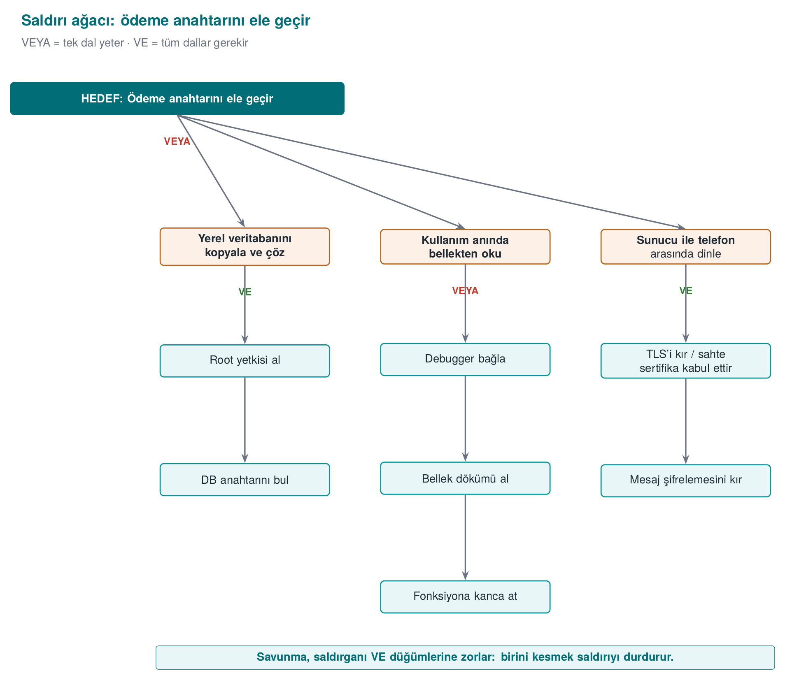
CEN429 Secure Programming · Week 1
Root · goal
The attacker's ultimate goal. Now let's break down the paths.
RTEU Computer Engineering · 2026-2027 Fall
64

Slide 65
CEN429 Secure Programming · Week 1
Attack tree: "Capture the payment key"
GOAL: Payment key — OR (one is enough)
1. Break the database — AND (all required): gain root privilege + find the database key
2. Read from memory — OR: attach a debugger | take a memory dump | hook a function
3. Eavesdrop on the traffic — AND: break TLS + break message-level encryption
RTEU Computer Engineering · 2026-2027 Fall
65

Slide 66
CEN429 Secure Programming · Week 1
Attack tree — the "Break the database" branch
AND node (all required):
1. Gain root privilege
2. AND find the database key
This path is expensive because both are needed.
This is proof that defence in depth works.
RTEU Computer Engineering · 2026-2027 Fall
66

Slide 67
CEN429 Secure Programming · Week 1
Attack tree — the "Read from memory" branch
OR node (one is enough): three alternatives
1. Attach a debugger
2. OR take a memory dump
3. OR hook a function
Three alternatives = the weakest point: the key in memory.
→ This week's Demo 2 · Week 6 runtime protection · Week 11 white-box
RTEU Computer Engineering · 2026-2027 Fall
67

Slide 68
CEN429 Secure Programming · Week 1
Attack tree — the "Eavesdrop on traffic" branch
AND node (all required):
1. Break TLS
2. AND break message-level encryption
Both layers must be broken at once → an expensive path.
The defender's goal: force the attacker into as many AND nodes as possible.
RTEU Computer Engineering · 2026-2027 Fall
68

Slide 69
CEN429 Secure Programming · Week 1
Attack tree — mapping to countermeasures
Let's map the attack tree's leaves directly onto a defence layer:
Leaf | Countermeasure
Debugger | Anti-debug (6)
Memory dump | Short lifetime + protection (6, 10)
Extract from binary | Obfuscation + white-box (9, 11)
Leak over the network | TLS + pinning (10)
RTEU Computer Engineering · 2026-2027 Fall
69

Slide 70
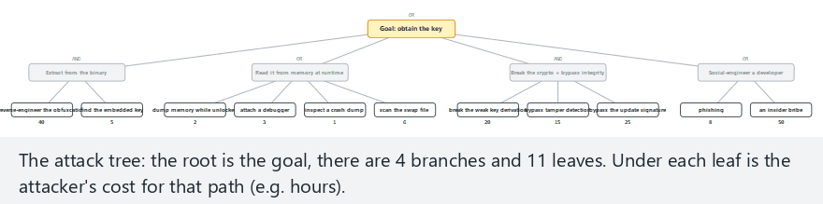
CEN429 Secure Programming · Week 1
Attack tree: cheapest path (animation)
RTEU Computer Engineering · 2026-2027 Fall
70
Notes:
Speaker note: Show how every AND/OR node's cost is computed bottom-up; the cheapest branch turns out to be B (read from memory).

Slide 71
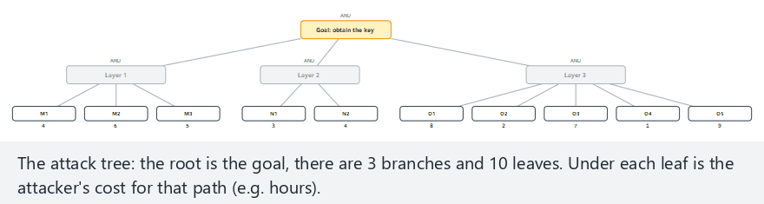
CEN429 Secure Programming · Week 1
Attack tree — edge case: every node AND
RTEU Computer Engineering · 2026-2027 Fall
71
Notes:
Speaker note: When every node is AND, costs add up — the most expensive, most defended-in-depth case.

Slide 72
CEN429 Secure Programming · Week 1
Data flow diagram: five symbols
Symbol | Name | Example
▭ Rectangle | External entity | User, payment terminal
◯ Circle | Process | Login module, crypto library
═ Two lines | Data store | Database, config file
→ Arrow | Data flow | HTTP request, function call
┄ Dashed line | Trust boundary | Internet ↔ server, app ↔ OS
➡️ Color every arrow that crosses a trust boundary red: start your review there
RTEU Computer Engineering · 2026-2027 Fall
72

Slide 73
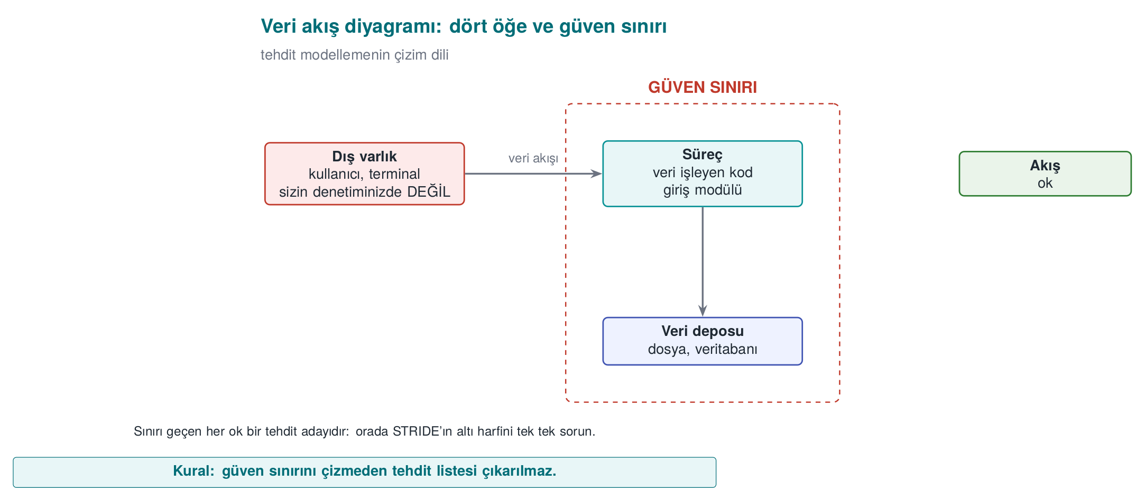
CEN429 Secure Programming · Week 1
Data flow diagram and trust boundary — diagram
RTEU Computer Engineering · 2026-2027 Fall
73

Slide 74
CEN429 Secure Programming · Week 1
Which letter for which element?
Element | S | T | R | I | D | E
--- | :-: | :-: | :-: | :-: | :-: | :-:
External entity | ✔ |  | ✔
Process | ✔ | ✔ | ✔ | ✔ | ✔ | ✔
Data store |  | ✔ | ✔¹ | ✔ | ✔
Data flow |  | ✔ |  | ✔ | ✔
¹ If it's an audit log · A data flow has no "identity" → S is not asked
RTEU Computer Engineering · 2026-2027 Fall
74
Notes:
Speaker note: A process is exposed to all six threats: it can be impersonated, its code altered, its memory read, it can be crashed, its privilege abused.

Slide 75
CEN429 Secure Programming · Week 1
Question and countermeasure for each letter
Letter | Ask yourself | Typical countermeasure
S | Is the other party really who they claim to be? | Authentication, signature, certificate pinning
T | Would I notice if it were changed? | MAC/HMAC, signature, integrity check
R | If they say "I didn't do it," do I have proof? | Tamper-resistant log, signed transaction
I | Does it leak on disk, network, memory, or in a log? | Encryption, memory wiping, masking
D | Can it be crashed, exhausted? | Input limits, rate limiting, quotas
E | Can a low-privileged actor get a high-privileged one's work done? | Least privilege, complete mediation, memory safety
An overflow = D (crashes) + E (control flow hijacked) + I (adjacent secret is read)
RTEU Computer Engineering · 2026-2027 Fall
75

Slide 76
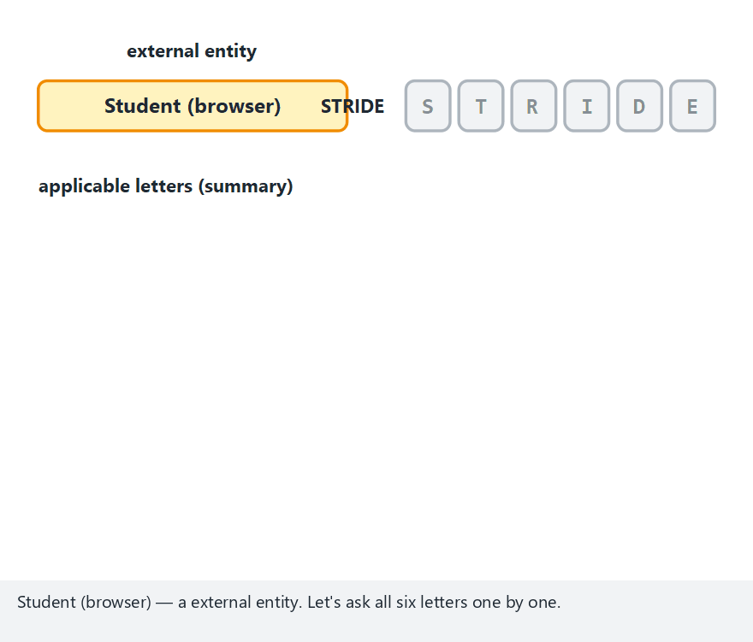
CEN429 Secure Programming · Week 1
DFD element -> STRIDE (animation)
RTEU Computer Engineering · 2026-2027 Fall
76
Notes:
Speaker note: Walk through the student grade system example step by step; stress why each letter is or isn't meaningful.

Slide 77
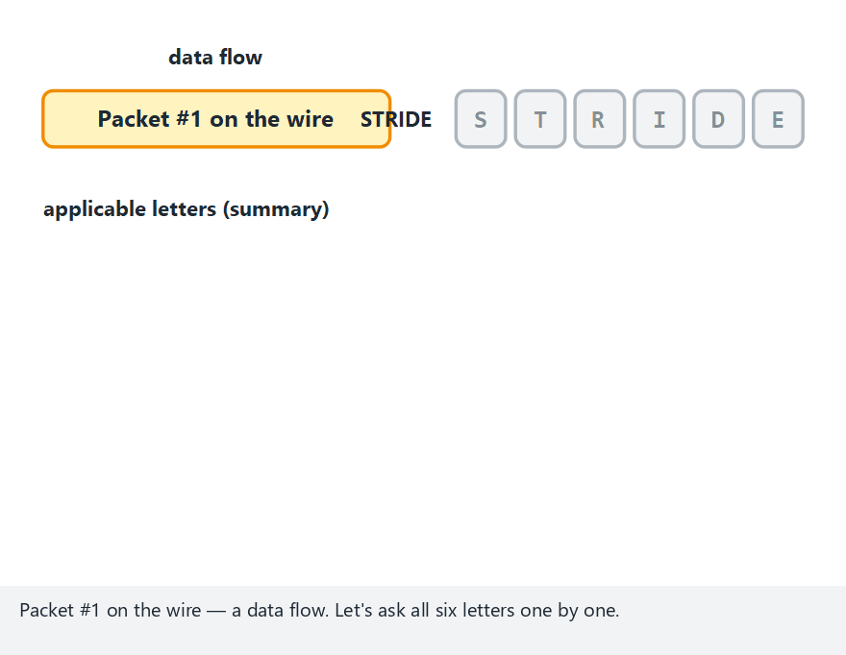
CEN429 Secure Programming · Week 1
STRIDE — edge case: all data flows
RTEU Computer Engineering · 2026-2027 Fall
77
Notes:
Speaker note: Show that a data flow never gets S, R or E — because it has no "identity".

Slide 78
CEN429 Secure Programming · Week 1
Risk score: likelihood × impact
 | Impact 1 | Impact 2 | Impact 3
--- | :-: | :-: | :-:
Likelihood 3 | 3 | 6 | 9 critical
Likelihood 2 | 2 | 4 | 6
Likelihood 1 | 1 | 2 | 3
• Likelihood: physical access, or over the internet? Expertise needed? Can it be automated?
• Impact: which asset, how many users, financial/legal consequence?
• More detailed: CVSS (week 2), attack potential (week 13)
RTEU Computer Engineering · 2026-2027 Fall
78

Slide 79
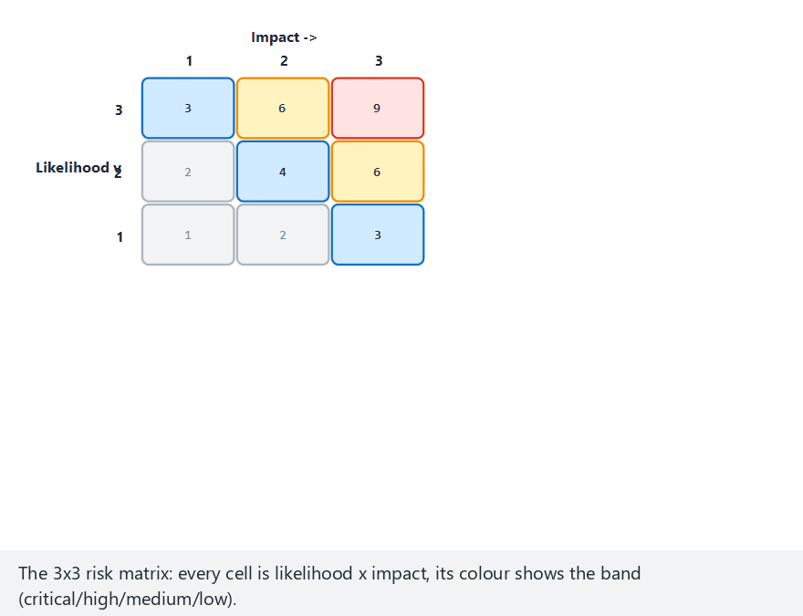
CEN429 Secure Programming · Week 1
Risk matrix (animation)
RTEU Computer Engineering · 2026-2027 Fall
79
Notes:
Speaker note: Place 12 threats on the matrix, then rank them by score; stress that the highest-scoring one goes first.

Slide 80
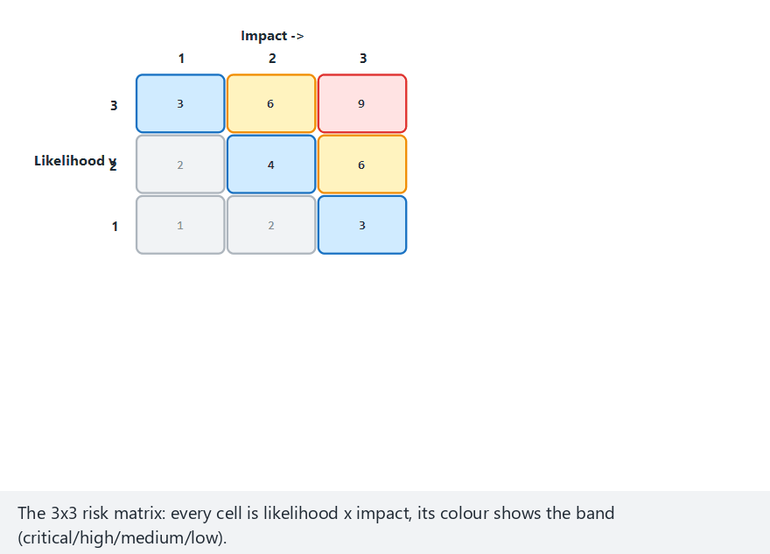
CEN429 Secure Programming · Week 1
Risk matrix — edge case: all critical
RTEU Computer Engineering · 2026-2027 Fall
80
Notes:
Speaker note: When every threat lands in the (3,3) cell, ranking alone doesn't help — discuss what other criteria you'd need.

Slide 81
CEN429 Secure Programming · Week 1
Four responses to a threat
1. Mitigate — add a countermeasure (most common)
2. Eliminate — never write the feature at all (strongest) If there's no "remember my password" feature, there's no disk-password threat either
3. Transfer — don't store card data, leave it to the payment provider
4. Accept — write it into the residual risk list, with a reason
⚠️ A risk not written into the plan is not accepted, it has been overlooked
RTEU Computer Engineering · 2026-2027 Fall
81

Slide 82
CEN429 Secure Programming · Week 1
4. Worked example: the "Vault" password vault
RTEU Computer Engineering · 2026-2027 Fall
82

Slide 83
CEN429 Secure Programming · Week 1
Step 0–1: Application and scope
Vault: a C++ desktop password vault
• Master password → derived key → records encrypted in a single file
• Copy to clipboard · optional cloud backup · auto-update
Field | Value
Target of evaluation | kasa 1.0 + vault_core + configuration
Out of scope | The backup server itself, the operating system
Security objective | Unreadable and undetectably unmodifiable to anyone who doesn't know the master password
RTEU Computer Engineering · 2026-2027 Fall
83

Slide 84
CEN429 Secure Programming · Week 1
Step 2: Architecture and interfaces
Interface | Ends | Authentication | Confidentiality / integrity
A | User → Interface | Master password | Never shown on screen
B | Interface → Core | Same process | Password erased after the call
C | Core → Vault file | — | AES-GCM, key from the password
D | Core → Clipboard | — | Cleared after 30 s
E | Core → Backup server | Certificate + token | TLS + already-encrypted file
F | Interface → Update | Package signature | TLS; the real assurance is the signature
RTEU Computer Engineering · 2026-2027 Fall
84
Notes:
Speaker note: Draw the diagram on the board; E and F are the arrows that cross the trust boundary.

Slide 85
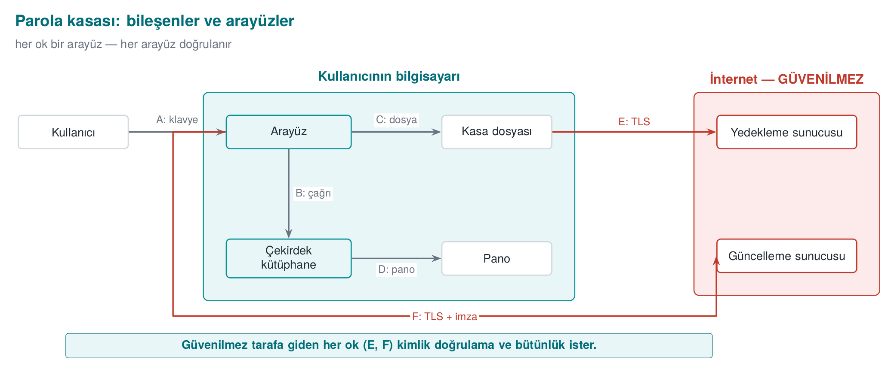
CEN429 Secure Programming · Week 1
Vault architecture — diagram
RTEU Computer Engineering · 2026-2027 Fall
85

Slide 86
CEN429 Secure Programming · Week 1
Step 3: Assets
# | Asset | Where | Creation → deletion | Protection
V1 | Master password | Memory only | Typed → derived → erased immediately | C
V2 | Vault key | Memory only | Derived → erased on lock | C, I
V3 | Decrypted record | Memory | Displayed → erased on close | C
V4 | Vault file | Disk, backup | Persistent | C, I
V5 | Salt, derivation parameter | File header | At creation | I
V6 | Update public key | Embedded in the app | At build time | I
Protection classes: C confidentiality · I integrity · I+ integrity + accountability · N none
RTEU Computer Engineering · 2026-2027 Fall
86

Slide 87
CEN429 Secure Programming · Week 1
Step 4: Threats
# | Where | Letter | Threat | Risk
--- | --- | :-: | --- | :-:
T1 | C / V4 | I | Stolen file, weak password brute-forced offline | 9
T2 | B / V1-2 | I | Password/key stays in memory → dump, swap | 6
T3 | D / V3 | I | Clipboard password read by another app | 6
T5 | C / V5 | T | Iteration count dropped to 1 | 3
T6 | F / V6 | T, E | A fake update is installed | 6
T8 | Process | T | A memory bug in the vault parser | 6
RTEU Computer Engineering · 2026-2027 Fall
87

Slide 88
CEN429 Secure Programming · Week 1
Step 3-4 (continued): remaining assets and threats
# | Asset/Threat | Detail | Value
V7 | Backup token | Disk (OS key store); created on connect → deleted on revoke | C
T4 | C / V4, T | Vault file is modified; a corrupted record is used without notice | Risk 4
T7 | E, S | A fake backup server steals the token | Risk 4
T9 | A, S | Master password read off the screen (shoulder surfing) | Risk 3
All nine threats must be in the table; a skipped threat is a threat that isn't closed.
RTEU Computer Engineering · 2026-2027 Fall
88

Slide 89
CEN429 Secure Programming · Week 1
Step 5: Countermeasures
Threat | Countermeasure | Layer
T1 | Slow derivation (Argon2id / high-iteration PBKDF2) + password strength requirement | 6, 2
T2 | Secure erase, mlock, disable dumps | 2
T3 | Clipboard cleared after 30 s | 1
T4-5 | Authenticated encryption; header = AAD; minimum iteration count hard-coded | 6, 2
T6 | Never run without verifying the signature; reject downgrades | 6
T8 | Length validation + fuzzing + compiler protections | 2, 3, 7
RTEU Computer Engineering · 2026-2027 Fall
89

Slide 90
CEN429 Secure Programming · Week 1
Step 5 (continued): T7 and T9 countermeasures
Threat | Countermeasure | Layer
T7 | Certificate validation + hostname check, optional certificate pinning | 6
T9 | Accept: mask the password on screen; physical observation is out of scope | —
The T9 example matters: not every threat needs a countermeasure added, sometimes accepting it is the right call.
RTEU Computer Engineering · 2026-2027 Fall
90

Slide 91
CEN429 Secure Programming · Week 1
Step 6–7: Verification and residual risk
Countermeasure | Test | Expected
Derivation | Time it | ≥ 250 ms
Erasure | Search a memory dump after lock for the password | Not found
Integrity | Modify one byte of the file | Says "corrupted," refuses to open, doesn't crash
Signature | A package with a broken signature | Rejected, logged
Residual risk: malware running with the same user while the vault is open · shoulder surfing · a very weak password
⚠️ A countermeasure with no test doesn't exist in an evaluator's eyes
RTEU Computer Engineering · 2026-2027 Fall
91

Slide 92
CEN429 Secure Programming · Week 1
Step 6 (continued): T5 and T8 tests
Countermeasure | Test | Expected
T5 parameter | Iteration count in the header set to 1 | The app rejects the file
T8 parser | 24 hours of fuzzing (week 4) | No crashes; no sanitizer findings
RTEU Computer Engineering · 2026-2027 Fall
92

Slide 93
CEN429 Secure Programming · Week 1
Step 7 (continued): residual risk — full table
Risk | Why accepted? | Re-evaluation
Memory can be read if malware runs while the vault is open | Full protection against same-user malware isn't possible; the lock timeout was kept short | Every release
Shoulder surfing (T9) | The physical environment is out of scope | —
Very weak master password | The user is warned but not forcibly blocked | Based on user feedback
RTEU Computer Engineering · 2026-2027 Fall
93

Slide 94
CEN429 Secure Programming · Week 1
Common mistakes
• Forgetting assets: keys, tokens, counters, configuration, the code itself
• Drawing the trust boundary wrong: treating your own client as "trusted"
• Not matching a countermeasure to a threat: "we use TLS" — which threat does it close, which doesn't it?
• A countermeasure with no test: saying "we erase it" without noticing the compiler removed the erasure (Demo 2)
RTEU Computer Engineering · 2026-2027 Fall
94
Notes:
Speaker note: These seven steps are the skeleton of the term project's security guide. This week, steps 0-4 are expected.

Slide 95
CEN429 Secure Programming · Week 1
5. Program start-up and secrets left in memory
RTEU Computer Engineering · 2026-2027 Fall
95

Slide 96
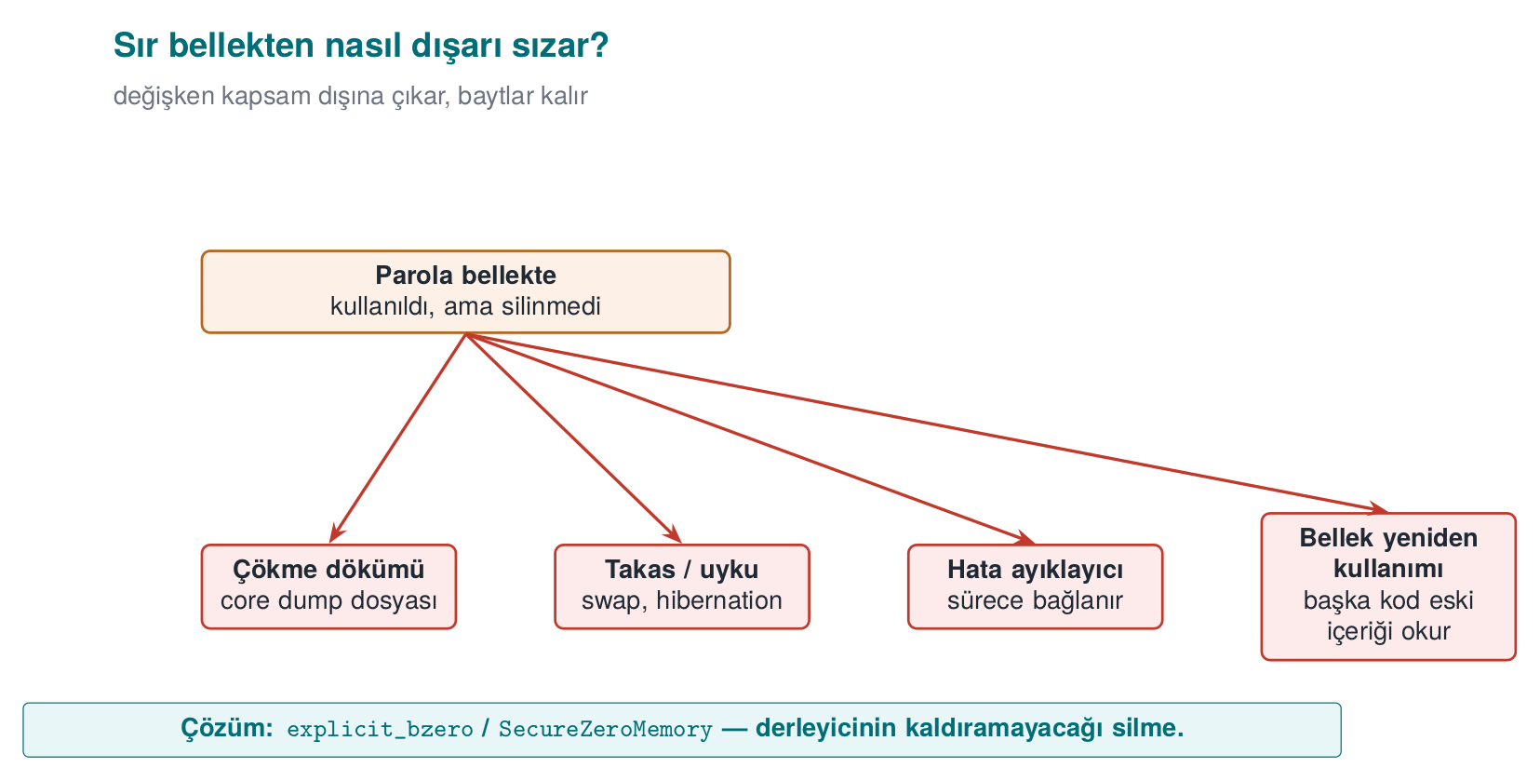
CEN429 Secure Programming · Week 1
How a secret leaks from memory — diagram
RTEU Computer Engineering · 2026-2027 Fall
96

Slide 97
CEN429 Secure Programming · Week 1
A program doesn't start with a blank page
What it inherits from whoever launched it:
• Environment variables: PATH, LD_PRELOAD, IFS…
• Open file descriptors, working directory, umask
• Resource limits, crash dump settings
If the program trusts these, whoever controls them controls the program. Book: Viega & Messier, Recipes 1.1–1.9
RTEU Computer Engineering · 2026-2027 Fall
97

Slide 98
CEN429 Secure Programming · Week 1
Demo 1 — Fooling via PATH (CWE-426)
int status = system(COMMAND); /* Linux: "date" Windows: "hostname" */
/* WHICH one will run? */
.demo.ps1 (Windows) · sh demo.sh (WSL / Linux)
STEP 2 - PATH="$PWD/fake:$PATH" ./bin/linux/report
Report date:
!!! FAKE 'date' ran !!!
STEP 3 - ./bin/linux/report_secure -> Report date: Sat Sep 26 ...
RTEU Computer Engineering · 2026-2027 Fall
98
Notes:
Speaker note: First show the fake/date file (fake\hostname.bat on Windows): it only prints a message. On Windows, cmd.exe searches the working directory before PATH too. Ask: "what would a real attacker do here?"

Slide 99
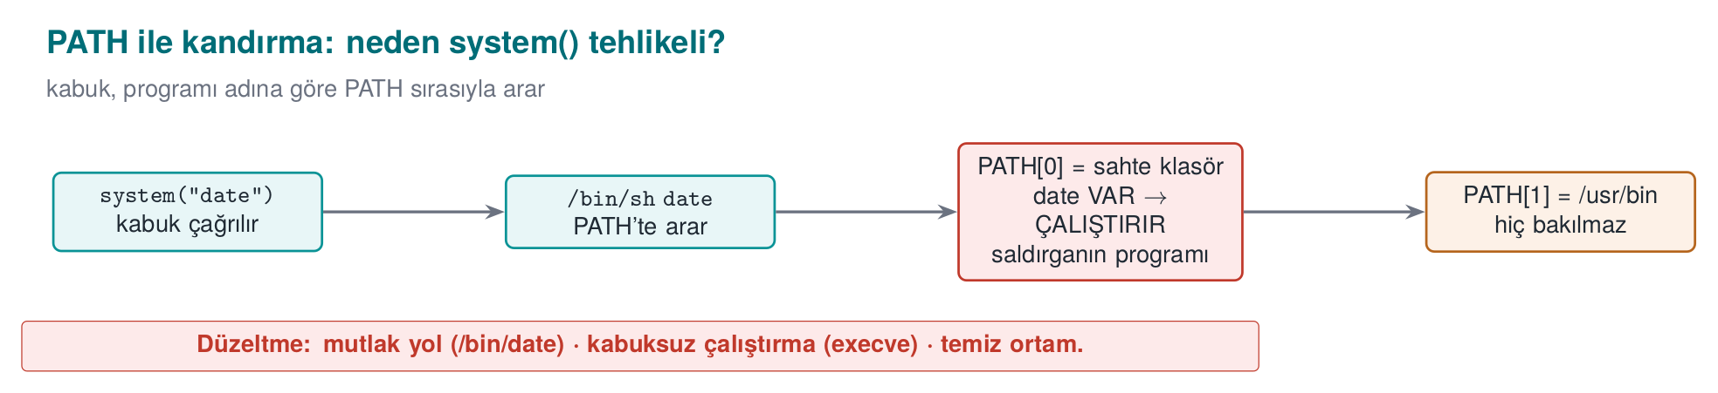
CEN429 Secure Programming · Week 1
Fooling via PATH — diagram
RTEU Computer Engineering · 2026-2027 Fall
99

Slide 100
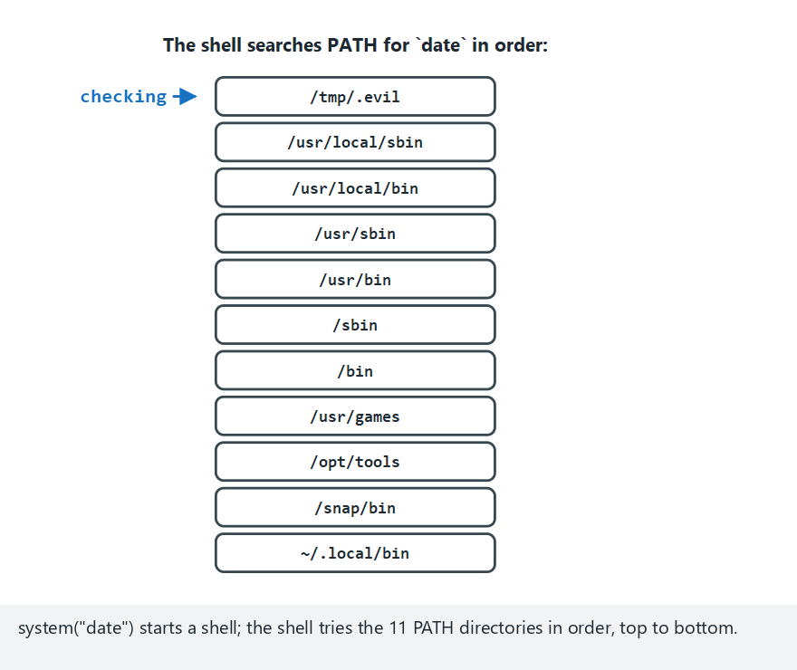
CEN429 Secure Programming · Week 1
PATH lookup — animation (the attack)
RTEU Computer Engineering · 2026-2027 Fall
100
Notes:
Speaker note: The fake directory is prepended to PATH; the shell finds the fake 'date' in the very first directory it tries and stops there. The real 'date' is never even checked.

Slide 101

CEN429 Secure Programming · Week 1
PATH lookup — edge case: the fake directory in the middle
RTEU Computer Engineering · 2026-2027 Fall
101
Notes:
Speaker note: The fake directory does not have to be first — anywhere before the real one is enough. Also show the "secure version" example (edge-secure-fix) from the picker: absolute path, no search.

Slide 102
CEN429 Secure Programming · Week 1
Fix: three rules
char *const args[] = { "date", NULL };
char *const clean_env[] = { "PATH=/usr/bin:/bin", "LANG=C", NULL };
posix_spawn(&pid, "/bin/date", NULL, NULL, args, clean_env);
1. Absolute path → no PATH search
2. No shell (posix_spawn / execve) → no special characters, no IFS
3. Clean environment → a known, small environment
Windows: CreateProcessW + System32hostname.exe + only SystemRoot
Best: avoid needing another program at all → strftime(), GetComputerNameW()
RTEU Computer Engineering · 2026-2027 Fall
102

Slide 103
CEN429 Secure Programming · Week 1
Secure start-up: what is inherited?
Inherited | Danger | Recipe
Environment variables | PATH, LD_PRELOAD change the program/library that loads | 1.1
Open file descriptors | The parent's hidden file leaks; if 0–2 are closed, the first file becomes "stdout" | 1.5
umask | 000 → world-writable files | 2.7
Resource limits | Core dump enabled → memory to disk | 1.9
Identity and privileges | setuid: more privilege than needed | 1.3
Rule: trust nothing you didn't set up yourself
RTEU Computer Engineering · 2026-2027 Fall
103

Slide 104
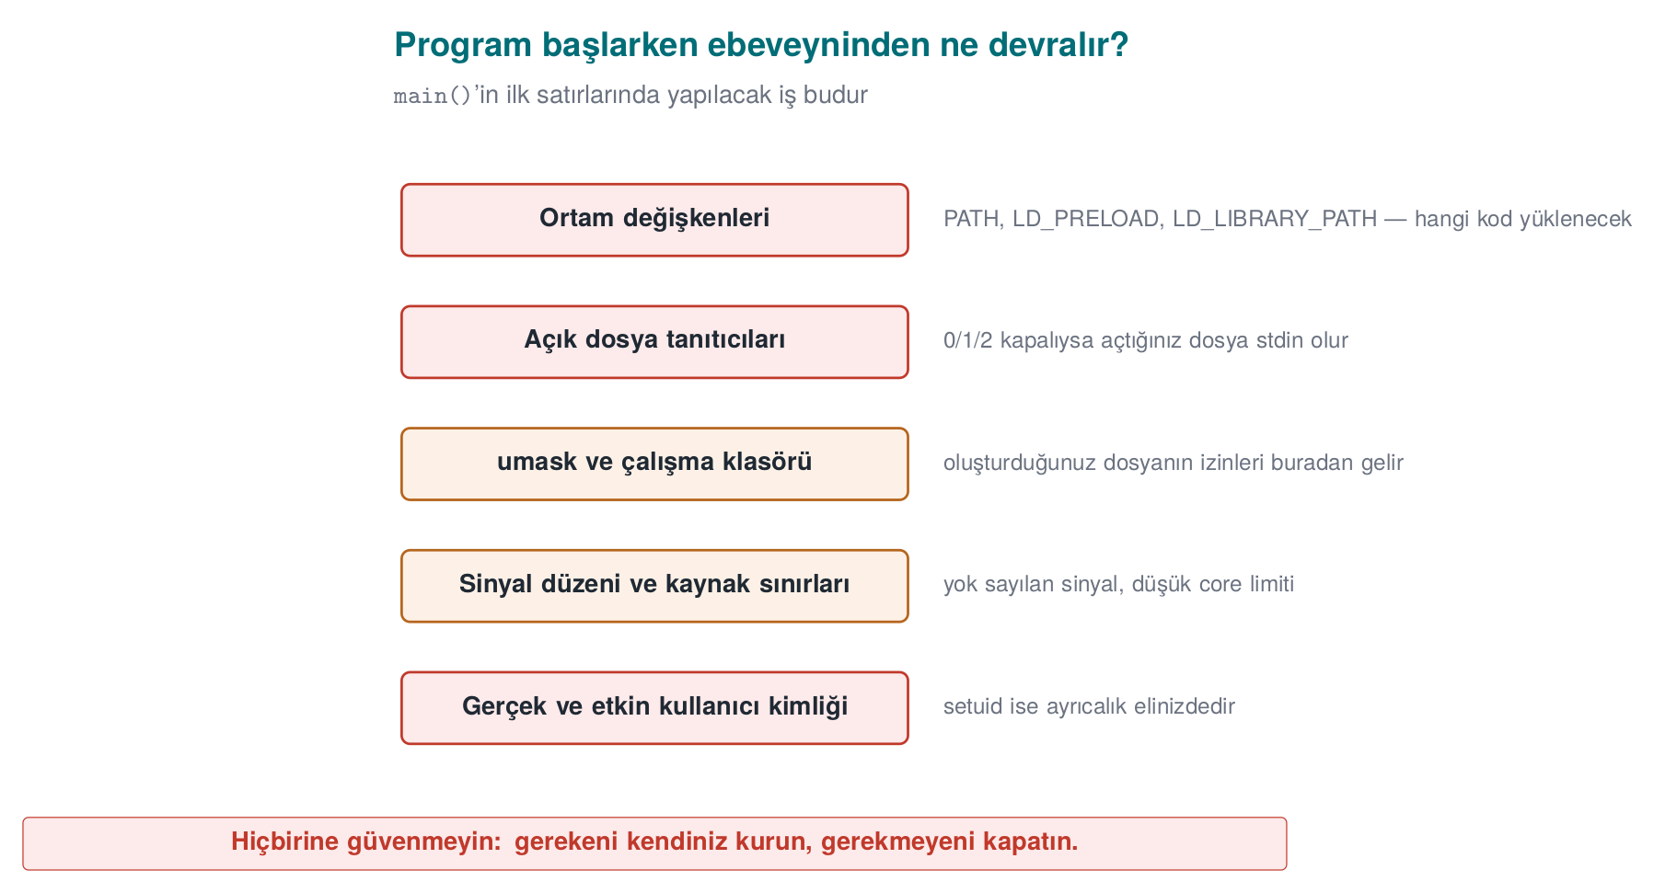
CEN429 Secure Programming · Week 1
What a program inherits — diagram
RTEU Computer Engineering · 2026-2027 Fall
104

Slide 105
CEN429 Secure Programming · Week 1
Other inherited risks: working directory, signals, dlopen
• Working directory: relative paths (./ayar.ini) can point into a folder the attacker chose
• Signal settings: signals the parent ignores are also ignored in the child
• `dlopen("lib.so")`: affected by LD_LIBRARY_PATH and search paths → use the full path; LD_* should already be cleaned in Step 1
Same rule: trust nothing the program itself did not set up.
RTEU Computer Engineering · 2026-2027 Fall
105

Slide 106
CEN429 Secure Programming · Week 1
Steps 1–2: Environment and descriptors
/* Environment: an ALLOWLIST, not a blocklist */
clearenv(); /* copy what you want to keep first! */
setenv("PATH", "/usr/bin:/bin", 1);
/* if 0-2 are closed, bind them to /dev/null, close the rest */
for (int fd = 0; fd <= 2; fd++)
if (fcntl(fd, F_GETFD) == -1 && open("/dev/null", O_RDWR) != fd) abort();
close_range(3, ~0U, 0); /* Linux 5.9+ */
• The getenv pointer becomes invalid after clearenv
• Always use O_CLOEXEC on your own files
RTEU Computer Engineering · 2026-2027 Fall
106

Slide 107
CEN429 Secure Programming · Week 1
Steps 3–4: Permissions and crash dumps
umask(077); /* rw------- */
int fd = open(path, O_WRONLY | O_CREAT | O_EXCL, 0600);
struct rlimit r = { 0, 0 };
setrlimit(RLIMIT_CORE, &r); /* dump size 0 */
prctl(PR_SET_DUMPABLE, 0, 0, 0, 0); /* + cannot be attached to via ptrace */
• Windows: SetErrorMode(SEM_FAILCRITICALERRORS | SEM_NOGPFAULTERRORBOX)
• The real defence: even if a dump is taken, no secret should be left inside it
RTEU Computer Engineering · 2026-2027 Fall
107
Notes:
Speaker note: Highlight PR_SET_DUMPABLE's second effect: even a debugger from the same user can't attach. A bridge to week 6.

Slide 108
CEN429 Secure Programming · Week 1
Step 5: Drop privilege permanently and verify
if (setresgid(g, g, g) != 0) abort(); /* 1. GROUP first */
if (setresuid(u, u, u) != 0) abort(); /* 2. then the user: all three r/e/s */
getresuid(&r, &e, &s);
if (r != u || e != u || s != u) abort(); /* 3. VERIFY */
• seteuid() is temporary: the saved identity stays privileged (week 2 Demo 13)
• Windows: a restricted token (CreateRestrictedToken)
• Better: privilege separation — a small privileged process + a large unprivileged one (Recipe 1.4)
RTEU Computer Engineering · 2026-2027 Fall
108

Slide 109
CEN429 Secure Programming · Week 1
Step 6: Loading programs and libraries
❌ Wrong | ✅ Correct
system("convert " + file) | execve("/usr/bin/convert", argv, clean_env)
execvp("convert", ...) | execve with a full path
CreateProcess(NULL, "C:Program Files...") | lpApplicationName = full path, quoted command line
LoadLibrary("helper.dll") | SetDefaultDllDirectories(LOAD_LIBRARY_SEARCH_DEFAULT_DIRS) + full path
The Windows DLL search order = the twin of the PATH problem (CWE-427)
RTEU Computer Engineering · 2026-2027 Fall
109

Slide 110
CEN429 Secure Programming · Week 1
All together: secure_startup()
int main(int argc, char **argv)
{
sanitize_file_descriptors(); /* 1. descriptors */
sanitize_environment(); /* 2. environment */
umask(077); /* 3. permissions */
disable_core_dump(); /* 4. dump */
drop_privileges(); /* 5. privilege */
/* ... the actual work ... */
}
Order matters: before doing anything else
RTEU Computer Engineering · 2026-2027 Fall
110
Notes:
Speaker note: An evaluator starts the program with stdout closed, a poisoned PATH/LD_PRELOAD, and umask 000. In the field, the native layer tests whether getenv is hooked with a setenv/getenv round-trip.

Slide 111
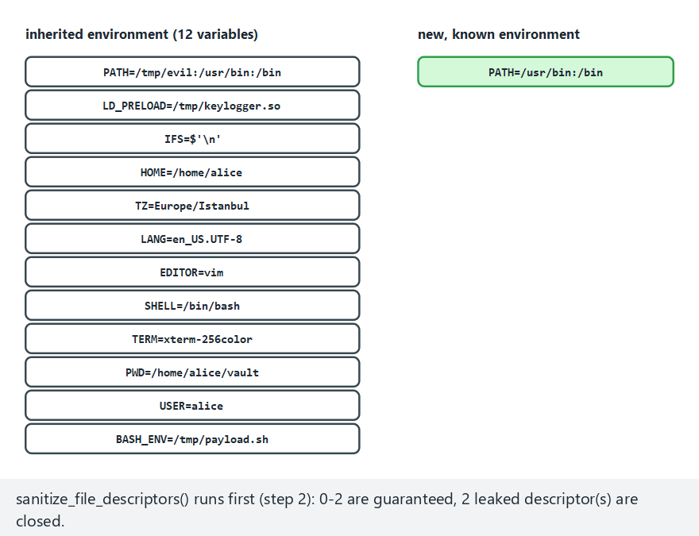
CEN429 Secure Programming · Week 1
Secure start-up pipeline (animation)
RTEU Computer Engineering · 2026-2027 Fall
111
Notes:
Speaker note: Stress that only a handful of the 12 inherited variables survive; why an allowlist beats a blocklist.

Slide 112
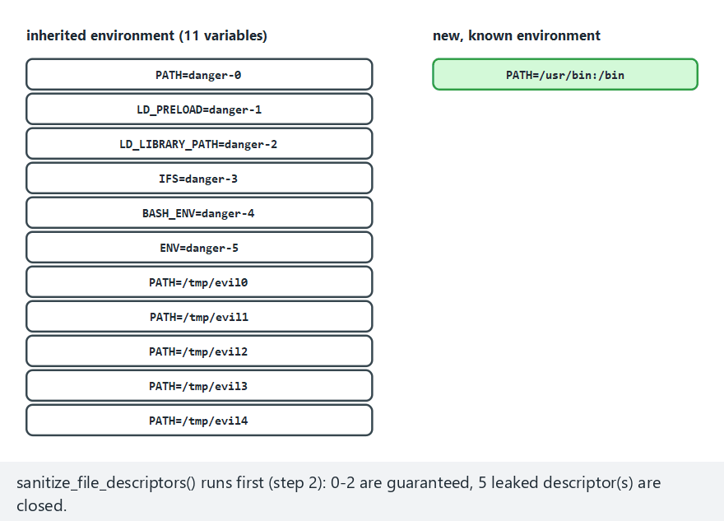
CEN429 Secure Programming · Week 1
Secure start-up — edge case: everything dangerous
RTEU Computer Engineering · 2026-2027 Fall
112
Notes:
Speaker note: Every known-dangerous variable is dropped; only PATH is forcibly set.

Slide 113
CEN429 Secure Programming · Week 1
Demo 2 — Password left in memory (CWE-14)
char password[64];
n = file_read(fd, password, sizeof(password) - 1);
key = derive_key(password, n);
memset(password, 0, sizeof(password)); /* version 2 */
explicit_bzero(password, sizeof(password)); /* version 3, Linux */
SecureZeroMemory(password, sizeof(password)); /* version 3, Windows */
Never wipes -> password FOUND in the dump
memset (-O2) -> password FOUND in the dump ← !!!
explicit_bzero -> password not found in the dump
RTEU Computer Engineering · 2026-2027 Fall
113
Notes:
Speaker note: On Linux the demo stops the program with gdb and dumps memory with gcore; on Windows the program writes its own memory with MiniDumpWriteDump. This is a safe simulation of a crash dump or debugger attack. MSVC /O2 also removes the memset. Machine code: objdump -d on Linux, the Disassembly window in Visual Studio.

Slide 114
CEN429 Secure Programming · Week 1
Why did the memset disappear?
The compiler's reasoning:
"password is never read after this point. Writing zeros into it doesn't change the result. Redundant — I'll remove it."
Dead store elimination: good for speed, a disaster for secrets.
Platform | Erasure that can't be removed
Linux (glibc) | explicit_bzero
Windows | SecureZeroMemory
C11 Annex K | memset_s
OpenSSL | OPENSSL_cleanse
+ setrlimit(RLIMIT_CORE, 0) · mlock · keep the secret short-lived, don't copy it
RTEU Computer Engineering · 2026-2027 Fall
114

Slide 115
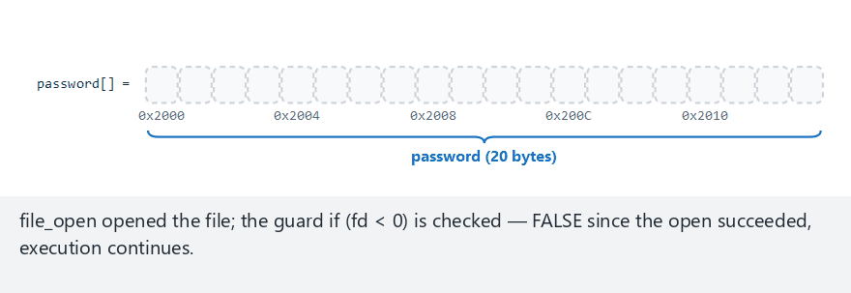
CEN429 Secure Programming · Week 1
Password in memory (animation)
RTEU Computer Engineering · 2026-2027 Fall
115
Notes:
Speaker note: With WIPE=1, memset is written but the compiler removes it; the password is still in the dump.

Slide 116
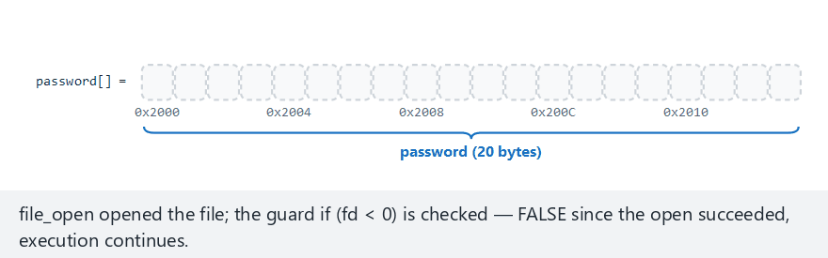
CEN429 Secure Programming · Week 1
Password in memory — edge case: genuine wipe
RTEU Computer Engineering · 2026-2027 Fall
116
Notes:
Speaker note: The same byte array is genuinely zeroed this time — nothing left in the dump.

Slide 117
CEN429 Secure Programming · Week 1
6. Process memory and overflows
RTEU Computer Engineering · 2026-2027 Fall
117

Slide 118
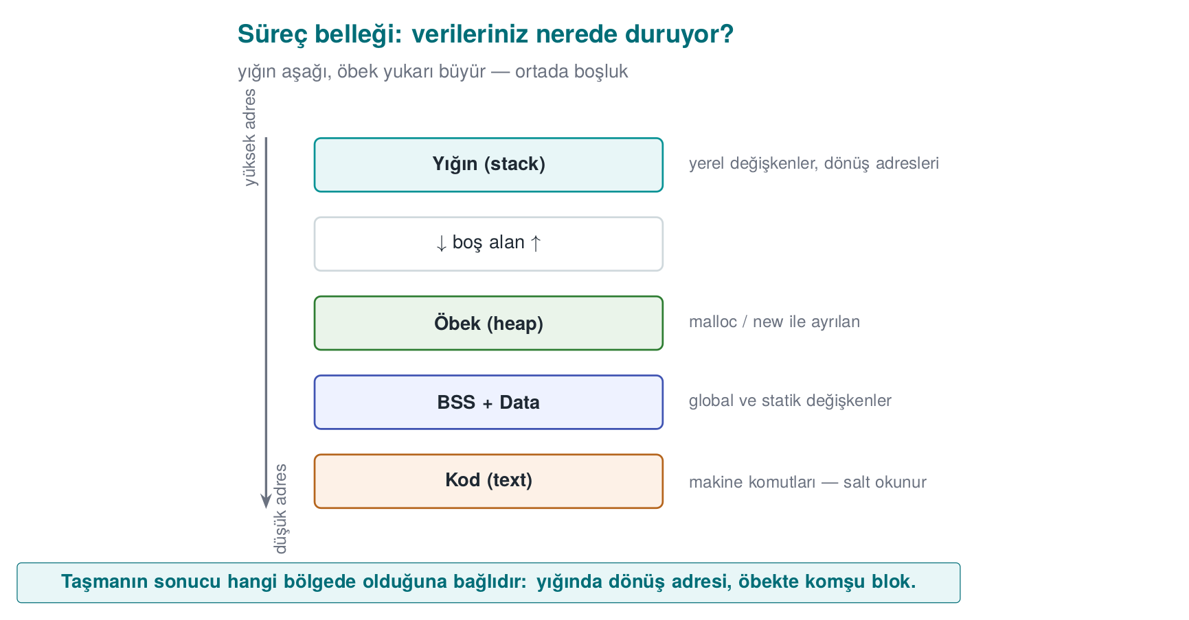
CEN429 Secure Programming · Week 1
Process memory
C does not check the end of an array. A 17th byte into name[16] → overwrites the next variable.
RTEU Computer Engineering · 2026-2027 Fall
118

Slide 119
CEN429 Secure Programming · Week 1
The structure in memory
struct session { char name[16]; int admin; };
offset: 0 ............................ 15 | 16 17 18 19
[ a l i c e \0 . . . . . ][ 00 00 00 00 ] admin = 0
"AAAAAAAAAAAAAAAAB" (17 characters) copied in:
[ A A A A A A A A A A A ][ 42 00 00 00 ] admin = 66 (!)
'B' '\0'
Little-endian: the lowest byte sits at the lowest address.
RTEU Computer Engineering · 2026-2027 Fall
119

Slide 120
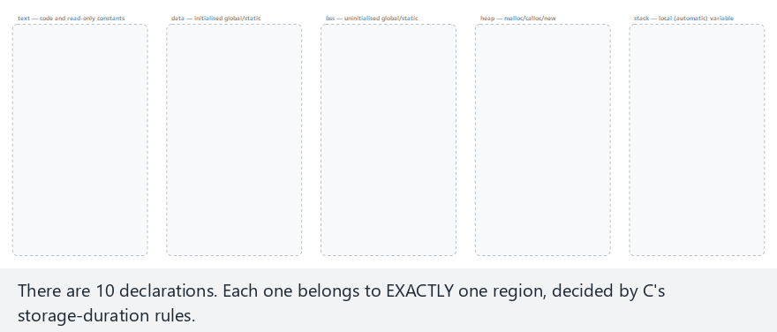
CEN429 Secure Programming · Week 1
Process memory (animation)
RTEU Computer Engineering · 2026-2027 Fall
120
Notes:
Speaker note: Even inside the same function, variables can live in different regions — it's the declaration, not the type, that decides.

Slide 121
CEN429 Secure Programming · Week 1
Process memory — edge case: everything on the heap
RTEU Computer Engineering · 2026-2027 Fall
121
Notes:
Speaker note: Remind them that everything malloc/calloc'd lives on the heap, while the pointer variable itself lives elsewhere.

Slide 122
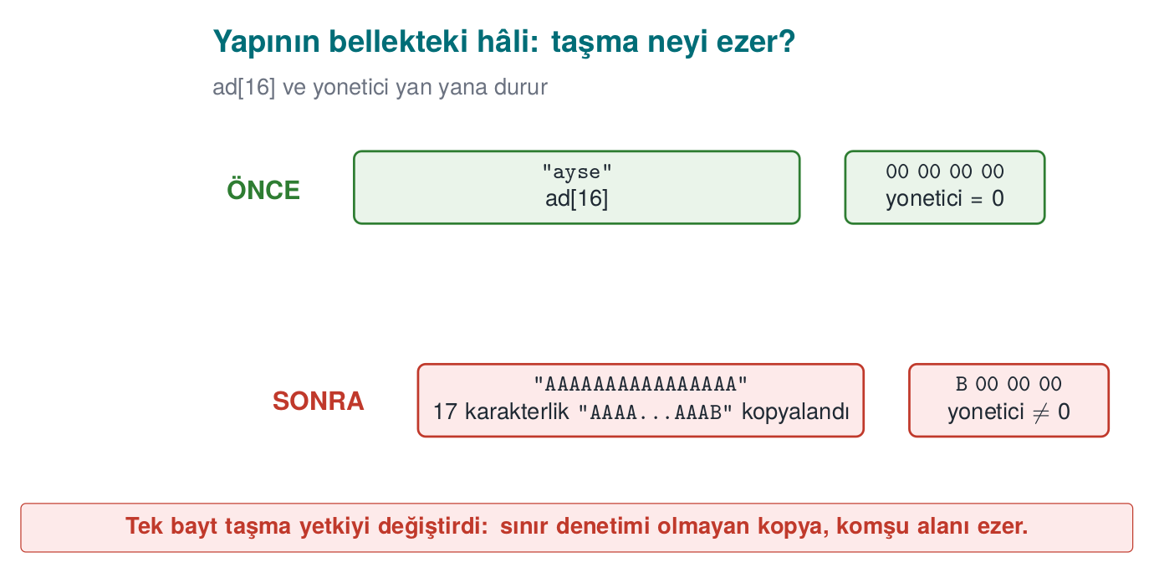
CEN429 Secure Programming · Week 1
Structure in memory and overflow — diagram
RTEU Computer Engineering · 2026-2027 Fall
122

Slide 123
CEN429 Secure Programming · Week 1
What is a buffer overflow?
Writing more data than allocated into an array → the overflowing bytes land over neighboring variables
Why does C overflow so easily?
1. An array doesn't know its own size
2. Only the starting address goes to the function
3. A string = an array ending in '0'; strcpy never asks the target's size
4. The compiler adds no bounds checking
CWE-787 "out-of-bounds write": always near the top of the CWE Top 25
RTEU Computer Engineering · 2026-2027 Fall
123

Slide 124
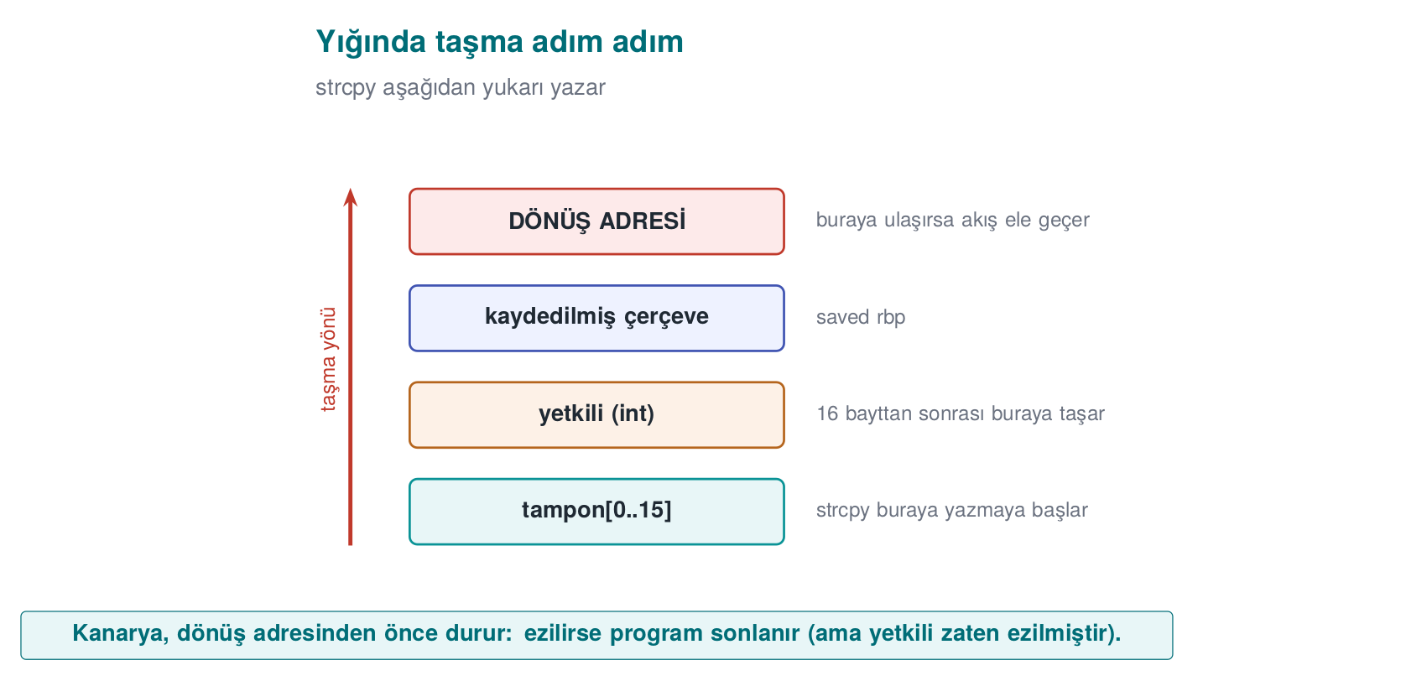
CEN429 Secure Programming · Week 1
A stack overflow
void greet_user(const char *name) {
int authorized = 0;
char buffer[16];
strcpy(buffer, name); /* name > 15 characters? */
}
RTEU Computer Engineering · 2026-2027 Fall
124
Notes:
Speaker note: The real layout varies by compiler. In this course we focus on how the bug happens, is found, and is prevented — not on the exploitation technique.

Slide 125
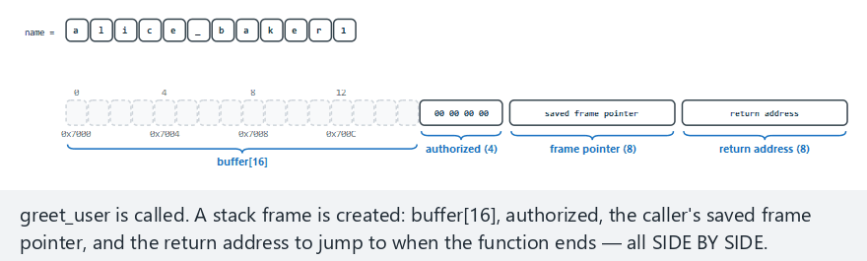
CEN429 Secure Programming · Week 1
The stack frame (animation)
RTEU Computer Engineering · 2026-2027 Fall
125
Notes:
Speaker note: buffer, authorized, the saved frame pointer and the return address sit side by side; show which one is smashed as the overflow grows.

Slide 126
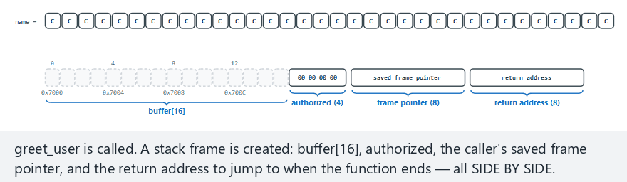
CEN429 Secure Programming · Week 1
Stack frame — edge case: return address smashed
RTEU Computer Engineering · 2026-2027 Fall
126
Notes:
Speaker note: Tie this back to Aleph One's 1996 article — this is exactly "smashing the stack".

Slide 127
CEN429 Secure Programming · Week 1
Types of overflow
Type | Typical cause | CWE
Stack overflow | strcpy, gets, unbounded scanf("%s") | 121
Heap overflow | A memcpy with the wrong length | 122
Off-by-one | <= instead of <; no room for '0' | 193
Out-of-bounds read | Trusting a length the other party reports | 125
Integer-driven | n * size overflows → small block, large copy | 190 → 787
RTEU Computer Engineering · 2026-2027 Fall
127

Slide 128
CEN429 Secure Programming · Week 1
Heartbleed (2014): nothing was written
• Client: "I'm sending 1 byte, but reporting 64 KB"
• Server: sent 64 KB back without checking the declared length
• Leaked: passwords, sessions, even the server's private key
• CVE-2014-0160 · CWE-125 · Fix: a single length check
➡️ An out-of-bounds read is as dangerous as a write; it doesn't crash, leaves no trace
RTEU Computer Engineering · 2026-2027 Fall
128

Slide 129
CEN429 Secure Programming · Week 1
The off-by-one bug
char name[8];
for (int i = 0; i <= 8; i++) /* 9 times: name[8] is out of bounds */
name[i] = source[i];
strncpy(name, source, sizeof name); /* source >= 8 -> no '\0' */
printf("%s\n", name); /* keeps reading past the end */
• strncpy is not a safe strcpy
• Even a single-byte overflow changes the low byte of a neighboring variable
RTEU Computer Engineering · 2026-2027 Fall
129

Slide 130
CEN429 Secure Programming · Week 1
Dangerous functions → use instead
❌ | ✅
gets(s) | fgets(s, sizeof s, stdin) — gets removed in C11
strcpy(d, s) | Length check + memcpy, snprintf, strlcpy (glibc 2.38+)
strcat(d, s) | Compute remaining room; snprintf, strlcat
sprintf(d, ...) | snprintf(d, sizeof d, ...) + check the return value
scanf("%s", s) | scanf("%15s", s)
memcpy(d, s, n) | First check n <= sizeof d
char a[n] (VLA), alloca | A fixed upper bound, or malloc
Today's Recipe 3.3–3.4: snprintf/strlcpy, MSVC strcpy_s, C++ std::string/span
RTEU Computer Engineering · 2026-2027 Fall
130

Slide 131
CEN429 Secure Programming · Week 1
The right pattern: validate first, then copy with a bound
int greet_user(const char *name)
{
char buffer[16];
size_t n = strnlen(name, sizeof buffer); /* read at most 16 bytes */
if (n == sizeof buffer) /* too long: REJECT */
return -1;
memcpy(buffer, name, n);
buffer[n] = '\0'; /* always terminate */
printf("Hello %s\n", buffer);
return 0;
}
Why reject instead of truncate? /home/ayse/gizli_rapor.txt → /home/ayse/gizli
RTEU Computer Engineering · 2026-2027 Fall
131

Slide 132
CEN429 Secure Programming · Week 1
C++: the type carries the size — but be careful
void greet_user(const std::string &name) {
if (name.size() > 15) throw std::invalid_argument("name too long");
std::cout << "Hello " << name << '\n';
}
• vector::operator[] does not check bounds → at() does
• Writing through a pointer taken with c_str() → all of C's problems come back
RTEU Computer Engineering · 2026-2027 Fall
132

Slide 133
CEN429 Secure Programming · Week 1
Who catches the overflow?
Layer | Tool | When?
Code | Bounds checking, safe API | Always
Warning | -Wall -Wextra -Wformat-security · /W4 /sdl | Development
Static analysis | clang --analyze, cppcheck, /analyze | CI
Sanitizer | -fsanitize=address · /fsanitize=address | Testing
Fuzzing | libFuzzer, AFL++ | Testing (week 4)
Compiler | Canary -fstack-protector-strong · /GS, _FORTIFY_SOURCE | Release
OS / hardware | DEP/NX, ASLR · Intel CET, ARM PAC | Release
⚠️ Protection makes exploitation harder, it doesn't fix the bug — a canary terminates the program = denial of service
RTEU Computer Engineering · 2026-2027 Fall
133

Slide 134
CEN429 Secure Programming · Week 1
Reading an ASan report
ERROR: AddressSanitizer: stack-buffer-overflow
WRITE of size 21 at 0x7ffd... thread T0
#0 in strcpy
#1 in greet_user example.c:7
#2 in main example.c:15
This frame has 1 object(s):
[32, 48) 'buffer' <== Memory access at offset 48 overflows this variable
1. What? a stack overflow, a 21-byte write
2. Where? example.c:7, strcpy
3. Which variable? buffer (16 bytes), the access is right past the bound
Roughly 2× slower → only in test builds
RTEU Computer Engineering · 2026-2027 Fall
134
Notes:
Speaker note: An evaluator first greps for dangerous functions, then checks whether every externally supplied length field is validated; checks protections with checksec / dumpbin.

Slide 135
CEN429 Secure Programming · Week 1
Demo 3 — Privilege escalation via overflow (CWE-121)
.demo.ps1 (Windows) · sh demo.sh (WSL / Linux)
Version | 17-character attack
login (unprotected) | ❌ ADMIN access granted
login_asan (ASan) | ❌ stayed silent — overflow inside the struct
login_asan + 40 characters | ✅ stack-buffer-overflow caught
login_checked (_FORTIFY_SOURCE=2 / strcpy_s) | ✅ program stopped
login_secure | ✅ Rejected
RTEU Computer Engineering · 2026-2027 Fall
135
Notes:
Speaker note: The real point: a single byte is enough; tools have limits; the real fix is in the code.

Slide 136
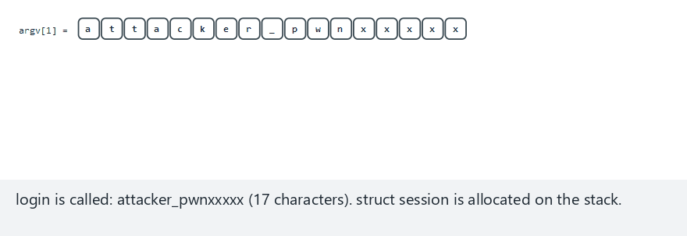
CEN429 Secure Programming · Week 1
Overflow — animation (17 bytes, sets admin)
RTEU Computer Engineering · 2026-2027 Fall
136
Notes:
Speaker note: Byte 17 (the last character itself, not the terminating NUL) lands on admin's first byte, making admin nonzero. The program counter stays on the strcpy line at every step.

Slide 137
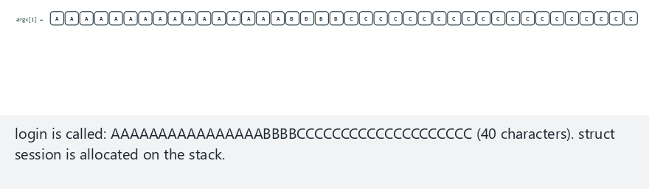
CEN429 Secure Programming · Week 1
Overflow — edge case: past the whole struct (40 bytes, ASan)
RTEU Computer Engineering · 2026-2027 Fall
137
Notes:
Speaker note: Also show, live, the "exactly 16 bytes" example (only the terminating NUL spills, admin can stay 0) and "the secure version rejects it" from the picker.

Slide 138
CEN429 Secure Programming · Week 1
Fix: validate, then copy with a bound
/* Allow-list: 1-15 characters, letters/digits/_/- */
static int name_is_valid(const char *s)
{
size_t n = strnlen(s, 16);
if (n == 0 || n >= 16) return 0;
for (size_t i = 0; i < n; i++) {
unsigned char c = (unsigned char)s[i];
if (!isalnum(c) && c != '_' && c != '-') return 0;
}
return 1;
}
struct session s = { .admin = 0 }; /* secure default */
snprintf(s.name, sizeof(s.name), "%s", argv[1]); /* a copy that knows the size */
Canary, NX, ASLR (week 4) make exploitation harder, they don't fix the bug.
RTEU Computer Engineering · 2026-2027 Fall
138

Slide 139
CEN429 Secure Programming · Week 1
Integers: when does -1 become huge?
int is signed · size_t is unsigned · negatives are two's complement
int -1 = 0xFFFFFFFFFFFFFFFF
size_t = 18 446 744 073 709 551 615
if (length > 16) return -1; /* -1 gets PAST this check */
memcpy(dest, source, length); /* int -> size_t */
RTEU Computer Engineering · 2026-2027 Fall
139

Slide 140
CEN429 Secure Programming · Week 1
Demo 4 — Signed length (CWE-195)
STEP 0 GCC -Wall -Wextra: silent · -Wsign-conversion: warning
MSVC (C): silent · the same code as C++: C4365
STEP 1 copy 8 -> Copied: SAMPLE-R
STEP 2 copy 100 -> Rejected
STEP 3 copy -1 -> Linux: SIGSEGV (139) · Windows: 0xC0000409
STEP 4 ASan -> negative-size-param: (size=-1)
STEP 5 copy_secure -1 / 12abc -> Rejected
Rule: sizes in size_t · lower and upper bound · strtol · turn on warnings
RTEU Computer Engineering · 2026-2027 Fall
140

Slide 141
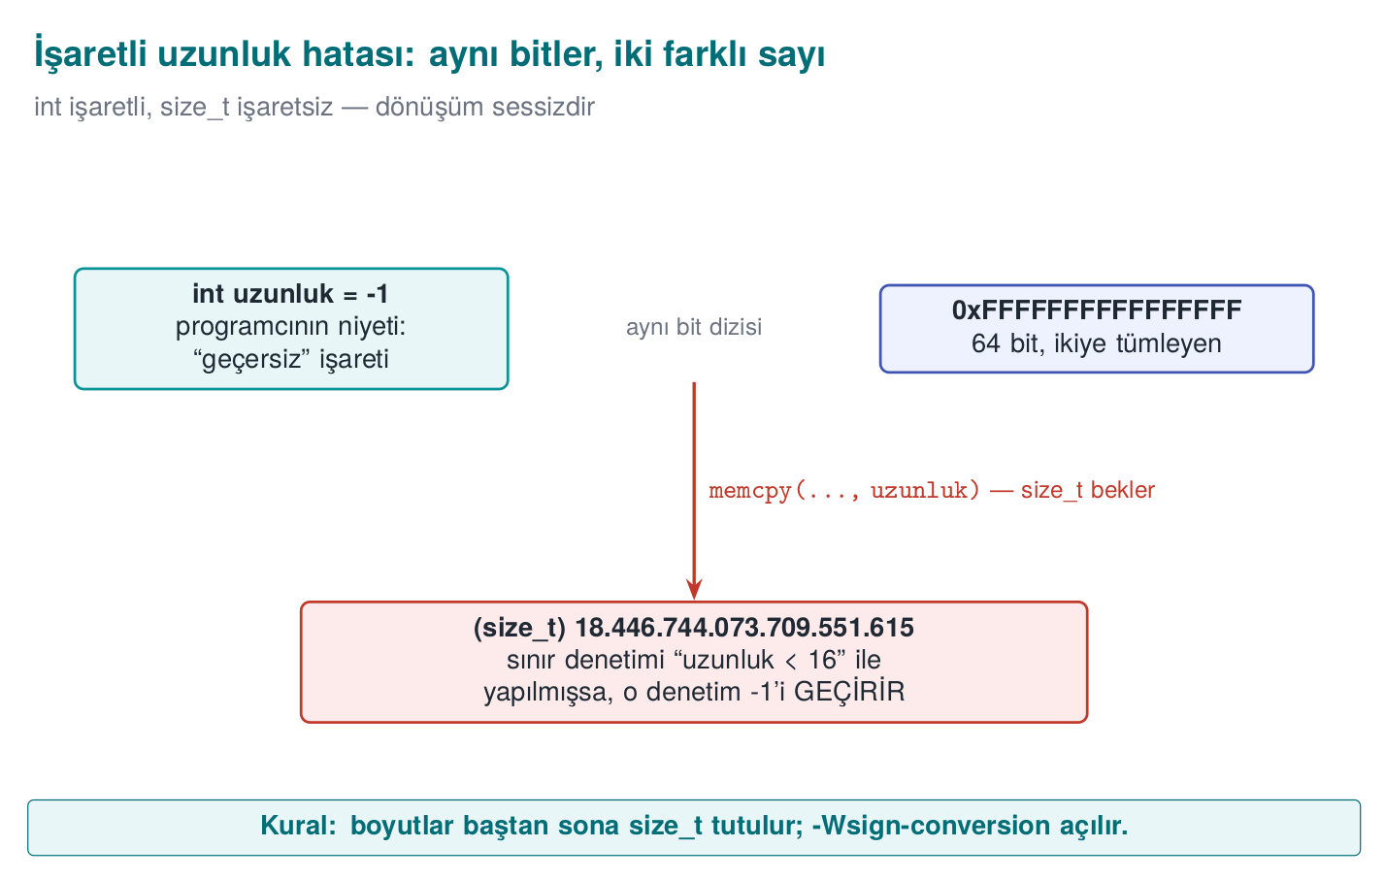
CEN429 Secure Programming · Week 1
The signed length bug — diagram
RTEU Computer Engineering · 2026-2027 Fall
141

Slide 142
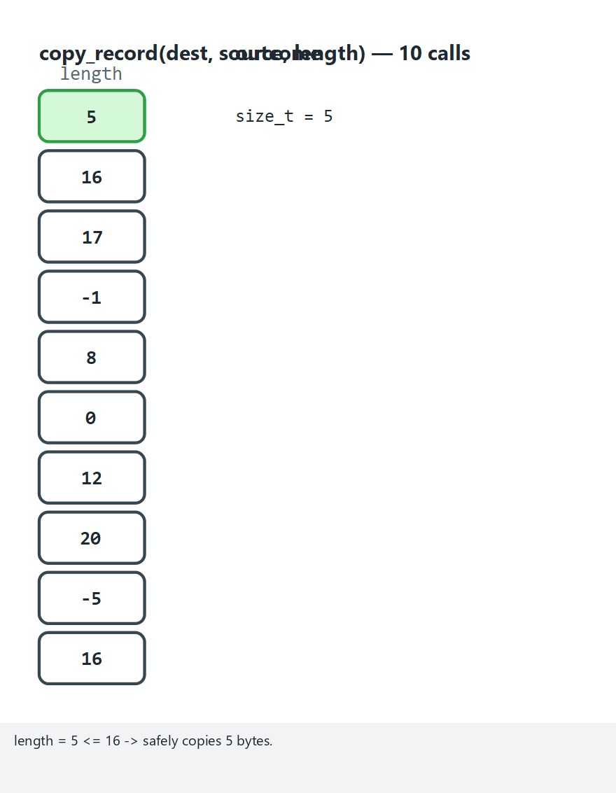
CEN429 Secure Programming · Week 1
Signed-length sweep (animation)
RTEU Computer Engineering · 2026-2027 Fall
142
Notes:
Speaker note: Stress how -1 becomes 18446744073709551615; the check only looks at the upper bound.

Slide 143
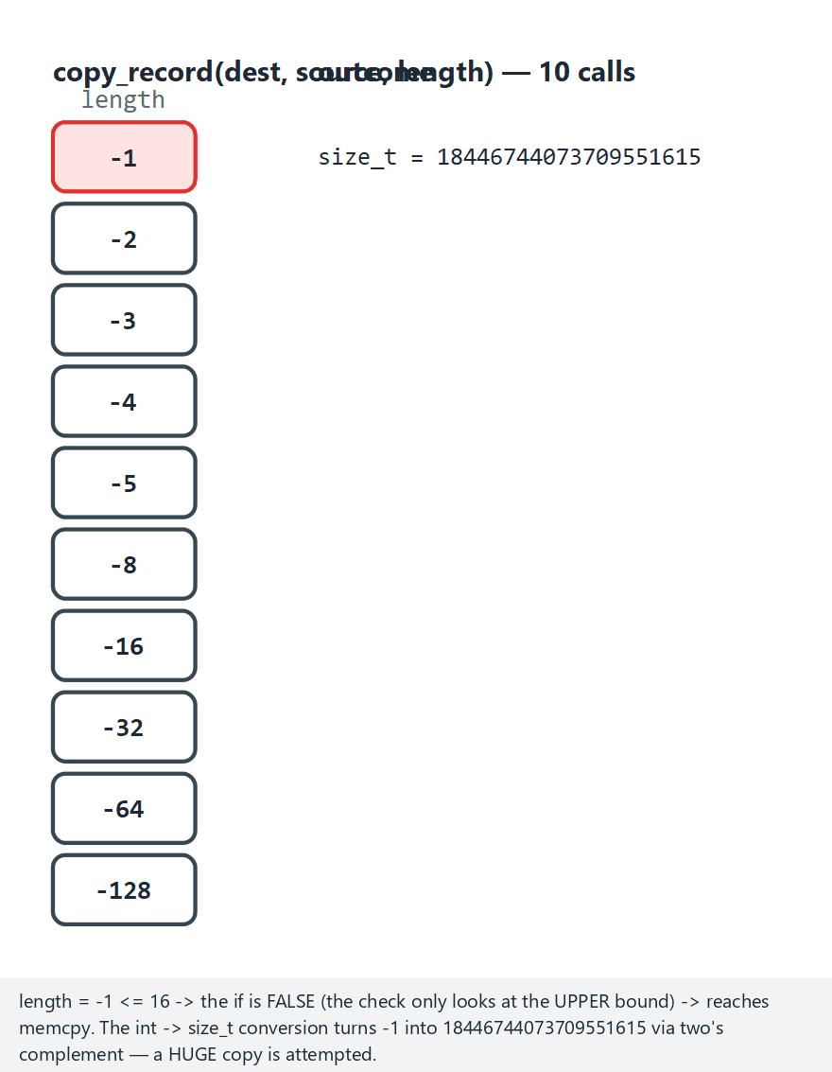
CEN429 Secure Programming · Week 1
Signed length — edge case: all negative
RTEU Computer Engineering · 2026-2027 Fall
143
Notes:
Speaker note: A single lower-bound check (length < 0) would have stopped every one of these.

Slide 144
CEN429 Secure Programming · Week 1
7. Memory management, partitioning, and secure processing
RTEU Computer Engineering · 2026-2027 Fall
144

Slide 145
CEN429 Secure Programming · Week 1
The lifecycle of dynamic memory
Allocate → validate → use → erase secret → free once → forget the pointer
Step | If forgotten | CWE
Validate | malloc returns NULL, unchecked → crash | 476
Use | Out-of-bounds write | 787
Erase secret | The block goes to another piece of code on the next malloc | 226
Free once | Double free | 415
Forget the pointer | Use-after-free (UAF) | 416
Never free | Leak → denial of service | 401
RTEU Computer Engineering · 2026-2027 Fall
145

Slide 146
CEN429 Secure Programming · Week 1
The four lifetimes of memory
Lifetime | How created? | When does it end? | Typical bug
Static | Global variable, static local | When the program ends | Multiple threads writing at once
Automatic | Local variable inside a function | On return | Returning the address of a local variable
Dynamic | malloc/calloc/new | On free/delete | Leak, double free, UAF
Thread | _Thread_local / thread_local | When the thread ends | —
This week's overflow and UAF examples all relate to the dynamic lifetime; knowing that alone isn't enough.
RTEU Computer Engineering · 2026-2027 Fall
146

Slide 147
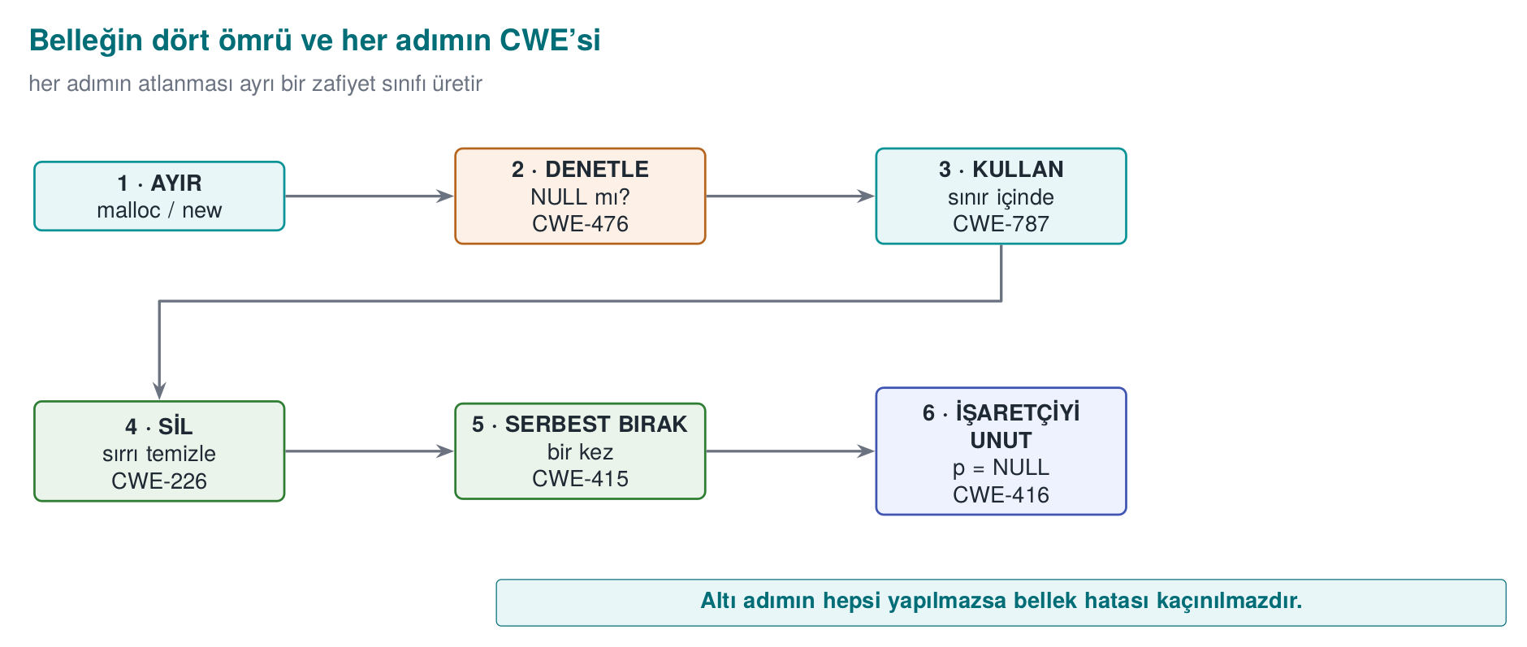
CEN429 Secure Programming · Week 1
The lifetime of memory and its CWEs — diagram
RTEU Computer Engineering · 2026-2027 Fall
147

Slide 148
CEN429 Secure Programming · Week 1
UAF: why is it so dangerous?
User *active = malloc(sizeof *active);
User *cached = active; /* a second owner */
free(active); active = NULL; /* cached is still at the old address */
char *note = malloc(sizeof(User)); /* the allocator may hand back the same block */
strcpy(note, "....");
if (cached->privilege) { ... } /* reading 'note's bytes */
• free doesn't return memory to the OS, it puts it on the free list → the same block gets handed out again
• ✅ Ownership rule: every block has one owner, only that owner frees it
RTEU Computer Engineering · 2026-2027 Fall
148

Slide 149
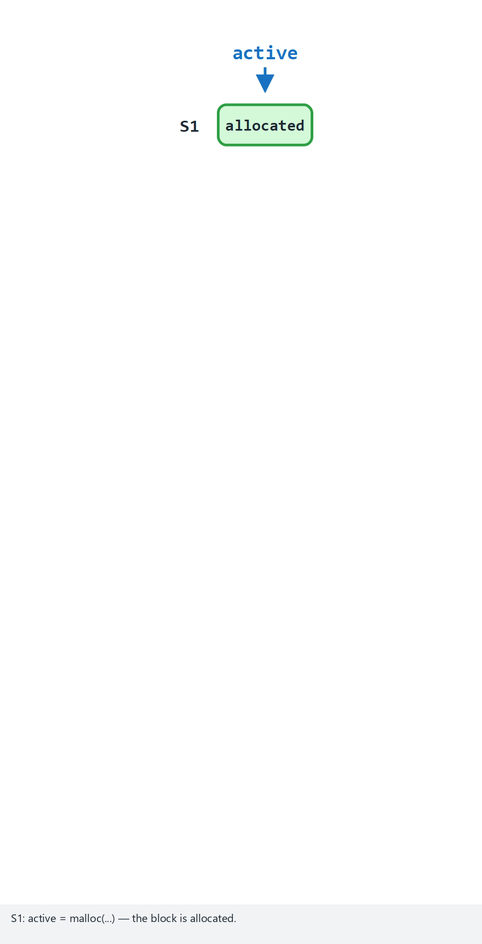
CEN429 Secure Programming · Week 1
A tour of memory mistakes (animation)
RTEU Computer Engineering · 2026-2027 Fall
149
Notes:
Speaker note: Ask students to guess which of the 10 sessions is clean, a leak, a double free, or a UAF before revealing each one.

Slide 150
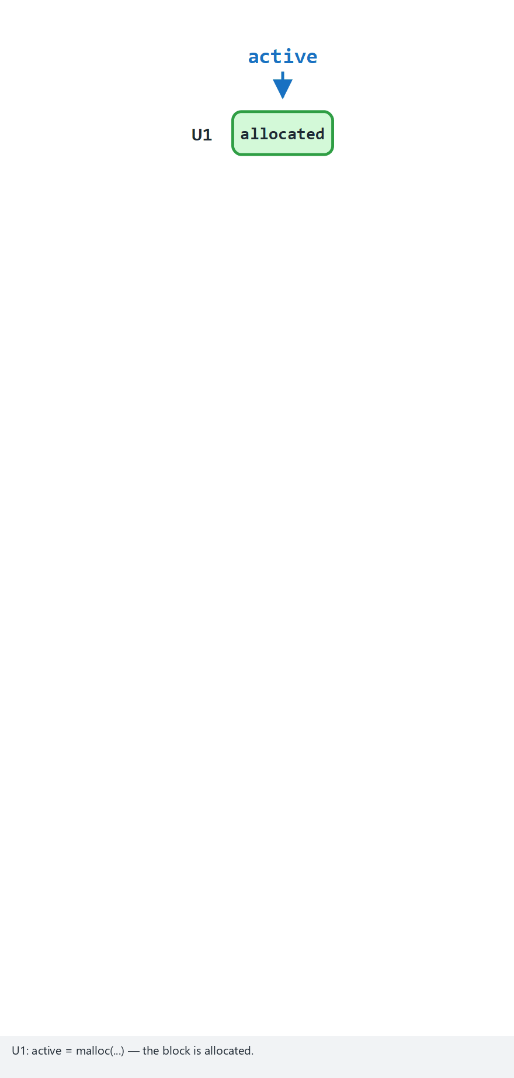
CEN429 Secure Programming · Week 1
Memory mistakes — edge case: all UAF
RTEU Computer Engineering · 2026-2027 Fall
150
Notes:
Speaker note: The same pattern repeats 10 times — stress how easily a UAF reproduces.

Slide 151
CEN429 Secure Programming · Week 1
Fixed patterns
Record *k = calloc(n, sizeof(Record)); /* checks the multiplication for overflow + zeroes */
if (k == NULL) return ERR_MEMORY;
Record *resized = reallocarray(k, n2, sizeof(Record));
if (resized == NULL) { free(k); return ERR_MEMORY; } /* do not lose k */
k = resized;
❌ buffer = realloc(buffer, n); → on failure, the old block is lost
❌ realloc on a buffer holding a secret → the moved-away old block isn't zeroed
RTEU Computer Engineering · 2026-2027 Fall
151

Slide 152
CEN429 Secure Programming · Week 1
Erasing secrets (Recipe 13.2)
Platform | Function
Linux, BSD | explicit_bzero(p, n)
Windows | SecureZeroMemory(p, n)
C11 Annex K / C23 | memset_s / memset_explicit
None available | Byte by byte through a volatile pointer
Hidden copies of a secret: structs passed by value · realloc's old block · std::string (SSO, vanishes without erasure) · I/O buffers · swap and hibernation files
RTEU Computer Engineering · 2026-2027 Fall
152
Notes:
Speaker note: In the field, session data is erased with random values the moment the operation ends; even a long run of zeros leaves a "there was a secret here" trace.

Slide 153
CEN429 Secure Programming · Week 1
Keep it off disk (Recipe 13.3) and RAII
mlock(key, sizeof key); /* Windows: VirtualLock */
/* ... use it ... */
secure_wipe(key, sizeof key);
munlock(key, sizeof key);
class SecretKey { /* destructor wipes automatically */
~SecretKey() { secure_wipe(v_.data(), v_.size()); }
SecretKey(const SecretKey&) = delete; /* copy = a second secret */
};
Locking is at the page level, and limited in amount → only a small key region
RTEU Computer Engineering · 2026-2027 Fall
153

Slide 154
CEN429 Secure Programming · Week 1
Memory-bug hunters
Tool | What it finds | Use
AddressSanitizer | Overflow, UAF, double free | -fsanitize=address · /fsanitize=address
LeakSanitizer | Leaks | With ASan (Linux)
MemorySanitizer | Uninitialized reads | Clang -fsanitize=memory
Valgrind | Everything (slow) | valgrind --leak-check=full ./prog
CRT debug heap | Leaks | MSVC _CrtSetDbgFlag
Evaluator: dumps memory after the process ends, searches for the test password
RTEU Computer Engineering · 2026-2027 Fall
154

Slide 155
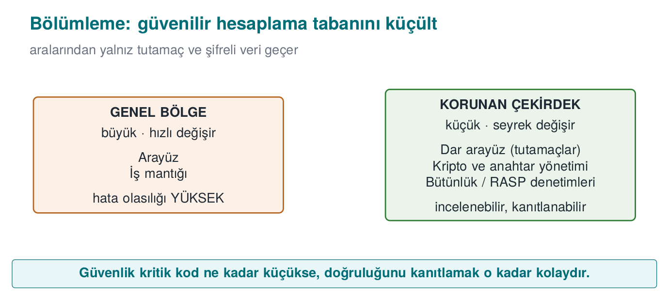
CEN429 Secure Programming · Week 1
Protected code partitioning: shrink the TCB
Trusted Computing Base (TCB): all the code where "if it's buggy, security collapses"
• A 200,000-line application, a 2,000-line protected core
• Review, obfuscation, integrity checking only for the core → cost stays there too
RTEU Computer Engineering · 2026-2027 Fall
155

Slide 156
CEN429 Secure Programming · Week 1
Partitioning options
Option | Isolation | Example
Separate module, same process | Low | A native library in a Java app
Separate process | Medium | Browser sandbox, privileged helper process (Recipe 1.4)
OS service | Medium–high | DPAPI, Keychain, Android Keystore
Hardware | High | Secure element, TPM, TEE
Move to server | Highest | The secret never goes to the client, stays in the HSM
Strongest: remove the secret from the client; failing that, hardware; failing that, software protection (this course's topic)
RTEU Computer Engineering · 2026-2027 Fall
156

Slide 157
CEN429 Secure Programming · Week 1
Interface: narrow, validated, secret-free
typedef struct VaultKey VaultKey; /* opaque type */
int vault_open(const char *password, size_t n, const unsigned char salt[16],
VaultKey **out); /* wipes the password */
int vault_decrypt(VaultKey *a, const unsigned char *cipher, size_t n,
unsigned char *plain, size_t capacity, size_t *written);
void vault_close(VaultKey *a); /* wipes the key */
1. Don't hand out the secret, do the work (a handle)
2. Validate everything that crosses the boundary
3. Never pass plain data across the boundary
RTEU Computer Engineering · 2026-2027 Fall
157

Slide 158
CEN429 Secure Programming · Week 1
Oracles and code lifting
• Decryption oracle: the attacker calls vault_decrypt with their own data — no key needed
• Code lifting: the protected function is copied as-is and run like a black box
Countermeasure | Idea
Bind to device/instance | Wrong result in another environment
Bind to version | Key won't decrypt on an old/modified version
Context checking | The caller's integrity and call order are verified
No shared static key | Breaking one copy doesn't affect others
RTEU Computer Engineering · 2026-2027 Fall
158

Slide 159
CEN429 Secure Programming · Week 1
Secure processing under encryption: the window of exposure
Bad: [open] ██████████████████████████████████ [close] key always open
Good: [open] ░░░░░██░░░░░░░░██░░░░░░░░░░░██░░░░ [close] only during the operation
1. Just-in-time decryption → erase before the function returns
2. Masking: key XOR a random mask — two meaningless pieces in memory
3. Splitting: kept in different places, combined only on use
4. Code encryption: function code decrypted at runtime (weeks 4, 9)
5. White-box: the key is never exposed at all (week 11)
RTEU Computer Engineering · 2026-2027 Fall
159
Notes:
Speaker note: In the field, a single static key is split down to the half-byte and spread across dozens of functions; the fingerprint is stored in two places with two different hashes and compared. Masking alone is not a fortress; it gains value combined with the other layers.

Slide 160
CEN429 Secure Programming · Week 1
Masking in memory — code example
typedef struct {
uint8_t mask[32]; /* generated randomly at start-up */
uint8_t masked[32]; /* key XOR mask */
} MaskedKey;
static void unmask_key(const MaskedKey *o, uint8_t temp[32])
{
for (size_t i = 0; i < 32; i++)
temp[i] = o->masked[i] ^ o->mask[i];
}
What sits in memory is not the key itself, but two meaningless pieces; combined only when used.
RTEU Computer Engineering · 2026-2027 Fall
160

Slide 161
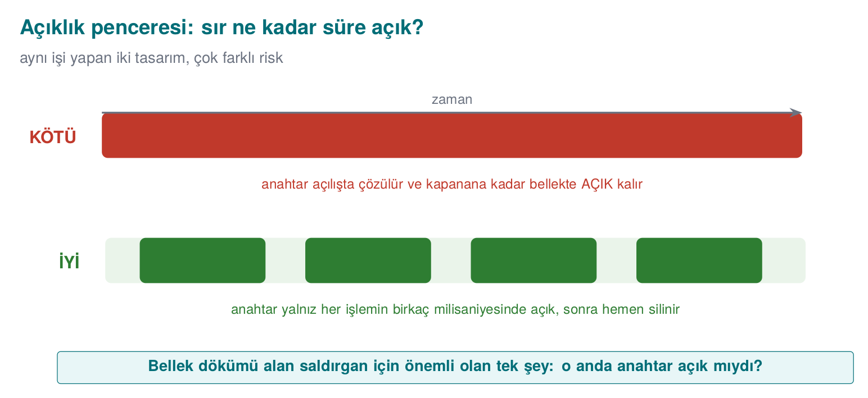
CEN429 Secure Programming · Week 1
Window of exposure — diagram
RTEU Computer Engineering · 2026-2027 Fall
161

Slide 162
CEN429 Secure Programming · Week 1
The secure development lifecycle
Stage | Activity | Week
Requirement | Security requirements from standards | 13
Design | Threat model, protection plan | 1–2
Implementation | Coding rules, banned functions, static analysis | 4–5
Verification | Sanitizer, fuzzing, penetration testing | 4, 12
Release | Signed build, unique version identity | 1, 10
Response | Vulnerability disclosure, emergency update | 12
Microsoft SDL · NIST SSDF (SP 800-218)
RTEU Computer Engineering · 2026-2027 Fall
162

Slide 163
CEN429 Secure Programming · Week 1
Unique version identity
Is what was reviewed the same as what was shipped? → 1.4.2 + git id + the binary's SHA-256
execute_process(COMMAND git rev-parse --short=12 HEAD
OUTPUT_VARIABLE GIT_COMMIT OUTPUT_STRIP_TRAILING_WHITESPACE)
target_compile_definitions(kasa PRIVATE VERSION="1.4.2" GIT_COMMIT="${GIT_COMMIT}")
Get-FileHash .kasa.exe -Algorithm SHA256 · sha256sum ./kasa
In the field, the version also feeds into key derivation → a version-rollback attack won't work
RTEU Computer Engineering · 2026-2027 Fall
163

Slide 164
CEN429 Secure Programming · Week 1
Change management: seven steps
1. Baseline → 2. Change request → 3. Classification → 4. Approval and planning → 5. Development and testing → 6. Release → 7. Verification
• Between 3 and 4, a security impact analysis: which asset, interface, threat, countermeasure?
• Reviewing only the changed part = delta assessment (week 13)
• Repository: protected branches · at least one reviewer · signed tag · MFA
RTEU Computer Engineering · 2026-2027 Fall
164

Slide 165
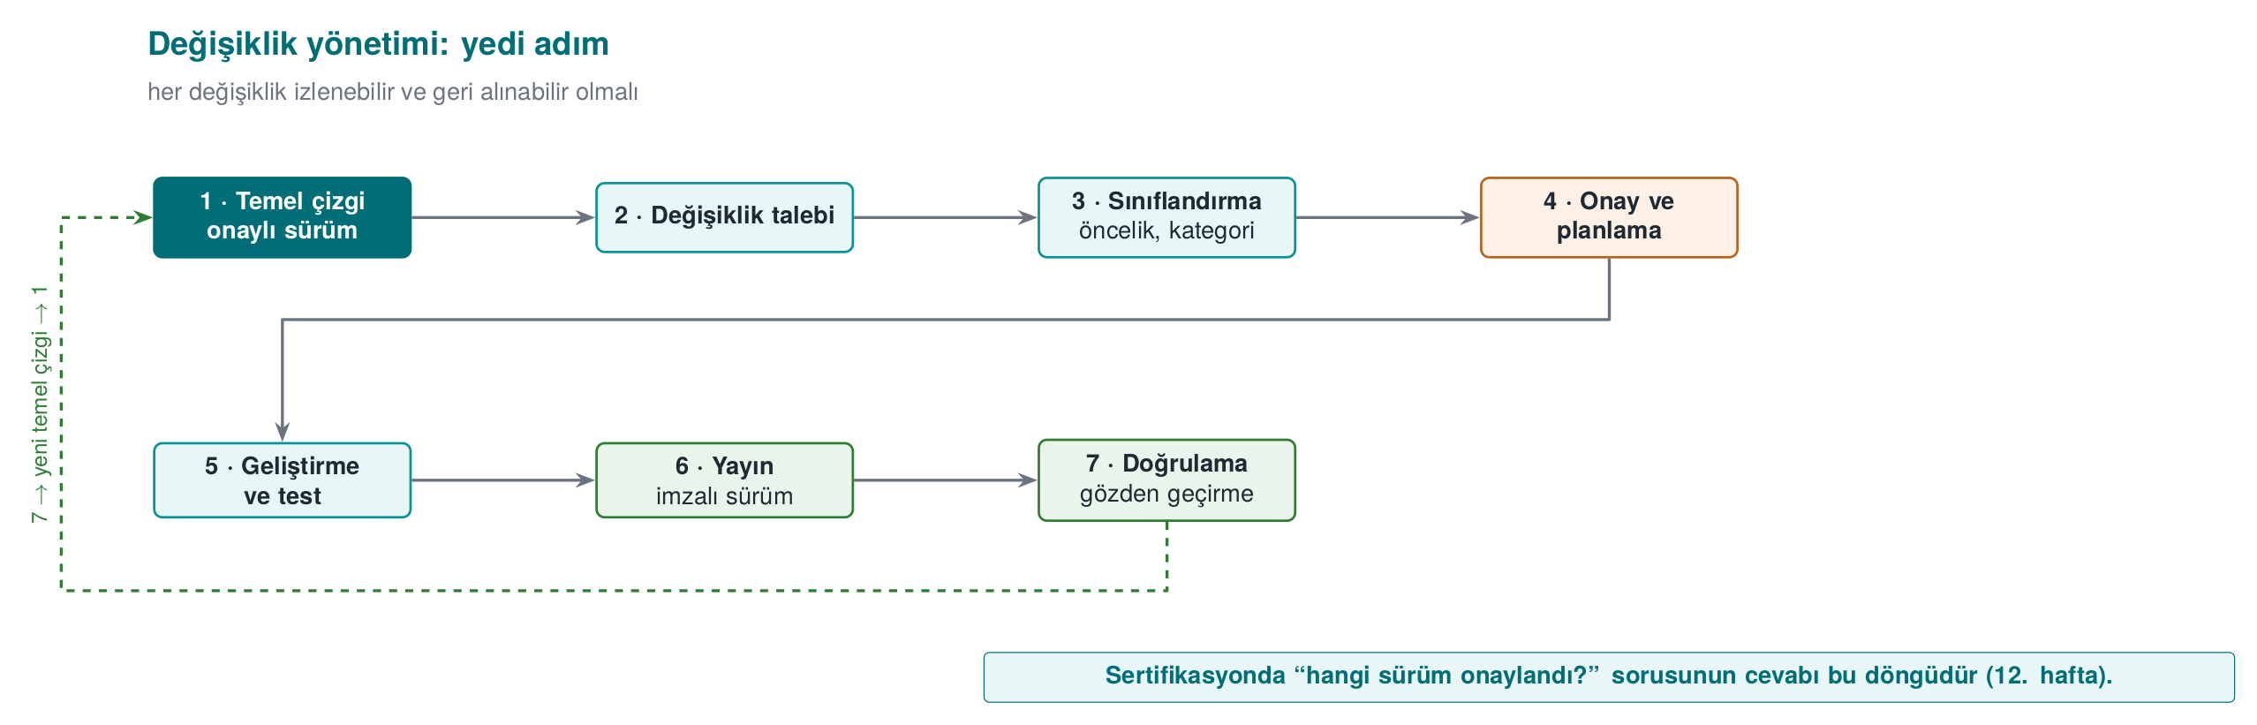
CEN429 Secure Programming · Week 1
Change management — diagram
RTEU Computer Engineering · 2026-2027 Fall
165

Slide 166
CEN429 Secure Programming · Week 1
Trade-off log
Decision | Chosen | Reason | Residual risk
Logging in release | Fully removed by a build macro | Silenced code remains as strings | Hard to diagnose in the field
Error codes | Only success/failure (opaque) | Detail gives the attacker a hint | A separate diagnostic channel
Native "debuggable" flag | On (justified exception) | Integrity checking needs to read its own memory | Compensated with debugger detection
Password derivation time | 250 ms | Balance between wait time and brute force | A very weak password
An unwritten trade-off is an error in an evaluator's eyes
RTEU Computer Engineering · 2026-2027 Fall
166
Notes:
Speaker note: Countermeasures like integrity checking also change the build pipeline: a hash is embedded, then rebuilt; a five-pass signed build in the field. The cost of protections is also measured: running the critical operation 20 times for the shortest, longest, average time.

Slide 167
CEN429 Secure Programming · Week 1
This week's toolbox
Task | Linux / GCC | Windows / MSVC
Suspicious-code warnings | -Wall -Wextra -Wsign-conversion | /W4
Library size checking | -D_FORTIFY_SOURCE=2 -O2 | _s functions like strcpy_s
Catching memory bugs | -fsanitize=address | /fsanitize=address
Memory dump | gdb + gcore | MiniDumpWriteDump
Machine code | objdump -d | VS Disassembly
Erasure that can't be removed | explicit_bzero | SecureZeroMemory
Running a program safely | posix_spawn + absolute path | CreateProcessW + full path
RTEU Computer Engineering · 2026-2027 Fall
167

Slide 168
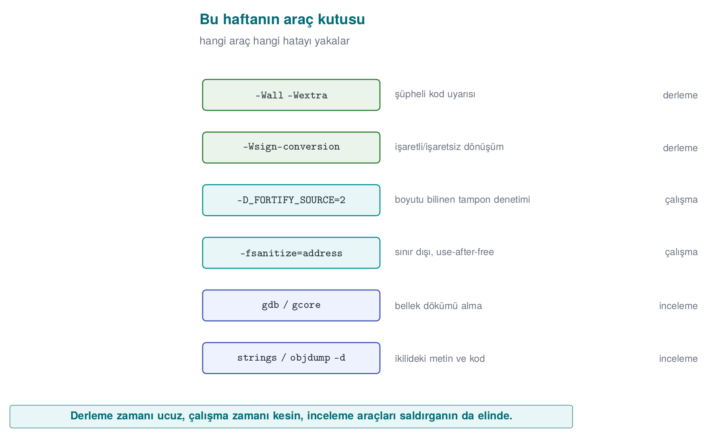
CEN429 Secure Programming · Week 1
This week's toolbox — diagram
RTEU Computer Engineering · 2026-2027 Fall
168

Slide 169
CEN429 Secure Programming · Week 1
8. Project and wrap-up
RTEU Computer Engineering · 2026-2027 Fall
169

Slide 170
CEN429 Secure Programming · Week 1
Project: this week's tasks
1. Team (individual or up to 4 people) and topic
2. GitHub repository + project plan (work packages, timeline) → get it approved
3. Security guide draft:
  – S0 cover and version history · S2 product overview
  – S3 architecture and interface table
  – S4 attacker model · STRIDE · attack tree
RTEU Computer Engineering · 2026-2027 Fall
170

Slide 171
CEN429 Secure Programming · Week 1
Class exercise (15 min)
Student grading system: the instructor enters grades, the student sees them, the data lives on a server.
1. Data flow diagram + trust boundaries
2. One threat from each STRIDE letter
3. Attack tree for "raise my grade from 45 to 85" — which is the cheapest path?
RTEU Computer Engineering · 2026-2027 Fall
171
Notes:
Speaker note: Groups of 3-4 people. 10 minutes of work, 5 minutes for two groups to present. Hint: for E, a direct URL to a grade-entry page; for R, no record of the change.

Slide 172
CEN429 Secure Programming · Week 1
End to End: Finishing the Vault's Defence
Section 4's threat table for the "Vault" had two open items; the rest of this week closes them with actual code:
Vault's threat | This week's answer
T2 — password/key left in memory | Section 5: explicit_bzero/SecureZeroMemory, mlock, disabling core dumps (Demo 2)
T8 — a memory bug in the parser | Sections 6–7: bounds checking, ASan, the safe pattern (Demo 3–4)
Security is not a feeling, it's a process: know the asset, model the threat, protect it in layers, write down the residual risk. We'll use this framework all term.
RTEU Computer Engineering · 2026-2027 Fall
172

Slide 173
CEN429 Secure Programming · Week 1
Classic Mistakes — Summary
Mistake | Section | Rule
Trusting PATH/the environment (CWE-426) | 5 | Absolute path + a clean environment + no shell
A secret left in memory (CWE-14) | 5 | explicit_bzero/SecureZeroMemory, in a way the compiler can't remove
A buffer overflow (CWE-121/787) | 6 | Validate first, then copy with a bound; avoid dangerous functions
The off-by-one bug (CWE-193) | 6 | Use <, not <=; always leave room for the terminator
A signed/unsigned integer bug (CWE-195) | 6 | Keep sizes as size_t; check both a lower and an upper bound
A leak, double free, or UAF (CWE-401/415/416) | 7 | Give every block a single owner; set the pointer to NULL after free
All six mistakes were covered earlier in this deck with a demo or code example; here they are gathered in one glance.
RTEU Computer Engineering · 2026-2027 Fall
173

Slide 174
CEN429 Secure Programming · Week 1
On Your Own (Not Graded)
1. The PATH trap: repeat with ls (Linux) / whoami (Windows), fix with a full path
2. In Demo 2, MOD optimize → MOD korumasiz: does memset work now?
3. In Demo 3, 16, 17, 18, 19, 20 characters: a table of admin values
4. Add balance to struct session: push it above 1000 with an overflow, then prevent it
5. A STRIDE table for your own project (≥ 8 threats + countermeasures)
6. Read the Heartbleed report: which check was missing? Which CWE?
Details and hints: course site → Week 1 → "Try it yourself"
RTEU Computer Engineering · 2026-2027 Fall
174

Slide 175
CEN429 Secure Programming · Week 1
Self-check
1. Difference between asset, threat, vulnerability?
2. The recipient IBAN changing in transit — which CIA property?
3. What does a white-box attacker do differently?
4. STRIDE "E" — which demo?
5. AND / OR node — which is good for defence?
6. Why is system("date") dangerous? Three fixes?
7. Why did memset disappear?
8. Why didn't ASan catch the 17 characters?
9. What happens when -1 reaches memcpy?
10. Defence in depth — an example from the mobile payment architecture?
RTEU Computer Engineering · 2026-2027 Fall
175
Notes:
ask first, then open the answer slide; full solutions in the appendix

Slide 176
CEN429 Secure Programming · Week 1
Self-check — answers (1–10)
1. Asset is a valuable thing to protect; threat is a possible harmful event/actor; vulnerability is the flaw a threat can exploit.
2. Integrity — an IBAN changing in transit is a data integrity violation.
3. White-box (MATE) owns the program (reads memory/key, modifies code); a network attacker only connects from outside.
4. E = Elevation of Privilege → the privilege-dropping / setuid demo.
5. AND is good for defence: the goal needs all sub-steps, cutting one stops the attack. OR is convenient for the attacker.
6. system interprets a shell → command injection/PATH hijacking. Fix: call directly with execvp (no shell), a full path, an input allowlist.
7. The compiler removed it as a dead store (never read afterward). Use memset_s/explicit_bzero/volatile.
8. The overflow didn't reach the redzone / that code path wasn't run; ASan only sees the instrumented region.
9. -1 becomes SIZE_MAX in a size_t → a huge copy → overflow/crash.
10. Payment: TLS+pinning (transit) · AEAD (at rest) · RASP/anti-debug · white-box/HSM key · server checks — layers.
RTEU Computer Engineering · 2026-2027 Fall
176

Slide 177
CEN429 Secure Programming · Week 1
Self-check (continued)
1. Why is S never asked of a data flow?
2. What are the four responses to a threat? Give an example of "eliminate"
3. Why is the group dropped first in a setuid program?
4. Why isn't strncpy a safe strcpy?
5. Why did Heartbleed leak data without anything crashing?
RTEU Computer Engineering · 2026-2027 Fall
177
Notes:
ask first, then open the answer slide

Slide 178
CEN429 Secure Programming · Week 1
Self-check — answers (continued 1–5)
1. S is not asked of a data flow: a flow has no identity (spoofing is asked of endpoints/assets).
2. Mitigate · eliminate · transfer · accept. "Eliminate" example: never offering a "remember my password" feature at all.
3. In setuid, the group is dropped first; if the user is dropped first, there's no privilege left to change the group.
4. strncpy doesn't add a terminator on a long source → an unterminated string.
5. Heartbleed only read; the memory it read was the process's own valid memory → it leaked without crashing.
RTEU Computer Engineering · 2026-2027 Fall
178

Slide 179
CEN429 Secure Programming · Week 1
Self-check (continued)
1. What does a canary do when it catches an overflow? Why is it still a problem?
2. What does free(p); p = NULL; prevent, and not prevent?
3. What does mlock prevent, and not prevent?
4. What is a "decryption oracle"? A countermeasure?
5. The three components of unique version identity?
RTEU Computer Engineering · 2026-2027 Fall
179
Notes:
ask first, then open

Slide 180
CEN429 Secure Programming · Week 1
Self-check — answers (continued 6–10)
1. When a canary is corrupted it terminates the program (denial of service); it does not see the overflow into the neighboring variable.
2. free(p); p=NULL; prevents double free/UAF; it does not protect against aliases (another pointer to the same address).
3. mlock prevents memory from being written to swap; it does not prevent it from being read, or a secret from staying unerased.
4. Decryption oracle: the ability to decrypt without the key. Countermeasure: context/integrity checking, a call limit, binding to the device.
5. Unique version: semantic version + git id + binary SHA-256.
RTEU Computer Engineering · 2026-2027 Fall
180

Slide 181
CEN429 Secure Programming · Week 1
Glossary
Term | Meaning
CIA | Confidentiality/integrity/availability
MATE | An attacker who owns the program
STRIDE | Six threat classes
Attack tree | Breaking a goal into sub-steps
DFD | Data flow diagram
Defence in depth | Many countermeasures together
RTEU Computer Engineering · 2026-2027 Fall
181

Slide 182
CEN429 Secure Programming · Week 1
Next Week
Week 2 — Computer Viruses and Security Models
We will apply the threat-modelling tools we built this week (STRIDE, attack trees) and the attacker model to a concrete class of threat — malware: how a virus spreads, how it hides, and which access-control models (DAC/MAC/RBAC) stop it.
The CWE classification we met for this week's memory-safety bugs will deepen next week with CVE and CVSS.
RTEU Computer Engineering · 2026-2027 Fall
182

