Slide 1

CEN429 Secure Programming · Week 11
Whitebox Cryptography
CEN429 Secure Programming — Week 11
Asst. Prof. Dr. Uğur CORUH · 27.11.2026
RTEU Computer Engineering · 2026-2027 Fall
Notes:
Speaker note: This week we treat whitebox cryptography as a security layer. Core rule: every published pure-software WBC design has been broken; WBC alone is not a solution — it is a layer that delays key extraction, and it only makes sense together with key rotation, device binding, and server-side risk checking. We study the attacks to test the defence.

Slide 2
CEN429 Secure Programming · Week 11
Today's Plan (3 Hours)
Time | Section | Topic
0:00–0:25 | 1 | Black/grey/white box models; WBC attacker capabilities
0:25–0:50 | 2 | Why the problem is hard; naive solutions: embedded key, XOR, code lifting
0:55–1:40 | 3 | Table-based WBC (Chow AES): encoding, bijections, table size/speed
1:45–2:20 | 4 | Attack history: BGE, DFA, DCA, WhibOx; "all broken" and countermeasures
2:20–2:45 | 5 | Its place in layered defence; hardware alternatives (TEE/SE, HSM/SoftHSM)
2:45–3:00 | 6–7 | Flawed→attack→protection; project S8; self-check
RTEU Computer Engineering · 2026-2027 Fall
2
Notes:
Speaker note: This week is whitebox cryptography. Students saw crypto in Weeks 3 and 10, but here we recap it from scratch. The main message is given up front: every published pure-software WBC has been broken; WBC is a layer, not magic.

Slide 3
CEN429 Secure Programming · Week 11
Where Does This Week Fit?
• Week 9: code obfuscation — we said "hiding doesn't protect the key"
• This week (11): so how do we protect the key in software? → whitebox
• Week 10: correct use of cryptography, the key lifecycle
Today we tackle the question: "what do we do while the key is in the attacker's hands?"
RTEU Computer Engineering · 2026-2027 Fall
3

Slide 4
CEN429 Secure Programming · Week 11
Learning Outcome
This week is about LO.2 / LO.4 (cryptography, secure communication).
By the end, you will be able to:
• Distinguish the black/grey/white box models
• Explain what whitebox does and why it isn't enough
• Make the right protection decision for a key
RTEU Computer Engineering · 2026-2027 Fall
4

Slide 5
CEN429 Secure Programming · Week 11
A Warning, Up Front
Every pure-software whitebox design published to date has been broken.
So today we won't say "whitebox = secure key."
We'll say: whitebox is a layer that delays key extraction — and it is not sufficient on its own.
RTEU Computer Engineering · 2026-2027 Fall
5
Notes:
Speaker note: Set this frame up front; we'll come back to it throughout the lecture.

Slide 6
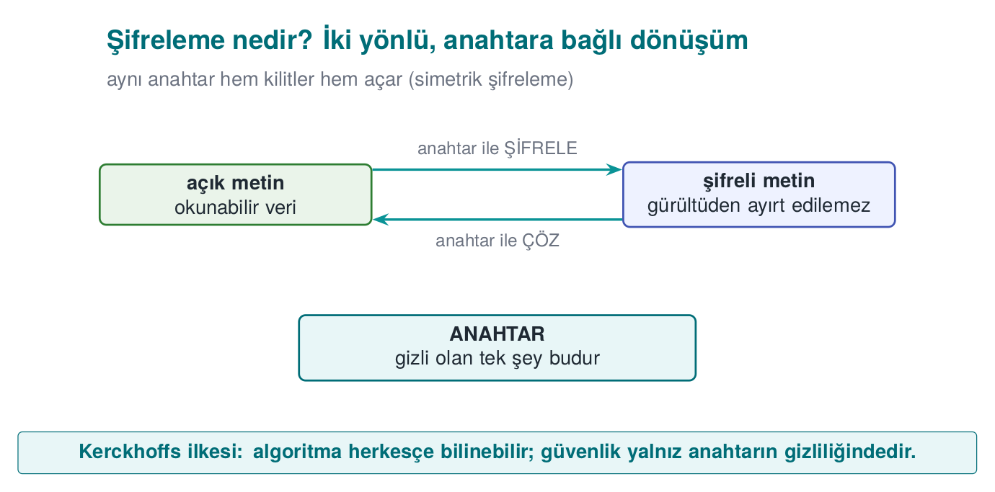
CEN429 Secure Programming · Week 11
What We Bring from Earlier Weeks (1)
• Encryption, key, symmetric/asymmetric — turning plaintext into unreadable ciphertext with a key; security rests on the key's secrecy, not the algorithm's (Week 3)
• AES and bit security level — the most widely used symmetric algorithm, 16-byte blocks, rounds; "n-bit security" ≈ 2ⁿ attempts (Week 10)
• XOR — 1 if the bits differ, 0 if they match; reversible via a^b^b=a; AES's key-addition step is a XOR (Week 5)
• Entropy — a measure of how random a data's bytes look; encrypted/random blocks look high-entropy (Week 2)
This week we reuse these tools in the whitebox context.
RTEU Computer Engineering · 2026-2027 Fall
6

Slide 7
CEN429 Secure Programming · Week 11
What We Bring from Earlier Weeks (2)
• Debugger — a tool that runs a program step by step and reads memory/registers (gdb, x64dbg) (Week 6)
• Static and dynamic analysis — inspection without running / by running; we'll use this to classify attacks (Week 4)
• Instrumentation and emulator — tools that automatically trace a program and that emulate a real processor in software (Week 6)
• HSM and SoftHSM — dedicated hardware that never lets the key out, and its software emulation (Week 10)
This week we meet these again as the whitebox attacker's toolbox and our defence options.
RTEU Computer Engineering · 2026-2027 Fall
7

Slide 8
CEN429 Secure Programming · Week 11
This Week's Concepts
Each term is defined once, where it first appears in the body; here we only mark where.
Concept | Where
Black/grey/white box, the WBC attacker model | Section 1
Why the problem is hard; naive solutions (embedded key, XOR, code lifting) | Section 2
Table-based WBC: partial evaluation, internal/external encoding, bijection | Section 3
Attack history: BGE, DFA, DCA, WhibOx | Section 4
Its place in layered defence; TEE/SE, HSM/SoftHSM | Section 5
The flawed → attack → protection scenario | Section 6
Project S8, self-check | Section 7
RTEU Computer Engineering · 2026-2027 Fall
8

Slide 9
CEN429 Secure Programming · Week 11
Background · What Is an S-box?
• S-box (substitution box): a fixed table that replaces one byte with another.
• This is AES's "byte substitution" step.
• Example: a 256-entry mapping such as S-box[0x53] = 0xED.
Keep this table in mind; it's the heart of whitebox.
RTEU Computer Engineering · 2026-2027 Fall
9

Slide 10
CEN429 Secure Programming · Week 11
Lookup Table
• Lookup table: an array that gives "output for a given input".
• T[x] = the precomputed result for x.
• Instead of computing, you read from the table; it's fast.
Whitebox buries computation inside tables.
RTEU Computer Engineering · 2026-2027 Fall
10

Slide 11
CEN429 Secure Programming · Week 11
Background · What Is a Side Channel?
• Side channel: an attack that uses not the algorithm's math but the physical/indirect information it leaks while running.
• Examples: elapsed time, power consumption, electromagnetic emission.
Classic on smart cards; shortly we'll see whitebox's software equivalent.
RTEU Computer Engineering · 2026-2027 Fall
11

Slide 12
CEN429 Secure Programming · Week 11
What Is DPA?
• DPA (Differential Power Analysis): a side-channel attack that applies statistics to a device's power consumption measurements to extract the key.
• It doesn't look inside the device; it measures from the outside.
Keep this idea in mind; whitebox's strongest attack (DCA) is the software form of exactly this.
RTEU Computer Engineering · 2026-2027 Fall
12

Slide 13
CEN429 Secure Programming · Week 11
Background · Bijection (a One-to-One, Onto Mapping)
• Bijection: a transformation that maps every input to exactly one output and is invertible.
• Example: f(x) = x ^ 0x5A is a bijection (its own inverse).
Whitebox wraps tables in secret bijections.
RTEU Computer Engineering · 2026-2027 Fall
13

Slide 14
CEN429 Secure Programming · Week 11
Background · TEE and Secure Element (SE)
• TEE (Trusted Execution Environment): a phone processor's secure region, isolated from the operating system.
• Secure element (SE): a separate, tamper-resistant hardware chip that stores keys.
These are the strongest protection for a key; whitebox is for the case when they aren't available.
RTEU Computer Engineering · 2026-2027 Fall
14

Slide 15
CEN429 Secure Programming · Week 11
Now We're Ready
Terms we know:
encryption/decryption · key · symmetric/asymmetric · AES · S-box · lookup table · XOR · bit security · side channel · DPA · bijection · TEE/SE · HSM/SoftHSM
Now to the real question: what do we do while the key is in the attacker's hands?
RTEU Computer Engineering · 2026-2027 Fall
15

Slide 16
CEN429 Secure Programming · Week 11
1. Three Attacker Models
RTEU Computer Engineering · 2026-2027 Fall
16

Slide 17
CEN429 Secure Programming · Week 11
A Brief History — Whitebox Cryptography
• 1883 — Kerckhoffs: security must lie in the key, not in the secrecy of the system
• 2002 — Chow et al. publish the first whitebox AES/DES (for DRM) — the birth of WBC
• 2004 — the BGE attack breaks the first WB-AES
• 2016 — DCA (Bos et al.): hardware DPA moves into software, breaks it automatically
• 2017–2024 — WhibOx: every published pure-software candidate is broken
Today's rule: WBC is a delaying layer; prefer hardware (TEE/SE/HSM) where possible.
RTEU Computer Engineering · 2026-2027 Fall
17

Slide 18
CEN429 Secure Programming · Week 11
Why a "Model"?
Before designing a defence, we must determine what the attacker can see.
This is called the attacker model.
There are three models: black, grey, white box.
RTEU Computer Engineering · 2026-2027 Fall
18

Slide 19
CEN429 Secure Programming · Week 11
Black Box
• The attacker sees only input and output.
• They cannot see the inside (key, intermediate values).
• Typical setting: a remote server (the code is yours, the attacker connects over the network).
AES/RSA's security proofs assume this.
RTEU Computer Engineering · 2026-2027 Fall
19

Slide 20
CEN429 Secure Programming · Week 11
Grey Box
• In addition to input/output, the attacker sees side channels (time, power, EM).
• They can't read the inside directly, but they measure it indirectly.
• Typical setting: a smart card or an embedded device in the attacker's hands.
RTEU Computer Engineering · 2026-2027 Fall
20

Slide 21
CEN429 Secure Programming · Week 11
White Box
• The attacker sees everything: code, memory, every intermediate value.
• And they can modify it.
• Typical setting: software running on the attacker's own device.
This is the real situation for a mobile/desktop application.
RTEU Computer Engineering · 2026-2027 Fall
21

Slide 22
CEN429 Secure Programming · Week 11
Three Models Side by Side
Model | Sees / does | Environment
Black | Input/output | Remote server
Grey | + side channel | Smart card
White | Everything + modifies | Software, own device
Crypto was designed for black box; we're in white box.
RTEU Computer Engineering · 2026-2027 Fall
22

Slide 23
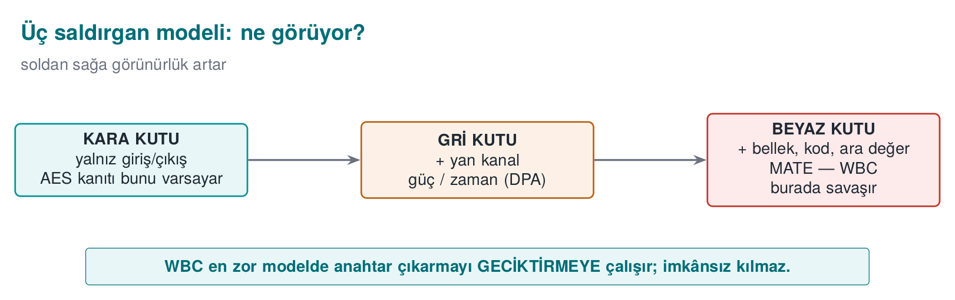
CEN429 Secure Programming · Week 11
The Three Attacker Models — What Do They See?
RTEU Computer Engineering · 2026-2027 Fall
23

Slide 24
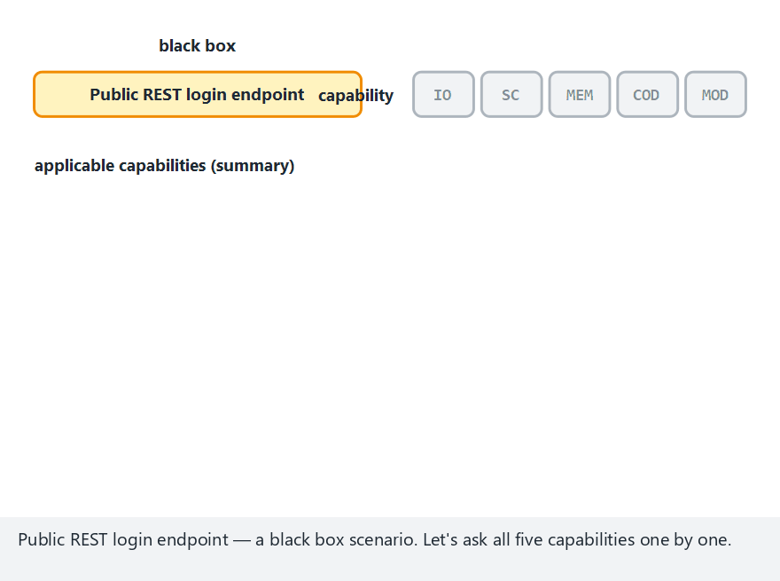
CEN429 Secure Programming · Week 11
Attacker Models (Animation)
RTEU Computer Engineering · 2026-2027 Fall
24
Notes:
Speaker note: walk through the 12 scenarios one at a time; stress how each model starts from IO alone and gains more capabilities.

Slide 25
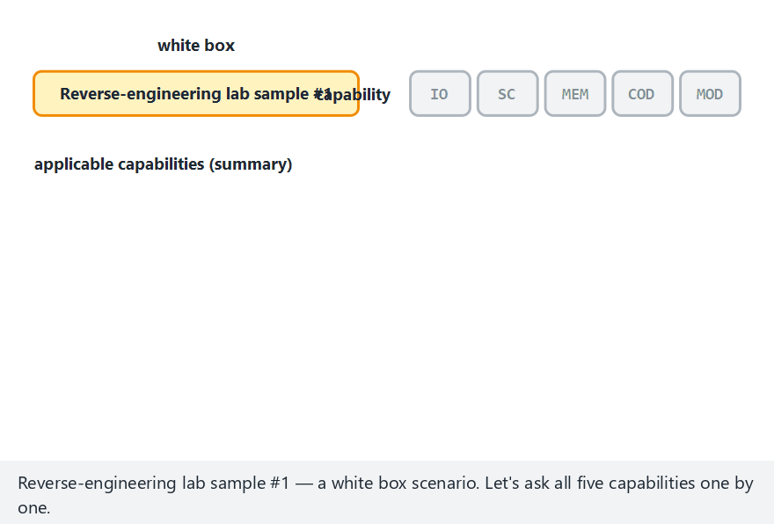
CEN429 Secure Programming · Week 11
Attacker Models — Edge Case: All White Box
RTEU Computer Engineering · 2026-2027 Fall
25
Notes:
Speaker note: show that in white box, MOD and COD are ALWAYS present — this is exactly what WBC targets.

Slide 26
CEN429 Secure Programming · Week 11
Here's the Problem
AES is mathematically strong. But:
• In white box, the key sits in memory somewhere
• The attacker can read memory
• So what good is AES's strength?
A strong lock is useless if you hang the key next to the door.
RTEU Computer Engineering · 2026-2027 Fall
26

Slide 27
CEN429 Secure Programming · Week 11
The Idea of Whitebox Cryptography (WBC)
• WBC: performing encryption so that the key is never explicitly in memory.
• The key is embedded inside precomputed lookup tables.
• There is no byte sequence in memory you could point to and say "that's the key."
RTEU Computer Engineering · 2026-2027 Fall
27

Slide 28
CEN429 Secure Programming · Week 11
WBC Is Not a Definition, It's an Attacker Model
• WBC was defined in 2002 by Chow and colleagues.
• It's really an attacker model: "how do you encrypt if the attacker can see and modify everything?"
RTEU Computer Engineering · 2026-2027 Fall
28

Slide 29
CEN429 Secure Programming · Week 11
What Can the WBC Attacker Do? (1)
Observes:
• Accesses the instructions being executed at that moment
• Watches the algorithm's flow
• Sees the memory being used
So they see every intermediate value the program sees.
RTEU Computer Engineering · 2026-2027 Fall
29

Slide 30
CEN429 Secure Programming · Week 11
What Can the WBC Attacker Do? (2)
Modifies:
• Tampers with the program's memory
• Runs only a single round of the algorithm
• Alters if conditions
• Alters loop counters
• Injects a fault (corrupts a value)
RTEU Computer Engineering · 2026-2027 Fall
30

Slide 31
CEN429 Secure Programming · Week 11
The Source's Compliance Clause
The technical guide opens this section with the following requirement:
"Cryptographic keys shall be secured and/or hidden to protect confidentiality and integrity."
RTEU Computer Engineering · 2026-2027 Fall
31

Slide 32
CEN429 Secure Programming · Week 11
But It Immediately Adds
The guide says that WBC is not the only thing protecting against these attacker capabilities:
What protects the application and its assets is code hardening (Week 9) and RASP (Week 6) methods.
WBC is never presented alone, from the very first sentence.
RTEU Computer Engineering · 2026-2027 Fall
32

Slide 33
CEN429 Secure Programming · Week 11
2. The Problem and Naive Solutions
RTEU Computer Engineering · 2026-2027 Fall
33

Slide 34
CEN429 Secure Programming · Week 11
Why Is the Problem So Hard?
The core tension:
• The program must access the key to encrypt
• The attacker sees everything the program sees
• So at some point the key is somewhere the attacker can also see
WBC tries to get past this by "baking the key into tables."
RTEU Computer Engineering · 2026-2027 Fall
34

Slide 35
CEN429 Secure Programming · Week 11
This Isn't Secrecy, It's Cost
WBC doesn't move secrecy away from the crypto.
It spreads the key across tables with a mathematical transformation.
The goal is the same as in Week 9: make extracting the key back out much more expensive.
RTEU Computer Engineering · 2026-2027 Fall
35

Slide 36
CEN429 Secure Programming · Week 11
Why Do Naive Solutions Collapse?
RTEU Computer Engineering · 2026-2027 Fall
36

Slide 37
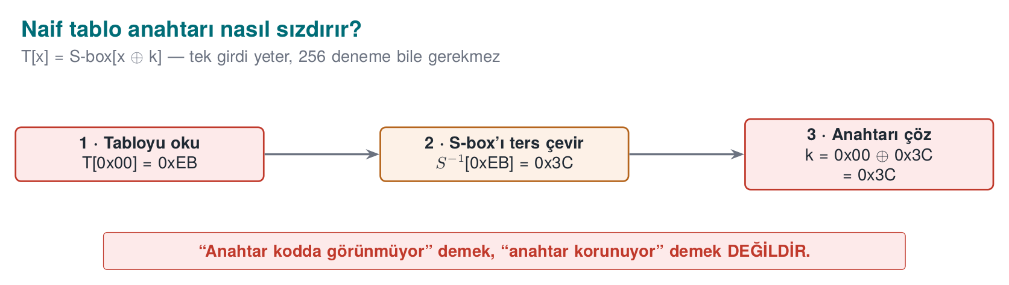
CEN429 Secure Programming · Week 11
How the Key Leaks From a Table — Diagram
RTEU Computer Engineering · 2026-2027 Fall
37

Slide 38
CEN429 Secure Programming · Week 11
Why Do We Study What Collapses?
To see why WBC is needed.
Every failed "easy" solution turns into a secure-programming rule.
RTEU Computer Engineering · 2026-2027 Fall
38

Slide 39
CEN429 Secure Programming · Week 11
Naive 1 · Embed the Key in an Array
static const uint8_t k[16] = { 0x2B, 0x7E, ... }; /* KÖTÜ */
The easiest way is the weakest way.
RTEU Computer Engineering · 2026-2027 Fall
39

Slide 40
CEN429 Secure Programming · Week 11
Naive 1 · How Is It Broken?
1. strings / byte scan: the 16-byte block is visible
2. Entropy scan: a high-entropy block says "the key is here" (the Shamir–van Someren observation)
3. Debugger: confirms this block is used in the encryption call
Time: minutes.
RTEU Computer Engineering · 2026-2027 Fall
40

Slide 41
CEN429 Secure Programming · Week 11
Naive 1 · Rule
A plainly embedded key is not key protection.
This is exactly Week 9's rule: "string hiding doesn't store the key."
RTEU Computer Engineering · 2026-2027 Fall
41

Slide 42
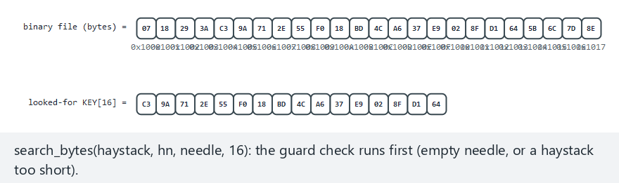
CEN429 Secure Programming · Week 11
Finding an Embedded Key by Scanning (Animation)
RTEU Computer Engineering · 2026-2027 Fall
42
Notes:
Speaker note: show the 16-byte window sliding across the binary step by step, and stopping the moment it matches.

Slide 43
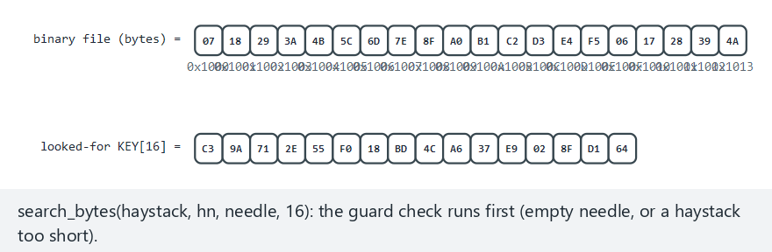
CEN429 Secure Programming · Week 11
Embedded-Key Scan — Edge Case: Key Absent
RTEU Computer Engineering · 2026-2027 Fall
43
Notes:
Speaker note: show the scan trying every window and returning -1 — this never happens in the real demo, since the key sits inside its own binary.

Slide 44
CEN429 Secure Programming · Week 11
Naive 2 · "Scramble" With XOR
static const uint8_t k_gizli[16] = ...; /* k ^ maske */
/* çalışırken: k = k_gizli ^ maske */
"I'll XOR the key with a mask and store that."
RTEU Computer Engineering · 2026-2027 Fall
44

Slide 45
CEN429 Secure Programming · Week 11
Naive 2 · Why Does It Collapse?
• The mask is also in the binary
• If the program can compute k, the attacker can too
• Just one extra step; not a real barrier
Whatever the program can do, the white-box attacker can do too.
RTEU Computer Engineering · 2026-2027 Fall
45

Slide 46
CEN429 Secure Programming · Week 11
Naive Threat 3 · Code Lifting
• Say WBC baked the key into tables.
• The attacker copies the encrypting code fragment (tables + interpreter) as is, without ever extracting the key.
• They use it in their own program: they steal the function without knowing the key.
RTEU Computer Engineering · 2026-2027 Fall
46

Slide 47
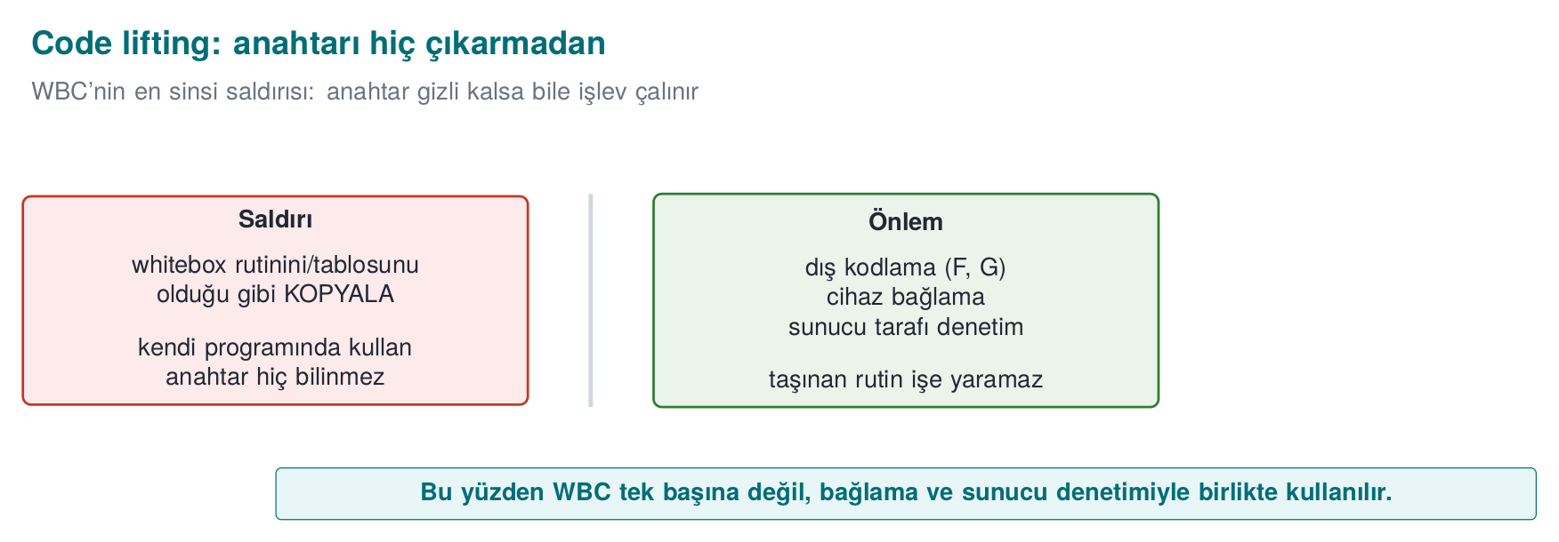
CEN429 Secure Programming · Week 11
Code Lifting — Diagram
RTEU Computer Engineering · 2026-2027 Fall
47

Slide 48
CEN429 Secure Programming · Week 11
Code Lifting · Rule
WBC saying "I hid the key" isn't enough.
Countering code lifting needs device/version binding (Section 3, shortly): the tables should only be meaningful on one specific device/version.
RTEU Computer Engineering · 2026-2027 Fall
48

Slide 49
CEN429 Secure Programming · Week 11
Naive Solutions: Summary
Naive solution | Broken by
Key embedded in an array | strings + entropy + gdb
XOR/whitening | the mask is inside too
(even WBC) | code lifting → needs device binding
RTEU Computer Engineering · 2026-2027 Fall
49

Slide 50
CEN429 Secure Programming · Week 11
Section 1–2 — Quick Check
1. The difference between black, grey, white box?
2. AES is strong, so what's the problem in white box?
3. Why isn't embedding the key in an array protection?
RTEU Computer Engineering · 2026-2027 Fall
50
Notes:
Speaker note: ask first, then open the answer.

Slide 51
CEN429 Secure Programming · Week 11
Section 1–2 — Answers
1. Black: input/output only · Grey: + side channels (time/power) · White: everything + modifies.
2. The key sits in memory at some point; the white-box attacker sees it. AES's strength rests on the black box assumption.
3. strings + entropy scan + gdb finds it in minutes; the program has to use it.
RTEU Computer Engineering · 2026-2027 Fall
51

Slide 52
CEN429 Secure Programming · Week 11
3. Table-Based WBC (Step by Step)
RTEU Computer Engineering · 2026-2027 Fall
52
Notes:
Speaker note: We build up Chow AES's idea step by step. We'll teach the logic and the cost, not the math. Go slowly.

Slide 53
CEN429 Secure Programming · Week 11
What Will We Learn?
Chow and colleagues' 2002 AES design is the classic of table-based WBC.
• Its idea (how it works)
• Its cost (table size, speed)
• Its limit (why it isn't enough)
No math on the exam; the idea and the limit are.
RTEU Computer Engineering · 2026-2027 Fall
53

Slide 54
CEN429 Secure Programming · Week 11
Reminder: Two Steps of an AES Round
1. XOR the state byte with the round key: x ^ k
2. Pass the result through the S-box: S-box[x ^ k]
Can these two steps be combined for a fixed k? Yes.
RTEU Computer Engineering · 2026-2027 Fall
54

Slide 55
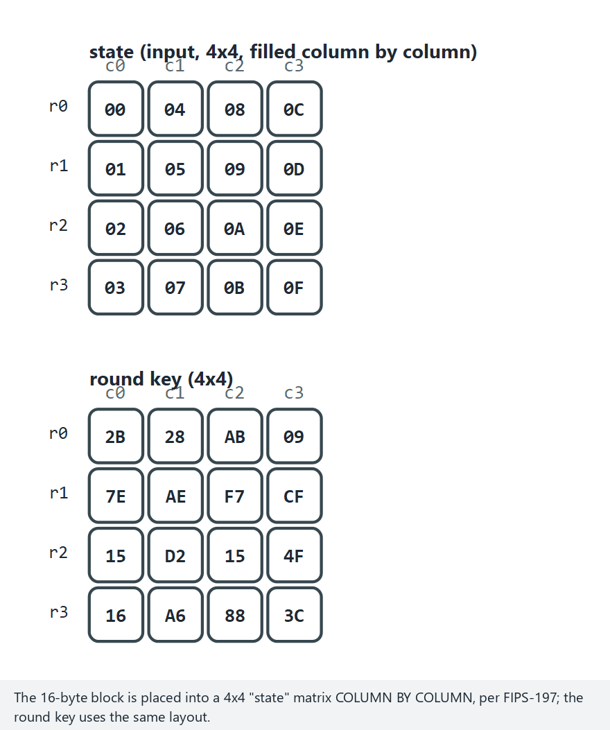
CEN429 Secure Programming · Week 11
The AES Round From Scratch (Animation)
RTEU Computer Engineering · 2026-2027 Fall
55
Notes:
Speaker note: stress that the 4x4 state fills column by column, and the order of the four steps (SubBytes, ShiftRows, MixColumns, AddRoundKey).

Slide 56
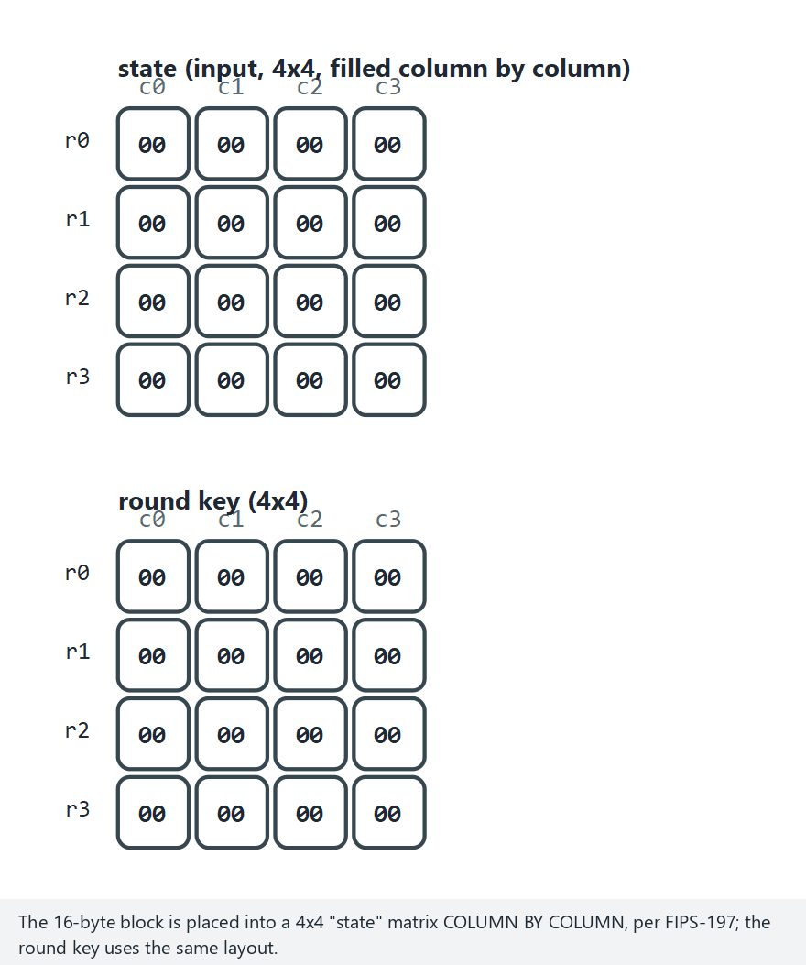
CEN429 Secure Programming · Week 11
AES Round — Edge Case: All Zero
RTEU Computer Engineering · 2026-2027 Fall
56
Notes:
Speaker note: show that even with an all-zero input, the output isn't zero, because of the S-box's own constant term (0x0D).

Slide 57
CEN429 Secure Programming · Week 11
Step 1 · "Bake" the Key Into a Table
Normal: çıktı = S-box[ x ^ k ]
WBC: T[x] = S-box[ x ^ k ] (256 girişli tablo)
There's no longer a k variable in the code. k is baked into the table.
RTEU Computer Engineering · 2026-2027 Fall
57

Slide 58
CEN429 Secure Programming · Week 11
Step 1 · What Did We Gain?
• There's no byte sequence named k in memory
• There's only the T table (256 entries)
The key seems to have disappeared. But...
RTEU Computer Engineering · 2026-2027 Fall
58

Slide 59
CEN429 Secure Programming · Week 11
Step 1 · Why Is This Insecure on Its Own?
• T is the S-box shifted by x ^ k
• The attacker compares T with the known S-box
• They recover k from the shift amount
This is why the tables need to be encoded.
RTEU Computer Engineering · 2026-2027 Fall
59

Slide 60
CEN429 Secure Programming · Week 11
Why a Toy Example?
Real AES works with 256-entry tables; that won't fit on a board.
We'll see the idea with a tiny 4-value example instead.
Goal: see by hand what "baking the key into a table" means.
RTEU Computer Engineering · 2026-2027 Fall
60

Slide 61
CEN429 Secure Programming · Week 11
Defining the Tiny S-box
Say we have 2-bit values (0,1,2,3) and this fixed S-box:
x: 0 1 2 3
S-box[x]: 3 2 0 1
This table is public (part of the algorithm, not a secret).
RTEU Computer Engineering · 2026-2027 Fall
61

Slide 62
CEN429 Secure Programming · Week 11
Key and Operation
• Key k = 1 (secret).
• Operation (a mini version of one AES round): output = S-box[x ^ k].
^ = XOR. x ^ 1: 0↔1, 2↔3 (flips the last bit).
RTEU Computer Engineering · 2026-2027 Fall
62

Slide 63
CEN429 Secure Programming · Week 11
Step by Step: Normal Operation
x=0 → x^1=1 → S-box[1]=2
x=1 → x^1=0 → S-box[0]=3
x=2 → x^1=3 → S-box[3]=1
x=3 → x^1=2 → S-box[2]=0
Here k=1 is used explicitly in the code. The attacker sees it.
RTEU Computer Engineering · 2026-2027 Fall
63

Slide 64
CEN429 Secure Programming · Week 11
"Bake" the Key Into a Table
Let's precompute T[x] = S-box[x ^ 1] as a table:
x: 0 1 2 3
T[x]: 2 3 1 0
There's no k in the code anymore; only T. The key seems to have disappeared.
RTEU Computer Engineering · 2026-2027 Fall
64

Slide 65
CEN429 Secure Programming · Week 11
But the Key Leaks! (Without Encoding)
The attacker compares T with the known S-box:
S-box: 3 2 0 1
T: 2 3 1 0
Knowing that T[x] = S-box[x ^ k], they try which k fits: k=1 fits.
Result: an unencoded table gives the key away. This is exactly why internal/external encoding exists.
RTEU Computer Engineering · 2026-2027 Fall
65

Slide 66
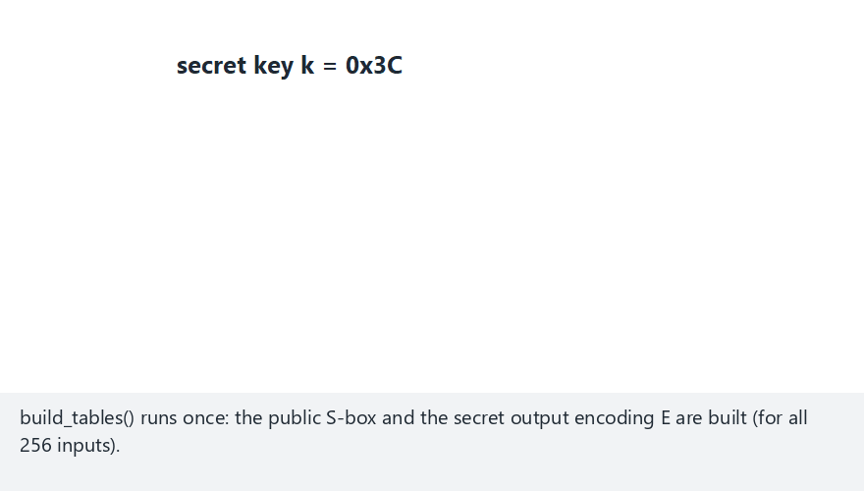
CEN429 Secure Programming · Week 11
Folding the Key Into a Table (Animation)
RTEU Computer Engineering · 2026-2027 Fall
66
Notes:
Speaker note: follow toy_table.c's real code; stress that the naive and encoded tables produce different bytes for the same x.

Slide 67
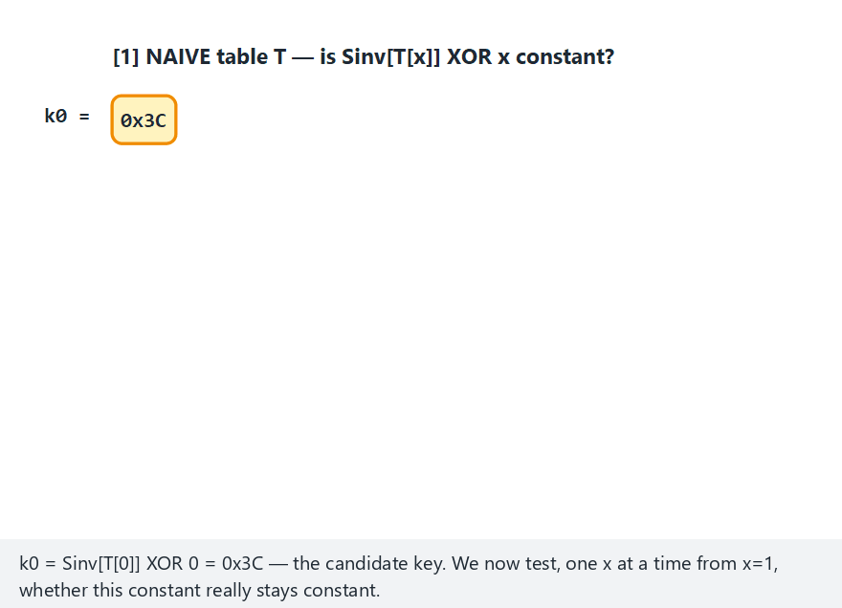
CEN429 Secure Programming · Week 11
Why a Table Leaks the Key (Animation)
RTEU Computer Engineering · 2026-2027 Fall
67
Notes:
Speaker note: show k0 staying constant all the way to x=255 on the naive table, and breaking immediately at x=1 on the encoded table.

Slide 68

CEN429 Secure Programming · Week 11
Table Leak — Edge Case: Zero Key
RTEU Computer Engineering · 2026-2027 Fall
68
Notes:
Speaker note: stress that even with k=0 the naive table still leaks, and the encoded table still blocks recovery.

Slide 69
CEN429 Secure Programming · Week 11
Step 2 · Grow the Tables (T-box)
• Instead of a single-byte mapping, combine the S-box with AES's mixing step (MixColumns)
• Result: larger tables (T-box) that take 8 bits in and give 32 bits out
• The XORs between bytes also become small XOR tables (4 bits)
RTEU Computer Engineering · 2026-2027 Fall
69

Slide 70
CEN429 Secure Programming · Week 11
Step 2 · Result
• The whole round turns into a network of lookup tables
• No explicit arithmetic key operation is visible anywhere
• But the tables can still be examined on their own → encoding is required
RTEU Computer Engineering · 2026-2027 Fall
70

Slide 71
CEN429 Secure Programming · Week 11
Step 3 · Internal Encodings
• Apply a secret bijection to each table's output
• Apply its inverse at the input of the next table
• Consecutive encodings cancel out → the result is still correct
But intermediate values look scrambled.
RTEU Computer Engineering · 2026-2027 Fall
71

Slide 72
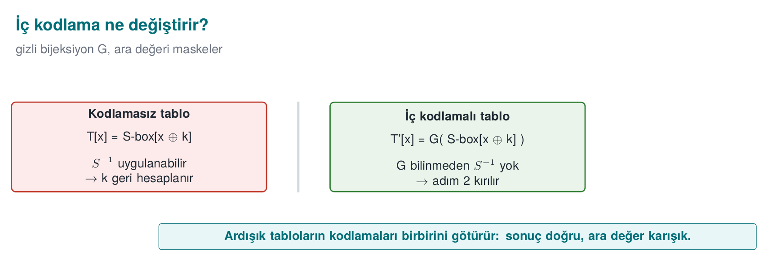
CEN429 Secure Programming · Week 11
Internal Encoding — Diagram
RTEU Computer Engineering · 2026-2027 Fall
72

Slide 73
CEN429 Secure Programming · Week 11
Step 3 · What Does It Prevent?
It aims to stop an attacker examining a table on its own.
Because that table's input/output has been scrambled by a secret encoding.
RTEU Computer Engineering · 2026-2027 Fall
73

Slide 74
CEN429 Secure Programming · Week 11
The Idea of Encoding (Tiny)
Apply a secret mapping E to the output: T'[x] = E(T[x]).
E: 0→1, 1→3, 2→0, 3→2 (gizli bijeksiyon)
T': E(2) E(3) E(1) E(0) = 0 2 3 1
Now T' doesn't resemble S-box; a simple comparison doesn't give up k.
RTEU Computer Engineering · 2026-2027 Fall
74

Slide 75
CEN429 Secure Programming · Week 11
The Price of Encoding
• The next step must apply E's inverse for the result to come out right.
• In real AES this is done by chaining tables (internal encodings).
• Every encoding means an extra table and more size → cost.
Even the tiny example shows the idea: secrecy isn't cheap.
RTEU Computer Engineering · 2026-2027 Fall
75

Slide 76
CEN429 Secure Programming · Week 11
Step 4 · Mixing Bijections
• On top of the internal encodings, linear mixing matrices over GF(2) (8×8, 32×32)
• These spread information across tables
• Information leaking from a single table alone doesn't mean much
(GF(2) = the math of working with bits and XOR arithmetic; no detail needed.)
RTEU Computer Engineering · 2026-2027 Fall
76

Slide 77
CEN429 Secure Programming · Week 11
Step 4 · Table Types
• In Chow's design these encoded/mixed tables have types (types I–IV in the literature).
• Each type plays a different role.
• For this course, it's enough to know: "the tables aren't all one type, they're varied."
RTEU Computer Engineering · 2026-2027 Fall
77

Slide 78
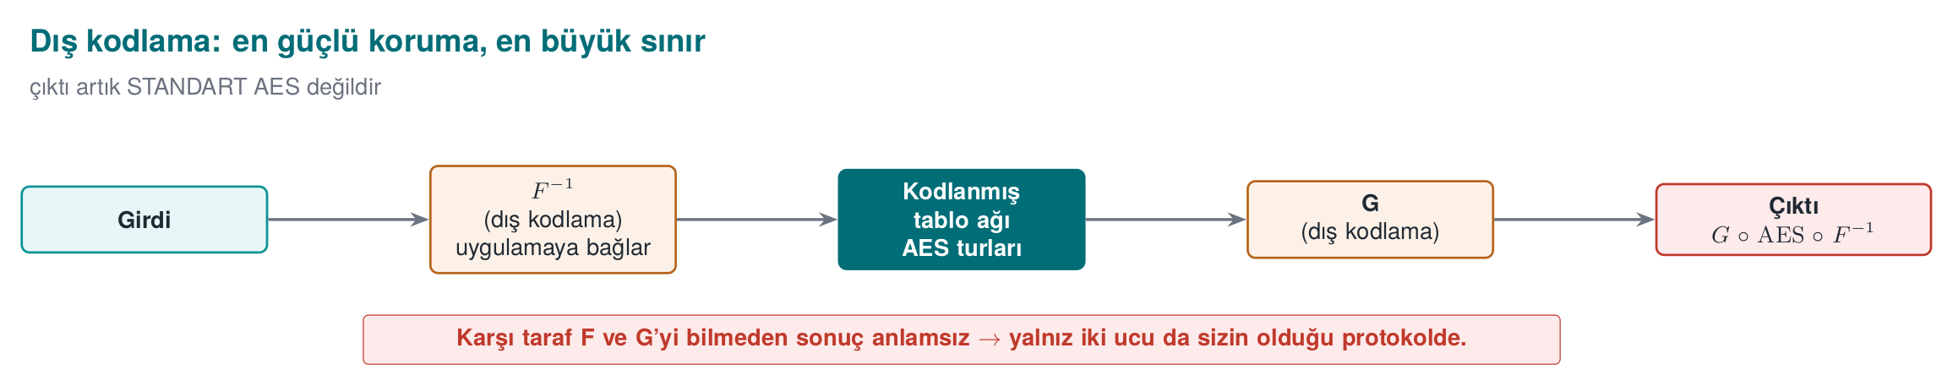
CEN429 Secure Programming · Week 11
Step 5 · External Encodings F and G
• On the outermost layer, the whole cipher is wrapped with two secret bijections: F and G
• Source guide: "the whitebox AES operation is encapsulated with two randomly chosen non-singular matrices called F and G"
• So the network is no longer plain AES:
RTEU Computer Engineering · 2026-2027 Fall
78

Slide 79
CEN429 Secure Programming · Week 11
Step 5 · Why Is External Encoding Strong?
• What the attacker sees at input/output is not standard AES's input/output
• It makes many attacks (statistical/algebraic) that look only at the tables much harder
RTEU Computer Engineering · 2026-2027 Fall
79

Slide 80
CEN429 Secure Programming · Week 11
Step 5 · But This Is Also the Biggest Limit
G ∘ AES ∘ F⁻¹ is not standard AES.
• The other side (server/other endpoint) gets a meaningless result unless it knows and undoes F and G
• So externally-encoded WBC is only usable in a protocol where you control both ends
• It may not be usable in a protocol like EMV that expects standard AES
RTEU Computer Engineering · 2026-2027 Fall
80

Slide 81
CEN429 Secure Programming · Week 11
Five Steps · Summary
1. Bake the key into a table
2. Grow the tables (T-box + XOR tables)
3. Internal encodings
4. Mixing bijections
5. External encodings (F, G)
Result: no explicit key; everything lives in encoded tables.
RTEU Computer Engineering · 2026-2027 Fall
81

Slide 82
CEN429 Secure Programming · Week 11
The Lesson From the Tiny Example
1. Baking the key into a table doesn't make it invisible (encoding is required)
2. Encoding solves the problem but adds size/complexity
3. In reality the tables run to hundreds of KB
This is the intuition behind the five steps in Section 2.
RTEU Computer Engineering · 2026-2027 Fall
82

Slide 83
CEN429 Secure Programming · Week 11
The Cost of WBC
RTEU Computer Engineering · 2026-2027 Fall
83

Slide 84
CEN429 Secure Programming · Week 11
WBC Isn't Free (1)
The price of baking the key into tables: huge tables.
Metric | Approximate (order of magnitude)
Table size | Hundreds of KB (~770 KB)
Comparison | Standard AES key: 16–32 bytes
RTEU Computer Engineering · 2026-2027 Fall
84

Slide 85
CEN429 Secure Programming · Week 11
WBC Isn't Free (2)
Metric | Approximate (order of magnitude)
Table lookups per round | Thousands (~3,000)
Speed | ~50× slower than standard AES
RTEU Computer Engineering · 2026-2027 Fall
85

Slide 86
CEN429 Secure Programming · Week 11
A Sense of Scale: a Table-Size Calculation
Example: 288 tables × 1 KB ≈ 294,912 bytes (~288 KB).
• The point isn't the exact number, it's the order of magnitude
• This is why WBC is applied only to selected, critical operations
• The same logic as Week 9's virtualization (K-10)
RTEU Computer Engineering · 2026-2027 Fall
86

Slide 87
CEN429 Secure Programming · Week 11
Section 3 — Quick Check
1. Why is T[x] = S-box[x ^ k] insecure on its own?
2. The difference between internal and external encoding?
3. What's the biggest limit of external encoding (F, G)?
4. Why is WBC applied only to selected operations?
RTEU Computer Engineering · 2026-2027 Fall
87
Notes:
Speaker note: ask first, then open the answer; after the break, attack history.

Slide 88
CEN429 Secure Programming · Week 11
Section 3 — Answers
1. T is the known S-box shifted by x^k; comparing the two tables recovers k.
2. Internal: scrambles the intermediate values between tables · External (F,G): wraps the whole cipher (G∘AES∘F⁻¹).
3. It's no longer standard AES; the other side has to know F/G — it may not be usable in standards like EMV.
4. Tables run to hundreds of KB + ~50× slower; the cost limits it to small/critical operations only.
RTEU Computer Engineering · 2026-2027 Fall
88

Slide 89
CEN429 Secure Programming · Week 11
4. Attack History and Countermeasures
RTEU Computer Engineering · 2026-2027 Fall
89
Notes:
Speaker note: We tell this history not to teach attacks, but to answer "how much can I trust this protection?"

Slide 90
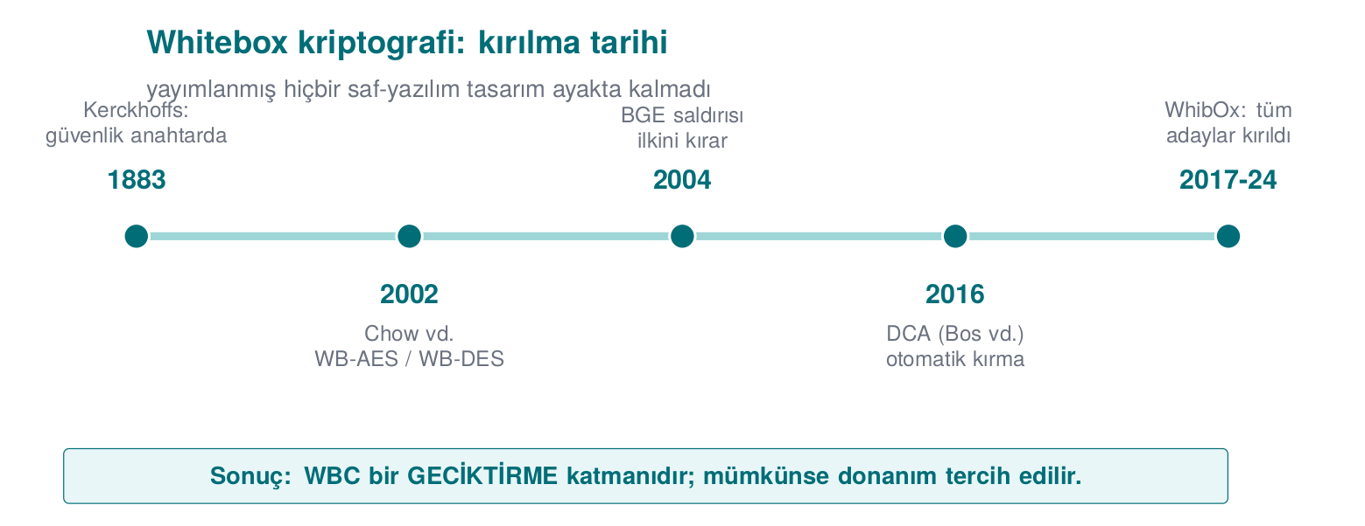
CEN429 Secure Programming · Week 11
WBC's Breaking History — Diagram
RTEU Computer Engineering · 2026-2027 Fall
90

Slide 91
CEN429 Secure Programming · Week 11
Why Do We Look at History?
How much you should trust a protection is told by its history of being broken.
Every row is an inference for the defender.
RTEU Computer Engineering · 2026-2027 Fall
91

Slide 92
CEN429 Secure Programming · Week 11
2002 · Birth
• Chow and colleagues publish the WB-AES and WB-DES designs.
• The table-based approach is born.
Inference: the idea is promising; but untested.
RTEU Computer Engineering · 2026-2027 Fall
92

Slide 93
CEN429 Secure Programming · Week 11
2004 · The BGE Attack
• BGE (Billet–Gilbert–Ech-Chatbi): breaks Chow AES in practical time (~2³⁰ operations).
• Solves the internal encodings.
Inference: internal encodings alone are not enough.
RTEU Computer Engineering · 2026-2027 Fall
93

Slide 94
CEN429 Secure Programming · Week 11
2007 · WB-DES Falls
• Goubin, Wyseur, and others break WB-DES and its externally-encoded variants.
Inference: DES-based WBC is abandoned.
RTEU Computer Engineering · 2026-2027 Fall
94

Slide 95
CEN429 Secure Programming · Week 11
2010s · The "More Tables" Attempt
• Karroumi's "dual AES" hardening is also broken (~2²²).
Inference: more tables is not more strength.
RTEU Computer Engineering · 2026-2027 Fall
95

Slide 96
CEN429 Secure Programming · Week 11
2015 · DFA (Fault Injection)
• DFA (Differential Fault Analysis): injects a fault into a value while running and computes the key back from the corrupted output.
• "Unboxing the White-Box" (Black Hat EU).
Inference: it can be broken without knowing the design's internal math.
RTEU Computer Engineering · 2026-2027 Fall
96

Slide 97
CEN429 Secure Programming · Week 11
2016 · DCA (the Most Important One)
• DCA (Differential Computation Analysis): collects a trace of the intermediate values produced while running, and extracts the key with DPA-like statistics.
• It ignores internal encodings most of the time.
Inference: classic side-channel defences are also needed for WBC.
RTEU Computer Engineering · 2026-2027 Fall
97

Slide 98
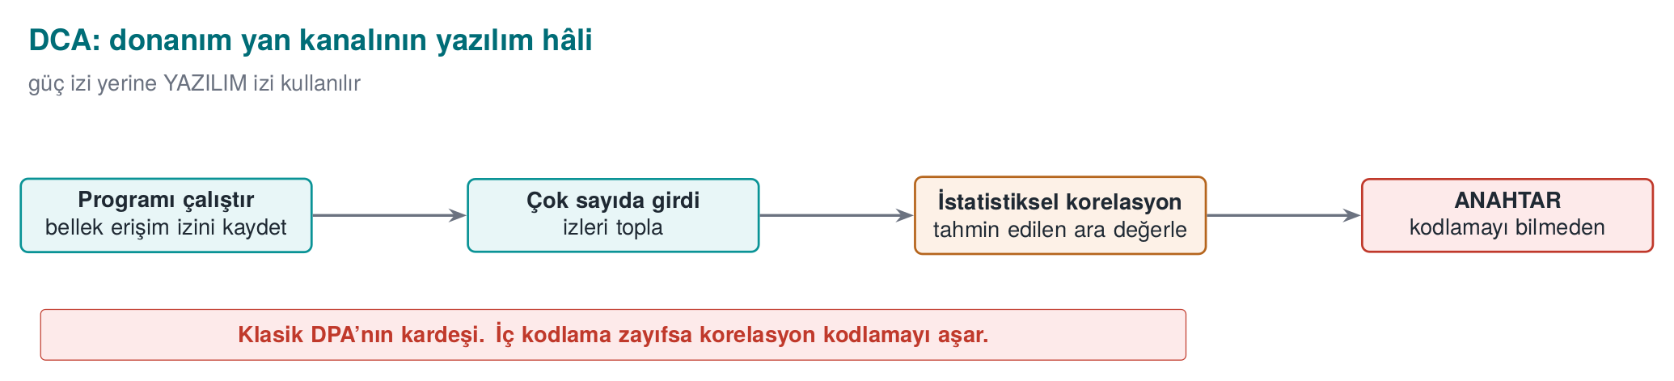
CEN429 Secure Programming · Week 11
The DCA Attack — Diagram
RTEU Computer Engineering · 2026-2027 Fall
98

Slide 99
CEN429 Secure Programming · Week 11
Intuition: What Is It Tracking?
• While WBC runs, it reads intermediate values from the tables.
• These intermediate values change depending on the secret key.
• DCA collects a trace of these values.
RTEU Computer Engineering · 2026-2027 Fall
99

Slide 100
CEN429 Secure Programming · Week 11
How Does Statistics Give Up the Key?
• The attacker makes a guess for one key byte.
• From the guess, they compute how the intermediate value should behave.
• Among the collected traces, the guess that fits best is the correct byte.
This is the software form of DPA (power analysis).
RTEU Computer Engineering · 2026-2027 Fall
100

Slide 101
CEN429 Secure Programming · Week 11
Why Doesn't Internal Encoding Stop DCA?
• Internal encoding scrambles the intermediate value but is a one-to-one mapping (bijection)
• Statistical correlation often survives it
• This is why WBC designs remained vulnerable to DCA after 2016
RTEU Computer Engineering · 2026-2027 Fall
101

Slide 102
CEN429 Secure Programming · Week 11
2017–2024 · WhibOx Competitions
• Academia and industry submit their designs to a competition.
• Every submitted design gets broken.
Inference (today): there is no published pure-software WBC left standing.
RTEU Computer Engineering · 2026-2027 Fall
102

Slide 103
CEN429 Secure Programming · Week 11
Chronology · Summary
Year | Event | Inference
2002 | Chow WB-AES/DES | Birth
2004 | BGE | Internal encoding isn't enough
2007 | WB-DES broken | DES abandoned
2010s | Karroumi broken | More tables ≠ strength
2015 | DFA | Without knowing the math
2016 | DCA | Side-channel defence needed
2017–24 | WhibOx | All broken
RTEU Computer Engineering · 2026-2027 Fall
103

Slide 104
CEN429 Secure Programming · Week 11
Why Do DCA and DFA Also Hit New Designs?
Because neither one tries to solve the design's secret math:
• DCA: doesn't open the box; collects a trace while running, finds the key with statistics
• DFA: injects a fault while running, computes it from the corrupted output
Because they're general and portable, they threaten every design.
RTEU Computer Engineering · 2026-2027 Fall
104

Slide 105
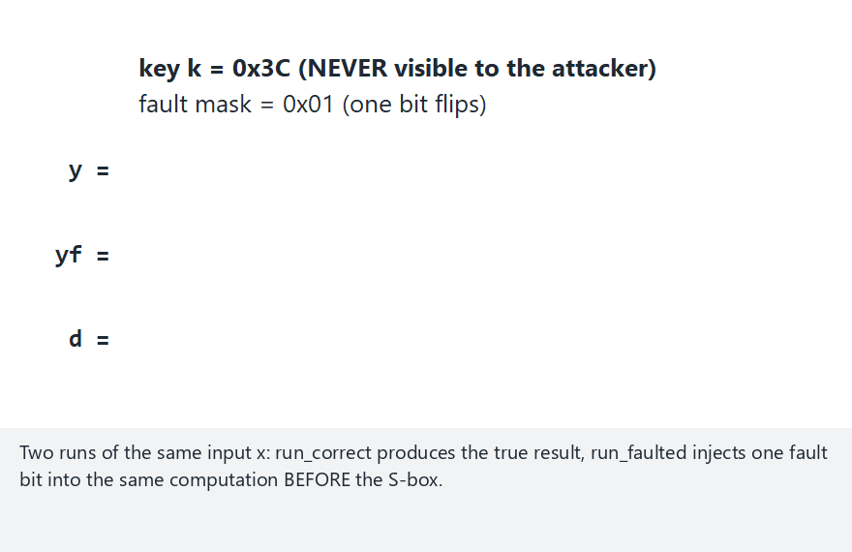
CEN429 Secure Programming · Week 11
A Differential/Fault Comparison at Toy Scale (Animation)
RTEU Computer Engineering · 2026-2027 Fall
105
Notes:
Speaker note: stress that the difference between the correct and faulted output is NOT zero for most inputs, but no single one gives up the key alone.

Slide 106

CEN429 Secure Programming · Week 11
Differential Comparison — Edge Case: Zero Fault Mask
RTEU Computer Engineering · 2026-2027 Fall
106
Notes:
Speaker note: show that with no fault (mask=0x00) the difference is ALWAYS zero, i.e. carries no information at all.

Slide 107
CEN429 Secure Programming · Week 11
So What Do We Do? (Countermeasures)
Research hasn't stopped; but no countermeasure says "now it's secure."
They all raise the cost and are used together. In order:
RTEU Computer Engineering · 2026-2027 Fall
107

Slide 108
CEN429 Secure Programming · Week 11
Countermeasure 1 · Non-Linear Masking
• Tries to break the linear correlation DCA relies on (e.g. Biryukov–Udovenko 2018).
• Makes the statistical attack harder.
RTEU Computer Engineering · 2026-2027 Fall
108

Slide 109
CEN429 Secure Programming · Week 11
Countermeasure 2 · External Encoding (F, G)
• Makes DCA/DFA/BGE harder.
• But we already saw the limit: it breaks standard-AES compatibility.
RTEU Computer Engineering · 2026-2027 Fall
109

Slide 110
CEN429 Secure Programming · Week 11
Countermeasure 3 · Layered Defence
• Week 9's obfuscation rules around WBC
• Week 6's RASP (anti-debug, tamper/integrity checking)
• Goal: make DCA's trace collection and DFA's fault injection harder
RTEU Computer Engineering · 2026-2027 Fall
110

Slide 111
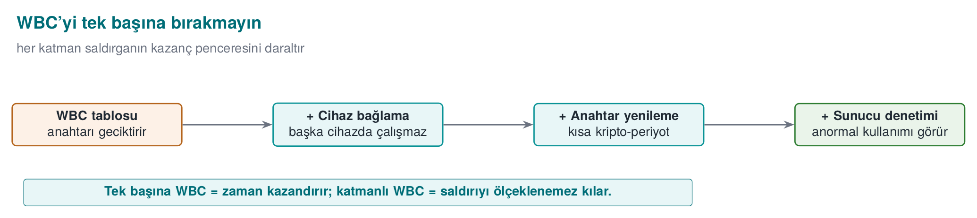
CEN429 Secure Programming · Week 11
Layered WBC — Diagram
RTEU Computer Engineering · 2026-2027 Fall
111

Slide 112
CEN429 Secure Programming · Week 11
Countermeasure 4 · Key Rotation
• If the key rotates often, extracting one key is worth less
• Week 10: crypto-period (a key's lifetime)
RTEU Computer Engineering · 2026-2027 Fall
112

Slide 113
CEN429 Secure Programming · Week 11
Countermeasure 5 · Device/Version Binding
• Tables are only meaningful on one specific device/version
• Blocks code lifting
RTEU Computer Engineering · 2026-2027 Fall
113

Slide 114
CEN429 Secure Programming · Week 11
Countermeasure 6 · Server-Side Risk Checking
• Whatever protection exists on the edge, the transaction is also evaluated on the server
• Rate limiting, anomaly detection, counter/ATC checking
• The last and most reliable defence
RTEU Computer Engineering · 2026-2027 Fall
114

Slide 115
CEN429 Secure Programming · Week 11
Countermeasure 7 · Move to Hardware
• If possible, never put the key in software at all
• TEE, secure element (SE), HSM
This is the subject of the next section.
RTEU Computer Engineering · 2026-2027 Fall
115

Slide 116
CEN429 Secure Programming · Week 11
The Core Rule (Again)
WBC is a layer, not a solution.
The right statement: "I'm delaying key extraction by this much; my real assurance comes from key rotation, device binding, and server-side risk checking."
RTEU Computer Engineering · 2026-2027 Fall
116

Slide 117
CEN429 Secure Programming · Week 11
Section 4 — Quick Check
1. How does "all of them were broken" affect your decision?
2. Which classic attack does DCA resemble?
3. Why don't internal encodings always stop DCA?
4. Which is the most reliable last line of defence?
RTEU Computer Engineering · 2026-2027 Fall
117
Notes:
Speaker note: ask first, then open the answer.

Slide 118
CEN429 Secure Programming · Week 11
Section 4 — Answers
1. WBC is not assurance on its own; combine with key rotation + device binding + server checking + obfuscation; move to hardware where possible.
2. DPA (power analysis) — DCA is its software form.
3. Internal encoding is a one-to-one mapping (bijection); statistical correlation often survives it.
4. Server-side risk checking (the last and most reliable).
RTEU Computer Engineering · 2026-2027 Fall
118

Slide 119
CEN429 Secure Programming · Week 11
5. WBC's Place in Layered Defence
RTEU Computer Engineering · 2026-2027 Fall
119

Slide 120
CEN429 Secure Programming · Week 11
Protecting a Key: the Options
WBC isn't the only option. There are several ways to protect a key; strength and cost differ.
In order, from weakest to strongest.
RTEU Computer Engineering · 2026-2027 Fall
120

Slide 121
CEN429 Secure Programming · Week 11
Option 1 · Plain Key in a Fixed Array
• Key: in the software, in the clear
• Strength: none
• When: never
RTEU Computer Engineering · 2026-2027 Fall
121

Slide 122
CEN429 Secure Programming · Week 11
Option 2 · Hidden/Split Key
• Key: in the software, hidden
• Strength: very low
• When: only for low-value, short-lived secrets
RTEU Computer Engineering · 2026-2027 Fall
122

Slide 123
CEN429 Secure Programming · Week 11
Option 3 · WBC + Layered Defence
• Key: in the software, embedded in tables
• Strength: medium (delays)
• When: no hardware root available; with key rotation + server checking
RTEU Computer Engineering · 2026-2027 Fall
123

Slide 124
CEN429 Secure Programming · Week 11
Option 4 · TEE / Secure Element (SE)
• Key: isolated by hardware
• Strength: high
• When: preferred if the device supports it
RTEU Computer Engineering · 2026-2027 Fall
124

Slide 125
CEN429 Secure Programming · Week 11
Option 5 · HSM / SoftHSM
• Key: in a hardware module (or its software emulation)
• Strength: high (HSM); SoftHSM for testing only
• When: server-side; the key never leaves
RTEU Computer Engineering · 2026-2027 Fall
125

Slide 126
CEN429 Secure Programming · Week 11
Options · One Table
Option | Where's the key | Strength
Plain array | In the clear, in software | None
Hidden/split | Hidden, in software | Very low
WBC + layers | Embedded in tables | Medium
TEE / SE | Isolated by hardware | High
HSM / SoftHSM | Hardware module | High
RTEU Computer Engineering · 2026-2027 Fall
126

Slide 127
CEN429 Secure Programming · Week 11
The Decision Rule
If you don't have to put the key in software, don't.
• If a hardware root (TEE/SE/HSM) exists, use it
• WBC is a trade-off solution for when there's no hardware root
• Always: together with key rotation + device binding + server checking
RTEU Computer Engineering · 2026-2027 Fall
127

Slide 128
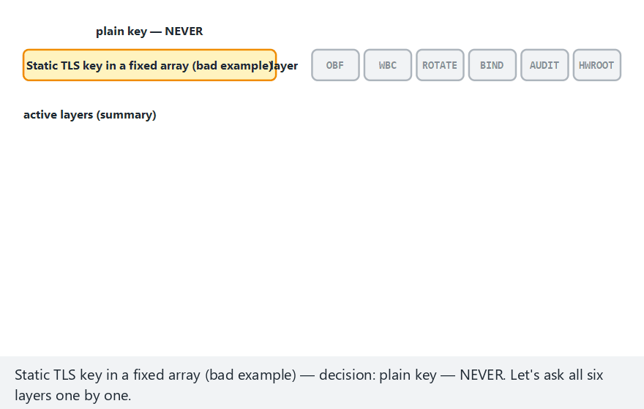
CEN429 Secure Programming · Week 11
Where Does WBC Sit in Layered Defence? (Animation)
RTEU Computer Engineering · 2026-2027 Fall
128
Notes:
Speaker note: stress that the wbc decision ALWAYS activates four layers (WBC, ROTATE, BIND, AUDIT) together.

Slide 129
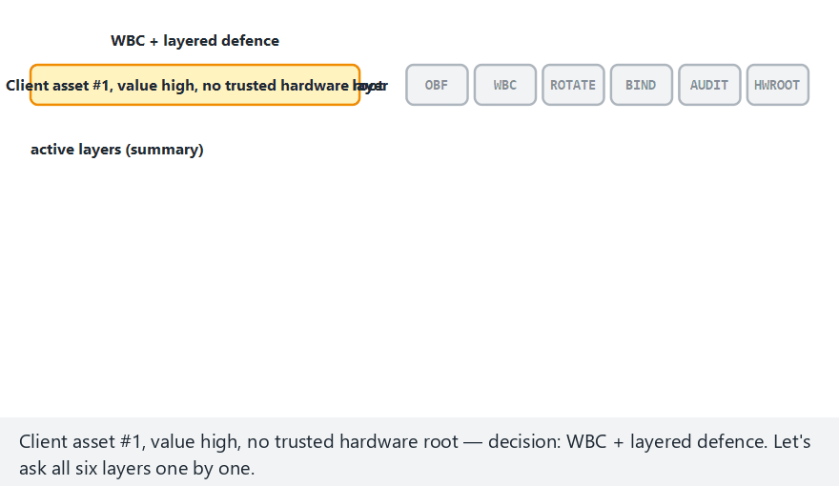
CEN429 Secure Programming · Week 11
Layered Defence — Edge Case: All WBC
RTEU Computer Engineering · 2026-2027 Fall
129
Notes:
Speaker note: show that even with no hardware root at all, the same four layers always arrive together.

Slide 130
CEN429 Secure Programming · Week 11
"How Do I Protect This Key?" — 1
Question 1: Does the device have a TEE/secure element?
• Yes → put the key there. Done (strongest).
• No → continue.
RTEU Computer Engineering · 2026-2027 Fall
130

Slide 131
CEN429 Secure Programming · Week 11
"How Do I Protect This Key?" — 2
Question 2: Is this a server-side key?
• Yes → HSM/PKCS#11 (HSM in production, SoftHSM in testing).
• No (client, no hardware) → continue.
RTEU Computer Engineering · 2026-2027 Fall
131

Slide 132
CEN429 Secure Programming · Week 11
"How Do I Protect This Key?" — 3
Question 3: Does the asset's value justify the cost of protection?
• Low → light hiding + a short lifetime is enough.
• High → WBC + layered defence + rotation + device binding + server checking.
RTEU Computer Engineering · 2026-2027 Fall
132

Slide 133
CEN429 Secure Programming · Week 11
"How Do I Protect This Key?" — 4
In every case:
• Don't embed the key plainly
• Write the decision and its rationale into S8
• State the remaining risk explicitly
RTEU Computer Engineering · 2026-2027 Fall
133

Slide 134
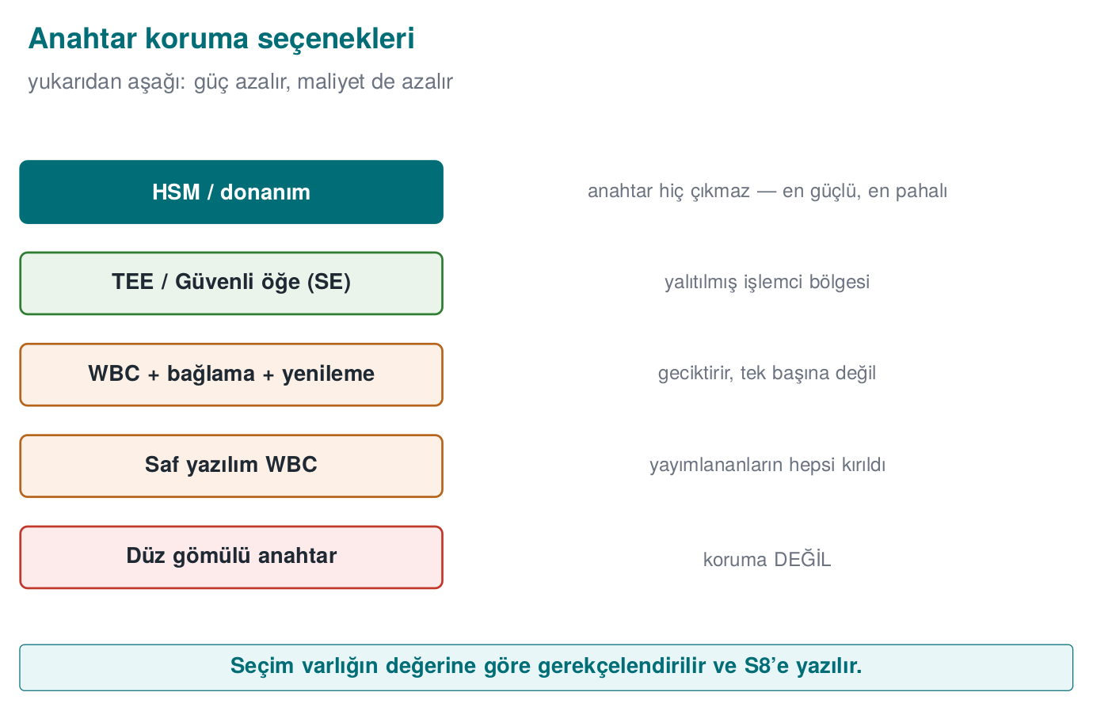
CEN429 Secure Programming · Week 11
Decision Flow · at a Glance
RTEU Computer Engineering · 2026-2027 Fall
134

Slide 135
CEN429 Secure Programming · Week 11
SoftHSM and PKCS#11 (Server-Side Bridge)
• PKCS#11: the standard interface for talking to key modules
• The application never sees the key's value; it just says "sign/encrypt this"
• SoftHSM: a software emulation offering the same interface; no real hardware protection → for development/testing
WBC is a client-side (edge) problem; this is the answer to the server's key problem.
RTEU Computer Engineering · 2026-2027 Fall
135

Slide 136
CEN429 Secure Programming · Week 11
6. Flawed → Attack → Protection
RTEU Computer Engineering · 2026-2027 Fall
136
Notes:
Speaker note: A synthetic, defence-oriented example that ties the whole week together in one scenario.

Slide 137
CEN429 Secure Programming · Week 11
1 · Flawed Design
/* İstemci uygulaması: veri şifreleme anahtarı gömülü */
static const uint8_t k[16] = { ... }; /* KÖTÜ */
A client embeds a data-encryption key in a fixed array.
RTEU Computer Engineering · 2026-2027 Fall
137

Slide 138
CEN429 Secure Programming · Week 11
2 · Attack (Conceptual)
1. strings + entropy scan → a high-entropy 16-byte block
2. Debugger → confirms this block is used in the encryption call
3. The key comes out in minutes
RTEU Computer Engineering · 2026-2027 Fall
138

Slide 139
CEN429 Secure Programming · Week 11
3 · Protection (Layered) — a
• Move the key to TEE/SE if possible
• Otherwise, bake it into WBC tables (no plain byte array left)
RTEU Computer Engineering · 2026-2027 Fall
139

Slide 140
CEN429 Secure Programming · Week 11
3 · Protection (Layered) — b
• Wrap WBC with Week 9's obfuscation and Week 6's RASP
  – Collecting a trace for DCA and injecting a fault for DFA both get harder
• Bind to device/version → code lifting doesn't work
RTEU Computer Engineering · 2026-2027 Fall
140

Slide 141
CEN429 Secure Programming · Week 11
3 · Protection (Layered) — c
• Rotate the key often (short crypto-period)
• Apply risk checking on the server (rate limiting, anomalies)
RTEU Computer Engineering · 2026-2027 Fall
141

Slide 142
CEN429 Secure Programming · Week 11
4 · The Risk That Honestly Remains
• A sufficiently determined attacker can still extract the key on a single device
• But now:
  – Breaking one copy doesn't open the whole system (device binding)
  – The extracted key has a short lifetime (rotation)
  – The server catches abnormal use
RTEU Computer Engineering · 2026-2027 Fall
142

Slide 143
CEN429 Secure Programming · Week 11
Rules That Come Out of the Scenario
• Don't embed the key in plain form
• Use a hardware root if one exists
• Never leave WBC alone
• Device binding + rotation + server checking
RTEU Computer Engineering · 2026-2027 Fall
143

Slide 144
CEN429 Secure Programming · Week 11
Case · Setup
A mobile app encrypts local data with a session key it downloads from the server.
• Some devices have a TEE, some don't.
• The key rotates once a day.
How do we protect it?
RTEU Computer Engineering · 2026-2027 Fall
144

Slide 145
CEN429 Secure Programming · Week 11
Case · Devices With a TEE
• Put the key in the TEE.
• The app never sees the key; encryption happens inside the TEE.
• The strongest solution; extra WBC is unnecessary.
RTEU Computer Engineering · 2026-2027 Fall
145

Slide 146
CEN429 Secure Programming · Week 11
Case · Devices Without a TEE
• Bake the key into WBC tables (no plain array).
• Wrap it with Week 9 obfuscation + Week 6 RASP.
• Bind to the device: the tables shouldn't work on another device.
RTEU Computer Engineering · 2026-2027 Fall
146

Slide 147
CEN429 Secure Programming · Week 11
Case · Shared Layers
• The key rotates once a day → a short lifetime for anything extracted.
• The server catches abnormal use (too many requests, an odd location).
• So even if one device gets broken, the damage is limited.
RTEU Computer Engineering · 2026-2027 Fall
147

Slide 148
CEN429 Secure Programming · Week 11
Case · Remaining Risk (Honest)
• On a device without a TEE, a determined attacker can extract the key.
• But: limited to one device + 24-hour lifetime + server checking.
• This trade-off is written explicitly into S8.
RTEU Computer Engineering · 2026-2027 Fall
148

Slide 149
CEN429 Secure Programming · Week 11
Case · Takeaway
There is no single "magic" protection.
Strength comes from the combination of layers and an honest analysis of the remaining risk.
This is exactly what the evaluator (Week 12) looks for.
To understand WBC is to put it in its right place.
RTEU Computer Engineering · 2026-2027 Fall
149

Slide 150
CEN429 Secure Programming · Week 11
7. Project and Closing
RTEU Computer Engineering · 2026-2027 Fall
150

Slide 151
CEN429 Secure Programming · Week 11
Project · S8 (Key Protection Rationale) — 1
Write a protection decision and its rationale for at least one sensitive key:
1. Where does the key live, how is it protected? (if not plain: TEE/SE, WBC, hiding — which one, why)
RTEU Computer Engineering · 2026-2027 Fall
151

Slide 152
CEN429 Secure Programming · Week 11
Project · S8 — 2
2. If the protection isn't sufficient (e.g. you're pure software), state this explicitly and list your compensating layers:
• key rotation period
• device/version binding
• server-side risk checking
RTEU Computer Engineering · 2026-2027 Fall
152

Slide 153
CEN429 Secure Programming · Week 11
Project · S8 — 3
3. If you didn't use WBC, give the reason why not:
• cost
• you have a hardware root
• the asset's value is low
A justified "we didn't use it" is a complete answer.
RTEU Computer Engineering · 2026-2027 Fall
153

Slide 154
CEN429 Secure Programming · Week 11
⚠️ No Real Keys in the Repository
• Every key file, table, and example must be synthetic
• A real key in the repo at certification time = one of the most severe findings
• It counts the same way in the project
RTEU Computer Engineering · 2026-2027 Fall
154

Slide 155
CEN429 Secure Programming · Week 11
Glossary (1)
Term | Meaning
Black/grey/white box | What the attacker sees
WBC | Crypto that runs in the white box
S-box | Fixed table that substitutes a byte
Bijection | Invertible one-to-one mapping
Internal/external encoding | Inside a table / secret transform wrapping the whole cipher
RTEU Computer Engineering · 2026-2027 Fall
155

Slide 156
CEN429 Secure Programming · Week 11
Glossary (2)
Term | Meaning
Code lifting | Copying the code without extracting the key
DCA | DPA-like statistics applied to execution traces
DFA | Injecting a fault and computing the key
Crypto-period | A key's lifetime
TEE/SE/HSM | Hardware-based key protection
RTEU Computer Engineering · 2026-2027 Fall
156

Slide 157
CEN429 Secure Programming · Week 11
Self-Check (1–6)
1. Three attacker models; which one does the AES proof assume?
2. "Run only one round" and "inject a fault" set up which attacks?
3. Why isn't a key embedded in an array protection? (entropy)
4. What is code lifting, which countermeasure closes it?
5. Why is T[x]=S-box[x^k] insecure on its own?
6. Internal vs. external encoding; the limit of external encoding?
RTEU Computer Engineering · 2026-2027 Fall
157

Slide 158
CEN429 Secure Programming · Week 11
Self-Check — Answers (1–6)
1. Black box (I/O only), grey box (+ side channel: power/time), white box (full access + modifies). The classic AES proof assumes black box.
2. "Run one round/observe an intermediate value" → DCA; "inject a fault" → DFA.
3. The key sits as a high-entropy block → found by an entropy scan/strings/pattern (demo --scan). Moving its location isn't hiding.
4. Code lifting: copying a table/routine as-is and using it elsewhere. Closed by: external encoding (+ device binding/server checking).
5. T[x]=S-box[x^k] depends directly on k; comparing the table with S-box recovers k. Mask it with internal encoding.
6. Internal encoding masks intermediate values with secret bijections; external encoding transforms the input/output (makes code lifting harder). Limit: the caller must match too → breaks standard AES compatibility.
RTEU Computer Engineering · 2026-2027 Fall
158

Slide 159
CEN429 Secure Programming · Week 11
Self-Check (7–12)
1. Table size/speed order of magnitude? Why only selected operations?
2. How does "all of them were broken" affect your decision?
3. Which hardware attack does DCA resemble?
4. Rank the key-protection options by strength/cost
5. What 3 layers should you add if you use WBC?
6. Write the S8 rationale for a key, in three sentences
RTEU Computer Engineering · 2026-2027 Fall
159

Slide 160
CEN429 Secure Programming · Week 11
Self-Check — Answers (7–12)
1. Tables run to hundreds of KB (standard AES key: 16–32 bytes) and are ~50× slower → applied only to selected/critical operations.
2. We don't count WBC alone as key protection; we use it as a delaying layer, together with rotation + binding + server checking (hardware where possible).
3. DPA (Differential Power Analysis); DCA replaces the power trace with a software trace (memory access/intermediate value).
4. (weak→strong) plain embedded key < encoded table (pure-software WBC) < WBC+binding/rotation < TEE/SE < HSM/hardware. Cost rises in the same direction.
5. Key rotation · device/application binding · server-side checking/revocation (+ RASP/integrity).
6. Example: "The DEK protects data at rest with AES-256-GCM. It is generated/stored in an HSM, never kept in plain memory. Hardware was chosen because pure-software whitebox has been broken and the asset's value is high."
RTEU Computer Engineering · 2026-2027 Fall
160

Slide 161
CEN429 Secure Programming · Week 11
Summary: This Week in One Sentence
Every published pure-software whitebox has been broken; WBC is a layer that delays key extraction, and it only gains meaning together with rotation, device binding, and server checking.
RTEU Computer Engineering · 2026-2027 Fall
161

Slide 162
CEN429 Secure Programming · Week 11
Sources
• The secure programming technical guide — the WBC attacker model, where whitebox AES sits in a product
• Chow, Eisen, Johnson, van Oorschot — WB-AES (SAC 2002), WB-DES (DRM 2002)
• Wyseur — "Hiding Keys in Software" (short introduction)
• BGE (SAC 2004); Bos et al. DCA (CHES 2016); "Unboxing the White-Box" (BH EU 2015)
• WhibOx competition results (2017–2024)
RTEU Computer Engineering · 2026-2027 Fall
162

Slide 163
CEN429 Secure Programming · Week 11
Next Week
Week 12 — Certification and Penetration-Test Planning
Measuring how much a protection "actually withstands" → the independent-evaluation process and reporting.
RTEU Computer Engineering · 2026-2027 Fall
163

