Slide 1

CEN429 Secure Programming · Week 13
Security Requirements
CEN429 Secure Programming — Week 13
Asst. Prof. Dr. Uğur CORUH · 11.12.2026
RTEU Computer Engineering · 2026-2027 Fall
Notes:
Speaker note: This week we learn to read security requirements and map them onto our own project: requirement, status, evidence.

Slide 2
CEN429 Secure Programming · Week 13
Today (3 Hours)
Time | Section | What Happens
0:00–0:20 | 1 | What is a requirement, how do you write a good one?
0:20–0:50 | 2–3 | Requirement-to-evidence traceability; the requirement-block pattern and deferred requirements
0:50–1:00 | Break
1:00–1:30 | 4 | Common Criteria: TOE, ST, PP, SFR/SAR, EAL
1:30–1:50 | 5 | FIPS 140-3 and cryptographic module validation
1:50–2:00 | Break
2:00–2:25 | 6 | ETSI, GSMA, EMVCo, PCI MPoC, OWASP MASVS
2:25–2:50 | 7–8 | Carrying requirements into the plan and asset management; the course's requirement families — compliance matrix activity
2:50–3:00 | 9+ | Project step (S14, S17), self-check
Learning outcomes (LO.5, 7): tell a good security requirement apart from a bad one · build a traceability/compliance matrix · compare what CC, FIPS, ETSI, EMVCo, PCI, and MASVS ask for
RTEU Computer Engineering · 2026-2027 Fall
2
Notes:
Speaker note: Today we learn to read security requirements and map them onto our own project: requirement → control → verification → evidence. Zero prior knowledge; we will define every term.

Slide 3
CEN429 Secure Programming · Week 13
What We Bring from Earlier Weeks
• Asset, threat, and the application protection plan — the written plan that governs a piece of software's security: scope, architecture, assets, threats, controls, verification, residual risk; where each asset lives, when it is created and destroyed, and which protection (C/I) it needs are listed in an asset table (Week 1)
• Independent evaluation, findings, and evidence — the evidence-based evaluation process run by an independent laboratory rather than the product's own developer; every gap the evaluator documents is a finding (Week 12)
This week: we link the asset table to every requirement, and we use the independent-evaluation discipline as a "requirement-to-evidence traceability chain" — the output is your project's compliance matrix (S17) and deferred requirements (S14).
RTEU Computer Engineering · 2026-2027 Fall
3

Slide 4
CEN429 Secure Programming · Week 13
This Week's Concepts
Each term is defined once, where it first appears in the body; here we only mark where.
Concept | Where
Requirement | Section 1
Three types of requirement | Section 1
Good vs. bad requirement | Section 1
Traceability | Section 2
Compliance matrix | Section 2
Requirement statuses | Section 2
Deferred requirement | Section 3
Common Criteria (CC) | Section 4
TOE, ST, PP | Section 4
SFR, SAR, EAL | Section 4
FIPS 140-3 | Section 5
Sector standards | Section 6
RTEU Computer Engineering · 2026-2027 Fall
4

Slide 5
CEN429 Secure Programming · Week 13
1. How Do You Write a Good Requirement?
RTEU Computer Engineering · 2026-2027 Fall
5

Slide 6
CEN429 Secure Programming · Week 13
A Brief History (1) — the Foundational Standards
• 1983/1985 — TCSEC (Orange Book), the US DoD's first attempt at security requirement levels
• 1984/1998 — IEEE 830, how to write ANY software requirements specification → superseded by ISO/IEC/IEEE 29148 (2011)
• 1991 — ITSEC, Europe's own evaluation criteria (parallel to TCSEC)
Requirements engineering is older than security certification — security just adds "and prove it, independently."
RTEU Computer Engineering · 2026-2027 Fall
6

Slide 7
CEN429 Secure Programming · Week 13
A Brief History (2) — Certification and Sector Standards
• 1994 → 1998 → 1999 — Common Criteria v1.0 → v2.0 → ISO/IEC 15408 (still revised today: CC:2022)
• 1994 → 2001 → 2019 — FIPS 140-1 → 140-2 → 140-3, cryptographic module requirements
• 2004 — PCI DSS (payment) · 2009 — OWASP ASVS (web) · 2016 — OWASP MASVS (mobile)
The unchanging principle: a requirement must be measurable and traceable; a "met" with no evidence is invalid.
RTEU Computer Engineering · 2026-2027 Fall
7

Slide 8
CEN429 Secure Programming · Week 13
What Is a Requirement?
• Requirement: a condition the system must meet.
• A security requirement: a security condition.
• A good requirement is verifiable (testable).
RTEU Computer Engineering · 2026-2027 Fall
8

Slide 9
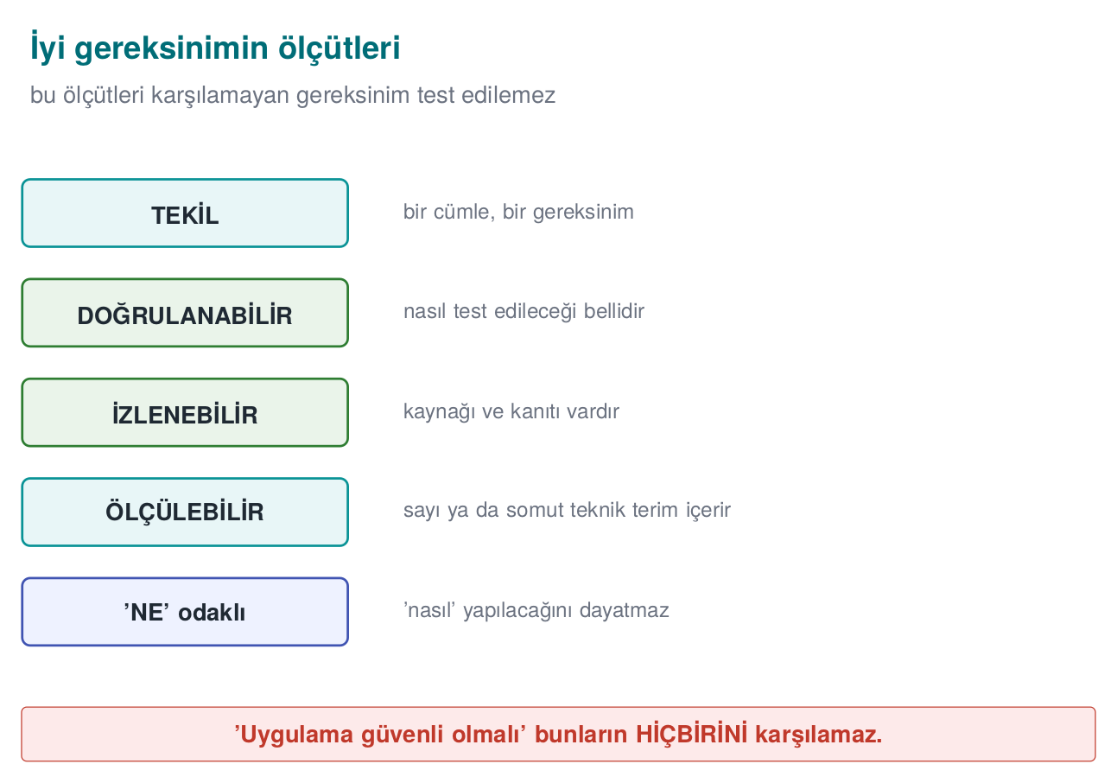
CEN429 Secure Programming · Week 13
Criteria of a Good Requirement — Diagram
RTEU Computer Engineering · 2026-2027 Fall
9

Slide 10
CEN429 Secure Programming · Week 13
Three Types (Recap)
Type | Question | Example
Functional | Which security function? | Sensitive data is protected with AEAD
Assurance | Was it done correctly? | Static analysis + test report
Process | How does the organisation work? | Every change is reviewed
RTEU Computer Engineering · 2026-2027 Fall
10

Slide 11
CEN429 Secure Programming · Week 13
Criteria of a Good Requirement
• Verifiable: can it be tested?
• Singular: does it state a single thing?
• Measurable: is it concrete?
• Feasible: is it achievable?
RTEU Computer Engineering · 2026-2027 Fall
11

Slide 12
CEN429 Secure Programming · Week 13
Bad → Good (1)
• Bad: "The application must be secure."
• Good: "The release build must be produced with a stack canary, PIE, and full RELRO."
Why is it good? Testable (checksec).
RTEU Computer Engineering · 2026-2027 Fall
12

Slide 13
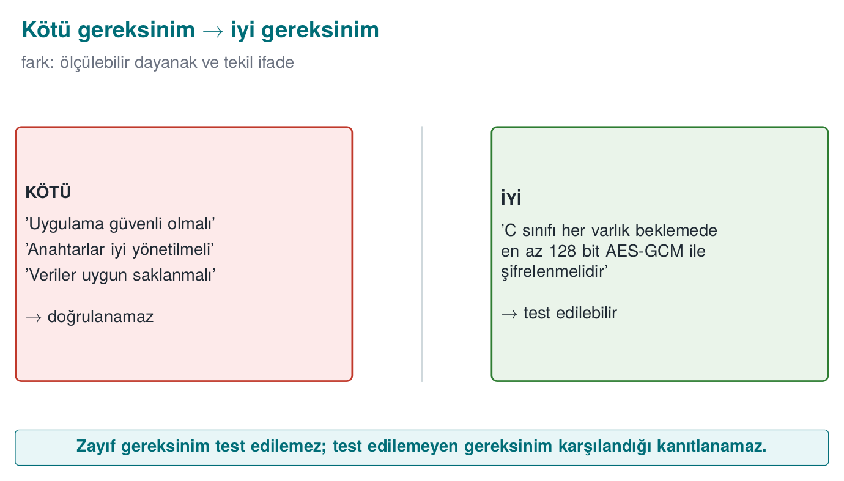
CEN429 Secure Programming · Week 13
Bad → Good Requirement — Diagram
RTEU Computer Engineering · 2026-2027 Fall
13

Slide 14
CEN429 Secure Programming · Week 13
Bad → Good (2)
• Bad: "Data must be encrypted."
• Good: "Every class-C asset must be encrypted at rest with AEAD at a level of ≥128 bits."
Why is it good? Which data, which level, which method is clear.
RTEU Computer Engineering · 2026-2027 Fall
14

Slide 15
CEN429 Secure Programming · Week 13
Bad → Good (3)
• Bad: "Keys must be well managed."
• Good: "(1) Every key's purpose, cryptoperiod, and destruction are documented. (2) It is erased from memory once its job is done."
Singular, verifiable items.
RTEU Computer Engineering · 2026-2027 Fall
15

Slide 16
CEN429 Secure Programming · Week 13
Worked Example · Improving a Bad Requirement
Starting sentence (from a real draft):
"The application must protect user data."
We will turn this sentence into a good requirement in six steps; at every step, before/after and why it changed.
RTEU Computer Engineering · 2026-2027 Fall
16

Slide 17
CEN429 Secure Programming · Week 13
Step 1 — Flag the Vague Words
• Before: "The application must protect user data."
• Vague words: "user data" (which data?), "must protect" (against what, at what level?).
• Why it changed: when an evaluator reads this sentence, they find nothing to test.
RTEU Computer Engineering · 2026-2027 Fall
17

Slide 18
CEN429 Secure Programming · Week 13
Step 2 — Link It to the Asset Table
• After: "Class-C fields in the local database must be protected."
• Why it changed: "user data" is not a single thing; it is separate rows in the asset table (Week 1) — session token, profile, payment token... each in a different class.
• "Must be protected" still isn't measurable → next step.
RTEU Computer Engineering · 2026-2027 Fall
18

Slide 19
CEN429 Secure Programming · Week 13
Step 3 — Clarify the Protection Goal
• After: "...the confidentiality and integrity of class-C fields must be protected."
• Why it changed: the threat model shows both "reading the file" (confidentiality) and "modifying the file" (integrity) as risks; both are needed at the same time.
RTEU Computer Engineering · 2026-2027 Fall
19

Slide 20
CEN429 Secure Programming · Week 13
Step 4 — Add a Measurable Technical Criterion
• After: "...must be protected with authenticated encryption (AEAD)."
• Why it changed: Week 9's rule — if confidentiality and integrity are both wanted at the same time, the right tool class is AEAD; still no specific library name is given.
RTEU Computer Engineering · 2026-2027 Fall
20

Slide 21
CEN429 Secure Programming · Week 13
Step 5 — Add the State and the Obligation Keyword
• After: "Sensitive class-C data at rest must be protected with authenticated encryption (AEAD)." (MUST)
• Why it changed: the data here is at rest (on disk); "must" was chosen because this is an indispensable condition against the threat — if it were "may," it would be treated as optional.
RTEU Computer Engineering · 2026-2027 Fall
21

Slide 22
CEN429 Secure Programming · Week 13
Step 6 — Give It an Id and Link It to the Threat
• After (final form): CEN429-DR-01 — "Sensitive class-C data at rest must be protected with authenticated encryption (AEAD)." (Threat: T-03, "an attacker who compromises the device reads/modifies the database file".)
• Why it changed: a requirement with no id never enters the traceability chain.
RTEU Computer Engineering · 2026-2027 Fall
22

Slide 23
CEN429 Secure Programming · Week 13
Six Steps · Which Ambiguity Did Each Remove?
Step | Ambiguity removed
1 | Flagging the vague word
2 | Which data (asset table)
3 | Which goal (confidentiality/integrity)
4 | Which tool class (AEAD)
5 | Which state, which obligation
6 | Id and threat link
If any one is missing, the requirement stays open to debate; the evaluator sends it back.
RTEU Computer Engineering · 2026-2027 Fall
23

Slide 24
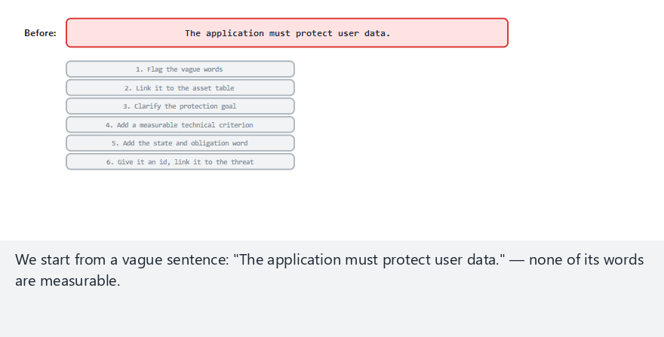
CEN429 Secure Programming · Week 13
A Requirement's Life (animation)
RTEU Computer Engineering · 2026-2027 Fall
24
Notes:
Speaker note: run the six steps live on "The application must protect user data." — watch which word gets added at each step.

Slide 25
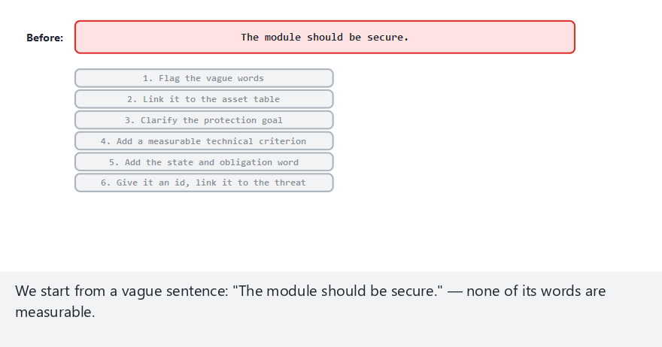
CEN429 Secure Programming · Week 13
A Requirement's Life — edge case: a one-word vagueness
RTEU Computer Engineering · 2026-2027 Fall
25
Notes:
Speaker note: even a very short sentence needs all six steps — a single vague word is enough to make it untestable.

Slide 26
CEN429 Secure Programming · Week 13
Second and Third Examples
• Second example (speed test): "Must be fast and secure" → two separate requirements in one sentence. Run through the same six steps: CEN429-ID-04 — "Every login attempt must be validated server-side; client-side checking alone must not be considered sufficient."
• Third example (process): "Code review must be performed." → Which change? Who reviews it? When? Good version: "Every change must be reviewed by at least one person other than the developer who wrote it, before being merged into the main branch, and the approval must be recorded in the version control system."
RTEU Computer Engineering · 2026-2027 Fall
26

Slide 27
CEN429 Secure Programming · Week 13
Section 1's Rule and the Obligation Keywords
• Write what is being asked for in the requirement column; write how you meet it in a separate control sentence.
• Common mistake: "Requirement: AES-256-GCM must be used." → this is a control, not a requirement; correct: "...must be protected with AEAD" (requirement) + "AES-256-GCM, S7.2" (control).
• Write the tool class (AEAD, CSPRNG, TLS 1.2+) in the requirement text; put a specific library/version name in the control.
• must (MUST): mandatory, a direct finding if not met. should (SHOULD): strong recommendation, needs a rationale. may (MAY): optional, not a finding.
RTEU Computer Engineering · 2026-2027 Fall
27

Slide 28
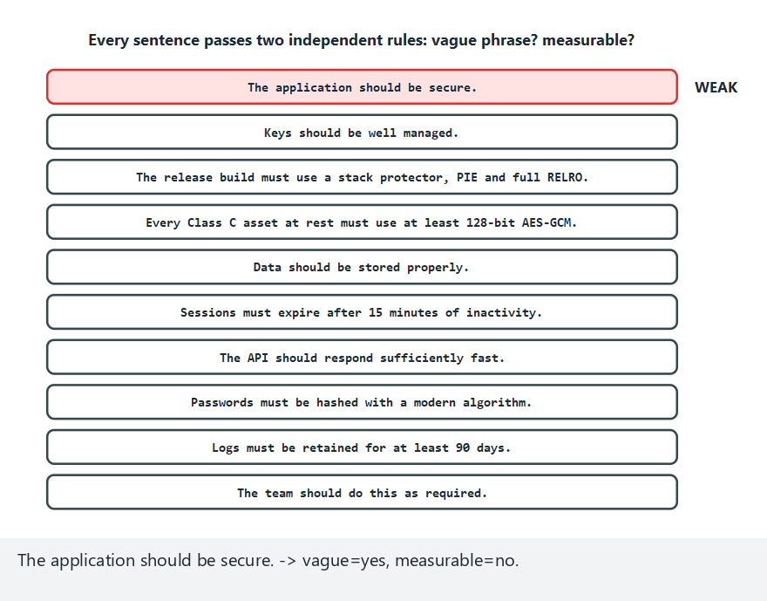
CEN429 Secure Programming · Week 13
Requirement Quality Checker (animation)
RTEU Computer Engineering · 2026-2027 Fall
28
Notes:
Speaker note: this is the demo tool `02-requirement-quality` — watch which rule (vague phrase, no measurable basis) fires on each sample sentence.

Slide 29
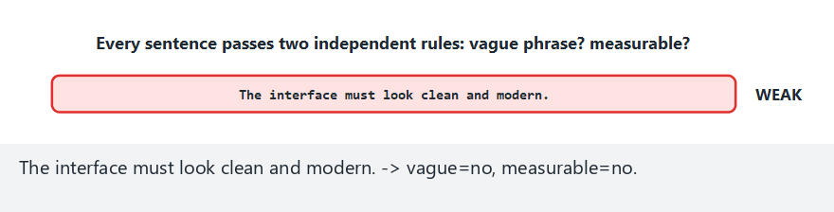
CEN429 Secure Programming · Week 13
Requirement Quality Checker — edge case: a single sentence, a single rule
RTEU Computer Engineering · 2026-2027 Fall
29
Notes:
Speaker note: not vague, but no number and no concrete technical term — the "no measurable basis" rule alone is enough.

Slide 30
CEN429 Secure Programming · Week 13
2. From Requirement to Evidence: Traceability
RTEU Computer Engineering · 2026-2027 Fall
30

Slide 31
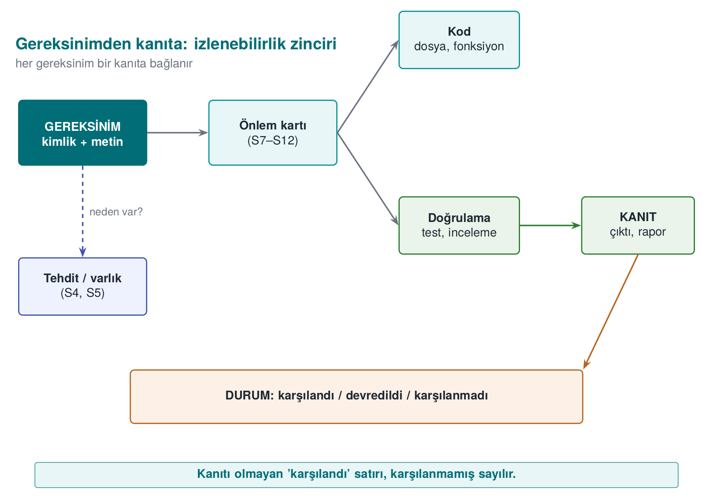
CEN429 Secure Programming · Week 13
The Chain
Every requirement must be linked to evidence through this chain.
RTEU Computer Engineering · 2026-2027 Fall
31

Slide 32
CEN429 Secure Programming · Week 13
Status and Decision Words — Summary
Word | When to use it | What must accompany it
Met | The product satisfies the requirement itself | Control + verification + evidence
Deferred | Another party satisfies it | To whom + why + how
Not met | Applies but not yet satisfied | Residual risk + planned fix
Not applicable | Does not apply to the product at all | Rationale
must (MUST) | Mandatory | A direct finding if not met
should (SHOULD) | Strong recommendation | A written rationale if not met
RTEU Computer Engineering · 2026-2027 Fall
32

Slide 33
CEN429 Secure Programming · Week 13
Why Is Traceability Important?
• The evaluator asks "where is this requirement?"
• Without traceability: searching everything from scratch.
• With it: found directly from the matrix.
RTEU Computer Engineering · 2026-2027 Fall
33

Slide 34
CEN429 Secure Programming · Week 13
A Traceability Example
Requirement | Control | Verification | Evidence
Data with AEAD | AES-GCM | Unit test | Test output
Release protections | Flags | checksec | Protection table
RTEU Computer Engineering · 2026-2027 Fall
34

Slide 35
CEN429 Secure Programming · Week 13
Two Directions
• Forward: requirement → where was it met?
• Backward: this code/test → which requirement does it meet?
• A good matrix is traceable in both directions.
RTEU Computer Engineering · 2026-2027 Fall
35

Slide 36
CEN429 Secure Programming · Week 13
⚠️ A "Met" With No Evidence
• If the matrix says "met" but there is no evidence...
• In the evaluator's eyes it counts as not met.
• It becomes one of the first findings.
RTEU Computer Engineering · 2026-2027 Fall
36

Slide 37
CEN429 Secure Programming · Week 13
Worked Example · An End-to-End Chain
Let's fill in how the chain is built, start to finish, through a single asset: the user's session token.
Six links: asset → threat → requirement → control → verification → evidence.
RTEU Computer Engineering · 2026-2027 Fall
37

Slide 38
CEN429 Secure Programming · Week 13
1. Asset
Field | Value
Asset | The user's session token
Location | Client memory; carried in the HTTP header on every request
Class | C (confidentiality)
Lifecycle | Generated at login → used on every request → invalidated at logout/timeout
RTEU Computer Engineering · 2026-2027 Fall
38

Slide 39
CEN429 Secure Programming · Week 13
2. Threat
• An attacker positioned on the network (e.g., on the same public Wi-Fi) can listen on an unencrypted connection and capture the token.
• Using the captured token in their own requests, they can act as the user.
• STRIDE: Spoofing + Information Disclosure (Week 1 terminology).
RTEU Computer Engineering · 2026-2027 Fall
39

Slide 40
CEN429 Secure Programming · Week 13
3. Requirement
The asset → threat → goal (confidentiality+identity) → tool class → state → obligation chain is briefly reapplied:
CEN429-DT-01 — "The session token must be carried over a channel using TLS 1.2 or higher, with the server certificate validated."
RTEU Computer Engineering · 2026-2027 Fall
40

Slide 41
CEN429 Secure Programming · Week 13
4. Control
The guide's S10.3 "Transport security" section:
"The client performs a TLS 1.2+ handshake on every connection to the server; the certificate chain and hostname are validated (see Week 10). No request is sent before the channel is established."
RTEU Computer Engineering · 2026-2027 Fall
41

Slide 42
CEN429 Secure Programming · Week 13
5. Verification
The security testing team tries to intercept the connection with a MITM (man-in-the-middle) tool:
• Verifies the connection is rejected when an invalid/self-signed certificate is presented.
• Verifies a plaintext (non-TLS) connection attempt is rejected.
RTEU Computer Engineering · 2026-2027 Fall
42

Slide 43
CEN429 Secure Programming · Week 13
6. Evidence
• The test tool's log output: mitm_test_2026-11-03.log
• CI run record: #617
• TLS handshake packet capture: handshake.pcapng
• Stored in the evidence/week13/ folder, referenced by these file names in the matrix.
RTEU Computer Engineering · 2026-2027 Fall
43

Slide 44
CEN429 Secure Programming · Week 13
The Chain's Filled-In Row
Id | Requirement | Status | Control | Verification | Evidence
CEN429-DT-01 | Session token must be carried over TLS 1.2+ with certificate validated | Met | S10.3 | MITM test: invalid certificate/plaintext rejected | mitm_test_2026-11-03.log, CI #617, handshake.pcapng
If one link were missing: without the asset, "which data" stays unclear; without the threat, the requirement looks arbitrary; without the control, the claim is unsupported; without verification, "how was it tested" goes unanswered; without evidence, the row becomes the first finding.
RTEU Computer Engineering · 2026-2027 Fall
44

Slide 45
CEN429 Secure Programming · Week 13
The Full Chain of the "Not Met" Status
Link | Met (DT-01) | Not met (DT-04)
Requirement | Session token carried over TLS | Server certificate must be pinned
Status | Met | Not met
Control | S10.3 | — (not yet)
Verification | MITM test passed | —
Evidence | Test log | Residual risk: written into S16.4
In "not met," the control/verification can stay blank, but the evidence (where the residual risk is documented) cannot.
RTEU Computer Engineering · 2026-2027 Fall
45

Slide 46
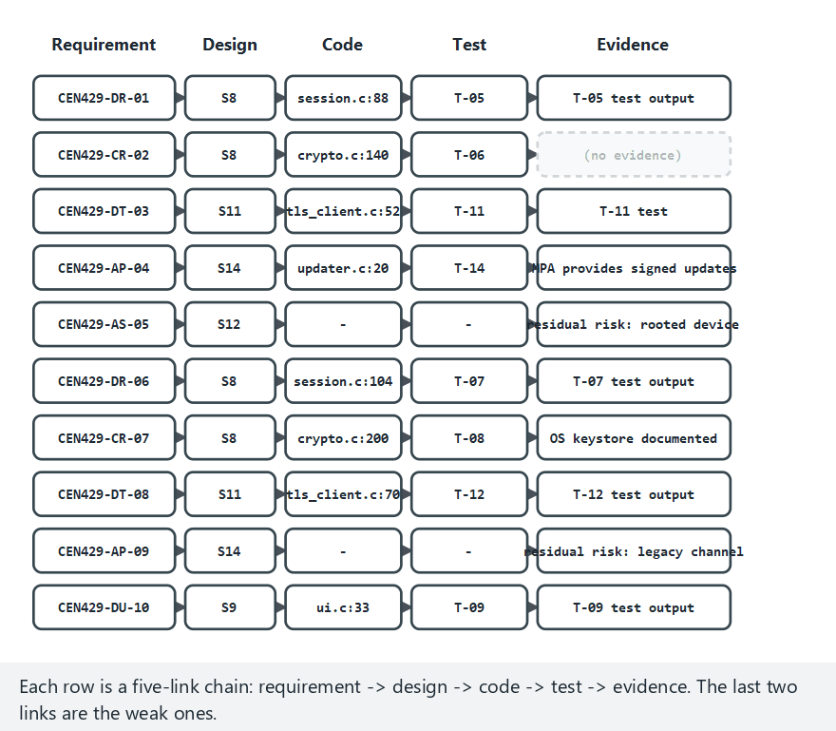
CEN429 Secure Programming · Week 13
Traceability Chain (animation)
RTEU Computer Engineering · 2026-2027 Fall
46
Notes:
Speaker note: the real compliance_matrix.c rule — a "met" or "delegated" row with an empty evidence column is a gap, scanned row by row.

Slide 47
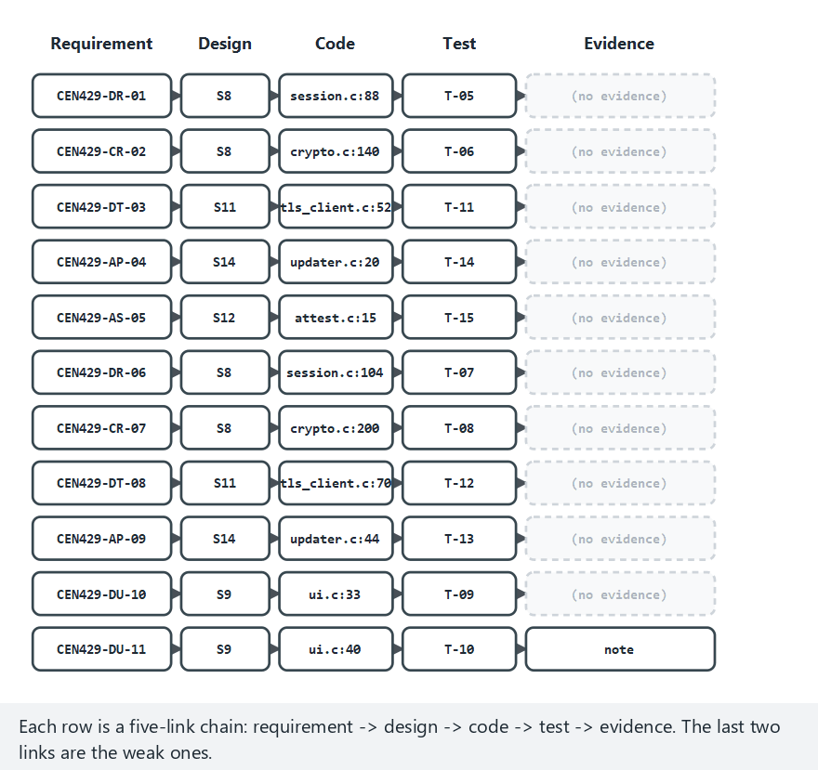
CEN429 Secure Programming · Week 13
Traceability Chain — edge case: every row a gap
RTEU Computer Engineering · 2026-2027 Fall
47
Notes:
Speaker note: an unrealistic matrix on purpose — shows the pattern of the finding message repeating on every single row.

Slide 48
CEN429 Secure Programming · Week 13
Section 2's Rule
• Every "met" row's evidence column must have a findable, named reference: a file name, a CI number, a test report section.
• "Exists," "tested" is not evidence, it is a promise of evidence.
• The evaluator's most common finding: a "met" with no evidence.
RTEU Computer Engineering · 2026-2027 Fall
48

Slide 49
CEN429 Secure Programming · Week 13
Sections 1–2 — Quick Check
1. What are the four criteria of a good requirement?
2. Why is "the application must be secure" bad?
3. What is the traceability chain?
RTEU Computer Engineering · 2026-2027 Fall
49
Notes:
Speaker note: Next, the requirement block and deferred requirements.

Slide 50
CEN429 Secure Programming · Week 13
Sections 1–2 — Answers
1. Specific · measurable/verifiable · singular · traceable (feasible, atomic).
2. Vague and unmeasurable; "secure" has no definition → cannot be tested, everyone understands it differently.
3. Threat/standard → requirement → design/code → test/evidence. Every requirement is linked both ways to a source and to evidence.
RTEU Computer Engineering · 2026-2027 Fall
50

Slide 51
CEN429 Secure Programming · Week 13
3. The Requirement Block and Deferred Requirements
RTEU Computer Engineering · 2026-2027 Fall
51

Slide 52
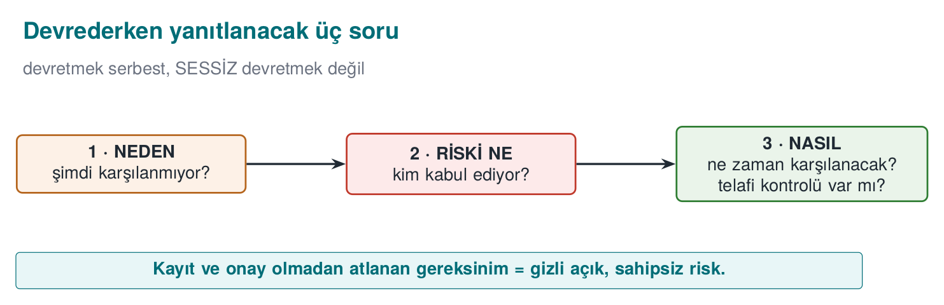
CEN429 Secure Programming · Week 13
Three Deferral Questions — Diagram
RTEU Computer Engineering · 2026-2027 Fall
52

Slide 53
CEN429 Secure Programming · Week 13
The Requirement-Block Pattern
Every requirement is written as a block:
• Id: a unique number (e.g., CEN429-DU-01)
• Text: what is asked for (singular, measurable)
• Status: met / deferred / not met
• Compliance: how it was met
• Verification + evidence
RTEU Computer Engineering · 2026-2027 Fall
53

Slide 54
CEN429 Secure Programming · Week 13
Example Block
CEN429-DU-01
Metin: Yerel DB'deki C sınıfı veri AEAD ile şifrelenir.
Durum: Karşılandı
Karşılama: AES-256-GCM, anahtar TEE'de
Doğrulama: T-05 birim testi
Kanıt: test çıktısı, S16
RTEU Computer Engineering · 2026-2027 Fall
54

Slide 55
CEN429 Secure Programming · Week 13
Why a Block?
• Every requirement has the same structure → comparable.
• The evaluator reads it fast.
• The compliance matrix is produced from these blocks.
RTEU Computer Engineering · 2026-2027 Fall
55

Slide 56
CEN429 Secure Programming · Week 13
What Is a Deferred Requirement?
• A component cannot meet a requirement itself.
• It defers the responsibility to the parent application/OS/hardware.
• This is not an escape, it is an explicit contract.
RTEU Computer Engineering · 2026-2027 Fall
56

Slide 57
CEN429 Secure Programming · Week 13
Three Questions When Deferring
Write, for every deferred requirement:
• To whom? (parent application / OS / hardware)
• Why? (why this component cannot meet it)
• How? (how the other party will meet it)
RTEU Computer Engineering · 2026-2027 Fall
57

Slide 58
CEN429 Secure Programming · Week 13
Deferred · Example
CEN429-AP-03: Güvenli kurulum ve güncelleme
Durum: Devredildi
Kime: Üst mobil uygulama (MPA)
Neden: SDK dağıtım kanalına sahip değil
Nasıl: MPA imzalı güncelleme + sürüm denetimi sağlar
RTEU Computer Engineering · 2026-2027 Fall
58

Slide 59
CEN429 Secure Programming · Week 13
⚠️ No Silent Deferring
• If you don't meet a requirement and don't write it down → a gap.
• Deferring must be documented; otherwise it counts as "not met."
• The S14 section exists exactly for this.
RTEU Computer Engineering · 2026-2027 Fall
59

Slide 60
CEN429 Secure Programming · Week 13
Met, or Deferred?
Status | Meaning
Met | The product provides it (with evidence)
Deferred | Another party provides it (to whom/why/how)
Not met | Not yet there (residual risk)
RTEU Computer Engineering · 2026-2027 Fall
60

Slide 61
CEN429 Secure Programming · Week 13
Worked Example · Filling In the Block (Met)
This is the written-into-the-guide form of the CEN429-DR-01 chain from Section 2:
CEN429-DRevidence/week13/test_butunluk_ci482.log.
RTEU Computer Engineering · 2026-2027 Fall
61

Slide 62
CEN429 Secure Programming · Week 13
The Same Pattern · Deferred
CEN429-AP
A deferred block also has a Compliance field — but it answers "how must the other party do it, why aren't we doing it" instead.
RTEU Computer Engineering · 2026-2027 Fall
62

Slide 63
CEN429 Secure Programming · Week 13
The Same Pattern · Not Met
CEN429-DT
The "not met" block fills in the Status and Residual risk fields instead of Compliance.
RTEU Computer Engineering · 2026-2027 Fall
63

Slide 64
CEN429 Secure Programming · Week 13
The Role of the Block's Fields
• Header line ([Family] Id — Status): tells the evaluator's eye quickly where to go.
• Requirement line: repeats the "what" from the standard/threat, not reinterpreted.
• Compliance: describes the "how" with concrete file/section names.
• Verification + Evidence: the last two links of the traceability chain.
RTEU Computer Engineering · 2026-2027 Fall
64

Slide 65
CEN429 Secure Programming · Week 13
Deferring to Hardware and Section 3's Rule
• If a secure element/TEE exists: the requirement can be deferred to hardware.
• If not: it cannot be deferred — there is no party to defer to; the product must take a software-based control or write "not met" + residual risk. Writing "deferred to hardware" here is an invalid deferral.
• Rule: the compliance text must always end with a concrete reference; before deferring, verify the other party can actually meet it.
RTEU Computer Engineering · 2026-2027 Fall
65

Slide 66
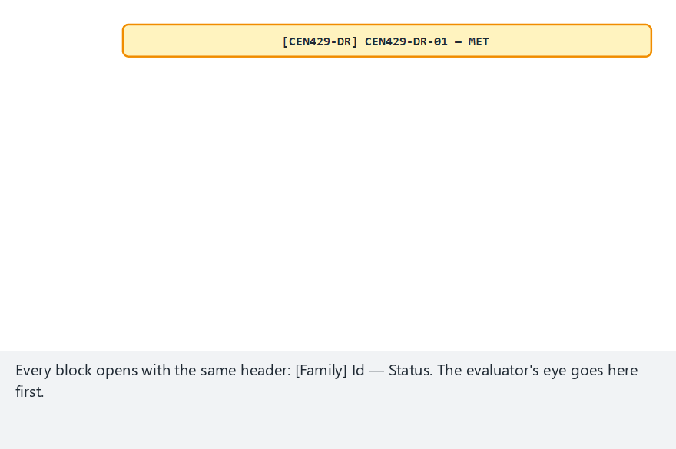
CEN429 Secure Programming · Week 13
The Requirement Block (animation)
RTEU Computer Engineering · 2026-2027 Fall
66
Notes:
Speaker note: fill in the same [Family] Id — Status block for a met and a delegated requirement; watch the three deferral questions get answered one at a time.

Slide 67
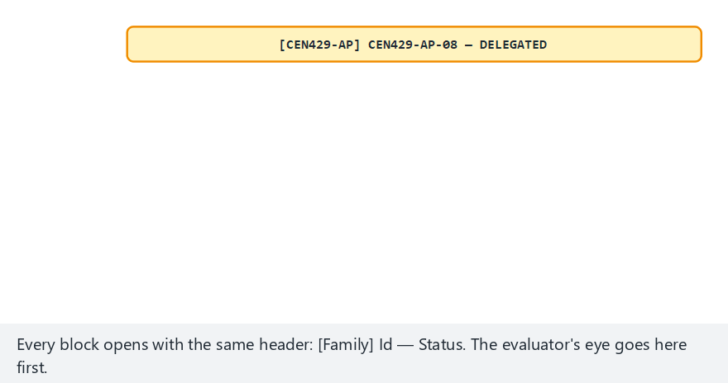
CEN429 Secure Programming · Week 13
The Requirement Block — edge case: a silent hand-off
RTEU Computer Engineering · 2026-2027 Fall
67
Notes:
Speaker note: "to whom" and "how" are answered but "why" is blank — still an incomplete block, still a finding.

Slide 68
CEN429 Secure Programming · Week 13
Section 3 — Quick Check
1. What are the requirement block's fields?
2. Which three questions are answered when deferring?
3. Why is silent deferring a problem?
RTEU Computer Engineering · 2026-2027 Fall
68
Notes:
Speaker note: Next, Common Criteria and FIPS.

Slide 69
CEN429 Secure Programming · Week 13
Section 3 — Answers
1. Id · measurable statement · source/rationale · related asset/threat · verification method (evidence) · status/priority.
2. (1) Why isn't it met now? (2) What's the risk, who accepts it (approval)? (3) When/how will it be met (plan/mitigation)?
3. Without a record/approval, the requirement gets skipped → a hidden gap, no one owns it, it blows up in the audit. Defer openly, with a rationale, and approved.
RTEU Computer Engineering · 2026-2027 Fall
69

Slide 70
CEN429 Secure Programming · Week 13
4. Common Criteria (ISO/IEC 15408)
RTEU Computer Engineering · 2026-2027 Fall
70

Slide 71
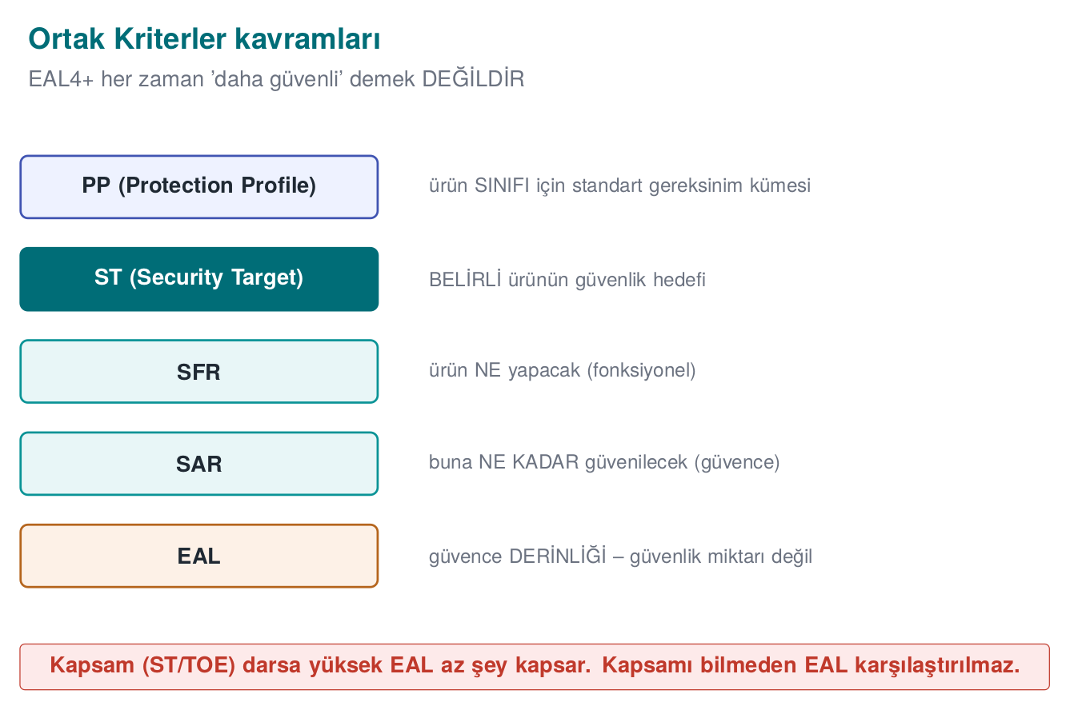
CEN429 Secure Programming · Week 13
Common Criteria — Diagram
RTEU Computer Engineering · 2026-2027 Fall
71

Slide 72
CEN429 Secure Programming · Week 13
What Is CC?
• Common Criteria: the international standard for evaluating product security.
• Provides a common language and method.
• Countries recognise each other's evaluations.
RTEU Computer Engineering · 2026-2027 Fall
72

Slide 73
CEN429 Secure Programming · Week 13
TOE · Target of Evaluation
• TOE (Target of Evaluation): the complete product being evaluated.
• Uniquely identified (Week 12): version + binary + hash.
• Out-of-scope components are written down.
RTEU Computer Engineering · 2026-2027 Fall
73

Slide 74
CEN429 Secure Programming · Week 13
ST · Security Target
• ST (Security Target): this product's security-target document.
• Contains: threats, objectives, requirements (SFR/SAR).
• Specific to the product.
RTEU Computer Engineering · 2026-2027 Fall
74

Slide 75
CEN429 Secure Programming · Week 13
PP · Protection Profile
• PP (Protection Profile): a common requirement set for a product class.
• Example: "mobile device PP," "smart card PP."
• STs generally build on a PP.
RTEU Computer Engineering · 2026-2027 Fall
75

Slide 76
CEN429 Secure Programming · Week 13
ST vs. PP
 | ST | PP
Scope | Single product | Product class
Written by | Developer | Community/authority
Role | This product's target | Common baseline
RTEU Computer Engineering · 2026-2027 Fall
76

Slide 77
CEN429 Secure Programming · Week 13
SFR · Functional Requirements
• SFR (Security Functional Requirements): what the product will do.
• Example: encryption, access control, logging.
• Chosen from a standard catalogue.
RTEU Computer Engineering · 2026-2027 Fall
77

Slide 78
CEN429 Secure Programming · Week 13
SAR · Assurance Requirements
• SAR (Security Assurance Requirements): how we will trust it was done correctly.
• Example: source review, test depth, vulnerability analysis.
• EAL determines these.
RTEU Computer Engineering · 2026-2027 Fall
78

Slide 79
CEN429 Secure Programming · Week 13
EAL · Evaluation Depth
• EAL (Evaluation Assurance Level): depth from 1 to 7.
• A higher EAL = a deeper review.
• "+" shows additional assurance components (EAL4+).
RTEU Computer Engineering · 2026-2027 Fall
79

Slide 80
CEN429 Secure Programming · Week 13
⚠️ A Common Misunderstanding of EAL
• EAL is the depth of security review, not the amount of security.
• Saying "EAL4+ > EAL2 is more secure" is wrong.
• Security depends on the threats and objectives in the ST.
RTEU Computer Engineering · 2026-2027 Fall
80

Slide 81
CEN429 Secure Programming · Week 13
Worked Example · ST Skeleton — TOE
Let's fill this in for a mobile payment component in three steps.
Step 1 — Define the TOE:
TOE: the "CEN429-Pay" library, version 1.0, Android ARM64 build only. Out of scope: the parent application's interface, server-side components, the operating system kernel.
Writing what's out of scope matters as much as writing the scope.
RTEU Computer Engineering · 2026-2027 Fall
81

Slide 82
CEN429 Secure Programming · Week 13
Threat → Objective → SFR Mapping
Threat | Security objective | SFR family | Course requirement
T.EAVESDROP | Transmitted data must stay confidential/intact | FCS, FTP | CEN429-DT-01
T.TAMPER | The application must check its integrity | FPT | CEN429-AP-04
— | Identity must be verified | FIA | CEN429-ID-02
This table is the heart of the ST: every row is a bridge between "why this requirement exists" and "what evidence is requested."
RTEU Computer Engineering · 2026-2027 Fall
82

Slide 83
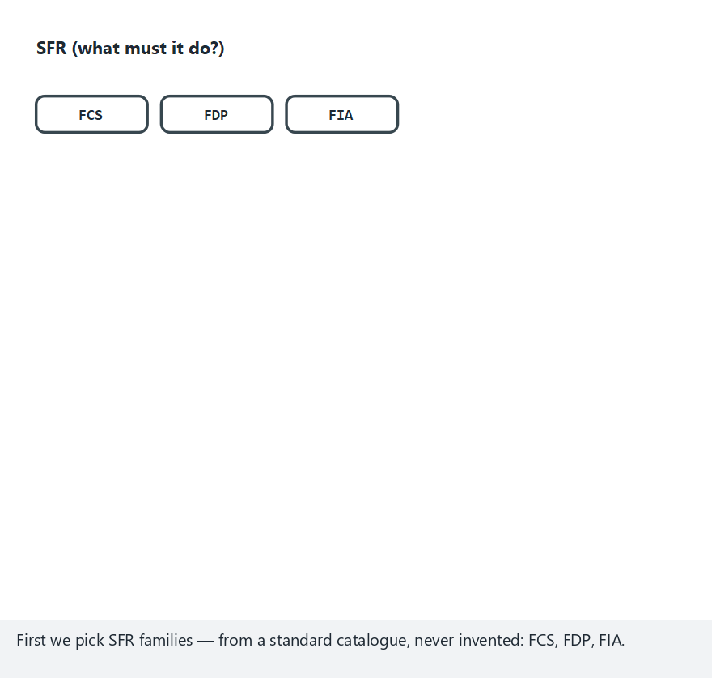
CEN429 Secure Programming · Week 13
The EAL Ladder (animation)
RTEU Computer Engineering · 2026-2027 Fall
83
Notes:
Speaker note: pick a target EAL and watch the SAR ladder fill in from EAL1 up — each level keeps everything the previous one required.

Slide 84
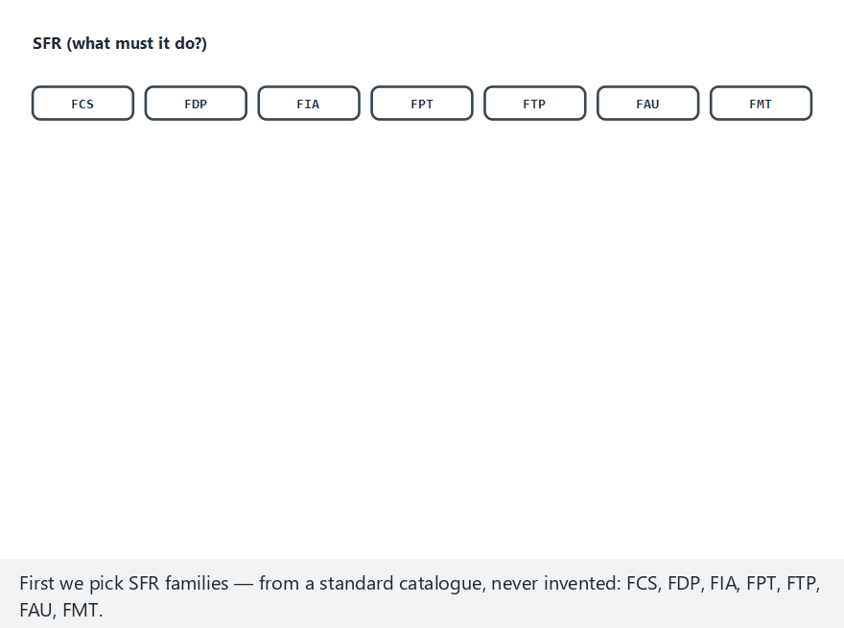
CEN429 Secure Programming · Week 13
The EAL Ladder — edge case: EAL7, the whole ladder
RTEU Computer Engineering · 2026-2027 Fall
84
Notes:
Speaker note: formally verified design — very high risk, small systems only; almost never the right target for a term project.

Slide 85
CEN429 Secure Programming · Week 13
Section 4's Rule
• A TOE definition always lists both what it includes and what it leaves out.
• SFRs are chosen from the catalogue, not invented; if there's no counterpart, justify it as an "extended component."
• The evaluator checks that every threat links to an objective, and every objective to an SFR.
RTEU Computer Engineering · 2026-2027 Fall
85

Slide 86
CEN429 Secure Programming · Week 13
5. FIPS 140-3
RTEU Computer Engineering · 2026-2027 Fall
86

Slide 87
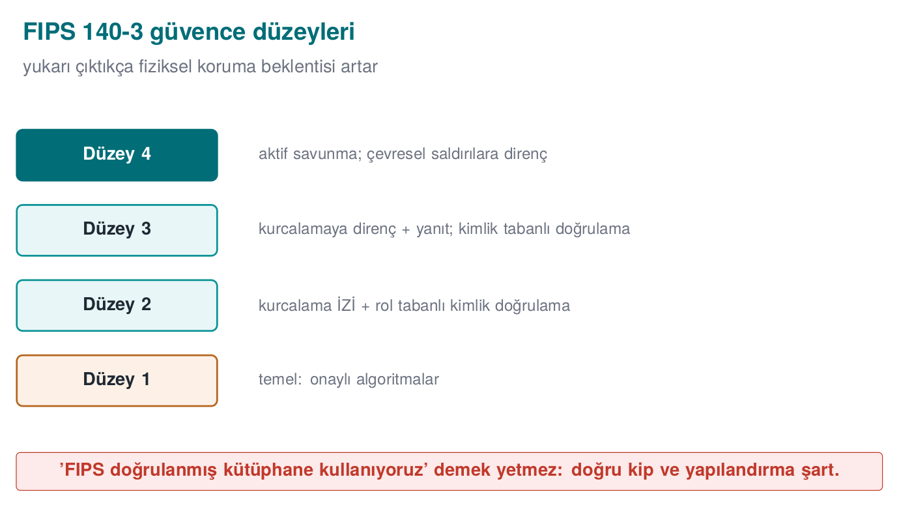
CEN429 Secure Programming · Week 13
FIPS 140-3 Levels — Diagram
RTEU Computer Engineering · 2026-2027 Fall
87

Slide 88
CEN429 Secure Programming · Week 13
What Is FIPS 140-3?
• The standard for validating cryptographic modules.
• The module's algorithms, self-test, key management.
• Covers only the module.
RTEU Computer Engineering · 2026-2027 Fall
88

Slide 89
CEN429 Secure Programming · Week 13
Security Levels (1–4)
Level | Roughly
1 | Basic; approved algorithms
2 | Tamper evidence
3 | Tamper resistance and response
4 | The highest physical protection
RTEU Computer Engineering · 2026-2027 Fall
89

Slide 90
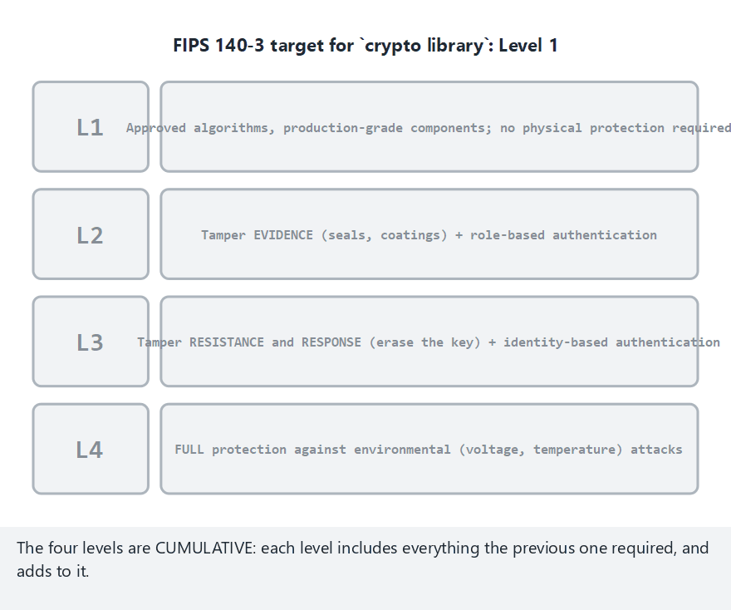
CEN429 Secure Programming · Week 13
FIPS 140-3 Levels (animation)
RTEU Computer Engineering · 2026-2027 Fall
90
Notes:
Speaker note: the four levels are cumulative — watch what each one adds on top of the level below it.

Slide 91
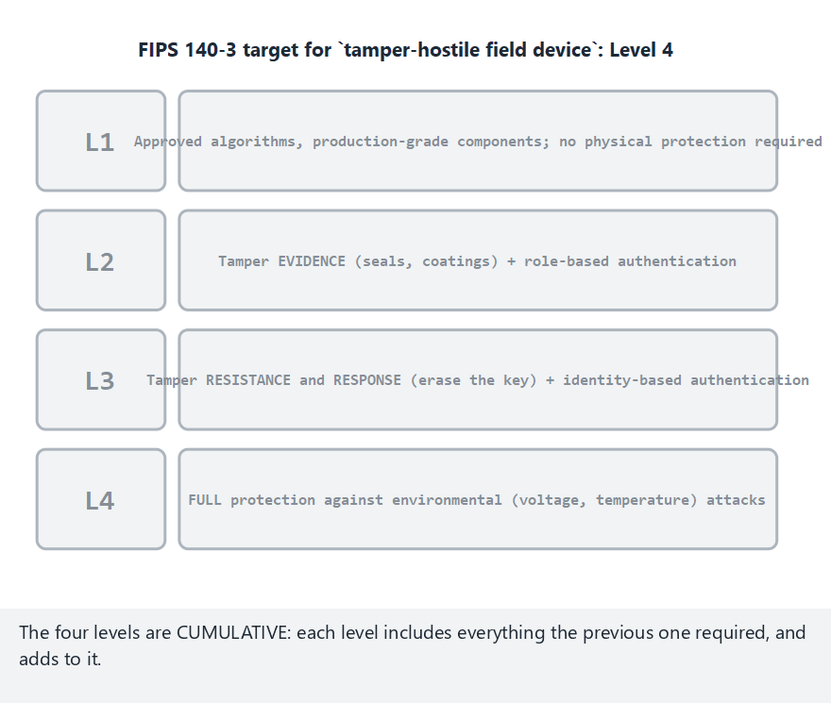
CEN429 Secure Programming · Week 13
FIPS 140-3 Levels — edge case: Level 4
RTEU Computer Engineering · 2026-2027 Fall
91
Notes:
Speaker note: a tamper-hostile field device — the only realistic case for Level 4 in most student projects is "we don't need this".

Slide 92
CEN429 Secure Programming · Week 13
⚠️ The FIPS Compliance Trap
• Using a FIPS-validated library does not automatically make the application FIPS-compliant.
• The application must use the module in approved mode and correctly.
• It must also manage keys correctly.
RTEU Computer Engineering · 2026-2027 Fall
92

Slide 93
CEN429 Secure Programming · Week 13
CC and FIPS Together
• CC: evaluates the whole product.
• FIPS: validates the crypto module.
• A product can use a FIPS-validated module inside a CC evaluation.
RTEU Computer Engineering · 2026-2027 Fall
93

Slide 94
CEN429 Secure Programming · Week 13
Worked Example · A FIPS Level 1 Audit
The project's crypto layer: OpenSSL's EVP interface, AES-256-GCM, keys generated from getrandom(), and it silently falls back to a default key on error.
Let's check off the Level 1 expectations one by one.
RTEU Computer Engineering · 2026-2027 Fall
94

Slide 95
CEN429 Secure Programming · Week 13
Level 1 · Status Table
Level 1 expectation | Status | Why
Approved algorithm, in approved mode | Partial | Can't be claimed without a CAVP certificate
Power-up/conditional self-tests | Not met | The project doesn't run its own self-tests
Roles and services defined | Not met | The code does no role separation
Zeroization of parameters | Not met | Falls back to a default key on error
Security policy document | Not met | No such document exists
RTEU Computer Engineering · 2026-2027 Fall
95

Slide 96
CEN429 Secure Programming · Week 13
The Most Critical Gap and Section 5's Rule
• Falling back to "a default key" on error is the exact opposite of the zeroization principle.
• Week 3's rule: "if the random generator fails, stop, don't continue" — the opposite is done here.
• Rule: a FIPS claim must always have a CMVP certificate number and scope behind it; if not, honestly narrow it to "we use FIPS-approved algorithms (not a validated module)."
RTEU Computer Engineering · 2026-2027 Fall
96

Slide 97
CEN429 Secure Programming · Week 13
Sections 4–5 — Quick Check
1. What is the difference between ST and PP?
2. What are SFR and SAR?
3. Why is "EAL4+ is always more secure" wrong?
4. Does a FIPS-validated library make the application FIPS-compliant?
RTEU Computer Engineering · 2026-2027 Fall
97
Notes:
Speaker note: Next, sector standards.

Slide 98
CEN429 Secure Programming · Week 13
Sections 4–5 — Answers
1. PP is a standard requirement set for a product class; ST is the document that says what a specific product (TOE) meets.
2. SFR is what the product will do (functional); SAR is how much it will be trusted (assurance; EAL comes from here).
3. EAL measures assurance depth, not the amount of security; if the scope (ST/TOE) is narrow, a high EAL covers little.
4. No. The module must be used in the correct mode/configuration, with approved algorithms. Module certificate ≠ application compliance.
RTEU Computer Engineering · 2026-2027 Fall
98

Slide 99
CEN429 Secure Programming · Week 13
6. Sector-Specific Requirement Sets
RTEU Computer Engineering · 2026-2027 Fall
99

Slide 100
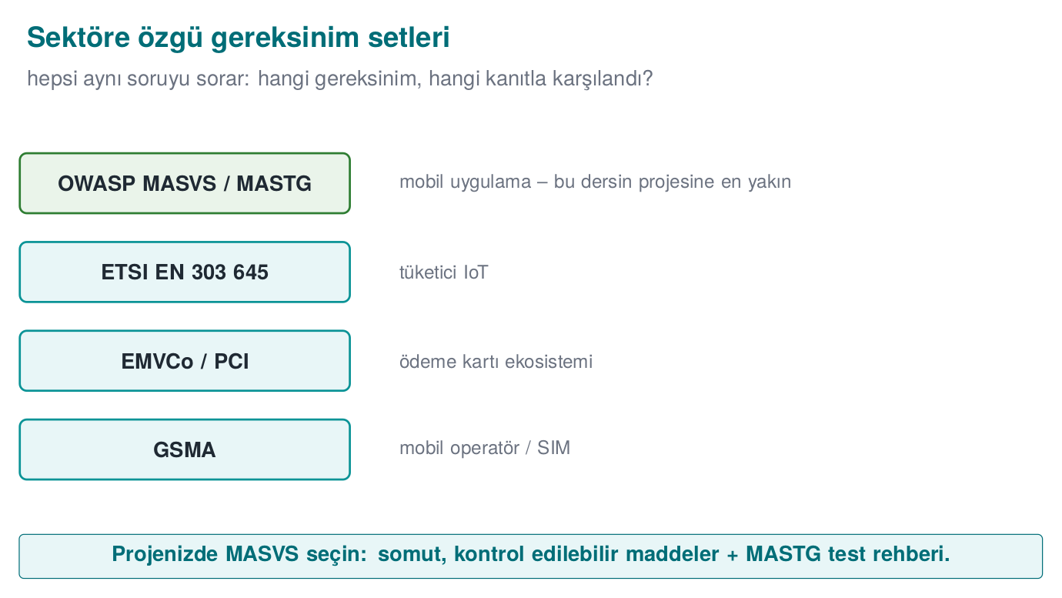
CEN429 Secure Programming · Week 13
Sector Standards — Diagram
RTEU Computer Engineering · 2026-2027 Fall
100

Slide 101
CEN429 Secure Programming · Week 13
Why Sector Standards?
• CC/FIPS are general; sectors want additional requirements suited to their own risks.
• IoT, mobile, payment are different threat environments.
• Follow whichever your project is closest to.
RTEU Computer Engineering · 2026-2027 Fall
101

Slide 102
CEN429 Secure Programming · Week 13
ETSI EN 303 645 (IoT)
• Baseline security requirements for consumer IoT.
• Example: no default passwords, secure updates, store sensitive parameters securely.
• A broad, applicable baseline.
RTEU Computer Engineering · 2026-2027 Fall
102

Slide 103
CEN429 Secure Programming · Week 13
ETSI · Example Provisions
• Unique passwords (no common default).
• Manage security updates.
• Securely store sensitive security parameters (→ project S5/S7/S8).
RTEU Computer Engineering · 2026-2027 Fall
103

Slide 104
CEN429 Secure Programming · Week 13
GSMA
• Security guidelines for the mobile operator ecosystem.
• Device, network, service security.
• SIM/eSIM, identity.
RTEU Computer Engineering · 2026-2027 Fall
104

Slide 105
CEN429 Secure Programming · Week 13
EMVCo
• Card payment ecosystem standards (cards, terminals, mobile payment).
• Functional conformance + security evaluation.
• Attack potential scoring (Week 12).
RTEU Computer Engineering · 2026-2027 Fall
105

Slide 106
CEN429 Secure Programming · Week 13
PCI
• PCI DSS: security for systems that process card data.
• PCI MPoC/CPoC: software-based payment acceptance.
• Strict; laboratory evaluation.
RTEU Computer Engineering · 2026-2027 Fall
106

Slide 107
CEN429 Secure Programming · Week 13
OWASP MASVS
• Mobile Application Security Verification Standard.
• Mobile application security requirements.
• Levels: baseline (L1), defence-in-depth (L2), resilience (R).
RTEU Computer Engineering · 2026-2027 Fall
107

Slide 108
CEN429 Secure Programming · Week 13
MASVS · For Your Project
• The most applicable requirement set.
• Tested with MASTG (Week 12).
• Crypto, storage, communication, code quality, resilience.
RTEU Computer Engineering · 2026-2027 Fall
108

Slide 109
CEN429 Secure Programming · Week 13
Standards · Comparison
Standard | Domain | Focus
CC | General product | Evaluation depth
FIPS 140-3 | Crypto module | Module validation
ETSI 303 645 | IoT | Baseline requirement
EMVCo/PCI | Payment | Functional + security
MASVS | Mobile | Application requirement
RTEU Computer Engineering · 2026-2027 Fall
109

Slide 110
CEN429 Secure Programming · Week 13
Comparison · The Lesson
• All share the same root: a written, verifiable requirement.
• The difference: scope and strictness.
• MASVS is the most practical starting point for your project.
RTEU Computer Engineering · 2026-2027 Fall
110

Slide 111
CEN429 Secure Programming · Week 13
The Same Requirement, Four Standards (1) — Data at Rest
Standard | Counterpart
Common Criteria | FCS + FDP components
FIPS 140-3 | Level 1: approved algorithm, self-test, zeroization
ETSI EN 303 645 | Provision 5.4 "Securely store sensitive parameters"
OWASP MASVS | MASVS-STORAGE
The course's family | CEN429-DR-01
RTEU Computer Engineering · 2026-2027 Fall
111

Slide 112
CEN429 Secure Programming · Week 13
The Same Requirement, Four Standards (2) — Weak Authentication
Standard | Counterpart
Common Criteria | FIA components
FIPS 140-3 | Level 2: role-based authentication
ETSI EN 303 645 | Provision 5.1 "No universal default passwords"
OWASP MASVS | MASVS-AUTH
The course's family | CEN429-ID-01 / CEN429-ID-02
RTEU Computer Engineering · 2026-2027 Fall
112

Slide 113
CEN429 Secure Programming · Week 13
Overlap and Section 6's Rule
• Compliance evidence for one standard can be partly reused for another — but that doesn't mean "automatically met"; every standard has its own additional criteria.
• Mapping the same requirement to several standards (by adding a standard column) speeds up the work; it isn't repeated even if certification changes.
• "We use a FIPS-validated module, so we also meet MASVS-CRYPTO" is a dangerous sentence.
• Rule: use overlap to speed up gathering evidence, but check off every standard separately.
RTEU Computer Engineering · 2026-2027 Fall
113

Slide 114
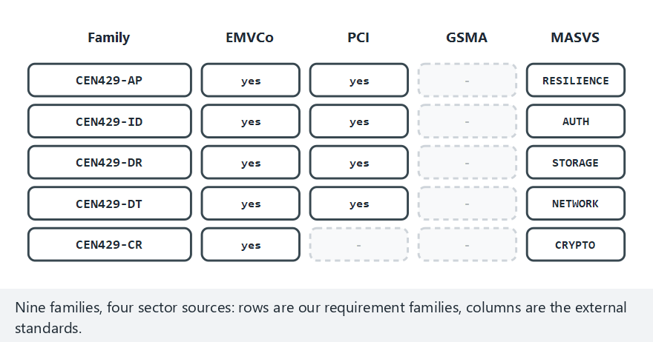
CEN429 Secure Programming · Week 13
Sector Standards Mapped Onto Our Families (animation)
RTEU Computer Engineering · 2026-2027 Fall
114
Notes:
Speaker note: EMVCo's own family list is almost identical to ours — watch why the GSMA column stays mostly empty (a facility audit, not a product one).

Slide 115
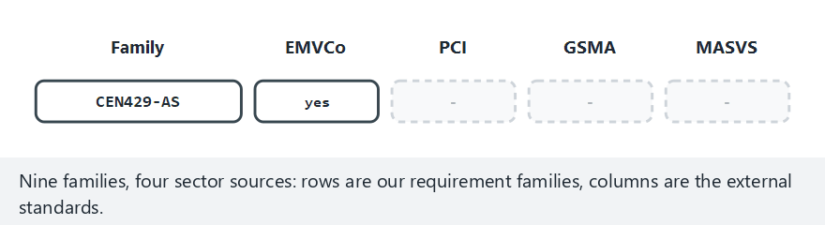
CEN429 Secure Programming · Week 13
Sector Standards Mapping — edge case: the family with no GSMA counterpart
RTEU Computer Engineering · 2026-2027 Fall
115
Notes:
Speaker note: not every "gap" in the matrix is a mistake — sometimes it just means the standard is asking a different kind of question.

Slide 116
CEN429 Secure Programming · Week 13
Section 6 — Quick Check
1. Who is ETSI EN 303 645 for?
2. Why is MASVS the most suitable for your project?
3. What is the difference between CC and MASVS?
RTEU Computer Engineering · 2026-2027 Fall
116
Notes:
Speaker note: Next, carrying requirements into the project.

Slide 117
CEN429 Secure Programming · Week 13
Section 6 — Answers
1. Baseline security for consumer IoT devices (no default passwords, updates, secure communication…).
2. The project is application-focused; MASVS has concrete, checkable items + the MASTG test guide → directly applicable.
3. CC is heavy, accredited lab/certificate (EAL); MASVS is a light, open, developer-friendly self-assessment standard.
RTEU Computer Engineering · 2026-2027 Fall
117

Slide 118
CEN429 Secure Programming · Week 13
7. Carrying Requirements Into the Software Plan and Asset Management
RTEU Computer Engineering · 2026-2027 Fall
118

Slide 119
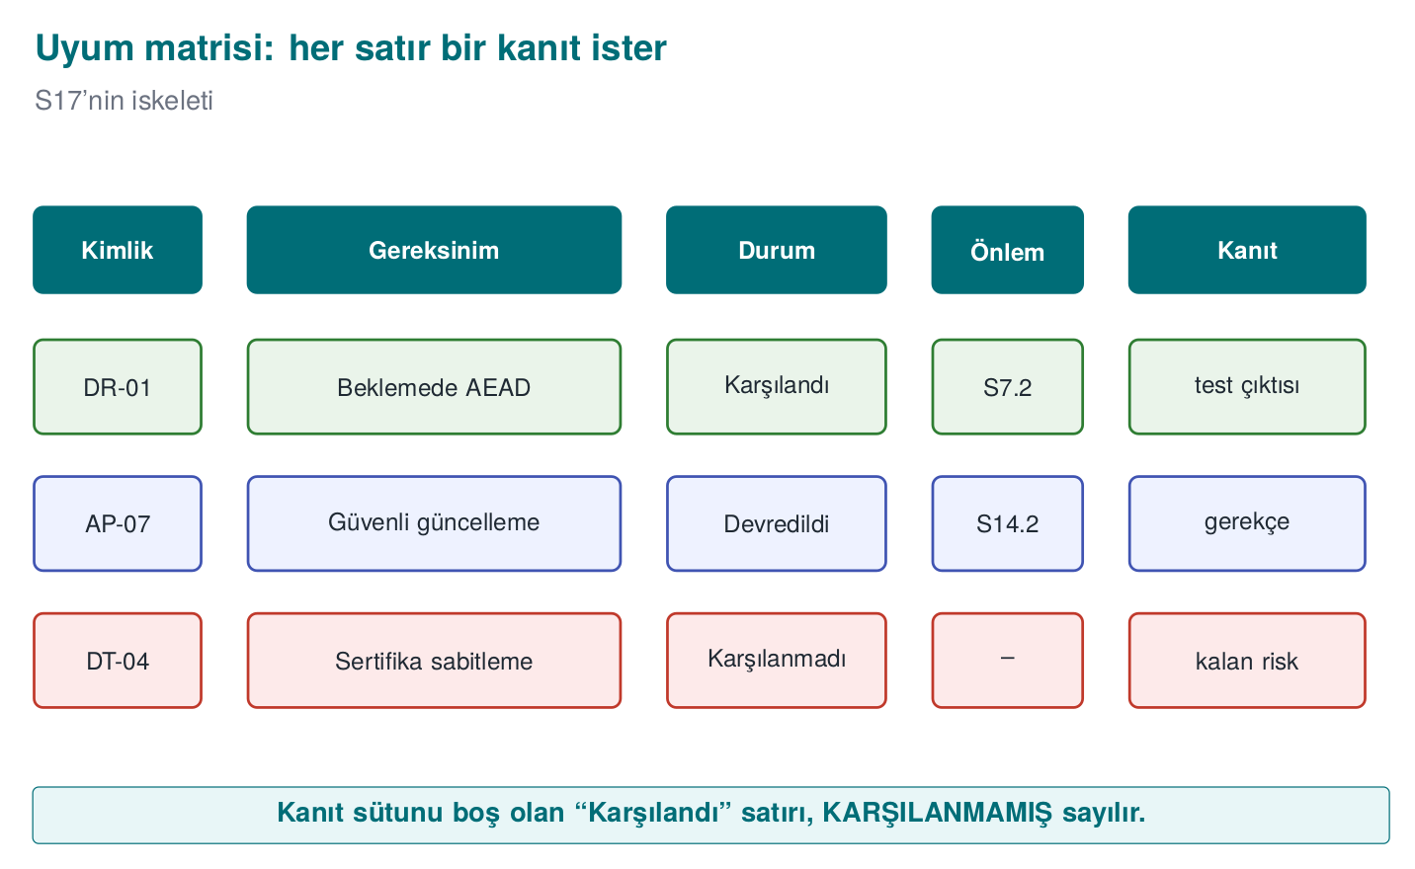
CEN429 Secure Programming · Week 13
Compliance Matrix Structure — Diagram
RTEU Computer Engineering · 2026-2027 Fall
119

Slide 120
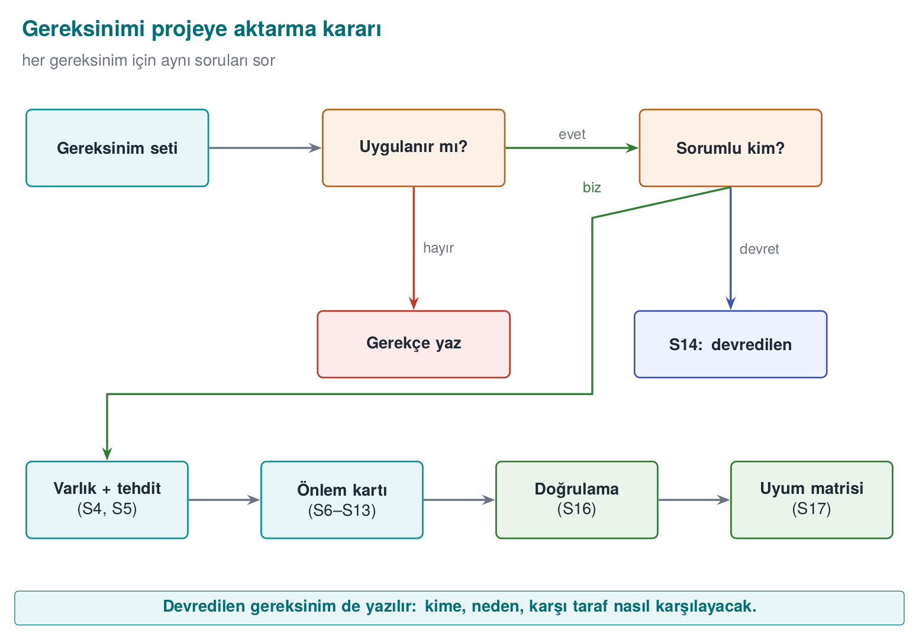
CEN429 Secure Programming · Week 13
Requirement Carry-Over Decision — Diagram
RTEU Computer Engineering · 2026-2027 Fall
120

Slide 121
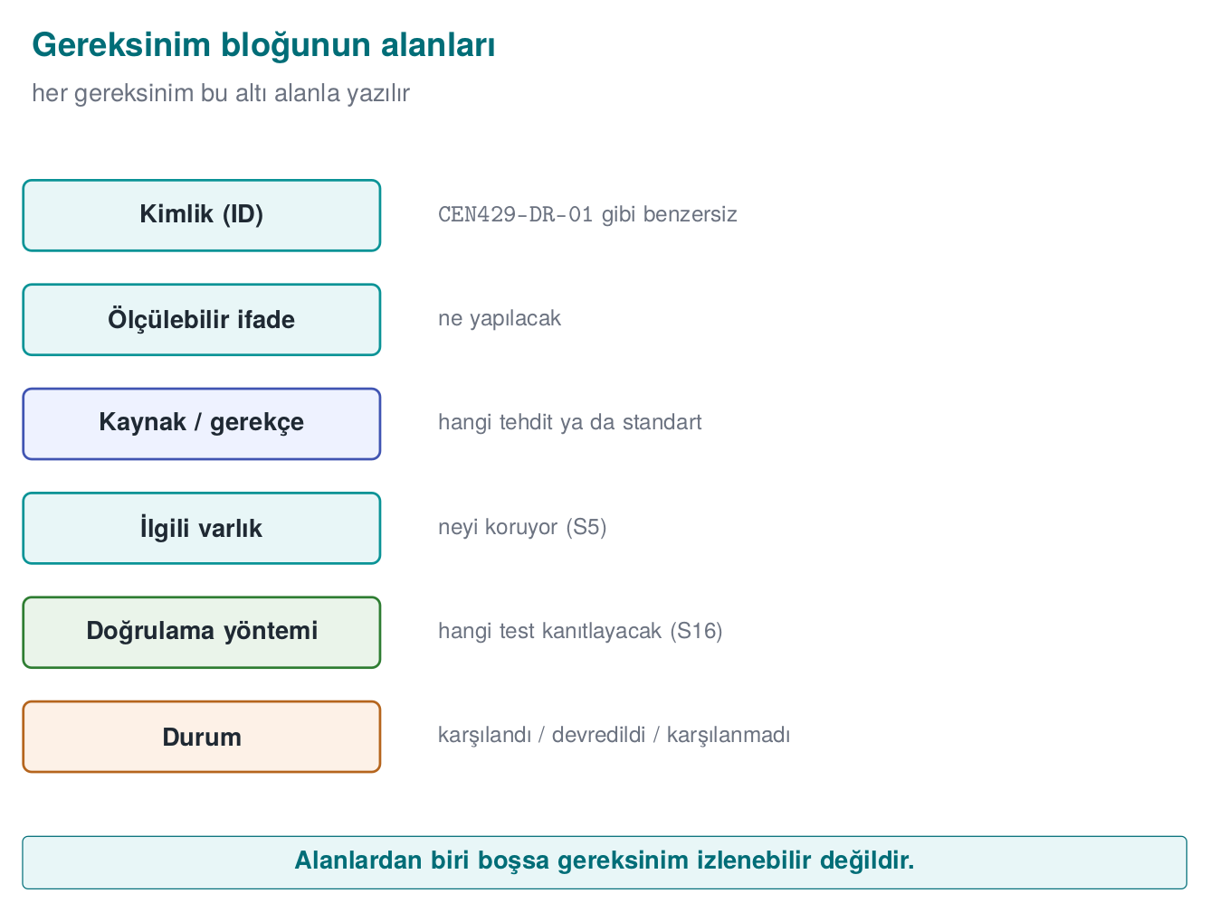
CEN429 Secure Programming · Week 13
Requirement → Asset → Control
Every requirement is linked to an asset and to a control.
RTEU Computer Engineering · 2026-2027 Fall
121

Slide 122
CEN429 Secure Programming · Week 13
The Link to Asset Management
• Requirements are linked to the S5 asset list.
• Every asset: C/I/I+ label, protection control.
• The requirement makes that protection mandatory.
RTEU Computer Engineering · 2026-2027 Fall
122

Slide 123
CEN429 Secure Programming · Week 13
Carrying It Into the Plan
• Functional requirement → design/code (S6–S11).
• Assurance requirement → test (S16).
• Process requirement → development process (S13).
RTEU Computer Engineering · 2026-2027 Fall
123

Slide 124
CEN429 Secure Programming · Week 13
Worked Example · Applying the Six Steps to CR-03
CEN429-CR-03 ("keys must be erased once their job is done"):
• 1. Applicability: there's a session key and a vault-file key → it applies.
• 2. Responsibility: the code is the project's own → we meet it ourselves.
• 3. Linking to assets: the vault-file key's "erasure" column is empty — the gap is noticed here.
RTEU Computer Engineering · 2026-2027 Fall
124

Slide 125
CEN429 Secure Programming · Week 13
The Same Example · From Threat to Release Plan
• 4. Linking to threats: links to the threat "an attacker with physical access takes a memory dump."
• 5. Control/verification: the crypto_wipe() call; verification: showing the key's bytes are not present in a memory dump.
• 6. Release plan: the session key was met in v0.9; the vault-file key is planned for v1.0, and until then written as not met + residual risk.
RTEU Computer Engineering · 2026-2027 Fall
125

Slide 126
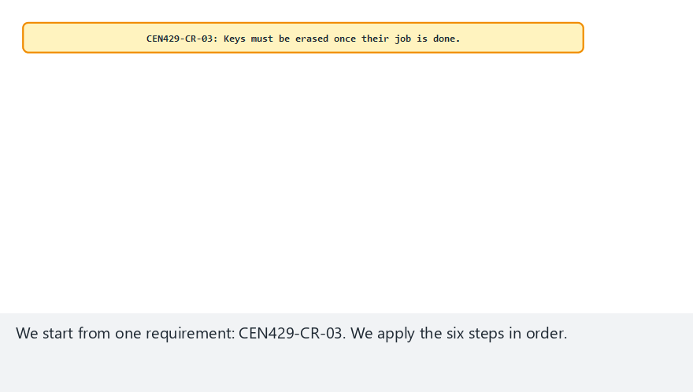
CEN429 Secure Programming · Week 13
Carrying a Requirement Into the Plan (animation)
RTEU Computer Engineering · 2026-2027 Fall
126
Notes:
Speaker note: walk CEN429-CR-03 through all six steps live, from "does this apply?" to a task in the release plan.

Slide 127
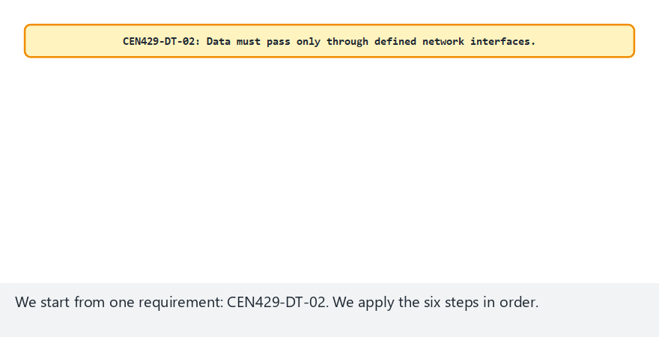
CEN429 Secure Programming · Week 13
Carrying a Requirement Into the Plan — edge case: not applicable
RTEU Computer Engineering · 2026-2027 Fall
127
Notes:
Speaker note: step 1 alone can end the process — but only when the rationale is written down, never silently.

Slide 128
CEN429 Secure Programming · Week 13
Section 7's Rule
• Every "not applicable" decision must be written together with evidence supporting its rationale (a code scan, an architecture diagram).
• A "not applicable" with no rationale is just as untrustworthy as a "met" with no evidence.
• Skipping steps 3 and 4 (linking to assets/threats) is the most common mistake.
RTEU Computer Engineering · 2026-2027 Fall
128

Slide 129
CEN429 Secure Programming · Week 13
8. The Course's Requirement Families
RTEU Computer Engineering · 2026-2027 Fall
129

Slide 130
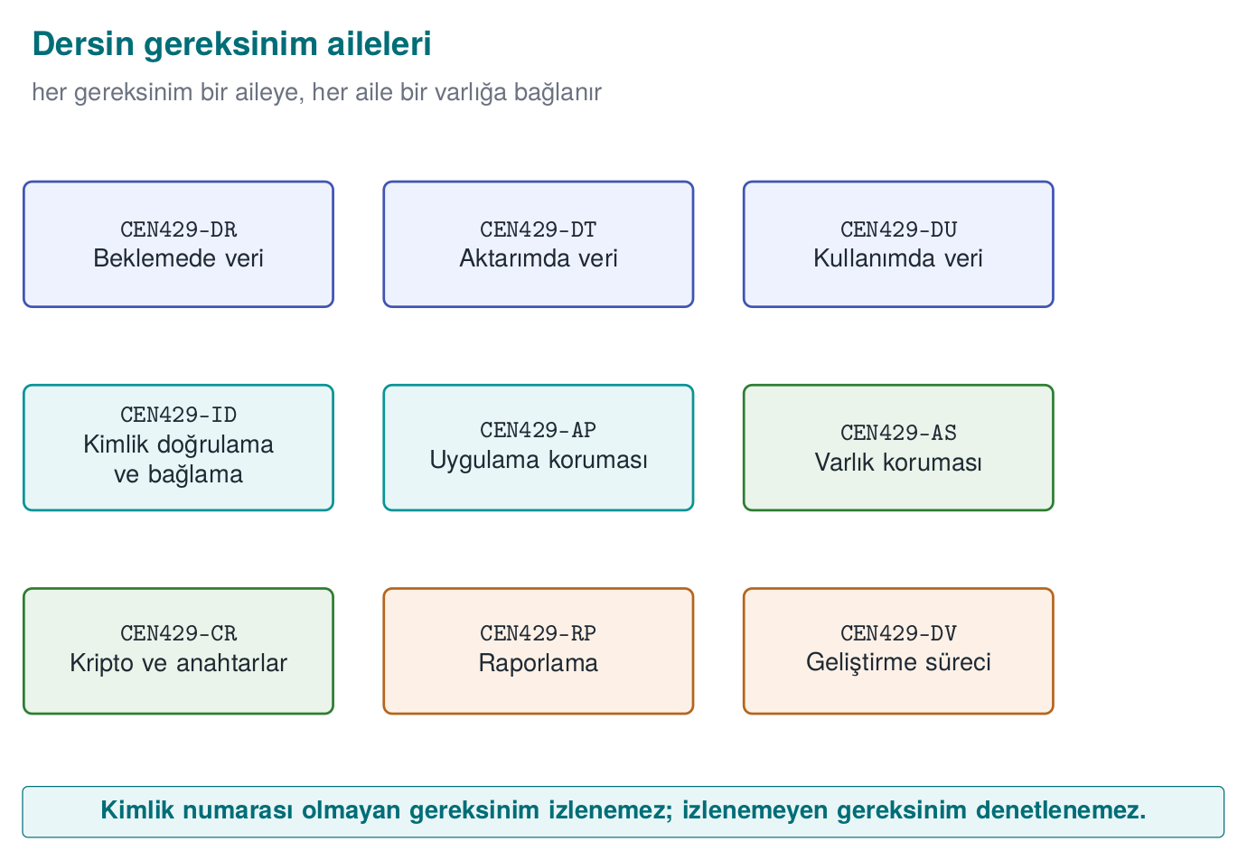
CEN429 Secure Programming · Week 13
Requirement Families — Diagram
RTEU Computer Engineering · 2026-2027 Fall
130

Slide 131
CEN429 Secure Programming · Week 13
The Course's Own Ids
This course uses its own requirement families, adapted from open standards:
CEN429-AP (application protection), ID (identity), AS (asset), DR/DU/DT (data: at rest/in use/in transit)…
RTEU Computer Engineering · 2026-2027 Fall
131

Slide 132
CEN429 Secure Programming · Week 13
Families (1)
Family | Topic | Example
AP | Application protection (obfuscation, RASP) | Sensitive functions are obfuscated and protected with an integrity check
ID | Identity and binding | The device and version are bound to key usage
AS | Asset management | Every asset is labelled C/I/I+ and its lifecycle is documented
DR | Data at rest | Local data is encrypted with AEAD
RTEU Computer Engineering · 2026-2027 Fall
132

Slide 133
CEN429 Secure Programming · Week 13
Families (2)
Family | Topic | Example
DU | Data in use | The key is erased after use
DT | Data in transit | TLS 1.3 + chain validation
RP | Reporting/logging | Sensitive data is never logged in plain text in the release
CR | Cryptography | Approved algorithm, mode, and key length; key hierarchy documented
DV | Development/process | Every change is reviewed before being merged; the SBOM is updated
RTEU Computer Engineering · 2026-2027 Fall
133

Slide 134
CEN429 Secure Programming · Week 13
Every Family → Links to Weeks
• AP → 4, 5, 6, 9, 11, 14
• CR/DR/DU/DT → 3, 10
• AS → 1, 3
• DV/RP → 12, 13
Your project chooses a subset of these families.
RTEU Computer Engineering · 2026-2027 Fall
134

Slide 135
CEN429 Secure Programming · Week 13
Compliance Matrix Activity · Step 1
• Choose five requirements from your own project (from different families).
• Write a requirement block for each one.
RTEU Computer Engineering · 2026-2027 Fall
135

Slide 136
CEN429 Secure Programming · Week 13
Activity · Step 2
Fill in a matrix row for every requirement:
Requirement | Status | Section | Verification | Evidence
… | … | … | … | …
RTEU Computer Engineering · 2026-2027 Fall
136

Slide 137
CEN429 Secure Programming · Week 13
Activity · Step 3
• Write at least one as deferred (to whom/why/how).
• Show at least one's evidence concretely.
• If there's a "not met," write it into the residual risk.
RTEU Computer Engineering · 2026-2027 Fall
137

Slide 138
CEN429 Secure Programming · Week 13
Activity · Evaluation
Check through an evaluator's eyes:
• Does every row have evidence?
• Are the deferred ones explicit?
• Are the requirements verifiable?
RTEU Computer Engineering · 2026-2027 Fall
138

Slide 139
CEN429 Secure Programming · Week 13
Worked Example · A First Draft (Inadequate)
A team's matrix row for CEN429-AP-04, in the first draft:
Id | Requirement | Status | Control | Verification | Evidence
CEN429-AP-04 | The application must check its integrity at runtime | Met | There's an integrity check | Tested | —
Three problems: (1) the control is a repetition of the requirement. (2) "Tested" is not a verification method. (3) The evidence is empty.
RTEU Computer Engineering · 2026-2027 Fall
139

Slide 140
CEN429 Secure Programming · Week 13
Fixing the Draft · Step by Step
1. Make the control concrete: a hash of the code section is computed at startup and compared with the embedded expected hash at build time; execution stops on mismatch (S12.3).
2. Clarify the verification method: a byte of the binary is changed, and it's verified the application refuses to start.
3. Add evidence: the CI job ci-integrity-check, run #391, integrity_test.log.
RTEU Computer Engineering · 2026-2027 Fall
140

Slide 141
CEN429 Secure Programming · Week 13
The Corrected Row
Id | Status | Control | Verification | Evidence
CEN429-AP-04 | Met | S12.3: a startup hash is computed, compared with the embedded hash | Tested: startup is refused when a byte changes | CI ci-integrity-check #391, integrity_test.log
RTEU Computer Engineering · 2026-2027 Fall
141

Slide 142
CEN429 Secure Programming · Week 13
Where Is the Difference?
• The difference isn't in the row's length, it's in the concreteness of every cell.
• The first draft also looked "filled in," but no cell could be verified independently.
• What matters to the evaluator: being able to answer "how do we know this?" for every cell.
RTEU Computer Engineering · 2026-2027 Fall
142

Slide 143
CEN429 Secure Programming · Week 13
Section 8's Rule
• Every row's evidence must be specific to that row: a specific test name, a specific CI number, a specific log file.
• Copying a single general report into every row makes the whole matrix look suspicious.
• If referencing a general report, state which section/page of it too.
RTEU Computer Engineering · 2026-2027 Fall
143

Slide 144
CEN429 Secure Programming · Week 13
Sections 7–8 — Quick Check
1. Which two things is a requirement linked to?
2. Name three of the course's requirement families.
3. What must be in every row of a compliance matrix?
RTEU Computer Engineering · 2026-2027 Fall
144
Notes:
Speaker note: Next, the project and the solved self-check.

Slide 145
CEN429 Secure Programming · Week 13
Sections 7–8 — Answers
1. Upward to a source (threat/standard/asset) and downward to evidence (test/code) — two directions.
2. (Any three of the nine families) e.g. data security · code hardening · RASP · crypto/certificates · memory protection · interface protection.
3. The requirement's id+statement · status (met/deferred) · evidence (test/file/S-section). A row with no evidence counts as not met.
RTEU Computer Engineering · 2026-2027 Fall
145

Slide 146
CEN429 Secure Programming · Week 13
End to End: NotKasa's Compliance Matrix (1/2)
For the synthetic application NotKasa (keeps local encrypted notes, talks to a server, gets updated), a requirement derives from a threat:
Tehdit: cihaz çalınırsa yerel notlar okunur
↓
Amaç: beklemede gizlilik
↓
Gereksinim: C sınıfı veri AEAD ile şifrelenir
Two "met" blocks from this chain:
DR-01 — data at rest:
CEN429-DR-01
Metin: Yerel DB'deki C sınıfı veri AES-256-GCM ile şifrelenir.
Durum: Karşılandı
Karşılama: AES-256-GCM, anahtar TEE'de
Doğrulama: T-05
Kanıt: test çıktısı (S16)
CR-02 — cryptography:
CEN429-CR-02
Metin: Anahtarların amacı, kripto-periyodu, imhası belgelenir.
Durum: Karşılandı
Karşılama: S8 anahtar tablosu
Doğrulama: belge incelemesi
Kanıt: S8
RTEU Computer Engineering · 2026-2027 Fall
146

Slide 147
CEN429 Secure Programming · Week 13
End to End: NotKasa's Compliance Matrix (2/2)
DT-03 — data in transit:
CEN429-DT-03
Metin: Sunucu iletişimi TLS 1.3 ve sertifika zinciri doğrulaması kullanır.
Durum: Karşılandı
Karşılama: TLS 1.3 + SAN denetimi + SPKI pin
Doğrulama: T-11
Kanıt: test + S11
AP-04 — application protection (deferred):
CEN429-AP-04
Metin: Güvenli kurulum ve güncelleme sağlanır.
Durum: Devredildi
Kime: Üst uygulama (MPA)
Neden: SDK dağıtım kanalına sahip değil
Nasıl: MPA imzalı güncelleme + sürüm denetimi
AS-05 — not met:
CEN429-AS-05
Metin: Tüm hassas varlıklar için bellek izleme tespiti.
Durum: Karşılanmadı
Kalan risk: köklü cihazda canlı bellek analizi
Azaltma: kısa ömürlü anahtar + sunucu denetimi
RTEU Computer Engineering · 2026-2027 Fall
147

Slide 148
CEN429 Secure Programming · Week 13
Matrix · Combined View
Id | Status | Section | Evidence
DR-01 | Met | S8 | T-05
CR-02 | Met | S8 | S8
DT-03 | Met | S11 | T-11
AP-04 | Deferred | S14 | —
AS-05 | Not met | S12 | residual risk
RTEU Computer Engineering · 2026-2027 Fall
148

Slide 149
CEN429 Secure Programming · Week 13
What the Matrix Tells Us
• Three met (with evidence), one deferred, one residual risk.
• Every row is traceable.
• The evaluator starts from this table.
RTEU Computer Engineering · 2026-2027 Fall
149

Slide 150
CEN429 Secure Programming · Week 13
Common Mistakes — Summary
Mistake | Section
An unverifiable requirement (e.g. "must be secure") | Section 1
A "met" with no evidence | Section 2
Silent deferring | Section 3
Mistaking EAL for the amount of security | Section 4
Assuming a FIPS-validated library = FIPS compliance | Section 5
Leaving residual risk blank | Section 2
Each row's detail was already covered in its section's ⚠️ box and rule; here we gather them in one view.
RTEU Computer Engineering · 2026-2027 Fall
150

Slide 151
CEN429 Secure Programming · Week 13
9. Term Project: This Week
RTEU Computer Engineering · 2026-2027 Fall
151

Slide 152
CEN429 Secure Programming · Week 13
Project · S14 and S17
S17 and S14 are the documents an evaluator opens first.
• S17 compliance matrix: status, section, verification, evidence for every applicable requirement.
• S14 deferred requirements: to whom, why, how.
• residual risk.
RTEU Computer Engineering · 2026-2027 Fall
152

Slide 153
CEN429 Secure Programming · Week 13
Through an Evaluator's Eyes
• A "met" with no evidence = not met.
• Are the deferred ones explicit and justified?
• Are the requirements verifiable?
RTEU Computer Engineering · 2026-2027 Fall
153

Slide 154
CEN429 Secure Programming · Week 13
Checklist
•
•
•
•
•
•
RTEU Computer Engineering · 2026-2027 Fall
154

Slide 155
CEN429 Secure Programming · Week 13
How to Prepare in 45 Minutes + the Evidence Folder
1. Mark the requirements that apply from the family table; leave the ones that don't as "not applicable, rationale: ..."
2. Fill in the six columns (id, requirement, status, control, verification, evidence); don't write "met" with no evidence.
3. Move the "deferred" rows to S14, with to-whom/why/how.
4. Link your asset table (S5) to every requirement; write which standards you're basing it on into S1.
evidence/week13/ <- test/log/pcap dosyaları
README.md <- her dosya hangi gereksinimin kanıtı, bir satırla
RTEU Computer Engineering · 2026-2027 Fall
155

Slide 156
CEN429 Secure Programming · Week 13
If Time Is Short · Priority Order
1. First, an S17 skeleton with at least 15 requirements (id+requirement+status) — far better than an empty S17.
2. Complete the "met" rows you actually have evidence for; honestly turn the ones without into "not met."
3. Move the deferred rows to S14.
4. Finally, fill in the remaining control/verification columns.
Rule: a "small but honest" matrix always scores better than a "large but evidence-free" one.
RTEU Computer Engineering · 2026-2027 Fall
156

Slide 157
CEN429 Secure Programming · Week 13
Solved Self-Check
RTEU Computer Engineering · 2026-2027 Fall
157

Slide 158
CEN429 Secure Programming · Week 13
Question 1
What are the four criteria of a good security requirement?
Answer: Verifiable, singular, measurable, feasible.
RTEU Computer Engineering · 2026-2027 Fall
158

Slide 159
CEN429 Secure Programming · Week 13
Question 2
Why is "the application must be secure" bad? How is it fixed?
Answer: It's unverifiable. Write it measurably: e.g., "the release build is produced with a stack canary, PIE, and full RELRO."
RTEU Computer Engineering · 2026-2027 Fall
159

Slide 160
CEN429 Secure Programming · Week 13
Question 3
What is the traceability chain?
Answer: Requirement → control → verification → evidence. Every requirement is linked to evidence.
RTEU Computer Engineering · 2026-2027 Fall
160

Slide 161
CEN429 Secure Programming · Week 13
Question 4
What does a "met" with no evidence mean in a compliance matrix?
Answer: It counts as not met for the evaluator; it's one of the first findings.
RTEU Computer Engineering · 2026-2027 Fall
161

Slide 162
CEN429 Secure Programming · Week 13
Question 5
Which three questions are answered when deferring a requirement?
Answer: To whom, why, how. Silent deferring counts as "not met."
RTEU Computer Engineering · 2026-2027 Fall
162

Slide 163
CEN429 Secure Programming · Week 13
Question 6
What is the difference between ST and PP?
Answer: ST is a single product's security target; PP is a common requirement set for a product class. ST generally builds on a PP.
RTEU Computer Engineering · 2026-2027 Fall
163

Slide 164
CEN429 Secure Programming · Week 13
Question 7
Is "EAL4+ is always more secure than EAL2" correct?
Answer: No. EAL is the depth of the evaluation; security depends on the threats and objectives in the ST. "+" is an additional assurance component.
RTEU Computer Engineering · 2026-2027 Fall
164

Slide 165
CEN429 Secure Programming · Week 13
Question 8
Is an application that uses a FIPS-validated library FIPS-compliant?
Answer: Not on its own. Validation covers the module; the application must use it in approved mode, correctly, and manage keys correctly.
RTEU Computer Engineering · 2026-2027 Fall
165

Slide 166
CEN429 Secure Programming · Week 13
Question 9
Where does ETSI EN 303 645's "securely store sensitive parameters" provision map to in the project?
Answer: S5 asset list, S7 data security/shell matrix, S8 key lifecycle.
RTEU Computer Engineering · 2026-2027 Fall
166

Slide 167
CEN429 Secure Programming · Week 13
Question 10
If a library cannot meet the "secure update" requirement?
Answer: It defers to the parent application and writes to-whom/why/how it will be met in the guide.
RTEU Computer Engineering · 2026-2027 Fall
167

Slide 168
CEN429 Secure Programming · Week 13
Glossary
Term | Meaning
Functional/assurance/process | The three requirement types
Traceability | Requirement→evidence chain
Deferred | A requirement carried over to another party
TOE/ST/PP | CC's basic concepts
SFR/SAR/EAL | Functional/assurance/depth
RTEU Computer Engineering · 2026-2027 Fall
168

Slide 169
CEN429 Secure Programming · Week 13
Next Week
Week 14 — Tigress and Diversification
This week we defined the course's requirement families; in week 14 we will see the concrete counterpart — the control side — of requirements such as "sensitive code sections must be obfuscated" from the CEN429-AP (application protection) family: you will apply code obfuscation and diversification transforms with Tigress and link them to the relevant rows of your compliance matrix (S17). The automated, diversified application of the obfuscation rules; measurement and the build pipeline.
RTEU Computer Engineering · 2026-2027 Fall
169

