Slide 1

CEN429 Secure Programming · Week 14
Tigress and Diversification
CEN429 Secure Programming — Week 14
Asst. Prof. Dr. Uğur CORUH · 18.12.2026
RTEU Computer Engineering · 2026-2027 Fall
Notes:
Speaker note: This week Tigress automates week 9's manual obfuscation rules using source-to-source obfuscation and diversification. Main rule: obfuscation does not grant unbreakability, it raises cost; combine transforms, diversify, measure. Tigress is applied only to your own code; it is not distributed in class.

Slide 2
CEN429 Secure Programming · Week 14
Today's Plan (3 Hours)
Hour | Section | Topic
1 | 1 | Source-to-source obfuscation · Tigress · license · basic flow
2 | 2 | Transform families · week 9 mapping · transform pipeline · step-by-step example
3 | 3–5 | Diversification · measurement · in-class flow · build pipeline (S15) · project
RTEU Computer Engineering · 2026-2027 Fall
2
Notes:
Speaker note: This week we automate week 9's manual obfuscation rules with a tool (Tigress). The main message is the same: obfuscation does not grant unbreakability, it raises cost; combine, diversify, measure.

Slide 3
CEN429 Secure Programming · Week 14
A Brief History — Source-to-Source Obfuscation and Diversification
• 1993 — Cohen: the idea of diversification (same function, different binary)
• 1997 — Collberg et al.'s obfuscation taxonomy; the same year, Forrest et al. argue for diversification
from a separate root
• 2002 — Necula et al., CIL: the infrastructure Tigress is built on
• ~2012–13 — Tigress: source-to-source + virtualisation + diversification for C
• 2015 — Obfuscator-LLVM: compiler-based obfuscation
• 2016–17 — Banescu et al. measure resilience with Tigress+KLEE
Main rule: resilience ↔ cost; protection is chosen in proportion to the value of the asset.
RTEU Computer Engineering · 2026-2027 Fall
3

Slide 4
CEN429 Secure Programming · Week 14
Where Does This Week Fit?
• Week 9: we learned obfuscation rules by hand
• Week 11: whitebox for the key
• This week (14): applying the same rules with a tool, automatically, and diversified → Tigress
All three form a whole; today is the automation step.
RTEU Computer Engineering · 2026-2027 Fall
4

Slide 5
CEN429 Secure Programming · Week 14
Learning Outcome
This week is about LO.3 (binary application protections).
By the end, you will be able to:
• Explain source-to-source obfuscation
• Describe how to set up a transform pipeline
• Diversify and measure obfuscation
• Put obfuscation into the build pipeline (S15)
RTEU Computer Engineering · 2026-2027 Fall
5

Slide 6
CEN429 Secure Programming · Week 14
A Reminder from the Start
Week 9's main rule still applies this week:
Obfuscation does not grant unbreakability, it raises cost.
Tigress is not magic; it automates what we did by hand and makes diversification easier.
RTEU Computer Engineering · 2026-2027 Fall
6

Slide 7
CEN429 Secure Programming · Week 14
What We Bring from Earlier Weeks
• Source code, compiler, binary — a human-written program text turned into an executable binary by a compiler (Week 9)
• Code obfuscation — a countermeasure that makes code hard for a human to understand without changing its behaviour, raising the attacker's cost (Week 9)
• Week 9's obfuscation rules (K-01–K-12) — manually applied rules such as opaque predicates, arithmetic encoding, control-flow flattening, string encoding, variable splitting, virtualization; this week we map these one by one to Tigress's transforms (Week 9)
• CFG (control-flow graph) — a diagram where basic blocks are nodes and transitions are edges (Week 9)
• Symbolic execution — an automatic analysis method that solves program paths as mathematical constraints (e.g. KLEE) (Week 9)
• Diversification — producing binaries that are behaviourally equivalent but structurally different from the same source; this week we automate it with Tigress's --Seed flag (Week 9)
• CI and build pipeline — a system that runs automatic build/test steps on every code change (Week 4)
• Version identity and digest (hash) value — a record showing which binary/source/digest triple a piece of software was distributed with; this week we add a seed field to it too (Week 1)
RTEU Computer Engineering · 2026-2027 Fall
7

Slide 8
CEN429 Secure Programming · Week 14
This Week's Concepts
Each term is defined once, where it first appears in the body; here we only mark where.
Concept | Where
Source-to-source obfuscation, Tigress and its licence | Section 1
Transform (--Transform) and targeting (--Functions) | Section 1
Transform families and the week 9 mapping | Section 2
Transform pipeline and the step-by-step cost increase | Section 2
Diversification tool: seed (--Seed) | Section 3
Measuring obfuscation and diversification | Section 3
The seven-step in-class flow | Section 4
S15 build and deployment pipeline, term project | Section 5
RTEU Computer Engineering · 2026-2027 Fall
8

Slide 9
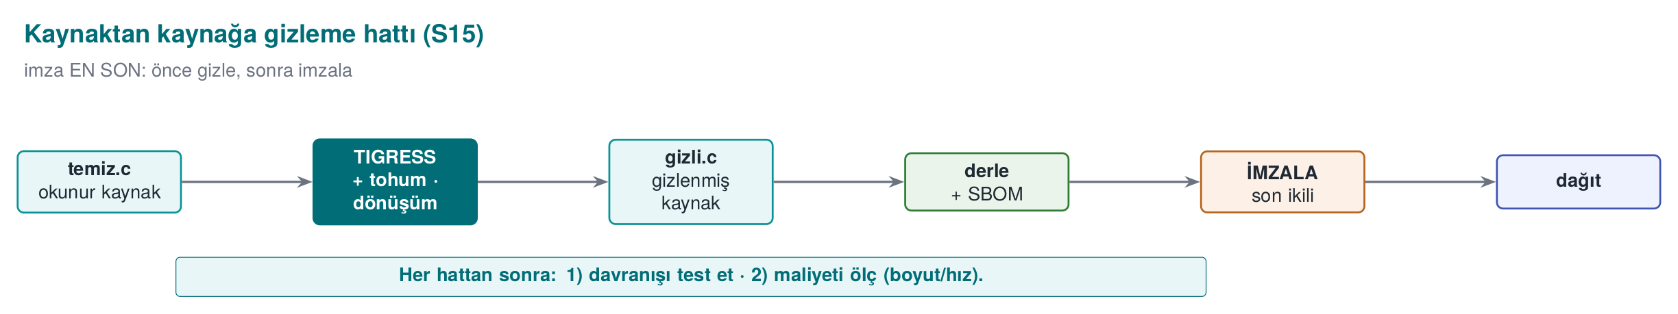
CEN429 Secure Programming · Week 14
Source-to-Source
• Input: C source. Output: C source again — but obfuscated.
• It is then compiled with your normal compiler.
RTEU Computer Engineering · 2026-2027 Fall
9

Slide 10
CEN429 Secure Programming · Week 14
What Is a Transform?
• Transform: a single obfuscation operation applied to the source (e.g., flattening).
• The tool offers many transforms; you choose which one, and where.
RTEU Computer Engineering · 2026-2027 Fall
10

Slide 11
CEN429 Secure Programming · Week 14
Transform Pipeline
• Pipeline: applying several transforms in sequence.
• Each transform is applied to the output of the previous one.
• Order matters.
RTEU Computer Engineering · 2026-2027 Fall
11

Slide 12
CEN429 Secure Programming · Week 14
What Is a Seed?
• Seed: a starting number that governs randomness.
• Same transform + different seed = different obfuscated output.
• This is the key to diversification.
RTEU Computer Engineering · 2026-2027 Fall
12

Slide 13
CEN429 Secure Programming · Week 14
What Is a CLI (Command Line)?
• CLI (Command-Line Interface): an interface where you run things by typing commands.
• Tigress is a CLI tool: tigress --Transform=... dosya.c.
RTEU Computer Engineering · 2026-2027 Fall
13

Slide 14
CEN429 Secure Programming · Week 14
Unit Test
• Unit test: a small test that automatically checks that a function works correctly.
• The same tests must pass after obfuscation (behaviour must be preserved).
RTEU Computer Engineering · 2026-2027 Fall
14

Slide 15
CEN429 Secure Programming · Week 14
1. Source-to-Source Obfuscation and Tigress
RTEU Computer Engineering · 2026-2027 Fall
15

Slide 16
CEN429 Secure Programming · Week 14
Three Problems with Manual Obfuscation
In week 9 we applied the rules by hand. It was instructive, but:
1. Error-prone — can break behaviour
2. Hard to maintain — the source becomes unreadable
3. Cannot be diversified — you cannot differentiate every copy by hand
RTEU Computer Engineering · 2026-2027 Fall
16

Slide 17
CEN429 Secure Programming · Week 14
The Solution: Let a Tool Do It
• Let a tool do the obfuscation.
• You keep the readable source.
• Obfuscation becomes an automatic step in the build pipeline.
RTEU Computer Engineering · 2026-2027 Fall
17

Slide 18
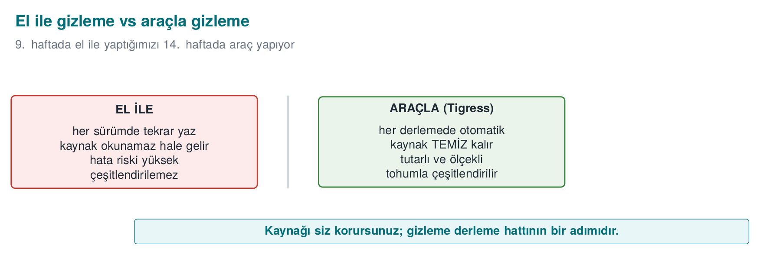
CEN429 Secure Programming · Week 14
The Source-to-Source Idea
The maintenance cost stays with the readable source; the distributed source is obfuscated.
RTEU Computer Engineering · 2026-2027 Fall
18

Slide 19
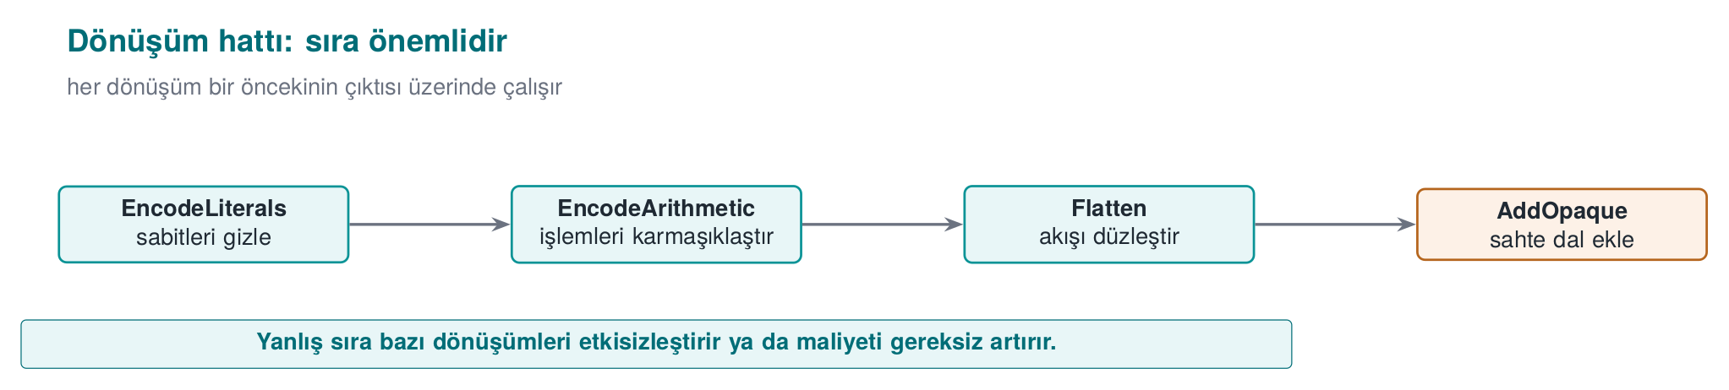
CEN429 Secure Programming · Week 14
Sequenced Transforms — Diagram
RTEU Computer Engineering · 2026-2027 Fall
19

Slide 20
CEN429 Secure Programming · Week 14
What Is Tigress?
• A source-to-source C obfuscator/diversifier developed by Collberg and his team at the University of Arizona.
• The automatic counterpart of week 9's manual rules.
RTEU Computer Engineering · 2026-2027 Fall
20

Slide 21
CEN429 Secure Programming · Week 14
Tigress · Features
• Cross-platform: Linux, macOS, Windows, Android
• Architectures: Intel, ARM, WebAssembly
• Compilers: GCC, Clang, MSVC
• Current version: v4
RTEU Computer Engineering · 2026-2027 Fall
21

Slide 22
CEN429 Secure Programming · Week 14
⚠️ License (Important)
• Non-profit (academic/research) use: free.
• Commercial use: requires a license from the University of Arizona.
• The source code is not open; researchers may request access to an encrypted source.
RTEU Computer Engineering · 2026-2027 Fall
22

Slide 23
CEN429 Secure Programming · Week 14
⚠️ Rule for Use in Class
• The Tigress binary or an old version is not distributed in class.
• Students download the current version themselves from the official site (tigress.wtf).
• They verify the license terms there.
• You apply it only to your own code, on your own machine.
RTEU Computer Engineering · 2026-2027 Fall
23

Slide 24
CEN429 Secure Programming · Week 14
Why a Tool, Not by Hand? (1)
By Hand (Week 9) | With a Tool (Tigress)
Instructive | Scales
Error-prone | Preserves behaviour (tested)
Source becomes unreadable | Readable source stays with you
RTEU Computer Engineering · 2026-2027 Fall
24

Slide 25
CEN429 Secure Programming · Week 14
Why a Tool, Not by Hand? (2)
By Hand | With a Tool
Diversification isn't feasible by hand | Automatic via seed
Uniform, recognisable | Varies with transform+seed
RTEU Computer Engineering · 2026-2027 Fall
25

Slide 26
CEN429 Secure Programming · Week 14
But a Tool Is Not Magic Either
• Tigress also does not grant unbreakability, it raises cost.
• The patterns of a well-known tool can become recognisable over time.
• That's why diversification and layered defence (RASP, server) are still essential.
RTEU Computer Engineering · 2026-2027 Fall
26

Slide 27
CEN429 Secure Programming · Week 14
Basic Flow · a Single Transform
# girdi: source.c → çıktı: variant.c
tigress --Transform=Flatten --Functions=grant_access \
--out=variant.c source.c
cc -o program variant.c
RTEU Computer Engineering · 2026-2027 Fall
27

Slide 28
CEN429 Secure Programming · Week 14
Basic Flow · Three Ideas
1. `--Transform=...` which transform (Flatten = flattening, week 9 K-04)
2. `--Functions=...` which functions (only the sensitive ones — the cost rule)
3. The output is C again; you compile it with your own compiler
RTEU Computer Engineering · 2026-2027 Fall
28

Slide 29
CEN429 Secure Programming · Week 14
Why Do We Target with --Functions?
• If obfuscation is applied to every function, the program slows down/bloats a lot.
• We target only sensitive functions (license, key derivation, integrity).
• This is the tool's version of week 9's "cost rule."
RTEU Computer Engineering · 2026-2027 Fall
29

Slide 30
CEN429 Secure Programming · Week 14
"Should I Obfuscate This Function?" — 1
Question 1: Is this function sensitive? (license, key, integrity, check)
• No → don't obfuscate; don't waste the cost.
• Yes → continue.
RTEU Computer Engineering · 2026-2027 Fall
30

Slide 31
CEN429 Secure Programming · Week 14
"Should I Obfuscate This Function?" — 2
Question 2: Is its value high?
• Medium → EncodeLiterals + EncodeArithmetic + Flatten + AddOpaque.
• High and small → the above + Virtualize.
RTEU Computer Engineering · 2026-2027 Fall
31

Slide 32
CEN429 Secure Programming · Week 14
"Should I Obfuscate This Function?" — 3
Question 3: In every case:
• Diversify (seed)
• Measure (size, time, blocks)
• Verify behaviour with unit tests
• Write it into S9/S15
RTEU Computer Engineering · 2026-2027 Fall
32

Slide 33
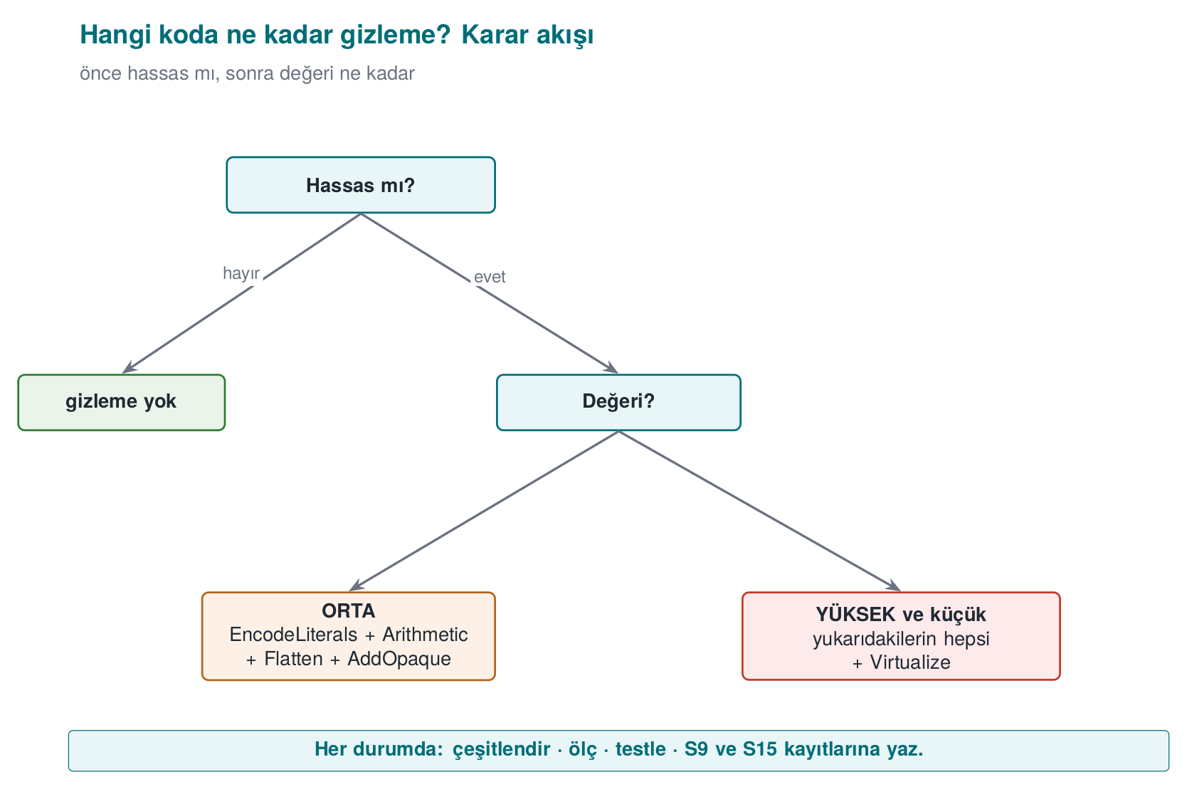
CEN429 Secure Programming · Week 14
Decision Flow · At a Glance
RTEU Computer Engineering · 2026-2027 Fall
33

Slide 34
CEN429 Secure Programming · Week 14
Section 1 — Quick Check
1. What is source-to-source obfuscation?
2. Three advantages over manual obfuscation?
3. Why isn't Tigress distributed in class?
RTEU Computer Engineering · 2026-2027 Fall
34
Notes:
Speaker note: Next, transform families.

Slide 35
CEN429 Secure Programming · Week 14
Section 1 — Answers
1. A transform is applied to the source code, producing new source (still C), which is then compiled normally. Tigress takes C, gives obfuscated C.
2. Repeatable/automatic (every build), consistent and scalable (many functions), the original source stays clean + diversification via seed.
3. License/terms of use; everyone downloads it themselves. If Tigress isn't available, demos work with a clean derivative/fallback.
RTEU Computer Engineering · 2026-2027 Fall
35

Slide 36
CEN429 Secure Programming · Week 14
2. Transform Families and Pipeline
RTEU Computer Engineering · 2026-2027 Fall
36
Notes:
Speaker note: Transform names can change slightly with the version; verify against the official documentation. We tie the concept to week 9's rules.

Slide 37
CEN429 Secure Programming · Week 14
Transforms = Week 9's Rules
Tigress transforms correspond to the obfuscation families we saw in week 9 (K-01–K-12).
Let's look at them group by group; we'll tie each one to a K-rule.
RTEU Computer Engineering · 2026-2027 Fall
37

Slide 38
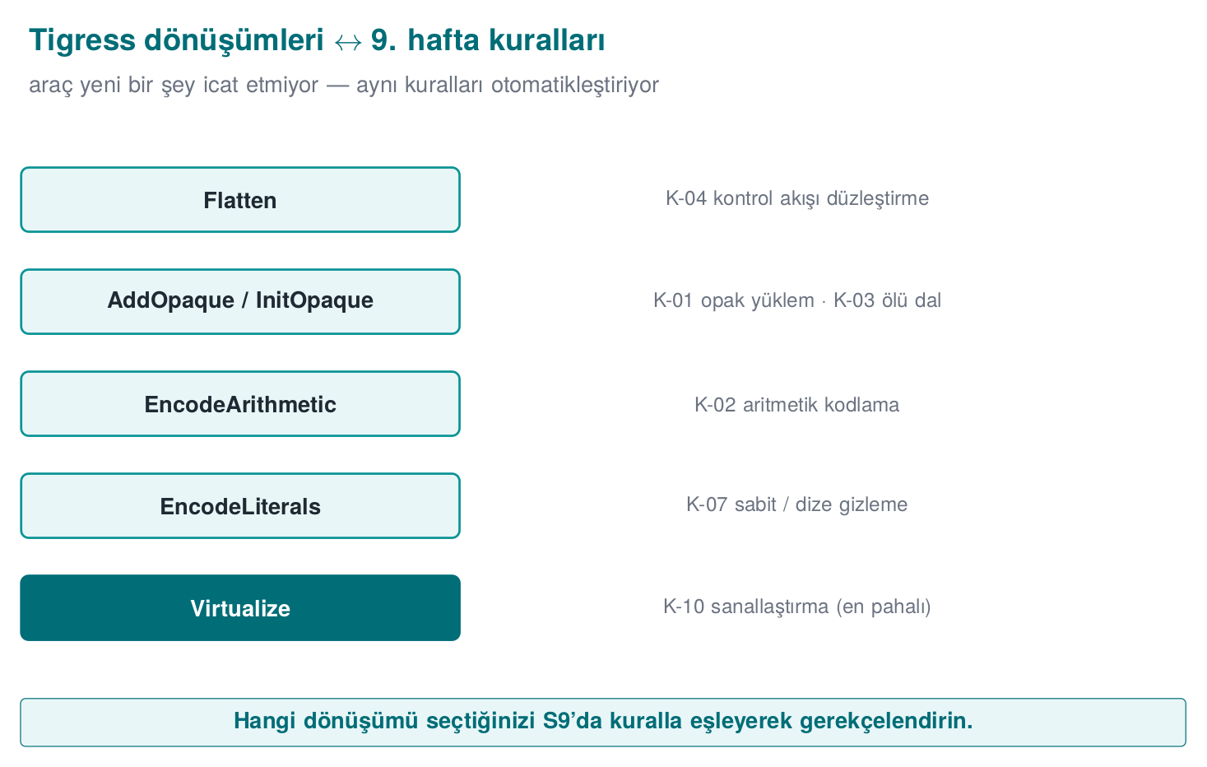
CEN429 Secure Programming · Week 14
Transform ↔ Rule Mapping — Diagram
RTEU Computer Engineering · 2026-2027 Fall
38

Slide 39
CEN429 Secure Programming · Week 14
Control-Flow Transforms
• Flatten: flattens control flow → K-04
• InitOpaque / AddOpaque / UpdateOpaque: opaque predicate + bogus branch → K-01, K-03
• Order: InitOpaque first, then AddOpaque.
RTEU Computer Engineering · 2026-2027 Fall
39

Slide 40
CEN429 Secure Programming · Week 14
Data Transforms
• EncodeArithmetic: arithmetic into an equivalent complex expression (MBA) → K-02
• EncodeLiterals: encodes constants and strings (cheap, applied almost always) → K-07, K-08
• EncodeData: encodes variable representation → K-09
RTEU Computer Engineering · 2026-2027 Fall
40

Slide 41
CEN429 Secure Programming · Week 14
Function Transforms
• Split / Merge: splits/merges functions → K-06
• Virtualize: turns the function into custom VM bytecode → K-10
• Jit: generates code at run time; use carefully alongside OS protections → K-12 (dynamic)
RTEU Computer Engineering · 2026-2027 Fall
41

Slide 42
CEN429 Secure Programming · Week 14
Anti-Analysis Transforms
• AntiBranchAnalysis / AntiAliasAnalysis / AntiTaintAnalysis: make static analysis techniques harder → preventive family
RTEU Computer Engineering · 2026-2027 Fall
42

Slide 43
CEN429 Secure Programming · Week 14
Diversification Transforms
• RandomFuns: random bogus functions
• RndArgs: bogus parameters
• Combined with a seed, every build differs → diversification, K-06
RTEU Computer Engineering · 2026-2027 Fall
43

Slide 44
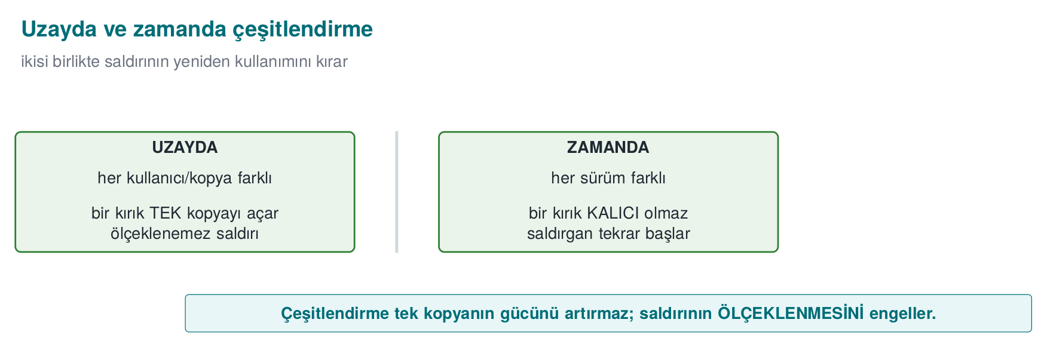
CEN429 Secure Programming · Week 14
Diversification in Space/Time — Diagram
RTEU Computer Engineering · 2026-2027 Fall
44

Slide 45
CEN429 Secure Programming · Week 14
Transform ↔ Rule · Table
Tigress | What It Does | Week 9
Flatten | Flattening | K-04
AddOpaque | Opaque predicate/bogus | K-01, K-03
EncodeArithmetic | Arithmetic encoding | K-02
EncodeLiterals | Constant/string | K-07, K-08
Virtualize | Virtualisation | K-10
RandomFuns/RndArgs | Diversification | K-06
RTEU Computer Engineering · 2026-2027 Fall
45

Slide 46
CEN429 Secure Programming · Week 14
Families and Cost
• Cheap: EncodeArithmetic, EncodeLiterals
• Moderate: Flatten, opaque predicates
• Expensive: Virtualize (tens of times slower)
That's why Virtualize is targeted only at small, critical functions; via --Functions.
RTEU Computer Engineering · 2026-2027 Fall
46

Slide 47
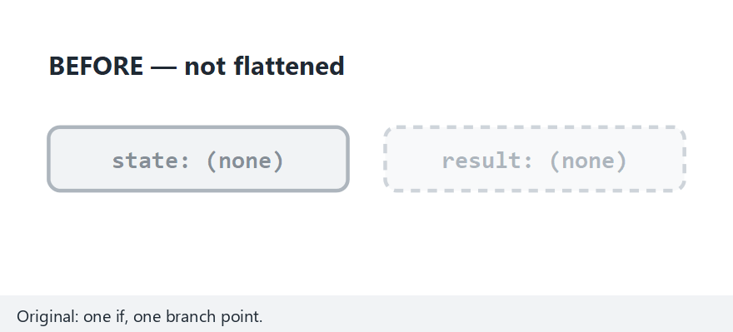
CEN429 Secure Programming · Week 14
Animation · One Transform, Step by Step
RTEU Computer Engineering · 2026-2027 Fall
47
Notes:
Speaker note: start with flatten-granted, show how case 7341 hides the decision; then arith-typical to
verify the MBA identity.

Slide 48
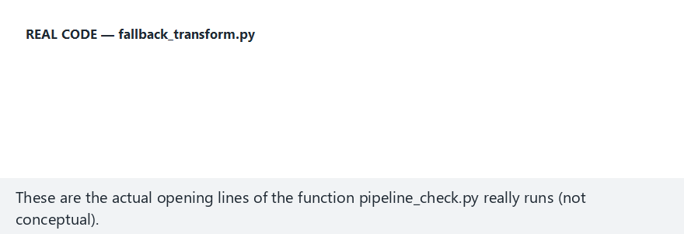
CEN429 Secure Programming · Week 14
Animation · Edge Case: Seed 0
RTEU Computer Engineering · 2026-2027 Fall
48
Notes:
Speaker note: even at q=0, (q*q)%4 can never be 2 — the predicate is still always true; real
fallback_transform.py lines.

Slide 49
CEN429 Secure Programming · Week 14
Combining Transforms in Sequence
RTEU Computer Engineering · 2026-2027 Fall
49

Slide 50
CEN429 Secure Programming · Week 14
"Not One Technique, Together"
Week 9's most important rule.
In Tigress, this means applying transforms in sequence.
RTEU Computer Engineering · 2026-2027 Fall
50

Slide 51
CEN429 Secure Programming · Week 14
Conceptual Pipeline
tigress \
--Transform=EncodeLiterals --Functions=grant_access \
--Transform=EncodeArithmetic --Functions=grant_access \
--Transform=Flatten --Functions=grant_access \
--Transform=AddOpaque --Functions=grant_access \
--out=variant.c source.c
RTEU Computer Engineering · 2026-2027 Fall
51

Slide 52
CEN429 Secure Programming · Week 14
What Does the Pipeline Do?
The single check (grant_access):
1. Encode constants/strings
2. Encode its arithmetic
3. Flatten
4. Strengthen with opaque predicates
= the automatic version of what week 9's K-04 called "strengthened flattening."
RTEU Computer Engineering · 2026-2027 Fall
52

Slide 53
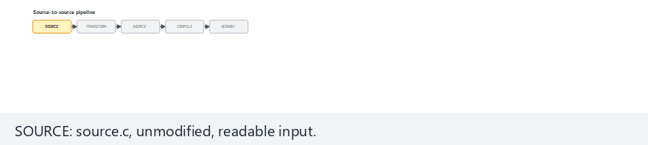
CEN429 Secure Programming · Week 14
Animation · Source-to-Source Pipeline
RTEU Computer Engineering · 2026-2027 Fall
53
Notes:
Speaker note: start with the normal preset (Tigress, two transforms); show students that the behavior-check
row runs once per token.

Slide 54
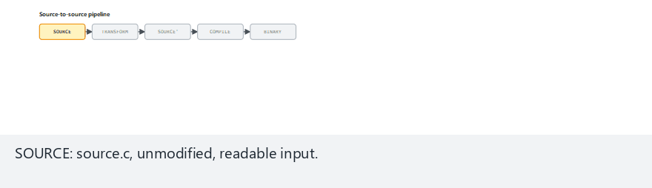
CEN429 Secure Programming · Week 14
Animation · Edge Case: Corrupted Variant
RTEU Computer Engineering · 2026-2027 Fall
54
Notes:
Speaker note: show how a hand-corrupted variant.c that changes behavior makes pipeline_check.py FAIL — the
concrete proof behind "never hand-edit variant.c."

Slide 55
CEN429 Secure Programming · Week 14
⚠️ Order and Testing Rule
• Transform order affects the result; some orders needlessly hurt performance.
• Rule: after every pipeline, run the unit tests (was behaviour preserved?) and measure size/speed.
• Obfuscation must never change behaviour; if it does, the pipeline is wrong.
This connects to week 12's "S16 results."
RTEU Computer Engineering · 2026-2027 Fall
55

Slide 56
CEN429 Secure Programming · Week 14
Step-by-Step Example
RTEU Computer Engineering · 2026-2027 Fall
56

Slide 57
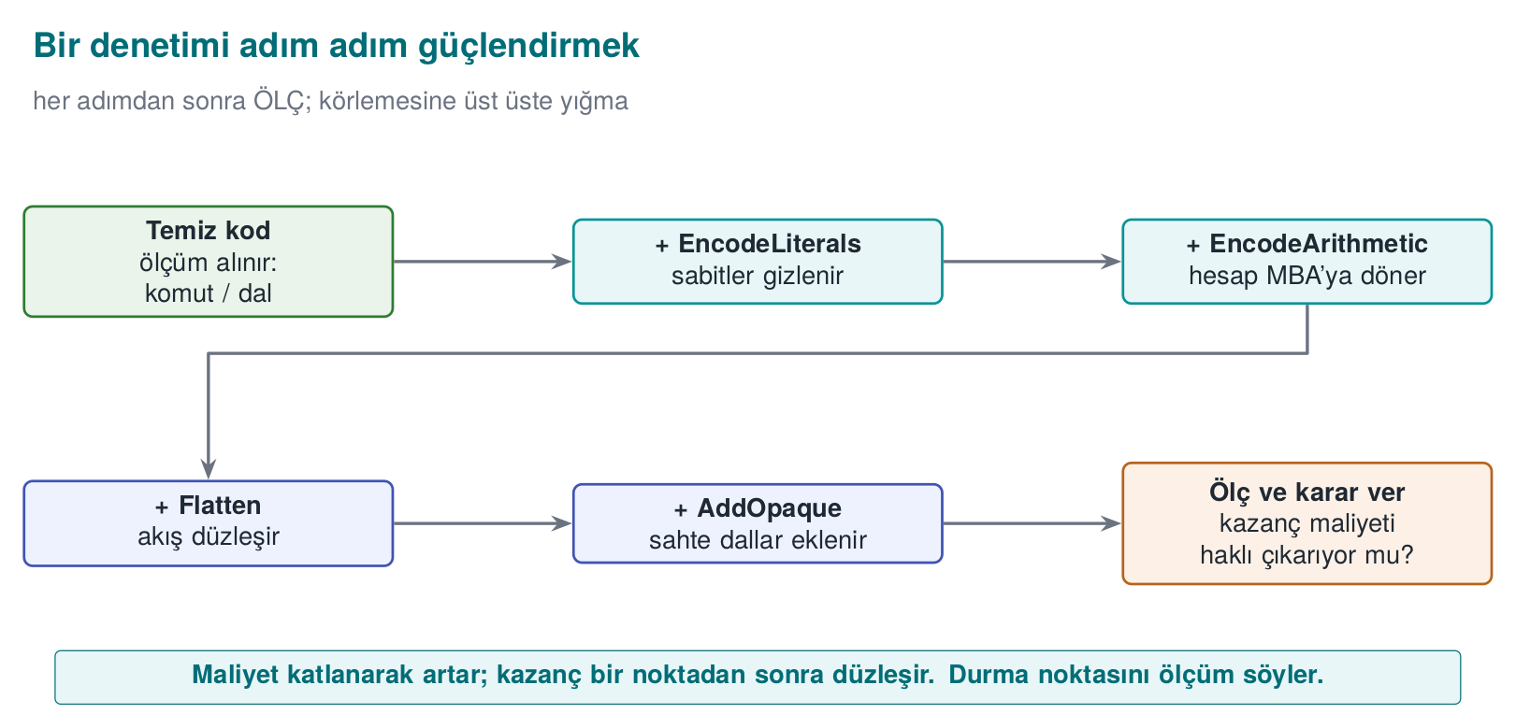
CEN429 Secure Programming · Week 14
Step-by-Step Strengthening — Diagram
RTEU Computer Engineering · 2026-2027 Fall
57

Slide 58
CEN429 Secure Programming · Week 14
Starting Point · source.c
int grant_access(const char *token) {
if (token_is_valid(token)) return GRANTED; /* tek dal */
return DENIED;
}
Unprotected: a single branch, bypassed with strings and a single-byte patch.
RTEU Computer Engineering · 2026-2027 Fall
58

Slide 59
CEN429 Secure Programming · Week 14
Step 0 · The Attacker
• strings → GRANTED/DENIED
• Reverse-compile → a single if
• Turn the failure branch into success
Time: minutes.
RTEU Computer Engineering · 2026-2027 Fall
59

Slide 60
CEN429 Secure Programming · Week 14
Layer by Layer
Step | Transform | What Changes | Cost
0 | — | Bypassed with a single-byte patch | —
1 | EncodeLiterals | GRANTED/DENIED no longer plain | Very low
2 | EncodeArithmetic | Comparison complex | Low
3 | Flatten | Single branch not visible | Moderate
4 | AddOpaque | Bogus branches | Moderate
5 | Virtualize (if needed) | VM bytecode | High
RTEU Computer Engineering · 2026-2027 Fall
60

Slide 61
CEN429 Secure Programming · Week 14
Takeaway
• Every step makes the attack a bit more expensive.
• Every step adds a cost.
• Where you stop: asset value + the cost you measured.
Step 5 (Virtualize) is unnecessary for most checks.
RTEU Computer Engineering · 2026-2027 Fall
61

Slide 62
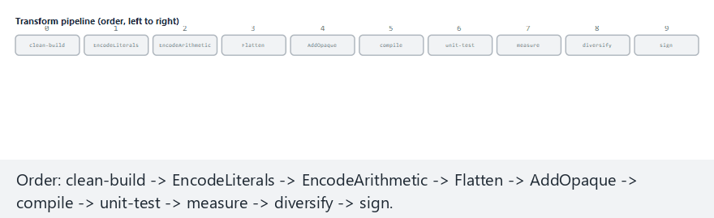
CEN429 Secure Programming · Week 14
Animation · Effect of Order: Scope and Signature
RTEU Computer Engineering · 2026-2027 Fall
62
Notes:
Speaker note: start with code-then-structure; show that EncodeLiterals only encodes constants visible so
far, and that sign is always the last stage.

Slide 63
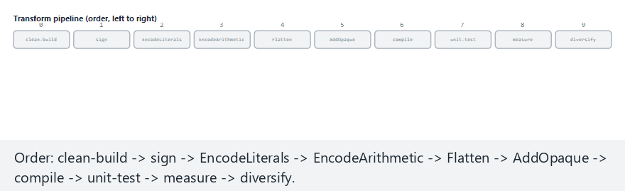
CEN429 Secure Programming · Week 14
Animation · Edge Case: Signing Too Early
RTEU Computer Engineering · 2026-2027 Fall
63
Notes:
Speaker note: if signing happens first, every later stage invalidates it — live proof of the "what if
signing runs before obfuscation" scenario.

Slide 64
CEN429 Secure Programming · Week 14
This Table → S9 Itself
This "step / transform / what changes / cost" table
is the direct counterpart of your project's S9 protection table.
RTEU Computer Engineering · 2026-2027 Fall
64

Slide 65
CEN429 Secure Programming · Week 14
O-LLVM (Compiler-Based)
• Obfuscator-LLVM: applies transforms at compile time.
• Not source-to-source; on top of the LLVM intermediate representation.
• Week 9 K-11. An alternative to Tigress.
RTEU Computer Engineering · 2026-2027 Fall
65

Slide 66
CEN429 Secure Programming · Week 14
Tigress or O-LLVM?
 | Tigress | O-LLVM
Where | Source (C→C) | Compiler (IR)
Visibility | You can see the obfuscated source | A build step
Transform richness | Many (including Virtualize) | More limited
RTEU Computer Engineering · 2026-2027 Fall
66

Slide 67
CEN429 Secure Programming · Week 14
Shared Limit
• Both are well known → their patterns can become recognisable.
• Both require diversification and layered defence.
• Neither one grants unbreakability.
RTEU Computer Engineering · 2026-2027 Fall
67

Slide 68
CEN429 Secure Programming · Week 14
Section 2 — Quick Check
1. Which K-rules do Flatten, EncodeArithmetic, Virtualize correspond to?
2. Why do you target with --Functions?
3. Two things you must always do after every pipeline?
RTEU Computer Engineering · 2026-2027 Fall
68
Notes:
Speaker note: After the break, diversification and measurement.

Slide 69
CEN429 Secure Programming · Week 14
Section 2 — Answers
1. Flatten = control-flow flattening; EncodeArithmetic = arithmetic/data obfuscation; Virtualize = virtualisation (strongest, most expensive).
2. Obfuscating every function blows up cost/performance; targeting only sensitive functions concentrates resilience there.
3. (1) Test behaviour (unit tests must pass), (2) measure cost (size/speed/instruction count, before-after).
RTEU Computer Engineering · 2026-2027 Fall
69

Slide 70
CEN429 Secure Programming · Week 14
3. Diversification and Measurement
RTEU Computer Engineering · 2026-2027 Fall
70

Slide 71
CEN429 Secure Programming · Week 14
Recall Rule 2
An attack that works on one copy should not work on all copies.
If an attacker can crack one copy and distribute the patch to everyone, one crack opens every door.
RTEU Computer Engineering · 2026-2027 Fall
71

Slide 72
CEN429 Secure Programming · Week 14
What Is Diversification?
Behaviourally equivalent, structurally different binaries from the same source.
Tigress does this with a seed:
• Same transforms + a different seed → opaque predicates, bogus branches, state values change.
RTEU Computer Engineering · 2026-2027 Fall
72

Slide 73
CEN429 Secure Programming · Week 14
Two Seeds, Two Different Binaries
tigress --Seed=1001 --Transform=Flatten --Transform=AddOpaque \
--Functions=grant_access --out=gizli_a.c source.c
tigress --Seed=2002 --Transform=Flatten --Transform=AddOpaque \
--Functions=grant_access --out=gizli_b.c source.c
gizli_a and gizli_b do the same job; their machine code is different.
RTEU Computer Engineering · 2026-2027 Fall
73

Slide 74
CEN429 Secure Programming · Week 14
Two Types of Diversification
• In space: a differently seeded copy for each user/device → one copy's attack doesn't work on another.
• In time: each version gets a new seed → an old attack breaks on the new version.
Works together with week 10's key/version renewal.
RTEU Computer Engineering · 2026-2027 Fall
74

Slide 75
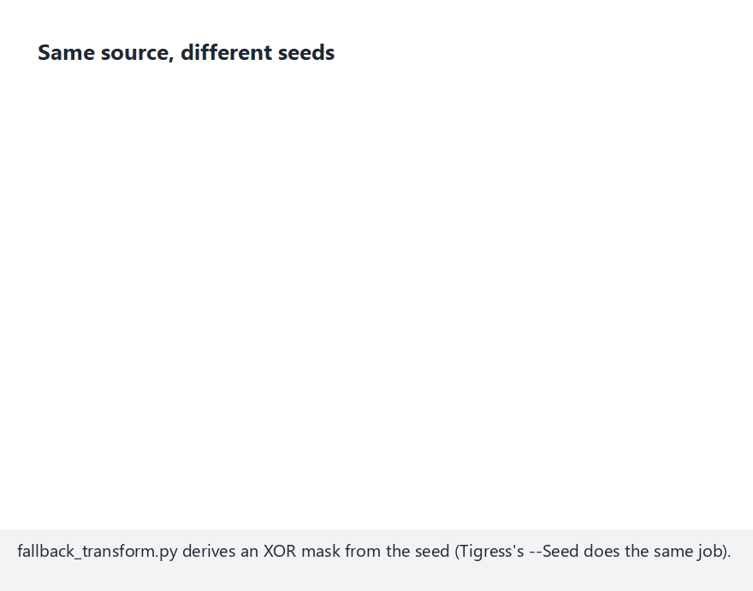
CEN429 Secure Programming · Week 14
Animation · Diversification with Seeds
RTEU Computer Engineering · 2026-2027 Fall
75
Notes:
Speaker note: three-seeds preset — show each seed's mask and encoded bytes side by side; all different
bytes, same GRANTED/DENIED behavior.

Slide 76
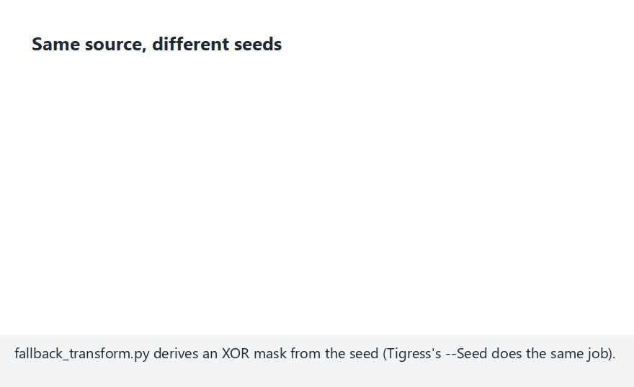
CEN429 Secure Programming · Week 14
Animation · Edge Case: A Forgotten Seed
RTEU Computer Engineering · 2026-2027 Fall
76
Notes:
Speaker note: reusing the same seed twice gives identical bytes — diversification did NOT happen; this is
why section 9's "one seed per release" rule exists.

Slide 77
CEN429 Secure Programming · Week 14
What Does Diversification Prevent?
• It does not increase the strength of obfuscation (cracking one copy is still possible).
• But it prevents it from scaling.
RandomFuns, RndArgs also change structure when combined with a seed.
RTEU Computer Engineering · 2026-2027 Fall
77

Slide 78
CEN429 Secure Programming · Week 14
Diversification Effectiveness · Metric
• Compile the same source with two seeds.
• Measure the byte difference of the protected functions.
• The higher the difference, the lower the chance that one attack works on the other.
Write the metric into S9.
RTEU Computer Engineering · 2026-2027 Fall
78

Slide 79
CEN429 Secure Programming · Week 14
Measuring Obfuscation
RTEU Computer Engineering · 2026-2027 Fall
79

Slide 80
CEN429 Secure Programming · Week 14
Tigress's Teaching Value
In week 9 we learned to measure obfuscation on four dimensions (potency, resilience, stealth, cost).
Tigress lets you make these measurements concrete: obfuscate the same program, measure before/after.
RTEU Computer Engineering · 2026-2027 Fall
80

Slide 81
CEN429 Secure Programming · Week 14
Cost Measurement (Easy, Mandatory)
Measure for every pipeline and write it into S9/S15:
Metric | How
Binary size | size / ls -l
Running time | Same input, N times, average
CFG complexity | Basic block count in the decompiler
RTEU Computer Engineering · 2026-2027 Fall
81

Slide 82
CEN429 Secure Programming · Week 14
Cost Measurement · Command
size ./program_temiz ./program_gizli # boyut farkı
# süre: aynı girdiyle N kez çalıştır, ortalamayı karşılaştır
Simple, but it produces evidence.
RTEU Computer Engineering · 2026-2027 Fall
82

Slide 83
CEN429 Secure Programming · Week 14
Cost · Example Table (Pipeline A and B)
Pipeline A: EncodeLiterals + EncodeArithmetic (light) · Pipeline B: Pipeline A + Flatten + AddOpaque (heavy)
Metric | Clean | Pipeline A | Pipeline B
Size | 100 KB | 103 KB | 131 KB
Time | 1.00× | 1.05× | 1.80×
Blocks (target fn.) | 5 | 7 | 40
Sensitive strings | 3 | 0 | 0
The figures are an example; you write your own measurements.
RTEU Computer Engineering · 2026-2027 Fall
83

Slide 84
CEN429 Secure Programming · Week 14
Cost · Raw Measurement Output
program_temiz:
boyut: 100 KB
işlem süresi: 1.00× (referans)
grant_access temel blok: 5
boyut: 103 KB (+%3)
süre: 1.05×
blok: 7
strings hassas dize: 0 (öncesi 3)
boyut: 131 KB (+%31)
süre: 1.80×
blok: 40
RTEU Computer Engineering · 2026-2027 Fall
84

Slide 85
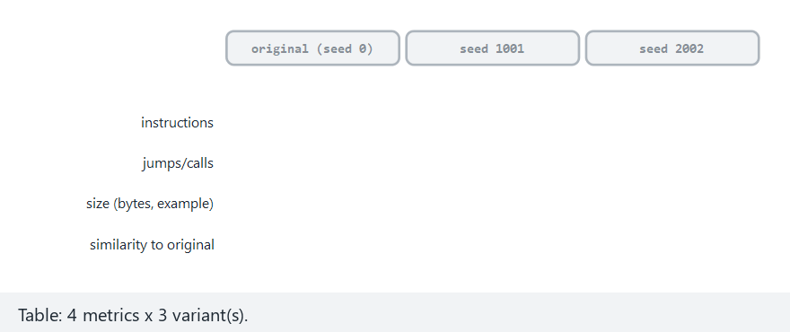
CEN429 Secure Programming · Week 14
Animation · Measuring: Size, Time, Instructions, Similarity
RTEU Computer Engineering · 2026-2027 Fall
85
Notes:
Speaker note: two-different-seeds preset — open the table row by row; instructions/branches are
seed-independent, size/similarity are seed-dependent.

Slide 86
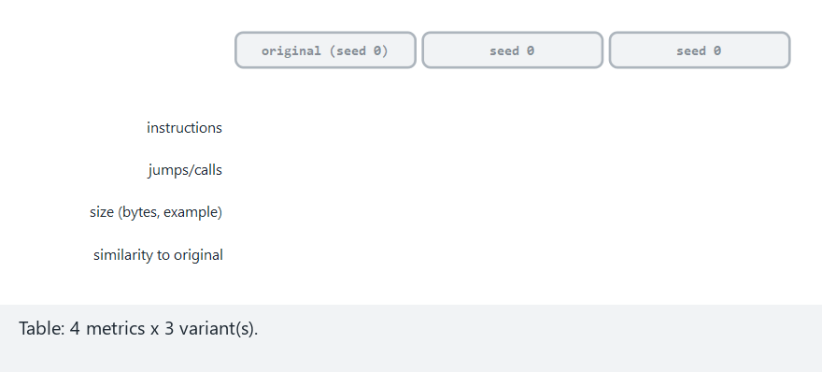
CEN429 Secure Programming · Week 14
Animation · Edge Case: Both "Seeds" Are the Original
RTEU Computer Engineering · 2026-2027 Fall
86
Notes:
Speaker note: seed 0 means "the original itself"; the table then shows 100% similarity to itself.

Slide 87
CEN429 Secure Programming · Week 14
Resilience Measurement (Advanced, Concept)
• Resilience = resistance to an automated tool (symbolic execution).
• Week 9: "not a claim, a measured quantity."
• Tigress is at the centre of this research.
RTEU Computer Engineering · 2026-2027 Fall
87

Slide 88
CEN429 Secure Programming · Week 14
Banescu et al. · Tigress + KLEE
A study measuring how much Tigress transforms resist symbolic execution. Findings:
• A single transform (Flatten alone) → usually unwound.
• Combining transforms + growing the state space → forces the solver exponentially.
• But cost also increases.
RTEU Computer Engineering · 2026-2027 Fall
88

Slide 89
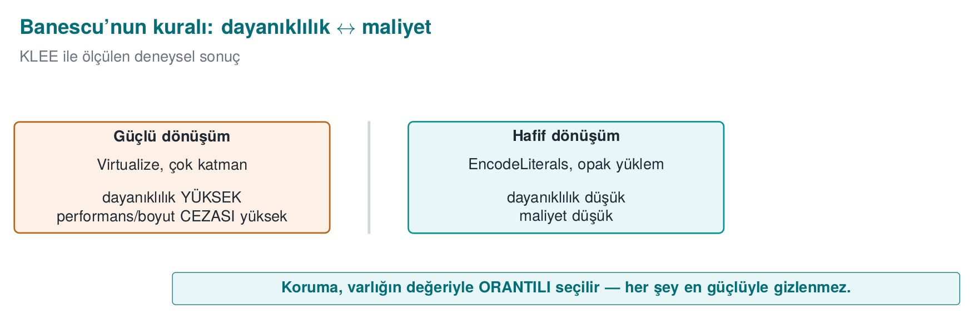
CEN429 Secure Programming · Week 14
Resilience ↔ Cost — Diagram
RTEU Computer Engineering · 2026-2027 Fall
89

Slide 90
CEN429 Secure Programming · Week 14
Takeaway for the Course
Resilience and cost are a trade-off (like week 9).
Don't say "strong"; say "it didn't let this tool solve a problem of this size within this time."
RTEU Computer Engineering · 2026-2027 Fall
90

Slide 91
CEN429 Secure Programming · Week 14
Measurement Rule (S9/S15)
Defend an obfuscation decision with measurements:
"The Flatten + AddOpaque pipeline grew the size by 30%, slowed the process by 1.8×; the target function's basic block count grew 8-fold."
Unmeasured obfuscation = a claim for the evaluator (week 12).
RTEU Computer Engineering · 2026-2027 Fall
91

Slide 92
CEN429 Secure Programming · Week 14
Decision
• Asset value low → Pipeline A is enough.
• Asset value high → Pipeline B (accept the cost) + diversification.
The decision rests on numbers, not a feeling.
RTEU Computer Engineering · 2026-2027 Fall
92

Slide 93
CEN429 Secure Programming · Week 14
Diversification Measurement (Example)
• Produce Pipeline B with seed 1001 and 2002.
• Byte difference of the protected function: 92%.
• Comment: a patch written for one copy most likely won't work on the other.
RTEU Computer Engineering · 2026-2027 Fall
93

Slide 94
CEN429 Secure Programming · Week 14
Section 3 — Quick Check
1. How does a seed provide diversification?
2. Difference between diversification in space and in time?
3. Banescu et al.'s main rule? (resilience ↔ cost)
RTEU Computer Engineering · 2026-2027 Fall
94
Notes:
Speaker note: Next, in-class flow, S15, project.

Slide 95
CEN429 Secure Programming · Week 14
Section 3 — Answers
1. Obfuscating the same source with a different seed makes the tool make different random choices → every build is a different binary (same behaviour).
2. In space: different copies/users differ (one crack doesn't crack everyone). In time: it changes across versions (a crack doesn't stay valid).
3. Stronger obfuscation means more resilience but more cost; protection is chosen in proportion to the value of the asset.
RTEU Computer Engineering · 2026-2027 Fall
95

Slide 96
CEN429 Secure Programming · Week 14
4. In-Class Flow (Step by Step)
RTEU Computer Engineering · 2026-2027 Fall
96
Notes:
Speaker note: Students download Tigress themselves and apply it to their own small program. Purely defensive; protecting and measuring your own code.

Slide 97
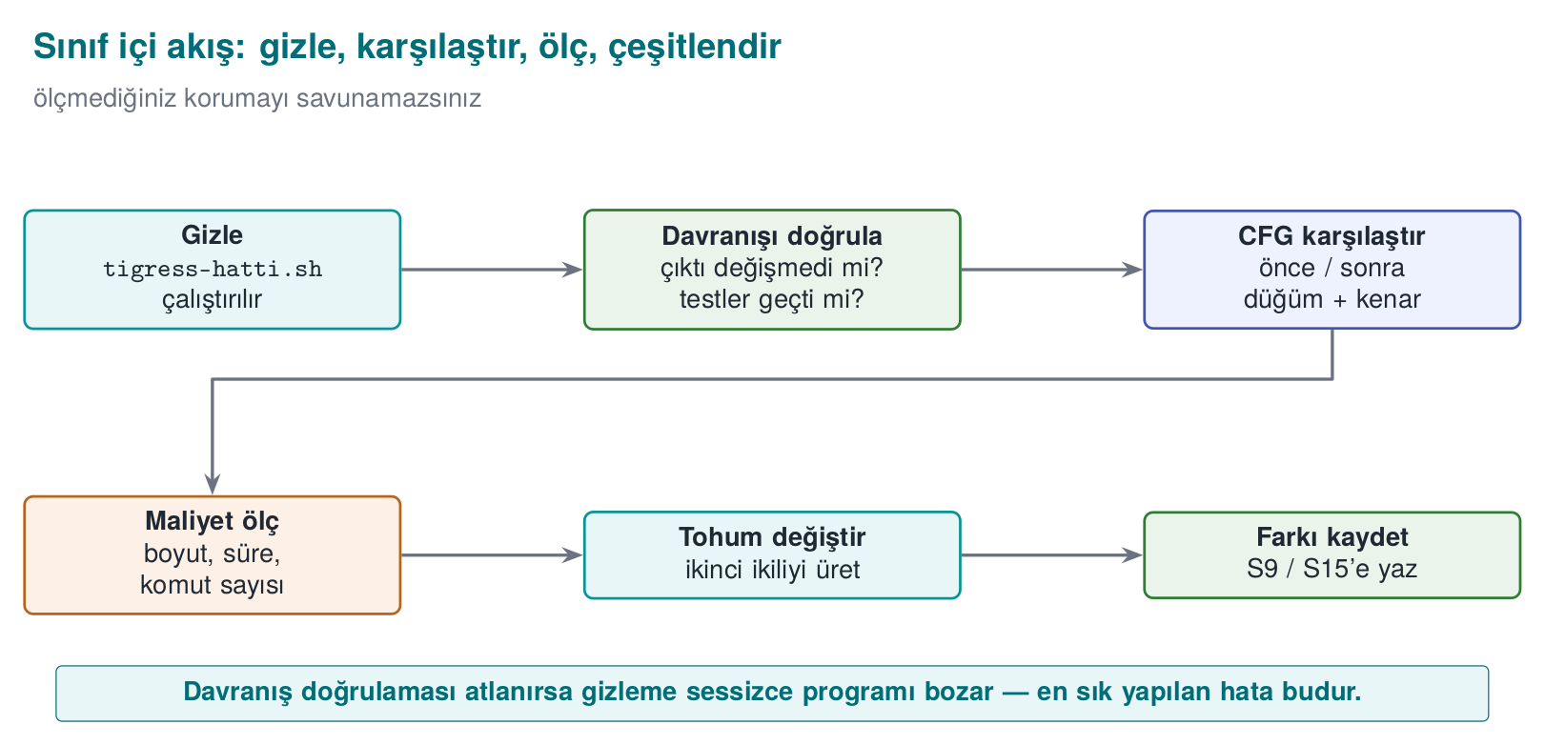
CEN429 Secure Programming · Week 14
In-Class Flow — Diagram
RTEU Computer Engineering · 2026-2027 Fall
97

Slide 98
CEN429 Secure Programming · Week 14
What Will We Do?
Take your own small, synthetic program:
obfuscate → verify behaviour → compare → measure → diversify → report
Let's go step by step.
RTEU Computer Engineering · 2026-2027 Fall
98

Slide 99
CEN429 Secure Programming · Week 14
Step 1 · Preparation
• Write a small, synthetic program (e.g., grant_access).
• Show with unit tests that it works correctly.
• This is your "clean" baseline.
RTEU Computer Engineering · 2026-2027 Fall
99

Slide 100
CEN429 Secure Programming · Week 14
Step 2 · Obfuscate
tigress --Transform=EncodeLiterals --Transform=EncodeArithmetic \
--Transform=Flatten --Transform=AddOpaque \
--Functions=grant_access --out=variant.c source.c
cc -o program_gizli variant.c
Apply a transform pipeline.
RTEU Computer Engineering · 2026-2027 Fall
100

Slide 101
CEN429 Secure Programming · Week 14
Step 3 · Verify Behaviour
• Run the same unit tests on the obfuscated version.
• The result must be exactly the same.
• If different: the pipeline is wrong → fix it.
Obfuscation never changes behaviour.
RTEU Computer Engineering · 2026-2027 Fall
101

Slide 102
CEN429 Secure Programming · Week 14
Step 4 · Compare
• Open the clean and obfuscated versions in a decompiler (Ghidra/objdump).
• Compare the control flow.
• Note the increase in basic block count.
RTEU Computer Engineering · 2026-2027 Fall
102

Slide 103
CEN429 Secure Programming · Week 14
Step 5 · Measure
size ./program_temiz ./program_gizli
# süre: aynı girdiyle N kez çalıştır, ortalamayı karşılaştır
Write down the size and time difference.
RTEU Computer Engineering · 2026-2027 Fall
103

Slide 104
CEN429 Secure Programming · Week 14
Step 6 · Diversify
• Run the same pipeline with two different seeds.
• Show that the two binaries are different (byte difference).
tigress --Seed=1001 ... --out=gizli_a.c source.c
tigress --Seed=2002 ... --out=gizli_b.c source.c
RTEU Computer Engineering · 2026-2027 Fall
104

Slide 105
CEN429 Secure Programming · Week 14
Step 7 · Report
Put your findings into a table:
Transform | Size | Time | Blocks | Seed Difference
… | … | … | … | …
This table goes directly into S9/S15.
RTEU Computer Engineering · 2026-2027 Fall
105

Slide 106
CEN429 Secure Programming · Week 14
⚠️ Ethical and Safe Use
• Tigress only on your own code.
• The example program does not harm the computer: it does not change system settings, does not touch the network.
• All values are synthetic.
RTEU Computer Engineering · 2026-2027 Fall
106

Slide 107
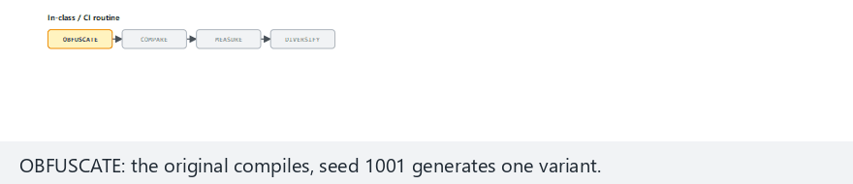
CEN429 Secure Programming · Week 14
Animation · In-Class Flow
RTEU Computer Engineering · 2026-2027 Fall
107
Notes:
Speaker note: all-pass preset — open the four stages (OBFUSCATE/COMPARE/MEASURE/DIVERSIFY) in order; show
how they line up with pipeline_check.py's real lines.

Slide 108
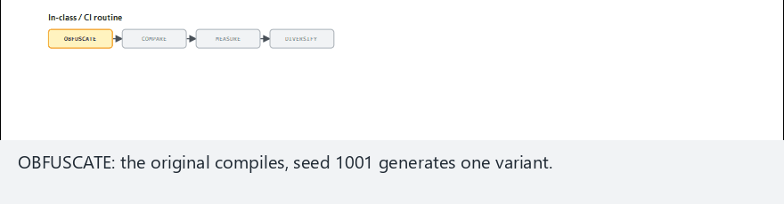
CEN429 Secure Programming · Week 14
Animation · Edge Case: Mismatch + Reused Seed
RTEU Computer Engineering · 2026-2027 Fall
108
Notes:
Speaker note: show where the flow reports FAILED when a token mismatches AND the seed is reused.

Slide 109
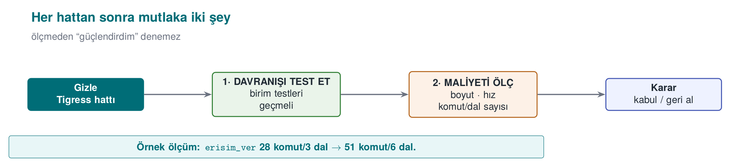
CEN429 Secure Programming · Week 14
In-Class · Summary Flow
RTEU Computer Engineering · 2026-2027 Fall
109

Slide 110
CEN429 Secure Programming · Week 14
Step-by-Step Flow · Why This Order?
• First behaviour (tests) — make sure nothing broke.
• Then evidence (CFG, measurement) — show the gain.
• Then diversification — break scalability.
Don't say "strong" without measuring.
RTEU Computer Engineering · 2026-2027 Fall
110

Slide 111
CEN429 Secure Programming · Week 14
New Example · Integrity Check
int dosya_saglam(const uint8_t *veri, size_t n,
const uint8_t *beklenen) {
uint8_t ozet[32];
ozet_hesapla(veri, n, ozet); /* SHA-256 benzeri */
return sabit_zamanli_esit(ozet, beklenen, 32);
}
A synthetic function that checks version integrity.
RTEU Computer Engineering · 2026-2027 Fall
111

Slide 112
CEN429 Secure Programming · Week 14
Why Obfuscate This?
• An attacker wants to find this check and bypass it (to get a tampered file to pass).
• The check's return point and comparison are the target.
• Week 9: opaque boolean + random exit are critical here.
RTEU Computer Engineering · 2026-2027 Fall
112

Slide 113
CEN429 Secure Programming · Week 14
Pipeline Choice
tigress \
--Transform=EncodeLiterals \
--Transform=EncodeArithmetic \
--Transform=Flatten \
--Transform=AddOpaque \
--Functions=dosya_saglam \
--out=variant.c source.c
RTEU Computer Engineering · 2026-2027 Fall
113

Slide 114
CEN429 Secure Programming · Week 14
Step by Step · What Happens?
• EncodeLiterals: 32 and any strings are no longer plain.
• EncodeArithmetic: the comparison becomes complex.
• Flatten: the single return point is not visible.
• AddOpaque: bogus branches; the "success" branch isn't in one place.
RTEU Computer Engineering · 2026-2027 Fall
114

Slide 115
CEN429 Secure Programming · Week 14
Behaviour Verification (Mandatory)
• A file with the correct hash → passes.
• A file with a corrupted hash → rejected.
• The obfuscated version gives the same result → pipeline correct.
RTEU Computer Engineering · 2026-2027 Fall
115

Slide 116
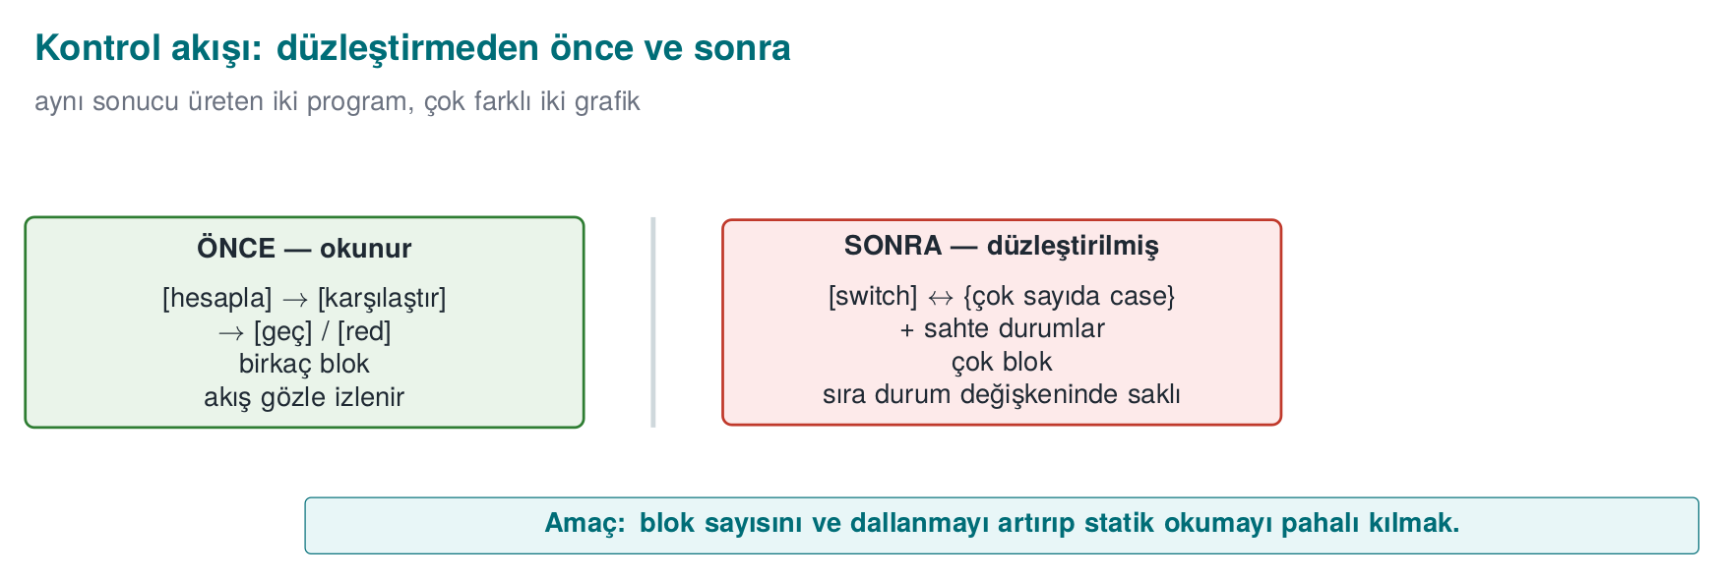
CEN429 Secure Programming · Week 14
CFG Before/After (Concept)
Where the check passes/fails can no longer be read from the flow.
RTEU Computer Engineering · 2026-2027 Fall
116

Slide 117
CEN429 Secure Programming · Week 14
⚠️ Constant-Time Behaviour Must Be Preserved
• Even obfuscated, sabit_zamanli_esit must stay constant time.
• If an early exit is added for the sake of obfuscation, a side channel opens (week 3).
• Test that the transforms don't break this.
RTEU Computer Engineering · 2026-2027 Fall
117

Slide 118
CEN429 Secure Programming · Week 14
Measurement (Example)
Metric | Before | After
Size | 100 KB | 128 KB
Time | 1.0× | 1.7×
Blocks (dosya_saglam) | 4 | 33
RTEU Computer Engineering · 2026-2027 Fall
118

Slide 119
CEN429 Secure Programming · Week 14
Diversification
• Produce with two seeds → two different binaries.
• A "skip the integrity check" patch that works on one copy won't work on the other, even if it succeeds once.
RTEU Computer Engineering · 2026-2027 Fall
119

Slide 120
CEN429 Secure Programming · Week 14
Second Example · Takeaway
• Obfuscation is valuable on functions that are a bypass target, like integrity checks.
• But the real strength: obfuscation + RASP (week 6) + server-side checking.
• Obfuscation alone delays bypass, it doesn't prevent it.
RTEU Computer Engineering · 2026-2027 Fall
120

Slide 121
CEN429 Secure Programming · Week 14
Section 4 — Quick Check
1. The first thing you must always do after obfuscating?
2. How do you show diversification?
3. Which project sections does the report table go into?
RTEU Computer Engineering · 2026-2027 Fall
121
Notes:
Speaker note: Next, the build pipeline (S15) and the project.

Slide 122
CEN429 Secure Programming · Week 14
Section 4 — Answers
1. Test that behaviour hasn't changed (unit tests must pass); obfuscation must not break function.
2. Produce with two different seeds; compare the binaries (hash/size/instructions differ) but same input → same output (diff/objdump).
3. S9 (code hardening) and S15 (build/deployment pipeline); before/after measurement as evidence.
RTEU Computer Engineering · 2026-2027 Fall
122

Slide 123
CEN429 Secure Programming · Week 14
5. Build Pipeline (S15) and Project
RTEU Computer Engineering · 2026-2027 Fall
123

Slide 124
CEN429 Secure Programming · Week 14
Obfuscation Is Not "By Hand at the End"
Obfuscation should be a step in the build pipeline.
Your project's S15 section, after the midterm, documents exactly this.
RTEU Computer Engineering · 2026-2027 Fall
124

Slide 125
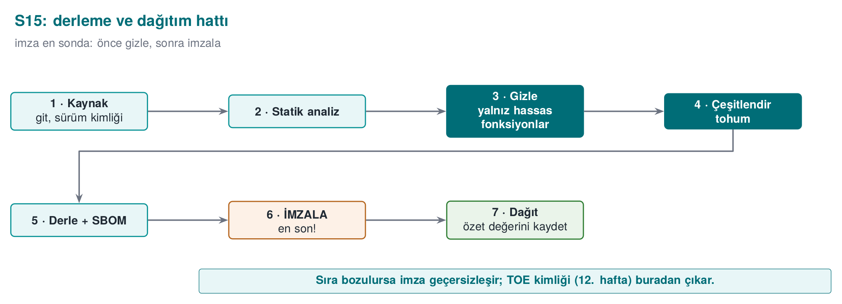
CEN429 Secure Programming · Week 14
Build Pipeline — Diagram
RTEU Computer Engineering · 2026-2027 Fall
125

Slide 126
CEN429 Secure Programming · Week 14
Pipeline Rule 1 · Sensitive Functions Only
• Obfuscate only sensitive functions with --Functions.
• Write down the rationale (which function, why).
• The cost rule (week 9).
RTEU Computer Engineering · 2026-2027 Fall
126

Slide 127
CEN429 Secure Programming · Week 14
Pipeline Rule 2 · Every Version Is Diversified
• Every version is diversified with a seed.
• The seed and build identity are recorded.
• Diversification in time (section 3).
RTEU Computer Engineering · 2026-2027 Fall
127

Slide 128
CEN429 Secure Programming · Week 14
Pipeline Rule 3 · Signing After Obfuscation
• First obfuscate, then sign.
• The build identity and hash values (week 12's TOE) must be consistent.
• Why afterwards? The signature must cover the final distributed binary.
RTEU Computer Engineering · 2026-2027 Fall
128

Slide 129
CEN429 Secure Programming · Week 14
Pipeline Rule 4 · Automatic in CI
• The pipeline runs in continuous integration (CI).
• Every version: unit tests + size/speed measurement automatic.
• If behaviour breaks, the build stops.
RTEU Computer Engineering · 2026-2027 Fall
129

Slide 130
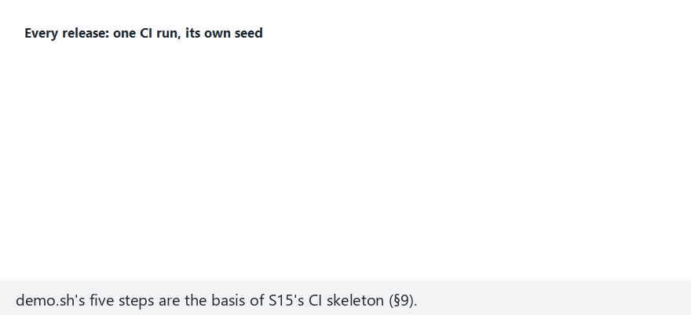
CEN429 Secure Programming · Week 14
Animation · CI Pipeline, Per-Release Seed
RTEU Computer Engineering · 2026-2027 Fall
130
Notes:
Speaker note: three-clean-releases preset — show three releases (v1.0/v1.1/v1.2) each passing all six
stages; the S15 record is exactly this.

Slide 131
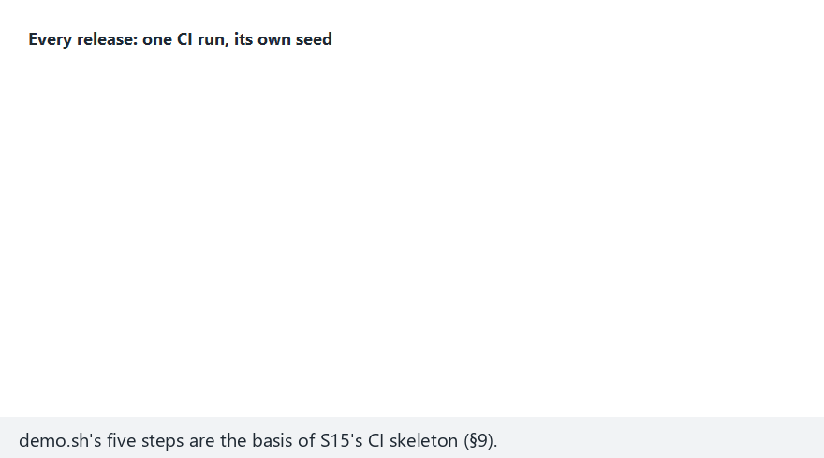
CEN429 Secure Programming · Week 14
Animation · Edge Case: A Reused Seed
RTEU Computer Engineering · 2026-2027 Fall
131
Notes:
Speaker note: show v1.3 reusing v1.0's seed, and how record-version catches it.

Slide 132
CEN429 Secure Programming · Week 14
9, 11, 14 Together
• 9: obfuscation rules (code)
• 11: whitebox (key)
• 14: automation + diversification (this week)
Common rule: protection = delay; strength comes from layers and measurement.
RTEU Computer Engineering · 2026-2027 Fall
132

Slide 133
CEN429 Secure Programming · Week 14
Project · S9 Extended + S15 Pipeline — 1
1. Transform pipeline (S9): which functions, which transforms, in what order, why.
RTEU Computer Engineering · 2026-2027 Fall
133

Slide 134
CEN429 Secure Programming · Week 14
Project · S9 + S15 — 2
2. Measurement table: size, time, (if available) block count — before/after.
RTEU Computer Engineering · 2026-2027 Fall
134

Slide 135
CEN429 Secure Programming · Week 14
Project · S9 + S15 — 3
3. Diversification: production with two seeds + a difference metric; if you won't apply it, a rationale.
RTEU Computer Engineering · 2026-2027 Fall
135

Slide 136
CEN429 Secure Programming · Week 14
Project · S9 + S15 — 4, 5
4. S15 pipeline: document the obfuscation + signing + build identity steps with a diagram.
5. Behaviour evidence: show that the obfuscated version passes the unit tests (the S16 link).
RTEU Computer Engineering · 2026-2027 Fall
136

Slide 137
CEN429 Secure Programming · Week 14
Through the Evaluator's Eyes
• Not "I used a lot of transforms."
• A rationale and a measurement for every transform.
• Unmeasured obfuscation = a claim (week 12).
RTEU Computer Engineering · 2026-2027 Fall
137

Slide 138
CEN429 Secure Programming · Week 14
Case · Setup
A synthetic application has a license check and a key derivation function.
Should we heavily obfuscate both?
RTEU Computer Engineering · 2026-2027 Fall
138

Slide 139
CEN429 Secure Programming · Week 14
Case · Decision
• License check: medium value → Pipeline B (Flatten + AddOpaque).
• Key derivation: high value → Pipeline B + Virtualize (acceptable cost because it's small).
• The rest: not obfuscated (unnecessary cost).
RTEU Computer Engineering · 2026-2027 Fall
139

Slide 140
CEN429 Secure Programming · Week 14
Case · Diversification + Pipeline
• Each version, a different seed.
• Build pipeline: obfuscate → sign → build identity.
• Unit tests + measurement automatic in CI.
RTEU Computer Engineering · 2026-2027 Fall
140

Slide 141
CEN429 Secure Programming · Week 14
Case · S9/S15 Output
Function | Pipeline | Size/Time | Rationale
lisans_dogrula | B | +31% / 1.8× | medium value
anahtar_turet | B+Virtualize | +60% / 3× | high value, small fn.
RTEU Computer Engineering · 2026-2027 Fall
141

Slide 142
CEN429 Secure Programming · Week 14
Case · Residual Risk
• A sufficiently determined attacker can still solve a single copy.
• Mitigation: diversification + a short-lived key + server-side checking.
• Written down explicitly.
RTEU Computer Engineering · 2026-2027 Fall
142

Slide 143
CEN429 Secure Programming · Week 14
Section 5 — Quick Check
1. Why is signing after obfuscation?
2. The rationale for the "sensitive functions only" rule?
3. The steps of the S15 pipeline?
RTEU Computer Engineering · 2026-2027 Fall
143
Notes:
Speaker note: Next, the solved self-check.

Slide 144
CEN429 Secure Programming · Week 14
Section 5 — Answers
1. The signature protects the final binary; if you sign first and obfuscate afterwards, the binary changes → the signature becomes invalid. Order: build → obfuscate → sign.
2. Obfuscating everything blows up performance/size and most code isn't sensitive; concentrate protection on critical functions → low cost, high impact.
3. Source → (static analysis) → build → obfuscate → diversify (seed) → package/SBOM → sign → deploy (all recorded in CI).
RTEU Computer Engineering · 2026-2027 Fall
144

Slide 145
CEN429 Secure Programming · Week 14
Solved Self-Check
RTEU Computer Engineering · 2026-2027 Fall
145
Notes:
Speaker note: Have the students answer first, then reveal the answer.

Slide 146
CEN429 Secure Programming · Week 14
Question 1
What is source-to-source obfuscation? Three advantages over manual obfuscation?
Answer: A tool takes C source and produces obfuscated C source. Advantages: preserves behaviour (error-resistant), the readable source stays with you, easy diversification via seed.
RTEU Computer Engineering · 2026-2027 Fall
146

Slide 147
CEN429 Secure Programming · Week 14
Question 2
Tigress's place in the course; which license, why isn't it distributed in class?
Answer: The automatic form of week 9's rules. Non-profit use is free, commercial needs an Arizona license. The source is closed → its binary is not distributed in class; students download it from the official site.
RTEU Computer Engineering · 2026-2027 Fall
147

Slide 148
CEN429 Secure Programming · Week 14
Question 3
Map these transforms to week 9's rules: Flatten, EncodeArithmetic, EncodeLiterals, Virtualize, AddOpaque.
Answer: Flatten→K-04, EncodeArithmetic→K-02, EncodeLiterals→K-07/K-08, Virtualize→K-10, AddOpaque→K-01/K-03.
RTEU Computer Engineering · 2026-2027 Fall
148

Slide 149
CEN429 Secure Programming · Week 14
Question 4
Why is a transform pipeline stronger than a single transform? Why does order matter?
Answer: Layers strengthen each other (week 9's "together"). Order affects the result and performance; some orders needlessly slow things down or give a weak result.
RTEU Computer Engineering · 2026-2027 Fall
149

Slide 150
CEN429 Secure Programming · Week 14
Question 5
Which two things do you always do after every transform pipeline?
Answer: (1) Run the unit tests (was behaviour preserved?), (2) measure size/speed (cost).
RTEU Computer Engineering · 2026-2027 Fall
150

Slide 151
CEN429 Secure Programming · Week 14
Question 6
Why is Virtualize applied only to small and critical functions?
Answer: Its cost is very high (tens of times slower, size). The benefit only justifies the cost for the most valuable, small functions.
RTEU Computer Engineering · 2026-2027 Fall
151

Slide 152
CEN429 Secure Programming · Week 14
Question 7
How does the seed (`--Seed`) provide diversification? Difference in space/time?
Answer: A different seed → different opaque predicate/bogus branch/state. In space: different copies at the same time. In time: each version gets a new seed.
RTEU Computer Engineering · 2026-2027 Fall
152

Slide 153
CEN429 Secure Programming · Week 14
Question 8
Does diversification prevent the strength of obfuscation, or its scalability?
Answer: It does not increase strength (one copy can still be cracked); it prevents scalability — one crack doesn't open every door.
RTEU Computer Engineering · 2026-2027 Fall
153

Slide 154
CEN429 Secure Programming · Week 14
Question 9
The main rule for the course from the Banescu et al. study?
Answer: Resilience is a measured quantity. Combining transforms forces symbolic execution exponentially; but cost also increases → resilience ↔ cost trade-off.
RTEU Computer Engineering · 2026-2027 Fall
154

Slide 155
CEN429 Secure Programming · Week 14
Question 10
When putting obfuscation into the build pipeline, why does signing come after obfuscation?
Answer: The signature must cover the final distributed binary. It's obfuscated first, then signed; the build identity/hash stays consistent.
RTEU Computer Engineering · 2026-2027 Fall
155

Slide 156
CEN429 Secure Programming · Week 14
Question 11
The rationale for S15's "only sensitive functions are obfuscated" rule?
Answer: Obfuscating every function slows down/bloats the program a lot. It makes sense to take on the cost only for valuable functions.
RTEU Computer Engineering · 2026-2027 Fall
156

Slide 157
CEN429 Secure Programming · Week 14
Question 12
Write the common rule of weeks 9, 11, and 14 in one sentence.
Answer: Protection provides not unbreakability but delay; its strength comes from combining layers, from diversification, and from being measured.
RTEU Computer Engineering · 2026-2027 Fall
157

Slide 158
CEN429 Secure Programming · Week 14
Closing · Three Weeks
• 9: obfuscation rules (by hand)
• 11: whitebox (key)
• 14: automation + diversification
All one framework: cost + layers + measurement.
RTEU Computer Engineering · 2026-2027 Fall
158

Slide 159
CEN429 Secure Programming · Week 14
Common Mistakes — Summary
Mistake | Where It Was Covered
Obfuscating everything | Section 1 (--Functions), Section 2 (cost)
Obfuscating without tests | Section 2 (order and testing rule)
Saying "strong" without measuring | Section 3 (measurement rule)
Skipping diversification | Section 3 (Rule 2)
Signing before obfuscating | Section 5 (Pipeline Rule 3)
Using an old/distributed Tigress | Section 1 (licence)
RTEU Computer Engineering · 2026-2027 Fall
159

Slide 160
CEN429 Secure Programming · Week 14
Glossary
Term | Meaning
Source-to-source | Obfuscation that takes C in and gives obfuscated C out
Transform | A single obfuscation operation
Pipeline | The ordered whole of the transforms
Seed | A number that governs randomness (diversification)
Symbolic execution | Path-solving automated analysis (KLEE)
RTEU Computer Engineering · 2026-2027 Fall
160

Slide 161
CEN429 Secure Programming · Week 14
Transform Selection Guide
You Want | Transform
Hide a string/constant | EncodeLiterals
Hide a calculation | EncodeArithmetic
Hide the structure | Flatten
Add bogus/opaque | AddOpaque
Hide machine code | Virtualize (expensive)
Diversify | --Seed, RandomFuns
RTEU Computer Engineering · 2026-2027 Fall
161

Slide 162
CEN429 Secure Programming · Week 14
Checklist
• --Functions)
•
•
•
•
•
•
RTEU Computer Engineering · 2026-2027 Fall
162

Slide 163
CEN429 Secure Programming · Week 14
Sources
• The Tigress official site/worksheets (tigress.wtf) — transforms, syntax, v4, license
• Collberg & Nagra, Surreptitious Software — taxonomy, measurement
• Banescu et al. — Tigress + KLEE resilience measurement
• Obfuscator-LLVM — a compiler-based alternative
RTEU Computer Engineering · 2026-2027 Fall
163

Slide 164
CEN429 Secure Programming · Week 14
Summary: This Week in One Sentence
Tigress applies week 9's obfuscation rules automatically and diversified; but the rule is the same: obfuscation is not unbreakability but delay; combine, diversify, measure.
The tool is powerful, but the decision is yours: what, why, at what cost are you obfuscating?
RTEU Computer Engineering · 2026-2027 Fall
164

Slide 165
CEN429 Secure Programming · Week 14
Next Week
Week 15 — Final Project Demonstrations (RAP2)
The semester's content is complete. The final report is expected to include this week's pipeline (S15) and measurements (S9). Week 16: Quiz-2.
RTEU Computer Engineering · 2026-2027 Fall
165

