Slide 1

CEN429 Secure Programming · Week 3
Data Security: In Transit, At Rest, In Use
CEN429 Secure Programming — Week 3
Asst. Prof. Dr. Uğur CORUH · 02.10.2026
RTEU Computer Engineering · 2026-2027 Fall
Notes:
Speaker note: This week the focus shifts from the program to the DATA. A secret has three states; each state has a different threat and a different defence. Main idea: the security shell (the concrete form of defence in depth).

Slide 2
CEN429 Secure Programming · Week 3
Today's Plan (3 Hours)
Hour | Topic
1 | Data states · Encryption fundamentals Demo 1 · Random numbers · Crypto APIs · IV/nonce Demo 2–3
2 | Passwords and HKDF Demo 4–5 · Key management · TLS 1.3 Demo 6 · Wiring up TLS in code, fail-open
3 | At rest Demo 7 · Masking · In use Demo 8 · Shells Demo 9 · Whitebox · Project
Learning outcomes: LO.2 (encryption, secure communication) · LO.4 (secure channel)
RTEU Computer Engineering · 2026-2027 Fall
2
Notes:
Speaker note: Build the lab in advance. build.ps1 on Windows, build.sh under WSL. Crypto comes from a single header: OpenSSL on Linux, BCrypt on Windows.

Slide 3
CEN429 Secure Programming · Week 3
What We Bring from Earlier Weeks
• The white-box attacker model — the owner of the device/server may also be the attacker; they can read memory, attach a debugger (Week 1)
• Secure erasure from memory — wiping a secret with explicit_bzero/OPENSSL_cleanse so the compiler can't remove it (Week 1)
• Entropy measurement — measuring the disorder in a file's bytes to tell encrypted/packed content apart (Week 2)
This week: the white-box model → data in use and whitebox; entropy → the random generator's input.
RTEU Computer Engineering · 2026-2027 Fall
3

Slide 4
CEN429 Secure Programming · Week 3
This Week's Concepts
Each term is defined once, where it first appears in the body; here we only mark where.
Concept | Where
The three states of data (+ security shell) | Section 1
Encryption | Section 2
AEAD | Section 2
Symmetric / asymmetric | Section 2
Hash | Section 2
MAC and signature | Section 2
Randomness / CSPRNG | Section 3
IV / nonce / salt | Section 4
Key derivation (KDF) | Section 5–6
Forward secrecy | Section 6
Key hierarchy | Section 7
TLS | Section 8
RTEU Computer Engineering · 2026-2027 Fall
4

Slide 5
CEN429 Secure Programming · Week 3
How Do the Demos Work?
• One source, two platforms: Windows (Visual Studio 2022) and WSL/Linux (GCC)
• Crypto from a common header: Linux → OpenSSL, Windows → BCrypt (CNG) — no need to install OpenSSL
• Build: Windows .build.ps1 · WSL ./build.sh
• Run: Windows .demo.ps1 · WSL sh demo.sh
• Binaries live in each demo's binwindows / bin/linux folder
⚠️ Ethics: the network is localhost only; the certificates are ours; try these techniques only on your own computer.
RTEU Computer Engineering · 2026-2027 Fall
5

Slide 6
CEN429 Secure Programming · Week 3
1. The Three States of Data and the Security Shell
RTEU Computer Engineering · 2026-2027 Fall
6

Slide 7
CEN429 Secure Programming · Week 3
Why Are We Focusing on Data?
• In the first two weeks, we protected the program itself with "bug → attack → fix."
• This week the focus shifts to the data: passwords, payment keys, personal information.
• A secret exists in three separate states throughout its lifecycle.
• Each state has a different threat and a different defence.
RTEU Computer Engineering · 2026-2027 Fall
7
Notes:
Speaker note: Weeks 1-2 protected the program; this week the focus is on data. The same defence-in-depth idea applies here too.

Slide 8
CEN429 Secure Programming · Week 3
A Brief History — Tools for Protecting Data
• 1976 Diffie–Hellman (public key) · 1977 RSA and DES
• 2001 — AES (Rijndael) replaces DES
• 2007 — GCM becomes a standard: the AEAD era (confidentiality + integrity together)
• 1995 → 2018 — SSL 2.0 → TLS 1.0 → TLS 1.3
The rule follows from this: don't write your own crypto, use AEAD, and manage the key correctly.
RTEU Computer Engineering · 2026-2027 Fall
8

Slide 9
CEN429 Secure Programming · Week 3
A Secret's Three States
State | Where | Threat | Defence
In transit | Network | Eavesdropping, MITM | TLS + pinning + message AEAD
At rest | Disk/DB | File theft | Field encryption (AEAD)
In use | RAM | Memory dump | Short lifetime, secure erasure
Each state's threat and defence are different. You have to think about all of them together.
RTEU Computer Engineering · 2026-2027 Fall
9
Notes:
Speaker note: Ask the students: a password in a banking app on your phone — which of these three states is it in? Answer: all of them.

Slide 10
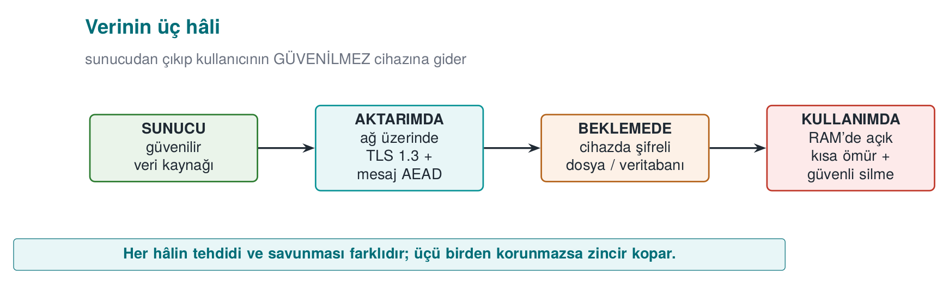
CEN429 Secure Programming · Week 3
The Three States — At a Glance
RTEU Computer Engineering · 2026-2027 Fall
10

Slide 11
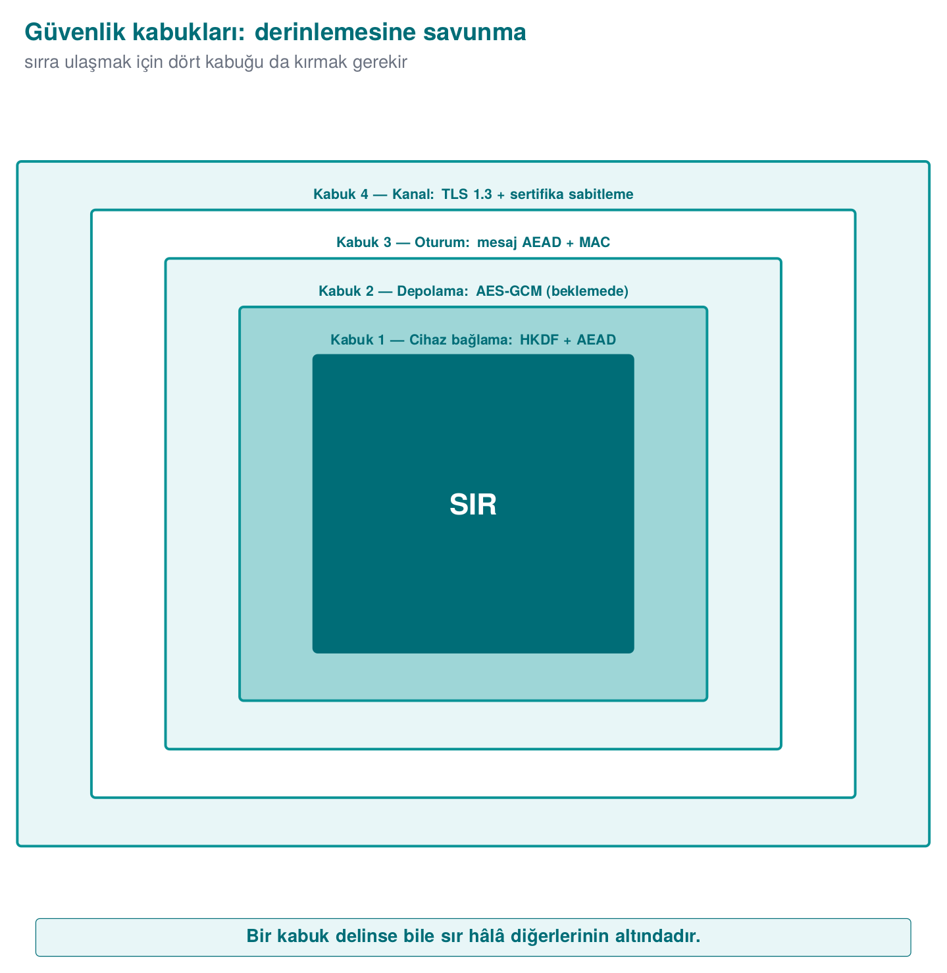
CEN429 Secure Programming · Week 3
Main Idea: The Security Shell
To reach the secret, the attacker must break all of them in sequence = defence in depth.
RTEU Computer Engineering · 2026-2027 Fall
11

Slide 12
CEN429 Secure Programming · Week 3
Example Architecture: Phone ↔ Server
• Phone: an untrusted environment — the user (i.e., a possible attacker) owns the device; it may be rooted/debugged.
• Server: the trusted party.
• At every interface, ask: which data, which state, how is identity verified, confidentiality or integrity?
RTEU Computer Engineering · 2026-2027 Fall
12
Notes:
Speaker note: These three questions are exactly what today's demos answer.

Slide 13
CEN429 Secure Programming · Week 3
2. Encryption Fundamentals
RTEU Computer Engineering · 2026-2027 Fall
13

Slide 14
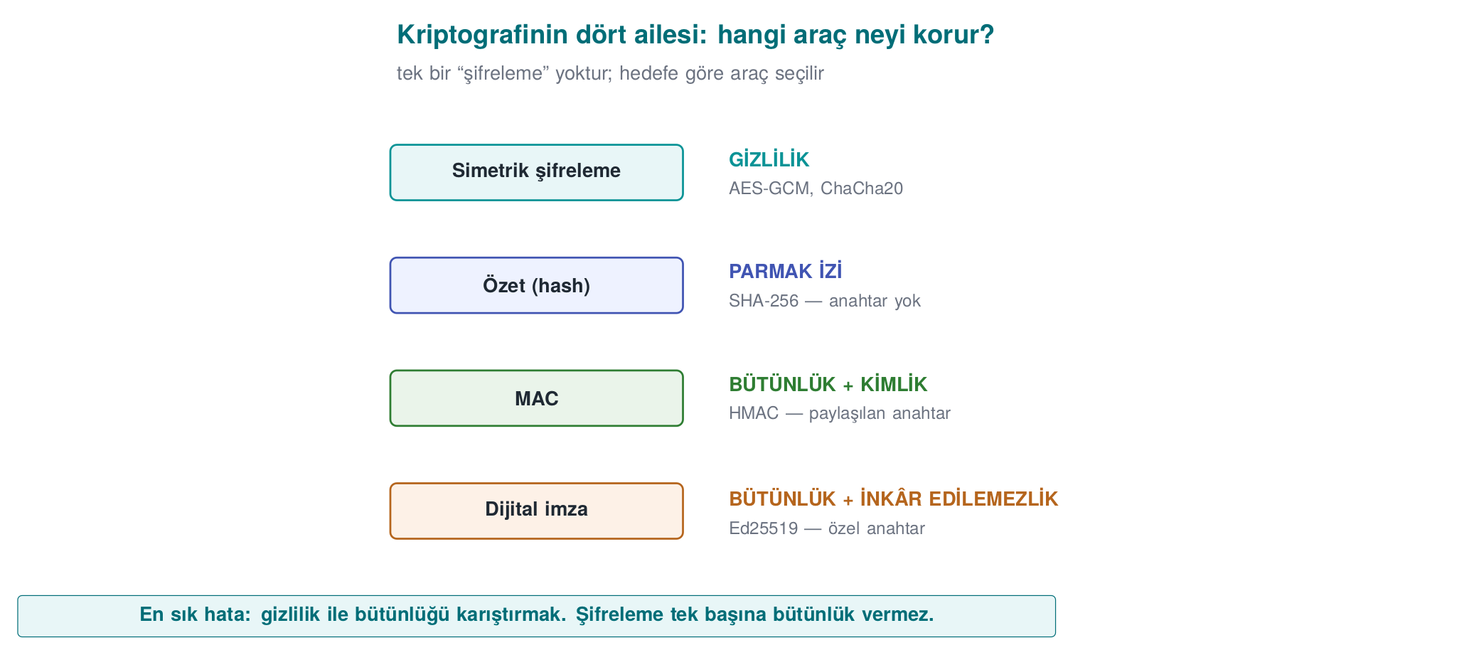
CEN429 Secure Programming · Week 3
The Four Families of Cryptography — Diagram
RTEU Computer Engineering · 2026-2027 Fall
14

Slide 15
CEN429 Secure Programming · Week 3
Cryptography Isn't One Thing
• Encryption, briefly: turning plaintext into unreadable ciphertext with a key; decryption reverses this with the same (or a matching) key; security rests on the key's secrecy.
• Different tools exist for different goals.
• The four most commonly confused families: encryption, hash, MAC, signature.
• Which gives confidentiality, which gives integrity, which gives both?
RTEU Computer Engineering · 2026-2027 Fall
15
Notes:
Speaker note: Students usually think "I encrypted it = it's safe." This section breaks that misconception from the start.

Slide 16
CEN429 Secure Programming · Week 3
Which Tool Protects What?
Tool | Provides | Example
Symmetric encryption | Confidentiality | AES, ChaCha20
Asymmetric encryption | Confidentiality + key distribution | RSA, EC
Hash | Fingerprint (keyless) | SHA-256
MAC | Integrity + identity (shared key) | HMAC
Signature | + non-repudiation | Ed25519
AEAD | Confidentiality + integrity together | AES-GCM
❌ Encrypting alone doesn't give integrity · ❌ Don't write your own algorithm (Kerckhoffs)
RTEU Computer Engineering · 2026-2027 Fall
16

Slide 17
CEN429 Secure Programming · Week 3
The Two Most Common Mistakes
1. Encrypting alone, forgetting integrity. Ciphertext (e.g., AES-CTR) doesn't stop an attacker from flipping bits undetected.
2. Writing your own cipher/mode. Kerckhoffs's principle: security rests on the key's secrecy, not the algorithm's.
Use standard, proven constructions; homemade crypto is broken almost every time.
RTEU Computer Engineering · 2026-2027 Fall
17

Slide 18
CEN429 Secure Programming · Week 3
Why Isn't Symmetric Enough On Its Own?
• Symmetric (AES): very fast.
• But both parties need to know the same secret key.
• How do you share that key over an insecure network?
The answer is on the next slide.
RTEU Computer Engineering · 2026-2027 Fall
18

Slide 19
CEN429 Secure Programming · Week 3
What Does Asymmetric Solve, What Does It Cost?
• Asymmetric (RSA/EC): everyone has a public (distributed) and a private (secret) key.
• It solves the key-distribution problem.
• But operations are slow; not suitable for large data (100–1000× slower).
RTEU Computer Engineering · 2026-2027 Fall
19

Slide 20
CEN429 Secure Programming · Week 3
Hybrid: Both Together
• Hybrid: asymmetric crypto carries a small symmetric key; the data is then encrypted with it using AEAD.
• Real systems always work this way.
This is exactly what TLS does: a session key via ECDHE → traffic with AES-GCM.
RTEU Computer Engineering · 2026-2027 Fall
20
Notes:
Speaker note: A 1 GB file isn't encrypted with RSA. Asymmetric only carries the key. Make this distinction clear.

Slide 21
CEN429 Secure Programming · Week 3
Symmetric vs. Asymmetric — Comparison
Property | Symmetric (AES) | Asymmetric (RSA/EC)
Speed | Very fast | Slow (100–1000×)
Key | Single, shared secret | Public/private pair
Use | Encrypting large data | Key transport, signatures
This week | File/DB/session | TLS key setup (Week 10)
RTEU Computer Engineering · 2026-2027 Fall
21

Slide 22
CEN429 Secure Programming · Week 3
What Is a Block Cipher?
• Block cipher: an algorithm that encrypts data in fixed-size blocks.
• AES: encrypts one 16-byte block at a time.
• Data longer than a block needs a mode (mode of operation).
RTEU Computer Engineering · 2026-2027 Fall
22

Slide 23
CEN429 Secure Programming · Week 3
Block or Stream? The Mode Matters
AES is a block cipher (16 bytes). Longer data needs a mode:
Mode | Status
ECB | ❌ leaks patterns (Demo 3)
CBC | needs a random IV, no integrity on its own
CTR | turns it into a stream, very sensitive to nonce reuse (Demo 2)
GCM | ✅ CTR + MAC = AEAD
RTEU Computer Engineering · 2026-2027 Fall
23

Slide 24
CEN429 Secure Programming · Week 3
ChaCha20: A Stream Cipher
• Stream cipher: no block concept; generates a keystream the same length as the data and XORs it.
• ChaCha20 is already a stream cipher.
• + Poly1305 MAC = AEAD (ChaCha20-Poly1305, RFC 8439).
Same result: confidentiality + integrity in one package.
RTEU Computer Engineering · 2026-2027 Fall
24

Slide 25
CEN429 Secure Programming · Week 3
Hash (Digest): A One-Way Fingerprint
• Keyless. Only shows whether the data has changed.
• An attacker can change the data and recompute the digest too.
• So a digest alone is not proof of integrity.
• Old MD5/SHA-1 are collision-prone; use SHA-256/SHA-3.
RTEU Computer Engineering · 2026-2027 Fall
25

Slide 26
CEN429 Secure Programming · Week 3
MAC: Integrity with a Shared Key
• MAC (e.g., HMAC-SHA-256): requires a shared secret key.
• It says, "someone who knows the key sent this message, and it hasn't changed."
• Since both parties know the key, a MAC does not provide non-repudiation.
• MAC comparison must be constant-time (CRYPTO_memcmp), not plain memcmp.
RTEU Computer Engineering · 2026-2027 Fall
26

Slide 27
CEN429 Secure Programming · Week 3
Signature: Non-Repudiation
• Digital signature (Ed25519, RSA-PSS): works with a public/private key pair.
• Only the private-key holder can produce a signature; anyone can verify it with the public key.
• That's why it provides non-repudiation.
• Certificates and release signing (Week 10) rely on this.
RTEU Computer Engineering · 2026-2027 Fall
27

Slide 28
CEN429 Secure Programming · Week 3
Hash / MAC / Signature: Which One, When?
Question | Tool
"Is the file corrupted?" (keyless) | Hash (SHA-256)
"Did someone who knows the key send it, unchanged?" | MAC (HMAC)
"Definitely this person signed it, they can't deny it" | Signature (Ed25519)
"Keep it secret AND prove its integrity" | AEAD (AES-GCM)
⚠️ A digest alone is not proof of integrity (the attacker can recompute it too).
RTEU Computer Engineering · 2026-2027 Fall
28

Slide 29
CEN429 Secure Programming · Week 3
AEAD Is Usually the Right Answer
• Instead of wiring up "encrypt + add a MAC" separately, use AEAD.
• It does both jobs in one call, in the right order (encrypt-then-MAC), with fewer chances for error.
• A separate MAC is needed only for data that won't be encrypted but still needs integrity (or via AEAD's AAD field).
RTEU Computer Engineering · 2026-2027 Fall
29

Slide 30
CEN429 Secure Programming · Week 3
What Is Demo 1?
• Demo 1 · `code/week-03/01-aes-gcm-file` — AEAD, NIST SP 800-38D.
• Encrypts a file with AES-256-GCM.
• Output format: [12-byte nonce][ciphertext][16-byte tag].
• Then we see that flipping one byte of the ciphertext, and of the tag alone, causes decryption to be rejected.
RTEU Computer Engineering · 2026-2027 Fall
30

Slide 31
CEN429 Secure Programming · Week 3
Demo 1 — Code
crypto_random(nonce, 12); /* a fresh nonce per message */
crypto_gcm_encrypt(key, nonce, 12, NULL, 0,
plain, plain_len, ct+12, tag);
int ok = crypto_gcm_decrypt(key, nonce, 12, NULL, 0, ct, ct_len, tag, plain);
if (!ok) { /* REJECT */ }
RTEU Computer Engineering · 2026-2027 Fall
31

Slide 32
CEN429 Secure Programming · Week 3
Demo 1 — Real Output
STEP 3 Decrypted and VERIFIED (54 bytes)
STEP 4 ciphertext byte changed -> VERIFICATION FAILED, REJECTED
STEP 5 only the tag changed -> REJECTED
RTEU Computer Engineering · 2026-2027 Fall
32

Slide 33
CEN429 Secure Programming · Week 3
Demo 1 — Steps 2 and 3: Nonce, Correct Decryption
• Step 2: A random 12-byte nonce was generated and written to the start of the file.
• The nonce is not secret (it sits in the clear in the file); it only needs to be unique.
• Step 3: Decrypted with the same key and nonce; the tag held, and the plaintext came back.
RTEU Computer Engineering · 2026-2027 Fall
33

Slide 34
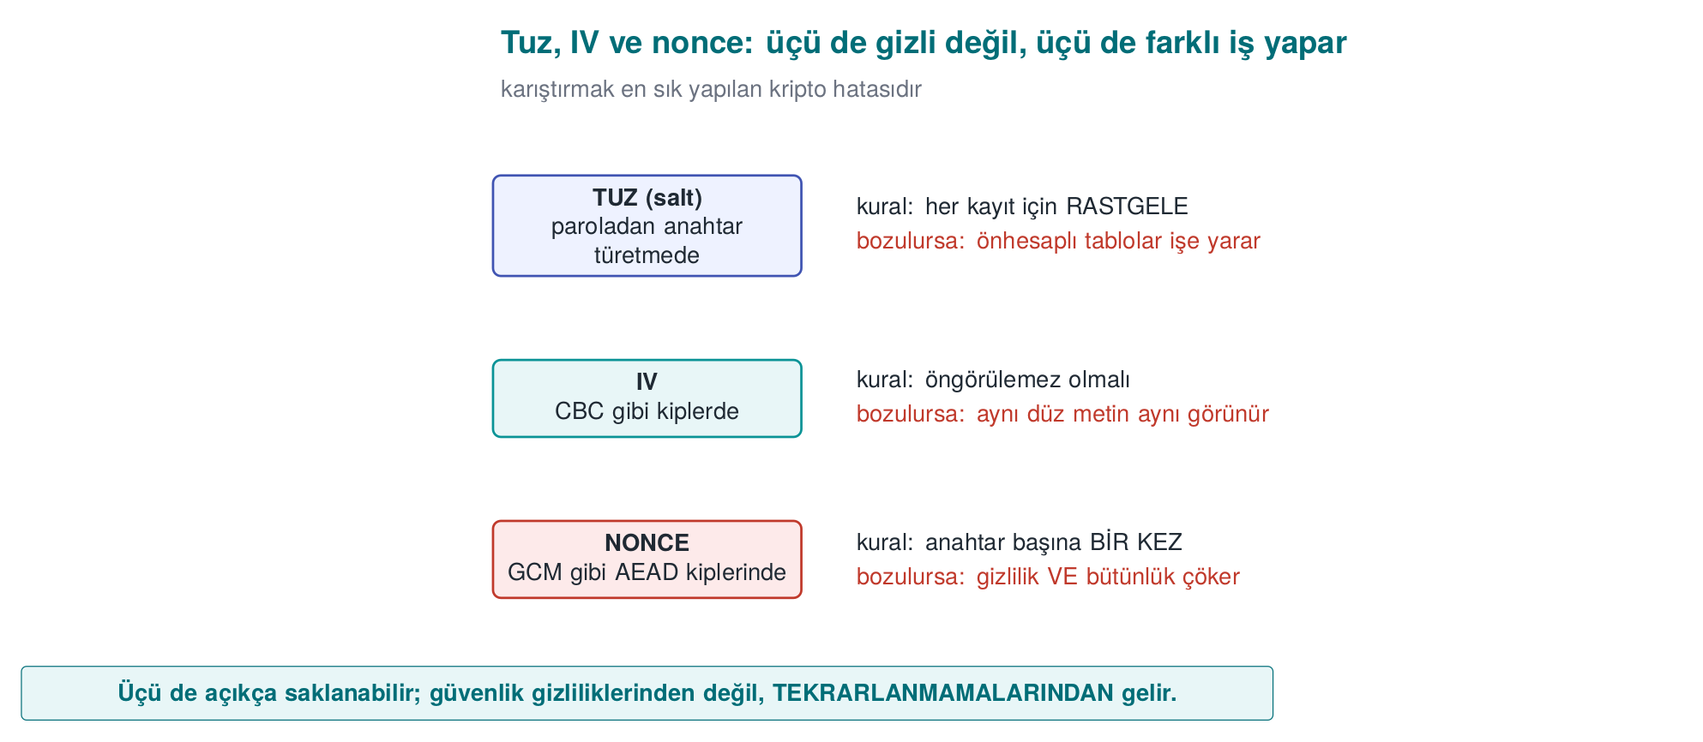
CEN429 Secure Programming · Week 3
Salt, IV, Nonce — Diagram
RTEU Computer Engineering · 2026-2027 Fall
34

Slide 35
CEN429 Secure Programming · Week 3
Demo 1 — Steps 4 and 5: Tampering → Rejection
• Step 4: Byte 20 of the ciphertext was XORed with a change. Since the GCM tag is computed over the whole ciphertext, even a single byte breaks the tag → decryption rejected.
• Step 5: This time only the tag was touched; also rejected.
• The tag is computed together with the data and the key; an attacker can't produce it without the key.
RTEU Computer Engineering · 2026-2027 Fall
35

Slide 36
CEN429 Secure Programming · Week 3
Demo 1 — Rule
✅ If you're encrypting something, use AEAD (AES-GCM / ChaCha20-Poly1305) ✅ A unique nonce for every message ✅ Always verify the tag; produce no output at all on failure (fail-closed) ✅ Don't leave integrity to a separate step
RTEU Computer Engineering · 2026-2027 Fall
36
Notes:
Speaker note: "The evaluator changes one byte and checks whether the app silently returns wrong data anyway." Recipe 6.18 in the textbook → AEAD.

Slide 37
CEN429 Secure Programming · Week 3
Demo 1 — Common-Mistakes Checklist
•
•
•
•
•
RTEU Computer Engineering · 2026-2027 Fall
37
Notes:
Speaker note: The evaluator also checks that encrypting the same plaintext twice gives different ciphertexts (no nonce reuse).

Slide 38
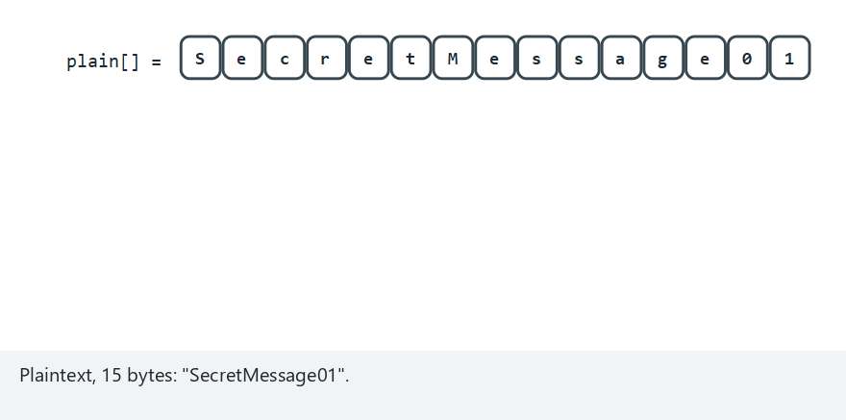
CEN429 Secure Programming · Week 3
AES-GCM: encryption and tag verification (animation)
RTEU Computer Engineering · 2026-2027 Fall
38
Notes:
Speaker note: Show the [nonce][ciphertext][tag] file layout and how the tag holds on a correct decrypt.

Slide 39
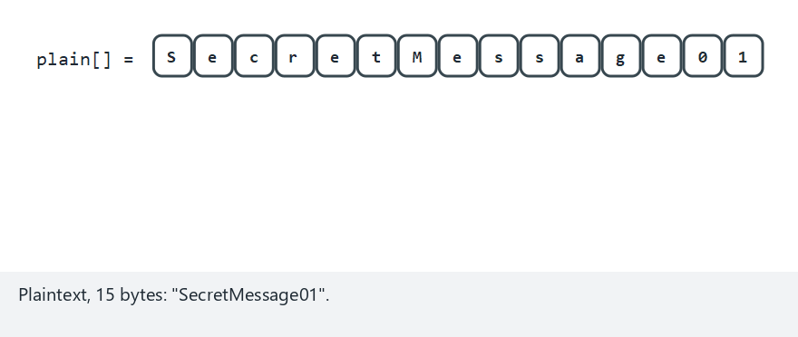
CEN429 Secure Programming · Week 3
AES-GCM — edge case: ciphertext tampered
RTEU Computer Engineering · 2026-2027 Fall
39
Notes:
Speaker note: Show that a single changed byte makes the recomputed tag disagree, and decryption is rejected.

Slide 40
CEN429 Secure Programming · Week 3
3. Random Numbers and Crypto APIs
RTEU Computer Engineering · 2026-2027 Fall
40

Slide 41
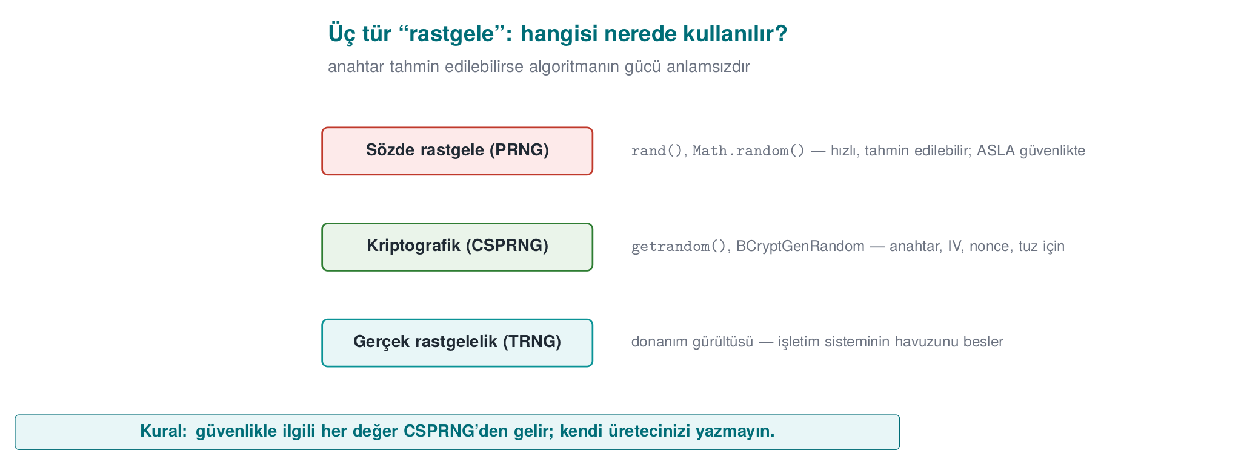
CEN429 Secure Programming · Week 3
Three Kinds of Randomness — Diagram
RTEU Computer Engineering · 2026-2027 Fall
41

Slide 42
CEN429 Secure Programming · Week 3
Why Does Randomness Matter So Much?
• Key, IV, nonce, salt, session ID — all rest on a single assumption: unpredictability.
• If the world's best encryption algorithm gets its key from a predictable generator, it protects nothing.
• In this section we'll look at the wrong ways first, then the right way.
RTEU Computer Engineering · 2026-2027 Fall
42

Slide 43
CEN429 Secure Programming · Week 3
Three Kinds of "Random"
Kind | Example | Predictable? | Use
Statistical | rand(), mt19937, Java Random | Yes | Games, simulation
Cryptographic (CSPRNG) | getrandom, BCryptGenRandom, RAND_bytes | No | Keys, IVs, nonces, salts, tokens
True (entropy) | Hardware noise | No | Seeding a CSPRNG
Rule: every security-relevant random value comes from a CSPRNG
Anyone who sees 624 outputs of mt19937 can compute every output after that
RTEU Computer Engineering · 2026-2027 Fall
43

Slide 44
CEN429 Secure Programming · Week 3
Mistake 1 — Seeding with Time
srand(time(NULL));
unsigned char key[16];
for (int i = 0; i < 16; i++)
key[i] = rand() & 0xFF;
If an attacker knows which day the key was generated, there are only 86,400 possible seeds for that day. A laptop tries them all in seconds.
RTEU Computer Engineering · 2026-2027 Fall
44

Slide 45
CEN429 Secure Programming · Week 3
Mistake 2 — Accidentally Wiping Out Entropy
The Debian OpenSSL disaster (2008): a packager removed two lines that added entropy to OpenSSL's random pool, to silence a warning.
• For two years, the only entropy source was the process ID (≤ 32,768 values).
• Attackers pre-generated and listed every possible key (CVE-2008-0166).
RTEU Computer Engineering · 2026-2027 Fall
45

Slide 46
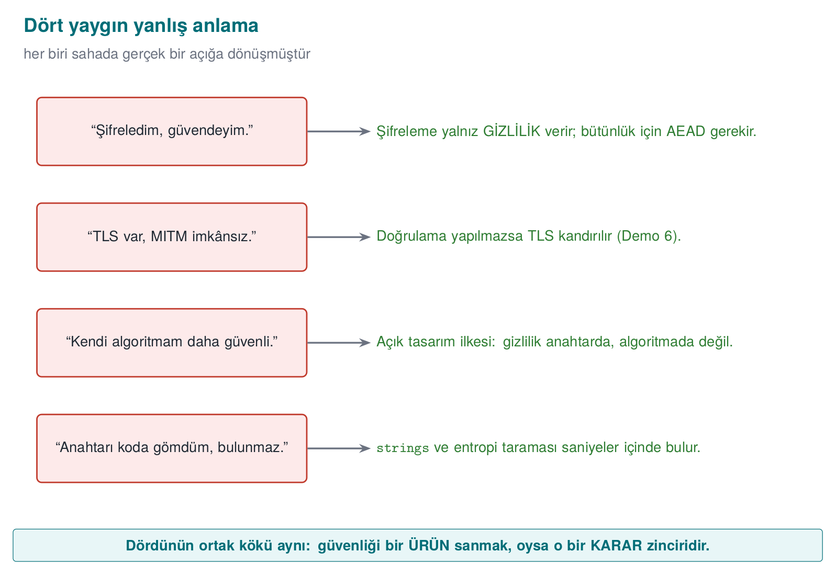
CEN429 Secure Programming · Week 3
Four Common Misconceptions — Diagram
RTEU Computer Engineering · 2026-2027 Fall
46

Slide 47
CEN429 Secure Programming · Week 3
Mistake 2 — Takeaway
➡️ Don't touch cryptographic code without understanding it.
➡️ Statistically testing a random generator's output does not prove its unpredictability.
RTEU Computer Engineering · 2026-2027 Fall
47
Notes:
Speaker note: The Debian incident is one of the most memorable examples in the course; "I deleted two lines, and for two years broken keys were generated" is a compelling narrative.

Slide 48
CEN429 Secure Programming · Week 3
Mistake 3 — Bias When Reducing to a Range
r % 6 looks harmless. If r is uniform over 0–255:
256 = 42*6 + 4
• Values 0–3 come out 43 times each, values 4–5 come out 42 times each.
• Irrelevant for a die roll; increases predictability when generating a password/OTP.
• The correct method is rejection sampling — next slide.
RTEU Computer Engineering · 2026-2027 Fall
48

Slide 49
CEN429 Secure Programming · Week 3
The Right Way: The Operating System's Generator
/* Linux (3.17+ / glibc 2.25+) */
while (n > 0) {
ssize_t r = getrandom(p, n, 0);
if (r < 0) { if (errno == EINTR) continue; return -1; }
p += r; n -= (size_t)r;
}
/* Windows */
BCryptGenRandom(NULL, buf, n, BCRYPT_USE_SYSTEM_PREFERRED_RNG);
/* OpenSSL */
if (RAND_bytes(buf, n) != 1) { /* NEVER continue */ }
⚠️ If you don't check the return value, you'll run with a zero key that you thought was "random"
RTEU Computer Engineering · 2026-2027 Fall
49

Slide 50
CEN429 Secure Programming · Week 3
Why Should You Check the Return Value?
• The random generator can fail.
• If unchecked, the buffer stays uninitialized (or zero).
• The program keeps running with what it thinks is a "random" but is actually a fixed key.
• The only correct behaviour on failure: stop the process.
RTEU Computer Engineering · 2026-2027 Fall
50
Notes:
Speaker note: This is another version of the Debian incident; an unchecked return value can lead to a similar disaster.

Slide 51
CEN429 Secure Programming · Week 3
Unbiased Range with Rejection Sampling
uint32_t random_in_range(uint32_t upper) { /* Recipe 11.11 */
uint32_t threshold = (uint32_t)(-upper) % upper, r; /* 2^32 mod upper */
do random_bytes(&r, sizeof r); while (r < threshold);
return r % upper;
}
Idea: use the largest part of the 2³² values that divides evenly by upper, and discard the remainder.
RTEU Computer Engineering · 2026-2027 Fall
51

Slide 52
CEN429 Secure Programming · Week 3
Random Values — Usage List
Value | Secret? | Unique?
Key | Yes | Yes
GCM nonce (12 B) | No | Never repeats (random: ≤ 2³² messages/key)
CBC IV | No | Unpredictable
Salt · Session token | No · Yes | Yes
RTEU Computer Engineering · 2026-2027 Fall
52
Notes:
Speaker note: Diagram requirement: the call to the random-number source must not be hookable. In the field, a client doesn't generate the payment random number; the native side only uses it to fill memory.

Slide 53
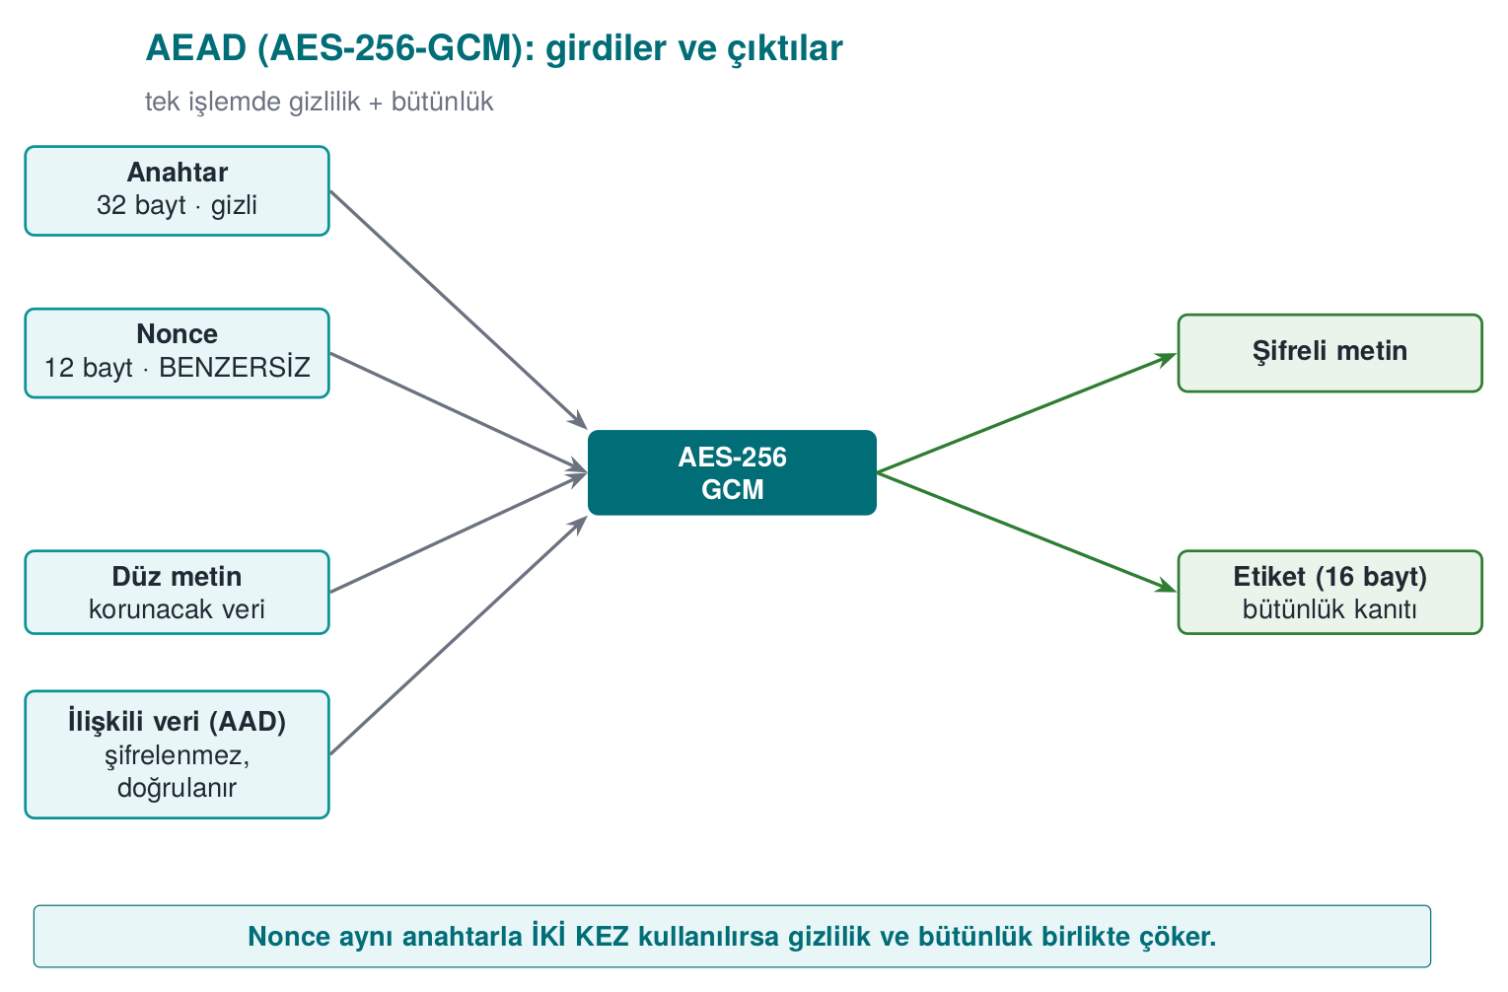
CEN429 Secure Programming · Week 3
AEAD: Four Inputs, Two Outputs
AAD: not encrypted, but if it's changed the tag won't hold — file header, version, record ID
Week 1's "Vault": derivation parameters as AAD → the iteration count can't be changed
RTEU Computer Engineering · 2026-2027 Fall
53

Slide 54
CEN429 Secure Programming · Week 3
Now Let's Open Up the Crypto API
• In Demo 1 we left the work to ready-made helper functions.
• Now we'll write OpenSSL's EVP interface line by line.
• Goal: see where mistakes can happen when using the library.
• The rule still applies: you don't write your own algorithm, but calling a ready-made algorithm correctly is also a skill.
RTEU Computer Engineering · 2026-2027 Fall
54

Slide 55
CEN429 Secure Programming · Week 3
EVP Encryption — Step 1: Choose the Algorithm
EVP_EncryptInit_ex(ctx, EVP_aes_256_gcm(), NULL, NULL, NULL);
• Choose the algorithm (AES-256-GCM).
• Don't give the key and nonce yet — that's the next step.
RTEU Computer Engineering · 2026-2027 Fall
55

Slide 56
CEN429 Secure Programming · Week 3
EVP Encryption — Step 2: Nonce Length
EVP_CIPHER_CTX_ctrl(ctx, EVP_CTRL_GCM_SET_IVLEN, 12, NULL);
• Set the nonce (IV) length.
• The recommended value for GCM is 12 bytes; that's also the default, but writing it explicitly is good practice.
RTEU Computer Engineering · 2026-2027 Fall
56

Slide 57
CEN429 Secure Programming · Week 3
EVP Encryption — Step 3: Key + Nonce
EVP_EncryptInit_ex(ctx, NULL, NULL, key, nonce);
• Give the key and the nonce now.
• The spots left NULL in the first Init call are filled in here.
RTEU Computer Engineering · 2026-2027 Fall
57

Slide 58
CEN429 Secure Programming · Week 3
EVP Encryption — Step 4: AAD
EVP_EncryptUpdate(ctx, NULL, &n, aad, aad_n);
• Give the AAD: the output buffer is `NULL`.
• The AAD is not encrypted, it only goes into the tag (file header, version, record ID).
RTEU Computer Engineering · 2026-2027 Fall
58

Slide 59
CEN429 Secure Programming · Week 3
EVP Encryption — Step 5: Encrypt the Data
EVP_EncryptUpdate(ctx, ciphertext, &n, plain, plain_n);
• Encrypt the plaintext.
• For large data, this step can be repeated in chunks.
RTEU Computer Engineering · 2026-2027 Fall
59

Slide 60
CEN429 Secure Programming · Week 3
EVP Encryption — Step 6: Finalize (MANDATORY)
EVP_EncryptFinal_ex(ctx, ciphertext + n, &n);
• Because GCM runs in stream mode, there is no padding; this call usually writes 0 bytes.
• But calling it is mandatory: the tag is computed here.
RTEU Computer Engineering · 2026-2027 Fall
60

Slide 61
CEN429 Secure Programming · Week 3
EVP Encryption — Step 7: Get the Tag
EVP_CIPHER_CTX_ctrl(ctx, EVP_CTRL_GCM_GET_TAG, 16, tag);
• Get the tag and store it along with the ciphertext.
RTEU Computer Engineering · 2026-2027 Fall
61

Slide 62
CEN429 Secure Programming · Week 3
Seven Steps — Together
EVP_EncryptInit_ex(ctx, EVP_aes_256_gcm(), NULL, NULL, NULL); /* 1 algorithm */
EVP_CIPHER_CTX_ctrl(ctx, EVP_CTRL_GCM_SET_IVLEN, 12, NULL); /* 2 nonce length */
EVP_EncryptInit_ex(ctx, NULL, NULL, key, nonce); /* 3 key+nonce */
EVP_EncryptUpdate(ctx, NULL, &n, aad, aad_n); /* 4 AAD (no output) */
EVP_EncryptUpdate(ctx, ciphertext, &n, plain, plain_n); /* 5 data */
EVP_EncryptFinal_ex(ctx, ciphertext + n, &n); /* 6 finish: MANDATORY */
EVP_CIPHER_CTX_ctrl(ctx, EVP_CTRL_GCM_GET_TAG, 16, tag); /* 7 tag */
Every call's return value is checked · a single exit point (goto done) · EVP_CIPHER_CTX_free
RTEU Computer Engineering · 2026-2027 Fall
62

Slide 63
CEN429 Secure Programming · Week 3
Decryption — Steps 1–2: Open, Set the Tag
EVP_DecryptUpdate(ctx, plain, &n, ciphertext, ciphertext_n); /* WRITES the plaintext... */
EVP_CIPHER_CTX_ctrl(ctx, EVP_CTRL_GCM_SET_TAG, 16, tag); /* BEFORE Final */
• DecryptUpdate writes the plaintext to the buffer immediately — it isn't verified yet!
• The expected tag is given before Final.
RTEU Computer Engineering · 2026-2027 Fall
63

Slide 64
CEN429 Secure Programming · Week 3
Decryption — Step 3: The Mandatory Final Check
if (EVP_DecryptFinal_ex(ctx, plain + n, &n) != 1) { /* the tag is verified HERE */
OPENSSL_cleanse(plain, ciphertext_n); /* wipe the half-decrypted data */
return -1;
}
Windows CNG: BCryptDecrypt → STATUS_AUTH_TAG_MISMATCH (0xC000A002)
🚨 The most common AEAD mistake: using the buffer's contents without checking Final's return value
RTEU Computer Engineering · 2026-2027 Fall
64

Slide 65
CEN429 Secure Programming · Week 3
Constant-Time Comparison
unsigned char diff = 0;
for (size_t i = 0; i < n; i++) diff |= a[i] ^ b[i]; /* always walk every byte */
return diff == 0; /* ≈ CRYPTO_memcmp */
memcmp stops at the first differing byte; the timing leaks how many bytes were correct. Ready-made alternatives: CRYPTO_memcmp, sodium_memcmp.
RTEU Computer Engineering · 2026-2027 Fall
65

Slide 66
CEN429 Secure Programming · Week 3
Checklist for Using a Crypto Library
• stop
• before use
• memcmp)
• oracle)
•
RTEU Computer Engineering · 2026-2027 Fall
66
Notes:
Speaker note: Field guides contain an algorithm inventory table. A few years back these inventories showed SHA-1 and CBC with a separate MAC; today they show SHA-256 and AEAD.

Slide 67
CEN429 Secure Programming · Week 3
In the Field: The Algorithm Inventory
• Real product guides include an algorithm inventory: every algorithm, its purpose, its key size.
• A good critical-reading exercise: old inventories show SHA-1 or CBC with a separate MAC.
• An inventory written today should show SHA-256 and AEAD instead.
RTEU Computer Engineering · 2026-2027 Fall
67

Slide 68
CEN429 Secure Programming · Week 3
How Does an Evaluator Test This?
• Compares the algorithm inventory against the source code.
• Examines nonce generation and repetition.
• Feeds back tampered ciphertext with one bit changed; confirms the application rejects it without a detailed error.
• Looks for memcmp in MAC comparisons.
RTEU Computer Engineering · 2026-2027 Fall
68

Slide 69
CEN429 Secure Programming · Week 3
4. IV / Nonce / Salt
RTEU Computer Engineering · 2026-2027 Fall
69

Slide 70
CEN429 Secure Programming · Week 3
All Three Are NOT Secret, But...
Concept | Where | Rule | If Broken
Salt | Key from password | random, per record | rainbow table
IV | CBC | random, unpredictable | first block leaks
Nonce | CTR/GCM | must never repeat with the key | keystream leaks
The only thing that's secret is the key.
RTEU Computer Engineering · 2026-2027 Fall
70

Slide 71
CEN429 Secure Programming · Week 3
Why Is Nonce Reuse a Disaster?
CTR/GCM: C = P ⊕ KS(key, nonce)
The same key and the same nonce in two messages:
C1 = P1 ⊕ AA C2 = P2 ⊕ AA
C1 ⊕ C2 = P1 ⊕ P2 <-- the keystream is gone!
The attacker obtains the XOR of two plaintexts. If they know one, they decrypt the other.
Real incidents: WEP's short IV, Sony PS3's repeated signature value.
RTEU Computer Engineering · 2026-2027 Fall
71

Slide 72
CEN429 Secure Programming · Week 3
Demo 2 — Nonce Reuse Leaks Data
BAD CASE (same nonce):
C1 xor C2 = 151b00000f4b42030906070d16000807 ... 44404015
P1 xor P2 = 151b00000f4b42030906070d16000807 ... 44404015 <-- SAME = leaked
P2 = (C1 xor C2) xor P1 = "Total balance is 45000, PIN is 1234"
GOOD CASE (different nonce):
C1 xor C2 != P1 xor P2 <-- no leak
✅ Generate the nonce randomly or as a persistent counter; never repeat it.
RTEU Computer Engineering · 2026-2027 Fall
72

Slide 73
CEN429 Secure Programming · Week 3
Demo 2 — Rule (Continued)
• A random nonce is practical; but with many messages under the same key (NIST recommendation: ≤ 2³²), the birthday-bound probability kicks in.
• Alternative: make the nonce a counter — but the counter must be stored persistently (not reset when the device restarts).
• Real incidents: WEP's short IV, Sony PS3's repeated random value in ECDSA (the private key was extracted).
RTEU Computer Engineering · 2026-2027 Fall
73

Slide 74
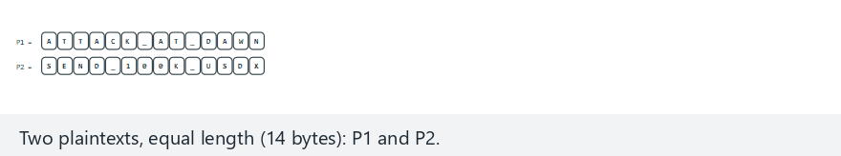
CEN429 Secure Programming · Week 3
The danger of nonce reuse (animation)
RTEU Computer Engineering · 2026-2027 Fall
74
Notes:
Speaker note: Show that C1 xor C2 equals P1 xor P2, and that an attacker who knows one message recovers the other.

Slide 75
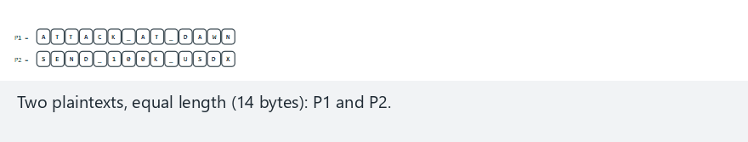
CEN429 Secure Programming · Week 3
Nonce reuse — edge case: different nonce, no leak
RTEU Computer Engineering · 2026-2027 Fall
75
Notes:
Speaker note: With the same two messages but different nonces, show the relation disappearing entirely.

Slide 76
CEN429 Secure Programming · Week 3
Demo 3 — ECB Leaks a Pattern ("the Penguin")
Original AES-128-ECB AES-256-GCM
######## ================ : -..--+%%*-:*
# ## ## =##==####====## *.#*##:*%+###:
# ##### =##=====##==### :+ .- .% +.#%=
######## ================ =%+## #:###%+%
❌ ECB: the same block → the same ciphertext block, the shape stays readable ✅ GCM/CTR: every block differs → noise
RTEU Computer Engineering · 2026-2027 Fall
76
Notes:
Speaker note: The ASCII version of the famous "ECB penguin" example. In code review, every occurrence of 'ecb' is a finding.

Slide 77
CEN429 Secure Programming · Week 3
ECB — Rule
✅ Don't use ECB. For encryption, use AEAD (GCM, ChaCha20-Poly1305); for disk, use XTS-AES.
Every occurrence of ecb in code review is a finding. An evaluator can catch ECB automatically by looking for repeated 16-byte blocks in the same plaintext.
RTEU Computer Engineering · 2026-2027 Fall
77

Slide 78
CEN429 Secure Programming · Week 3
This Section's Rule
• Salt, IV, nonce: none of them is secret, but each requires a different kind of non-repetition.
• A nonce must never repeat with the same key.
• ECB is forbidden. Choosing a mode is a security decision.
RTEU Computer Engineering · 2026-2027 Fall
78
Notes:
Speaker note: These three concepts are among the most confused on the exam; reinforce the "secret vs. unique" distinction.

Slide 79
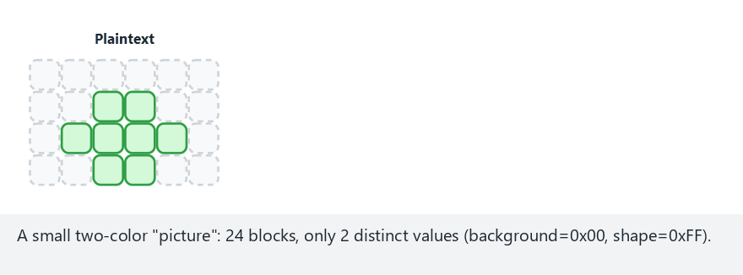
CEN429 Secure Programming · Week 3
ECB leaks the pattern, GCM does not (animation)
RTEU Computer Engineering · 2026-2027 Fall
79
Notes:
Speaker note: Encrypt the small picture live and show the shape stay readable under ECB, then vanish under GCM.

Slide 80
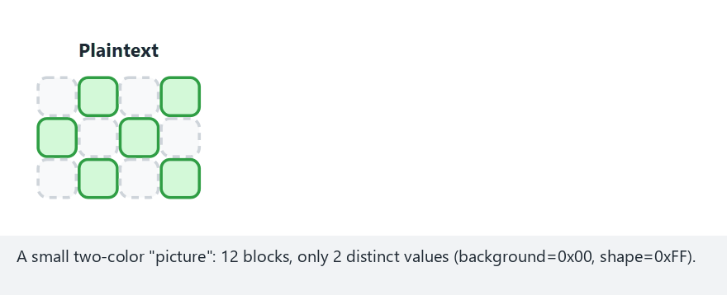
CEN429 Secure Programming · Week 3
ECB — edge case: checkerboard
RTEU Computer Engineering · 2026-2027 Fall
80
Notes:
Speaker note: Even on a checkerboard, show that the ECB output only ever has 2 distinct values.

Slide 81
CEN429 Secure Programming · Week 3
5. Deriving a Key from a Password
RTEU Computer Engineering · 2026-2027 Fall
81

Slide 82
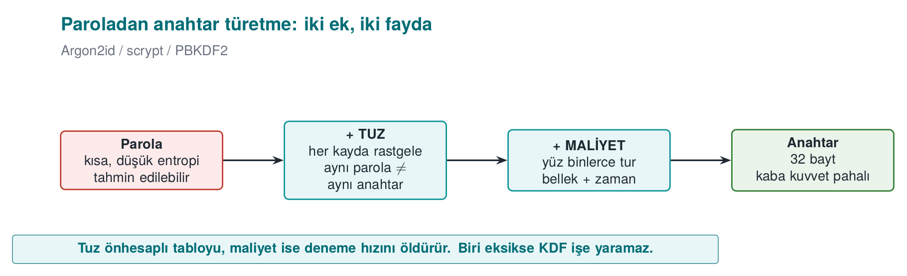
CEN429 Secure Programming · Week 3
Deriving a Key from a Password — Diagram
RTEU Computer Engineering · 2026-2027 Fall
82

Slide 83
CEN429 Secure Programming · Week 3
Why Can't a Password Be a Key Directly?
• A password is short, low-entropy, and predictable.
• Made directly into a key, brute force becomes cheap.
• Solution: a key derivation function from a password (KDF).
• KDFs in general: you can derive a key not only from a password but also from a master secret — we'll see this in Section 6 (HKDF).
RTEU Computer Engineering · 2026-2027 Fall
83

Slide 84
CEN429 Secure Programming · Week 3
A KDF Does Two Jobs
1. Salt: random → rainbow tables are useless, matching passwords aren't obvious
2. Slowness: hundreds of thousands of rounds → every attempt is expensive, brute force slows down
KDF | Cost | When
PBKDF2 | CPU (rounds) | compatibility/FIPS
scrypt | CPU + memory | memory-hard
Argon2id | CPU + memory + parallelism | first choice
RTEU Computer Engineering · 2026-2027 Fall
84

Slide 85
CEN429 Secure Programming · Week 3
Demo 4 — Round Count, Timing, Salt
1) SALT: same password + same salt -> SAME key
same password + DIFFERENT salt -> DIFFERENT key
2) ROUNDS vs TIME (WSL):
rounds = 1000 -> 0.37 ms
rounds = 100000 -> 39.05 ms
rounds = 600000 -> 209.55 ms <-- OWASP 2023 minimum
rounds =2000000 -> 628.42 ms
RTEU Computer Engineering · 2026-2027 Fall
85

Slide 86
CEN429 Secure Programming · Week 3
Demo 4 — The Effect of the Salt
• Same password + same salt → the same key every time.
• If the salt is fixed, an attacker can build one table and search everyone.
• Same password + different salt → a completely different key.
➡️ The salt must be random and unique for every record.
RTEU Computer Engineering · 2026-2027 Fall
86

Slide 87
CEN429 Secure Programming · Week 3
Demo 4 — The Effect of Cost
• As the round count went from 1,000 to 2,000,000, the time went from ~0.4 ms to ~628 ms.
• This is a direct multiplier: every attempt by the attacker gets that much more expensive too.
• "200 ms at user login" is acceptable; for an attacker, it means thousands of attempts instead of billions.
RTEU Computer Engineering · 2026-2027 Fall
87
Notes:
Speaker note: Argon2id additionally requires memory; it makes parallel brute force with a GPU/ASIC harder than PBKDF2 does.

Slide 88
CEN429 Secure Programming · Week 3
Demo 4 — Rule
✅ Random salt + Argon2id (or high-round PBKDF2). ❌ Plain/unsalted SHA-256.
RTEU Computer Engineering · 2026-2027 Fall
88
Notes:
Speaker note: 200 ms is acceptable to the user; for an attacker it means thousands of attempts instead of billions.

Slide 89
CEN429 Secure Programming · Week 3
Going Further: Pepper
• In addition to the salt, a secret pepper can be added — not stored in the database, but kept in configuration or an HSM.
• If the DB is stolen (as long as the pepper doesn't leak), the digests get one more layer of protection.
• The salt is not secret; the pepper is.
RTEU Computer Engineering · 2026-2027 Fall
89

Slide 90
CEN429 Secure Programming · Week 3
This Section's Rule
• Never make a password a key directly.
• A random salt + a KDF with enough cost (Argon2id preferred).
• Tune the cost to the hardware, and increase it over the years.
RTEU Computer Engineering · 2026-2027 Fall
90

Slide 91
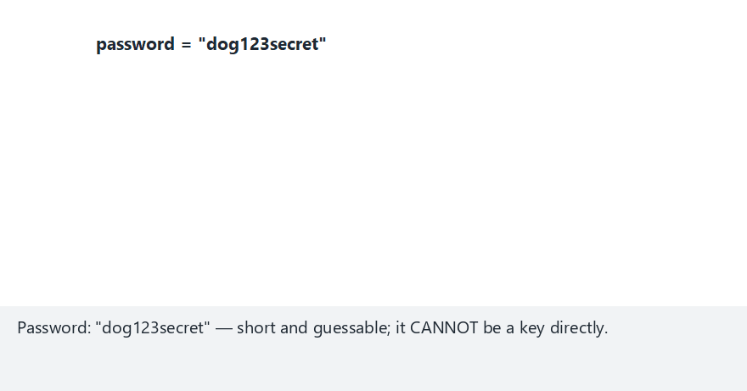
CEN429 Secure Programming · Week 3
Deriving a key from a password: salt and rounds (animation)
RTEU Computer Engineering · 2026-2027 Fall
91
Notes:
Speaker note: Show live that the same password + the same salt gives the same key, and a different salt gives a completely different one.

Slide 92
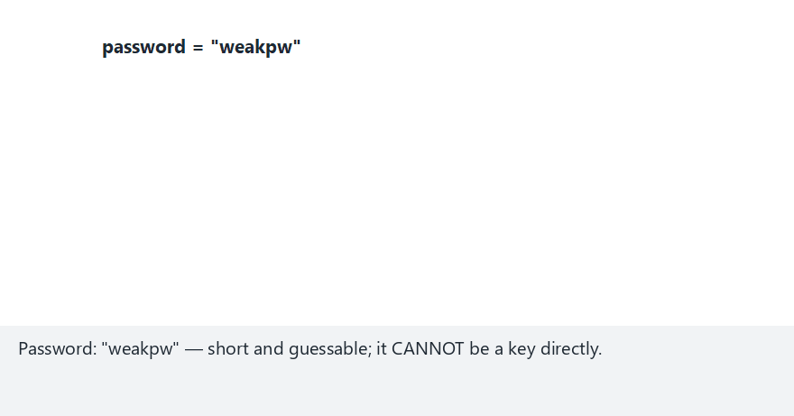
CEN429 Secure Programming · Week 3
PBKDF2 — edge case: a single round
RTEU Computer Engineering · 2026-2027 Fall
92
Notes:
Speaker note: Stress that one round is for illustration only — the real PBKDF2 uses 100,000+ rounds.

Slide 93
CEN429 Secure Programming · Week 3
6. HKDF, Session Keys, Forward Secrecy
RTEU Computer Engineering · 2026-2027 Fall
93

Slide 94
CEN429 Secure Programming · Week 3
Why Not Use the Master Secret Directly?
• A long-lived "master secret" is never used directly.
• Separate keys are derived from it for every purpose and every session.
• The tool: HKDF (RFC 5869) — a two-stage KDF.
RTEU Computer Engineering · 2026-2027 Fall
94

Slide 95
CEN429 Secure Programming · Week 3
HKDF Step 1: Extract
• Input: master secret + salt.
• Output: a uniform pseudorandom key (PRK).
• Goal: compress the irregularity in the raw secret into a uniform key.
RTEU Computer Engineering · 2026-2027 Fall
95

Slide 96
CEN429 Secure Programming · Week 3
HKDF Step 2: Expand
• Input: PRK + an `info` label.
• Output: a key of the requested length.
• Different `info` → different key. From the same PRK, an encryption key, a MAC key, and a session key each come out separately.
RTEU Computer Engineering · 2026-2027 Fall
96

Slide 97
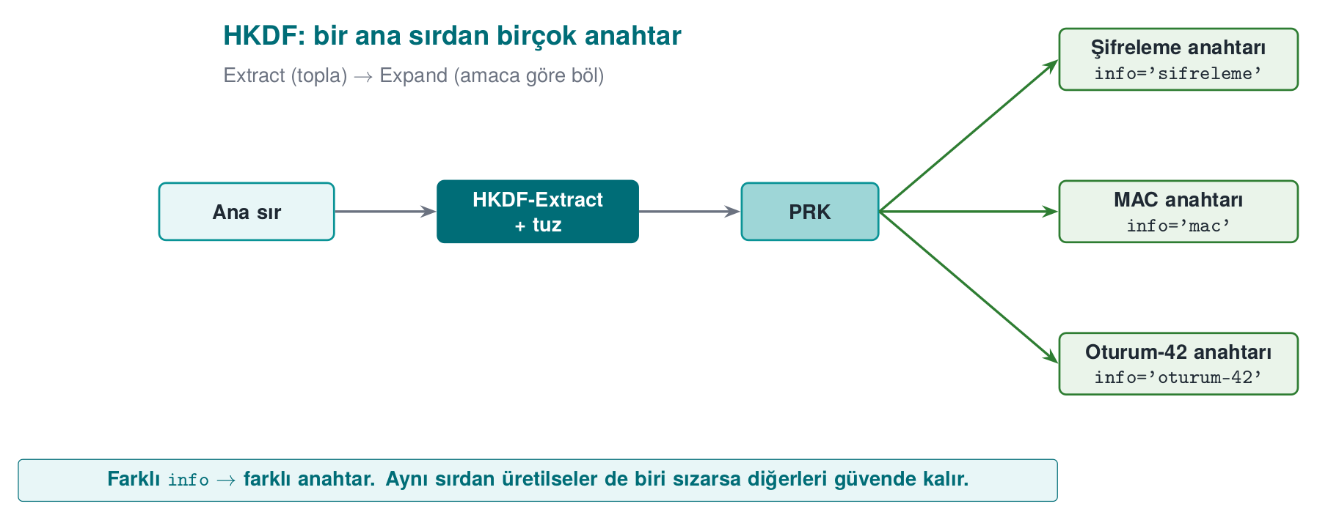
CEN429 Secure Programming · Week 3
HKDF: Derived Keys from a Master Secret
Different info → different key. One purpose's key is never used for another purpose.
RTEU Computer Engineering · 2026-2027 Fall
97

Slide 98
CEN429 Secure Programming · Week 3
What Is Forward Secrecy?
• Forward secrecy: even if today's key leaks, old sessions can't be decrypted.
• A one-way chain: K0 = master secret, Kᵢ = HKDF(Kᵢ₋₁).
• Delete the previous one at every step.
RTEU Computer Engineering · 2026-2027 Fall
98

Slide 99
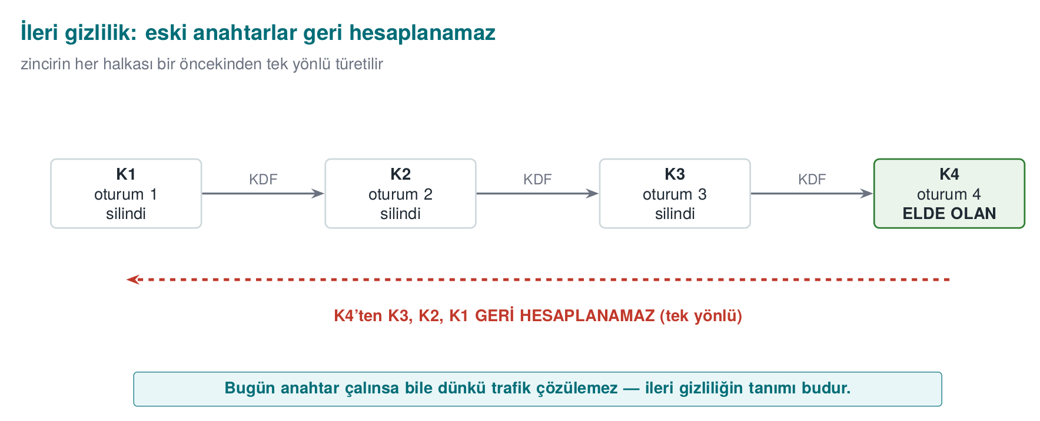
CEN429 Secure Programming · Week 3
Forward Secrecy — Diagram
Even if today's key leaks, old sessions stay safe. Default in TLS 1.3 (with ephemeral ECDHE).
RTEU Computer Engineering · 2026-2027 Fall
99

Slide 100
CEN429 Secure Programming · Week 3
Demo 5 — HKDF Output
info='...encryption...' -> 5a5ed417c87e3566...0d37002cb
info='...MAC...' -> 4c63a348654a076c...0ce1750e6 (different)
FORWARD SECRECY chain:
K1=cbbe8fdd0b6ca8be K2=1113abf7352881e0
K3=a99c7ad8e0e6fb6b K4=4974f0e86d9dcb37
^ the old key is wiped at every step
RTEU Computer Engineering · 2026-2027 Fall
100

Slide 101
CEN429 Secure Programming · Week 3
Demo 5 — Explanation
• From the same master secret, different keys came out with different info values; one purpose's key can't be used for another.
• In the forward-secrecy chain, the previous key was deleted at every step.
• Only K4 remains; since the chain is one-way, K3, K2, K1 can't be recomputed from K4.
RTEU Computer Engineering · 2026-2027 Fall
101

Slide 102
CEN429 Secure Programming · Week 3
Demo 5 — Rule
✅ A separate key per purpose/session · a unique info for every derivation · delete after use.
RTEU Computer Engineering · 2026-2027 Fall
102

Slide 103
CEN429 Secure Programming · Week 3
This Section's Rule
• Derive separate keys from the master secret for each purpose and session.
• Give every derivation a unique info/label.
• Delete short-lived session keys after use.
RTEU Computer Engineering · 2026-2027 Fall
103
Notes:
Speaker note: "Don't run one key through every job" — this section's one-sentence summary.

Slide 104
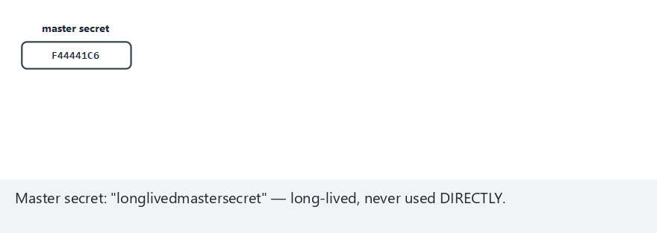
CEN429 Secure Programming · Week 3
HKDF: Extract/Expand and forward secrecy (animation)
RTEU Computer Engineering · 2026-2027 Fall
104
Notes:
Speaker note: Show two different keys deriving from the same PRK with two different info labels, then the forward-secrecy chain wiping the old key.

Slide 105
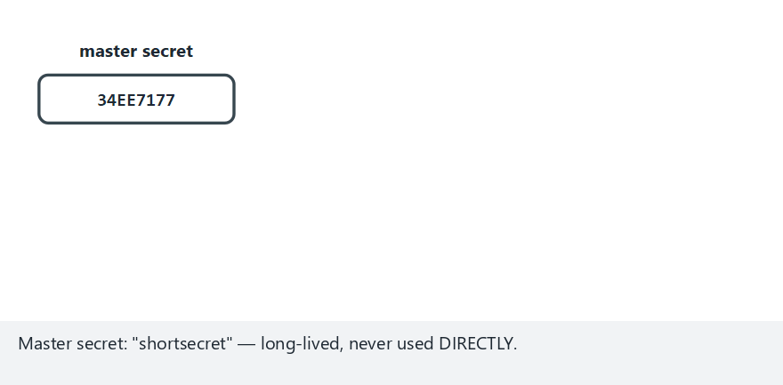
CEN429 Secure Programming · Week 3
HKDF — edge case: a one-step chain
RTEU Computer Engineering · 2026-2027 Fall
105
Notes:
Speaker note: Show the smallest chain and highlight K0 being wiped as K1 takes over.

Slide 106
CEN429 Secure Programming · Week 3
7. Dynamic Key Management
RTEU Computer Engineering · 2026-2027 Fall
106

Slide 107
CEN429 Secure Programming · Week 3
Was the Algorithm Broken, or Was the Key Mismanaged?
• Of the incidents reported as "the algorithm was broken," only a tiny fraction are actually the algorithm breaking.
• The vast majority are key-management mistakes: a key embedded in code, a key that never changes, one key for every job.
• This section exists to prevent these mistakes.
RTEU Computer Engineering · 2026-2027 Fall
107

Slide 108
CEN429 Secure Programming · Week 3
A Key's Life (NIST SP 800-57)
Generation → Distribution → Storage → Use → Renewal → Revocation → Destruction
Stage | Typical mistake
Generation | rand(), a fixed key, a key generated where it shouldn't be (the client)
Distribution | Plaintext; relying only on TLS
Storage | Plain in source code / a configuration file
Use | The same key for encryption and MAC
Renewal | Never changing
Destruction | A copy left in a backup, a log, memory
RTEU Computer Engineering · 2026-2027 Fall
108

Slide 109
CEN429 Secure Programming · Week 3
What Is a Crypto-Period?
• The length of time a key is allowed to be used.
• Once it expires, the key is no longer used to encrypt new data.
• It may be kept a while longer to decrypt old data.
• Factors: how much data is protected, how long it must stay confidential, how exposed the key is.
RTEU Computer Engineering · 2026-2027 Fall
109

Slide 110
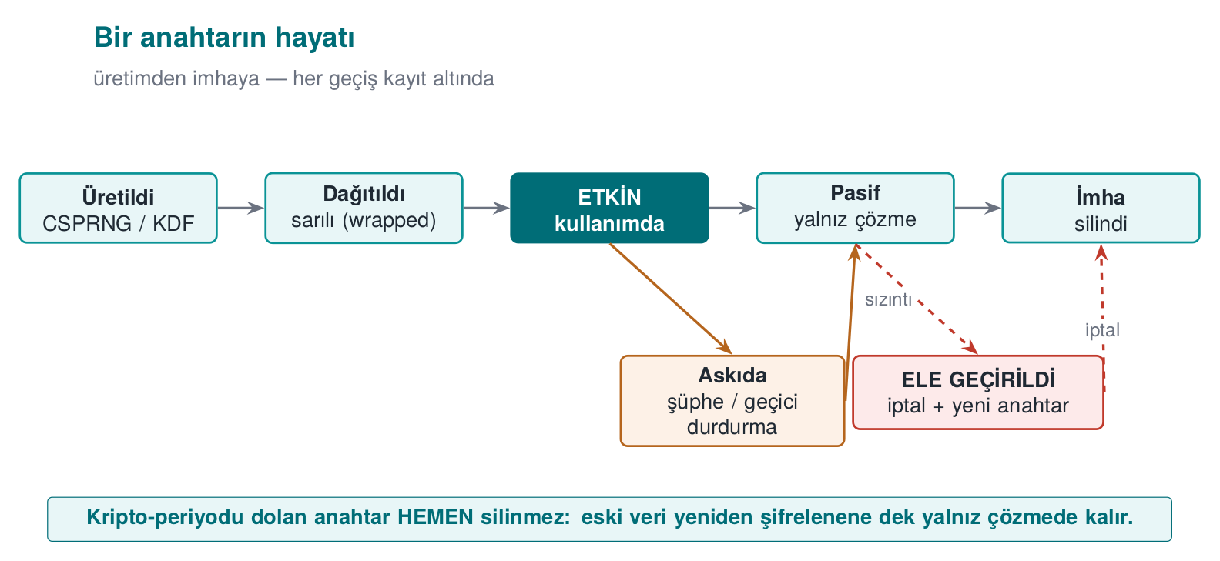
CEN429 Secure Programming · Week 3
A Key's Life — Diagram
RTEU Computer Engineering · 2026-2027 Fall
110

Slide 111
CEN429 Secure Programming · Week 3
Key Hierarchy: Two Basic Ideas
1. Key separation: different keys for different purposes (via HKDF info).
2. Limiting the damage: compromising a lower-level key affects only that branch.
RTEU Computer Engineering · 2026-2027 Fall
111

Slide 112
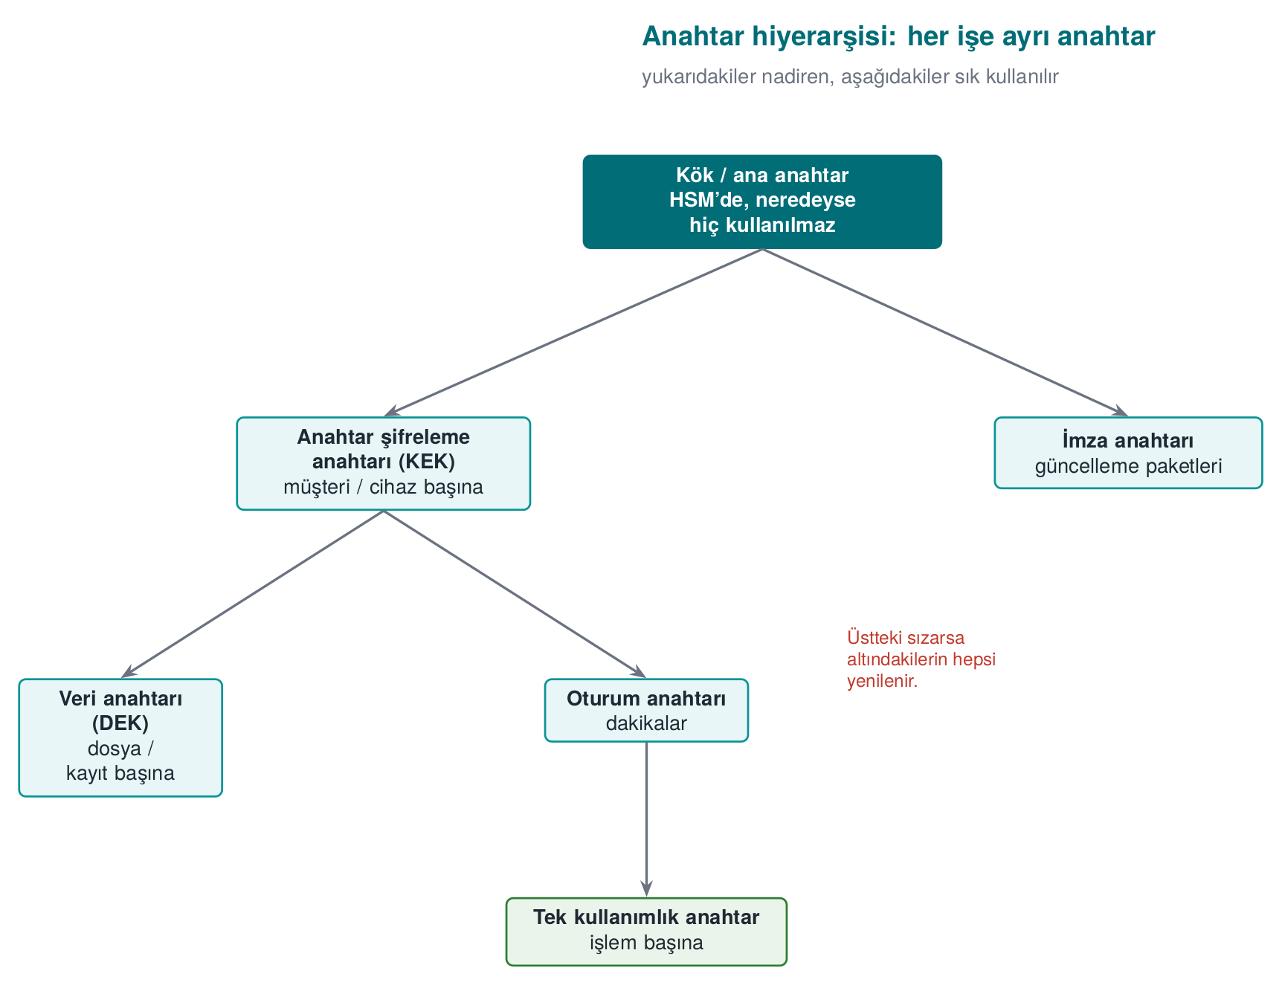
CEN429 Secure Programming · Week 3
Key Hierarchy
• Key separation: a separate key for each purpose (HKDF info)
• Limiting damage: if a single-use key is stolen, what's lost = one transaction
RTEU Computer Engineering · 2026-2027 Fall
112

Slide 113
CEN429 Secure Programming · Week 3
Hierarchy and Key Renewal in Payments
An EMV-style chain:
Issuer master key (HSM) → card master key (card no. + sequence no.) → session key (transaction counter) → single-use key
• Only the limited-use keys at the bottom reach the phone
• New ones are requested from the server when they run out (replenishment)
• Even if the phone is compromised: a few transactions' worth of key, easily revoked server-side
RTEU Computer Engineering · 2026-2027 Fall
113

Slide 114
CEN429 Secure Programming · Week 3
Envelope Encryption — Why?
Encrypting large data directly with the master key creates two problems:
• The master key is used often → more exposure time.
• When the key changes, all the data must be re-encrypted.
RTEU Computer Engineering · 2026-2027 Fall
114

Slide 115
CEN429 Secure Programming · Week 3
Envelope Encryption — Four Steps
1. A random data encryption key (DEK) is generated per record; the data is encrypted with it.
2. The DEK is wrapped with a key encryption key (KEK).
3. The KEK sits somewhere secure: a TPM, an HSM, a cloud KMS.
4. When the KEK is renewed, only the small DEKs are rewrapped — not the data.
RTEU Computer Engineering · 2026-2027 Fall
115

Slide 116
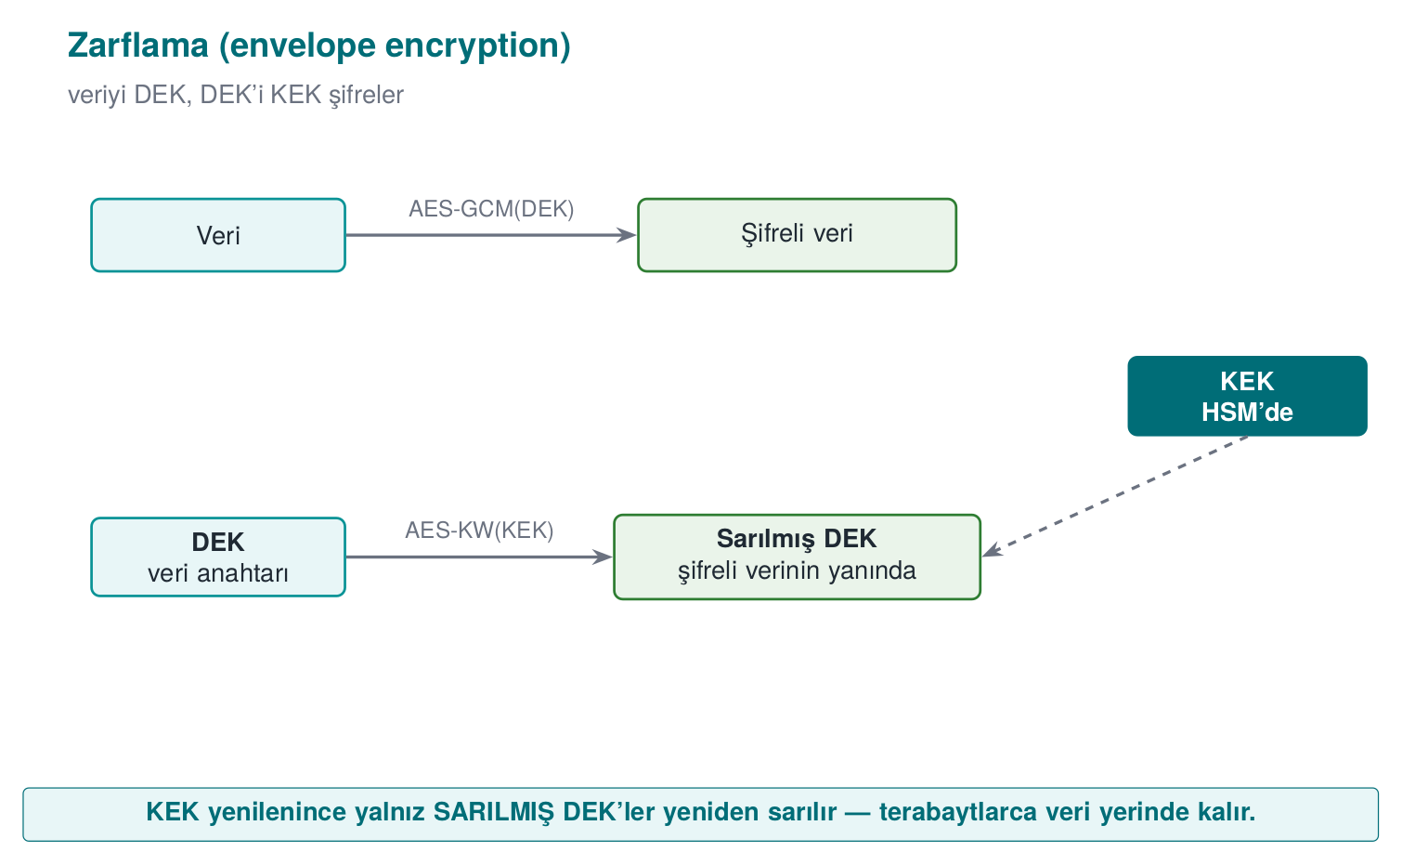
CEN429 Secure Programming · Week 3
Envelope Encryption and Key Versioning
• The reader looks at the version → finds the right key
• The version field is AAD → an attacker can't redirect to an old/weak key
RTEU Computer Engineering · 2026-2027 Fall
116

Slide 117
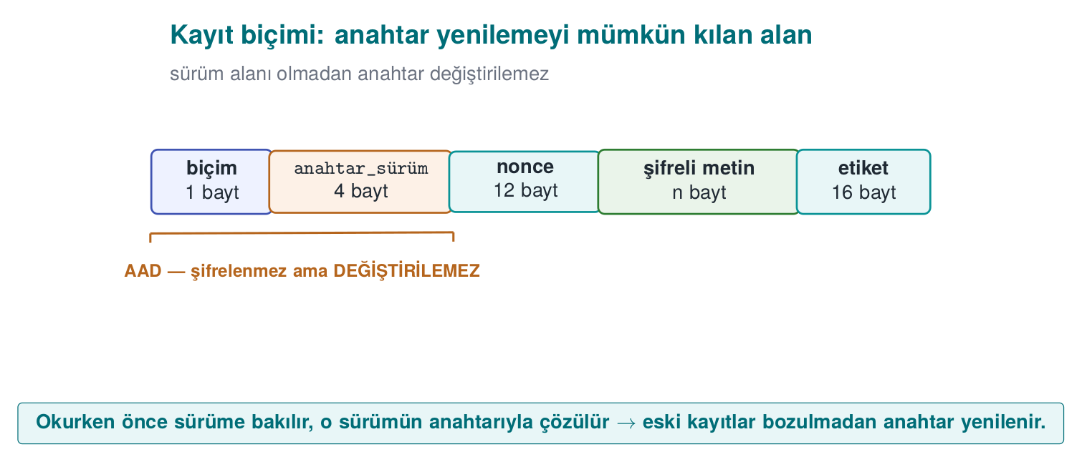
CEN429 Secure Programming · Week 3
Record Format and AAD — Diagram
RTEU Computer Engineering · 2026-2027 Fall
117

Slide 118
CEN429 Secure Programming · Week 3
Where Is the Key Stored?
Option | Protection
Source code · configuration · environment variable | None / weak
DPAPI (CryptProtectData) | Tied to the user/machine account
Keychain · Android Keystore | OS, sometimes hardware
TPM | Hardware; key can't be extracted
HSM / cloud KMS | The key never leaves the HSM
The client only gets keys with limited damage, short lifetime
RTEU Computer Engineering · 2026-2027 Fall
118

Slide 119
CEN429 Secure Programming · Week 3
From the Field: Scheme Requirements and Four Key Groups
Requirement (Scheme-A / Scheme-B) | Corresponds to
Standard algorithm, secure configuration | Correct API use, TLS
Every key: hierarchy, use, crypto-period; single purpose | Hierarchy, key separation
Install, update, delete when the job is done | Lifecycle
The random-number call must not be hookable | Week 6
Keys bound to, and different per, device and app | Device/version binding
Groups: dynamic device keys (whitebox) · dynamic payment keys · a single static key (string obfuscation) · server certificate
RTEU Computer Engineering · 2026-2027 Fall
119

Slide 120
CEN429 Secure Programming · Week 3
Session Key: A Flow from the Field
1. Server generates a 32-byte session ID → encrypted with the configuration key → arrives via push notification
2. Client decrypts it with whitebox AES
3. Authentication code = SHA-256(part of the session ID + wallet ID + device fingerprint)
4. Session key = HMAC(digest of the configuration key, session ID) → 16-byte AES
5. Message: AES-CTR + 256-bit MAC
RTEU Computer Engineering · 2026-2027 Fall
120

Slide 121
CEN429 Secure Programming · Week 3
Session Key: Today's Recommendation
In the design | Today
CTR + separate MAC | AEAD (GCM / CCM / ChaCha20-Poly1305)
Custom HMAC derivation | HKDF + separate info
SHA-1 | SHA-256 · ephemeral (EC)DH for forward secrecy
RTEU Computer Engineering · 2026-2027 Fall
121
Notes:
Speaker note: Critical reading: it met the requirements of its design era; the skill is explaining, with reasons, what should change today and why.

Slide 122
CEN429 Secure Programming · Week 3
This Section's Rule
• Organise keys within a hierarchy; give every key a single purpose and a crypto-period.
• Envelope-encrypt the data; protect the key version with AAD.
• Only download keys with limited damage, short lifetime to the client device.
RTEU Computer Engineering · 2026-2027 Fall
122

Slide 123
CEN429 Secure Programming · Week 3
8. Data in Transit: TLS 1.3
RTEU Computer Engineering · 2026-2027 Fall
123

Slide 124
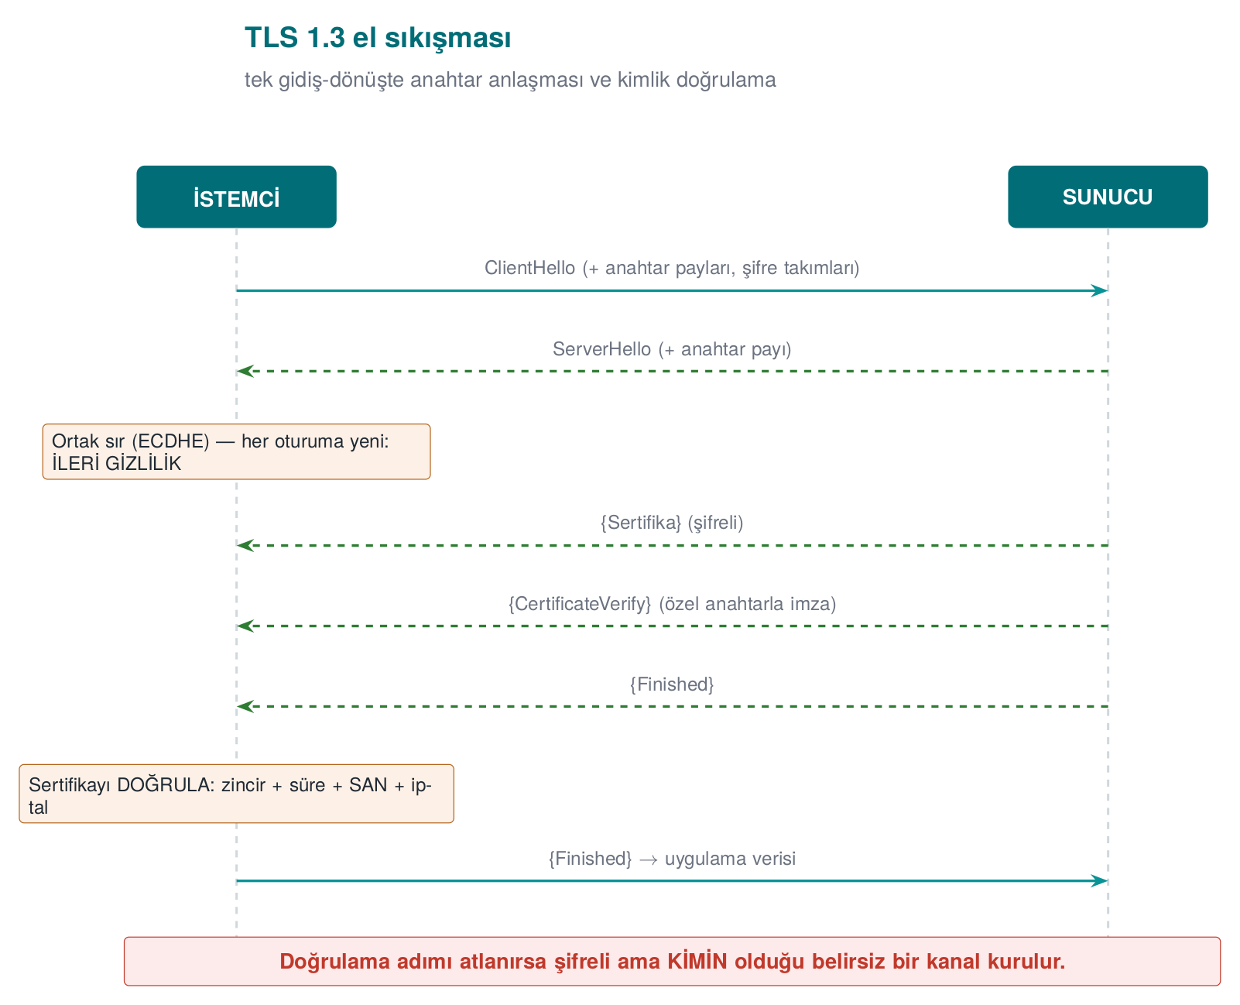
CEN429 Secure Programming · Week 3
TLS 1.3 Handshake
A single round trip · always ephemeral ECDHE → forward secrecy by default.
RTEU Computer Engineering · 2026-2027 Fall
124

Slide 125
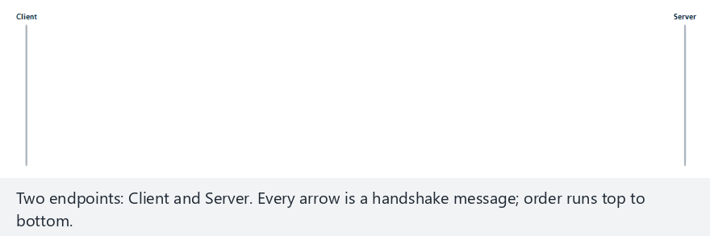
CEN429 Secure Programming · Week 3
TLS 1.3 handshake: message sequence (animation)
RTEU Computer Engineering · 2026-2027 Fall
125
Notes:
Speaker note: Walk the message order step by step on the two lifelines; stress it completes in a single round trip.

Slide 126
CEN429 Secure Programming · Week 3
Handshake — edge case: aborted
RTEU Computer Engineering · 2026-2027 Fall
126
Notes:
Speaker note: Show that once certificate validation fails, Finished is never sent at all.

Slide 127
CEN429 Secure Programming · Week 3
Three Layers of Validation
Layer | Question
Chain | Did a trusted CA sign it, is it expired/revoked?
Hostname | Is the certificate really for this server?
Pinning | Is it the specific key I expect?
⚠️ OpenSSL's default: doesn't validate! SSL_VERIFY_PEER + SSL_set1_host are required.
RTEU Computer Engineering · 2026-2027 Fall
127

Slide 128
CEN429 Secure Programming · Week 3
Pinning and TOFU
• Pinning: embed the SHA-256 of the server's public key (SPKI). Even if the chain
is valid, REJECT if the key doesn't match. (Common on mobile.)
• TOFU: without a PKI, remember the first key, warn if it changes (the SSH model).
TLS 1.2 → 1.3: a single RTT · only strong AEAD suites · weak features removed · enforce a minimum version against downgrade.
RTEU Computer Engineering · 2026-2027 Fall
128

Slide 129
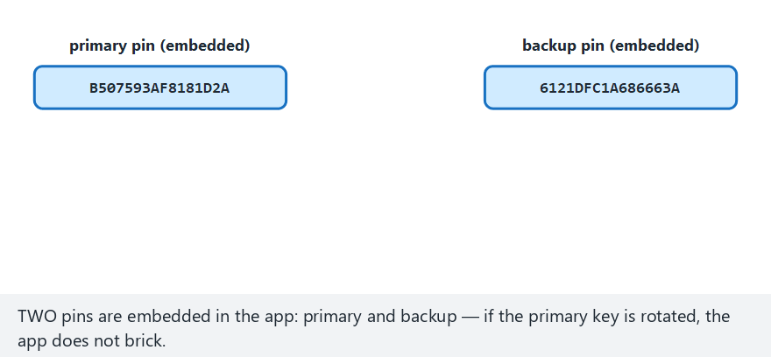
CEN429 Secure Programming · Week 3
Certificate pinning: primary, backup, mismatch (animation)
RTEU Computer Engineering · 2026-2027 Fall
129
Notes:
Speaker note: Show the server's pin compared first with the primary, then (if needed) with the backup pin.

Slide 130
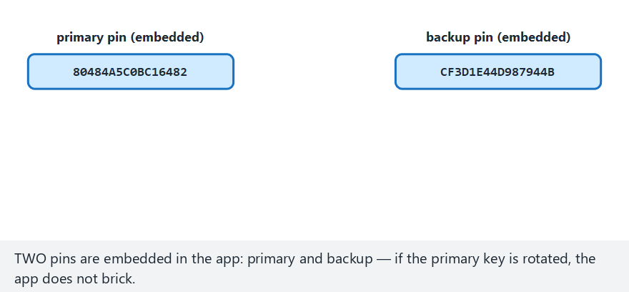
CEN429 Secure Programming · Week 3
Pinning — edge case: matches neither pin
RTEU Computer Engineering · 2026-2027 Fall
130
Notes:
Speaker note: In an attack attempt, show that neither the primary nor the backup pin matches, and the connection is rejected.

Slide 131
CEN429 Secure Programming · Week 3
Demo 6 — MITM → Hostname + Pinning
1 Insecure -> ATTACKER: ACCEPTED (DANGEROUS, MITM would work)
2 Verify -> REAL : VERIFIED, ACCEPTED
3 Verify -> ATTACKER : REJECTED (self-signed)
4 Pin -> REAL : pin MATCHED, ACCEPTED
5 Pin -> ATTACKER : pin did NOT match, REJECTED
Only 127.0.0.1, certificates we generated ourselves. (Windows: run it under WSL.)
RTEU Computer Engineering · 2026-2027 Fall
131
Notes:
Speaker note: Comment out the SSL_set1_host line and rebuild; which attacker still gets caught, which one slips through? Class activity.

Slide 132
CEN429 Secure Programming · Week 3
"Don't Rely on TLS Alone"
• The TLS channel protects the connection, but the endpoints can be untrusted (a rooted
phone, faulty pinning)
• In high-security settings, add one more layer inside TLS: message-level AEAD + MAC
• This way, even if TLS is bypassed, the body is still encrypted → the outermost 2 layers of the security shell
✅ Don't swallow a certificate error, don't fall back to the trust store (fail-closed).
RTEU Computer Engineering · 2026-2027 Fall
132

Slide 133
CEN429 Secure Programming · Week 3
TLS Client: Steps 1–4 (Recipes 9.1, 10.7, 10.8)
SSL_CTX *ctx = SSL_CTX_new(TLS_client_method()); /* 1 */
SSL_CTX_set_min_proto_version(ctx, TLS1_2_VERSION); /* 2 against downgrade */
SSL_CTX_set_verify(ctx, SSL_VERIFY_PEER, NULL); /* 3 VALIDATE */
SSL_CTX_set_default_verify_paths(ctx); /* 4 the root store */
1. A version-agnostic client context.
2. Sets the minimum version to TLS 1.2 — skip it and you're exposed to a downgrade attack.
3. Validate the peer's certificate — skip it and OpenSSL accepts any certificate.
4. Loads the operating system's trusted root store.
RTEU Computer Engineering · 2026-2027 Fall
133

Slide 134
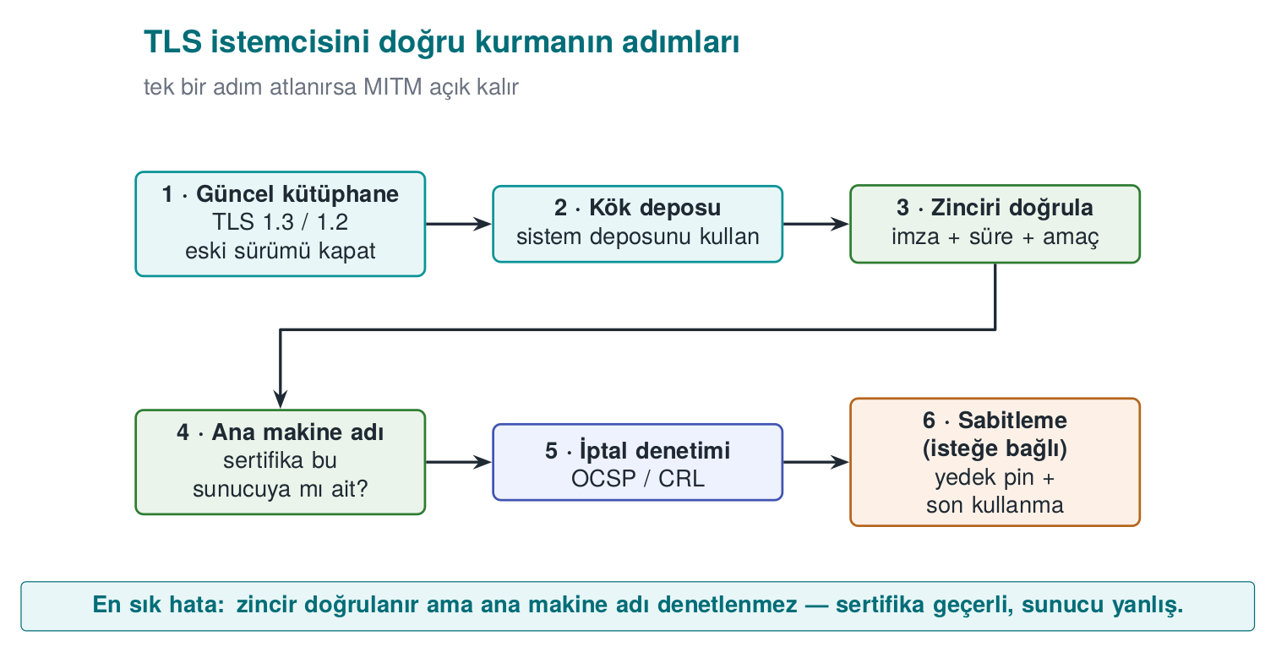
CEN429 Secure Programming · Week 3
The TLS Client's Steps — Diagram
RTEU Computer Engineering · 2026-2027 Fall
134

Slide 135
CEN429 Secure Programming · Week 3
TLS Client: Steps 5–7
SSL_set_tlsext_host_name(ssl, host); /* 5 SNI */
SSL_set1_host(ssl, host); /* 6 hostname check */
/* connect + handshake */
SSL_get_verify_result(ssl) == X509_V_OK; /* 7 belt + suspenders */
1. Tells the server which name it wants (SNI) — skip it and the wrong certificate can come back on a shared IP.
2. Checks that the name on the certificate is this server.
3. Explicitly asks for the validation result — so a configuration mistake doesn't pass silently (belt and suspenders).
Textbook: OpenSSL's non-validating default is "possibly the worst default there is"
RTEU Computer Engineering · 2026-2027 Fall
135

Slide 136
CEN429 Secure Programming · Week 3
Why Is Step 6 Critical?
• Chain validation only asks, "did a trusted CA sign it?"
• An attacker can get a completely valid certificate for their own domain
• Without a name check, a certificate for attacker.example gets accepted in place of bank.example
➡️ The 2012 "world's most dangerous code" study: a large number of applications and libraries skipped this step
RTEU Computer Engineering · 2026-2027 Fall
136

Slide 137
CEN429 Secure Programming · Week 3
SPKI Pinning
X509 *cert = SSL_get_peer_certificate(ssl); /* 3.x: SSL_get1_... */
int n = i2d_X509_PUBKEY(X509_get_X509_PUBKEY(cert), NULL);
/* convert to DER -> SHA256 -> compare with the pin list via CRYPTO_memcmp */
for (i = 0; i < PIN_COUNT; i++)
if (CRYPTO_memcmp(digest, TRUSTED_PINS[i], 32) == 0) return 1;
return 0; /* no match: CUT */
openssl s_client -connect server.example:443 -servername server.example </dev/null \
| openssl x509 -pubkey -noout | openssl pkey -pubin -outform der \
| openssl dgst -sha256 -binary | base64
RTEU Computer Engineering · 2026-2027 Fall
137

Slide 138
CEN429 Secure Programming · Week 3
Keeping Pinning Sustainable
Rule | Why?
Pin the SPKI, not the certificate | A certificate renewed with the same key keeps working
Always have a backup pin | The app doesn't "brick" if the primary is lost
Keep the backup key offline | So they aren't compromised together
Roll out a new pin before removing the old one | An upgrade window
Report pin failures | Attack, or misconfiguration?
Can't be disabled with a flag | The attacker would flip the flag first
Browsers dropped HPKP in 2018; pinning continues on mobile/desktop (MASVS-NETWORK)
RTEU Computer Engineering · 2026-2027 Fall
138

Slide 139
CEN429 Secure Programming · Week 3
Windows: WinHTTP / Schannel
• WinHTTP validates the certificate and name by default
• Danger: flags that turn validation off
DWORD flags = SECURITY_FLAG_IGNORE_UNKNOWN_CA |
SECURITY_FLAG_IGNORE_CERT_CN_INVALID |
SECURITY_FLAG_IGNORE_CERT_DATE_INVALID; /* NEVER in a release build */
WinHttpSetOption(request, WINHTTP_OPTION_SECURITY_FLAGS, &flags, sizeof flags);
✅ Add the test server's CA to the development machine's trust store; keep the code the same
RTEU Computer Engineering · 2026-2027 Fall
139

Slide 140
CEN429 Secure Programming · Week 3
Critical Reading: A Door Left Silently Open
defaultValidator.checkServerTrusted(chain, authType); // 1 chain
try {
PublicKey expected = keyStore.getCertificate("ca").getPublicKey();
if (!Arrays.equals(expected.getEncoded(), chain[0].getPublicKey().getEncoded()))
throw new CertificateException("pin did not match"); // 2 pin
} catch (KeyStoreException e) {
e.printStackTrace(); // 3 ??? -> connection ACCEPTED
}
• The error is swallowed → pinning was skipped = fail-open
• Also: revocation checking off in the fallback validator · "file not found, continue" · a single pin
• ✅ Fail-closed: if you can't determine the result → reject
RTEU Computer Engineering · 2026-2027 Fall
140
Notes:
Speaker note: In code review, also look specifically for catch blocks and "not found, continuing" log lines.

Slide 141
CEN429 Secure Programming · Week 3
Most Common TLS Mistakes
Mistake | Result
A validation callback that's always "valid" / a TrustManager that trusts everything | Every certificate accepted
Name check disabled (HostnameVerifier always true) | Another site's certificate accepted
"Continue anyway" on a certificate error (webview) | An interceptor goes unnoticed
A debug flag left in the release build | The attacker turns it on
A leaf-certificate pin with no backup | App crashes on renewal → pinning gets removed
"We already have TLS" | Data isn't protected in the clear on the server/client
RTEU Computer Engineering · 2026-2027 Fall
141

Slide 142
CEN429 Secure Programming · Week 3
Test Your Own Connection
openssl s_client -connect server.example:443 -servername server.example -verify_return_error -brief
openssl s_client -connect server.example:443 -tls1_1 # should be rejected
1. A self-signed certificate → reject (Demo 6)
2. A valid certificate for another name → reject
3. Install your own CA on the device + a proxy → a pinning app should reject
4. Is a pin failure reported?
RTEU Computer Engineering · 2026-2027 Fall
142
Notes:
Speaker note: An example transfer from the field: TLS + public-key pinning + server certificate-chain check (the outer shell) plus session-keyed message encryption inside it. If the server address and pin values come from the parent app as parameters, protecting them becomes the parent app's responsibility, and the guide should say so.

Slide 143
CEN429 Secure Programming · Week 3
This Section's Rule
• Manually turn on validation on the client: CA store + SSL_VERIFY_PEER + SSL_set1_host + min. TLS 1.2.
• Add SPKI pinning for high risk, always keep a backup pin.
• Stay closed on error (fail-closed): don't swallow the exception and fall back to the trust store.
RTEU Computer Engineering · 2026-2027 Fall
143

Slide 144
CEN429 Secure Programming · Week 3
9. Data at Rest and in Use
RTEU Computer Engineering · 2026-2027 Fall
144

Slide 145
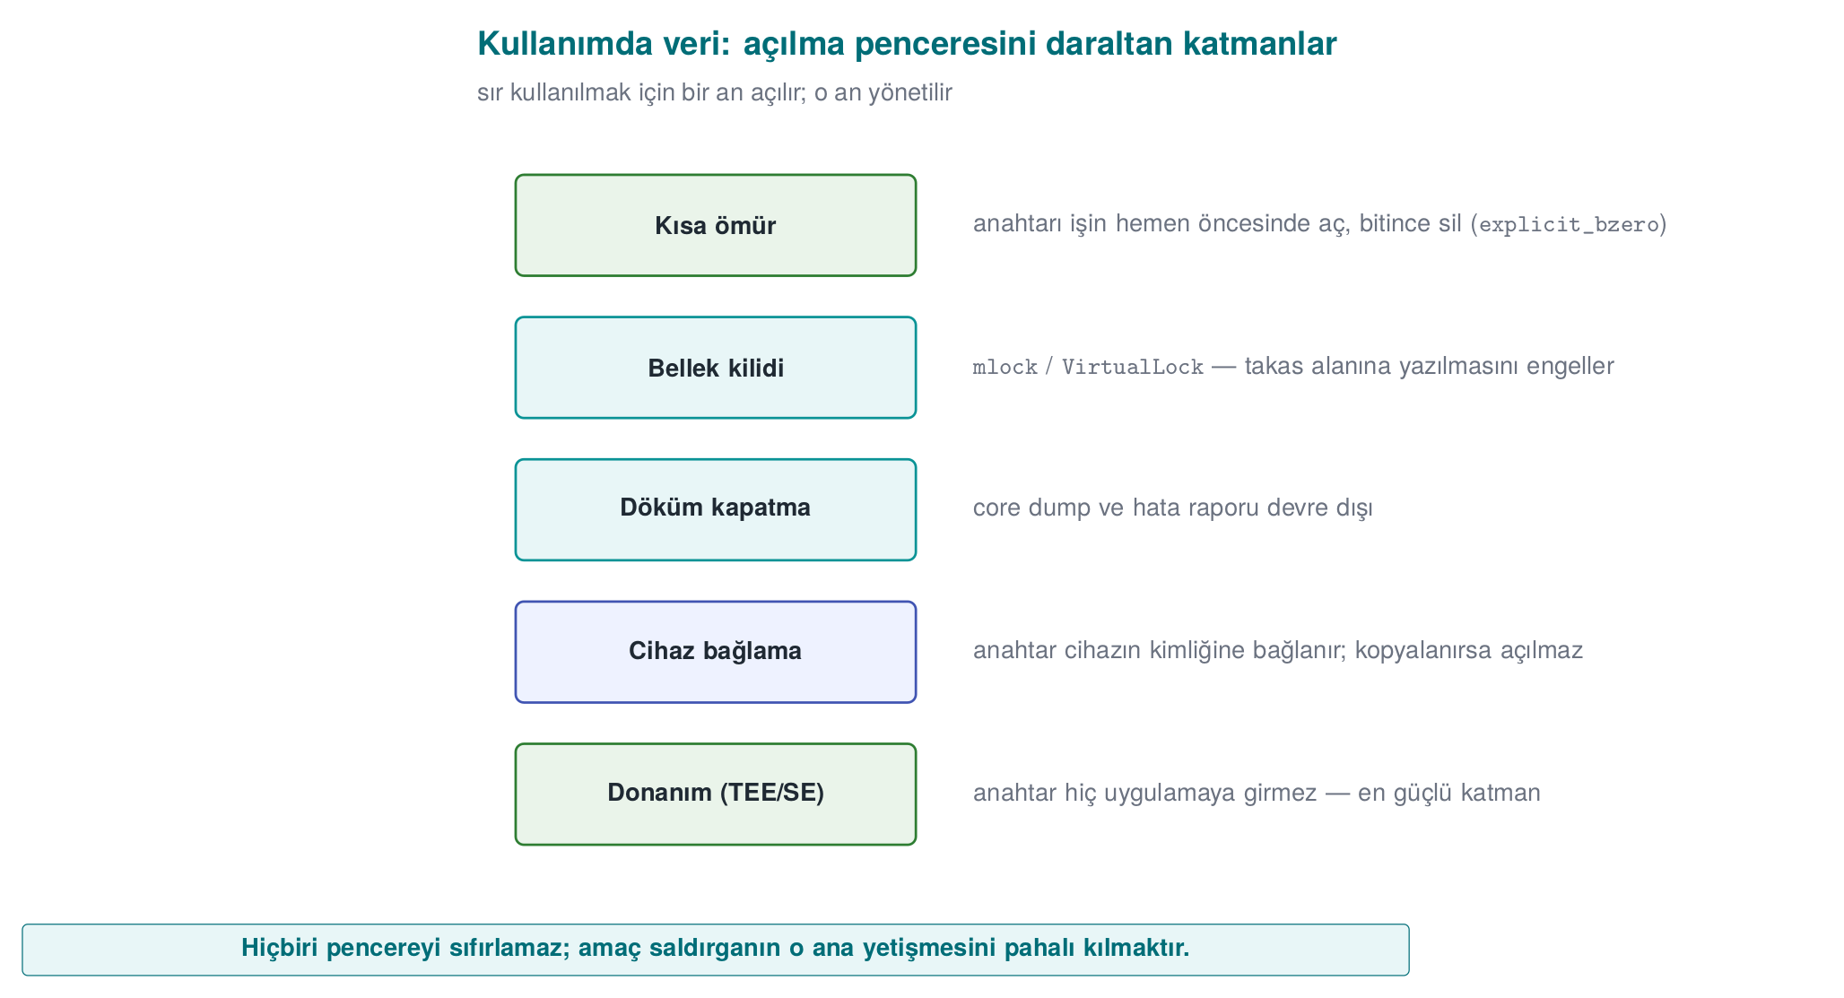
CEN429 Secure Programming · Week 3
Layers of Data in Use — Diagram
RTEU Computer Engineering · 2026-2027 Fall
145

Slide 146
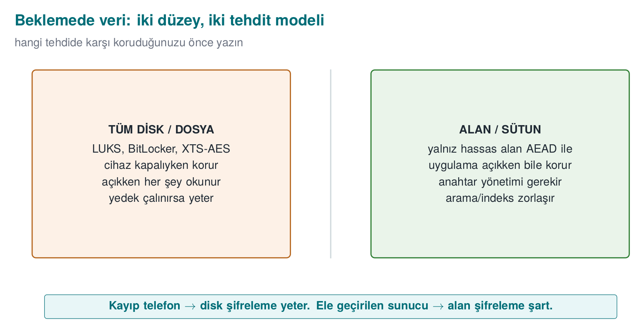
CEN429 Secure Programming · Week 3
Data at Rest: Two Levels — Diagram
RTEU Computer Engineering · 2026-2027 Fall
146

Slide 147
CEN429 Secure Programming · Week 3
Data at Rest: File/Field Encryption
• Full disk/file: LUKS, BitLocker, XTS-AES, or application-level AEAD
• Field/column: encrypt only sensitive fields at the application layer with AEAD
• Masking: **** **** **** 4242 — this is not encryption, it reduces exposure
(logs, screen, testing, tokenization)
Masking doesn't replace encryption, it complements it (different threats).
RTEU Computer Engineering · 2026-2027 Fall
147

Slide 148
CEN429 Secure Programming · Week 3
Demo 7 — Encrypt a Field in SQLite with AES-GCM
Attacker opened the DB:
1|Jane Doe|C6EA7420... <- card field ENCRYPTED
App reading with the correct key:
1|Jane Doe|4242-4242-4242-4242
Wrong key:
1|Jane Doe|(COULD NOT DECRYPT - wrong key?)
name is in the clear, card_encrypted is encrypted. The key isn't embedded in the code (device-bound KDF). Linux sqlite3, Windows built-in winsqlite3.
RTEU Computer Engineering · 2026-2027 Fall
148

Slide 149
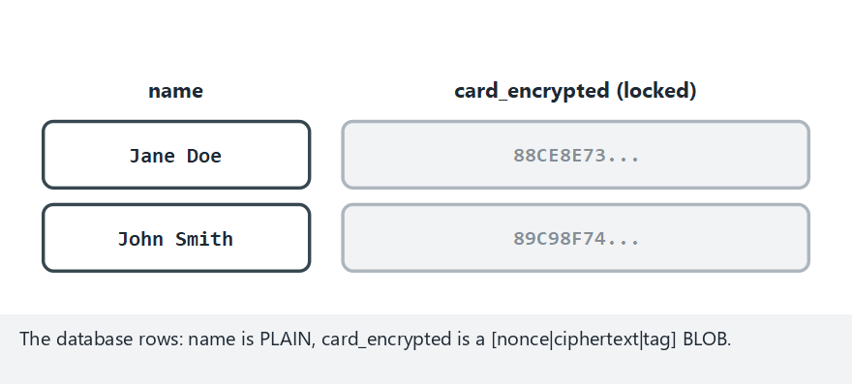
CEN429 Secure Programming · Week 3
SQLite field encryption: correct and wrong key (animation)
RTEU Computer Engineering · 2026-2027 Fall
149
Notes:
Speaker note: Show both rows decrypting with the correct key, and EVERY row being rejected with the wrong key.

Slide 150
CEN429 Secure Programming · Week 3
SQLite field encryption — edge case: wrong key
RTEU Computer Engineering · 2026-2027 Fall
150
Notes:
Speaker note: Stress that no row ever returns garbage with the wrong key — both are rejected.

Slide 151
CEN429 Secure Programming · Week 3
Data Masking: Four Techniques
Technique | Reversible? | Use
Masking at display | No | Screen, receipt, log
Tokenization | Only for those with vault access | Card storage, payment
Pseudonymization | Matched back by whoever holds the key | Analytics, testing
Anonymization | No | Open data
Pseudonymized data is still personal data (KVKK, GDPR) · "anonymous" is a much stronger claim
RTEU Computer Engineering · 2026-2027 Fall
151

Slide 152
CEN429 Secure Programming · Week 3
Masking at Display
/* "1234567812345678" -> "************5678" */
void mask_pan(const char *pan, char *out, size_t out_size) {
size_t n = strnlen(pan, 19);
if (out_size < n + 1) { if (out_size) out[0] = '\0'; return; }
for (size_t i = 0; i < n; i++)
out[i] = (i + 4 < n) ? '*' : pan[i];
out[n] = '\0';
}
• PCI DSS: at most the first 6 (8 in newer versions) + last 4
• Mask close to the source: send it already masked to the client
RTEU Computer Engineering · 2026-2027 Fall
152

Slide 153
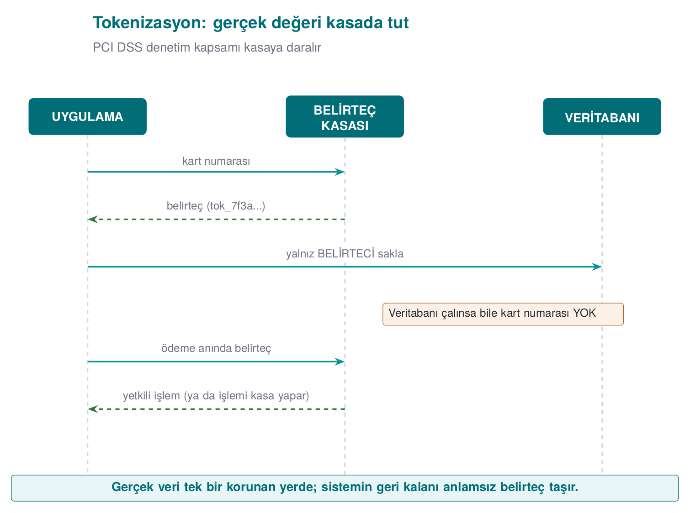
CEN429 Secure Programming · Week 3
Tokenization
• Even if the database, reports, or logs are stolen, there's no card number
• PCI DSS scope shrinks = Week 1's "transfer" answer
• What reaches the phone in mobile payment = a device-specific token number
• Format can be preserved: FF1 (NIST SP 800-38G)
RTEU Computer Engineering · 2026-2027 Fall
153

Slide 154
CEN429 Secure Programming · Week 3
Pseudonym and Test Data
crypto_hmac_sha256(pseudonym_key, 32, id_number, strlen(id_number), pseudonym);
• ❌ Plain SHA-256: an 11-digit ID number → all of them can be tried
• ✅ Keyed HMAC; key separate from the dataset · destroying the key = effectively anonymous
Preferred test data: 1. synthetic → 2. static masking → 3. dynamic masking
RTEU Computer Engineering · 2026-2027 Fall
154

Slide 155
CEN429 Secure Programming · Week 3
Masking in Logs
• Prevent at the source: a sensitive type always prints masked
• Filter at the output: 13–19 digits + Luhn, password=, token= → ****
while ((p = strstr(p, "password=")) != NULL) {
p += strlen("password=");
while (*p && !isspace((unsigned char)*p)) *p++ = '*';
}
⚠️ The filter is a second line of defence: it doesn't understand JSON, the data is already in memory · in the field, logging is removed entirely in the release build
RTEU Computer Engineering · 2026-2027 Fall
155
Notes:
Speaker note: An evaluator looks for full card/ID numbers and passwords in screens, network responses, logs, crash reports, and backups; they also ask whether real data is used in the test environment.

Slide 156
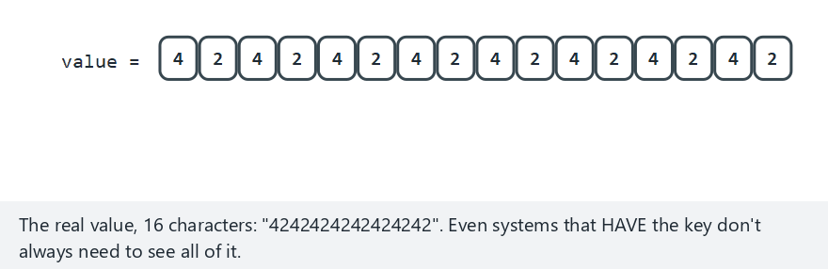
CEN429 Secure Programming · Week 3
Data masking: 3 techniques side by side (animation)
RTEU Computer Engineering · 2026-2027 Fall
156
Notes:
Speaker note: Process the same value with partial masking, tokenization, and pseudonymization in turn.

Slide 157
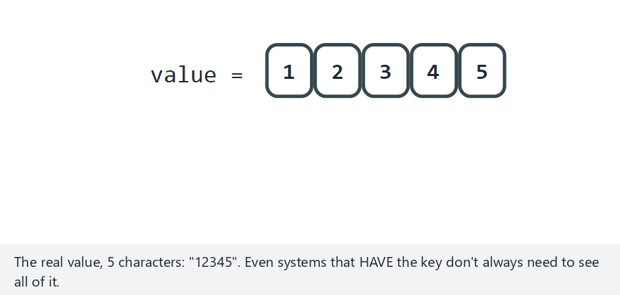
CEN429 Secure Programming · Week 3
Masking — edge case: a very short value
RTEU Computer Engineering · 2026-2027 Fall
157
Notes:
Speaker note: Show that a value too short to mask stays unchanged.

Slide 158
CEN429 Secure Programming · Week 3
Data in Use: 3 Layers
Layer | Linux | Windows
Block dumps | RLIMIT_CORE=0 | SetErrorMode
Lock memory | mlock | VirtualLock
Secure erase | OPENSSL_cleanse | SecureZeroMemory
+ short lifetime, no copying. memset can be optimised away at -O2; cleanse cannot be removed.
RTEU Computer Engineering · 2026-2027 Fall
158

Slide 159
CEN429 Secure Programming · Week 3
Demo 8 — mlock + Secure Erasure
Layer 1 - crash dump turned off: OK
Layer 2 - mlock blocked writing to swap: OK
Secret in use: non-zero bytes = 23
Layer 3 - non-zero bytes after secure wipe = 0
OPENSSL_cleanse call stays in machine code (unlike memset, cannot be removed)
Device binding: wrap the key from the device fingerprint with HKDF + AEAD → can't be opened on another device (Demo 9).
RTEU Computer Engineering · 2026-2027 Fall
159

Slide 160
CEN429 Secure Programming · Week 3
This Section's Rule
• At rest: encrypt sensitive fields with AEAD, don't embed the key in code.
• Masking doesn't replace encryption, it complements it (log, screen, testing).
• In use: open the secret at the last moment, keep it as briefly as possible, and erase it irrecoverably.
RTEU Computer Engineering · 2026-2027 Fall
160

Slide 161
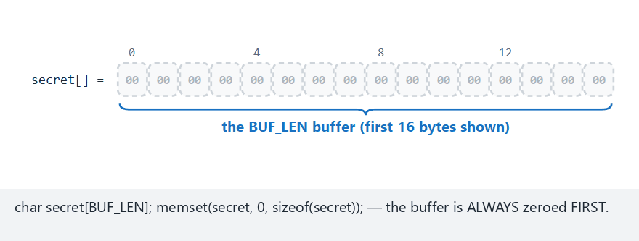
CEN429 Secure Programming · Week 3
Secure wiping in memory (animation)
RTEU Computer Engineering · 2026-2027 Fall
161
Notes:
Speaker note: Walk through the three layers (dump prevention, locking, secure wipe) protecting the secret step by step.

Slide 162
CEN429 Secure Programming · Week 3
Memory wipe — edge case: special characters
RTEU Computer Engineering · 2026-2027 Fall
162
Notes:
Speaker note: Show that special characters are wiped just as securely.

Slide 163
CEN429 Secure Programming · Week 3
10. Security Shells
RTEU Computer Engineering · 2026-2027 Fall
163

Slide 164
CEN429 Secure Programming · Week 3
Demo 9 — Wrap with 4 Shells, Open in Reverse Order
WRAP: secret -> K1(device) -> K2(storage) -> K3(session) -> K4(channel)
Layer 4 = 128 bytes <- transmitted packet
UNWRAP: K4 -> K3 -> K2 -> K1 -> secret (all OK, secret CORRECT)
Attack 1: tamper 1 bit -> Layer 4 REJECTED (tag did not hold)
Attack 2: copy to another device -> outer 3 layers open,
Layer 1 (device) REJECTED -> secret CANNOT be opened
✅ Not "which single measure?" but "which layers?" · independent keys.
RTEU Computer Engineering · 2026-2027 Fall
164

Slide 165
CEN429 Secure Programming · Week 3
The Shell Matrix in the Field
Shell | Content
1 | Payment key in whitebox DES form — never in the clear
2 | WB-AES-CBC with the wallet key + device + app binding
3 | At rest: WB-AES-CBC + SHA-256 MAC + device + version · In transit: session-keyed AES + MAC
4 | TLS + public-key pinning + server certificate check
Outer | Authentication code (session key + binding)
RTEU Computer Engineering · 2026-2027 Fall
165

Slide 166
CEN429 Secure Programming · Week 3
One Asset, Five Stages
Stage | K1 | K2 | K3 | K4
--- | :-: | :-: | :-: | :-:
Transfer from server | ✔ | ✔ | ✔ | ✔
Storage in database | ✔ | ✔ | ✔ | —
Decryption / API on the Java side | ✔ | ✔ | — | —
Java side in payment | ✔ | ✔ | — | —
Native side in payment | ✔ | — | — | —
• Even at the innermost point, one shell remains · RASP protects that moment's exposure
• A "normal" asset: 1 shell at rest, 2 in transit → cost balance
• Once an attack is detected, the local database is wiped entirely
RTEU Computer Engineering · 2026-2027 Fall
166
Notes:
Speaker note: Today an AES-based whitebox and AEAD modes would be preferred over DES; the matrix idea itself is timeless. This table will be filled in for S7 in the project.

Slide 167
CEN429 Secure Programming · Week 3
This Section's Rule
• When protecting a critical asset, don't ask "which single measure?" — ask "which layers?"
• Put a shell on every stage (transport, storage, use).
• Build the shells with independent keys from one another; breaking one shouldn't give up another.
RTEU Computer Engineering · 2026-2027 Fall
167

Slide 168
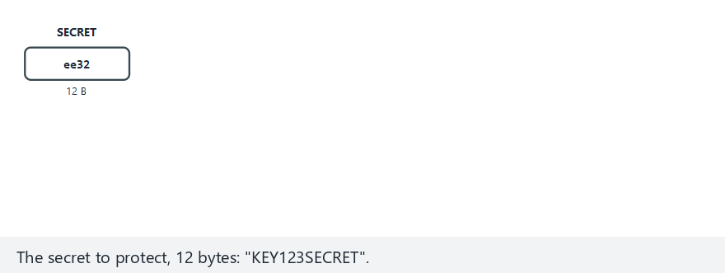
CEN429 Secure Programming · Week 3
Security shells: a four-layer defense (animation)
RTEU Computer Engineering · 2026-2027 Fall
168
Notes:
Speaker note: Walk through wrapping and unwrapping the four layers step by step, ending with the secret recovered.

Slide 169
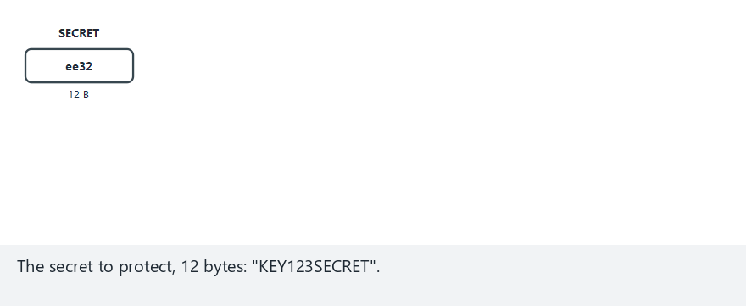
CEN429 Secure Programming · Week 3
Security shells — edge case: another device
RTEU Computer Engineering · 2026-2027 Fall
169
Notes:
Speaker note: Show the outer three layers opening fine, but the device-bound innermost layer rejecting on another device.

Slide 170
CEN429 Secure Programming · Week 3
11. Introduction to Whitebox Cryptography
RTEU Computer Engineering · 2026-2027 Fall
170

Slide 171
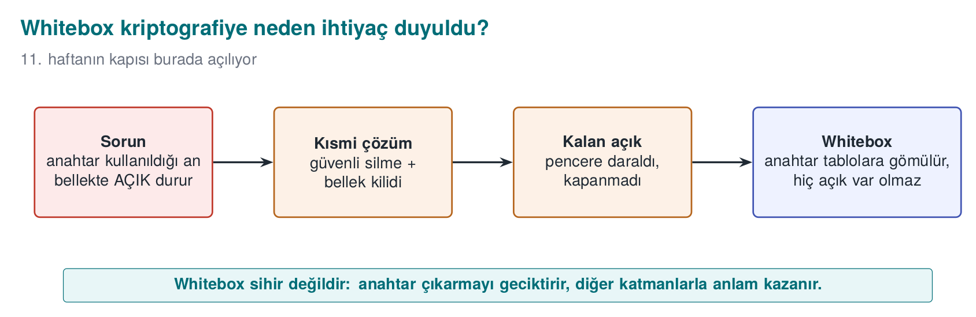
CEN429 Secure Programming · Week 3
The Road to Whitebox — Diagram
RTEU Computer Engineering · 2026-2027 Fall
171

Slide 172
CEN429 Secure Programming · Week 3
Why Whitebox?
• This week's hidden assumption: the key sits in the clear in memory while it's in use
• "The device owner is the attacker" can read memory → catches that moment
• Secure erasure narrows the window, it doesn't close it
• Whitebox: embeds the key into tables, its raw form never appears in memory
⚠️ Not a magic wand: still open to oracle/code-lifting attacks → needs the other shells too. Details: Week 11.
RTEU Computer Engineering · 2026-2027 Fall
172

Slide 173
CEN429 Secure Programming · Week 3
Common Misconceptions
• ❌ "I encrypted it, I'm safe" → encryption only gives confidentiality; use AEAD for integrity
• ❌ "TLS is on, MITM is impossible" → possible without validation (Demo 6)
• ❌ "I stored the password with SHA-256" → unsalted/fast; needs Argon2id + salt
• ❌ "The nonce must be secret" → no, it must be unique; the key is what's secret
• ❌ "I'll write my own cipher" → Kerckhoffs: security is in the key, not the algorithm
RTEU Computer Engineering · 2026-2027 Fall
173

Slide 174
CEN429 Secure Programming · Week 3
End to End: Protecting a Note in All Three States
An app protects a user's "note": it arrives from the server (in transit), sits on disk (at rest), and is shown on screen (in use).
State | Protection | Section
In transit | TLS 1.3 + chain/SAN + SPKI pin (where applicable) | 8
At rest | AES-256-GCM (AEAD), a unique nonce, key from a KDF | 5, 9
In use | Keep it in memory as briefly as possible, erase when done | 9
Key chain: password → KDF → master key → HKDF → data/session key; AEAD integrity comes along at every stage.
RTEU Computer Engineering · 2026-2027 Fall
174

Slide 175
CEN429 Secure Programming · Week 3
Classic Crypto Mistakes — Summary
Mistake | Section | Rule
Nonce reuse | 4 | Never repeat with the same key; use a counter or a sufficiently random nonce
Weak randomness | 3 | Not rand() — a CSPRNG (getrandom, BCryptGenRandom)
Making the password the key directly | 5 | Derive it with a KDF (salted, slow)
ECB mode | 4 | Leaks patterns (the "penguin"); use AEAD
Encryption without integrity | 2 | AEAD or encrypt-then-MAC
A non-constant-time comparison | 3 | Not memcmp — compare in constant time
All six mistakes were covered earlier in this deck; here they are gathered in one glance.
RTEU Computer Engineering · 2026-2027 Fall
175

Slide 176
CEN429 Secure Programming · Week 3
Project: This Week (S5, S7)
• S5 — Asset list (draft): every sensitive asset; location, lifetime, C/I/I+, protection
• S7 — Data security + shell matrix: every asset × three states × shells; secure
erasure policy
Requirement families: CEN429-DT/DR/DU (in transit/at rest/in use), AS, CR
Add a row to the S17 compliance matrix for every requirement.
RTEU Computer Engineering · 2026-2027 Fall
176

Slide 177
CEN429 Secure Programming · Week 3
Class Activities
1. Stop the MITM: disable SSL_set1_host in Demo 6 → which attacker slips through?
2. Repeat a nonce: a fixed nonce in Demo 1 → XOR two ciphertexts
3. Map the three data states: a threat/countermeasure table for a health app
4. KDF cost: find the round count that gives 100 ms
RTEU Computer Engineering · 2026-2027 Fall
177
Notes:
Speaker note: Make groups of 3-4. Activities 1 and 3 are the most productive for discussion.

Slide 178
CEN429 Secure Programming · Week 3
Self-Check (Sample)
1. The difference between AEAD and AES-CTR?
2. Why is nonce reuse a disaster?
3. Why isn't ECB used?
4. The OpenSSL client's most dangerous default?
5. What does pinning catch, what does hostname validation catch?
6. What is a security shell, give an example?
Full list (20 questions) and answers on the course site. Quiz-1 is in this style + code reading.
RTEU Computer Engineering · 2026-2027 Fall
178

Slide 179
CEN429 Secure Programming · Week 3
Self-Check — Answers (Sample 1–6)
1. AES-CTR provides confidentiality only; AEAD (AES-GCM) provides confidentiality + integrity/identity together with a tag. Changes go unnoticed in CTR.
2. The same key+nonce repeats the keystream; the XOR of two ciphertexts leaks the plaintext, and in GCM the authentication key is at risk.
3. ECB turns the same block into the same ciphertext block → patterns are visible; no semantic security.
4. The client doesn't validate the certificate/hostname on its own; without turning it on manually, MITM is possible.
5. Pinning: pins the expected server key (SPKI) → catches a fake-but-"valid" certificate. Hostname validation: catches whether the certificate belongs to the correct domain.
6. Security shell: protection wrapped around an asset (C=confidentiality, I=integrity). E.g., a key file = AES-GCM (C) + tag/HMAC (I).
RTEU Computer Engineering · 2026-2027 Fall
179

Slide 180
CEN429 Secure Programming · Week 3
Self-Check (Continued)
1. Why can't rand() be used for security? What instead?
2. EVP_DecryptFinal_ex returned failure; what do you do with the plaintext in the buffer?
3. Why is memcmp risky for MAC comparison?
4. Is a key whose crypto-period has expired deleted immediately?
5. Why isn't the data re-encrypted when the KEK is renewed in envelope encryption?
RTEU Computer Engineering · 2026-2027 Fall
180
Notes:
ask first, then open the answer slide

Slide 181
CEN429 Secure Programming · Week 3
Self-Check — Answers (7–11)
1. rand() is statistical and predictable → use a CSPRNG (RAND_bytes / getrandom).
2. If decryption fails, securely erase the plaintext in the buffer (memset_s) and reject it — integrity wasn't verified, don't use it.
3. memcmp exits early → a timing leak; use CRYPTO_memcmp / a constant-time comparison.
4. No. It's not used for new encryption, but it's kept for decryption only until the old data is re-encrypted.
5. The data is encrypted with the DEK; when the KEK is renewed, only the DEKs are rewrapped, not the data.
RTEU Computer Engineering · 2026-2027 Fall
181

Slide 182
CEN429 Secure Programming · Week 3
Self-Check (Continued)
1. What happens if SSL_set1_host isn't called?
2. Why SPKI for pinning, and why a backup pin?
3. What is "fail-open"? An example
4. Why can't a plain SHA-256 of an ID number be a pseudonym?
5. Why does tokenization shrink PCI DSS scope?
RTEU Computer Engineering · 2026-2027 Fall
182
Notes:
ask first, then open the answer slide

Slide 183
CEN429 Secure Programming · Week 3
Self-Check — Answers (12–16)
1. Without SSL_set1_host, the hostname isn't validated; a valid certificate for another name gets accepted → MITM.
2. The SPKI stays the same even if the certificate is renewed (as long as the key is the same); a backup pin prevents the app from "bricking" when the key changes.
3. Fail-open: treating an error as "passed/allow"; e.g., a swallowed `KeyStoreException` skipping validation.
4. An ID number's value space is small/predictable → plain SHA-256 can be brute-forced back; a keyed HMAC is needed.
5. Tokenization: the real PAN stays only in the vault; the rest of the system holds tokens → the PCI DSS audit scope shrinks.
RTEU Computer Engineering · 2026-2027 Fall
183

Slide 184
CEN429 Secure Programming · Week 3
Self-Check (Continued)
1. The three states of data and each one's protection?
2. Why can't a password be a key directly?
3. What does AEAD provide, which separate steps does it replace?
4. What does forward secrecy mean?
5. Is IV/nonce/salt secret? What's the rule?
6. Why is a CSPRNG needed?
7. Why does a key hierarchy exist?
RTEU Computer Engineering · 2026-2027 Fall
184
Notes:
ask first, then open the answer slide

Slide 185
CEN429 Secure Programming · Week 3
Self-Check — Answers (17–23)
1. In transit (TLS), at rest (AEAD encryption), in use (short lifetime + erasure).
2. It's low-entropy and predictable; it's derived, salted and slow, with a KDF (PBKDF2/Argon2).
3. Confidentiality + integrity together; it replaces separate encryption + MAC steps.
4. A new key every session; even if the long-term key leaks, old sessions can't be decrypted.
5. Not secret, but must be unique/non-repeating; nonce reuse and a fixed salt are dangerous.
6. rand() is predictable; a CSPRNG (the OS) is needed for keys/nonces/salts.
7. A single key isn't used for every job; derived keys come from a master key, each with its own job and lifetime.
RTEU Computer Engineering · 2026-2027 Fall
185

Slide 186
CEN429 Secure Programming · Week 3
Glossary
Term | Meaning
Three states | In transit/at rest/in use
AEAD | Encryption + integrity
CSPRNG | Secure random generator
KDF/HKDF | Key derivation
Nonce/salt | Unique/random helper value
Forward secrecy | Old sessions can't later be decrypted
RTEU Computer Engineering · 2026-2027 Fall
186

Slide 187
CEN429 Secure Programming · Week 3
Next Week
Week 4 — Code Hardening: C/C++
This week we learned to protect data (keys, plaintext) with correct encryption and key management; but the encryption code itself is also a C/C++ program, and a buffer overflow, format-string bug, or integer error can leak the very key and plaintext we carefully protected.
Week 4 covers preventing exactly these mistakes with the SEI CERT C/C++ rules, and catching them with static analysis and sanitizers.
We'll go deeper into PKI and certificates in Week 10.
RTEU Computer Engineering · 2026-2027 Fall
187

