Slide 1

CEN429 Secure Programming · Week 5
Code Hardening: Java and Interpreted Languages
CEN429 Secure Programming — Week 5
Asst. Prof. Dr. Uğur CORUH · 16.10.2026
RTEU Computer Engineering · 2026-2027 Fall
Notes:
Speaker note: This week we move to managed languages: memory safety comes for free, but injection, deserialisation, readable bytecode and dependencies bring new risks.

Slide 2
CEN429 Secure Programming · Week 5
Today
Hour | Section | Topic
1 | 1–4 | Managed languages and the root of injection, SEI CERT · SQL injection Demo 1 · Command injection Demo 2 · Path traversal Demo 3
2 | 5–7 | Unsafe deserialisation Demo 7 · XML/XXE, templates, XSS · Python and JavaScript (ReDoS)
3 | 8–12 | Bytecode Demo 4 · ProGuard/R8 + string obfuscation Demo 5 · Android R8/measurement · SBOM Demo 6 · Project
Learning outcomes (LO.3 / LO.4): recognise and prevent the injection class (SQL, command, path, XML, deserialisation) · obfuscate with ProGuard/R8 and write -keep rules · produce an SBOM and manage dependency risk
A managed language largely solves memory bugs; but data mixing with commands (injection) exists in every language.
RTEU Computer Engineering · 2026-2027 Fall
2
Notes:
Speaker note: We cover Week 4's C/C++ counterpart in Java/interpreted languages. We assume zero prior knowledge; every term will be defined.

Slide 3
CEN429 Secure Programming · Week 5
What We Bring from Earlier Weeks
• Memory bugs (overflow, use of freed memory, undefined behaviour) — across the first four weeks we saw how these bugs arise in C/C++ and how they are prevented (Week 4)
• The structure of the SEI CERT rule book — identifier, non-compliant example, compliant solution and risk (Week 4)
• TOCTOU (time-of-check to time-of-use) — the gap between checking a file's permissions and actually using it is a race-condition flaw (Week 2)
This week: memory bugs → which ones disappear at the language level (Section 1); the SEI CERT structure → the Oracle Java standard (Section 1); TOCTOU → re-checking the root after the file is opened, in path traversal (Section 4).
RTEU Computer Engineering · 2026-2027 Fall
3

Slide 4
CEN429 Secure Programming · Week 5
This Week's Concepts
Each term is defined once, where it first appears in the body; here we only mark where.
Concept | Where
Injection | Section 1
The JVM and bytecode | Section 8
Parameterised query | Section 2
Deserialisation | Section 5
XXE | Section 6
Path traversal | Section 4
ProGuard / R8 | Section 9
The -keep rule | Section 9
SBOM | Section 12
RTEU Computer Engineering · 2026-2027 Fall
4

Slide 5
CEN429 Secure Programming · Week 5
Background: Managed Languages and Garbage Collection
• Managed language: a language that manages memory automatically (Java, C#, Python, JS); the programmer never calls malloc/free.
• GC (garbage collector): automatically cleans up objects no longer used, in the background; the programmer never frees memory by hand.
• This single difference → most memory bugs (overflow, use-after-free) disappear; Section 1 shows this in detail.
RTEU Computer Engineering · 2026-2027 Fall
5

Slide 6
CEN429 Secure Programming · Week 5
Background: Databases and SQL
• SQL: a database query language (SELECT ... WHERE ...).
• The application puts user input into the query.
• If put in wrong → SQL injection (Section 2).
RTEU Computer Engineering · 2026-2027 Fall
6

Slide 7
CEN429 Secure Programming · Week 5
Background: Reflection and Dependencies
• Reflection: finding and calling a class/method by its name, at run time (Class.forName("..."), getMethod("...")); obfuscation can break this → -keep is required (Section 9).
• Dependency: an external library your project uses that your own team did not write; even if your own code is secure, a flaw in a dependency affects you (Section 12).
RTEU Computer Engineering · 2026-2027 Fall
7

Slide 8
CEN429 Secure Programming · Week 5
How Do the Demos Work?
• 7 demos, in the code/week-05 folder — need Python 3 and JDK 17+
• The main part of the SQL demo runs with Python's built-in sqlite3 module, with nothing to download
• Run: Windows .demo.ps1 · WSL/Linux sh demo.sh
• For the optional Java parts (JDBC, ProGuard) every demo folder has a hazirla (prepare) script
⚠️ Ethics: the injection examples run only against the synthetic database/files in the demo folder; never apply these techniques to someone else's system.
RTEU Computer Engineering · 2026-2027 Fall
8

Slide 9
CEN429 Secure Programming · Week 5
1. Managed languages and the root of injection
RTEU Computer Engineering · 2026-2027 Fall
9

Slide 10
CEN429 Secure Programming · Week 5
Short history — managed languages and the gaps that remain
• 1995 — Java/JVM: most memory bugs end at the language level
• 1998 — SQL injection is documented · 2003 OWASP Top 10
• 2002 — ProGuard (later R8): because bytecode is easy to reverse
• 2015 deserialisation · 2020–21 SolarWinds and Log4Shell → the SBOM era
The language solves memory bugs; it does not solve injection or dependency risk.
RTEU Computer Engineering · 2026-2027 Fall
10

Slide 11
CEN429 Secure Programming · Week 5
What does a managed language solve?
• Automatic memory management (GC) → overflow, UAF, double free are largely gone.
• Array access is bounds-checked → ArrayIndexOutOfBounds (a crash, not exploitation).
• Type safety is stricter.
RTEU Computer Engineering · 2026-2027 Fall
11

Slide 12
CEN429 Secure Programming · Week 5
What does a managed language NOT solve?
• Injection (data = command) — exists in every language.
• Logic errors, authorisation errors.
• Dependency vulnerabilities.
• Deserialisation attacks.
Memory bugs went down; the new front is injection and the supply chain.
RTEU Computer Engineering · 2026-2027 Fall
12

Slide 13
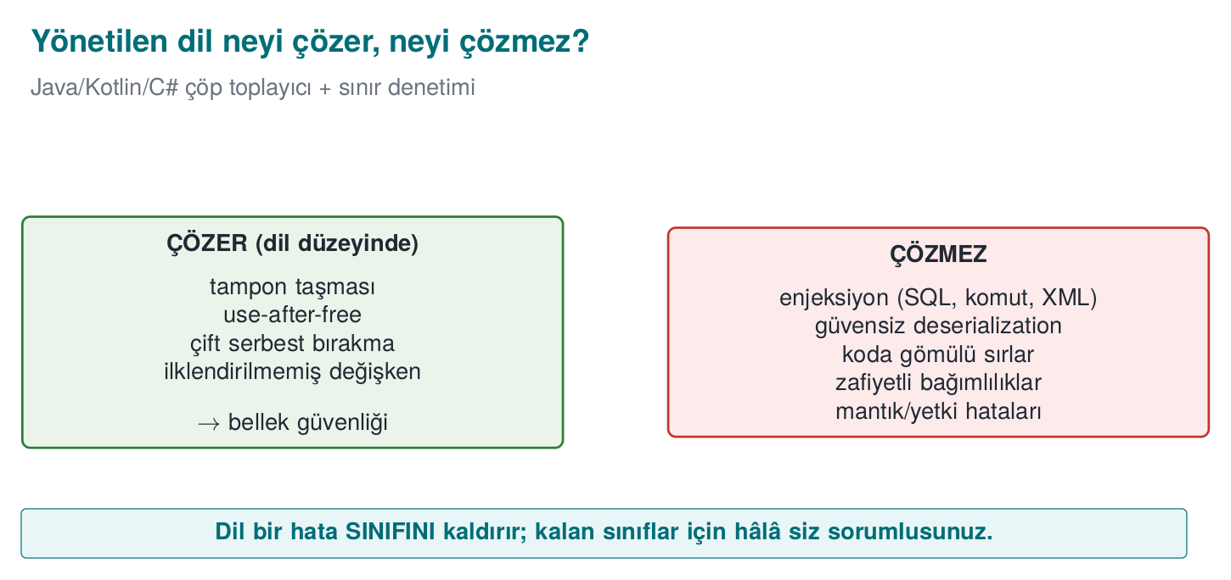
CEN429 Secure Programming · Week 5
Managed language: solves / does not solve — diagram
RTEU Computer Engineering · 2026-2027 Fall
13

Slide 14
CEN429 Secure Programming · Week 5
SEI CERT Oracle Java
• A separate rule book for Java (CERT Oracle Coding Standard for Java).
• Same structure: noncompliant example + compliant solution + risk.
• Sample areas: injection, serialisation, concurrency, sensitive data.
RTEU Computer Engineering · 2026-2027 Fall
14

Slide 15
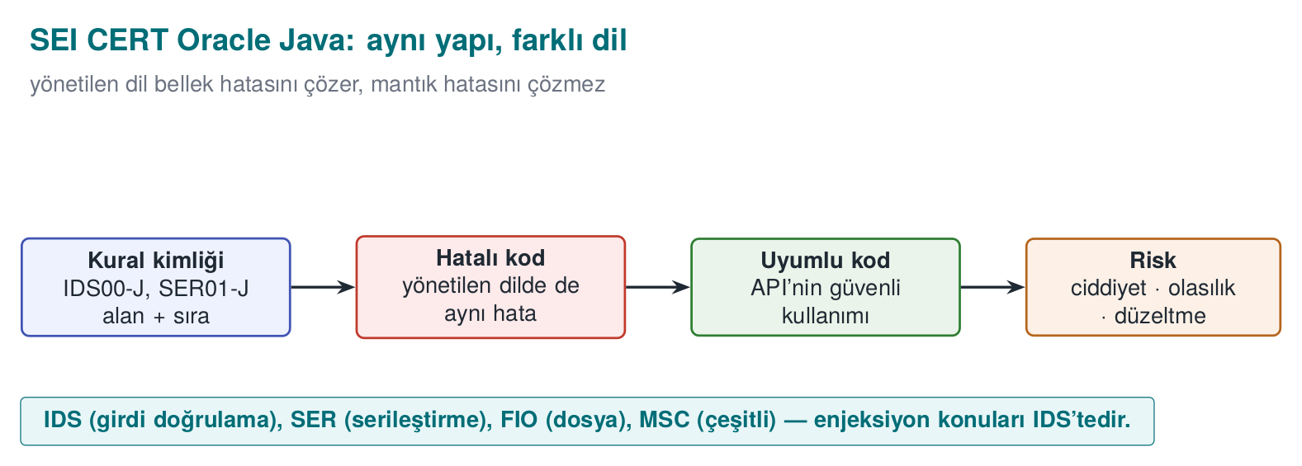
CEN429 Secure Programming · Week 5
CERT Oracle Java — diagram
RTEU Computer Engineering · 2026-2027 Fall
15

Slide 16
CEN429 Secure Programming · Week 5
SEI CERT · rules touching this week
Prefix | Category | Rule (example)
IDS | Input validation | IDS00-J SQL · IDS07-J Runtime.exec · IDS16/17-J XML
FIO | Input/output | FIO16-J: canonicalise path names
SER | Serialisation | SER12-J: do not deserialise untrusted data
MSC | Miscellaneous | MSC03-J: do not embed sensitive information in code
ERR | Error handling | ERR01-J: do not leak sensitive information in an exception
IDs end with the -J suffix.
RTEU Computer Engineering · 2026-2027 Fall
16

Slide 17
CEN429 Secure Programming · Week 5
Sensitive data in Java
• Java String is immutable → it cannot be erased from memory.
• For a password/key use char[], and fill it (Arrays.fill) once you are done.
• The GC does not guarantee when it will collect.
RTEU Computer Engineering · 2026-2027 Fall
17

Slide 18
CEN429 Secure Programming · Week 5
The common root of injection
Injection = data mixing with command.
• User data goes to an interpreter (SQL, shell, XML) as a command.
• The root is the same; the target (SQL/shell/XML) changes.
RTEU Computer Engineering · 2026-2027 Fall
18

Slide 19
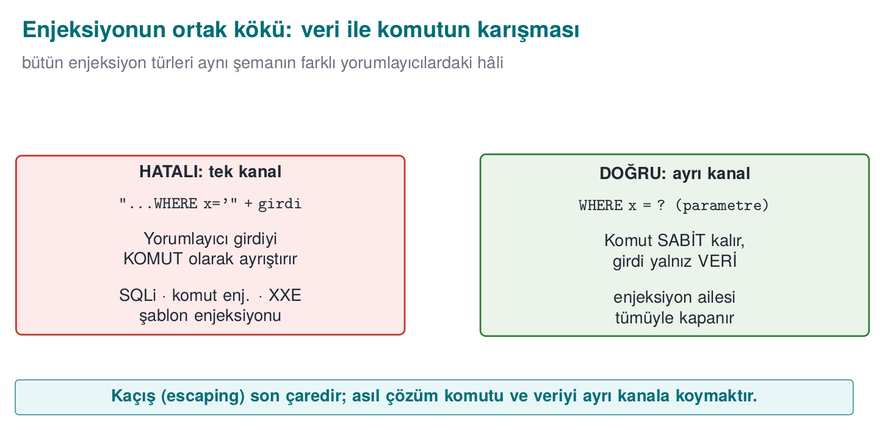
CEN429 Secure Programming · Week 5
The root of injection — data or code? — diagram
RTEU Computer Engineering · 2026-2027 Fall
19

Slide 20
CEN429 Secure Programming · Week 5
The common root of the fix
The same principle in every injection type:
• Separate data from code (a parameterised API).
• Never embed data into a command via string concatenation.
• Allow list + context-appropriate escaping (last resort).
RTEU Computer Engineering · 2026-2027 Fall
20

Slide 21
CEN429 Secure Programming · Week 5
One channel or two channels? — table
Interpreter | One channel (wrong) | Two channels (correct)
SQL engine | "...WHERE name='" + name + "'" | PreparedStatement + ?
Shell | exec("sh -c '...' " + host) | ProcessBuilder(...) — no shell
File system | new File(root, request) | Canonicalise + root check
XML | Building XML by string concatenation | Building elements with a DOM/StAX API
Same principle, four different interpreters.
RTEU Computer Engineering · 2026-2027 Fall
21

Slide 22
CEN429 Secure Programming · Week 5
Injection families (today)
• SQL injection
• Command injection
• Path traversal
• Deserialisation
• XML/XXE, templates, XSS
All share the same root and the same fix logic.
RTEU Computer Engineering · 2026-2027 Fall
22

Slide 23
CEN429 Secure Programming · Week 5
Rule of this section
A managed language solves the memory bug; it does not solve injection.
• The root of injection is always the same: data = command.
• The fix is always the same: separate data from code.
• We will now see this principle applied to each injection type in turn.
RTEU Computer Engineering · 2026-2027 Fall
23

Slide 24
CEN429 Secure Programming · Week 5
Section 1 — quick check
1. Which error class does a managed language largely solve?
2. What does it not solve?
3. What is the common root of injection?
RTEU Computer Engineering · 2026-2027 Fall
24
Notes:
Speaker note: Next, SQL injection.

Slide 25
CEN429 Secure Programming · Week 5
Section 1 — answers
1. Memory-safety bugs (buffer overflow, use-after-free, double/dangling pointer) — through the GC + bounds checking.
2. Logic/injection/authorisation bugs, unsafe deserialisation, weak cryptography, dependency flaws — these are above the language, unsolved.
3. Untrusted DATA mixing with CODE/command in the same channel; the interpreter parses the data as a command.
RTEU Computer Engineering · 2026-2027 Fall
25

Slide 26
CEN429 Secure Programming · Week 5
2. SQL injection
RTEU Computer Engineering · 2026-2027 Fall
26

Slide 27
CEN429 Secure Programming · Week 5
Buggy code
String q = "SELECT * FROM users WHERE name = '" + name + "'";
stmt.executeQuery(q); // WRONG: name leaks into the query
What if name contains a quote and SQL?
RTEU Computer Engineering · 2026-2027 Fall
27

Slide 28
CEN429 Secure Programming · Week 5
Attack · example
The user enters this as name:
' OR '1'='1
The query becomes:
SELECT * FROM users WHERE name = '' OR '1'='1'
'1'='1' is always true → all rows are returned.
RTEU Computer Engineering · 2026-2027 Fall
28

Slide 29
CEN429 Secure Programming · Week 5
Why did it happen?
• name was concatenated into the query text.
• The quote closed the data and moved into the command part.
• Data and command got mixed.
RTEU Computer Engineering · 2026-2027 Fall
29

Slide 30
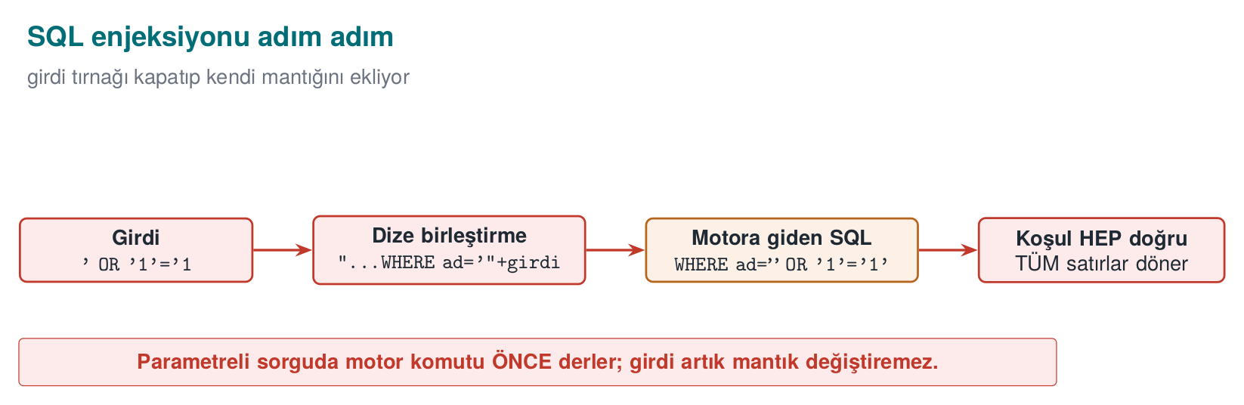
CEN429 Secure Programming · Week 5
SQL injection step by step — diagram
RTEU Computer Engineering · 2026-2027 Fall
30

Slide 31
CEN429 Secure Programming · Week 5
Correct · parameterised query
PreparedStatement ps =
con.prepareStatement("SELECT * FROM users WHERE name = ?");
ps.setString(1, name); // name is only DATA
ps.executeQuery();
? is a parameter; name is never interpreted as a command.
RTEU Computer Engineering · 2026-2027 Fall
31

Slide 32
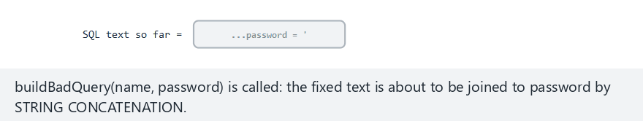
CEN429 Secure Programming · Week 5
SQL injection — animation
RTEU Computer Engineering · 2026-2027 Fall
32
Notes:
Speaker note: The first quote typed into the password field closes the string literal; every character after it is now read as SQL SYNTAX, not DATA. In a parameterized query the same characters stay a single VALUE. Show the "Edge case" examples from the picker too.

Slide 33
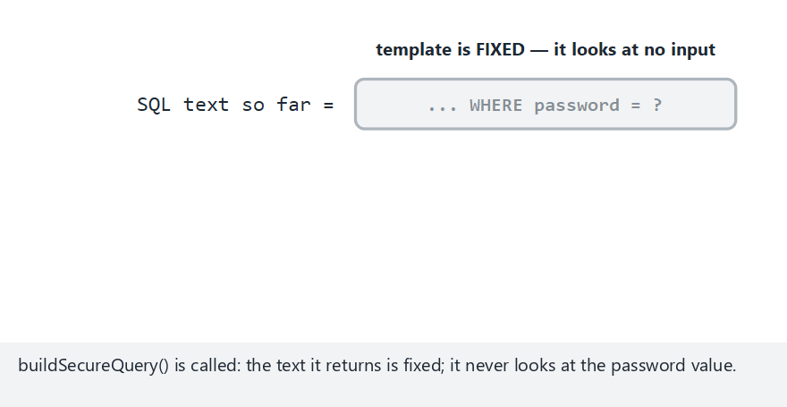
CEN429 Secure Programming · Week 5
SQL injection — edge case: even a single quote is harmless in a parameterized query
RTEU Computer Engineering · 2026-2027 Fall
33
Notes:
Speaker note: The same dangerous character (a single quote) this time in a parameterized query: the query's STRUCTURE never changes, the quote stays just part of the VALUE.

Slide 34
CEN429 Secure Programming · Week 5
Why does it work?
• The query skeleton is sent (compiled) to the database beforehand.
• ad is bound afterwards as data.
• Even if it contains a quote, it stays data.
RTEU Computer Engineering · 2026-2027 Fall
34

Slide 35
CEN429 Secure Programming · Week 5
Other layers
• Least privilege: the application's DB user should do only what is needed.
• Input validation: an allow list, regardless.
• If you use an ORM, use its parameterised API too (not string concatenation).
RTEU Computer Engineering · 2026-2027 Fall
35

Slide 36
CEN429 Secure Programming · Week 5
⚠️ Escaping is the last resort
• Manually escaping quotes is error-prone; every DB is different.
• The always-first priority is a parameterised query.
• Escaping only where parameters are not possible, and carefully.
RTEU Computer Engineering · 2026-2027 Fall
36

Slide 37
CEN429 Secure Programming · Week 5
SQL injection · rule of this section
• Never build a query with string concatenation.
• Always use a parameterised query (PreparedStatement, ?).
• Use an allow list for identifiers such as column/table names.
• Escaping only as a last resort.
RTEU Computer Engineering · 2026-2027 Fall
37

Slide 38
CEN429 Secure Programming · Week 5
3. Command injection
RTEU Computer Engineering · 2026-2027 Fall
38

Slide 39
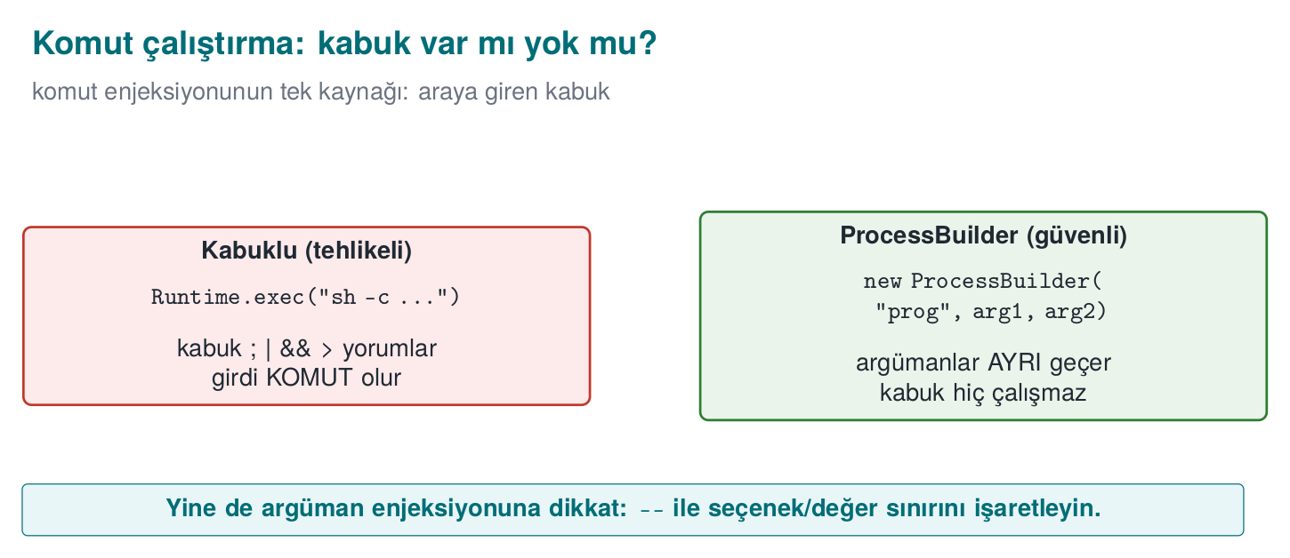
CEN429 Secure Programming · Week 5
Shell or no shell — diagram
RTEU Computer Engineering · 2026-2027 Fall
39

Slide 40
CEN429 Secure Programming · Week 5
Buggy code
Runtime.getRuntime().exec("ping " + host); // HATALI
What if host contains a shell metacharacter?
RTEU Computer Engineering · 2026-2027 Fall
40

Slide 41
CEN429 Secure Programming · Week 5
Attack · example
As host:
example.com; rm -rf data
The shell runs this as two commands: ping and rm.
(The example is synthetic; never run it.)
RTEU Computer Engineering · 2026-2027 Fall
41

Slide 42
CEN429 Secure Programming · Week 5
Why did it happen?
• The command was handed to a shell as text.
• ;, |, && are command separators in the shell.
• Data got mixed into the command line.
RTEU Computer Engineering · 2026-2027 Fall
42

Slide 43
CEN429 Secure Programming · Week 5
Correct · argument array
new ProcessBuilder("ping", "-c", "1", host).start();
• No shell; host is a single argument.
• Metacharacters are not interpreted.
RTEU Computer Engineering · 2026-2027 Fall
43

Slide 44
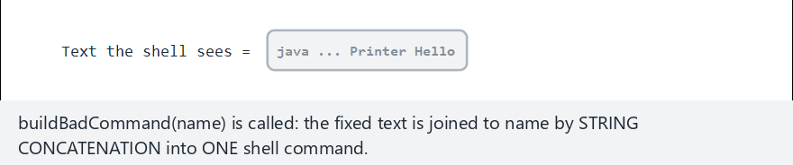
CEN429 Secure Programming · Week 5
Command injection — animation
RTEU Computer Engineering · 2026-2027 Fall
44
Notes:
Speaker note: The shell tokenizes the text first; a bare ';'/'&' token means "start a new command", not "another argument". In an argv list the same characters stay inside ONE argument, the shell never runs at all.

Slide 45
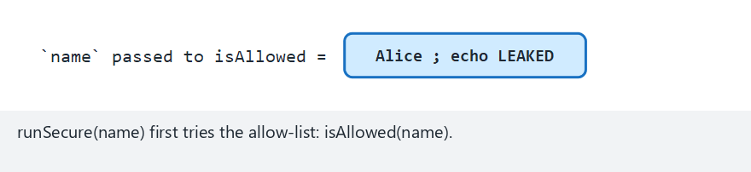
CEN429 Secure Programming · Week 5
Command injection — edge case: the same attack hits the allow-list first
RTEU Computer Engineering · 2026-2027 Fall
45
Notes:
Speaker note: `runSecure` runs `isAllowed(name)` first; this input is REJECTED right there, `buildSecureArgs`/`ProcessBuilder` is never even called. Two independent layers of defence: the allow-list, and the argv list.

Slide 46
CEN429 Secure Programming · Week 5
Additional rules
• Where possible, do not run an external command at all; use a library API.
• If you must: a fixed path, an argument array, an allow list.
• Similar to ENV33-C: calling system()/a shell.
RTEU Computer Engineering · 2026-2027 Fall
46

Slide 47
CEN429 Secure Programming · Week 5
Command injection · rule of this section
• Where possible, never run an external command.
• If you must: a shell-less argument array (ProcessBuilder).
• A fixed path + allow list; watch input starting with - (argument injection).
RTEU Computer Engineering · 2026-2027 Fall
47

Slide 48
CEN429 Secure Programming · Week 5
4. Path traversal
RTEU Computer Engineering · 2026-2027 Fall
48

Slide 49
CEN429 Secure Programming · Week 5
Path traversal
• Path traversal: escaping outside the allowed folder with ../.
• Like files/../../etc/passwd.
• Prevented with canonicalisation + a root check.
RTEU Computer Engineering · 2026-2027 Fall
49

Slide 50
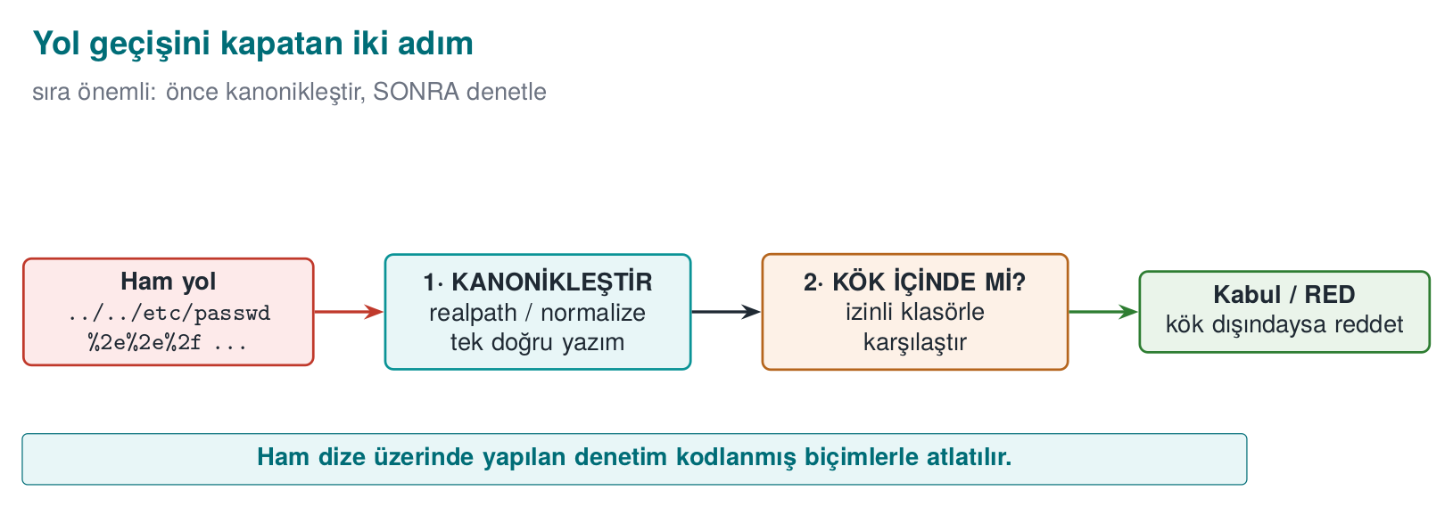
CEN429 Secure Programming · Week 5
Two steps that close off path traversal — diagram
RTEU Computer Engineering · 2026-2027 Fall
50

Slide 51
CEN429 Secure Programming · Week 5
Buggy code
File f = new File("uploads/" + name); // WRONG
What if name contains ../?
RTEU Computer Engineering · 2026-2027 Fall
51

Slide 52
CEN429 Secure Programming · Week 5
Attack · example
As name:
../../etc/passwd
Result: uploads/../../etc/passwd → outside the allowed folder.
RTEU Computer Engineering · 2026-2027 Fall
52

Slide 53
CEN429 Secure Programming · Week 5
Why did it happen?
• name was appended directly into the file path.
• The ../ sequence was read by the interpreter (the file system) as "go up a folder."
• There was no check: whether the folder was left was never even asked.
RTEU Computer Engineering · 2026-2027 Fall
53

Slide 54
CEN429 Secure Programming · Week 5
Correct · canonicalise + root check
Path root = Paths.get("uploads").toRealPath();
Path target = root.resolve(name).normalize().toRealPath();
if (!target.startsWith(root)) throw new SecurityException();
Is the canonical path inside the root? If not, reject.
RTEU Computer Engineering · 2026-2027 Fall
54

Slide 55
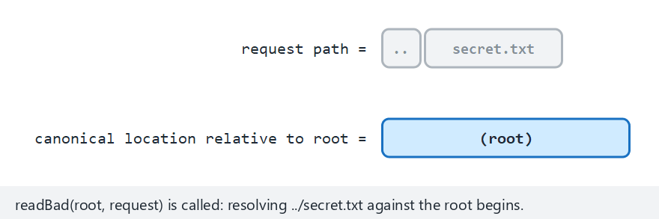
CEN429 Secure Programming · Week 5
Path traversal — animation
RTEU Computer Engineering · 2026-2027 Fall
55
Notes:
Speaker note: The request is processed segment by segment; a '..' while already at the root is an attempt to leave the root. The insecure path reads without ever checking; the secure path canonicalizes and checks against the root.

Slide 56
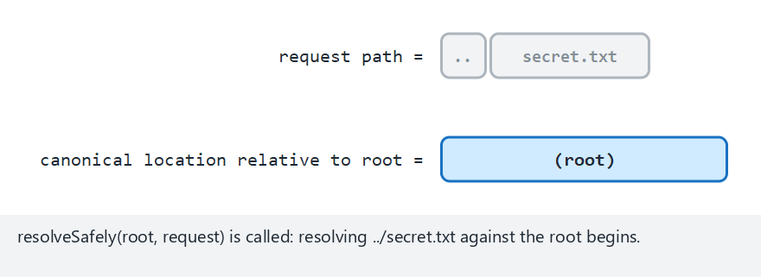
CEN429 Secure Programming · Week 5
Path traversal — edge case: the secure version rejects the same attack
RTEU Computer Engineering · 2026-2027 Fall
56
Notes:
Speaker note: The same '../secret.txt' request, this time through resolveSafely: the canonical path lands outside the root, so it returns null and the file is never read.

Slide 57
CEN429 Secure Programming · Week 5
Why does it work?
• First the path is turned canonical (single, definite).
• Then we check whether the canonical path is inside the root.
• ../, an encoded form (..%2f), or a symbolic link — all of them land on the same real path after canonicalisation; none of them can escape the check.
RTEU Computer Engineering · 2026-2027 Fall
57

Slide 58
CEN429 Secure Programming · Week 5
Path traversal · extra
• Restrict the file name to an allow list ([a-zA-Z0-9_.-]).
• Symbolic links (symlink) are resolved by canonicalisation.
• Do not make a user name directly into a file name.
RTEU Computer Engineering · 2026-2027 Fall
58

Slide 59
CEN429 Secure Programming · Week 5
Path traversal · rule of this section
• Never trust the raw string (contains("..") is not enough).
• First canonicalise, then check whether it is inside the root.
• Resolve symbolic links too (toRealPath()); repeat the check after the file is opened as well.
RTEU Computer Engineering · 2026-2027 Fall
59

Slide 60
CEN429 Secure Programming · Week 5
Three injections · common lesson
Type | Wrong | Correct
SQL | String concatenation | Parameterised query
Command | Text to the shell | Argument array
Path | Concatenating ../ | Canonicalise + root check
Same root: separate data from code/command.
RTEU Computer Engineering · 2026-2027 Fall
60

Slide 61
CEN429 Secure Programming · Week 5
Sections 2–4 — quick check
1. Why does ' OR '1'='1 return all rows?
2. Why is a ProcessBuilder argument array safe?
3. Which two steps close off path traversal?
RTEU Computer Engineering · 2026-2027 Fall
61
Notes:
Speaker note: Next, deserialisation and XML.

Slide 62
CEN429 Secure Programming · Week 5
Sections 2–4 — answers
1. Once joined into the string it makes the WHERE condition always true → all rows (data was parsed as code).
2. Arguments pass to the program, not the shell, one by one; there is no metacharacter interpretation (; |) → command injection is closed off.
3. (1) Convert to a canonical path (realpath/normalise), (2) verify it is inside the allowed root directory (an allow list). Never put user input directly into a path.
RTEU Computer Engineering · 2026-2027 Fall
62

Slide 63
CEN429 Secure Programming · Week 5
5. Unsafe deserialisation
RTEU Computer Engineering · 2026-2027 Fall
63

Slide 64
CEN429 Secure Programming · Week 5
Serialisation
• Serialisation: converting an object to a byte sequence (to save or send it).
• Deserialisation: converting the bytes back into an object.
• Deserialising untrusted bytes is dangerous (code execution).
RTEU Computer Engineering · 2026-2027 Fall
64

Slide 65
CEN429 Secure Programming · Week 5
Buggy code
Object o = new ObjectInputStream(giris).readObject(); // TEHLİKELİ
What if giris comes from an untrusted source?
RTEU Computer Engineering · 2026-2027 Fall
65

Slide 66
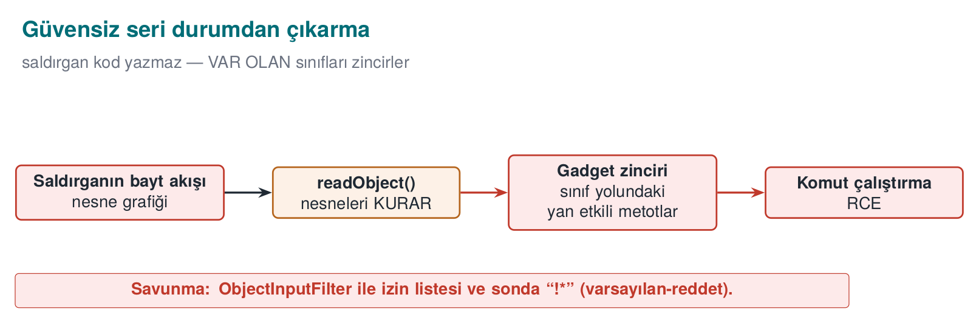
CEN429 Secure Programming · Week 5
Deserialisation gadget chain — diagram
RTEU Computer Engineering · 2026-2027 Fall
66

Slide 67
CEN429 Secure Programming · Week 5
The problem
• Turning untrusted bytes into an object is dangerous.
• In Java, ObjectInputStream.readObject() can run code while unpacking (gadget chains).
• Result: remote code execution.
RTEU Computer Engineering · 2026-2027 Fall
67

Slide 68
CEN429 Secure Programming · Week 5
Why is this so bad?
• Objects' constructors/methods run during unpacking.
• If suitable libraries (gadgets) are present, they can be chained to run commands.
• Input that looks like "just data" behaves like code.
RTEU Computer Engineering · 2026-2027 Fall
68

Slide 69
CEN429 Secure Programming · Week 5
Correct · best: do not do it at all
• Do not deserialise untrusted data with native serialisation.
• Use a JSON/data format + a strict schema instead.
• Read only the fields you expect.
RTEU Computer Engineering · 2026-2027 Fall
69

Slide 70
CEN429 Secure Programming · Week 5
If you must · filter
ObjectInputFilter f = ObjectInputFilter.Config
.createFilter("com.app.*;!*"); // allowed classes only
ois.setObjectInputFilter(f);
If a single class is expected, a narrower pattern also works:
ois.setObjectInputFilter(ObjectInputFilter.Config
.createFilter("com.app.Session;!*")); // this class only
• Allow list: only the expected classes.
• Also set a depth/size limit (against DoS).
RTEU Computer Engineering · 2026-2027 Fall
70

Slide 71
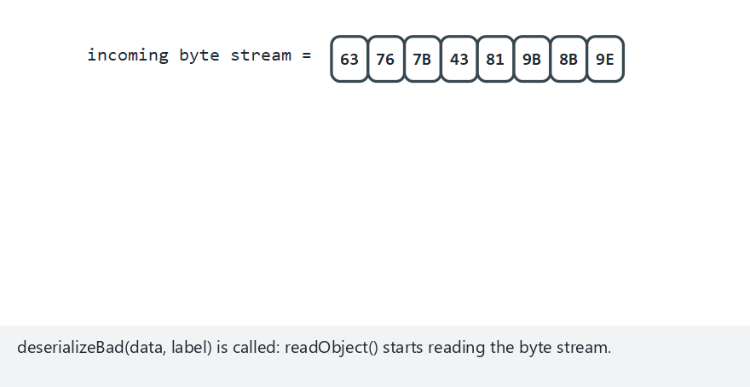
CEN429 Secure Programming · Week 5
Deserialization — animation
RTEU Computer Engineering · 2026-2027 Fall
71
Notes:
Speaker note: An unfiltered stream instantiates whatever class it names, no matter what. A filtered stream checks the class name against the allow-list pattern first; no match -> InvalidClassException, the class is never built at all.

Slide 72
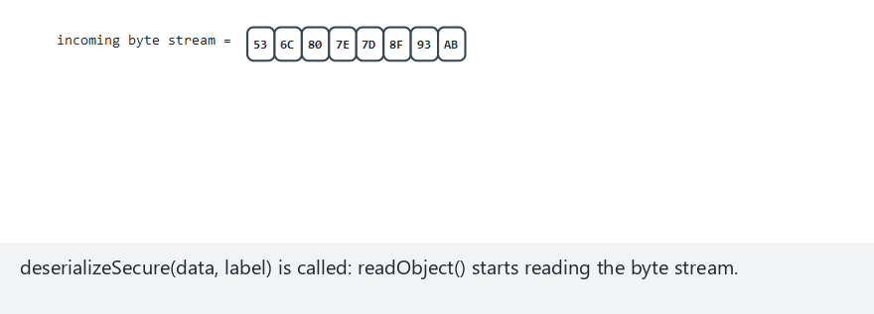
CEN429 Secure Programming · Week 5
Deserialization — edge case: the filter rejects an unexpected class
RTEU Computer Engineering · 2026-2027 Fall
72
Notes:
Speaker note: This time ObjectInputFilter IS active; the class name in the stream matches no part of the pattern, InvalidClassException is thrown, the object is NEVER built.

Slide 73
CEN429 Secure Programming · Week 5
Deserialisation · rule of this section
• Deserialising an untrusted byte stream hands the attacker the power to choose a class.
• Best: do not do it at all (JSON + a strict schema).
• If you must: an allow-list filter, a depth/size limit.
RTEU Computer Engineering · 2026-2027 Fall
73

Slide 74
CEN429 Secure Programming · Week 5
6. XML, templates, XSS
RTEU Computer Engineering · 2026-2027 Fall
74

Slide 75
CEN429 Secure Programming · Week 5
XML and XXE
• XML: a structured data format (built from tags).
• XXE (XML External Entity): abuse of XML's "external entity" feature → file reading, SSRF.
• External entities are disabled in the XML parser.
RTEU Computer Engineering · 2026-2027 Fall
75

Slide 76
CEN429 Secure Programming · Week 5
XXE · the problem
• XML lets you define an external entity; the parser resolves it.
• An attacker can use this to read files or make the server issue a request (SSRF).
RTEU Computer Engineering · 2026-2027 Fall
76

Slide 77
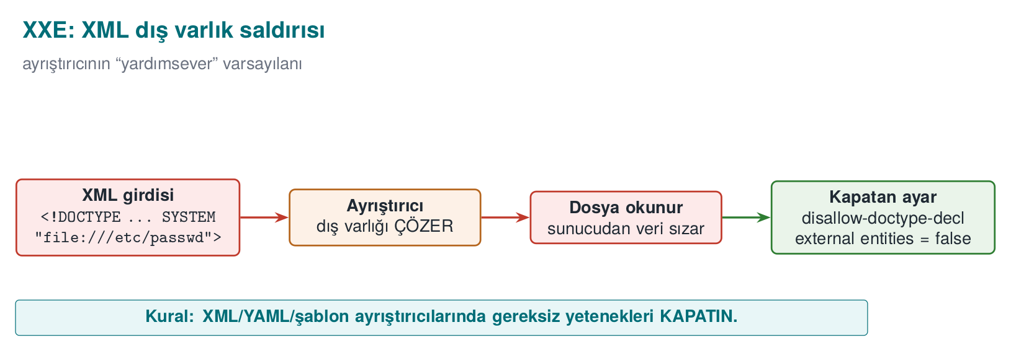
CEN429 Secure Programming · Week 5
XXE — diagram
RTEU Computer Engineering · 2026-2027 Fall
77

Slide 78
CEN429 Secure Programming · Week 5
XXE · correct
dbf.setFeature(
"http://apache.org/xml/features/disallow-doctype-decl", true);
// ya da dış varlıkları kapat
• Disable external entities, reject DOCTYPE.
• A one-line setting in most libraries.
RTEU Computer Engineering · 2026-2027 Fall
78

Slide 79
CEN429 Secure Programming · Week 5
Template injection (SSTI)
• Handing user input to a template engine as the template itself.
• The engine can run it like code.
• Rule: user input is data, the template is fixed.
RTEU Computer Engineering · 2026-2027 Fall
79

Slide 80
CEN429 Secure Programming · Week 5
XSS (briefly)
• XSS: user data leaking into a web page as HTML/JS.
• Fix: context-appropriate output encoding (HTML-encode), CSP.
• Same root again: data ≠ code.
RTEU Computer Engineering · 2026-2027 Fall
80

Slide 81
CEN429 Secure Programming · Week 5
XML/template/XSS · rule of this section
• Know which feature of the interpreter is turned on, and disable what is not needed.
• XML: external entities + DOCTYPE disabled.
• Templates: user data is only a variable, never the template itself.
• HTML: encode output context-appropriately.
RTEU Computer Engineering · 2026-2027 Fall
81

Slide 82
CEN429 Secure Programming · Week 5
7. The same bugs in Python and JavaScript
RTEU Computer Engineering · 2026-2027 Fall
82

Slide 83
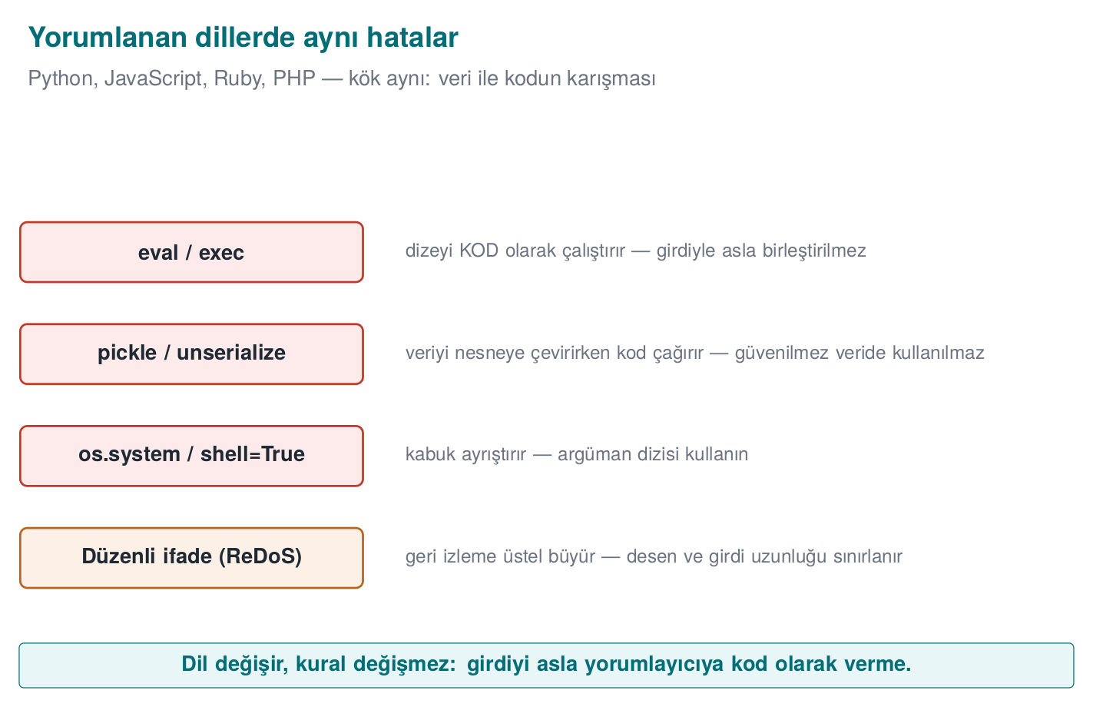
CEN429 Secure Programming · Week 5
The same bugs in interpreted languages — diagram
RTEU Computer Engineering · 2026-2027 Fall
83

Slide 84
CEN429 Secure Programming · Week 5
Same root, different language
• Injection exists in every language: Python os.system, JS child_process.
• The fix is the same: an argument array, a parameterised query.
RTEU Computer Engineering · 2026-2027 Fall
84

Slide 85
CEN429 Secure Programming · Week 5
Python · examples
• os.system("cmd " + x) → command injection; use subprocess.run([...]).
• eval(input) / pickle.loads(untrusted) → never with untrusted data.
• SQL: parameterised (cursor.execute("... ?", (x,))).
RTEU Computer Engineering · 2026-2027 Fall
85

Slide 86
CEN429 Secure Programming · Week 5
Python · eval example (code)
value = eval(input_text) # WRONG: any Python expression
import ast
value = ast.literal_eval(input_text) # Better: literals only
value = int(input_text) # Best: parse the expected type
Rule: user data must never reach eval.
RTEU Computer Engineering · 2026-2027 Fall
86

Slide 87
CEN429 Secure Programming · Week 5
ReDoS (regular expression DoS)
• A bad regex can spend exponential time on certain input.
• An attacker can use this to lock up the CPU.
• Fix: a safe regex, an input-length limit, a timeout.
RTEU Computer Engineering · 2026-2027 Fall
87

Slide 88
CEN429 Secure Programming · Week 5
ReDoS · a concrete example
Desen: ^(a+)+$
Girdi: "aaaaaaaaaaaaaaaaaaaaaaaaaaaaa!"
• The engine tries millions of paths to prove there is no match.
• A single request locks the CPU for seconds/minutes (CWE-1333).
RTEU Computer Engineering · 2026-2027 Fall
88

Slide 89
CEN429 Secure Programming · Week 5
JavaScript · prototype pollution
• Prototype pollution: an attacker corrupts a property shared by all objects, through __proto__.
• Unexpected behaviour, authorisation bypass.
• Fix: safe merging, Object.create(null), up-to-date libraries.
RTEU Computer Engineering · 2026-2027 Fall
89

Slide 90
CEN429 Secure Programming · Week 5
Interpreted languages · common rule
• eval, exec, pickle, dynamic require → do not use with untrusted data.
• Input validation + a parameterised API + up-to-date dependencies.
RTEU Computer Engineering · 2026-2027 Fall
90

Slide 91
CEN429 Secure Programming · Week 5
Sections 5–9 — quick check
1. Why can unsafe deserialisation run code?
2. Which setting disables XXE?
3. What is ReDoS, and how is it mitigated?
RTEU Computer Engineering · 2026-2027 Fall
91
Notes:
Speaker note: Next, bytecode and obfuscation.

Slide 92
CEN429 Secure Programming · Week 5
Sections 5–9 — answers
1. While an object is being constructed, classes' side-effecting methods (readObject/gadget chain) fire → an attacker builds a flow using the object graph.
2. The parser setting that disables external entities and DOCTYPE (disallow-doctype-decl, external entities off).
3. ReDoS: a catastrophic-backtracking regex; bad input → exponential time → the CPU locks up. Mitigation: a linear-time engine (RE2), avoid nested quantifiers, a length/time limit.
RTEU Computer Engineering · 2026-2027 Fall
92

Slide 93
CEN429 Secure Programming · Week 5
8. Bytecode and decompilation
RTEU Computer Engineering · 2026-2027 Fall
93

Slide 94
CEN429 Secure Programming · Week 5
The JVM and bytecode
• JVM (Java Virtual Machine): the virtual machine that runs Java.
• Bytecode: the intermediate form Java source is compiled into (.class files).
• Bytecode is machine-independent; the JVM executes it.
RTEU Computer Engineering · 2026-2027 Fall
94

Slide 95
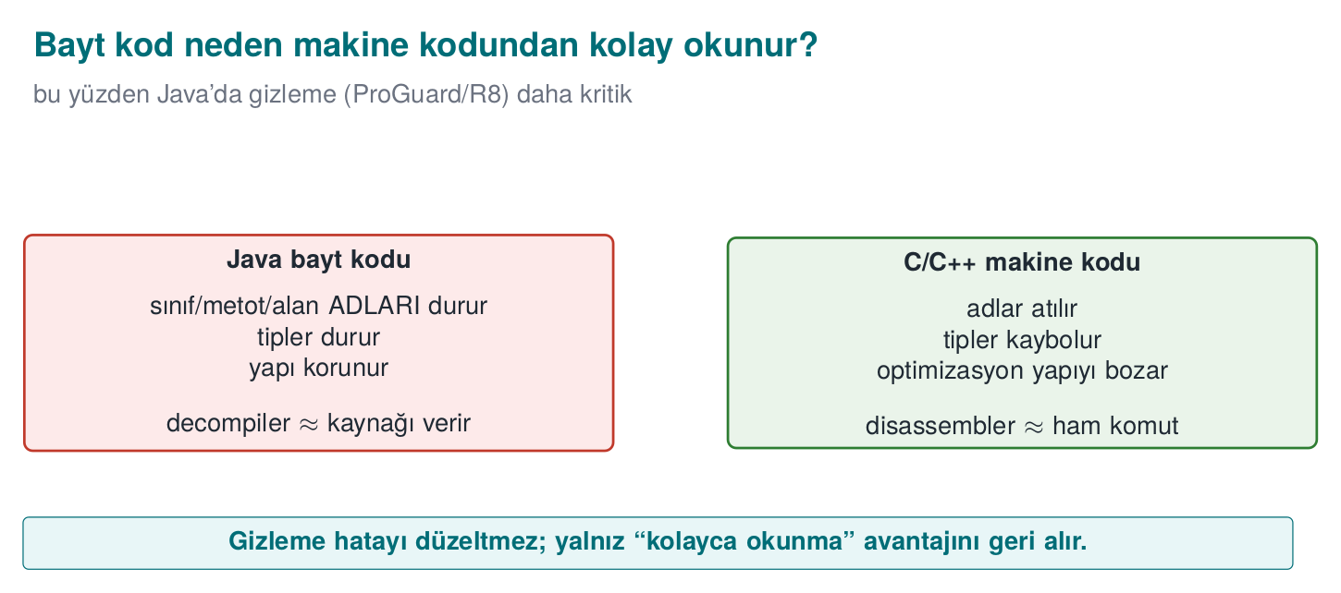
CEN429 Secure Programming · Week 5
Bytecode vs machine code — diagram
RTEU Computer Engineering · 2026-2027 Fall
95

Slide 96
CEN429 Secure Programming · Week 5
Java bytecode is easy to read
• .class/.jar bytecode decompiles back very close to the source.
• Tools: javap (disassembly), JD-GUI/CFR/Procyon (decompilation).
• Names, strings, structure are largely visible.
RTEU Computer Engineering · 2026-2027 Fall
96

Slide 97
CEN429 Secure Programming · Week 5
javap example
javap -c -p Application.class # disassemble the bytecode
• Method names, calls, constants are visible.
• This is exactly why obfuscation is even more necessary in Java.
RTEU Computer Engineering · 2026-2027 Fall
97

Slide 98
CEN429 Secure Programming · Week 5
javap output — what is visible?
private static final java.lang.String VALID_PIN;
static boolean pinCorrect(java.lang.String);
Code:
0: ldc #9 // String 4729
2: aload_0
3: invokevirtual #11 // String.equals
6: ireturn
There is no source code, but the constant (4729), the names (VALID_PIN, pinCorrect) and the logic ("compare the input against this constant") are plainly visible.
RTEU Computer Engineering · 2026-2027 Fall
98

Slide 99
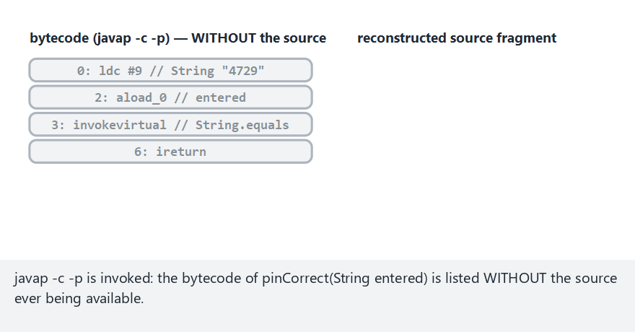
CEN429 Secure Programming · Week 5
From bytecode to source — animation
RTEU Computer Engineering · 2026-2027 Fall
99
Notes:
Speaker note: The four bytecode instructions (ldc, aload_0, invokevirtual, ireturn) map one at a time onto source fragments; by the end, `return VALID_PIN.equals(entered);` is fully reconstructed.

Slide 100
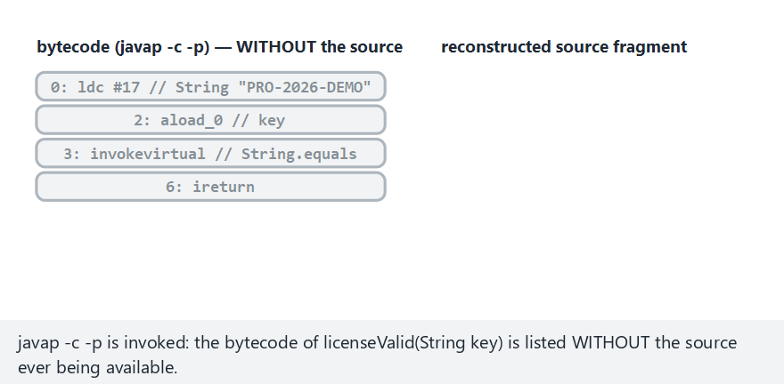
CEN429 Secure Programming · Week 5
From bytecode to source — edge case: the license check, wrong year
RTEU Computer Engineering · 2026-2027 Fall
100
Notes:
Speaker note: The same four bytecode instructions this time for `licenseValid`; the candidate does not match `LICENSE_KEY` exactly, so the logic read from the bytecode gives `false`.

Slide 101
CEN429 Secure Programming · Week 5
Why is it easier than C?
• Bytecode is high-level and carries type information.
• Variable/method names are mostly preserved.
• → reverse engineering is cheap; obfuscation is essential.
RTEU Computer Engineering · 2026-2027 Fall
101

Slide 102
CEN429 Secure Programming · Week 5
⚠️ There are no secrets on the client
• Obfuscation makes this harder, but it does not really hide the secret.
• A key/password that does not have to live on the client → keep it on the server.
• A secret that has to live on the client needs whitebox cryptography (Week 11).
RTEU Computer Engineering · 2026-2027 Fall
102

Slide 103
CEN429 Secure Programming · Week 5
9. ProGuard and R8
RTEU Computer Engineering · 2026-2027 Fall
103

Slide 104
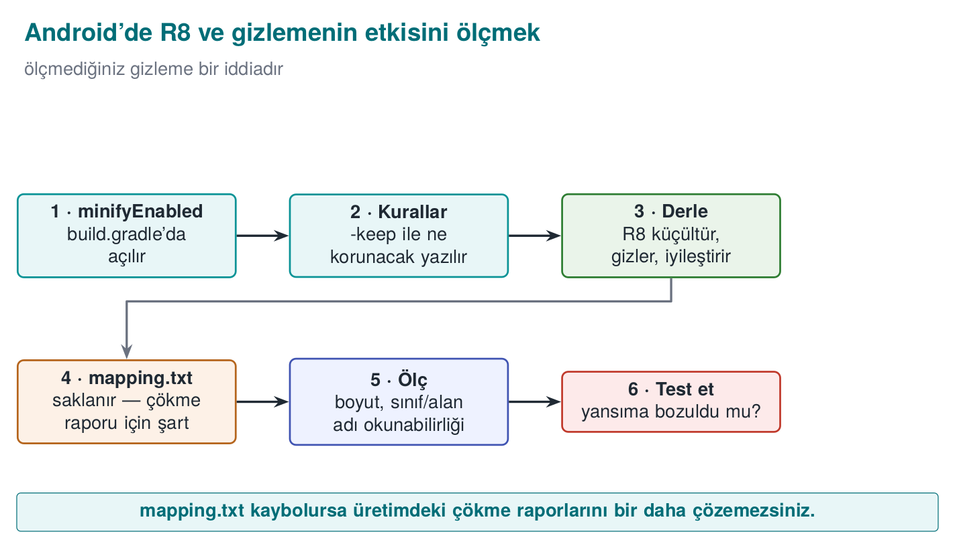
CEN429 Secure Programming · Week 5
R8 and the measurement steps — diagram
RTEU Computer Engineering · 2026-2027 Fall
104

Slide 105
CEN429 Secure Programming · Week 5
What do ProGuard/R8 do?
Three jobs:
• Shrinking: drops unused code.
• Optimisation: simplifies the code.
• Obfuscation: makes names meaningless (a, b, c).
RTEU Computer Engineering · 2026-2027 Fall
105

Slide 106
CEN429 Secure Programming · Week 5
ProGuard/R8 · four stages — table
Stage | What it does | Security contribution
Shrinking | Drops unused code | Attack surface shrinks
Optimisation | Inlining, constant folding | Structure moves away from the source
Obfuscation | Turns names into a, b, c | Meaningful names disappear
Preverification | Verification info for older JVMs | —
RTEU Computer Engineering · 2026-2027 Fall
106

Slide 107
CEN429 Secure Programming · Week 5
Name obfuscation example
LicenseChecker.verify() → a.b()
• Meaningful names disappear.
• The map gets harder for a reverse engineer.
• Removing dead code shrinks the binary.
RTEU Computer Engineering · 2026-2027 Fall
107

Slide 108
CEN429 Secure Programming · Week 5
Why is -keep needed?
• Code called by name through reflection (an API, entry points, JNI) must be kept.
• If obfuscation changes the name, the call breaks.
-keep class com.app.Api { public *; }
For multiple entry points and annotation-marked members:
-keep class com.app.PublicApi { public *; }
-keepclassmembers class * {
@com.app.Reflected *;
}
RTEU Computer Engineering · 2026-2027 Fall
108

Slide 109
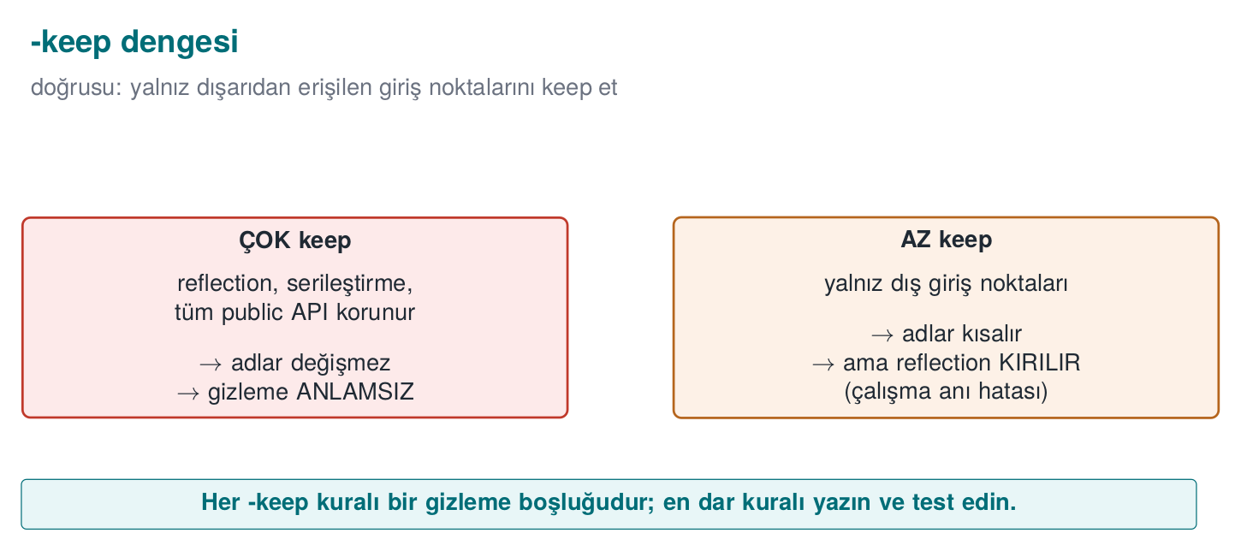
CEN429 Secure Programming · Week 5
The -keep balance — diagram
RTEU Computer Engineering · 2026-2027 Fall
109

Slide 110
CEN429 Secure Programming · Week 5
The -keep balance
• Too little `-keep`: the application crashes (reflection breaks).
• Too much `-keep`: obfuscation is weakened (everything stays exposed).
• Keep only the entry points that are genuinely required.
• Test flows that use reflection — any crash after obfuscation?
RTEU Computer Engineering · 2026-2027 Fall
110

Slide 111
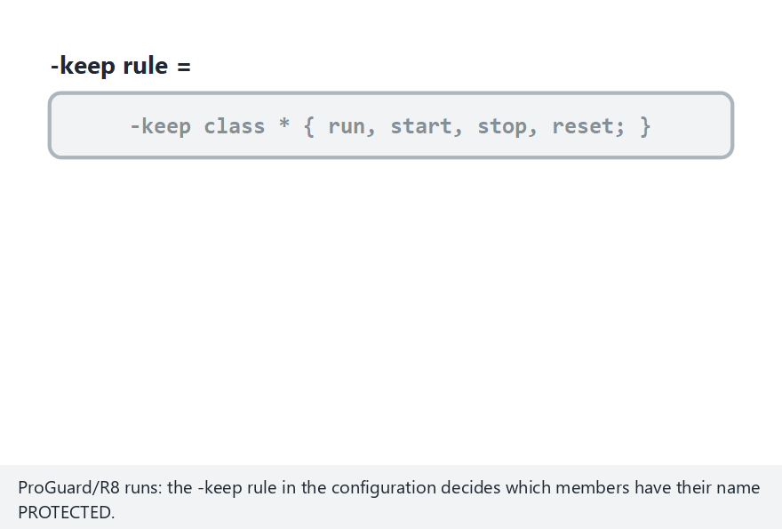
CEN429 Secure Programming · Week 5
ProGuard/R8 — animation
RTEU Computer Engineering · 2026-2027 Fall
111
Notes:
Speaker note: Every member is either kept because it matches a -keep rule, or renamed to a short a/b/c-style name. In this edge case -keep covers EVERY member -- nothing gets renamed, obfuscation accomplishes nothing.

Slide 112
CEN429 Secure Programming · Week 5
The mapping file
• R8 produces a mapping.txt: obfuscated name → real name.
• It is kept secret (not shipped), but it is retained to decode crash traces.
• Archived together with the version identifier.
RTEU Computer Engineering · 2026-2027 Fall
112

Slide 113
CEN429 Secure Programming · Week 5
Mapping file · example (mapping.txt)
com.example.payment.CardManager -> com.example.a:
android.content.Context context -> a
boolean setDefaultCard(java.lang.String) -> b
Old name → new name. This file completely undoes the obfuscation.
RTEU Computer Engineering · 2026-2027 Fall
113

Slide 114
CEN429 Secure Programming · Week 5
ProGuard/R8 · rule of this section
• Shrink + optimise + obfuscate; it does not obfuscate strings.
• -keep only for what is genuinely called through reflection/JNI.
• mapping.txt is a secret: keep it, do not distribute it.
RTEU Computer Engineering · 2026-2027 Fall
114

Slide 115
CEN429 Secure Programming · Week 5
10. String obfuscation and reflection
RTEU Computer Engineering · 2026-2027 Fall
115

Slide 116
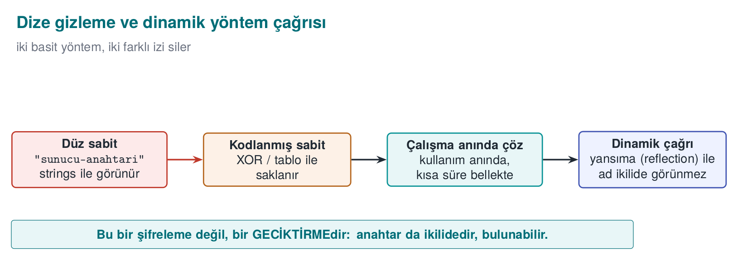
CEN429 Secure Programming · Week 5
String obfuscation and dynamic invocation — diagram
RTEU Computer Engineering · 2026-2027 Fall
116

Slide 117
CEN429 Secure Programming · Week 5
Strings are exposed in Java
• Constant strings inside .class appear in the clear (strings, a decompiler).
• Sensitive URLs, key fragments, messages leak.
RTEU Computer Engineering · 2026-2027 Fall
117

Slide 118
CEN429 Secure Programming · Week 5
String obfuscation
• Strings are encoded at build time, decoded at use.
• Same rule as Week 4: it stops strings, it does not keep a secret.
• The decoding code is also in the bytecode → limited protection.
RTEU Computer Engineering · 2026-2027 Fall
118

Slide 119
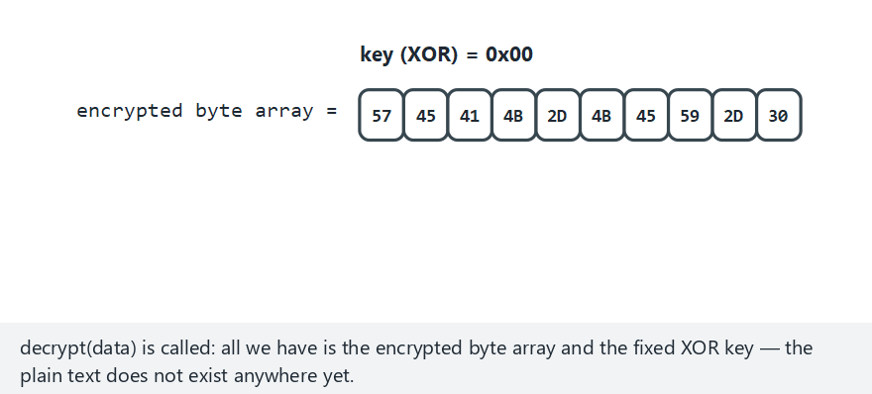
CEN429 Secure Programming · Week 5
String obfuscation — animation
RTEU Computer Engineering · 2026-2027 Fall
119
Notes:
Speaker note: The encrypted byte array is processed byte by byte, building the decrypted string live. In this edge case the key is 0x00 -- the "encrypted" bytes are already identical to the plain text; a "0" XOR key hides nothing.

Slide 120
CEN429 Secure Programming · Week 5
⚠️ Reflection conflicts with obfuscation
• A call by name (getMethod("verify")) breaks after obfuscation.
• Fix: either -keep, or drop reflection and call directly.
• Reducing reflection is good for both security and obfuscation.
RTEU Computer Engineering · 2026-2027 Fall
120

Slide 121
CEN429 Secure Programming · Week 5
11. Android R8 and measurement
RTEU Computer Engineering · 2026-2027 Fall
121

Slide 122
CEN429 Secure Programming · Week 5
R8 on Android
• R8 is the default shrinker/obfuscator of the Android build.
• minifyEnabled true + proguard-rules.pro.
• Produces DEX (Android bytecode).
RTEU Computer Engineering · 2026-2027 Fall
122

Slide 123
CEN429 Secure Programming · Week 5
Turning R8 on for the release build
android { buildTypes { release {
minifyEnabled true
shrinkResources true
proguardFiles getDefaultProguardFile('proguard-android-optimize.txt'),
'proguard-rules.pro'
}}}
The debug build is not obfuscated; verify that the shipped build is the release one. A plain Java/Gradle project without Android needs only a simpler form:
buildTypes { release {
minifyEnabled true
proguardFiles(..., 'proguard-rules.pro')
}}
RTEU Computer Engineering · 2026-2027 Fall
123

Slide 124
CEN429 Secure Programming · Week 5
Measuring the effect of obfuscation
• Before/after obfuscation:
  – the ratio of meaningful names
  – the count of plain-text sensitive strings
  – APK size
• Measure it and write it into S9 (the measurement logic from Week 9).
RTEU Computer Engineering · 2026-2027 Fall
124

Slide 125
CEN429 Secure Programming · Week 5
Measurement table — extended
Metric | Expected change
Number of classes/methods | Decreases with shrinking
Meaningful-name ratio | Drops sharply with obfuscation
Plain-text sensitive strings | Goes to zero with string obfuscation
Package size | Decreases with shrinking
Number of log calls | Zero in the release
Time to locate a check | Increases (human trial)
RTEU Computer Engineering · 2026-2027 Fall
125

Slide 126
CEN429 Secure Programming · Week 5
Static analysis for Java
• SpotBugs, Error Prone, SonarQube.
• Checks close to the CERT Java rules.
• On every merge, in CI.
RTEU Computer Engineering · 2026-2027 Fall
126

Slide 127
CEN429 Secure Programming · Week 5
Sections 8–13 — quick check
1. Why is Java bytecode easier to read than C?
2. What is the -keep balance?
3. Why does reflection conflict with obfuscation?
RTEU Computer Engineering · 2026-2027 Fall
127
Notes:
Speaker note: Next, SBOM and dependency security.

Slide 128
CEN429 Secure Programming · Week 5
Sections 8–13 — answers
1. Bytecode is high-level; type and name metadata (class/field/method) are preserved → a decompiler produces near-source output. C compiles to machine code, discarding names.
2. The `-keep` balance: too much keep → obfuscation is weak; too little keep → reflection/serialisation breaks. Keep only the external entry points.
3. Reflection calls by string name; once the obfuscator renames it, the string no longer matches → a run-time error. Those names need to be kept (a gap in the obfuscation).
RTEU Computer Engineering · 2026-2027 Fall
128

Slide 129
CEN429 Secure Programming · Week 5
12. Dependency security and SBOM
RTEU Computer Engineering · 2026-2027 Fall
129

Slide 130
CEN429 Secure Programming · Week 5
The problem · supply chain
• Even if your own code is flawless, a flaw in a library you use affects you.
• A modern application contains hundreds of dependencies.
• "Which version do I have?" is a critical question.
RTEU Computer Engineering · 2026-2027 Fall
130

Slide 131
CEN429 Secure Programming · Week 5
Real examples
• Log4Shell (Log4j): a single library flaw affected millions of systems.
• A malicious package (typosquatting): a fake package with a similar name.
• An unmaintained/abandoned dependency.
RTEU Computer Engineering · 2026-2027 Fall
131

Slide 132
CEN429 Secure Programming · Week 5
Log4Shell · a concrete example (December 2021)
• A specific expression logged by Log4j 2 loaded and ran a class from a remote address.
• CVE-2021-44228, CVSS 10.0 (the highest score).
• The real crisis was not applying the patch: it was the question of which system had which version.
RTEU Computer Engineering · 2026-2027 Fall
132

Slide 133
CEN429 Secure Programming · Week 5
What is an SBOM?
• The software's bill of materials: which component, which version, which licence.
• When a flaw is announced, "am I affected?" is answered quickly.
RTEU Computer Engineering · 2026-2027 Fall
133

Slide 134
CEN429 Secure Programming · Week 5
SBOM formats
• CycloneDX (OWASP) — security-focused, widely used.
• SPDX (Linux Foundation) — strong on licensing too.
• Generated automatically by tools (during the build step).
RTEU Computer Engineering · 2026-2027 Fall
134

Slide 135
CEN429 Secure Programming · Week 5
A CycloneDX example (JSON, synthetic)
{
"bomFormat": "CycloneDX",
"components": [{
"type": "library", "name": "example-json", "version": "1.2.0",
"purl": "pkg:maven/com.example/example-json@1.2.0"
}]
}
Every component: name, version, purl (an ecosystem-independent, uniform identifier), a hash value.
RTEU Computer Engineering · 2026-2027 Fall
135

Slide 136
CEN429 Secure Programming · Week 5
What is VEX?
• VEX (Vulnerability Exploitability eXchange): shares "I have this flaw, but it is not exploitable" information.
• Reduces noise: not every CVE is a panic.
• Accompanies the SBOM.
RTEU Computer Engineering · 2026-2027 Fall
136

Slide 137
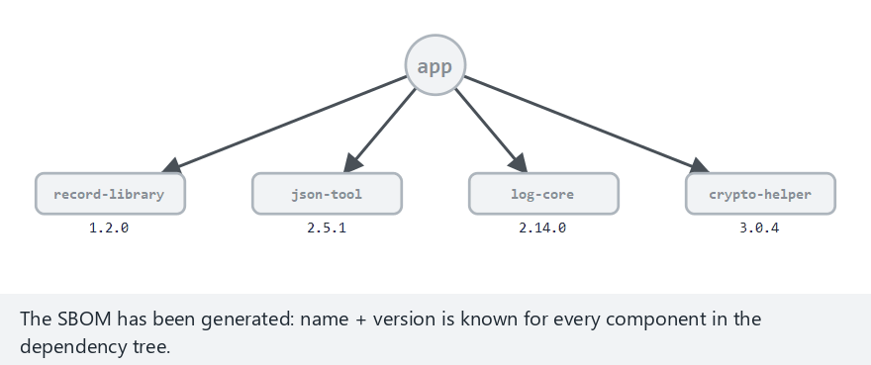
CEN429 Secure Programming · Week 5
SBOM → CVE matching — animation
RTEU Computer Engineering · 2026-2027 Fall
137
Notes:
Speaker note: Every component is checked, one at a time, by name AND exact version against the known-vulnerable list. This example is Demo 6's real SBOM -- two components (log-core, json-tool) get flagged.

Slide 138
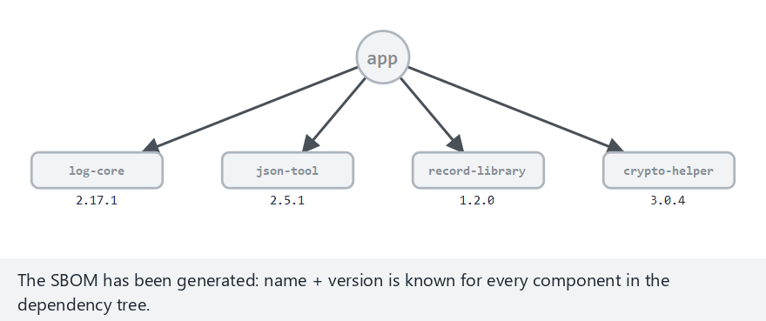
CEN429 Secure Programming · Week 5
SBOM → CVE matching — edge case: the fixed version is no longer flagged
RTEU Computer Engineering · 2026-2027 Fall
138
Notes:
Speaker note: Same name, `log-core`, but the version is now 2.17.1 (the fixed release) -- `if record and version in record["versions"]` now gives `no`, no warning at all. This is why matching the EXACT version matters.

Slide 139
CEN429 Secure Programming · Week 5
Dependency management rules
• Pin versions; do not pull "latest" at random.
• Scan for known vulnerabilities (dependency-check, npm audit, pip-audit).
• A safe update process; apply critical patches fast.
RTEU Computer Engineering · 2026-2027 Fall
139

Slide 140
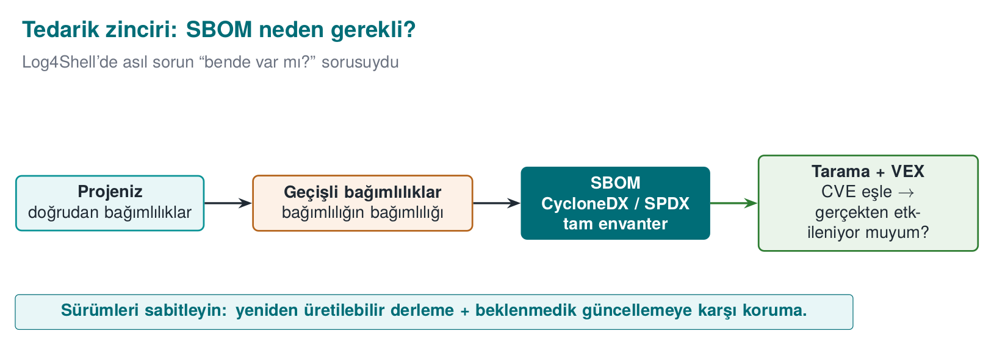
CEN429 Secure Programming · Week 5
SBOM generation · example flow
Each release's SBOM is stored with its release identifier.
# örnek: CycloneDX eklentisi
mvn org.cyclonedx:cyclonedx-maven-plugin:makeBom
dependency-check --scan . --format HTML
RTEU Computer Engineering · 2026-2027 Fall
140

Slide 141
CEN429 Secure Programming · Week 5
Link to the project
• S13: a secure development process + SBOM.
• An up-to-date SBOM and dependency scan for every release.
• Handed-off requirements: "safe updates" belong to the upstream application (Week 13).
RTEU Computer Engineering · 2026-2027 Fall
141

Slide 142
CEN429 Secure Programming · Week 5
SBOM · rule of this section
• Even if your own code is flawless, your dependency's flaw affects you.
• SBOM = the bill of materials; VEX = the answer to "am I genuinely affected?"
• Pin the version, scan continuously, apply the critical patch fast.
RTEU Computer Engineering · 2026-2027 Fall
142

Slide 143
CEN429 Secure Programming · Week 5
Section 14 — quick check
1. What is an SBOM good for?
2. Why does VEX reduce noise?
3. Why do we pin dependency versions?
RTEU Computer Engineering · 2026-2027 Fall
143
Notes:
Speaker note: Next, the project and the solved self-check.

Slide 144
CEN429 Secure Programming · Week 5
Section 14 — answers
1. SBOM = a component/dependency inventory; when a new flaw appears it answers "do I have it?" quickly.
2. VEX states whether the flaw is genuinely exploitable in the product; unaffected ones are marked "not affected" → false alarms drop.
3. A pinned version = a reproducible build + supply-chain security; it blocks an unexpected/malicious update.
RTEU Computer Engineering · 2026-2027 Fall
144

Slide 145
CEN429 Secure Programming · Week 5
Context · a login form
An application that logs a user in with a username and password.
String q = "SELECT * FROM users WHERE name='" + name +
"' AND password='" + p + "'";
Where is the mistake?
RTEU Computer Engineering · 2026-2027 Fall
145
Notes:
Speaker note: We trace a single SQL injection from buggy code to the attack, the fix, and layered defence.

Slide 146
CEN429 Secure Programming · Week 5
Step 1 · the attacker's input
Into the name field:
admin' --
-- starts a comment in SQL; everything after it is ignored.
RTEU Computer Engineering · 2026-2027 Fall
146

Slide 147
CEN429 Secure Programming · Week 5
Step 2 · what does the query become?
SELECT * FROM users WHERE name='admin' -- ' AND password='...'
The password check stayed inside the comment → an admin login with no password.
RTEU Computer Engineering · 2026-2027 Fall
147

Slide 148
CEN429 Secure Programming · Week 5
Step 3 · impact
• Authentication was bypassed.
• Further: reading other tables with UNION SELECT.
• ; DROP TABLE (if stacked queries are supported) — data loss.
RTEU Computer Engineering · 2026-2027 Fall
148

Slide 149
CEN429 Secure Programming · Week 5
Step 4 · the fix
PreparedStatement ps = con.prepareStatement(
"SELECT * FROM users WHERE name=? AND password_hash=?");
ps.setString(1, name);
ps.setString(2, hash(p));
name and the password are now data; -- has no effect.
RTEU Computer Engineering · 2026-2027 Fall
149

Slide 150
CEN429 Secure Programming · Week 5
Step 5 · layered defence
• Never store a password in plain text: a hash + salt (Week 3).
• Least privilege: the DB user only has SELECT.
• Input validation: an allow list for the username.
• Logging/monitoring: failed login attempts.
RTEU Computer Engineering · 2026-2027 Fall
150

Slide 151
CEN429 Secure Programming · Week 5
Lesson
• A single root: data got mixed with the command.
• The real fix: a parameterised query.
• But defence in depth at every layer.
RTEU Computer Engineering · 2026-2027 Fall
151

Slide 152
CEN429 Secure Programming · Week 5
The same bug, three languages
Danger | Java | Python | JS
Command | Runtime.exec(str) | os.system(str) | exec(str)
Safe | ProcessBuilder([...]) | subprocess.run([...]) | execFile([...])
RTEU Computer Engineering · 2026-2027 Fall
152

Slide 153
CEN429 Secure Programming · Week 5
The same bug, extracting data
Danger | Java | Python | JS
Code execution | readObject | pickle.loads, eval | eval, Function
Safe | JSON + schema | json.loads | JSON.parse
The root is always the same: data ≠ code.
RTEU Computer Engineering · 2026-2027 Fall
153

Slide 154
CEN429 Secure Programming · Week 5
Three languages · one rule
• A dynamic "run" (eval, exec, pickle, readObject) → never with untrusted data.
• Command → an argument array.
• SQL → parameterised.
• Input → an allow list + rejection.
RTEU Computer Engineering · 2026-2027 Fall
154

Slide 155
CEN429 Secure Programming · Week 5
Injection · the general lesson
• Injection is not tied to a language; it is tied to a pattern.
• Recognise the pattern: "is user data going to an interpreter as a command?"
• Once recognised, the fix is ready: separate.
RTEU Computer Engineering · 2026-2027 Fall
155

Slide 156
CEN429 Secure Programming · Week 5
Classic Mistakes — Summary
Mistake | Section | Rule
Building SQL/commands with string concatenation | 2, 3 | Use a parameterised query / an argument array
eval/pickle/readObject with untrusted data | 5, 7 | Use a data format + schema, never execute it
Leaving external entities open in XML | 6 | Disable external entities and DOCTYPE
Protecting everything with -keep * | 9 | Keep only the entry points that are genuinely required
Not scanning dependencies | 12 | Produce an SBOM, scan continuously
All five were covered earlier in this deck; here they are gathered in one glance.
RTEU Computer Engineering · 2026-2027 Fall
156

Slide 157
CEN429 Secure Programming · Week 5
Project · S9/S13 (the Java side)
•
•
•
•
• -keep only the entry points that are needed.
• strings/a decompiler.
•
RTEU Computer Engineering · 2026-2027 Fall
157

Slide 158
CEN429 Secure Programming · Week 5
Question 1
Which error class does a managed language solve, and which does it not?
Answer: It largely solves memory bugs (overflow, UAF). It does not solve injection, logic/authorisation errors, dependency, and deserialisation attacks.
RTEU Computer Engineering · 2026-2027 Fall
158

Slide 159
CEN429 Secure Programming · Week 5
Question 2
Why does `' OR '1'='1` return all rows?
Answer: The input enters the query through string concatenation; the quote closes the data, and OR '1'='1' is always true. A parameterised query prevents this.
RTEU Computer Engineering · 2026-2027 Fall
159

Slide 160
CEN429 Secure Programming · Week 5
Question 3
How does `ProcessBuilder` prevent command injection?
Answer: It supplies arguments as an array without using a shell; metacharacters (;, |) are not interpreted, and the input stays a single argument.
RTEU Computer Engineering · 2026-2027 Fall
160

Slide 161
CEN429 Secure Programming · Week 5
Question 4
Which two steps close off path traversal?
Answer: Canonicalisation (normalize/toRealPath) + a root check (startsWith(root)). Plus a file-name allow list.
RTEU Computer Engineering · 2026-2027 Fall
161

Slide 162
CEN429 Secure Programming · Week 5
Question 5
Why is unsafe deserialisation dangerous? The fix?
Answer: Object methods run while unpacking; code can be run through a gadget chain. Fix: a data format + schema instead of native serialisation; if you must, an ObjectInputFilter allow list.
RTEU Computer Engineering · 2026-2027 Fall
162

Slide 163
CEN429 Secure Programming · Week 5
Question 6
What is XXE, and which setting disables it?
Answer: Abuse of XML external entities (file reading/SSRF). The parser setting that disables external entities and DOCTYPE.
RTEU Computer Engineering · 2026-2027 Fall
163

Slide 164
CEN429 Secure Programming · Week 5
Question 7
What are ReDoS and prototype pollution?
Answer: ReDoS: a bad regex spending exponential time (DoS). Prototype pollution: corrupting all objects through __proto__ in JS. Both need input validation + a safe API.
RTEU Computer Engineering · 2026-2027 Fall
164

Slide 165
CEN429 Secure Programming · Week 5
Question 8
Why does Java bytecode need obfuscation more than most?
Answer: Bytecode is high-level and carries type and name information; it decompiles very close to the source. Names/strings appear in the clear.
RTEU Computer Engineering · 2026-2027 Fall
165

Slide 166
CEN429 Secure Programming · Week 5
Question 9
What is the `-keep` balance?
Answer: Too little -keep → reflection breaks, the application crashes. Too much → obfuscation is weakened. Only the entry points genuinely called through reflection are kept.
RTEU Computer Engineering · 2026-2027 Fall
166

Slide 167
CEN429 Secure Programming · Week 5
Question 10
Does string obfuscation keep a key secret in Java?
Answer: No. It stops strings/static scanning, but the decoded string is in the clear in memory, and the decoding code is in the bytecode. A key needs different protection.
RTEU Computer Engineering · 2026-2027 Fall
167

Slide 168
CEN429 Secure Programming · Week 5
Question 11
What are SBOM and VEX for?
Answer: An SBOM is the component list; when a flaw is announced it tells you quickly whether you are affected. VEX states whether the flaw is exploitable, reducing noise.
RTEU Computer Engineering · 2026-2027 Fall
168

Slide 169
CEN429 Secure Programming · Week 5
Question 12
What is the common root and fix of every injection type?
Answer: Root: data mixing with command. Fix: separating data from code (a parameterised/argument-array API), not building a command with string concatenation.
RTEU Computer Engineering · 2026-2027 Fall
169

Slide 170
CEN429 Secure Programming · Week 5
Glossary
Term | Meaning
Injection | Data = command mixing
Parameterised query | Data is bound separately
Deserialisation | Bytes → object (risky)
XXE | Abuse of an XML external entity
R8/ProGuard | Shrinking + name obfuscation
SBOM/VEX | Component list / exploitability
RTEU Computer Engineering · 2026-2027 Fall
170

Slide 171
CEN429 Secure Programming · Week 5
Next Week
Week 6 — RASP and Run-Time Protection
This week we used obfuscation and shrinking to make bytecode harder to read statically; but an attacker can also examine an application while it runs (attaching a debugger, dumping memory, installing a hook).
In Week 6 we will see how an application verifies itself at run time with RASP (Runtime Application Self-Protection), and how it detects debuggers and hooks — the next layer built on top of this week's static defences.
RTEU Computer Engineering · 2026-2027 Fall
171

