Slide 1

CEN429 Secure Programming · Week 6
Runtime Application Self-Protection (RASP)
CEN429 Secure Programming — Week 6
Asst. Prof. Dr. Uğur CORUH · 23.10.2026
RTEU Computer Engineering · 2026-2027 Fall
Notes:
Speaker note: This week the focus shifts from "hardening the program" to "the program protecting itself while it runs." Core assumption: the device's owner is the attacker (MATE). Core idea: don't rely on a single check — detection + response + device binding.

Slide 2
CEN429 Secure Programming · Week 6
Today
Hour | Section | Topic
1 | 1–3 | What RASP is, RASP architecture · Integrity checking (self-hashing) Demo 1
2 | 4–6 | Debugger detection Demo 2 · Environment/emulator detection Demo 3 · Hook/instrumentation detection Demo 4
3 | 7–10 | Memory protection · Root/signature verification Demo 6-7 · Control-flow integrity Demo 5 · Response policy Demo 8 · Project
Learning outcome (LO.3): recognise RASP checks (integrity, anti-debug, environment, hooking) · design a response policy and device binding · explain RASP's limits and its ethical framework
RASP = Runtime Application Self-Protection: the application monitoring itself while it runs and responding to threats. Detect → defend → deter. But never a single check — a layer.
RTEU Computer Engineering · 2026-2027 Fall
2
Notes:
Speaker note: This week we cover runtime protections (RASP). Zero prior knowledge assumed; we will define every term. Core framework: RASP detects, defends, deters — but never alone, always layered.

Slide 3
CEN429 Secure Programming · Week 6
What We Bring from Earlier Weeks
• The white-box attacker model — the user who owns the device may also be the attacker; they can read memory and attach a debugger (Week 1)
• Digest, MAC, and HMAC — a digest is a one-way fingerprint computed from data; HMAC proves a message hasn't changed using a shared secret key (Week 3)
• Deriving keys from a master secret (HKDF) — deriving new keys from a master secret through Extract and Expand steps (Week 3)
• Device binding — a secret being meaningful only on a specific device, the innermost layer of the security shell (Week 3)
This week: the white-box model → the MATE attacker model (Section 1); HMAC → verifying the application's own code (Section 3); HKDF → deriving a key from a device fingerprint (Section 10); device binding → part of a RASP response policy (Section 10).
RTEU Computer Engineering · 2026-2027 Fall
3

Slide 4
CEN429 Secure Programming · Week 6
This Week's Concepts
Each term is defined once, where it first appears in the body; here we only mark where.
Concept | Where
RASP (detect/defend/deter) | Section 1
The MATE attacker model | Section 1
RASP architecture (when/where/how) | Section 2
Integrity / self-hashing | Section 3
Debugger detection | Section 4
Emulator/VM detection | Section 5
Hook / LD_PRELOAD detection | Section 6
Dynamic memory protection | Section 7
Root indicator | Section 8
Component signature verification | Section 8
Control-flow counter | Section 9
Response policy and device binding | Section 10
RTEU Computer Engineering · 2026-2027 Fall
4

Slide 5
CEN429 Secure Programming · Week 6
1. What Is RASP?
RTEU Computer Engineering · 2026-2027 Fall
5

Slide 6
CEN429 Secure Programming · Week 6
A Brief History — the Application Protects Itself
• 1980s — the crack/anti-crack culture: the origin of anti-debug and self-checks
• 2000s — DRM and mobile banking move protection inside the application
• 2012 — Gartner coins the term RASP
• today — OWASP MASVS-RESILIENCE turns this into an auditable requirement
RASP is not a new idea: it is the name of the corporate answer to the MATE attacker.
RTEU Computer Engineering · 2026-2027 Fall
6

Slide 7
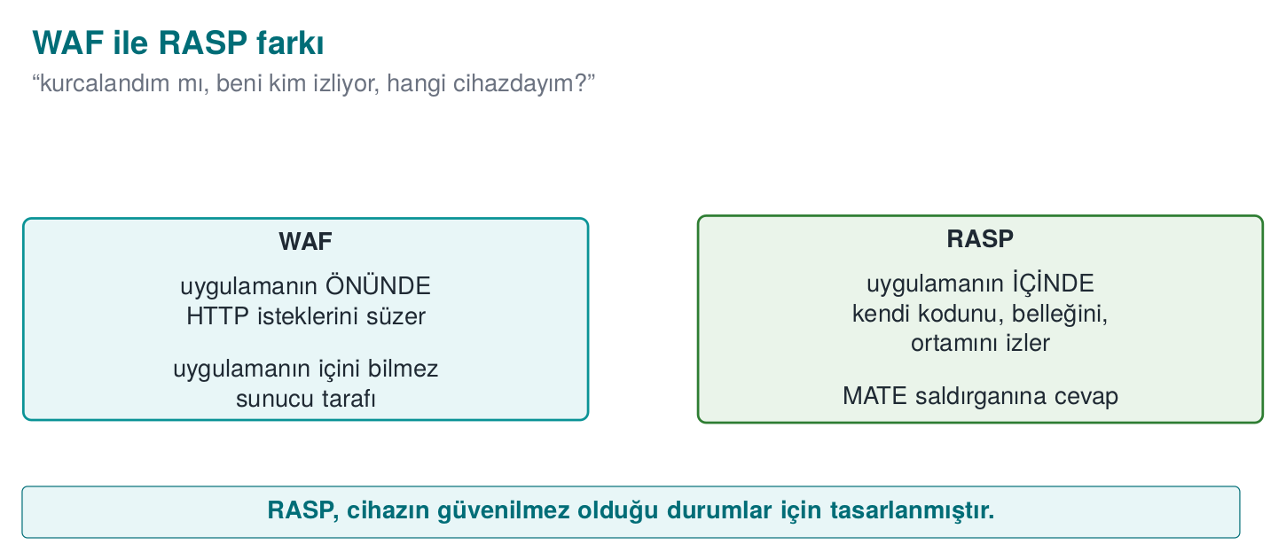
CEN429 Secure Programming · Week 6
WAF ↔ RASP — Diagram
RTEU Computer Engineering · 2026-2027 Fall
7

Slide 8
CEN429 Secure Programming · Week 6
WAF ↔ RASP Comparison
Protection | Where It Stops | What It Sees
Network firewall | At the network edge | Packets
WAF (Web App Firewall) | In front of the application | HTTP requests
RASP | Inside the application | Its own code, memory, environment
A WAF asks "is the incoming request malicious?"; RASP asks "have I been tampered with?"
RTEU Computer Engineering · 2026-2027 Fall
8

Slide 9
CEN429 Secure Programming · Week 6
The Attacker Model: MATE
• MATE (Man-At-The-End): an attacker who owns the endpoint the application runs on. They read memory, modify code, and trace it with a debugger. Identical to the white-box model from Week 11.
• The hard truth: if the device's owner is the attacker, no client-side protection is ultimately unbreakable.
• So why does RASP exist? The goal is not unbreakability; it's making the attack unscalable and expensive.
RTEU Computer Engineering · 2026-2027 Fall
9

Slide 10
CEN429 Secure Programming · Week 6
Three Jobs: Detect, Defend, Deter
• Detect: sense the abnormal environment/behaviour (debugger, emulator, tampering).
• Defend: if there's a threat, restrict/halt the feature.
• Deter: make the attack costly → the attacker gives up.
RTEU Computer Engineering · 2026-2027 Fall
10

Slide 11
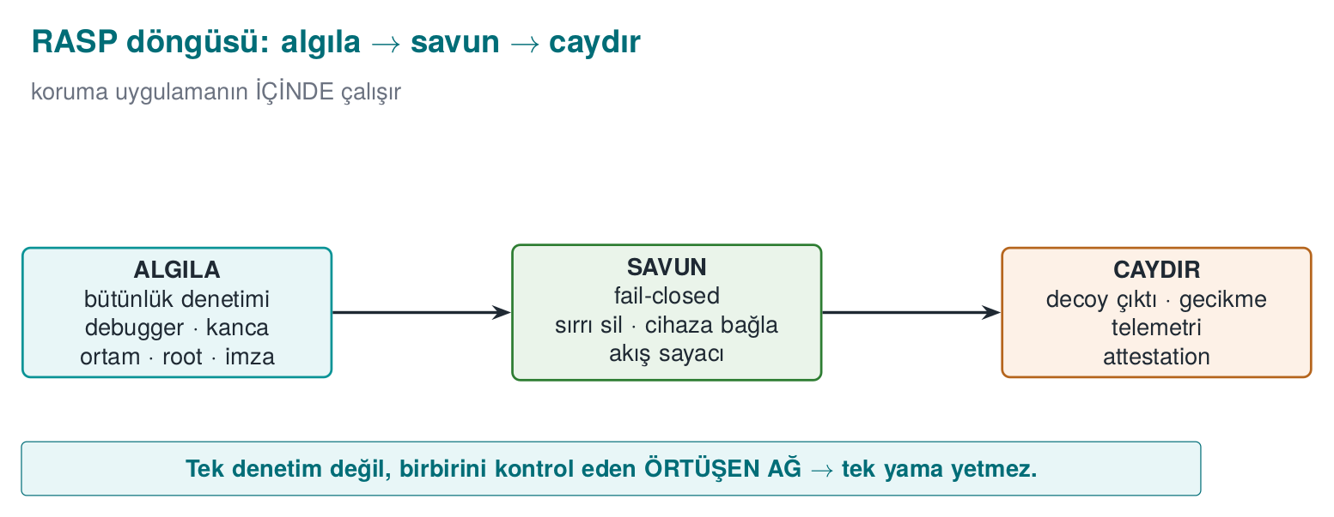
CEN429 Secure Programming · Week 6
The RASP Loop — Detect → Defend → Deter
RTEU Computer Engineering · 2026-2027 Fall
11

Slide 12
CEN429 Secure Programming · Week 6
What Does RASP Complete?
• Static protections (Weeks 4–5) apply without running.
• Obfuscation (Weeks 9/11/14) makes understanding harder.
• RASP adds active defence while the program runs.
Obfuscation hides RASP; RASP protects obfuscation while it runs.
RTEU Computer Engineering · 2026-2027 Fall
12

Slide 13
CEN429 Secure Programming · Week 6
Why Is RASP Necessary?
• A white-box attacker runs the program and observes it (debugger, Frida).
• Static obfuscation alone does not stop this.
• RASP checks "am I being watched?" and responds.
RTEU Computer Engineering · 2026-2027 Fall
13

Slide 14
CEN429 Secure Programming · Week 6
The Main Rule (Up Front)
RASP is not unbreakable on its own; it gains strength from layered and varied checks.
A single "is it rooted?" check is easily bypassed; dozens of different checks together are hard.
RTEU Computer Engineering · 2026-2027 Fall
14

Slide 15
CEN429 Secure Programming · Week 6
2. RASP Architecture
RTEU Computer Engineering · 2026-2027 Fall
15

Slide 16
CEN429 Secure Programming · Week 6
When Does a Check Run?
• At startup: environment check on launch.
• Right before a critical operation: immediately before payment/key use.
• Periodically: regularly, in the background.
• Randomly: at unpredictable moments (so the attacker can't time it).
RTEU Computer Engineering · 2026-2027 Fall
16

Slide 17
CEN429 Secure Programming · Week 6
Where Does a Check Run?
• On the native side (C/C++): harder to reverse-engineer, preferred.
• On the managed side (Java): easier to read, but still necessary.
• Cross-checking: the two sides check each other.
RTEU Computer Engineering · 2026-2027 Fall
17

Slide 18
CEN429 Secure Programming · Week 6
The Cross-Check Idea
• The Java side checks the native library's digest.
• The native side checks the Java side's integrity.
• The attacker has to bypass both at once.
RTEU Computer Engineering · 2026-2027 Fall
18

Slide 19
CEN429 Secure Programming · Week 6
Multi-Point Placement and Decoy Parameters
• Multi-point placement: the same check done in many places in the code, each time in a slightly different form; when one point is patched, the others still run.
• Inside the protected function itself: a valuable function (e.g., key derivation) performs several checks of its own at its entry point — in the field this can reach close to fifteen checks.
• Decoy parameters: at an entry point, there can be extra parameters, hidden for readability, that trigger an integrity check (Week 4).
RTEU Computer Engineering · 2026-2027 Fall
19

Slide 20
CEN429 Secure Programming · Week 6
How Does a Check Run? (Hidden)
• The check code is obfuscated (Week 9): so the attacker can't easily find it.
• The result is opaque (not plain true/false).
• The response can be delayed (more on this shortly).
RTEU Computer Engineering · 2026-2027 Fall
20

Slide 21
CEN429 Secure Programming · Week 6
Weak Design — a Single Decision Point
if (debugger_present() || is_rooted() || integrity_broken())
return ERROR; /* patching this one line
bypasses everything */
decrypt_key();
An attacker who flips a single comparison bypasses the entire protection.
RTEU Computer Engineering · 2026-2027 Fall
21

Slide 22
CEN429 Secure Programming · Week 6
Strong Design — Data Dependency
The check result feeds into the data of the next computation, not into an if:
• Check results feed into key derivation (the correct key if clean, a different but plausible-looking key if not).
• Check results are carried with opaque values (Week 4).
• The response happens far in time and code from the trigger.
RTEU Computer Engineering · 2026-2027 Fall
22

Slide 23
CEN429 Secure Programming · Week 6
A Layered Network of Checks
• Not a single check, but dozens of different checks.
• A network that checks itself (a checker network).
• Bypassing one triggers another.
RTEU Computer Engineering · 2026-2027 Fall
23

Slide 24
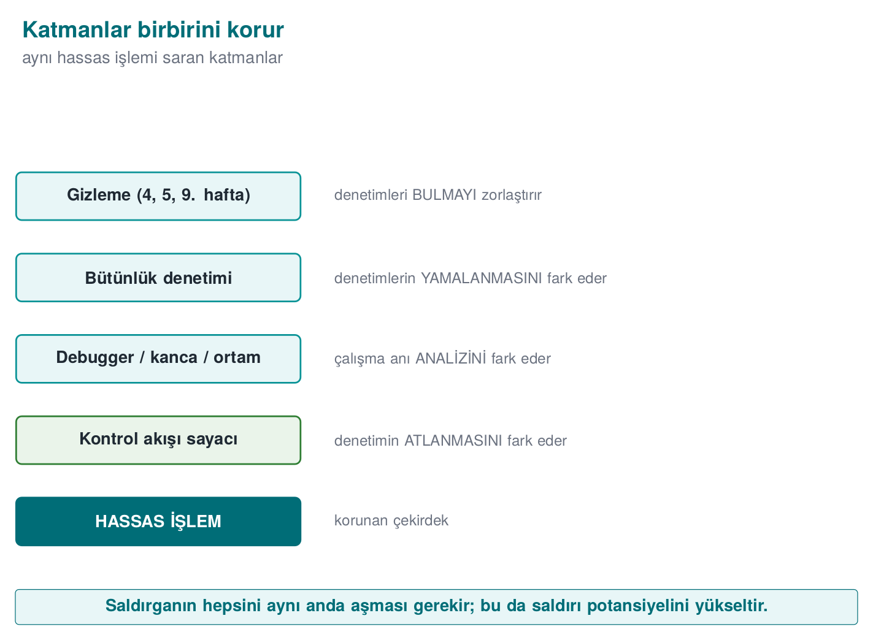
CEN429 Secure Programming · Week 6
Layers Protect Each Other — Diagram
RTEU Computer Engineering · 2026-2027 Fall
24

Slide 25
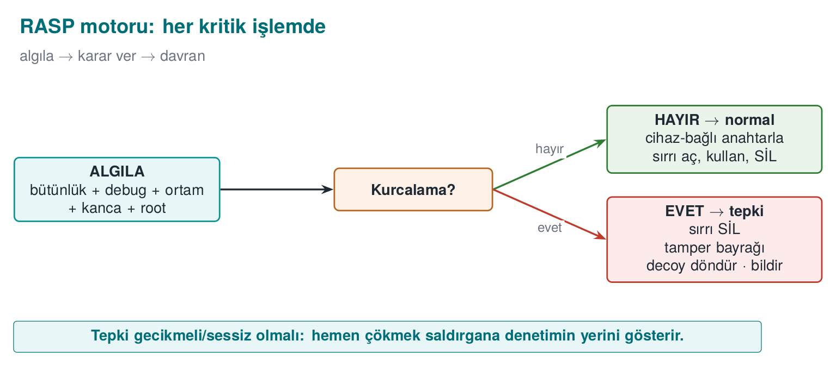
CEN429 Secure Programming · Week 6
Architecture · Summary Diagram
RTEU Computer Engineering · 2026-2027 Fall
25

Slide 26
CEN429 Secure Programming · Week 6
This Section's Rule (1–2)
Do not do the check in one place, at one moment, with one `if`.
Multi-point, cross-checked, hidden, and data-dependent checks together build a RASP architecture.
RTEU Computer Engineering · 2026-2027 Fall
26

Slide 27
CEN429 Secure Programming · Week 6
Section 1–2 — Quick Check
1. RASP's three jobs?
2. Why is cross-checking strong?
3. Why a network instead of a single check?
RTEU Computer Engineering · 2026-2027 Fall
27
Notes:
Speaker note: Next, integrity checking.

Slide 28
CEN429 Secure Programming · Week 6
Section 1–2 — Answers
1. Detect (tampering/debugging/emulator), Defend (protect the key/data, restrict the feature), Deter (response: shut down/break/notify).
2. Checks watch each other; when the attacker disables one, another notices → silencing a single point isn't enough.
3. A single check is bypassed with a single patch; an overlapping network requires breaking every node separately → it raises the cost of the attack.
RTEU Computer Engineering · 2026-2027 Fall
28

Slide 29
CEN429 Secure Programming · Week 6
3. Integrity Checking (Self-Hashing)
RTEU Computer Engineering · 2026-2027 Fall
29

Slide 30
CEN429 Secure Programming · Week 6
The Idea
• The program computes a digest of its own code sections.
• It compares it against the expected digest.
• If it's been tampered with, the digest won't match → response.
RTEU Computer Engineering · 2026-2027 Fall
30

Slide 31
CEN429 Secure Programming · Week 6
How Does It Work? · Step by Step
1. After compilation, the digest of the critical code blocks is recorded.
2. While running, the program recomputes the digest of the same blocks.
3. It compares it against the recorded digest.
4. If there's a difference → tampering → response.
RTEU Computer Engineering · 2026-2027 Fall
31

Slide 32
CEN429 Secure Programming · Week 6
Step 1 · Record the Digest
• After compilation finishes, the critical code/data region is identified.
• This region's digest is computed and stored as the golden value.
• This value is the signature of the "untampered" state.
RTEU Computer Engineering · 2026-2027 Fall
32

Slide 33
CEN429 Secure Programming · Week 6
Step 2 · Recompute While Running
• While running, the program recomputes the digest of the same recorded code/data region.
• This computation happens not at compile time, but at runtime.
• It can be done not just once, but periodically.
RTEU Computer Engineering · 2026-2027 Fall
33

Slide 34
CEN429 Secure Programming · Week 6
Step 3 · Compare
• The newly computed digest is compared against the recorded golden value.
• The comparison must be done in constant time (not memcmp): a plain comparison stops at the first differing byte and leaks timing (Week 3).
• If equal: integrity is fine.
RTEU Computer Engineering · 2026-2027 Fall
34

Slide 35
CEN429 Secure Programming · Week 6
Step 4 · Respond
• If the digest doesn't match → tampering (a patch) has been detected.
• The result is tied not directly to an if, but to a response (Section 10).
• A smarter response is preferred over "crash immediately."
RTEU Computer Engineering · 2026-2027 Fall
35

Slide 36
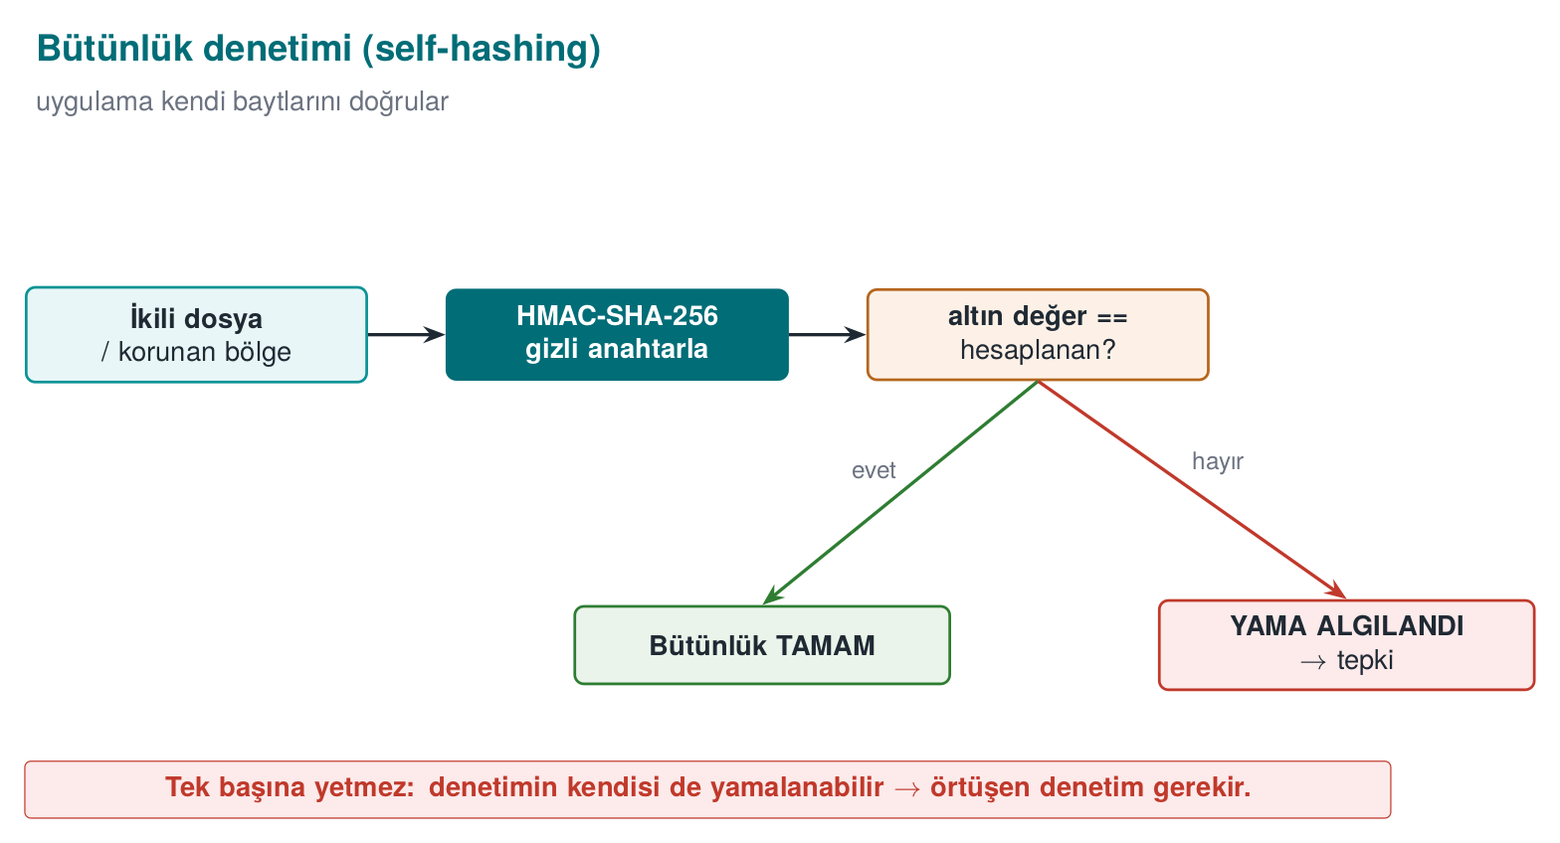
CEN429 Secure Programming · Week 6
Self-Hashing — Diagram
RTEU Computer Engineering · 2026-2027 Fall
36

Slide 37
CEN429 Secure Programming · Week 6
What Does It Catch?
• A patch applied to the binary file.
• Bytes changed to skip a check.
• Injected code.
RTEU Computer Engineering · 2026-2027 Fall
37

Slide 38
CEN429 Secure Programming · Week 6
Demo 1 · Runtime Integrity Checking
code/week-06/01-integrity-hmac — self-hashing, HMAC-SHA-256.
• The textbook (Viega & Messier, Recipe 12.2) does this with CRC32; CRC32 is not cryptographic, an attacker can easily adjust bytes to make the CRC match. We use HMAC-SHA-256 (needs a secret key).
• The program computes its own binary file's digest and records it as the golden value.
• A copy of the binary file is made and one byte in it is changed (a patch simulation); the patched copy's digest is compared against the golden value.
RTEU Computer Engineering · 2026-2027 Fall
38

Slide 39
CEN429 Secure Programming · Week 6
Demo 1 · The Core of the Code
/* Find own path, read the file, compute HMAC */
self_path(path, sizeof(path));
read_file(path, &data, &size);
crypto_hmac_sha256(RASP_KEY, 32, data, size, digest);
/* constant-time comparison */
unsigned char diff = 0;
for (int i = 0; i < 32; i++)
diff |= expected[i] ^ digest[i];
if (diff == 0) { /* OK */ } else { /* PATCH */ }
RTEU Computer Engineering · 2026-2027 Fall
39

Slide 40
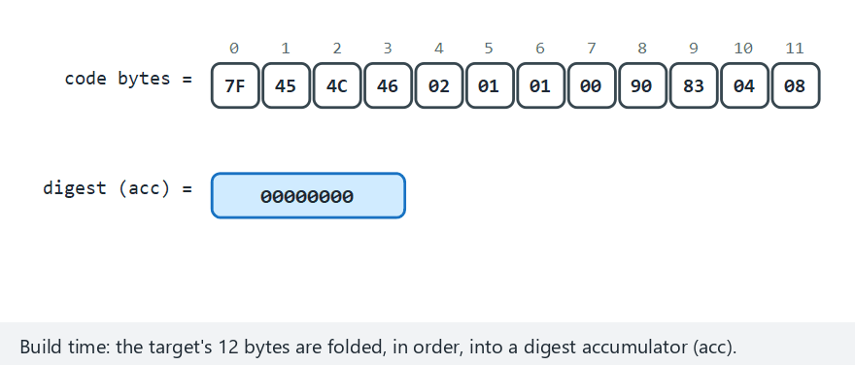
CEN429 Secure Programming · Week 6
Integrity check (animation)
RTEU Computer Engineering · 2026-2027 Fall
40
Notes:
Speaker note: show how the bytes fold into a digest one at a time, then how the "golden" value is compared against the re-read bytes.

Slide 41
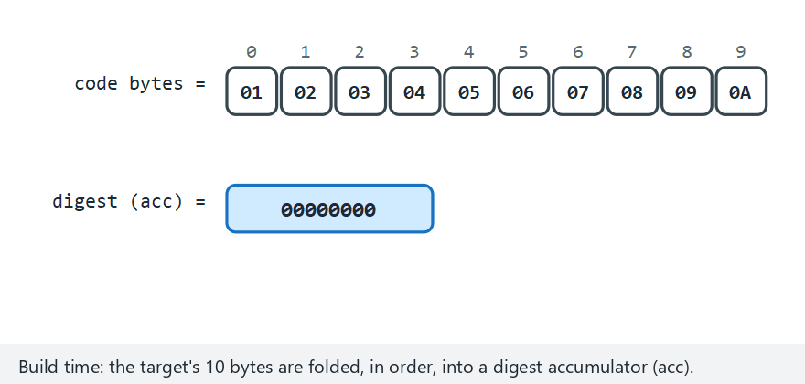
CEN429 Secure Programming · Week 6
Integrity check — edge case: first byte patched
RTEU Computer Engineering · 2026-2027 Fall
41
Notes:
Speaker note: it doesn't matter WHERE in the file the patch is — the avalanche effect changes the whole digest either way.

Slide 42
CEN429 Secure Programming · Week 6
Demo 1 · Actual Output
STEP 2 - Normal run: integrity verifies OK (no patch)
Expected : 5aeaf45226dbb29af7...b55115de4
Computed : 5aeaf45226dbb29af7...b55115de4
RESULT: INTEGRITY OK - target unchanged.
STEP 3 - Attack: 1 byte of the copy is changed
STEP 4 - The patched copy's HMAC is compared
Expected : 5aeaf45226dbb29af7...b55115de4
Computed : c47c35687dc205b93a...aca0ec8a
RESULT: PATCH DETECTED - target was modified!
Changing a single byte completely changed the digest (the avalanche effect).
RTEU Computer Engineering · 2026-2027 Fall
42

Slide 43
CEN429 Secure Programming · Week 6
⚠️ Self-Hashing Alone Is Not Enough
• The attacker can find the digest function and force it to always say "match."
• Or bypass the check with hardware breakpoints (van Oorschot et al.).
• So: hide it, diversify it, cross-check it.
RTEU Computer Engineering · 2026-2027 Fall
43

Slide 44
CEN429 Secure Programming · Week 6
Strengthening It
• The digest-checking code is hidden (Week 9).
• Multiple blocks, overlapping regions.
• The result is not a plain comparison, it feeds into a computation (the check result affects the program's behaviour).
RTEU Computer Engineering · 2026-2027 Fall
44

Slide 45
CEN429 Secure Programming · Week 6
Overlapping Checks
• One check also covers another check's code.
• When the attacker disables one, the other breaks.
• Bypassing from a single point becomes hard.
RTEU Computer Engineering · 2026-2027 Fall
45

Slide 46
CEN429 Secure Programming · Week 6
This Section's Rule (3)
Verify the integrity of critical code/data regions at runtime with a cryptographic digest (HMAC/signature), not CRC.
Don't do the check at a single point and only at startup; make it periodic, multiple, and overlapping.
RTEU Computer Engineering · 2026-2027 Fall
46

Slide 47
CEN429 Secure Programming · Week 6
4. Debugger Detection
RTEU Computer Engineering · 2026-2027 Fall
47

Slide 48
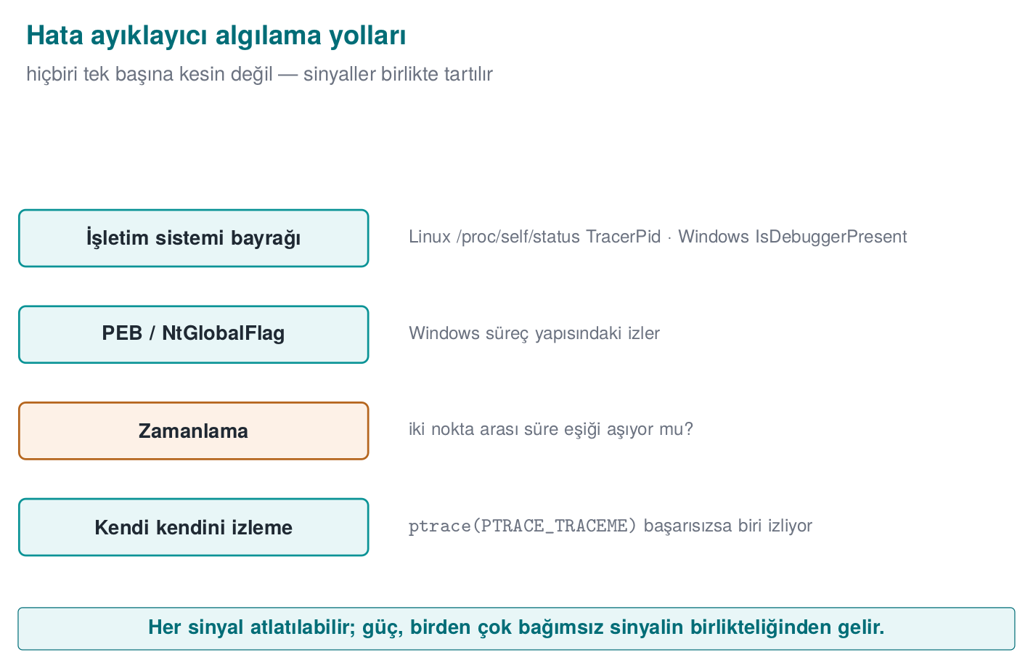
CEN429 Secure Programming · Week 6
Anti-Debug Approaches — Diagram
RTEU Computer Engineering · 2026-2027 Fall
48

Slide 49
CEN429 Secure Programming · Week 6
Why Is a Debugger Dangerous?
• Debugger: a tool that runs a program step by step, halting it and reading its memory (gdb, lldb, x64dbg, WinDbg).
• The attacker halts the program, reads memory, changes values.
• They can bypass checks one by one.
• RASP checks "is a debugger attached to me?"
RTEU Computer Engineering · 2026-2027 Fall
49

Slide 50
CEN429 Secure Programming · Week 6
Detection Approaches for a Debugger (Concept)
• Asking the operating system for "am I being traced?" information.
• The state of specific debugging interfaces.
• Timing: if an operation took much longer than expected, someone may be single-stepping it.
RTEU Computer Engineering · 2026-2027 Fall
50

Slide 51
CEN429 Secure Programming · Week 6
Indicators by Platform · What's Outdated
Environment | Indicator
Linux / WSL | /proc/self/status → TracerPid (if > 0, we're being traced); is the parent process gdb/strace
Windows | IsDebuggerPresent (PEB BeingDebugged); CheckRemoteDebuggerPresent; PEB NtGlobalFlag
From 2003 to today: SoftICE is dead, replaced by x64dbg/WinDbg/gdb/lldb/Frida; ptrace+TracerPid is still valid.
RTEU Computer Engineering · 2026-2027 Fall
51

Slide 52
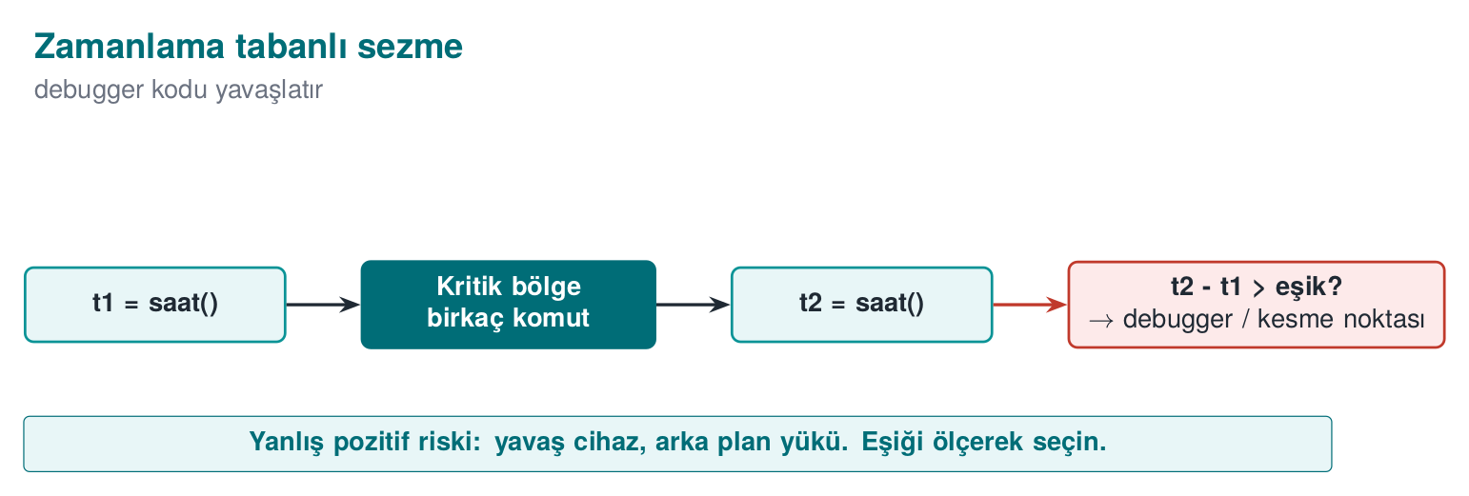
CEN429 Secure Programming · Week 6
Timing-Based Detection
Debugger single-stepping slows down the work.
RTEU Computer Engineering · 2026-2027 Fall
52

Slide 53
CEN429 Secure Programming · Week 6
Demo 2 · Debugger Detection
code/week-06/02-debugger-detection — anti-debug, read-only.
• The program looks at several independent signals and changes nothing.
• It doesn't even self-ptrace; it only reads /proc and PEB fields.
• demo.sh runs the program first normally, then under gdb.
/* Read TracerPid from /proc/self/status */
long tp = tracer_pid();
if (tp > 0) suspicious++; /* a process is watching us */
RTEU Computer Engineering · 2026-2027 Fall
53

Slide 54
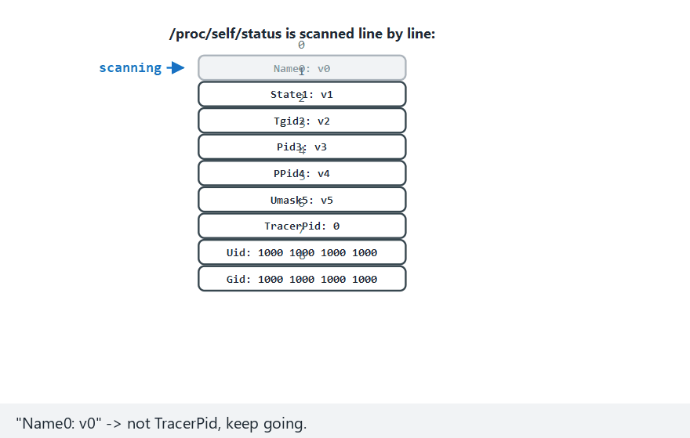
CEN429 Secure Programming · Week 6
Debugger detection (animation)
RTEU Computer Engineering · 2026-2027 Fall
54
Notes:
Speaker note: show /proc/self/status being scanned line by line, and how the scan stops as soon as TracerPid is found.

Slide 55
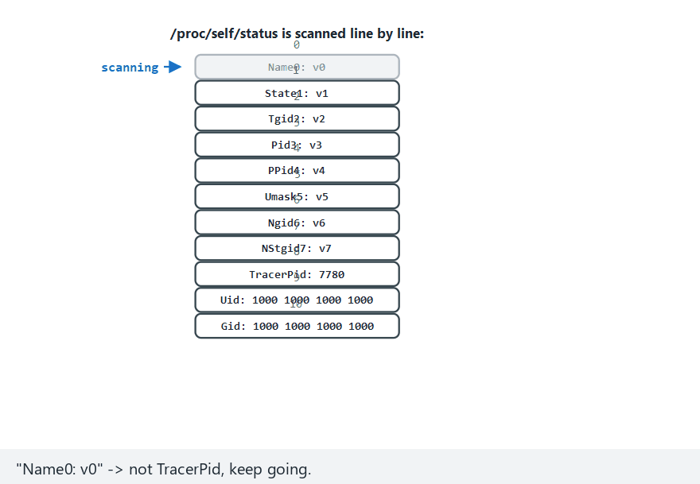
CEN429 Secure Programming · Week 6
Debugger detection — edge case: gdb attached
RTEU Computer Engineering · 2026-2027 Fall
55
Notes:
Speaker note: TracerPid and the parent process name both fire at once, giving "detected (2 signals)".

Slide 56
CEN429 Secure Programming · Week 6
Demo 2 · Actual Output (WSL)
STEP 1 - Normal run (NO debugger)
1) /proc/self/status TracerPid : 0 (no tracer)
2) Parent process name : sh
RESULT: clean - no tracing tool visible.
STEP 2 - Run under gdb
1) /proc/self/status TracerPid : 41885 (TRACED)
RESULT: a debugger/tracing TOOL was detected (2 signal(s)).
Without a debugger, TracerPid is 0; under gdb it came out 41885 (>0).
RTEU Computer Engineering · 2026-2027 Fall
56

Slide 57
CEN429 Secure Programming · Week 6
⚠️ The Detection–Counter-Detection Race
Anti-debug is a classic arms race: the attacker can turn ptrace into a no-op with LD_PRELOAD, patch IsDebuggerPresent's return value, or clear the PEB flag.
• Every single method is known and can be bypassed.
• Strength: many different methods + obfuscation + diversification.
• The goal is still deterrence and delay.
RTEU Computer Engineering · 2026-2027 Fall
57

Slide 58
CEN429 Secure Programming · Week 6
What About the Response?
• Crashing immediately is not always good (it tells the attacker "there's a check here").
• Better: a delayed, indirect response (Section 10, shortly).
RTEU Computer Engineering · 2026-2027 Fall
58

Slide 59
CEN429 Secure Programming · Week 6
This Section's Rule (4)
Don't write anti-debug as a single if (IsDebuggerPresent()) exit();.
Collect multiple independent signals, tie the result to a behaviour, delay the response.
RTEU Computer Engineering · 2026-2027 Fall
59

Slide 60
CEN429 Secure Programming · Week 6
Section 3–4 — Quick Check
1. What does self-hashing catch?
2. Why isn't it enough alone?
3. How does timing give away a debugger?
RTEU Computer Engineering · 2026-2027 Fall
60
Notes:
Speaker note: Next, emulator and hook detection.

Slide 61
CEN429 Secure Programming · Week 6
Section 3–4 — Answers
1. Code/binary bytes being changed (a patch, breakpoint/code injection) — it computes its own digest at runtime and compares it against the expected one.
2. The attacker can find/bypass the hash routine or the expected value, or NOP out the comparison; it also only catches a static change. Overlapping checks are needed.
3. A debugger/breakpoint slows down the code; if the elapsed time between two points crosses a threshold, debugging is sensed.
RTEU Computer Engineering · 2026-2027 Fall
61

Slide 62
CEN429 Secure Programming · Week 6
5. Environment Detection: Emulator/VM
RTEU Computer Engineering · 2026-2027 Fall
62

Slide 63
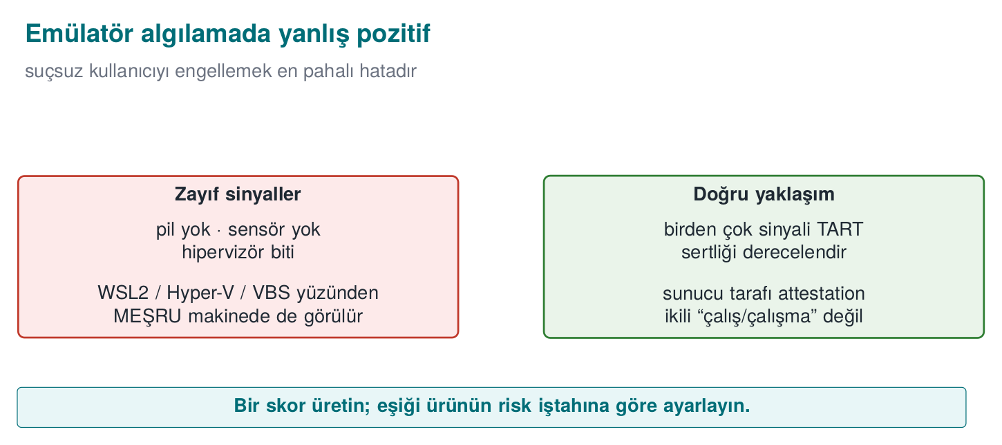
CEN429 Secure Programming · Week 6
Emulator False Positive — Diagram
RTEU Computer Engineering · 2026-2027 Fall
63

Slide 64
CEN429 Secure Programming · Week 6
Why an Emulator?
• Emulator/VM: a software environment that imitates a device (an Android emulator, QEMU).
• The attacker does their analysis in an emulator instead of a real device.
• Halting, tracing, and resetting is easy in an emulator.
• RASP checks "am I on a real device?"
RTEU Computer Engineering · 2026-2027 Fall
64

Slide 65
CEN429 Secure Programming · Week 6
Detection Clues (Concept)
• Hardware/sensor gaps specific to emulators.
• Typical fake identifiers.
• The absence of features expected on a real device.
RTEU Computer Engineering · 2026-2027 Fall
65

Slide 66
CEN429 Secure Programming · Week 6
Detection Techniques (Concrete)
Technique | How | Note
CPUID hypervisor bit | CPUID.1:ECX[31] — "hypervisor present" | 0 on bare metal
Hypervisor vendor signature | CPUID leaf 0x40000000 → 12 characters | Some hypervisors hide it
Timing | Measure an operation; heavy emulation slows it down a lot | Threshold varies by machine
RTEU Computer Engineering · 2026-2027 Fall
66

Slide 67
CEN429 Secure Programming · Week 6
Demo 3 · VM/Emulator and Timing
code/week-06/03-environment-timing — only reads a CPU instruction and the clock.
(A) CPUID.1:ECX[31] hypervisor bit : PRESENT
Hypervisor vendor signature : "Microsoft Hv"
(B) time for 2,000,000 iterations : 0.662 ms
RESULT: a hypervisor was SEEN.
This output was captured on a real Windows laptop (Hyper-V).
RTEU Computer Engineering · 2026-2027 Fall
67

Slide 68
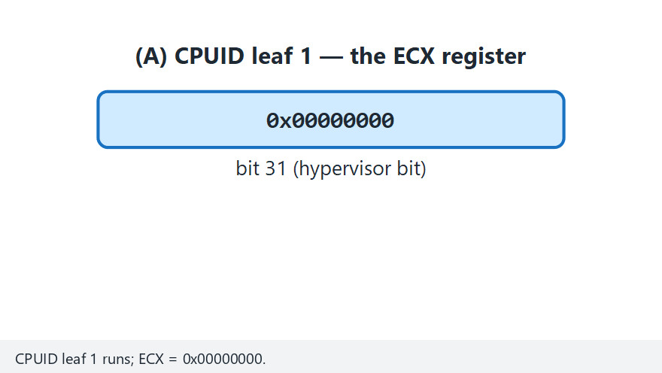
CEN429 Secure Programming · Week 6
VM/emulator detection (animation)
RTEU Computer Engineering · 2026-2027 Fall
68
Notes:
Speaker note: show how the hypervisor bit is read, then how the 12-byte vendor signature is assembled byte by byte.

Slide 69
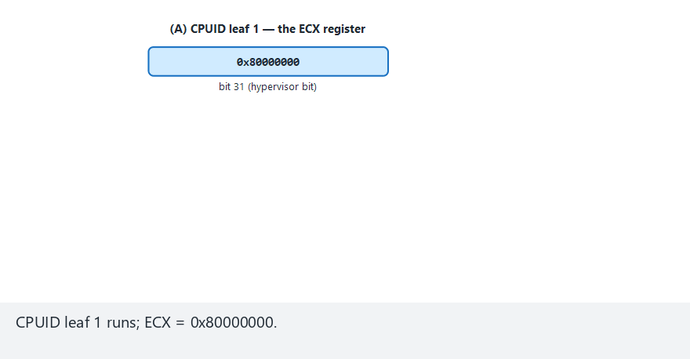
CEN429 Secure Programming · Week 6
VM/emulator detection — edge case: blank vendor signature
RTEU Computer Engineering · 2026-2027 Fall
69
Notes:
Speaker note: even with the hypervisor bit PRESENT, the vendor signature can come back entirely blank — another reason it's not proof by itself.

Slide 70
CEN429 Secure Programming · Week 6
⚠️ The Most Important Lesson: False Positives
• The output above said the hypervisor "IS PRESENT" AND the vendor signature is visible ("Microsoft Hv").
• But this is not an analysis environment — it's an ordinary developer machine!
• On modern Windows, most machines report a hypervisor because of Hyper-V, WSL2, VBS.
RTEU Computer Engineering · 2026-2027 Fall
70

Slide 71
CEN429 Secure Programming · Week 6
The Cost of a False Positive
• This bit alone does not mean "an attacker is analysing."
• If an application refused to run just because it saw a hypervisor, it would block millions of legitimate users.
• Legitimate users: developers, enterprise VM users, ordinary Windows users with WSL2/Hyper-V/VBS.
• RASP always weighs multiple indicators and accepts that any single one can be bypassed.
RTEU Computer Engineering · 2026-2027 Fall
71

Slide 72
CEN429 Secure Programming · Week 6
Rule: a Risk Score, Not a Binary Decision
• Use environment detection as a risk score.
• Combine multiple indicators.
• Make the final decision together with a server-side risk engine.
RTEU Computer Engineering · 2026-2027 Fall
72

Slide 73
CEN429 Secure Programming · Week 6
How Is This Applied in the Field?
• In the mobile world the equivalent is emulator detection: ro.kernel.qemu, fake sensors, typical IMEI/serial values.
• The same principle applies: a signal, not proof.
• Combination + server-side verification.
RTEU Computer Engineering · 2026-2027 Fall
73

Slide 74
CEN429 Secure Programming · Week 6
This Section's Rule (5)
In emulator/VM detection, a single bit never means "attack."
Use a risk score instead of a harsh response; the result is evaluated together with server-side verification.
RTEU Computer Engineering · 2026-2027 Fall
74

Slide 75
CEN429 Secure Programming · Week 6
6. Hook and Instrumentation Detection
RTEU Computer Engineering · 2026-2027 Fall
75

Slide 76
CEN429 Secure Programming · Week 6
Brief History — From Static to Dynamic
• 1990s — IAT/PLT-GOT hooks: hand-written, target-specific tools.
• 2000s — LD_PRELOAD / DLL injection: general-purpose but static.
• 2013–2014 — Frida emerged: hook code is written in JavaScript at runtime, no compilation needed.
RTEU Computer Engineering · 2026-2027 Fall
76

Slide 77
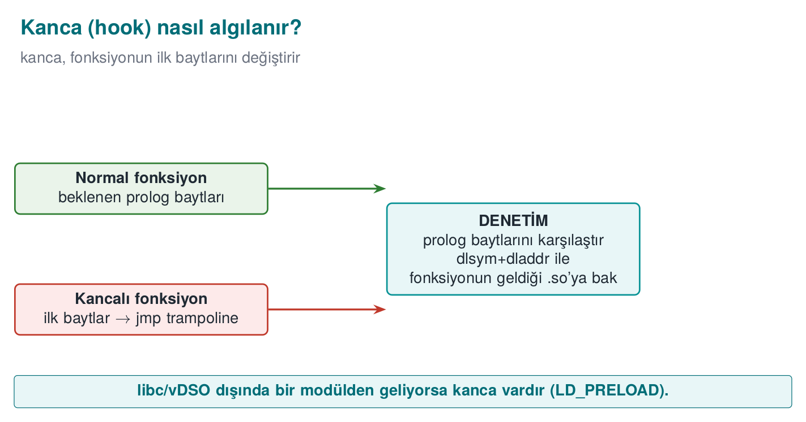
CEN429 Secure Programming · Week 6
Hook Detection — Diagram
RTEU Computer Engineering · 2026-2027 Fall
77

Slide 78
CEN429 Secure Programming · Week 6
The Hook Threat
• The attacker hooks a critical function: intercepts and changes the call.
• Example: making the "is the signature valid?" function always return "yes."
• Tool: Frida, Xposed.
• Instrumentation: injecting code into a running program to observe/change its behaviour; Frida is the most common tool for this.
RTEU Computer Engineering · 2026-2027 Fall
78

Slide 79
CEN429 Secure Programming · Week 6
LD_PRELOAD Hooking
• On Linux, loading a library before the program to replace functions.
• The critical function is replaced with the attacker's version.
• RASP checks the loaded libraries.
RTEU Computer Engineering · 2026-2027 Fall
79

Slide 80
CEN429 Secure Programming · Week 6
Hooking Techniques — Table
Technique | How | Platform
LD_PRELOAD | Preloading a .so and replacing a function | Linux
PLT/GOT hooking | Redirecting a call-table entry | Linux/ELF
Inline hooking | Overwriting the first bytes with a jmp | Everywhere
Frida / Xposed | Dynamic binary instrumentation | Mobile/desktop
RTEU Computer Engineering · 2026-2027 Fall
80

Slide 81
CEN429 Secure Programming · Week 6
Detection Approaches for a Hook (Concept)
• Unexpected loaded libraries/modules.
• Traces of known instrumentation tools (in memory, on ports).
• Function addresses deviating from the expected.
RTEU Computer Engineering · 2026-2027 Fall
81

Slide 82
CEN429 Secure Programming · Week 6
⚠️ A Weak Approach: getenv
if (getenv("LD_PRELOAD") == NULL) printf("temiz\n");
getenv itself can also be hooked to return NULL. That's why you need to verify the source:
1. Resolve the critical function (dlsym) → 2. find which module it comes from (dladdr) → 3. check whether it's legitimate → 4. decide.
RTEU Computer Engineering · 2026-2027 Fall
82

Slide 83
CEN429 Secure Programming · Week 6
Step 1 · Resolve the Function
void *p = dlsym(RTLD_DEFAULT, "time");
• dlsym finds, at runtime, which function would actually be called.
• If a preloaded hook exists, dlsym returns that one (a manipulated result).
RTEU Computer Engineering · 2026-2027 Fall
83

Slide 84
CEN429 Secure Programming · Week 6
Step 2 · Find the Source
Dl_info info;
dladdr(p, &info); /* the .so that provides the function */
• dladdr tells you which shared object (.so) an address comes from.
• It does not rely on getenv-style spoofing — it looks directly at the memory address.
RTEU Computer Engineering · 2026-2027 Fall
84

Slide 85
CEN429 Secure Programming · Week 6
Step 3 · Check Whether It's Legitimate
int hook = !is_legitimate(info.dli_fname);
• The expected source is libc, the vDSO, or the dynamic loader.
• If it comes from a foreign .so → there's a hook.
RTEU Computer Engineering · 2026-2027 Fall
85

Slide 86
CEN429 Secure Programming · Week 6
Step 4 · Decide
• If it's not in the list of legitimate sources → the hook flag is raised.
• The result isn't left alone; it's tied to the response policy (Section 10).
• It's repeated for multiple functions (a single function isn't enough).
RTEU Computer Engineering · 2026-2027 Fall
86

Slide 87
CEN429 Secure Programming · Week 6
Function Integrity
• Are the critical function's first bytes what's expected?
• A hook usually places a jump at the start → the bytes change.
• If they've changed → there's a hook.
RTEU Computer Engineering · 2026-2027 Fall
87

Slide 88
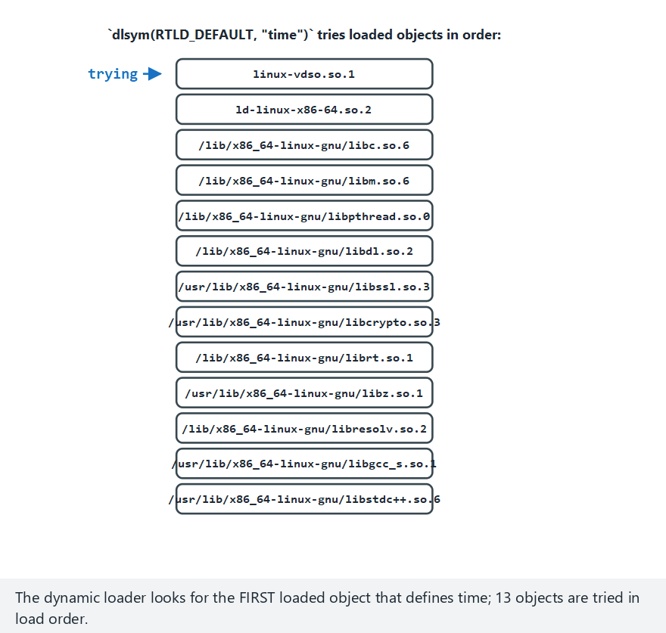
CEN429 Secure Programming · Week 6
LD_PRELOAD symbol resolution order (animation)
RTEU Computer Engineering · 2026-2027 Fall
88
Notes:
Speaker note: show the load order of loaded objects, and the order the dynamic loader tries when resolving `time`.

Slide 89
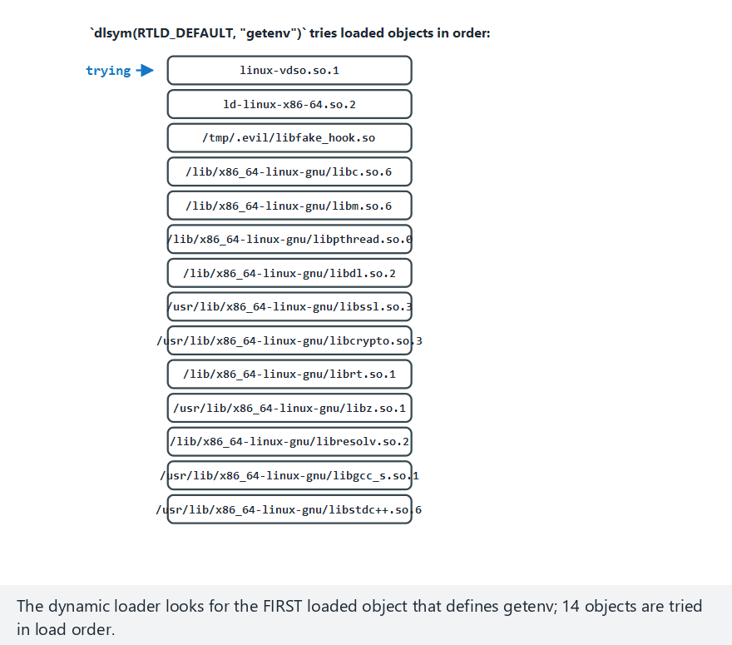
CEN429 Secure Programming · Week 6
LD_PRELOAD order — edge case: hook right after vDSO
RTEU Computer Engineering · 2026-2027 Fall
89
Notes:
Speaker note: it doesn't matter WHERE in the list the hook sits — ANY hook that loads before libc wins.

Slide 90
CEN429 Secure Programming · Week 6
Demo 4 · LD_PRELOAD Hooking — Actual Output
STEP 1 - Normal run (no LD_PRELOAD)
time -> linux-vdso.so.1
getenv -> /lib/x86_64-linux-gnu/libc.so.6
RESULT: clean - no preload/hook visible.
STEP 2 - Attack: the fake hook is loaded ONLY into this process
time -> bin/linux/libfake_hook.so (HOOK!)
time(NULL) returned : 1234567890 (fixed fake value)
RESULT: function hook / preload DETECTED (2 signal(s)).
In the clean run, time resolved from the kernel's vDSO — this is legitimate, not a hook.
RTEU Computer Engineering · 2026-2027 Fall
90

Slide 91
CEN429 Secure Programming · Week 6
⚠️ Hook Detection Can Also Be Bypassed
• Advanced tools hide their traces.
• Strength: multiple methods + obfuscation + server-side verification.
RTEU Computer Engineering · 2026-2027 Fall
91

Slide 92
CEN429 Secure Programming · Week 6
This Section's Rule (6)
In hook detection, don't trust manipulable sources like getenv(LD_PRELOAD).
Verify the source of critical functions (dlsym+dladdr); check multiple functions.
RTEU Computer Engineering · 2026-2027 Fall
92

Slide 93
CEN429 Secure Programming · Week 6
7. Dynamic Memory Protection
RTEU Computer Engineering · 2026-2027 Fall
93

Slide 94
CEN429 Secure Programming · Week 6
Brief History — "Only in RAM" Is Not Enough
• 2008 — Halderman and co-authors, in "Cold Boot Attacks," showed DRAM retains its contents for
seconds to minutes after power loss; they recovered full-disk-encryption keys from memory by cooling a laptop and rebooting it.
• This is the direct motivation for the "short lifetime" and "never leave it in the clear" countermeasures.
RTEU Computer Engineering · 2026-2027 Fall
94

Slide 95
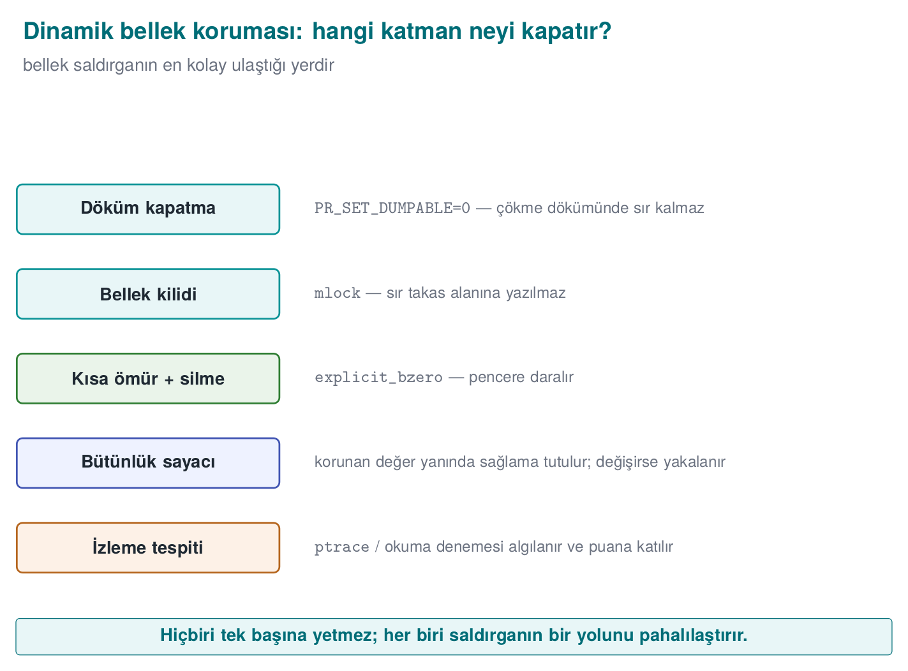
CEN429 Secure Programming · Week 6
Memory Protection Layers — Diagram
RTEU Computer Engineering · 2026-2027 Fall
95

Slide 96
CEN429 Secure Programming · Week 6
The Problem
• Sensitive values (keys, counters) sit in memory.
• The attacker can read/change memory and bypass a check.
RTEU Computer Engineering · 2026-2027 Fall
96

Slide 97
CEN429 Secure Programming · Week 6
What Does the Attacker Do With Memory?
Attack | Example | Target
Reading | Dumping process memory, searching for a known value | Key, PIN, decrypted data
Changing | Changing a counter/flag in memory | Logic and checks
Watching | Tools that alert when a value changes | Discovering where variables live
All of these require the attacker to access process memory (debugger, OS interface, injected library).
RTEU Computer Engineering · 2026-2027 Fall
97

Slide 98
CEN429 Secure Programming · Week 6
The Protected Counter Idea
• Instead of keeping a critical counter in the plain:
  – keep it together with a shadow copy + a digest.
  – check consistency on every read/write.
RTEU Computer Engineering · 2026-2027 Fall
98

Slide 99
CEN429 Secure Programming · Week 6
Protected Value · Concept
typedef struct { uint32_t value; uint32_t shadow; uint32_t mac; } Protected;
/* read: is value == ~shadow, and is mac correct? */
If the attacker changes only value, the inconsistency is caught.
RTEU Computer Engineering · 2026-2027 Fall
99

Slide 100
CEN429 Secure Programming · Week 6
Memory-Scanning Detection
• Is there unexpected access to sensitive regions being watched?
• Traces of a memory dump/scan.
• Goal: raise the cost of live memory analysis.
RTEU Computer Engineering · 2026-2027 Fall
100

Slide 101
CEN429 Secure Programming · Week 6
⚠️ Memory Protection Is Limited
• A determined attacker can still get access.
• Goal: delay, make the key short-lived (Week 10).
RTEU Computer Engineering · 2026-2027 Fall
101

Slide 102
CEN429 Secure Programming · Week 6
This Section's Rule (7)
Keep things in memory briefly, minimally, and scattered; protect a critical value with a shadow copy + digest.
An inconsistency must be tied to a response — silently ignoring it defeats the protection.
RTEU Computer Engineering · 2026-2027 Fall
102

Slide 103
CEN429 Secure Programming · Week 6
Section 5–7 — Quick Check
1. Why is there a false-positive risk in emulator detection?
2. Why does a hook change function bytes?
3. What does a protected counter catch?
RTEU Computer Engineering · 2026-2027 Fall
103
Notes:
Speaker note: Next, root/signature, control-flow integrity, response.

Slide 104
CEN429 Secure Programming · Week 6
Section 5–7 — Answers
1. A legitimate user may also use a VM/emulator/CI; weak signals also show up on real devices → the risk of blocking the innocent. Grade the severity of the response.
2. A hook changes the target's first bytes with a jump (jmp/trampoline) so the call diverts into the attacker's code → prologue bytes differ from expected.
3. A check in the control flow being skipped: the counter increases as critical checks run; if it doesn't reach the expected value, a check has been bypassed.
RTEU Computer Engineering · 2026-2027 Fall
104

Slide 105
CEN429 Secure Programming · Week 6
8. Root Environment and Signature Verification
RTEU Computer Engineering · 2026-2027 Fall
105

Slide 106
CEN429 Secure Programming · Week 6
Brief History — Package Signing
• Android 1.0 (2008) — original APK signing (v1): a modified APK cannot carry the original signature.
• Android 7.0 Nougat (2016) — APK Signature Scheme v2: signs the whole APK, not file by file.
• Android 9 Pie (2018) — v3 added key rotation support to the same principle.
RTEU Computer Engineering · 2026-2027 Fall
106

Slide 107
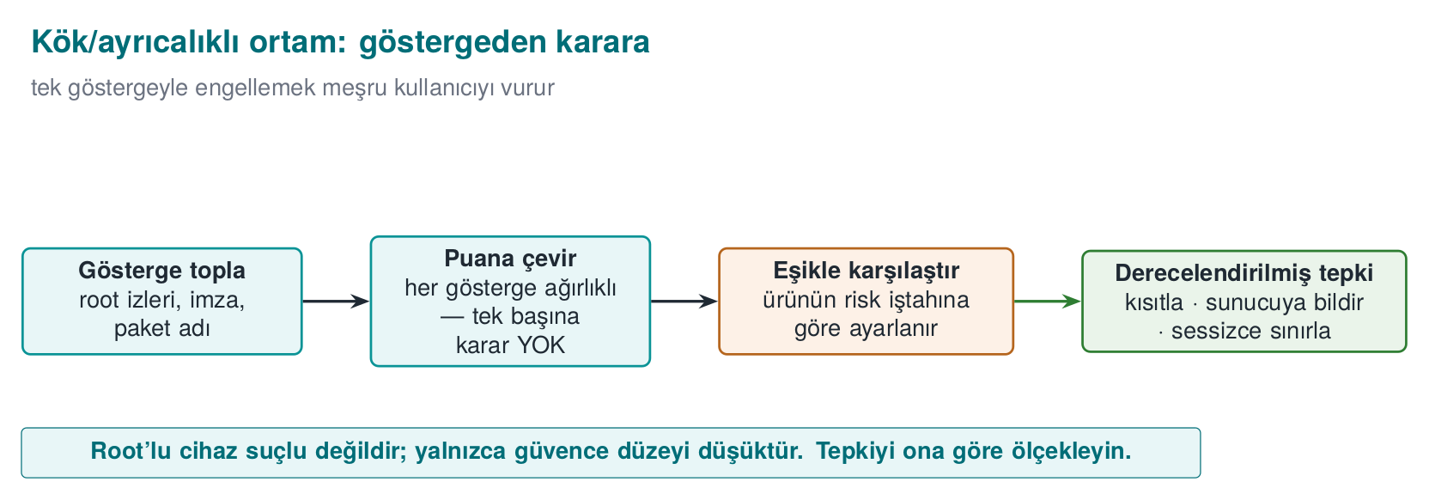
CEN429 Secure Programming · Week 6
From Root Indicator to Decision — Diagram
RTEU Computer Engineering · 2026-2027 Fall
107

Slide 108
CEN429 Secure Programming · Week 6
Why Is a Rooted Device a Risk?
• Root = full privilege.
• Protections weaken; the attacker gains access to memory, files, the process.
• RASP checks "is the device rooted?"
RTEU Computer Engineering · 2026-2027 Fall
108

Slide 109
CEN429 Secure Programming · Week 6
Root Detection (Concept)
• The presence of known root tools/files.
• Being able to perform operations that are normally restricted.
• System-integrity indicators.
RTEU Computer Engineering · 2026-2027 Fall
109

Slide 110
CEN429 Secure Programming · Week 6
⚠️ Root Detection Can Be Bypassed
• Root hiding tools exist.
• A single indicator isn't enough; many indicators + server-side verification.
• Response: restrict the critical feature, not block everything (don't hurt the user).
RTEU Computer Engineering · 2026-2027 Fall
110

Slide 111
CEN429 Secure Programming · Week 6
Component Signature Verification
• Is the caller's/loaded component's digital signature the expected one?
• Catch it if a fake/modified application is calling the library.
• Example: only the main application with the expected signature can use the SDK.
RTEU Computer Engineering · 2026-2027 Fall
111

Slide 112
CEN429 Secure Programming · Week 6
Signature + Digest Together
• Signature: who published the component?
• Digest: has the component changed?
• Together they make forgery harder.
RTEU Computer Engineering · 2026-2027 Fall
112

Slide 113
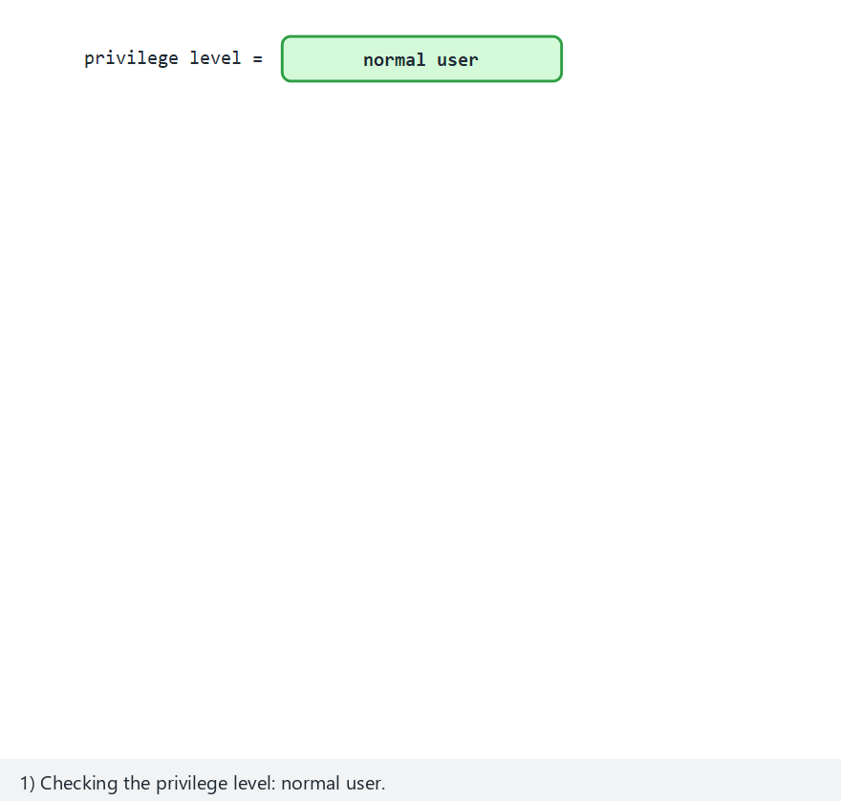
CEN429 Secure Programming · Week 6
Root/Privilege Indicator Scan (animation)
RTEU Computer Engineering · 2026-2027 Fall
113
Notes:
Speaker note: show the scan of 14 known indicators, and how the privilege level adds to the score.

Slide 114
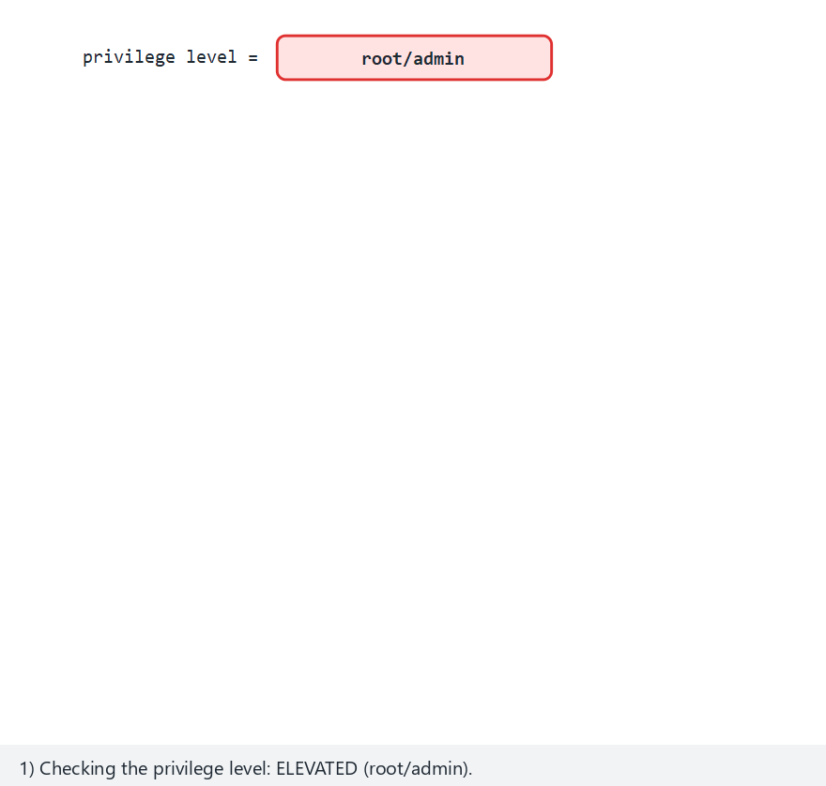
CEN429 Secure Programming · Week 6
Root Indicator — edge case: multiple marks + elevated
RTEU Computer Engineering · 2026-2027 Fall
114
Notes:
Speaker note: as indicators pile up the signal count rises — still not "proof" alone, but a bigger contribution to the risk score.

Slide 115
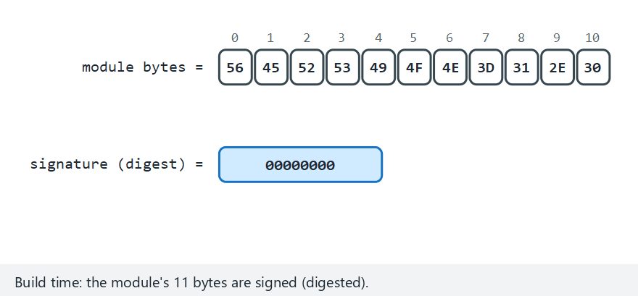
CEN429 Secure Programming · Week 6
Component Signature Verification (animation)
RTEU Computer Engineering · 2026-2027 Fall
115
Notes:
Speaker note: show build-time signing and pre-load verification side by side.

Slide 116
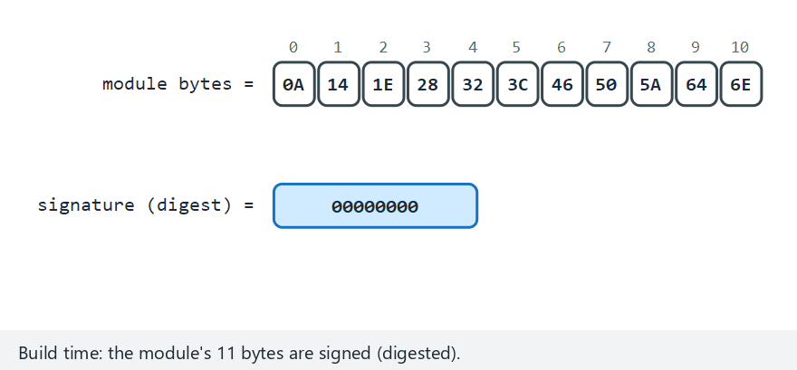
CEN429 Secure Programming · Week 6
Component Signature — edge case: truncated module
RTEU Computer Engineering · 2026-2027 Fall
116
Notes:
Speaker note: not just APPENDING a byte — REMOVING one also breaks the signature; length matters too.

Slide 117
CEN429 Secure Programming · Week 6
Demo 6 and 7 · Actual Outputs
# Demo 7 (root/privilege indicator)
Privilege level : normal user
[FOUND] output\fake_su (extra indicator)
RESULT: an elevated/risky environment INDICATOR is present.
# Demo 6 (component signature)
Module signature DID NOT HOLD -> REPACKAGED.
Loading REJECTED.
Both demos work by only reading/verifying; they don't change the system.
RTEU Computer Engineering · 2026-2027 Fall
117

Slide 118
CEN429 Secure Programming · Week 6
This Section's Rule (8)
Root/privilege indicators are a signal, not proof — they're easily spoofed.
Cryptographically verify every dynamically loaded component before loading it; set up mutual verification where possible.
RTEU Computer Engineering · 2026-2027 Fall
118

Slide 119
CEN429 Secure Programming · Week 6
9. Control-Flow Integrity
RTEU Computer Engineering · 2026-2027 Fall
119

Slide 120
CEN429 Secure Programming · Week 6
Brief History — From Tamper-Resistance to CFI
• 1996 — Aucsmith: distributed integrity checks that cross-check each other.
• 2001 — the Collberg/Thomborson taxonomy; Chang/Atallah's "guard" idea — multiple checkers.
• 2005 — Abadi, Budiu, Erlingsson, Ligatti formally defined Control-Flow Integrity (CFI).
RTEU Computer Engineering · 2026-2027 Fall
120

Slide 121
CEN429 Secure Programming · Week 6
Why Isn't a Single if Enough?
if (signature_valid()) proceed(); /* single point */
• The attacker patches this single branch → the check is skipped.
• Week 9's opaque boolean + randomised exit is critical here.
RTEU Computer Engineering · 2026-2027 Fall
121

Slide 122
CEN429 Secure Programming · Week 6
Control-Flow Counter
• Critical checks must pass in the correct order.
• Every check updates a counter.
• If the counter isn't the expected value at the end → one was skipped.
RTEU Computer Engineering · 2026-2027 Fall
122

Slide 123
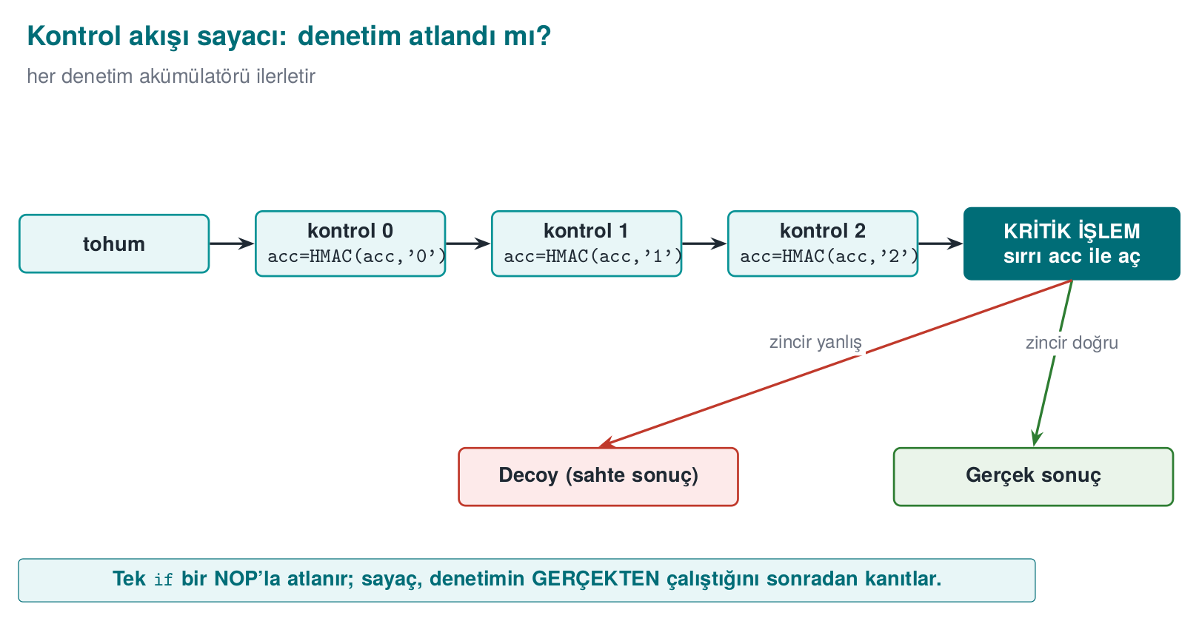
CEN429 Secure Programming · Week 6
Control-Flow Counter — Diagram
RTEU Computer Engineering · 2026-2027 Fall
123

Slide 124
CEN429 Secure Programming · Week 6
Dual Counters
• count (how many checkpoints ran) + visited_mask (which checkpoints ran, a bit set).
• Both are separate from the HMAC chain and give a readable diagnostic — but neither decides alone.
• Even if the attacker patches these, the real key still comes only from the HMAC chain (Demo 5).
RTEU Computer Engineering · 2026-2027 Fall
124

Slide 125
CEN429 Secure Programming · Week 6
Tie the Result to a Behaviour
• The check result is not a plain if.
• The result feeds into the computation of the next step (e.g., a key derivation).
• If skipped, the program behaves incorrectly (breaks silently).
RTEU Computer Engineering · 2026-2027 Fall
125

Slide 126
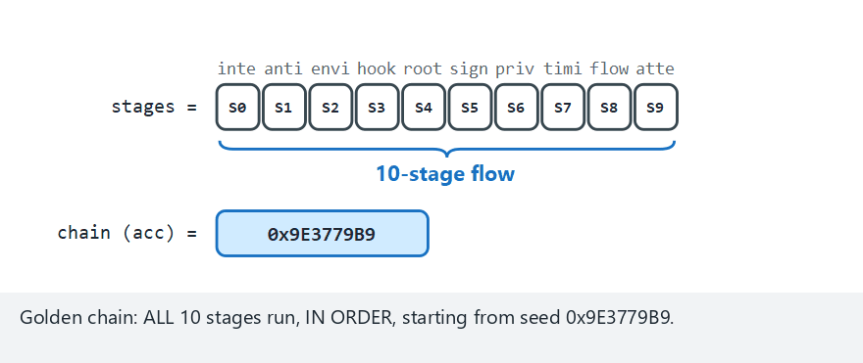
CEN429 Secure Programming · Week 6
Control-Flow Counter (animation)
RTEU Computer Engineering · 2026-2027 Fall
126
Notes:
Speaker note: show how the stages build the golden chain, then compare it against the actual run order.

Slide 127
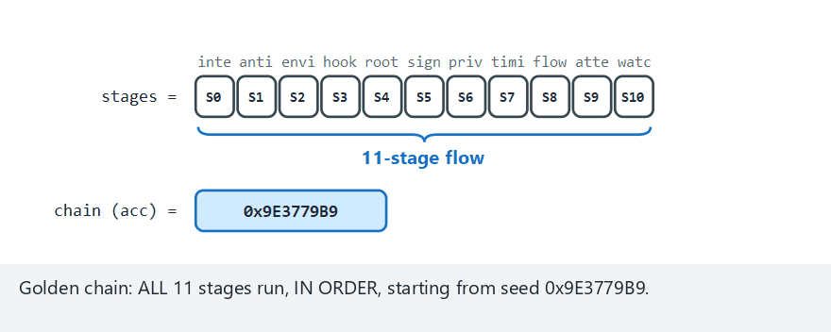
CEN429 Secure Programming · Week 6
Control-Flow Counter — edge case: wrong order
RTEU Computer Engineering · 2026-2027 Fall
127
Notes:
Speaker note: even with every stage present, the wrong ORDER breaks the chain — the double counter alone can't catch this, the HMAC chain does.

Slide 128
CEN429 Secure Programming · Week 6
Demo 5 · Skip Attack — Actual Output
SCENARIO 1 - normal: every checkpoint runs in order
RESULT: PAYMENT APPROVED -> "PAYMENT-APPROVAL-TOKEN-4242"
SCENARIO 2 - skip: the checks are SKIPPED entirely
(warning: count=0 visited_mask=0x0 expected=3/0x7)
RESULT: PAYMENT DENIED (wrong chain key). a decoy is returned
SCENARIO 4 - reorder: the checks run in the WRONG ORDER
RESULT: PAYMENT DENIED (wrong chain key). a decoy is returned
When checks are skipped or their order is broken, the chain comes out different; the real result couldn't be produced.
RTEU Computer Engineering · 2026-2027 Fall
128

Slide 129
CEN429 Secure Programming · Week 6
This Section's Rule (9)
Don't tie critical decisions to a single boolean (it gets patched).
Tie security checks to a control-flow counter and, where possible, to a data dependency.
RTEU Computer Engineering · 2026-2027 Fall
129

Slide 130
CEN429 Secure Programming · Week 6
10. Response Policy and Deterrence
RTEU Computer Engineering · 2026-2027 Fall
130

Slide 131
CEN429 Secure Programming · Week 6
Why Is "Crash Immediately" Bad?
• Response policy: deciding what RASP does once it sees a threat.
• It tells the attacker "the check is exactly here."
• It makes finding and bypassing the check easier.
• Smarter responses are needed.
RTEU Computer Engineering · 2026-2027 Fall
131

Slide 132
CEN429 Secure Programming · Week 6
Examples of Good Responses
• Delayed: trigger the response later, somewhere else (hide the source).
• Indirect: silently break the feature (produce a wrong result).
• Notify the server: raise the risk score, reject the operation server-side.
RTEU Computer Engineering · 2026-2027 Fall
132

Slide 133
CEN429 Secure Programming · Week 6
Response Strategies — Table
Strategy | What It Does
Fail-closed | Reject the operation when in doubt, don't fall back to a trusting default
Erase the secret | Securely erase the valuable data the instant tampering is found
Decoy output | Return a random/fake result instead of crashing
Delayed/implicit response | Separate the response from the trigger, in time/distance
Device/version binding | Bind the secret to the device/version
Telemetry/attestation | Report the event to the server; let the server's risk engine decide
RTEU Computer Engineering · 2026-2027 Fall
133

Slide 134
CEN429 Secure Programming · Week 6
Designing the Response
• Don't break the user experience (false-positive risk).
• A harsh response only on a high-confidence indicator.
• In most cases: restrict + server-side verification.
RTEU Computer Engineering · 2026-2027 Fall
134

Slide 135
CEN429 Secure Programming · Week 6
The Detect → Decide → Respond Loop
Demo 8 (code/week-06/08-tamper-response) combines this loop into a single self-protection engine:
1. A series of checks run (integrity, anti-debug, environment...).
2. The secret is wrapped with a device-bound key (HKDF + AES-GCM).
3. The number of failed checks (and whether the device matches) is turned into a four-state response policy (NORMAL/WARN/DEGRADE/LOCK) — not a binary clean/tamper decision.
RTEU Computer Engineering · 2026-2027 Fall
135

Slide 136
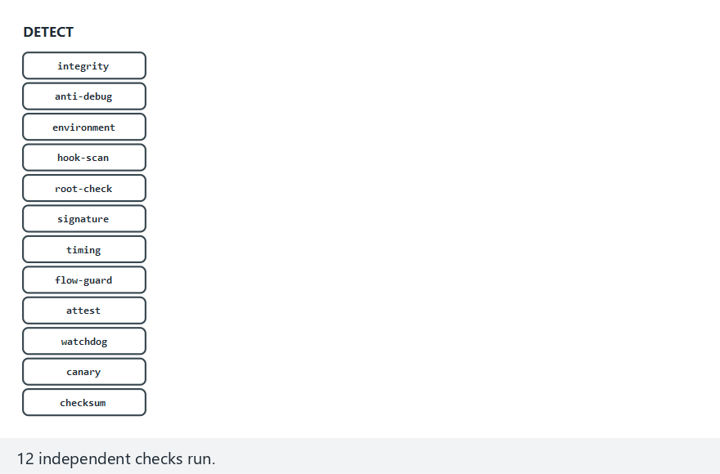
CEN429 Secure Programming · Week 6
RASP Pipeline: Detect → Decide → Respond (animation)
RTEU Computer Engineering · 2026-2027 Fall
136
Notes:
Speaker note: show how the checks collapse into a "failed count", then how that count turns into a state and a concrete response.

Slide 137
CEN429 Secure Programming · Week 6
RASP Pipeline — edge case: device mismatch despite passing checks
RTEU Computer Engineering · 2026-2027 Fall
137
Notes:
Speaker note: a device mismatch jumps straight to LOCK, INDEPENDENTLY of how many checks passed.

Slide 138
CEN429 Secure Programming · Week 6
Step A · Detect (Scenario 1 — Normal)
SCENARIO 1 - normal: 0 failed checks, device matches -> NORMAL
RESULT: NORMAL. The secret opened and is in use
-> "PAYMENT-KEY-7C4A"
(the secret was safely wiped from memory after use)
Checks passed, the device was correct → the secret was opened, used, and immediately erased.
RTEU Computer Engineering · 2026-2027 Fall
138

Slide 139
CEN429 Secure Programming · Week 6
Step B · Decide (Scenario: warn/degrade)
SCENARIO 2 - warn: 1 failed check -> WARN
RESULT: WARN. One weak signal is not worth degrading
service over. The secret still opened.
SCENARIO 3 - degrade: 2 failed checks -> DEGRADE
RESULT: DEGRADE. Multiple signals -> full trust withdrawn.
RESULT-VALUE: PAYM**** (redacted)
One check failed → the engine still opened the secret, just logged it (WARN). Two checks failed → the secret was erased, a redacted result came back (DEGRADE).
RTEU Computer Engineering · 2026-2027 Fall
139

Slide 140
CEN429 Secure Programming · Week 6
Step C · Respond (Scenario: lock / a different device)
SCENARIO 4 - lock: 3 failed checks -> LOCK
RESULT: LOCK -> detection checks failed (tamper)
SCENARIO 5 - other-device: checks pass, device key
does not hold -> LOCK
RESULT: LOCK -> device/version binding failed (cloned?)
Even though checks passed, the device-bound key didn't match → the secret couldn't be opened; three failed checks lead to the same LOCK state. This is the innermost layer of Week 3's security shell.
RTEU Computer Engineering · 2026-2027 Fall
140

Slide 141
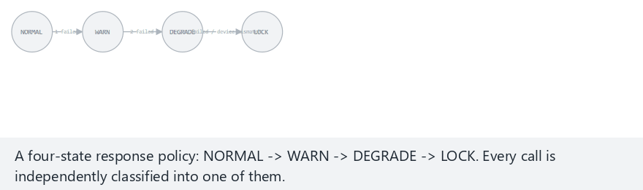
CEN429 Secure Programming · Week 6
Response Policy State Machine (animation)
RTEU Computer Engineering · 2026-2027 Fall
141
Notes:
Speaker note: show how every call on a monitoring timeline gets classified into one of the four states.

Slide 142
CEN429 Secure Programming · Week 6
State Machine — edge case: always LOCK
RTEU Computer Engineering · 2026-2027 Fall
142
Notes:
Speaker note: even with zero failed checks, a device mismatch ALWAYS leads to LOCK.

Slide 143
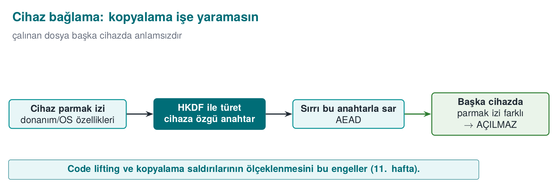
CEN429 Secure Programming · Week 6
Device Binding — Diagram
RTEU Computer Engineering · 2026-2027 Fall
143

Slide 144
CEN429 Secure Programming · Week 6
Device Binding
• The key/data is meaningful only on a specific device.
• If copied (to another device), it's useless.
• A defence against code lifting (Weeks 9/11).
RTEU Computer Engineering · 2026-2027 Fall
144

Slide 145
CEN429 Secure Programming · Week 6
The Device-Binding Flow · Step by Step
Step 1 — read the fingerprint: the device's hardware/OS fingerprint is read (Week 5).
Step 2 — derive a key: a key is derived from the fingerprint + version string with HKDF; the secret is wrapped with this key using AES-GCM.
Step 3 — if moved, try to open: even if the file is copied to another device, that device's fingerprint is different, so the derived key won't match → the secret cannot be opened.
RTEU Computer Engineering · 2026-2027 Fall
145

Slide 146
CEN429 Secure Programming · Week 6
Deterrence · the Ultimate Goal
RASP does not make the attack impossible; it makes it costly and risky.
Enough layers + server-side verification → the attacker gives up or gets caught.
RTEU Computer Engineering · 2026-2027 Fall
146

Slide 147
CEN429 Secure Programming · Week 6
Response: How Do You Decide?
1. How reliable is the indicator? Highly reliable → reject + notify the server. Uncertain → continue, raise the risk score.
2. Will it affect the user experience? If the false-positive risk is high, don't respond harshly; prefer silent restriction + server-side verification.
3. Does the response give away the check? Crashing immediately reveals the source; a delayed/indirect response hides it.
RTEU Computer Engineering · 2026-2027 Fall
147

Slide 148
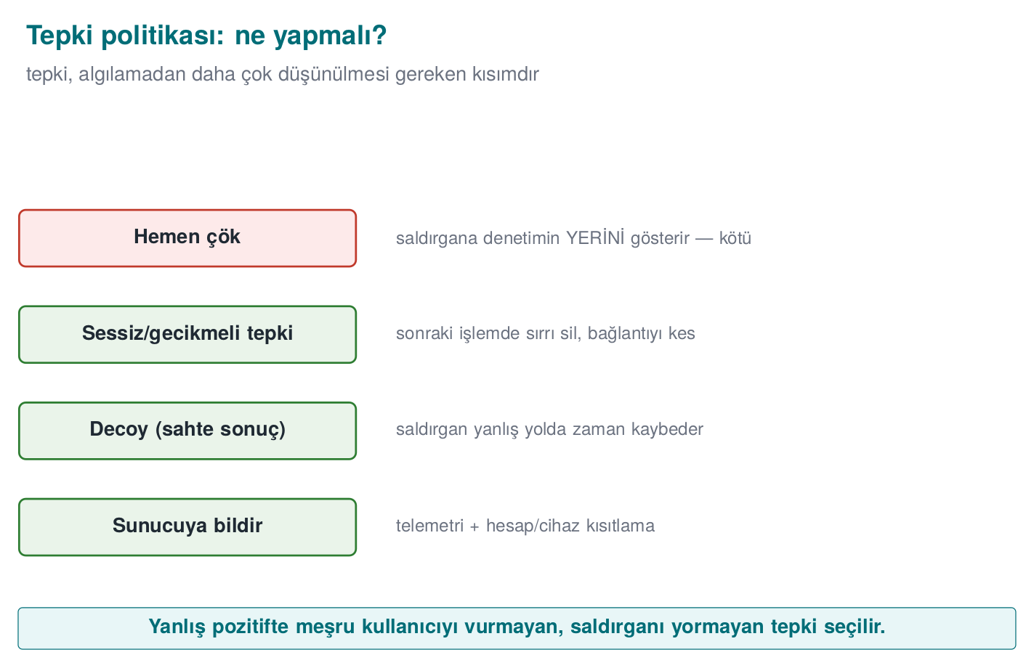
CEN429 Secure Programming · Week 6
Response Flow · At a Glance
RTEU Computer Engineering · 2026-2027 Fall
148

Slide 149
CEN429 Secure Programming · Week 6
This Section's Rule (10)
Separate the response from the trigger: an immediate exit() hands the attacker a map.
The instant tampering is found, erase the secret, return a decoy instead of crashing, report the event to the server, bind the secret to the device.
RTEU Computer Engineering · 2026-2027 Fall
149

Slide 150
CEN429 Secure Programming · Week 6
Section 8–10 — Quick Check
1. Why is a rooted device a risk?
2. Why does a counter strengthen a single if?
3. Why can "crash immediately" be a bad response?
RTEU Computer Engineering · 2026-2027 Fall
150
Notes:
Speaker note: Next, limits, ethics, the project.

Slide 151
CEN429 Secure Programming · Week 6
Section 8–10 — Answers
1. Root/jailbreak removes the barriers against reading/writing memory, hooking, and certificate injection → RASP's assumptions and isolation collapse.
2. A single if is bypassed with a NOP/patch; the counter verifies after the fact that the check actually ran (distributed proof) → a single patch isn't enough.
3. "Crash immediately" shows the attacker exactly where the check is, and on a false positive it hits a legitimate user. A delayed/silent/deceptive response is better.
RTEU Computer Engineering · 2026-2027 Fall
151

Slide 152
CEN429 Secure Programming · Week 6
11. Limits and Ethics
RTEU Computer Engineering · 2026-2027 Fall
152

Slide 153
CEN429 Secure Programming · Week 6
RASP's Limits
• Every single check can be bypassed.
• Its strength decreases on a rooted device.
• A false positive → a real user can be hurt.
• Maintenance cost is high (tools evolve).
RTEU Computer Engineering · 2026-2027 Fall
153

Slide 154
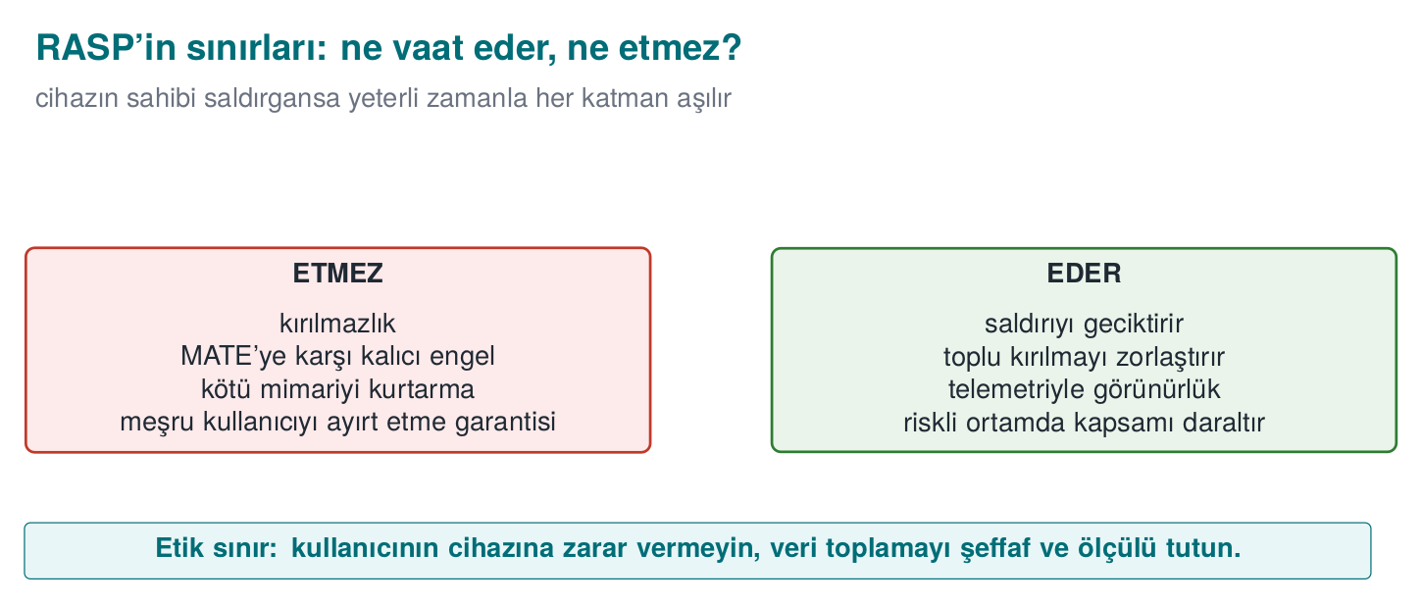
CEN429 Secure Programming · Week 6
RASP's Limits — Diagram
RTEU Computer Engineering · 2026-2027 Fall
154

Slide 155
CEN429 Secure Programming · Week 6
That's Why RASP Is...
• Layered (many checks), diversified, hidden.
• Combined with server-side verification (the real guarantee).
• Claiming it's "unbreakable" on its own is wrong.
RTEU Computer Engineering · 2026-2027 Fall
155

Slide 156
CEN429 Secure Programming · Week 6
Ethics and the User
• RASP runs on the user's device; excessive data collection is not ethical.
• A false positive can deny the user service → respond carefully.
• A balance between transparency and privacy.
RTEU Computer Engineering · 2026-2027 Fall
156

Slide 157
CEN429 Secure Programming · Week 6
⚠️ The Safe-Example Rule
• Course demos do not harm the student's device.
• No real root/system change; synthetic indicators.
• The goal is teaching the concept, not building an attack tool.
RTEU Computer Engineering · 2026-2027 Fall
157

Slide 158
CEN429 Secure Programming · Week 6
End to End: Building a RASP Layer
Let's protect a synthetic "license check" with RASP:
• integrity checking
• debugger checking
• a smart response
RTEU Computer Engineering · 2026-2027 Fall
158
Notes:
Speaker note: We build integrity + anti-debug + response step by step in a synthetic example.

Slide 159
CEN429 Secure Programming · Week 6
Step 1 · The Point to Protect
int license_is_valid(void) {
/* ... check ... */
return result; /* the attacker's target */
}
This function and the flow that calls it are critical.
RTEU Computer Engineering · 2026-2027 Fall
159

Slide 160
CEN429 Secure Programming · Week 6
Step 2 · Add an Integrity Check
• After compilation, record this region's digest.
• Recompute and compare while running.
• A difference → raise the tampering flag.
RTEU Computer Engineering · 2026-2027 Fall
160

Slide 161
CEN429 Secure Programming · Week 6
Step 3 · Add Anti-Debug
• "Am I being watched?" via timing + OS indicators.
• Don't leave the result alone; combine it with another check.
RTEU Computer Engineering · 2026-2027 Fall
161

Slide 162
CEN429 Secure Programming · Week 6
Step 4 · Tie the Result to a Behaviour
• license_is_valid's result is not plain true/false.
• The integrity + anti-debug indicators feed into the result's computation.
• If there's tampering, the function behaves incorrectly.
RTEU Computer Engineering · 2026-2027 Fall
162

Slide 163
CEN429 Secure Programming · Week 6
Step 5 · Response
• Instead of crashing immediately: report the flag to the server, restrict the feature.
• Delayed trigger: hide the source.
RTEU Computer Engineering · 2026-2027 Fall
163

Slide 164
CEN429 Secure Programming · Week 6
Step 6 · Obfuscate and Diversify
• Obfuscate the check code (Week 9).
• Place it differently in every version (diversification).
• Add a cross-check.
RTEU Computer Engineering · 2026-2027 Fall
164

Slide 165
CEN429 Secure Programming · Week 6
Step 7 · Measure and Document
• How many checks, where, and what response?
• Performance cost (checks slow things down).
• Write it up in S10.
RTEU Computer Engineering · 2026-2027 Fall
165

Slide 166
CEN429 Secure Programming · Week 6
Attacker and Defender: A Dialogue
RTEU Computer Engineering · 2026-2027 Fall
166
Notes:
Speaker note: For every check, we show the "what does the attacker do → what does the defence add" loop. This makes concrete why layered defence is necessary.

Slide 167
CEN429 Secure Programming · Week 6
Why This Dialogue?
Security is a move-countermove game.
Every defence gets an attack, every attack gets a new defence.
This is why layered defence is necessary.
RTEU Computer Engineering · 2026-2027 Fall
167

Slide 168
CEN429 Secure Programming · Week 6
Integrity · Dialogue
• Defence: add self-hashing.
• Attacker: find the digest function, force it to always say "match."
• Defence: obfuscate the digest check, overlap it, tie the result to a behaviour.
RTEU Computer Engineering · 2026-2027 Fall
168

Slide 169
CEN429 Secure Programming · Week 6
Anti-Debug · Dialogue
• Defence: add a debugger check.
• Attacker: find the check, bypass it.
• Defence: many methods + timing + obfuscation; make the response delayed.
RTEU Computer Engineering · 2026-2027 Fall
169

Slide 170
CEN429 Secure Programming · Week 6
Hook · Dialogue
• Defence: check the function's bytes.
• Attacker: hide the hook, restore the bytes.
• Defence: cross-checking + server-side verification.
RTEU Computer Engineering · 2026-2027 Fall
170

Slide 171
CEN429 Secure Programming · Week 6
Root · Dialogue
• Defence: check root indicators.
• Attacker: use a root-hiding tool.
• Defence: many indicators + a server-side risk score; restriction instead of a harsh response.
RTEU Computer Engineering · 2026-2027 Fall
171

Slide 172
CEN429 Secure Programming · Week 6
The Lesson From the Dialogue
• A single defence is always eventually bypassed.
• Strength: multiplicity + secrecy + diversity + the server.
• Goal: make the attack no longer economical.
RTEU Computer Engineering · 2026-2027 Fall
172

Slide 173
CEN429 Secure Programming · Week 6
RASP Check Catalogue (1)
Check | What It Catches | Limit
Integrity (self-hash) | A binary patch | The digest fn. can be bypassed
Anti-debug | A debugger attached | Known methods get bypassed
Emulator | A fake environment | False positives
RTEU Computer Engineering · 2026-2027 Fall
173

Slide 174
CEN429 Secure Programming · Week 6
RASP Check Catalogue (2)
Check | What It Catches | Limit
Hook/Frida | A function hook | Hidden tools
Root | Privilege escalation | Root hiding tools
Signature | A fake component | If the key leaks
CFI counter | A skipped check | A sophisticated patch
RTEU Computer Engineering · 2026-2027 Fall
174

Slide 175
CEN429 Secure Programming · Week 6
The Lesson From the Catalogue
• Every check has a blind spot.
• None of them is enough alone.
• Choose several from the catalogue, combine them, diversify them.
RTEU Computer Engineering · 2026-2027 Fall
175

Slide 176
CEN429 Secure Programming · Week 6
Choosing Checks
• How many layers, based on the asset's value?
• Which checks make sense for the platform?
• What's the performance budget?
Write the decision and its rationale in S10.
RTEU Computer Engineering · 2026-2027 Fall
176

Slide 177
CEN429 Secure Programming · Week 6
Common Mistakes
• Relying on a single check.
• Not obfuscating the check (easily found).
• A "crash immediately" response (gives away the source).
• A harsh response + a high false-positive rate (hurts the user).
• Skipping server-side verification (the real guarantee is there).
RTEU Computer Engineering · 2026-2027 Fall
177

Slide 178
CEN429 Secure Programming · Week 6
12. Project: This Week (S10)
RTEU Computer Engineering · 2026-2027 Fall
178

Slide 179
CEN429 Secure Programming · Week 6
Project · S10 (RASP + Response)
•
• hidden and diversified.
•
• when/where the checks run.
• smart (delayed/indirect — not "crash immediately").
•
•
•
•
RTEU Computer Engineering · 2026-2027 Fall
179

Slide 180
CEN429 Secure Programming · Week 6
Through the Evaluator's Eyes
• "RASP exists" isn't enough; how many layers, how hidden, what response?
• How does it combine with server-side verification?
• How is the false-positive risk managed?
RTEU Computer Engineering · 2026-2027 Fall
180

Slide 181
CEN429 Secure Programming · Week 6
Solved Self-Check
RTEU Computer Engineering · 2026-2027 Fall
181

Slide 182
CEN429 Secure Programming · Week 6
Question 1
What are RASP's three jobs?
Answer: Detect (abnormal environment/tampering), defend (restrict/halt the feature), deter (raise the cost).
RTEU Computer Engineering · 2026-2027 Fall
182

Slide 183
CEN429 Secure Programming · Week 6
Question 2
What does self-hashing catch, and why isn't it enough alone?
Answer: It catches a patch/tampering applied to the binary. It isn't enough alone because the attacker can find and bypass the digest function; obfuscation + cross-checking + overlapping checks are needed.
RTEU Computer Engineering · 2026-2027 Fall
183

Slide 184
CEN429 Secure Programming · Week 6
Question 3
Why is cross-checking strong?
Answer: Java checks native, native checks Java; the attacker has to bypass both at once.
RTEU Computer Engineering · 2026-2027 Fall
184

Slide 185
CEN429 Secure Programming · Week 6
Question 4
How does timing-based anti-debug work?
Answer: If a small piece of work took much longer than expected, someone may be single-stepping the program (a debugger).
RTEU Computer Engineering · 2026-2027 Fall
185

Slide 186
CEN429 Secure Programming · Week 6
Question 5
Why does a control-flow counter strengthen a single `if` check?
Answer: It counts that checks passed in the correct order; patching a single branch breaks the counter, and the skip is caught.
RTEU Computer Engineering · 2026-2027 Fall
186

Slide 187
CEN429 Secure Programming · Week 6
Question 6
Why isn't "crash immediately" always a good response?
Answer: It shows the attacker exactly where the check is. A delayed/indirect response + server notification is better.
RTEU Computer Engineering · 2026-2027 Fall
187

Slide 188
CEN429 Secure Programming · Week 6
Question 7
Why does the false-positive risk matter in emulator detection?
Answer: A real device/developer environment can look like an emulator; a harsh response hurts a real user.
RTEU Computer Engineering · 2026-2027 Fall
188

Slide 189
CEN429 Secure Programming · Week 6
Question 8
What is RASP's fundamental limit?
Answer: Every single check can be bypassed; it weakens on a rooted device. Strength comes from layering, diversity, and server-side verification.
RTEU Computer Engineering · 2026-2027 Fall
189

Slide 190
CEN429 Secure Programming · Week 6
Quiz-1-Style Sample Questions
RTEU Computer Engineering · 2026-2027 Fall
190

Slide 191
CEN429 Secure Programming · Week 6
Example · Multiple Choice
What is the goal of RASP cross-checking?
A) Shrinking the code B) Forcing the attacker to bypass both sides ✓ C) Speeding up encryption D) Turning off logging
RTEU Computer Engineering · 2026-2027 Fall
191

Slide 192
CEN429 Secure Programming · Week 6
Example · Short Answer
Name three methods that strengthen an integrity check.
Obfuscation · multiple/overlapping blocks · cross-checking · tying the result to a behaviour.
RTEU Computer Engineering · 2026-2027 Fall
192

Slide 193
CEN429 Secure Programming · Week 6
Glossary
Term | Meaning
RASP | Runtime self-protection
MATE | The attacker at the endpoint (the device's owner)
Self-hashing | Checking a digest of one's own code
Hook/Frida | Intercepting and changing a function call
CFI counter | Verifying check order by counting
Device binding | Binding data to a specific device (with HKDF)
Decoy | A fake result returned instead of crashing
Fail-closed | Rejecting an operation when in doubt
Attestation | Server-side proof of integrity
RTEU Computer Engineering · 2026-2027 Fall
193

Slide 194
CEN429 Secure Programming · Week 6
Next Week
Week 7 — Interim Project Demos (RAP1) and Week 8 — Quiz-1
In Week 7 you will present this week's RASP checks (integrity checking, debugger/environment/hook detection, the control-flow counter, the response policy) live in your project. Week 8 is Quiz-1, covering weeks 1–6.
Then Week 9 — Advanced Obfuscation and Diversification continues by deepening this week's debugger/environment detection ideas and its "obscurity/deterrence is not unbreakability" theme on the code-obfuscation side.
RTEU Computer Engineering · 2026-2027 Fall
194

