Slide 1

CEN429 Secure Programming · Week 7
Midterm Project Demonstrations
CEN429 Secure Programming — Week 7
Asst. Prof. Dr. Uğur CORUH · 30.10.2026
RTEU Computer Engineering · 2026-2027 Fall
Notes:
Speaker note: This week is not a lecture but a demonstration week: each team shows the midterm sections of its security guide and its working application.

Slide 2
CEN429 Secure Programming · Week 7
This Week: Midterm Project Demonstrations (RAP1)
• No lecture; each team submits its interim report and demonstrates its application
• RAP1 = 60% of the midterm · Quiz-1 = 40% → Grade_Midterm = 0.6·RAP1 + 0.4·QUIZ1
• Detailed rubric: project guide · order, timing, submission time: in class
• ⚠️ Late submissions are not accepted
RTEU Computer Engineering · 2026-2027 Fall
2

Slide 3
CEN429 Secure Programming · Week 7
Midterm Rubric: Five Criteria
Criterion | LO | Guide
Security analysis | 1 | S2 · S3 interface table · S4 threat/attacker model
Data security | 2 | S5 asset list · S7 shell matrix
C/C++ hardening and RASP | 3 | S9 (basic) · S10
Project management | 5 | S13 process, SBOM · GitHub repo and plan
Interim report | 7 | All midterm sections
Evidence = the relevant guide section + code + test output; show at least one control for every threat.
RTEU Computer Engineering · 2026-2027 Fall
3

Slide 4
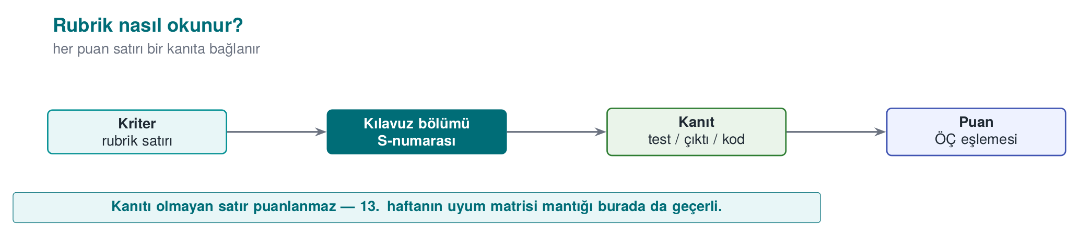
CEN429 Secure Programming · Week 7
How the Rubric Is Read — Diagram
RTEU Computer Engineering · 2026-2027 Fall
4

Slide 5
CEN429 Secure Programming · Week 7
Which Sections in the Interim Report?
Complete | Draft / brief / plan
S0 cover · S2 overview · S3 architecture · S4 threat model | S1 scope (draft) · S5 assets (draft)
S7 data security · S10 RASP · S13 process | S9 hardening (basic) · S12 reporting (brief)
 | S16 testing (plan) · S17 compliance matrix (draft)
Left for the final: S6 · S8 · S11 · S14 · S15
RTEU Computer Engineering · 2026-2027 Fall
5

Slide 6
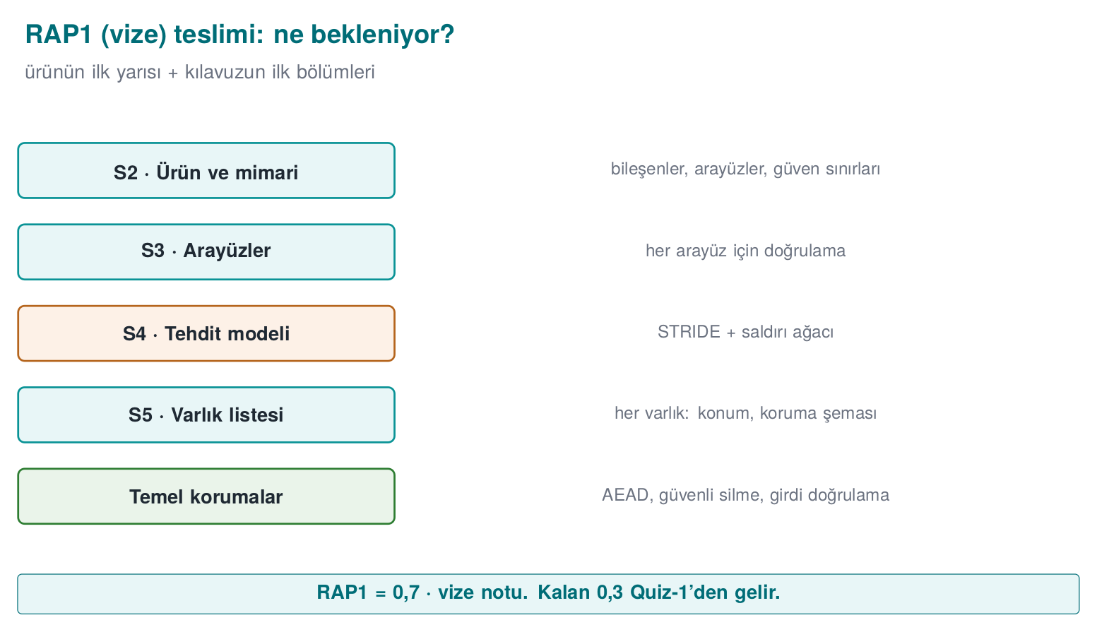
CEN429 Secure Programming · Week 7
RAP1 Submission — Diagram
RTEU Computer Engineering · 2026-2027 Fall
6

Slide 7
CEN429 Secure Programming · Week 7
Preparation Checklist
Week | What you should be able to show
1 | Repo + plan · S2 · S3 interface table · S4 STRIDE + attack tree · S5 draft (C/I/I+)
2 | Every threat → CWE + CVSS v3.1 vector
3 | S7 algorithm/key/binding · shell matrix · CSPRNG · AEAD verification
4 | S9 protection table · CERT findings · ASan+UBSan · fuzz result
5 | SBOM + scan · input validation table
6 | S10 RASP inventory · response policy · a bypass attempt
RTEU Computer Engineering · 2026-2027 Fall
7

Slide 8
CEN429 Secure Programming · Week 7
Suggested Demonstration Flow
1. Product and architecture (S2–S3, ~2 min): one diagram, trust boundaries
2. Threats and assets (S4–S5): the three most critical threats, a control for each
3. Live demonstration: at least one control working live (e.g. encrypted data, signature verification, a RASP trigger) — backup video + commands ready
4. Evidence: protection table, sanitizer/fuzz, SBOM — command + output
5. Remaining risk and plan: what remains before the final? (honest analysis earns points)
For every control: What does it protect? · How was it built? · How was it proven?
RTEU Computer Engineering · 2026-2027 Fall
8

Slide 9
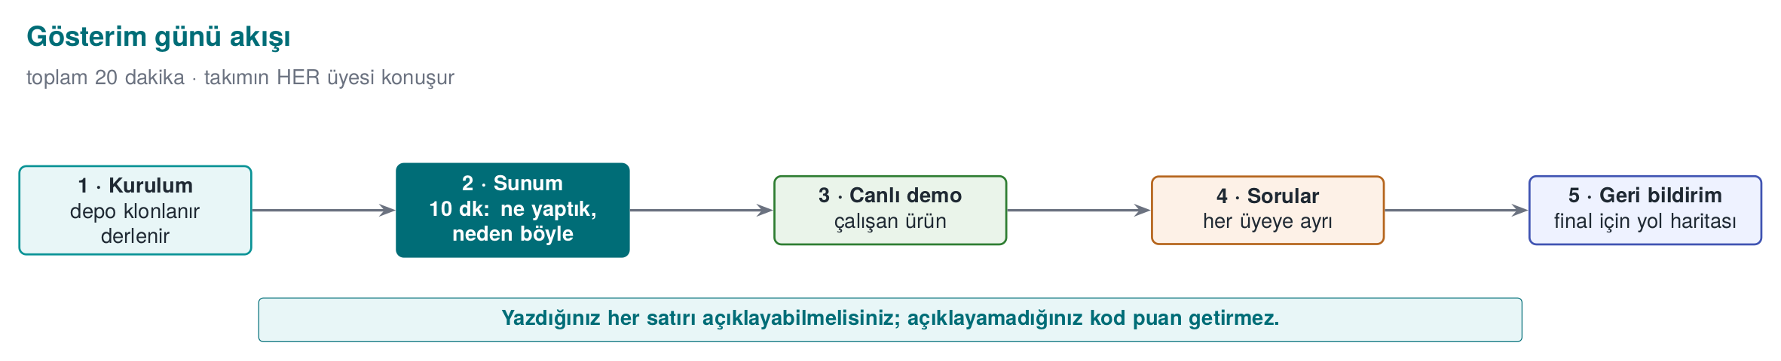
CEN429 Secure Programming · Week 7
Demonstration Day Flow — Diagram
RTEU Computer Engineering · 2026-2027 Fall
9

Slide 10
CEN429 Secure Programming · Week 7
Demo checklist
What you open and show, in this order:
1. The home page of the local site (9-open-site-..., on http://localhost).
2. Each report page: tests, code coverage, documentation coverage (Windows and Linux).
3. The API docs.
4. The `release/` folder listing.
5. Run the app from the release archive.
6. The GitHub Release page of your private repository (the instructor is a collaborator).
RTEU Computer Engineering · 2026-2027 Fall
10

Slide 11
CEN429 Secure Programming · Week 7
Sample Questions
• Which flow crossing a trust boundary is the riskiest?
• How long does this asset stay unencrypted in memory, and where is it wiped?
• Where does the key come from, where does it live, when is it deleted? Can the nonce repeat?
• Which compiler protection is turned off, and why?
• What happens when a RASP check fails?
• Does the SBOM contain a vulnerable component? Are you affected?
• What are your three most critical assets, their C/I/I+ labels, and their lifecycle?
• Which control addresses a given threat, and how was it verified? (threat → control → evidence)
• What is your remaining risk, and why is it acceptable? (answer honestly and with justification)
RTEU Computer Engineering · 2026-2027 Fall
11

Slide 12
CEN429 Secure Programming · Week 7
Common Mistakes
Mistake | Why is it a problem?
Guide and code are inconsistent | One of the most serious findings
"Secure" claimed without evidence | Not scored
Keys/logs/code missing from the asset list | What is not in the list is not protected
Threat table from general knowledge | Project-specific threats get missed
Unrehearsed demonstration | Time is wasted
Real password/key/personal data in the repo | A serious security mistake; values must be synthetic
Live demo crashes with no backup / remaining-risk section left empty | Looks like a lack of preparation and honest analysis
RTEU Computer Engineering · 2026-2027 Fall
12

Slide 13
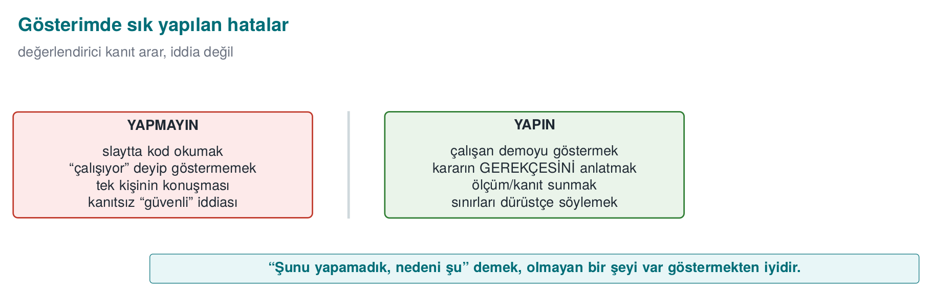
CEN429 Secure Programming · Week 7
Common Mistakes — Diagram
RTEU Computer Engineering · 2026-2027 Fall
13

Slide 14
CEN429 Secure Programming · Week 7
Academic Integrity
• Uncredited code/text, work from outside the team, fabricated results are not acceptable
• Every submitted line must be explainable
• Any team member should be able to present their own section; anyone may be asked a question
RTEU Computer Engineering · 2026-2027 Fall
14

Slide 15
CEN429 Secure Programming · Week 7
After the Demonstration
• Write the feedback as a finding list (finding · severity · fix · date) → a small model of Week 12
• Final sections: S6 · S8 · S11 · S14 · S15 · S16 results · S17
A demonstration is a presentation of evidence: every claim should be backed by a document, a test, or live output.
RTEU Computer Engineering · 2026-2027 Fall
15

Slide 16
CEN429 Secure Programming · Week 7
Next Week
Week 8 — Midterm Exam Week: Quiz-1
• Scope: weeks 1–6
• Study guide and sample questions: Week 8 page
RTEU Computer Engineering · 2026-2027 Fall
16

