Slide 1

CEN429 Secure Programming · Week 16
Final Exam Period: Quiz-2
CEN429 Secure Programming — Week 16
Asst. Prof. Dr. Uğur CORUH · 04–17.01.2027
RTEU Computer Engineering · 2026-2027 Fall
Notes:
Speaker note: Quiz-2 period: we review the concepts of weeks 9-14; this deck is a study guide.

Slide 2
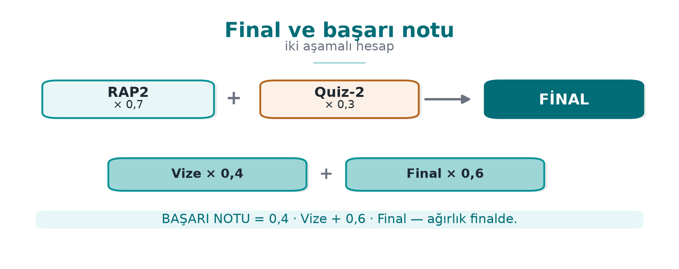
CEN429 Secure Programming · Week 16
Final and Course Passing Grade — Diagram
RTEU Computer Engineering · 2026-2027 Fall
2

Slide 3
CEN429 Secure Programming · Week 16
Quiz-2: What, When?
• Scope: weeks 9–14 · 30% of the final grade
• Date, time, place, duration, format: announced in class
• Best preparation: Self-check questions · Week 10 OpenSSL steps · Week 13 compliance matrix
RTEU Computer Engineering · 2026-2027 Fall
3

Slide 4
CEN429 Secure Programming · Week 16
Topic Map
Week | Focus
9 | Purpose, cost, and measurement of obfuscation (potency, resilience, cost)
10 | Security level · modes and padding · HMAC, EtM, replay · OAEP/PSS, Ed25519/X25519 · signature · DH · PKI, X.509 · CRL/OCSP · PKCS#11
11 | White-box/black-box models · white-box's role and limits in layered defence
12 | 13 steps · requirement template · finding–action · impact analysis · delta assessment
13 | Good requirement · compliance matrix · deferred requirements · CC, EAL · FIPS 140-3 · ETSI, EMVCo, PCI, MASVS
14 | Purpose of diversification · measuring cost and effectiveness
RTEU Computer Engineering · 2026-2027 Fall
4

Slide 5
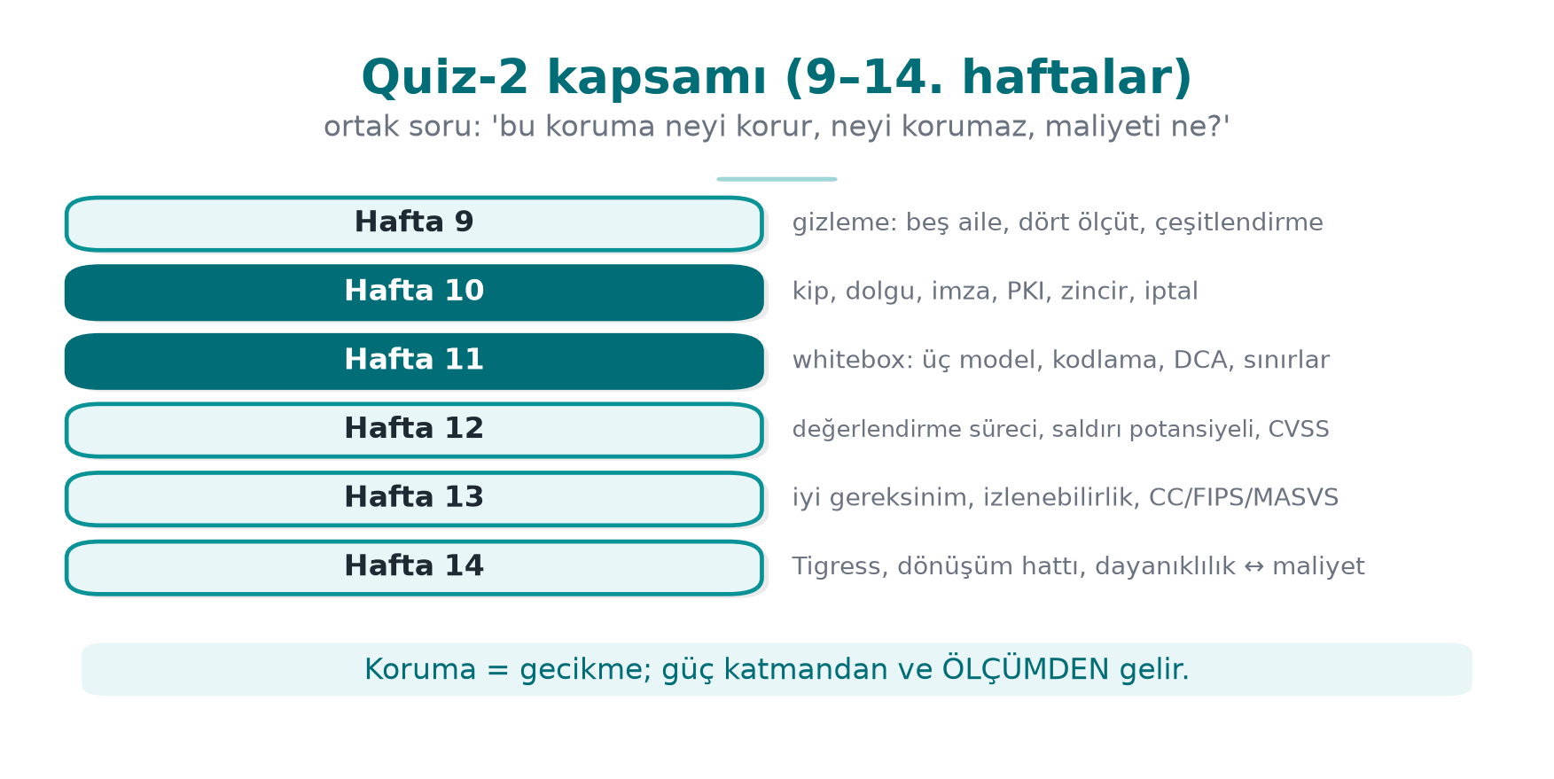
CEN429 Secure Programming · Week 16
Quiz-2 Scope — Diagram
RTEU Computer Engineering · 2026-2027 Fall
5

Slide 6
CEN429 Secure Programming · Week 16
Frequently Confused
A | B | Difference
CBC | GCM | Confidentiality + padding · AEAD, no padding
OAEP | PSS | Encryption · signature
Ed25519 | X25519 | Signature · key agreement
CN | SAN | Name check → SAN
CRL | OCSP | List · live query
ST | PP | Security target · product class requirement set
EAL | Attack potential | Depth · attacker's resources
Met | Deferred | Product meets it · another party (who, why, how)
Impact analysis | Delta assessment | Documents · re-assesses only what changed
RTEU Computer Engineering · 2026-2027 Fall
6

Slide 7
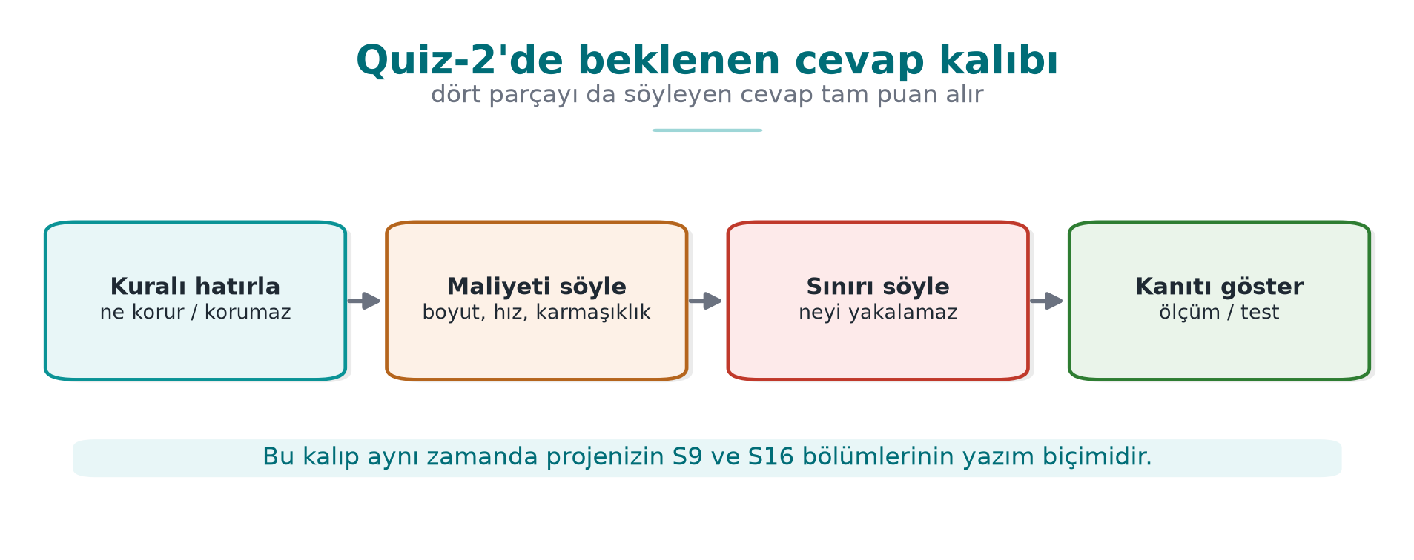
CEN429 Secure Programming · Week 16
Answer Pattern — Diagram
RTEU Computer Engineering · 2026-2027 Fall
7

Slide 8
CEN429 Secure Programming · Week 16
Sample Questions (Week 10)
1. RSA-2048 + AES-256: security level?
2. "Padding invalid" vs. "MAC invalid" as separate messages: risk?
3. Why is if (EVP_DigestVerify(...)) wrong?
4. Why does verify fail without the intermediate certificate?
5. Accepting when OCSP is unreachable: which pattern?
6. What protects against unauthenticated DH?
RTEU Computer Engineering · 2026-2027 Fall
8
Notes:
Speaker note: 1) ~112 bits; RSA-3072 or X25519. 2) Padding oracle; single error, AEAD. 3) A negative error counts as valid; must be == 1, and the version must be signed. 4) The chain doesn't reach the root. 5) Fail-open; Must-Staple, short lifetime. 6) Signed DH, CertificateVerify.

Slide 9
CEN429 Secure Programming · Week 16
Sample Questions (Weeks 12–13)
1. Why must the TOE be uniquely defined?
2. Relationship between impact analysis and delta assessment?
3. How is "the application must be secure" fixed?
4. What does "met" without evidence mean?
5. If a library cannot meet the secure-update requirement?
6. Is EAL4+ always more secure than EAL2?
7. Does a FIPS-validated library mean the application is FIPS compliant?
RTEU Computer Engineering · 2026-2027 Fall
9
Notes:
Speaker note: Answers appear in collapsible boxes on the Week 16 page.

Slide 10
CEN429 Secure Programming · Week 16
Good Luck
• Answers on the Week 16 page
• Your guide is a portfolio item (make sure it contains no confidential information)
RTEU Computer Engineering · 2026-2027 Fall
10

Slide 11
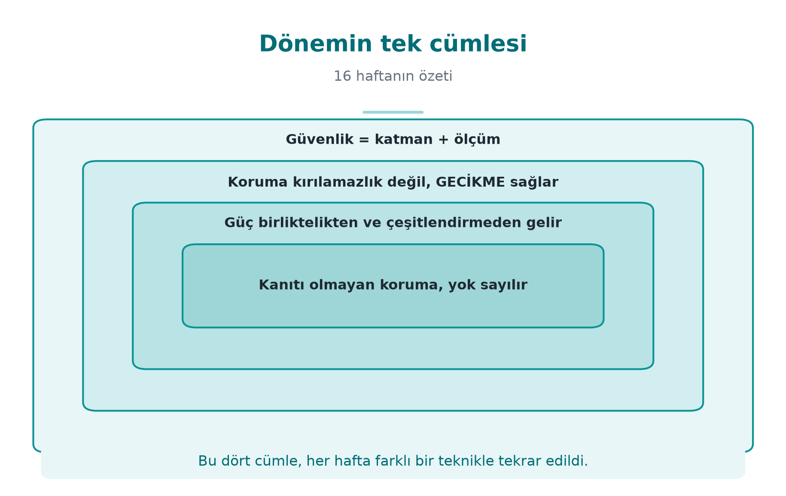
CEN429 Secure Programming · Week 16
The Term in One Sentence — Diagram
RTEU Computer Engineering · 2026-2027 Fall
11

Slide 12
CEN429 Secure Programming · Week 16
Appendix · Week-by-Week Topic Map (9–14)
RTEU Computer Engineering · 2026-2027 Fall
12
Notes:
Speaker note: Quiz-2 covers weeks 9-14. Weeks 9, 11, and 14 have now been published; sample questions have been added.

Slide 13
CEN429 Secure Programming · Week 16
Week 9 · Key Points
• Obfuscation: not unbreakability, but cost.
• Techniques: opaque predicates, control-flow flattening, bogus/dead code, data encoding.
• Measurement: potency, resilience, stealth, cost.
• Diversification.
RTEU Computer Engineering · 2026-2027 Fall
13

Slide 14
CEN429 Secure Programming · Week 16
Week 10 · Key Points
• Security level; weakest link.
• Modes and padding; padding oracle → AEAD.
• HMAC, encrypt-then-MAC, replay.
• OAEP/PSS, Ed25519/X25519; PKI, X.509, CRL/OCSP.
RTEU Computer Engineering · 2026-2027 Fall
14

Slide 15
CEN429 Secure Programming · Week 16
Week 11 · Key Points
• Black/gray/white box.
• Table-based WBC; internal/external encoding.
• "All broken" → WBC is one layer.
• Key renewal + device binding + server.
RTEU Computer Engineering · 2026-2027 Fall
15

Slide 16
CEN429 Secure Programming · Week 16
Week 12 · Key Points
• 13-step assessment.
• Attack potential + CVSS.
• Penetration test plan; test card.
• Impact analysis vs. delta.
RTEU Computer Engineering · 2026-2027 Fall
16

Slide 17
CEN429 Secure Programming · Week 16
Week 13 · Key Points
• Good requirement; traceability.
• Compliance matrix; deferred requirements.
• CC (TOE/ST/PP/SFR/SAR/EAL); FIPS 140-3.
• ETSI/EMVCo/PCI/MASVS.
RTEU Computer Engineering · 2026-2027 Fall
17

Slide 18
CEN429 Secure Programming · Week 16
Week 14 · Key Points
• Source-to-source (Tigress).
• Transformation pipeline; seed-based diversification.
• Cost + resilience measurement.
• Build pipeline (S15).
RTEU Computer Engineering · 2026-2027 Fall
18

Slide 19
CEN429 Secure Programming · Week 16
Frequently Confused
A | B | Difference
CBC | GCM | Padding / AEAD
OAEP | PSS | Encryption / signature
Ed25519 | X25519 | Signature / key
EAL | Attack potential | Depth / attacker resources
Met | Deferred | Product / another party
Impact analysis | Delta | Documents / re-assesses only what changed
RTEU Computer Engineering · 2026-2027 Fall
19

Slide 20
CEN429 Secure Programming · Week 16
Appendix · Solved Practice (9, 11, 14)
RTEU Computer Engineering · 2026-2027 Fall
20

Slide 21
CEN429 Secure Programming · Week 16
Question · Week 9
Difference between bogus code and dead code?
Answer: Bogus code executes but doesn't change the result; dead code with an opaque predicate never executes. Both hide the real logic.
RTEU Computer Engineering · 2026-2027 Fall
21

Slide 22
CEN429 Secure Programming · Week 16
Question · Week 9
The four dimensions that measure obfuscation? Which ones trade off?
Answer: Potency, resilience, stealth, cost. As potency/resilience increase, cost increases and stealth decreases.
RTEU Computer Engineering · 2026-2027 Fall
22

Slide 23
CEN429 Secure Programming · Week 16
Question · Week 11
How does "all published pure-software WBCs have been broken" affect your decision?
Answer: WBC alone cannot count as key assurance; combine with renewal + device binding + server checks + obfuscation; move to hardware where possible.
RTEU Computer Engineering · 2026-2027 Fall
23

Slide 24
CEN429 Secure Programming · Week 16
Question · Week 11
Which hardware attack does DCA resemble?
Answer: DPA (power analysis); it applies statistics to software traces and often defeats internal encoding.
RTEU Computer Engineering · 2026-2027 Fall
24

Slide 25
CEN429 Secure Programming · Week 16
Question · Week 14
Two things that must always be done after a transformation pipeline?
Answer: Unit tests (is behaviour preserved?) and size/speed measurement (cost).
RTEU Computer Engineering · 2026-2027 Fall
25

Slide 26
CEN429 Secure Programming · Week 16
Question · Week 14
What does the seed (`--Seed`) provide?
Answer: Diversification; the same transformations produce a different binary with a different seed, so an attack written against one copy won't work on another.
RTEU Computer Engineering · 2026-2027 Fall
26

Slide 27
CEN429 Secure Programming · Week 16
Question · Week 10
The four questions of chain validation?
Answer: Is the signature valid, does it reach a trusted root, has it not expired, does the name (SAN) match.
RTEU Computer Engineering · 2026-2027 Fall
27

Slide 28
CEN429 Secure Programming · Week 16
Question · Weeks 12–13
Is "EAL4+ is always more secure" true?
Answer: No; EAL is depth, security depends on the threats and objectives in the ST.
RTEU Computer Engineering · 2026-2027 Fall
28

Slide 29
CEN429 Secure Programming · Week 16
Example · Multiple Choice
What is the limit of external encoding (F,G) in white-box cryptography?
A) Too slow B) Not standard AES ✓ C) Table too small D) Key exposed
RTEU Computer Engineering · 2026-2027 Fall
29

Slide 30
CEN429 Secure Programming · Week 16
Study Plan
• Do the solved practice items on the Week 9, 11, and 14 pages.
• Review the Week 10 OpenSSL steps.
• Fill in the Week 13 compliance matrix activity yourself.
RTEU Computer Engineering · 2026-2027 Fall
30

Slide 31
CEN429 Secure Programming · Week 16
Final Word (Quiz-2 Prep)
Protection = delay; strength comes from layering and measurement. Reasoning is measured, not memorized.
Good luck.
RTEU Computer Engineering · 2026-2027 Fall
31

