Slide 1

CEN429 Secure Programming · Week 8
Midterm Exam Week: Quiz-1
CEN429 Secure Programming — Week 8
Asst. Prof. Dr. Uğur CORUH · 31.10–08.11.2026
RTEU Computer Engineering · 2026-2027 Fall
Notes:
Speaker note: Quiz-1 week: we review the concepts of weeks 1-6; this deck is a study guide.

Slide 2
CEN429 Secure Programming · Week 8
Quiz-1: What, When?
• Scope: weeks 1–6 · 40% of the midterm
• Date, time, place, duration, question format: announced in class
• What's measured: not memorization, but the why question
• Best preparation: each week's Self-check questions + rerunning the demos
RTEU Computer Engineering · 2026-2027 Fall
2

Slide 3
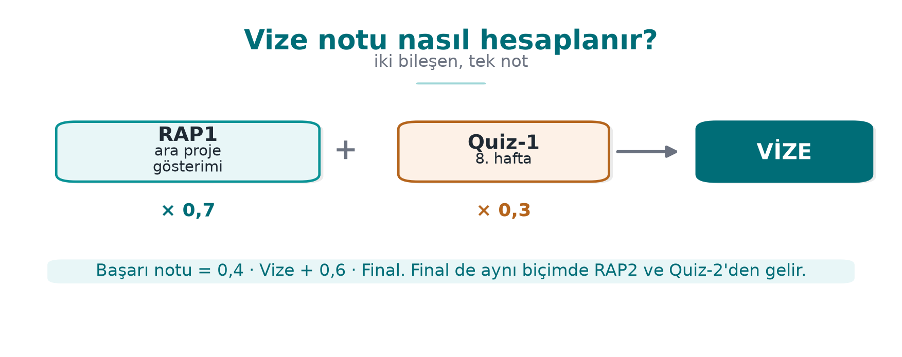
CEN429 Secure Programming · Week 8
Midterm Grade Calculation — Diagram
RTEU Computer Engineering · 2026-2027 Fall
3

Slide 4
CEN429 Secure Programming · Week 8
Topic Map (1)
Week | Core concepts
1 | CIA · asset–threat–vulnerability–risk · white-box · Saltzer–Schroeder · 7 layers · 7-step protection plan · interface/asset table · STRIDE, DFD · attack tree · secure startup · memory errors · secure erasure
2 | Virus/worm/trojan · outbreak · rule-based detection · integrity monitoring · BLP, Biba, Clark–Wilson · Unix/Windows ACL · RBAC · CWE, OWASP, CVE, CVSS · log injection
3 | AEAD · digest/MAC/signature · CSPRNG · nonce/IV/salt · ECB · Argon2id · HKDF · key lifecycle · TLS 1.3 · pinning · fail-open · masking · shells
RTEU Computer Engineering · 2026-2027 Fall
4

Slide 5
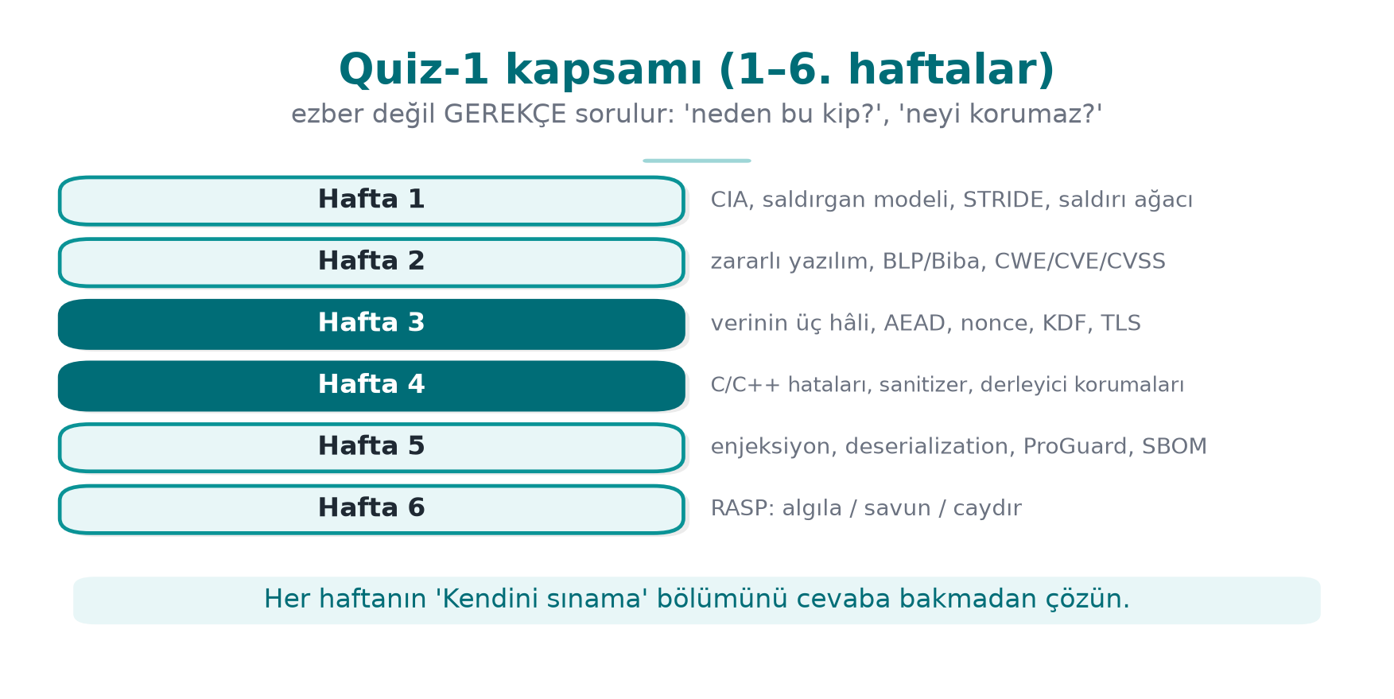
CEN429 Secure Programming · Week 8
Quiz-1 Scope — Diagram
RTEU Computer Engineering · 2026-2027 Fall
5

Slide 6
CEN429 Secure Programming · Week 8
Topic Map (2)
Week | Core concepts
4 | SEI CERT · input validation · format string · UAF · integer/UB · error handling, signals · static analysis · sanitizers · fuzzing · canary/FORTIFY/ASLR/NX/RELRO/CFI · introduction to obfuscation
5 | Managed language · CERT Java · injection root cause · SQL/command/path · deserialisation · XXE/XSS · Python/JS, ReDoS · bytecode · ProGuard/R8 · SBOM, VEX
6 | Detection–defence–deterrence · MATE · RASP architecture · integrity · debugger/environment/hook · memory protection · root/signature · flow counter · response, decoy, device binding
RTEU Computer Engineering · 2026-2027 Fall
6

Slide 7
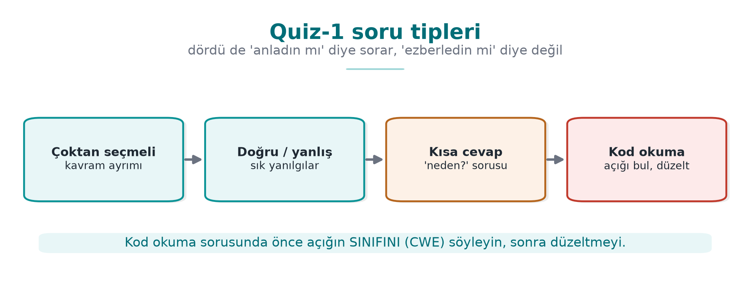
CEN429 Secure Programming · Week 8
Question Types — Diagram
RTEU Computer Engineering · 2026-2027 Fall
7

Slide 8
CEN429 Secure Programming · Week 8
Frequently Confused (1)
A | B | Difference
Encoding | Encryption | Encoding is keyless, no confidentiality
Digest | MAC | MAC requires a secret key
MAC | Signature | Signature is asymmetric → non-repudiation
Nonce | Salt | Nonce never repeats · salt is per password
PBKDF2/Argon2id | HKDF | Password (slow) · high-entropy secret (fast)
Chain validation | Hostname verification | "Trusted CA?" · "For this server?"
Fail-open | Fail-closed | On error "pass" · on error "reject"
RTEU Computer Engineering · 2026-2027 Fall
8

Slide 9
CEN429 Secure Programming · Week 8
Frequently Confused (2)
A | B | Difference
Canary | ASLR | Overflow detection on return · address randomisation
ASan | UBSan | Memory access · undefined behaviour
Unsigned wraparound | Signed overflow | Defined · undefined
Parameterised query | Escaping | The real fix · a second line of defence
ProGuard | String obfuscation | Names · strings
Obfuscation | Secure coding | Delays · fixes
Masking | Tokenization | Hide on display · token bound to a vaulted value
Pseudonym | Anonymous | Still personal data · cannot be linked to a person
RTEU Computer Engineering · 2026-2027 Fall
9

Slide 10
CEN429 Secure Programming · Week 8
A One-Week Plan
Day | What to do
1 | Week 1: STRIDE, attack tree, protection plan · Demo 1–4
2 | Week 2: BLP, Biba, Clark–Wilson · score a CVSS vector yourself
3 | Week 3 (1): AEAD, nonce, KDF, random numbers · Demo 1–5
4 | Week 3 (2): key management, TLS, pinning, shells · Demo 6–9
5 | Week 4: CERT pairs, format string, UAF, UB, protections
6 | Weeks 5–6: injection, deserialisation, ProGuard, SBOM, RASP
7 | Work through sample questions against the clock, review mistakes
RTEU Computer Engineering · 2026-2027 Fall
10

Slide 11
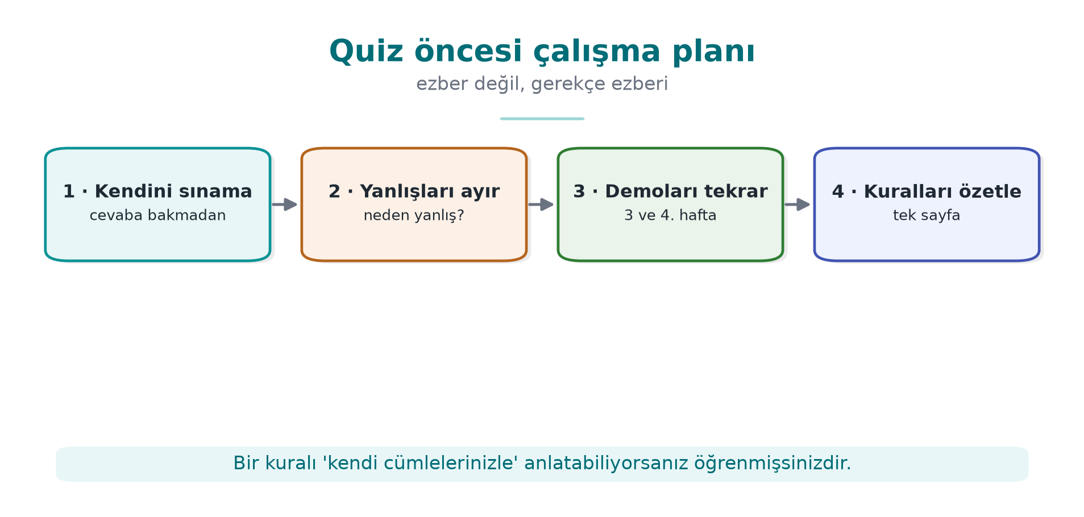
CEN429 Secure Programming · Week 8
Study Plan — Diagram
RTEU Computer Engineering · 2026-2027 Fall
11

Slide 12
CEN429 Secure Programming · Week 8
Example: Find the Bug (1)
void kaydet(const char *ad) {
char tampon[32];
sprintf(tampon, "kullanici=%s", ad);
syslog(LOG_INFO, tampon);
}
char parola[64]; oku(parola, sizeof parola); dogrula(parola);
memset(parola, 0, sizeof parola); return;
RTEU Computer Engineering · 2026-2027 Fall
12
Notes:
Speaker note: 1) sprintf overflow (STR31-C, use snprintf) + syslog format string (FIO30-C, use "%s"). 2) memset can be removed by the compiler (MSC06-C) → use explicit_bzero/SecureZeroMemory.

Slide 13
CEN429 Secure Programming · Week 8
Example: Find the Bug (2)
String sql = "SELECT * FROM notlar WHERE ogrenci = '" + no + "'";
EVP_DecryptUpdate(ctx, acik, &n, sifreli, sifreli_n);
kullan(acik, n);
EVP_DecryptFinal_ex(ctx, acik + n, &m);
try { pinDenetle(zincir); } catch (KeyStoreException e) { e.printStackTrace(); }
RTEU Computer Engineering · 2026-2027 Fall
13
Notes:
Speaker note: 1) SQL injection → use a PreparedStatement. 2) The plaintext is used before the tag is verified, and the return value of Final is never checked. 3) Fail-open: the error is swallowed and the connection is accepted.

Slide 14
CEN429 Secure Programming · Week 8
Example: Scenarios
1. The same embedded AES key on every user's device: risks and recommendation?
2. A shipped package is a debug build: which findings?
3. "I did not make this transaction": which STRIDE letter, which evidence?
4. A function that extracts an archive: which bugs do you guard against?
5. What was the real problem in Log4Shell, what would have prevented it?
6. Why shouldn't RASP checks be evaluated with a single if?
RTEU Computer Engineering · 2026-2027 Fall
14
Notes:
Speaker note: Answers are on the Week 8 page, in collapsible boxes.

Slide 15
CEN429 Secure Programming · Week 8
Next Week
Week 9 — Advanced Code Obfuscation and Diversification
• Obfuscation taxonomy, opaque predicates, data encoding
• Virtualisation and compiler-based obfuscation (concept)
• Measuring obfuscation: potency, resilience, cost
RTEU Computer Engineering · 2026-2027 Fall
15

Slide 16
CEN429 Secure Programming · Week 8
Appendix · Week-by-Week Topic Map (1–6)
RTEU Computer Engineering · 2026-2027 Fall
16
Notes:
Speaker note: Quiz-1 covers weeks 1-6. We review each week's key points and the most commonly confused distinctions.

Slide 17
CEN429 Secure Programming · Week 8
Week 1 · Key Points
• CIA triad; a bug ≠ a vulnerability.
• MATE (white-box) attacker.
• STRIDE, attack tree, DFD.
• Layered defence; design principles.
RTEU Computer Engineering · 2026-2027 Fall
17

Slide 18
CEN429 Secure Programming · Week 8
Week 2 · Key Points
• Threat modelling steps.
• Trust boundary; least privilege.
• Asset list and C/I/I+ labels.
RTEU Computer Engineering · 2026-2027 Fall
18

Slide 19
CEN429 Secure Programming · Week 8
Week 3 · Key Points
• The three states of data.
• AEAD; nonce reuse is catastrophic.
• CSPRNG; KDF (password → key).
• Key hierarchy; forward secrecy.
RTEU Computer Engineering · 2026-2027 Fall
19

Slide 20
CEN429 Secure Programming · Week 8
Week 4 · Key Points
• Three layers: code → compiler/OS → obfuscation.
• CERT/CWE; UAF; integer/UB.
• Sanitizers (ASan/UBSan), fuzzing.
• Compiler protections (canary, ASLR, NX).
RTEU Computer Engineering · 2026-2027 Fall
20

Slide 21
CEN429 Secure Programming · Week 8
Week 5 · Key Points
• A managed language solves memory errors, not injection.
• SQL/command/path injection → parameterization/argument array.
• Deserialisation; ProGuard/R8; SBOM.
RTEU Computer Engineering · 2026-2027 Fall
21

Slide 22
CEN429 Secure Programming · Week 8
Week 6 · Key Points
• RASP: detect, defend, deter.
• Integrity (self-hashing), anti-debug, hook detection.
• Cross-checking; response policy; device binding.
RTEU Computer Engineering · 2026-2027 Fall
22

Slide 23
CEN429 Secure Programming · Week 8
Frequently Confused
A | B | Difference
Bug | Vulnerability | An exploitable bug
Black-box | White-box (MATE) | Has the program
Symmetric | Asymmetric | Single / paired key
AEAD | Encryption only | + integrity
Obfuscation | Secure code | Does not fix the bug
RTEU Computer Engineering · 2026-2027 Fall
23

Slide 24
CEN429 Secure Programming · Week 8
Appendix · Solved Practice Questions
RTEU Computer Engineering · 2026-2027 Fall
24

Slide 25
CEN429 Secure Programming · Week 8
Question 1
Why does a MATE attacker make cryptography alone insufficient?
Answer: The key sits in memory; the attacker can run the program and read it. Cryptography provides confidentiality, but in a white-box setting the key is not protected; RASP/obfuscation/white-box cryptography is needed.
RTEU Computer Engineering · 2026-2027 Fall
25

Slide 26
CEN429 Secure Programming · Week 8
Question 2
What happens if the same nonce is used twice in AES-GCM?
Answer: Confidentiality and integrity collapse; the keystream and data can leak. The nonce must always be unique.
RTEU Computer Engineering · 2026-2027 Fall
26

Slide 27
CEN429 Secure Programming · Week 8
Question 3
What definitively prevents SQL injection?
Answer: A parameterised query (prepared statement); data is never interpreted as a command. No string concatenation.
RTEU Computer Engineering · 2026-2027 Fall
27

Slide 28
CEN429 Secure Programming · Week 8
Question 4
Which overflow can ASan not see?
Answer: A field-to-field overflow within the same structure (there is no poisoned region in between).
RTEU Computer Engineering · 2026-2027 Fall
28

Slide 29
CEN429 Secure Programming · Week 8
Question 5
What does a canary stop, and what does it not stop?
Answer: Stops: a stack overflow that reaches the return address. Does not stop: heap overflow, variables before the canary, a leaked canary.
RTEU Computer Engineering · 2026-2027 Fall
29

Slide 30
CEN429 Secure Programming · Week 8
Question 6
Why is RASP self-hashing not enough on its own?
Answer: The attacker can find the digest function and bypass it. Obfuscation + cross-checking + overlapping checks are needed.
RTEU Computer Engineering · 2026-2027 Fall
30

Slide 31
CEN429 Secure Programming · Week 8
Question 7
Why a KDF and a salt when deriving a key from a password?
Answer: A password has low entropy; the KDF slows down guessing, and the salt stops identical passwords from producing the same key (rainbow table).
RTEU Computer Engineering · 2026-2027 Fall
31

Slide 32
CEN429 Secure Programming · Week 8
Question 8
An example of the least-privilege principle?
Answer: The application's DB user should only be able to SELECT; it should not have DROP privilege. Excess privilege = greater damage.
RTEU Computer Engineering · 2026-2027 Fall
32

Slide 33
CEN429 Secure Programming · Week 8
Question 9
What is the "E" in STRIDE, and one control for it?
Answer: Elevation of privilege. Control: least privilege, authorization checks, secure defaults.
RTEU Computer Engineering · 2026-2027 Fall
33

Slide 34
CEN429 Secure Programming · Week 8
Question 10
Why is deserialisation dangerous, and what is the fix?
Answer: Code can execute during extraction (a gadget chain). Fix: a data format + schema; an allowlist filter if unavoidable.
RTEU Computer Engineering · 2026-2027 Fall
34

Slide 35
CEN429 Secure Programming · Week 8
Example · Multiple Choice
Which of the following is an AEAD mode?
A) ECB B) CBC C) GCM ✓ D) Raw RSA
RTEU Computer Engineering · 2026-2027 Fall
35

Slide 36
CEN429 Secure Programming · Week 8
Example · True/False
• Obfuscation fixes the bug. (F)
• The nonce must be secret. (F — must be unique, not secret)
• A parameterised query prevents SQL injection. (T)
RTEU Computer Engineering · 2026-2027 Fall
36

Slide 37
CEN429 Secure Programming · Week 8
Study Plan
• Do each week's "Self-check" without looking at the answers.
• Learn frequently confused pairs by their reason, not by rote.
• Review the Week 3 and Week 4 demos once more.
RTEU Computer Engineering · 2026-2027 Fall
37

Slide 38
CEN429 Secure Programming · Week 8
Final Word (Quiz-1 Prep)
Not memorization — what's measured is the why: "why this mode?", "why this check?", "what doesn't it protect?"
Good luck.
RTEU Computer Engineering · 2026-2027 Fall
38

