Slide 1

CEN429 Secure Programming · Week 15
Final Project Demonstrations
CEN429 Secure Programming — Week 15
Asst. Prof. Dr. Uğur CORUH · 25.12.2026
RTEU Computer Engineering · 2026-2027 Fall
Notes:
Speaker note: Final demonstration week: each team shows the complete security guide, its protected application, and its test results.

Slide 2
CEN429 Secure Programming · Week 15
This Week: Final Project Demonstrations (RAP2)
• No lecture; final report (the complete guide) + protected application + test results
• RAP2 = 70% of the final · Quiz-2 = 30% · Course grade = 0.4·Grade_Midterm + 0.6·Grade_Final
• Detailed rubric: project guide · order and timing: in class
• ⚠️ No late submissions · a finding–action list for the midterm feedback
RTEU Computer Engineering · 2026-2027 Fall
2

Slide 3
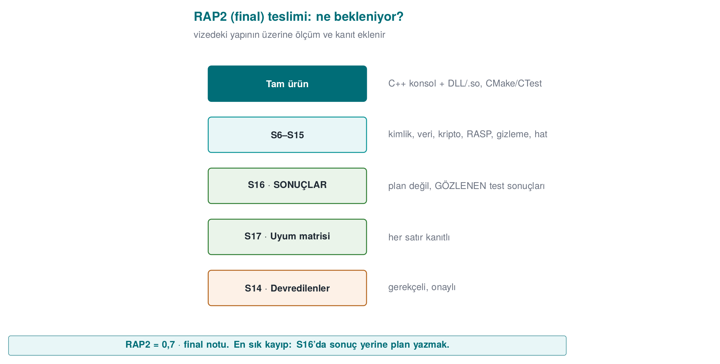
CEN429 Secure Programming · Week 15
RAP2 Submission — Diagram
RTEU Computer Engineering · 2026-2027 Fall
3

Slide 4
CEN429 Secure Programming · Week 15
Final Rubric
Criterion | LO | Guide
Cryptography | 2 | S8
Secure communication | 4 | S6 · S11
Asset management | 5 | S5 (complete) · S8
Binary protections | 3 | S9 (advanced) · S15
Security testing and unit tests | 6 | S16 results
Standards | 7 | S1 · S14 · S17
Final report and presentation | 7 | All
RTEU Computer Engineering · 2026-2027 Fall
4

Slide 5
CEN429 Secure Programming · Week 15
From Midterm to Final: New and Completed Sections
New | To be completed / updated
S6 identity and binding | S5 assets (complete)
S8 cryptography and keys | S9 hardening (advanced)
S11 secure communication | S12 reporting (complete)
S14 assumptions and deferred requirements | S13 updated SBOM
S15 build and deployment pipeline | S16 results · S17 complete matrix
RTEU Computer Engineering · 2026-2027 Fall
5

Slide 6
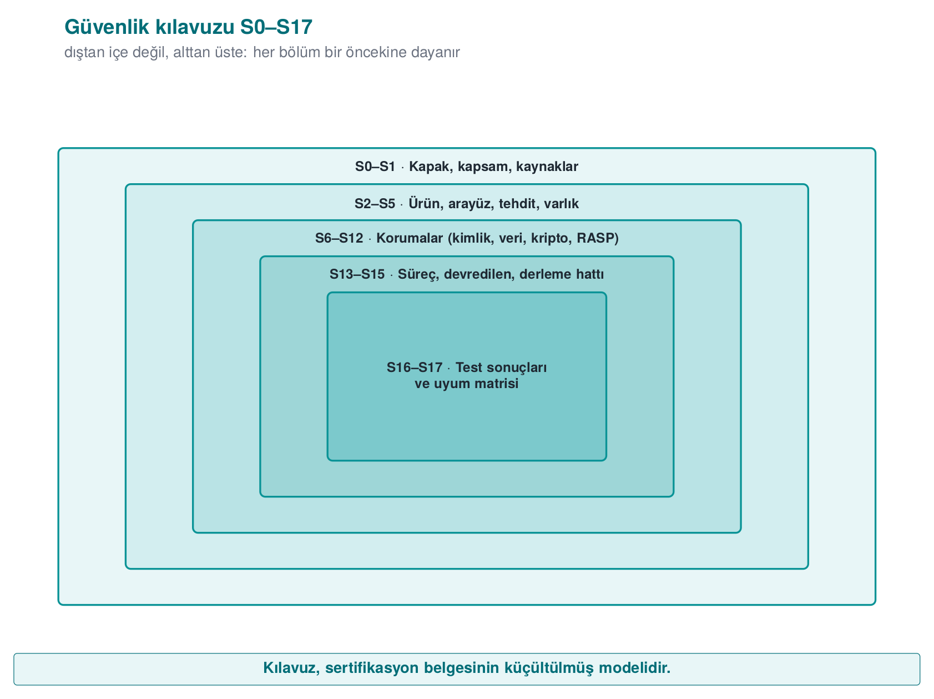
CEN429 Secure Programming · Week 15
Security Guide Map S0–S17 — Diagram
RTEU Computer Engineering · 2026-2027 Fall
6

Slide 7
CEN429 Secure Programming · Week 15
Preparation Checklist
Week | What you should be able to show
9, 14 | Obfuscated functions and justification · cost table · obfuscation and signing in the build pipeline
10 | Algorithm inventory · key lifecycle · TLS/pinning · signature verification
11 | Protection method or justification for a sensitive asset
12 | Test plan + results · unit tests · CI · finding–action list
13 | Compliance matrix · assumptions and deferred requirements
RTEU Computer Engineering · 2026-2027 Fall
7

Slide 8
CEN429 Secure Programming · Week 15
Suggested Demonstration Flow
1. Summary: product, architecture, the three most critical assets
2. Since the midterm: finding–action list (finding → action → closure; the assessor looks for this loop)
3. Live demonstration: cryptography, secure communication, a protection layer working live (e.g., a tampered file being rejected)
4. Evidence: tests, protection table, SBOM, compliance matrix
5. Remaining risk: what was deliberately scoped out, and why
RTEU Computer Engineering · 2026-2027 Fall
8

Slide 9
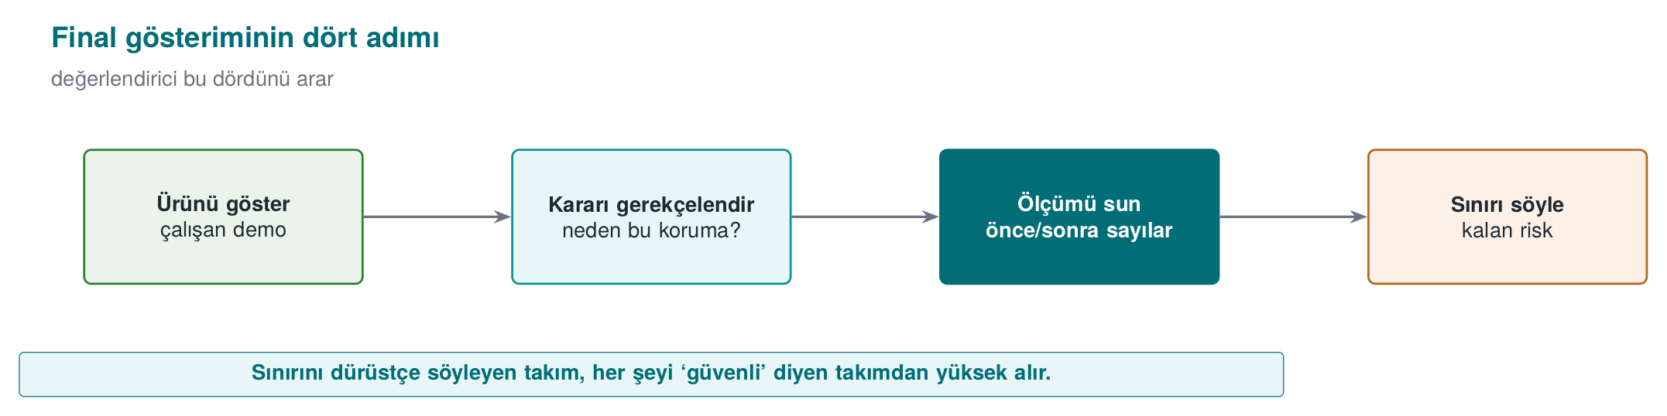
CEN429 Secure Programming · Week 15
Final Demonstration — Diagram
RTEU Computer Engineering · 2026-2027 Fall
9

Slide 10
CEN429 Secure Programming · Week 15
Sample Questions
• Which key is this key derived from, where does it live, when is it deleted?
• How do you verify the certificate chain? Where is hostname verification performed?
• What happens if signature verification fails? Can an old but validly signed version still be installed?
• Did you measure the cost of obfuscation? Which function did you obfuscate, and why?
• In the compliance matrix, where is the evidence for this row marked "met"?
• Which requirement did you defer, and how will the other party meet it?
RTEU Computer Engineering · 2026-2027 Fall
10

Slide 11
CEN429 Secure Programming · Week 15
Common Mistakes
Mistake | Why is it a problem?
A test plan exists, but no results | At the final, results are expected
"Met" without evidence | Counted as unmet
Guide and code version differ | The assessed product becomes ambiguous
Empty remaining-risk section | Incomplete analysis
Midterm feedback was ignored | The finding–action loop is part of the process
Real secret / personal data in the repo | Values must be synthetic
RTEU Computer Engineering · 2026-2027 Fall
11

Slide 12
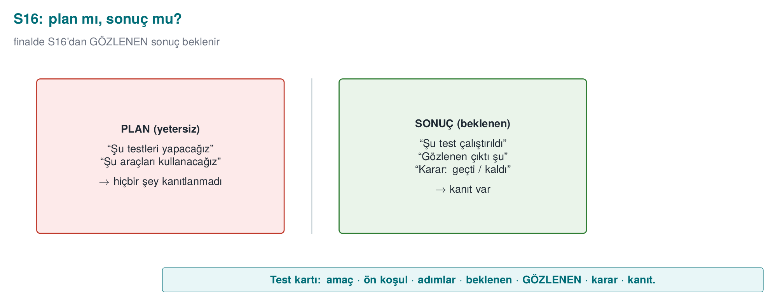
CEN429 Secure Programming · Week 15
Academic Integrity
The syllabus's "Academic Integrity" section also applies to the project; every submitted line must be explainable, and any team member may be asked a question during the demonstration.
RTEU Computer Engineering · 2026-2027 Fall
12

Slide 13
CEN429 Secure Programming · Week 15
At the End of the Term
• Your guide = a small model of certification documents → portfolio (make sure it contains no confidential information)
At the final, results are expected: every protection is shown working, every requirement is tied to evidence.
RTEU Computer Engineering · 2026-2027 Fall
13

Slide 14
CEN429 Secure Programming · Week 15
Next Week
Week 16 — Quiz-2
After the final demonstration (RAP2), it's time for Quiz-2; the scope is weeks 9–14. The study guide is on the Week 16 page.
RTEU Computer Engineering · 2026-2027 Fall
14

