Slide 1
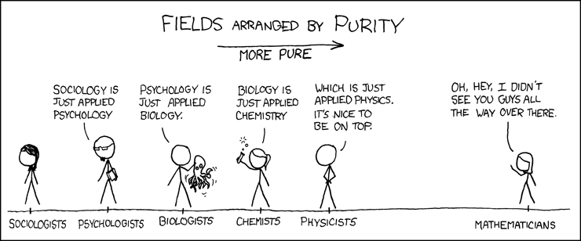

Slide 2
Hierarchies of
Creative Domains:
Disciplinary Constraints on Blind Variation and Selective Retention

Slide 3
Fundamental Question
Is creativity “one or many”?
If the former, then what is the single unifying process or procedure?
If the latter, how do the various forms of creativity differ?
  Does creativity vary willy-nilly?
  Or, is there some method in the madness?

Slide 4
Integrative Solution
Two independent intellectual traditions
  Creativity contingent on disciplinary hierarchies
  Creativity contingent on blind-variation and selective-retention (BVSR)
Argument:
  Disciplinary hierarchy largely defined by the degree that creativity is contingent on BVSR

Slide 5
Disciplinary Hierarchies
Dichotomous distinctions
  Plato (ca. 360 BCE): mathematics versus visual arts
  Kant (1790): fine arts versus science
  Kuhn (1972): paradigmatic versus pre-paradigmatic sciences
Ordinal differentiations
  Comte (1839-1842): astronomy, physics, chemistry, biology, sociology

Slide 6
Disciplinary Hierarchies
Dichotomous distinctions
  Plato (ca. 360 BCE): mathematics versus visual arts
  Kant (1790): fine arts versus science
  Kuhn (1972): paradigmatic versus pre-paradigmatic sciences
Ordinal differentiations
  Comte (1839-1842)
  Bliss (1935):

Slide 7
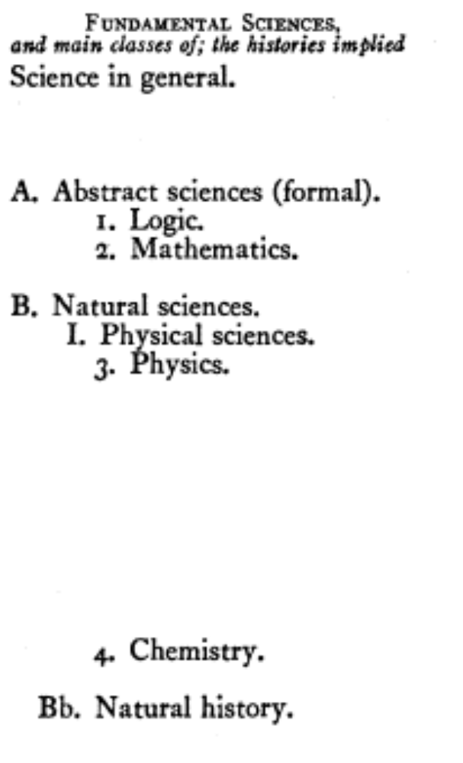
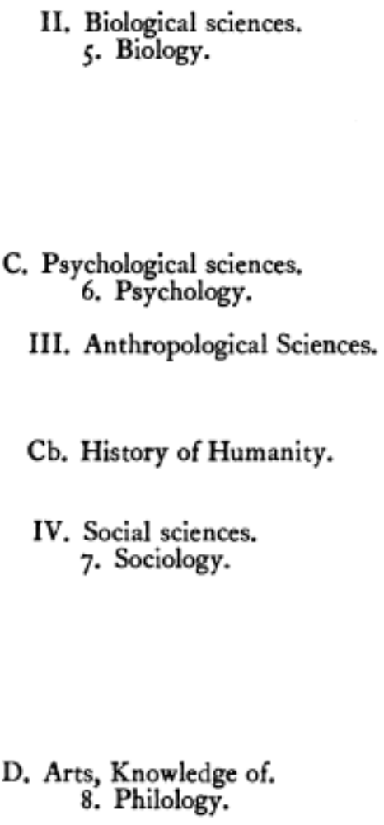

Slide 8
BVSR Creativity
Anticipators
  Bain (1855); cf. Darwin (1859)
  James (1880); cf. Darwin (1871)
  Mach (1896)
  Poincaré (1921)

Slide 9
BVSR Creativity
Originators
  Philosophical: Popper (1959, 1963, 1979)
  Psychological: Campbell (1960, 1974)

Slide 10
BVSR Creativity
Proponents
  Philosophical: e.g., Briskman (1981/2009), Kantorovich (1993); Nickles (2003)
  Psychological: e.g., Cziko (1998); Martindale (1990); Simonton (1988-2010); Staw (1990)

Slide 11
BVSR Creativity
Opponents
  Philosophical: e.g. Kronfeldner (2010); Thagard (1988)
  Psychological: e.g. Dasgupta (2004); Gabora (2005, 2010); Sternberg (1998, 1999)

Slide 12
BVSR Creativity
Misconceptions regarding blind variation
  Blindness does not mean random; blindness can be systematic rather than stochastic
  Blindness does not negate volition, but only imposes a disjoint between will and outcome
  Blindness is not a qualitative property, but rather is a quantitative attribute defined by a bipolar blindness-sightedness dimension
Above misconceptions all based on a false presumption of a Darwinian analogy

Slide 13
BVSR Creativity
Unfortunately, Campbell’s (1960) original formulation was too imprecise to carry the weight of BVSR theory
Therefore, it is necessary to propose a formal (mathematical) definition
The definition begins with a set of k hypothetical ideational variants that define the search space for a given problem (e.g., trial solutions)

Slide 14
Set of k Hypothetical Variants
Variant | Probability | Utility | Expectation
X₁ | p₁ | u₁ | q₁
X₂ | p₂ | u₂ | q₂
X₃ | p₃ | u₃ | q₃
… | … | … | …
X_{i} | p_{i} | u_{i} | q_{i}
… | … | … | …
X_{k} | p_{k} | u_{k} | q_{k}
where q_{i} = P (X_{i} | u_{i})

Slide 15
Yielding …

Slide 16
Variant Typology
Type | p_{i} | u_{i} | q_{i} | Generation | Status | Designation
1 | > 0 | > 0 | > 0 | possible | true positive | sighted inclusion
2 | > 0 | > 0 | = 0 | possible | true positive | blind inclusion
3 | > 0 | = 0 | = 0 | possible | false positive | blind inclusion
4 | = 0 | > 0 | > 0 | impossible | false negative | blind exclusion
5 | = 0 | > 0 | = 0 | impossible | false negative | blind exclusion
6 | = 0 | = 0 | = 0 | impossible | true negative | sighted exclusion
N.B.: Variants with u_{i} = 0 but q_{i} > 0 expectations are ruled out of court

Slide 17
Blind-Sighted Continuum
Blind-sighted measure of p-q coupling: 0 ≤ C_{pq} ≤ 1:
C_{pq} = 0 → perfect blindness
  e.g., systematic scans; combinatorial searches; aleatoric creativity; genetic algorithms

Slide 18
Blind-Sighted Continuum
Blind-sighted measure of p-q coupling: 0 ≤ C_{pq} ≤ 1:
C_{pq} = 0 → perfect blindness
C_{pq} = 1 → perfect sightedness
  e.g., domain-specific algorithmic methods that guarantee (routine) solutions

Slide 19
Blind-Sighted Continuum
Blind-sighted measure of p-q coupling: 0 ≤ C_{pq} ≤ 1:
C_{pq} = 0 → perfect blindness
C_{pq} = 1 → perfect sightedness
0 << C_{pq} << 1 → intermediate blindness-sightedness
  e.g., domain-general heuristic methods, such as means-end analysis, analogy, hill-climbing (steepest ascent), and trial and error (generate and test)

Slide 20
Empirical Integration
Domains
Creators
Domain-Creator Correspondence

Slide 21
Domains
Empirical research establishes the following hierarchy for six core scientific domains (Simonton, 2002, 2004; see also Fanelli, 2010; Prpić, 2008):

Slide 22
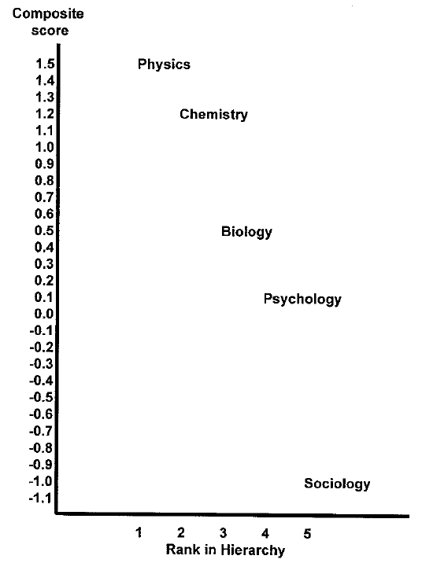

Slide 23
Placement Criteria:
↓Positive versus Negative↓
Citation concentration
Citation immediacy
Early impact rate
Peer evaluation consensus
Obsolescence rate
Anticipation frequency
Graph prominence
Rated disciplinary hardness
Lecture disfluency
Theories-to-laws ratio
Consultation rate
Confirmatory hypothesis tests
Objectivity in the scientist rather than in the research process
Age at receipt of Nobel prize

Slide 24
Extrapolations and Interpolations
Extrapolation to encompass the arts and humanities, with the humanities falling between the sciences and the arts: e.g.,
  Obsolescence rate:
    psychology/sociology > history > English
  Lecture disfluency:
    psychology/sociology < political science < art history < English (cf. philosophy)

Slide 25
Extrapolations and Interpolations
Interpolation within creative domains:
  Paradigmatic sciences in normal versus revolutionary stages (e.g., classical versus quantum physics)
  Non-paradigmatic sciences with contrasting theoretical/methodological orientations (e.g., the natural-science versus human-science psychologies)
  Formal versus expressive arts (i.e., Apollonian versus Dionysian; Classical versus Romantic; etc.)

Slide 26
Two Working Hypotheses
First, the extended and differentiated hierarchy represents an underlying bipolar dimension expressing whether creativity in the domain tends to be
  more logical, factual, objective, precise, formal, and consensual
  versus
  more irrational, imaginative, subjective, ambiguous, expressive, and individualistic

Slide 27
Two Working Hypotheses
Second, the former bipolar dimension determines the extent to which domain creativity is dependent on BVSR, that is,
  for disciplines high in the hierarchy, dependence is low (i.e., the modal problem-solving episode has ~.5 < C_{pq} < 1), whereas
  for disciplines low in the hierarchy, dependence is high (i.e., the modal problem-solving episode has 0 < C_{pq} < ~.5)

Slide 28
Creators
BVSR in part depends on specific
  Dispositional traits:
    cognitive processes
    openness to experience
    psychopathology
  Developmental experiences:
    home environment
    birth order
    education and training
    mentors and role models
    sociocultural Zeitgeist

Slide 29
Domain-Creator Correspondence
Thus, the more a domain depends on BVSR, the higher the concentration of creators in that domain who have the corresponding dispositional traits and developmental experiences
In particular …

Slide 30
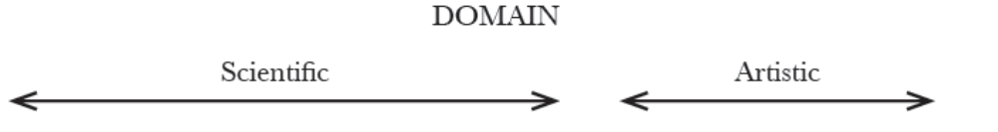


Slide 31
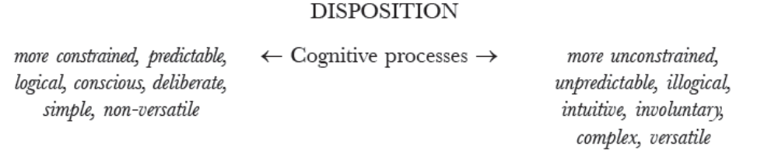

Slide 32
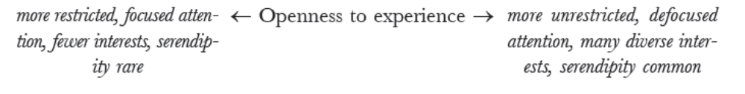

Slide 34
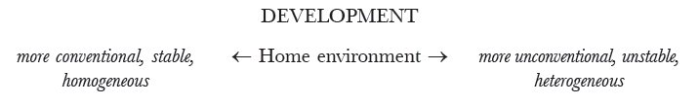

Slide 36
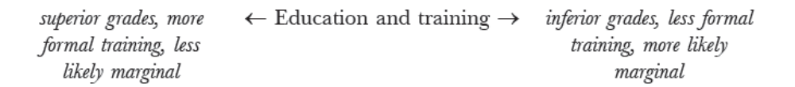

Slide 39
Confessions
Despite empirical support, this is a speculative sketch only
Two primary limitations
  First, the connection between BVSR and both domain and creator attributes needs to be more precisely articulated
    e.g., birth order vis-a-vis latent inhibition
  Second, differences among disciplines most likely multidimensional
    e.g., pure versus applied domains

Slide 40
Confessions
Nonetheless, I maintain that the current sketch provides a promising framework for future research on creativity
In particular, we should be able to establish that …

Slide 41
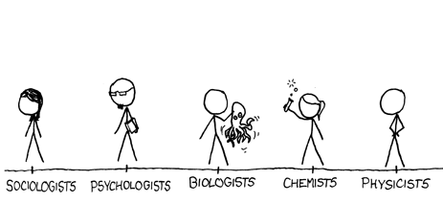
CREATORS AND DOMAINS VARY ACCORDING TO RELATIVE BVSR DEPENDENCE
← MORE BVSR LESS BVSR →

