Slide 1
What is RPC?
Professional definition: RPC (Remote Procedure Call) is a computer communication protocol that allows programs to communicate and interact between different computers, just like local calls.

Slide 2
Why do you need RPC?
RPC allows a program (called a service consumer) to call the interface of another program (called a service provider) just like calling the method of its own program, without knowing the data transmission process, the details of the underlying network communication, etc. These will be completed for you by the RPC framework, allowing developers to easily call remote services and quickly develop distributed systems.

Slide 3
For example, project A providing data services, and project B requesting data.
If there is no RPC framework, how can project B call the services of project A?
First of all, since project A and project B are independent systems, they cannot be introduced as dependent packages like the SDK. Then you need project A to provide web services and write a data interface to expose the service. For example, you can call the data service by visiting http://XXX.com;
Then project B, as a service consumer, needs to construct your own request and request the above through HttpClient address. If Project B needs to call more third-party services, it will be very troublesome to write an HTTP request for each service and method call!

Slide 4
For example, project A providing data services, and project B requesting data.
Sample pseudocode is as follows:
url = "http://XXX.com"
req = new Req(parameter 1, parameter 2, parameter 3)
res = httpClient.post(url).body(req).execute()
orderId = res.data.orderId

Slide 5
With the RPC framework, Project B can be called with one line of code!
Sample pseudocode is as follows:
orderId = orderService.order(parameter 1, parameter 2, parameter 3)
It seems to be no different from calling the method of your own project! Isn’t it silky smooth?

Slide 6
RPC framework implementation ideas
See in the Framework.Docx

Slide 7
Other important issues to consider
What happens when a service provider goes offline? Need a mechanism for failing node rejection.
Will performance be bad if the service consumer pulls information from the registry every time? Caching can be used to optimize performance.
How to optimize the performance of transport communication of RPC framework? For example, choosing the right network framework, customizing the protocol header, and saving the transmission volume.
How to make the whole framework more scalable? For example, using Java's SPI mechanism, configurations, and so on.

Slide 8
Code Showcase
See in the Code.Docx

Slide 9
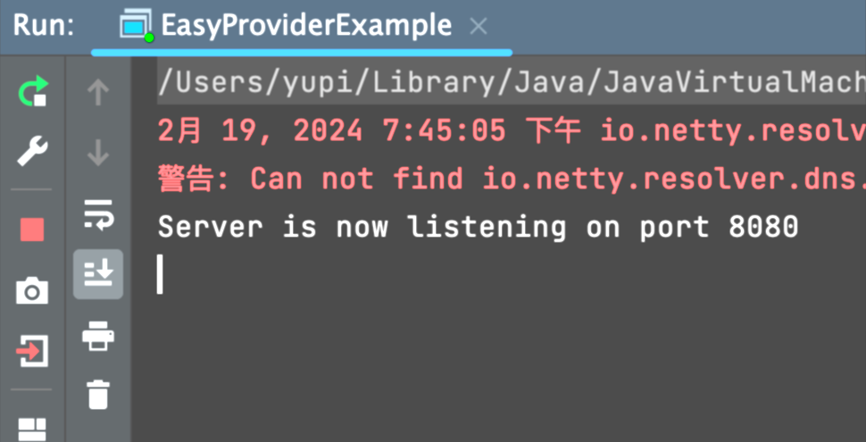
Test verification
1) Start the service provider in debug mode and execute the main method:

Slide 10
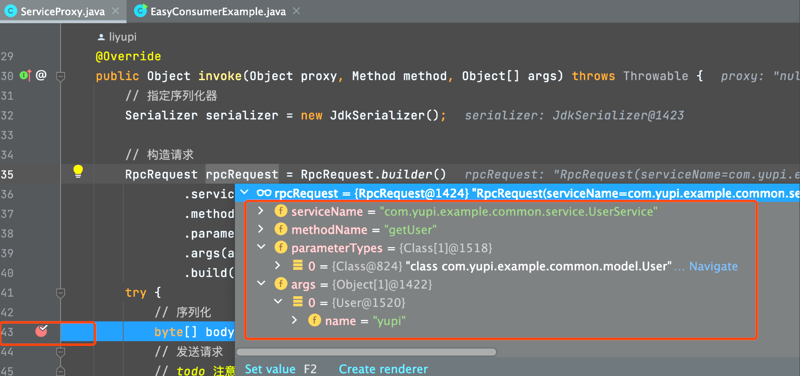
2)Start the service consumer in debug mode and execute the main method.
Add a breakpoint in the ServiceProxy proxy class. You can see that when userService is called, the invoke method of the proxy object is actually called, and information such as serviceName, methodName, parameter type, and list are obtained.

Slide 11
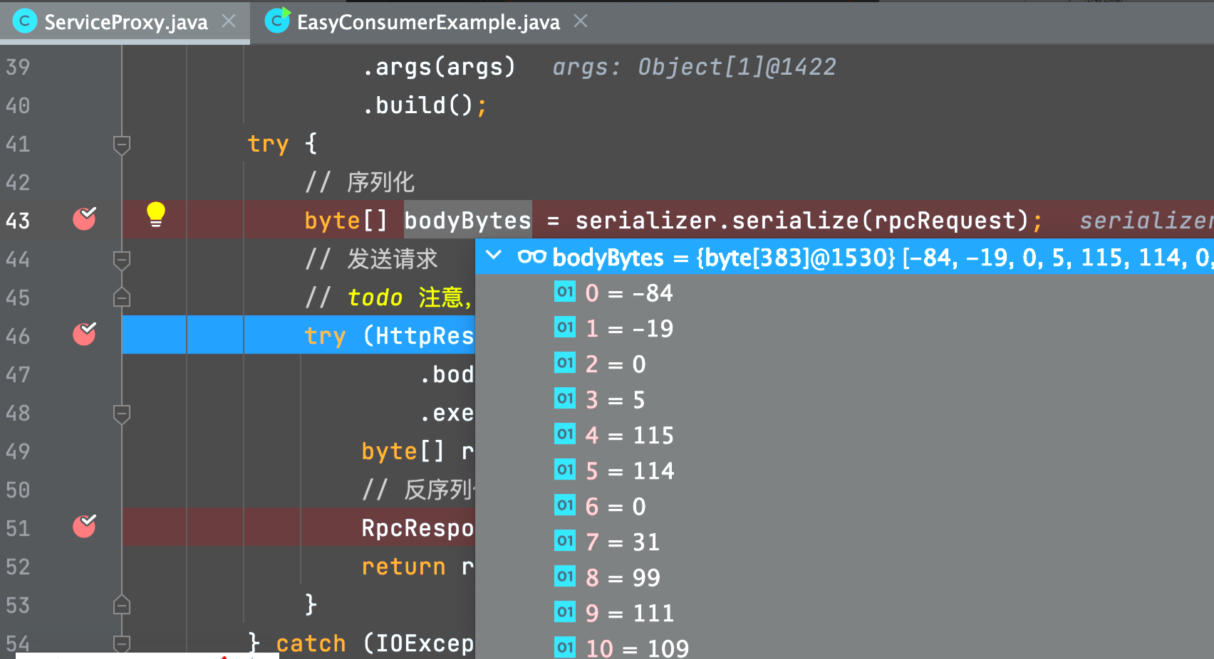
3) Continue debugging, you can see the serialized request object, the structure is a byte array:

Slide 12
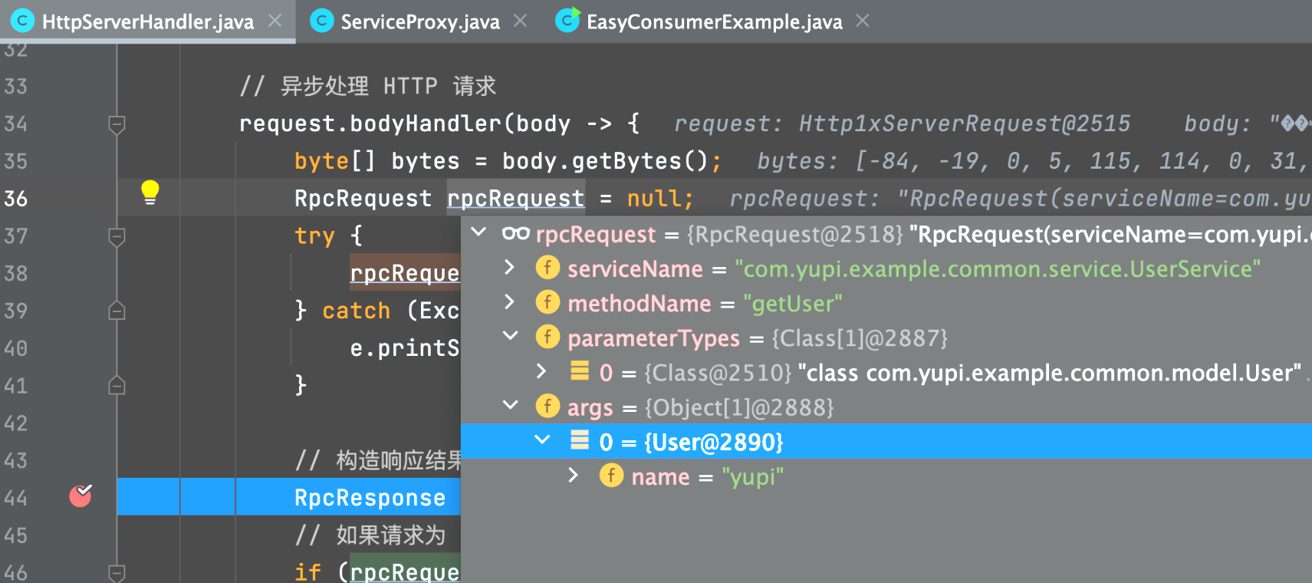
4) Break the point in the request processor of the service provider module, and you can see that the accepted and deserialized request is consistent with the content when sent:

Slide 13
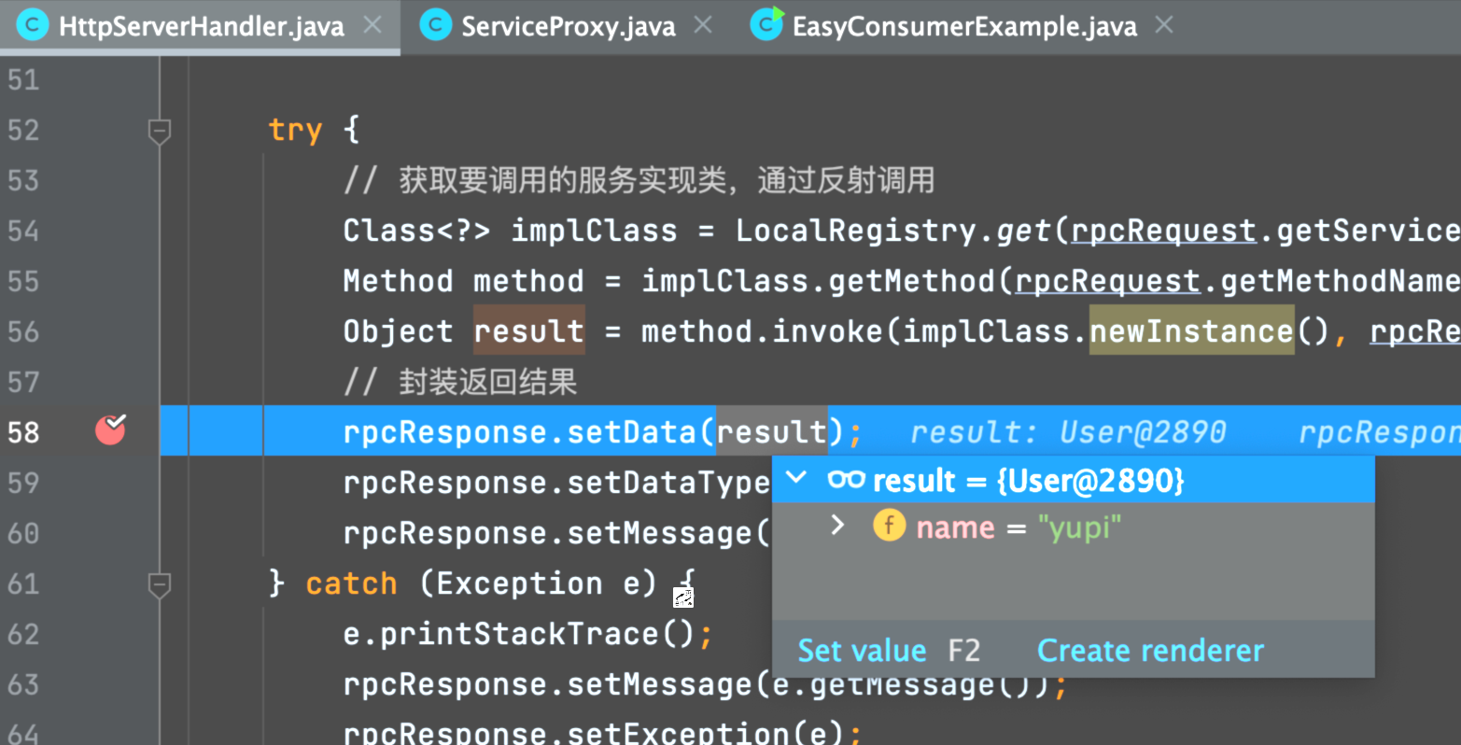
5) Continue debugging and you can see that in the request processor, the method is successfully called through reflection and the returned User object is obtained.

Slide 14
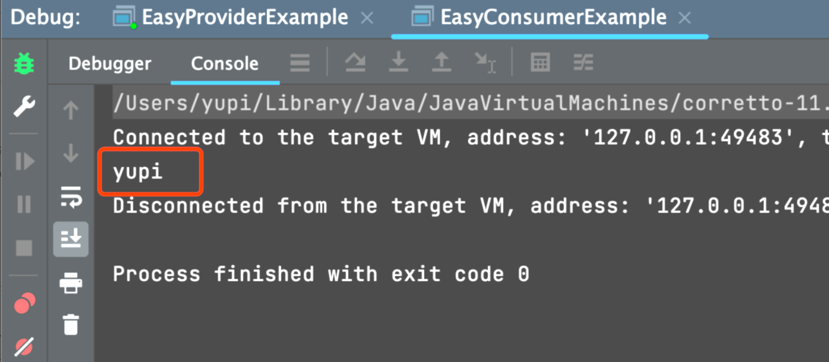
6) Finally, the user name is output in both the service provider and consumer modules, indicating that the entire calling process is successful.

Slide 15
Interesting question
What is the difference between RPC and HTTP? Which layer of computer network protocol is RPC?
1) Design purpose:
RPC: used to implement remote method calls in distributed systems, allowing applications to call remote services just like calling local methods.
HTTP: Used to transfer hypertext documents between clients and servers and used for communication between web applications.
2) Implementation method:
RPC: Usually based on specific communication protocols and encoding mechanisms, such as message transmission based on TCP and custom protocol headers, which can provide higher performance.
HTTP: Based on the TCP protocol, communication is carried out through the request-response model, using message headers and message bodies in text format.
3) Usage scenarios: RPC is more used for communication between servers; HTTP can be used for server-side, back-end and front-end communication at the same time.
To put it bluntly: HTTP is just an optional method of network transmission in the RPC framework.

Slide 16
Interesting question
What protocols does my RPC framework use?
In order to improve request performance and reduce data transmission, I independently designed a set of RPC protocols, including custom message structures and network transmission methods.
When I designed a custom protocol, I drew on Dubbo's protocol.
1) Custom message structure: The core concept of the design is "use the least space to transmit the required information", so I use a byte array to store the spliced ​​message. The message content is divided into message header + message body. The content in the message header includes magic number, version number, serializer, message type, status, request id, and message body length information.
2) Network transmission method: I choose to use the TCP protocol to complete network transmission, which has higher performance than the HTTP protocol.
Because the HTTP header information is relatively large, it will affect the transmission performance. In addition to this, HTTP itself is a stateless protocol, which means that each HTTP request is independent, and the connection must be re-established and closed for each request/response, which will also affect performance.

Slide 17
Interesting question
Why customize the protocol?
Why customize the protocol? The reasons are as follows:
1.Higher performance. Custom protocols allow me to design data formats and communication mechanisms based on the specific needs of the application, thereby reducing unnecessary data transmission, reducing network latency, and increasing data processing speed.
2.Flexibility and scalability. By customizing the protocol, I designed a protocol header that contains version information to support backward compatibility and protocol upgrades.
3.safety. For example, a magic number is introduced in the message header for security verification.

Slide 18
THANKS!

