Slide 1

Artificial Intelligence in Aviation
Defınetıon &sample of aı,threaths and opportunıtıes OF aI ın the avıatıon ındustry

Slide 2
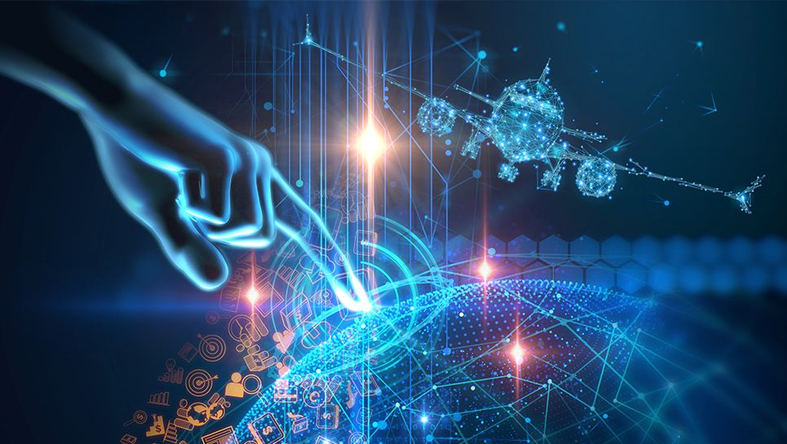
AYÇA UÇAR
STUDENT AT ANKARA UNIVERSITY
COMPUTER ENGINEERING

Slide 3
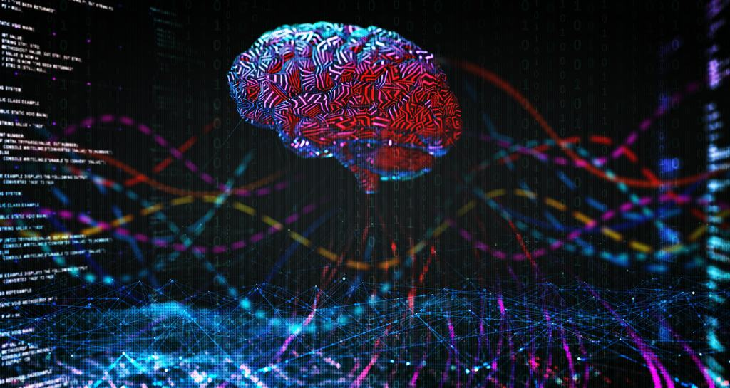
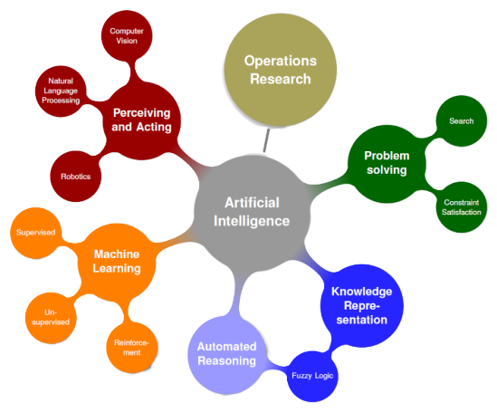
The Artificial Intelligence
There are no easy answers, which brings us back to the lack of a singular definition of artificial intelligence. In simple terms, AI is the simulation of human intelligence by computers. It relates to the ability to learn, rationalize and undertake appropriate actions to achieve a specific goal. [1}

Slide 4
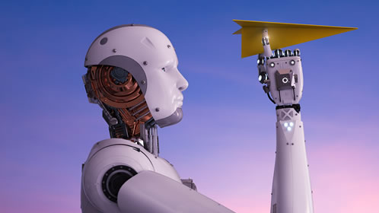
Executing Process of AI
Human intelligence often follows a sequence known as the perception-cognition-action computing cycle. Individuals perceive something in the world around them, think about what to do, and then, once they weigh the options, make a decision.
A computer first detects the world around it through cameras, microphones, or touch sensors and create an up-to-date model. Then processes incoming data with optimization and validation algorithms with action selection made in a similar way to humans.The important thing is that he can constantly update and reconfigure the world model he creates.

Slide 5
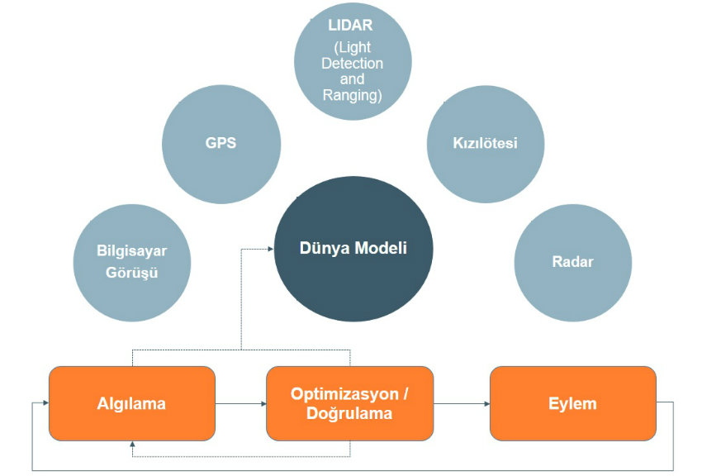
The model of the world in which autonomous IHA navigation works is relatively simple as it includes maps showing preferred routes, altitude barriers and no-fly zones. Radars increase this model in real time, specifying which places are cleared of obstacles. GPS coordinates are sent to the IHA where they are needed, and the purpose of the GPS coordinate plan is that not to take the IHA into a no-fly zone or prevent it from colliding with an obstacle.​

Slide 6
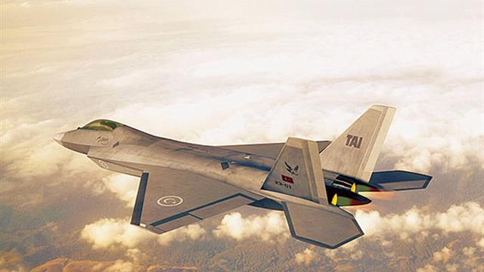
Some Example for AI in Avionics Applications
[2]
AI systems, over time, learn from the data fed to them. Therefore, AI will be able to learn how pilots operate at work and take decisions during a flight. In the absence of a pilot, an AI system can take his place. In fact, AI can also become a co-pilot!
Runway overrun prevention systems (ROPS) is a system that assists pilots to make safe decisions while landing an aircraft. With the help of AI, the system can predict the weather conditions enroute to the destination. If the weather conditions are adverse, the system suggests alternate routes to reach the destination. Such suggestions help the aviation industry to enhance its safety.

Slide 7

Fuzzy Logic
It is used in space exploration and Aerospace Industries, and studies on fuzzy logic are carried out in research and development at TAI (Turkish Aerospace Industries). It is also used in the control of unmanned helicopters for control of a helicopter model, radio control by verbal instruction, automatic route entry in inadequate engine situations, and sea rescues. [3,4].
In the application of maintenance planning for the power system in aircraft, fuzzy logic is used to improve the safety and reliability of the equipment in aircraft and to determine the possible failure before the failure occurs. This practice is very important in aviation especially in maintenance activities where companies can make a profit [5].

Slide 8

Artificial Neural Network
[6]
Determining the target type in noisy environments is a very important problem in military applications. A method based on artificial neural networks is presented to separate different types of radar targets such as cargo, Combat, Bomber, commercial aircraft. Their target trajectories are derived from real aircraft radars.
Target recognition and tracking systems
Performance analysis of new sensors
Radar and image signals processing
Determination of flight trajectories of military aircraft
New types of image signals, including image detection, sensor, radar and comparison of documents, distinguishing appearance and noise suppression, signal/image identification
High performance of Autopilot in aircraft, flight path parodies, aircraft control systems, increase of Autopilot features, parodies of aircraft sections, error detectors of aircraft sections

Slide 9
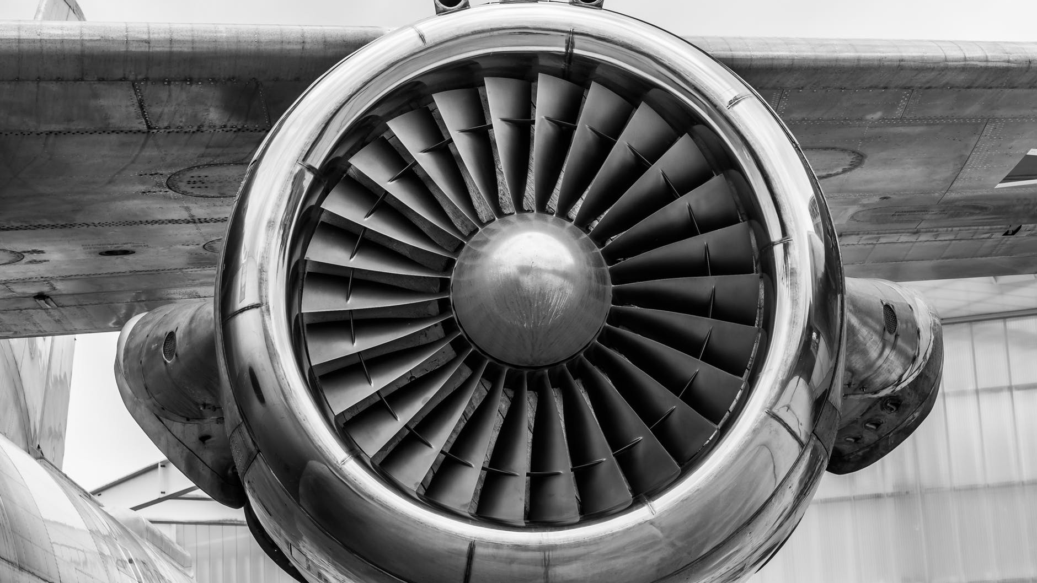
THREATS & OPPORTUNITIES
One of the major advantages of artificial intelligence is that its decisions are based on facts rather than emotions. Even after our utmost efforts, it is a wellknown fact that human decisions are always affected in a negative way by our emotions
Unlike humans, machines with artificial intelligence do not need any sleep, thus overcoming the inherent disadvantage of tiredness in humans
Easier spreading of knowledge. Once an artificial mind is trained for something, it can be very easily copied to the others reducing the time wasted in otherwise passing on knowledge to other humans through training .
Lack of creativity in responses
Inability to explain the logic and reasoning behind a certain decision
Current development is at a stage where the AI cannot know when there is no solution to a particular problem
Any malfunctioning can lead to the AI producing wrong solutions and since it cannot explain the reasoning behind its answer, blind reliance on AI can lead to problems
Lack of common sense in reasoning can also cause major problems
It can be used to cause mass scale destruction if given in the wrong hands

Slide 10

REFERENCES
[1} https://news.cgtn.com/news/2019-06-12/Everything-you-need-to-know-about-artificial-intelligence-HswDK6aQdW/index.html
[2]https://www.bbntimes.com/en/technology/artificial-intelligence-and-the-aviation-industry
[3] http://members.tripod.com/~Bagem/bagem/ yz3.html (10.06.2003)
[4]Şenol F., “Bulanık Mantık Kontrolcüsü”, Gazi Ü. Lisans Tezi, Ankara, 2000
[5]OOSTREAM, M., BABUSKA, R., “Virtual Sensor For Fault Detection And Isolation In Flight Control Systems-Fuzzy Modeling Approach”, Proceedings of 39th IEEE Conference on Decision and Control, Sydney, December 2000.
[6]Caner YAĞCI, İlhan GÖKÇE, Tülay BOZÜYÜK, Görkem AKAR, "YAPAY ZEKA TEKNOLOJİSİNİN ENDÜSTRİDEKİ UYGULAMALARI", MARMARA ÜNİVERSİTESİ, İstanbul, 2004

