Slide 1

TensorFlow

Slide 2
TensorFlow este o librarie pentru invatare automata care este folosita de Google in diferite arii.

Slide 3
TensorFlow ruleaza pe Unix
Pasii pentru instalare se gasesc la urmatoarea adresa :
https://www.tensorflow.org/versions/master/get_started/os_setup.html#download-and-setup

Slide 4
TensorFlow pune la dispozitie diferite tutorial:
Convolutional Neural Networks
Vector Representations of Words
Recurrent Neural Networks
MNIST Data Download

Slide 5
Image Recognition
Poate recunoaste obiectele din imagine folosind retele neuronale
Tutorialul se poate gasi la adresa :https://www.tensorflow.org/versions/master/tutorials/image_recognition/index.html

Slide 6
Aceste comenzi clasficia imaginile din imagenet (Realizeaza modelul de antrenament )
cd tensorflow/models/image/imagenet
python classify_image.py

Slide 7
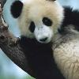
Exemplu model antrenament
giant panda, panda, panda bear, coon bear, Ailuropoda melanoleuca (score = 0.88493)
indri, indris, Indri indri, Indri brevicaudatus (score = 0.00878)
lesser panda, red panda, panda, bear cat, cat bear, Ailurus fulgens (score = 0.00317)
custard apple (score = 0.00149)
earthstar (score = 0.00127)

Slide 8
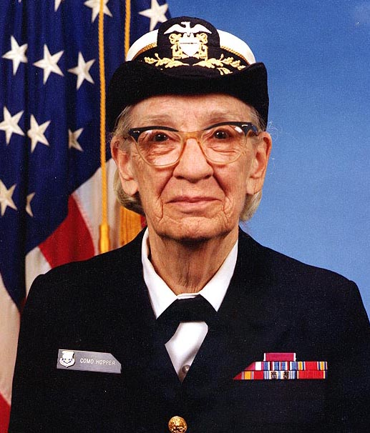
In urma procesarii imaginii au fost afisare urmatoarele informatii:
I tensorflow/examples/label_image/main.cc:200] military uniform (866): 0.647296
I tensorflow/examples/label_image/main.cc:200] suit (794): 0.0477196
I tensorflow/examples/label_image/main.cc:200] academic gown (896): 0.0232411
I tensorflow/examples/label_image/main.cc:200] bow tie (817): 0.0157356
I tensorflow/examples/label_image/main.cc:200] bolo tie (940): 0.0145024

Slide 9
Echipa
Gusa Andrei
Olaru Gabriel
Sturza Gabriel

