Slide 1
Introduction to InfluxDB
Michael Desa & Jack Zampolin
Tweet me @Benstronaut

Slide 2
By the end of this section, participants will be able to…
Describe what time series data is and recognize its use cases.
Explain the differences between InfluxDB and other TSDBs.
Describe the InfluxDB Data model.
Write data into InfluxDB using the InfluxDB CLI.

Slide 3
What is time series data?
Tweet me @Benstronaut

Slide 4
Time series data is…
A time series is a sequence of data points, typically consisting of successive measurements made from the same source over a time interval.
What this essentially means is that if you were to plot the points on a graph, one of your axes would always be time.

Slide 5
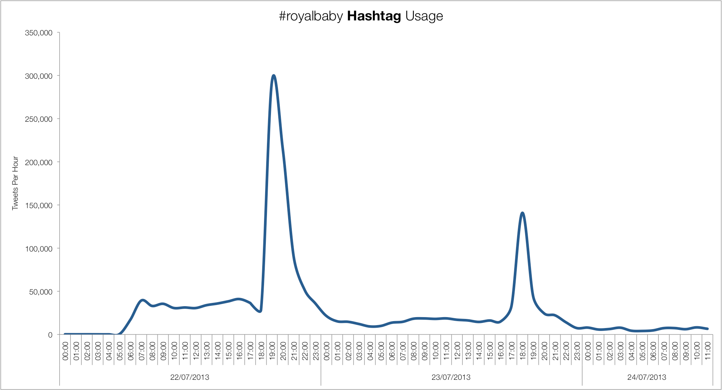
Time series data

Slide 6
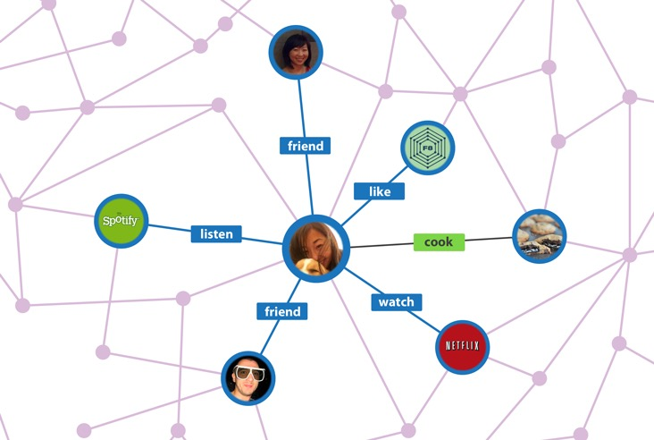
Not time series data

Slide 7
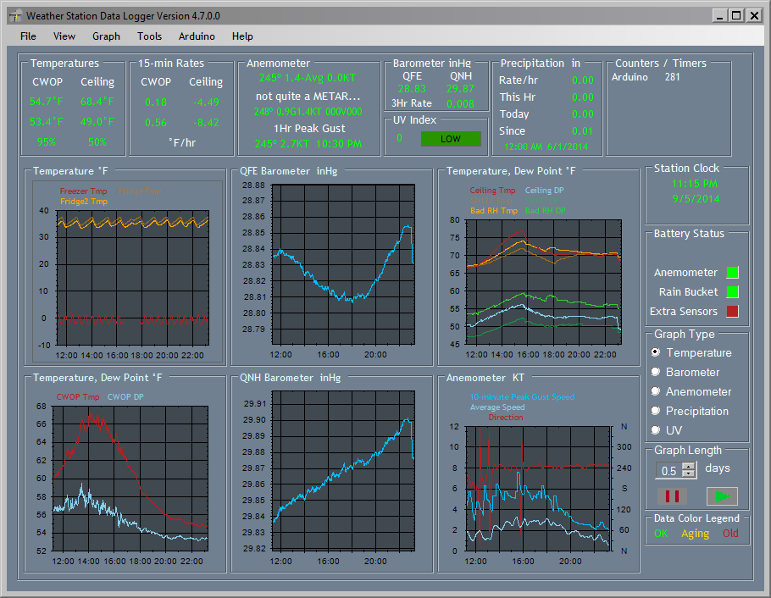
Time series data

Slide 8
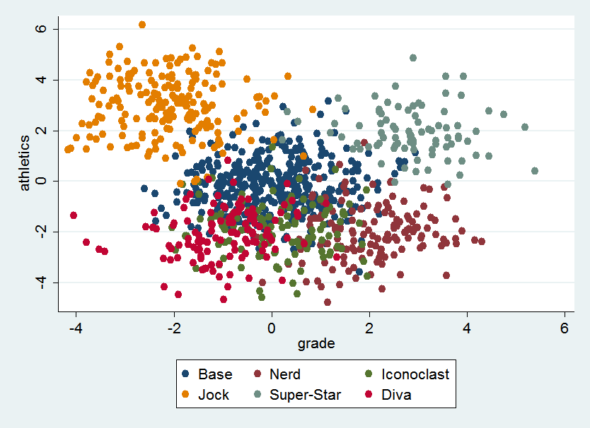
Not time series data

Slide 9
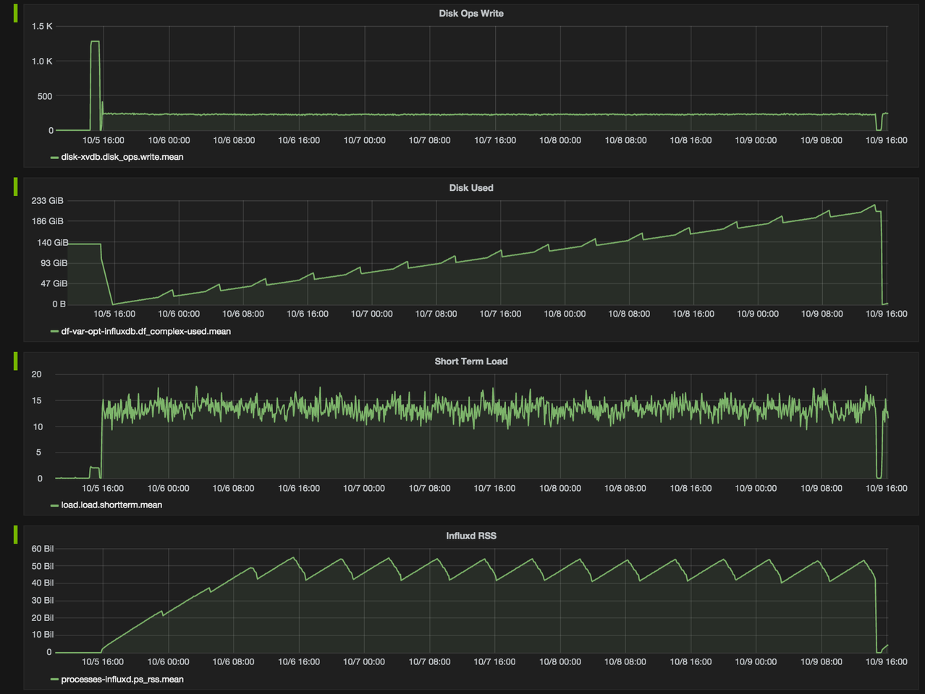
Time series data

Slide 10
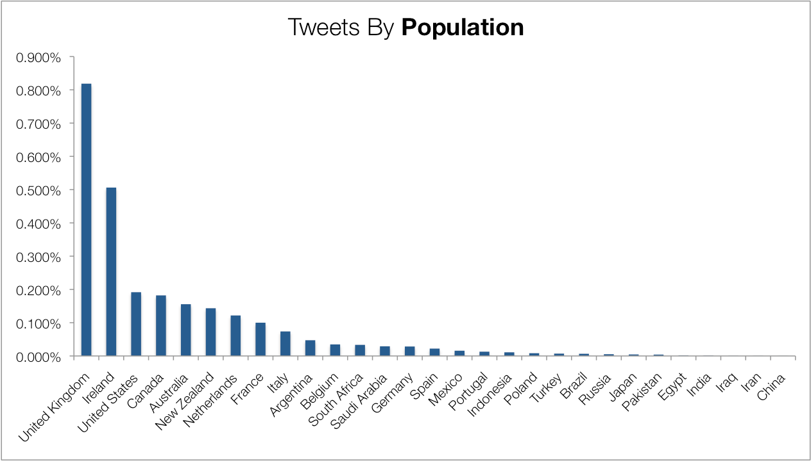
Not time series data

Slide 11
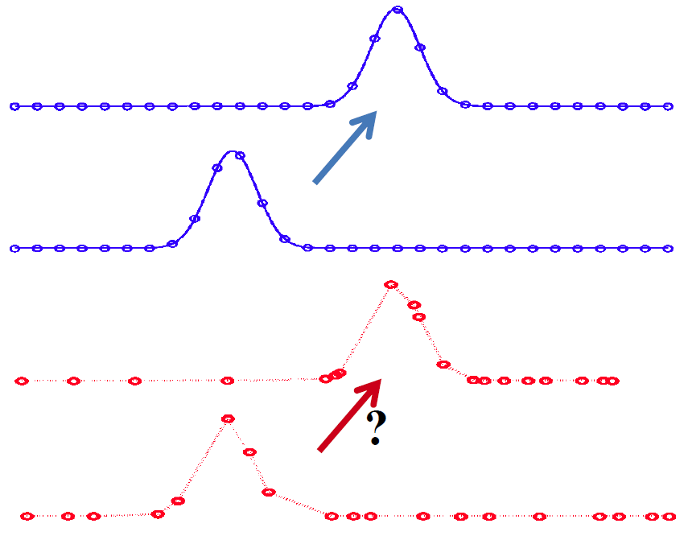
Regular vs Irregular Timeseries

Slide 12
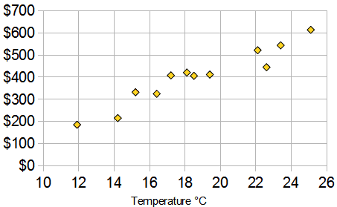
Exercise
Is it time series?

Slide 13
Exercise
Is it time series?

Slide 14
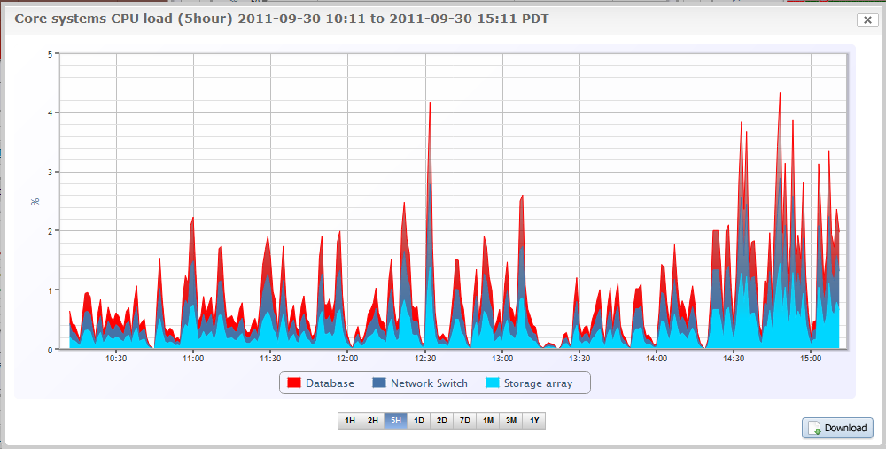
Exercise
Is it time series?

Slide 15
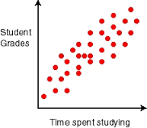
Exercise
Is it time series?

Slide 16
What is time series database?
Tweet me @Benstronaut

Slide 17
Time series database is…
A database where you manage and store time series data…

Slide 18




Other TSDB’s
KDB+
OpenTSDB
Graphite
Riak TS

Slide 19
Why cant I just use [your favorite db]?
You could...
...but you would be implementing a lot of the functionality that a time-series database comes with by default.

Slide 20

Why Choose InfluxDB?
Easy to get started with
Familiar query syntax
No external dependencies
Allows for regular and irregular time series
Horizontally scalable
Member of a cohesive time series platform

Slide 21
The InfluxDB Data Model

Slide 22
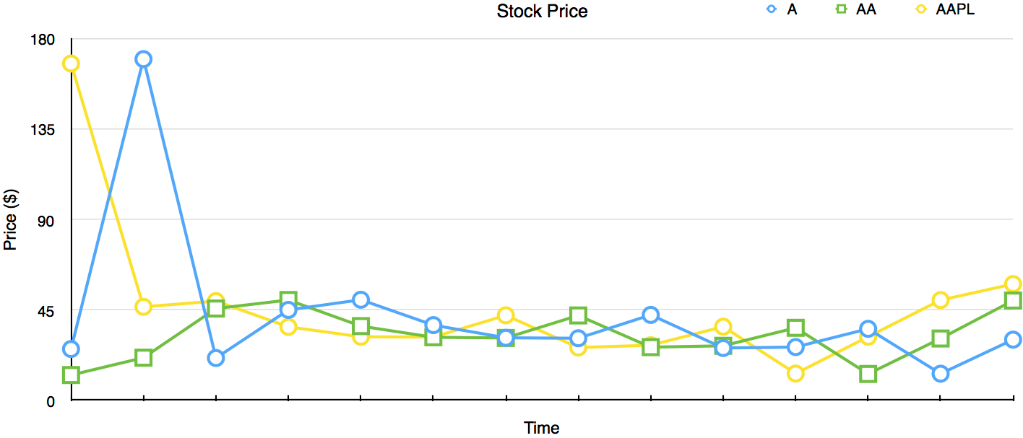
A typical time series graph
What components do we have?

Slide 23
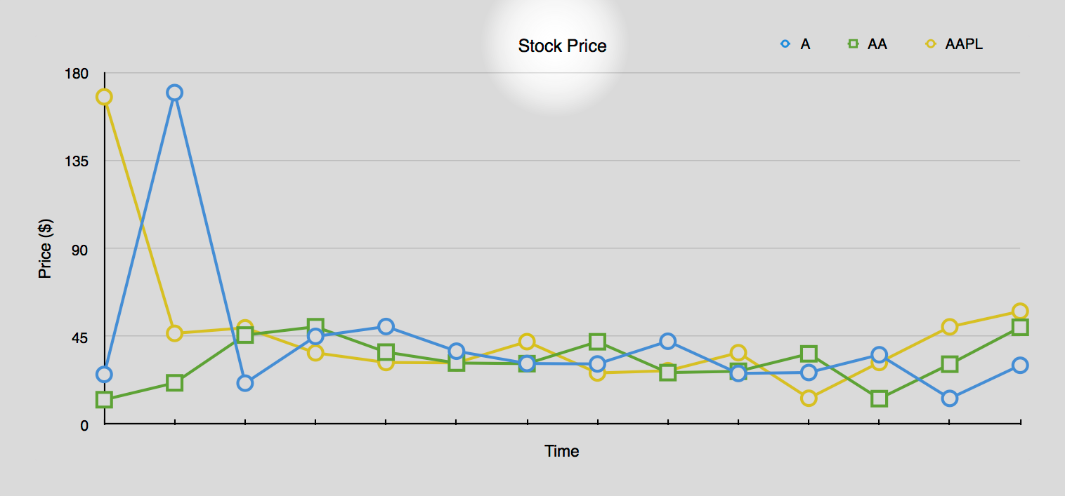
The Label
stock_price
We call this the measurement

Slide 24
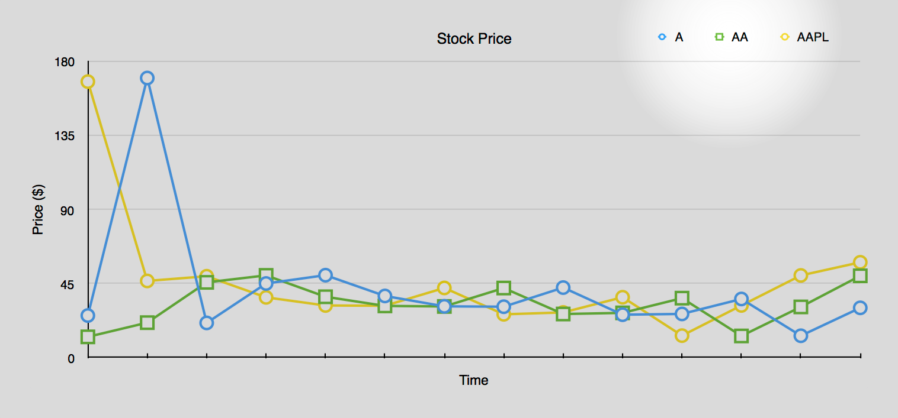
The Legend (metadata)
ticker=A
ticker=AA
ticker=AAPL
market=NASDAQ
market=NYSE
We call these tags.
Tags are indexed.

Slide 25
Collection of all tags
ticker=A,market=NASDAQ
ticker=AA,market=NYSE
ticker=AAPL,market=NASDAQ
We call this the tagset.

Slide 26
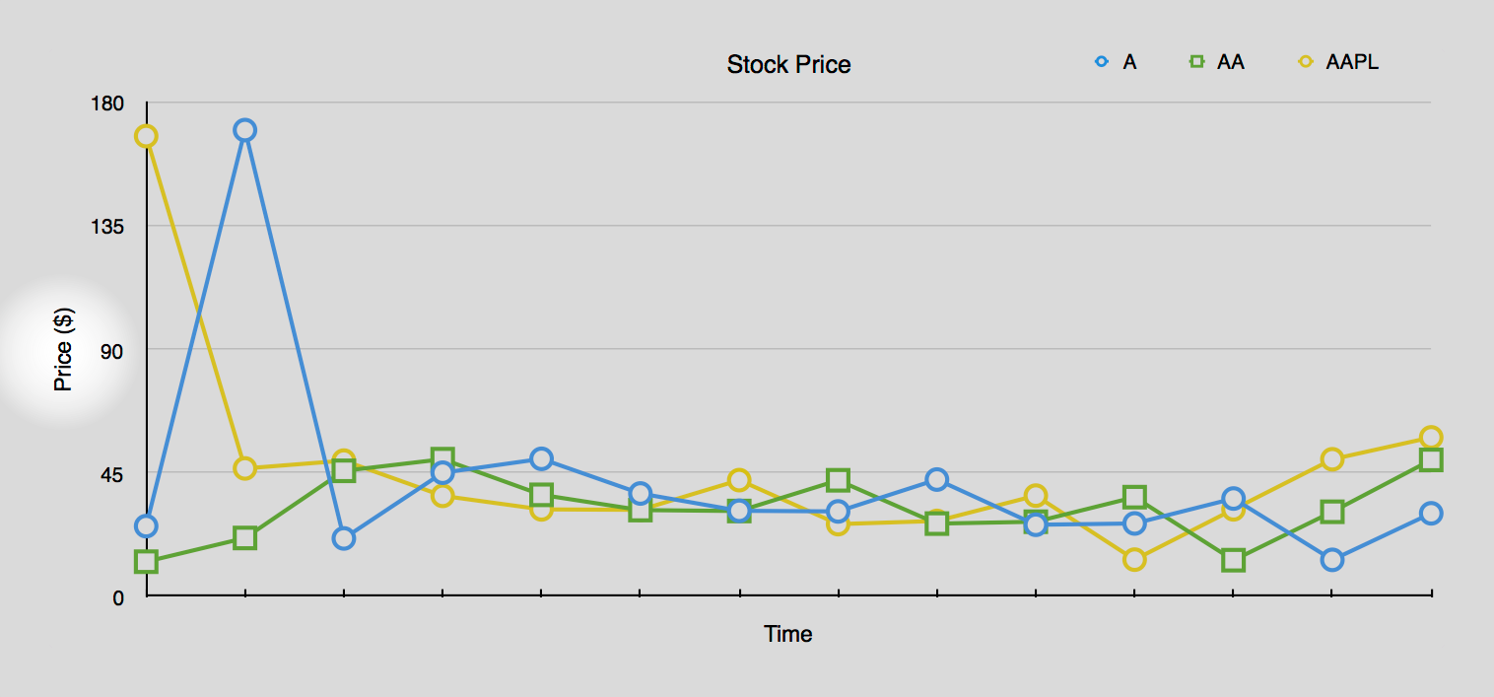
Y-Axis Values
price=177.03
price=32.10
price=35.52
We call these fields.
Note that the values that the field stores can be floats, ints, strings, or bools.

Slide 27
The Collection of Fields
price=177.03
price=32.10
price=35.52
We call the fieldset.
Note that in this case, there's only one field.
(There could be many.)

Slide 28
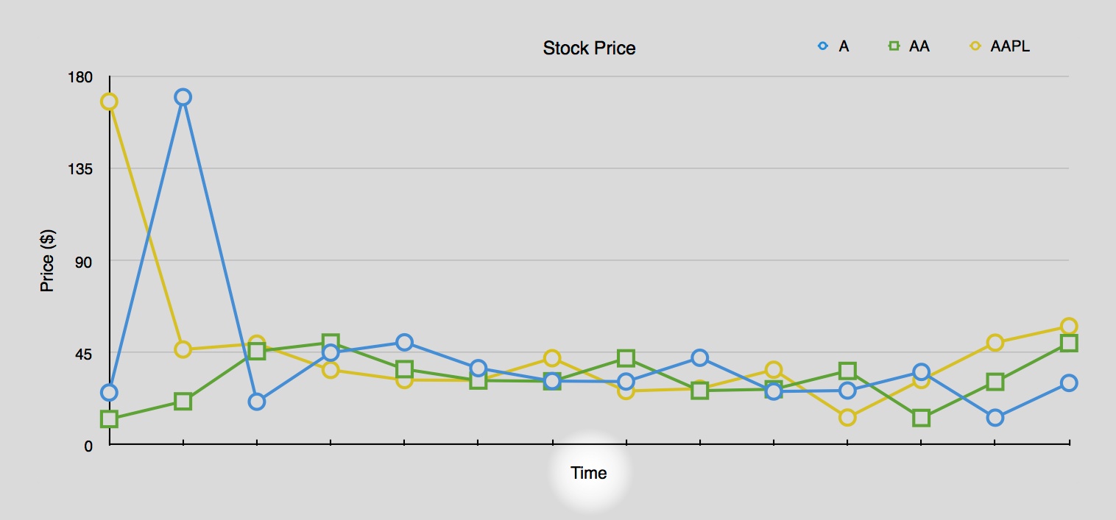
X-Axis Value
1445299200000000000
We call this the timestamp.

Slide 29
Exercise
What components do we have?

Slide 30
How do we represent points textually?
Tweet me @Benstronaut

Slide 31
The Line protocol
measurement,tagset fieldset timestamp
stock_price,ticker=A,market=NASDAQ price=177.03 14452992000000000

Slide 32
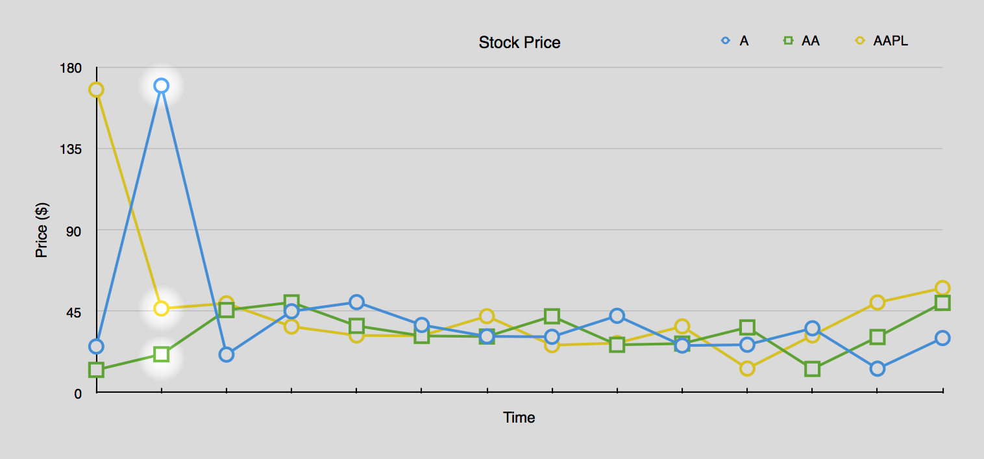
Points in InfluxDB look like…
stock_price,ticker=A,market=NASDAQ price=177.03 1445299200000000000
stock_price,ticker=AA,market=NYSE price=32.10 1445299200000000000
stock_price,ticker=AAPL,market=NASDAQ price=45 1445299200000000000

Slide 33
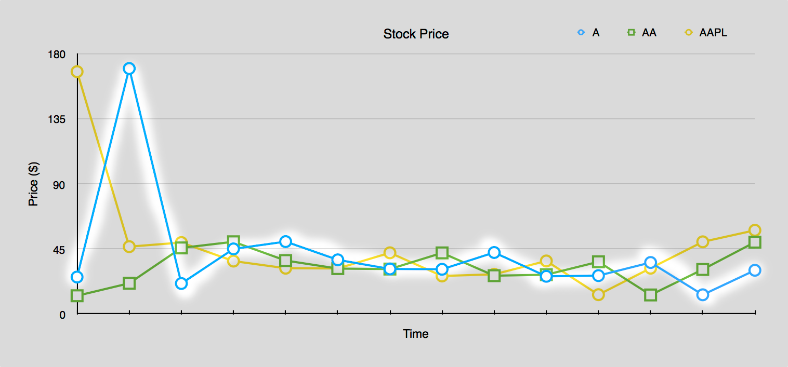
A Series in InfluxDB
measurement + tagset = the series as a whole
measurement + tagset + timestamp = single point

Slide 34
Examples of points in Line Protocol
cpu,host=server1 value=100 1445299200000000000
temperature,zipcode=94107,country=usa value=75,humidity=10
response_time,method=GET,precision=ms value=12i 1445299200000000000

Slide 35
Exercise
Do the following points belong to the same series?
stock_price,ticker=NN value=100 1445299200000000000
stock_price,ticker=NN other=100 1445299200000000000
stock_price,ticker=NN value=10,other=10 1445299200000000000

Slide 36
Exercise
Express a point with measurement
stock_price
with one tag
ticker=NN stock_price,ticker=NN value=10
that has a single field
value=10
without a timestamp.

Slide 37
Exercise
Express a point with measurement
stock_price
with two tags
ticker=AA
and
exchange=NASDAQ
stock_price,ticker=AA,exchange=NASDAQ value=10 1233433432
with a single field
value=10
with a timestamp.

Slide 38
Exercise
Express a point under the same measurement as the example below, but belonging to a different series.
stock_price,ticker=AAPL,market=NASDAQ value=1032 1445299200
stock_price,ticker=AAPL,market=NYSE other=123 432
stock_price,ticker=AAPL,market=IDK,random=TAG v=100 34323
stock_price x=1,y=1 12234325214
stock_price,tick=AAPL y=1 213213213

Slide 39
Writing Data into InfluxDB

Slide 40
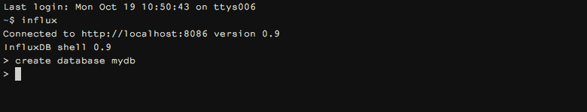
Creating a database
CREATE DATABASE mydb

Slide 41
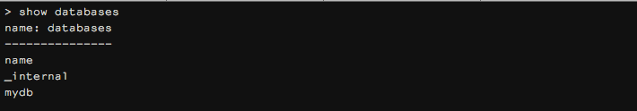
Verifying that it was created
SHOW DATABASES

Slide 42

Using the database we just created
USE mydb

Slide 43

Inserting data into the database
insert cpu,host=server1,location=us-west value=10
insert cpu,host=server1,location=london value=11
insert cpu,host=server2,location=us-west value=12

Slide 44
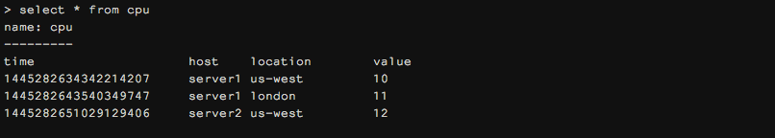
Verifying that the data was written
SELECT * FROM cpu
PS. Be careful! This query can be very expensive.
SHOW SERIES
SHOW MEASUREMENTS

