Slide 1
Working with the InfluxDB CLI and Query Language
Michael Desa & Jack Zampolin
Tweet me @Benstronaut

Slide 2
By the end of this section, participants will be able to…
Navigate an InfluxDB instance using the CLI
Query InfluxDB using the InfluxDB CLI
Understand the structure of the data that is returned from a query
Articulate what InfluxQL can do
Create novel queries of their own

Slide 3
Before we get into things let’s add our dataset
$ curl https://s3-us-west-2.amazonaws.com/influx-sample-data/NOAA.txt > NOAA_data.txt

Slide 4
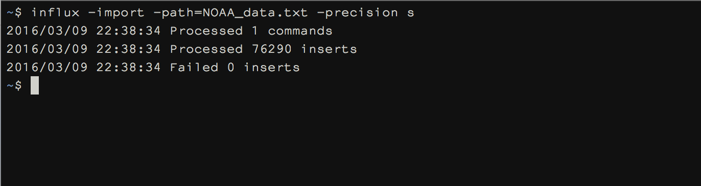
Import our Dataset
influx -import -path=NOAA_data.txt -precision s

Slide 5
CLI Tips and Tricks

Slide 6
Why Use the CLI?
$ influx
> precision rfc3339
# Where the metadata/raft database is stored
dir = "/var/lib/influxdb/meta"
# The default address to bind to
bind-address = ":8088"
# The default address to bind the API to
http-bind-address = ":8091"
https-enabled = false
https-certificate = “”
…
Controls if this node should run the meta service and participate in the Raft group
It’s always there - comes with every InfluxDB package
It’s better than the web admin UI
It’s easier than just using cURL
Provides a number of convenient utilities for interacting with the database

Slide 7
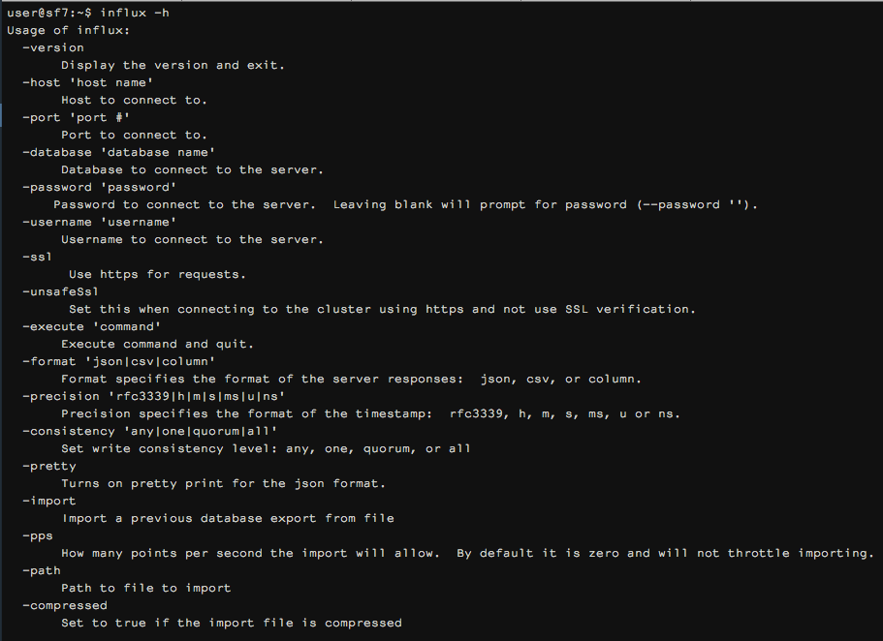
InfluxDB CLI Options
$ influx -h

Slide 8
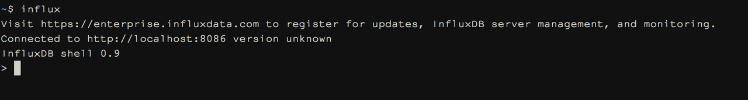
Pop into the CLI
$ influx

Slide 9
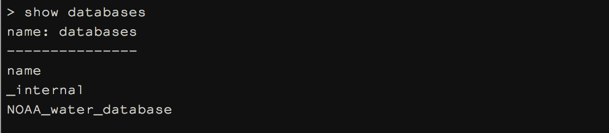
Verify that we created the NOAA DB
SHOW DATABASES

Slide 10
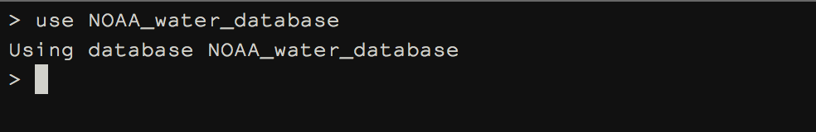
Use the NOAA database
USE NOAA_water_database

Slide 11
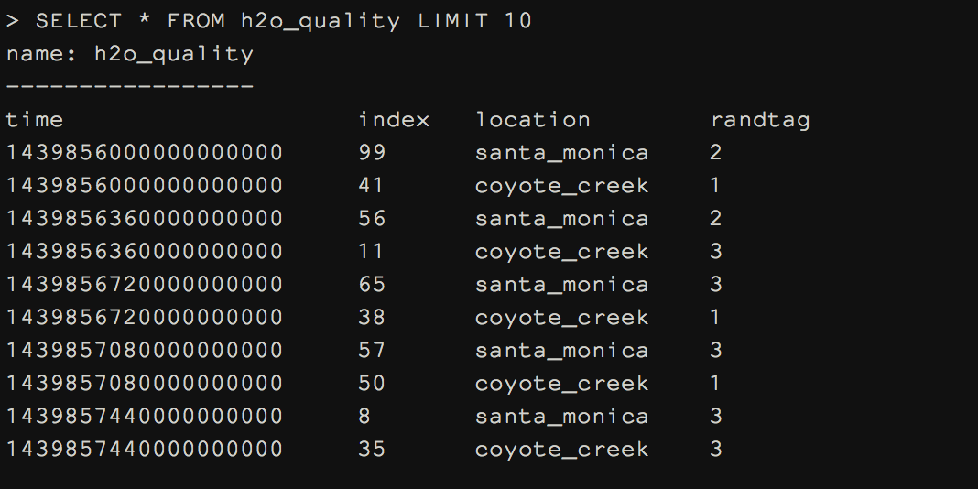
Basic Select Statement
SELECT * FROM h2o_quality LIMIT 10

Slide 12
Changing the Precision on Time
Precision specifies the format of the timestamp:
rfc3339, h, m, s, ms, u or ns.
$ influx -precision rfc3339
or
$ influx
> precision rfc3339

Slide 13
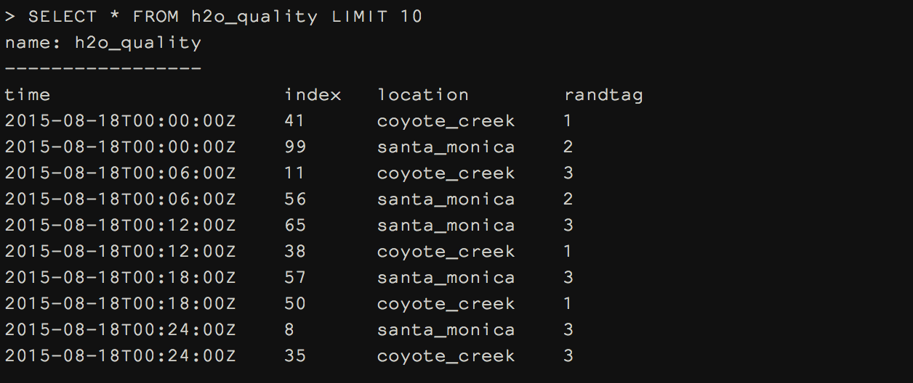
Basic Select Statement (rfc3339)
PRECISION rfc3339

Slide 14
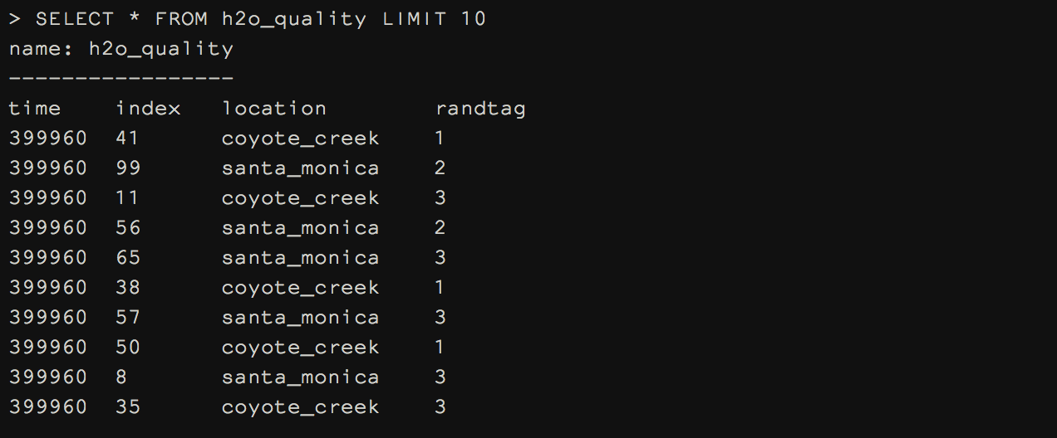
Basic Select Statement (hours)
PRECISION h

Slide 15
Changing the Format of the results
Format specifies the format of the server responses:
json, csv, or column.
$ influx -format json
or
$ influx
> format json

Slide 16
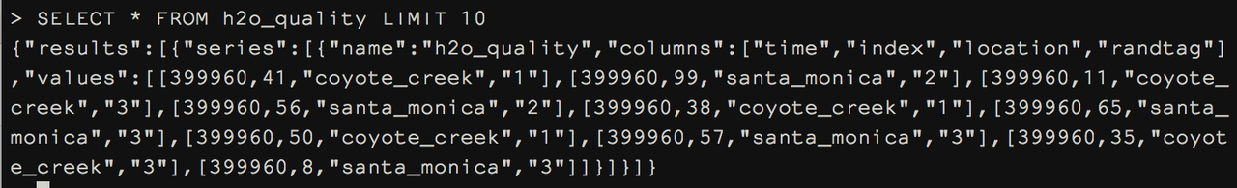
Basic Select Statement (json)
FORMAT JSON
Thats awful!

Slide 17
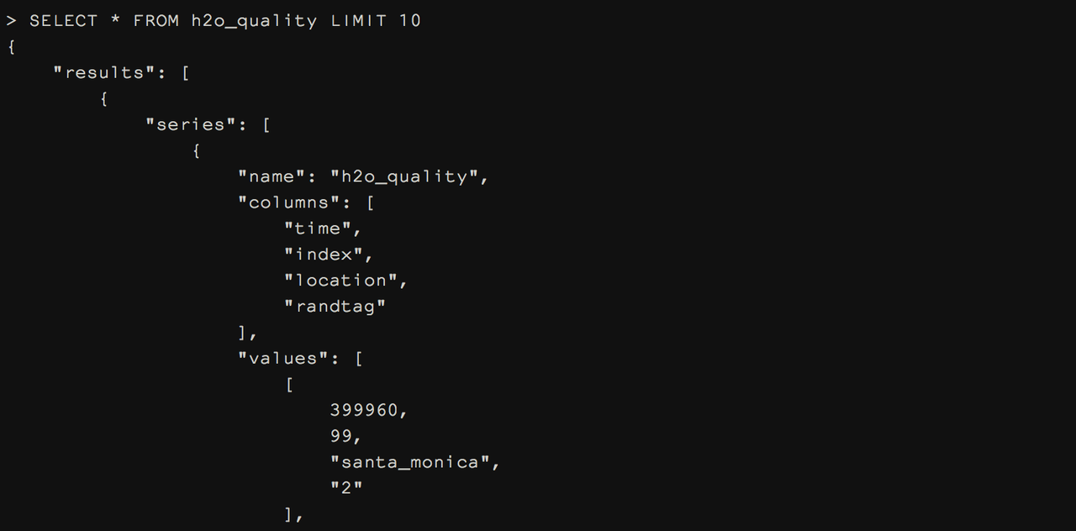
Basic Select Statement (json pretty)
PRETTY

Slide 18
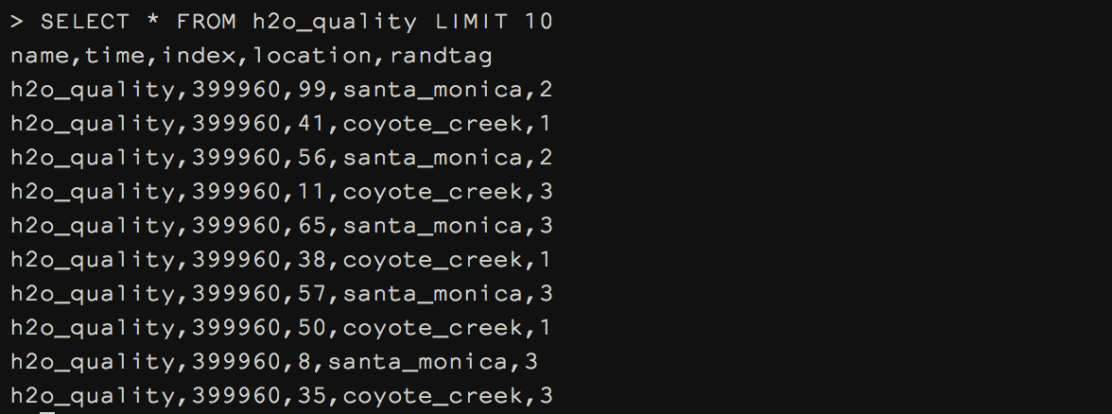
Basic Select Statement (csv)
FORMAT csv

Slide 19
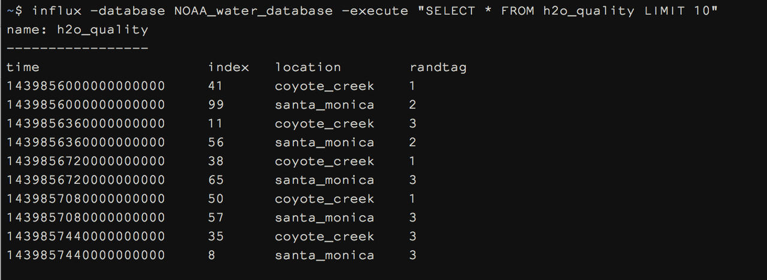
Using the -execute Flag
influx -database NOAA_water_database —execute [query]

Slide 20
Connecting to a Remote Host
influx -database [db] —execute [query] -host 107.23.91.18

Slide 21
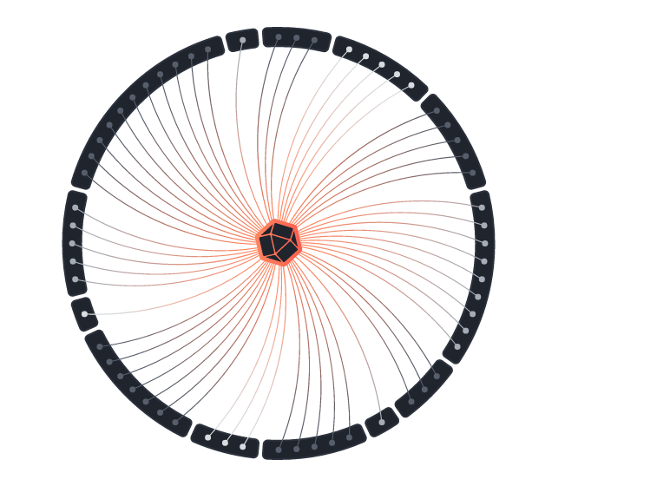
InfluxQL
Meta-Queries
Queries

Slide 22
InfluxQL Basics
If you're familiar with basic SQL, you're familiar with InfluxQL

Slide 23
Meta Queries
…tell you about the underlying structure of the data.
SHOW DATABASES
SHOW SERIES
SHOW MEASUREMENTS
SHOW TAG KEYS
SHOW FIELD KEYS

Slide 24
Exercise
Use the meta-queries SHOW SERIES, SHOW TAG KEYS, and SHOW FIELD KEYS to extrapolate out the schema of the dataset we loaded in.

Slide 25
Queries

Slide 26
Basic Select Statement
SELECT <field> FROM <measurement>
SELECT * FROM cpu
SELECT free FROM mem
SELECT x + y FROM vars
SELECT x,y FROM nums
Try Running:
SELECT * FROM h2o_quality LIMIT 10

Slide 27
Select Statement with WHERE Clause
SELECT <field> FROM <measurement> WHERE <conditions>
SELECT * FROM cpu WHERE busy > 50
SELECT free FROM mem WHERE host = 'server1'
SELECT x + y FROM vars WHERE some_tag = 'some_key'
SELECT x,y FROM nums WHERE domain =~ /.*/
Try Running:
SELECT * FROM average_temperature WHERE location='santa_monica' LIMIT 10

Slide 28
Select Statement with Relative Time
SELECT <field> FROM <measurement> WHERE <time condition>
SELECT * FROM cpu WHERE time > now() - 1h
SELECT * FROM cpu WHERE time > now() - 10s
SELECT free FROM mem WHERE time > now() - 4d
SELECT x + y FROM vars WHERE time > now() - 10w
SELECT x,y FROM nums WHERE time > now() + 15m
Using now() implies relative time
Try Running:
SELECT * FROM h2o_pH WHERE time > now() - 300d LIMIT 10

Slide 29
Select Statement with Absolute Time
SELECT <field> FROM <measurement> WHERE <time condition>
SELECT * FROM cpu WHERE time > '2015-08-18 23:00:01.232000000'
SELECT free FROM mem WHERE time < '2015-09-19'
SELECT x + y FROM vars WHERE time > '2015-08-18T23:00:01.232000000Z'
SELECT x,y FROM nums WHERE time > 1388534400s
Absolute time can be specified in two ways
Date Time: YYYY-MM-DD HH:MM:SS.nnnnnnnnn (RFC 3339)
Epoch: number of nanoseconds since January 1, 1970
Try Running:
SELECT * FROM h2o_pH WHERE time > '2015-08-18' LIMIT 10

Slide 30
Select Statement with ORDER BY time
[SELECT STATEMENT] ORDER BY time DESC
SELECT * FROM cpu WHERE time > now() - 1h ORDER BY time DESC
SELECT free FROM mem ORDER BY time DESC
Currently ordering by time is the only supported functionality, but ordering by arbitrary fields is to come eventually. Using ASC is redundant.
Try Running:
SELECT * FROM h2o_quality ORDER BY time DESC LIMIT 10

Slide 31
Select Statement with Conjunction
SELECT <field> FROM <measurement> WHERE <conditions> [AND | OR] <conditions>
SELECT * FROM cpu WHERE busy > 50 AND location = 'us-west'
SELECT free FROM mem WHERE time > now() - 1h AND host = 'server1'
SELECT x + y FROM vars WHERE time < '2015-09-19' AND time > '2015-08-19'
SELECT x, y FROM nums WHERE x = 10 OR x = 100
Try Running:
SELECT * FROM h2o_feet WHERE location = 'santa_monica' AND water_level > 7

Slide 32
Select Statement with GROUP BY Clause
[SELECT STATEMENT] GROUP BY <tag>
SELECT * FROM cpu GROUP BY host
SELECT * FROM cpu GROUP BY *
SELECT free FROM mem WHERE time > now() - 4d GROUP BY location
Try Running:
SELECT * FROM h2o_quality GROUP BY * LIMIT 10
SELECT * FROM h2o_quality GROUP BY location LIMIT 10

Slide 33
Functions
…in InfluxDB fall into 3 major types…
Aggregators
Selectors
Transformers

Slide 34
Aggregators
count()
distinct()
integral()
mean()
median()
spread()
sum()
stddev()

Slide 35
Using an Aggregator
SELECT <aggregator>(<field>) FROM <measurement> [extra stuff]
SELECT count(value) FROM cpu
SELECT mean(free) FROM mem WHERE time > now() - 1h
SELECT sum(x) FROM vars WHERE x > 100
SELECT median(y) FROM nums WHERE domain = 'Z'
Try Running:
SELECT count(index) FROM h2o_quality
SELECT count(index) FROM h2o_quality WHERE location = 'coyote_creek'

Slide 36
Select Statement with GROUP BY time
[SELECT STATEMENT] WHERE <time condition> GROUP BY time(<period>)
SELECT max(busy) FROM cpu WHERE time > now() - 1h GROUP BY time(10m)
SELECT mean(free) FROM mem WHERE time > now() - 1d GROUP BY time(1h), host
Note that the following queries are not valid:
SELECT busy FROM cpu WHERE time > now() - 1h GROUP BY time(10m)
SELECT mean(busy) FROM cpu GROUP BY time(10m)
SELECT mean(busy) FROM cpu GROUP BY time(10m) WHERE time > now() - 1h
Try Running:
SELECT mean(degrees) FROM average_temperature WHERE time < '2015-09-19' AND time > '2015-09-18' GROUP BY time(1h)
SELECT mean(degrees) FROM average_temperature WHERE time < '2015-09-19' AND time > '2015-09-18' GROUP BY time(1h), *

Slide 37
Selectors
bottom()
first()
last()
max()
min()
percentile()
top()

Slide 38
Using a Selector
SELECT <selector>(<field>) FROM <measurement> [extra stuff]
SELECT percentile(busy,90) FROM cpu WHERE time > now() - 1h
SELECT bottom(water_level,10) FROM factory WHERE location = 'SF'
SELECT max(x) FROM vars
SELECT last(y) FROM nums WHERE domain = ‘Z'
Try Running:
SELECT max(degrees) FROM average_temperature GROUP BY *
SELECT top(degrees, 10) FROM average_temperature GROUP BY *

Slide 39
Transformers
derivative()
non_negative_derivative()
difference()
moving_average()

Slide 40
Using a Transformer
SELECT <transformer>(<field>) FROM <measurement> [extra stuff]
SELECT derivative(mean(write_ops)) FROM disk WHERE time > now() - 10m GROUP BY time(10s)
SELECT non_negative_derivative(x) FROM vars

Slide 41
Select Statement with fill
[SELECT STATEMENT] GROUP BY time(<period>) fill(<value>)
SELECT max(busy) FROM cpu WHERE time > now() - 1h GROUP BY time(10m) fill(0)
SELECT mean(free) FROM free WHERE time > now() - 1d GROUP BY time(1h) fill(previous)
SELECT max(busy) FROM cpu WHERE time > now() - 1h GROUP BY time(10m) fill(none)
SELECT mean(free) FROM free WHERE time > now() - 1d GROUP BY time(1h) fill(10)
Try Running
SELECT mean(degrees) FROM average_temperature WHERE time > '2015-09-17' AND time < '2015-09-20' GROUP BY time(1h) fill(previous)
SELECT mean(degrees) FROM average_temperature WHERE time > '2015-09-17' AND time < '2015-09-20' GROUP BY time(1h) fill(0)

Slide 42
Queries with multiple functions
SELECT <thing>[,<thing>] FROM <field> [other stuff]
SELECT max(busy), mean(user) FROM cpu
SELECT mean(free), median(used) FROM mem WHERE time > now() - 1d
SELECT stddev(used), sum(free) FROM disk WHERE host = 'server1'
Try Running:
SELECT max(degrees), min(degrees), mean(degrees) FROM average_temperature

Slide 43
Select Statement with AS
SELECT <thing> as <other_thing> [,<thing> as <other_thing>] FROM <field> [other stuff]
SELECT max(busy) as busy, mean(user) as user FROM cpu
SELECT mean(free) as free, median(used) as median_used FROM mem
SELECT stddev(used) as dev, mean(used) as avg FROM disk WHERE host = 'server1'
Try Running:
SELECT max(degrees) AS max_temp, min(degrees) AS min_temp, mean(degrees) AS avg_temp FROM average_temperature

Slide 44
Queries with INTO Clause
SELECT <stuff> INTO <measurement> FROM <measurement> [other stuff]
SELECT max(busy) as busy, mean(user) as user INTO new_cpu FROM cpu
SELECT mean(free) INTO mean_mem FROM mem
SELECT stddev(used) as dev INTO other_disk FROM disk
The INTO clause place the results of one query into another measurement in the database.
Try Running:
SELECT max(degrees) AS max_temp, min(degrees) AS min_temp, mean(degrees) AS avg_temp INTO downsampled_avg_tmp FROM average_temperature WHERE time > '2015-09-17' AND time < '2015-09-20' GROUP BY time(6h), * fill(0)
SELECT * FROM downsampled_avg_tmp

Slide 45
SHOW/Kill QUERIES
The SHOW QUERIES command shows all active running queries
The KILL QUERY <qid> command willl kill an actively running query

