Slide 1
Schema Design
Michael Desa & Jack Zampolin
Tweet me @Benstronaut

Slide 2
By the end of this section, participants will be able to…
Identify poorly designed schemas.
Design a basic schema for a common use case and query it efficiently.
Explain what a continuous query is and what they are used for.
Create their own continuous queries.
Describe what a retention policy is and its relation to databases and series
Create their own retention policies.
Combine retention policies and continuous queries in novel ways to manage their data’s lifecycle.

Slide 3
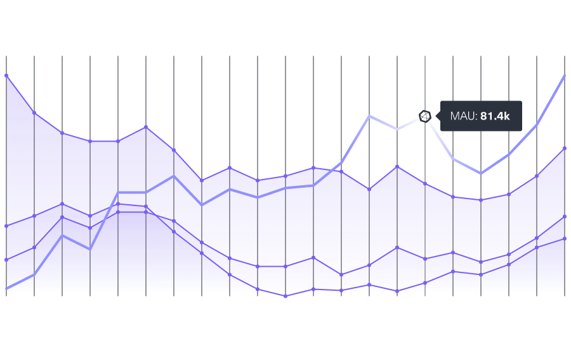
Important Things to Remember
Tags are Indexed
Fields are not
All points are indexed by time
You want to minimize the number of unique series

Slide 4
What not to do

Slide 5
DON'T ENCODE DATA INTO THE MEASUREMENT NAME
Measurement names like:
cpu.server-5.us-west value=2 1444234982000000000
cpu.server-6.us-west value=4 1444234982000000000
mem-free.server-6.us-west value=2500 1444234982000000000
Encode that information as tags:
cpu,host=server-5,region=us-west value=2 1444234982000000000
cpu,host=server-6,region=us-west value=4 1444234982000000000
mem-free,host=server-6,region=us-west value=2500 1444234982000000

Slide 6
What if my plugin sends data like that to InfluxDB?
Write something that sits between your plugin and InfluxDB to sanitize the data OR use one of our write plugins:
Example - Graphite Plugin:
Takes input like…
sensu.metric.net.server0.eth0.rx_packets 461295119435 1444234982
sensu.metric.net.server0.eth0.tx_bytes 1093086493388480 1444234982
sensu.metric.net.server0.eth0.rx_bytes 1015633926034834 1444234982
…and parses it with the following template…
[“sensu.metric.* ..measurement.host.interface.field”]
…resulting in the following points in line protocol hitting the database:
net,host=server0,interface=eth0 rx_packets=461295119435 1444234982
net,host=server0,interface=eth0 tx_bytes=1093086493388480 1444234982
net,host=server0,interface=eth0 rx_bytes=1015633926034834 1444234982

Slide 7
DON’T OVERLOAD TAGS
BAD
cpu,server=localhost.us-west value=2 1444234982000000000
cpu,server=localhost.us-east value=3 1444234982000000000
GOOD
Separate out into different tags:
cpu,host=localhost,region=us-west value=2 1444234982000000000
cpu,host=localhost,region=us-east value=3 1444234982000000000

Slide 8
DON’T USE TAGS THAT HAVE HIGH VARIABILITY, E.G. UUIDS, HASHES, RANDOM STRINGS
BAD
response_time,session_id=33254331,request_id=3424347 value=340 14442349820000
You might need to do something like that, so consider:
Vertical sharding across instances
Use prefix tag groupings
Use a cluster to horizontally shard series

Slide 9
DON’T HAVE A HUGE NUMBER OF INDEPENDENT TAGS
BAD
cpu,week=10,weekday=tues,hour=14,min=34,...,host=api-0 value=2 1444234982000
This increases the memory requirement of InfluxDB.

Slide 10
DON’T USE THE SAME NAME FOR A FIELD AND A TAG
BAD
This leads to unqueryable data:
login,user=admin user=2342,success=1 1444234982000
GOOD
Differentiate the names somehow:
login,user_type=admin user_id=2342,success=1 1444234982000

Slide 11
DON'T USE TOO FEW TAGS
BAD
cpu,region=us-west host="server1",value=0.5 1444234986000
cpu,region=us-west host="server2",value=4 1444234982000
cpu,region=us-west host="server2",value=1 1444234982000
cpu,region=us-west,short="2" host="server2",value=1 1444234982000
Some problems you might run into:
If points in the same series have the same timestamp, the last one will overwrite the ones before (LWW, last write wins).
Not indexed means inefficient queries - will have to scan through all points to get to ones with specific field.
Won't be able to GROUP BY host

Slide 12
DON'T WRITE DATA WITH THE WRONG PRECISION
BAD
Writing data using second precision when you need millisecond precision
Timestamps will collide and you'll lose data.
The database might think its 1970.
The database might think its 2185.
BAD
Writing data using nanosecond precision when you need second precision
More data over the wire.
Decreased write throughput.
Larger size on disk.
Even if your data points are about 1 sec apart, make sure they are at least 1 sec apart to avoid collisions after rounding.

Slide 13
What should you do?
There's no single answer. Every InfluxDB use-case is a special flower.
However...

Slide 14
HERE'S SOME GENERAL THINGS TO KEEP IN MIND
ASK
What kind of queries do I want to run?
Do I want to look things up by a particular value?
Do I lose information by storing a value as a string?
GUIDELINES
Anything in a GROUP BY clause must be a tag.
Anything that you want to pass into a function must be a field.
Few measurements with many tags is better than many measurements with few tags.
If you lose information by storing as a string, use a field.

Slide 15
Designing a Run Tracking App

Slide 16
THE APP SENDS BACK THE FOLLOWING INFORMATION EACH SECOND OF A RUN
user_id Which user is running
run_id Which run is being tracked (a unique identifier)
distance The distance the runner had run in the last second
heart_rate What the user's average heart rate was over the last second
speed What the user's average speed was over the last second

Slide 17
THE APP REPORTS TO INFLUXDB EVERY SECOND
We only care about minute resolution.
Keep this in mind as we go forward.

Slide 18
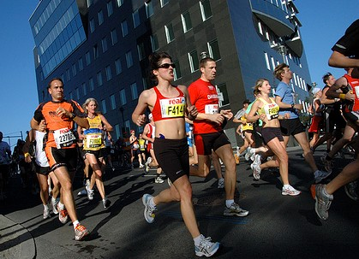
SOME INFORMATION WE'D LIKE TO GET OUT OF THE DATA:
What was the user's average speed during a run?
How far did the user run?
What was the user's average heart rate during a run?
What was the users maximum heart rate during a run?

Slide 19
QUESTION
How can we organize our data so that we can easily get the results that we want from the database?

Slide 20
Exercise
Why would it be a bad idea to make distance, heart_rate, or speed a tag instead of a field?

Slide 21
OPTION 1
Encode all of the information into the measurement name.
measurement(s):
user_1.run_1
user_1.run_2
user_2.run_3
tags:
fields:
distance
speed
heart_rate

Slide 22
OPTION 2
Everything as fields
measurement:
run_stats
tags:
fields:
user_id
run_id
distance
speed
heart_rate

Slide 23
OPTION 3
Use a single measurement, 2 tags, and the rest fields.
measurement:
run_stats
tags:
user_id
run_id
fields:
distance
speed
heart_rate

Slide 24
Exercise
Given that run_id is unique, does the inclusion of user_id as a tag increase the series cardinality?

Slide 25
Solution
Given that run_id is unique, does the inclusion of user_id as a tag increase the series cardinality?
No. Since each run_id has a unique user, having the tag user_id doesn't increase the number of unique series.

Slide 26
Schema for Run app
measurement:
run_stats
tags:
user_id run_id
fields:
distance speed heart_rate
Examples in LP
run_stats,user_id=1,run_id=3 distance=0.1,speed=10.1,heart_rate=170i 142309324834700
run_stats,user_id=1,run_id=3 distance=0.09,speed=9.3,heart_rate=150i 142309324834701
run_stats,user_id=1,run_id=3 distance=0.06,speed=7.4,heart_rate=140i 142309324834702

Slide 27
Information we’d like to get out of the data…
What was the users average speed during a run?
How far did the user run?
What was the user's average heart rate during a run?
What was the users maximum heart rate during a run?

Slide 28
REMINDER
We receive information with 1 second granularity.
We only care about 1 minute granularity.

Slide 29
Let’s create a database for the app
CREATE DATABASE runner

Slide 30
Exercise
In the last hour, what was the average speed for the run with run_id=3 for each minute?

Slide 31
Solution
In the last hour, what was the average speed for the run with run_id=3 for each minute?
SELECT mean(speed)
FROM run_stats
WHERE time > now() - 1h AND run_id='3'
GROUP BY time(60s)

Slide 32
Exercise
In the last hour, what was the total distance per minute for the run with run_id=3?

Slide 33
Solution
In the last hour, what was the total distance per minute for the run with run_id=3?
SELECT sum(distance)
FROM run_stats
WHERE time > now() - 1h AND run_id='3'
GROUP BY time(60s)

Slide 34
Exercise
In the last hour, what was the average heart_rate per minute for the run with run_id=3?

Slide 35
Solution
In the last hour, what was the average heart_rate per minute for the run with run_id=3?
SELECT mean(heart_rate)
FROM run_stats
WHERE time > now() - 1h AND run_id='3'
GROUP BY time(60s)

Slide 36
Exercise
In the last hour, what was the max heart_rate per minute for the run with run_id=3?

Slide 37
Solution
In the last hour, what was the max heart_rate per minute for the run with run_id=3?
SELECT max(heart_rate)
FROM run_stats
WHERE time > now() - 1h AND run_id='3'
GROUP BY time(60s)

Slide 38
Put it all together…
Combine the last 4 queries into a single query:
SELECT
mean(speed) as speed,
sum(distance) as distance,
mean(heart_rate) as heart_rate,
max(heart_rate) as max_hr
FROM run_stats WHERE time > now() - 1h AND run_id='3'
GROUP BY time(60s)

Slide 39
This is only for a specific run ID
We want it for each run_id in the time range.

Slide 40
Exercise
So let’s group by run_id and user_id
SELECT
mean(speed) as speed,
sum(distance) as distance,
mean(heart_rate) as heart_rate,
max(heart_rate) as max_hr
FROM run_stats WHERE time > now() - 1h
GROUP BY time(60s), run_id, user_id

Slide 41
Questions
What do we do with the results of the query?
When do we run the query to downsample all of our data?

Slide 42
Continuous queries
Continuous queries are queries that will periodically run on data in InfluxDB.
They're somewhat similar to running queries with cron.
They're used to "downsample" data or pre-calculate common queries.

Slide 43
FORMAT OF A CONTINUOUS QUERY
CREATE CONTINUOUS QUERY [name_of_continuous_query]
ON [name_of_db]
[RESAMPLE [EVERY interval] [FOR interval]]
BEGIN
SELECT [inner_part_of_select]
INTO [new_measurement]
FROM [measurement]
GROUP BY time([frequency]), [tags]
END
The EVERY clause specifies how frequently the CQ will run.
The FOR clause specifies how far back the CQ resamples.

Slide 44
Exercise
Turn the query we wrote earlier into a CQ:
SELECT
mean(speed) as speed,
sum(distance) as distance,
mean(heart_rate) as heart_rate,
max(heart_rate) as max_hr
FROM run_stats WHERE time > now() - 1h
GROUP BY time(60s), run_id, user_id

Slide 45
Solution
CREATE CONTINUOUS QUERY reduce_reso ON runner BEGIN
SELECT
mean(speed) as speed,
sum(distance) as distance,
mean(heart_rate) as heart_rate,
max(heart_rate) as max_hr
INTO reduced_run_stats
FROM run_stats
GROUP BY time(60s), run_id, user_id
END
Verify that the CQ was created:
SHOW CONTINUOUS QUERIES

Slide 46
NOW THAT WE'VE DOWNSAMPLED OUR DATA...
What do we do with our old data?

Slide 47
RETENTION POLICIES
A retention policy describes how long the data should be stored in the database. (DURATION)
A retention policy belongs to a database.

Slide 48
Creating a Retention Policy
CREATE RETENTION POLICY [name_of_policy]
ON [name_of_database]
DURATION [time_duration]
REPLICATION [number] [DEFAULT]

Slide 49
Exercise
Create a retention policy for 1 hour with a replication of 1 that is the default retention policy for the database.

Slide 50
Solution
Create a retention policy for 1 hour with a replication of 1 that is the default retention policy for the database.
CREATE RETENTION POLICY one_hour ON runner DURATION 1h REPLICATION 1 DEFAULT
Verify that the retention policy was created with:
SHOW RETENTION POLICIES ON runner

Slide 51
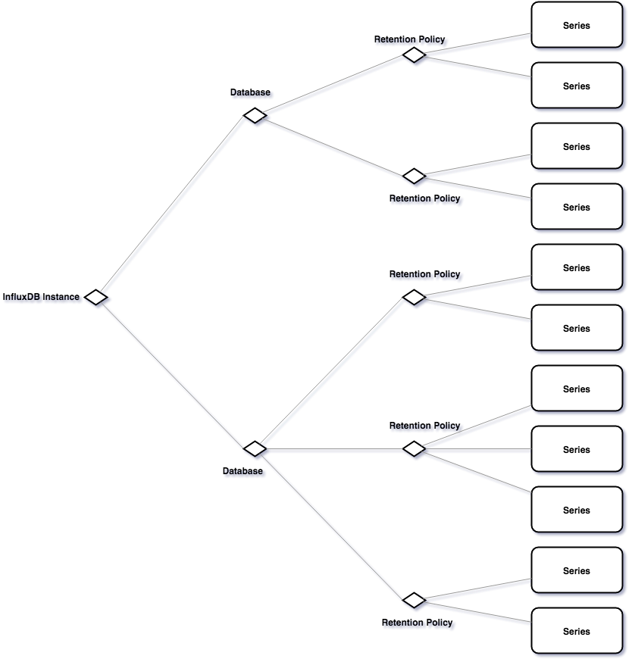
A Full Picture

Slide 52
A fully qualified measurement
Measurements in InfluxDB are fully qualified by their database and retention policy.
"database"."retention_policy"."measurement"

Slide 53
Exercise
Modify the continuous query below so that the data from run_stats gets downsampled into a measurement in the "default" retention policy.
CREATE CONTINUOUS QUERY reduce_reso ON runner BEGIN
SELECT
mean(speed) as speed,
sum(distance) as distance,
mean(heart_rate) as heart_rate,
max(heart_rate) as max_hr
INTO reduced_run_stats
FROM run_stats
GROUP BY time(60s), run_id, user_id
END

Slide 54
Solution
CREATE CONTINUOUS QUERY reduce_reso ON runner BEGIN
SELECT
mean(speed) as speed,
sum(distance) as distance,
mean(heart_rate) as heart_rate,
max(heart_rate) as max_hr
INTO "runner"."default"."reduced_run_stats"
FROM "runner"."one_hour"."run_stats"
GROUP BY time(60s), run_id, user_id
END

Slide 55
A Complete Picture
CQ
CQ
CQ

Slide 56
Load testing your system

Slide 57
influx_stress -v2
A utility that generates synthetic load on InfuxDB and comes bundled with every installation (written by Michael and Jack)
Requires a working InfluxDB installation at localhost.
This instance will be used for recording metrics as well as providing a target for the stress test.
Many configuration options to increase load or present different load profiles
Extensible syntax useful for testing different schemas from a write as well as a query perspective
Useful for setting up CQ & RP environments
To run:
influx_stress -v2 -config file.iql

Slide 58
Sample Config
$ cat file.iql
CREATE DATABASE IF NOT EXISTS thing
CREATE RETENTION POLICY ON thing DURATION 1h
SET Database [thing]
SET Precision [s]
GO INSERT devices
devices,
city=[str rand(8) 100],country=[str rand(8) 25],device_id=[str rand(10) 100]
lat=[float rand(90) 0],lng=[float rand(120) 0],temp=[float rand(40) 0]
100000 10s
GO QUERY devices
SELECT count(%f) FROM %m WHERE %t
DO 100
WAIT
DROP DATABASE thing

