Slide 1
CS48 Lecture Schedule
Today (Week 2)
  Intro to SWE: Process & requirements analysis
Next week: Requirements analysis and specification
  Basics: project description, vision statement, initial features as use cases or user stories
  Requirements Analysis Doc due 2/2/18
Weeks 4-6
  In depth analysis: modelling system behavior (UML)
  Design principles
  Implementing and testing
  Draft project due 2/23/18: build up/evolve your Doc
Rest of class: Midterm, demo prep, demos

Slide 2
Software Engineering
Set of "Activities" – not "steps"
    Often happening simultaneously
    Not necessarily discrete
  Planning: mostly study the requirements
  Domain analysis: study the problem area
  System design: devise computer solution
  Implementation: write the code
  Testing, documentation, maintenance, …
Management activities: developers, teams, customers
Guided by CS theory

Slide 3
Software engineering
A subset of system engineering
Covers all software development activities, planning through maintenance
Also includes various management tasks
  Determine project roles, and assign personnel
  Create and monitor development schedules
  Some client relations and customer support
Guided by CS theory
  But really just heuristics, and often ad hoc

Slide 4
Professional, ethical responsibility
Above all, do no harm! (Hippocratic Oath)
  NO VIRUSES or other malicious programs
  Avoid inventing “the bomb” or a plague, or …
Basically demonstrate loyalty to employer, clients, co-workers, country, humanity, …
See “Software Engineering Code of Ethics and Professional Practice” by ACM/IEEE-CS
  https://www.acm.org/about-acm/acm-code-of-ethics-and-professional-conduct
  Extra credit exam question on this

Slide 5
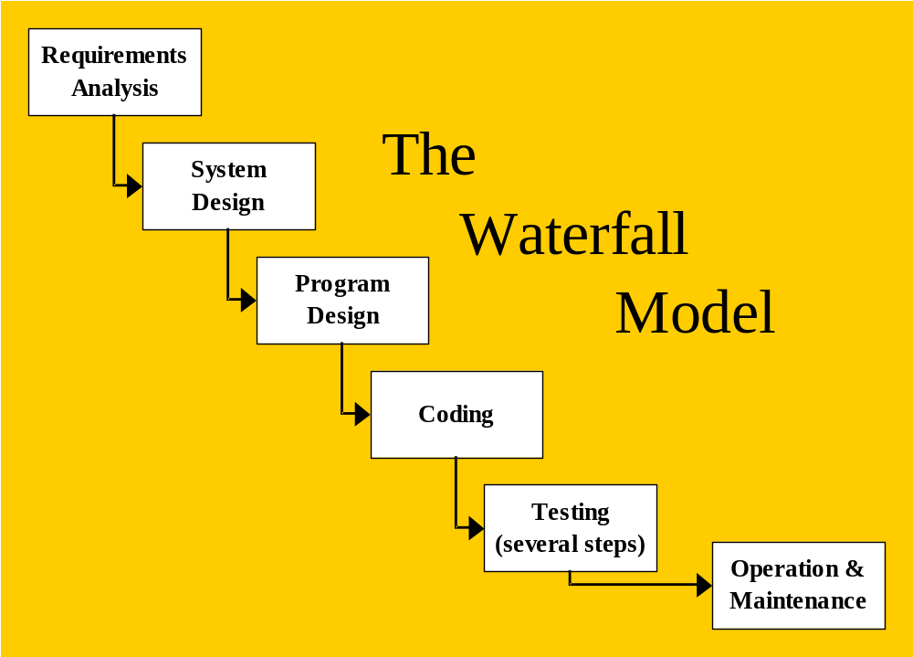
Development process modeling
The classic:
Step after step, after step, …
Never back up

Slide 6
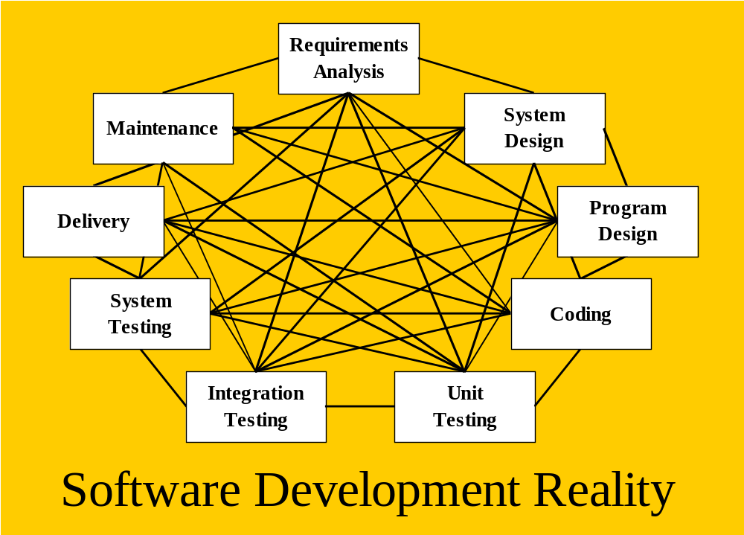
Alternatives to waterfall model
Okay, we all agree – this extreme doesn’t work either
Is there a middle ground?

Slide 7
Considering risk
Requirements
Design
Implement
Integrate &
Analysis
System Test
Potential
In a waterfall lifecycle,
impact of
high risk issues such as
risks being
integration and load test
tackled
may be tackled late.
Time
Research conclusion: it is wise to do some implementing and testing early in the process

Slide 8
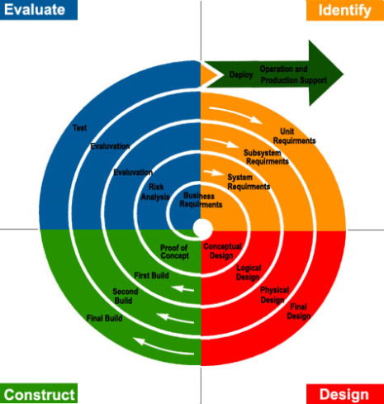
Engineering the risk factor
Spiral Model
  Includes frequent risk analyses
  Frequent reevaluation during an extended planning stage

Slide 9
Spiral Model:
Pros/Cons
Pros
Risks are identified early on in the project
Rapid prototyping shows progress and gives users an idea of the system
Feedback can be obtained early from these prototypes
Cons
Time is wasted on making too many prototypes
Risk analysis is too time consuming for small projects
It’s complex
It can be hard to set milestones
It can be never ending if hurdles are not overcome.

Slide 10
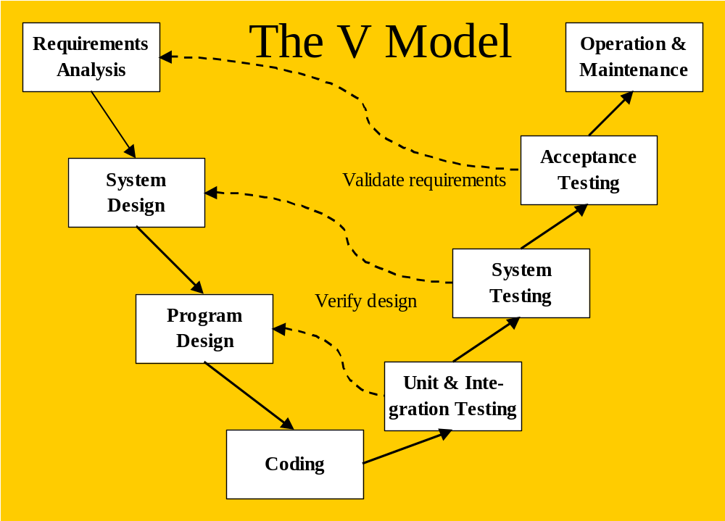
Testing and iterating
Accounts for requirement changes and mistakes
Key idea: plan to iterate
But still a bit too rigid?

Slide 11
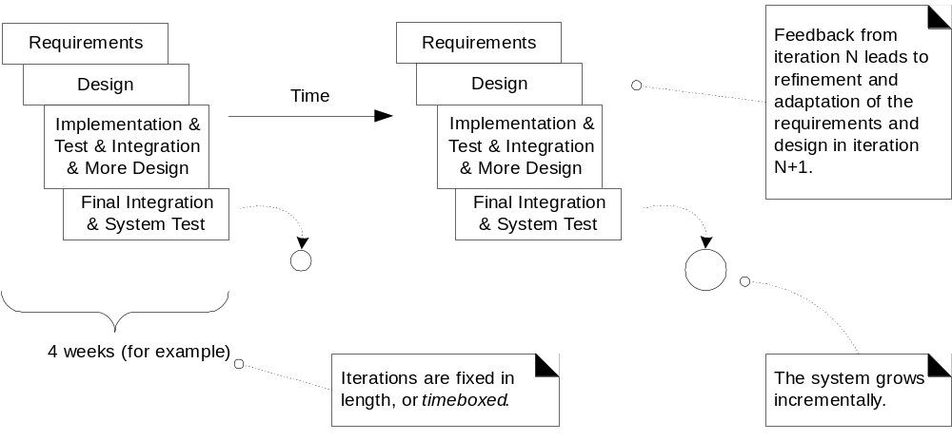
Incremental / iterative process
Hmmm … a hybrid that makes sense!

Slide 12
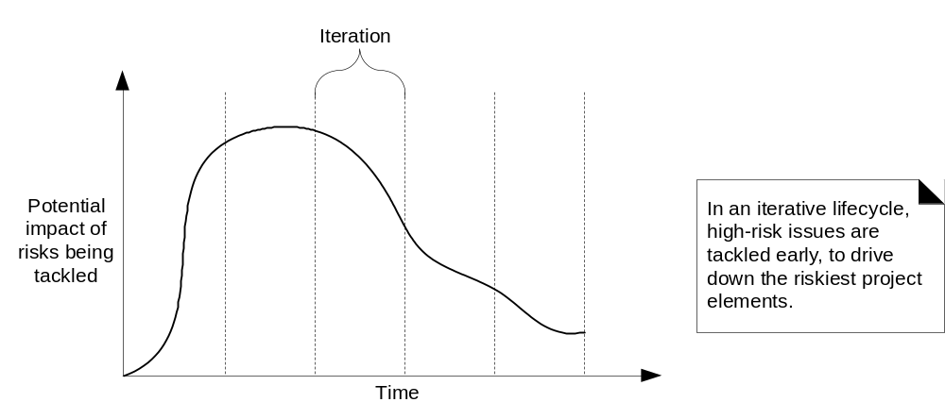
Iterating reduces risk overall
Especially if thorny issues are tackled early

Slide 13
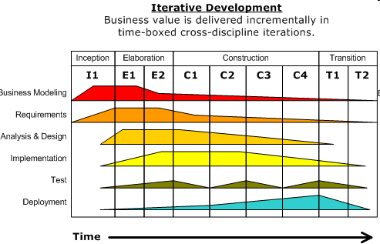
Unified Process (UP)
By Rumbaugh, Jacobson, Booch, others (~1999)
Customizable to different settings/teams/projects
Iterative and incremental through 4 phases
  Release at end of each timeboxed iteration
Use case driven
Architecture-centric
Risk-focused
UML describes
requirements & design
  Standardized notation
    Object oriented
  Static models
  Dynamic models

Slide 14
Agile Software Development
Agility – observed to be a common feature of successful processes
Different projects need different processes
Generally better to focus on skills, communication, and community instead of processes
Fruitful to consider it “a cooperative game of invention and communication” (Cockburn, 2002)

Slide 15
Agile Software Development
Manifesto for Agile Software Development (2001)
available at: http://agilemanifesto.org/
“We are uncovering better ways of developing software by doing it and helping others do it. Through this work we have come to value:
Individuals and interactions over processes and tools
Working software over comprehensive documentation
Customer collaboration over contract negotiation
Responding to change over following a plan
That is, while there is value in the items on the right, we value the items on the left more”

Slide 16
Extreme Programming (XP)
A type of agile software development process proposed by Kent Beck (~late 90’s)
XP follows the agile software development principles as
  Software is built iteratively, with frequent releases
  Each release implements the set of most valuable features/use-cases/stories that are chosen by the customer
  Each release is implemented in a series of iterations, each iteration adds more features/use-cases/stories
  Programmers turn the stories into smaller-grained tasks, which they individually accept responsibility for
  The programmer turns a task into a set of test cases that will demonstrate that the task is finished
  Working as pairs, the programmers make the test cases run, evolving the design in the meantime to maintain the simplest possible design for the system as a whole
See www.extremeprogramming.org

Slide 17

Scrum
An evolutionary/iterative/incremental/agile software process implementation
  See: Scrum and XP from the Trenches -- free online book by Kniberg

Slide 18
Scrum
An evolutionary/iterative/incremental/agile software process impl.
  See: Scrum and XP from the Trenches -- free online book by Kniberg
The main roles in Scrum are:
  Scrum team: Team of software developers
  Scrum master : Project manager
  Product owner: Client or business lead (accepts/rejects result)
Characteristics of Scrum:
  Self-organizing teams
  Product development in two to four week sprints (iterations)
  Requirements are captured as items in a list of product backlog
    Yours will come from your requirements analysis document
    Sprint backlog is subset of product backlog for this sprint
  Retrospective after each iteration (identify ways to improve)

Slide 19
Sprint and Scrum: Implementation
Sprint planning
  Use cases or user stories broken down into tasks
    Team members assign timings (how long each will take)
    And pick tasks
  Tasks = designing, implementing, testing, and demo'ing
    Includes code review
  Any new tasks identified enroute go onto backlog for inclusion next time
Daily standup
    What I did yesterday, what I'm doing today, + any blockers
    Short/quick so done standing up!
Retrospective and end of each iteration (identify ways to improve) – what worked and what didn't
    Vote on what to work on next time

Slide 20

Next Up: Requirements Analysis & Specification

Slide 21
Requirements analysis
What do stakeholders want from the system?
  What should it to do?
  What should it look like? Sound like? Be like?
Object-oriented analysis and design
  From an object perspective
  System composed of objects or concepts (UML helps here)
    What must the system do?
    How will system fulfill the requirements?
    How do objects/concepts interact?
Means not: function-oriented
  System composed of processes, functions
    What to do, and how to do it?
    Mostly worry about “flow of control”
Catalog Library Book Librarian
Record loans
Add resources
Report fines

Slide 22
Requirements analysis
Analysis starts with a project description
  Usually written (or otherwise expressed) by major stakeholder
    a.k.a. “Client” – might be a customer, another department in the company, management, professor, …
    Or project team writes it for an anticipated market
Results in a series of RA artifacts: 2 purposes
  Shows the client what they will be getting
  Used to kick-off and guide later development activities
  Vision
    Problem statement, system goals, features, constraints
  Use cases/user stories
    Used to guide development and estimate costs
    Turn into product (and sprint/iteration) backlog

Slide 23
Start by not even thinking about programming
Try to focus on domain concepts at first
  Not software constructs (wait until design stage)
  Avoids complexity overload
  Design and eventual system will be better too!
Create and maintain a steady stream of artifacts
  Mostly pre-programming – diagrams, class specifications, glossary, …
    Use online tools (UML, drawing tools)
  Guides initial implementation, and aids subsequent modification, maintenance, and software reuse
  Commit to github repo – counts as CS48 “progress”

Slide 24
CS 48 development schedule
Overview: a planning phase, followed by at least 2 complete development iterations – each iteration produces a working system
  Follow agile principles
Now: Planning phase – Requirements Analysis
  First be the client – describe the project
  Then analyze the requirements
    Identify/enumerate system features and characteristics
    Write use cases and user stories
    Prioritize and assign use cases/stories to development iterations
      See next week lecture notes if you want to get started early http://www.cs.ucsb.edu/~cs48/slides/index.html

Slide 25
CS 48 schedule (cont.)
Early iteration(s) –draft project (report and current system)
  Analyze the domain pertinent to the iteration
    Identify classes, class attributes, and associations
    Identify system behavior (as a “black box”)
  Design the current system
    Specify the way objects will behave and interact
    Tie to other systems/tools as necessary
  Implement and test
Complete at least 1 more iteration – final project
  Analyze/design/implement/test and update documents
    Demonstrate system to class during last week of quarter

Slide 26
Tools for Agile Specification, Design, & Development
Requirements specification and design
  PDF: Written document with drawings
  UML – Unified Modeling Language
    Standardized notation – now well accepted
    Online UML drawing: https://yuml.me/
      Getting highly sophisticated now
        Can generate code from modeling diagrams
        Can do reverse engineering, …
  Use cases and user stories: Trello, PivotalTracker, Jira
    Helps with supporting your agile process (iterations, scrum)
Free plans for small projects, trial period, students…

