Slide 1
Draft Project (next deliverable)
Due Feb 23 by 5pm
Domain analysis: static class and sequence diagrams
System design
Source code
  Everything necessary to build and run the project
  README.md that describes the steps for doing so
    Make sure you have tested that these work on a clean clone!
  Tests
    Unit and integration tests
    README.md with steps for running both sets of tests
Evolved requirements analysis doc: glossary, use cases/stories (10+ new ones with acceptance tests that match unit or integration tests); UML for analysis & design; diagrams
Due Feb 23, 5pm via piazza PDF and github commits

Slide 2
Domain analysis
Goal: build an object-oriented model of the real-world system (or imaginary world)
Slicing the soup: OOA vs. OOD
  OOA concerned with “what”, not “how”
  OOA activities focus on the domain layer
Common OOA activities: identify classes (concepts), assign (some) responsibilities to classes
  Larman’s OOA: domain model (classes, associations, attributes), and system operations
    Includes static and dynamic views of the domain

Slide 3
Domain analysis activities
Static view – model the domain
  Identify domain concepts
  Identify associations between the concepts
    Now ready to start drawing domain model – a visual representation of these concepts and associations
  Identify attributes of the concepts
Dynamic view – model the system behavior
  Make system sequence diagrams
  Write system operation contracts

Slide 4
Identifying concepts
Class = major abstraction (i.e.,not just an attribute)
  1 for each of your major concepts
How to find candidate classes?
  Think/brainstorm about the domain
    Ask Who? What? When? Where?
    But save the "HOW" questions for OOD (design phase)
  Identify the nouns & noun phrases in problem statement, use case descriptions, other …
Consider all as candidates to start; refine later
  i.e., a candidate class turns out to be just an attribute
    But common error to decide too early

Slide 5
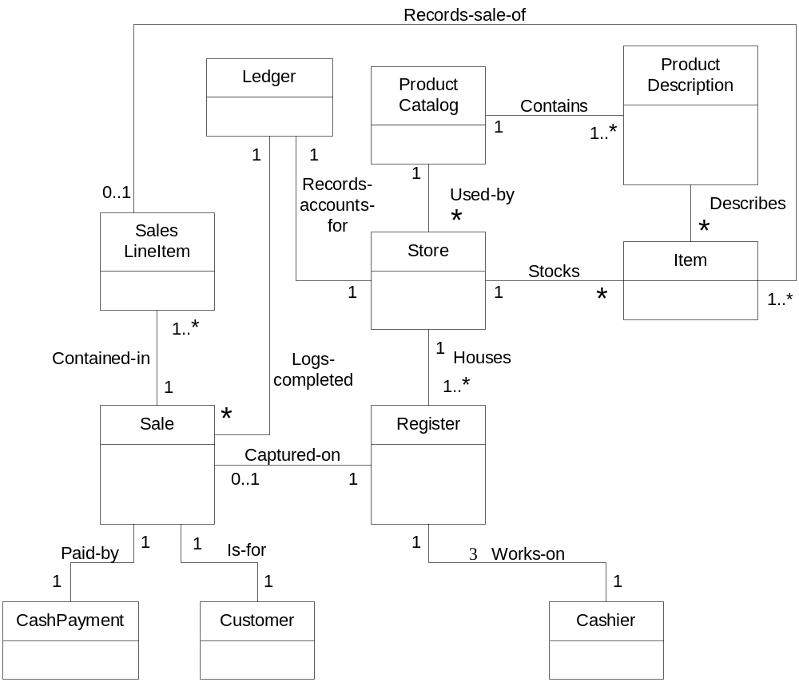
Partial domain model for a Point-of-Sale app
a.k.a. static class diagram
Concepts are boxes
Associations are lines connecting boxes
Other UML details to follow

Slide 6
Associations
Def: relationships between concepts
Common associations:
  Dependency – a class “uses” another
  Generalization – a class is derived from another
  Aggregation – one class is a collection of others
  But can be any kind of relationship
Good association names are important too
  And helpful to identify the direction of association
  Named associations
Also helpful to use proper UML

Slide 7
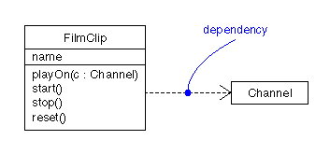
UML: dependency relationship
When a class “uses” or otherwise depends on another class to fulfill a responsibility
  Dashed line with arrow in UML

Slide 8
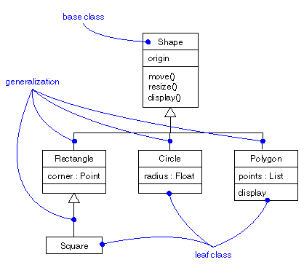
UML: showing generalization
a.k.a., inheritance – one class is derived from another
  In UML, triangle at end of line “points” at parent class
Child concept is a parent concept

Slide 9
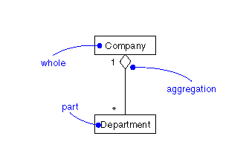
UML: aggregation & multiplicity
many
“Whole” is identified by the diamond shape at that end of the line

Slide 10
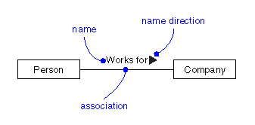
Naming associations
Recommended for any relation between concepts
  Absolutely necessary if UML lacks notation (like dependency, aggregation, or generalization)
Use verb or verb phrase: e.g., “records”, “paid by”

Slide 11
Partial domain model for a Point-of-Sale app
a.k.a. static class diagram
Concepts are boxes
Associations are lines connecting boxes
Other UML details to follow

Slide 12
Identifying associations
Don’t overdo it
  Useful associations only – otherwise clutter
  Must be domain-meaningful at this stage
Highest priority categories are “need-to-know” associations – knowledge of the relationship must be preserved for awhile
  A is physically or logically part of B
  A is physically or logically contained in B
  A is recorded in B

Slide 13
Generalization
A domain model term, concerning general-specific relationships
  e.g., Bird – general – a.k.a. supertype
  Penguin – specific – a.k.a. subtype
  A Penguin is a Bird.
Aids abstract thinking
Facilitates handling
  Express more economically in conceptual model
  Lends itself to implementation using inheritance

Slide 14
When to use generalization
Define a subtype of a concept when instances of the subtype differ from other instances, as in:
  They have additional attributes, and/or associations
  They are handled differently, in important ways
  They represent things with varying behaviors
Define a supertype to generalize concepts when:
  All subtypes are true variations of a single concept,
  Subtypes share the same attributes and associations,
  And subtypes all conform to both:
    100% rule – all supertype attributes and associations apply
    “is a” rule

Slide 15
Abstract Classes
Def.: If every instance of a class C must also be an instance of a subclass, then C is called an abstract conceptual class.
Payment
CashPayment
CreditPayment
CheckPayment

Slide 16
vs Concrete Classes
If a Payment instance exists which is not a member of a subclass, then Payment is not abstract – it is concrete.
Payment
CashPayment
CreditPayment
CheckPayment

Slide 17
UML: Abstract Classes
UML notation: italicized class name
Def.: If every instance of a class C must also be an instance of a subclass, then C is called an abstract conceptual class
  If an instance can be of class C, then class is concrete
Payment
Cash
Payment
Credit
Payment
Check
Payment

Slide 18
Class attributes
a.k.a., “properties” of classes
  Describe an object’s state at a point in time
  Attributes are “pure data values” – not complex things (which are concepts, not attributes)
    Fields and operations
Encapsulation principles help guide attribution
  Info is most useful if stored where it’s needed most
  Identity info of an object is best stored with that object

Slide 19
More attribution principles
What to store depends on the application
  e.g. Employee – Name? Address? Wage? Title?
    Key question: What does this application need?
  i.e., need pertinent abstractions of concepts
Representation depends on application too
  i.e., how to represent in the conceptual model
    e.g., Title just a String? – okay – else if complex meaning, maybe it is a concept of its own, or an association
Should be simple – “data types”
  e.g., 5, “white” – an instance has no unique identity

Slide 20
Attribute or Class?
Classes: objects with unique identities
  e.g., 2 instances of Person
Attributes: primitive types
  e.g., number, string, time…
What to do with non-primitive data types?
  composed of separate sections (address)
  quantities with units (payment amount)
  has more attributes (promotional price: start/end)
  has operations associated (SSN: validate)

Slide 21
UML: Attribute or Class?
Non-primitive data types may be shown as attributes or classes!
1
1
ProductSpecification
ItemID
or
ProductSpecification
id: ItemID

Slide 22
Attribution in practice
Two complementary approaches:
  1. Choose a class – list its properties
  2. Choose a property – ask what it describes
  Do it both ways for a complete set of attributes
Probably will discover new concepts
  Okay – augment the conceptual model
  Note: sometimes an association should store attributes
    Means the association is a concept of its own
    e.g., Gymnast, Team – and Membership to associate them

Slide 23
Attribution Pitfall
Relate conceptual classes with an association, not an attribute!
Cashier
name
currentRegister
Cashier
Register
1
uses
1
name
number

Slide 24
Glossary notes
Record all attributes in the glossary
  Sometimes called the “data dictionary”
Also record all concepts, associations, operations, use cases, …
  And any terms that require clarification
Purpose: reduce risk of miscommunication
  With clients, and other team members
  And for yourself a few weeks down the road
  And in CS 48 – so we can understand your artifacts
But don’t overdo it – always minimize busywork

Slide 25
Domain analysis activities
Static view – model the domain
  Identify domain concepts
  Identify associations between the concepts
    Now ready to start drawing domain model – a visual representation of these concepts and associations
  Identify attributes of the concepts
Dynamic view – model the system behavior
  Make system sequence diagrams
  Write system operation contracts

Slide 26
System behavior
Focus is on dynamic view: states and sequences
State of the system is like a snapshot – a point-in-time record of memory contents
  What objects currently exist?
  What associations are currently formed?
  What are the current values of object attributes?
System sequences involve changes in state
  Objects are created and destroyed
  Associations are formed and broken
  Values of attributes are modified

Slide 27
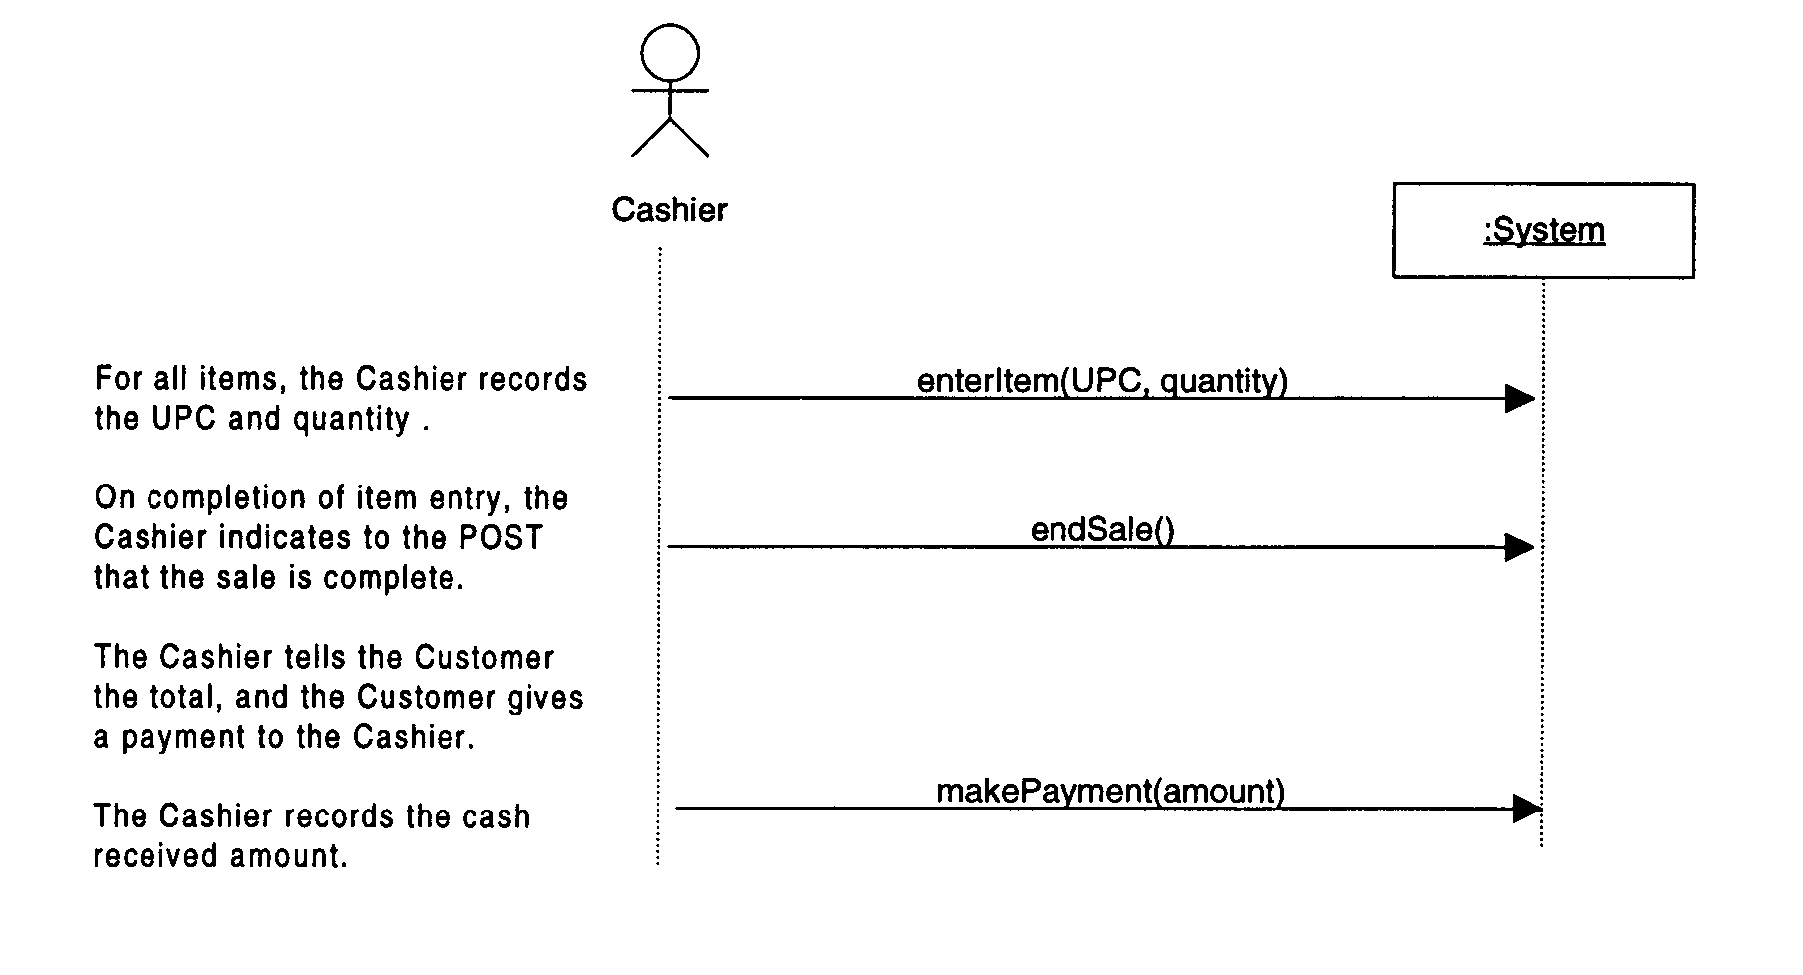
System sequence diagrams
Actor triggers each event
Note :System is an instance – and a “black box”
Each event has a signature
Partial SSD for Larman’s BuyItems use case

Slide 28
Naming events
Use “level of intent” (still OOA, not OOD)
  i.e., not committed to a particular design
    e.g., makePayment instead of submitCash – leaves flexibility for other payment types (in later cycle)
Start with a verb – signifies something to happen
Be sure to cover each event in each use case
  i.e., playGame() is not an event! – it is at least a whole use case; probably many events
  Best place to look: use cases’ typical courses of events
Tip: if a simple name doesn’t work – maybe trying to name a complex process, not an event

Slide 29
System operations
Focus in analysis stage is on effect of operations
  i.e., what happens to system’s state? – not how
System operation contracts – describe the system’s response to events
  Operation – same as event name; include parameters
  Cross References – at least the use case(s) involved
  Pre-conditions – assumptions about system state before the operation begins
  Post-conditions – end changes the operation makes to system state: instances, attributes, associations

Slide 30
Contract Example
Operation: makePayment(amount: Money)
Cross References: UseCases: ProcessSale
Preconditions: A sale is underway.
Postconditions:
  a payment instance p was created
  p.amountTendered became amount
  p was associated with current Sale
  current Sale was associated with Store
Add pre/post conditions to your use cases going forward
  Post conditions become your acceptance test/criteria
    And can be translated directly into coded tests in some cases

Slide 31
Contract Guidelines
Identify system operations from SSDs
For complex operations (may have subtle results, unclear in use case): write contract
For postconditions, use categories:
  instance creation/deletion
  attribute modification
  associations formed & broken
As usual: Don’t overdo it!

