Slide 1
CS48: Upcoming Schedule
No class this Wednesday (no oral progress report)
  Online progress report form due by 5pm Weds
  Progress evaluated at TA meeting this week
No class next Monday 2/19 (UCSB Holiday)
Wednesday 2/21: Implementation/Testing lecture
  No oral progress report
  Progress evaluated at TA meeting this week
Next project artifact: Due Friday 2/23 by 5pm
  Draft project: http://www.cs.ucsb.edu/~cs48/project/draft.html
2/26 midterm review, 2/28 (Weds) Midterm
1 week of demo prep then 3/12, 3/14 Team Demos
3/16 (Fri) Attend Capstone presentations at the CS Summit
Final projects due 3/19 by 5pm

Slide 2
Transition: analysis to design
Now know "what"
Time to focus on "how"
Decided what to do
Might as well do it right

Slide 3
System design
Goal, in general: solve the problem
  Goal of OOD: convert OOA results into something that can be implemented
    e.g, as software (and/or hardware, services, …)
Key considerations (a.k.a. tradeoffs):
  Cost-effectiveness of solution vs. design/coding effort
    Can reduce effort by applying patterns, idioms, 3rd party, …
  Reusability – maybe worth investing effort in
    Could save lots of effort later
    But can overly complicate a simple problem if overdone

Slide 4
Design in practice
No "cookbook" method – no "right" way
  But have some basic principles for guidance
  And have a growing knowledge base on patterns
Is an exercise in problem solving, so attack using the usual strategies
  Divide/conquer – solve sub-problems to solve whole
  Top-down approach, with stepwise refinements
Unlike analysis – leave room for creativity
  Concentration → incubation → inspiration

Slide 5
Design activities
Consider "real" use cases
  Sharpen focus to actual technology, specific user interfaces, particular other systems, …
Package coherent subsystems together
  And organize the packages into overall system architecture
Model the interactions between objects
  Including interactions between packages
See Draft Project: System Design
  Details and deliverables posted
  2 design patterns for use case implementation w/ tests
  10 new use cases or user stories
  System (static class) diagram: UML evolved from requirements doc
  State diagram
  Interaction diagrams (2)

Slide 6
System architecture
High-level descriptions of the system
  Broad focus on significant structural elements
    Subsystems, packages, interfaces to other systems
  Level of detail all developers & stakeholders can follow
    Use case views, deployment views, design views, …
Many basic architecture types – vary by purpose
  Pipes & Filters – for flexibility without user interaction
  Repository – favor big data storage-retrieval systems
  Layers – considered the "object-oriented architecture”
    Much more to come …

Slide 7
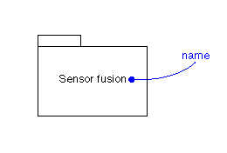
Diagramming packages
Groups of classes – good for architectural modeling
  Abstraction benefit: lots of concepts modeled as one
    A handy way to "divide and conquer" the problem
Idea is to separate functional subsystems
  Many associations among classes in same package
  Few associations between packages
Side benefit: team members can split work by packages
  Works best with "clean" interfaces
UML package symbolism

Slide 8
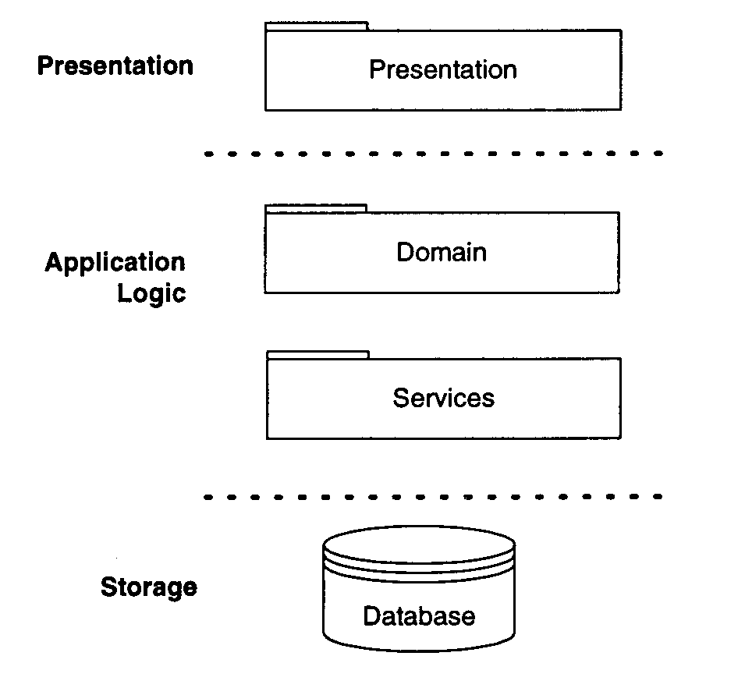
Basic 3-tier architecture
Can have many layers, but 3 are basic:
  1. Presentation layer – windows, reports, GUIs; AKA View
  2. Application logic layer – domain, object services; AKA Controller
  3. Storage layer – persistent data, basic services; AKA Model

Slide 9
Application logic layer partitions
Partition by logical units (organize as packages)
  Refer to collaborations on CRC cards – look for:
    Minimal coupling between packages (few collaborations)
    Highly cohesive within packages (many collaborations)
CS 48: Agree on package interfaces as a team
  Then split up the work accordingly
At least split domain from service classes
  e.g., report generators, database interfaces, offscreen graphics builders, …

Slide 10
About layered architectures
Concept – each layer is a base for implementing layers above it
  Ideally, knowledge and contact is one-way: down ↓
  Lower layers don’t even know upper layers exist
  Interaction ONLY with adjacent layer
What are some good reasons to use layers?
  Reduce complexity – separate the domain from the implementation as much as possible
  Increase modifiability, and reuse potential
  Easy to plug in off-the-shelf and 3rd party stuff
Reflects a recurring OOP themes – encapsulation and information hiding

Slide 11
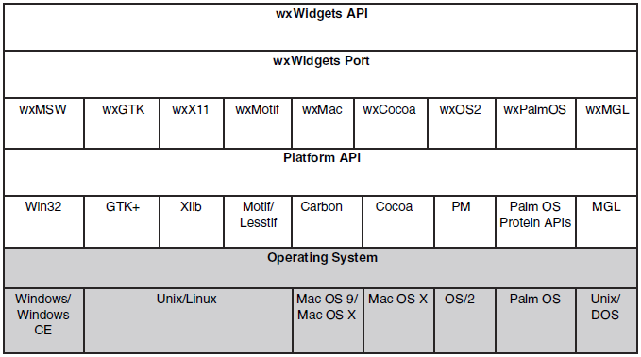
Layers can free up our thinking: e.g., wxWidgets architecture

Slide 12
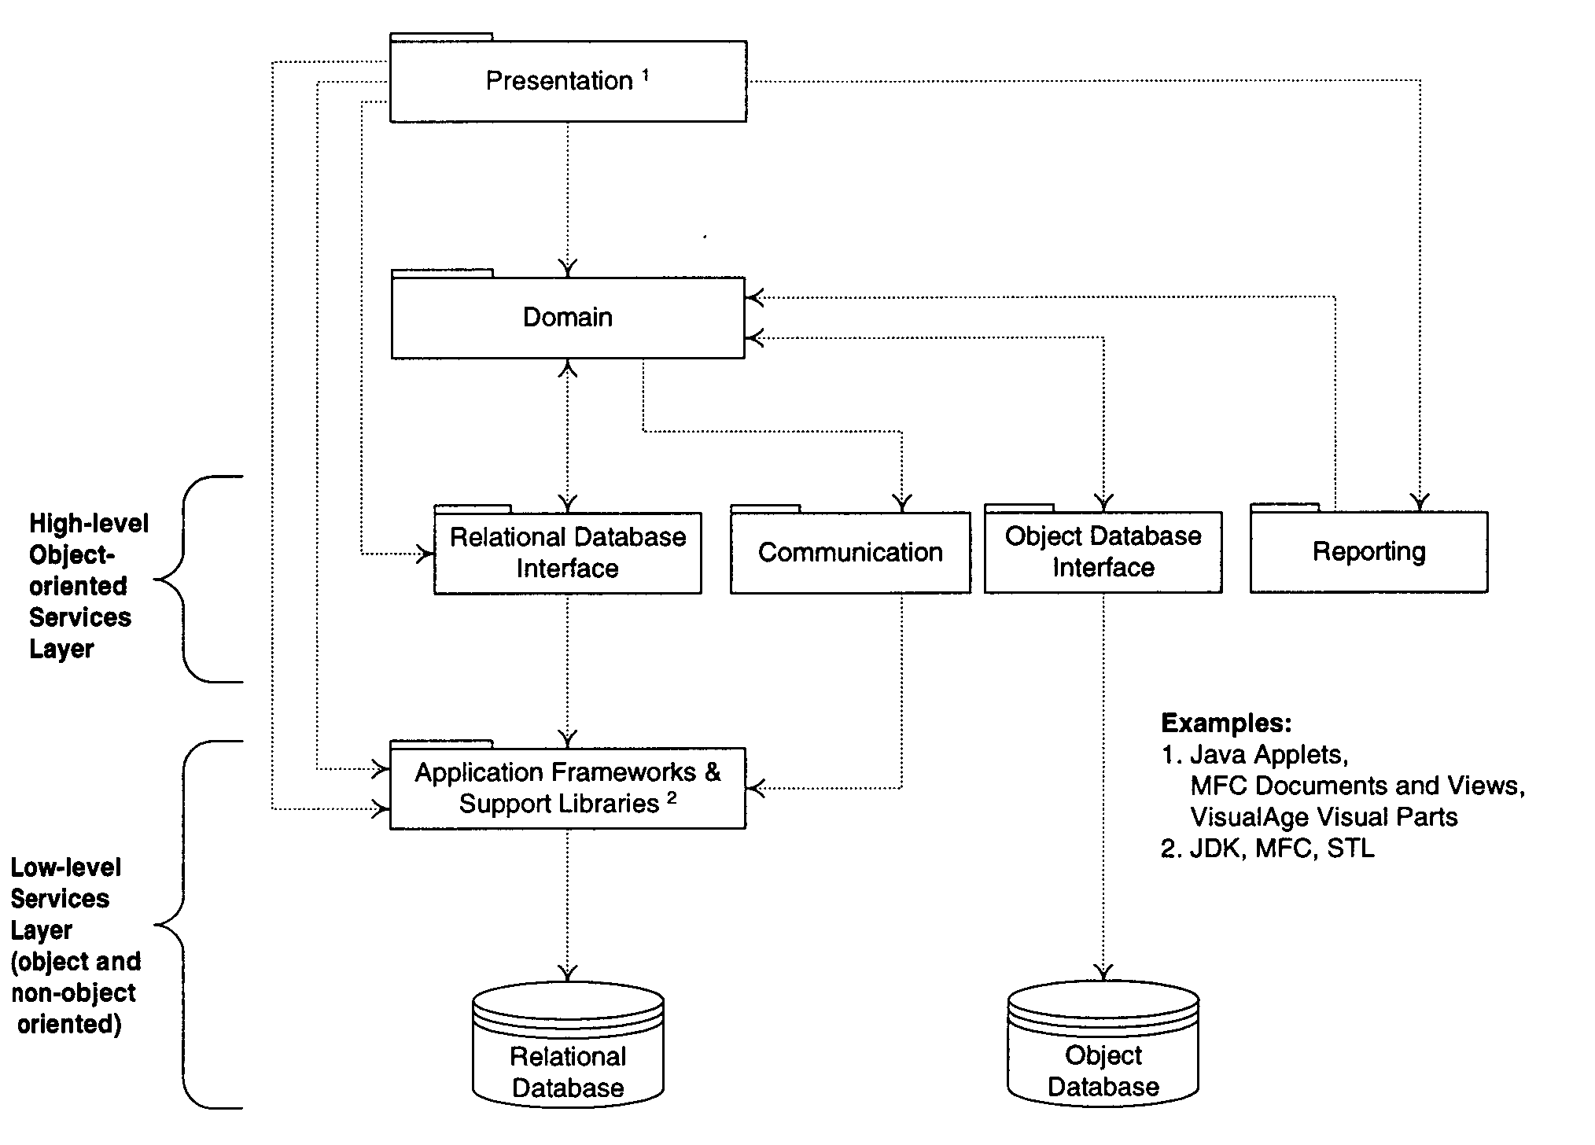
Data services sub-layers
Goal: insulate domain classes from storage details
How? – interface classes
Note: often start design by choosing services (inc. software and hardware choices)
Notes:
MFC=microsoft foundation classes

Slide 13
Storage and network layer(s)
The lowest and least coupled layers
3 main ways to store and/or transmit data
  1. Object databases, and remote object interaction
    Most abstract, so easiest to adapt (high level access)
  2. Relational databases, and query-response sessions
    Mid-level access (records ←→ objects) – need an interface
  3. Do-it-yourself schemes – lowest level access
Best to decide early
  And whether to buy or build new, adapt old, …

Slide 14
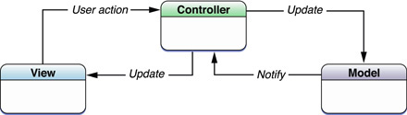
Separating models and views
Basic principle: domain (model) never directly contacts the presentation (view)
  But is ready to answer requests from the view
  Or can contact indirectly by "broadcasting"
Related idea: view should not control the domain
  Okay if GUI signals an event (then model takes over)
  Often use a mediator, an "application coordinator"

Slide 15
Model-view separation benefits
Reuse model with different views
Maybe reuse view with different models
Have multiple views of the same model
  Even simultaneously!
  e.g., view model from many angles
Side benefit – complexity management
  Benefit here – don't have to worry about display while working on the model
Reflects a recurring OOP themes – encapsulation and information hiding

Slide 16
About domain "controllers"
Not usually a domain concept
  Added to the model during design
They tie the system to external events
  e.g., classes a GUI will know about
Common types:
  Façade controller – represents whole system, overall business, "world" – e.g., an application coordinator
  Role controller – mimics a real-world role
  Use case controller – handles sequences of events, monitors use case progress

Slide 17
Interaction diagrams
Dynamic views of interacting objects
  Usually starts by system event (i.e., external message)
  Receiving object either handles alone, or passes message along (internal messages)
Why bother diagramming interactions?
  Get big picture view – better design, code, system
  Easier to change drawing than code
Do together with class diagrams/specifications
  Links in diagrams indicate visibility between classes
2 basic types: sequence and communication

Slide 18
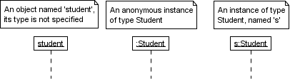
Sequence Diagrams: Classes
Dashed lines are called Object Lifetimes
Messages between objects are method/function calls
  Can be asyncronous or synchronous
Notes:
-http://www.tracemodeler.com/articles/a_quick_introduction_to_uml_sequence_diagrams/
-Also applies to class diagrams in UML
-The dotted line

Slide 19

Synchronous Messages
:Foo
:Bar
doSomething( 5 )
Notes:
-Note that this is for a void function
-White boxes are called activation boxes, which indicate that we are waiting for a message that we issued to be processed

Slide 20
Return Values
Represented with a dashed arrow with a stick head
Returned to caller, can be annoted with kind/type of info returned
:Foo
:Bar
doSomething( 5 )
getSomething( x )
something

Slide 21
Asynchronous Messages
Represented with solid arrows with stick heads
Call may never return
Semantics may be of parallel execution, but hard to represent
:Foo
:Bar
aSyncCall( i )
getSomething( x )
something
Notes:
-:Bar may be doing something between aSyncCall and getSomething

Slide 22
Long Message
Something that takes awhile to process
Usually used for I/O bound activities
  Disk access, network access
Used to indicate a potentially noticeable delay
Represented with a slanted arrow with an enclosed head
:Foo
:Bar
doSomethingLong( 5 )
something

Slide 23
Object Creation
For objects that did not exist at the beginning
Shown further down the diagram
:Foo
new( i )
:Bar
getSomething( x )
something

Slide 24
Object Destruction
Ending the lifetime of an object
Represented with an “X”
:Foo
new( i )
:Bar
<<destroy>>

Slide 25
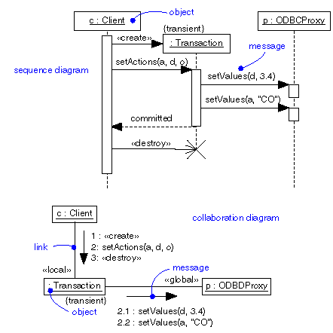
Sequence diagrams

Slide 26
Sequence diagrams
Use for simpler interactions – sequence easily shown as top-to-bottom interactions

Slide 27
Communication diagrams
Handy for more complicated interactions – show sequences by numbering the interactions

Slide 28
Notation for interactions
Class vs. instance –
  Sale – class name for static methods only
  mySale:Sale – object name:type for other
Messages – shown along link line
  Must number in communication diagram
  Show parameters too (with optional types)
    e.g., 2: cost:=price(amount:double)
  And return values if not void
    e.g., 1.1: items:=count():int
Iteration – use * and optional [iteration clause]
  e.g., 3*: [i:=1…10]li:=item(i):LineItem

Slide 29
State Diagrams: Events, states, and transitions
Event – a significant occurrence
  e.g., telephone receiver taken “off hook”
State – condition of an object at a moment in time (the time between events)
  e.g., telephone “idle” between being placed on hook and taken off hook
Transition – relationship between two states as an event occurs
  e.g., when “off hook” event occurs, transition from “idle” to “active” state

Slide 30
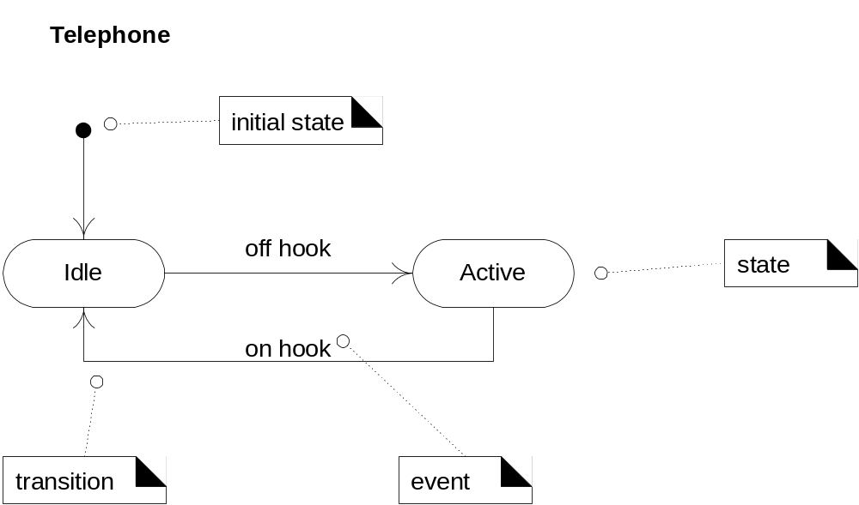
State diagrams
Purpose: to model the changing states of complex objects

Slide 31
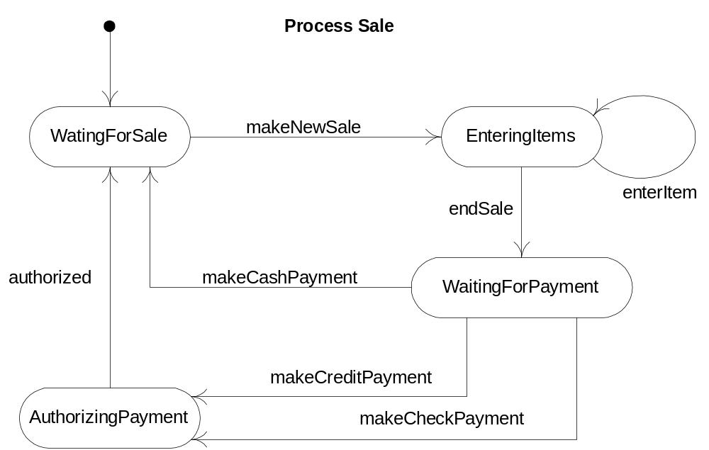
A use case statechart diagram
Helps designer ensure things are done in the correct order

Slide 32
Design principles and patterns
Not exactly "rules" – instead things to consider
  Should lead to high quality designs
    Easier to maintain, understand, reuse, and extend
  e.g., expert, low coupling, high cohesion
General Responsibility Assignment Software Patterns (GRASP) - principles labeled by Larman as patterns
  Notes: "one person's pattern is another's primitive building block” to acknowledge not exactly design patterns
    Polymorphism, indirection, fabrication, protected variation

Slide 33
The expert principle
Assign responsibility to class that has the necessary information
  i.e., the "information expert"
  Colocate the method/code/operation where the DATA is
Avoids passing info between objects
Still have collaboration as objects help others
  e.g., Sale knows about all LineItems, and LineItems know quantity (and get price from Specs)
    So let LineItem calculate subtotal()
    Sale accumulates total from subtotals
Main benefit: encapsulation maintained
  Easier to program, maintain, extend independently

Slide 34
Design Principles: Low Coupling & High Cohesion
Coupling is a measure of a module’s independence
  The degree of dependency among modules (lower is better)
  Minimize and localize change to one module v/s those that depend on it
Cohesion is a measure of the degree to which all elements of a module are directed toward a single task (how self contained are they?)
  The internal glue that holds a module together (higher is better)

Slide 35
Low coupling
Minimize dependencies between classes
  Note how expert principle does this too
  e.g., Sale does not contact ProductSpecification directly – LineItem does that instead; otherwise, Sale needs parallel collection of ProductSpecifications
So fundamental it influences all design decisions
  Is an "evaluative" pattern – used to rate design quality
Supports independent classes
  More reusable, less subject to changes elsewhere, easier to program, …

Slide 36
High cohesion
Refers to functional cohesion
  Means no class does too much work – especially not a bunch of unrelated things
  Basically should avoid "bloated" classes
    Hard to understand, maintain, reuse, …
    Usually means other classes should take some responsibilities
      Like an overworked manager – should delegate more
Rule of thumb: insure all parts of a class are somehow related – all attributes and operations
  Working together to provide "well-bounded behavior"
Benefits – the usual list, plus greater simplicity

Slide 37
Utility of state diagrams
Normally not useful for internal events
  An internal event is one that is triggered by an object inside the system boundary
  Interaction diagrams already cover internal events
Useful for monitoring (whole) system sequences
  Idea is to model the changing system states during the course of a use case
Previous students in the CS project class said they are very useful tools for making sure all important states and sequences are managed properly
  So don’t just take the instructor’s word for it!

Slide 38
GRASP principles
Polymorphism – if behavior varies by type
  Assign responsibility for the variation to the types
    Do not test for type or use other conditional logic!
Indirection – to reduce coupling
  Assign responsibility to intermediate class or interface
Pure fabrication – artificial, non-domain class
  e.g., encapsulate a cohesive set of responsibilities
Protected variations – for variable/unstable parts
  Assign responsibilities to stable interfaces

Slide 39
Software realities
Do-it-myself principle (a.k.a., animation pattern)
  Objects must do for themselves what normally is done to the real world objects they represent
  e.g., in real world, somebody draws the figure – in software, figure draws itself: figure.draw()
  Another e.g., trajectory.map() – normally would be mapped by outside observer if at all
Assume/ensure basic services are always available
  i.e., get/set for attributes, add/remove/… for lists, …
  So no need to include in class diagrams or specs

Slide 40
Design patterns
“Tricks of the trade” for OO designers
  Tried and true solutions to recurrent problems
    Generally apply to various situations – e.g., Façade Pattern
  Created FOR and from perspective of C++ developers
  Usually reflect basic design principles
“Gang of Four” (GoF) patterns – seminal catalog
  Four essential elements:
    1. A meaningful name – elevates thought to higher abstraction
    2. A problem description – where the pattern can apply
    3. The solution – like a template to apply the pattern
    4. Consequences – results and trade-offs
Recurring theme: “encapsulate what varies most”

Slide 41
Types of GoF design patterns
7 are structural patterns – composition of classes/objects
  e.g., Adapter
    Problem: tool has interface X, client prefers interface Y
    Solution: Adapter satisfies X, but looks like Y
    Consequences: don’t reprogram X, and don’t distort Y to satisfy X
  Bridge, Composite, Decorator, Façade, Flyweight and Proxy
5 are creational patterns – for creating objects
  Abstract Factory, Builder, Factory Method, Prototype, Singleton
11 are behavioral patterns – ways classes/objects interact
  e.g., Chain of Responsibility, Command, and … 9 more
See http://www.cs.ucsb.edu/~cs48/slides/designdiagrams.pdf
  https://sourcemaking.com/design_patterns
  Great reference with examples: https://github.com/kamranahmedse/design-patterns-for-humans

Slide 42
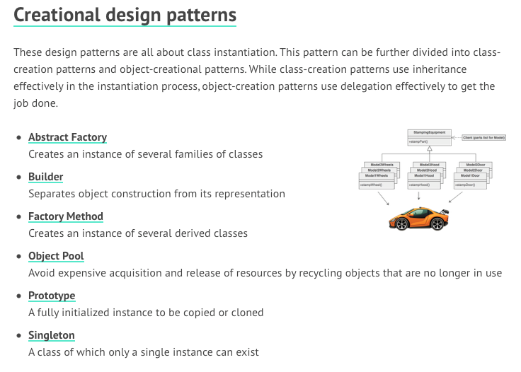
Design Patterns

Slide 43
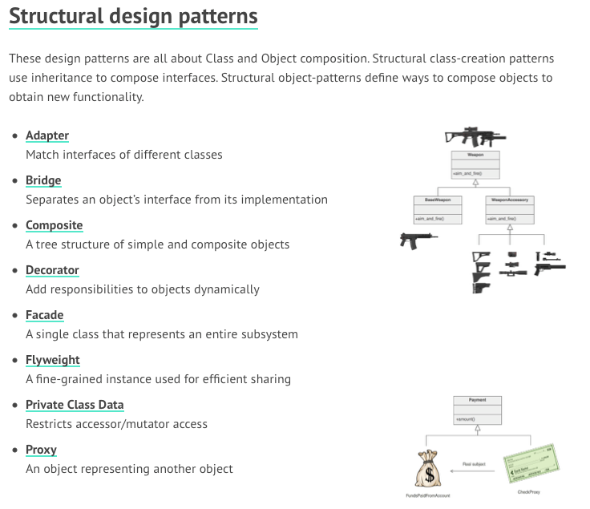
Design
Patterns

Slide 44
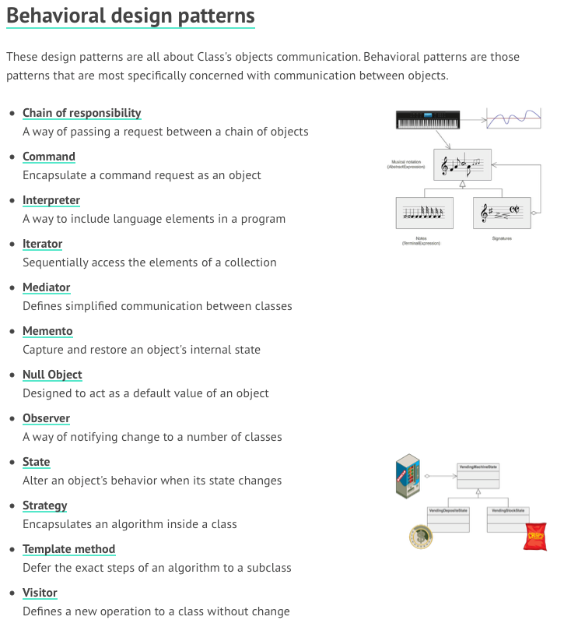
Design
Patterns

Slide 45
User interface design
Major goal: match the skills, experience and expectations of its anticipated users
Consider “human factors”
  People have limited short-term memory, they make mistakes, and they are not all the same
Some basic principles of UI design
  User-oriented, not computer-oriented
  Consistency – and especially minimal surprise
  Recoverability, and guidance

Slide 46
User Interface issues
Two fundamental problems to solve
  How should information from the user be provided to the computer system?
  How should information from the computer system be presented to the user?
Many interaction styles – each has a place
  Direct manipulation
  Menu selection
  Form fill-in
  Commands – and (ideally) natural language

Slide 47
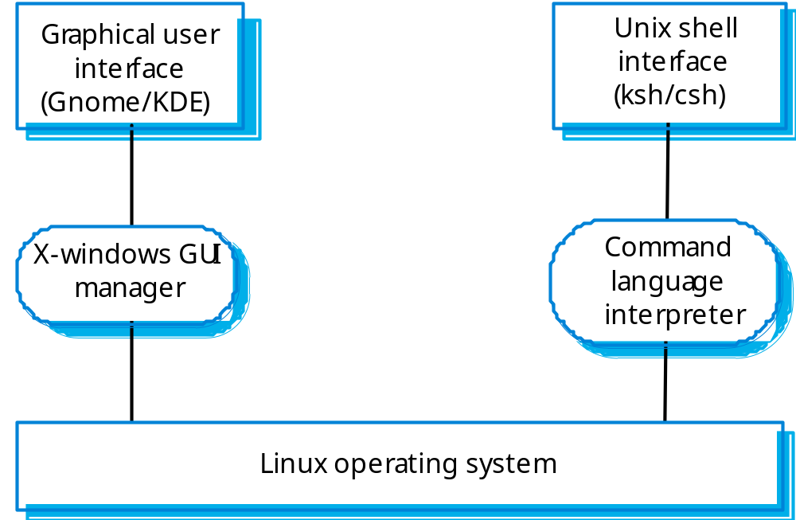
Sometimes multiple interfaces
Figure from Ian Sommerville, Software Engineering 8th edition, Chapter 16

Slide 48
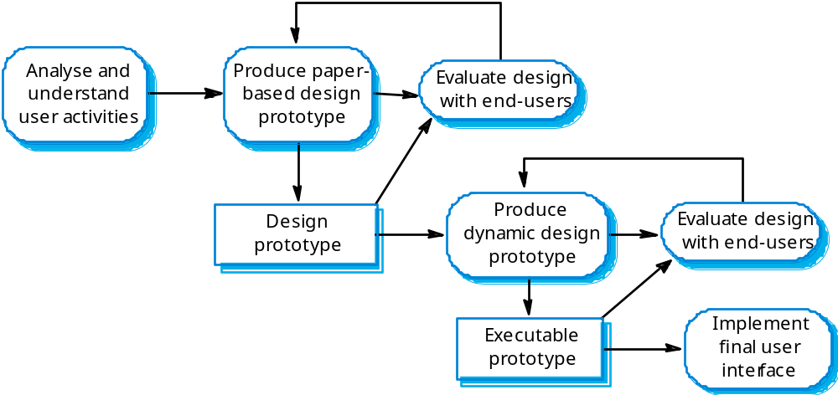
UI design process
Figure from Ian Sommerville, Software Engineering 8th edition, Chapter 16

Slide 49
Next Steps
Identify two design patterns from the list that fit 1+ use cases
  Leverage UML examples here: http://www.cs.ucsb.edu/~cs48/slides/designdiagrams.pdf
  See examples: https://github.com/kamranahmedse/design-patterns-for-humans
  See schedule page, click on slides link at bottom, link to diagrams and examples is on slides (and resources) page
    Implement and test them this week and next
Add 5 more use cases (each -- this week and next)
Evolve your static class diagram to include the above
Sketch out your (refine over the next week)
  Interaction diagrams (2)
  State diagram (1)

