Slide 1
From designing to coding
1st step: sensibly split work among team members
  Choose splits along “thin” interfaces
    Probably not equal parts; split biggest parts again later
  Formalize the interfaces – think of them as contracts
  Write least-coupled parts first … most-coupled last
    i.e., classes that don’t depend on any other classes
Oh yeah, one more thing to think about: Reserve ample time for testing!

Slide 2
*.h files – consider them contracts
Write interfaces first – share with the team
Helps to formalizes much of the contract
  Precisely defines available services (methods)
  But pre- and post-conditions are not insured
    These are communicated by documentation only
Implement classes and their client classes independently
  Can even compile clients (but cannot fully test)

Slide 3
Pre- and post-conditions
Pre-conditions – what the client is responsible for
  The “requires” clauses of the contract
    Especially include any restrictions on calling arguments
    Also any associations that should already exist
Post-conditions – what will be accomplished by the operation if the pre-conditions are met
  The “effects” and/or “modifies” contract clauses
  Include objects created/destroyed, associations formed/broken, attribute values modified
  Also remember to list side effects, and identify any exceptions that might be thrown

Slide 4
Converting designs into code
Largely a direct translation of key artifacts
  Class specs – variables and method definitions
  Class and package diagrams – associations
    Translate to instance variables and/or method arguments
  Interaction and state-chart diagrams – method calls and sequences
Still involves creativity, and probably change
  Good ideas often arise during coding – okay, go for it
    But also plan to revise design artifacts to match later

Slide 5
Code from class diagrams
SalesLineItem
ProductSpecification
quantity : Integer
described by
…
getSubtotal() : Money
…
class SalesLineItem {
public:
SalesLineItem(ProductSpecification spec, int qty);
Money getSubtotal();
...
private:
int quantity; // attribute
ProductSpecification productSpec; // association
};

Slide 6
Implementing interactions – e.g., enterItem(id, qty)
{
ProductSpecification spec = catalog.getSpecification(id);
sale.makeLineItem(spec, qty);
}
enterItem(id, qty)
2: makeLineItem(spec, qty)
:Register
:Sale
1: spec := getSpecification(id)
:Product
Catalog

Slide 7
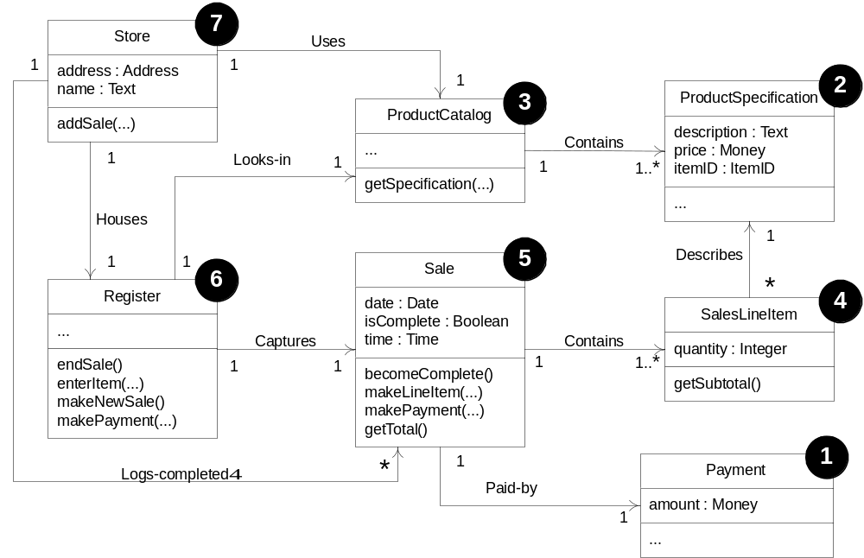
Least- to most-coupled order

Slide 8
Use your resources
i.e., “don’t reinvent the wheel” if possible
  Use STL and other library tools
  See advice in Code Complete (our textbook) and others
On a real project: consider 3rd party solutions, existing code, other quick fixes
  Of course, we hope you mostly do yourself in CS 48
Program in pairs – it works!
And don’t wrestle with revision control problems – use a revision control system

Slide 9
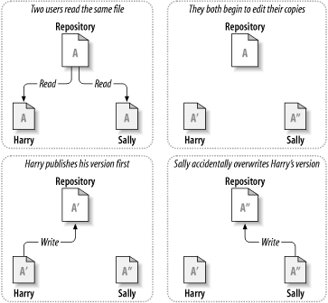
Revision control problem

Slide 10
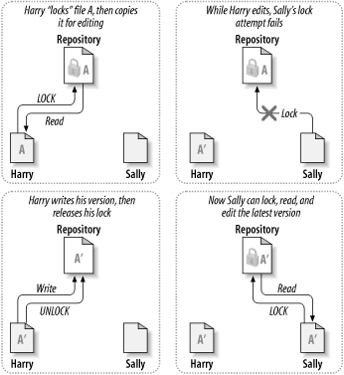
Lock-Modify-Unlock Solution

Slide 11
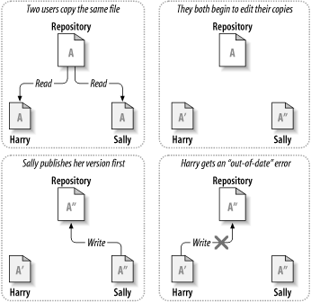
Copy-Modify-Merge Solution: 1
Continued next slide

Slide 12
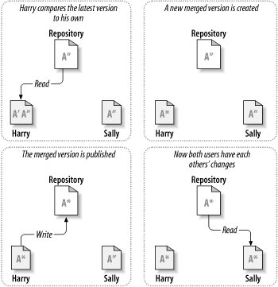
Copy-Modify-Merge Solution: 2
e.g., Subversion – open source and widely used revision control, and everybody’s new favorite: Git

Slide 13
Testing – goal is to find faults
Faults (a.k.a. bugs) cause systems to fail
  e.g., a system crashes – the most obvious type of fault
  e.g., a security system that allows unauthorized entry
Can verify the presence of bugs, not their absence
Testing and debugging are separate processes
  Testing identifies faults
  Debugging corrects/removes faults
    But it can also introduce new ones, so retesting is required

Slide 14
When are faults introduced?
During requirements analysis
  Incorrect, missing, or unclear requirements
During domain analysis and system design
  Incorrect or unclear translation of problem
  Incorrect or unclear design specification
During system implementation
  Misinterpretation of system design
  Incorrect syntax or semantics
Even during testing
  New faults introduced when old ones corrected
Note how naïve it is to consider this the only source of bugs

Slide 15
Testing steps
Unit testing – insure each part is correct
  Each method of each class of each package should be tested independently
Integration testing – insure parts work together
System testing
  Functional tests – a.k.a. use case testing
  Performance tests – test system attribute requirements
  Acceptance tests – client hands-on testing
  Installation tests – final platform testing (on-site)
Use frameworks (googletest, junit, ...)!
Ideal: Test-Driven Development

Slide 16
Unit and integration testing
Test parts of the system before the whole
  Units – test basic parts individually (each function, each class, each package)
  Integration – test basic connections between parts (not whole system at once yet though)
Requires special purpose test programs
  i.e., “driver” programs and “stubs”
  Or can use a framework like googletest (for testing C++ programs), Junit (Java), Cunit, …

Slide 17
The Example
A collection class SmallSet
    Semantics for a set data structure
    containing up to N objects (hence “small”)
    typical operations:
    we’ll implement add(), size()
add | adds item
contains | item in the set?
size | # items

Slide 18
Test Driven Development
We’ll go about in small iterations
    add a test
    run all tests and watch the new one fail
    make a small change
    run all tests and see them all succeed
    refactor (as needed)
We’ll use JUnit

Slide 19
Setting up to use JUnit Testing
"File > New > Other > Java - JUnit - JUnit Test Case" will generate a new JUnit Test case class, and this triggers Eclipse to ask me whether I want to add JUnit 4 to the build path
  It automates all the needed steps
Legend has it that you can also:
  Right click on the project and select Properties.
  In the left column select Java Build Path.
  To the right select the Libraries tab.
  Click the Add External JARs... button. You should start off in the Eclipse install directory, otherwise search through the file system until you find the Eclipse install directory.
  Under the Eclipse install directory select plugins/org.junit_3.8.1/junit.jar. Click OK.

Slide 20
JUnit
What do JUnit tests look like?
SmallSetTest.java
package edu.ucsb.cs.cs48;
import org.junit.Test;
import static org.junit.Assert.*;
public class SmallSetTest {
@Test public void testFoo() {
SmallSet s = new SmallSet();
...
assertTrue(...);
}
@Test public void testBar() {
...
}
}
SmallSet.java
package edu.ucsb.cs.cs48;
public class SmallSet {
...
}

Slide 21
A List of Tests
add | adds item
contains | item in the set?
size | # items
We start by thinking about how to test,
not how to implement
    size=0 on empty set
    size=N after adding N distinct elements
    adding element already in set doesn’t change it
    throw exception if adding too many
    ...
Each test verifies a certain “feature”

Slide 22
A First Test
We pick a feature and test it:
This doesn’t compile: size() is undefined
But that’s all right: we’ve started designing the interface by using it
SmallSet
class SmallSet {}
SmallSetTest
class SmallSetTest {
@Test public void testEmptySetSize() {
SmallSet s = new SmallSet();
assertEquals(0, s.size());
}
}

Slide 23
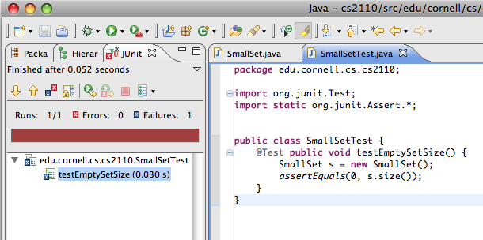
Red Bar
A test can be defined before the code is written
Running the test
yields a red bar
indicating failure:
If we add the size function and re-run the the test, it works!
SmallSet
class SmallSet {
public int size() {
return 0;
}
}

Slide 24

Green Bar
What’s the simplest way to make a test pass?
“Fake it till you make it”
Re-running yields the legendary JUnit Green Bar:
We could now refactor, but we choose to move on with the next feature instead
SmallSet
class SmallSet {
public int size() {
return 0;
}
}

Slide 25
Adding Items
To implement adding items, we first test for it:
add() is undefined, so to run the test we define it:
SmallSetTest
class SmallSetTest {
@Test public void testEmptySetSize() ...
@Test public void testAddOne() {
SmallSet s = new SmallSet();
s.add(new Object());
assertEquals(1, s.size());
}
}
SmallSet
public int size() ...
public void add(Object o) {}

Slide 26
Adding Items
The test now fails as expected:
It seems obvious we need to count the number of items:
And we get a green bar:
SmallSet
private int _size = 0;
public int size() {
return 0;
return _size;
}
public void add(Object o) {
++_size;
}

Slide 27
Adding Something Again
So what if we added an item already in the set?
As expected, the test fails...
SmallSetTest
class SmallSetTest {
@Test public void testEmptySetSize() ...
@Test public void testAddOne() ...
@Test public void testAddAlreadyInSet() {
SmallSet s = new SmallSet();
Object o = new Object();
s.add(o);
s.add(o);
assertEquals(1, s.size());
}
}

Slide 28
Remember that Item?...
We need to remember which items are in the set...
All tests pass, so we can refactor that loop...
SmallSet
private int _size = 0;
public static final int MAX = 10;
private Object _items[] = new Object[MAX];
...
public void add(Object o) {
for (int i=0; i < MAX; i++) {
if (_items[i] == o) {
return;
}
}
_items[_size] = o;
++_size;
}

Slide 29
Refactoring
(...loop) which doesn’t “speak to us” as it could...
All tests still pass, so we didn’t break it!
SmallSet (after)
private boolean inSet(Object o) {
for (int i=0; i < MAX; i++) {
if (_items[i] == o) {
return true;
}
}
return false;
}
public void add(Object o) {
if (!inSet(o)) {
_items[_size] = o;
++_size;
}
}
SmallSet (before)
public void add(Object o) {
for (int i=0; i < MAX; i++) {
if (_items[i] == o) {
return;
}
}
_items[_size] = o;
++_size;
}

Slide 30
Too Many
What if we try to add more than SmallSet can hold?
The test fails with an error: ArrayIndexOutOfBoundsException
We know why this occurred, but it should bother us: “ArrayIndex” isn’t a sensible error for a “set”
SmallSetTest
...
@Test public void testAddTooMany() {
SmallSet s = new SmallSet();
for (int i=0; i < SmallSet.MAX; i++) {
s.add(new Object());
}
s.add(new Object());
}

Slide 31
Size
We first have add() check the size,
... re-run the tests, check for green,
define our own exception...
... re-run the tests, check for green,
and...
SmallSet
public void add(Object o) {
if (!inSet(o) && _size < MAX) {
_items[_size] = o;
++_size;
}
}
SmallSetFullException
public class SmallSetFullException extends Error {}

Slide 32
Testing for Exceptions
... finally test for our exception:
The test fails as expected,
so now we fix it...
SmallSetTest
@Test public void testAddTooMany() {
SmallSet s = new SmallSet();
for (int i=0; i < SmallSet.MAX; i++) {
s.add(new Object());
}
try {
s.add(new Object());
fail(“SmallSetFullException expected”);
}
catch (SmallSetFullException e) {}
}

Slide 33
Testing for Exceptions
... so now we modify add() to throw:
All tests now pass, so we’re done:
SmallSet
public void add(Object o) {
if (!inSet(o) && _size < MAX) {
if (_size >= MAX) {
throw new SmallSetFullException();
}
_items[_size] = o;
++_size;
}
}

Slide 34
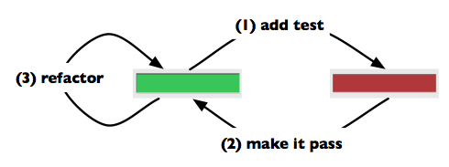
Review
Started with a “to do” list of tests / features
    could have been expanded
    as we thought of more tests / features
Added features in small iterations
“a feature without a test doesn’t exist”

Slide 35
Is testing obligatory?
Yes and no…
  When you write code in professional settings with teammates, definitely!
    In such settings, failing to test your code just means you are inflicting errors you could have caught on teammates!
    At Google, people get fired for this sort of thing!
  So… in industry… test or perish!
But what if code is just “for yourself”?
  Testing can still help you debug, and if you go to the trouble of doing the test, JUnit helps you “keep it” for re-use later.

Slide 36
A bug can reveal a missing test
… but can also reveal that the specification was faulty in the first place, or incomplete
  Code “evolves” and some changing conditions can trigger buggy behavior
    Perhaps specification needs to evolve
  This isn’t your fault or the client’s fault but finger pointing is common
Great testing dramatically reduces bug rates
  And can make fixing bugs way easier
  But can’t solve everything: Paradise isn’t attainable in the software industry

Slide 37
Reasons for TDD
By writing the tests first, we
    test the tests
    design the interface by using it
    ensure the code is testable
    ensure good test coverage
By looking for the simplest way to make tests pass,
    the code becomes “as simple as possible, but no simpler”
    may be simpler than you thought!
Notes:
“things should be as simple as possible, but no simpler” A. Einstein

Slide 38

Not the Whole Story
There’s a lot more worth knowing about TDD
    What to test / not to test
        e.g.: external libraries?
    How to refactor tests
    Fixtures
    Mock Objects
    Crash Test Dummies
    ...
Beck, Kent: Test-Driven Development: By Example
Notes:
In the time I had, I could only give you is a TASTE
Kent Beck is one of the authors of JUnit

Slide 39
How people build really big programs
When applications are small, you can understand every element of the system
But as systems get very large and complex, you increasingly need to think in terms of interfaces, documentation that defines how modules work, and your code is more fragmented
This forces you into a more experimental style
  Test that the code you use works (cover your behind)

Slide 40
System testing phases
Use case testing or user stories
  Test pre- and post-conditions of system functions
    Implement acceptance tests for stories
  Best if independent of the user interface
    i.e., also requires special purpose testing code
Performance, acceptance, installation tests
  All involve the complete working system, GUI and all
If any changes to code – rerun all tests
  Term for this philosophy: regression testing

Slide 41
Tragic truth: testing takes time
But it can save time and money in the long run
  Get in the habit: “code a little, test a little, …”
Inadequate testing costs lots of real world $$$ and maybe lives
Fact: costs of testing/debugging increase as development progresses
  Cheapest during requirements analysis (especially if an impossible requirement is uncovered)
  Cheaper during unit than integration testing, …

Slide 42
CS48: Upcoming Schedule
Online progress report form due by 5pm today
  Progress evaluated at TA meeting this week
Next project artifact: Due this Friday 2/23 by 5pm
  Draft project: http://www.cs.ucsb.edu/~cs48/project/draft.html
  2 design patterns for use case implementation w/ tests
  10 new use cases or user stories
  System (static class) diagram: UML evolved from requirements doc
  State diagram
  Interaction diagrams (2)

Slide 43
CS48: Upcoming Schedule
Online progress report form due by 5pm today
  Progress evaluated at TA meeting this week
Next project artifact: Due this Friday 2/23 by 5pm
  Draft project: http://www.cs.ucsb.edu/~cs48/project/draft.html
Next week: (Mon) midterm review, (Weds) midterm
1 week of demo prep, testing and debugging
3/12, 3/14 Team Demos + 3/16 (Fri) Attend Capstone presentations at the CS Summit
Final projects due 3/19 by 5pm
Group 3 come see me....

