Slide 1

CurrentSee
Group Prograham Cracker:
Jay Mutarevic
Kristen Morse
Branton Horsley
Nick Krause
PowWow Energy
Mentor: Olivier Jerphagnon

Slide 2

What are we doing wrong?
Energy uses fossil fuels: gas, coal, etc

Slide 3

How can we take action?
IDEA:
get consumers to SEE their CURRENT electric usage!
allow them to understand the difference they can make

Slide 4
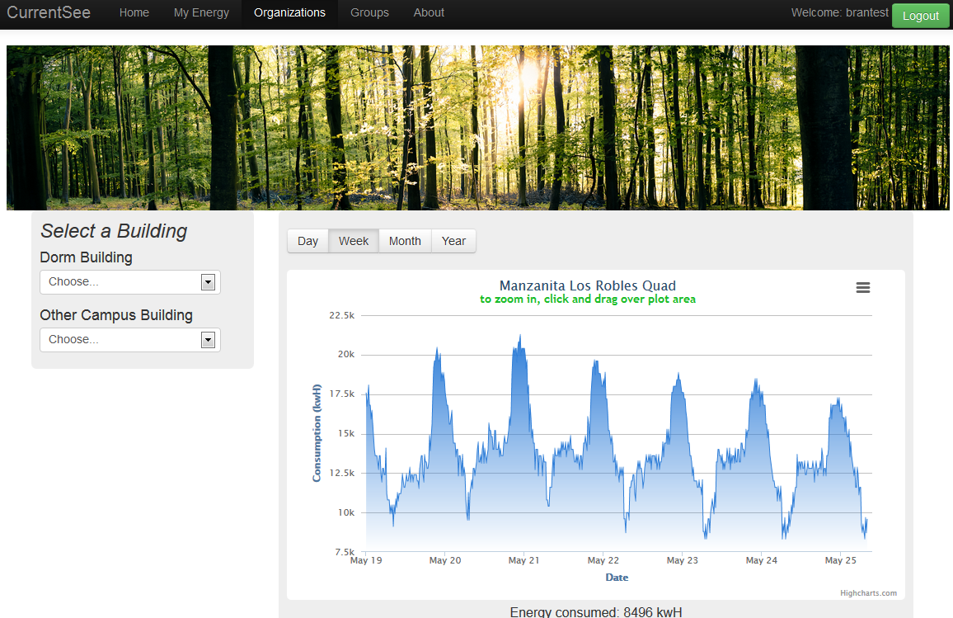
Current See:
providing a usable solution
user friendly
intuitive
inspirational

Slide 5
Basic Idea:
Retrieves energy data from the clients house
Processes the information
Relay useful statistics back to the client
Notes:
about the product

Slide 6
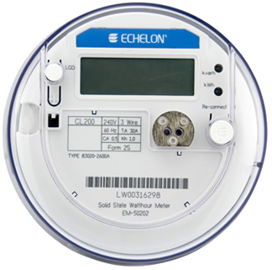
Smart Meters
Replace conventional meters
Transmit power usage every 15 minutes
Connected directly to power company
Notes:
about the product

Slide 7
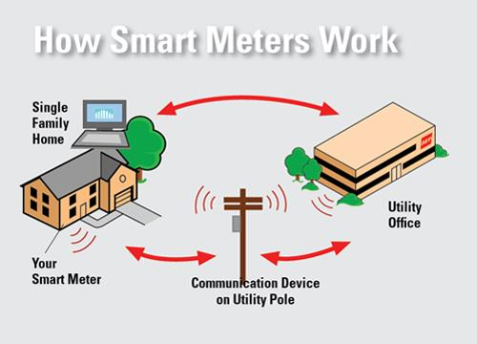
Smart Meters
37,290,374 installed as of January 10, 2013
SDGE, PG&E, or SCE customers have one already in their homes
source: http://www.eia.gov/tools/faqs/faq.cfm?id=108&t=3

Slide 8
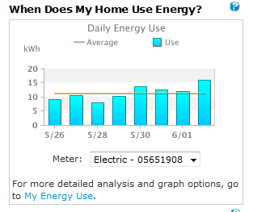
How is this data used
Most do not know it exists
Accessible via utility websites
Cumbersome

Slide 9

Green Button Data
Government backed program
Started last year
Make power data accessible to consumers
API for third party applications to use

Slide 10
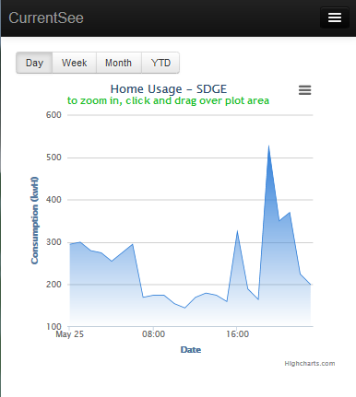
How we use it
Easily view your home energy usage
Groups
Compete with friends
Smartphone accessible
Check your usage on the go!

Slide 11
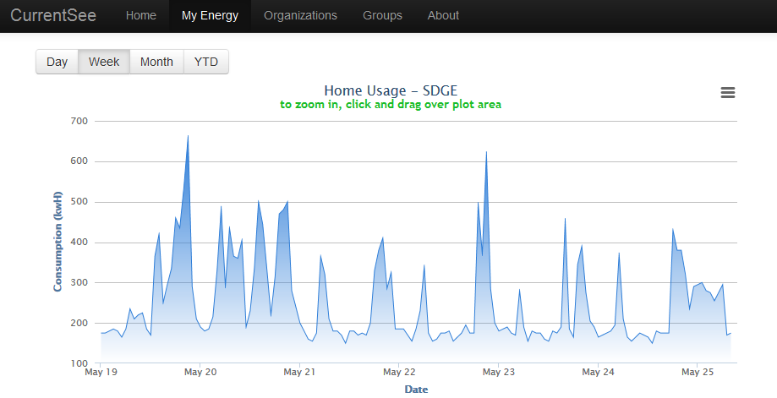
Partner: San Diego Gas & Electric
In testing phases with SDGE
Currently have test data transmitted to our server
View your home power usage
Extensible to any utility
Notes:
about the product

Slide 12
Partner: Energy Institute at UCSB
Power usage for every on campus building
Green Button-style data
Energy Competitions
Competitions drive change
Main focus of our application
Notes:
about the product

Slide 13





What we're using

Slide 14
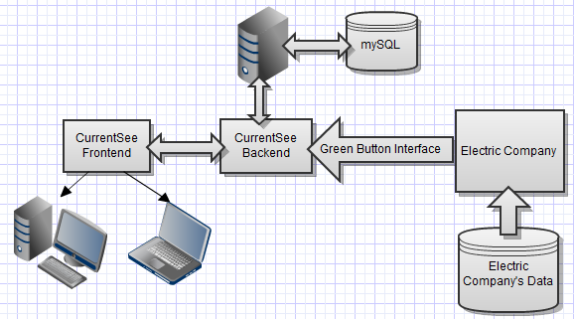
Operating Environment

Slide 15
DEMO
Notes:
about the product

Slide 16
Questions?
Notes:
about the product

Slide 18

Try it now!
Notes:
about the product

Slide 19
Notes:
about the product

Slide 20
Notes:
about the product

Slide 21
Why?
Put data to good use
Educate and produce efficient electricity consumer
Use data set to find trends in electricity consumption
State, County, City, Neighborhood
Year, Month, Week, Day, Hour
Notes:
why it is useful

Slide 22

Green Button Data
Notes:
Plan of Attack : jay = 1,2,3 bryan = 4,5 Branton=6,9 Kristen = 7,8 Nick =11,12

Slide 23
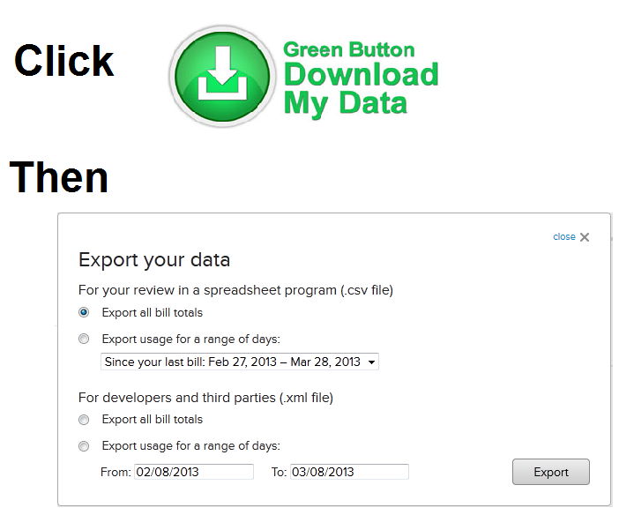
Green Button Data
Notes:
Plan of Attack : jay = 1,2,3 bryan = 4,5 Branton=6,9 Kristen = 7,8 Nick =11,12

Slide 24
Green Button Data
Notes:
Plan of Attack : jay = 1,2,3 bryan = 4,5 Branton=6,9 Kristen = 7,8 Nick =11,12

Slide 25

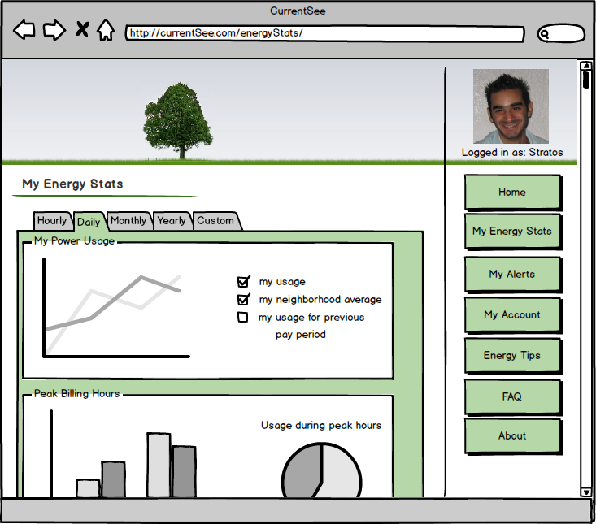
Detailed Stats
Hourly, Daily, Monthly, Yearly data graphs.
Comparisons to neighborhood averages and previous pay periods
Detailed peak hour usage stats

Slide 26
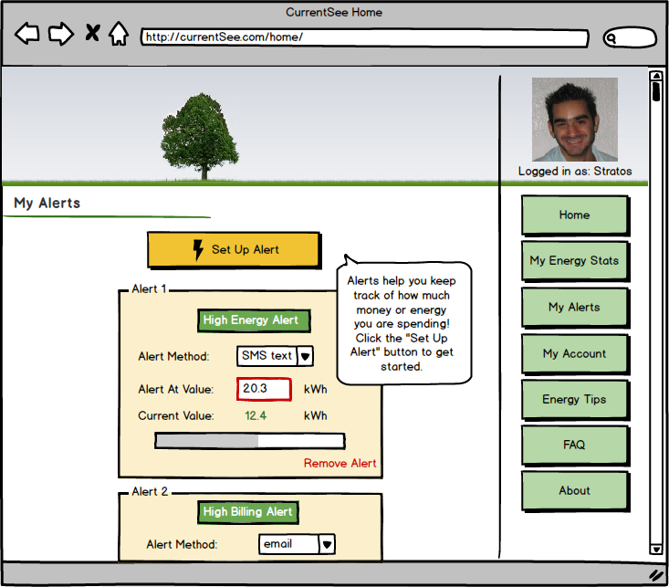
Setting up Alerts
Pick:
a. type
b. method
c. value
Get alerts every month!
Notes:
where we are and what we have done

Slide 27
Progress
Done:
- Web server up and running
- Database setup
- Login page, registration page, database
integration
Notes:
what we plan to do

Slide 28
Progress
Done:
- Web server up and running
- Database setup
- Login page, registration page, database
integration
Notes:
what we plan to do

Slide 29
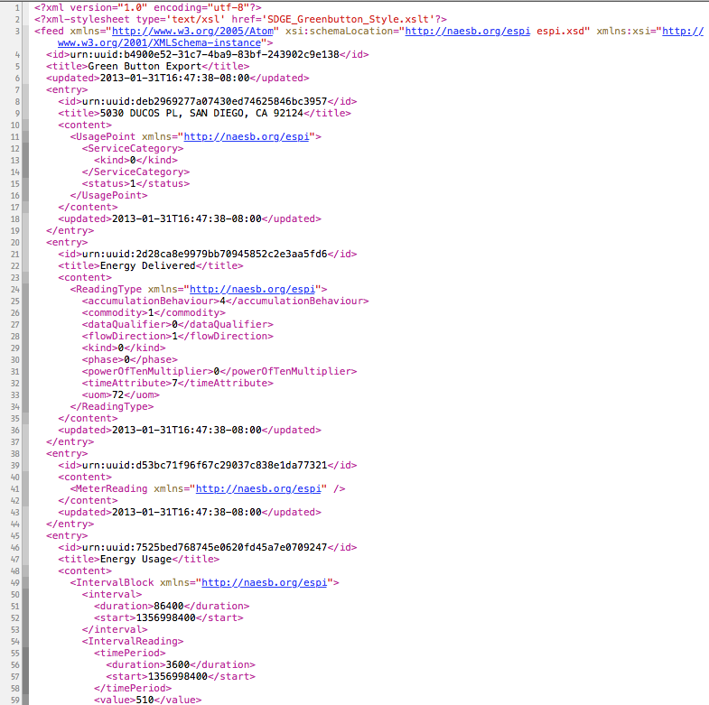

To do's
Store XML
Graph the Stored Data
Show graphs and include features
Notes:
the problems we have come across. kristen is a poopy head.

Slide 30
Obstacles
New technologies
Different Platforms
Power Companies responding
(issues with connections)
Notes:
the problems we have come across. kristen is a poopy head.

Slide 31
Overcoming Obstacles
Lots of reading
Cooperation of the power companies
Thinking of backup options
Notes:
the problems we have come across. kristen is a poopy head. Jay is a bigger poopy head.

Slide 32
Questions?
Notes:
the problems we have come across. kristen is a poopy head.

Slide 33
Why?
60% of oil fields are now post peak and the average rate of decline is 6-9%
To meet increasing demands, we need 120 million barrels of oil a day by 2030.
Saudi Arabia has the world’s biggest oil fields, and it produces 10 million barrels a day now.
Information retreived from ENGR101 PPT-Olivia Walling
Notes:
why it is useful

Slide 34

Power Company
Power Company
Consumption
Notes:
Dont think we need

Slide 35
Why?
1 billion 60-watt incandescent light bulbs weigh 20,000 metric tons (with packaging)
When they are all on, they will consume 60 megawatts of electricity, requiring a new power plant just to keep them burning
If the power plant is coal fired, it will burn 1.4 million tons of coal per year
Information retreived from ENGR101 PPT-Olivia Walling
Notes:
why it is useful

Slide 36
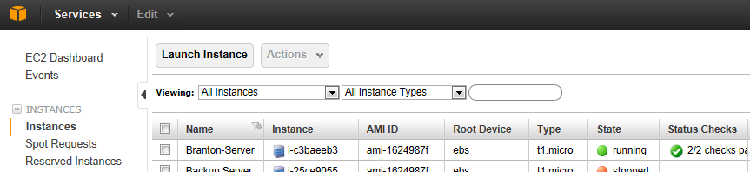
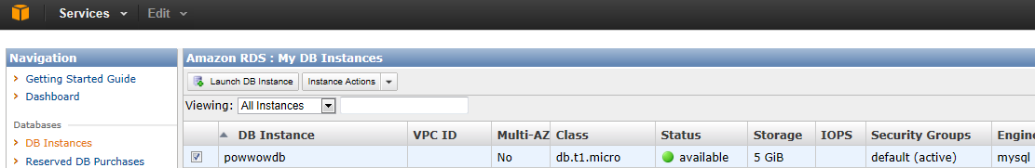
Progress
Done:
- Web server up and running
- Database setup
- Login page, registration page, database link
Todo:
- Store XML data
- Graph stored data
- Website Features
Notes:
what we plan to do

