Slide 1

A Social Augmented Reality Experience
Maxwell Hinson
Jhon Faghih-Nassiri
Lucas Buckland
Andy Chou
JiCheng Huang
Project Lead, Databases
User Experience
Graphics/Rendering
Facebook Integration
Vuforia
Notes:
Max: Good afternoon. We are Team Epsilon, and we have been working with Qualcomm to build three60, a social augmented reality experience. My name is Max, I am the project lead and I have designed and implemented our system’s databases.
Luke: I’m Luke, I worked on graphics and rendering.
Jhon: I’m Jhon, I worked on User Experience.
JiCheng: I’m JiCheng, I worked on Vuforia.
Andy: I’m Andy, I worked on Facebook Integration.

Slide 2
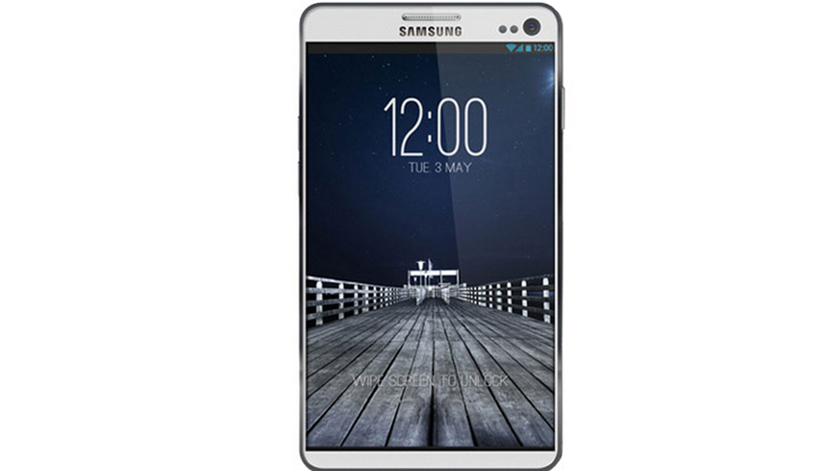
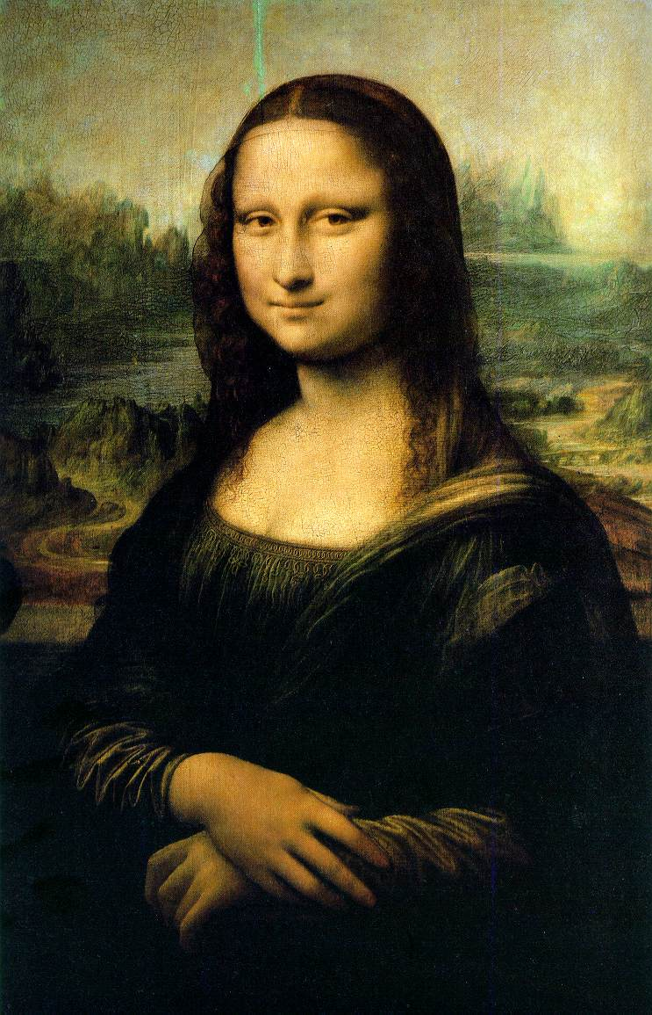
What if…
New and Improved!
Notes:
Let’s say you are walking through the Louvre Museum in Paris and come to the Mona Lisa.
<click>
She is looking a little dull today. What if you could get out your phone…
<click>
And make a couple of improvements? And what if you could share this with your friends so that any time they look at the Mona Lisa, they can see your message?

Slide 3

Introducing three60
Mobile
Android
Social Messaging
Augmented Reality
Notes:
Three60 is a mobile android application that allows you to do just that. Three60 creates a fun new social experience by combining traditional messaging with an exciting new technology: augmented reality.

Slide 4
What is Augmented Reality?
Visualize and interact with virtual objects
Place virtual messages on real-world objects
In order to show the right messages, we need to know what we are looking at!
Three main tasks:
Recognize image target
Track image target
Show virtual object

Slide 5
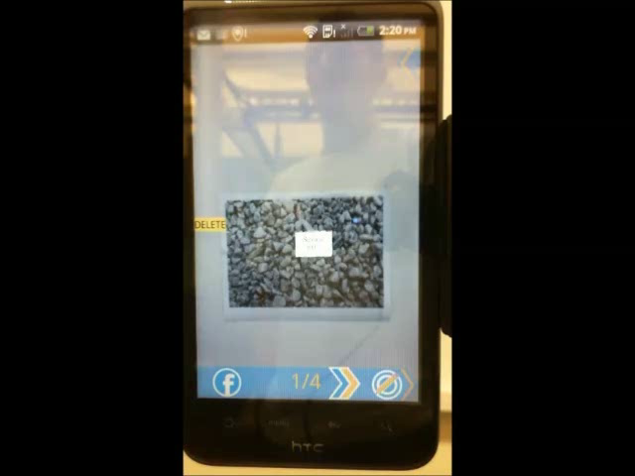
Notes:
Augmented reality allows us to recognize and track image targets

Slide 6

Social Messaging with three60
Facebook integration
Share what you see or create
Share only with your friends
Notes:
One of our main goals was to create an application that provides a truly social experience. We have accomplished this through significant integration with Facebook.
Three60 enables you to share your creations with your friends in two ways:
The first involves taking screenshots of preexisting augmentations and sharing them via Facebook.
The second involves sharing your own augmentations. After you have created an augmentation, you have the option to share is associated target via Facebook. When any of your friends looks at that target, they will be able to see your augmentation.
Three60 allows you to share your augmentations with only those who you think should see them. When you create a new augmentation, you have the option to share with the public, with all of your friends, or with only a select group of people.

Slide 7
Challenges
How do we:
recognize and track image targets?
store targets and augmentations?
associate targets with augmentations?
associate users with their augmentations?
share messages with friends?
Notes:
Now I’m going to hand it off to JiCheng, who is going to explain how we solved these challenges.

Slide 8
System Overview
Amazon S3
three60
Vuforia Cloud Database
Facebook SDK
Amazon S3 SDK
Vuforia SDK
JDBC
Android
Facebook
MySQL
Amazon RDS
Facebook
Login
Friends lists
Post to wall
Amazon S3
Store image targets
Store augmentation images
Java DataBase Connectivity
Stores user information
Stores target information
Stores augmentation information
Vuforia
Target recognition and tracking
Augmentation rendering
Target upload

Slide 9
How does it work?
How do these components work together to:
create augmentations?
view augmentations?

Slide 10
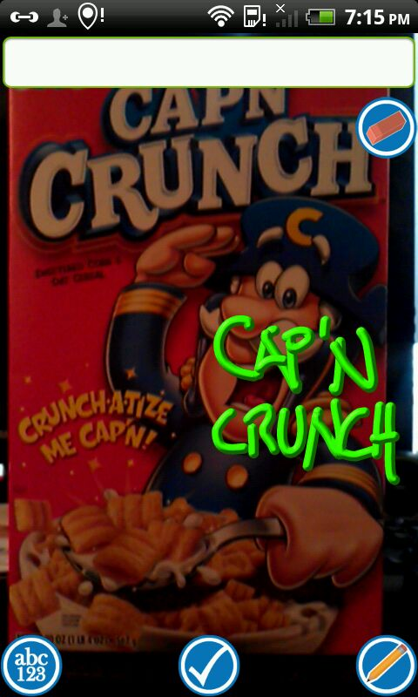
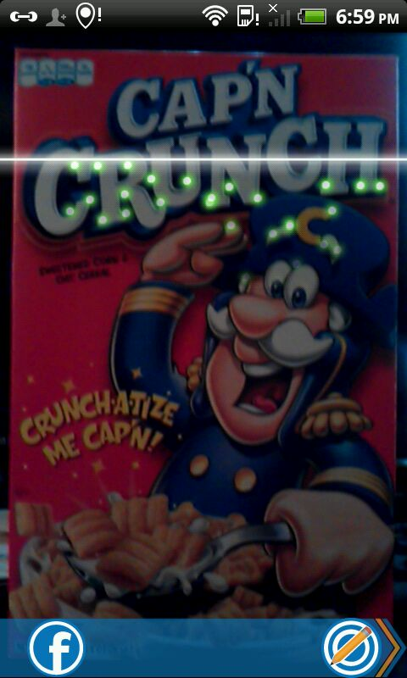
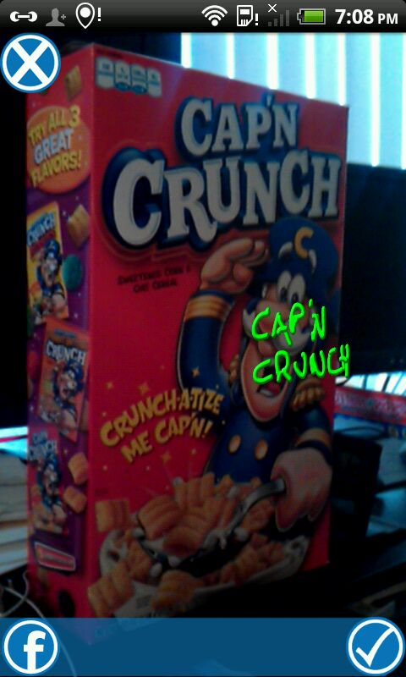

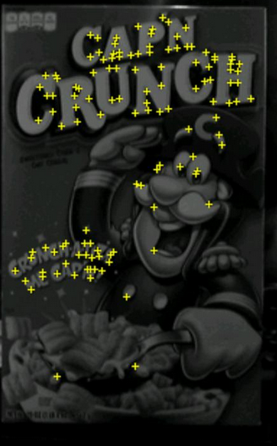
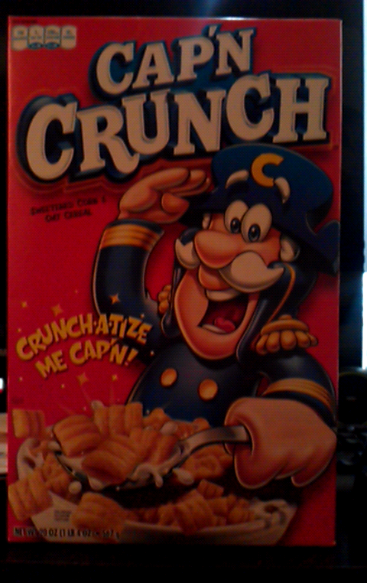
Creating Augmentations
three60
Vuforia
MySQL
S3
Facebook
Points of interest map
Target ID
Target ID, Aug ID, User Info
Target & Augmentation Images
Post to wall

Slide 11
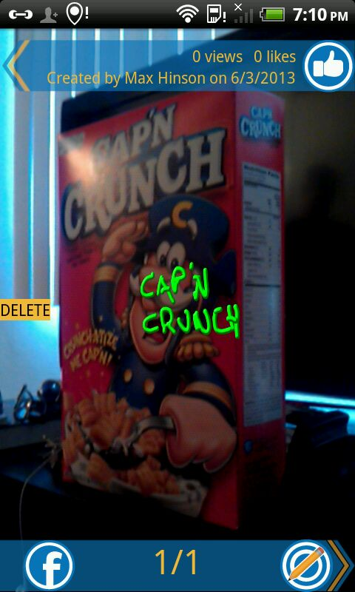
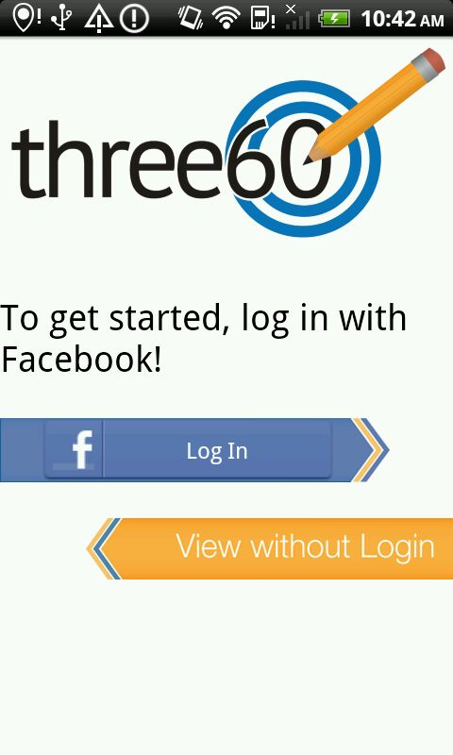
Viewing Augmentations
three60
Vuforia
MySQL
S3
Facebook
Login credentials
Points of interest
Target ID
Target ID, user info
Augmentation info
Augmentation ID
Augmentation image

Slide 12
Let’s Try it Out!
Notes:
During the break, we selected a volunteer to try out our application for all of you. Let’s give (Alex) a big round of applause for his bravery. (Alex) has already downloaded our application and added me as a friend on Facebook.
Let’s now answer a question I’m sure many of you are probably asking. How do you use our application? Let’s say you would like to send a message to a friend. Our streamlined creation process makes this 4-step process extremely simple.
Find target
To get started, all you need to do is select an image target to use as the trigger for displaying the message.
Recognition and tracking works best for targets that are flat and have a lot of detail.
Draw/Type message
This is where you can create the message you would like to send to your friend. Our application allows you to create freehand drawings, as well as type text.
Review
After you have finished creating your augmentation, you have the ability to review your message in real time before uploading it to the system. If you do not like what you see, you may go back and modify it.
Share
When you are ready to confirm your augmentation, you may share it via Facebook. You have the option to post it to your own wall, or a friend’s wall. Our privacy options allow you to make sure that your augmentation is only viewed by people who you allow to see it.

Slide 13
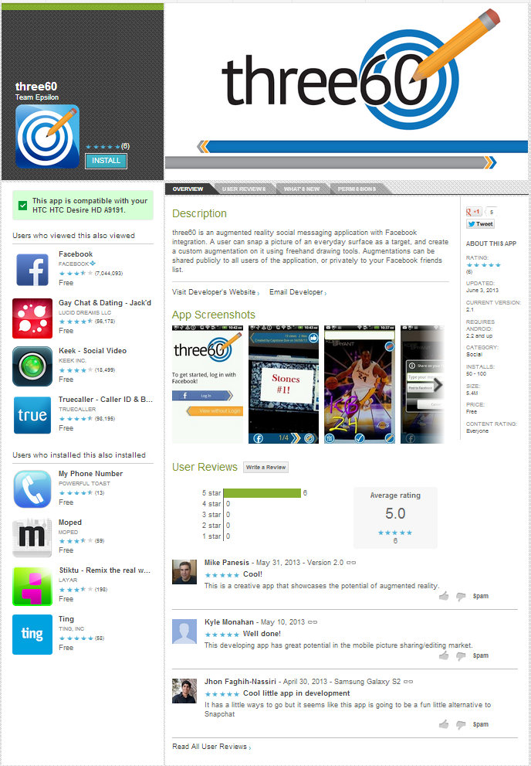

three60 on Google Play
Get the latest version
2 releases each week
67 downloads
Search “three60” and download today!

Slide 14
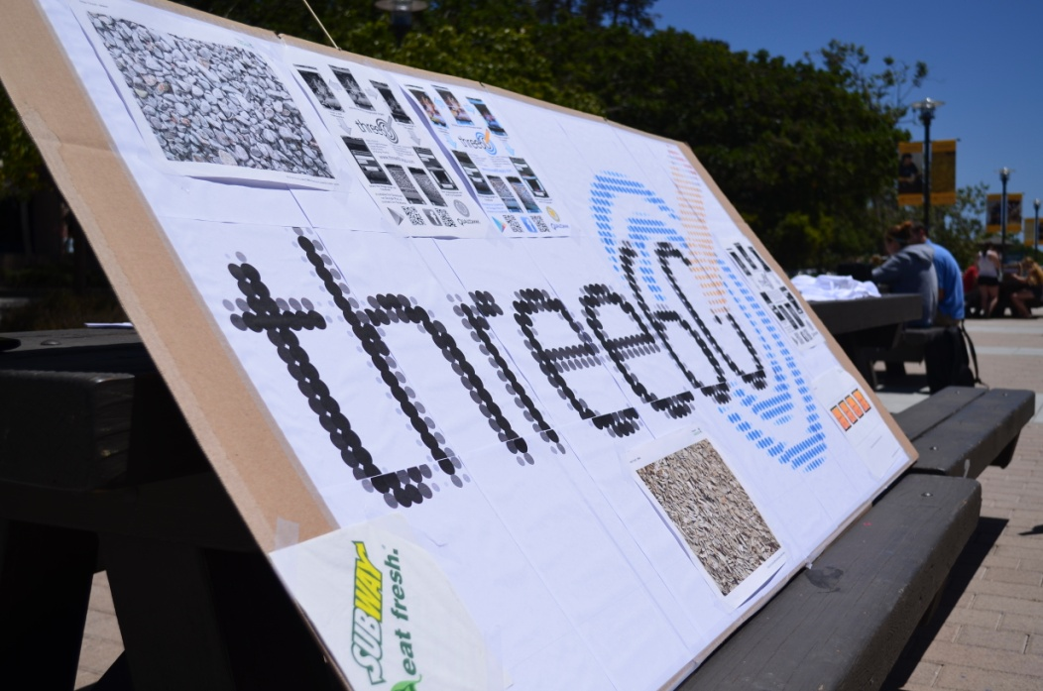
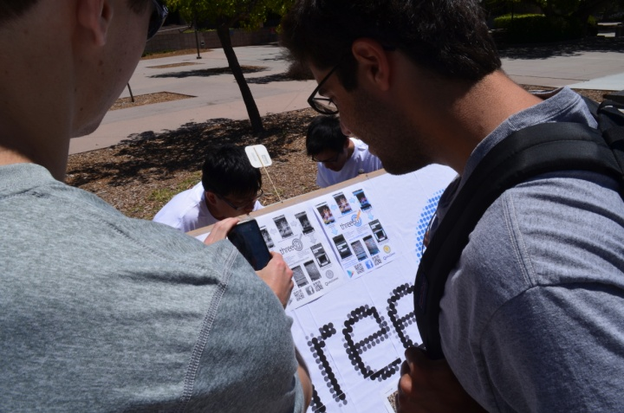
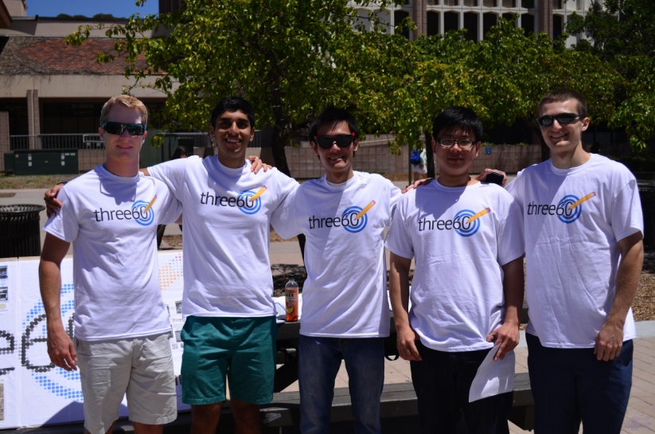
three60 on Campus

Slide 15
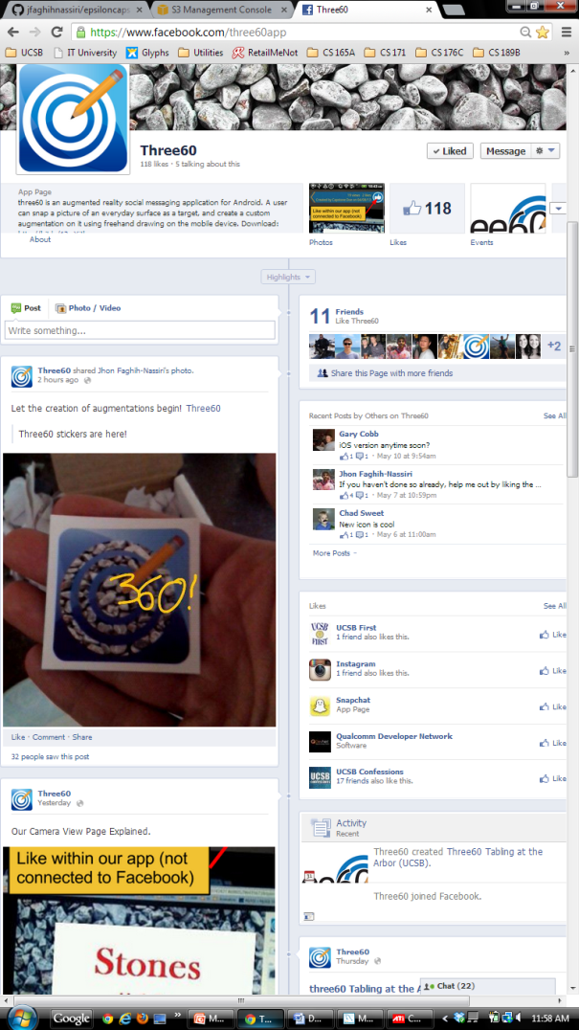
three60 on Facebook
News and updates
Communication with users
User-created augmentations
Reach: 5,590
Likes: 134
www.facebook.com/three60app
Notes:
We set up a Facebook account

Slide 16
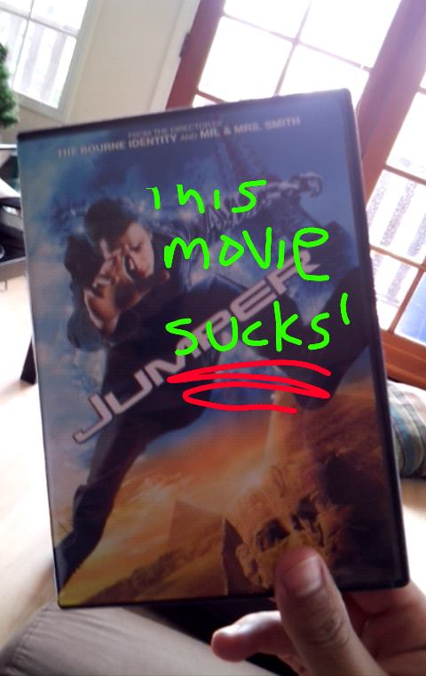
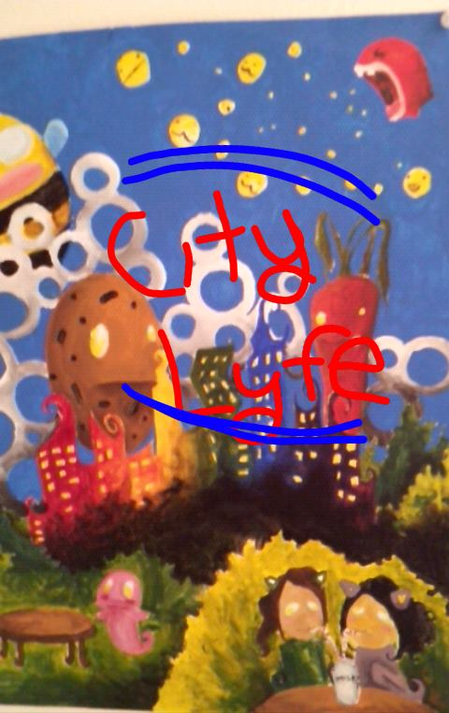
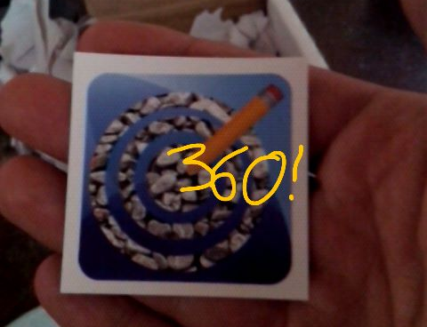
three60 in Action

Slide 17
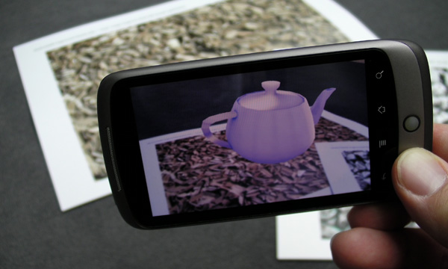
Future Work
3D Augmentations
Manager Dashboard
iOS Version

Slide 18


Acknowledgements
Chandra Krintz
Tim Sherwood
Stratos Dimopoulos
Janet Kayfetz
Chad Sweet
Prince Gupta
Katelyn Hicks
Kyle Monahan

Slide 19
Questions
Notes:
We would now like to open up for questions.

