Slide 1

Tribal Knowledge
Team Undefined Reference to teamName
Andrew Cooney, Andrew Thomas, Leif Dreizler, Scott Bishop, Zach Sperske

Slide 2
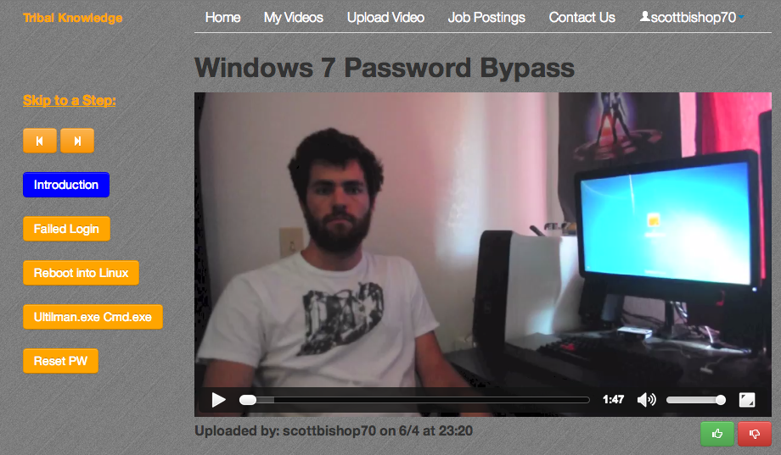
Step-by-Step Videos

Slide 3
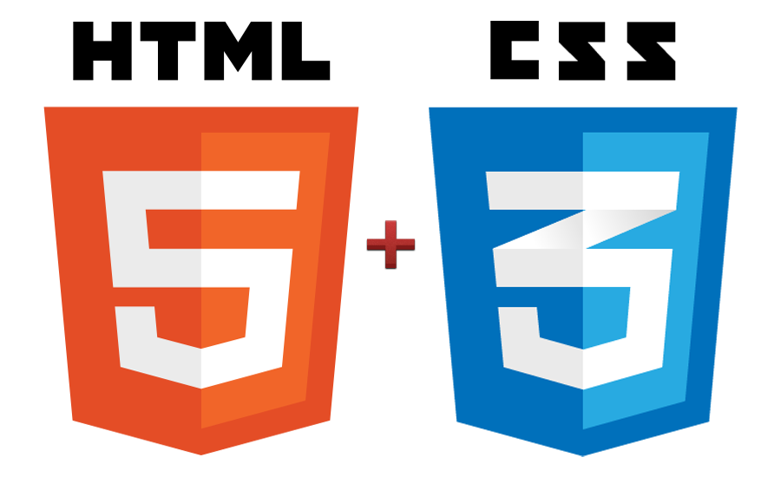

Twitter Bootstrap
=

Slide 4

Job Postings

Slide 5

Google App Engine

Slide 6

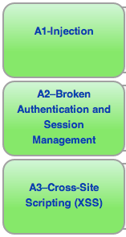

Slide 7

GAE DataStore and BlobStore

Slide 8
Fuzzy Search Algorithm
Also known as approximate string matching
Finds strings that match a pattern approximately
"GetHub" → "GitHub"

Slide 9
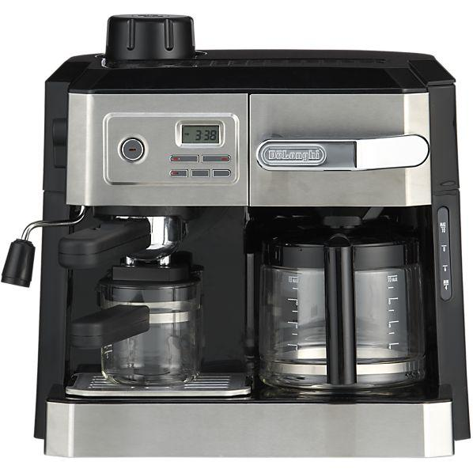
Fuzzy Search Algorithm

Slide 10
Fuzzy Search Algorithm
Number of operations necessary to convert the string to an exact match
Insertion: cot → coat
Deletion: coat → cot
Substitution: coat → cost

Slide 11
Search Scores
No Match Perfect Match
"z" "Knowledge" "Tribal Knowledge"
If searching for a video titled "Tribal Knowledge"

Slide 12
Google Query Language
SQL-like language for retrieving entities or keys from datastore
Example queries:
GqlQuery("SELECT * FROM Videos")
GqlQuery("SELECT * FROM Videos WHERE videoID = :1", int(vid_id))
GqlQuery("SELECT * FROM Videos WHERE creator = :1 ORDER BY
date DESC", user.nickname())

Slide 13
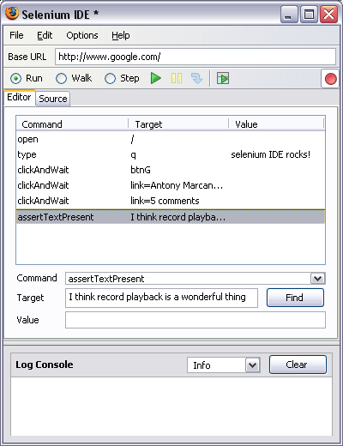
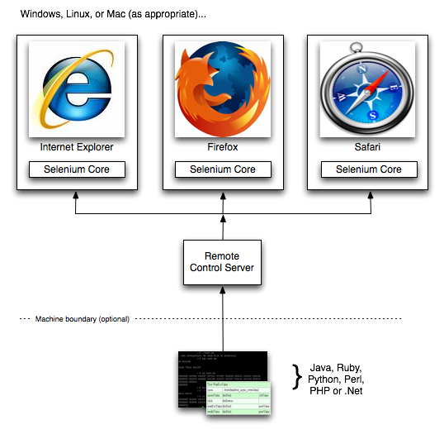
Selenium Testing
Selenium IDE WebDriver

