Slide 1
Camera Timing Characterization
Raw vs. RGB888, single- and dual-camera, for FTA closed-loop beam tracking
Target loop latency: 10 ms — disturbance band: 10–20 Hz beacon wobble

Slide 2
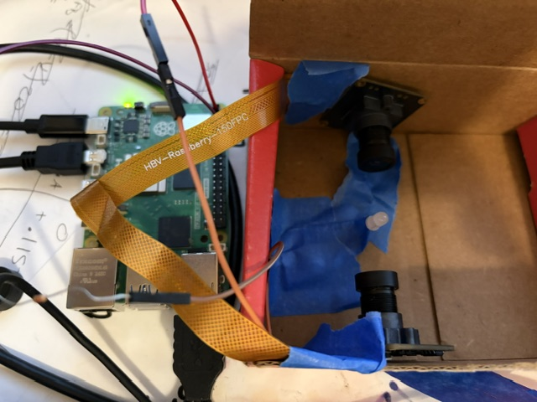
Test Setup
Raspberry Pi 5 + dual OV9281 cameras, dark enclosure, single bench LED as ground truth
Pi 5 with two CSI camera ports — each OV9281 on its own CFE/ISP device pair
Cameras mounted in a cardboard enclosure to suppress background light for the dark-box brightness tests
Single LED taped in frame as a repeatable, known ground-truth signal for both cameras
Ribbon cables (HBV adapter boards) carry each camera's CSI signal back to the Pi
2

Slide 3
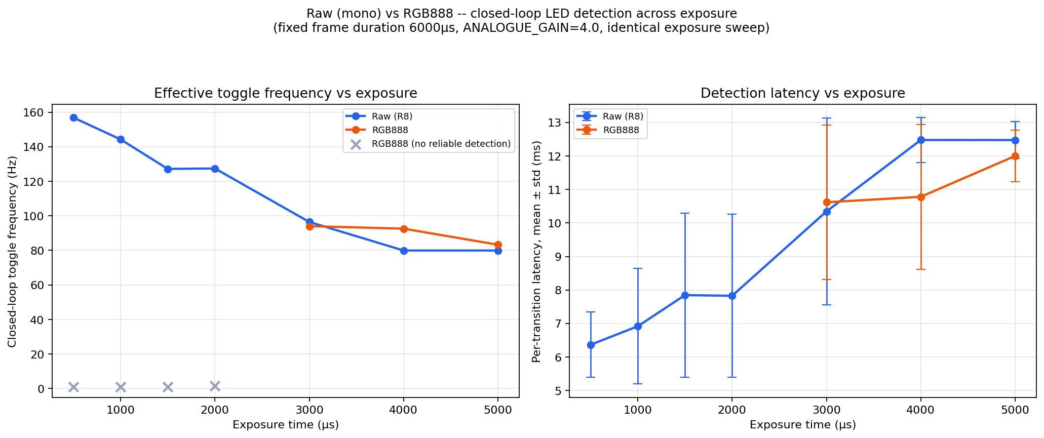
Raw vs. RGB888: Latency & Frequency vs. Exposure
Fixed frame duration (6000µs), identical exposure sweep on both streams
Below ~2500µs exposure, RGB888 detects nothing at all; raw stays usable across the full range. Where both can detect, frequency converges — the raw advantage is mainly at short exposure / low light.
3

Slide 4
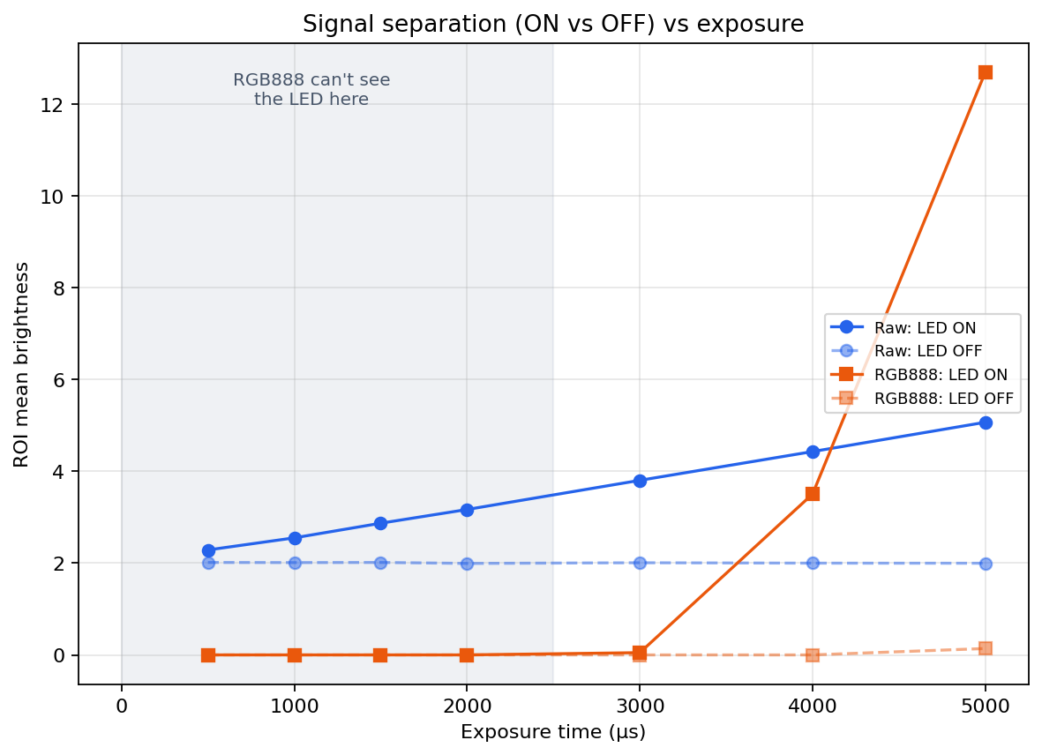
Why: RGB888 Can't See the LED at Short Exposure
ROI mean brightness, ON vs. OFF, across the same exposure sweep
ISP black-level subtraction and digital gain need enough exposure to have a signal to work with. Raw preserves low-level sensor values directly, so it keeps a usable ON/OFF gap even at 500µs.
4

Slide 5
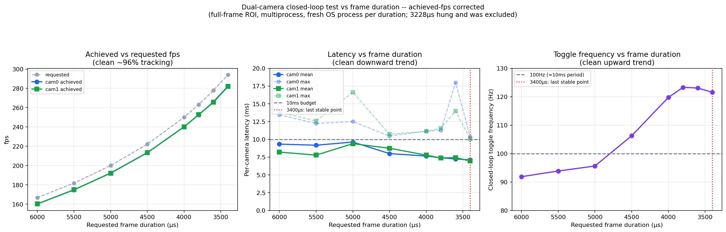
Dual-Camera Closed-Loop: Latency vs. Frame Duration
Multiprocess (2 separate OS processes, not threads) — corrected with achieved-fps instrumentation
Once achieved fps (not requested) is measured, latency drops and frequency rises cleanly as duration shortens. 3400µs is the last stable point (mean ~7ms, ~122Hz); 3228µs hung the process — true floor sits between the two.
5

Slide 6
Why ~120 Hz, Not ~280 Hz? It's the Question, Not the Camera
Two genuinely different measurements -- both correct, answering different things
Raw capture throughput
Confirmed step-and-response (this LED test)
~282 fps (~3.5 ms/frame)
~120 Hz (~8 ms)
Pure capture-rate test, no LED or confirmation logic. Near the sensor's own rated ceiling (309.79 fps mode) — this is the true hardware limit.
Command a state, wait for BOTH cameras to positively confirm it happened, then proceed. The ~2× gap is inherent to confirming a transition, not a camera bottleneck.
Why the gap exists
A frame already mid-exposure when the LED toggles can't show the new state — you always need the next one (~1 frame period, unavoidable).
Waiting for two independent cameras to both confirm costs whichever one is slower that cycle (order-statistics penalty).
The real question for Phil: which control style does the FTA algorithm use?
Discrete step-and-confirm (perturb, measure, adjust): expect ~120 Hz — matches this test closely.
Continuous latest-frame tracking (chasing a moving beacon, no confirmation step): could approach ~280 fps raw rate, ~3.5 ms pure latency.
6

Slide 7
Where This Leaves Us
~122 Hz
~7 ms
3228µs
Best stable dual-camera
closed-loop frequency
(3400µs frame duration)
Mean per-camera latency
at 3400µs (camera + GPIO
only — no FTA settling)
Hard floor — this value
hung the process;
don't go below 3400 solo
Open questions for Phil
Is the 10 ms target a mean loop period or a hard per-cycle ceiling? At 3400µs we're comfortably under on mean, borderline on max.
FTA mechanical settling time is still uncharacterized — today's numbers are camera + GPIO only.
Control architecture (previous slide) determines which speed number actually applies — needs to be settled before more camera tuning is useful.
GPIO round-trip alone (wired GPIO17→GPIO27, no camera): 305,522 Hz / 3.27µs per cycle — confirms camera capture, not GPIO, accounts for essentially all of the ~7 ms floor.
7

