Slide 1
FTA BEAM-TRACKING · CLOSED-LOOP CONTROL
Serial Timing & Step Response
Session Results — 2026-07-23 (short form)
Real serial round-trip latency and safe throughput rule out needing I2C for FTA control; measured actual step response on both axes.
Raspberry Pi 5 + OV9281 · NUCLEO-L432KC “FTA Controller” · target: 10 ms loop latency, 10–20 Hz disturbance rejection

Slide 2
HEADLINE RESULT · 01
Serial is fast enough — no I2C needed
Fire-and-forget rate-sweep: safe up to ~1600Hz, then a sharp cliff.
• Serial round-trip latency MEASURED: setpos mean 1.26ms / p99 2.03ms — ping mean 2.14ms / p99 3.00ms
• I2C was never round-trip or throughput measured in this project — only a rough ~0.2–1ms latency estimate exists, and there's no I2C data to plot against the chart below
• Safe fire-and-forget ceiling: 0 of 300 dropped through 1600Hz, drops begin at 1800Hz+
• Combined with ~3.5–4ms camera latency: ~5–6ms total, inside Phil's 10ms budget — no remaining performance case for keeping I2C
Dropped commands, out of 300 sent per rate (Hz)
FTA Position Calibration · Serial Timing & Step Response · 2026-07-23
2

Slide 3
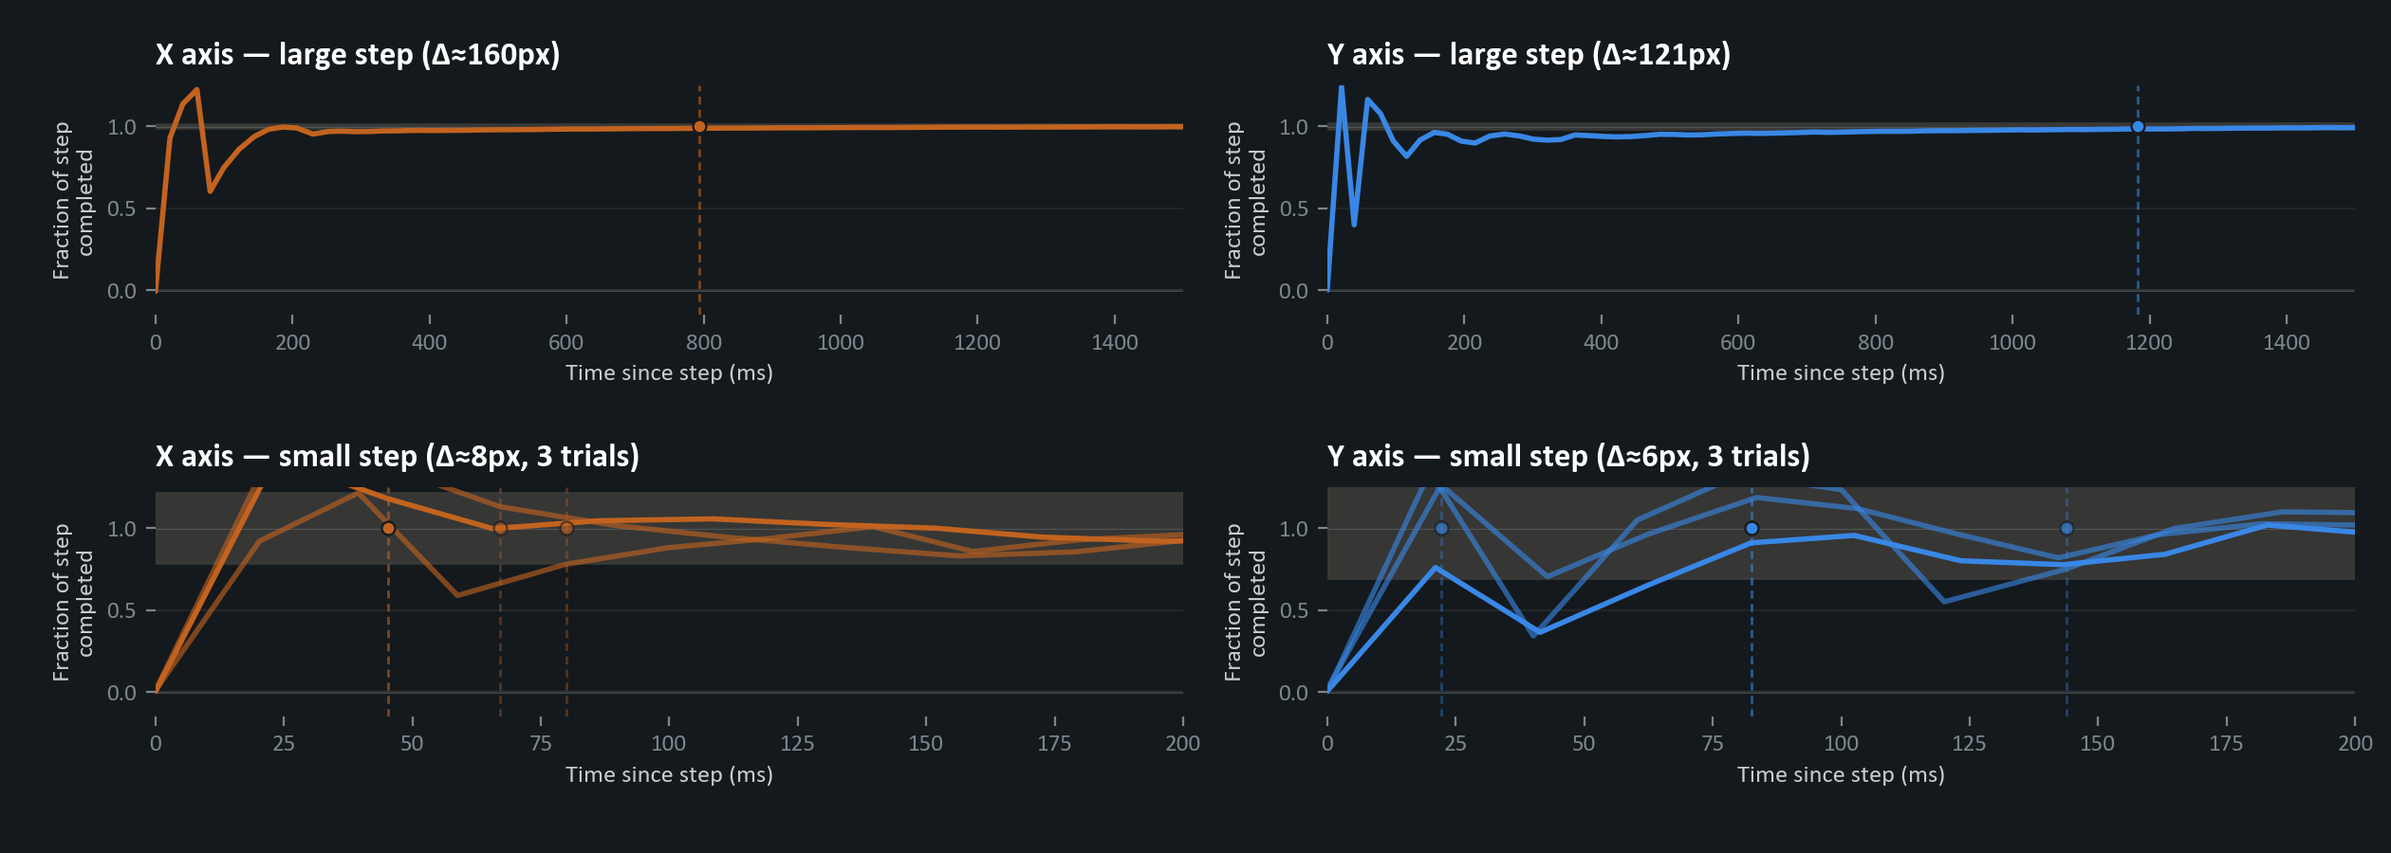
HEADLINE RESULT · 02
Actual step response, both axes
Fraction of the commanded step completed vs. time — small steps settle in tens of ms; big steps take the better part of a second.
FTA Position Calibration · Serial Timing & Step Response · 2026-07-23
3

