Slide 1
FTA Closed-Loop PID Tuning
Session summary — gain search at the old control rate, a Pi-side throughput change that broke it, resonance remeasurement, and the notch-filter attempt

Slide 2
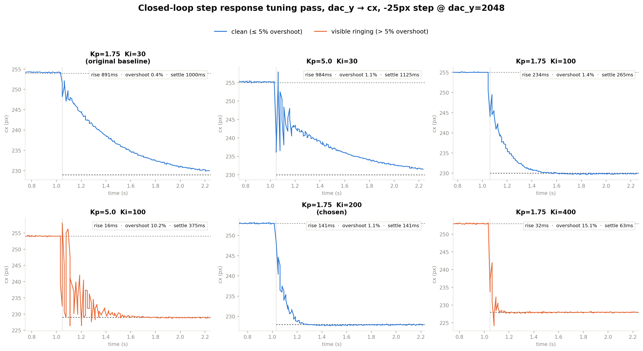
Where we started: best clean P+I result (~210-235Hz control rate)
• Kp=1.75 counts/px held fixed all session; Ki was the effective speed lever, not Kp.
• Ki=200: 141ms rise, 1.1% overshoot, 141ms settling — a single clean transition, the best confirmed result.
• Ki=400 went faster (63ms) but with real 15% overshoot — a genuine speed/overshoot tradeoff, not free.
• Raising Kp alone never helped: same or worse settling, more overshoot, at every Ki tried.

Slide 3
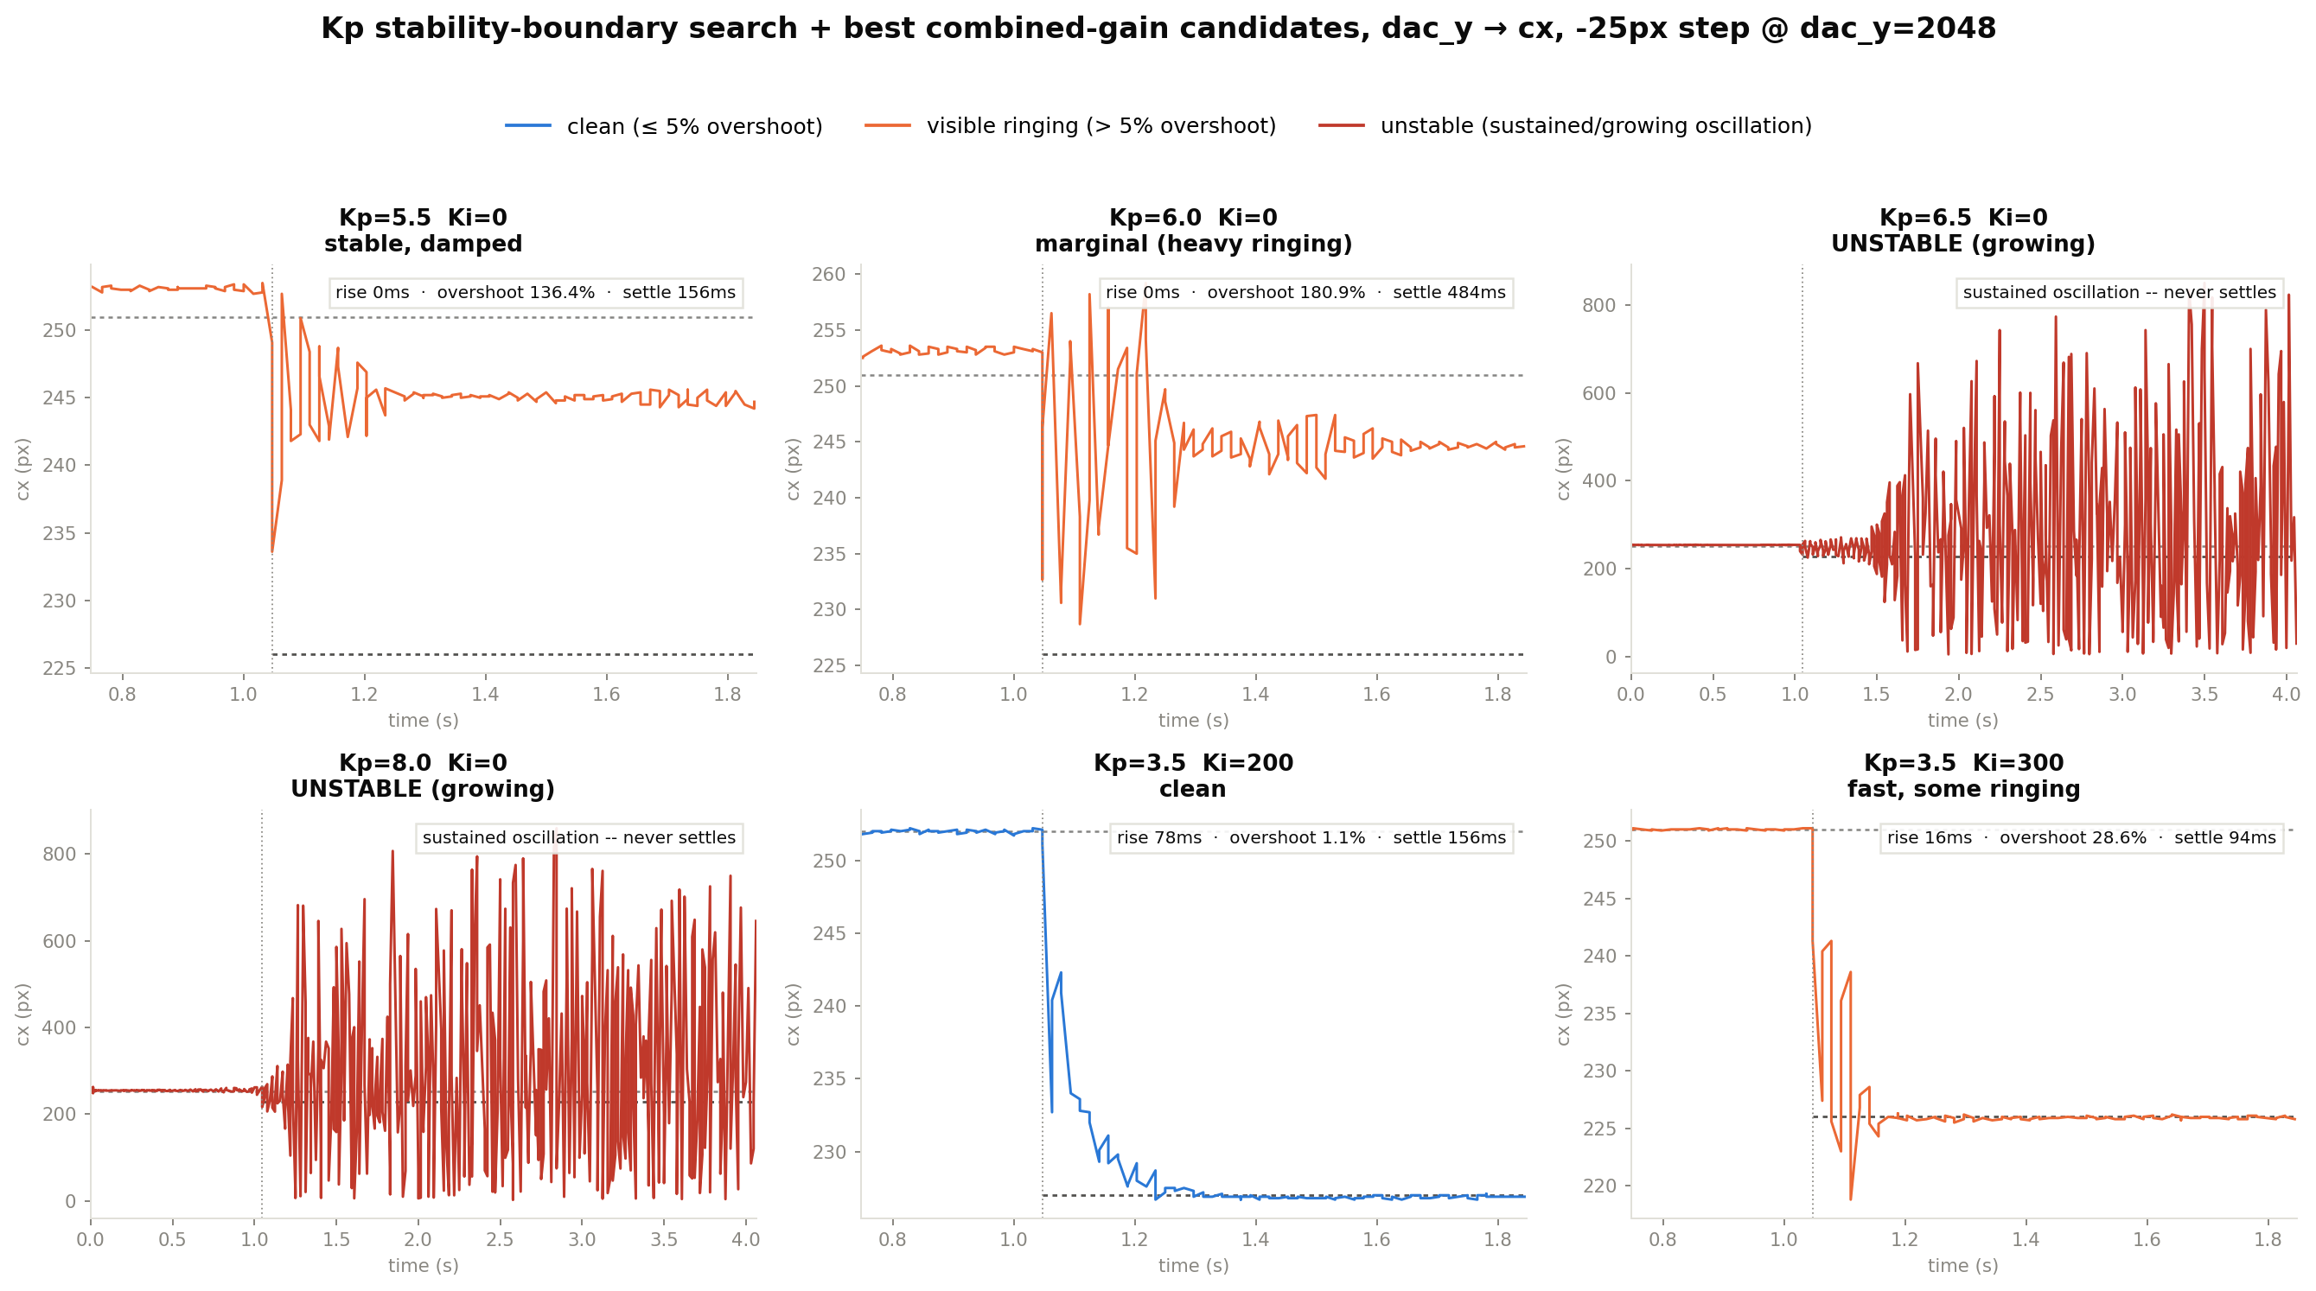
A real Kp instability boundary was found (~6-6.5 counts/px)
• Kp=5.5 stable, Kp=6.0 marginal (decaying ringing), Kp=6.5+ genuinely unstable — growing oscillation, never settles.
• Far below the naive “matched-to-plant-gain” estimate (~11 counts/px) — phase lag erodes margin, static gain alone isn't a safe guide.
• Pushing toward the boundary didn't buy speed either — the marginal Kp=6.0 case settled slower than the safely-stable Kp=5.5.
• All excursions stayed physically bounded by the firmware's DAC clamp regardless of how bad the tuning was.

Slide 4
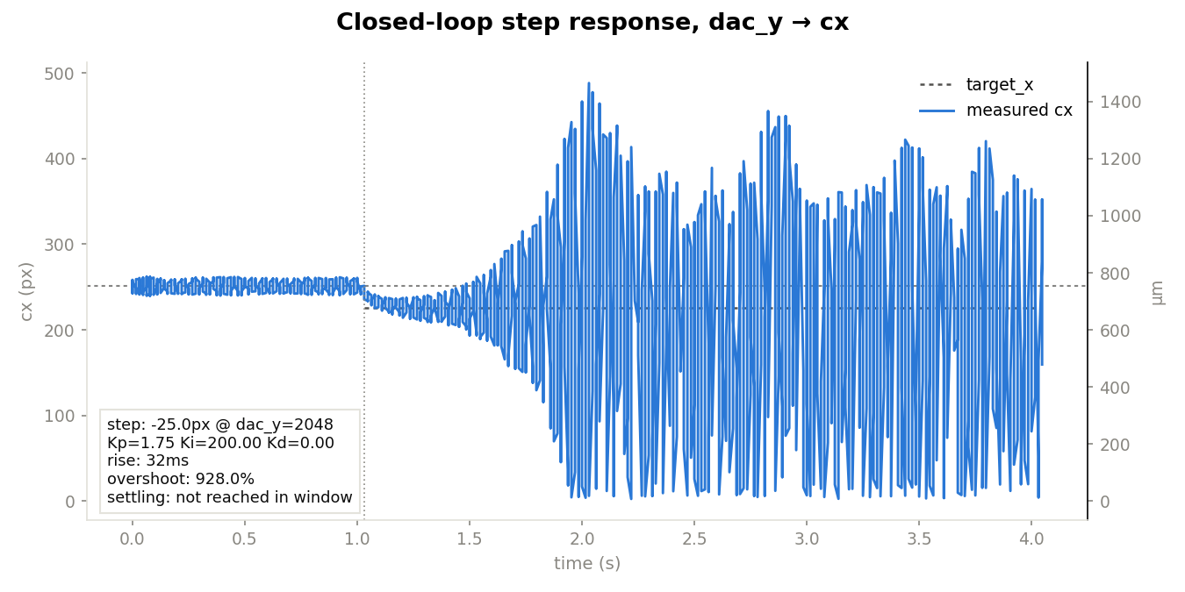
Pi-side ROI change raised telemetry ~210Hz → ~465Hz — the old gains broke
• Real throughput win on the Pi side (ROI + other changes) — telemetry now streams at ~440-475Hz, up from ~210-235Hz.
• Updated the PID's fixed sample-time constant to match (1/210s → 1/457.5s) and rebuilt.
• Kp=1.75 / Ki=200 — the best result from the previous slide — is now genuinely UNSTABLE: growing oscillation, not settling.
• Also jumped wildly in X when stepping Y — checked directly: the OTHER axis (cy) stays flat through the step, so this is the controlled axis itself misbehaving, not cross-axis coupling.

Slide 5
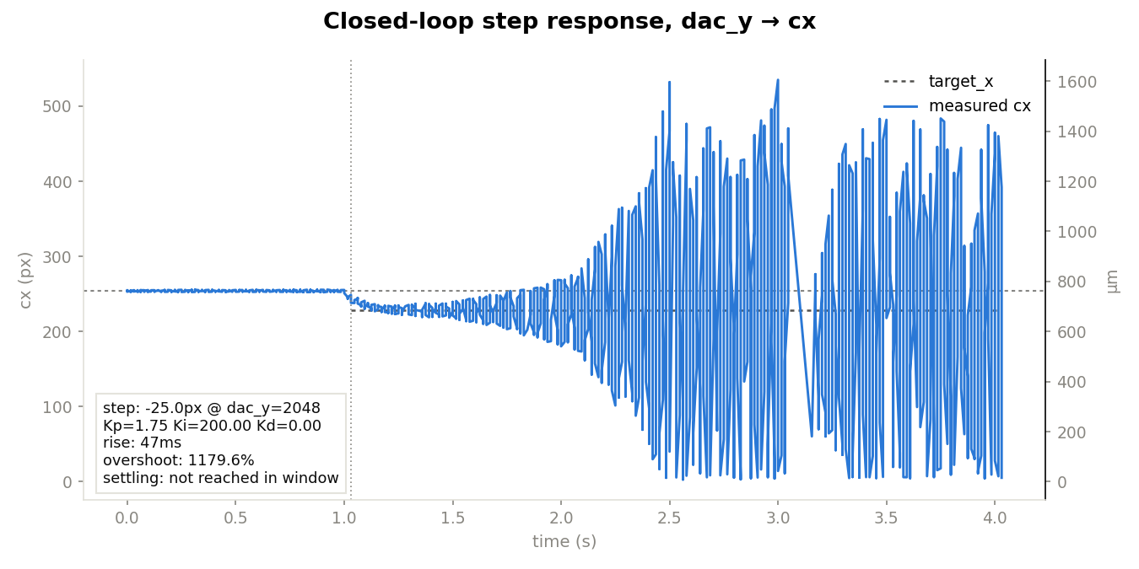
Ruled out sample rate itself as the cause
• Hypothesis: more updates/second gives the integral term more chances to accumulate before the plant's ~41ms delay reflects earlier corrections back.
• Direct test: throttled the control loop back to ~200Hz while telemetry stayed at ~465Hz (decoupling the two).
• Same Kp=1.75/Ki=200 — still badly unstable (1180% overshoot) even at the OLD control rate.
• This falsifies “rate caused it” cleanly — something else changed. Static DC gain was also checked and ruled out (0.094-0.095 vs ~0.09 px/count, unchanged).

Slide 6
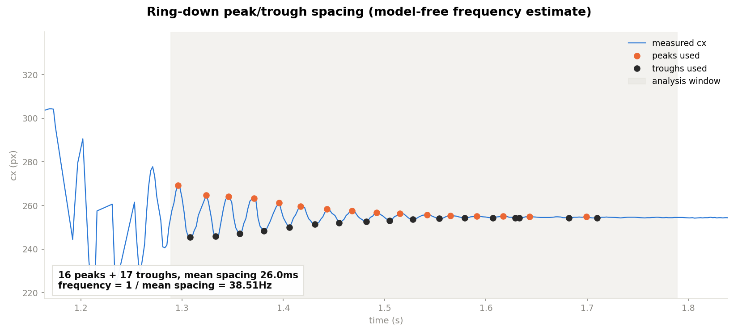
Ring-down resonance test (amp-off / pulse / amp-off, free decay)
• User's own idea: preload a setpoint with the amp OFF (no physical effect), pulse the amp briefly, then cut it and watch the actuator ring down under pure mechanical dynamics — independent of the control loop or camera-rate phase fitting.
• First two attempts used host arrival timestamps — turned out to be bucketed into ~15-16ms bursts by Windows thread scheduling, giving wrong answers (22Hz, then an 8.6Hz curve_fit that looked plausible but wasn't).
• Fixed by timestamping from the firmware's own tick counter instead of the host clock, and abandoning curve_fit for a model-free peak/trough-spacing measurement.
• Real result: 16 peaks + 17 troughs, mean spacing 26.0ms → 38.5Hz — well outside the 10-20Hz target band, and different from the original (now known-unreliable) 15.3Hz reading.

Slide 7
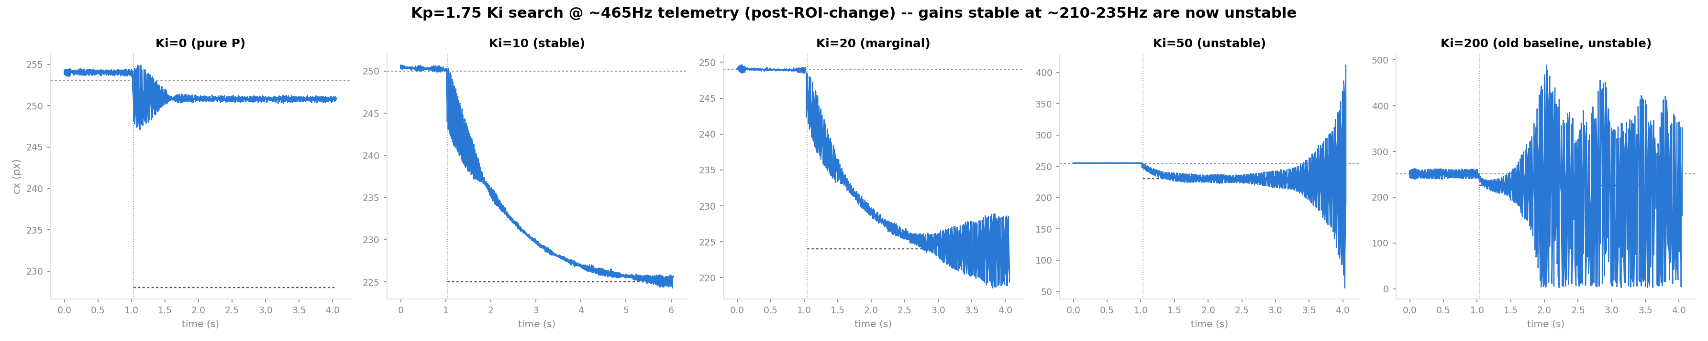
Fresh Ki search — Ki=19 looked clean, but under a leftover throttle
• Bisected Ki with Kp fixed at 1.75: 15 → 2265ms, 18 → 1953ms, 19 → 1797ms — clean and monotonic, no instability anywhere in this range.
• Kp=2.5 and Kp=3.5 both unstable, even just holding a fixed setpoint — the real Kp boundary sits below 2.5.
• Caveat found LATER (see two slides ahead): this whole search — Ki=15/18/19, the Kp check, and the D-term retry that follows — was unknowingly run with the control loop still capped at ~200Hz by a diagnostic throttle from earlier rate-falsification testing that never got reverted.
• So “Ki=19 is the new best result” did not hold up once that throttle was found and removed — treat this slide as the story of how the search unfolded, not the final answer.

Slide 8
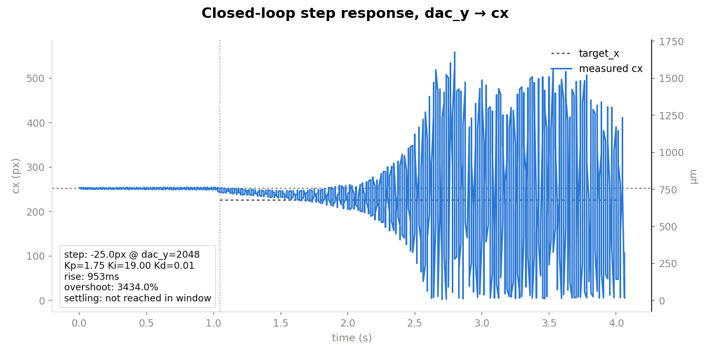
D-term retried with a resonance-informed cutoff — still doesn't help
• Retried on top of the (still-throttled) Ki=19 baseline with a 10Hz derivative filter cutoff, informed by the corrected 38.5Hz resonance.
• Kd=0.005 → 3434% overshoot, wrong direction entirely. Kd=0.001 (smallest representable) → still 1392% overshoot.
• Decisive result regardless of the throttle issue: tested across cutoffs 1-20Hz and Kd 0.001-0.05, combined with both Ki=19 and the old Ki=200 — every single combination made things worse than P+I alone.
• Root cause: PIDController.hpp's derivative filter is a single-pole low-pass — any cutoff low enough to reject the resonance also removes the useful signal; any cutoff high enough to keep signal also passes the resonance straight through.

Slide 9
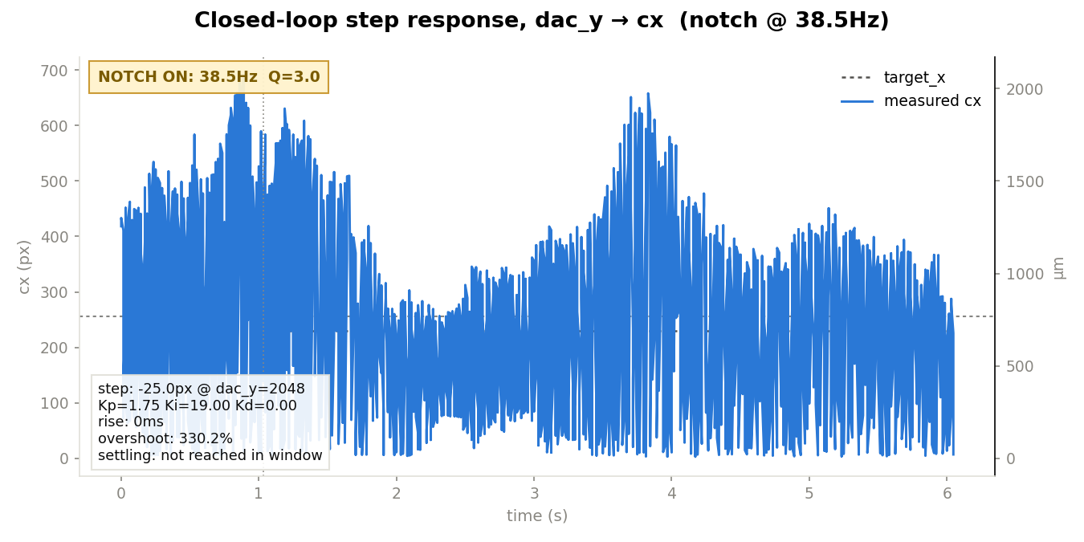
Caught: the whole afternoon's tuning ran under a leftover ~200Hz throttle
• The earlier rate-falsification test (checking whether sample rate itself caused instability) added a temporary throttle that gated the control loop to ~200Hz while telemetry stayed at the real ~465Hz — and it was never removed.
• Every result since then — Ki=15/18/19, the Kp=2.5/3.5 check, both D-term retests, and the first notch-filter test — was run at that artificial ~200Hz, not the true rate this project has actually been streaming at.
• Fixed: removed the throttle, restored the PID's internal time-step to match the true ~457.5Hz rate, rebuilt, reflashed.
• Retested the “best result,” Kp=1.75/Ki=19, at the TRUE rate: badly unstable — chaotic oscillation even while just holding the baseline, before the step is even applied.

Slide 10
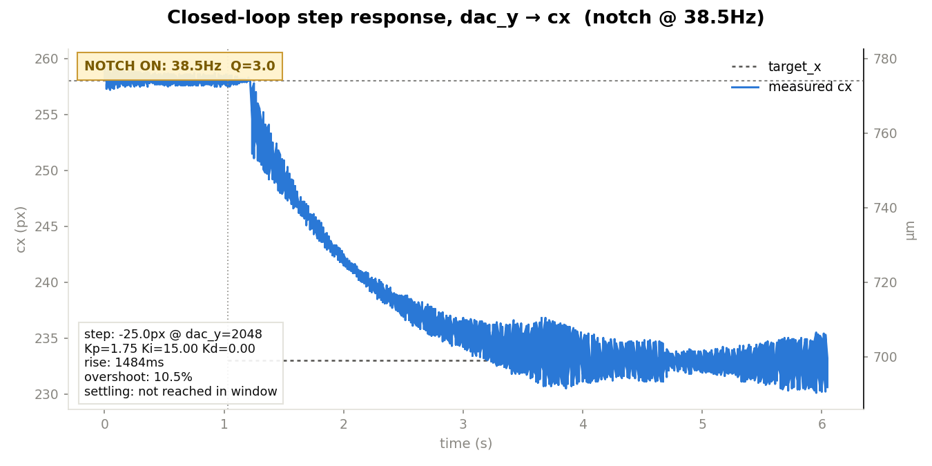
Real Ki search at the true rate, notch active — Ki=15 is honestly the best point
• Ki=15: clean, bounded convergence, no growth (this plot). Ki=20: bounded but a visible slow “beating” envelope. Ki=30: same beating, now visibly growing.
• Also retried Kp=2.5/Ki=15 with the notch on, hoping it would buy Kp headroom — still badly unstable, same chaotic signature.
• The notch does not move the Ki or Kp stability boundary in any measurable way — the clean/marginal/unstable transition lands in essentially the same place with or without it.
• Honest best working point at the true rate, notch on or off: Kp=1.75, Ki=15 — well short of the pre-ROI-change 141ms/1.1% result.

Slide 11
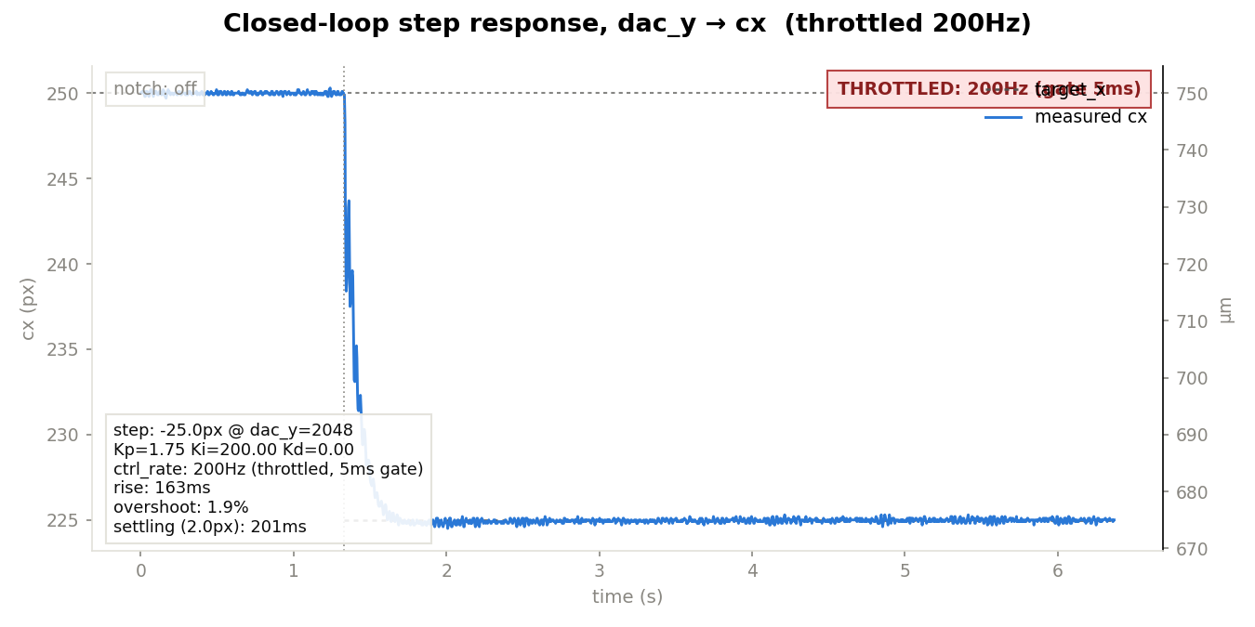
A properly-built control-rate throttle unexpectedly recovers the OLD fast behavior
• Tested directly: does throttling the control loop back to ~200Hz (this time atomically pairing the throttle with the PID's assumed sample time, so they can't drift apart) recover the pre-ROI-change Kp=1.75/Ki=200 behavior?
• Result: yes — 163-168ms rise, ~2% overshoot, ~193-201ms settling, confirmed reproducible on an immediate repeat. Essentially matches the historical 141-297ms range.
• Contradicts an EARLIER same-day attempt at nominally the same throttled config, which was catastrophically unstable (1180% overshoot) — could not identify a concrete mechanism for the discrepancy. Flagged honestly as an open mystery, not a solved one.

Slide 12
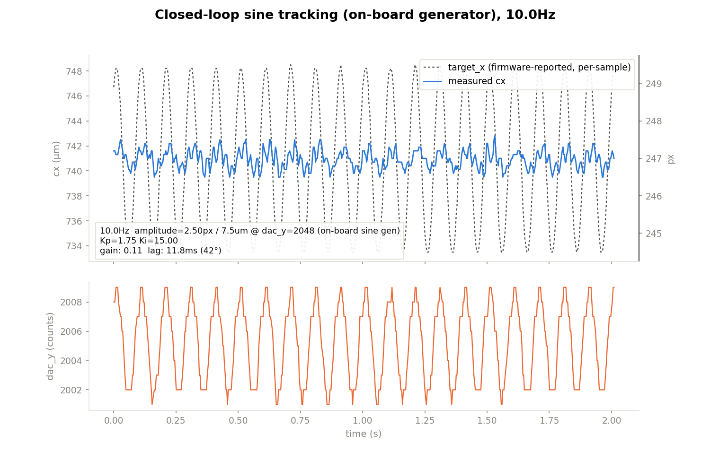
Sine tracking at Ki=15 reveals a much bigger problem than slow settling
• Step response only tells you settling time for one jump — the real mission needs continuous rejection of a moving disturbance, so tested sine tracking at the “safe” Ki=15.
• Result: tracking gain (T) only 10-16% across 1-10Hz — the actuator barely follows a target moving that fast.
• For a feedback loop, S = 1 − T (sensitivity = disturbance rejection). Low T at a frequency IS poor rejection at that frequency — not a separate concern.
• T≈0.10-0.16 means S≈0.84-0.90: a real 5-10Hz beacon wobble would still show up as position error, 84-90% uncorrected. “Safe” Ki=15 is stable but not remotely fast enough for the actual mission.

Slide 13
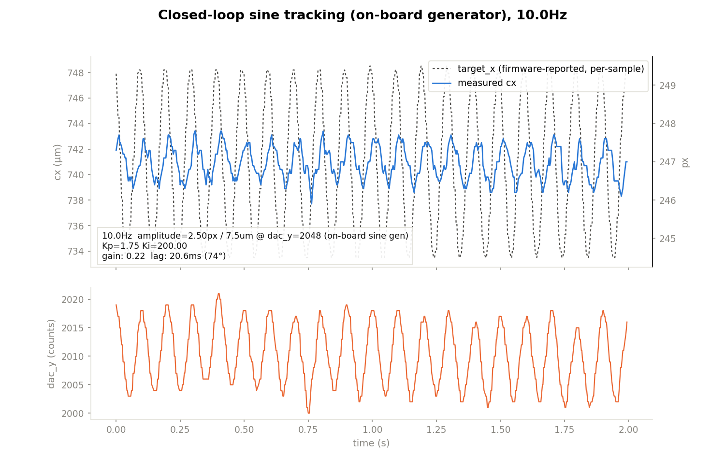
Sine-validated the recovered config — real improvement, still not enough
• Kp=1.75/Ki=200, throttled to 200Hz: tracking gain 20-34% across 5-20Hz (vs. 10-16% for Ki=15) — a real ~2-3x improvement, clean and stable at every tested frequency.
• But S is still 66-80% across the band — most of a real disturbance would still get through. Fast step settling and good disturbance rejection at 10-20Hz are NOT the same property.
• Consistent with the much earlier open-loop finding that the actuator/plant itself has real rolloff in this band — not something PID tuning alone fixes.

Slide 14
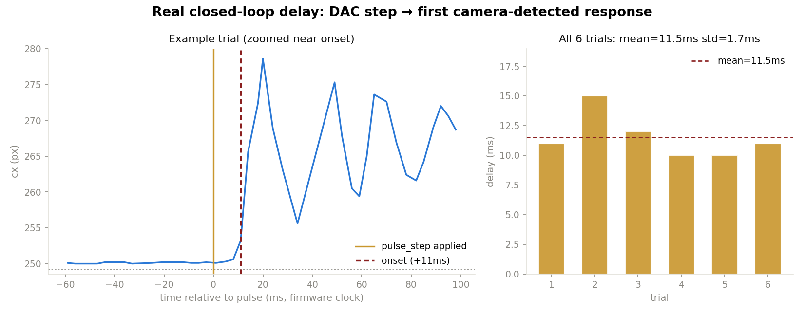
Real closed-loop delay measured directly: ~11.5ms, not the assumed ~41ms
• Built a firmware primitive (pulse_step) that timestamps both the DAC step and the telemetry response on the SAME firmware clock — no host-clock timing anywhere in the measurement, avoiding every host-timing bug hit earlier this session.
• Result: 11.5ms mean delay, tight (std 1.7ms), 6/6 consistent trials — much smaller than the ~41ms figure this project had been reasoning from (that number was from an older, slower VCP-relay test method, not the real I2C-direct control path).
• Changes the picture: 11.5ms of pure delay doesn't consume 90° of phase until ~22Hz, not ~6Hz — real headroom remains in the 10-20Hz band. The dominant constraint is more likely the plant's own ~38.5Hz resonance (visibly ringing in this data) than raw latency.

Slide 15
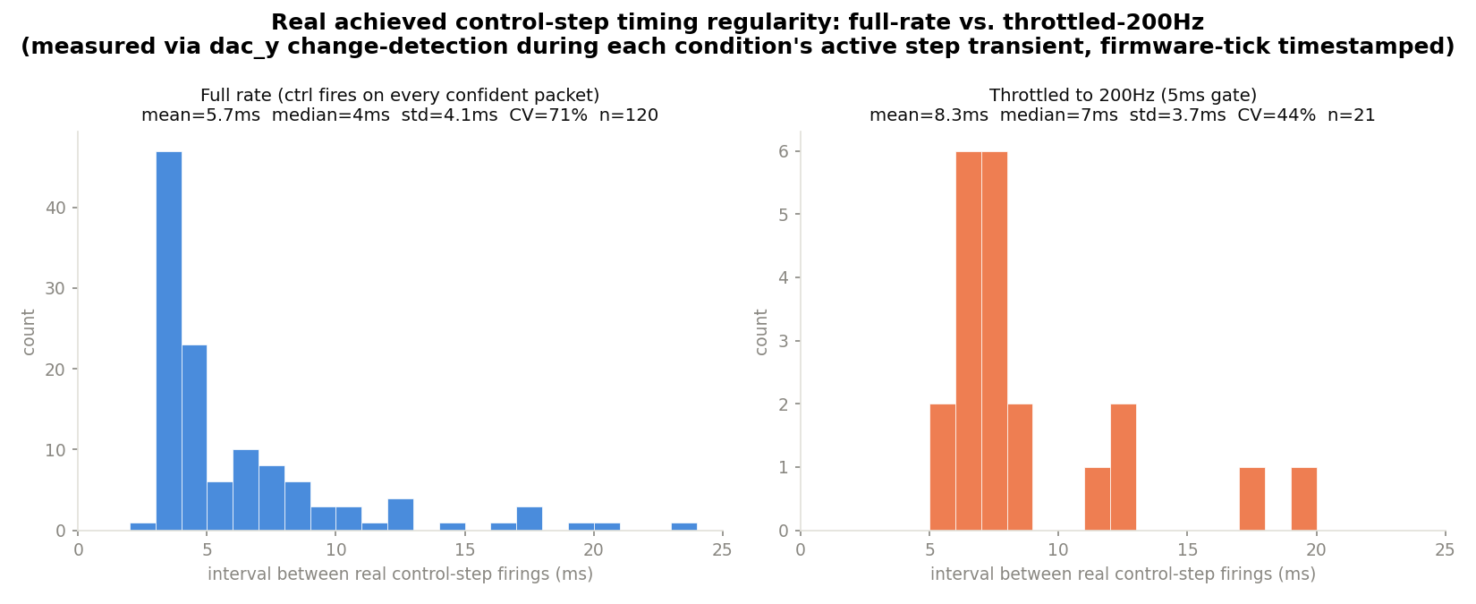
Does throttling help because it's more REGULAR, not just less frequent?
• Open question: throttling to 200Hz recovered old Kp=1.75/Ki=200 behavior, but why is still unexplained — sample rate itself, or how UNIFORM the control-update timing is?
• Measured directly via dac_y as a firing-detector (apply_dac only runs inside a real control step), firmware-clock timestamped throughout: full rate CV (relative jitter) ≈ 71% (long tail to 20+ms) vs. throttled-200Hz CV ≈ 44% (tighter, shorter tail) — genuinely more regular, not just slower, though n=21 for the throttled case is a small sample and 44% CV is still real jitter.

Slide 16
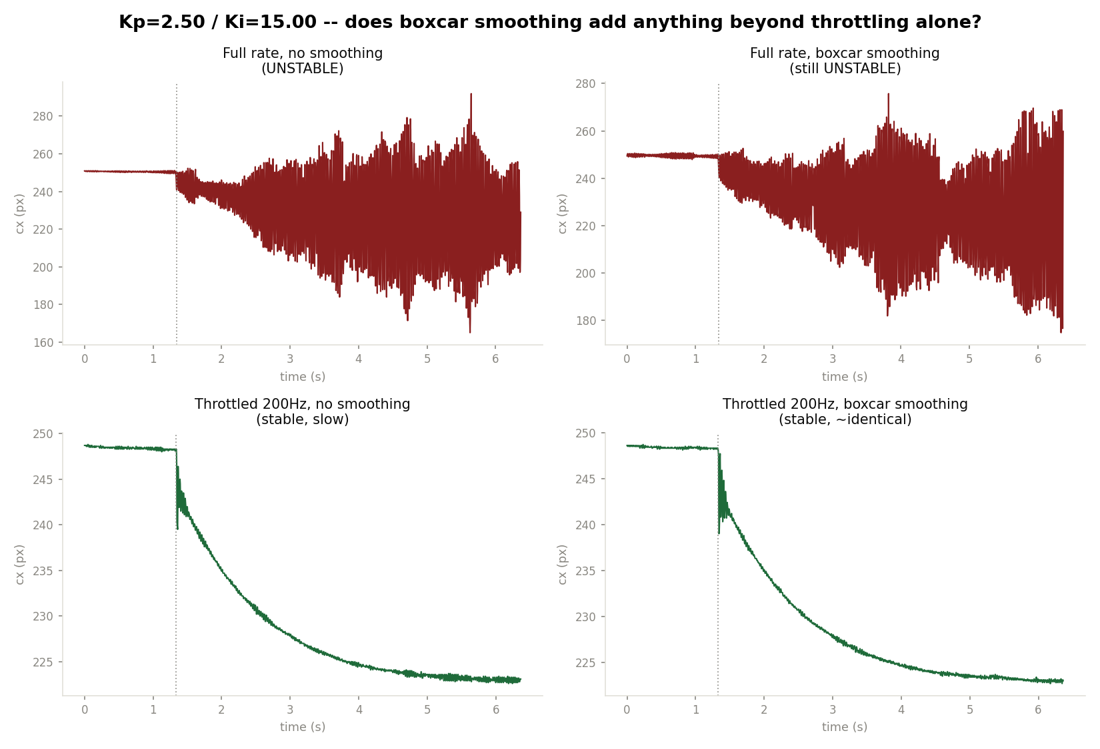
Tested a boxcar smoothing pre-filter — first result was a false alarm, real test says no
• Full-rate + smoothing on Kp=1.75/Ki=200 looked like a clean win (161ms/3.5%/247ms) — until re-running full-rate WITHOUT smoothing on the exact same config also came back clean. The original instability had stopped reproducing for unrelated reasons — same mystery as the throttle recovery, not a smoothing effect (also makes sense mathematically: at full rate the averaging window is ~1 sample, a near no-op).
• Found a config that's still genuinely unstable right now (Kp=2.5/Ki=15) to test properly: smoothing does NOT rescue it at full rate (still 195% overshoot). Throttling alone DOES stabilize it (slow, ~2.2s). Adding smoothing on top of throttling changes nothing measurable — visually identical traces.
• Honest conclusion: rate reduction (throttling) is the real lever; boxcar averaging adds no measurable benefit on top of it. The deeper mystery — why the original instability stopped reproducing at all — remains open and is arguably the more important unresolved question now.

Slide 17
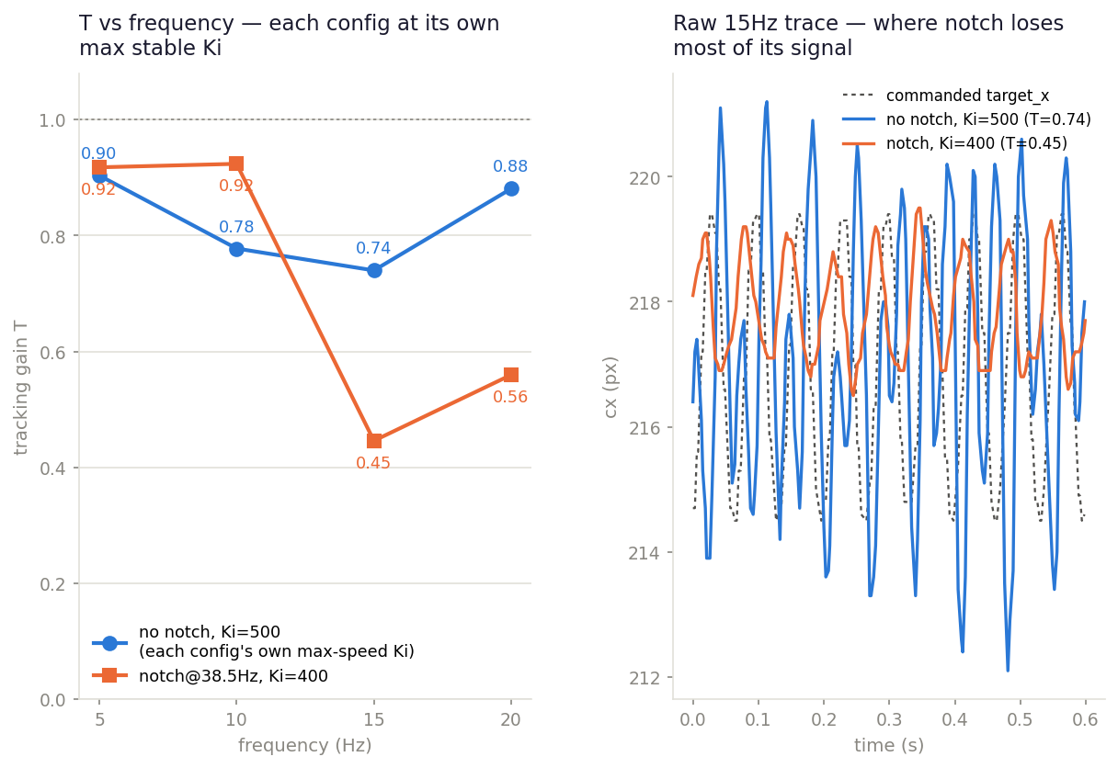
Notch vs. no notch, each tuned to its OWN max-speed Ki — a real, mixed result
• Rebuilt the comparison properly: bisected each config's OWN max stable Ki (step-response, mode-engagement now explicitly verified, not just trusted) instead of comparing notch against a fixed low-Ki baseline.
• No-notch's real ceiling is HIGHER (Ki=500) than the notch's (Ki=400) — the notch never raised the Ki boundary. Confirms the earlier “doesn't move the boundary” finding, now with a fully mode-verified harness.
• At each config's own best: notch wins at 5-10Hz (T~0.92 vs. 0.78-0.90) but loses badly at 15-20Hz (T 0.45-0.56 vs. 0.74-0.88) — worse than no notch, not just less-improved.
• Likely cause: the notch's stopband skirt (Q=3 @ 38.5Hz) still attenuates real 15-20Hz signal, with no extra Ki headroom to compensate.
⚠ CORRECTION (2026-08-27): the notch used here was mis-clocked (~16.8Hz, not 38.5Hz) due to a firmware sample-rate bug — see the following slide. Step-response Ki ceiling has been rechecked with the real notch; the 5-20Hz sine-tracking comparison above has not yet been rerun.

Slide 18
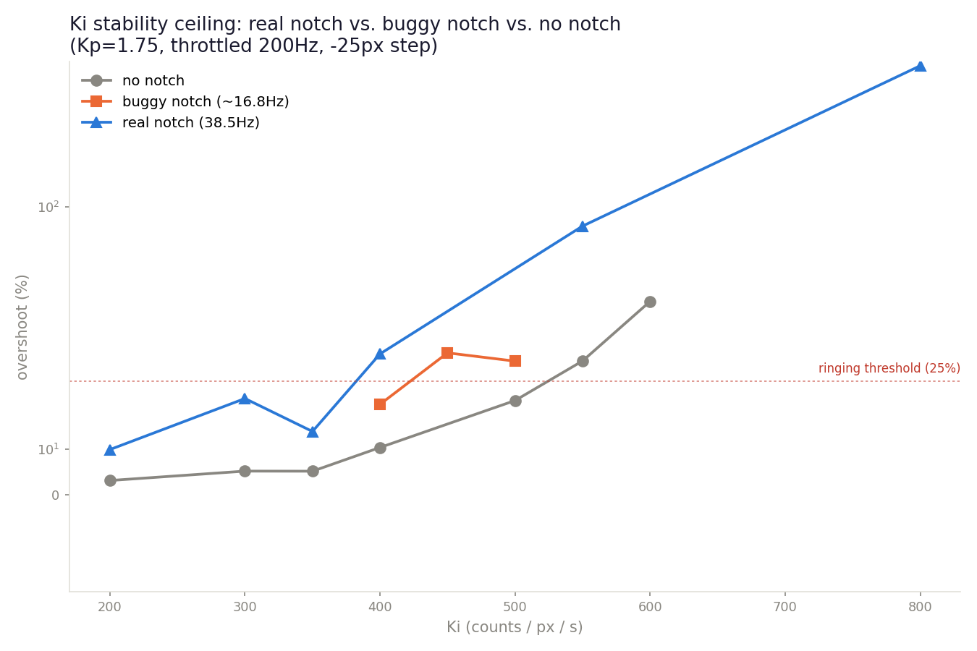
Found a real notch bug: it was mis-clocked at ~16.8Hz, not 38.5Hz — fixed, and the real notch is WORSE
• cmd_set_notch hardcoded the filter's assumed sample rate to 457.5Hz — at our throttled 200Hz operating point, a notch requested at 38.5Hz actually landed at ~16.8Hz, carving a hole in the 10-20Hz band instead of suppressing the resonance.
• Fixed to use the real current control rate (same pattern the lead compensator's set_lead already used correctly). Built clean, flashed, hardware-verified.
• Reran the Ki sweep with the REAL 38.5Hz notch: clean through Ki~350, rings by 400 — a LOWER ceiling than no notch at all (~500-550) and even lower than the buggy 16.8Hz version (~400). Not yet root-caused why.
• Does NOT explain the lead-compensator divergence: every lead+notch test ran at Ki=200, which is clean under both the buggy AND the real notch — that investigation is still open.
• Every notch number on record before this fix (including the previous slide's 5-20Hz sine comparison) should be treated as unverified until rerun.

Slide 19
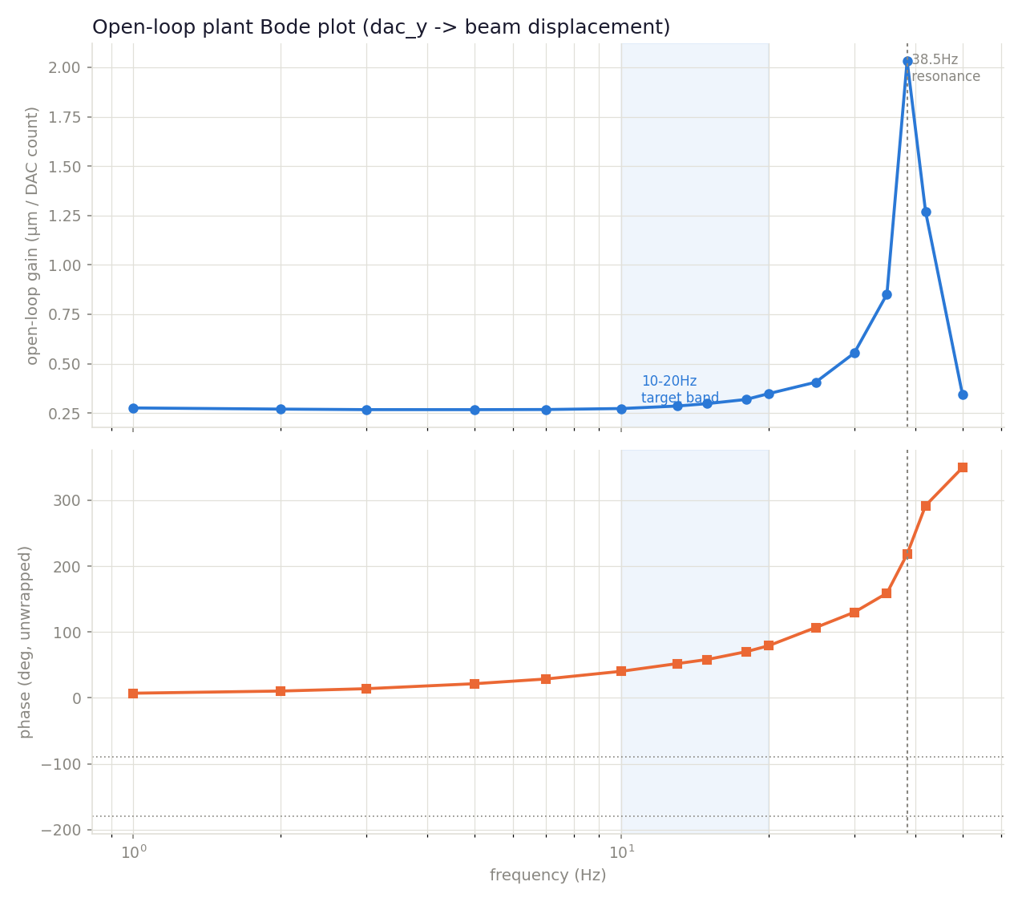
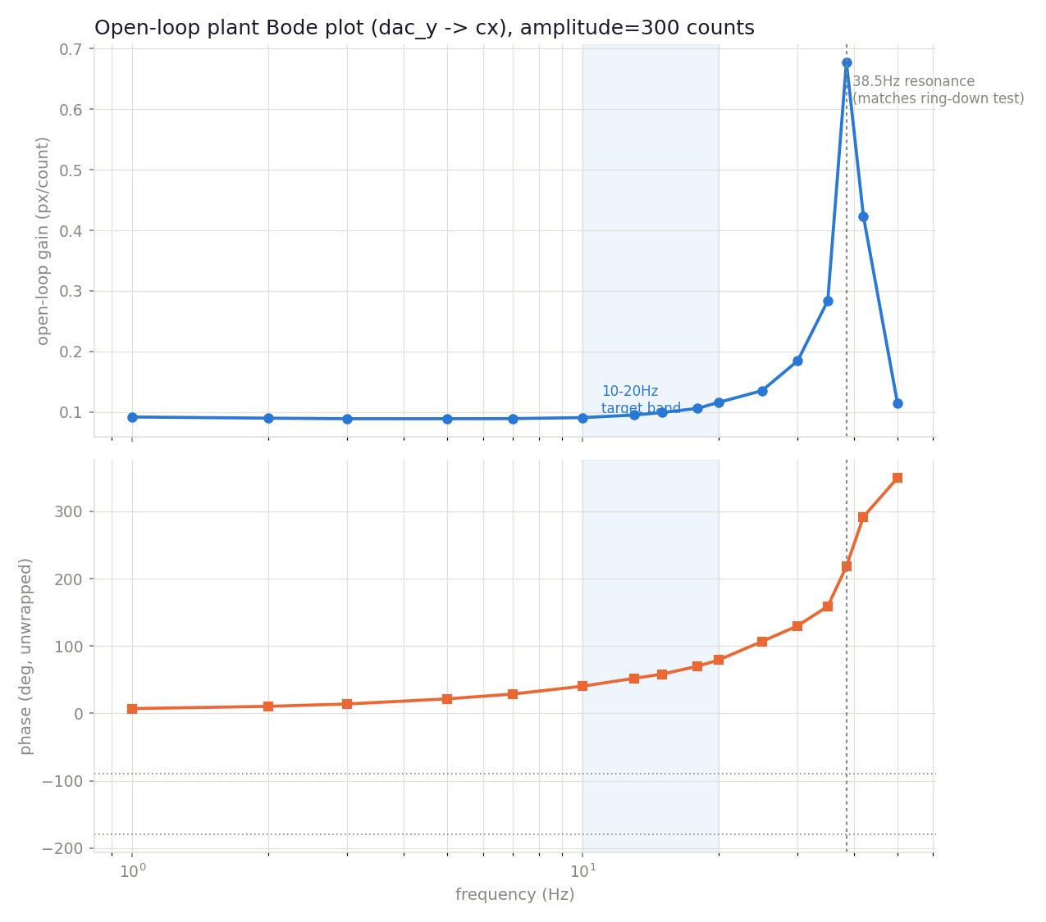
Open-loop plant Bode plot — the resonance, not delay or tuning, is the ceiling
• Built a firmware open-loop sine generator (bypasses the PID entirely, drives dac_y directly) and swept dac_y→cx across 1-50Hz — the first real open-loop frequency response measured this project.
• Phase has real margin through 10-20Hz (40° at 10Hz, 79° at 20Hz) — the plant itself isn't the problem IN that band.
• Sharp resonance at 38.5Hz (gain ~7.6x DC) — matches the ring-down test exactly, from a completely independent method (forced sine vs. free decay). Strong cross-validation, not a fluke.
• 5Hz lag (12.0ms) matches the directly-measured pure loop delay (~11.5ms) — a third independent cross-check.
• Any Ki high enough to push gain-crossover toward ~20-25Hz+ runs into the resonance's fast phase rotation (~140° in under two octaves) — explains the hard Ki ceiling all session, and why the notch's narrow fix gave a mixed result (previous slide).
• Strongest evidence yet for a hardware fix (stiffen/damp the flexure) over continued controller tuning.

Slide 20
Where this leaves us
• Best working point found: Kp=1.75 / Ki=200, throttled to 200Hz — settling ~15x faster and tracking gain ~2-3x higher (5-20Hz) than the un-throttled Ki=15 fallback.
• But even this doesn't solve the mission: sine validation shows S (disturbance sensitivity) still 66-80% across 5-20Hz — most of a real beacon wobble would still show up as position error. Fast step settling ≠ good disturbance rejection.
• Real closed-loop delay measured directly at ~11.5ms (not the ~41ms this project had assumed) — more phase-margin headroom than feared. A full open-loop Bode sweep (previous slide) CONFIRMS the resonance (38.5Hz), not raw latency, is the dominant constraint — cross-validated against the ring-down test and the delay measurement itself.
• Boxcar smoothing tested and ruled out — throttling's rate reduction is the real lever, averaging adds nothing on top of it.
• The single most important open question: the ORIGINAL Kp=1.75/Ki=200 full-rate instability that motivated this whole day's investigation has stopped reproducing, for reasons unconnected to any software change made today. This casts real doubt on how durable ANY of today's "stable" configurations actually are — worth understanding before trusting them long-term.
• Notch filter: doesn't raise the Ki ceiling (400 vs. 500 without it) — rebuilt comparison at each config's own max speed found it helps at 5-10Hz but is worse than no notch at 15-20Hz (stopband skirt attenuates real signal there). D-term: ruled out at every setting tried, but only under the same since-fixed throttle bug — worth one clean retest.
• HEADLINE: the open-loop Bode plot shows real phase margin through 10-20Hz on its own, but a sharp resonance starting ~20-25Hz caps how far Ki can push the loop's gain-crossover — this looks like a real mechanical bandwidth ceiling, not a controller-tuning problem. Recommend a hardware change (stiffen/damp the flexure) over further gain search.

Slide 21
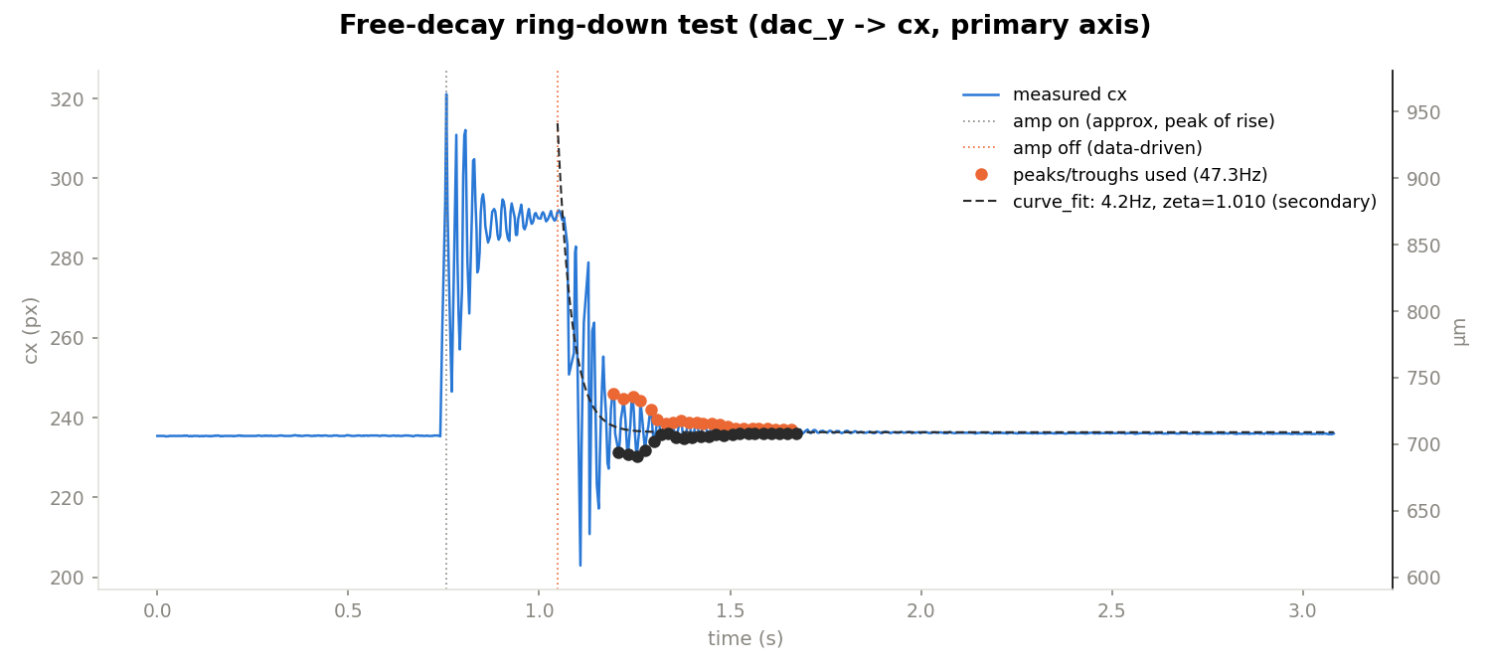
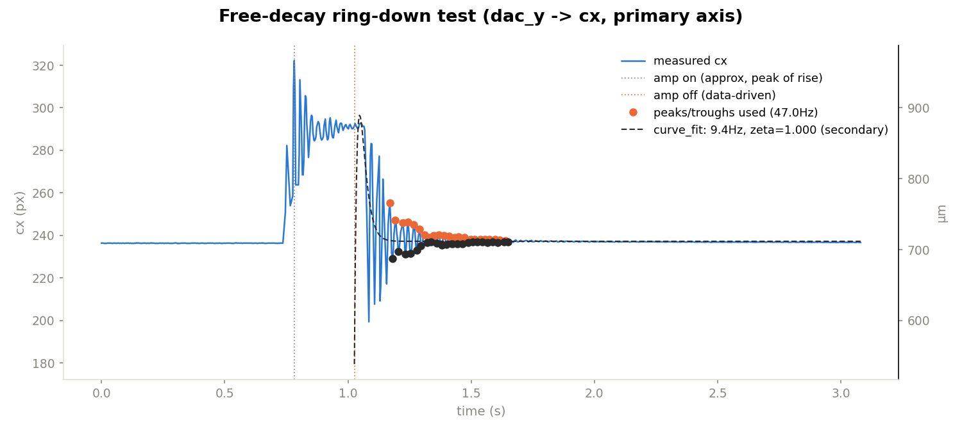
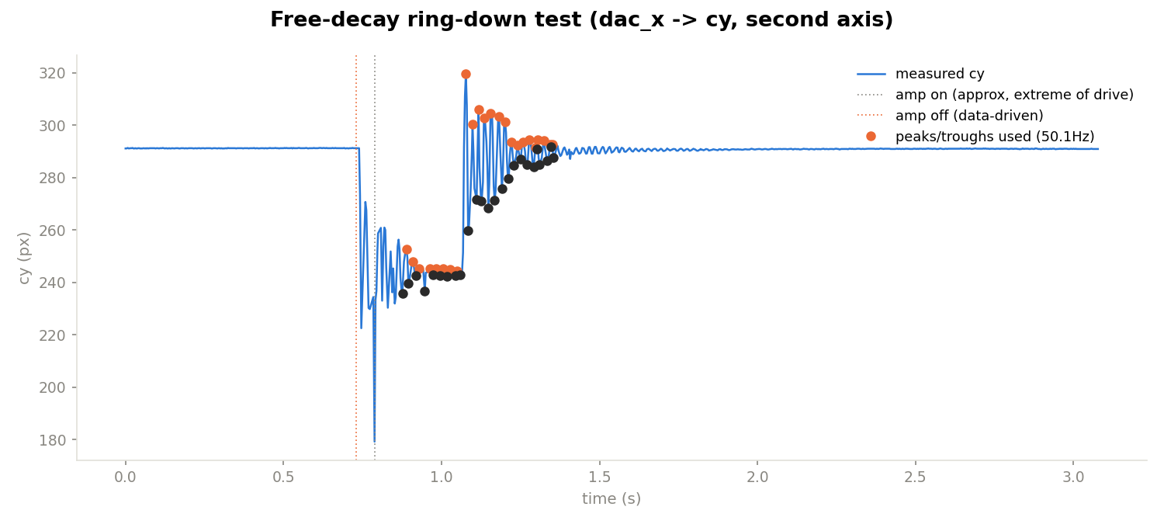
New ring-down measurements, both axes — the resonance behind the updated FEA comparison
Model-free peak-spacing estimate (dashed curve_fit overlay is unreliable — see annotation on each plot); tick-timestamped, same method as the original 38.5Hz measurement.
X-axis, trial 1: 47.3Hz
dac_y→cx, primary axis
X-axis, trial 2 (immediate repeat): 47.0Hz
dac_y→cx — tight agreement with trial 1
Y-axis, first-ever trial: 50.1Hz
dac_x→cy — only one trial so far
Both axes land close to each other and notably not close to the previously-documented 38.5Hz. Same trustworthy tick-timestamped peak-spacing method as the original measurement, so this reads as a real, reproducible shift in the physical resonance since then — see next slide for the updated FEA comparison.

Slide 22
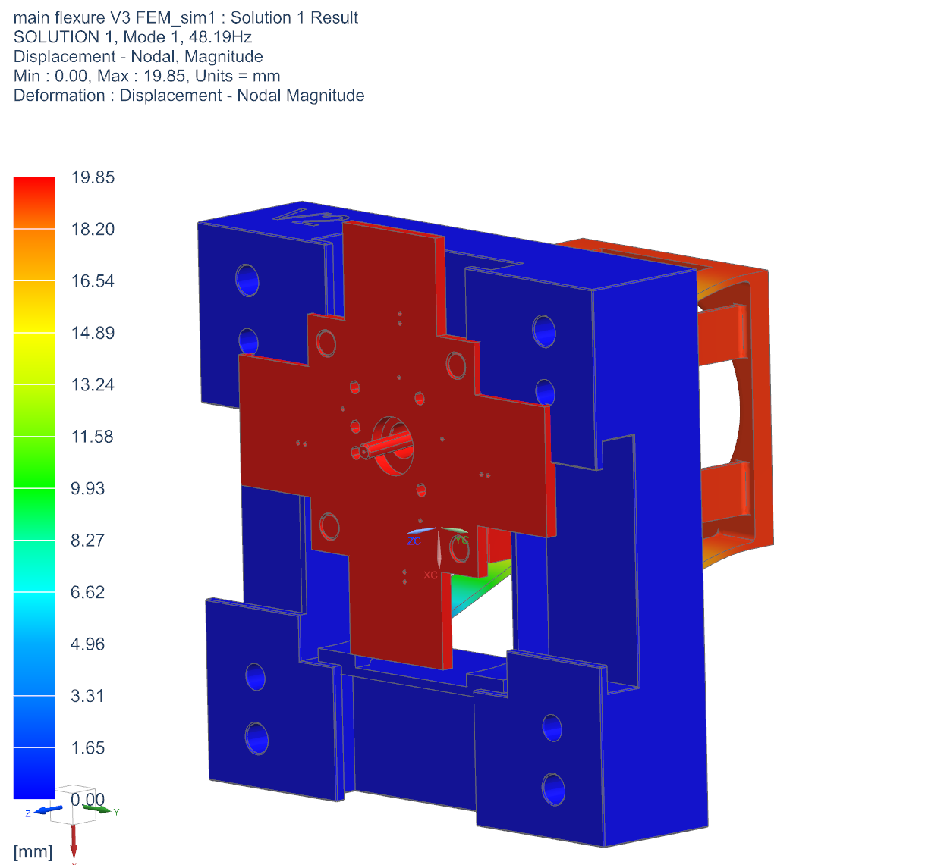
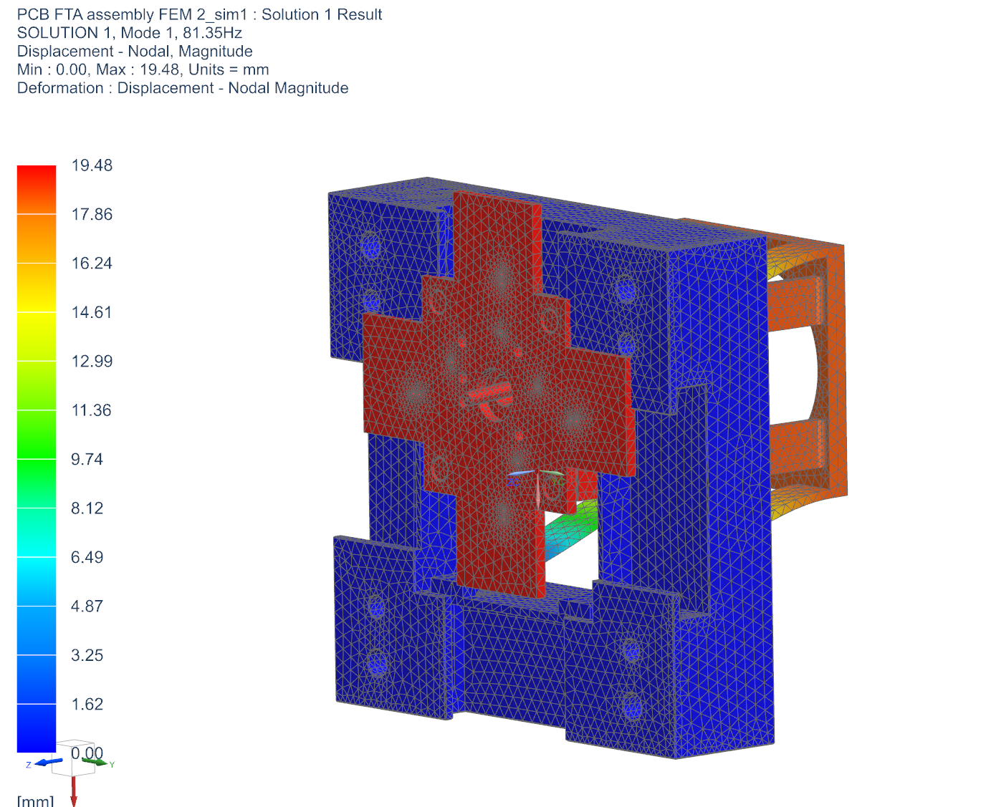
Bench resonance re-measured: 38.5Hz → ~47-50Hz — now close to FEA, not 20% below it
Superseded number, stated plainly: 38.5Hz (previous bode/ring-down) is superseded — after fixing ring-down timing bugs and testing both axes, the same peak-spacing method now reads 47.0-47.3Hz (x-axis, 2 trials) and 50.1Hz (y-axis, 1 trial). A real physical shift per CLAUDE.md, not a methodology fix; cause not yet identified.
• 0.5mm FEA has two close bending modes (48.19Hz, 52.92Hz) — pairing x-axis↔mode 1, y-axis↔mode 2 gives measured/FEA = 0.978 and 0.947: within ~2-5% of FEA, not the ~20% gap previously reported.
• Applying that ~0.95-0.98 ratio (not the old 0.80) to the 0.75mm-arm FEA (81.35Hz, 90.55Hz, below) gives a revised estimate of ~79-86Hz — close to raw FEA, not the ~65/72Hz previously stated.
• Against the 20Hz PID target that's ~4x margin, not the more pessimistic 3.25x previously concluded here — close to what raw FEA always suggested.
• Open questions: physical cause of the shift unidentified; y-axis has only 1 trial vs. x's 2. Action unchanged: rerun bode + ring-down on the actual 0.75mm part once installed.

Slide 23
FEA mode frequencies — 0.5mm vs. 0.75mm flexure arms
Mode | 0.5mm arms (Hz) | 0.75mm arms (Hz)
1 | 48.19 | 81.35
2 | 52.92 | 90.55
3 | 238.27 | 273.23
4 | 599.31 | 661.07
5 | 687.61 | 798.01
6 | 844.12 | 951.15
First six modes from the SOLUTION 1 real-eigenvalue tables (main_flexure_v3 / PCB_FTA_assembly .f06 results). Bench-measured resonance for the 0.5mm part: 47.0-47.3Hz (x-axis) / 50.1Hz (y-axis), re-measured after fixing ring-down timing bugs (originally 38.5Hz) — see previous slide.

Slide 24
I2C link + PID completion: essentially lossless end to end
• Link completeness (Pi send → Nucleo I2C reception): the Pi's own capture-enumerated seq counter (increments once per camera frame, before detection/send outcome is known) unwrapped and compared against the Nucleo's ISR-level pkts+errs counters — real ground truth on both ends, immune to the separately-known ~4-8% VCP relay line loss (that only affects host-side observability, not the real link).
• Confident packet → completed PID loop: measured via two new firmware counters (confident_pkts=, cseq=). 99.97% (6423/6425) across 3 trials — the single-slot g_latest_beam "mailbox" can in principle drop a packet if two I2C receptions land in the same critical section; measured rate is ~1 in 3200, not a meaningful limiter.
• Not measured: whether the camera driver itself (Picamera2/libcamera) drops frames before Python's capture_array() call returns them — a different, deeper layer than anything checked here.
Trial | Pi sends (seq) | Nucleo registered | Lost
1 | 3610 | 3610 | 0
2 | 3672 | 3672 | 0
3 | 3591 | 3591 | 0
Total | 10873 | 10873 | 0
0 lost across all 3 trials, ~10,873 real sends -- 8s windows, open_loop/amp off, link-only check

Slide 25
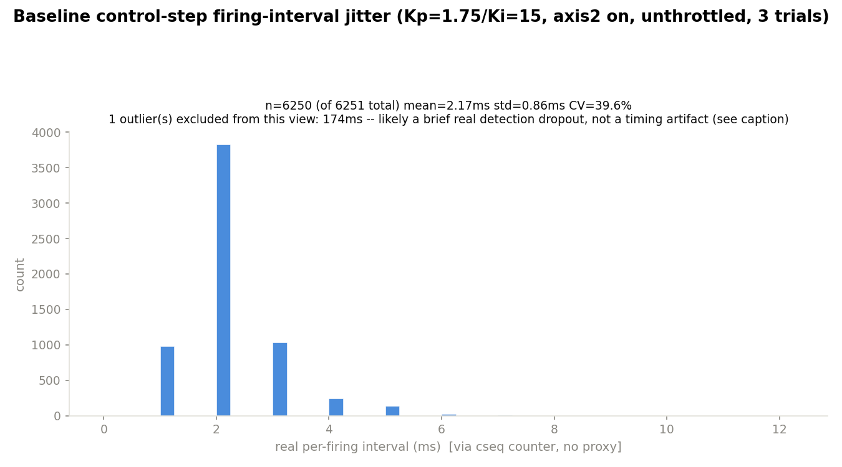
Real control-step timing jitter (current config)
• Measured via the g_ctrl_step_seq counter (cseq=) -- real per-firing intervals from consecutive firmware tick= deltas, NOT the earlier dac_y-value-change proxy (which silently undercounts near settled periods and produced unusable jitter numbers, see prior entry).
• Kp=1.75/Ki=15, axis2 on, unthrottled, 3 trials pooled: dominant cluster n=6250, mean=2.17ms, std=0.86ms, CV=39.6% — a real, honest consistency number, not the 88-127% chaos the old method gave.
• One 174ms outlier (1 of 6251, 0.016%) excluded from the CV above and shown separately — cseq only increments on a confident detection, so this most likely reflects a brief real detection dropout, not a comms/firmware stall.

Slide 26
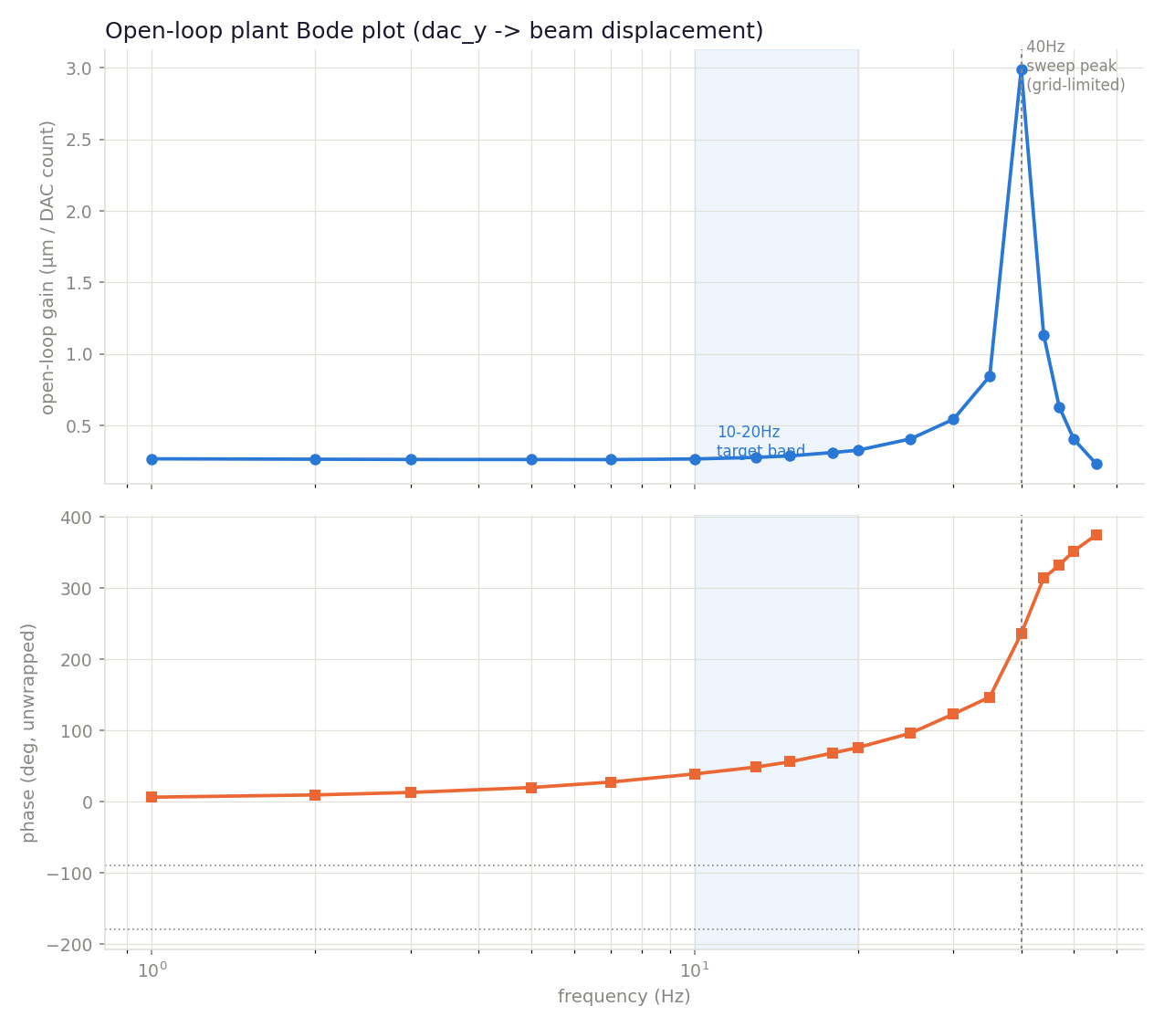
Fresh Bode re-sweep, primary axis (dac_y -> cx) — same resonance shape, used to design the lead compensator
• Fresh 18-point re-sweep (1-55Hz, amplitude reduced 300→150 counts for margin) of the same pathway already characterized on 2026-08-19 — re-run to get a clean, trustworthy basis for a new lead-compensator design.
• Confirms the same qualitative shape as the original sweep: flat gain 1-13Hz, real phase margin through 10-20Hz (40° lag at 10Hz, matching almost exactly), then a sharp resonant peak.
• Grid-sampled peak lands at 40Hz (~11x the low-frequency baseline gain) — grid-limited (35/40/44Hz sampled around it), so read as consistent with, not a correction to, either the 38.5Hz or ~47-50Hz ring-down numbers already on record.
• This data was used to design the fz≈15.4Hz/fp≈26Hz lead compensator on the next slide — which failed violently on hardware, tracing back to gain this resonance skirt adds in the 15-35Hz band, not a design or coefficient error.

Slide 27
Lead compensator, designed from real Bode data -- still fails, but not from a bug
• Designed fz≈15.4Hz / fp≈26Hz via standard phase-margin sizing from the fresh Bode sweep. Coefficient math independently re-derived and verified correct against lead_compute_coeffs()/lead_apply() -- bilinear-transform substitution matches exactly, DC gain ≈1.0, Nyquist-band gain matches the designed fp/fz ratio.
• Tested on hardware (Kp=1.75/Ki=400): 598% overshoot, oscillation building even BEFORE the commanded step -- worse than the 106% no-lead baseline, not better. Genuine instability, not poor damping.
• Loop-gain simulation against the real measured plant data explains why: both configs cross gain=1 a SECOND time right where the resonance's gain is already climbing steeply (well before its 40Hz peak). Any lead compensator adds gain along with phase -- that extra gain lands right in the danger zone and pushes the crossing to a worse point, not a better one.
Config | 2nd gain=1 crossover | phase there | naive margin
no lead (baseline) | 36.4 Hz | -217° | -37°
with lead (fz=15.4/fp=26) | 34.3 Hz | -177° | +2.6°
Caveat: this loop crosses gain=1 three times, so a naive "180+phase" margin isn't strictly valid -- applied to a config already confirmed clean on hardware it predicted instability too. The COMPARATIVE read (lead's crossing is lower and worse) is the trustworthy part, not the exact degree values.

Slide 28
Tried a much tighter notch instead -- real hardware says it's worse, not better
• Simulation suggested tightening the notch (Q=3→30) should cost almost nothing in the 10-20Hz band (<0.4% gain change vs. no notch) -- worth testing directly on hardware, no rebuild needed (set_notch is live-tunable).
• Real sweep: Q ∈ {8, 12, 20} × Ki ∈ {200, 400, 600, 800} at Kp=1.75, notch @ 40Hz, throttled 200Hz. ALL 12 combinations were worse than the already-poor Q=3 result, and worse monotonically as Q increased -- Q=20 diverges even at Ki=200, previously safe under both no-notch and Q=3.
• Likely explanation: the simulation only checked magnitude attenuation, never phase. A notch's phase distortion swings across a much wider band than its visible magnitude dip -- at ~200Hz sample rate vs. a 40Hz center (only ~5x oversampled), that phase cost is real and gets worse, not better, as Q tightens.
• Net: D-term, the original Q=3 notch, this higher-Q sweep, and now a correctly-designed lead compensator have ALL failed against this resonance -- four independent approaches. Recommend treating the flexure hardware redesign as the primary path, not further controller tuning.
Notch Q | Ki=200 verdict | note
3 (earlier baseline) | CLEAN (9.9% overshoot) | already known-good
8 | RINGING (91.4%) | worse than Q=3
12 | GROWING / UNSTABLE | worse still
20 | DIVERGED | unstable even at the safest Ki tested

Slide 29
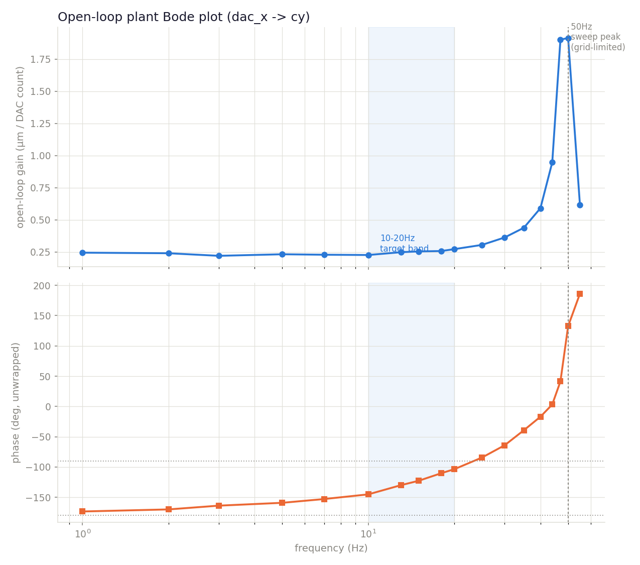
Second axis (dac_x -> cy): its own resonance, corroborated two ways
• First-ever open-loop Bode sweep on this pathway (18 points, 1-55Hz) -- previously only a single ring-down trial and a step-response smoke test existed for this axis.
• Real resonance found at ~47-50Hz (grid-limited), gain peaking at 0.63-0.64 px/count vs. a ~0.07-0.08 px/count low-frequency baseline (~8x amplification).
• Closely matches the existing ring-down measurement for this SAME axis (50.1Hz) -- two independent methods (forced sine vs. free decay), same answer.
• Gentler than the primary axis's resonance (~8x here vs. ~11x for dac_y->cx), but in the same 40-50Hz neighborhood -- worth checking whether the two axes share a common physical mode before finalizing the flexure redesign.

Slide 30
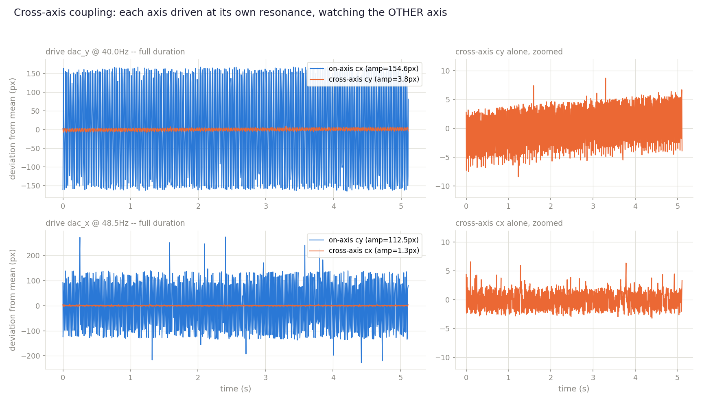
Cross-axis coupling test: FEA's independence prediction confirmed on hardware
• FEA predicts the two flexure axes are totally independent modes -- driven each axis at its own resonance (real, large excitation: 154.6px on dac_y@40Hz, 112.5px on dac_x@48.5Hz) and watched the OTHER axis for any response.
• Cross-axis response in both directions was indistinguishable from that axis's own quiet-sitting noise floor (cy: 3.8px vs. 2.8px baseline std; cx: 1.3px vs. 3.5px baseline std) -- no coupling signal in either direction, despite driving right at peak excitation.
• Confirms the FEA prediction with a real measurement, not just consistency with it -- the flexure redesign can treat the two axes as separate problems.

Slide 31
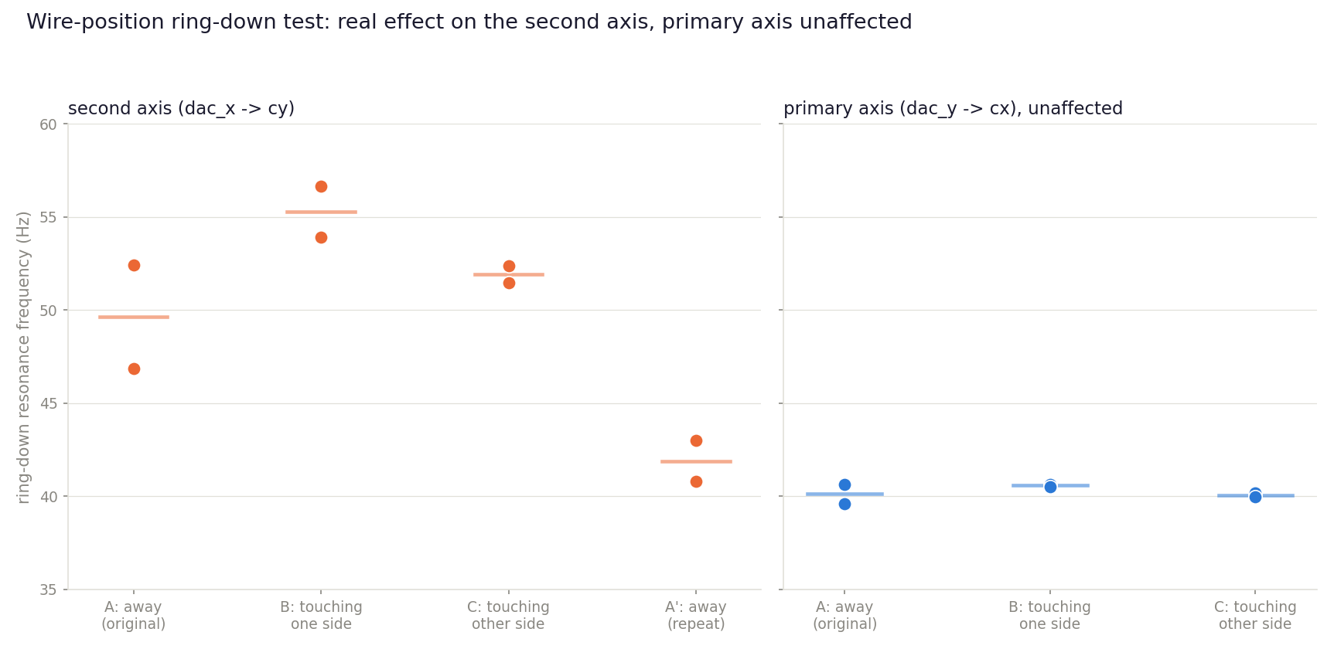
Wire-position ring-down test: a real, partial explanation for the resonance drift
• Tested whether cable routing explains why this project's resonance measurements have drifted session to session -- ring-down on both axes across 4 wire configurations (away / touching one side / touching the other side / back to away).
• Real, reproducible effect on the second axis (dac_x -> cy) only: touching one side pushed the resonance up (~55Hz avg vs. ~50Hz away), touching the other side landed in between (~52Hz) -- the primary axis (dac_y -> cx) stayed flat (39.6-40.7Hz) through every configuration, unaffected.
• The repeat "back to away" trial did NOT cleanly reproduce the original away measurement (43.0/40.8Hz vs. the original 46.9/52.4Hz) -- wire contact is a real, confirmed lever, but it's a partial explanation, not the full story; something else still moves this axis's resonance too.
• Doesn't block anything: the ~47-50Hz figure already used for the FEA comparison sits comfortably inside this session's full observed range (40.8-56.6Hz) -- proceeding with the flexure redesign on that basis remains reasonable.

Slide 32
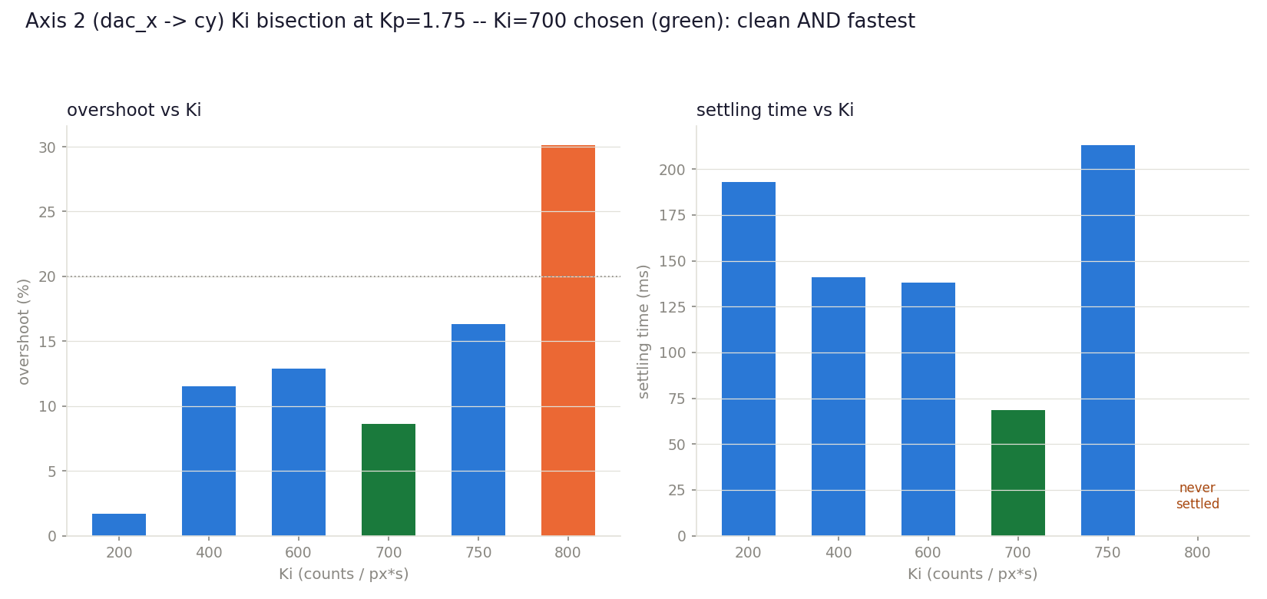
Axis 2 (dac_x -> cy) tuned independently for the first time -- beats axis 1's best-ever result
• Axis 2 always mirrored axis 1's gains before today -- added independent set_kp2/set_ki2/set_kd2 and set_target_y (needed to command a step at all) to tune it on its own merits.
• Ki bisected at Kp=1.75: real ceiling sits 750-800 (ringing/diverging past that).
• Kp=1.75/Ki=700 chosen: 8.6% overshoot, 68.5ms settling -- clean AND the fastest point tested, beating axis 1's own historical best (141-193ms) with the same methodology.

Slide 33
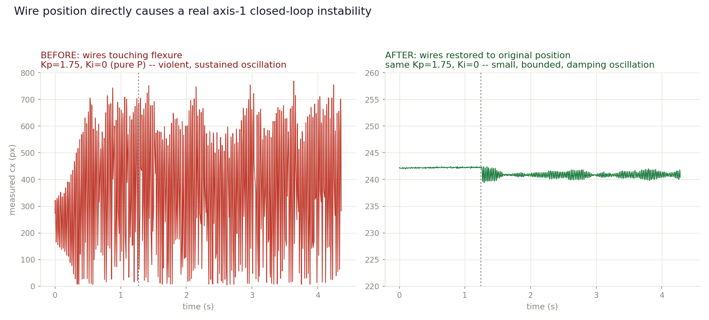
A real, severe wire-position instability found on axis 1 -- confirmed and fixed
• Small-amplitude testing (motivated by the real disturbance being atmospheric, not periodic) hit a severe, non-monotonic axis-1 degradation -- much bigger than expected from step size alone.
• Isolated to pure P (Kp=1.75, Ki=0, no integral at all): violent, SUSTAINED ~600px oscillation, present even holding a fixed point before any step. This project has never seen Kp=1.75 alone be unstable -- the known P-only boundary is ~Kp=6-6.5, over 3x higher.
• Root cause: the wire manipulation from the same day's wire-position ring-down test -- confirmed by asking the wires be restored to their original position and rerunning the IDENTICAL test.
• A real, standalone finding: wire routing can destabilize this rig's PRIMARY axis's basic closed-loop stability, not just shift the secondary axis's resonance frequency -- worth permanently securing the wires away from the flexure.

Slide 34
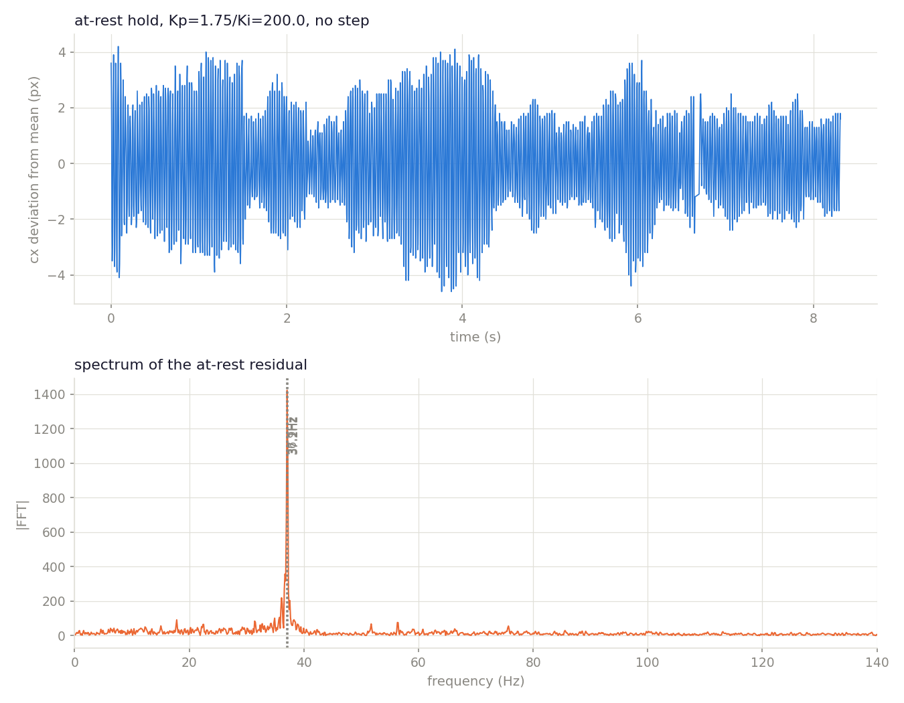
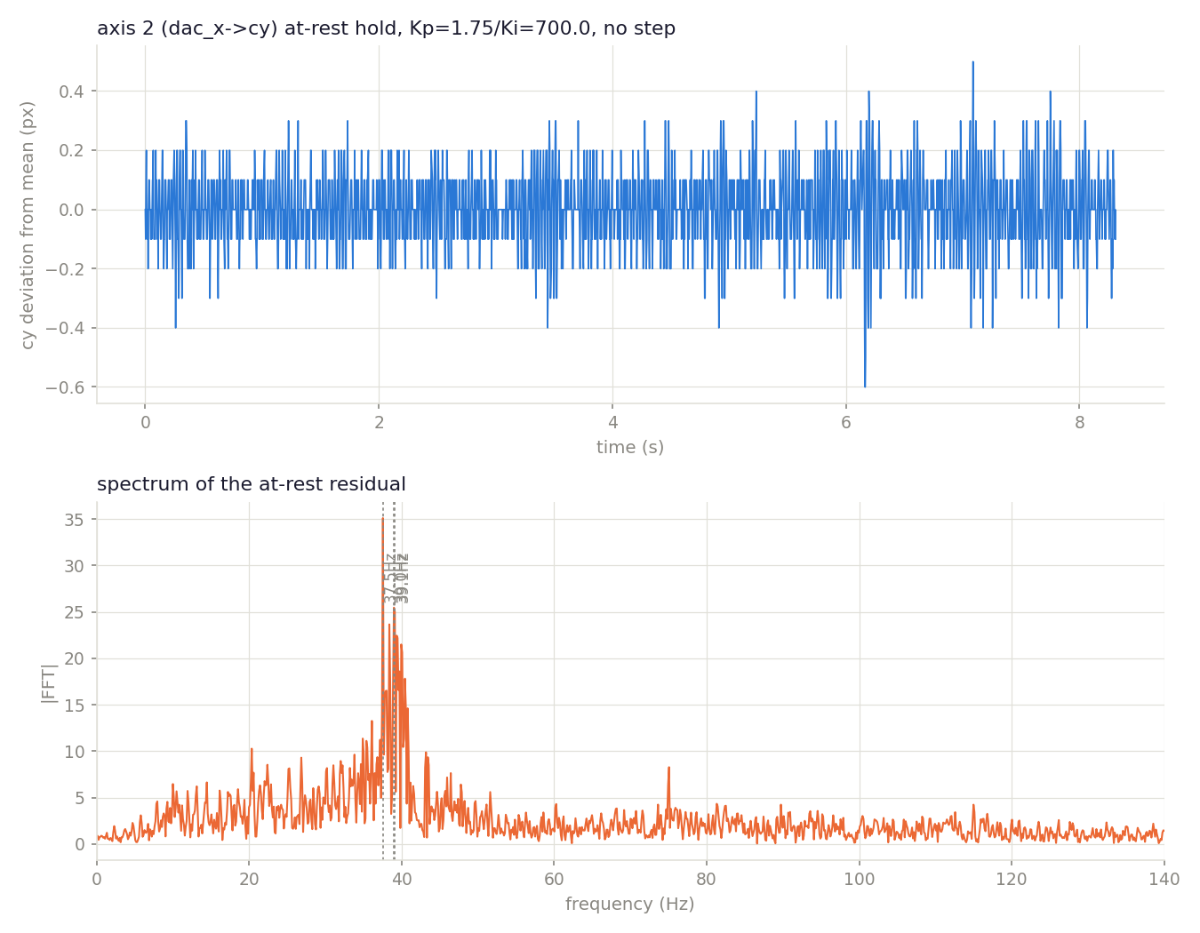
The persistent background buzz is the flexure resonance, self-excited at rest
• Every axis-1 trace all session showed a small, sustained oscillation even holding a fixed point -- FFT'd a genuine zero-step hold on both axes to find out why.
• Axis 1: a single, sharp, dominant peak at ~37Hz -- matches this session's other resonance measurements (Bode ~40Hz, ring-down 39.6-40.7Hz). The buzz IS the resonance, continuously self-excited by the loop.
• Axis 2: dramatically quieter -- noise floor ~7x smaller, only a weak broadband bump, no sharp peak. A third independent signal (with the gentler resonance and better small-step behavior) that axis 2 is the healthier pathway.
• Closes today's last open thread: every finding traces back to the same ~37-40Hz resonance -- the flexure redesign remains the fix, not further controller tuning.

Slide 35
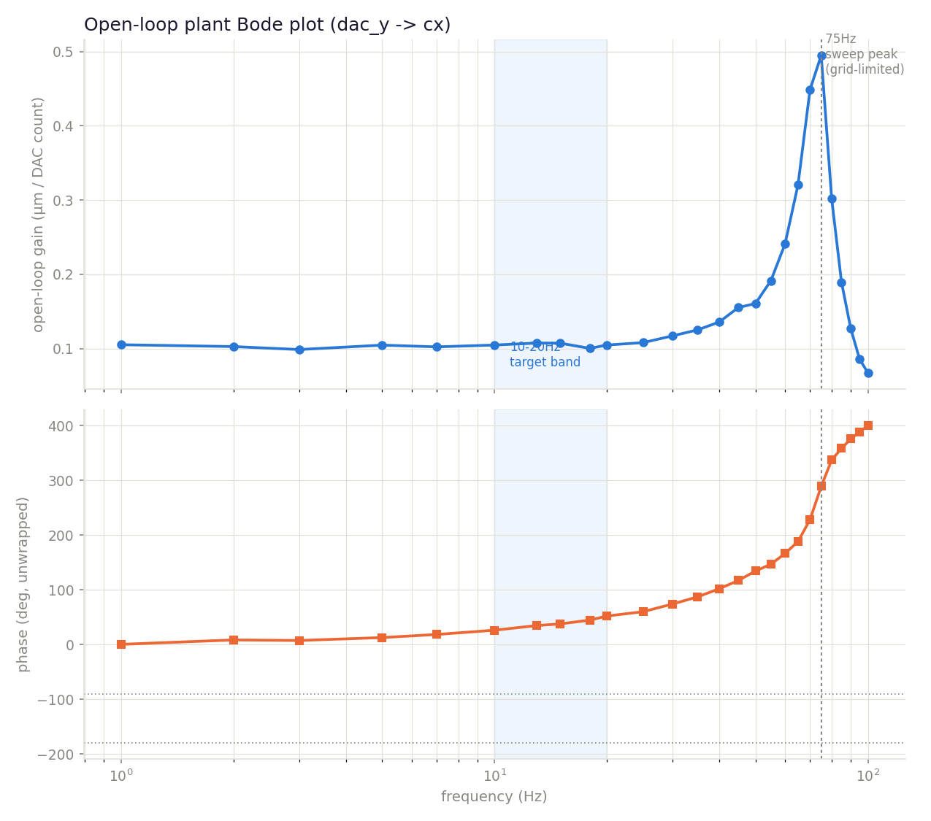
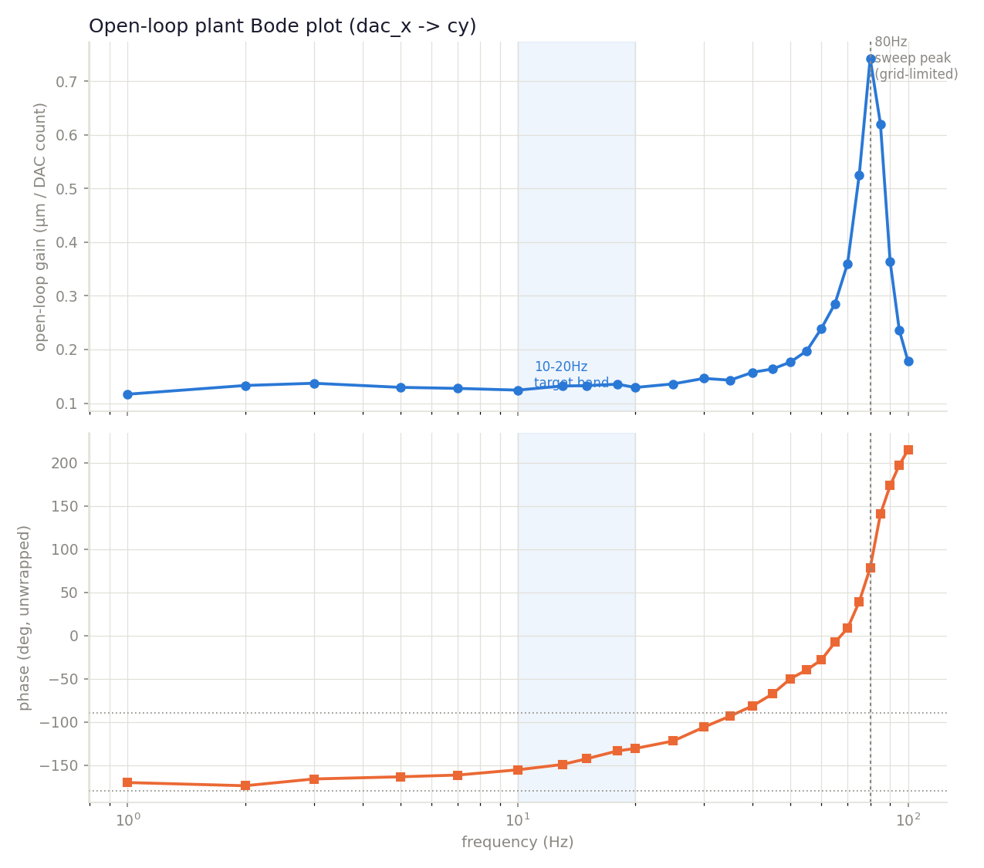
New flexure open-loop Bode sweeps, both axes -- resonance pushed well past 10-20Hz
• 1-100Hz open-loop sweep (firmware sine generator, amplitude=150 counts, base=2048) on both DAC axes -- the first full-band open-loop characterization of the new (stiffer) flexure.
• Axis 1 (dac_y->cx): resonance peak at 75Hz (grid-limited), ~4.9x DC gain. Axis 2 (dac_x->cy): peak at 80Hz, ~5.8x DC gain, visibly cleaner/lower-noise curve. Both roughly 2x the old flexure's ~38-50Hz range.
• Both axes show flat gain and modest phase lag through the 10-20Hz target band (axis 1: 26 deg at 10Hz, 52 deg at 20Hz) -- axis 2's large negative phase at low frequency is a known sign-convention offset (negative static gain), not real lag; its RELATIVE phase growth over the band is comparable to axis 1's.
• Closely matches the FEA-corrected prediction for the 0.75mm flexure arm (~77-80Hz) and the fresh ring-down trials (65.7/80.5Hz) -- three independent measurements converging on the same answer.

Slide 36
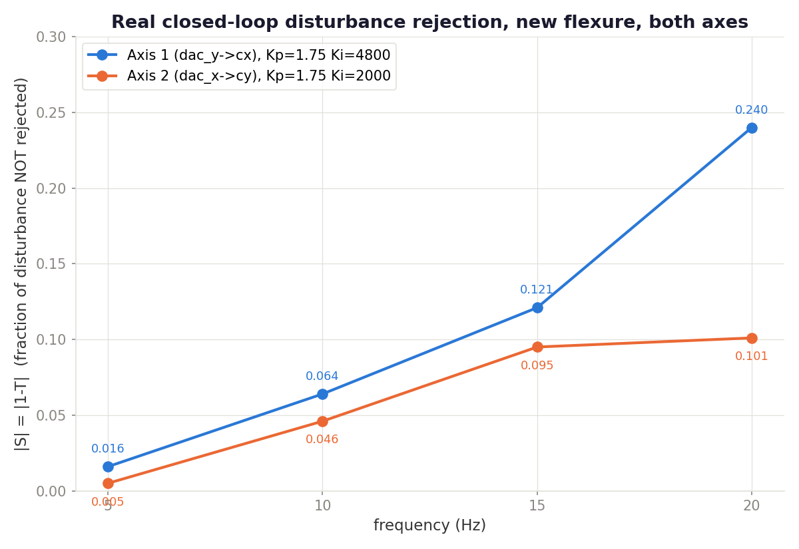
New flexure, both axes tuned and validated -- real disturbance rejection confirmed
• Fresh Kp/Ki gain search on axis 1 (dac_y->cx): Ki bisected 200->6400, real ceiling ~5200-5600 -- far above the old flexure's ~200-400. Chose Ki=4800 (Kp=1.75) for margin.
• Kd retried given the higher resonance (~75-80Hz vs old ~38-40Hz) -- still no usable window found (clean at 0.01, unstable by 0.02); Kp headroom above 1.75 found real but useless (no speed gain).
• Found and fixed a real thermal-risk bug along the way: the INACTIVE axis's DAC was left parked at the open-loop floor (95) -- near-MAX drive on this inverting amp, not near-zero -- explaining the amp heat and a real square-wave artifact seen mid-session. Fixed in every closed-loop test script.
• Axis 2 (dac_x->cy) given its own independent gain search for the first time on this flexure: real ceiling ~2400-2800, lower than axis 1's. Chose Ki=2000 (Kp=1.75) for margin.
• Extended the firmware's on-board closed-loop sine generator (previously axis-1-only) to sweep axis 2's target too -- new tgt_y=/sine_axis= telemetry, rebuilt, reflashed, verified.

