Slide 1
FTA Actuator Step-Response Bench Test
camera_centroid_receiver firmware, post NVIC-priority fix
2026-08-04 – 2026-08-06

Slide 2
Methodology
• Measured entirely from the laptop over the Nucleo's VCP (COM4, 115200 baud) — no camera/Pi access needed for this test.
• Position data sourced from camera_centroid_receiver's per-packet I2C-relay print line (≈170–190 samples/sec), not a direct camera capture.
• Protocol replicates the pre-fix 2026-07-23 baseline exactly: 95→2000 (large step), then 2000↔2100 ×3 (small steps, both directions + repeat), on each axis.
• Amp enabled once for the whole batch; board returned to idle (dac=95/95, amp off) between axis groups and at the end.
• Prerequisite fixes this session: NVIC priority swap (USART2 now preempts I2C1) eliminated VCP command byte-loss under live telemetry load — verified 30/30 clean commands before this data was collected.

Slide 3
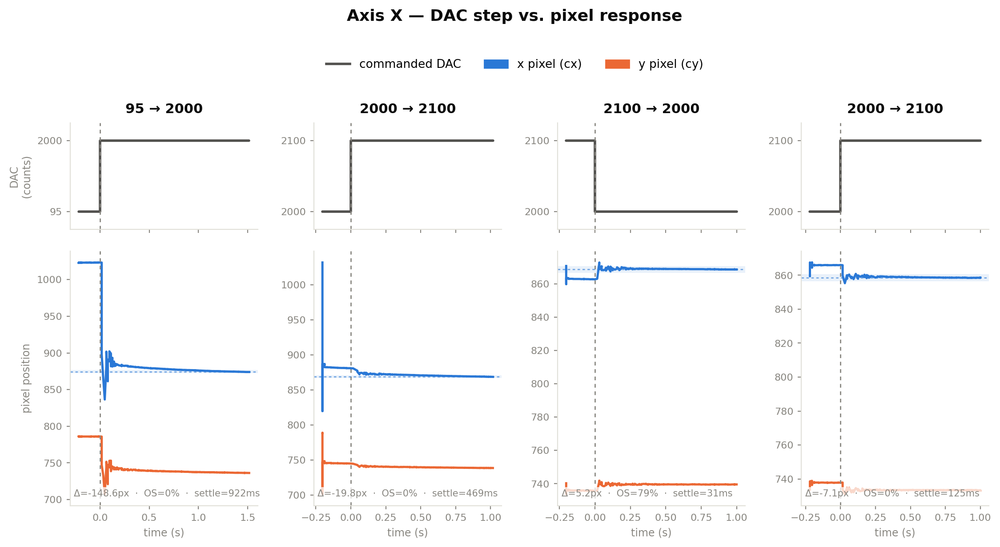
Axis X results

Slide 4
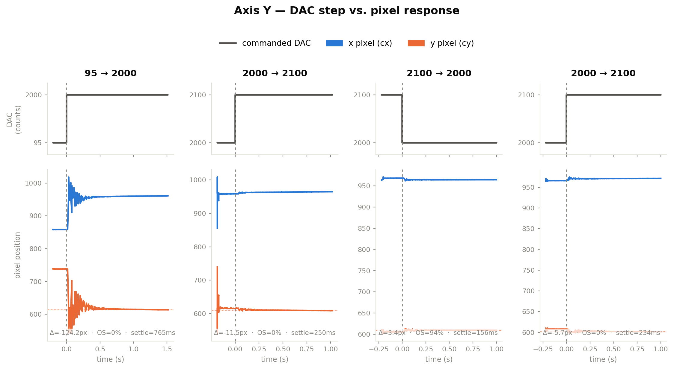
Axis Y results

Slide 5
Summary metrics
Axis | Step | Dominant | Delta (px) | Overshoot | Settling
X | 95 → 2000 | x | -148.6 | 0.0% | 922ms
X | 2000 → 2100 | x | -19.8 | 0.0% | 469ms
X | 2100 → 2000 | x | 5.2 | 79.1% | 31ms
X | 2000 → 2100 | x | -7.1 | 0.0% | 125ms
Y | 95 → 2000 | y | -124.2 | 0.0% | 765ms
Y | 2000 → 2100 | y | -11.5 | 0.0% | 250ms
Y | 2100 → 2000 | y | 3.4 | 94.1% | 156ms
Y | 2000 → 2100 | y | -5.7 | 0.0% | 234ms

Slide 6
Findings vs. pre-fix baseline (2026-07-23)
• Actuator confirmed physically moving on every run — the pre-fix "no movement" scare doesn't reproduce; amp_enable was always reaching the board.
• Axis coupling flipped, consistently across all 8 runs: DAC-x now drives pixel-x directly (was pixel-y pre-fix), DAC-y now drives pixel-y (was pixel-x). Not measurement noise — the direction is consistent. Cause not identified (likely camera/actuator reorientation during the SB16/SB18 rework or bench reconfiguration).
• → Any old fta_calibration.py fit matrix is now invalid — a fresh calibration sweep is required.
• Small-step settling times are larger and noisier than pre-fix (125–469ms vs. 22–144ms); large-step settling is comparable (765–922ms vs. 793–1183ms).
• → Not yet distinguished: a real dynamics change from the rework, vs. this method's lower sample rate (≈180Hz VCP relay vs. the original's camera-direct rate) making the settling-time criterion more sensitive to a single noisy tail sample.

Slide 7
Sine tracking — methodology
• Complements the step-response tests: commands a continuous sine on axis X (±200 DAC counts around 2000) and measures how well the pixel position follows it — directly relevant to rejecting the project's actual 10-20Hz disturbance band.
• Same laptop-only VCP approach as the step tests: set_x commands paced at 200Hz, measured position sourced from the Nucleo's per-packet I2C-relay print. Amp state is now explicitly verified (not fire-and-forget) after a real false result on 2026-08-06: a silently-failed amp_enable produced a near-zero response briefly mistaken for a genuine actuator finding.
• Frequency is known exactly, so fitting the measured trace to A·sin(ωt)+B·cos(ωt)+C is linear least-squares, no iterative fit needed.
• IMPORTANT CORRECTION: the step-response data already showed DAC increases move the pixel value DOWN on this axis (a real, normal sign convention, not a bug). A negative gain shows up in a raw amplitude/phase fit as ≈180° phase at EVERY frequency, regardless of real dynamics — initially misread as a huge lag. Fixed by reporting a signed gain plus the residual lag relative to whichever reference (0° or 180°) the fit actually landed near.

Slide 8
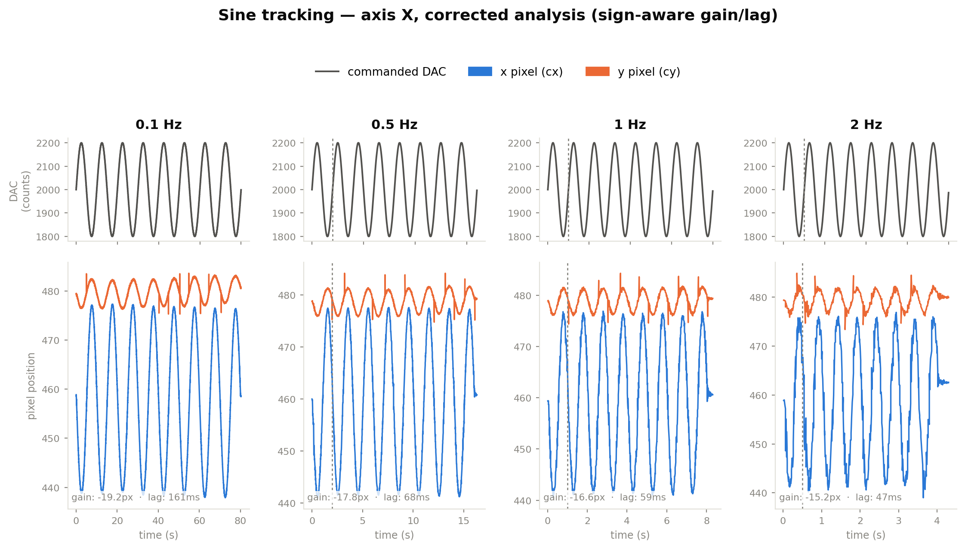
Sine tracking results (corrected)

Slide 9
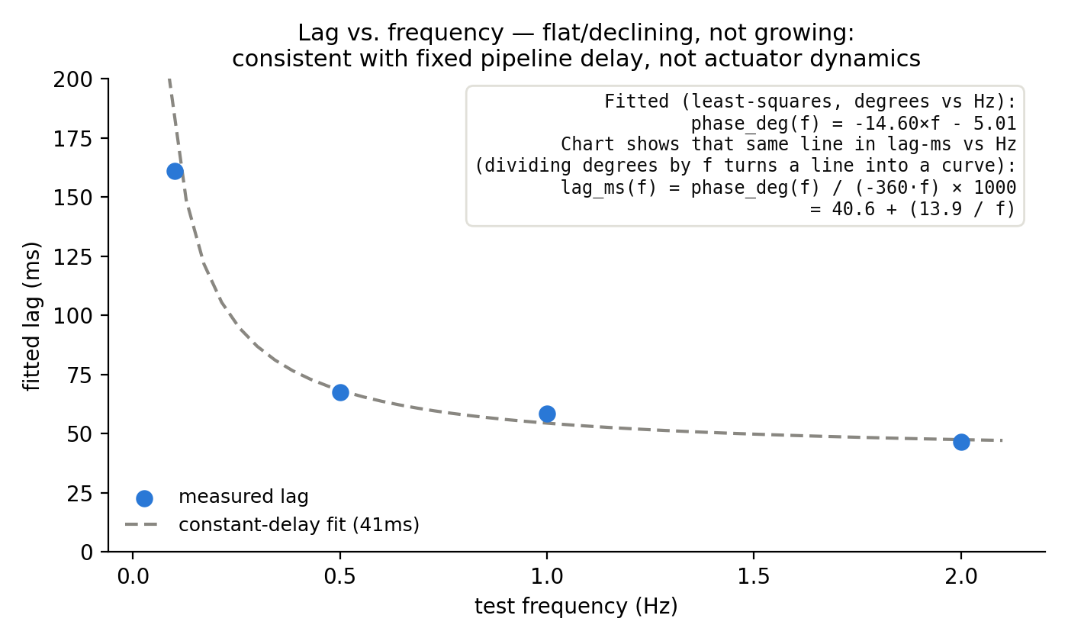
Sine tracking — lag analysis & findings
Freq | Gain (px) | Lag (ms)
0.1 Hz | -19.2 | 161
0.5 Hz | -17.8 | 68
1 Hz | -16.6 | 59
2 Hz | -15.2 | 47
• Lag-vs-frequency is close to a straight line through near-zero (residuals under 1.5° across 0.1-2Hz) — the signature of a roughly CONSTANT time delay (~41ms), not frequency-dependent actuator dynamics (which would curve/plateau, not stay linear).
• ~41ms is a plausible total for this test's own measurement pipeline (camera capture → I2C → Nucleo print → USB VCP → Python read) — a real closed-loop PID running on the Nucleo reads telemetry directly at ISR level and would not pay most of this cost.
• Gain is consistent across all 4 frequencies (-15 to -19px per 200 DAC counts, mildly declining with frequency) — no sign of the actuator failing to track or distorting at any rate tested so far, up to 2Hz.
• Net effect: the actuator's own dynamics look faster/cleaner than initially feared. Doesn't yet answer the real question (10-20Hz) — next step is pushing frequency into that band, now that the analysis is trustworthy.

Slide 10
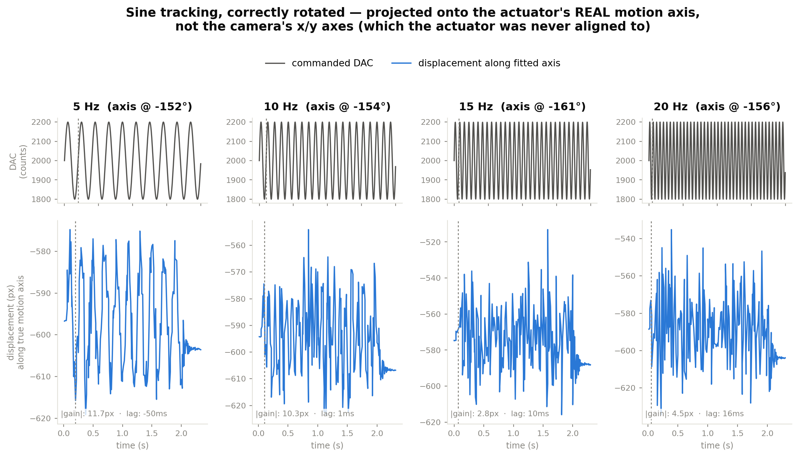
Pushing toward the 10-20Hz disturbance band
Projected onto the actuator's fitted motion axis, not the camera's x/y axes

Slide 11
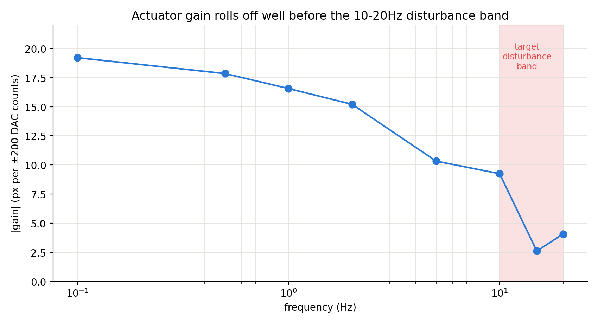
Gain rolls off well before 10-20Hz
Freq | Gain (px) | Lag
0.1 Hz | -19.2 | 161ms
0.5 Hz | -17.8 | 68ms
1 Hz | -16.6 | 59ms
2 Hz | -15.2 | 47ms
5 Hz | +10.3 | -50ms
10 Hz | +9.2 | unreliable*
15 Hz | +2.6 | unreliable*
20 Hz | -4.1 | unreliable*
• Gain drops from ~19px (0.1Hz) to ~2.6-4px (15-20Hz) — down to roughly 15-20% of the low-frequency value, right at the frequencies this project actually needs to reject.
• *Lag not reported above ~5-10Hz: at 10Hz the phase already reaches the fundamental single-frequency wraparound boundary (~180°) — a real mathematical ambiguity, not a bug — and by 15-20Hz the signal is small enough that noise likely dominates the fit anyway (visible directly in the previous slide's traces).
• CORRECTION (see "Amplitude matters" slides further on): this entire slide used ±200 DAC counts. Repeating at ±400/±800 shows the 15-20Hz collapse seen here was largely a nonlinear threshold effect specific to small commanded amplitude, not a hard actuator bandwidth ceiling — do not treat this slide's rolloff as the final word.

Slide 12
Correcting for cross-axis coupling: true displacement, not just x
• Every gain number on the previous slides was the x-pixel projection only — it ignored the real cross-axis (y) component confirmed in every test so far. True displacement is |vector| = sqrt(gain_x² + gain_y²), not gain_x alone.
• At 0.1-2Hz the correction is small (~1%) — the cross-coupling fraction is modest there. At 5-20Hz it's 6-14% larger than the x-only number — meaningful, though on its own it doesn't overturn the ±200-count rolloff conclusion.
• The motion vector's ANGLE appeared to rotate sharply between 2-3Hz (~-171.5° → ~-150 to -160°) in this pass. RETRACTED two slides on ("Angle rotation was a batch artifact") — repeating a low frequency later in a clean single-session sweep showed this was a time-dependent shift between test batches, not a frequency effect.
• Ran a finer 3-12Hz sweep (1Hz steps) to locate what looked at the time like real structure — see the correction for what that sweep actually showed once the batch-artifact issue was understood.

Slide 13
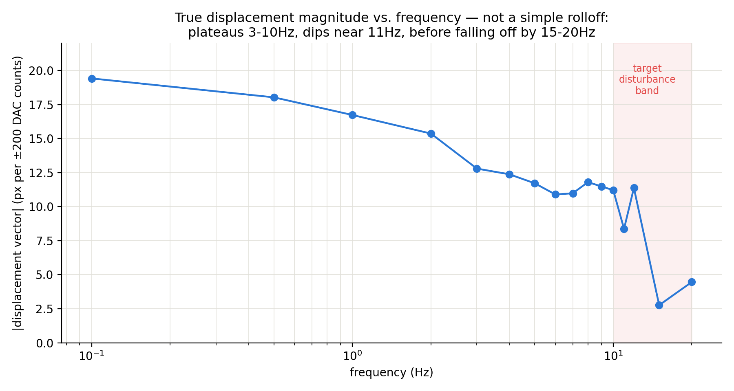
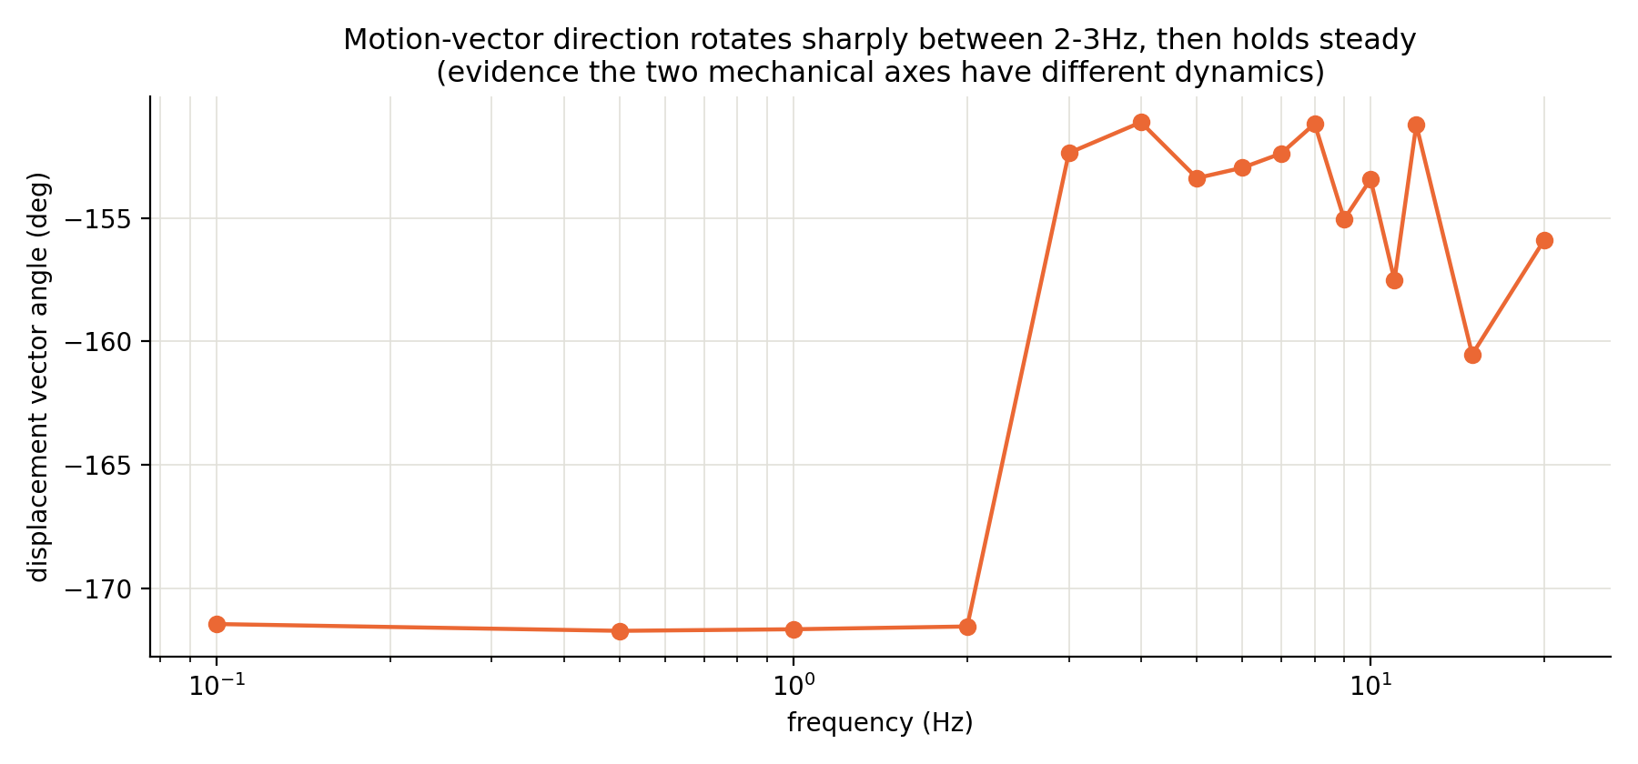
Fine sweep, as understood at the time (see retraction on the next slide)
• Magnitude plateaus 6-10Hz, dips sharply at 11Hz, partially recovers at 12Hz, then collapses by 15Hz — at the time read as resonance/anti-resonance from a two-mode mechanical system.
• That reading is now considered unreliable: this entire fine sweep was run in the same post-calibration session/batch as the earlier 5-20Hz points, so it shares whatever caused the angle/offset shift documented on the next slide. The dip-and-recovery shape's cause (measurement noise vs. a real feature) was not re-verified with a clean repeat before this deck was built.
• Kept in the deck for the record, not as a trusted finding — see the retraction and the amplitude-comparison slides for the corrected picture.

Slide 14
Retraction: the angle rotation was a batch artifact, not frequency-dependent
• User question that caught this: could the 2-3Hz angle rotation just be a sudden camera/rig shift rather than real dynamics? Checked the baseline pixel offset per test: mean y jumped from ~478-480px (0.1-2Hz batch, run ~18:58) to ~379-386px (3-20Hz batch, run ~19:39 onward, after two calibration sweeps at ~19:12-19:16) — a ~100px shift. DAC-y was confirmed unchanged (95) throughout via the printed status line, so this isn't a commanded-position difference.
• Decisive test: reran 2Hz alone, standalone, well after the calibration sweeps. Result: offset and angle matched the "high-frequency batch" pattern (~-151°), NOT the original 2Hz result (~-171.5°) — same frequency, different answer. Confirms the shift is tied to elapsed time / an intervening event (most likely the two calibration sweeps, which swing the actuator across nearly its full range), not to test frequency.
• The "two mechanical axes have different dynamics" claim on the earlier slides is retracted. Frequency and test order were confounded in that data (tests were run in increasing-frequency order over time) — this is exactly why a clean single-session sweep (next slides) was needed.

Slide 15
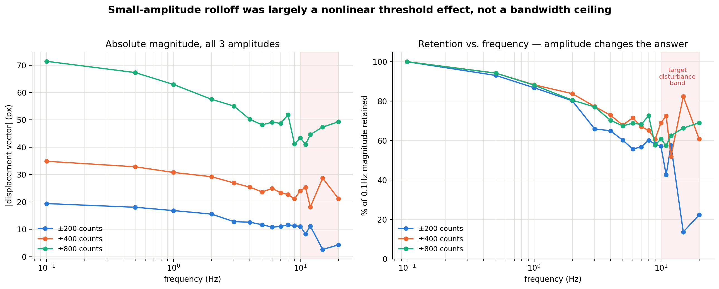
Clean resweep at 3 amplitudes: the rolloff was mostly a small-signal effect
Full 0.1-20Hz sweep repeated in one uninterrupted pass at ±200/±400/±800 DAC counts

Slide 16
What the amplitude comparison means
• % of 0.1Hz magnitude retained at 20Hz: 22% at ±200 counts, 61% at ±400, 69% at ±800 — a completely different answer depending on how hard the actuator is driven.
• If the system were linear, doubling amplitude should double the response at every frequency equally (ratio ≈ 2.0×200→400 everywhere). That roughly holds 0.1-9Hz (ratios 1.6-2.3×) but breaks badly at 15Hz (10.8×) and 20Hz (4.9×) — the signature of a nonlinear threshold (stiction/backlash/dead-band), not a linear bandwidth limit.
• Read: at small commanded amplitude, the actuator apparently can't generate enough force fast enough to break through some threshold at 15-20Hz, so it barely moves. At larger amplitude there's enough "push" to get past it, and the response recovers substantially (though not completely — even at ±800, 20Hz retains only ~69%, so there IS still some real rolloff, just far less severe than ±200 suggested).
• Bonus confirmation: angle stayed stable (~-146 to -157°) across ALL 16 frequencies in BOTH clean amplitude sweeps — further confirming the earlier "axis rotation" finding was a batch artifact, not real.
• Practical implication, not yet resolved: which amplitude regime matters depends on how large the actual beacon-wobble disturbance is in DAC-equivalent terms. If real disturbances are small, the controller may still fight this stiction effect in practice (possibly needing a small dither signal to stay unstuck) even though large-signal bandwidth looks much healthier than first measured.

Slide 17
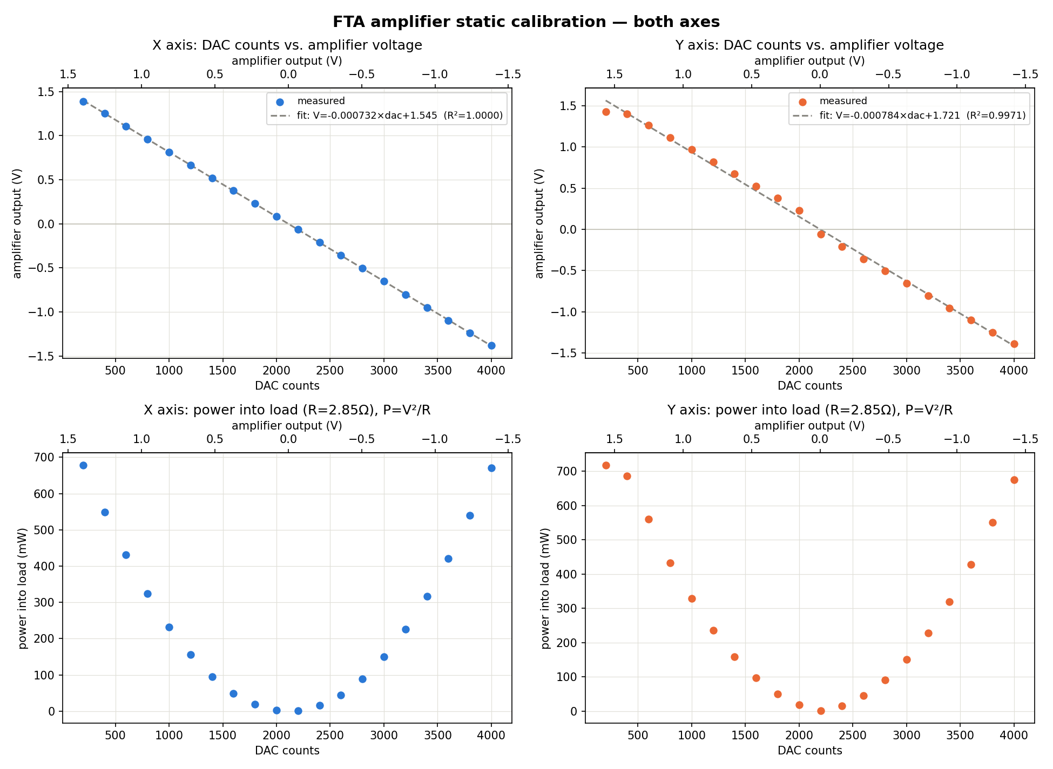
FTA amplifier static calibration — both axes
DAC counts ↔ amplifier output voltage, R=2.85Ω load
 | R² | counts/V | counts/A
X | 1.0000 | -1365 | -3891
Y | 0.9971 | -1276 | -3636
• Both axes are highly linear statically (R²=1.0000 X, 0.9971 Y) — no visible kink or dead-band across the full 200-4000 DAC range.
• counts/V and counts/A are negative because voltage decreases as DAC counts increase on both axes (same sign convention already established from the step-response/sine-tracking data).
• Complementary evidence for the sine-tracking amplitude-comparison finding: since the DAC/amp stage is this linear when swept slowly, the dynamic nonlinear threshold seen at 15-20Hz more likely lives in actuator mechanics or a frequency-dependent electrical effect, not simple DC nonlinearity here.

Slide 18
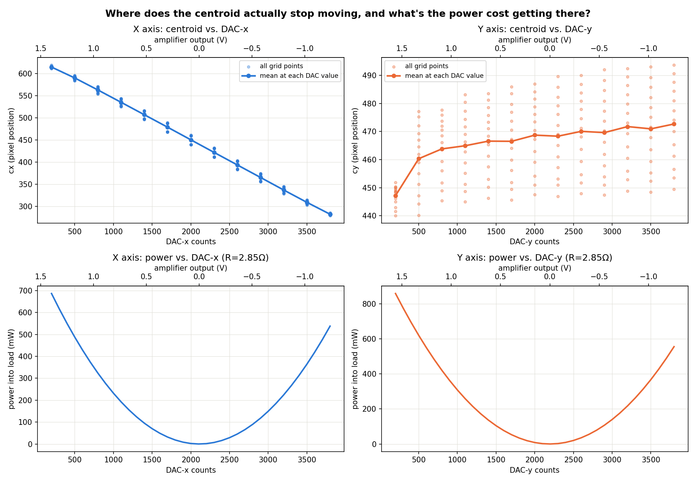
Where does the centroid actually stop moving?
Calibration sweep (DAC→centroid) combined with the amplifier power fit
• X axis: cx tracks dac_x linearly across the ENTIRE tested range (200-3800) — no flattening at either end, still responding right up to both extremes.
• Y axis: cy rises steeply from dac_y=200→~500 (~0.028 px/count), then flattens almost completely for the rest of the range 500-3800 (~0.003 mid-range, ~0.0015 at the high end — a 94-95% sensitivity drop) while power keeps climbing to ~850mW at the far end.
• Read: the Y axis's real useful travel is only about DAC 200-500/800 — a small fraction of what was swept. Past that, DAC-y commands spend power for essentially zero additional beam movement, consistent with hitting a real mechanical limit early.

Slide 19
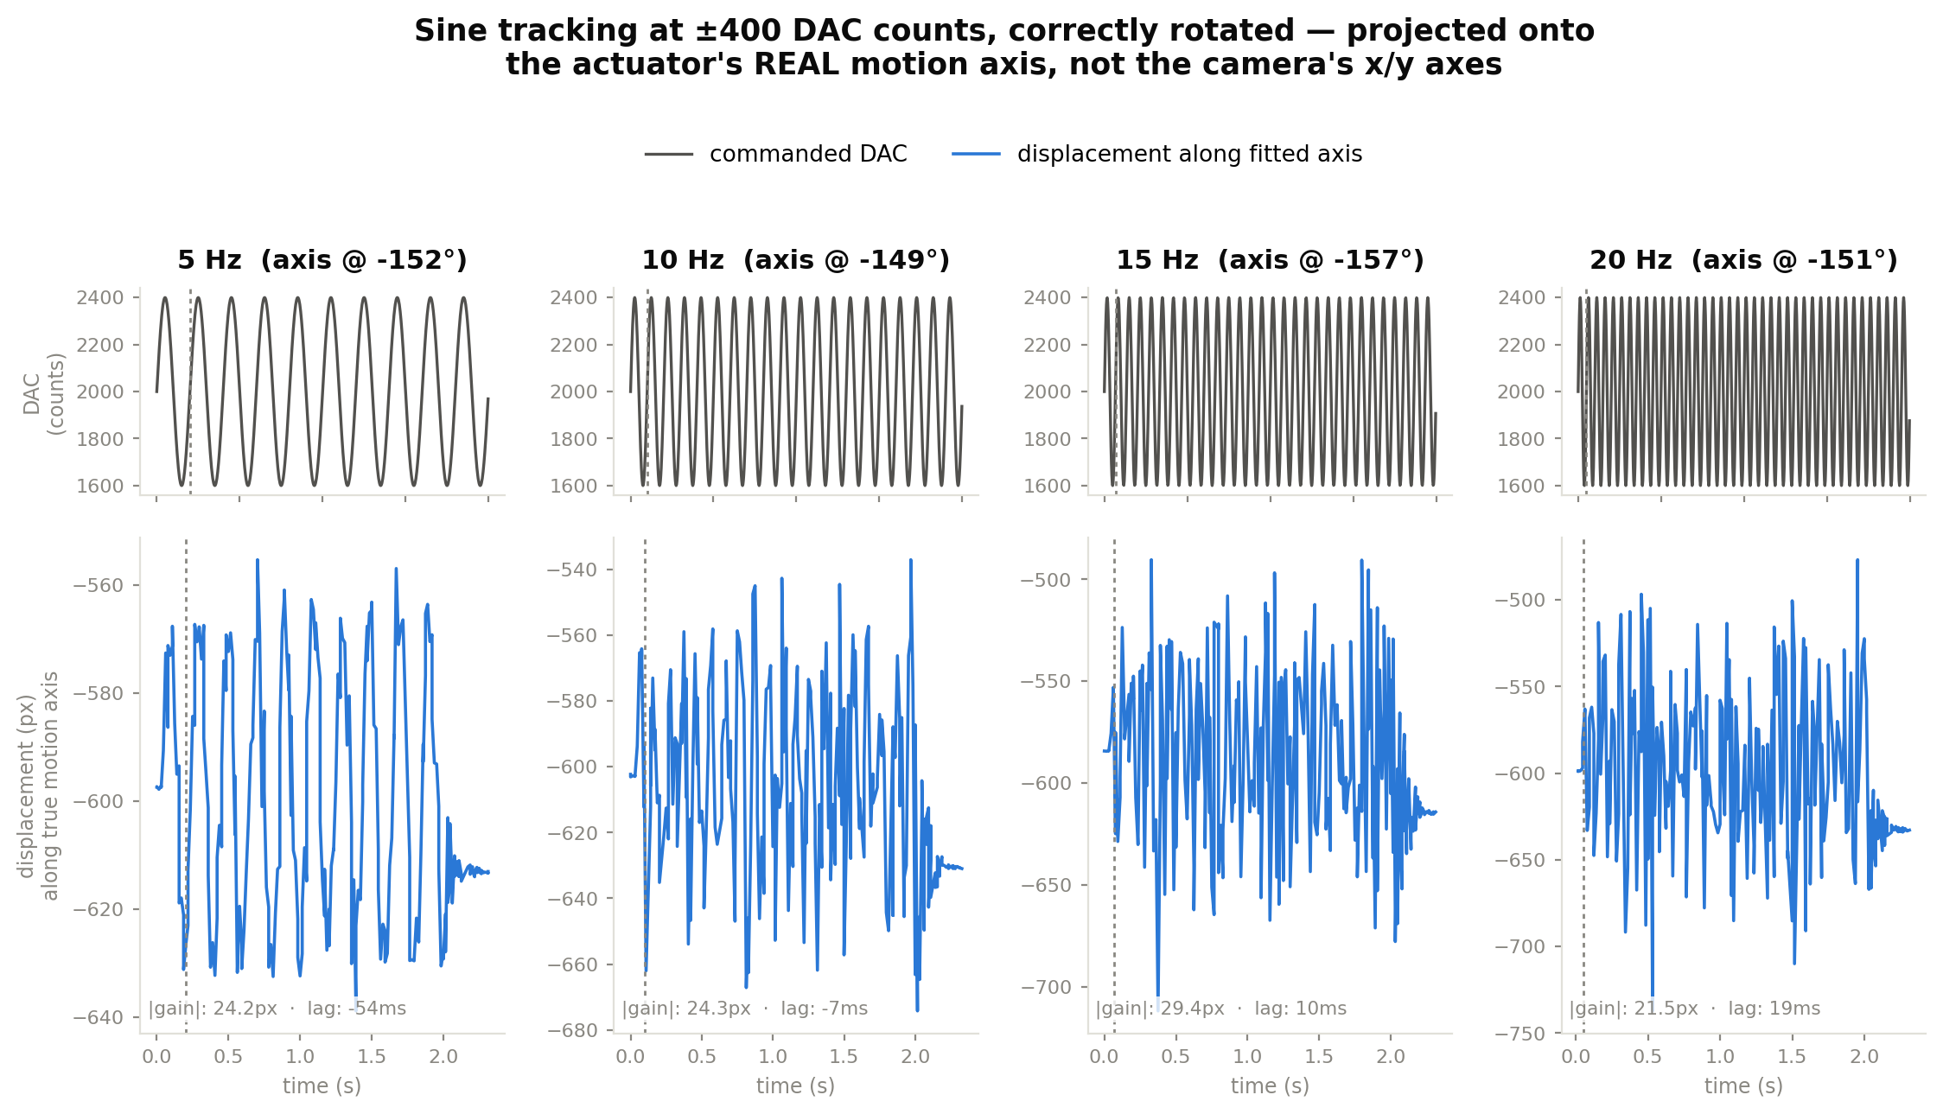
Same view as slide 10, at ±400 DAC counts
Projected onto the actuator's fitted motion axis, not the camera's x/y axes

Slide 20
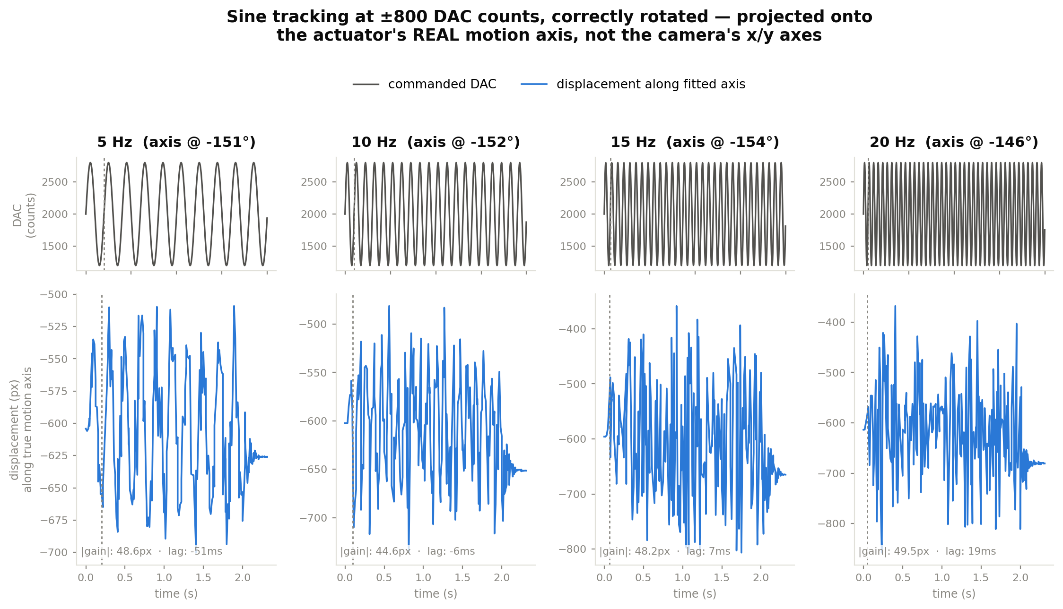
Same view as slide 10, at ±800 DAC counts
Projected onto the actuator's fitted motion axis, not the camera's x/y axes

Slide 21
RETRACTED: slide 18's Y-axis travel limit was a dropped-command bug
fta_calibration_vcp.py fired set_x then set_y with no wait -- the firmware's one-line VCP buffer silently dropped set_y
• Symptom: re-running the grid sweep after switching to full-frame, the beam visibly moved on only ONE axis at a time -- manual set_x/set_y control clearly worked on both.
• Root cause (main.c HAL_UART_RxCpltCallback): the firmware buffers exactly one pending VCP command line at a time. A new command's bytes arriving before the previous line's reply is drained by the main loop are silently dropped -- no error, no signal.
• fta_calibration_vcp.py wrote set_x then immediately set_y with zero delay and never read either reply. set_x (sent first) almost always landed; set_y frequently got dropped while set_x's OK reply was still pending -- silently sticking dac_y while dac_x kept updating.
• This affected every automated calibration grid sweep this session, including the one behind slide 18. fta_manual_control.py was never affected -- it already waits for each reply before sending the next command, which is exactly why manual control looked fine.
• Fix: added send_command() to fta_calibration_vcp.py -- writes a command and blocks until that command's OK/ERR reply arrives before returning, guaranteeing the firmware's one-line buffer is empty before the next command is sent.

Slide 22
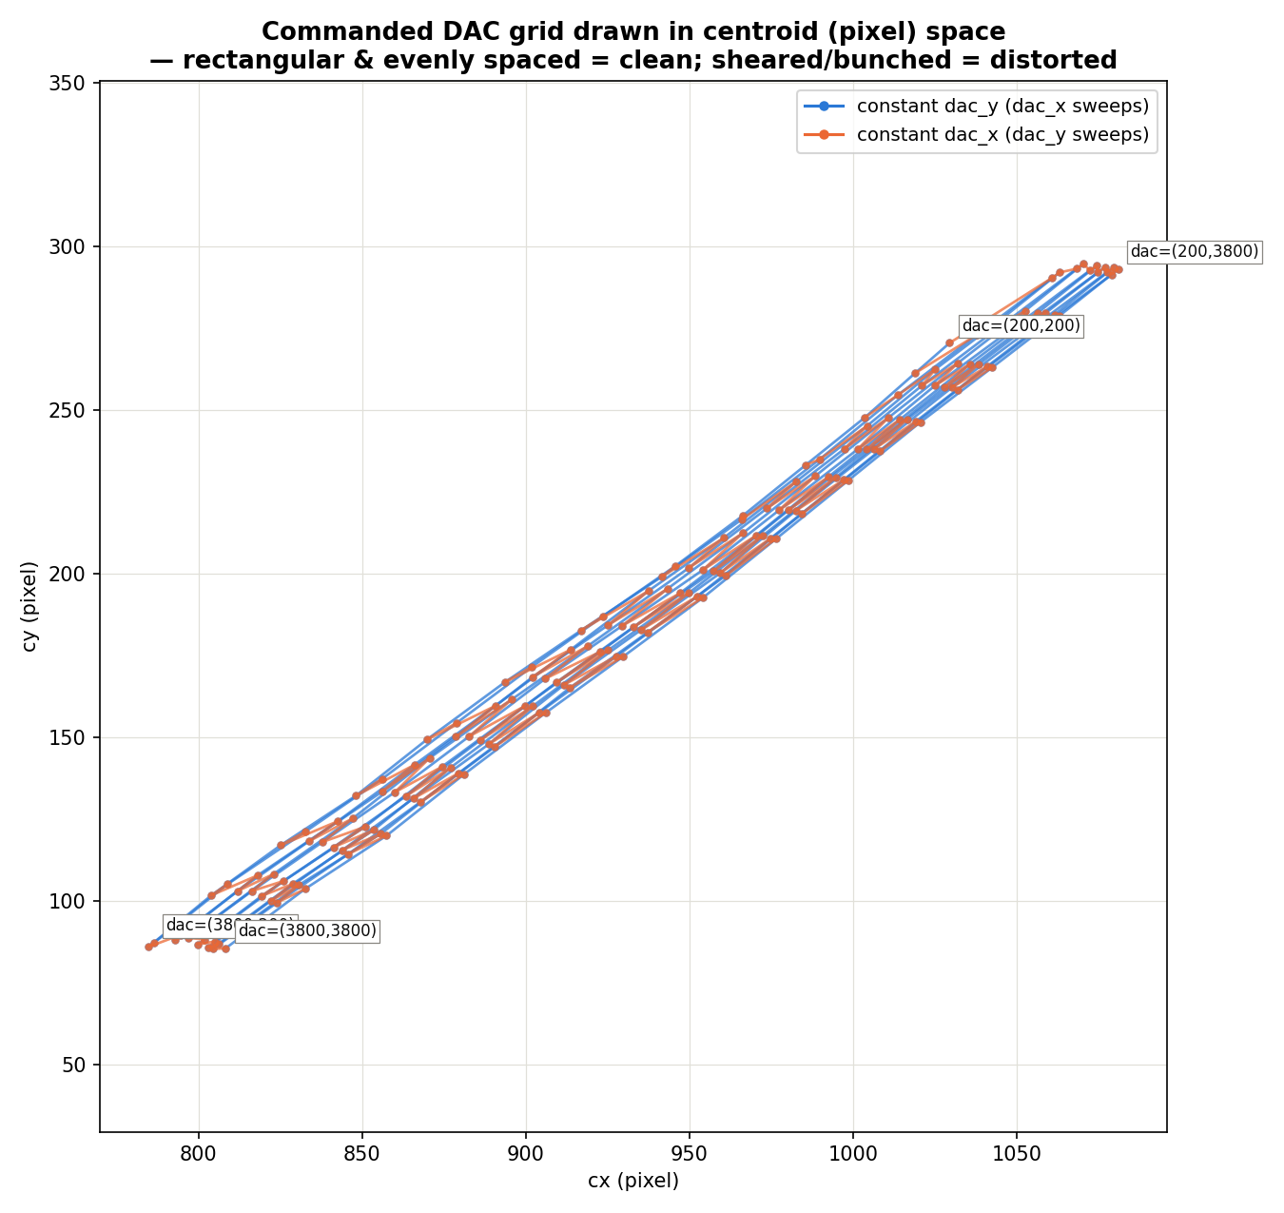
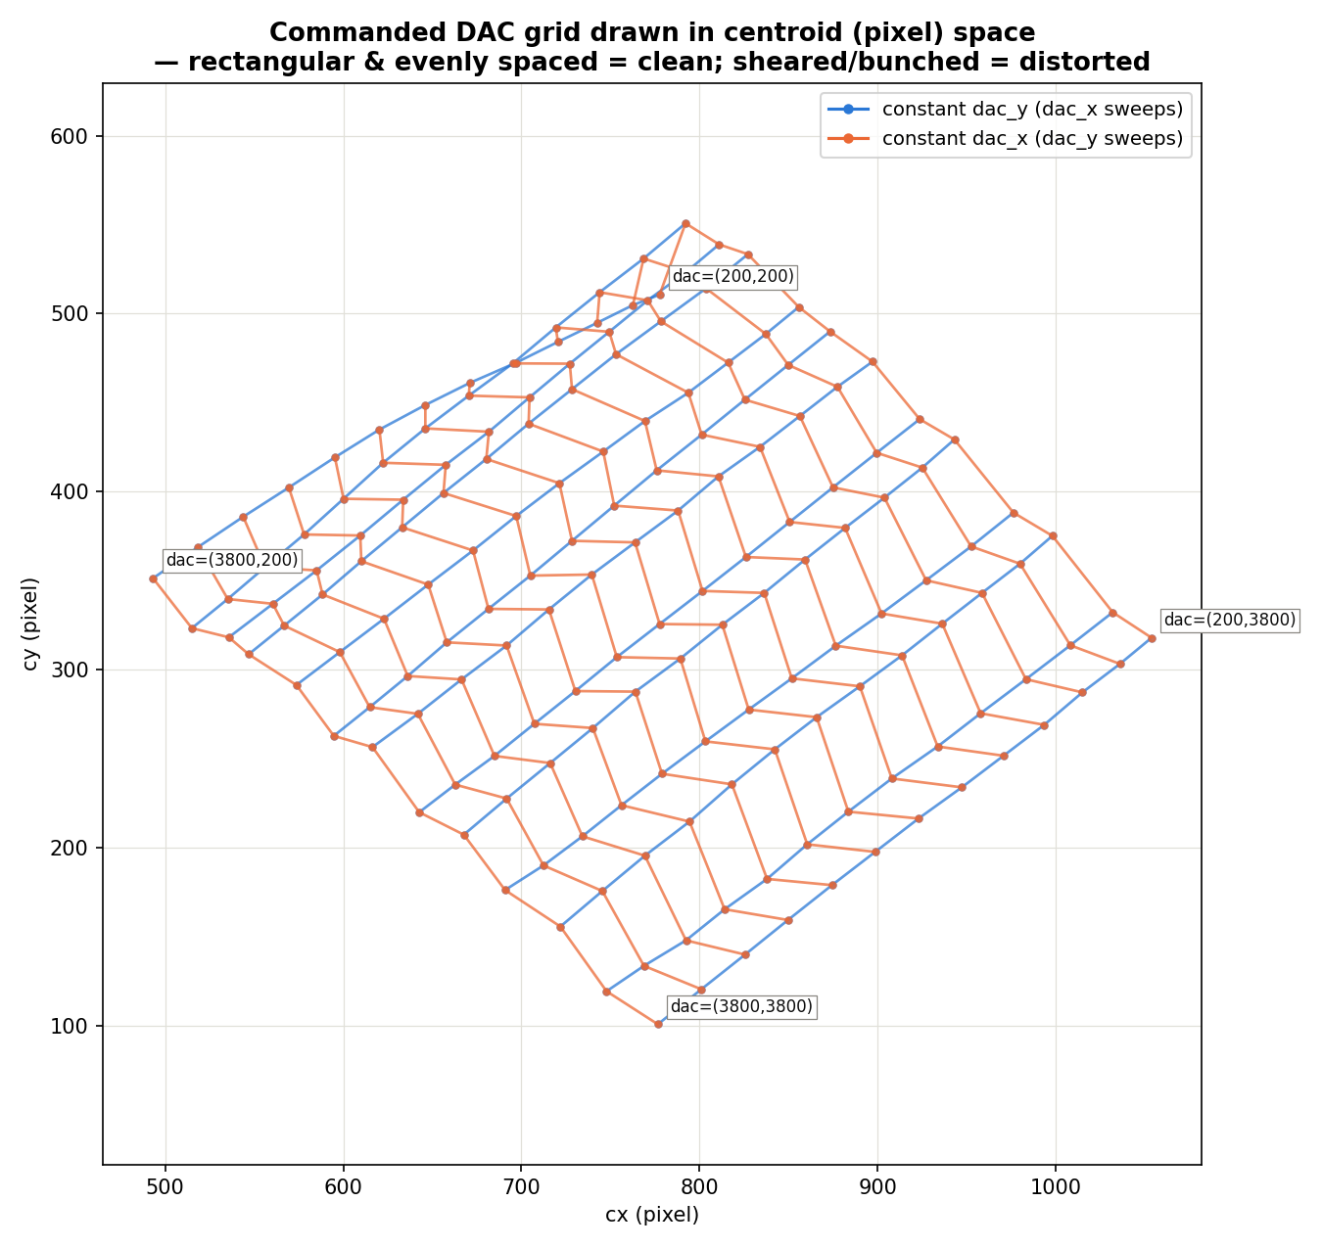
The grid mesh before and after the fix
Same 200-3800 / step-300 grid, drawn directly in centroid (pixel) space -- rows share dac_y, columns share dac_x
• LEFT (buggy): near-degenerate sliver, 2x2 gain-block determinant ~0.0004 -- dac_y barely moves the centroid independent of dac_x.
• RIGHT (fixed): clean, evenly-spaced parallelogram, determinant ~0.01 (25-30x larger) -- both axes genuinely independent, rotated relative to camera x/y (consistent with the ~-150° motion-axis angle already found from the sine-tracking rotated view, slides 10/19/20 -- those were never affected by this bug since they only ever send set_x in a loop).

Slide 23
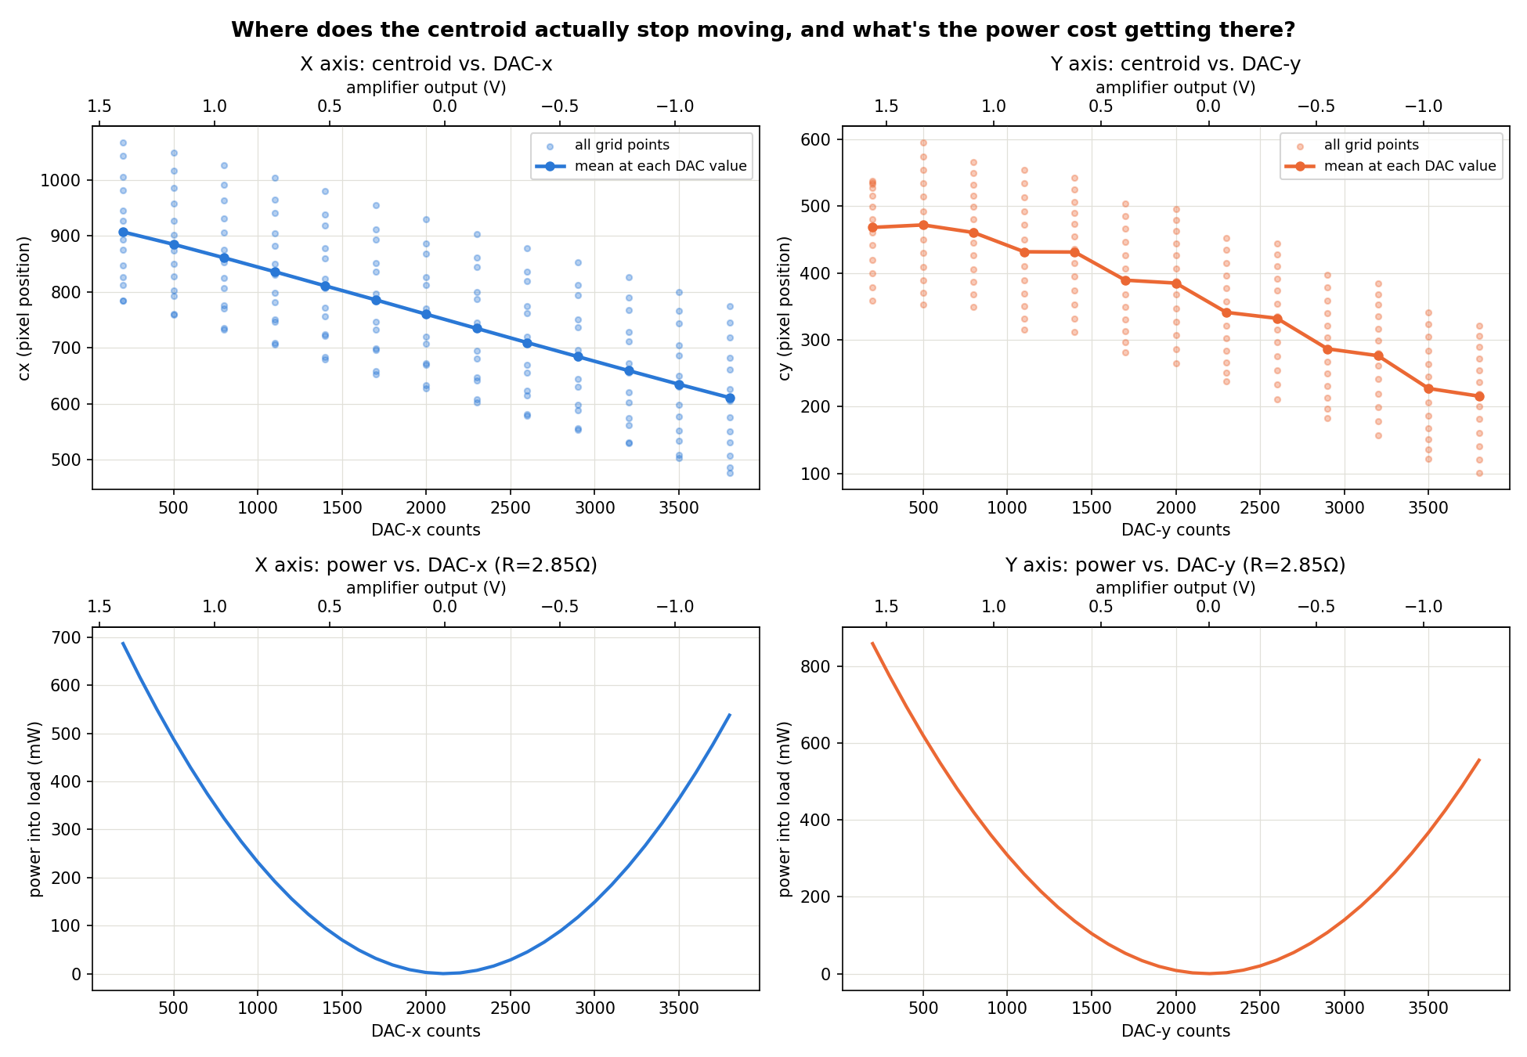
Corrected travel-range analysis: no Y-axis saturation
Same plot as slide 18, re-run on the fixed calibration data -- cy now declines smoothly across the full range, mirroring cx
• Y axis now tracks dac_y smoothly across the entire 200-3800 range, just like X -- no flattening past ~500 counts.
• Slide 18's "Y's real useful travel is only DAC 200-500/800" finding and its "restrict Y calibration to that range" recommendation are both retracted.
• Confirmed at both normal dwell (0.3s settle/0.15s capture) and ~4x longer dwell (1.2s/0.6s, to rule out settling noise) -- same result both times.

