Slide 1
Camera Models
Reading:
[FP] Chapter 1, “Geometric Camera Models” [HZ] Chapter 6 “Camera Models”
Credit: CS231a, Stanford, Silvio Savarese

Slide 2
Agenda
Pinhole cameras
Cameras & lenses
The geometry of pinhole cameras

Slide 3
Agenda
Pinhole cameras
Cameras & lenses
The geometry of pinhole cameras

Slide 4
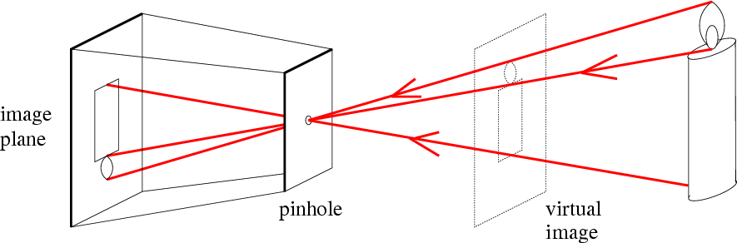
Pinhole camera
f
o
f = focal length
o = aperture = pinhole = center of the camera

Slide 5
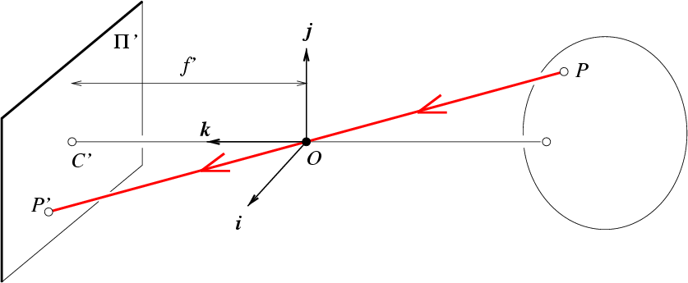
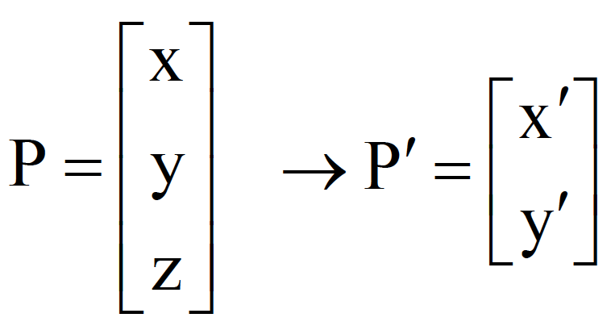
Pinhole camera
f
⎧x'= f ^{x}
⎪ ⎨
z
y
[Eq. 1]
⎪
⎪⎩y' = f _{z}
Derived using similar triangles

Slide 6

Pinhole camera
f
i
[Eq. 2]
f
P = [x, z]
x′
x
k
=
f z
O
P’=[x’, f ]

Slide 7


Pinhole camera
Is the size of the aperture important?
Kate lazuka ©

Slide 8
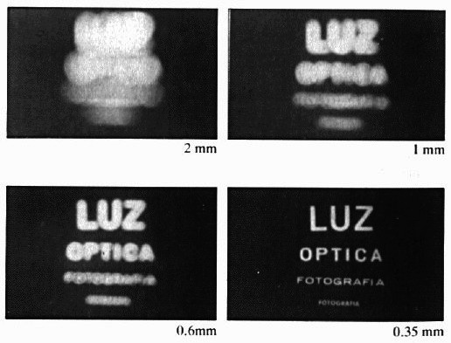
Shrinking aperture size
-What happens if the aperture is too small?
-Less light passes through
Adding lenses!

Slide 9
Agenda
Pinhole cameras
Cameras & lenses
The geometry of pinhole cameras

Slide 10
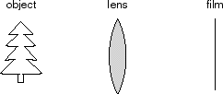
Cameras & Lenses
image
P
P’
A lens focuses light onto the film

Slide 11
Cameras & Lenses
focal point
f
A lens focuses light onto the film
All rays parallel to the optical (or principal) axis converge to one point (the focal point) on a plane located at the focal length f from the center of the lens.
Rays passing through the center are not deviated

Slide 12
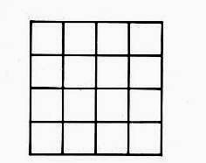
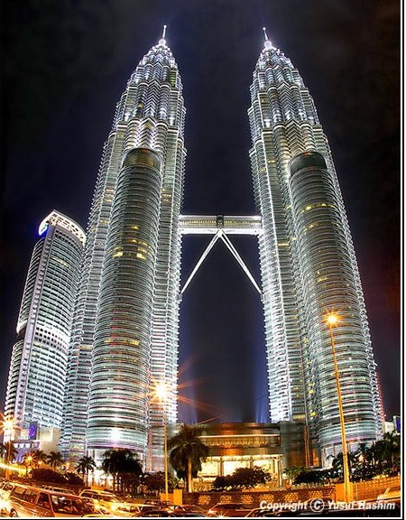
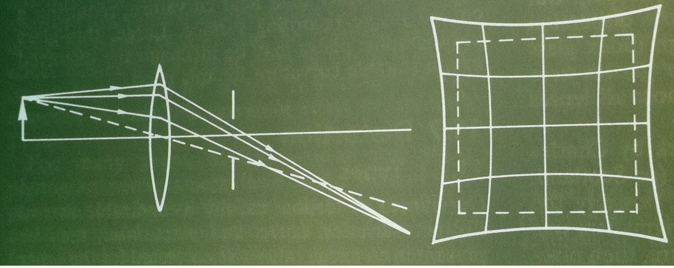
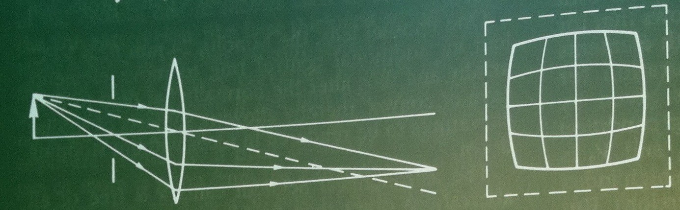
Issues with lenses: Radial Distortion
– Deviations are most noticeable for rays that pass through the edge of the lens
No distortion
Pin cushion
Barrel (fisheye lens)
Image magnification decreases with distance from the optical axis

Slide 13
Agenda
Pinhole cameras
Cameras & lenses
The geometry of pinhole cameras
Intrinsic
Extrinsic

Slide 14

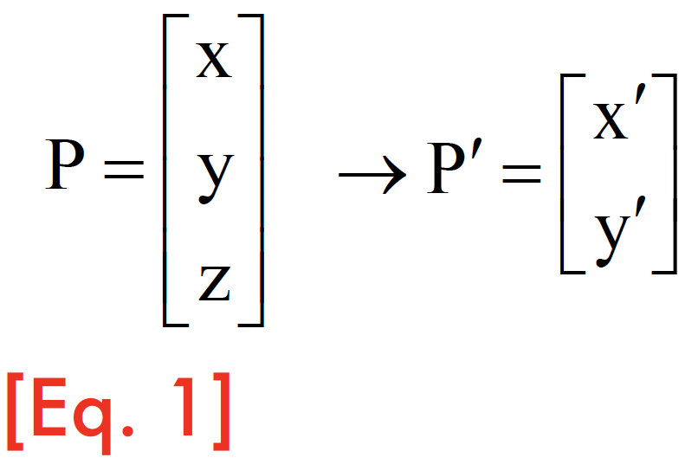
Pinhole camera
f
⎧x'= f ^{x}
⎪
z
E
⎨
ℜ³→ℜ²
y
⎪
⎪⎩y' = f _{z}
f = focal length
o = center of the camera

Slide 15

From retina plane to images
f
Retina plane
Digital image
Pixels, bottom-left coordinate systems

Slide 16
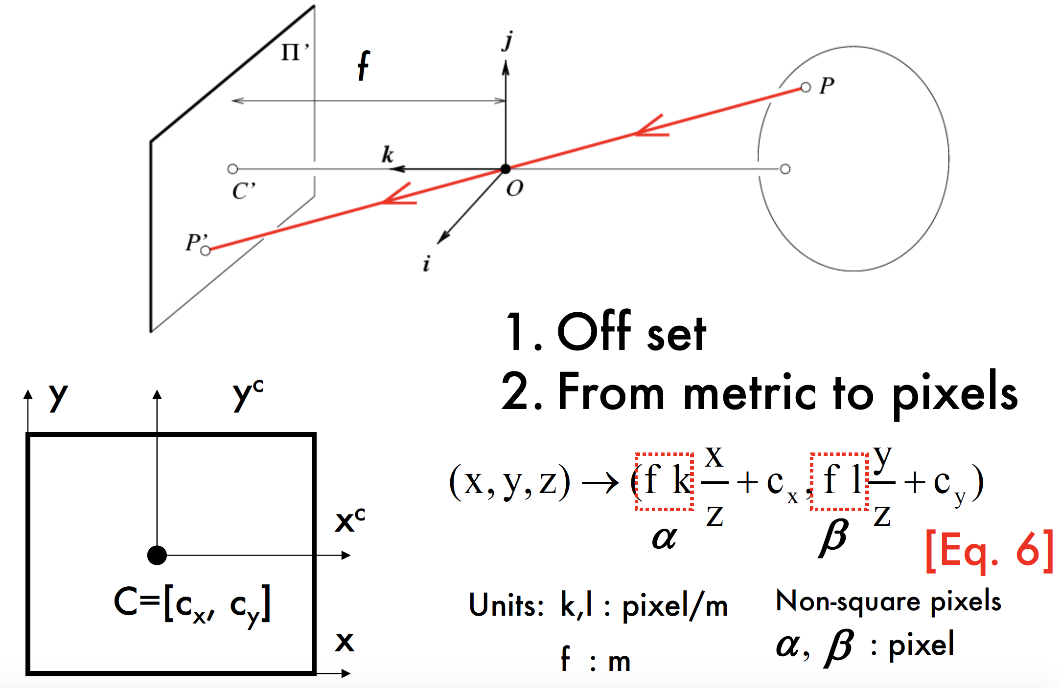

Coordinate systems
1. Offset
_{y}c
y
(x, y, z) → (f ^{x} + c , f ^{y} + c )
_{x}c
x y
z z
C’’=[c_{x}, c_{y}]
[Eq. 5]
x

Slide 17
Converting to pixels

Slide 18
Is this projective transformation linear?
f
P = (x, y, z) → P ' = (α ^{x} + c , β ^{y} + c )
x y
_{y}c
z z
y
[Eq. 7]
_{x}c
Is this a linear transformation?
No — division by z is nonlinear
Can we express it in a matrix form?
C=[c_{x}, c_{y}]
x

Slide 19

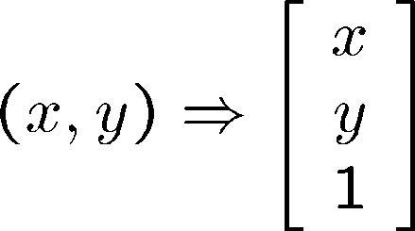
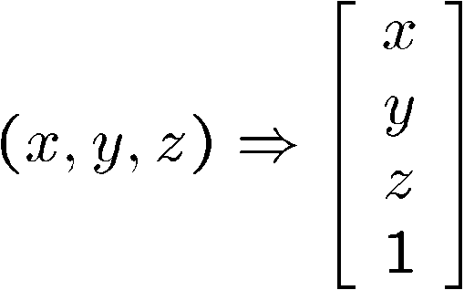

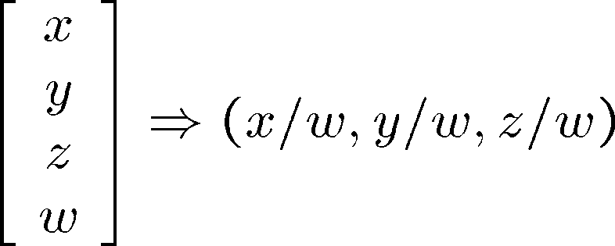
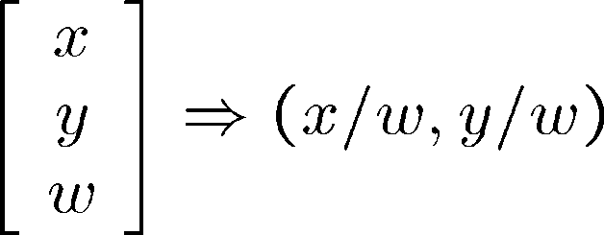
Homogeneous coordinates
homogeneous image coordinates
homogeneous scene coordinates
Converting back from homogeneous coordinates

Slide 20
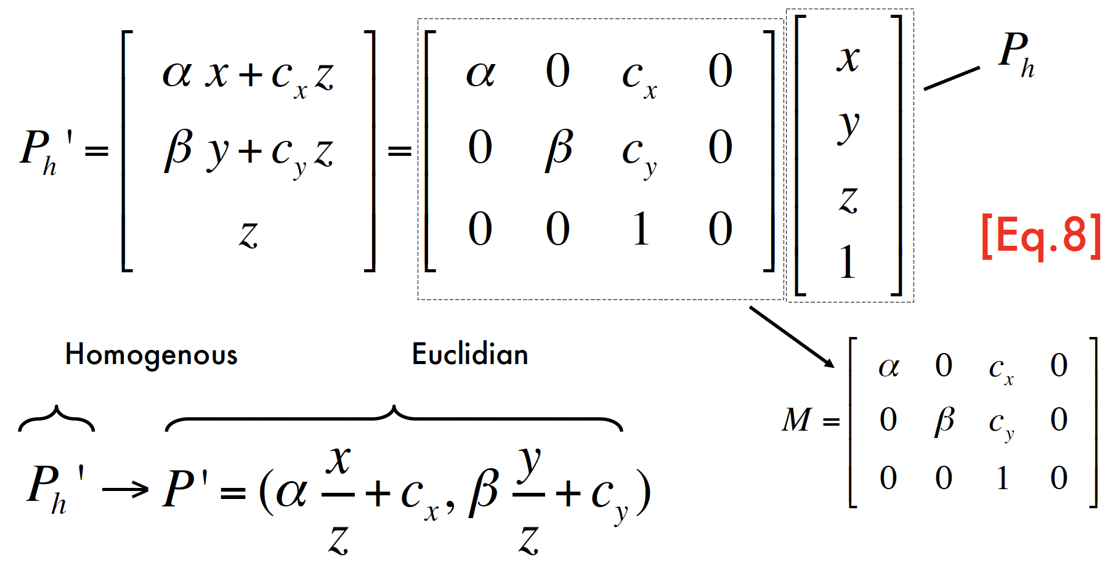
Projective transformation in the homogenous coordinate system

Slide 21
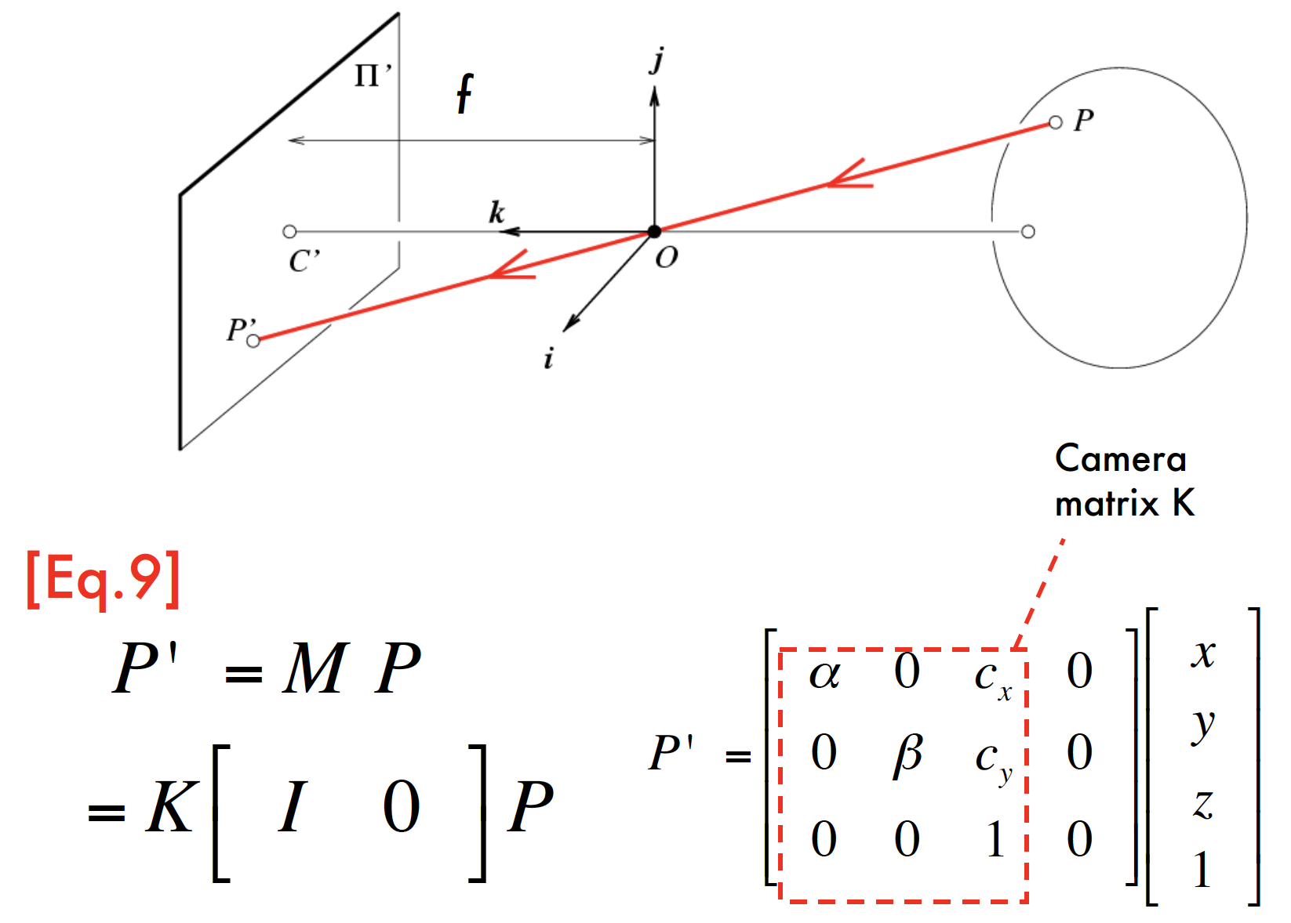
The Camera Matrix

Slide 22
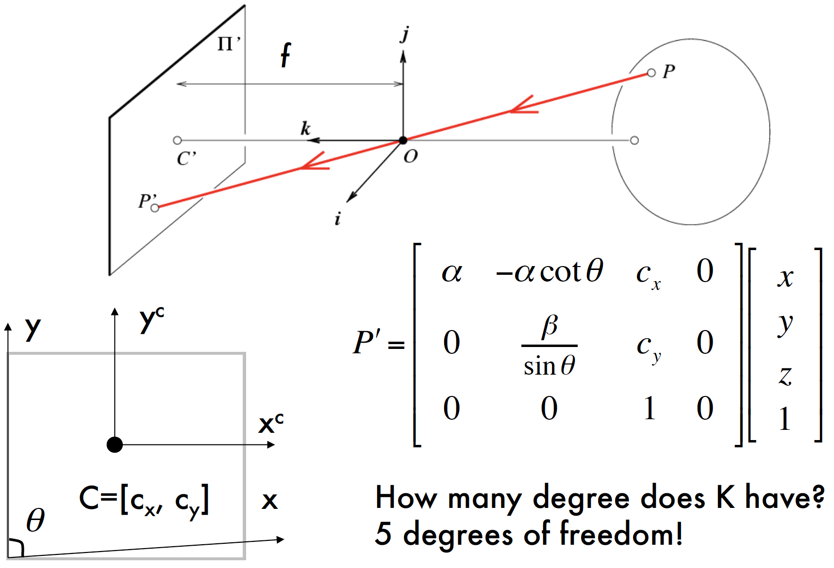
Camera Skewness

Slide 23
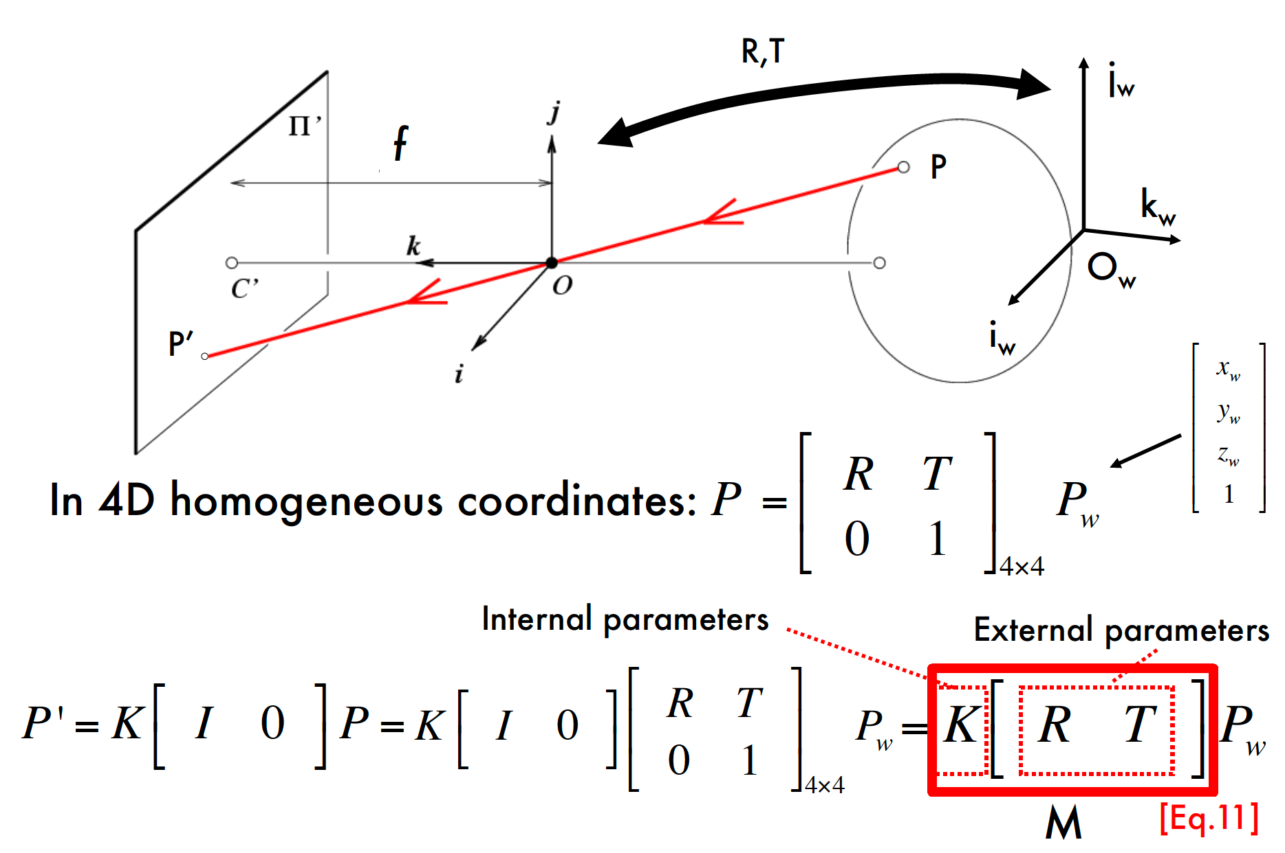
World reference system
intrinsic
extrinsic

Slide 24
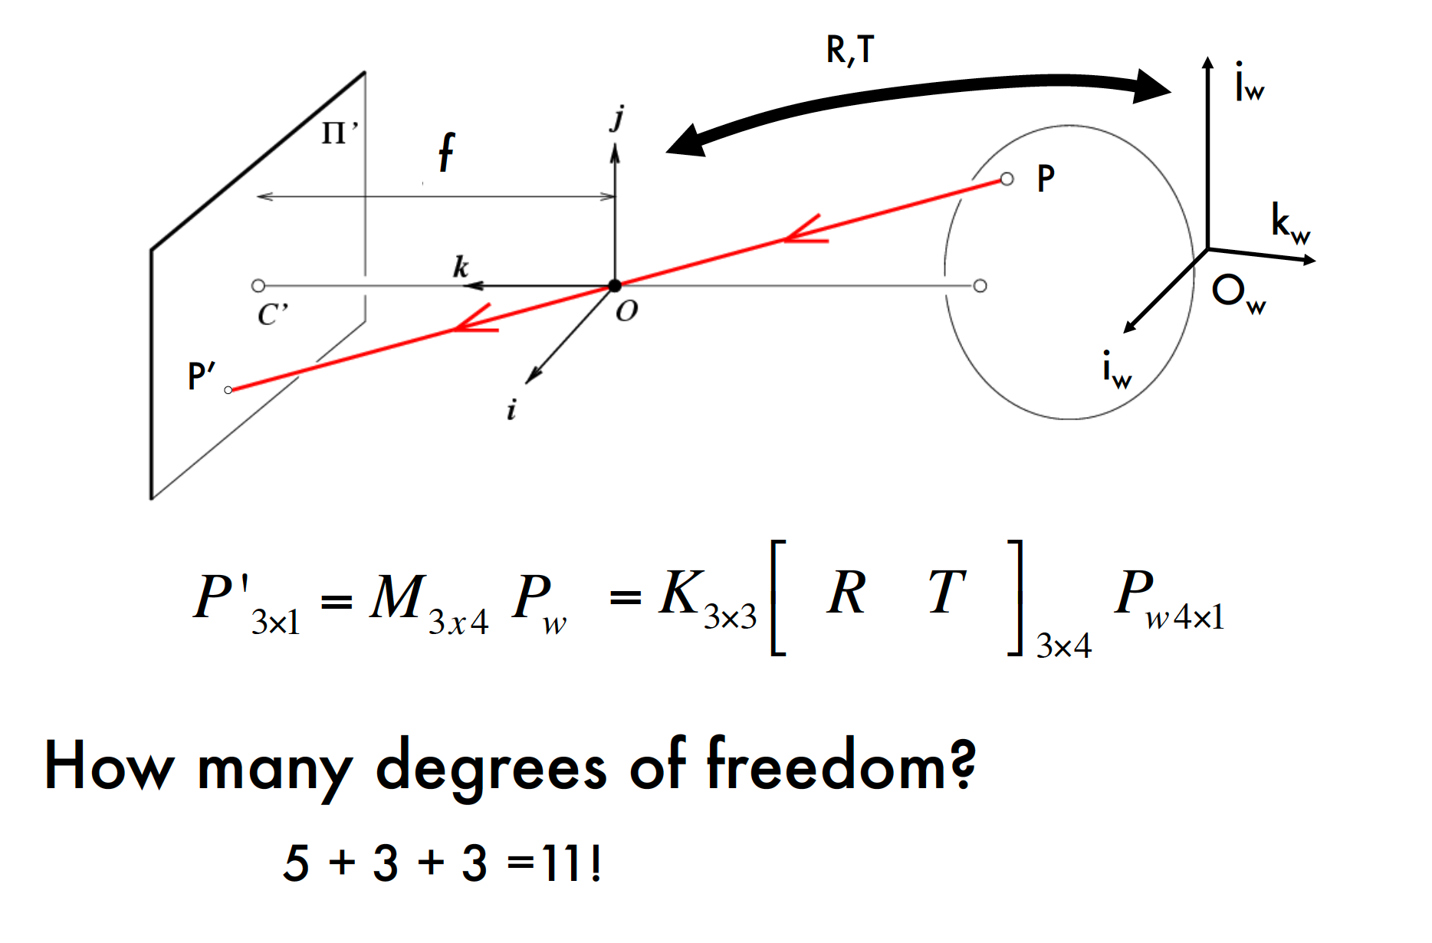
The projective transformation

Slide 25

Properties of projective transformations
Points project to points
Lines project to lines
Distant objects look smaller

Slide 26
Properties of Projection
Angles are not preserved
Parallel lines meet!
Parallel lines in the world intersect in the image at a “vanishing point”

Slide 27
Horizon line (vanishing line)
Angles are not preserved
Parallel lines meet!
Parallel lines in the world intersect in the image at a “vanishing point”

Slide 28
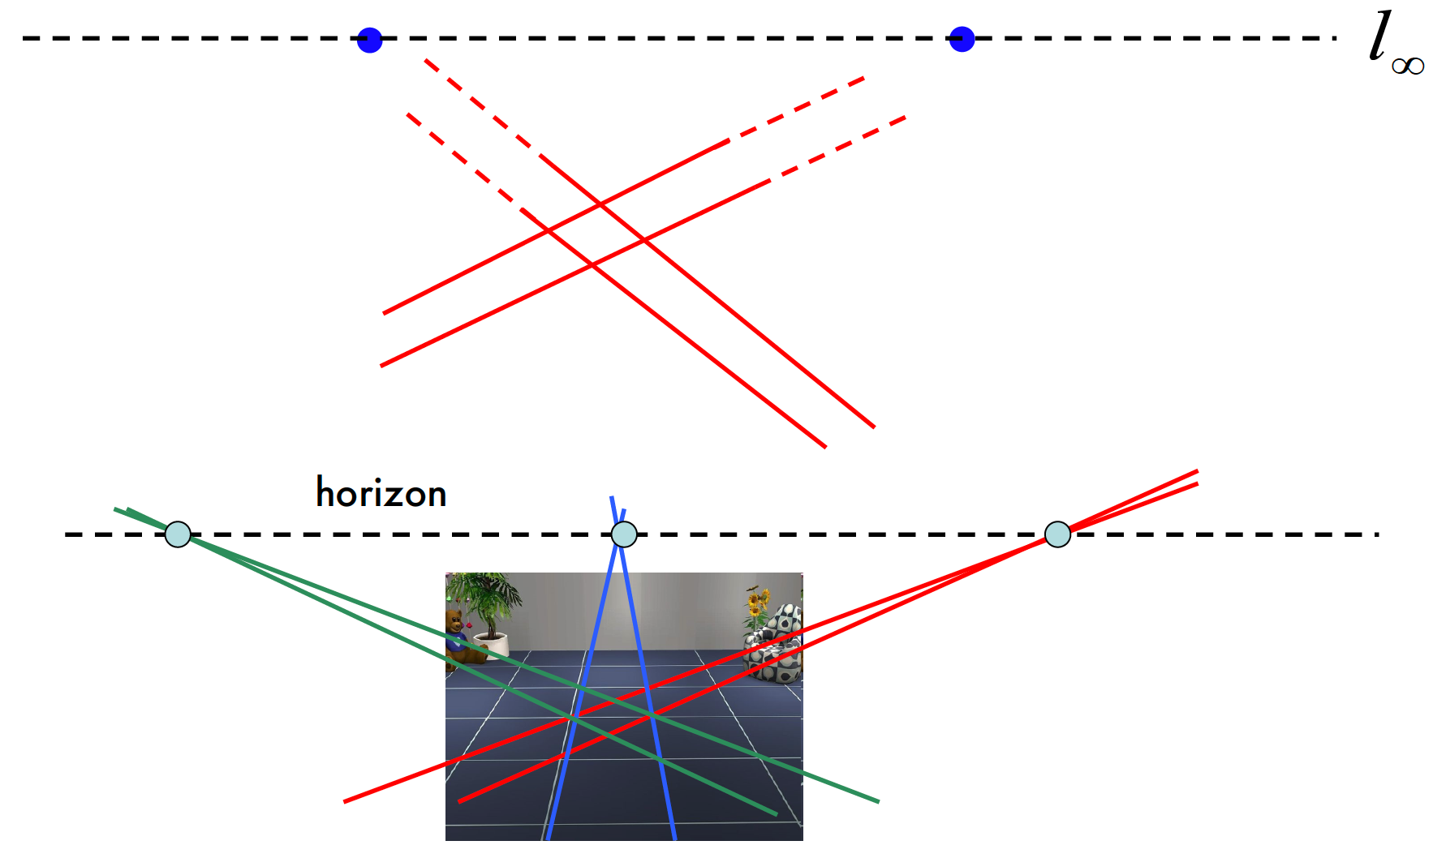
Horizon line (vanishing line)

