Slide 1
Linear Algebra Primer
And a video discussion of linear algebra from EE263 is here (lectures 3 and 4):
https://see.stanford.edu/Course/EE263
slides from Stanford CS131

Slide 2
Outline
Vectors and matrices
Basic Matrix Operations
Determinants, norms, trace
Special Matrices
Transformation Matrices
Homogeneous coordinates
Translation
Matrix inverse
Matrix rank
Eigenvalues and Eigenvectors
Matrix Calculus

Slide 3
Outline
Vectors and matrices are just collections of ordered numbers that represent something: movements in space, scaling factors, pixel brightness, etc. We’ll define some common uses and standard operations on them.
Vectors and matrices
Basic Matrix Operations
Determinants, norms, trace
Special Matrices
Transformation Matrices
Homogeneous coordinates
Translation
Matrix inverse
Matrix rank
Eigenvalues and Eigenvectors
Matrix Calculus

Slide 4
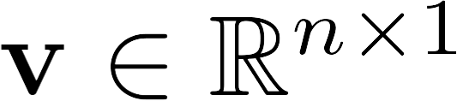
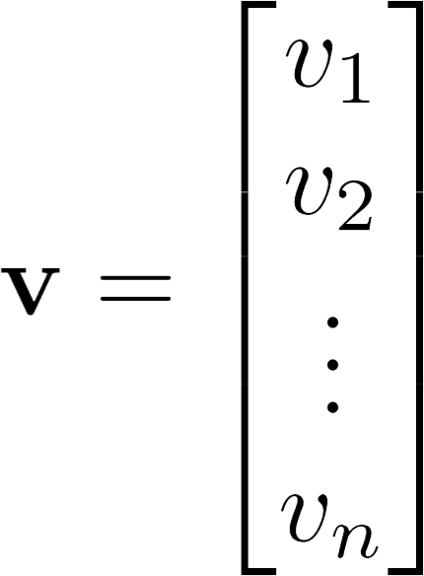
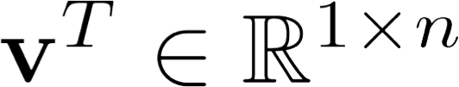
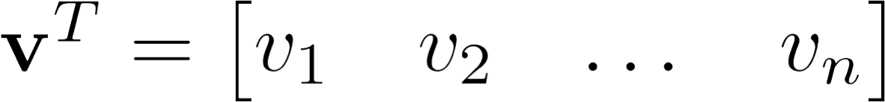

Vector
A column vector
where
A row vector where
denotes the transpose operation

Slide 5

Vector
We’ll default to column vectors in this class
You’ll want to keep track of the orientation of your vectors when programming in python
You can transpose a vector V in matlab by writing V’ (But in class materials, we will always use V^{T} to indicate transpose, and we will use V’ to mean “V prime”)

Slide 6
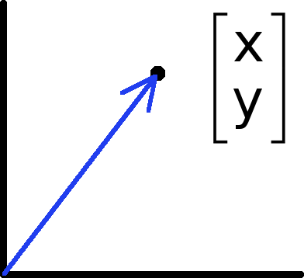
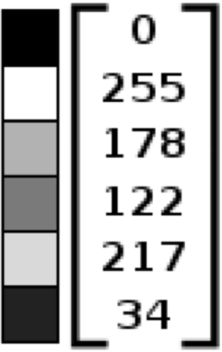
Vectors have two main uses
Data (pixels, gradients at an image keypoint, etc) can also be treated as a vector
Vectors can represent an offset in 2D or 3D space
Points are just vectors from the origin
Such vectors don’t have a geometric interpretation, but calculations like “distance” can still have value

Slide 7
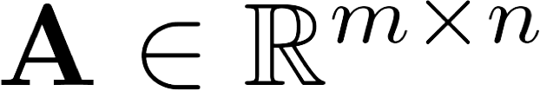
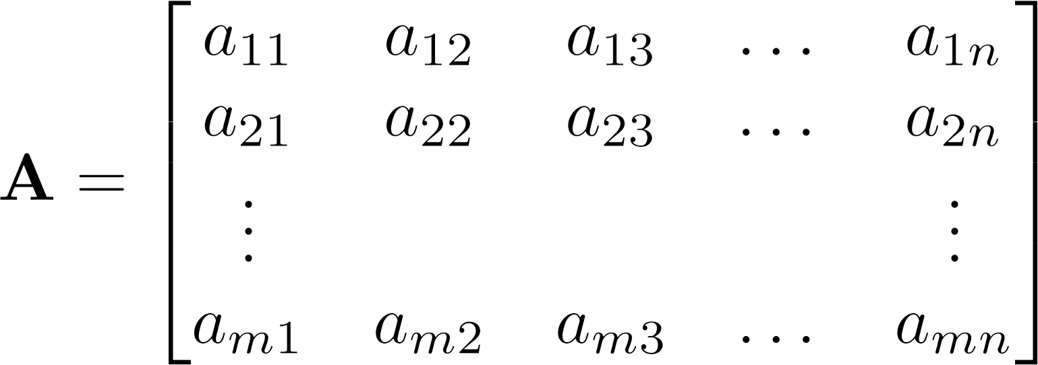


Matrix
A matrix is an array of numbers with size by , i.e. m rows and n columns.
If
, we say that
is square.

Slide 8

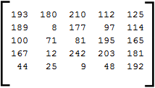
Images
=
MATLAB represents an image as a matrix of pixel brightnesses
Note that the upper left corner is (y,x) = (1,1)

Slide 9
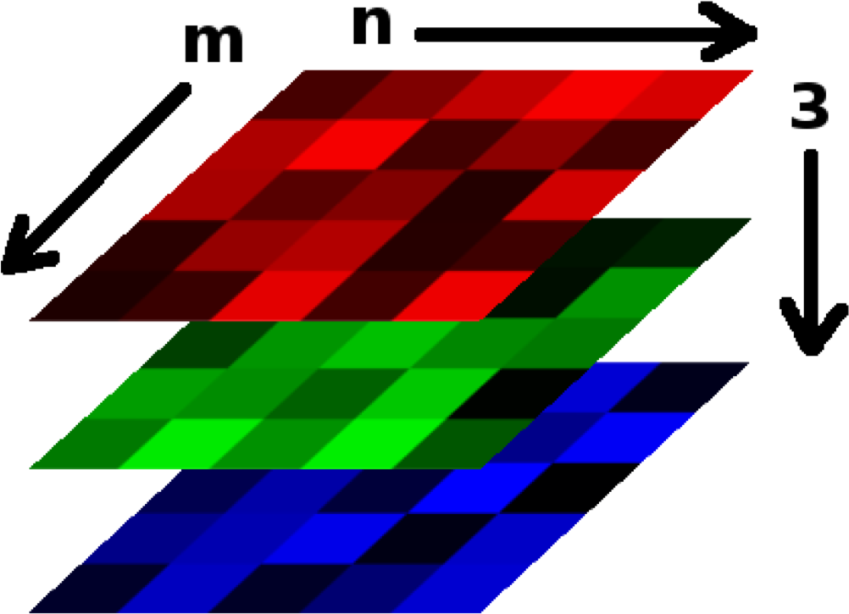

Color Images
Grayscale images have one number per pixel, and are stored as an m × n matrix.
Color images have 3 numbers per pixel – red, green, and blue brightnesses (RGB)
Stored as an m × n × 3 matrix
=

Slide 10
Basic Matrix Operations
We will discuss:
Addition
Scaling
Dot product
Multiplication
Transpose
Inverse / pseudoinverse
Determinant / trace

Slide 11
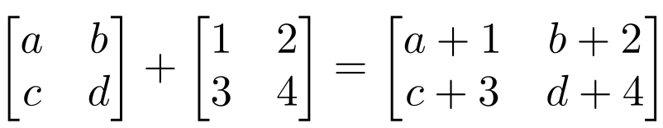
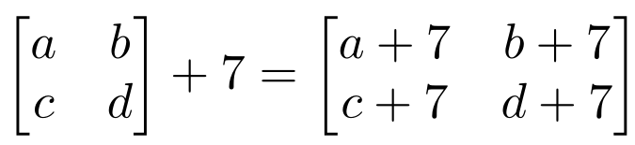
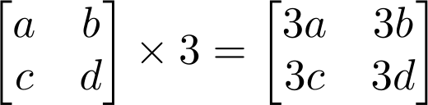
Matrix Operations
Addition
– Can only add a matrix with matching dimensions, or a scalar.
Scaling

Slide 12
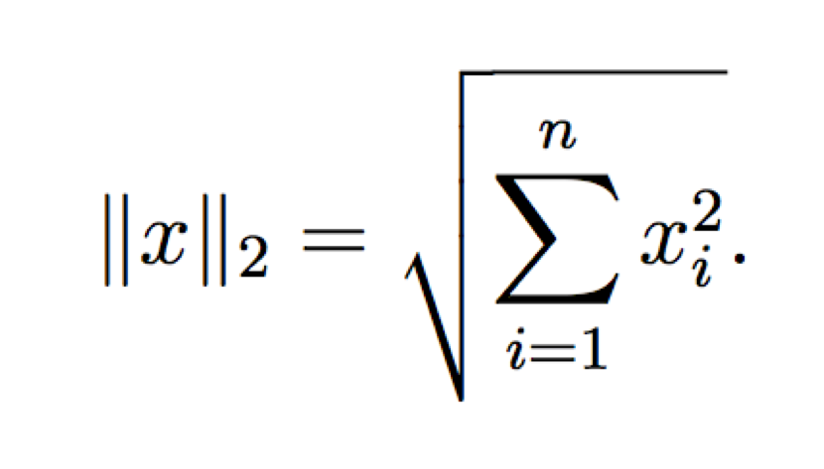

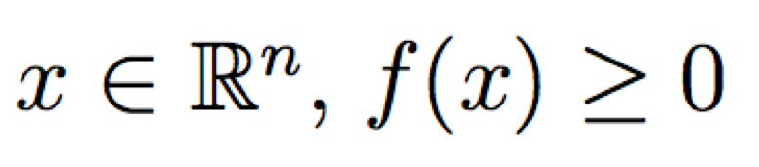
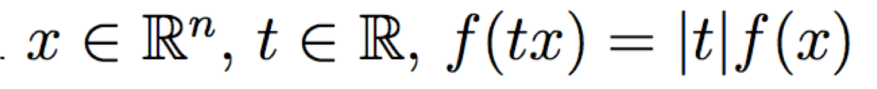
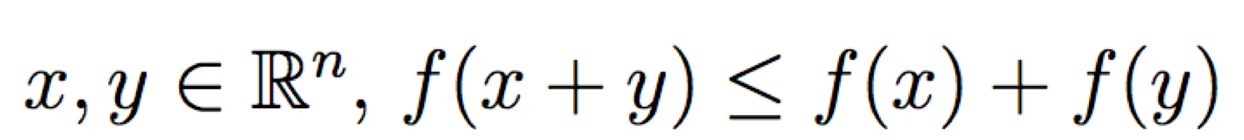
Vectors
Norm
More formally, a norm is any function that satisfies 4 properties:
Non-negativity: For all
Definiteness: f(x) = 0 if and only if x = 0.
Homogeneity: For all
Triangle inequality: For all

Slide 13
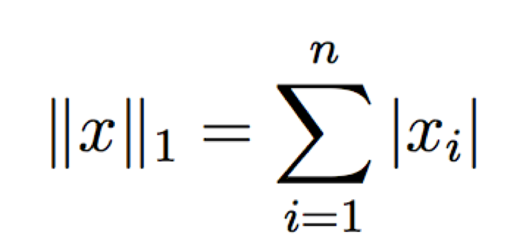
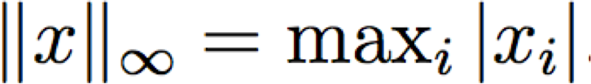
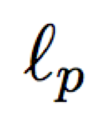
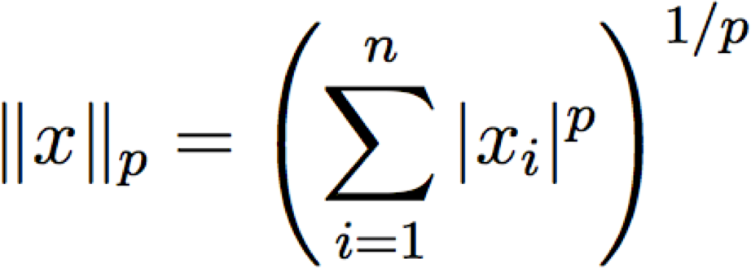
Matrix Operations
Example Norms
General
norms:

Slide 14
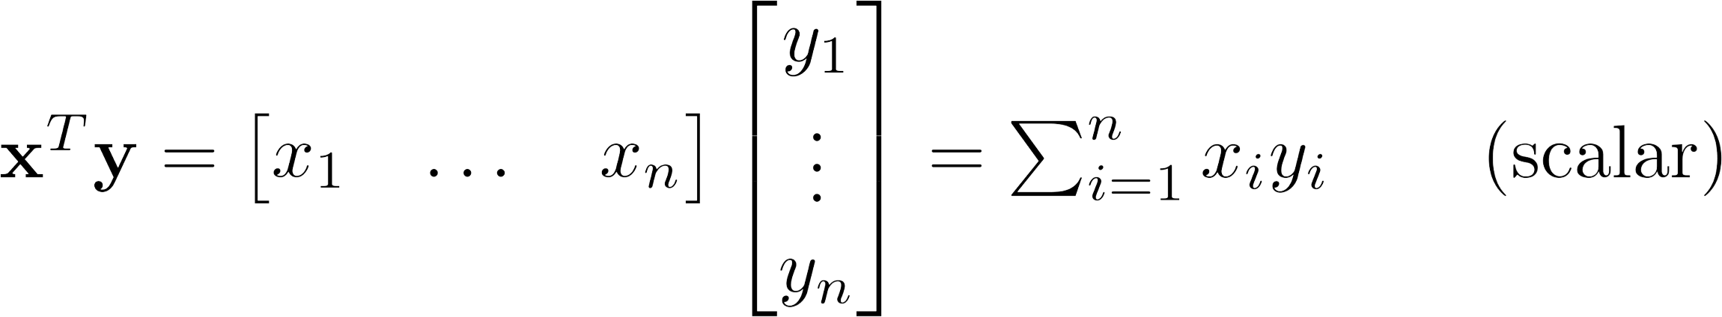
Matrix Operations
Inner product (dot product) of vectors
Multiply corresponding entries of two vectors and add up the result
x·y is also |x||y|Cos( the angle between x and y )

Slide 15
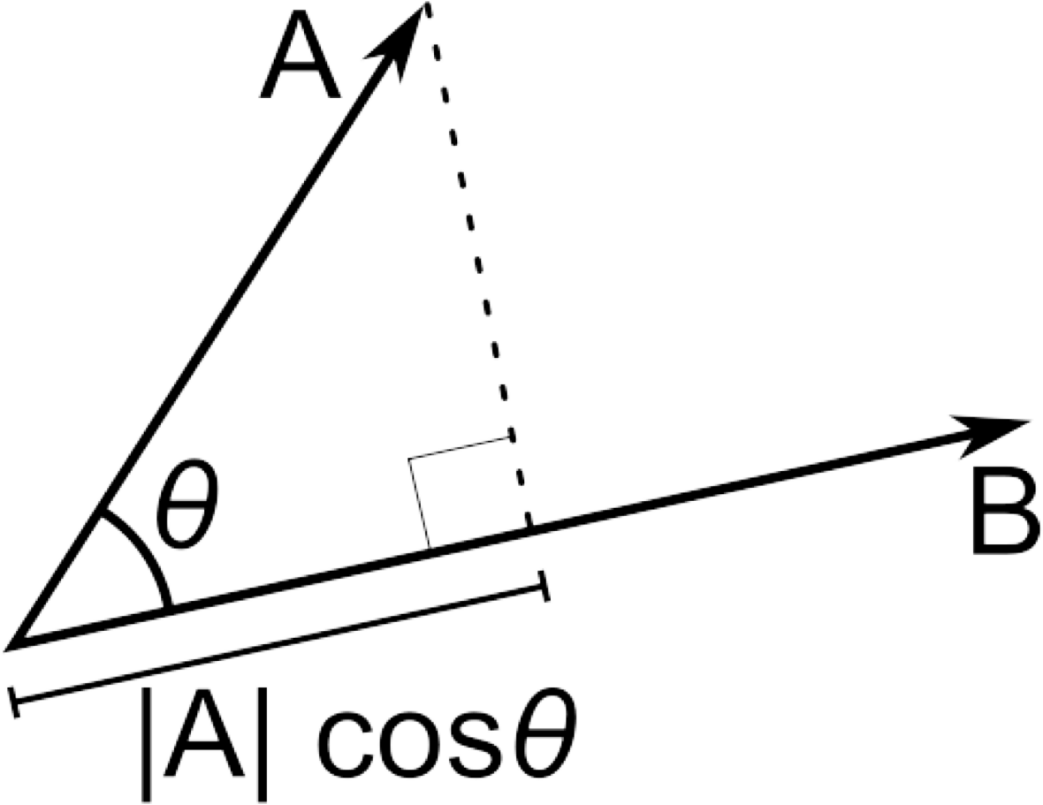
Matrix Operations
Inner product (dot product) of vectors
– If B is a unit vector, then A·B gives the length of A which lies in the direction of B

Slide 16
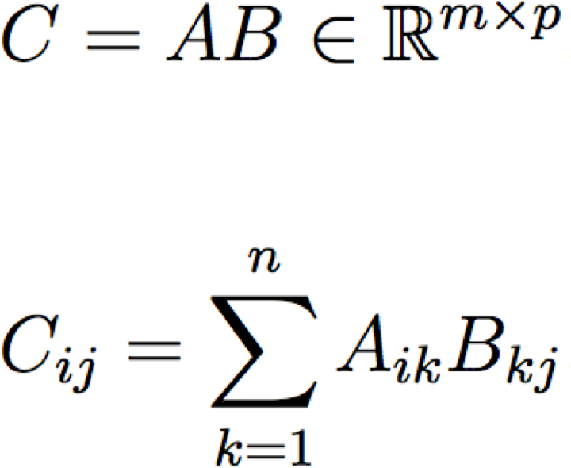


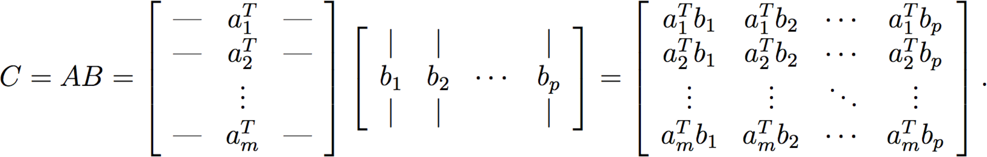
Matrix Operations
The product of two matrices

Slide 17
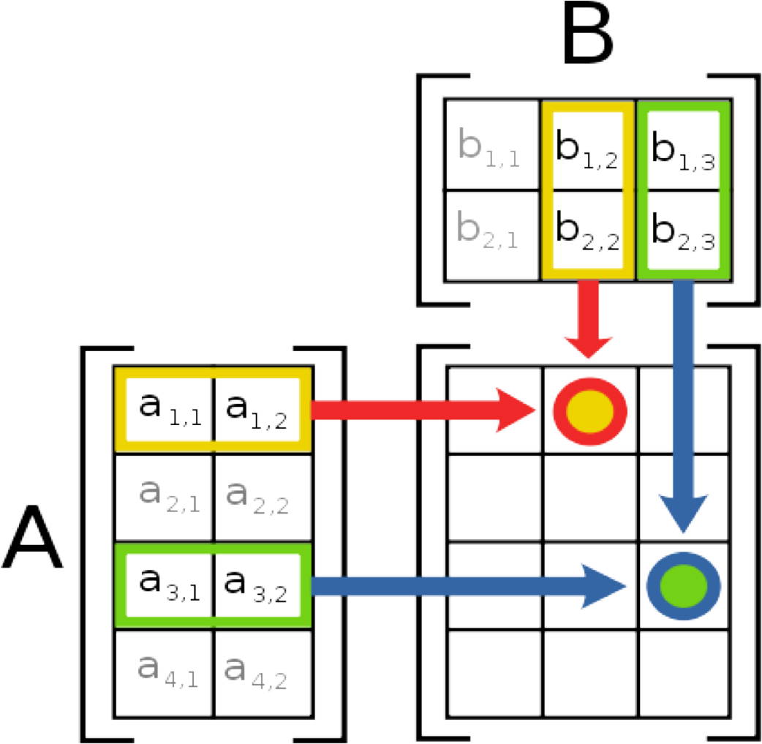
Matrix Operations
Multiplication
The product AB is:
Each entry in the result is (that row of A) dot product with (that column of B)
Many uses, which will be covered later

Slide 18
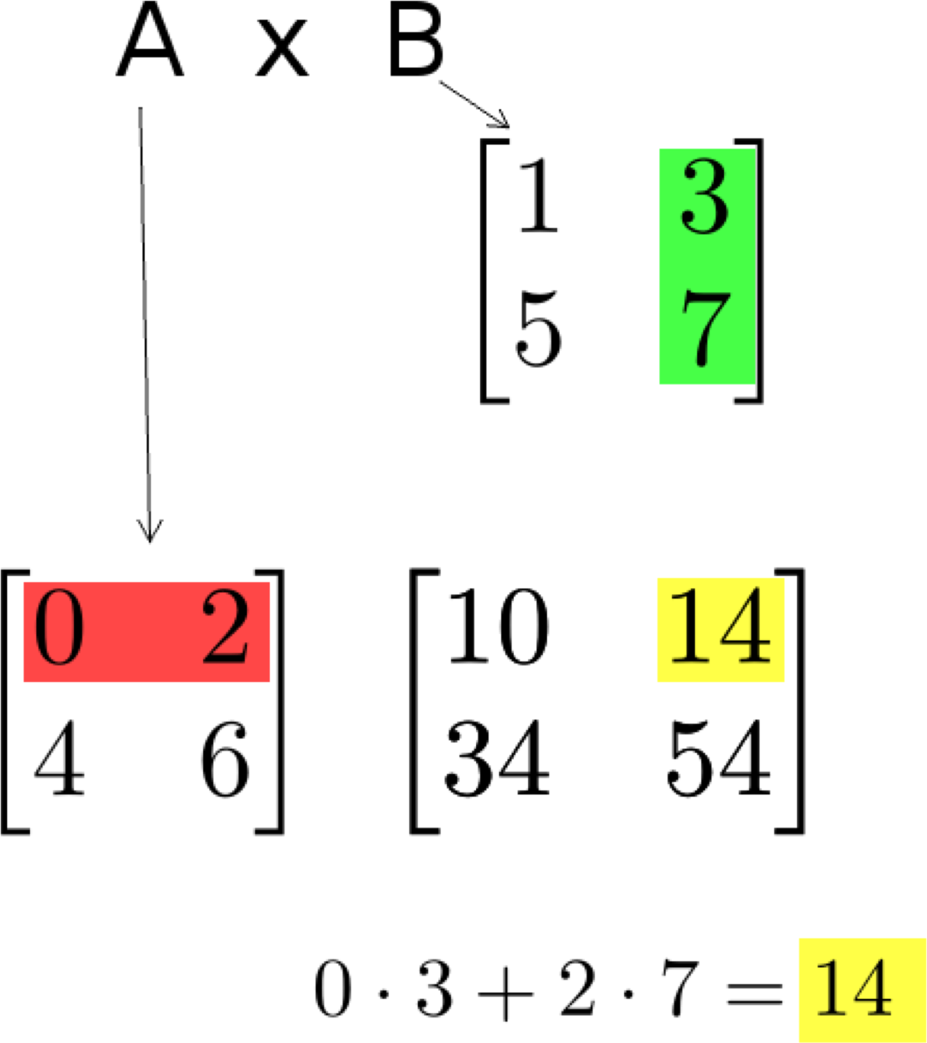
Matrix Operations
Multiplication example:
– Each entry of the matrix product is made by taking the dot product of the corresponding row in the left matrix, with the corresponding column in the right one.

Slide 19
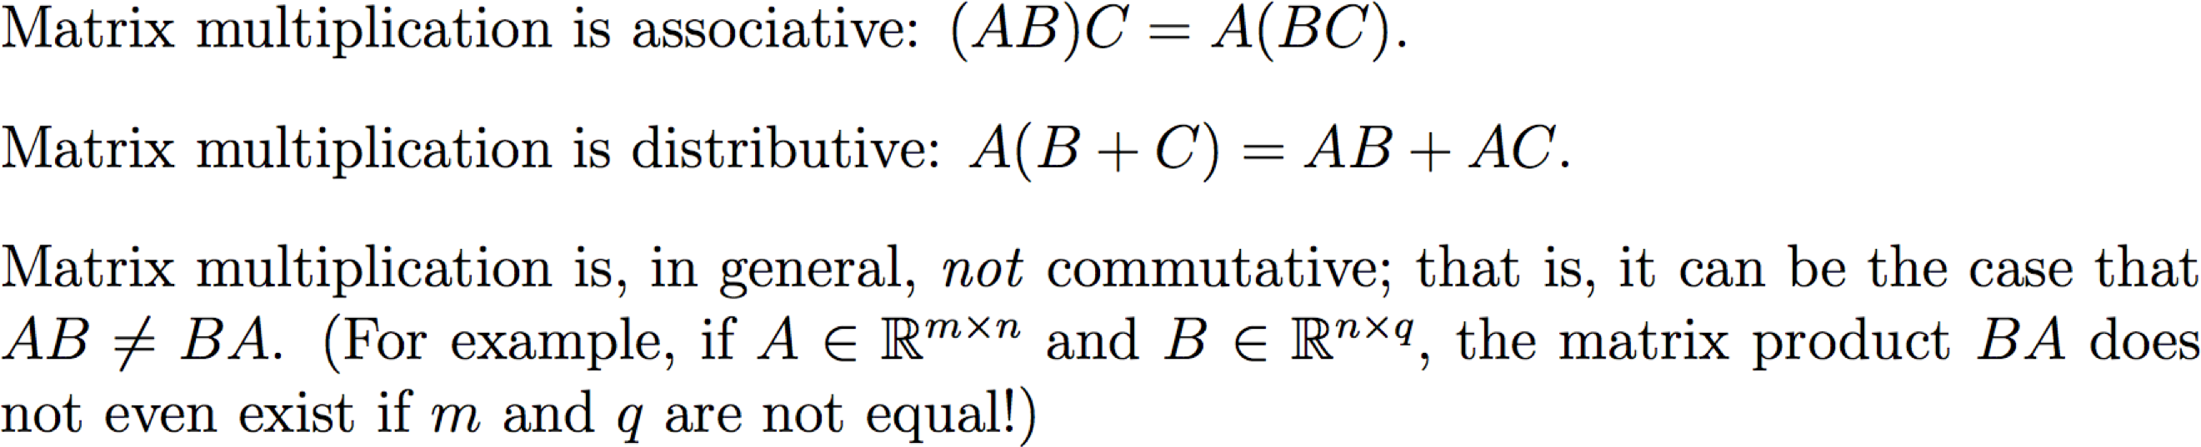
Matrix Operations
The product of two matrices

Slide 20
Matrix Operations
Powers
By convention, we can refer to the matrix product AA as A², and AAA as A³, etc.
Obviously only square matrices can be multiplied that way

Slide 21
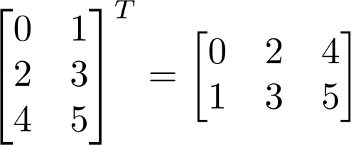
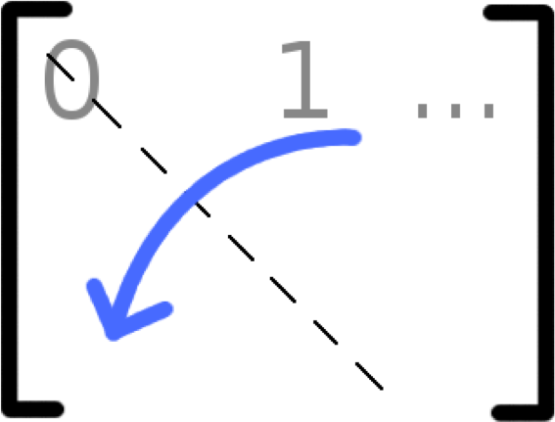

Matrix Operations
Transpose – flip matrix, so row 1 becomes column 1
A useful identity:

Slide 22
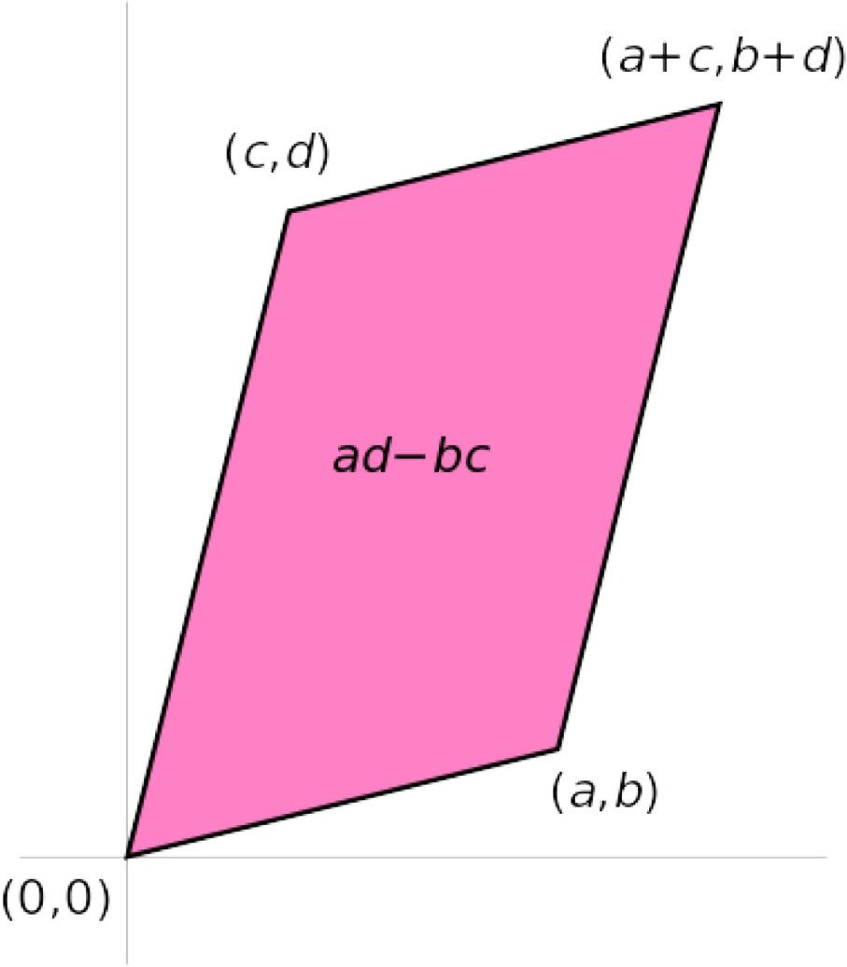

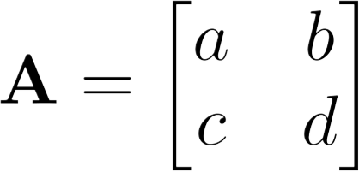

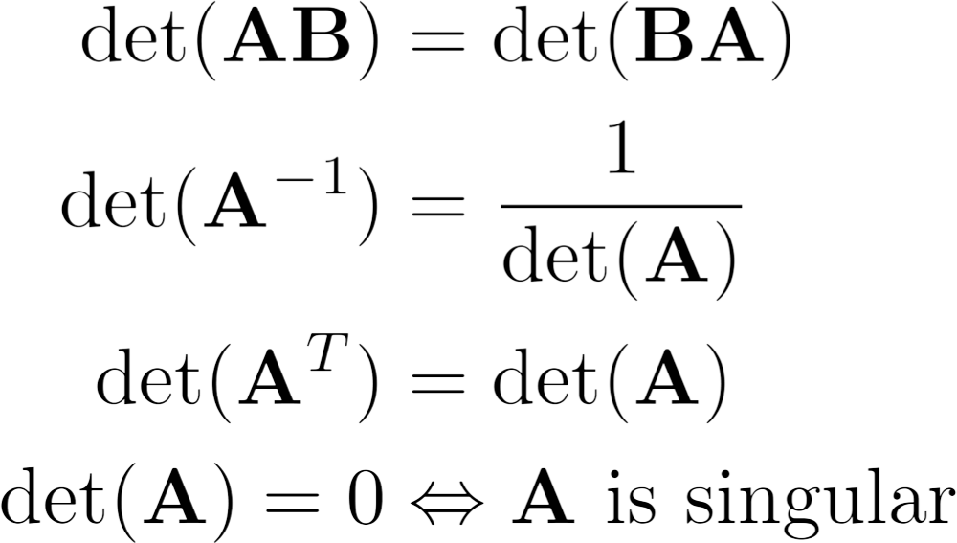
Matrix Operations
Determinant
returns a scalar
Represents area (or volume) of the parallelogram described by the vectors in the rows of the matrix
For
Properties:
,
det $% = det $ det(%)

Slide 23
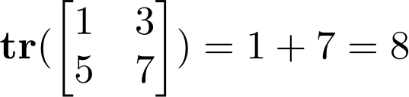
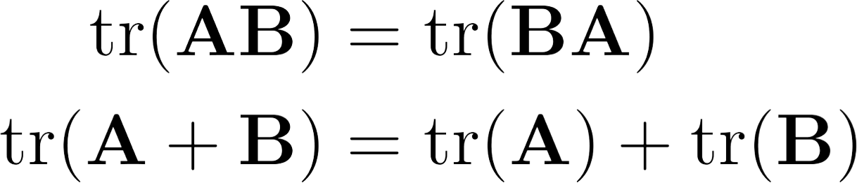
Matrix Operations
Trace
Invariant to a lot of transformations, so it’s used sometimes in proofs. (Rarely in this class though.)
Properties:

Slide 24
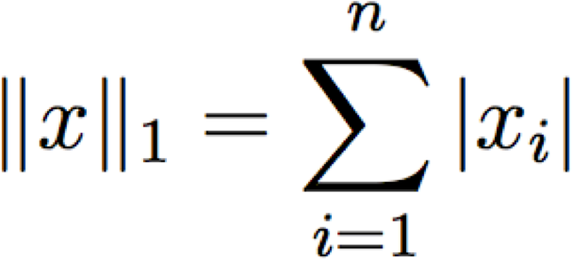
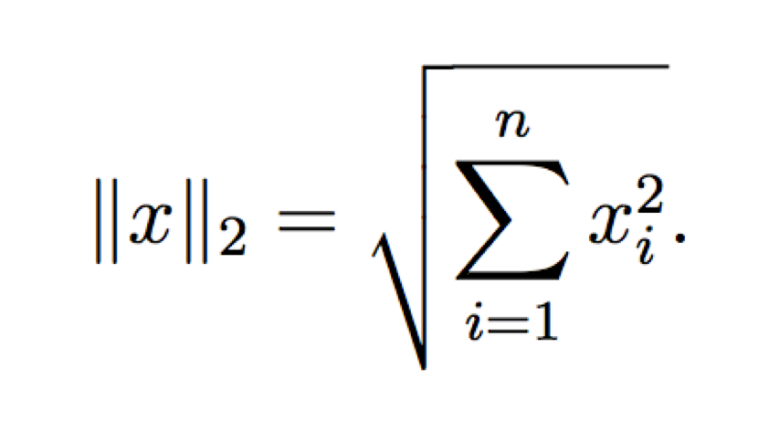

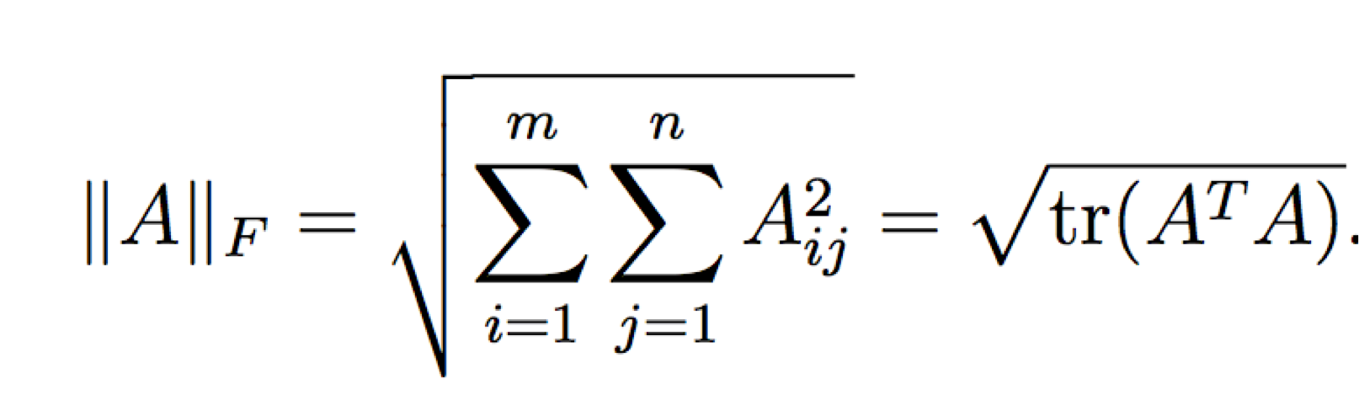
Matrix Operations
Vector Norms
Matrix norms: Norms can also be defined for matrices, such as the Frobenius norm:

Slide 25
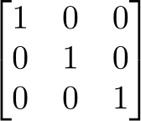
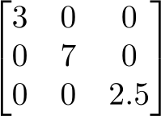
Special Matrices
Identity matrix I
Square matrix, 1’s along diagonal, 0’s elsewhere
I · [another matrix] = [that matrix]
Diagonal matrix
Square matrix with numbers along diagonal, 0’s elsewhere
A diagonal · [another matrix] scales the rows of that matrix

Slide 26
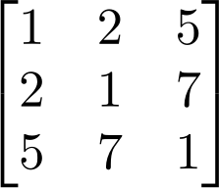


Special Matrices
Symmetric matrix
Skew-symmetric matrix
0 -2 -5
2 0 -7
5 7 0

Slide 27

Outline
Vectors and matrices
Basic Matrix Operations
Determinants, norms, trace
Special Matrices
Transformation Matrices
Homogeneous coordinates
Translation
Matrix inverse
Matrix rank
Eigenvalues and Eigenvectors
Matrix Calculus
Matrix multiplication can be used to transform vectors. A matrix used in this way is called a transformation matrix.

Slide 28
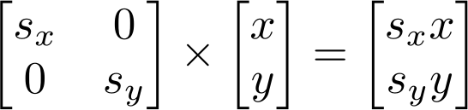
Transformation
Matrices can be used to transform vectors in useful ways, through multiplication: x’= Ax
Simplest is scaling:
(Verify to yourself that the matrix multiplication works out this way)

Slide 29
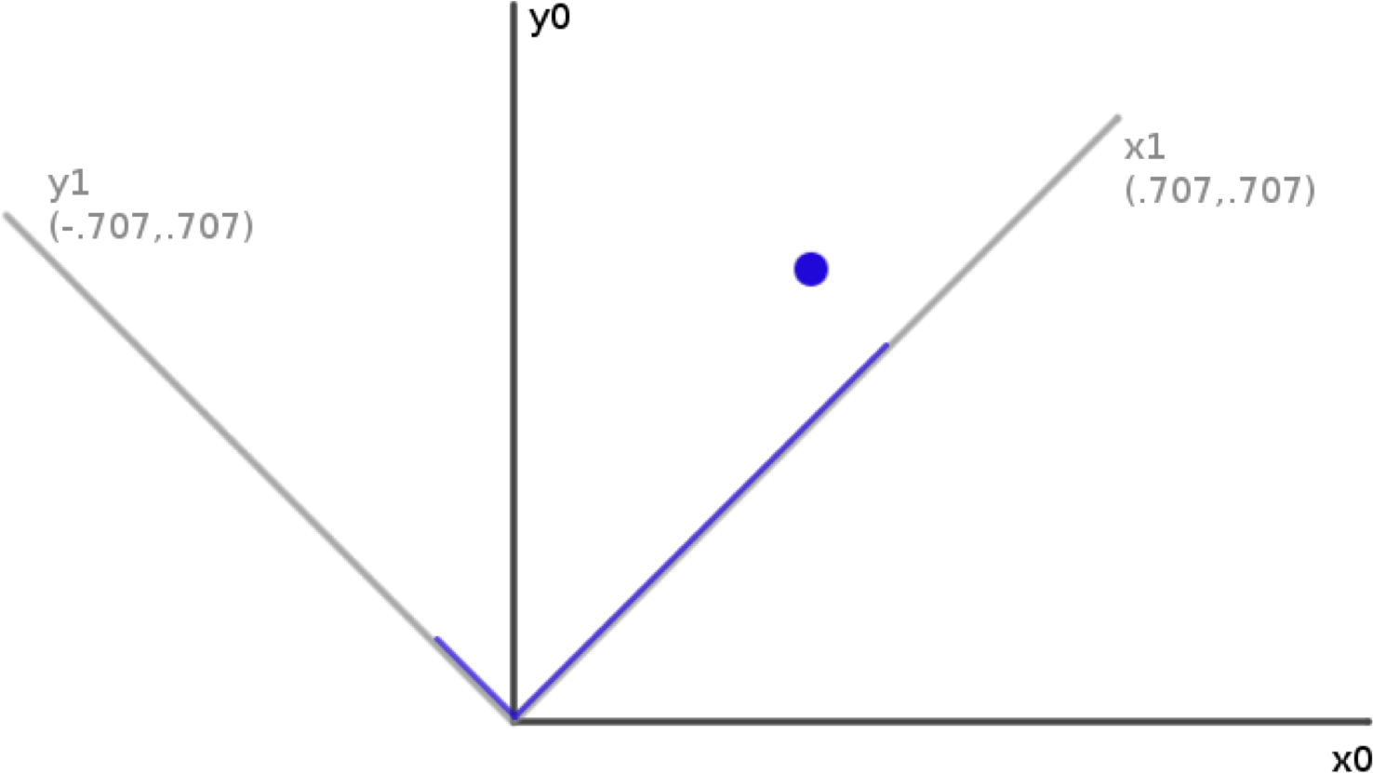


Rotation
How can you convert a vector represented in frame “0” to a new, rotated coordinate frame “1”?

Slide 30
Rotation
How can you convert a vector represented in frame “0” to a new, rotated coordinate frame “1”?
Remember what a vector is:
[component in direction of the frame’s x axis, component in direction of y axis]

Slide 31
Rotation
So to rotate it we must produce this vector:
[component in direction of new x axis, component in direction of new y axis]
We can do this easily with dot products!
New x coordinate is [original vector] dot [the new x axis]
New y coordinate is [original vector] dot [the new y axis]

Slide 32

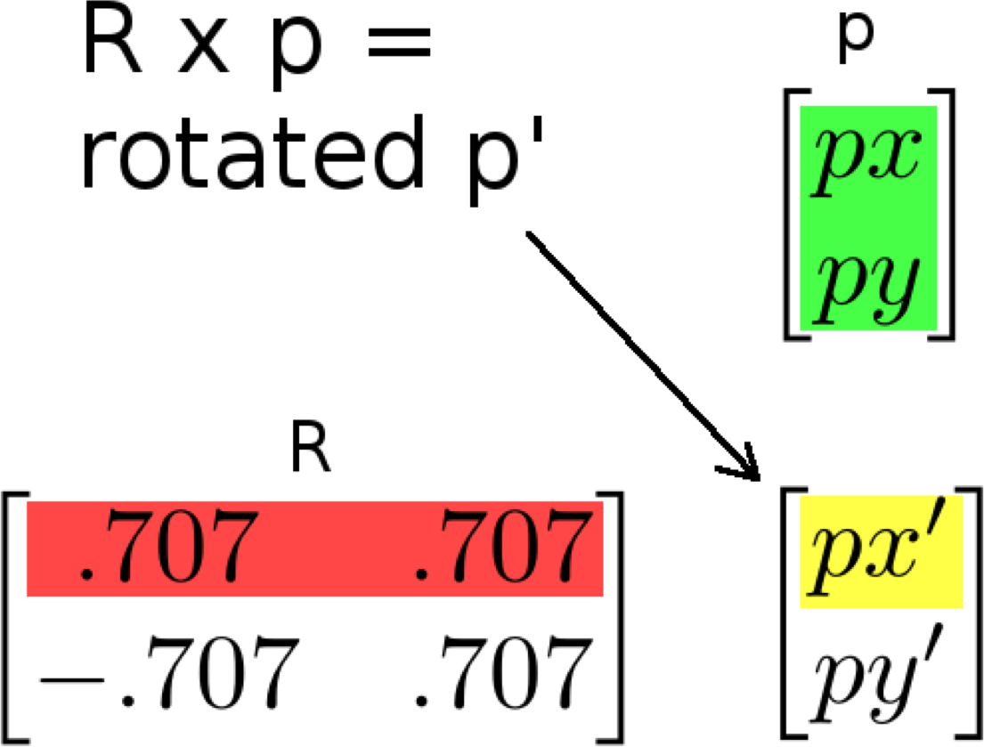
Rotation
Insight: this is what happens in a matrix*vector multiplication
Result x coordinate is:
[original vector] dot [matrix row 1]
So matrix multiplication can rotate a vector p:

Slide 33
Rotation
Suppose we express a point in the new coordinate system which is rotated left
If we plot the result in the original coordinate system, we have rotated the point right
– Thus, rotation matrices can be used to rotate vectors. We’ll usually think of them in that sense-- as operators to rotate vectors

Slide 34











2D Rotation Matrix Formula
Counter-clockwise rotation by an angle θ
x'= cos θ x − sin θ y
y'= cos θ y + sin θ x
P’
y’
y
θ
P
⎡ x'⎤ ₌ ⎡cosq
− sin q ⎤⎡ x⎤
x’
x
⎢ _{y'}⎥
⎢sin q
cosq ⎥⎢ y⎥
⎣ ⎦ ⎣
P' = R P
⎦⎣ ⎦

Slide 35
Transformation Matrices
Multiple transformation matrices can be used to transform a point:
p’=R₂ R₁ S p

Slide 36
Transformation Matrices
Multiple transformation matrices can be used to transform a point:
p’=R₂ R₁ S p
The effect of this is to apply their transformations one after the other, from right to left.
In the example above, the result is (R₂ (R₁ (S p)))

Slide 37
Transformation Matrices
Multiple transformation matrices can be used to transform a point:
p’=R₂ R₁ S p
The effect of this is to apply their transformations one after the other, from right to left.
In the example above, the result is (R₂ (R₁ (S p)))
The result is exactly the same if we multiply the matrices first, to form a single transformation matrix:
p’=(R₂ R₁ S) p

Slide 38
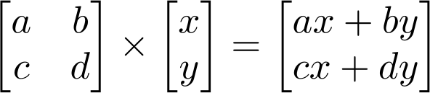
Homogeneous system
In general, a matrix multiplication lets us linearly combine components of a vector
This is sufficient for scale, rotate, skew transformations.
But notice, we can’t add a constant! L

Slide 39
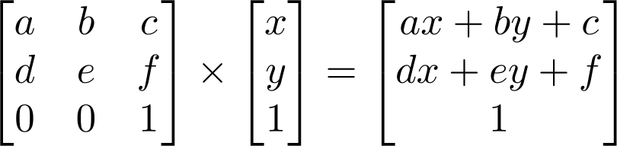
Homogeneous system
– The (somewhat hacky) solution? Stick a “1” at the end of every vector:
Now we can rotate, scale, and skew like before, AND translate (note how the multiplication works out, above)
This is called “homogeneous coordinates”

Slide 40
Homogeneous system
– In homogeneous coordinates, the multiplication works out so the rightmost column of the matrix is a vector that gets added.
– Generally, a homogeneous transformation matrix will have a bottom row of [0 0 1], so that the result has a “1” at the bottom too.

Slide 41
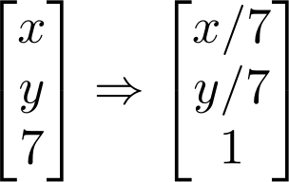
Homogeneous system
One more thing we might want: to divide the result by something
Matrix multiplication can’t actually divide
So, by convention, in homogeneous coordinates, we’ll divide the result by its last coordinate after doing a matrix multiplication
41
10/2/17

Slide 42



2D Translation
P’
P
t

Slide 43





P = (x, y) → (x, y,1)
2D Translation using Homogeneous Coordinates
P’
t
ty
P
t = (t_{x} , t_{y} ) → (t_{x} , t_{y} ,1)
y
P
⎡ x + t_{x} ⎤
⎡ ⎤ ⎡ x⎤
1 0 t_{x}
0 1 t_{y}
0 0 1
x
tx
⎥⋅ ⎢ _{y}⎥
P'→ ⎢ y + t ⎥ = ⎢
⎢ ^{y} ⎥ ⎢ ⎢⎣ ⎥⎦ ⎢⎣
⎥ ⎢ ⎥ ⎥⎦ ⎢⎣1⎥⎦
1

Slide 44
P = (x, y) → (x, y,1)
2D Translation using Homogeneous Coordinates
P’
t
ty
P
t = (t_{x} , t_{y} ) → (t_{x} , t_{y} ,1)
y
P
⎡ x + t_{x} ⎤ ⎡1
0 t_{x}
⎤ ⎡ x⎤
x
tx
⎥⋅ ⎢ _{y}⎥
P'→ ⎢ y + t ⎥ = ⎢
0 1 t_{y}
0 0 1
⎢ ^{y} ⎥ ⎢ ⎢⎣ ⎥⎦ ⎢⎣
⎥ ⎢ ⎥ ⎥⎦ ⎢⎣1⎥⎦
1

Slide 45
P = (x, y) → (x, y,1)
2D Translation using Homogeneous Coordinates
P’
t
ty
P
t = (t_{x} , t_{y} ) → (t_{x} , t_{y} ,1)
y
P
⎡ x + t_{x} ⎤ ⎡1 0
t_{x}
⎤ ⎡ x⎤
x
tx
⎥⋅ ⎢ _{y}⎥
P'→ ⎢ y + t ⎥ = ⎢
0 1 t_{y}
0 0 1
⎢ ^{y} ⎥ ⎢ ⎢⎣ ⎥⎦ ⎢⎣
⎥ ⎢ ⎥ ⎥⎦ ⎢⎣1⎥⎦
1

Slide 46
P = (x, y) → (x, y,1)
2D Translation using Homogeneous Coordinates
P’
t
ty
P
t = (t_{x} , t_{y} ) → (t_{x} , t_{y} ,1)
y
P
⎡ x + t_{x} ⎤ ⎡1 0
t_{x} ⎤ ⎡ x⎤
x
tx
⎥⋅ ⎢ _{y}⎥
P'→ ⎢ y + t ⎥ = ⎢
0 1 t_{y}
0 0 1
⎢ ^{y} ⎥ ⎢ ⎢⎣ ⎥⎦ ⎢⎣
⎥ ⎢ ⎥ ⎥⎦ ⎢⎣1⎥⎦
1

Slide 47
P = (x, y) → (x, y,1)
2D Translation using Homogeneous Coordinates
P’
t
ty
P
t = (t_{x} , t_{y} ) → (t_{x} , t_{y} ,1)
t
y
P
⎡ x + t_{x} ⎤ ⎡1 0
P'→ ⎢ y + t ⎥ = ⎢0 1
0
t_{x}
t_{y}
⎤ ⎡ x⎤
x
tx
⎥⋅ ⎢ _{y}⎥
⎢ ^{y} ⎥ ⎢ ⎢⎣ ⎥⎦ ⎢⎣0
⎥ ⎢ ⎥
1
1 ⎥⎦ ⎢⎣1⎥⎦
₌ ⎡I
⎢₀ ₁⎥
^{t⎤} ⋅ P = T ⋅ P
⎣ ⎦

Slide 48



Scaling
P’
P

Slide 49
Scaling Equation
P’
s y
P = (x, y) → P'= (s_{x} x, s_{y} y)
P = (x, y) → (x, y,1)
P'= (s_{x} x, s_{y} y) → (s_{x} x, s_{y} y,1)
y
P
y
x s_{x} x

Slide 50
Scaling Equation
P’
s y
P = (x, y) → P'= (s_{x} x, s_{y} y)
y
P
y
P = (x, y) → (x, y,1)
P'= (s_{x} x, s_{y} y) → (s_{x} x, s_{y} y,1)
⎤ ⎡ x⎤
x s_{x} x
⎡s_{x} x⎤
⎡s_{x} 0 0
⎢
⎢ 0 s_{y} 0
⎢⎣ 0 0 1
⎥⋅ ⎢ _{y}⎥
P'→ ⎢s y⎥ =
⎢ ⎥
⎥ ⎢ ⎥ ⎥⎦ ⎢⎣1⎥⎦
y
⎢⎣ 1 ⎥⎦

Slide 51
Scaling Equation
P’
s y
P = (x, y) → P'= (s_{x} x, s_{y} y)
P = (x, y) → (x, y,1)
P'= (s_{x} x, s_{y} y) → (s_{x} x, s_{y} y,1)
y
P
y
x s_{x} x
⎡s_{x} x⎤
⎡s_{x} 0
0⎤ ⎡ x⎤
₀⎥⋅ ⎢ _{y}⎥ ₌ ⎡^{S'}
P'→ ⎢s y⎥ = ⎢ 0 s
^{0⎤} ⋅ P = S ⋅ P
⎢ ⎥ ⎢ ⎢⎣ 1 ⎥⎦ ⎢⎣ 0
⎥ ⎢ ⎥
1⎥⎦ ⎢⎣1⎥⎦
⎢ ₀ ₁⎥
y
y
0
S
⎣ ⎦

Slide 52
Scaling & Translating
P’’
P
P’=S∙P P’’=T∙P’
P’’=T · P’=T ·(S · P)= T · S ·P

Slide 53

Scaling & Translating
∀ ₁
% ∀ _{s}
x
∃ 0 t_{x}
P '' = T ⋅ S ⋅ P = ∃ 0 1 t_{y}
0 1
0 %∀ _{x} %
∋ ∃ ⁰ ∋∃
∋⋅∃ 0 s_{y}
∋ ∃ ∋& ∃# 0 0
∋
0 ∋∃ y ∋
=
∃ ₀
₁ ∋∃ ₁ ∋
∃#
∋&# &
∀ s_{x} 0 t_{x} %∀ _{x} % ∀ s_{x} x + t_{x} % ∀ _{x} %
∃ ∋∃ ∋ ∃ ∋ ∀ _{S t} %∃ ∋
= ∃ 0 s_{y} t_{y} ∋∃ y ∋ = ∃ s_{y} y + t_{y} ∋ = ∃ ∋∃ y ∋
∃ ∋∃ ∋ ∃ ∋ # ⁰ ¹ &∃ ∋ #∃ 0 0 1 &∋# 1 & #∃ 1 &∋ # 1 &
A

Slide 54
Scaling & Translating
∀ ₁
% ∀ _{s}
x
∃ 0 t_{x}
P '' = T ⋅ S ⋅ P = ∃ 0 1 t_{y}
0 1
0 %∀ _{x} %
∋ ∃ ⁰ ∋∃
∋⋅∃ 0 s_{y}
∋ ∃ ∋& ∃# 0 0
∋
0 ∋∃ y ∋ =
∃ ₀
₁ ∋∃ ₁ ∋
∃#
∋&# &
∀ _{s}
x
0 t_{x}
0 s_{y}
0 0 1
%∀ _{x} %
%
∀ _{x} %
∀ s x + t
x x
∃
= ∃
∃
∃#
∋∃
∋
∃
∋
∀ _{S t} %∃
∋
t_{y} ∋∃ y ∋ = ∃ s_{y} y + t_{y}
∋ = ∃ ∋∃ y ∋
0 1
∋∃ ₁ ∋
∃
∃#
∋ #
∋&
&∃ ₁ ∋
∋&# &
1
# &

Slide 55
Translating & Scaling versus Scaling & Translating
⎡1 0 t_{x} ⎤⎡s_{x} 0
⎢ 1
⎢⎣0 0
⎡s_{x} 0
⎡s_{x} x + t_{x} ⎤
0⎤⎡x⎤ t_{x} ⎤⎡x⎤
P'''= T ⋅S ⋅P = ⎢0
_{t} ⎥⎢ ₀
s
₀⎥⎢_{y}⎥ ₌ ⎢ ₀
s t ⎥⎢y⎥ = ⎢s y + t ⎥
^{y} ⎥⎢
1 ⎥⎦⎢⎣ 0
⎥⎢ ⎥ ⎢
0 1⎥⎦⎣⎢1⎥⎦ ⎢⎣ 0
^{y} ⎥⎢ ⎥ ⎢
y ⎥
⎥⎦
y
y
y
0 1 ⎥⎦⎢⎣1⎥⎦ ⎢⎣ 1

Slide 56
Translating & Scaling
!= Scaling & Translating
⎡1 0 t_{x} ⎤⎡s_{x} 0
⎢ 1
⎢⎣0 0
⎡s_{x} 0
⎡s_{x} x + t_{x} ⎤
0⎤⎡x⎤ t_{x} ⎤⎡x⎤
P'''= T ⋅S ⋅P = ⎢0
_{t} ⎥⎢ ₀
s
₀⎥⎢_{y}⎥ ₌ ⎢ ₀
s t ⎥⎢y⎥ = ⎢s y + t ⎥
^{y} ⎥⎢
1 ⎥⎦⎢⎣ 0
⎥⎢ ⎥ ⎢
0 1⎥⎦⎣⎢1⎥⎦ ⎢⎣ 0
^{y} ⎥⎢ ⎥ ⎢
y ⎥
⎥⎦
y
y
y
0 1 ⎥⎦⎢⎣1⎥⎦ ⎢⎣ 1
⎡s_{x} 0 0⎤⎡1 0
1
0
t_{x} ⎤⎡x⎤
₀⎥⎢₀
_{t} ⎥⎢_{y}⎥₌
P'''= S ⋅ T ⋅ P = ⎢ 0
s
⎢
⎢⎣ 0
y
⎥⎢
1⎥⎦⎢⎣0
^{y} ⎥⎢ ⎥
1 ⎥⎦⎢⎣1⎥⎦
0
⎡s_{x} 0 s_{x} t_{x} ⎤⎡x⎤ ⎡s_{x} x + s_{x} t_{x} ⎤
= ⎢ 0 s s t ⎥⎢y⎥ = ⎢s y +s t ⎥ ⎢ y y y ⎥⎢ ⎥ ⎢ y y y ⎥
⎢⎣ 0 0 1 ⎥⎦⎢⎣1⎥⎦ ⎢⎣ 1 ⎥⎦

Slide 57
Translating & Scaling
!= Scaling & Translating
⎡1 0 t_{x} ⎤⎡s_{x} 0
⎢ 1
⎢⎣0 0
⎡s_{x} 0
⎡s_{x} x + t_{x} ⎤
0⎤⎡x⎤ t_{x} ⎤⎡x⎤
P'''= T ⋅S ⋅P = ⎢0
_{t} ⎥⎢ ₀
s
₀⎥⎢_{y}⎥ ₌ ⎢ ₀
s t ⎥⎢y⎥ = ⎢s y + t ⎥
^{y} ⎥⎢
1 ⎥⎦⎢⎣ 0
⎥⎢ ⎥ ⎢
0 1⎥⎦⎣⎢1⎥⎦ ⎢⎣ 0
^{y} ⎥⎢ ⎥ ⎢
y ⎥
⎥⎦
y
y
y
0 1 ⎥⎦⎢⎣1⎥⎦ ⎢⎣ 1
⎡s_{x} 0 0⎤⎡1 0
1
0
t_{x} ⎤⎡x⎤
₀⎥⎢₀
_{t} ⎥⎢_{y}⎥₌
P'''= S ⋅ T ⋅ P = ⎢ 0
s
⎢
⎢⎣ 0
y
⎥⎢
1⎥⎦⎢⎣0
^{y} ⎥⎢ ⎥
1 ⎥⎦⎢⎣1⎥⎦
0
⎡s_{x} 0 s_{x} t_{x} ⎤⎡x⎤
⎡s_{x} x + s_{x} t_{x} ⎤
⎥
= ⎢ 0 s s t ⎥⎢y⎥ = ⎢s y + s t
y y ⎥ ⎥⎦
⎢ ⎢⎣0
^{y} ⎥⎢ ⎥ ⎢ ⎥⎦⎢⎣1⎥⎦ ⎢⎣
y
0 1 1
y
y

Slide 58


Rotation
P’
P

Slide 59
Rotation Equations
Counter-clockwise rotation by an angle θ
x'= cos θ x − sin θ y
y'= cos θ y + sin θ x
P’
y’
y
θ
P
⎡ x'⎤ ₌ ⎡cosq
− sin q ⎤⎡ x⎤
x’
x
⎢ _{y'}⎥
⎢sin q
cosq ⎥⎢ y⎥
⎣ ⎦ ⎣
P' = R P
⎦⎣ ⎦

Slide 60
Rotation Matrix Properties
⎡ x'⎤ ₌ ⎡cosq − sin q ⎤⎡ x⎤
⎢ _{y'}⎥
⎣ ⎦ ⎢sin q cosq ⎥⎢ y⎥ ⎣ ⎦⎣ ⎦
A 2D rotation matrix is 2x2
Note: R belongs to the category of normal matrices and satisfies many interesting properties:
R ⋅ R^{T} = R^{T} ⋅ R = I
det(R) = 1

Slide 61
Rotation Matrix Properties
Transpose of a rotation matrix produces a rotation in the opposite direction
R ⋅ R^{T} = R^{T} ⋅ R = I
det(R) = 1
The rows of a rotation matrix are always mutually perpendicular (a.k.a. orthogonal) unit vectors
– (and so are its columns)

Slide 62


Scaling + Rotation + Translation
P’= (T R S) P
⎡1 0 t_{x} ⎤⎡cos θ − sinθ 0⎤⎡s_{x} 0
1 cos θ
0 0 0
0⎤⎡x⎤
P'= T ⋅ R ⋅ S ⋅ P = ⎢0
t ⎥⎢ sin θ
₀⎥⎢ ₀
s
₀⎥⎢_{y}⎥₌
^{y} ⎥⎢
1 ⎥⎦⎢⎣
− sin θ t_{x} ⎤⎡s_{x} 0 cos θ
0
⎢ ⎢⎣0
⎥⎢
1⎥⎦⎢⎣ 0
y
⎥⎢ ⎥
1⎥⎦⎢⎣1⎥⎦
0
⎡cos θ
0⎤⎡x⎤
= ⎢ sin θ
_{t} ⎥⎢ ₀
s
₀⎥⎢_{y}⎥₌
⎢ ⎢⎣
^{y} ⎥⎢
1 ⎥⎦⎢⎣ 0
y
⎥⎢ ⎥
1⎥⎦⎢⎣1⎥⎦
This is the form of the general-purpose transformation matrix
0
0
⎡R t⎤⎡S
⎣ 0 1⎦⎣0
_{0⎤}⎡ x⎤
_{t⎤}⎡ x⎤
⎥⎢ _{y}⎥ _{= ⎢}
⎡R S
⎥⎢ _{y}⎥
= ⎢
⎥⎢
_{1⎦}⎢ ⎥
_{1⎦}⎢ ⎥
⎣ 0
⎢⎣1⎥⎦
⎢⎣1⎥⎦

Slide 63
Announcements
HW0 will be released this Friday night

Slide 64
Outline
Vectors and matrices
Basic Matrix Operations
Determinants, norms, trace
Special Matrices
Transformation Matrices
Homogeneous coordinates
Translation
Matrix inverse
Matrix rank
Eigenvalues and Eigenvectors
Matrix Calculate
The inverse of a transformation matrix reverses its effect

Slide 65
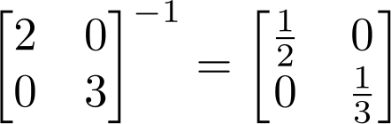
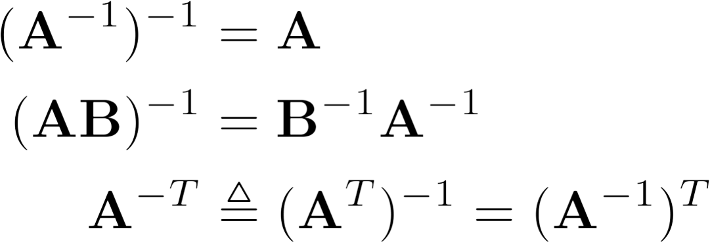
Inverse
Given a matrix A, its inverse A⁻¹ is a matrix such that AA⁻¹ = A⁻¹A = I
E.g.
Inverse does not always exist. If A⁻¹ exists, A is
invertible or non-singular. Otherwise, it’s singular.
Useful identities, for matrices that are invertible:

Slide 66
Matrix Operations
Pseudoinverse
– Say you have the matrix equation AX=B, where A and B are known, and you want to solve for X

Slide 67
Matrix Operations
Pseudoinverse
Say you have the matrix equation AX=B, where A and B are known, and you want to solve for X
You could calculate the inverse and pre-multiply by it: A⁻¹AX=A⁻¹B → X=A⁻¹B

Slide 68
Matrix Operations
Pseudoinverse
Say you have the matrix equation AX=B, where A and B are known, and you want to solve for X
You could calculate the inverse and pre-multiply by it: A⁻¹AX=A⁻¹B → X=A⁻¹B
MATLAB command would be inv(A) * B
But calculating the inverse for large matrices often brings problems with computer floating-point resolution (because it involves working with very small and very large numbers together).
Or, your matrix might not even have an inverse.

Slide 69
Matrix Operations
Pseudoinverse
Fortunately, there are workarounds to solve AX=B in these situations. And MATLAB can do them!
Instead of taking an inverse, directly ask python to solve for X in AX=B, by typing A\B
MATLAB will try several appropriate numerical methods (including the pseudoinverse if the inverse doesn’t exist)
MATLAB will return the value of X which solves the equation
If there is no exact solution, it will return the closest one
If there are many solutions, it will return the smallest one

Slide 70

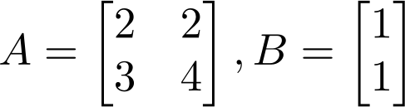
Matrix Operations
MATLAB example:
>> | x | = | A | \ | B
x | =
1.0000
-0.5000

Slide 71
Outline
Vectors and matrices
Basic Matrix Operations
Determinants, norms, trace
Special Matrices
Transformation Matrices
Homogeneous coordinates
Translation
Matrix inverse
Matrix rank
Eigenvalues and Eigenvectors
Matrix Calculate
The rank of a transformation matrix tells you how many dimensions it transforms a vector to.

Slide 72
Linear independence
Suppose we have a set of vectors v₁, …, v_{n}
If we can express v₁ as a linear combination of the other vectors v₂…v_{n}, then v₁ is linearly dependent on the other vectors.
– The direction v₁ can be expressed as a combination of the directions v₂…v_{n}. (E.g. v₁ = .7 v₂ -.7 v₄)

Slide 73
Linear independence
Suppose we have a set of vectors v₁, …, v_{n}
If we can express v₁ as a linear combination of the other vectors v₂…v_{n}, then v₁ is linearly dependent on the other vectors.
The direction v₁ can be expressed as a combination of the directions v₂…v_{n}. (E.g. v₁ = .7 v₂ -.7 v₄)
If no vector is linearly dependent on the rest of the set, the set is linearly independent.
Common case: a set of vectors v₁, …, v_{n} is always linearly independent if each vector is perpendicular to every other vector (and non-zero)

Slide 74
Linear independence
Linearly independent set
Not linearly independent

Slide 75
Matrix rank
Column/row rank
– Column rank always equals row rank
Matrix rank

Slide 76


Matrix rank
For transformation matrices, the rank tells you the dimensions of the output
E.g. if rank of A is 1, then the transformation
p’=Ap
maps points onto a line.
Here’s a matrix with rank 1:
All points get mapped to the line y=2x

Slide 77
Matrix rank
If an m x m matrix is rank m, we say it’s “full rank”
Maps an m x 1 vector uniquely to another m x 1 vector
An inverse matrix can be found
If rank < m, we say it’s “singular”
At least one dimension is getting collapsed. No way to look at the result and tell what the input was
Inverse does not exist
Inverse also doesn’t exist for non-square matrices

