Slide 1
Linear Algebra Primer
Juan Carlos Niebles and Ranjay Krishna
Stanford Vision and Learning Lab
Another, very in-depth linear algebra review from CS229 is available here:
http://cs229.stanford.edu/section/cs229-linalg.pdf
And a video discussion of linear algebra from EE263 is here (lectures 3 and 4):
https://see.stanford.edu/Course/EE263

Slide 2
Outline
Vectors and matrices
Basic Matrix Operations
Determinants, norms, trace
Special Matrices
Transformation Matrices
Homogeneous coordinates
Translation
Matrix inverse
Matrix rank
Eigenvalues and Eigenvectors
Matrix Calculus

Slide 3
Outline
Vectors and matrices are just collections of ordered numbers that represent something: movements in space, scaling factors, pixel brightness, etc. We’ll define some common uses and standard operations on them.
Vectors and matrices
Basic Matrix Operations
Determinants, norms, trace
Special Matrices
Transformation Matrices
Homogeneous coordinates
Translation
Matrix inverse
Matrix rank
Eigenvalues and Eigenvectors
Matrix Calculus

Slide 4
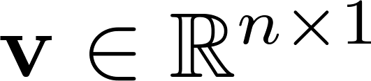
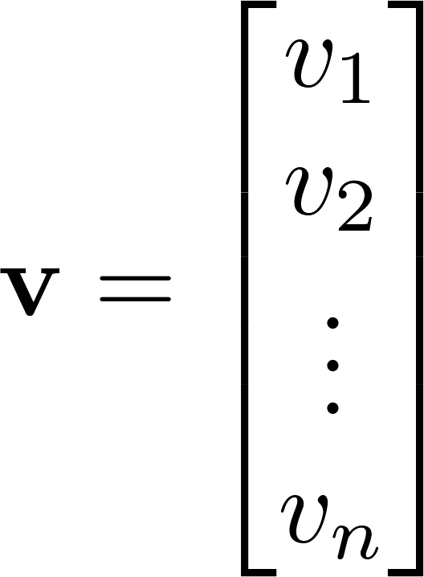
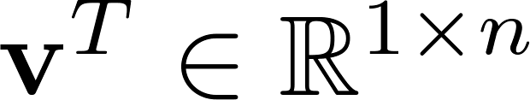
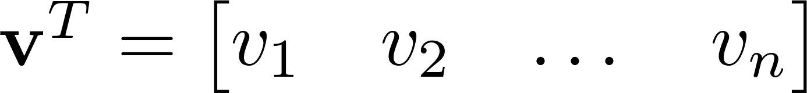

Vector
A column vector where
A row vector where
denotes the transpose operation

Slide 5
Vector
We’ll default to column vectors in this class
You’ll want to keep track of the orientation of your vectors when programming in python
You can transpose a vector V in python by writing V.t. (But in class materials, we will always use V^{T} to indicate transpose, and we will use V’ to mean “V prime”)

Slide 6
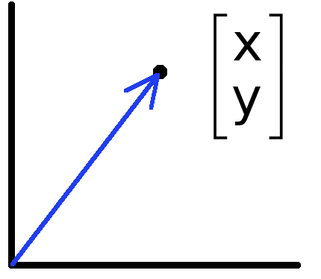

Vectors have two main uses
Data (pixels, gradients at an image keypoint, etc) can also be treated as a vector
Such vectors don’t have a geometric interpretation, but calculations like “distance” can still have value
Vectors can represent an offset in 2D or 3D space
Points are just vectors from the origin

Slide 7
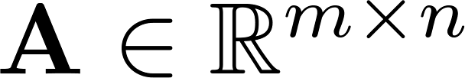
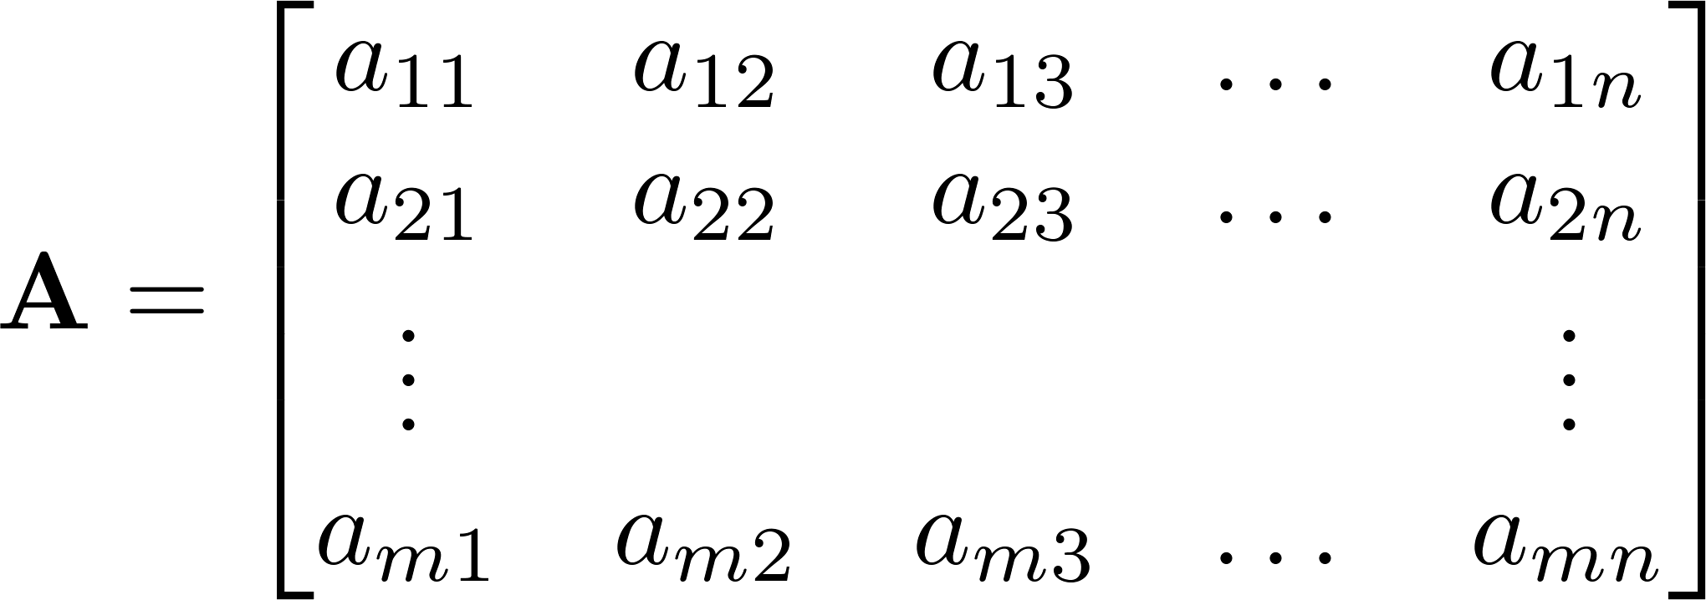


Matrix
A matrix is an array of numbers with size by , i.e. m rows and n columns.
If , we say that is square.

Slide 8

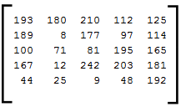
Images
=
Python represents an image as a matrix of pixel brightnesses
Note that the upper left corner is [y,x] = (0,0)
Notes:
Coordinates: [row, column]

Slide 9
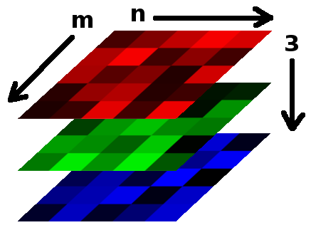

Color Images
Grayscale images have one number per pixel, and are stored as an m × n matrix.
Color images have 3 numbers per pixel – red, green, and blue brightnesses (RGB)
Stored as an m × n × 3 matrix
=

Slide 10
Basic Matrix Operations
We will discuss:
Addition
Scaling
Dot product
Multiplication
Transpose
Inverse / pseudoinverse
Determinant / trace

Slide 11
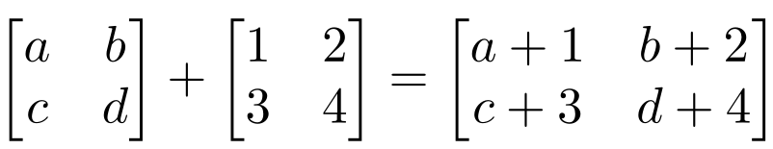
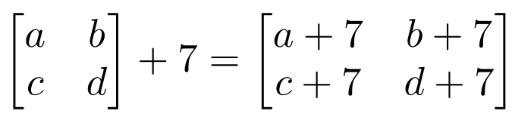
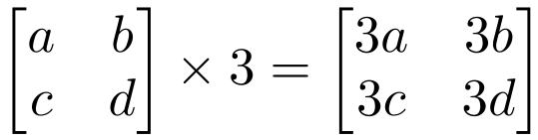
Matrix Operations
Addition
Can only add a matrix with matching dimensions, or a scalar.
Scaling

Slide 12
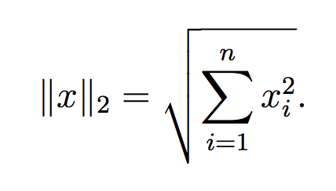




Vectors
Norm
More formally, a norm is any function that satisfies 4 properties:
Non-negativity: For all
Definiteness: f(x) = 0 if and only if x = 0.
Homogeneity: For all
Triangle inequality: For all

Slide 13
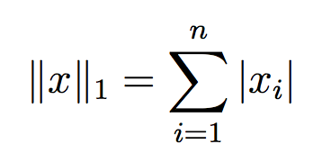
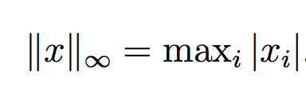

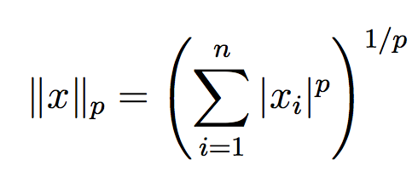
Matrix Operations
Example Norms
General norms:

Slide 14
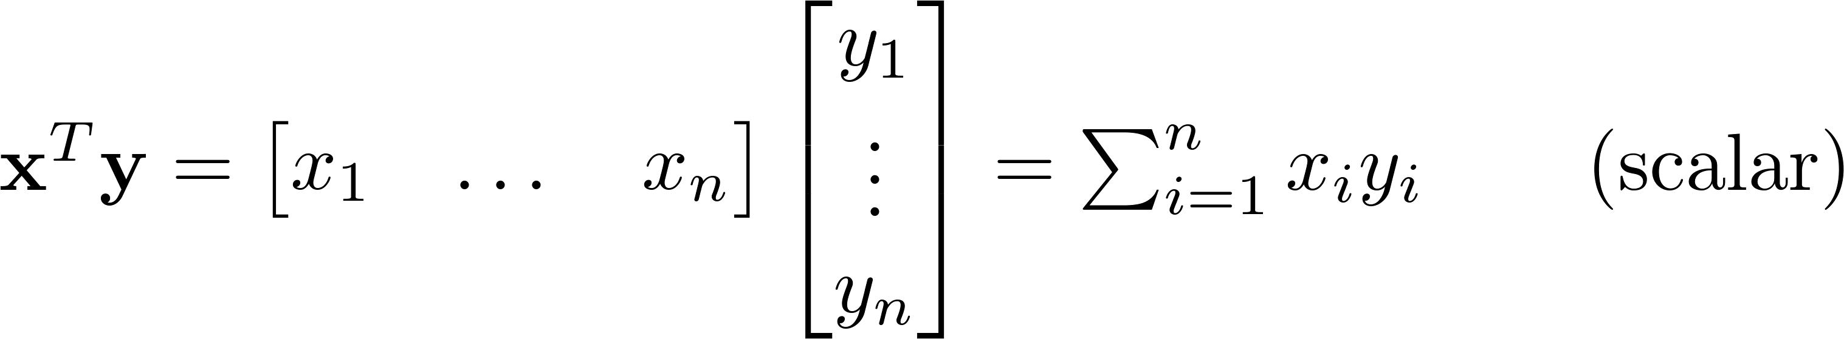
Matrix Operations
Inner product (dot product) of vectors
Multiply corresponding entries of two vectors and add up the result
x·y is also |x||y|Cos( the angle between x and y )

Slide 15
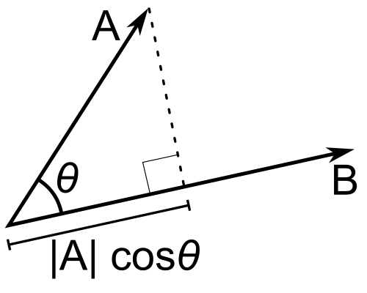
Matrix Operations
Inner product (dot product) of vectors
If B is a unit vector, then A·B gives the length of A which lies in the direction of B

Slide 16
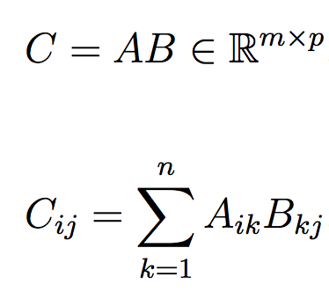


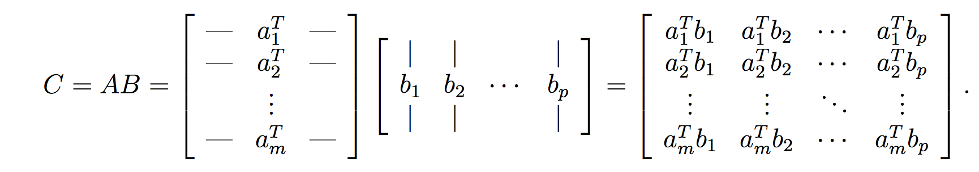
Matrix Operations
The product of two matrices

Slide 17
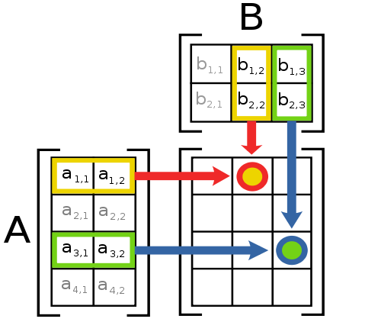
Matrix Operations
Multiplication
The product AB is:
Each entry in the result is (that row of A) dot product with (that column of B)
Many uses, which will be covered later

Slide 18
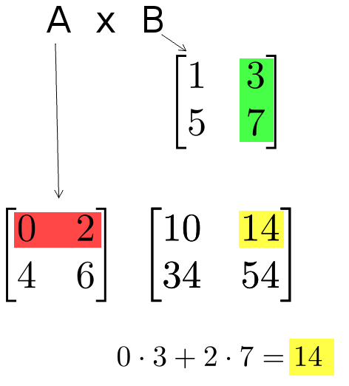
Matrix Operations
Multiplication example:
Each entry of the matrix product is made by taking the dot product of the corresponding row in the left matrix, with the corresponding column in the right one.

Slide 19
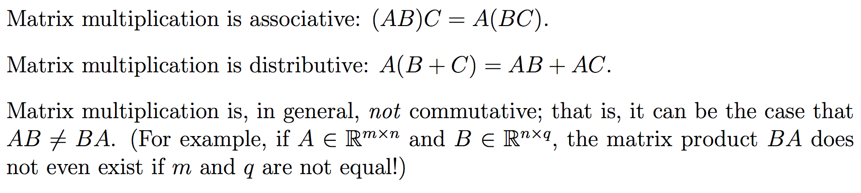
Matrix Operations
The product of two matrices

Slide 20
Matrix Operations
Powers
By convention, we can refer to the matrix product AA as A², and AAA as A³, etc.
Obviously only square matrices can be multiplied that way

Slide 21
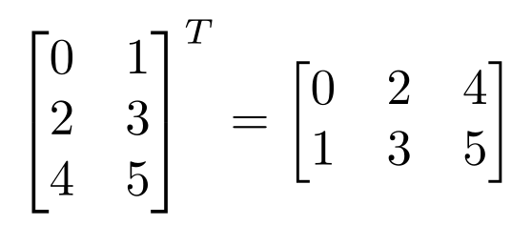
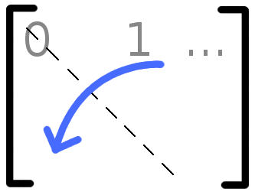

Matrix Operations
Transpose – flip matrix, so row 1 becomes column 1
A useful identity:

Slide 22
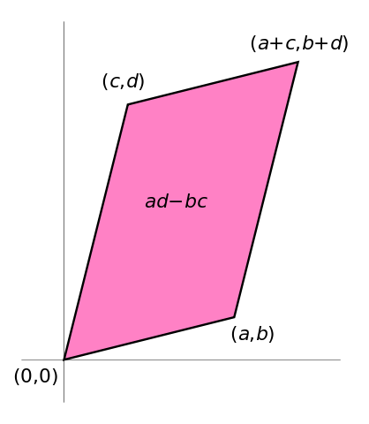

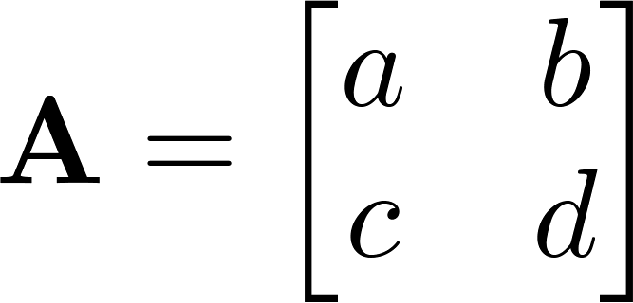

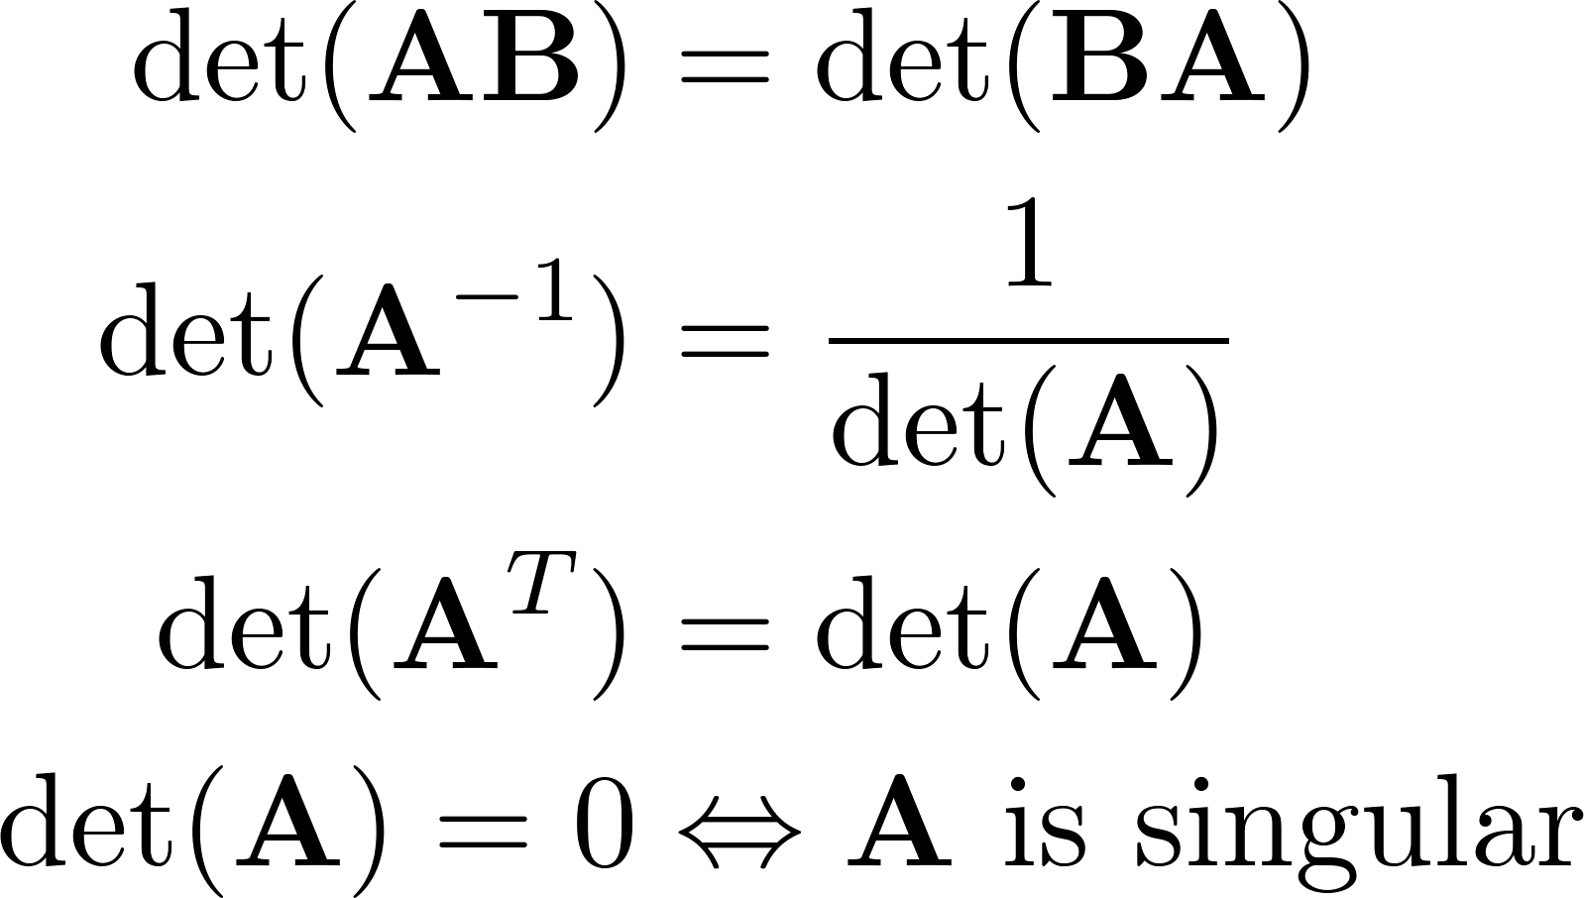
Matrix Operations
Determinant
returns a scalar
Represents area (or volume) of the parallelogram described by the vectors in the rows of the matrix
For ,
Properties:

Slide 23
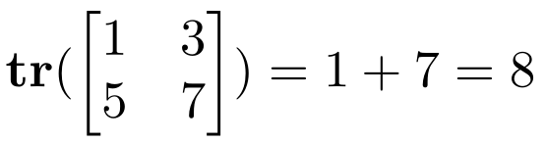
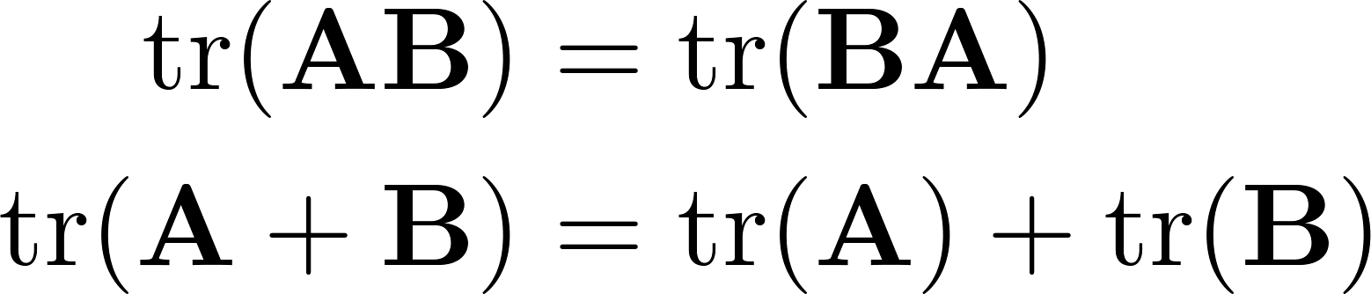
Matrix Operations
Trace
Invariant to a lot of transformations, so it’s used sometimes in proofs. (Rarely in this class though.)
Properties:

Slide 24
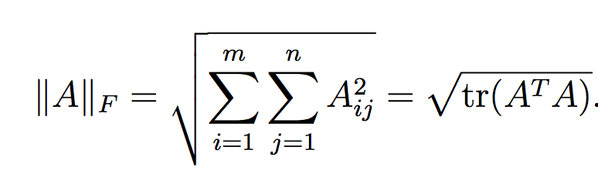
Matrix Operations
Vector Norms
Matrix norms: Norms can also be defined for matrices, such as the Frobenius norm:

Slide 25
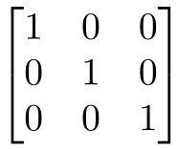
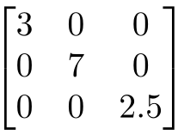
Special Matrices
Identity matrix I
Square matrix, 1’s along diagonal, 0’s elsewhere
I ∙ [another matrix] = [that matrix]
Diagonal matrix
Square matrix with numbers along diagonal, 0’s elsewhere
A diagonal ∙ [another matrix] scales the rows of that matrix

Slide 26
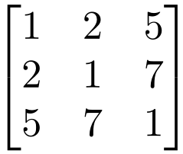


Special Matrices
Symmetric matrix
Skew-symmetric matrix

Slide 27
Linear Algebra Primer
Juan Carlos Niebles and Ranjay Krishna
Stanford Vision and Learning Lab
Another, very in-depth linear algebra review from CS229 is available here:
http://cs229.stanford.edu/section/cs229-linalg.pdf
And a video discussion of linear algebra from EE263 is here (lectures 3 and 4):
https://see.stanford.edu/Course/EE263

Slide 28
Announcements – part 1
HW0 submitted last night
HW1 is due next Monday
HW2 will be released tonight
Class notes from last Thursday due before class in exactly 48 hours

Slide 29
Announcements – part 2
Future homework assignments will be released via github
Will allow you to keep track of changes IF they happen.
Submissions for HW1 onwards will be done all through gradescope.
NO MORE CORN SUBMISSIONS
You will have separate submissions for the ipython pdf and the python code.

Slide 30
Recap - Vector
A column vector where
A row vector where
denotes the transpose operation

Slide 31
Recap - Matrix
A matrix is an array of numbers with size by , i.e. m rows and n columns.
If , we say that is square.

Slide 32
Recap - Color Images
Grayscale images have one number per pixel, and are stored as an m × n matrix.
Color images have 3 numbers per pixel – red, green, and blue brightnesses (RGB)
Stored as an m × n × 3 matrix
=

Slide 33
Recap - Vectors
Norm
More formally, a norm is any function that satisfies 4 properties:
Non-negativity: For all
Definiteness: f(x) = 0 if and only if x = 0.
Homogeneity: For all
Triangle inequality: For all

Slide 34
Recap – projection
Inner product (dot product) of vectors
If B is a unit vector, then A·B gives the length of A which lies in the direction of B

Slide 35
Outline
Vectors and matrices
Basic Matrix Operations
Determinants, norms, trace
Special Matrices
Transformation Matrices
Homogeneous coordinates
Translation
Matrix inverse
Matrix rank
Eigenvalues and Eigenvectors
Matrix Calculus
Matrix multiplication can be used to transform vectors. A matrix used in this way is called a transformation matrix.

Slide 36
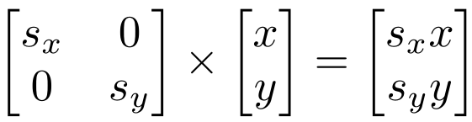
Transformation
Matrices can be used to transform vectors in useful ways, through multiplication: x’= Ax
Simplest is scaling:
(Verify to yourself that the matrix multiplication works out this way)

Slide 37
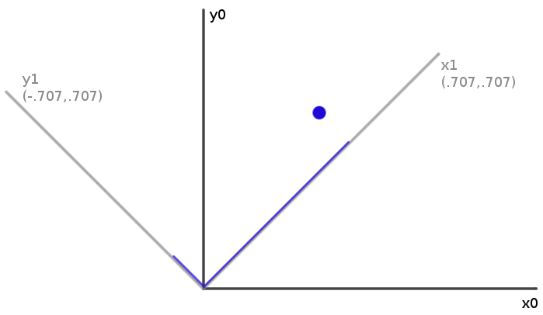
Rotation
How can you convert a vector represented in frame “0” to a new, rotated coordinate frame “1”?

Slide 38
Rotation
How can you convert a vector represented in frame “0” to a new, rotated coordinate frame “1”?
Remember what a vector is: [component in direction of the frame’s x axis, component in direction of y axis]

Slide 39
Rotation
So to rotate it we must produce this vector: [component in direction of new x axis, component in direction of new y axis]
We can do this easily with dot products!
New x coordinate is [original vector] dot [the new x axis]
New y coordinate is [original vector] dot [the new y axis]

Slide 40
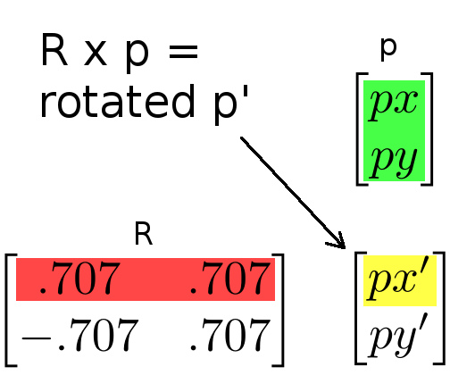
Rotation
Insight: this is what happens in a matrix*vector multiplication
Result x coordinate is: [original vector] dot [matrix row 1]
So matrix multiplication can rotate a vector p:
Notes:
RED is rotation matrix

Slide 41
Rotation
Suppose we express a point in the new coordinate system which is rotated left
If we plot the result in the original coordinate system, we have rotated the point right
Thus, rotation matrices can be used to rotate vectors. We’ll usually think of them in that sense-- as operators to rotate vectors
Notes:
Left rotation of axis == right rotation of point

Slide 42
2D Rotation Matrix Formula
Counter-clockwise rotation by an angle θ
P’
y’
θ
y
P
x’
x

Slide 43
Transformation Matrices
Multiple transformation matrices can be used to transform a point: p’=R₂ R₁ S p

Slide 44
Transformation Matrices
Multiple transformation matrices can be used to transform a point: p’=R₂ R₁ S p
The effect of this is to apply their transformations one after the other, from right to left.
In the example above, the result is (R₂ (R₁ (S p)))

Slide 45
Transformation Matrices
Multiple transformation matrices can be used to transform a point: p’=R₂ R₁ S p
The effect of this is to apply their transformations one after the other, from right to left.
In the example above, the result is (R₂ (R₁ (S p)))
The result is exactly the same if we multiply the matrices first, to form a single transformation matrix: p’=(R₂ R₁ S) p

Slide 46
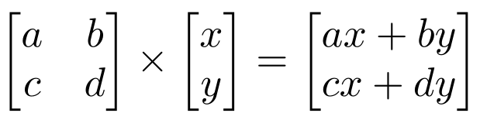
Homogeneous system
In general, a matrix multiplication lets us linearly combine components of a vector
This is sufficient for scale, rotate, skew transformations.
But notice, we can’t add a constant! ☹

Slide 47
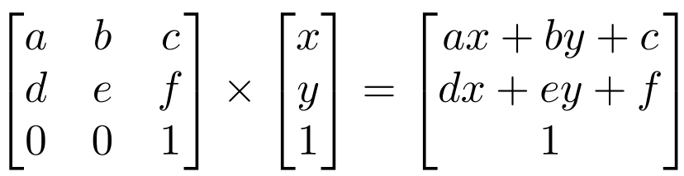
Homogeneous system
The (somewhat hacky) solution? Stick a “1” at the end of every vector:
Now we can rotate, scale, and skew like before, AND translate (note how the multiplication works out, above)
This is called “homogeneous coordinates”

Slide 48
Homogeneous system
In homogeneous coordinates, the multiplication works out so the rightmost column of the matrix is a vector that gets added.
Generally, a homogeneous transformation matrix will have a bottom row of [0 0 1], so that the result has a “1” at the bottom too.

Slide 49
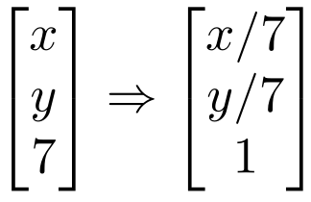
Homogeneous system
One more thing we might want: to divide the result by something
For example, we may want to divide by a coordinate, to make things scale down as they get farther away in a camera image
Matrix multiplication can’t actually divide
So, by convention, in homogeneous coordinates, we’ll divide the result by its last coordinate after doing a matrix multiplication

Slide 50
2D Translation
P’
P
t

Slide 51
2D Translation using Homogeneous Coordinates
P’
t
ty
P
y
P
x
tx

Slide 52
2D Translation using Homogeneous Coordinates
P’
t
ty
P
y
P
x
tx

Slide 53
2D Translation using Homogeneous Coordinates
P’
t
ty
P
y
P
x
tx

Slide 54
2D Translation using Homogeneous Coordinates
P’
t
ty
P
y
P
x
tx

Slide 55
2D Translation using Homogeneous Coordinates
P’
t
ty
P
t
y
P
x
tx

Slide 56
Scaling
P’
P

Slide 57
Scaling Equation
P’
s_{y} y
P
y
x
s_{x} x

Slide 58
Scaling Equation
P’
s_{y} y
P
y
x
s_{x} x

Slide 59
Scaling Equation
P’
s_{y} y
P
y
x
s_{x} x

Slide 60
Scaling & Translating
P’’
P
P’=S∙P
P’’=T∙P’
P’’=T ∙ P’=T ∙(S ∙ P)= T ∙ S ∙P

Slide 61
Scaling & Translating
A

Slide 62
Scaling & Translating

Slide 63
Translating & Scaling versus Scaling & Translating

Slide 64
Translating & Scaling != Scaling & Translating

Slide 65
Translating & Scaling != Scaling & Translating

Slide 66
Rotation
P’
P

Slide 67
Rotation Equations
Counter-clockwise rotation by an angle θ
P’
y’
θ
y
P
x’
x

Slide 68
Rotation Matrix Properties
A 2D rotation matrix is 2x2
Note: R belongs to the category of normal matrices
and satisfies many interesting properties:

Slide 69
Rotation Matrix Properties
Transpose of a rotation matrix produces a rotation in the opposite direction
The rows of a rotation matrix are always mutually perpendicular (a.k.a. orthogonal) unit vectors
(and so are its columns)

Slide 70
Scaling + Rotation + Translation
P’= (T R S) P
This is the form of the general-purpose transformation matrix

Slide 71
Outline
Vectors and matrices
Basic Matrix Operations
Determinants, norms, trace
Special Matrices
Transformation Matrices
Homogeneous coordinates
Translation
Matrix inverse
Matrix rank
Eigenvalues and Eigenvectors
Matrix Calculate
The inverse of a transformation matrix reverses its effect

Slide 72
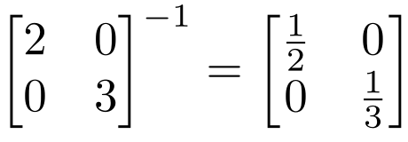
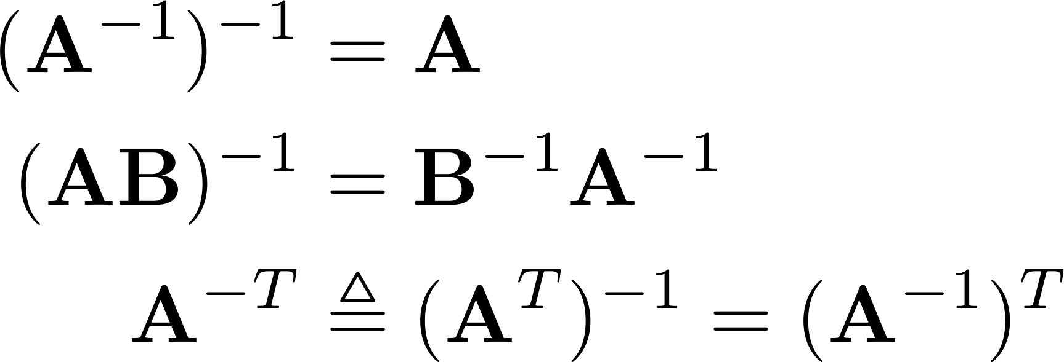
Inverse
Given a matrix A, its inverse A⁻¹ is a matrix such that AA⁻¹ = A⁻¹A = I
E.g.
Inverse does not always exist. If A⁻¹ exists, A is invertible or non-singular. Otherwise, it’s singular.
Useful identities, for matrices that are invertible:

Slide 73
Matrix Operations
Pseudoinverse
Say you have the matrix equation AX=B, where A and B are known, and you want to solve for X

Slide 74
Matrix Operations
Pseudoinverse
Say you have the matrix equation AX=B, where A and B are known, and you want to solve for X
You could calculate the inverse and pre-multiply by it: A⁻¹AX=A⁻¹B → X=A⁻¹B

Slide 75
Matrix Operations
Pseudoinverse
Say you have the matrix equation AX=B, where A and B are known, and you want to solve for X
You could calculate the inverse and pre-multiply by it: A⁻¹AX=A⁻¹B → X=A⁻¹B
Python command would be np.linalg.inv(A)*B
But calculating the inverse for large matrices often brings problems with computer floating-point resolution (because it involves working with very small and very large numbers together).
Or, your matrix might not even have an inverse.

Slide 76
Matrix Operations
Pseudoinverse
Fortunately, there are workarounds to solve AX=B in these situations. And python can do them!
Instead of taking an inverse, directly ask python to solve for X in AX=B, by typing np.linalg.solve(A, B)
Python will try several appropriate numerical methods (including the pseudoinverse if the inverse doesn’t exist)
Python will return the value of X which solves the equation
If there is no exact solution, it will return the closest one
If there are many solutions, it will return the smallest one

Slide 77

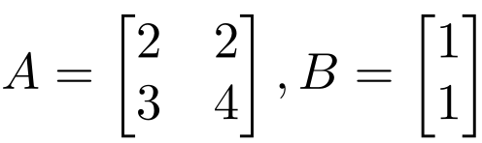
Matrix Operations
Python example:
>> import numpy as np
>> x = np.linalg.solve(A,B)
x =
1.0000
-0.5000

Slide 78
Outline
Vectors and matrices
Basic Matrix Operations
Determinants, norms, trace
Special Matrices
Transformation Matrices
Homogeneous coordinates
Translation
Matrix inverse
Matrix rank
Eigenvalues and Eigenvectors
Matrix Calculate
The rank of a transformation matrix tells you how many dimensions it transforms a vector to.

Slide 79
Linear independence
Suppose we have a set of vectors v₁, …, v_{n}
If we can express v₁ as a linear combination of the other vectors v₂…v_{n}, then v₁ is linearly dependent on the other vectors.
The direction v₁ can be expressed as a combination of the directions v₂…v_{n}. (E.g. v₁ = .7 v₂ -.7 v₄)
Notes:
Second bullet point: define linear combination in blackboard

Slide 80
Linear independence
Suppose we have a set of vectors v₁, …, v_{n}
If we can express v₁ as a linear combination of the other vectors v₂…v_{n}, then v₁ is linearly dependent on the other vectors.
The direction v₁ can be expressed as a combination of the directions v₂…v_{n}. (E.g. v₁ = .7 v₂ -.7 v₄)
If no vector is linearly dependent on the rest of the set, the set is linearly independent.
Common case: a set of vectors v₁, …, v_{n} is always linearly independent if each vector is perpendicular to every other vector (and non-zero)
Notes:
Second bullet point: define linear combination in blackboard

Slide 81
Linear independence
Linearly independent set
Not linearly independent
Notes:
Geometric interpretation

Slide 82
Matrix rank
Column/row rank
Column rank always equals row rank
Matrix rank

Slide 83
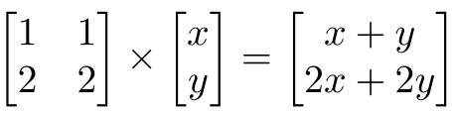
Matrix rank
For transformation matrices, the rank tells you the dimensions of the output
E.g. if rank of A is 1, then the transformation
p’=Ap
maps points onto a line.
Here’s a matrix with rank 1:
All points get mapped to the line y=2x
Notes:
Example of how a rank deficient matrix can collapse all the space (any point) into a line

Slide 84
Matrix rank
If an m x m matrix is rank m, we say it’s “full rank”
Maps an m x 1 vector uniquely to another m x 1 vector
An inverse matrix can be found
If rank < m, we say it’s “singular”
At least one dimension is getting collapsed. No way to look at the result and tell what the input was
Inverse does not exist
Inverse also doesn’t exist for non-square matrices
Notes:
Geometrically: transformation is like a rotation, scale, translation…
Singular -> cannot go back to original data

Slide 85
Outline
Vectors and matrices
Basic Matrix Operations
Determinants, norms, trace
Special Matrices
Transformation Matrices
Homogeneous coordinates
Translation
Matrix inverse
Matrix rank
Eigenvalues and Eigenvectors(SVD)
Matrix Calculus

Slide 86
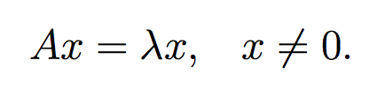
Eigenvector and Eigenvalue
An eigenvector x of a linear transformation A is a non-zero vector that, when A is applied to it, does not change direction.

Slide 87
Eigenvector and Eigenvalue
An eigenvector x of a linear transformation A is a non-zero vector that, when A is applied to it, does not change direction.
Applying A to the eigenvector only scales the eigenvector by the scalar value λ, called an eigenvalue.

Slide 88

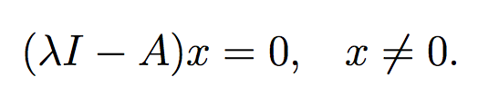
Eigenvector and Eigenvalue
We want to find all the eigenvalues of A:
Which can we written as:
Therefore:

Slide 89
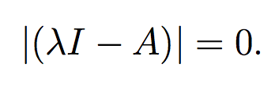
Eigenvector and Eigenvalue
We can solve for eigenvalues by solving:
Since we are looking for non-zero x, we can instead solve the above equation as:

Slide 90
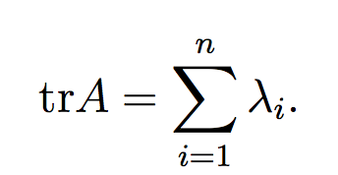
Properties
The trace of a A is equal to the sum of its eigenvalues:

Slide 91
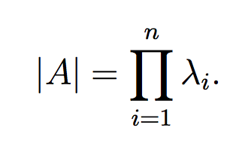
Properties
The trace of a A is equal to the sum of its eigenvalues:
The determinant of A is equal to the product of its eigenvalues

Slide 92
Properties
The trace of a A is equal to the sum of its eigenvalues:
The determinant of A is equal to the product of its eigenvalues
The rank of A is equal to the number of non-zero eigenvalues of A.

Slide 93
Properties
The trace of a A is equal to the sum of its eigenvalues:
The determinant of A is equal to the product of its eigenvalues
The rank of A is equal to the number of non-zero eigenvalues of A.
The eigenvalues of a diagonal matrix D = diag(d1, . . . dn) are just the diagonal entries d1, . . . dn

Slide 94

Spectral theory
We call an eigenvalue λ and an associated eigenvector an eigenpair.
The space of vectors where (A − λI) = 0 is often called the eigenspace of A associated with the eigenvalue λ.
The set of all eigenvalues of A is called its spectrum:

Slide 95

Spectral theory
The magnitude of the largest eigenvalue (in magnitude) is called the spectral radius
Where C is the space of all eigenvalues of A

Slide 96
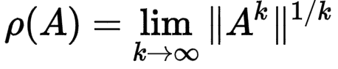
Spectral theory
The spectral radius is bounded by infinity norm of a matrix:
Proof: Turn to a partner and prove this!

Slide 97

Spectral theory
The spectral radius is bounded by infinity norm of a matrix:
Proof: Let λ and v be an eigenpair of A:

Slide 98
Diagonalization
An n × n matrix A is diagonalizable if it has n linearly independent eigenvectors.
Most square matrices (in a sense that can be made mathematically rigorous) are diagonalizable:
Normal matrices are diagonalizable
Matrices with n distinct eigenvalues are diagonalizable
Lemma: Eigenvectors associated with distinct eigenvalues are linearly independent.

Slide 99
Diagonalization
An n × n matrix A is diagonalizable if it has n linearly independent eigenvectors.
Most square matrices are diagonalizable:
Normal matrices are diagonalizable
Matrices with n distinct eigenvalues are diagonalizable
Lemma: Eigenvectors associated with distinct eigenvalues are linearly independent.

Slide 100


Diagonalization
Eigenvalue equation:
Where D is a diagonal matrix of the eigenvalues

Slide 101

Diagonalization
Eigenvalue equation:
Assuming all λ_{i}’s are unique:
Remember that the inverse of an orthogonal matrix is just its transpose and the eigenvectors are orthogonal

Slide 102
Symmetric matrices
Properties:
For a symmetric matrix A, all the eigenvalues are real.
The eigenvectors of A are orthonormal.

Slide 103




Symmetric matrices
Therefore:
where
So, if we wanted to find the vector x that:

Slide 104
Symmetric matrices
Therefore:
where
So, if we wanted to find the vector x that:
Is the same as finding the eigenvector that corresponds to the largest eigenvalue.

Slide 105
Some applications of Eigenvalues
PageRank
Schrodinger’s equation
PCA

Slide 106
Outline
Vectors and matrices
Basic Matrix Operations
Determinants, norms, trace
Special Matrices
Transformation Matrices
Homogeneous coordinates
Translation
Matrix inverse
Matrix rank
Eigenvalues and Eigenvectors(SVD)
Matrix Calculus

Slide 107


Matrix Calculus – The Gradient
Let a function take as input a matrix A of size m × n and returns a real value.
Then the gradient of f:

Slide 108


Matrix Calculus – The Gradient
Every entry in the matrix is:
the size of ∇_{A}f(A) is always the same as the size of A. So if A is just a vector x:

Slide 109


Exercise
Example:
Find:

Slide 110


Exercise
Example:
From this we can conclude that:

Slide 111

Matrix Calculus – The Gradient
Properties

Slide 112


Matrix Calculus – The Hessian
The Hessian matrix with respect to x, written or simply as H is the n × n matrix of partial derivatives

Slide 113

Matrix Calculus – The Hessian
Each entry can be written as:
Exercise: Why is the Hessian always symmetric?

Slide 114

Matrix Calculus – The Hessian
Each entry can be written as:
The Hessian is always symmetric, because
This is known as Schwarz's theorem: The order of partial derivatives don’t matter as long as the second derivative exists and is continuous.

Slide 115
Matrix Calculus – The Hessian
Note that the hessian is not the gradient of whole gradient of a vector (this is not defined). It is actually the gradient of every entry of the gradient of the vector.

Slide 116

Matrix Calculus – The Hessian
Eg, the first column is the gradient of

Slide 117


Exercise
Example:

Slide 118
Exercise

Slide 119
Exercise
Divide the summation into 3 parts depending on whether:
i == k or
j == k

Slide 120
Exercise

Slide 121
Exercise

Slide 122
Exercise

Slide 123
Exercise

Slide 124
Exercise

Slide 125
Exercise

Slide 126

Exercise

Slide 127
Exercise

Slide 128

Exercise

Slide 129
What we have learned
Vectors and matrices
Basic Matrix Operations
Special Matrices
Transformation Matrices
Homogeneous coordinates
Translation
Matrix inverse
Matrix rank
Eigenvalues and Eigenvectors
Matrix Calculate

