Slide 1
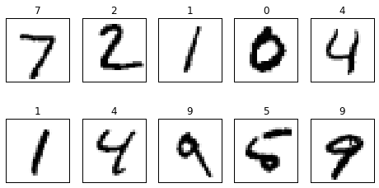
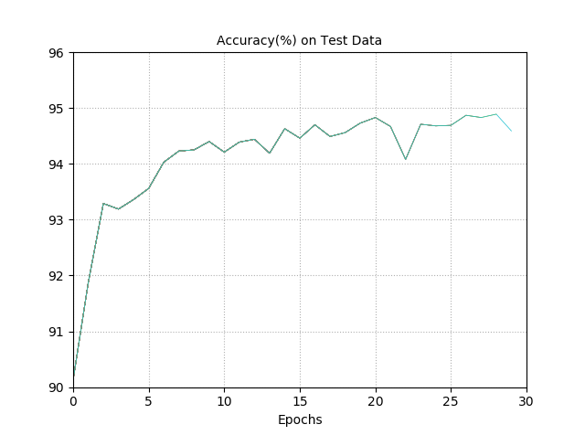
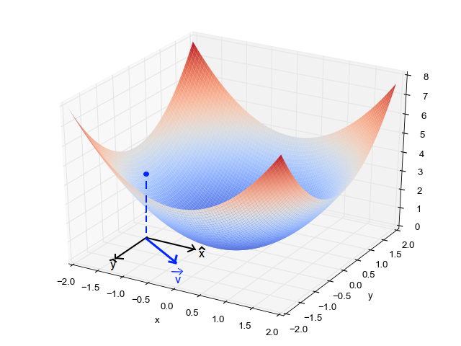
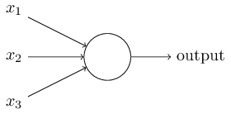
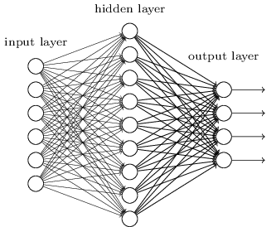
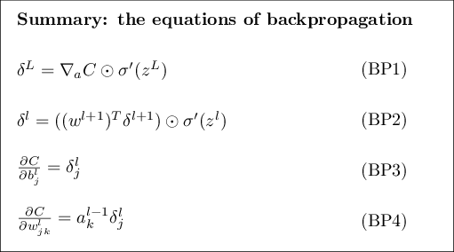
Artificial Neural Network to Classify MNIST
Michael J. Jaber
UCSD SPIS 2017 Final Project
1. Abstract
2. MNIST
4. Gradient Descent
Neural networks (or Artificial Neural Networks) are a tool designed to mimic the way the human brain learns. This property allows for the user to effectively teach the machine how to perform a given task. The basic principle revolves around the idea of using large amounts of training data to teach the network, followed by testing its accuracy with a set of data that the network has not yet seen. The problem of classification of digits with neural networks is an intriguing one, since recognizing digits is a relatively simple task for the human brain, but one that can be quite complicated when performed by a computer. The implementation of artificial neural networks requires the use of various techniques, which when combined in the proper alignment, can produce astounding accuracy and results. This implementation relies on a learning algorithm, which involves training the network, and having the network respond with the appropriate adaptations. In this sense, the computer is “learning”, hence the term “machine learning.”
Sample of the MNIST Dataset
3. Structure of a Neural Network
Schematic of an Artificial Neuron, or Perceptron
The network implemented here was able to reach a peak classification accuracy of 96.02%.
Even with this accuracy, this network lacks many of the various techniques and improvements that have been developed in machine learning. These improvements include, but are not limited to, weight decay, regularization, early stopping, softmax regression, and much more refined cost functions.
Advancements in fields such as deep learning are only possible because of neural networks.
6. Conclusion
5. Backpropagation
7. References
Karpathy, A. (n.d.). Hacker's guide to Neural Networks. Retrieved September 06, 2017, from http://karpathy.github.io/neuralnets/
LeCun, Y., & Cortes, C. (1998). THE MNIST DATABASE. Retrieved September 06, 2017, from http://yann.lecun.com/exdb/mnist/
Nielsen, M. A. (1970, January 01). Neural Networks and Deep Learning. Retrieved September 06, 2017, from http://neuralnetworksanddeeplearning.com/
Layout of an Artificial Neural Network,
where each node represents a neuron
This project owes its success to Sudarshan Srinivasan, Jiaxiao Zhou, Prof. Yingjun Cao, Dr. Ramamohan Paturi, and the 2017 SPIS Program.

