Slide 1
Algorithmic Problem Solving
SPIS 2017
Benjamin Cosman

Slide 2
What is APS?
There are two steps to getting from here…
…to here:
def findMax(lst):
biggest = 0
for num in lst:
if num > biggest:
biggest = num
return biggest
”Find the biggest number in a list of positive numbers.”
???

Slide 3
What is APS?
Programming is turning algorithms into code
APS is finding the algorithm in the first place
This is an important skill, and it doesn’t require a computer!
”For each number in the list, if it is greater than the old biggest number, forget that old number and store the new one instead.”
Algorithmic Problem Solving
def findMax(lst):
biggest = 0
for num in lst:
if num > biggest:
biggest = num
return biggest
”Find the biggest number in a list of positive numbers.”
Programming

Slide 4
What is APS?
“As there is little foolish wand-waving here, many of you will hardly believe this is magic.” –Snape, on Potions class
There will be no computers in this course, but it is Computer Science!

Slide 5
What is APS?
Goals in this course:
Develop a toolbox of algorithmic strategies
Practice applying those strategies to solve problems
Write solutions precisely and coherently
Analyze the speed of algorithms

Slide 6
Today: Divide-and-Conquer

Slide 7
Learning Goals
Divide-and-Conquer will be the first tool in your toolbox
After this week you should be able to
Define the Divide-and-Conquer algorithmic strategy
Apply the strategy to solve some of those problems
Analyze how many steps a simple algorithm takes to run

Slide 8
Example 1: Find the Fake Coin
You have a pile of 12 coins, 1 of which is counterfeit.
Real coins each weigh 10 grams; the fake one weighs 9.
You have a scale which can tell you how much a pile of coins weighs.
How can you identify the fake coin in as few weighings as possible?
Notes:
Is the problem clear? Work with neighbors

Slide 9
Fake Coin solution
Divide and Conquer!
Split the coins into two piles as evenly as possible
Weigh one of the piles.
If the weight ends in 9, it is the pile with the fake.
Otherwise, the other pile has the fake.
Use this same strategy on whichever pile has the fake to keep narrowing it down by half.
If there is one coin left, we are done: it’s the fake!
Division
Recursion
Base Case

Slide 10
Divide-and-conquer
Division – Split the problem into 2 or more subproblems
Recursion – Solve subproblems the same way as the original
Base Case – When the problem gets small enough, declare victory
There will always be some additional work somewhere in there
In example 1: before recursion, to choose which subproblem to look at
Usually best to put base case first

Slide 11
Fake Coin solution
Why is is important to put that base case first?
a) If we don’t, it can be impossible to do what the algorithm says
b) If we don’t, the algorithm can go on forever
c) There is a different reason it’s important
d) I don’t know
Split the coins into two piles as evenly as possible.
Weigh one of the piles.
If the weight ends in 9, it is the pile with the fake.
Otherwise, the other pile has the fake.
Use this same strategy on whichever pile has the fake to keep narrowing it down by half.
If there is one coin left, we are done: it’s the fake!

Slide 12
Fake Coin solution
How long does this algorithm take on 12 coins?
4 weighings
5 weighings
4 or 5
3 or 4
I don’t know
If there is one coin left, we are done: it’s the fake!
Split the coins into two piles as evenly as possible.
Weigh one of the piles.
If the weight ends in 9, it is the pile with the fake.
Otherwise, the other pile has the fake.
Use this same strategy on whichever pile has the fake to keep narrowing it down by half.

Slide 13
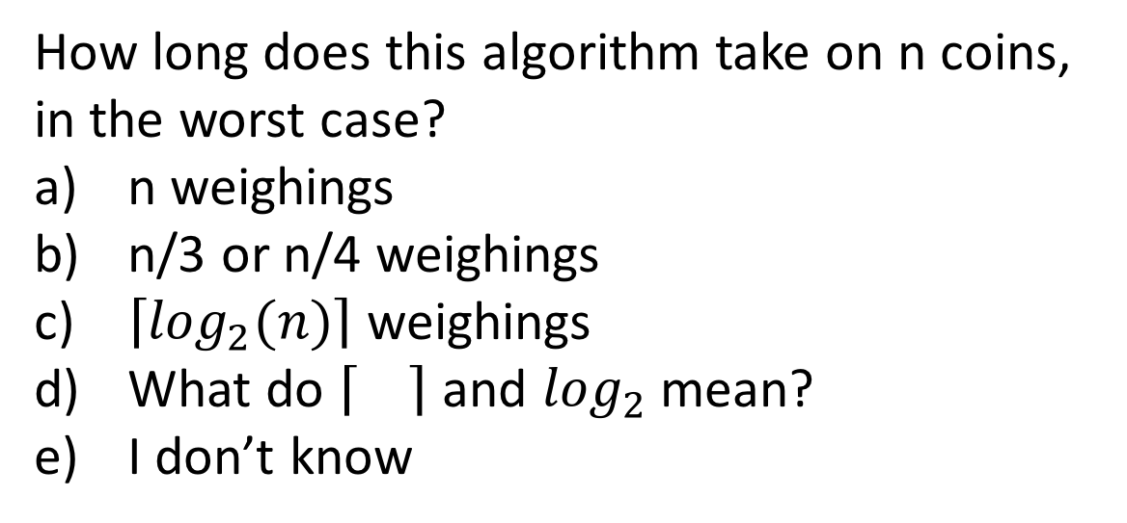
Fake Coin solution
How long does this algorithm take on n coins, in the worst case?
n weighings
n/3 or n/4 weighings
$\left\lceil \log_{2}(n)\right\rceil$ weighings
What do and $\log_{2}$ mean?
I don’t know
If there is one coin left, we are done: it’s the fake!
Split the coins into two piles as evenly as possible.
Weigh one of the piles.
If the weight ends in 9, it is the pile with the fake.
Otherwise, the other pile has the fake.
Use this same strategy on whichever pile has the fake to keep narrowing it down by half.

Slide 14
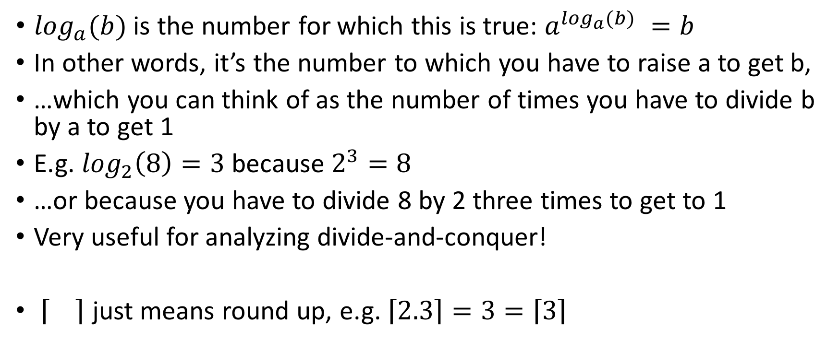
A quick refresher on Logarithms
$\log_{a}(b)$ is the number for which this is true: $a^{\log_{a}(b) }=b$
In other words, it’s the number to which you have to raise a to get b,
…which you can think of as the number of times you have to divide b by a to get 1
E.g. $\log_{2}\left(8\right)=3$ because $2^{3}=8$
…or because you have to divide 8 by 2 three times to get to 1
Very useful for analyzing divide-and-conquer!
just means round up, e.g. $\left\lceil 2.3\right\rceil =3=\left\lceil 3\right\rceil$

Slide 15
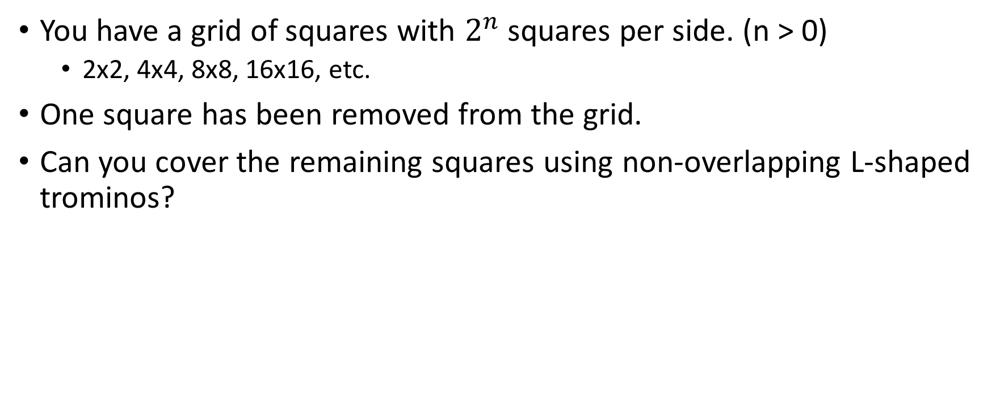
Example 2: Tile a Grid with L’s
You have a grid of squares with $2^{n}$ squares per side. (n > 0)
2x2, 4x4, 8x8, 16x16, etc.
One square has been removed from the grid.
Can you cover the remaining squares using non-overlapping L-shaped trominos?
How can we split this into subproblems (like the original, but smaller?)

Slide 18
Tiling solution
If the grid size is 2x2 (with a removed square), place one tromino on the remaining 3 squares and we’re done.
Otherwise, split the grid into quarters.
The center 4 squares of the grid belong one each to the four different quarters. Place a tromino on the 3 of them belonging to the quarters that do not yet have a removed square. Treat those covered squares as “removed”: every quarter now has a removed square.
Solve each quarter recursively using this same algorithm.

Slide 19
Divide-and-conquer
Division – Split the problem into 2 or more subproblems
Recursion – Solve subproblems the same way as the original
Base Case – When the problem gets small enough, declare victory
There will always be some additional work somewhere in there
In example 1: before recursion, to choose which subproblem to look at
In example 2: before recursion, to make the subproblems actually subproblems

Slide 20
Example 3: Sorting a list
You have a list of numbers, e.g. [2, 4, 1, 6, 8, 5, 3, 7]
How can you sort the list?
How can you sort the list quickly?

Slide 21
Sorting a list, take 1
“Insertion sort”: https://youtu.be/i-SKeOcBwko?t=3m57s
In the worst case, how far do we have to slide each number?
The 1st number doesn’t have to move
The 2nd might have to move 1 space
The 3rd might have to move 2 spaces
…
The n^{th} might have to move n-1 spaces
Total slides: 0 + 1 + 2 + … + n-1 ≈ n²/2

Slide 22
Sorting a list, take 2
“Merge sort”: https://youtu.be/TzeBrDU-JaY?t=2m25s
It takes (approx.) n comparisons to merge the lists at one level of the tree up to the next level
There are (approx.) log₂n levels of the tree
So merge sort takes ≈ n * log₂n comparisons
For a large list (large n), this is many fewer than n²/2

Slide 23
Divide-and-conquer
Division – Split the problem into 2 or more subproblems
Recursion – Solve subproblems the same way as the original
Base Case – When the problem gets small enough, declare victory
There will always be some additional work somewhere in there
In example 1: before recursion, to choose which subproblem to look at
In example 2: before recursion, to make the subproblems actually subproblems
In example 3: after recursion, to merge the subproblem solutions into an overall solution

Slide 24
Course Logistics
Meet here Wed and Fri 8:45-10am
(Approximate) topic list:
Divide-and-Conquer ✓
Greedy Method
Iterative Improvement
Backtracking
Dynamic Programming
Homework due Sunday night at 10pm

Slide 25
Homework
You can brainstorm ideas together, but write solutions by yourself
Do not use any resource other than those linked from the SPIS site
Have a resource you think you should be able to use, or otherwise unsure about these expectations? Ask me (or a mentor)
This week, I will be at open lab hours every day (1:15-2:45)

