Slide 1
Dynamic Programming
SPIS APS 2017
Benjamin Cosman

Slide 2
Week 1 Homework Feedback

Slide 3
Constructive criticism
I see the most useful kind of feedback to be telling you what you can improve
I don’t give much “positive” feedback; mentors may follow my lead
So congratulations on all the things you did right!
Now go fix those other things ☺

Slide 4
Clarity, aka we are not computers
Option 1: “Divide the pile into thirds as evenly as possible.”
Option 2: “Divide the pile into thirds, rounding down. Then if there are any coins remaining, add them one each to the new piles until you run out.”
Option 2 may be closer to what we’d actually do on a computer, but...
...1 is more concise and (I think) also clearer for a human reader
The goal for problems in this class is to
Come up with the algorithm
Communicate your ideas clearly

Slide 5
Using examples
What’s wrong with “Split the 6-digit number into two numbers, e.g. 123456 into 123 and 456”?
You may include examples, but your algorithm should make sense without them
Low bar: convince me you know the algorithm
High bar: communicate the algorithm clearly to one who doesn’t know it
We aim for the high bar

Slide 6
Justifying answers
I didn’t ask you to justify your answers, but from now on that’s the default
Don’t need a formal proof, just a brief reasonably convincing argument
Justify algorithm correctness as well as things like runtime analysis
“Always remove the leftmost H.” Why?
“It takes logarithmic time.” Why?
Again, assume the reader does NOT know the answers

Slide 7
Today: Dynamic Programming

Slide 8
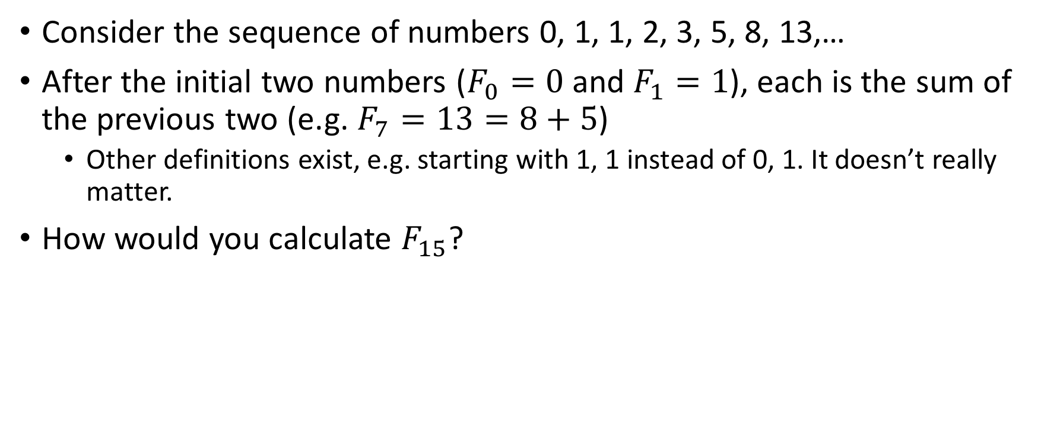
Example 1: Fibonacci Sequence
Consider the sequence of numbers 0, 1, 1, 2, 3, 5, 8, 13,…
After the initial two numbers ($F_{0}=0$ and $F_{1}=1$), each is the sum of the previous two (e.g. $F_{7}=13=8+5$)
Other definitions exist, e.g. starting with 1, 1 instead of 0, 1. It doesn’t really matter.
How would you calculate $F_{15}$?
Notes:
Is the problem clear? Work with neighbors

Slide 9
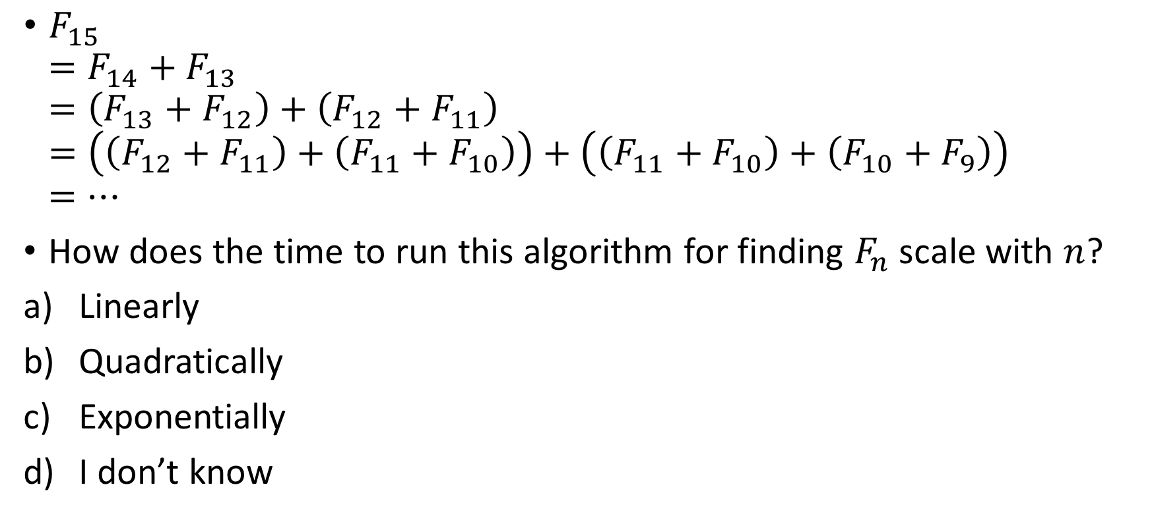
Fibonacci Sequence: slow solution
$F_{15}$ $=F_{14}+F_{13}$ $=\left(F_{13}+F_{12}\right)+\left(F_{12}+F_{11}\right)$ $=\left(\left(F_{12}+F_{11}\right)+\left(F_{11}+F_{10}\right)\right)+\left(\left(F_{11}+F_{10}\right)+\left(F_{10}+F_{9}\right)\right)$ $=…$
How does the time to run this algorithm for finding $F_{n}$ scale with $n$?
Linearly
Quadratically
Exponentially
I don’t know
Notes:
Is the problem clear? Work with neighbors

Slide 10
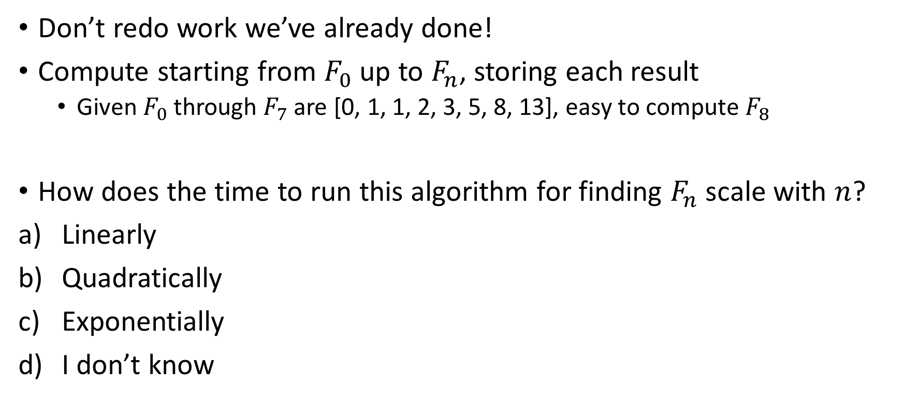
Fibonacci Sequence: better solution
Don’t redo work we’ve already done!
Compute starting from $F_{0}$ up to $F_{n}$, storing each result
Given $F_{0}$ through $F_{7}$ are [0, 1, 1, 2, 3, 5, 8, 13], easy to compute $F_{8}$
How does the time to run this algorithm for finding $F_{n}$ scale with $n$?
Linearly
Quadratically
Exponentially
I don’t know

Slide 11
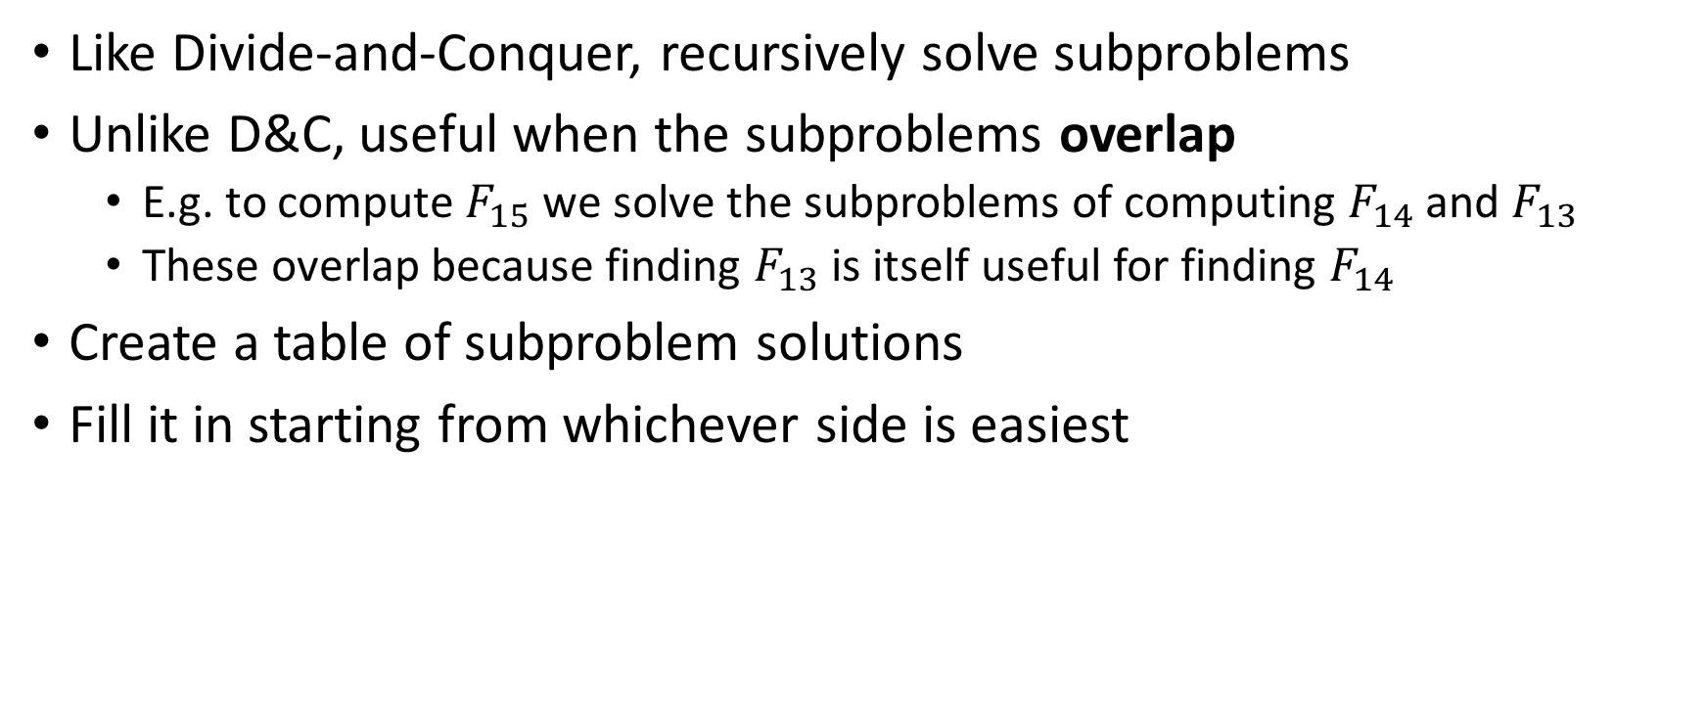
Dynamic Programming
Like Divide-and-Conquer, recursively solve subproblems
Unlike D&C, useful when the subproblems overlap
E.g. to compute $F_{15}$ we solve the subproblems of computing $F_{14}$ and $F_{13}$
These overlap because finding $F_{13}$ is itself useful for finding $F_{14}$
Create a table of subproblem solutions
Fill it in starting from whichever side is easiest

Slide 12
Example 2: Unique shortest paths
We have a grid of streets
We want to travel from the top left to the bottom right as fast as possible
How many different ways are there to do this?

Slide 13
Unique shortest paths

Slide 14
Unique shortest paths
 | x
y

Slide 15
Unique shortest paths
x+y | x
y

Slide 16
Unique shortest paths
35 | 20 | 10 | 4 | 1
15 | 10 | 6 | 3 | 1
5 | 4 | 3 | 2 | 1
1 | 1 | 1 | 1 | 1

Slide 17
Unique shortest paths: solution
Mark the bottom right vertex with a 1 (there is 1 way to get from it to itself: don’t move)
For each vertex (from right to left, bottom to top), compute the number of paths from that vertex to the end by adding the values at the vertices below it and to its right.
If a vertex does not exist, treat it as having value 0

Slide 18
Example 3: Gene alignment
What is the worst possible similarity score for two sequences of length n?
n
2n
Infinite
I don’t know
We have two genetic sequences, e.g.
TAGATA
CGATGA
Compute a similarity score: the minimum number of additions and deletions required to get from one to the other
TAGATA
CTAGATA
CAGATA
CGATA
CGATGA
Add C
Del T
Del A
Add G

Slide 19
Gene alignment: solution
At each step, we know the first unmatched letter in the target sequence
E.g. for TAGATA and CGATGA, we have to get a C at front
There are two potential ways to get there: ADD that letter to the front directly, or DELETE the first letter hoping to find that letter later in the sequence
If we choose ADD, the first letters now match, so we move on to the rest of the string and the target effectively gets smaller: match CTAGATA to CGATGA
If we choose DELETE, our string gets smaller: match AGATA to CGATGA
Find the path with least cost in the resulting graph (see homework)

Slide 20
