Slide 1
CSE12F20-Oct16-1
A stack has two operations, push and pop. Pushing adds an element to the top of the stack, and pop removes the top element and returns it.
A queue has two operations, enqueue and dequeue. Enquing adds an element to the back of the queue, and dequeue removes the front element and returns it.
Stack<Integer> s = new ALStack<>();
s.push(4);
s.push(10);
s.push(13);
Integer i = s.pop();
s.push(5);
Integer i2 = s.pop();
What number is stored in i?
A: 4 B: 10 C: 13 D: 5 E: Something else
What number is stored in i2?
A: 4 B: 10 C: 13 D: 5 E: Something else
What is the contents of the stack? (starting at the top)
A. 5, 13, 10, 4
B. 10, 4
C. 5, 13
D. 13, 10, 4
E. other
Queue<Integer> q = new ALQueue<>();
q.enqueue(4);
q.enqueue(10);
q.enqueue(13);
Integer i = q.dequeue();
q.enqueue(5);
Integer i2 = q.dequeue();
What number is stored in i?
A: 4 B: 10 C: 13 D: 5 E: Something else
What number is stored in i2?
A: 4 B: 10 C: 13 D: 5 E: Something else
What is the contents of the queue? (starting at the front)
A. 4, 10, 13, 5
B. 10, 13, 5
C. 5, 10
D. 13, 5
E. other
import java.util.ArrayList;
public interface Stack<E> {
void push(E element);
E pop();
int size();
}
// IDEA: Use array lists to implement both
class ALStack<E> implements Stack<E> {
}
import java.util.ArrayList;
public interface Queue<E> {
void enqueue(E element);
E dequeue();
int size();
}
class ALQueue<E> implements Queue<E> {
}

Slide 2
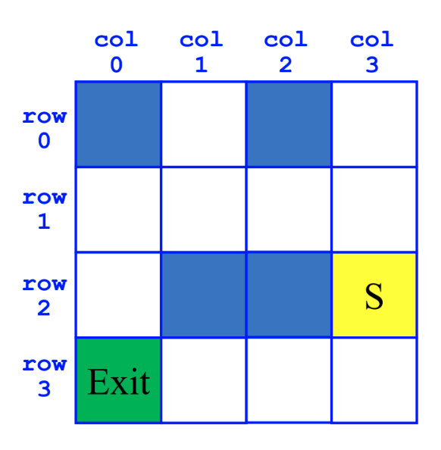
CSE12F20-Oct16-1
Class ArrayList<E>
void | add​(int index, E element) | Inserts the specified element at the specified position.
E | remove​(int index) | Removes the element at the specified position in this list.
int | size() | Returns the number of elements in this list.
E | set​(int index, E element) | Replaces the element at the specified position in this list with the specified element.
int | indexOf​(Object o) | Returns the index of the first occurrence of the specified element in this list, or -1 if this list does not contain the element.
SearchForTheExit
Initialize a Stack to hold Squares as we search
Mark starting square as visited
Put starting square on task list
While Stack is not empty
Pop square sq from Stack
Mark sq as visited
If sq is the Exit, we're done!
For each of square's unseen neighbors (S, W, N, E):
Set neighbor's previous to sq
Push neighbor to Stack
SearchForTheExit
Initialize a Queue to hold Squares as we search
Mark starting square as visited
Put starting square on task list
While Queue is not empty
Dequeue square sq from Queue
Mark sq as visited
If sq is the Exit, we're done!
For each of square's unseen neighbors (S, W, N, E):
Set neighbor's previous to sq
Enqueue neighbor to Queue
Maze images & pseudocode from Christine Alvarado and Cynthia Lee

