Slide 1
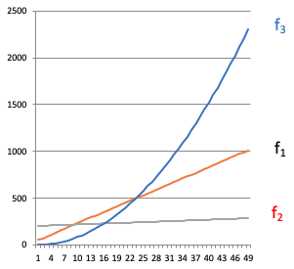
CSE12F20-Oct20-1
f(n) is O(g(n)), if there are positive constants c and n₀ such that f(n) ≤ c * g(n) for all n ≥ n₀.
f(n) is Ω(g(n)), if there are positive constants c and n₀ such that f(n) ≥ c g(n) for all n ≥ n₀.
f(n) is θ(g(n)) if f(n) is O(g(n)) and f(n) is Ω(g(n)).

Slide 2
CSE12F20-Oct20-2
For each function in the list below, it is related to the function below it by O, and the reverse is not true. That is, n is O(n²) but n² is not O(n).
f(n) = 1/(n²)
f(n) = 1/n
f(n) = 1
f(n) = log(n)
f(n) = sqrt(n)
f(n) = n
f(n) = n²
f(n) = n³
f(n) = n⁴
… and so on for constant polynomials …
f(n) = 2^{n}
f(n) = n!
f(n) = n^{n}
boolean find1( String[] theList, String toFind ) { for ( int i = 0; i < theList.length; i += 1 ) { if ( theList[i].equals( toFind )) { return true; } } return false; }
boolean find2( String[] theList, String toFind ) { boolean found = false; for ( int i = 0; i < theList.length; i += 1 ) { if ( theList[i].equals( toFind )) { found = true; } } return found; }
public static boolean isSorted1(int[] arr) {
for(int i = 0; i < arr.length - 1; i += 1) {
if(arr[i] > arr[i + 1]) { return false; }
}
return true;
}
public static boolean isSorted2(int[] arr) {
for(int i = 0; i < arr.length; i += 1) {
for(int j = i + 1; j < arr.length; j += 1) {
if(arr[i] > arr[j]) { return false; }
}
}
return true;
}

