Slide 1
Clustering and K-means

Slide 2
Root Mean Square Error (RMS)

Slide 3
PCA based prediction
o
x
x
o
o
x
x
o
o
x
o
x
x
o
o
x

Slide 4
Regression based Prediction
o
x
x
o
o
x
x
o
o
x
o
x
x
o
o
x

Slide 5
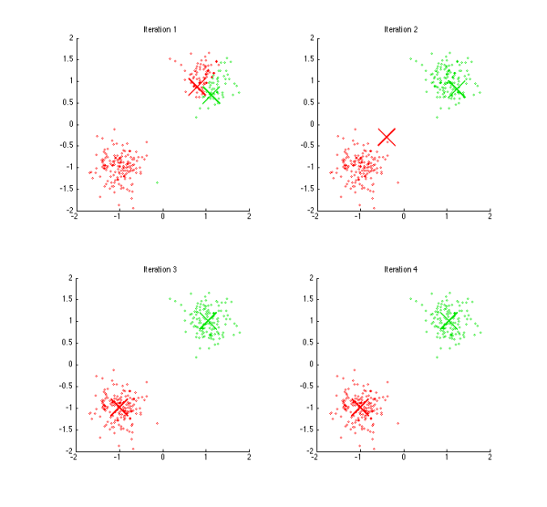
K-means clustering

Slide 6
K-means Algorithm

Slide 8
Simple Initialization
Simplest Initialization: choose representative from data points independently at random.
Problem: some representatives are close to each other and some parts of the data have no representatives.
Kmeans is a local search method – can get stuck in local minima.

Slide 9
Kmeans++
A different method for initializing representatives.
Spreads out initial representatives
Add representatives one by one
Before adding representative, define distribution over unselected data points.

Slide 10
Example for Kmeans++
This is an unlikely initialization for kmeans++

Slide 11
Parallelized Kmeans
Suppose the data points are partitioned randomly across several machines.
We want to perform the a,b steps with minimal communication btwn machines.
Choose initial representatives and broadcast to all machines.
Each machine partitions its own data points according to closest representative. Defines (key,value) pairs where key=index of closest representative. Value=example.
Compute the mean for each set by performing reduceByKey. (most of the summing done locally on each machine).
Broadcast new reps to all machines.

Slide 12
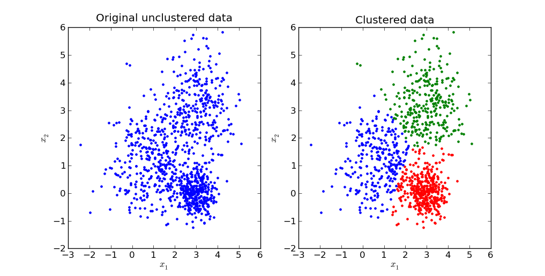
Clustering stability

Slide 13
Clustering stability
Clustering using
Starting points I
Clustering using
Starting points 2
Clustering using
Starting points 3

Slide 14
Measuring clustering stability
Entry in row “clustering j”, column “xi” contains the index of the closest representative to xi for clustering j
 | x1 | x2 | x3 | x4 | x5 | x6 |  |  | xn
Clustering 1 | 1 | 1 | 3 | 1 | 3 | 2 | 2 | 2 | 3
Clustering 2 | 2 | 2 | 1 | 2 | 1 | 3 | 3 | 3 | 1
Clustering 3 | 2 | 2 | 3 | 2 | 3 | 1 | 1 | 1 | 3
Clustering 4 | 1 | 1 | 1 | 1 | 3 | 3 | 3 | 3 | 1
The first three clusterings are completely consistent with each other
The fourth clustering has a disagreement in x5

Slide 15
How to quantify stability?
We say that a clustering is stable if the examples are always grouped in the same way.
When we have thousands of examples, we cannot expect all of them to always be grouped the same way.
We need a way to quantify the stability.
Basic idea: measure how much groupings differ between clusterings.

Slide 16
Entropy

Slide 17
Entropy of a combined partition

