Slide 1


BLoc: CSI-based Accurate Localization for BLE Tags
Roshan Ayyalasomayajula, Deepak Vasisht, Dinesh Bharadia
CoNEXT 2018
Notes:
Hi, today I will be briefly talking about BLoc: our algorithm for CSI based accurate localization for BLE tags

Slide 2
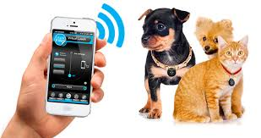
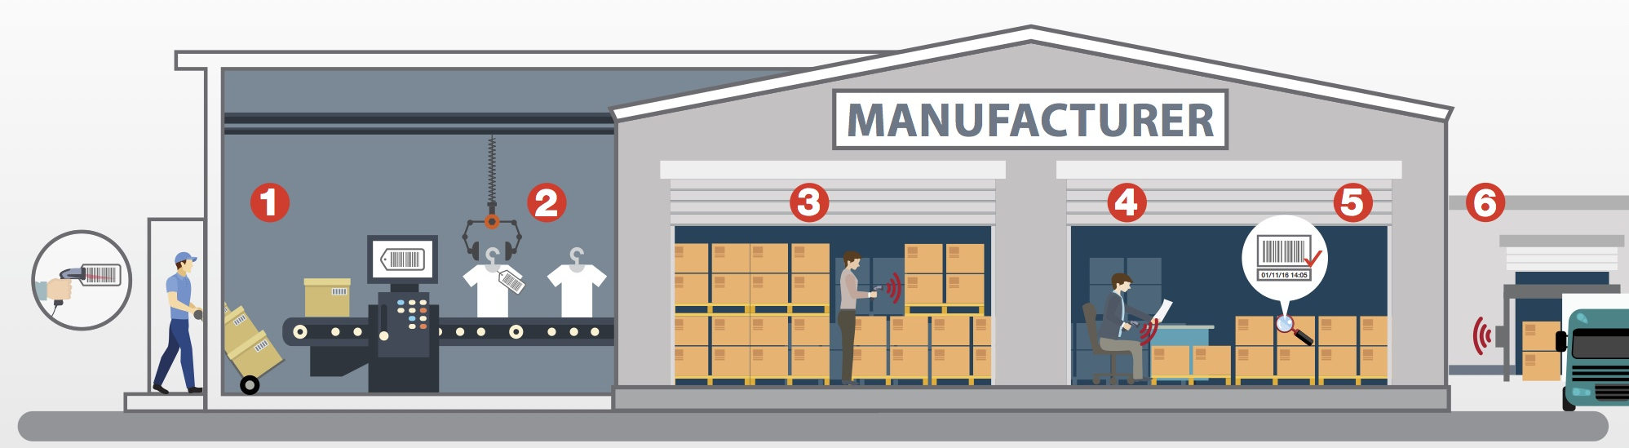

IoT Vision
Connect everything to the internet and locate them.​
Notes:
In the recent past there has been a development in this vision of Iot where we want to connect everything to internet and micro-manage the objects and environment around us. For this it is important that we know the accurate location of these IoT devices. Not only this, we want to locate our pets using our smartphones, we want to locate tools or products on the factory floor, we want to locate roombas, the small robots roaming around our homes. We want to Connect everything to the internet and locate them

Slide 3
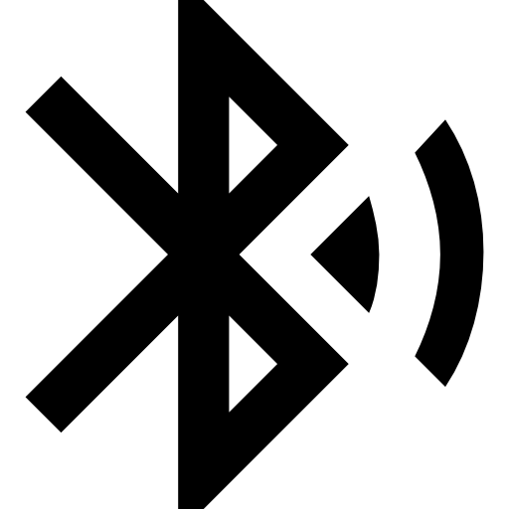
BLE
Low Power (10-500mW) : Lifetime of 2yrs
Long Range (5-10m) : Good Enough for Indoor settings
Accessible ($5) : You can buy one online
Connects from smartphones, Ipads, laptops
Notes:
And the main push for this has come from Bluetooth LowEnergy or BLE.
The key thing that promotes this protocol is that it is very low power, like the BLE tracker in my hand can last on a single cell for 2years, it has long range for locating objects in an indoor environment, and it is very cheap and accessible , that is I can get one off-the-shelf. As a results everything around us has BLE, my smartphone has BLE, my pet tracker, my laptops have BLE, everything around us has BLE and this makes it easy gateway for the internet beyond just the access points.. So, I said we want to locate all of these objects using BLE, so let us see how well we can do that today

Slide 4
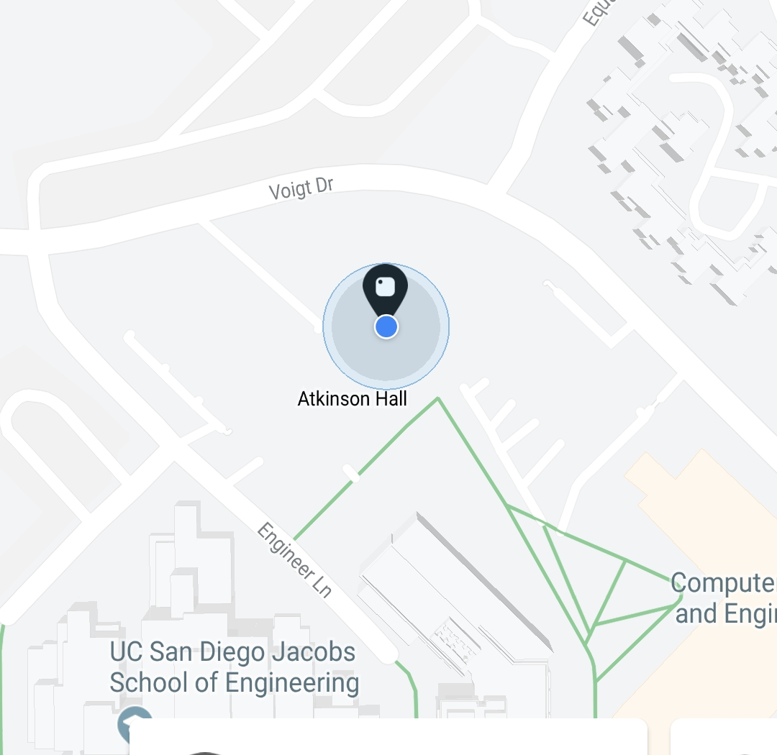
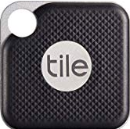
Let’s Locate
Notes:
I have this tag, which is the state of the art tag used widely, which comes with a smartphone app that reports it’s location. And you can see that the location estimate given by the BLE tag is almost covering an entire building’s range. Which implies that I lost my keys somewhere in this building, but I already know that I lost them in this building, what I want to know is where exactly in it, at the entrance, on my desk, in someone’s office or so… So, why is the error of the estimate so high?

Slide 5
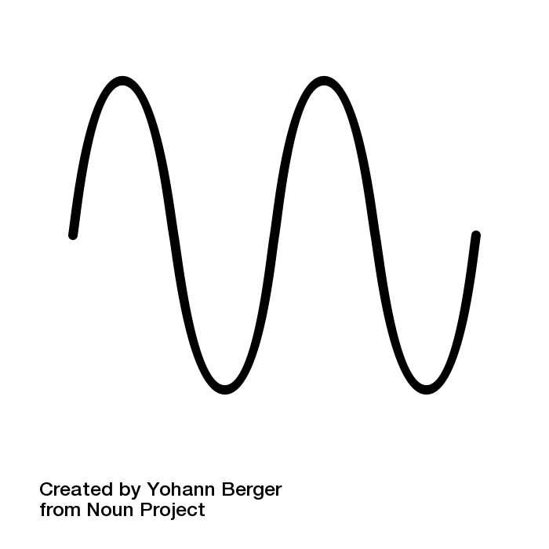
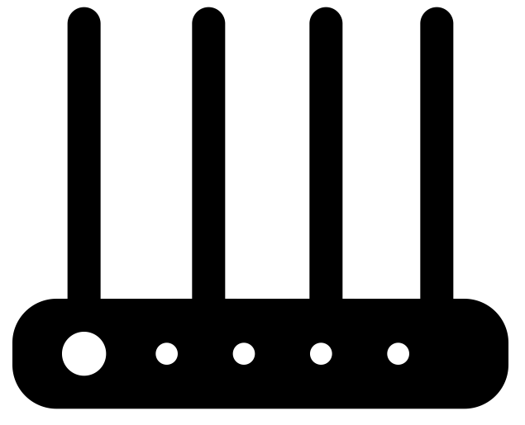
State of the art in BLE
RSSI based localization
AP
BLE Tag
Notes:
Lets try to dig deeper and try to understand why the location error is so high.
So, this is how the state of the art localization works, the transmitter sends the signal and the receiver receives it, and then the receiver measures the strength of the signal and uses that strength to estimate distance, this strength is what we call RSSI, the farther the transmitter the lesser the strength and the closer the stronger, that’s the high level idea.
So why is the error so high, in an indoor setting, the signal reflects across multiple objects like walls, floors, TV screens, etc…, and when these multiples signals combine they can add constructively or destructively, which may either increase or decrease the strength of the signal.
So BLE has such high location error. But WiFi does better

Slide 6
Wi-Fi achieves sub-meter level accuracies
Chronos[NSDI’16], SpotFi[Mobicom’15], Witrack [NSDI’14], WiSee[Mobicom’14], ArrayTrack[NSDI’13], . . .
HIGH POWER
Using CSI based localization
Notes:
In Wi-Fi we can achieve sub meter level localization.
So why does WiFi achieve such high accuracies.
The reason is that instead of just using the strength of the signal they also use the phase of the signal, and by using this phase they are able to accurately resolve the multipath from the direct path, I will come to this later in the talk and discuss how is it resolved.
But the problem with Wi-Fi is its high power, think of your smartphone it runs out of battery in just a day.
So, we don’t want to use WiFi for all these devices, but we want same accuracy as WiFi in BLE.
So, now the solution is obvious we want to use the combined information of both signal strength and it’s phase, which we call CSI to localize my BLE tag.
(Work on this transition)

Slide 7
What does it take to bring CSI based localization to BLE tags and achieve sub-m accuracy?
BLoc
Notes:
And that is going to be the focus of my talk, how do we achieve this Csi based sub-m level accuracy for BLE tags, where I present our system, Bloc, (going to next slide while I say this sentence ) which uses CSI based localization to locate BLE tags with sub-m level accuracies.

Slide 8
BLoc: CSI-based Localization for BLE
First CSI based localization system for BLE
Getting accurate wideband CSI for BLE
Resolving Multipath
Achieves sub-meter accuracy in real world deployment
Notes:
As far as we know, our system Bloc is the first CSI based localization system for BLE. And to explain our system, in this talk I would take about two main contributions of our system
Firstly, how do we get accurate wideband CSI for BLE, I will tell you why accurate and wideband are important as we go forward
Next, I would also describe a novel multipath algorithm to identify the direct path from all the reflections.
And then I will show you that we achieve sub-meter accuracy in a real world implementation of our system.

Slide 9
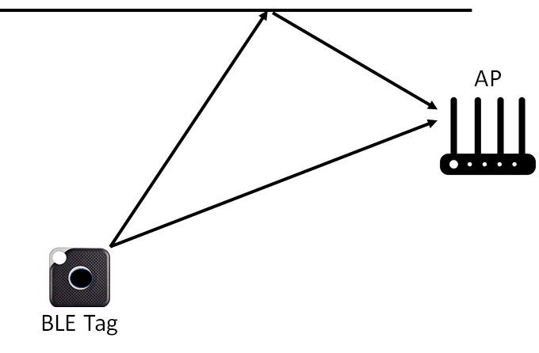
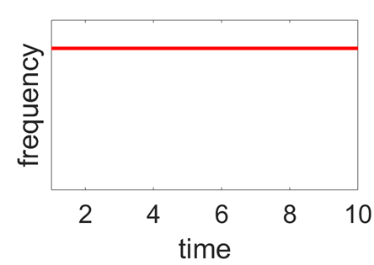
Measuring CSI
Notes:
Now we said we wanted accurate wideband CSI. Let us understand what is CSI and how is it estimated on a high level. The transmitter sends out a signal at one frequency, say f, and the receiver receives the signal which includes both the strength and phase of the received signal for just that frequency, and this is the channel state information for that frequency which is typically measured as a part of standard decoding process for WiFi decoder.

Slide 10
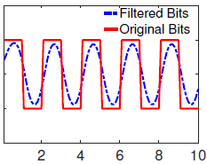
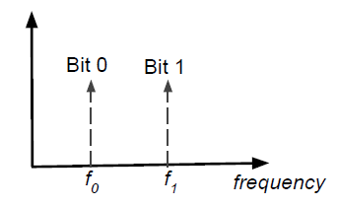
How do we get CSI for BLE?
BLE employs GFSK
GFSK
Actual Bits
f₀
frequency
f₁
2MHz
Time
Continuously varying frequency​
Notes:
Now, what about BLE, can we do the same for BLE? Turns out we cannot.
To understand why let us see how BLE works. BLE uses 2MHz bands to transmit signals with GFSK modulation – what it really means is it uses frequency fo to communicate bit 0 and f1 to communication bit 1.
This is further shown on this figure on the right in red, the x axis is time and y axis shows the frequency, however, to remove the sharp edges of frequency change the receiver use filtered waveform to transmit the signal, which basically leads to continuously changing frequency as can be seen from the blue curve and therefore learning channel per frequency becomes challenging,
A natural question how do standard decoder, decode such a data, they just use zero crossing of the frequency to decode the data. In summary we are left with no channel state information, which for WiFi systems is part of standard decoding process, therefore recovering CSI is not very trivial because of continuously varying frequency. Is there some we can bypass this problem, turns out…(to the next slide)

Slide 11
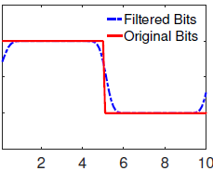
Transmitting long sequences of 1/0’s
CSI at f₀
GFSK
Actual Bits
GFSK
Actual Bits
f₀
f₀
frequency
frequency
Vs
f₁
f₁
Time
Now we can estimate CSI at f_{c} subcarrier as (CSI at f₀+CSI at f₁)/2
CSI at f₁
Notes:
We can avoid this by transmitting long sequences of each individual bits. That is transmit 0’s continuously for few time slots and also 1’s continuously for few time slots. By this we can see that the frequency remains stable for longer duration helping us to measure the CSI at the frequencies corresponding to f0 and f1.
From this CSI information at subcarriers f0 and f1 we can estimate the CSI at the carrier or central frequency by taking the average of these two CSI estimates, by which we remove packet detection delay. To understand why and how that happens.
So, we have calculated CSI in a band, can we go forward and locate our tag accurately? Not so fast..

Slide 12

Bandwidth Accuracy
80MHz
WiFi BW – 20MHz-160MHz
BLE BW – 2MHz
Notes:
You see Bandwidth is proportional to accuracy, that is higher the bandwidth the higher the accuracy.
While WiFi has a possible bandwidth of 20-160MHz, BLE just has 2MHz,
so the accuracy for BLE at this point would be atleast 10 times worse. So, what can we do?

Slide 13
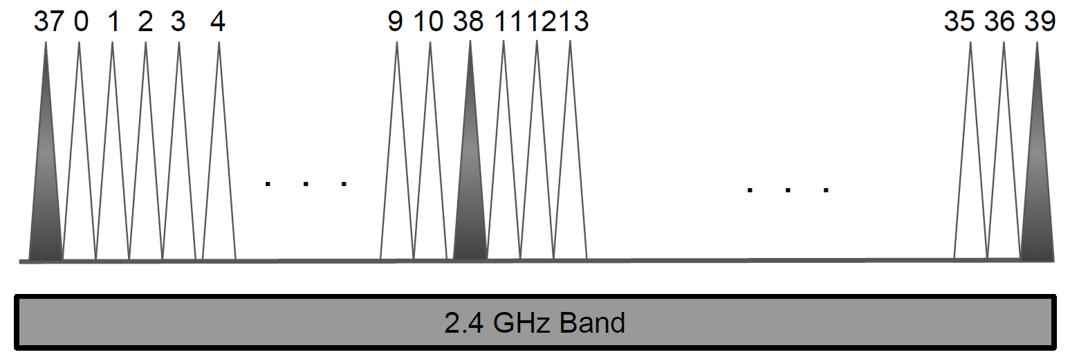
Observation: BLE hops frequency bands
Idea: Stitch information across frequency bands
Notes:
Here is an interesting observation, BLE changes its frequency every time it transmits. After each communication time it just hops to a different band and transmits there and these frequency bands are spread across 80MHz.
So, here is an idea… we can stitch CSI information across all these frequency bands

Slide 14
Band Stitching
Now we have an effective Bandwidth of 80MHz
Notes:
Now that we have information across multiple bands, we can stitch them and have an effective BW of 80MHz, that’s great we are almost as good as WiFi, did we solve our problem? Unfortunately that’s not so simple.. Why?

Slide 15
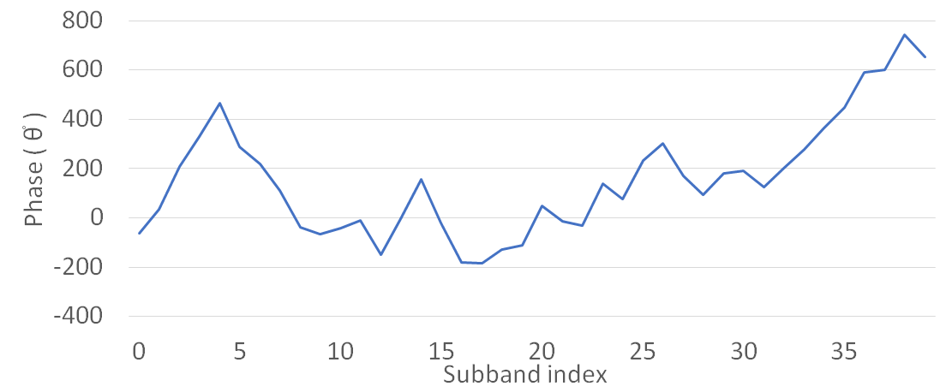
Problem: Phase is not consistent across frequency hops
Each Frequency hop has a different initial phase
Notes:
Because the phase information that we so dearly wanted to resolve the multipath is corrupted when you hop across multiple frequency bands. It’s like when you measure phase at one frequency it is different and when you jump to another frequency, the phase is different there.
In fact when we measured this phase information across 37 frequency bands, we observed this graph, where you can see the frequency is changing from -200degrees to 400 degrees and then to -200 degrees and going as large as 800 degrees… my point is, it is varying a lot, we know that any stable system needs a linear phase not a phase that is varying this heavily. So, it means that the phase information we have received is not usable as it is… how do we clean it up?

Slide 16
Consider
AP3
BLE Tag
AP4
AP2
AP1
Notes:
For this, let us Consider the following scenario when you have to locate a tag when there are multiple Anchor Points, and the tag is communicating with on of the anchor points while the others overhear this communication, now let us consider just two of the Anchor Points..

Slide 17
RESPONSE
BLE Tag
AP0
PACKET
φ_{T}-φ_{AP0}
OVERHEAR
OVERHEAR
φ_{T}-φ_{AP1}
φ_{AP0}-φ_{AP1}
AP1
Let’s combine these Phase offsets as following:
(φ_{T}-φ_{AP1}) - (φ_{AP0}-φ_{AP1}) - (φ_{T}-φ_{AP0}) = 0
Notes:
Now we have two Anchor points AP0 and AP1, and the tag is talking to AP0 while AP1 is overhearing their communication. All the while both AP0 and AP1 are estimating the CSI information of the communication they are hearing. Now the phase information of the packet from the tag to AP0 would have a phase of offset of phit-phiap0, similarly the two communications overheard by the AP1 will have the phase offsets of phit-phiAP1 and phiap0-phiap1.
Now, if we combine these offsets as following we see that the effective phase offset is zero, which means when we take the phase information of the tag’s transmission at AP1 with respect to AP0, we can avoid phase offsets all together and get clean phase information and thus have cleaner CSI information

Slide 18
Phase Offset corrected
Accurate wideband CSI calculated for BLE
Notes:
Now let us go back and plot this relative phase across these 37 subbands.. Now we can see that the phase is more linear. So, can we now goand use this phase and CSI information to locate BLE, yes, we have calculated the accurate wideband CSI for BLE, which is as good as WiFi and can be used to locate our BLE tags.

Slide 19
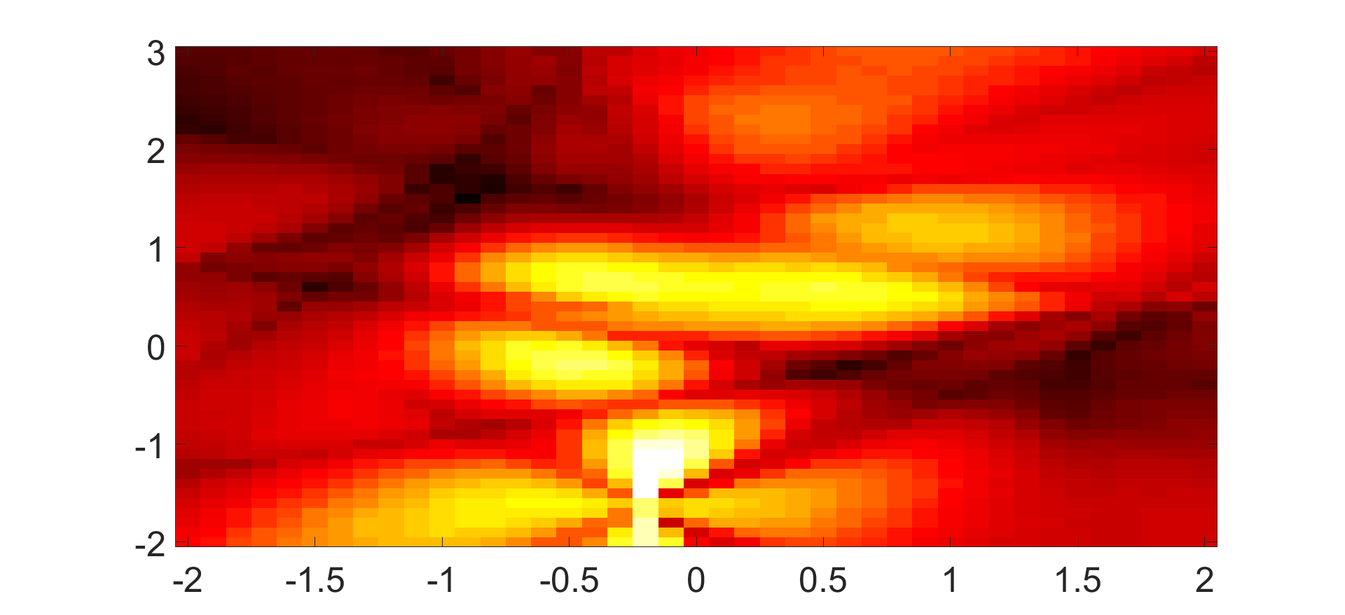
CSI to Location
Notes:
Now, since we have accurate wideband CSI, we can use the existing algorithms, like MUSIC, to convert this CSI information across multiple frequency bands and across multiple antennas on each anchor, to a location probability heatmap which looks like this, where brighter the pixel the higher the probability of the tag being located there and vice versa, so can we just say that I pick up the global maxima and get accurate location of my tag? No, it is not so simple…
Include few lines about what is happening too much of a jump

Slide 20
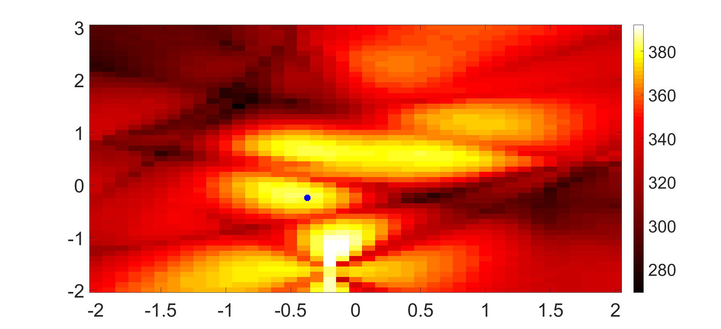
Multipath
Notes:
If we see here, the actual location is not the global maxima, but one of the other local maxima, this is the reason why we need an algorithm to resolve the direct path among all the multipath components. How can achieve that?

Slide 21
Observations
Shortest distance path is the direct path
Multipath reflections are more spread out while direct path is more peaky
Notes:
Here are a few observations regarding multipath:
Firstly, the shortest path travelled is always the direct path. Further from the heatmap image we can see that the multipath components’ peaks are more smoother than the direct path which is more peaky.. Based on these two observations we define the following algorithm to resolve the direct path

Slide 22
Algorithm
Identify all the local maxima
For each of these spots I calculate entropy (H) and the summed up path distance from each Anchor
Use this information to weigh each peaks probability and pick the global maxima
Notes:
Firstly, we identify all the local maxima, and then we weigh these local maxima with their local entropy in a specified neighbourhood and with their summed up distance from all the Anchor points in the environment, and after this weighing function, the global maxima would be my actual location. Thus we resolve multipath and estimate accurate location using BLoc.

Slide 23
Experimental Evaluation
Notes:
I have told you our main contributions so far. Of course There are many more details in the paper and I highly encourage you to go through it. But now I want to briefly talk about our experimental evaluation.

Slide 24
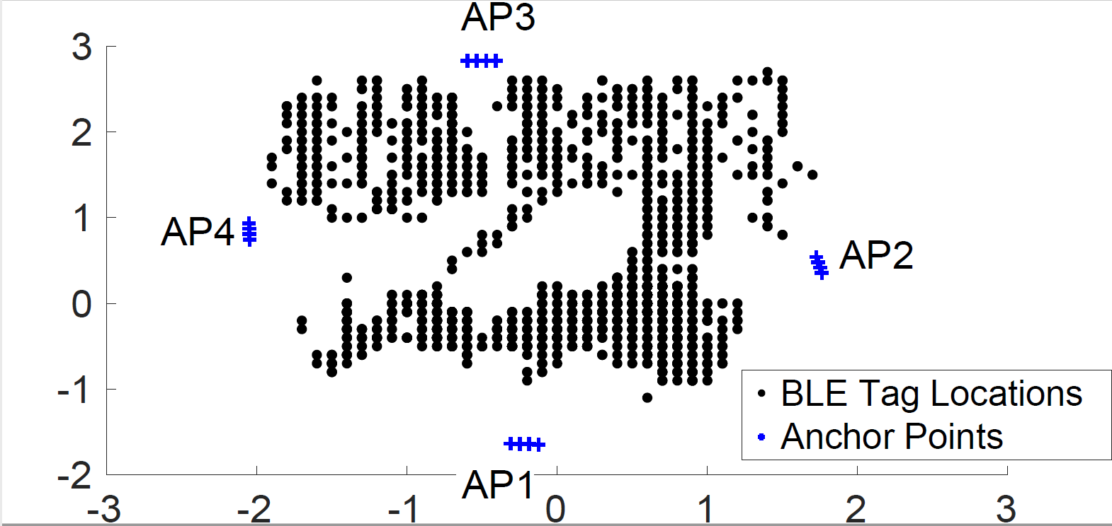
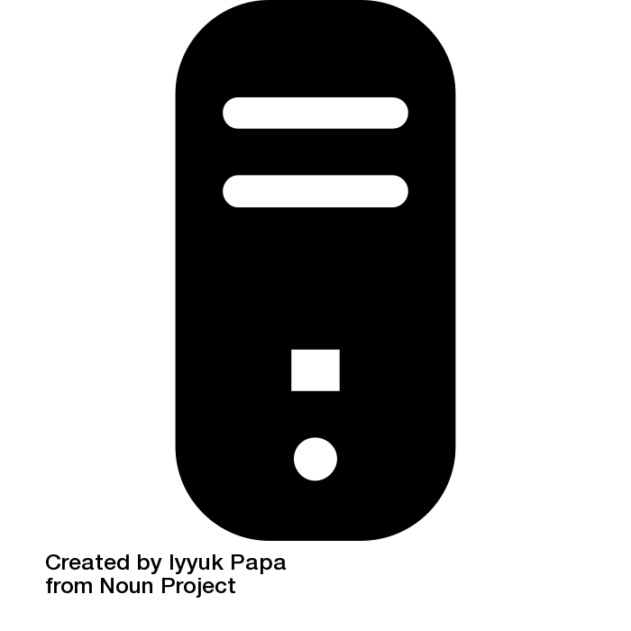
Setup
Notes:
We have experimented with a real world deployment in a 5mx6m environment where we have these 4 anchors and the tag goes around to 1600 different locations in this region while the Anchors collect the CSI at a central server which you can see is placed in the center.

Slide 25
Localization Accuracy
Bloc achieves 86cm median error
Notes:
With this setup we estimate the location of our tag using Bloc, we compare it with the state of the art indoor WiFi localization system baseline which depends on Angle of Arrival of the signal. And as we can see while median localization error for the AoA baseline is about 243 cm, Bloc achieves a median error of just 86cm, thus we can see that Bloc has achieved sub-m level localization for indoor environments.

Slide 26
Dependence on Number of Sub-bands
In BLoc, BLE tag needs to just hop across 4 bands
Notes:
We further check how many minimum bands do we need to stitch information across to achieve sub-m level localization accuracy. We check this by varying the number of hops of BLE from 4 to 40 bands and see that the localization error does not increase as we hop across even just 4 bands as long as these 4 bands are spread across 80MHz.

Slide 27
Related Work
BLE Localization
RSSI-based bluetooth indoor localization [MSN’15]; Locating and tracking BLE beacons with smartphones [CoNEXT’17]
RF-based Localization
Multipath triangulation[MobiSyS’18]; Chronos[NSDI’16]; SpotFi[Mobicom’15]; Witrack [NSDI’14]; WiSee[Mobicom’14], ArrayTrack[NSDI’13]; PinPoint[NSDI’13]; PinIt[SIGCOMM’13]; Zee[MobiCom’12]; PinLoc[MobySys’12]; FM-based[MobySys’12]; EZ[MobiCom’10]; ...
Notes:
Now, let us see some related work in this domain.
As I have mentioned earlier, the current state of the art BLE localization uses RSSI based localization.
Also, as I have talked about WiFi, there are other algorithms which implement CSI based localization in Wi-Fi, radar and other wireless protocols but none has so far worked on BLE.

Slide 28
Conclusion
BLoc: the first CSI based indoor-localization algorithm for BLE
Achieves BLE sub-meter(86cm) median error indoor localization
Enables sub-meter localization for IoT
Notes:
So, in conclusion, I would like to say that Our system, Bloc, is the first CSI based indoor-localization algorithm for BLE
using which we have achieve sub-meter level median error for indoor localization.
And coming to my vision of locating everything indoor, now we can locate our pts, or my keys, or my roombas accurately in an indoor setting thus enabling sub-meter level localization for IoT devices.

