Slide 1

Software Requirement Specification
Ryan Hayden, Uriah Stover, Tobias Hill, Chloe Thacker
Mentor: Dr. Waseem Alaqqad

Slide 2
Introduction

Slide 3
Purpose
The purpose of our project is to create an adaptive network intrusion model that can detect different types of attacks on any given IoT network.
Notes:
Tobias

Slide 4
Intended Audience
The intended audience of these specifications are the project developers, the project advisor, relevant WVU Tech instructors, and users who are interested in the products design and functionality.
Notes:
Tobias

Slide 5
Scope
Network Guardian is an open-source intrusion detection tool.
Main focus is detecting abnormal traffic across different networks.
To be built and tested on a simulated IoT Lan we are building.
Tested using ARP Spoofing, deauthentication flooding, replay attacks.
Question to Answer:
    How well will our model adapt to different network environments and configurations?
    How well can it identify and flag anomalous traffic it wasn’t trained on?
Notes:
Tobias

Slide 6
Overall Description

Slide 7
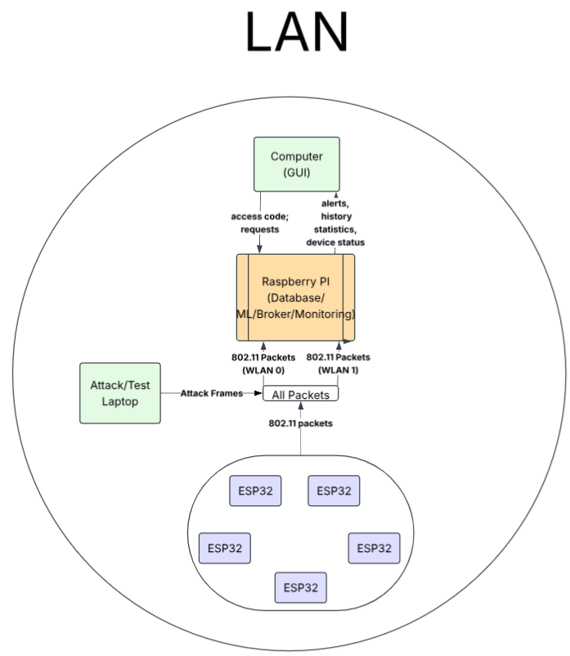
Product Perspective
Network Guardian aims to create a machine learning model to detect malicious behavior across different IoT LAN network environments and configurations. The system is locally hosted on a Raspberry Pi and is designed to integrate easily within the network.
Notes:
Tobias

Slide 8
Product Functions
Identify anomalies in network traffic
Adapt to different network environments and configurations
Classify attack types with a confidence score
Display new findings when analyzed on the network
Provide a history of previously flagged network traffic
Notes:
Uriah

Slide 9
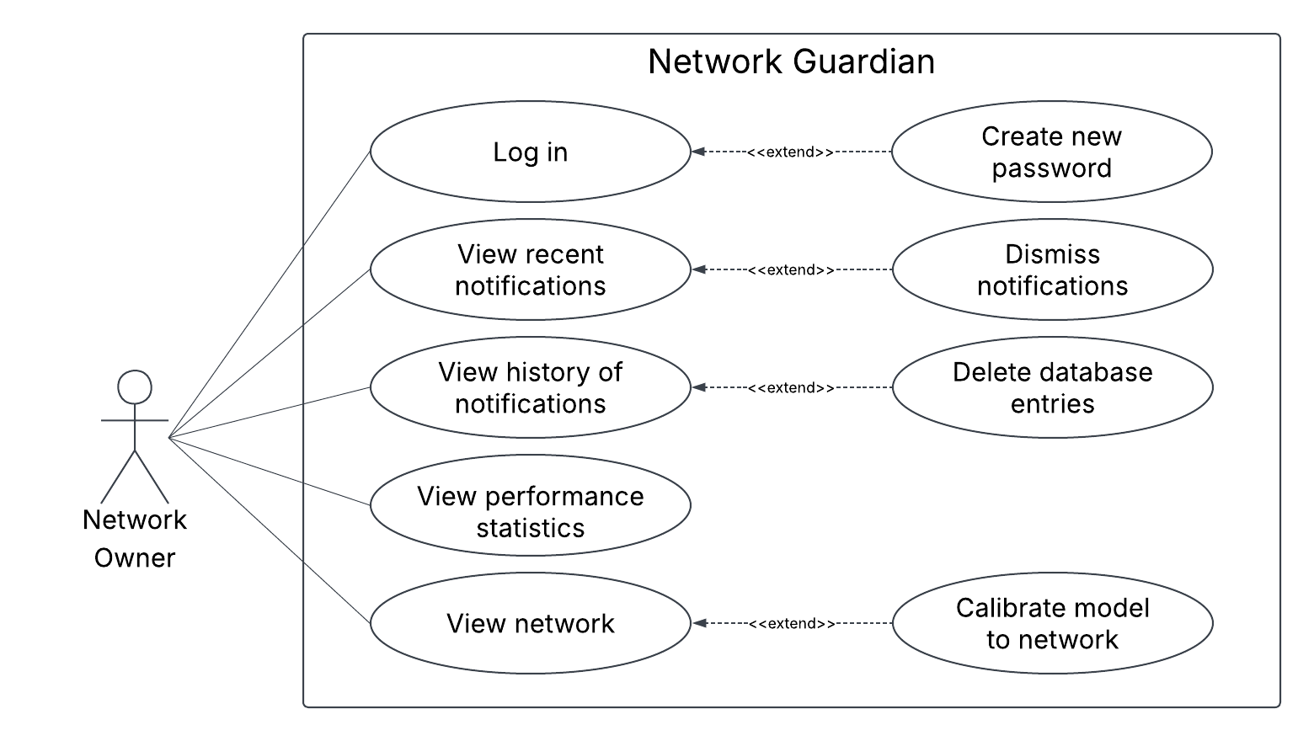
User Classes and Characteristics
Small Businesses
Homeowners
Individual Users
Notes:
Chloe

Slide 10
Operating Environment
Raspberry Pi OS Lite
Software operable on Raspberry Pi with 8GB
Notes:
Ryan

Slide 11
Design and Implementation Constraints
Software, database, and Web UI run locally
RAM and processing limitations
Scalability
Notes:
Chloe
1) RAM and processing restrictions
2) All three simultaneously need a lot of resources
3) When more devices are added there is more traffic which requires more resources

Slide 12
Assumptions and Dependencies
Processing Power
All components will function together
Software Libraries
Raspberry Pi Libraries
ESP32 Libraries
AWID2
Notes:
Uriah

Slide 13
External Interface Requirements

Slide 14
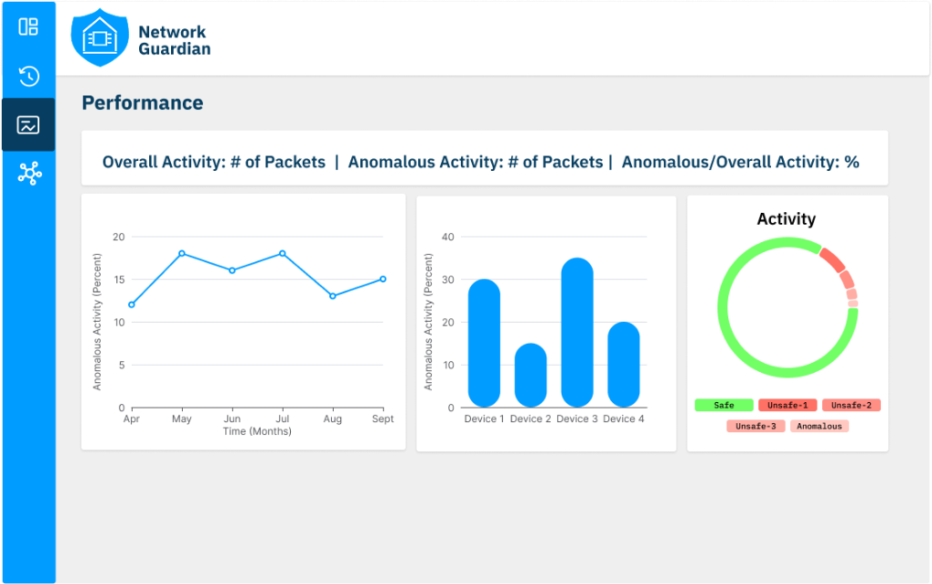
User Interfaces
Network Guardian will use a Web UI to communicate
anomalous packet notifications
notification history
system performance
network information
Notes:
Chloe

Slide 15
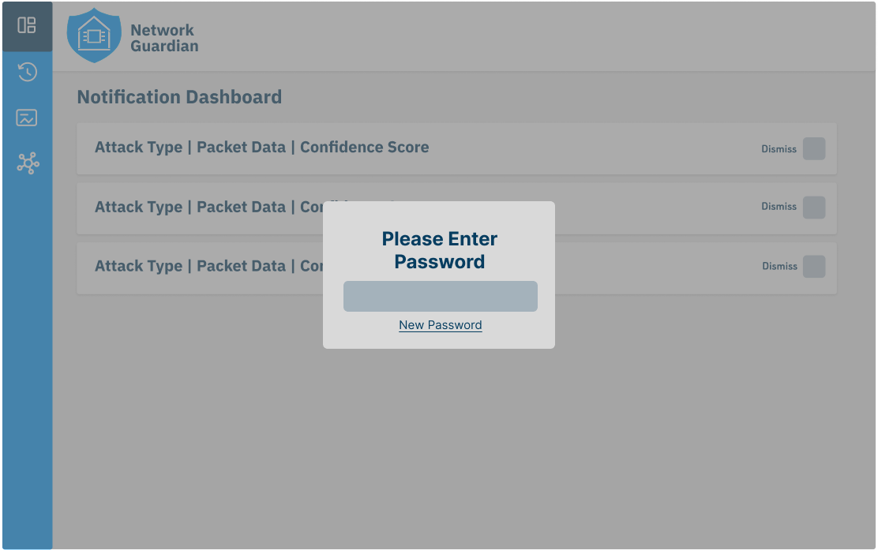
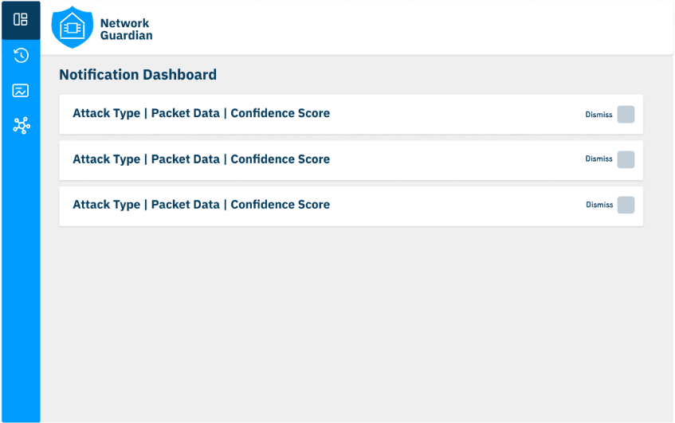
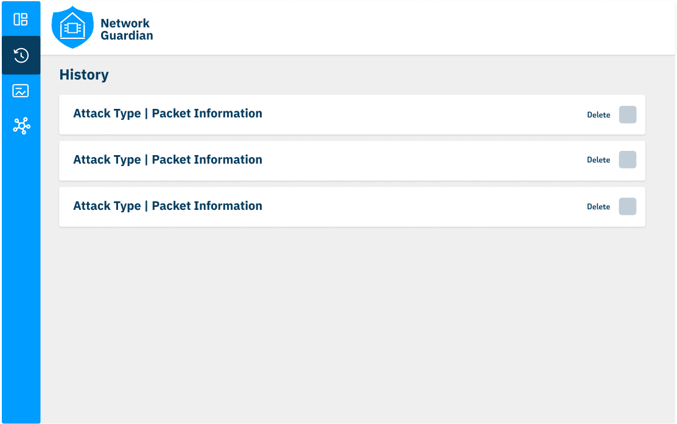
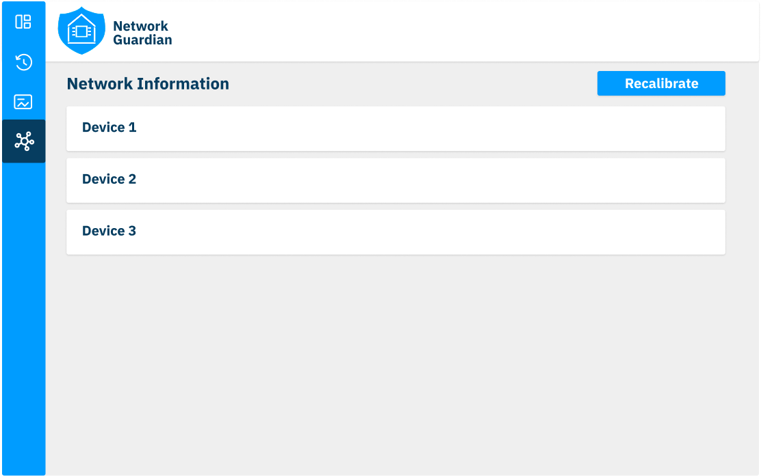
Notes:
Chloe

Slide 16
Hardware Interfaces
LAN to Broker Service
WebUI to Laptop
IoT Devices to ML Model
Notes:
Ryan

Slide 17


Software Interfaces
MQTT Protocol
Software On the Server
  Python
  MQTT Broker
  Flask
  SQL
Test Bed Server and IoT Devices
WebUI
Notes:
Ryan

Slide 18
Communication Interfaces
TCP/IP ➡️ MQTT
SQLite➡️ DB access
Wi-Fi access point➡️WPA2-AES encryption➡️ IoT devices
HTTP➡️ Web UI Requests
Notes:
Ryan

Slide 19
System Features

Slide 20
List of Features
Network Traffic Monitoring
Feature Extraction
Machine Learning Intrusion Detection
Model Adaptation/Calibration
Detection Logging and Storing
Web-Based Dashboard
Evaluation and Performance Modeling
Notes:
Uriah

Slide 21
Other Nonfunctional Requirements

Slide 22
Performance Requirements
ML model must process packets at the same rate they’re captured. Multithreading could potentially be added.
Web UI must refresh at a rate that matches the packet flow.
Database write process can’t cause unbound memory growth.
Notes:
Ryan

Slide 23
Security
Safety
FCC and CFAA guidelines
Development error prevention
Local breach prevention
Encrypted Database
User Data Retention
Simulated Data
Notes:
Tobias

Slide 24
Software Quality Attributes
Adaptive
Lightweight
Accurate
Secure
Notes:
Uriah

Slide 25
Business Rules
Privacy
LAN Research
User Network Management
Notes:
Tobias

Slide 26

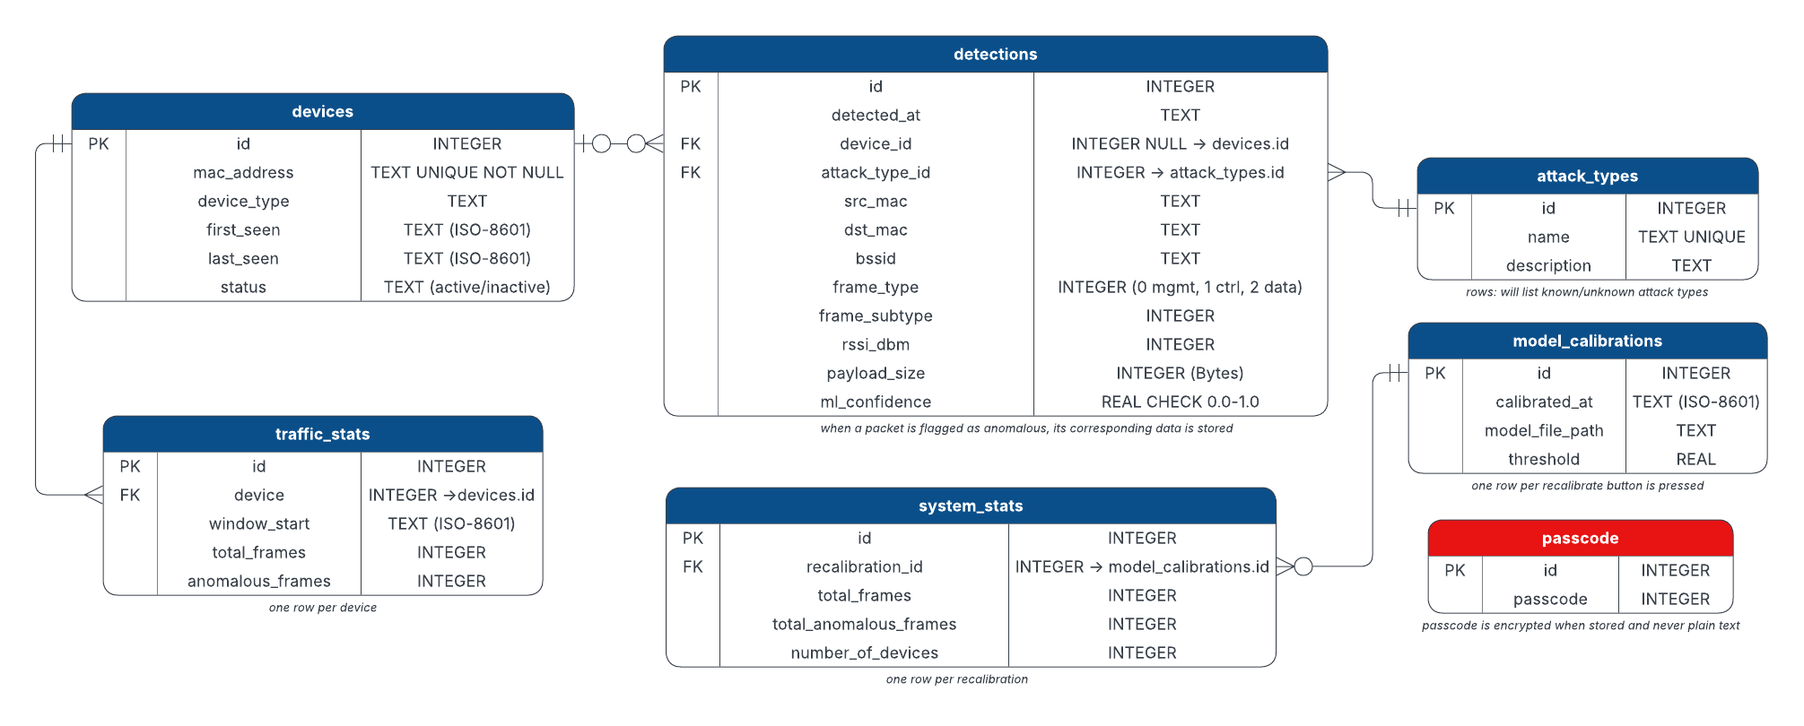
Database ER Diagram
Notes:
Ryan

Slide 27
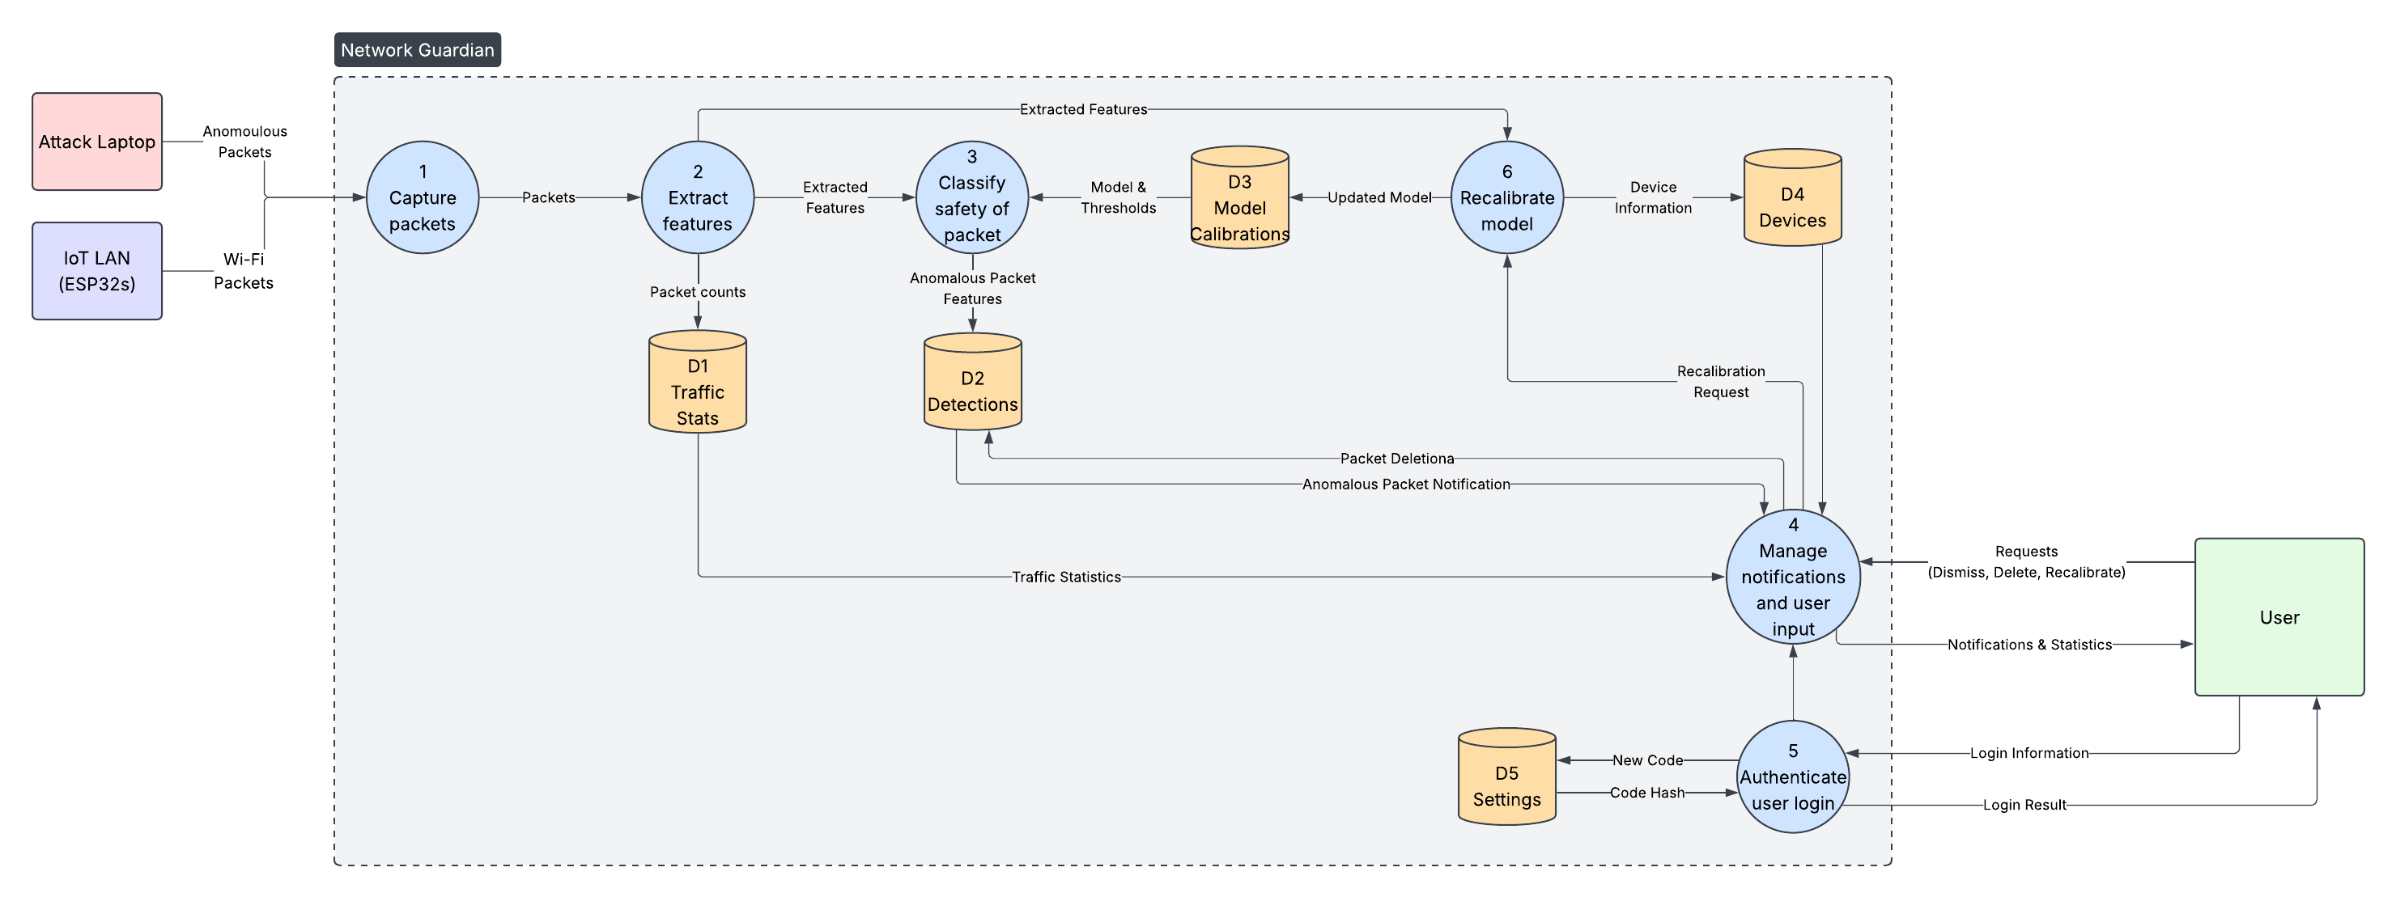
Dataflow Diagram
Notes:
Chloe

Slide 28
Conclusion

Slide 29
Future Work
Continue to work on software.
Begin planning for HLD document.
Begin ordering hardware for our project.
Notes:
Uriah

Slide 30

GitHub Repo QR
Gantt Chart
Notes:
Uriah

Slide 31
References
[1] “AWID - Aegean Wi-Fi Intrusion Dataset,” Aegean.gr, 2024. [Online]. Available: https://icsdweb.aegean.gr/awid/ (accessed: Sept. 25, 2026).
[2] F. Cerasuolo, G. Bovenzi, C. Marescalco, F. Cirillo, D. Ciuonzo, and A. Pescapè, "Adaptive Intrusion Detection Systems: Class Incremental Learning for IoT Emerging Threats," in 2023 IEEE International Conference on Big Data (BigData), Sorrento, Italy, 2023, pp. 3547–3555, doi: 10.1109/BigData59044.2023.10386129.
[3] Pandas, “pandas documentation — pandas 1.0.1 documentation,” pandas.pydata.org, 2024. [Online]. Available: https://pandas.pydata.org/docs/ (accessed: Sept. 25, 2026).
[4] Scikit-Learn, “User guide: contents — scikit-learn 0.22.1 documentation,” Scikit-learn.org, 2019. [Online]. Available: https://scikit-learn.org/stable/user_guide.html (accessed: Sept. 25, 2026).
[5] Joblib Developers “Development — joblib 1.5.2 documentation,” Readthedocs.io, 2025. [Online]. Available: https://joblib.readthedocs.io/en/stable/developing.html (accessed: Sept. 25, 2026).
[6] M. A. Mahdi, "Secure and Efficient IoT Networks: An AI and ML-based Intrusion Detection System," 2024 3rd International Conference on Artificial Intelligence For Internet of Things (AIIoT), Vellore, India, 2024, pp. 1-6, doi: 10.1109/AIIoT58432.2024.10574789.
[7] B. Laxmaiah, V. Ramesh, P. Patel, M. Prashanthi, J.Deepika and R.BagavathiLakshmi, "AI Based Cyber security Solutions for Detecting and Preventing Threats in IoT Systems," 2025 2nd International Conference on Recent Trends in Electrical, Electronics and Computing Technologies (ICRTEECT), Warangal, India, 2025, pp. 1-6, doi: 10.1109/ICRTEECT67512.2025.11448925.
[8] Python Software Foundation, "Download Python," Python.org. [Online]. Available: https://www.python.org/downloads/. (accessed: Sept. 25, 2026).
[9] Raspberry Pi Ltd, "Raspberry Pi OS," Raspberry Pi Documentation. [Online]. Available: https://www.raspberrypi.com/documentation/computers/os.html. (accessed: Sept. 25, 2026).
[10] MQTT.org, "MQTT: The standard for IoT messaging," 2024. [Online]. Available: https://mqtt.org/. (accessed: Sept. 25, 2026).
[11] GitHub, Inc., "Quickstart for writing on GitHub," GitHub Docs. [Online]. Available: https://docs.github.com/en/get-started/writing-on-github/getting-started-with-writing-and-formatting-on-github/quickstart-for-writing-on-github. (accessed: Sept. 25, 2026).
[12] Eclipse Foundation, "Eclipse Mosquitto: An open source MQTT broker," 2018. [Online]. Available: https://mosquitto.org/. (accessed: Sept. 25, 2026).
[13] Raspberry Pi Ltd., “Buy a Raspberry Pi 5,” Raspberry Pi, 2026. [Online]. Available: https://www.raspberrypi.com/products/raspberry-pi-5/. (accessed: Sept. 25, 2026).
[14] M. Grinberg, “Flask-SocketIO,” Flask-SocketIO Documentation, 2026. [Online]. Available: https://flask-socketio.readthedocs.io/en/latest/. (accessed: Sept. 25, 2026).

Slide 32
References
[15] SQLite, “SQLite: Small. Fast. Reliable. Choose any three,” SQLite. [Online]. Available: https://www.sqlite.org/. (accessed: Sept. 25, 2026).
[16] Linux Wireless, “hostapd: IEEE 802.11 AP, IEEE 802.1X/WPA/WPA2/WPA3/EAP/RADIUS authenticator,” Linux Wireless Documentation. [Online]. Available: https://wireless.docs.kernel.org/en/latest/en/users/documentation/hostapd.html. (accessed: Sept. 25, 2026).
[17] S. Kelley, “dnsmasq,” dnsmasq Documentation. [Online]. Available: https://thekelleys.org.uk/dnsmasq/doc.html. (accessed: Sept. 25, 2026).
[18] Arduino, “PubSubClient,” Arduino Documentation. [Online]. Available: https://docs.arduino.cc/libraries/pubsubclient/. (accessed: Sept. 25, 2026).
[19] B. Blanchon, “ArduinoJson,” ArduinoJson Documentation. [Online]. Available: https://arduinojson.org/. (accessed: Sept. 25, 2026).
[20] Cisco Meraki, “Wireless Fundamentals: Encryption and Authentication,” Cisco Meraki Documentation, 2026. [Online]. Available: https://documentation.meraki.com/Wireless/Design_and_Configure/Architecture_and_Best_Practices/Wireless_Fundamentals:_Encryption_and_Authentication. (accessed: Sept. 25, 2026).
[21] IEEE Standard for Information Technology—Telecommunications and Information Exchange Between Systems Local and Metropolitan Area Networks—Specific Requirements—Part 11: Wireless LAN Medium Access Control (MAC) and Physical Layer (PHY) Specifications, IEEE Std 802.11-2024, 2025.
[22] Federal Communications Commission, “Part 15—Radio Frequency Devices,” Code of Federal Regulations, 47 C.F.R. § 15.5. [Online]. Available: https://www.ecfr.gov/current/title-47/chapter-I/subchapter-A/part-15. (accessed: Sept. 25, 2026).
[23] U.S. Congress, “18 U.S.C. § 1030—Fraud and related activity in connection with computers,” United States Code, Title 18, § 1030. [Online]. Available: https://uscode.house.gov/view.xhtml?edition=prelim&req=granuleid%3AUSC-prelim-title18-section1030. (accessed: Sept. 25, 2026).
Used Assets
[1] SQLite, "SQLite logo," SQLite. Accessed: Sep. 28, 2026. [Online]. Available: https://www.sqlite.org/
[2] Raspberry Pi Ltd, "Raspberry Pi logo," Raspberry Pi. Accessed: Sep. 28, 2026. [Online]. Available: https://www.raspberrypi.com/
[3] Python Software Foundation, "Python logo," Python.org. Accessed: Sep. 28, 2026. [Online]. Available: https://www.python.org/
[4] MQTT.org, "MQTT logo," MQTT.org. Accessed: Sep. 28, 2026. [Online]. Available: https://mqtt.org/

Slide 33
Thank You

Slide 34












Hidden Assets

